Slide 1
Profiler Mechanics Update
INSIDE Pisa Meeting
9/10 June 2015
V.Patera

Slide 2
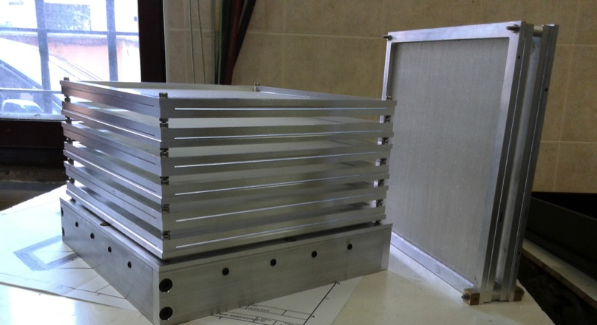
General status
Tracker mechanics almost finished ( frame & fibers)
Waiting for electronics PCB (beginning July) to finalize cooling system design
Calorimeter mechanics started
Dose Profiler complete tracking system with the calorimeter support plus 2 spare tracking planes

Slide 3
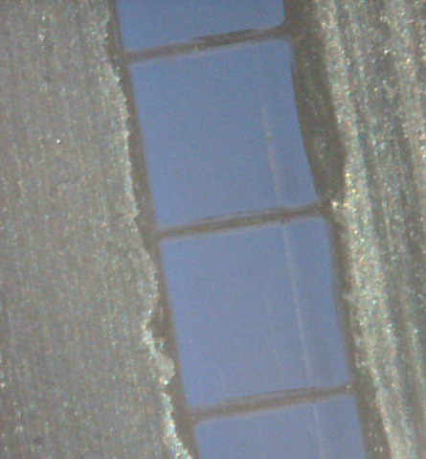
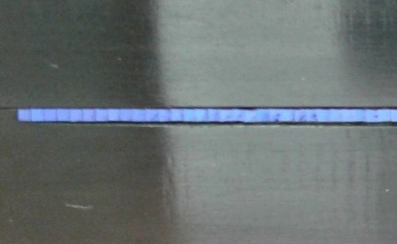
Mechanics: tracker status
All the tracker plane (6+2 spares) ready: final frames and machined fibers in place
Waiting for electronics PCB (beginning July) to finalize cooling system design

Slide 4
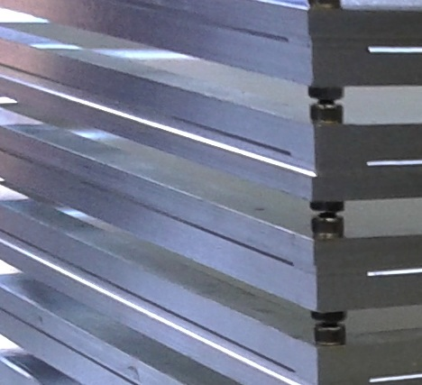
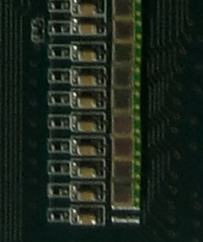
fiber planes have been machined to match the profile of SiPMs and passive components soldered on the BASIC-board

Slide 5
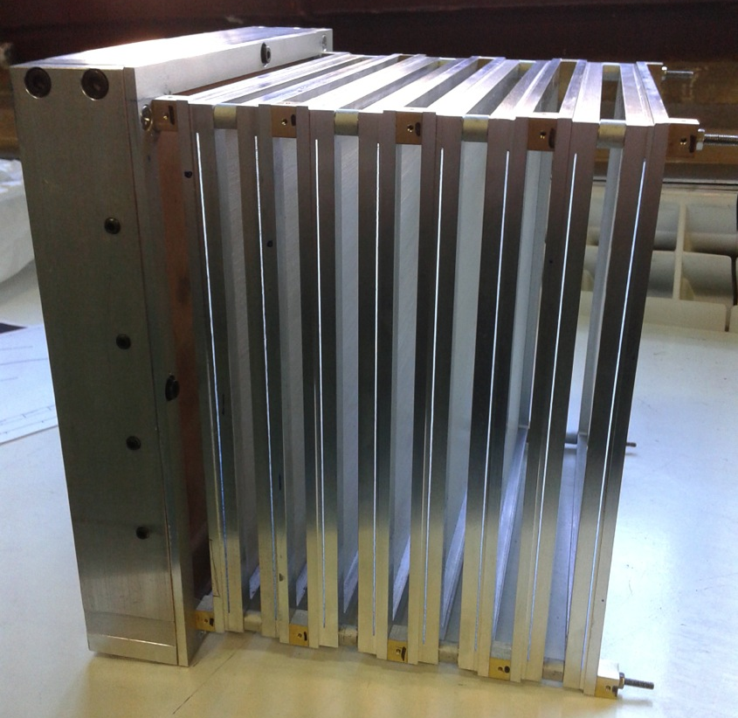
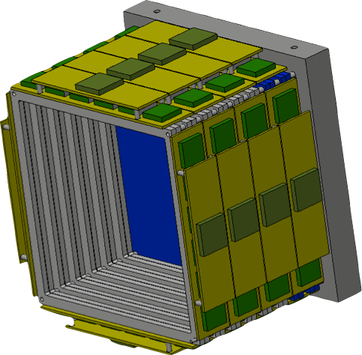
Tracker mech. and cooling
asimmetric (0,5 mm) spacers among planes have
been drilled; they will help heat transport
Final configuration with PCB must be tested for heat flow

Slide 6
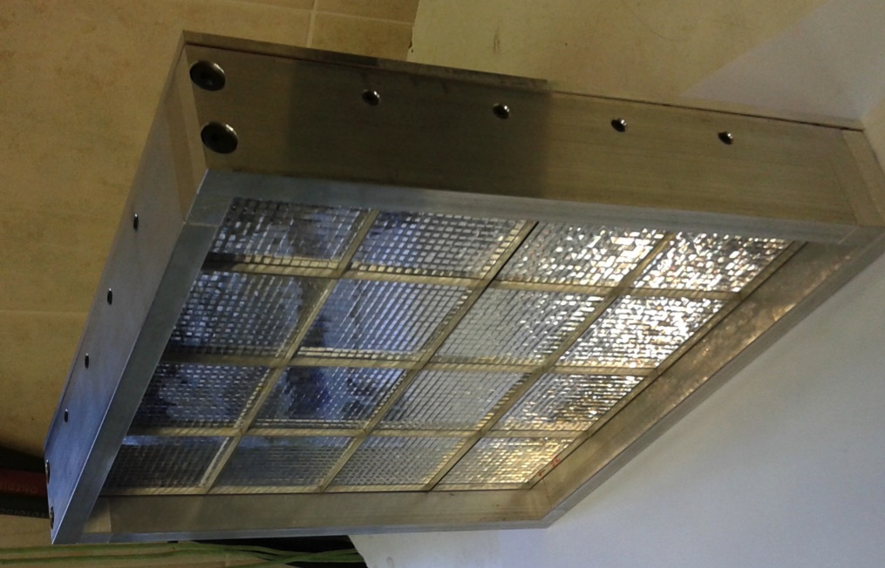
Calorimeter Mechanics Status
External frame, to be fixed to the tracker, finalized
Developed a fixing system of the crystals+MAPMT elements
Integration with electronics ( and cooling) on going

Slide 7
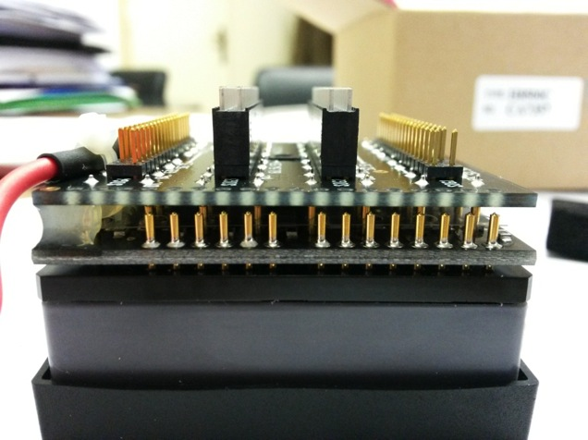
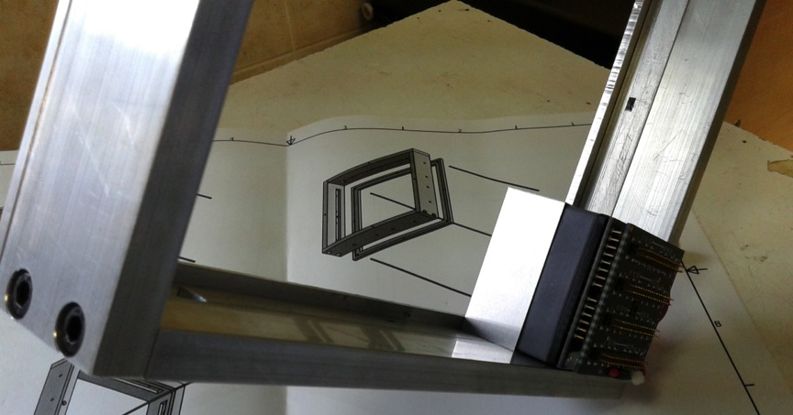
Holding LSF matrices
connectors on H8500 will create a space in which an insulated 4 mm x 6 mm Al bar, a spring and a screw will press the MAPMT against the crystal matrix
2 Al bars will
press the crystals sideways
stiff 10 mm Al structure
1/16: crystal + H8500

Slide 8
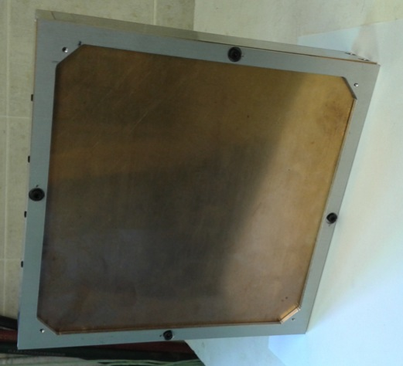
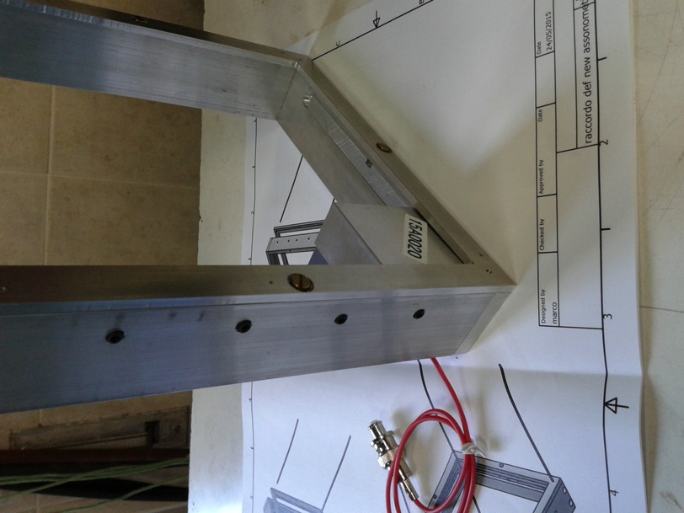
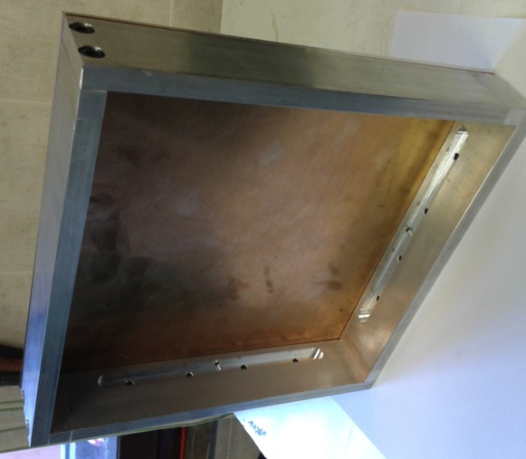
0,25 mm phosphor bronze foil inserted matrix and MAPMT elements will be pressed against it

Slide 9
Stiffness of the system
Complete setup of the 16 Matrices: 20 cm x 20 cm² LFS calorimeter
Test of stability: put the calorimeter orizontally -> all the weight leans on the foil and monitor the bending of the foil

Slide 10
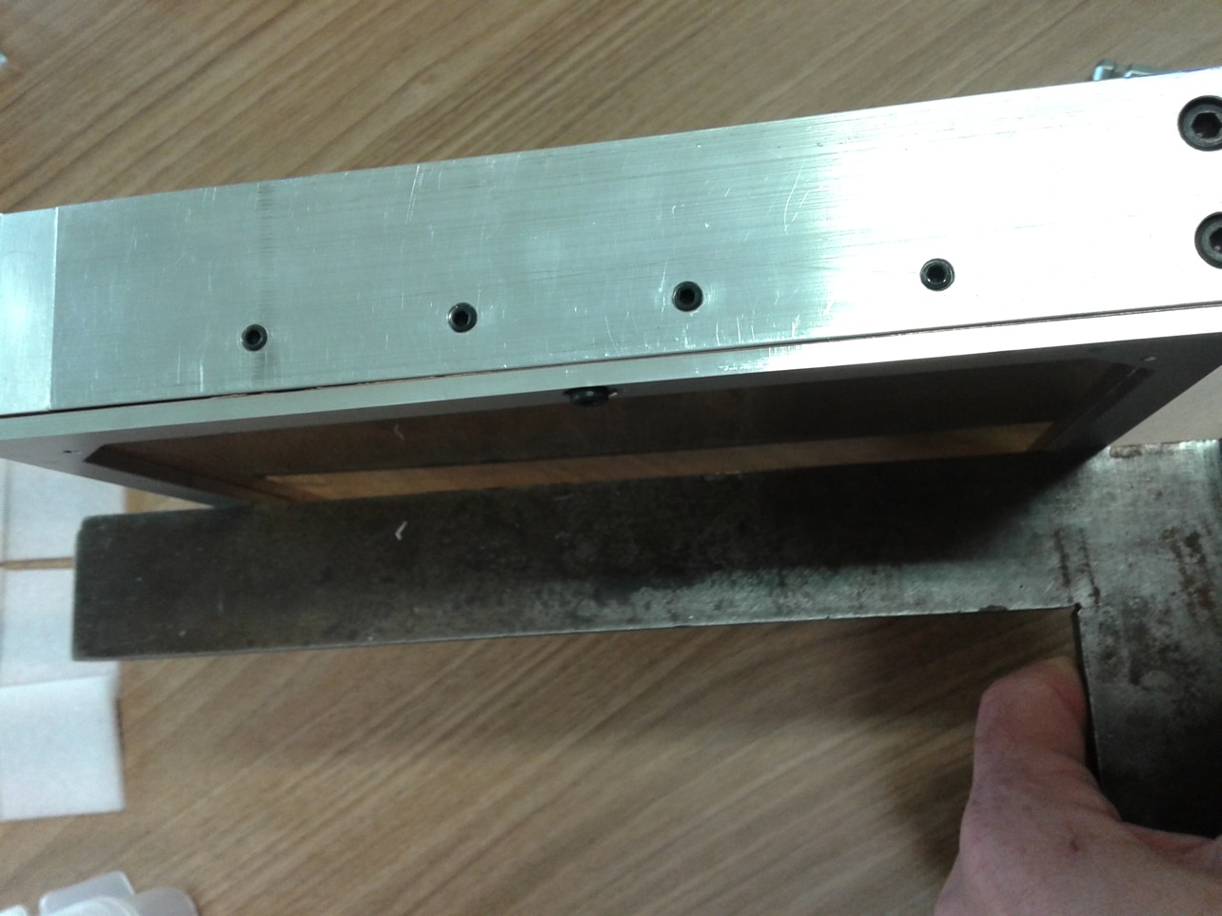
Stability test
After a week, gravity did not succeed to move the crystals
phosphor bronze foil could be thinned (250 μm → 150 μm)

Slide 11
Calo electronic update
LNF electronic service is taking care of calorimeter electronics
Preliminary layout ready -> building phase
HV PCB modules for H8500 ordered (->Centro Fermi)
front-end for calorimeter order is being prepared (12k€+IVA->INSIDE)
Concentrator FPGA board design ok-> order will follow

Slide 12
spares

Slide 13
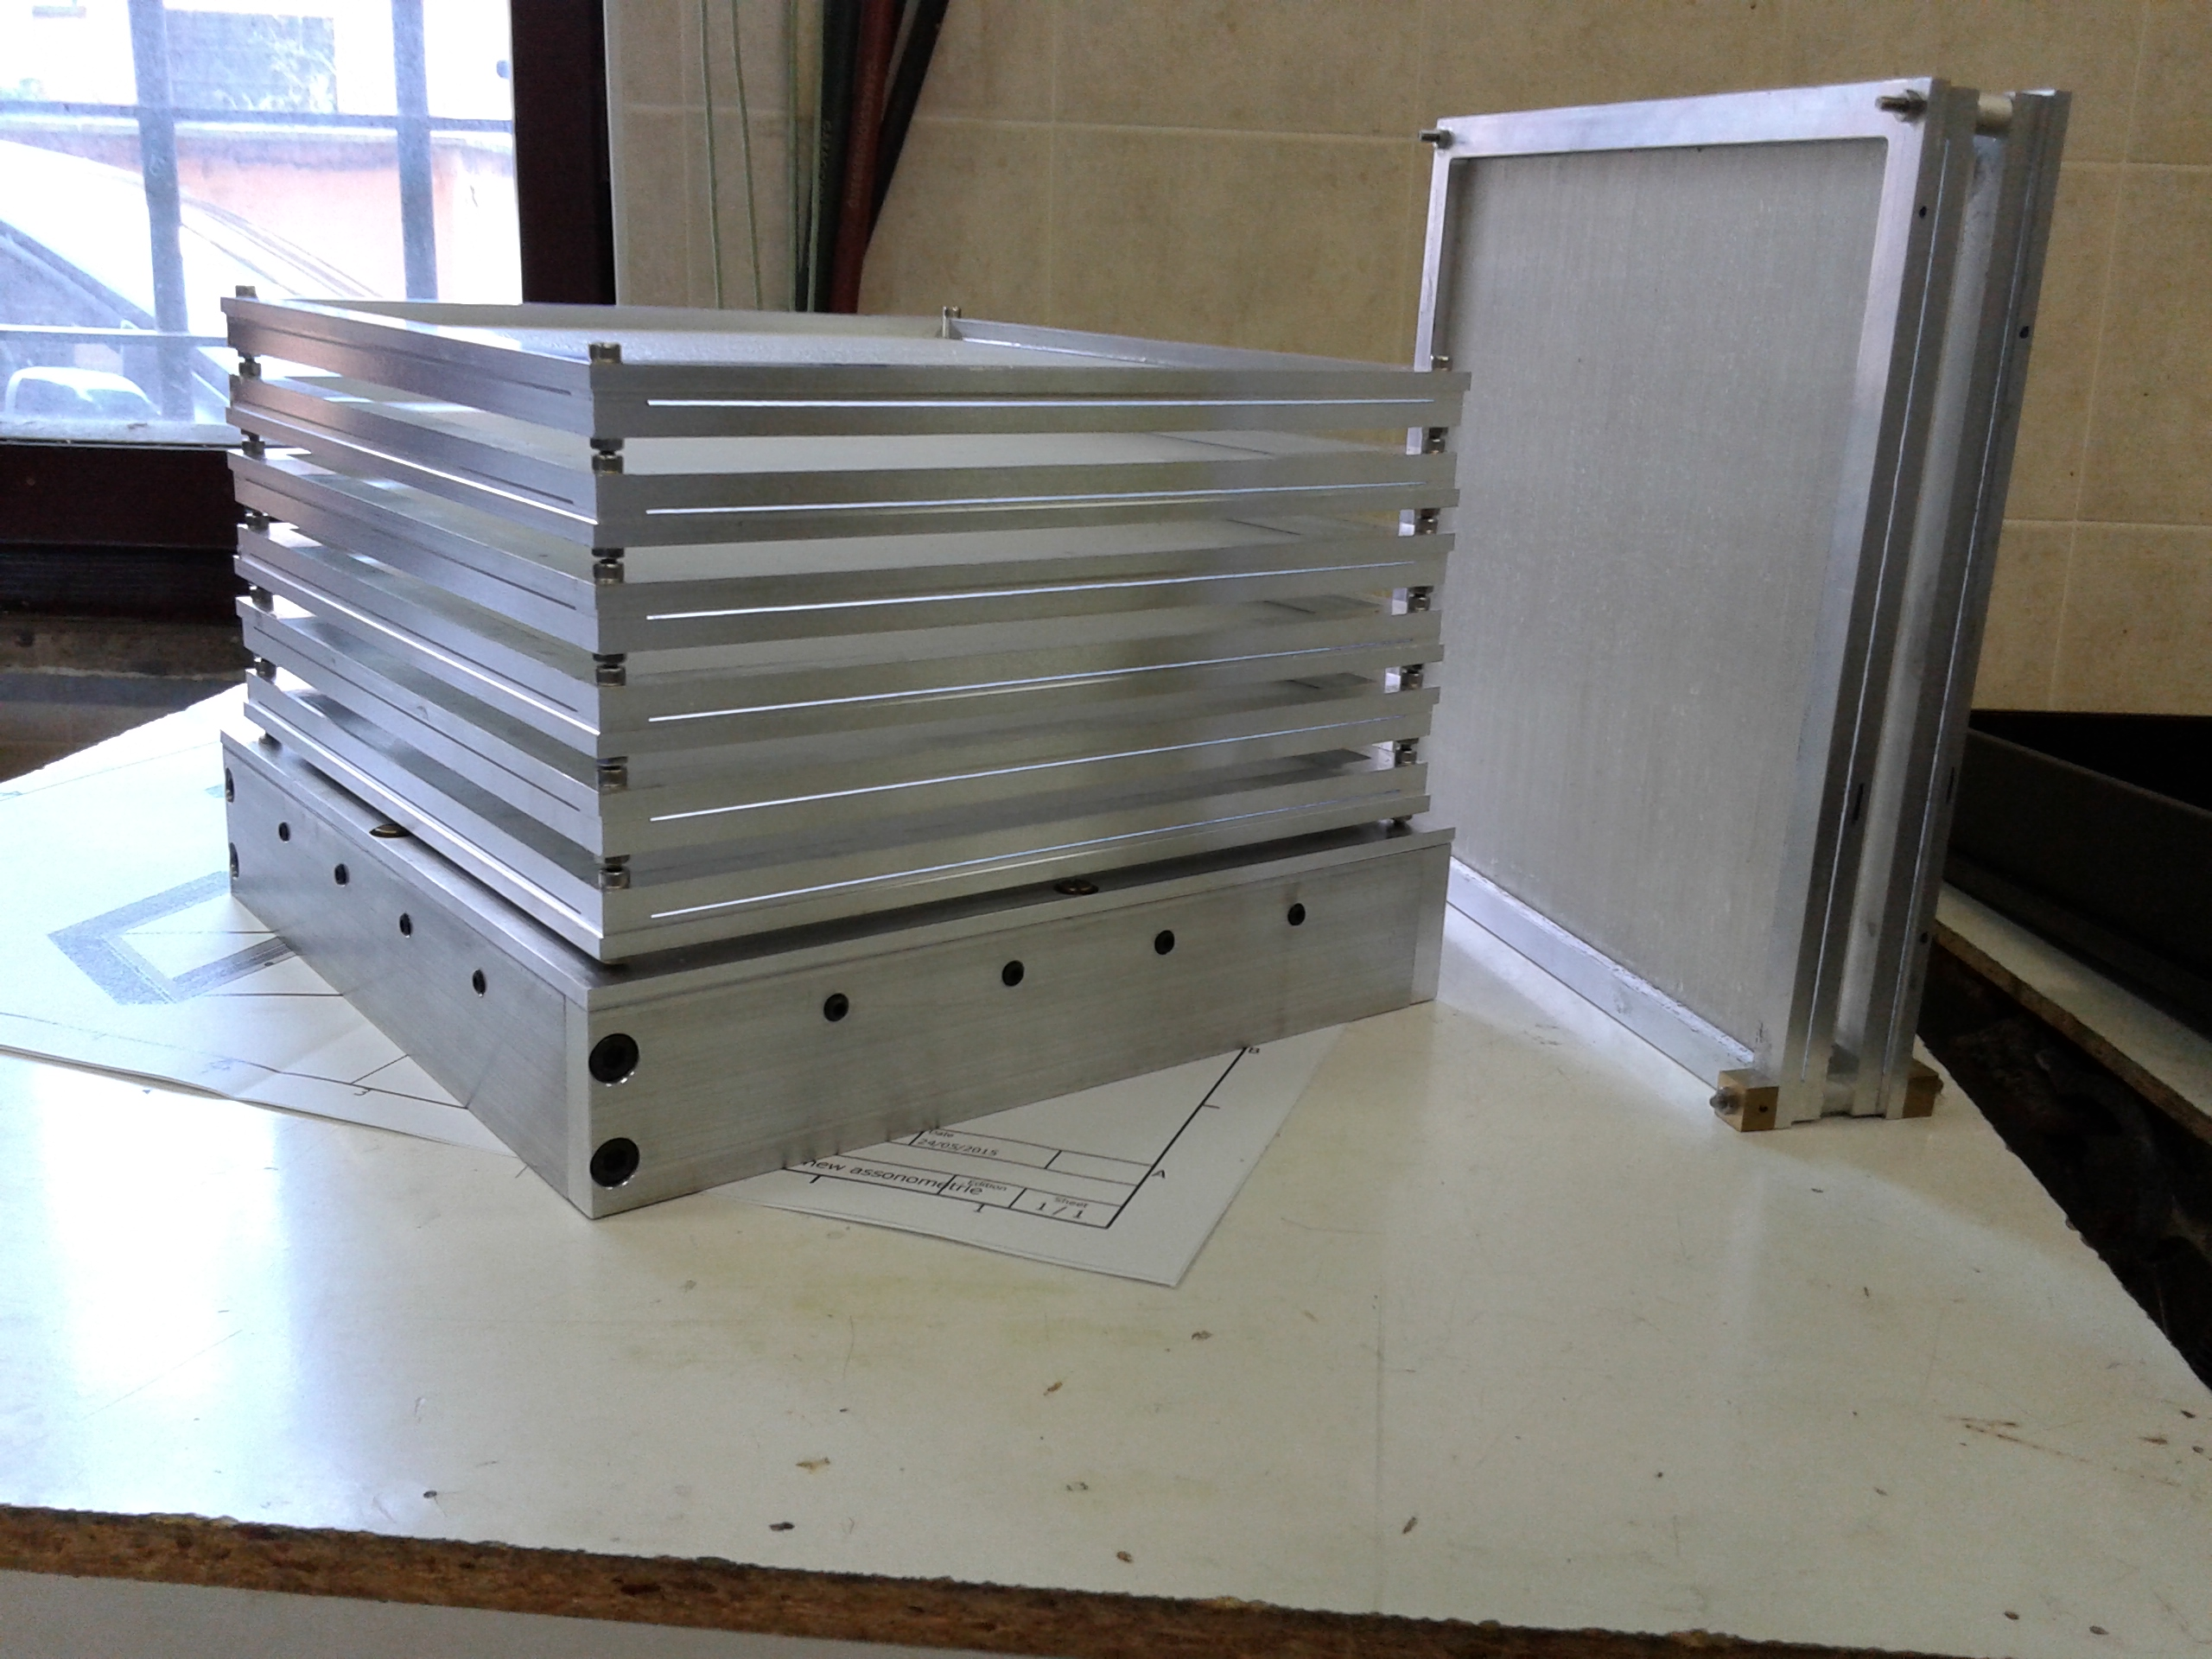
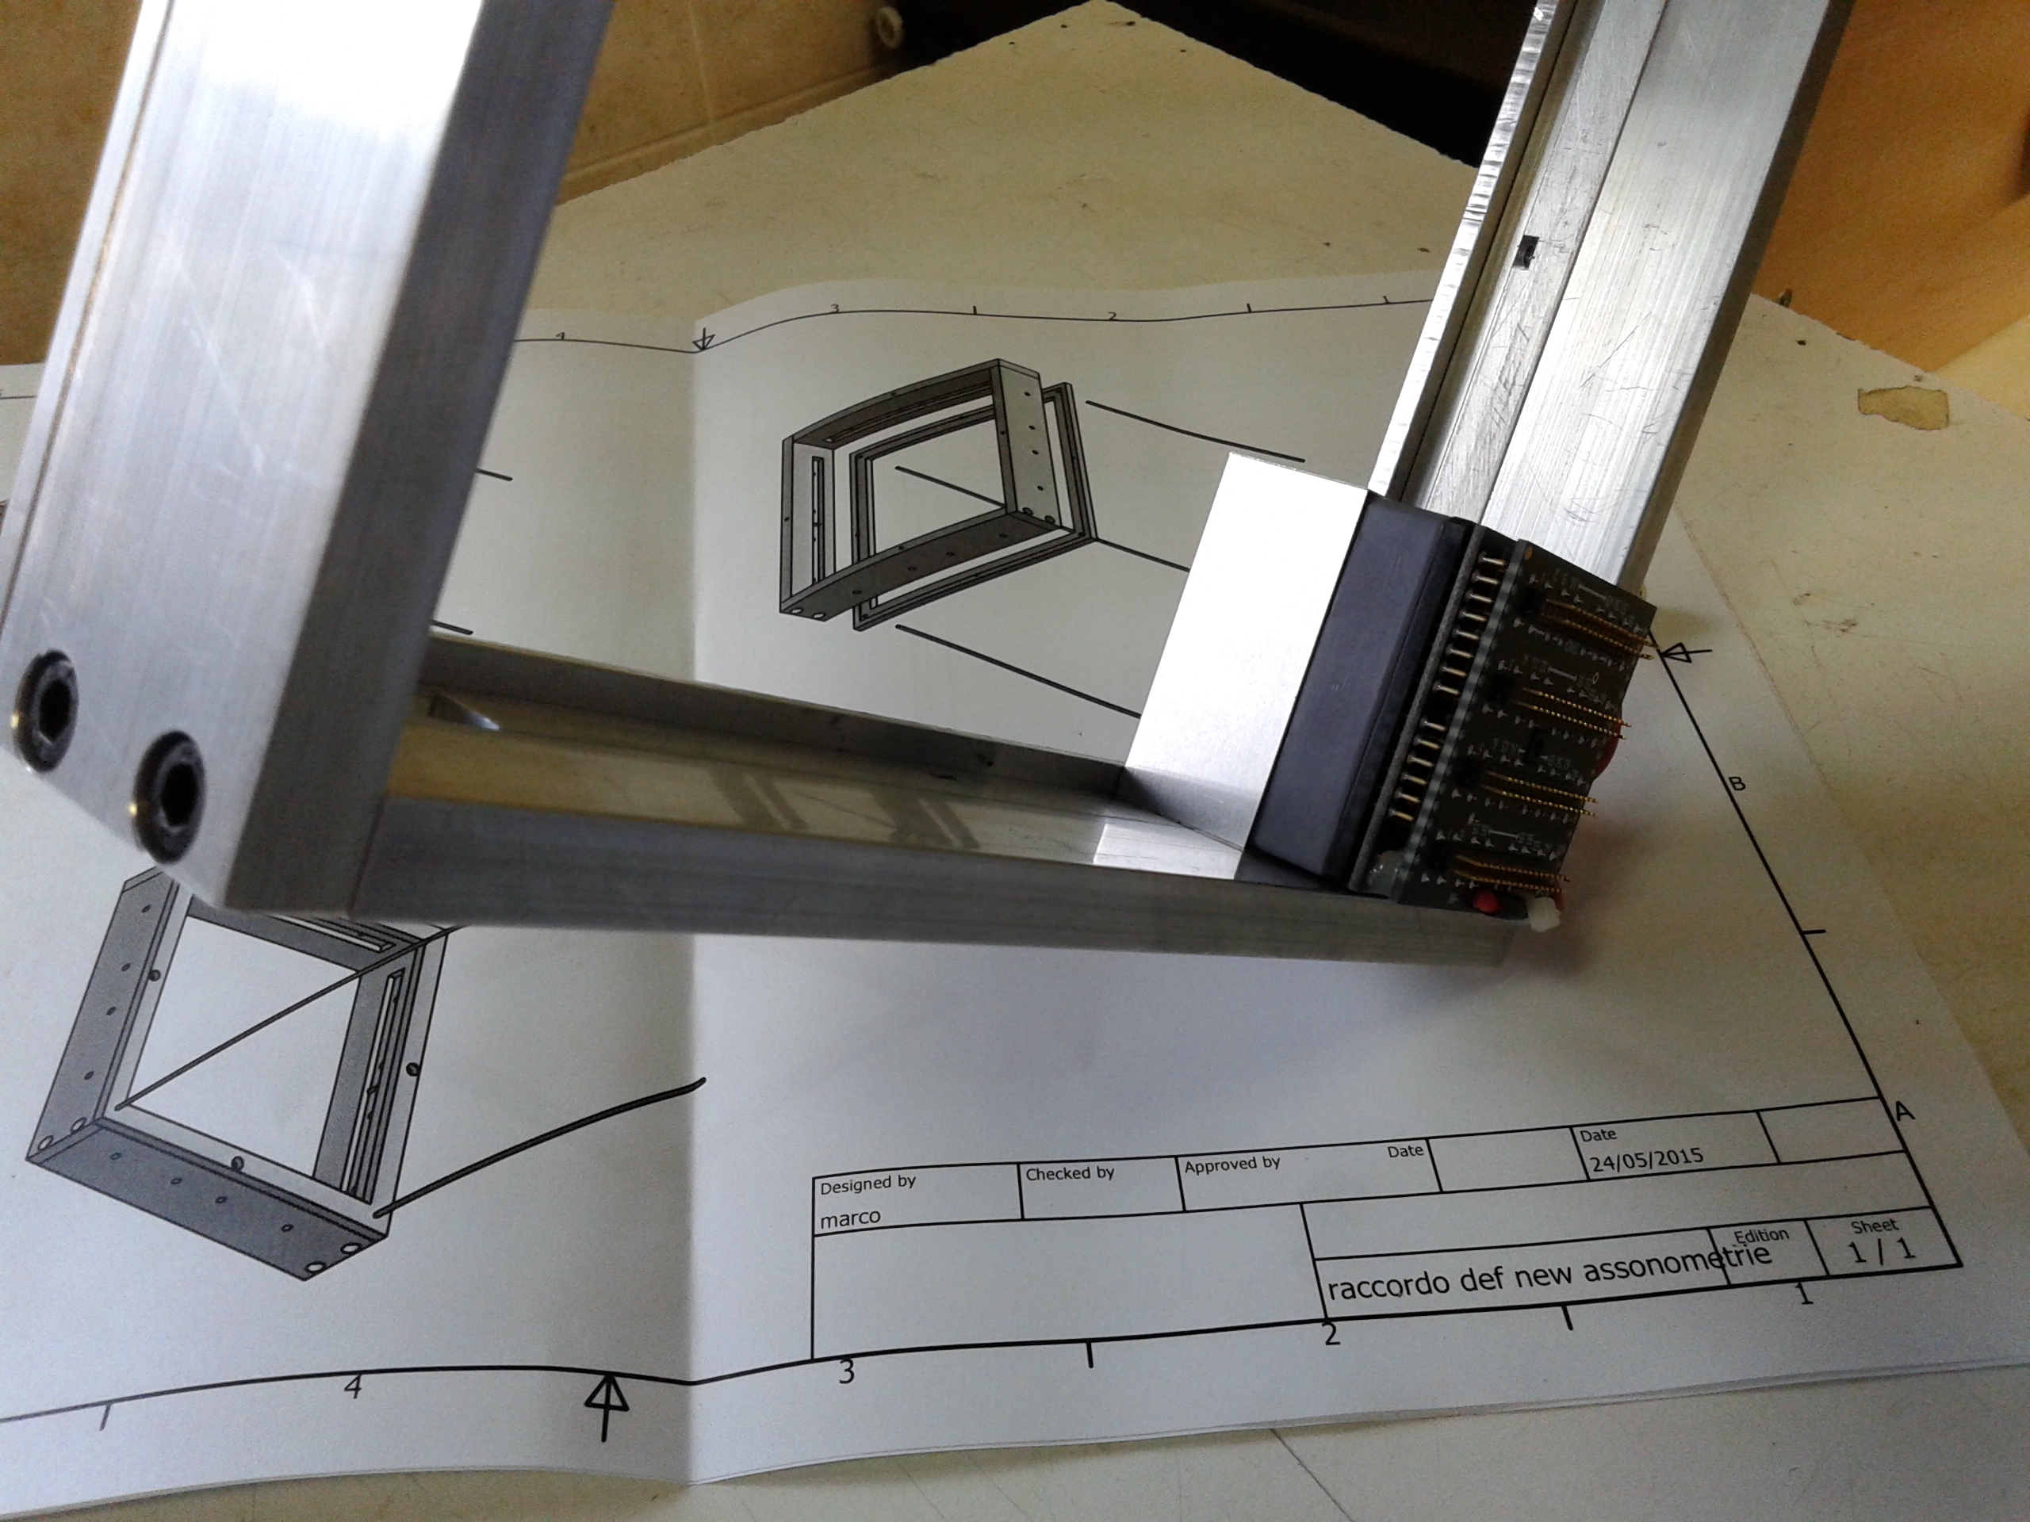
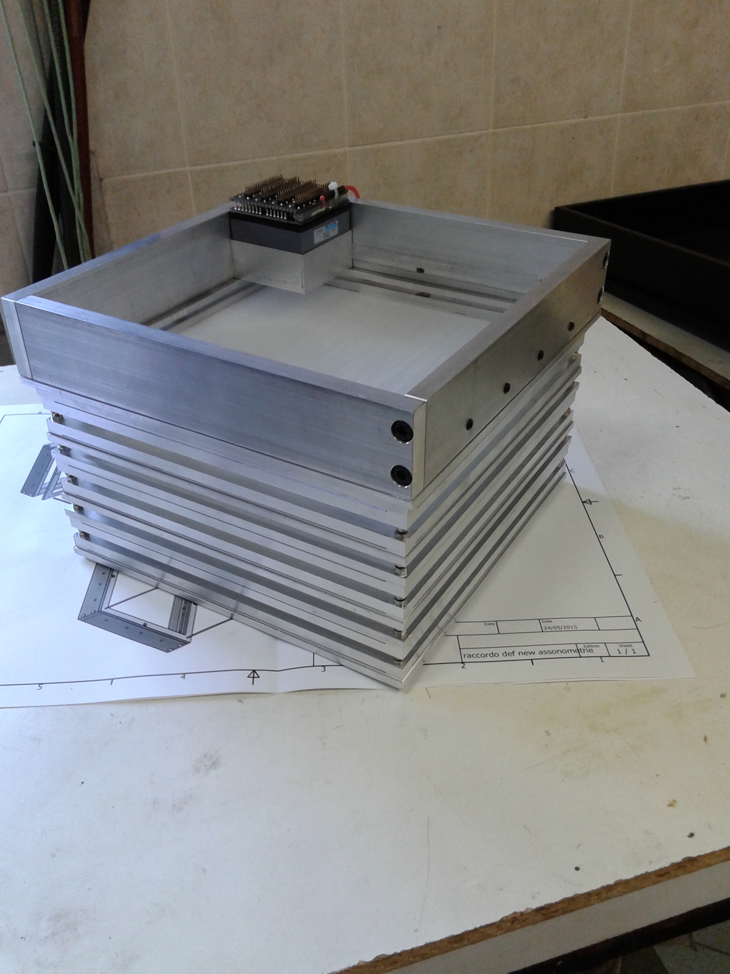
6 X-Y fiber planes + 2 spares ready
calorimeter structure almost ready
waiting for electronics to finalize cooling
system
210x210x0,3 mm³ foil to be inserted here
crystal fixation system
thanks to MARCO MAGI

