Slide 1
The INFN in-kind contribution to
the accelerator of the
European Spallation Source

Slide 2


INFN contribution to the European Spallation Source
INFN-LNS
INFN-LNL
INFN-MI
3,6 MeV
90 MeV
2000 MeV
INFN is in charge of the management of the WP3-Normal Conducting Linac
Ion Source & LEBT (INFN-Laboratori Nazionali del Sud, Italy)
RFQ (CEA-IRFU, France),
MEBT (ESS Bilbao, Spain)
Drift Tube Linac (INFN-Laboratori Nazionali di Legnaro, Italy)
INFN-LASA-Milano (superconducting elliptical cavities for WP5) construction of medium beta section (strong industrial background for series construction)
Potential: LNL for ICS ; LNS, LNL and Milan for support to commissioning
1+4+5+management WP3 is agreed with ESS Accelerator Division, 6 under discussion

Slide 3
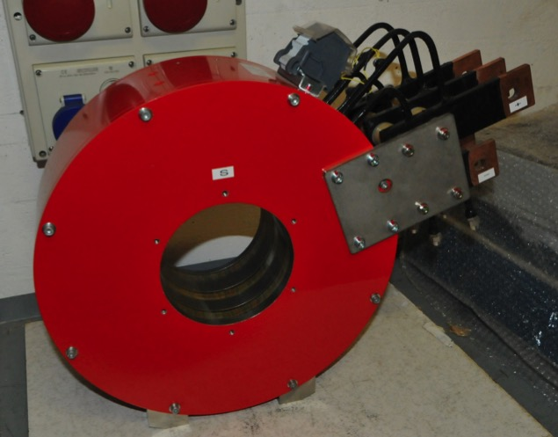
The PS-ESS very flexible magnetic system
Magnet manufactured by Sigma-phi
Magnetic system already delivered at LNS
Ready for installation!

Slide 4
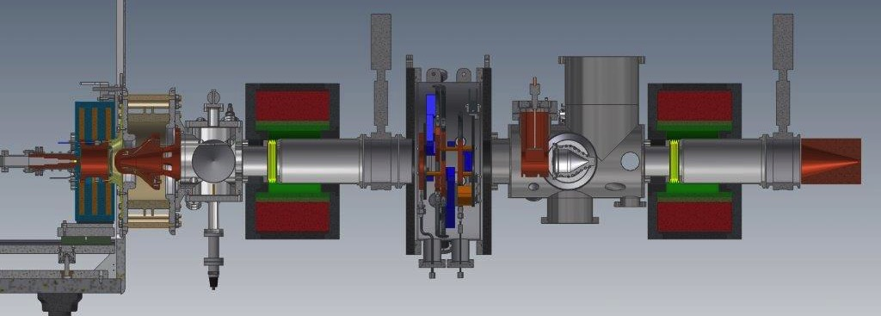
LEBT Layout
2654 mm from plasma electrode to LEBT collimator
540 mm Iris utilities + Diagnostics + Vacuum + Chopper
239 mm Vacuum + Utilities
128 mm Gate valve
128 mm Gate valve
234 mm Extraction
425 mm Solenoid
425 mm Solenoid
210 mm Collimator
325 mm Iris

Slide 5
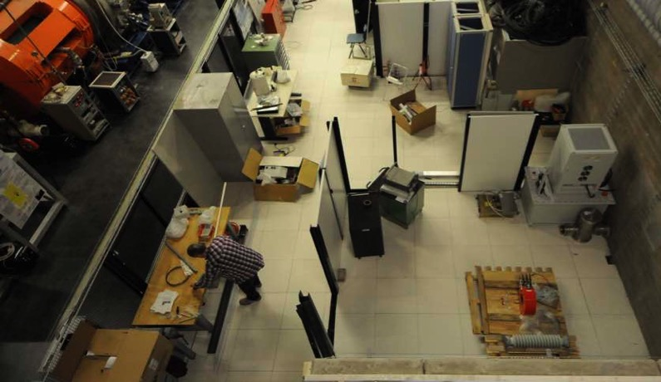
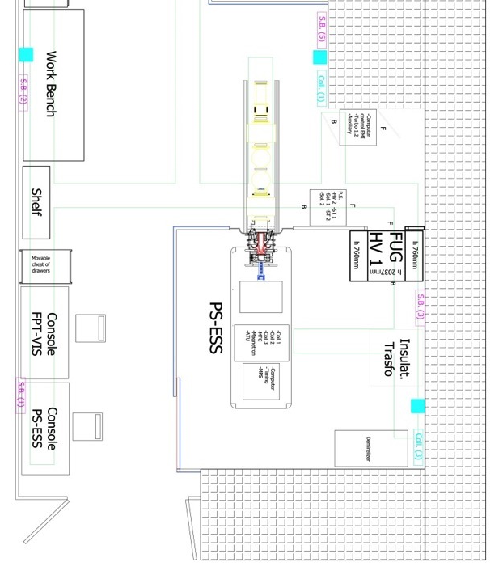
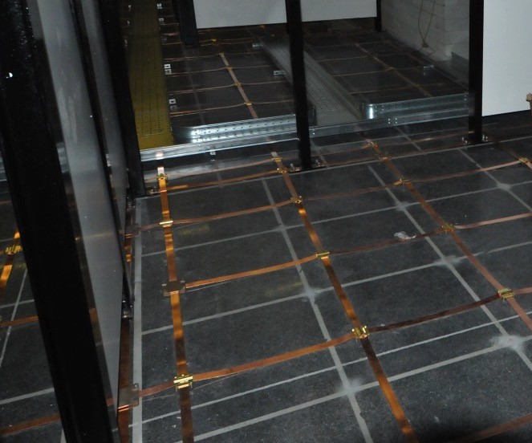
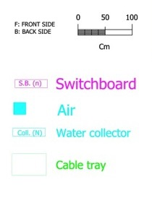
ESS test area at LNS
Particular attention in the grounding to minimize the effects of sparks

Slide 6
Status and open items
Sites
LNS site | Complete except for interlocks
ESS-Lund site | in progress, interaction supp. by Lead Engineer
Proton source (PS-ESS) and accelerator column
HV platform | To be ordered, short delivery time
Power supplies (High current, High voltage) | Delivered
Microwaves equipment | Ordered
Magnetic system | Delivered
Plasma chamber | Ordered
Mechanical integration and LEBT | already defined
Extraction system | Ordered
Interfaces
MPS | definition in progress
Control interface | definition in progress

Slide 7

Technical performances (SoW)
Drift Tube Linac
The DTL (Drift Tube Linac) cavity is constituted of 20 modules, assembled in 5 tanks, composed of 4modules each, for a total length of approximately 40 m.
First tank
CERN-INFN prototype

Slide 8
ESS DTL properties: design parameters fixed
Tank | 1 | 2 | 3 | 4 | 5
Cells | 61 | 34 | 29 | 26 | 23
E₀ [MV/m] | 3.00 | 3.16 | 3.07 | 3.04 | 3.13
E_{max}/E_{k} | 1.55 | 1.55 | 1.55 | 1.55 | 1.55
φ_{s} [deg] | -35,-25.5 | -25.5 | -25.5 | -25.5 | -25.5
L_{Tank} [m] | 7.62 | 7.09 | 7.58 | 7.85 | 7.69
R_{Bore} [mm] | 10 | 11 | 11 | 12 | 12
L_{PMQ} [mm] | 50 | 80 | 80 | 80 | 80
Tun. Range [MHz] | ±0.5 | ±0.5 | ±0.5 | ±0.5 | ±0.5
Q0/1.25 | 42512 | 44455 | 44344 | 43894 | 43415
Optimum β | 2.01 | 2.03 | 2.01 | 1.91 | 1.84
Beam Det [kHz] | +2.3 | +2.0 | +2.0 | +1.8 | +1.8
P_{cu} [kW] (no margin) | 870 | 862 | 872 | 901 | 952
E_{out} [MeV] | 21.29 | 39.11 | 56.81 | 73.83 | 89.91
P_{TOT} [kW] | 2192 | 2191 | 2196 | 2189 | 2195
Notes:
Constant E0 – ramped phase in tank 1 and intertank for beam matching – increasing bore radius for beam loss control but not at the price of final energy – total power
Calcolate le caratteristiche ottimali per il funzionamento delle cinque tank di accelerazione

Slide 9
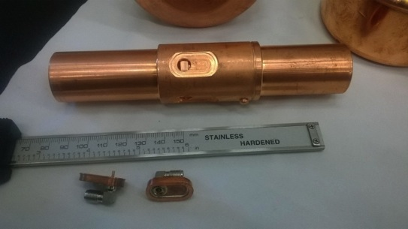
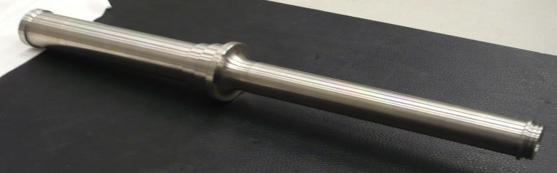
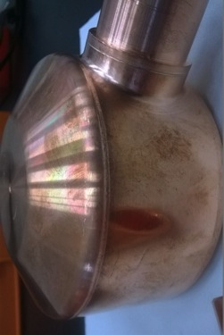
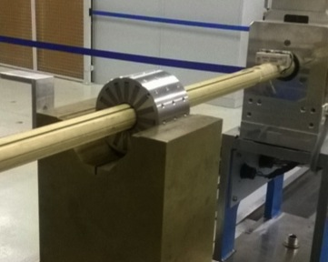
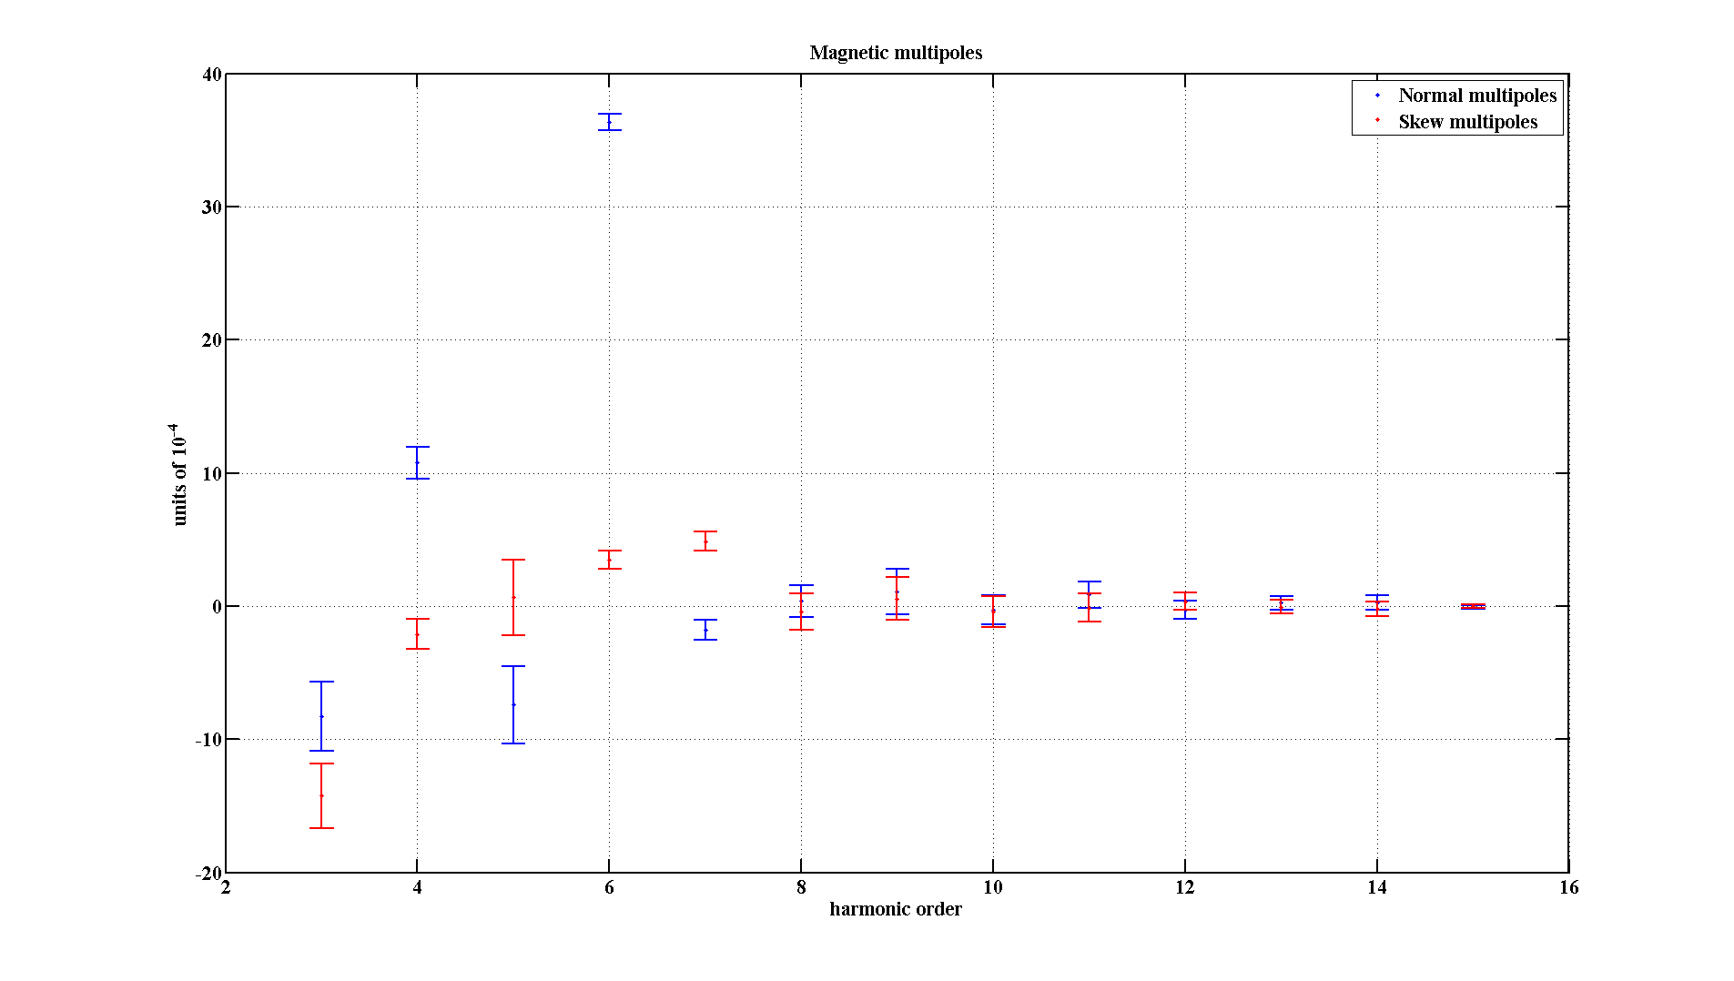
Prototyping
Test of Cu-plating on Stainless steel Stem order to be placed. It will make them more rigid compared and will allow for a larger bore for the BPM and corrector cables.
BPM: feedthrough to be welded on the BPM stripline
EBW on Brazing: DT brazed and EB-welded. Vacuum test ok. Next step: section and micrography
PMQ fully tested

Slide 10
WP03 Master Schedule

Slide 11
Medium β-cavities contribution to ESS
Up to the end of 2014 INFN-Mi involved in XFEL;
Expression of interest for in-kind contribution to ESS of medium-β cavities;
Well consolidated expertise + good connection with industries for series production

Slide 12
XFEL 1.3 GHz SC cavities:
Cavities Performances (EZ)
1st test of cavities (as rrived from EZ)
XFEL goal:
E_{acc} ≥ 23.6 MV/m, Q₀ ≥ 1▪10¹⁰
E_{acc}
Re-treatment typically due to field emission
Cavities “cured” mainly by HPR (done both at DESY and at the Company)
Average maximum gradient before re-treatment: (29.1 ± 5.9) MV/m
after re-treatment: (32.0 ±3.8) MV/m
Average usable gradient before re-treatment: (25.8 ± 6.1) MV/m
after re-treatment: (29.0 ±3.6) MV/m

Slide 13
Medium Beta Cavities
Technical performances
INFN Medium Beta Cavities Technical Performances
Requirements | Medium beta
Frequency (MHz) | 704.42
Geometric beta | 0.67
Nominal Accelerating Gradient (MV/m) | 16.7
Epk (MV/m) | < 50
Cell coupling k(%) | ≥ 1.5
RF peak power (kW) | 1100
Q ext | 7.5 10⁵
Q0 at nominal gradient | > 5 10⁹

Slide 14
Elliptical SC cavities: in-kind contribution
Deliverable no. | Deliverable
1 | Medium beta pre-series cavity, vertically tested at LASA
2 | High beta pre-series cavity, vertically tested at LASA
From 3 To 38 (# 36) | Superconducting RF cavity for the medium beta section of the linac, equipped of all the necessary ancillaries (helium tank, flanges, vacuum valve, frame, RF antenna and pickup), tested vertically and delivered at the cryomodule assembling facility.
Two spare cavities could be foreseen during the series production (constituting Deliverable nos. 39-40).
RI and EZ keep average production rate of 4 cav/week
End of XFEL cavities production September 2015
First 4 series cavities delivered by end 2017

Slide 15
In-kind contribution
Some preliminary work, for about 6M€ (a great part from INFN) has been carried out in the frame of Accelerator Design Update and the contract for this phase was concluded in Dec.2014 with the acceptance of ESS-AB of these pre-construction contributions as in-kind.
The IK contribution related to Isrc & LEBT, DTL and WP3 management is well defined
The IK contribution related to medium beta superc. cavities has been recently agreed and the details of integration in cryomodules will be defined soon.
The amount of contribution related to ICS and to the support to commissioning has been estimated by INFN but not yet defined in details
The amount of INFN contributions should account to about 33 M€
As the conditions for the signature of in-kind contract are not yet mature, a preliminary set of “Heads of Agreement” are going to be signed.
IK contract preparation is under way.

Slide 16
INFN contribution to ESS
 | ISLEBT+WP3 managmt | DTL | Sup. cavities | Control system, support to commissioning (INFN)
2015 | 710 | 1700 | 1000 | 0
2016 | 2500 | 4000 | 2500 | 300
2017 | 1000 | 4000 | 2000 | 600
2018 | 300 | 4500 | 2500 | 500
2019 | 34 | 2027 | 2500 | 500
2020 | 0 | 0 | 0 | 129
2021 | 0 | 0 | 0 | 0
2022 | 0 | 0 | 0 | 0
Totale | 4544 | 16227 | 10500 | 2029
INFN | 33,300 k€

Slide 17
3 institutes’ contribution to ESS (2015-22)
INFN | 33,100 k€
ELETTRA Ts | 30,050 k€
CNR | 20,050 k€
Total | 83,200 k€
Cash contribution 20,800 k€, Grand total 104 M€ (+6 preconstruction=110 M€, i.e. 6%)

Slide 18
Contract between Italy and ESS
ERIC will be established in summer 2015
Italy should sign before end of the year (no VAT → urgent)
Heads of Agreement approved by Executive board and Directors’ Council, to be signed by INFN President and Elettra President before June 10th
In-kind Agreement to be prepared and signed with or before ERIC signature
Human resources at LNL and Milan-LASA to be increased

