Slide 1
DMNR – sistema per monitoraggio online in tempo reale di rifiuti radioattivi
RadSieve - sensori operativi per gestione e cernita di materiale radioattivo
HELNEM – rivelatori per neutroni termici
Paolo Finocchiaro, Luigi Cosentino, Alfio Pappalardo¹,
Sergio Scirè², Carlotta Scirè³, Gianfranco Vecchio⁴,
Carmela Greco⁵, Stefania Grillo⁵
INFN Laboratori Nazionali del Sud, Catania, Italy
Scadenza contratto Dicembre 2015, ha già contatti per lasciare i LNS
Scadenza assegno Giugno 2016
Ha lasciato i LNS, in forza all’INAF con borsa di studio
Solo consulenza, assegno LNS per controlli acceleratori in scadenza a Dicembre 2015
Laureate a Maggio 2015, non più ai LNS

Slide 2
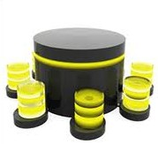
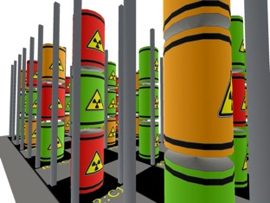
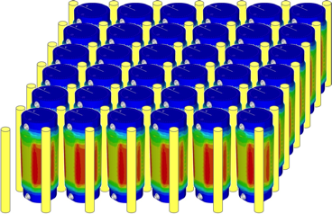







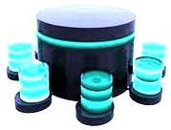

DMNR system for radwaste storage real-time monitoring
local
data
storage
Data
Data
Web
remote
data
storage

Slide 3







DMNR system for radwaste storage real-time monitoring
low-cost solution for granular online radwaste monitoring
in collaboration with Ansaldo Nucleare
Detector Mesh for Nuclear Repositories
in collaboration with SOGIN
a prototype pallet installed in a storage site
2-year agreement renewal?
INFN now member of IGD-TP (Implementing Geological Disposal – Technology Platform)
EU lobby
INFN now member of JOPRAD (JOint Programming for RAdwaste Disposal)
EU lobby
collaboration with CAEN?
NDA signed

Slide 4
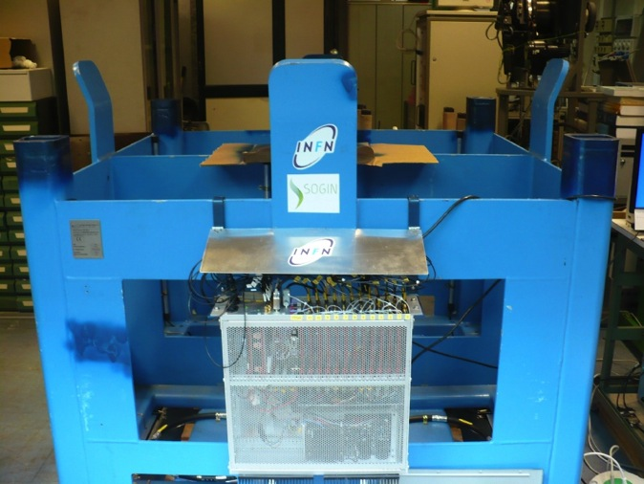
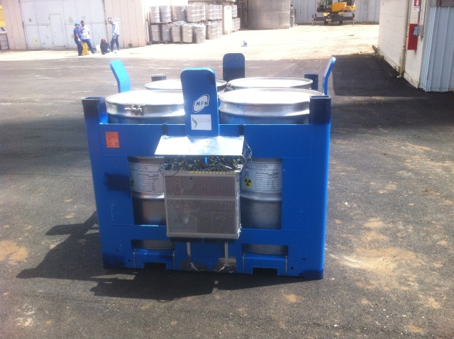
prototype: 12 fiber sensors installed (June 2014)
empty
with drums
first field tests extremely encouraging
sensitivity ≈ 0.01 µSv/h at 50 standard deviations

Slide 5
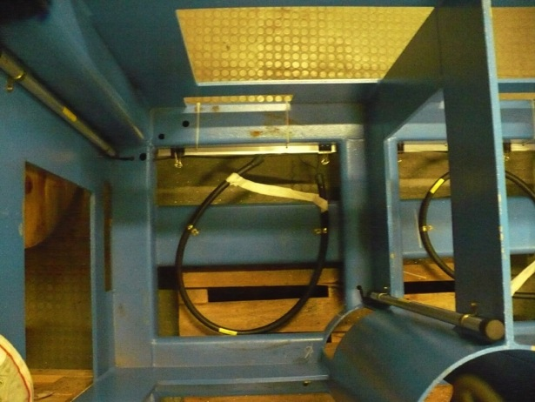
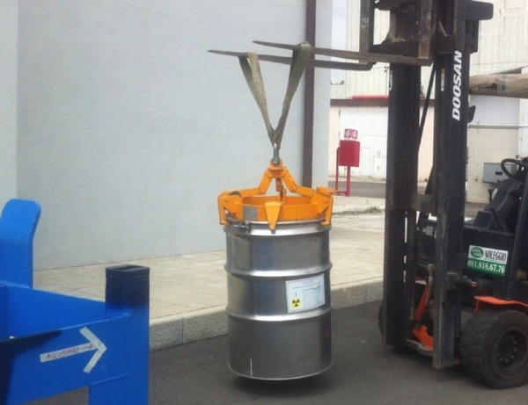
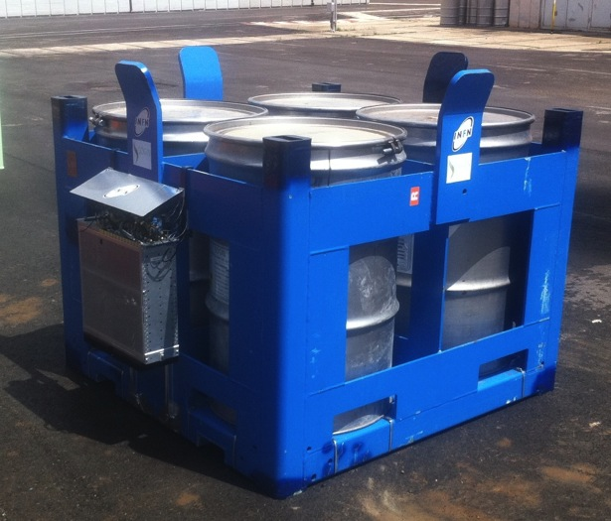
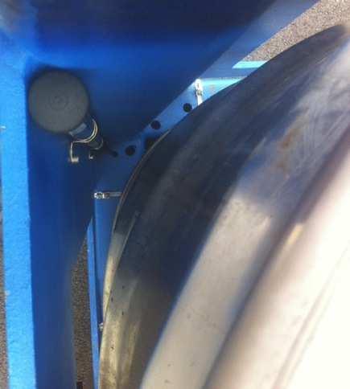
Confidential

Slide 6
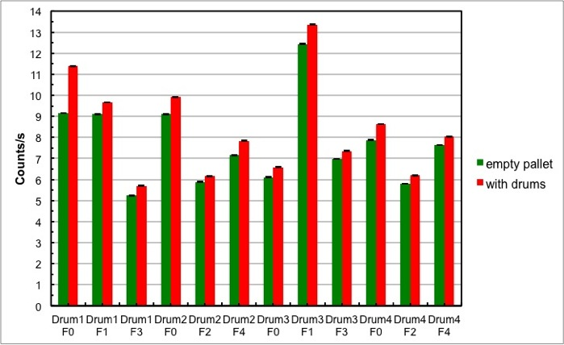
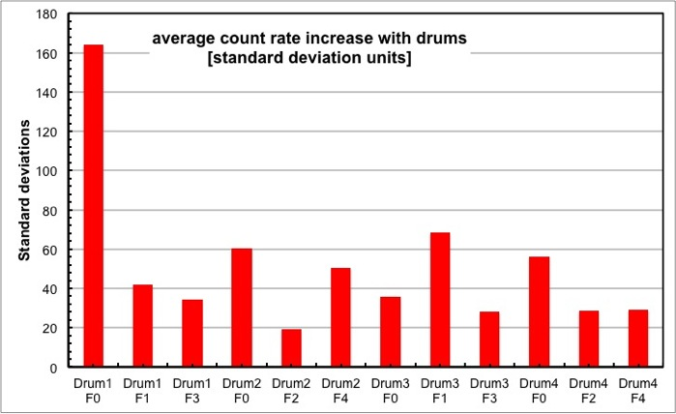
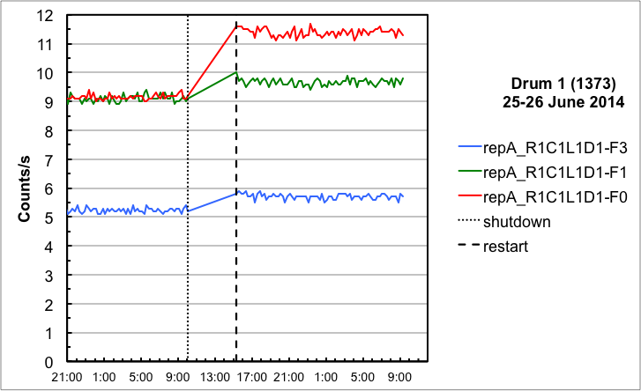
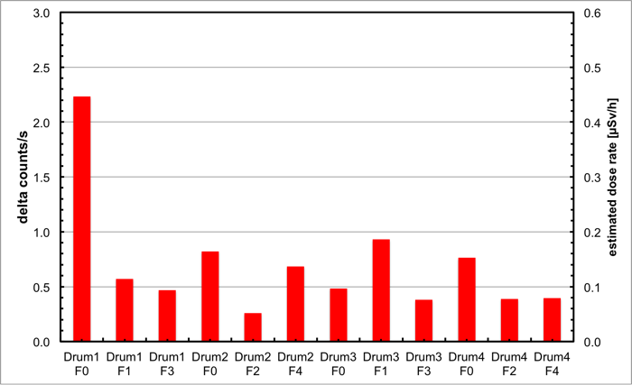
First results

Slide 7



mishandled computer by Sogin: crash!!!
S.S. & G.V. went to Sogin:
system restored
wrong operation again: computer death

Slide 8


RadSieve
  Radwaste sorting table for decommissioning
  (Radwaste package fill optimization)
  (Radwaste drum rough characterization)
end of June:
meeting at LNS with ELSE Nuclear
NDA signed

Slide 9
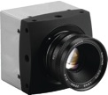

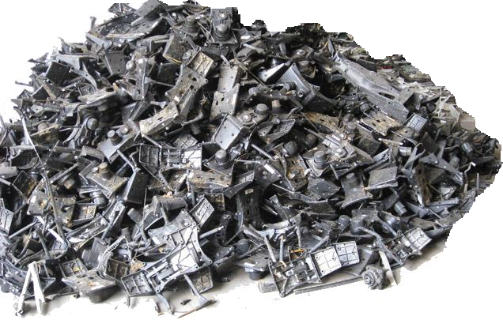
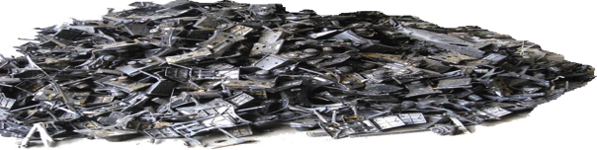
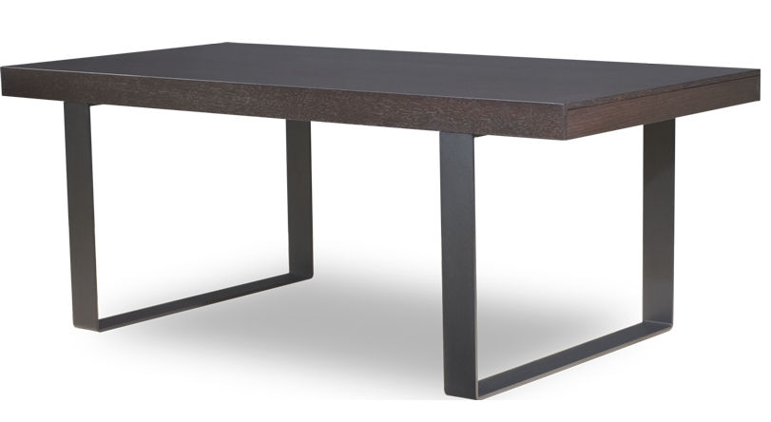
RadSieve
Sorting table for hot spots detection in decommissioning
patent in preparation

Slide 10
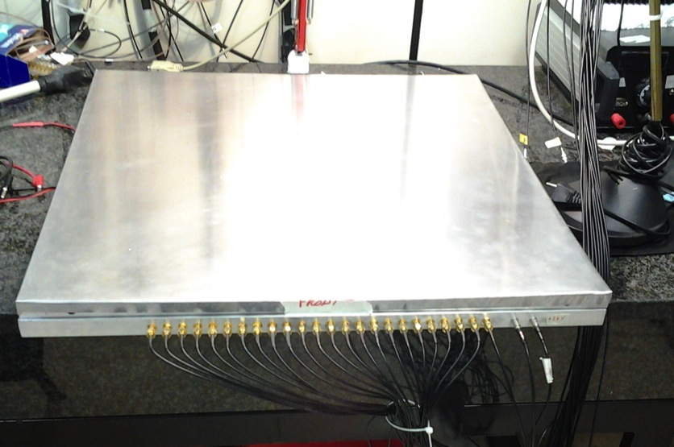
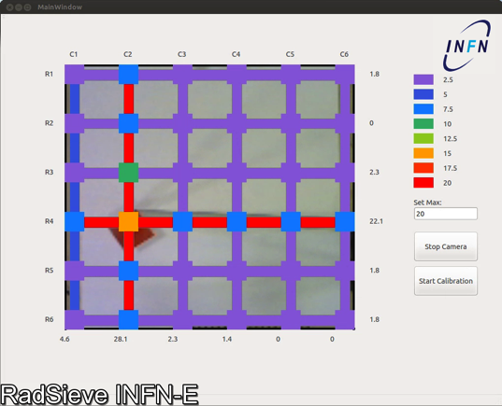
table prototype
60 cm
prototype 60cm x 60cm
ready

Slide 11
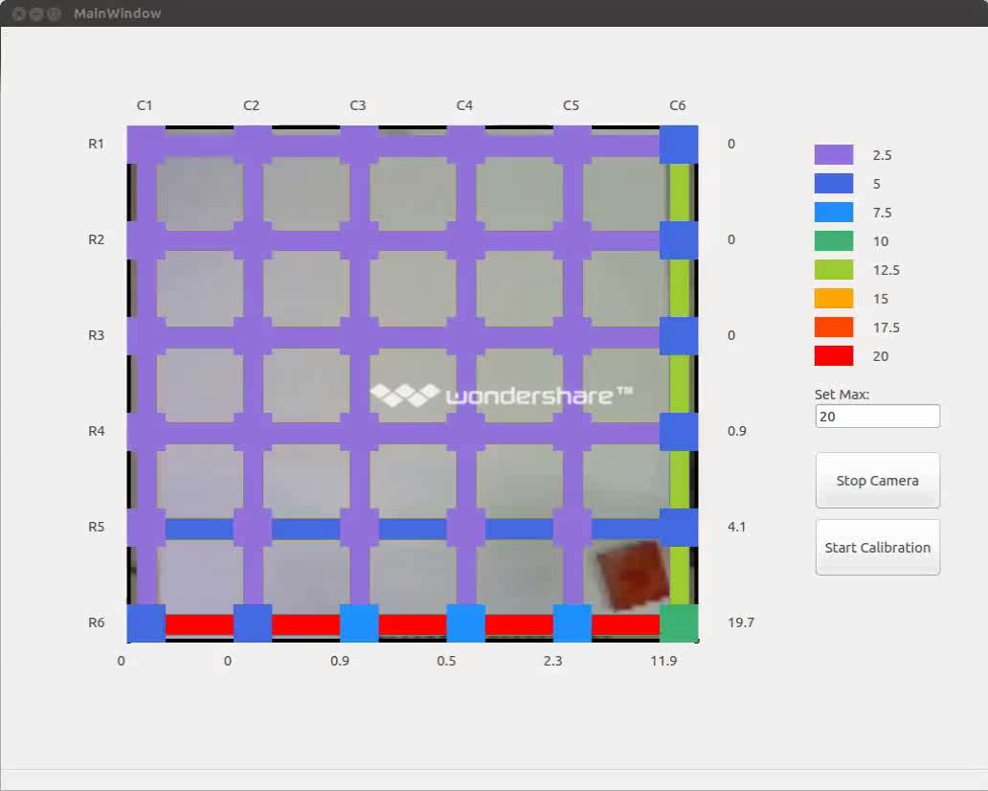
Test with a gamma source (²²Na, 250 kBq)

Slide 12
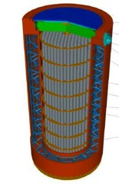
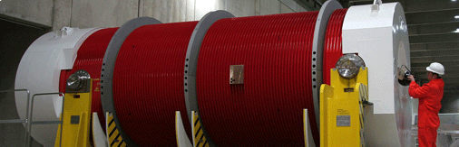
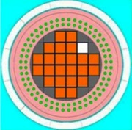
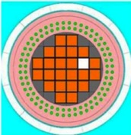
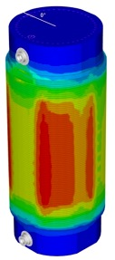
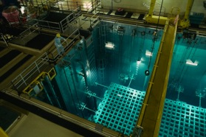
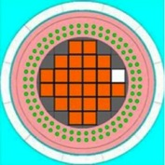
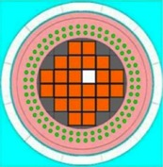
HELNEM
³HE-Less NEutron Monitors
Collaboration with JRC & Euratom: neutron detection
(INFN patent pending RM2013A000254)
spent fuel monitoring
preventing the smuggling of nuclear fuel
detection of possible diversion of fuel elements from Castor containers
(P.Peerani, M.Galletta, Nuclear Engineering and Design 237 (2007) 94-99)

Slide 13

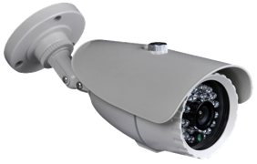
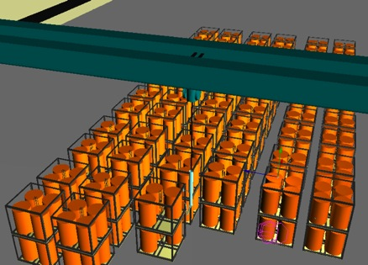


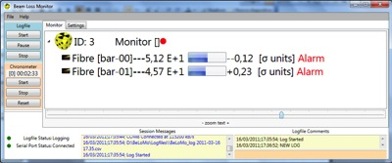
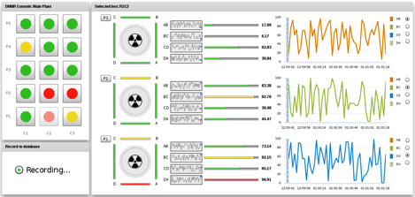
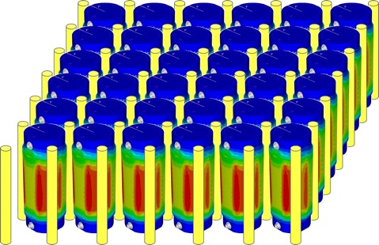
ensuring continuity of knowledge
current monitoring method: video camera
our idea: granular, real time, automatic

Slide 14
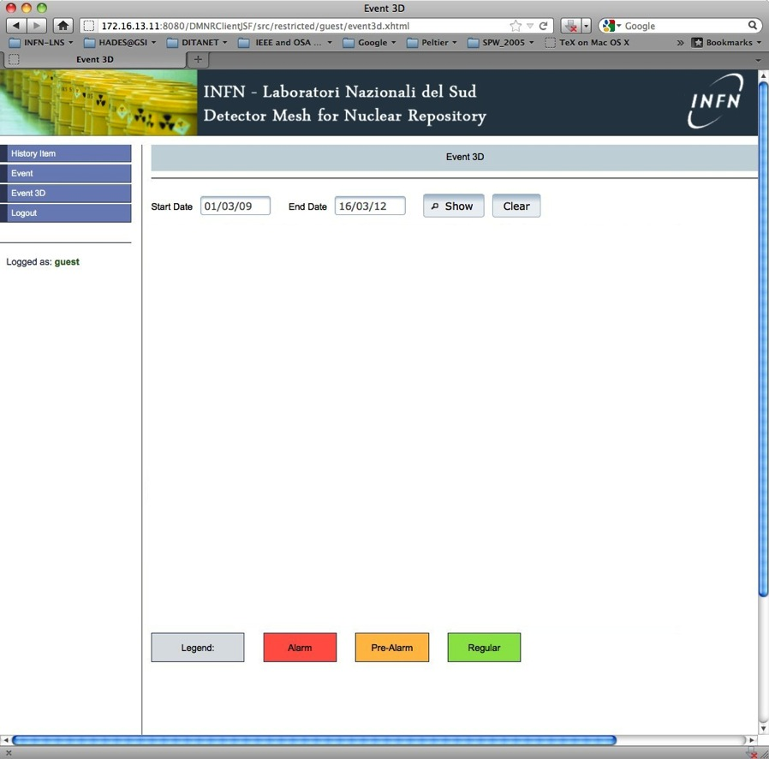

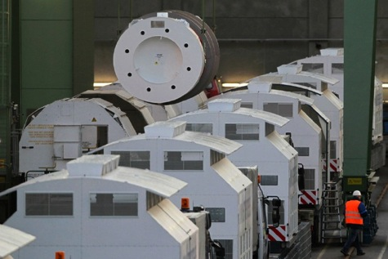

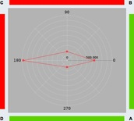
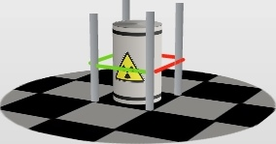
real-time castor storage monitoring
collaboration with JRC & Euratom...
wireless transmission
easily integrated into the existing hardware and software architecture of DMNR:
electronics
data acquisition
system control
data logging
database handling
Graphical User Interface

Slide 15
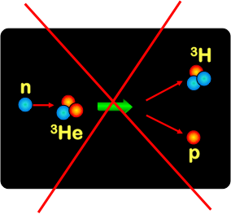
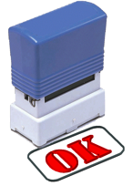
new neutron detectors
materials for thermal neutron conversion
³He
σ(0.025)
≈ 5330 b
available energy
0.76 MeV
no gamma rays
⁶Li
perfect gas detector but... worldwide lack of ³He
σ(0.025)
≈ 940 b
available E
4.78 MeV

Slide 16

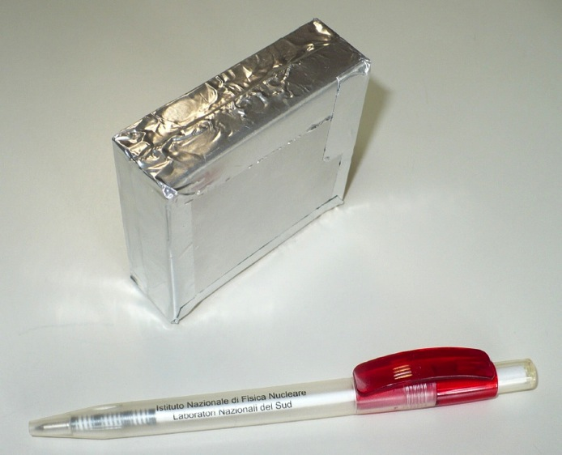
new neutron detectors
low cost
compact, robust, simple to use
detection efficiency comparable to ³He tube
10⁻⁶ neutron/gamma discrimination

Slide 17

SiMon2: neutron beam monitor for flux normalization
Si detector + ⁶LiF
Si
Si
³H
n
⁶LiF foil
⁴He
5 min run
Si
Si
triton
alpha
gamma
n_TOF collaboration @ CERN
special thanks to A.Musumarra

Slide 18
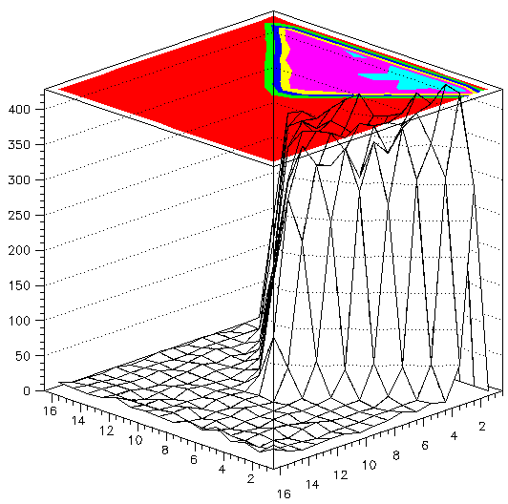
BeaMon: neutron beam characterization
Si detector + ⁶LiF
real data
the idea...
⁶LiF foil
16+16 strip Si
XY distribution
the test with AmBe source
special thanks to A.Musumarra
high-quality results with n_TOF beam

Slide 19
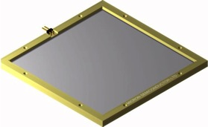
Ongoing collaboration with JRC & Euratom:
panels for neutron coincidence measurements
as possible ³He panels replacement
21 detectors purchased by EURATOM
delivered to LNS
invitation to a JRC-DOE workshop, October 2014
Collaboration with CIVIDEC (Austria)
³H, ⁴He
gamma
diamond detectors for thermal neutrons
outstanding results with the first tests at a reactor
CIVIDEC purchased a few neutron converter samples from LNS. Possible mass production?
Samples already delivered and paid
Perfect test results

Slide 20
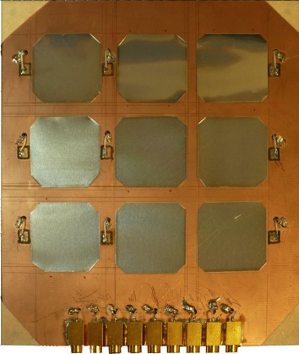
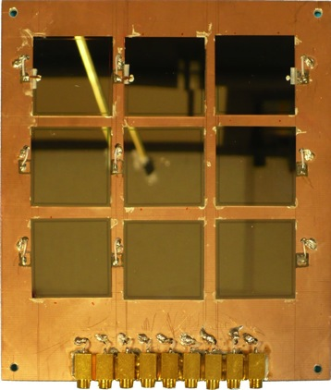
3x3 base-tile assembling
back converters
detectors placed
front converters
front+back converter
front+back converter
LIN
back converter
LOG
back converter
α
t
α
t

Slide 21
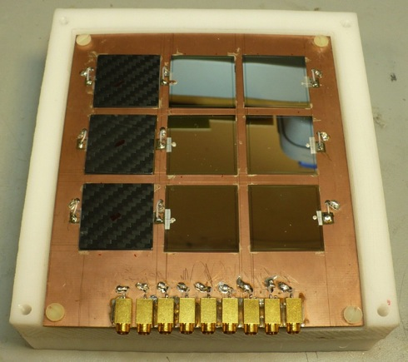
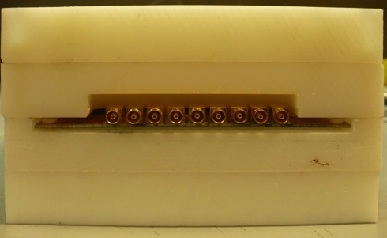
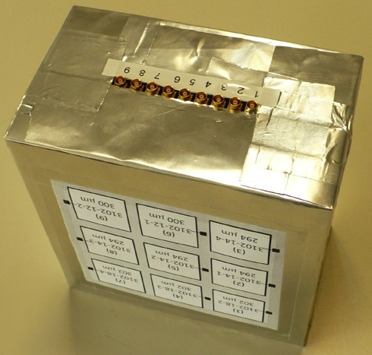
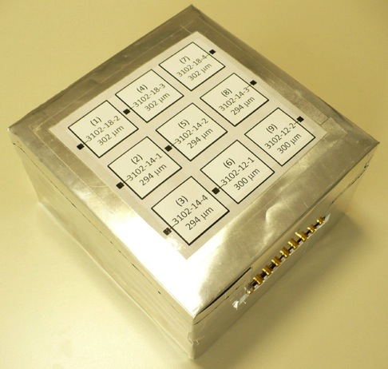

Slide 22

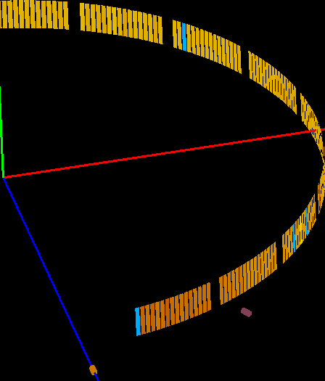
Comparison between a SiLiF neutron detector and 3He tubes
at INES (ISIS-RAL)
L.Cosentino, P.Finocchiaro, C.Marchetta, A.Pappalardo
INFN Laboratori Nazionali del Sud, Catania, Italy
F. Aliotta, T.Minniti, R.Ponterio, G.Salvato, C.Vasi
CNR-IPCF, Messina, Italy
A.Scherillo
STFC-ISIS, Rutherford Appleton Laboratory, Didcot, UK
SiLiF detector

Slide 23
INES DAQ readout
rescaled per unit area and time
detected flux
3He/SiLiF = 4
beam target: copper rod
the resolution is apparently worse due to the wider angular coverage of SiLiF (3cm) vs 3He tube (1.25cm)

Slide 24

beam target: copper rod
detected flux ³He/SiLiF ≈ 4
new SiLiF detector configuration:
efficiency improved by a factor 7
(paper submitted to Rev. Sci. Instr.)
SiLiF achieves the same (or better?) efficiency
as the ³He tubes of INES
technology much cheaper than ³He
flat detectors
efficiency evaluated analytically
fine position sensitivity (mm) already achieved with strips
coarse position sensitivity (cm) with pads
robust, low voltage, easily handled
implementation at ISIS and ESS ?
final demo-test at ISIS on 9-15 June 2015

Slide 25

Scintillators
patent? YES
Patent Pending
RM2013A000254

Slide 26
SiPM
SiPM
25 x 3 x 1 mm³ CsI(Tl)
⁶LiF + Al wrap
GEANT4
exp data

Slide 27
SiPM
⁶LiF
2 mm
SiPM
CsI(Tl)
Al wrap
GEANT4
exp data

Slide 28
outlook: application fields
Nuclear physics research
• Homeland security (nuclear material smuggling)
• Dosimetry
• Radwaste monitoring
• Spent fuel handling and storage monitoring
• Neutron beam science
• other...
ongoing developments
Plastic scintillators: promising results coming soon

Slide 29





pending collaboration issues
collaboration with CNR-IPCF
collaboration with SITAEL?
NDA signed
collaboration with LUNA?
collaboration with ESS Italy?
collaboration with SCIONIX?
NDA signed
collaboration with CIVIDEC (converters sold)
collaboration with CERN (converters sold)

Slide 30
scientific production ≈ 80
invited papers
invited book chapters
patents
peer reviewed journals
invited talks
conference contributions
student awards
theses
C.Greco, upper level (master) Thesis (2015)
S.Grillo, upper level (master) Thesis (2015)
R.Alvano, upper level (master) thesis (2014)
L.Russo, upper level (master) Thesis (2013)
F.Oliveri, first level Thesis (2013)
L.Curcuruto, upper level (master) Thesis (2012)
M.Campione, upper level (master) Thesis (2012)
S.Scirè, upper level (master) Thesis (2012)
C.Greco, first level Thesis (2011)
S.Grillo, first level Thesis (2011)
C.Scirè, upper level (master) Thesis (2011)
V.Finocchiaro, first level Thesis (2011)
G.Guardo, upper level (master) Thesis (2011)
V.Febbraro, upper level (master) Thesis (2009)
S.Scirè, LNS Stage final report (2009)
G.Greco, upper level (master) Thesis (2009)
M.Barbagallo, upper level (master) Thesis (2009)

Slide 31
IV SNRI
Seminario Nazionale Rivelatori Innovativi
INFN LNS e Sez. di Catania
10-14 Novembre 2014
1 lab exercise on DMNR sensors
1 lab exercise on HELNEM sensors
highly positive feedback
(anonymous questionnaires)

Slide 32











Miniradmeter: a miniature detector for gamma rays
G.Alimonti (INFN-MI), P.Finocchiaro, A.Pappalardo, S.Scirè

Slide 33


possible step-up: a cheap and performing personal detector
current version
Gamma spectrum
with ¹³⁷Cs source
FWHM 10% @662keV
minimum overall detector size ≈ 5mm x 5mm x 5mm
the rest is battery, discrete components electronics
could be integrated inside a mobile phone or tablet
collaboration with CAEN?
collaboration with ST?
NDA signed
NDA signed

