Slide 1
Notes:
Slide 1: Company Logo Full Page
Before you start editing the slides of your talk change to the Master Slide view:
Microsoft Office :Menu: View > Slide Master;
Macintosh – View > Master > Slide Master
Edit the following items:
On the Slide Master (first master slide) – lower area
a) On the left Delete the text and write the title of the event/Conference, Location
b) On the right delete the text and write the name and surname of the speaker and the date (day, month , year)
Close Master View

Slide 2
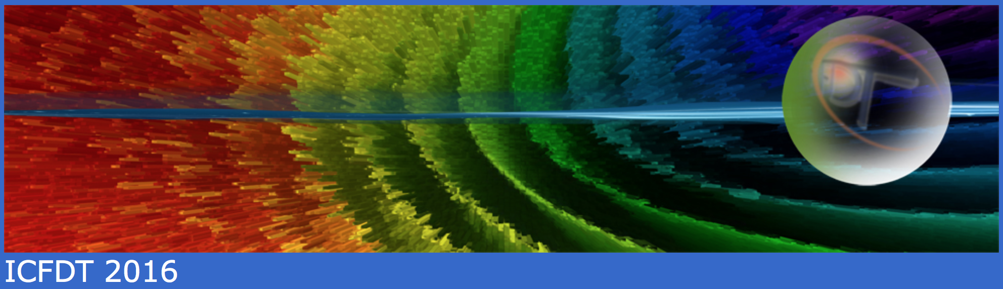
Photon Pulse Characterization at FERMI Free Electron Laser
Marco Zangrando
On behalf of the FERMI team

Slide 3
OUTLINE
of the talk
Brightness: synchrotrons vs. FELs
FERMI FEL: layout, basic principles, and operational results
Photon Beam Transport System (PADReS):
GAS-BASED DIAGNOSTICS, PRESTO, AC/DC, Coherence, WFS
Pulse length measurements: cross-correlation, SPIDER
Polarization (measurement and control)
Conclusions
Notes:
The generation of two-color FEL pulses by the same electron bunch at FERMI-FEL has opened unprecedented opportunity for jitter-free FEL pump-FEL probe time resolved coherent diffraction imaging (CDI) experiments in order to access spatial aspects in dynamic processes. This possibility was first explored in proof-of-principle resonant CDI experiments using specially designed sample consisting of Ti grating. The measurements performed tuning the energies of the FEL pulses to the Ti M-absorption edge clearly demonstrated the time dependence in optical constant in Ti varying the FEL-pump intensity and probe time delay. The next planned CDI experiments in February 2013 will explore transient states in multicomponent nanostructures and magnetic systems, using the controlled linear or circular polarization of the two-color FEL pulses with temporal resolution in the fs to ps range.

Slide 4
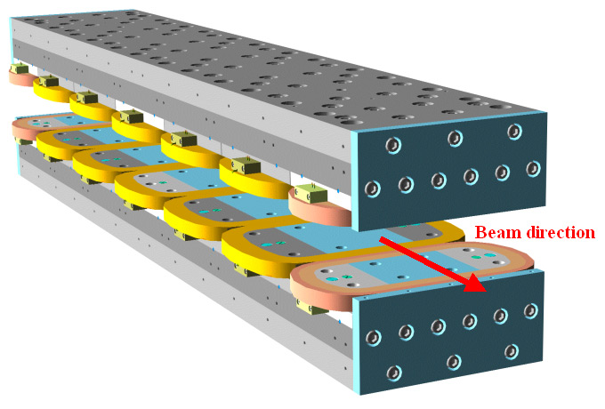
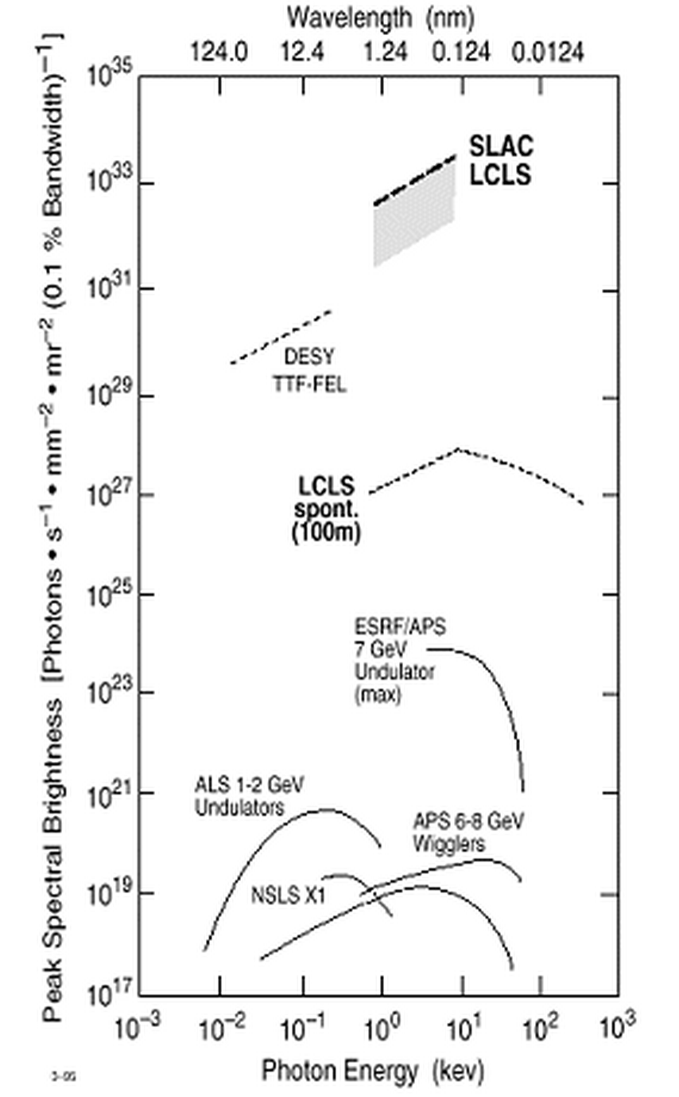
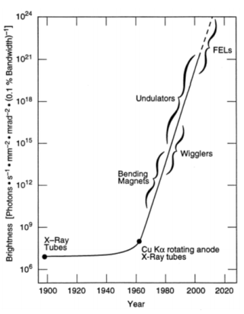
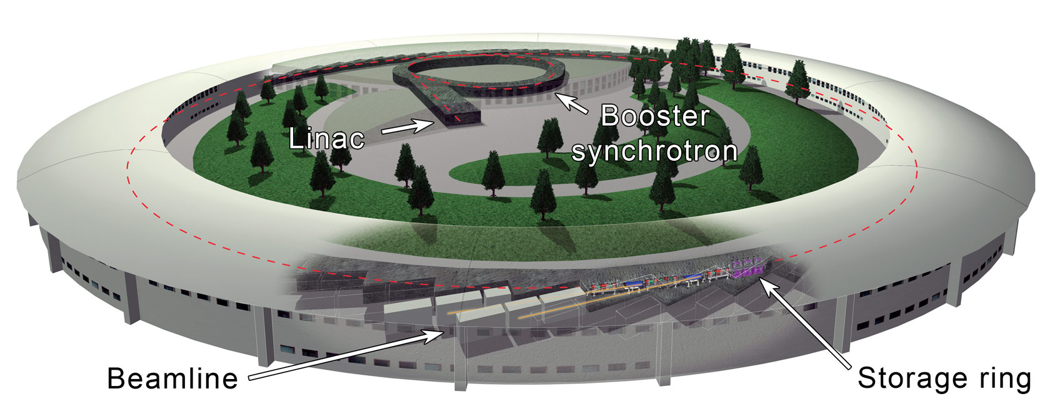


BRIGHTNESS
Different lightsources
FELs
Courtesy of Luca Giannessi
FERMI
FEL-1 & 2
10 orders
of
magnitude
Storage Rings
10¹⁰
10⁶
Notes:
The generation of two-color FEL pulses by the same electron bunch at FERMI-FEL has opened unprecedented opportunity for jitter-free FEL pump-FEL probe time resolved coherent diffraction imaging (CDI) experiments in order to access spatial aspects in dynamic processes. This possibility was first explored in proof-of-principle resonant CDI experiments using specially designed sample consisting of Ti grating. The measurements performed tuning the energies of the FEL pulses to the Ti M-absorption edge clearly demonstrated the time dependence in optical constant in Ti varying the FEL-pump intensity and probe time delay. The next planned CDI experiments in February 2013 will explore transient states in multicomponent nanostructures and magnetic systems, using the controlled linear or circular polarization of the two-color FEL pulses with temporal resolution in the fs to ps range.

Slide 5
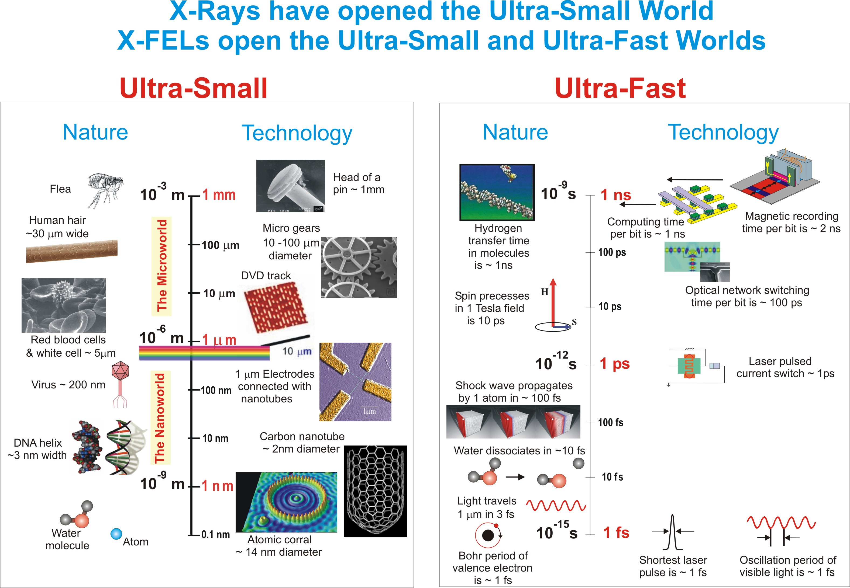
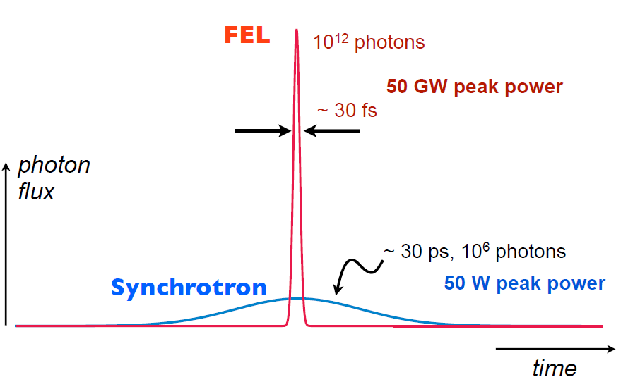
X-RAYS
Smaller and shorter
Unique new opportunities thanks to the distinct properties of FEL light:
(i) High peak power, (ii) Ultrashort and (iii) Coherent pulses
Notes:
The generation of two-color FEL pulses by the same electron bunch at FERMI-FEL has opened unprecedented opportunity for jitter-free FEL pump-FEL probe time resolved coherent diffraction imaging (CDI) experiments in order to access spatial aspects in dynamic processes. This possibility was first explored in proof-of-principle resonant CDI experiments using specially designed sample consisting of Ti grating. The measurements performed tuning the energies of the FEL pulses to the Ti M-absorption edge clearly demonstrated the time dependence in optical constant in Ti varying the FEL-pump intensity and probe time delay. The next planned CDI experiments in February 2013 will explore transient states in multicomponent nanostructures and magnetic systems, using the controlled linear or circular polarization of the two-color FEL pulses with temporal resolution in the fs to ps range.

Slide 6
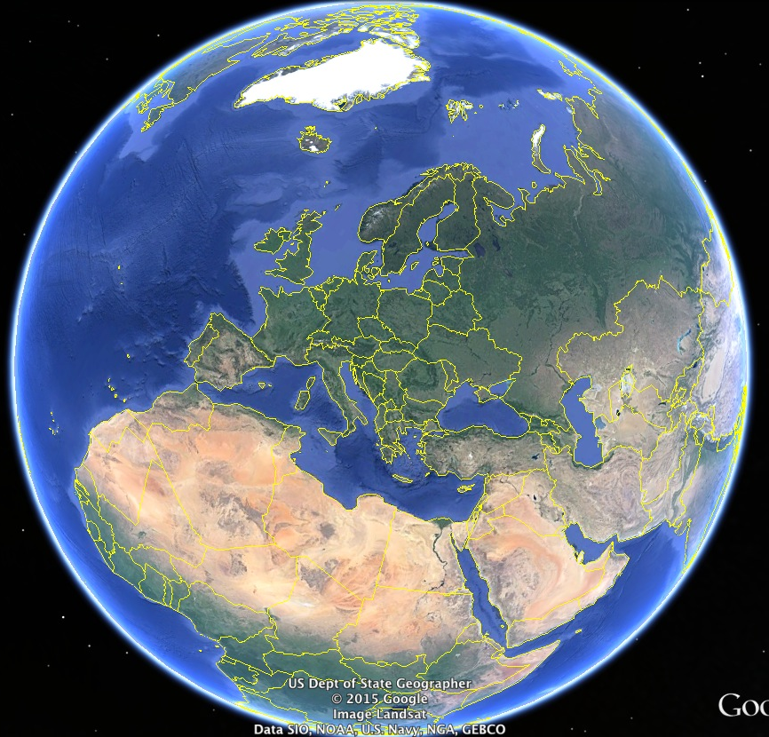
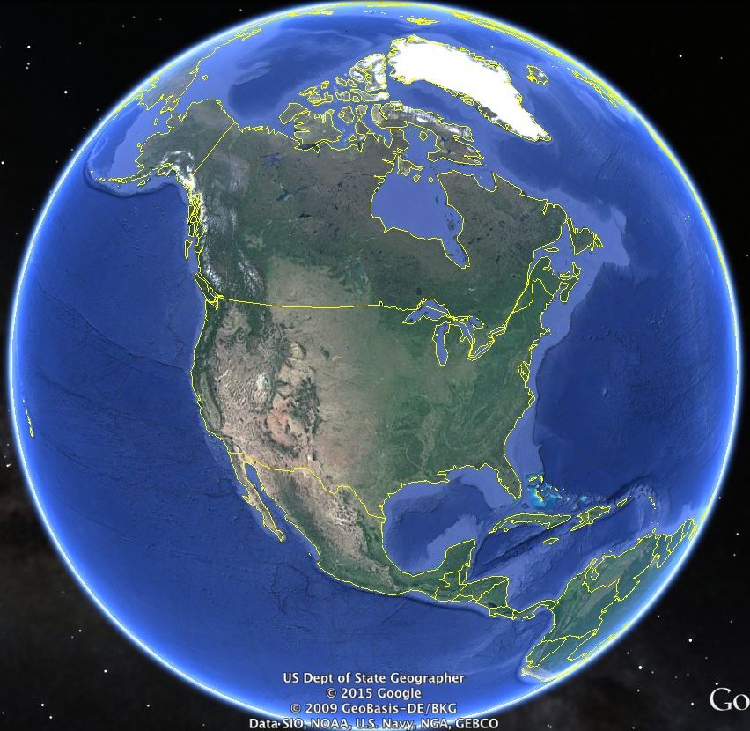

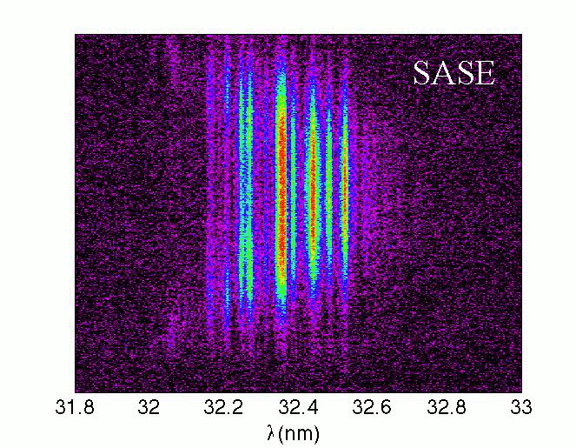
FEL USER FACILITIES
Existing and in construction
Existing
FEL user
facilities
… in construction
Lasing expected between 2016-2018
FLASH
X-FEL
PSI
FERMI
DALIAN
SACLA
LCLS
SDUV FEL
PAL
LCLS II
Notes:
The generation of two-color FEL pulses by the same electron bunch at FERMI-FEL has opened unprecedented opportunity for jitter-free FEL pump-FEL probe time resolved coherent diffraction imaging (CDI) experiments in order to access spatial aspects in dynamic processes. This possibility was first explored in proof-of-principle resonant CDI experiments using specially designed sample consisting of Ti grating. The measurements performed tuning the energies of the FEL pulses to the Ti M-absorption edge clearly demonstrated the time dependence in optical constant in Ti varying the FEL-pump intensity and probe time delay. The next planned CDI experiments in February 2013 will explore transient states in multicomponent nanostructures and magnetic systems, using the controlled linear or circular polarization of the two-color FEL pulses with temporal resolution in the fs to ps range.

Slide 7
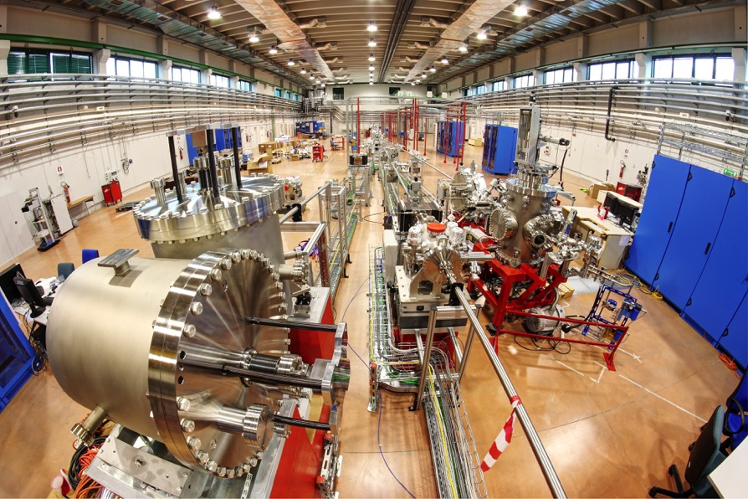
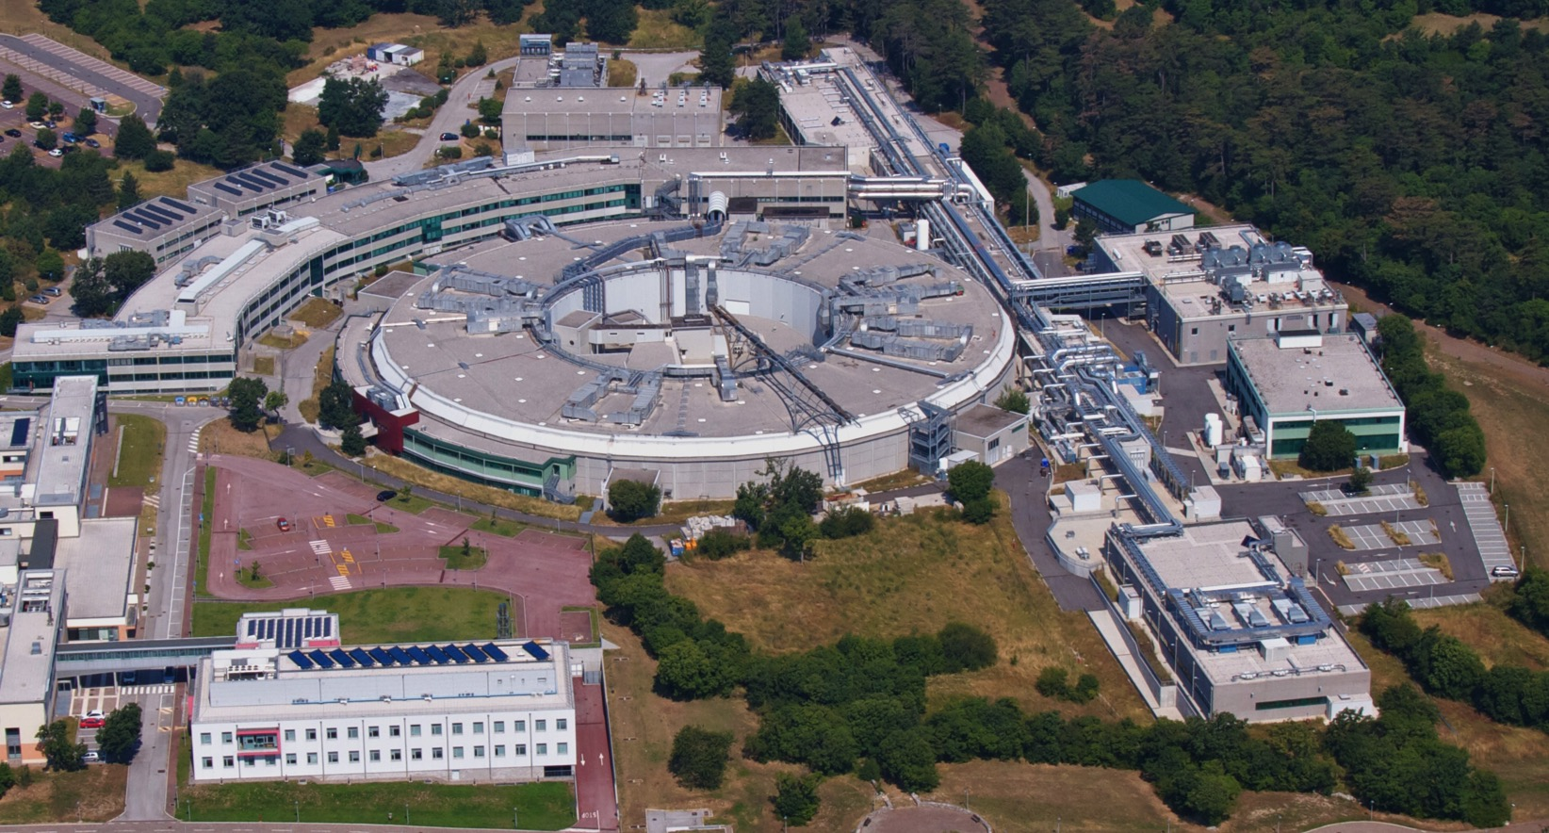
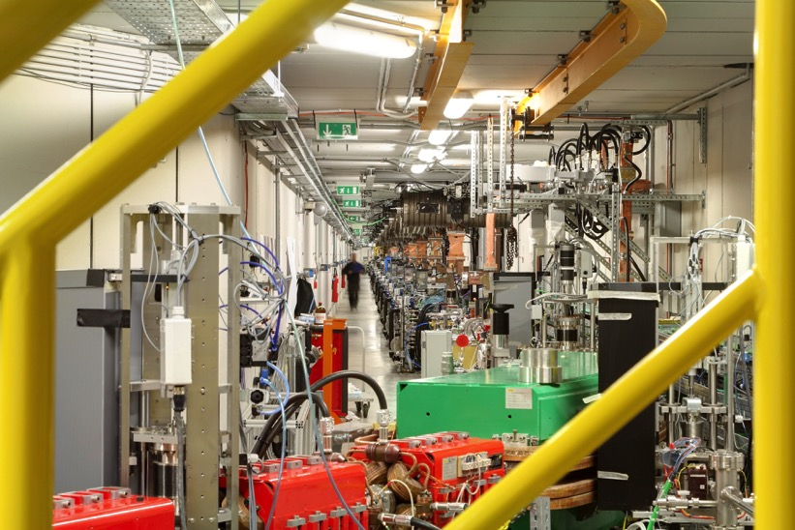
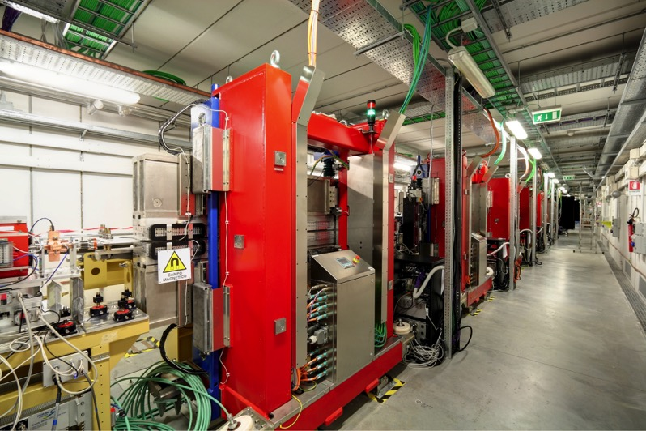
ELETTRA
The lightsources
ELETTRA Synchrotron Light Source:
up to 2.4 GeV – TOP-UP mode
~800 proposals from 40 countries every year
FERMI FEL-1 & FEL-2 Free Electron Laser
100nm to 4 nm
High Gain Harmonic Generation FEL (HGHG)
~70 proposals from first two calls for experiments in 2012/2013
~50 proposals in the 3rd call (2014)
~75 proposals in the 4th call (2015)
∼ 100 m
Undulator Hall
∼ 200 m
Linac Tunnel +
Injector Extension
∼ 60 m
Experim. Hall
Courtesy of Enrico Allaria
Sponsored by: Italian Minister of University and Research (MIUR), Regione Auton. Friuli Venezia Giulia, European Investment Bank (EIB), European Research Council (ERC), European Commission (EC)

Slide 8
FERMI
Machine layout
Linac Tunnel
200m
1.2 GeV
100 MeV
300 MeV
800 MeV
1.5 GeV
Gun
L0
Laser-heater
L1
BC1
L2
L3
BC2
L4
Diagnostic
Beam Dump
Undulator Hall
100m
1.2 GeV
Dispersive
Section
FEL1
Spreader
To the Beamlines
1st Dispersive
Section
Delay
Line
2nd Dispersive
Section
FEL-2
1.5 GeV
Modulator Undulator
Main Beam Dump
Radiator Undulator
60m
Experimental Hall
EIS
Elastic and Inelastic Scattering
FEL1
Slits
Spectrometer
Diffraction and Projection Imaging
DIPROI
FEL2
I/O Monitors & Gas Cells
Switching Mirror
LDM
Low
Density
Matter
Photon
Analysis
Delivery and
Reduction
System
PADReS
Notes:
The generation of two-color FEL pulses by the same electron bunch at FERMI-FEL has opened unprecedented opportunity for jitter-free FEL pump-FEL probe time resolved coherent diffraction imaging (CDI) experiments in order to access spatial aspects in dynamic processes. This possibility was first explored in proof-of-principle resonant CDI experiments using specially designed sample consisting of Ti grating. The measurements performed tuning the energies of the FEL pulses to the Ti M-absorption edge clearly demonstrated the time dependence in optical constant in Ti varying the FEL-pump intensity and probe time delay. The next planned CDI experiments in February 2013 will explore transient states in multicomponent nanostructures and magnetic systems, using the controlled linear or circular polarization of the two-color FEL pulses with temporal resolution in the fs to ps range.

Slide 9
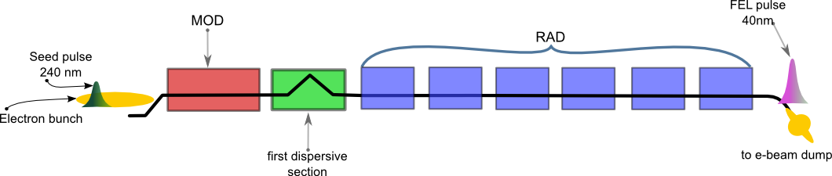
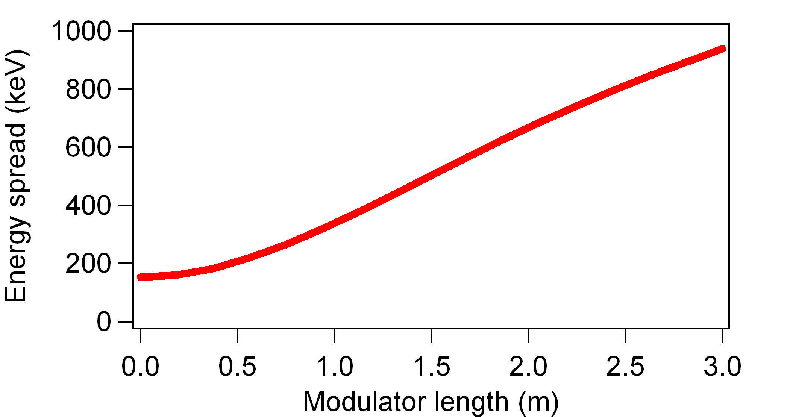
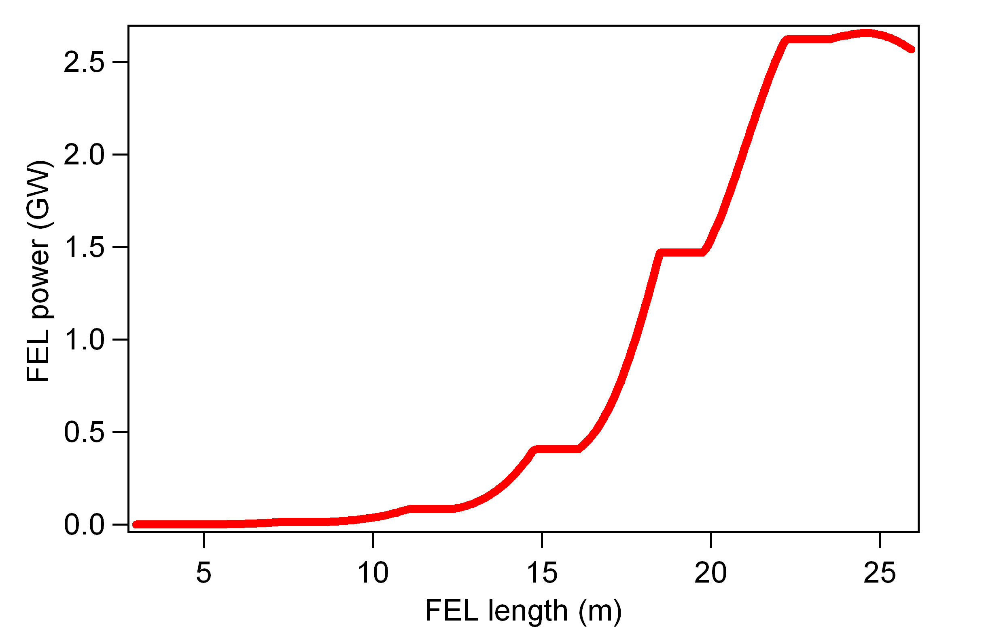
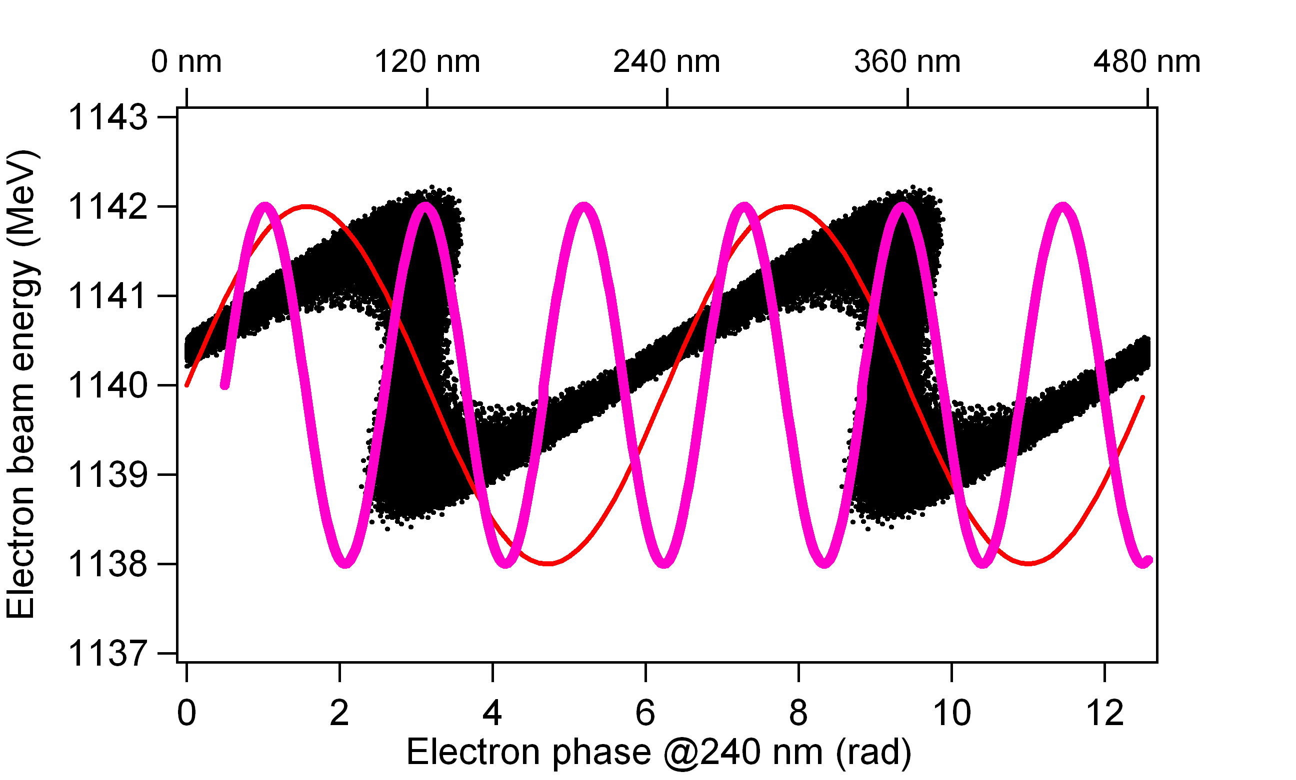
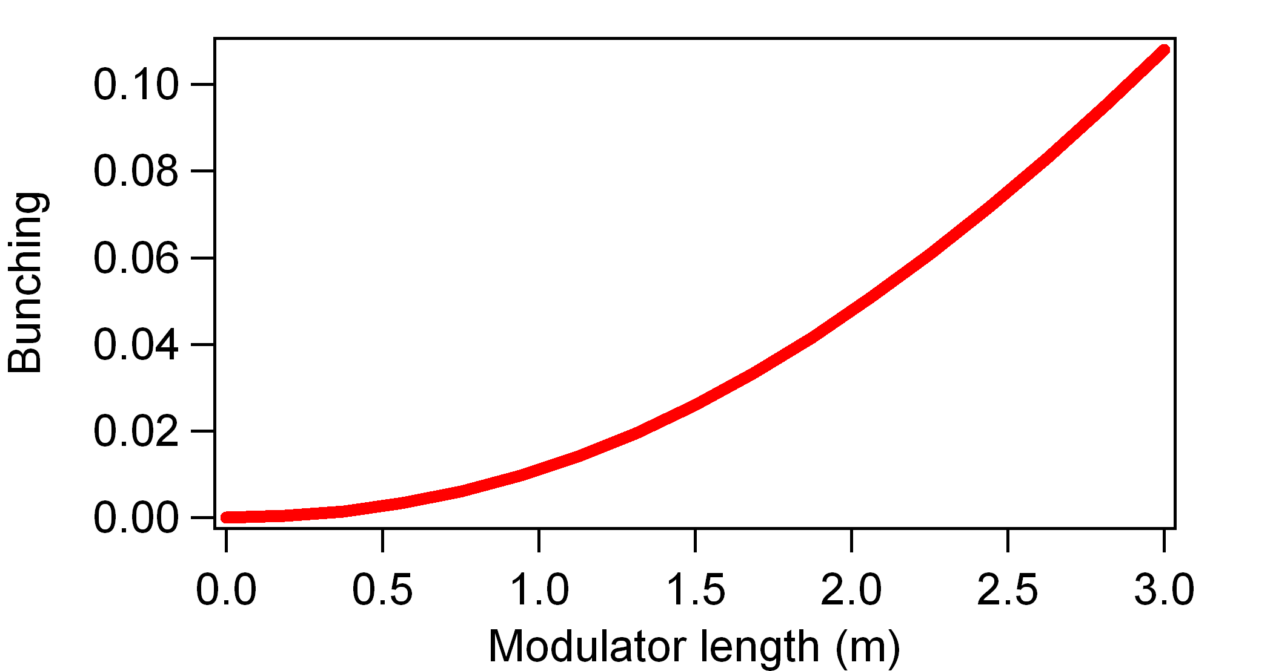
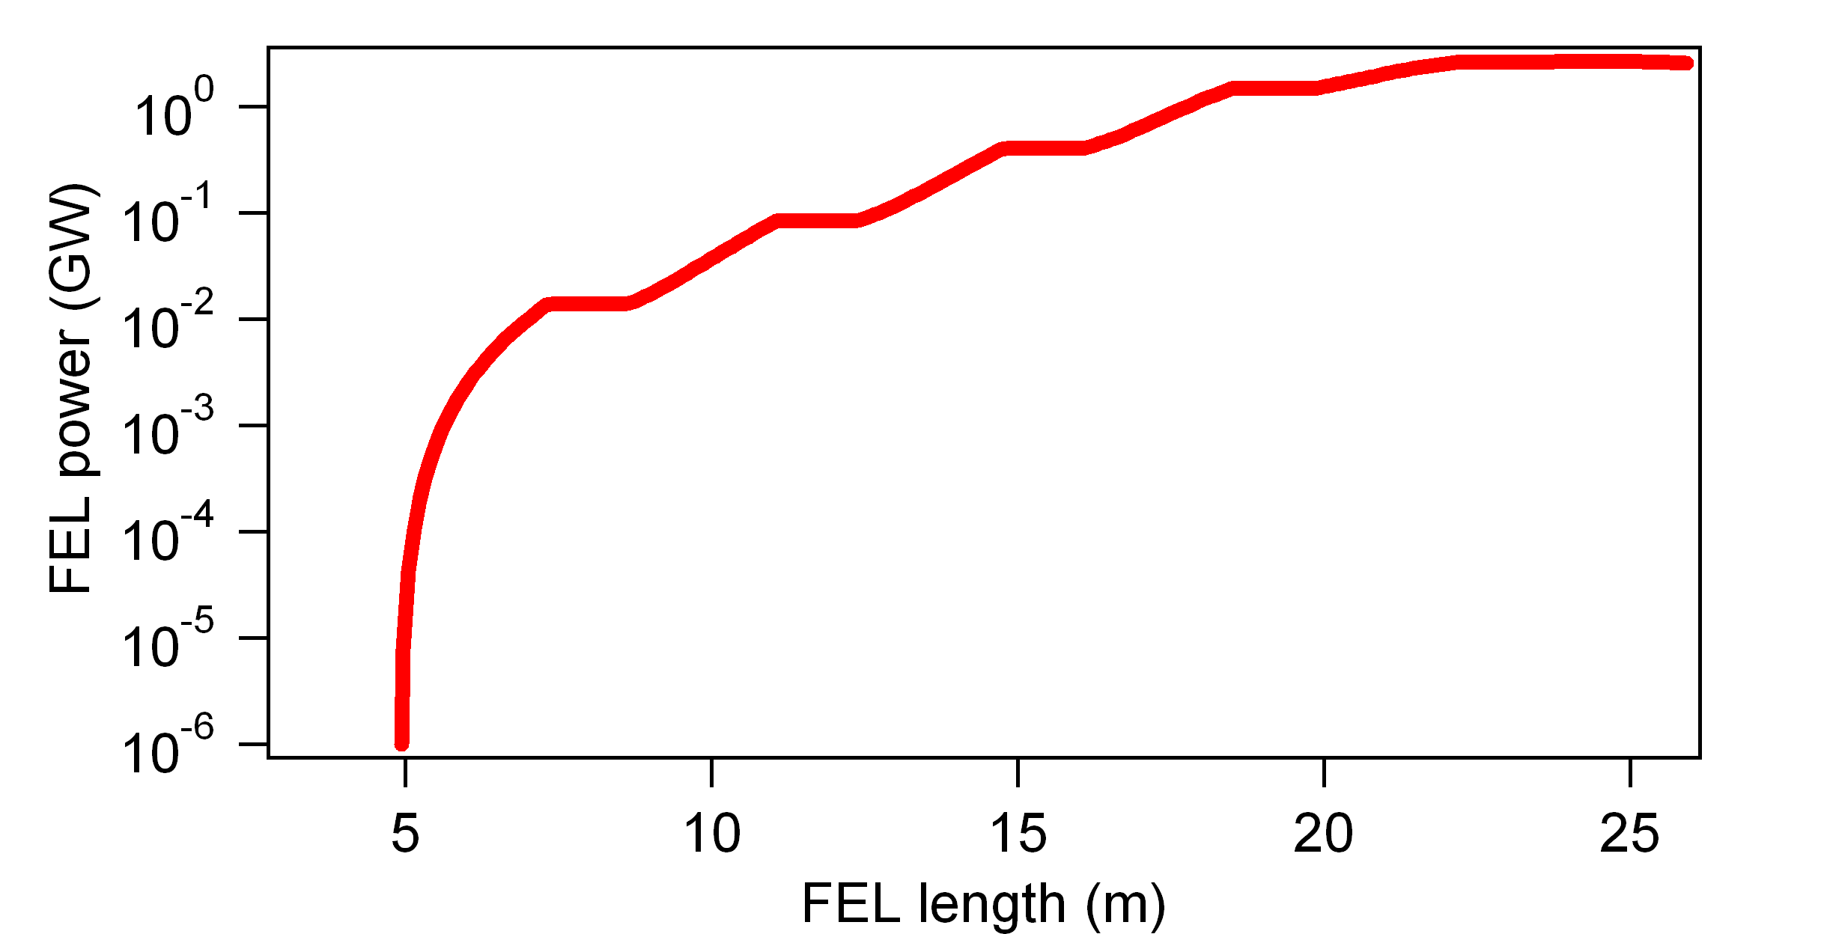
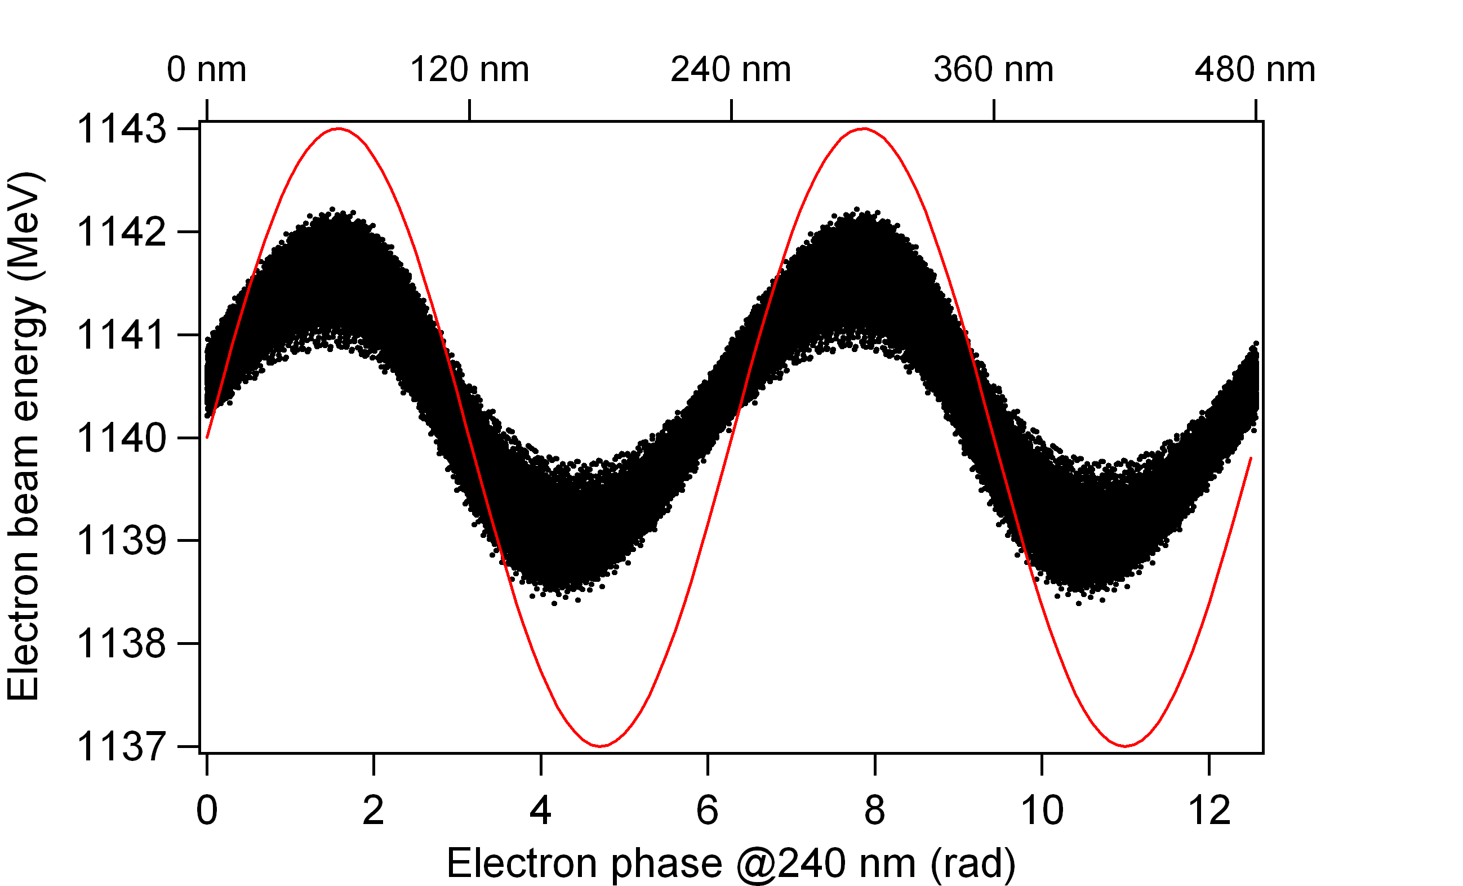
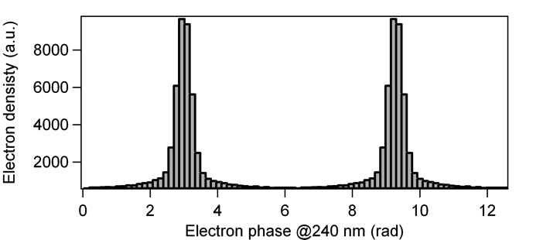
FERMI FEL
High Gain Harmonic Generation scheme
Dispersive section
Modulator
Radiator
An external laser interacts with the electron beam in the modulator inducing a periodic modulation of the electron beam energy.
In a dispersive region, energy modulation is converted into density modulation with significant harmonic content. Beam current modulation inherits coherence properties from the input laser.
Coherent bunching produces coherent emission in the radiator at the desired harmonic that is then amplified.
Courtesy of Enrico Allaria
Notes:
The generation of two-color FEL pulses by the same electron bunch at FERMI-FEL has opened unprecedented opportunity for jitter-free FEL pump-FEL probe time resolved coherent diffraction imaging (CDI) experiments in order to access spatial aspects in dynamic processes. This possibility was first explored in proof-of-principle resonant CDI experiments using specially designed sample consisting of Ti grating. The measurements performed tuning the energies of the FEL pulses to the Ti M-absorption edge clearly demonstrated the time dependence in optical constant in Ti varying the FEL-pump intensity and probe time delay. The next planned CDI experiments in February 2013 will explore transient states in multicomponent nanostructures and magnetic systems, using the controlled linear or circular polarization of the two-color FEL pulses with temporal resolution in the fs to ps range.

Slide 10
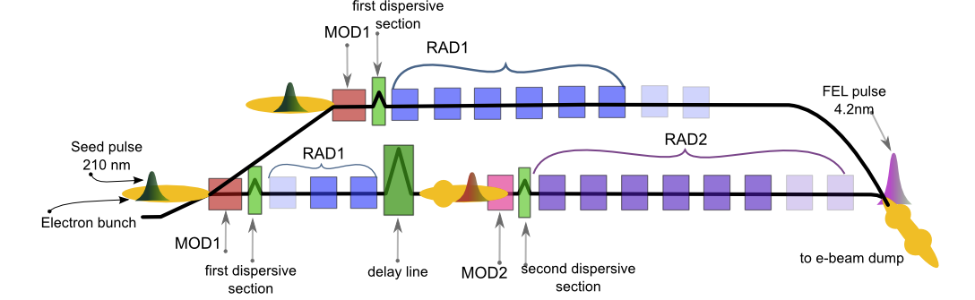
FERMI
FEL-1 and FEL-2
FEL-1: single stage HGHG seeded by a UV laser, covers the range 100 nm – 20 nm.
FEL-2: double cascade HGHG to reach the wavelength 20 nm – 4 nm.
FEL-1 (Nature Phot. 6, 699 (2012))
Tuning range | 100-20 nm (12-60 eV)
Relative bandwidth | 1X10⁻³ (FWHM)
Pulse length | <100 fs
Pulse energy | 20-100 µJ
FEL-2 (Nature Phot. 7, 913 (2013), J. Synch. Rad. 22 (2015))
Tuning range | 20-4 nm (60-300 eV)
Relative bandwidth | 1X10⁻³ (FWHM)
Pulse length | ~50 fs
Pulse energy | 5-70 µJ
Both FELs have APPLE-II undulators in the final radiator allowing polarization control.
Notes:
The generation of two-color FEL pulses by the same electron bunch at FERMI-FEL has opened unprecedented opportunity for jitter-free FEL pump-FEL probe time resolved coherent diffraction imaging (CDI) experiments in order to access spatial aspects in dynamic processes. This possibility was first explored in proof-of-principle resonant CDI experiments using specially designed sample consisting of Ti grating. The measurements performed tuning the energies of the FEL pulses to the Ti M-absorption edge clearly demonstrated the time dependence in optical constant in Ti varying the FEL-pump intensity and probe time delay. The next planned CDI experiments in February 2013 will explore transient states in multicomponent nanostructures and magnetic systems, using the controlled linear or circular polarization of the two-color FEL pulses with temporal resolution in the fs to ps range.

Slide 11
FERMI FEL
Tunability
Seed
THG or
tunable OPA
modulator
High gain radiator tuned at n^{th} harmonic
dispersion
FEL-1: Single stage HGHG configuration, nominal range 100-20 nm - Typical energy per pulse in the range 20-100-400 µJ. Seed: third harmonic of the Ti:Sa (up to 80-90 µJ, very limited (1%) tunability. Effective tunability: frequency upconverted OPA seed laser system. Most used OPA configuration (230-260 nm)
Other OPA processes (296-360nm). This requires a change of all the seed transport optics (>10 mirrors)
1st mod.
1st rad.
2nd mod.
DS1
DL
DS2
2nd rad.
FEL-2: Double stage HGHG configuration, nominal range 20-4 nm
Typical energy per pulse in the range 10-100 µJ, depending on wavelength.
FEL performances tested in the range 14.4 – 4 nm – Upgrades: additional radiator in first stage/Higher e-beam energy – Improved seed laser system
4
14.4
20
Notes:
The generation of two-color FEL pulses by the same electron bunch at FERMI-FEL has opened unprecedented opportunity for jitter-free FEL pump-FEL probe time resolved coherent diffraction imaging (CDI) experiments in order to access spatial aspects in dynamic processes. This possibility was first explored in proof-of-principle resonant CDI experiments using specially designed sample consisting of Ti grating. The measurements performed tuning the energies of the FEL pulses to the Ti M-absorption edge clearly demonstrated the time dependence in optical constant in Ti varying the FEL-pump intensity and probe time delay. The next planned CDI experiments in February 2013 will explore transient states in multicomponent nanostructures and magnetic systems, using the controlled linear or circular polarization of the two-color FEL pulses with temporal resolution in the fs to ps range.

Slide 12
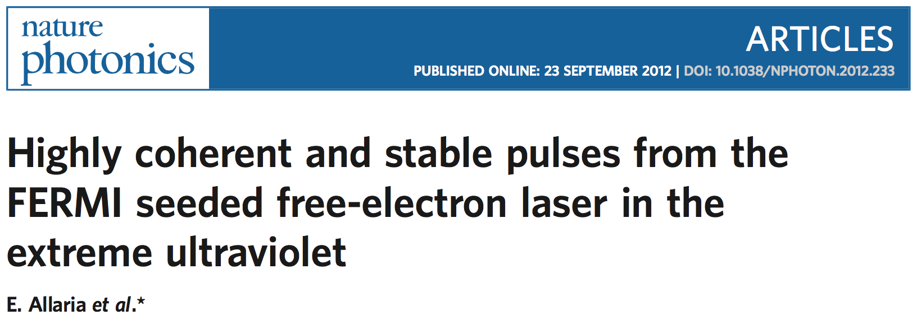
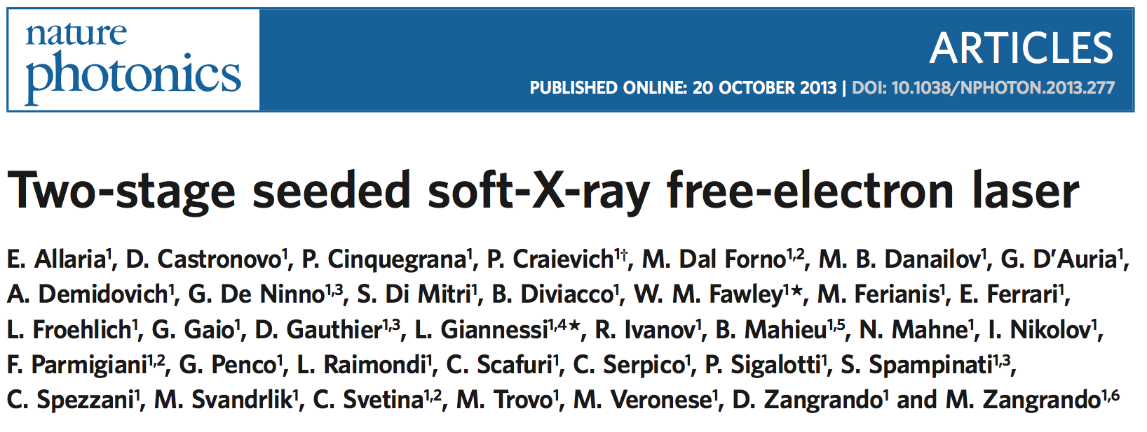
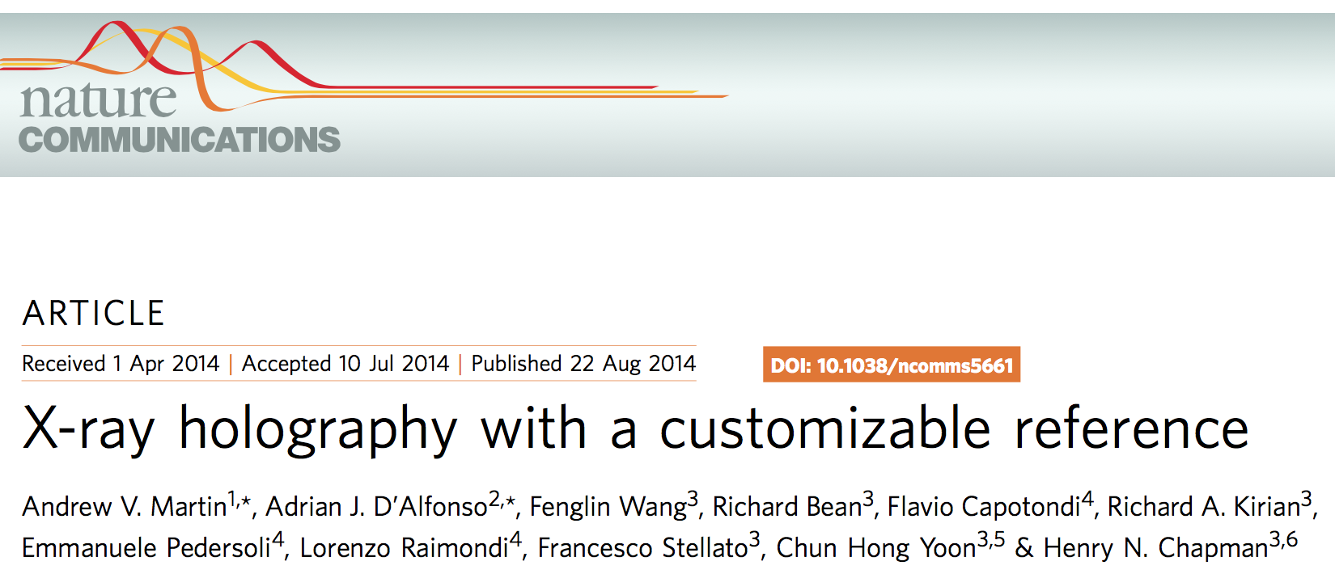
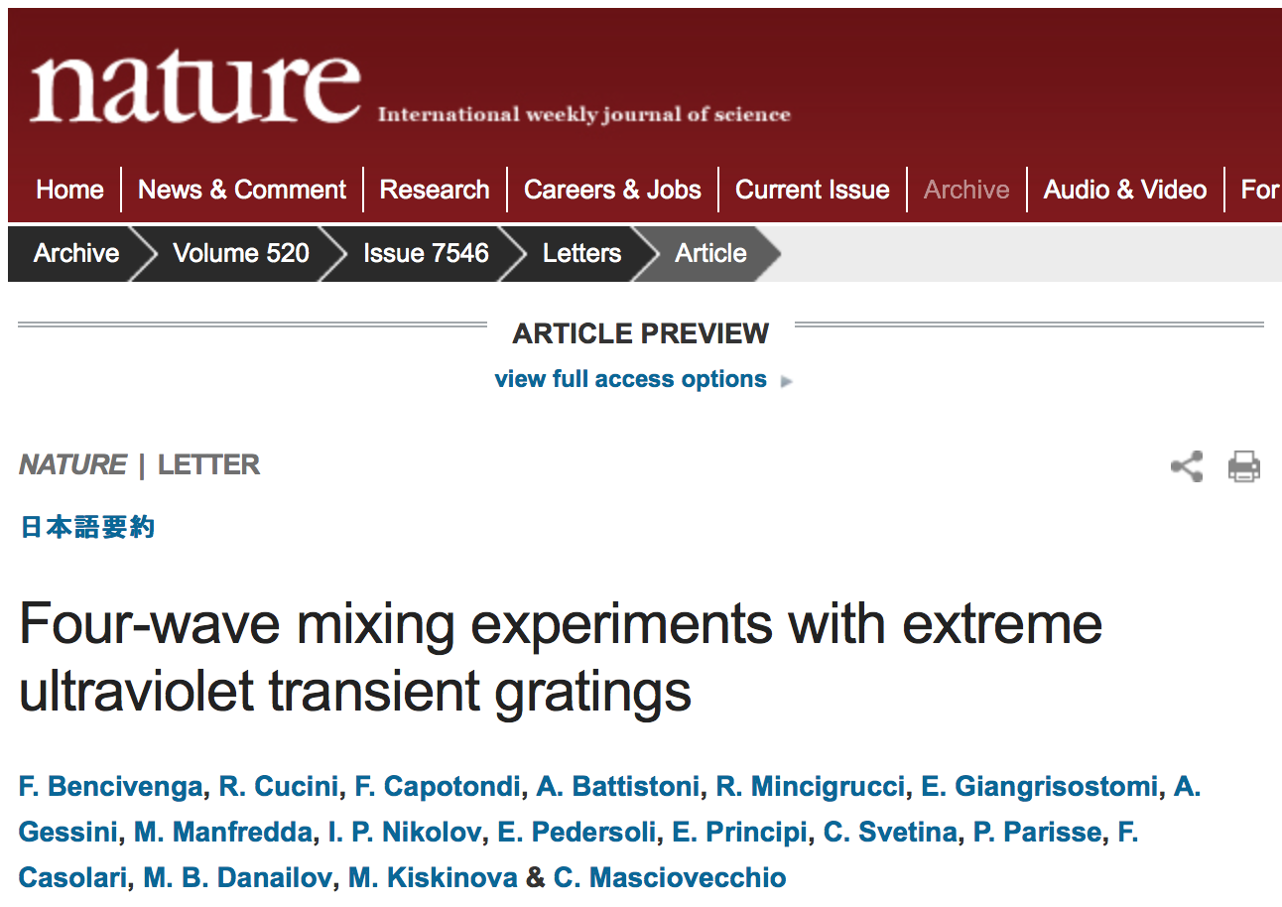
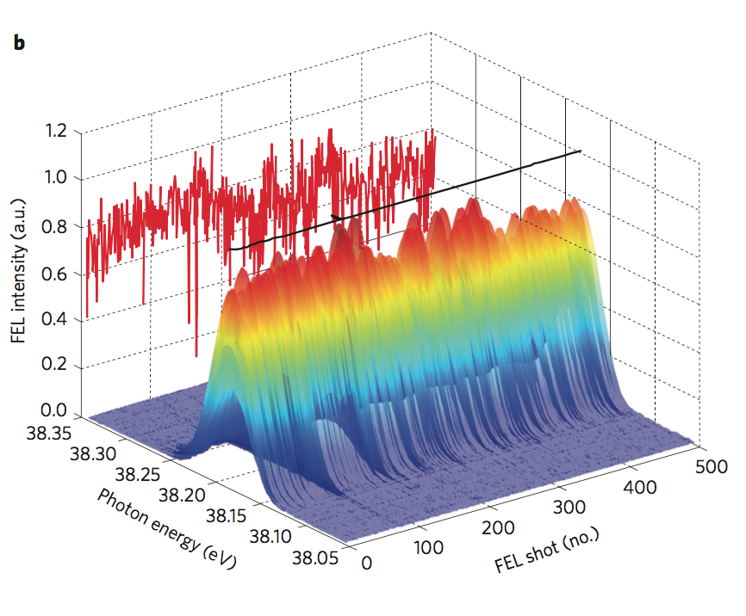
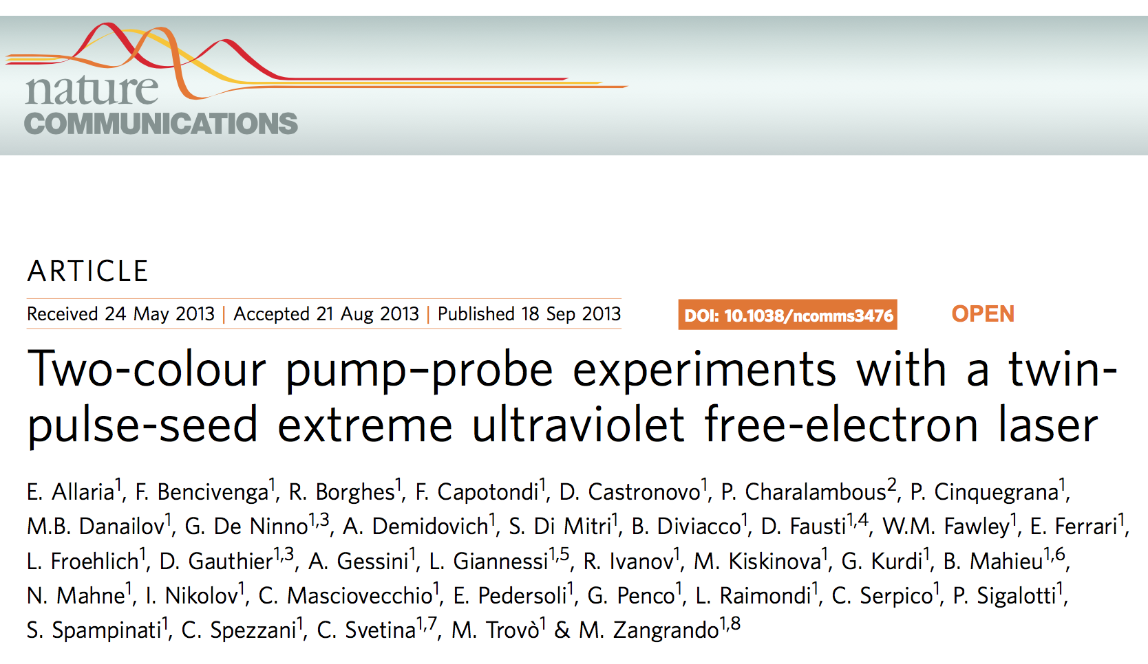
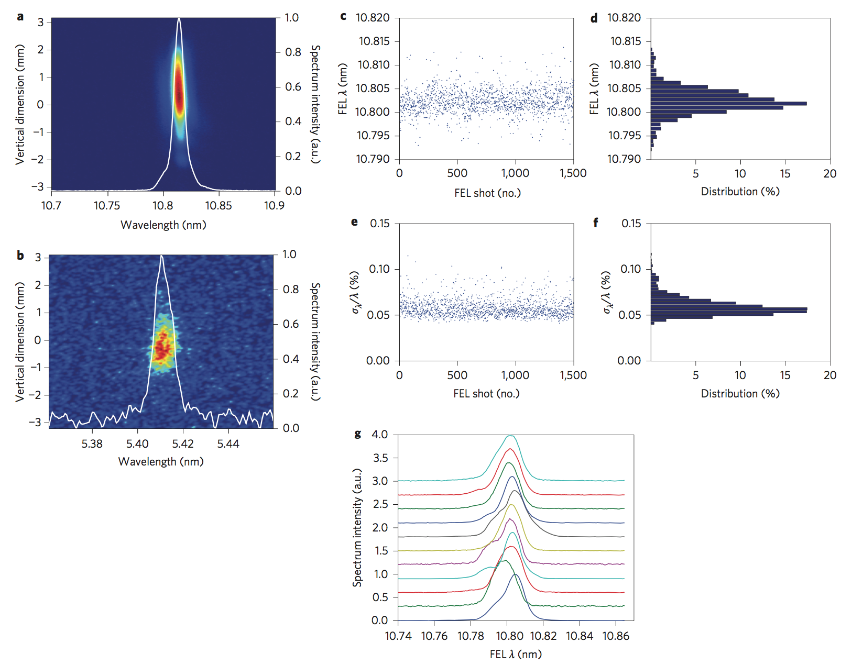
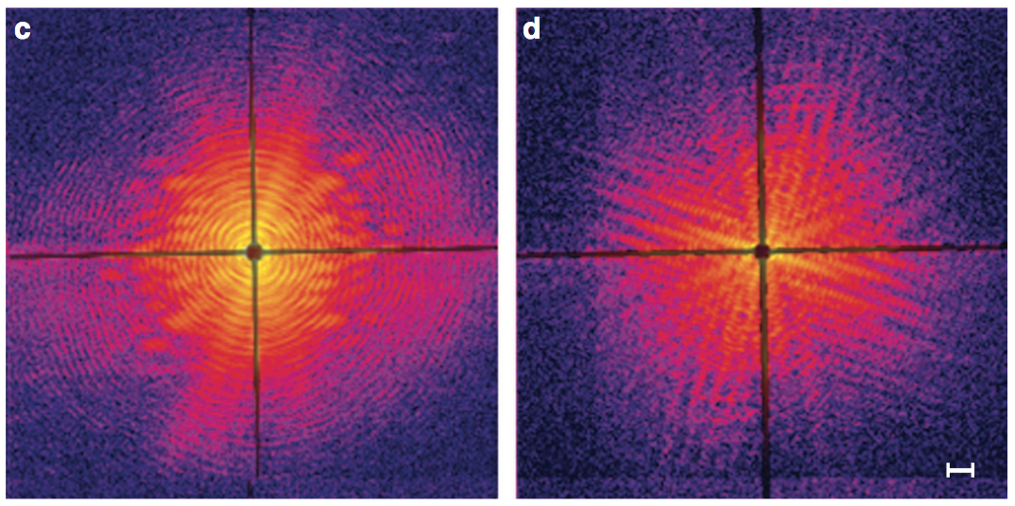
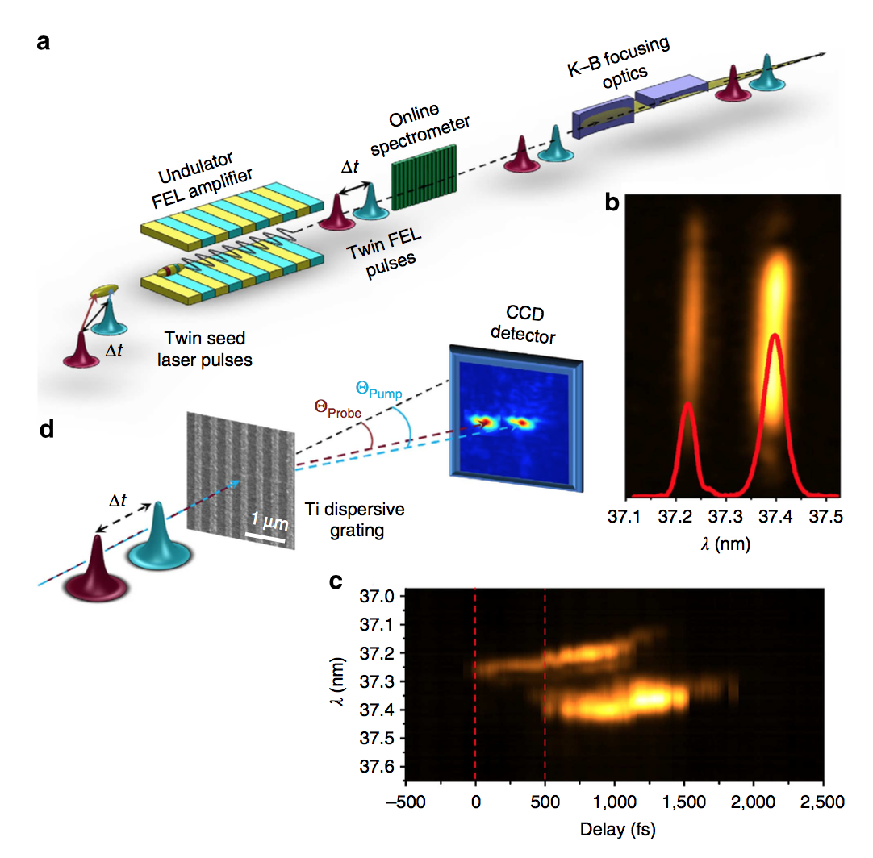
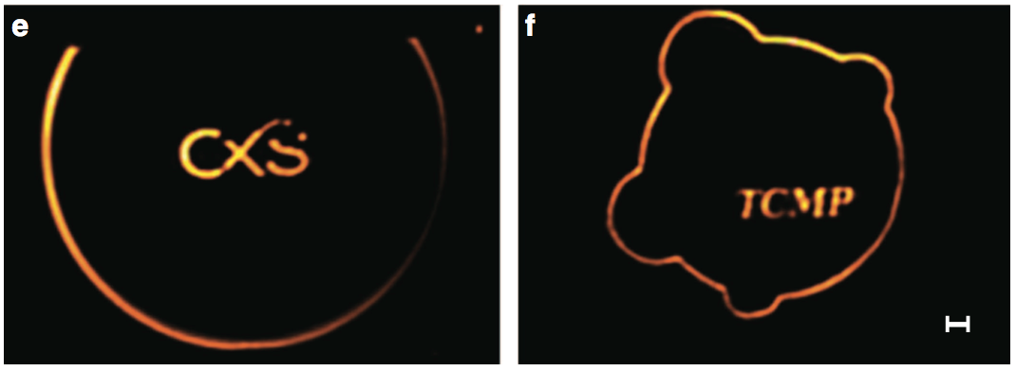
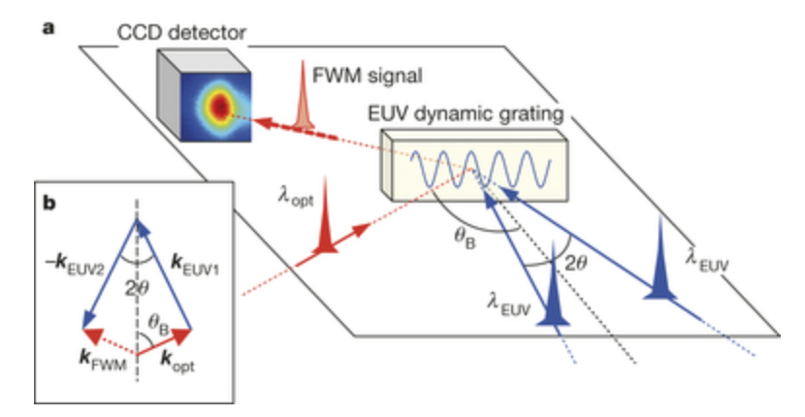
FERMI FEL
Results and status
FERMI FEL-1 and FERMI FEL-2 are both open to user experiments and provides unprecedented performances in terms of spatial and temporal coherence, wavelength and intensity stability, and spectral purity
Notes:
The generation of two-color FEL pulses by the same electron bunch at FERMI-FEL has opened unprecedented opportunity for jitter-free FEL pump-FEL probe time resolved coherent diffraction imaging (CDI) experiments in order to access spatial aspects in dynamic processes. This possibility was first explored in proof-of-principle resonant CDI experiments using specially designed sample consisting of Ti grating. The measurements performed tuning the energies of the FEL pulses to the Ti M-absorption edge clearly demonstrated the time dependence in optical constant in Ti varying the FEL-pump intensity and probe time delay. The next planned CDI experiments in February 2013 will explore transient states in multicomponent nanostructures and magnetic systems, using the controlled linear or circular polarization of the two-color FEL pulses with temporal resolution in the fs to ps range.

Slide 13
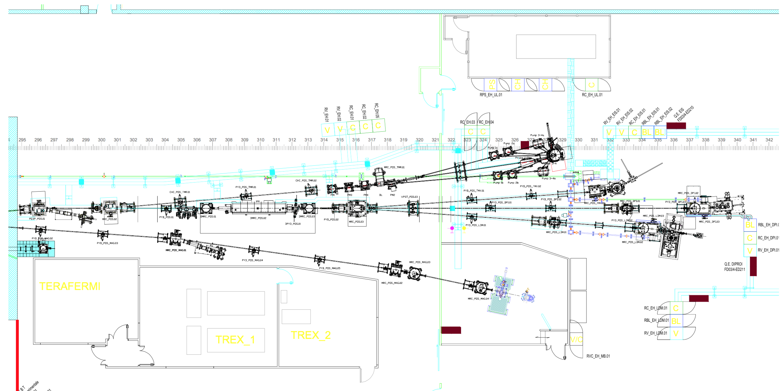
FERMI
The experimental hall
Notes:
The generation of two-color FEL pulses by the same electron bunch at FERMI-FEL has opened unprecedented opportunity for jitter-free FEL pump-FEL probe time resolved coherent diffraction imaging (CDI) experiments in order to access spatial aspects in dynamic processes. This possibility was first explored in proof-of-principle resonant CDI experiments using specially designed sample consisting of Ti grating. The measurements performed tuning the energies of the FEL pulses to the Ti M-absorption edge clearly demonstrated the time dependence in optical constant in Ti varying the FEL-pump intensity and probe time delay. The next planned CDI experiments in February 2013 will explore transient states in multicomponent nanostructures and magnetic systems, using the controlled linear or circular polarization of the two-color FEL pulses with temporal resolution in the fs to ps range.

Slide 14
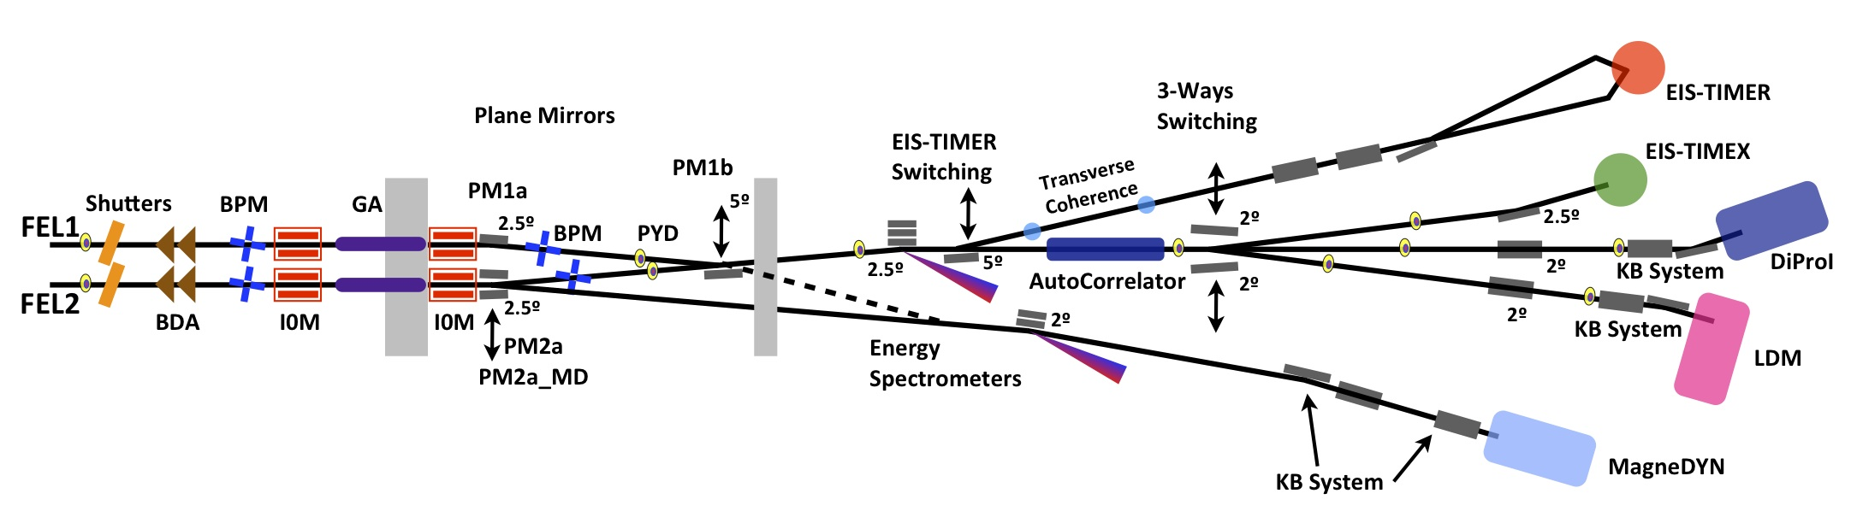
FERMI
Photon transport system PADReS
Notes:
The generation of two-color FEL pulses by the same electron bunch at FERMI-FEL has opened unprecedented opportunity for jitter-free FEL pump-FEL probe time resolved coherent diffraction imaging (CDI) experiments in order to access spatial aspects in dynamic processes. This possibility was first explored in proof-of-principle resonant CDI experiments using specially designed sample consisting of Ti grating. The measurements performed tuning the energies of the FEL pulses to the Ti M-absorption edge clearly demonstrated the time dependence in optical constant in Ti varying the FEL-pump intensity and probe time delay. The next planned CDI experiments in February 2013 will explore transient states in multicomponent nanostructures and magnetic systems, using the controlled linear or circular polarization of the two-color FEL pulses with temporal resolution in the fs to ps range.

Slide 15
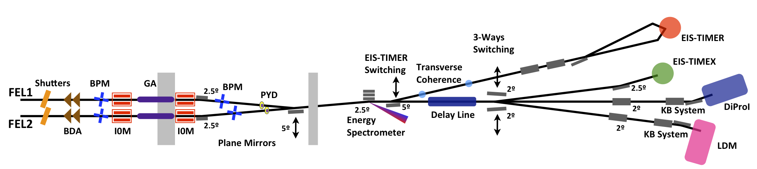
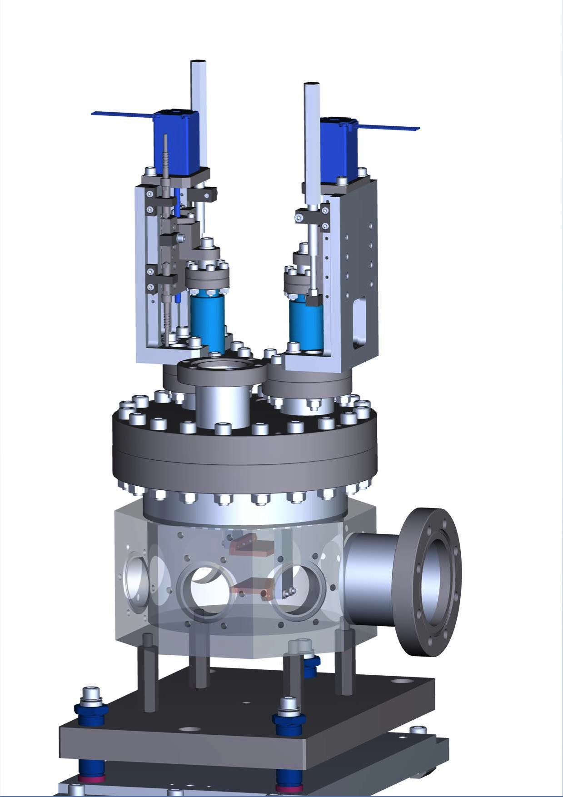
PADReS
Gas-based I₀ monitors and absorbers
Intensity monitors:
Measures the number of photons of each pulse
(~3% precision, 1% reproducibility)
Online and shot-to-shot
Transparent
Gas absorber:
Need to align the beam w/out destroying the sample + intensity-dependent studies
Max attenuation at all λ: 10⁻⁴
Preservation of coherence, spectrum, statistics, etc.
p = 2 ∙ 10⁻⁵ mbar

Slide 16
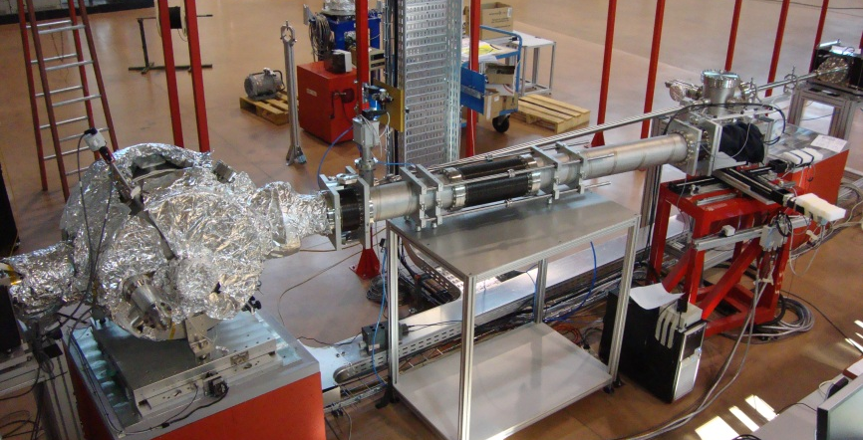
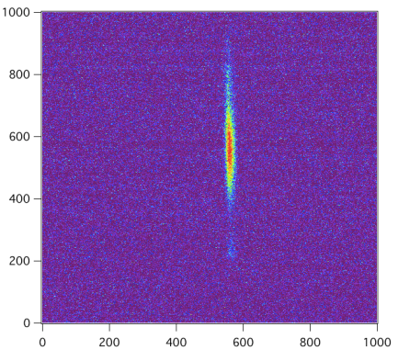
PADReS
Energy spectrometer PRESTO
Pulse-Resolved Energy Spectrometer: Transparent and Online
Spectrometer (PRESTO)
Online (non invasive)
Shot-to-Shot
~97% of FEL → beamlines
1% of FEL → YAG + triggered CCD
Resolving Power ~15000 @32.5nm (2.5meV)
Available information: λ, BW, spectral content
250mm
60 mm

Slide 17
FERMI FEL
Pulse-resolved spectral content
FEL pulses inherit the coherence from the external seed laser.
The use of seed pulses close to the Fourier limit, allows the production of FEL pulses that are also close to the Fourier limit.
Typical seed pulses are 120 fs long with 0.9 nm spectral width.
43.7 nm
FEL pulses: single mode spectra with narrow linewidth.
FEL spectra: Gaussian with both wavelength and bandwidth stability.
Calculated Fourier-limited pulse length is close to theoretical predictions suggesting a very high longitudinal coherence.
23.8 nm
4.4 nm
4.0 nm
Notes:
The generation of two-color FEL pulses by the same electron bunch at FERMI-FEL has opened unprecedented opportunity for jitter-free FEL pump-FEL probe time resolved coherent diffraction imaging (CDI) experiments in order to access spatial aspects in dynamic processes. This possibility was first explored in proof-of-principle resonant CDI experiments using specially designed sample consisting of Ti grating. The measurements performed tuning the energies of the FEL pulses to the Ti M-absorption edge clearly demonstrated the time dependence in optical constant in Ti varying the FEL-pump intensity and probe time delay. The next planned CDI experiments in February 2013 will explore transient states in multicomponent nanostructures and magnetic systems, using the controlled linear or circular polarization of the two-color FEL pulses with temporal resolution in the fs to ps range.

Slide 18
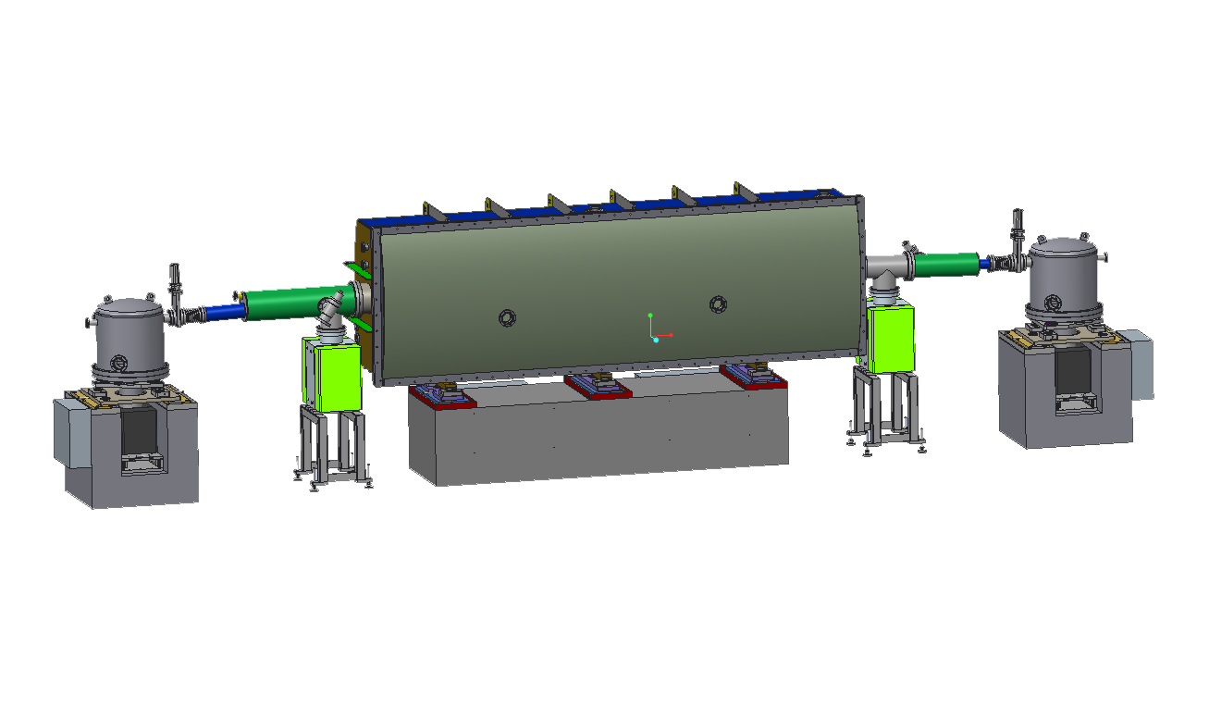

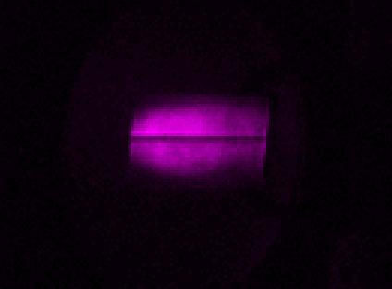
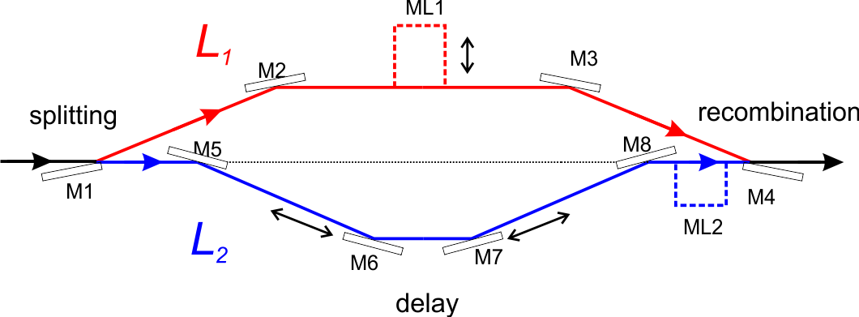
PADReS
Split and Delay Line AC/DC
AutoCorrelator / Delay Creator
Split and delay line:
Split the beam, retard half of it, then recombine it
Wavefront splitting by means
of a sharp-edge mirror
Delay: -1.5ps ≤ ∆t ≤ 30ps (for all λ)
0.1fs-resolution
ML1: ∆t₁: 0.3 ÷ 1.5ns (on selected λ)
ML2: ∆t₂: 0.33ns
Notes:
The generation of two-color FEL pulses by the same electron bunch at FERMI-FEL has opened unprecedented opportunity for jitter-free FEL pump-FEL probe time resolved coherent diffraction imaging (CDI) experiments in order to access spatial aspects in dynamic processes. This possibility was first explored in proof-of-principle resonant CDI experiments using specially designed sample consisting of Ti grating. The measurements performed tuning the energies of the FEL pulses to the Ti M-absorption edge clearly demonstrated the time dependence in optical constant in Ti varying the FEL-pump intensity and probe time delay. The next planned CDI experiments in February 2013 will explore transient states in multicomponent nanostructures and magnetic systems, using the controlled linear or circular polarization of the two-color FEL pulses with temporal resolution in the fs to ps range.

Slide 19
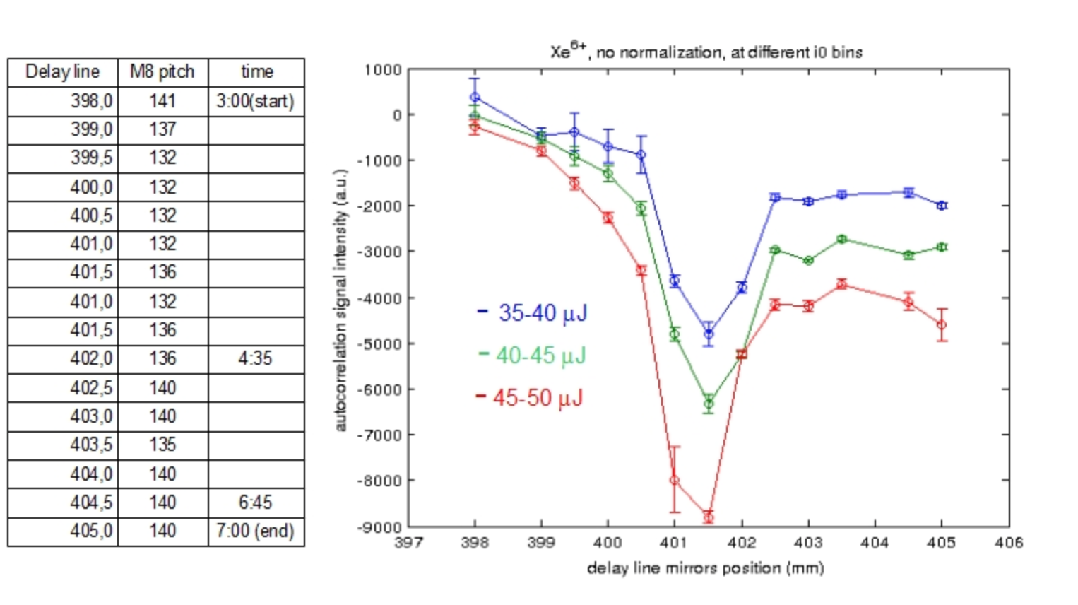
PULSE LENGTH
First AC/DC measurements
Ionization of Xe to highly charged states (autocorrelation measurement)
The FERMI Commissioning Team
N. Mahne, C. Svetina, L. Raimondi, M .Zangrando - PADRES
A. Ciavardini, C. Callegari, K. Prince,M. Coreno, M. Di Fraia, P. Finetti,
P. O’Keeffe, O. Plekan, T. Mazza, R. Richter - LDM
D. Garzella, A. Klisnick
Data analysis still in progress…
Notes:
The generation of two-color FEL pulses by the same electron bunch at FERMI-FEL has opened unprecedented opportunity for jitter-free FEL pump-FEL probe time resolved coherent diffraction imaging (CDI) experiments in order to access spatial aspects in dynamic processes. This possibility was first explored in proof-of-principle resonant CDI experiments using specially designed sample consisting of Ti grating. The measurements performed tuning the energies of the FEL pulses to the Ti M-absorption edge clearly demonstrated the time dependence in optical constant in Ti varying the FEL-pump intensity and probe time delay. The next planned CDI experiments in February 2013 will explore transient states in multicomponent nanostructures and magnetic systems, using the controlled linear or circular polarization of the two-color FEL pulses with temporal resolution in the fs to ps range.

Slide 20
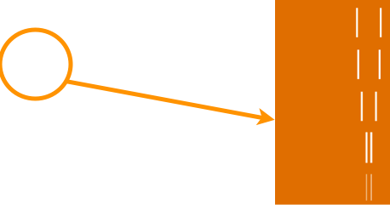
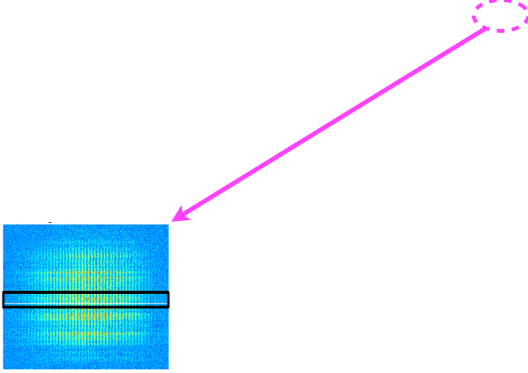
FERMI TRANSVERSE COHERENCE
Direct beam
Notes:
The generation of two-color FEL pulses by the same electron bunch at FERMI-FEL has opened unprecedented opportunity for jitter-free FEL pump-FEL probe time resolved coherent diffraction imaging (CDI) experiments in order to access spatial aspects in dynamic processes. This possibility was first explored in proof-of-principle resonant CDI experiments using specially designed sample consisting of Ti grating. The measurements performed tuning the energies of the FEL pulses to the Ti M-absorption edge clearly demonstrated the time dependence in optical constant in Ti varying the FEL-pump intensity and probe time delay. The next planned CDI experiments in February 2013 will explore transient states in multicomponent nanostructures and magnetic systems, using the controlled linear or circular polarization of the two-color FEL pulses with temporal resolution in the fs to ps range.

Slide 21
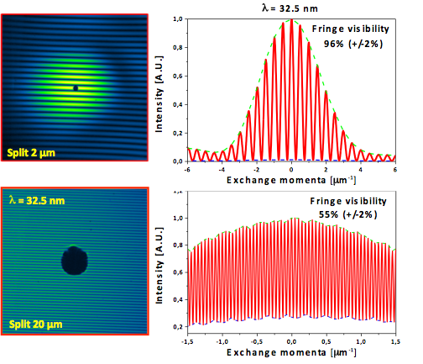
FERMI TRANSVERSE COHERENCE
Focused beam
Measurements of the transverse coherence using a mask with pairs of pinholes or slits on it (sample prepared by M. Barthelmess) – beamline DiProI
Notes:
The generation of two-color FEL pulses by the same electron bunch at FERMI-FEL has opened unprecedented opportunity for jitter-free FEL pump-FEL probe time resolved coherent diffraction imaging (CDI) experiments in order to access spatial aspects in dynamic processes. This possibility was first explored in proof-of-principle resonant CDI experiments using specially designed sample consisting of Ti grating. The measurements performed tuning the energies of the FEL pulses to the Ti M-absorption edge clearly demonstrated the time dependence in optical constant in Ti varying the FEL-pump intensity and probe time delay. The next planned CDI experiments in February 2013 will explore transient states in multicomponent nanostructures and magnetic systems, using the controlled linear or circular polarization of the two-color FEL pulses with temporal resolution in the fs to ps range.

Slide 22
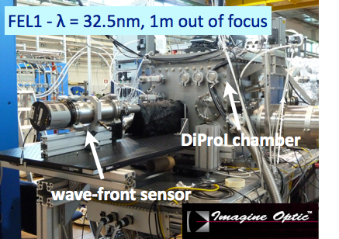
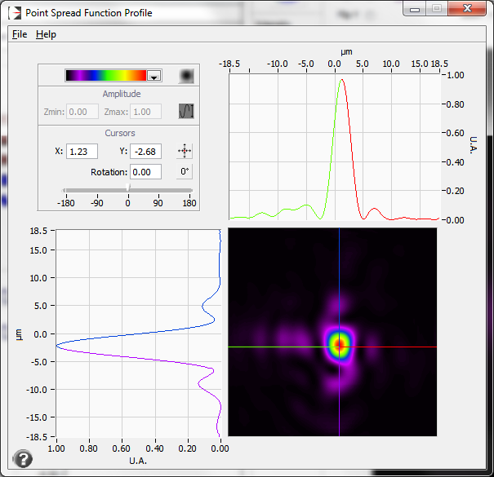
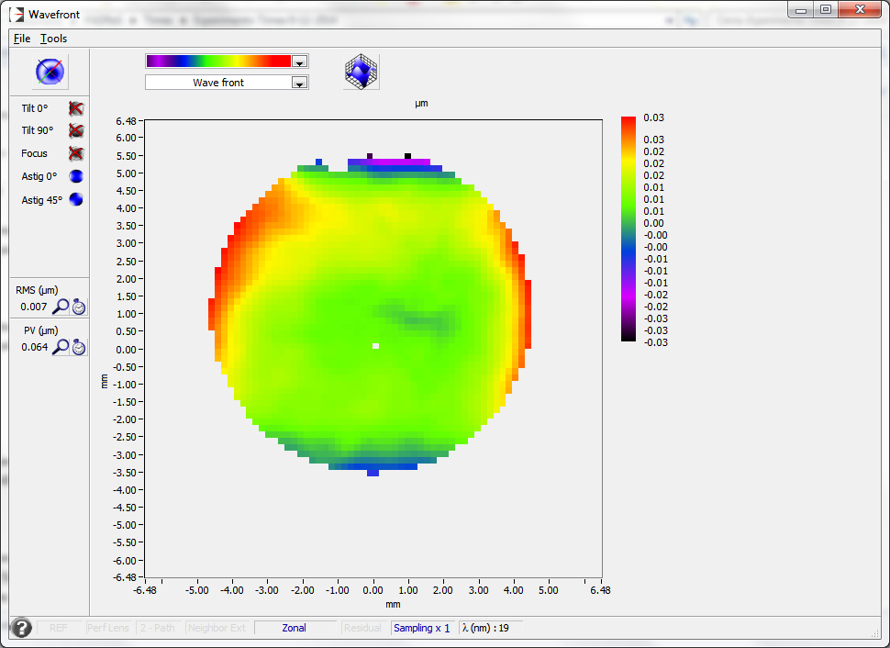


FERMI SPOT SIZES
Wavefront sensors and other techniques
Wavefront sensors
Initial activity (2012-2014) with DESY WFS (LLG)
One WFS (Imagine Optic) operative in experimental hall (CENILS – G. De Ninno)
Another WFS realized in collaboration with DESY and LaserLab Gottingen (2015-2016)
Other techniques
PMMA and Si indentation
Pixelated-P array
Spot sizes (FWHM) @32.5nm
Diffr.-limited spot: 4×5 µm²
Best spot measured: 5×5 µm²
Best spot simulated: 5.2×7.7 µm²
See L. Raimondi’s talk at 18:20
Notes:
The generation of two-color FEL pulses by the same electron bunch at FERMI-FEL has opened unprecedented opportunity for jitter-free FEL pump-FEL probe time resolved coherent diffraction imaging (CDI) experiments in order to access spatial aspects in dynamic processes. This possibility was first explored in proof-of-principle resonant CDI experiments using specially designed sample consisting of Ti grating. The measurements performed tuning the energies of the FEL pulses to the Ti M-absorption edge clearly demonstrated the time dependence in optical constant in Ti varying the FEL-pump intensity and probe time delay. The next planned CDI experiments in February 2013 will explore transient states in multicomponent nanostructures and magnetic systems, using the controlled linear or circular polarization of the two-color FEL pulses with temporal resolution in the fs to ps range.

Slide 23



SEED LASER TO ENDSTATIONS
Pump-probe opportunities
Large timing jitter/drift reduction expected.
FEL pulse timing is fixed by the seed pulse.
A fraction of the seed is propagated to the beamlines and used for Pump-Probe Experiments.
FEL Pulse
Two pass optical delay line ±600ps
Automatic attenuator plate and vertical horizontal polarizer
Laser shot-by-shot Intensity monitor
Pulse selector shutter
FEL
Pump
CCD 1
CCD 2
Laser Pulse
L1
IR
Probe
L2
Since Feb-2013 DiProI end station equipped with external user laser
USERS-LASER DELAY BREADBOARD
Sample Plane
y
x
DiProI Team, PADReS team, Lasers team

Slide 24
FEL-IR TIME ARRIVAL
TR Si₃N₄ reflectivity
*
M.Danailov, et al., Optics Express 22, 12869 (2014)
Arrival time jitter FEL-IR laser ~10±2 fs (RMS)→ 3µm over 100m-path length !!!
(Measured at the ½ drop point of the reflectivity curve)
Long term (~1 day) stability time zero between FEL and IR laser ~70 – 60 fs.
Recent result @DiProi: 6.6fs RMS jitter between a NOPA Pumped by the IR seed and FEL

Slide 25





PULSE LENGTH
Cross-correlation measurements
Two cross-correlation methods have been implemented and used for measuring the FEL pulse length.
Solid state cross correlation:
*
temporally & spatially encode FEL in the surface of a Si₃N₄ target probed with an ultrashort laser pulse
In both cases FEL pulse length has been studied as a function of seed laser parameters and FEL wavelength.
Cross correlation measurement probing the intensity of sidebands in electron spectra
**
Expected FEL pulse shortening at higher harmonics (shorter wavelength) has been confirmed by measurements.
* In collaboration with F. Tavella team
** In collaboration with C. Callegari and LDM team
Notes:
The generation of two-color FEL pulses by the same electron bunch at FERMI-FEL has opened unprecedented opportunity for jitter-free FEL pump-FEL probe time resolved coherent diffraction imaging (CDI) experiments in order to access spatial aspects in dynamic processes. This possibility was first explored in proof-of-principle resonant CDI experiments using specially designed sample consisting of Ti grating. The measurements performed tuning the energies of the FEL pulses to the Ti M-absorption edge clearly demonstrated the time dependence in optical constant in Ti varying the FEL-pump intensity and probe time delay. The next planned CDI experiments in February 2013 will explore transient states in multicomponent nanostructures and magnetic systems, using the controlled linear or circular polarization of the two-color FEL pulses with temporal resolution in the fs to ps range.

Slide 26



PULSE LENGTH
SPIDER measurements
With two seed laser pulses one can control and change the relative time between two FEL pulses.
For coherent pulses, a fine tuning allows to control the relative phase between the two FEL pulses.
The phase locked FEL pulses are then suitable for SPIDER§ measurement (amplitude and phase).
§“Spectral Phase Interferometry for Direct Electric-field Reconstruction …” . OPTICS LETTERS 23, 792 1998
From a single measurement of the interference spectrogram of two identical pulses (with slightly different time and wavelength) the SPIDER algorithm reconstructs the intensity and phase profiles in the temporal domain.
Spectral measurements at different seed laser delay give the wavelength separation.
*G. De Ninno et al., Nat. Commun., 6, 8075 (2015)
Notes:
The generation of two-color FEL pulses by the same electron bunch at FERMI-FEL has opened unprecedented opportunity for jitter-free FEL pump-FEL probe time resolved coherent diffraction imaging (CDI) experiments in order to access spatial aspects in dynamic processes. This possibility was first explored in proof-of-principle resonant CDI experiments using specially designed sample consisting of Ti grating. The measurements performed tuning the energies of the FEL pulses to the Ti M-absorption edge clearly demonstrated the time dependence in optical constant in Ti varying the FEL-pump intensity and probe time delay. The next planned CDI experiments in February 2013 will explore transient states in multicomponent nanostructures and magnetic systems, using the controlled linear or circular polarization of the two-color FEL pulses with temporal resolution in the fs to ps range.

Slide 27


POLARIZATION MEASUREMENT
Setup
LOA
polarimeter
E. Allaria et al., Phys. Rev. X 4, 041040 (2014)
X-FEL
E-TOF
LDM
Groups from XFEL, LOA and SLAC were invited by FERMI to collaborate with different hardware or as observers (Coordinated by E. Allaria)
Different polarization modes measured with 3 different techniques
… and different wavelengths 26nm/32.7nm and 52nm
P04 group @ PETRA III: Leif Glaser, Frank Scholz, Jörn Seltmann - European XFEL: Jens Buck (WP-74), Alberto De Fanis (WP-85), - Patrick Gessler (WP-75&76), Jan Grünert (WP-74), Markus Ilchen (WP-85), Tommaso Mazza (WP-85), Michael Meyer (WP-85) Universität Kassel: André Knie FERMI: Enrico Allaria, Mauro Trovò, Giovanni De Ninno, Primož Rebernik, David Gauthier, Carlo Spezzani, Bruno Diviacco, Simone Di Mitri, Guiseppe Penco, Luca Giannessi, William Fawley, Marco Zangrando, Nicola Mahne, Cristian Svetina, Lorenzo Raimondi, Flavio Capotondi, Paola Finetti, Carlo Callegari, Marcello Coreno, Cesare Grazioli, Oksana Plekan, Barbara Ressel, Antti Kivimäki, Laboratoire d'Optique Appliquée (LOA): Benoît Mahieu, Guillaume Lambert, Boris Vodungbo, Philippe Zeitoun, Jan Luning SLAC: Zhirong Huang, Yuantao Ding, Alberto Lutman, Stefan Moeller

Slide 28







POLARIZATION MEASUREMENT
e-TOF polarimeter
LOA
polarimeter
X-FEL
E-TOF
LDM
A single shot polarimeter based on angle resolving electron spectrometer has been developed by J.Viefhaus’ group at DESY
Theory predicts specific electron distributions over the 16 detectors depending on the used gas and FEL polarization.
Notes:
The generation of two-color FEL pulses by the same electron bunch at FERMI-FEL has opened unprecedented opportunity for jitter-free FEL pump-FEL probe time resolved coherent diffraction imaging (CDI) experiments in order to access spatial aspects in dynamic processes. This possibility was first explored in proof-of-principle resonant CDI experiments using specially designed sample consisting of Ti grating. The measurements performed tuning the energies of the FEL pulses to the Ti M-absorption edge clearly demonstrated the time dependence in optical constant in Ti varying the FEL-pump intensity and probe time delay. The next planned CDI experiments in February 2013 will explore transient states in multicomponent nanostructures and magnetic systems, using the controlled linear or circular polarization of the two-color FEL pulses with temporal resolution in the fs to ps range.

Slide 29






POLARIZATION MEASUREMENT
EUV and Visible light polarimeters
LOA
polarimeter
X-FEL
E-TOF
LDM
Optical polarimeter for EUV sources (LOA): 4 coated grazing incidence mirrors used as phase retarder for s and p field components and a 45° mirror used as a polarized.
Setup installed at FERMI: suitable for characterizing 26nm and 32nm with circular and vertical polarizations.
Proper fit of the measured detector signal as a function of the detector angle β → FEL polarization state
Measuring the polarization of fluorescence light emitted in the visible range following suitable X-UV excitations → FEL polarization state
Optical transitions selected:
He + λ₁→He1s(1)3p(1)→He1s(1)2s(1)+λ₂
Polarization measured in the visible with standard optical methods using a retarder (λ/4) and a polarizer. Acquisition are done by scanning the polarizer angle for various values of the retarder angle.
Notes:
The generation of two-color FEL pulses by the same electron bunch at FERMI-FEL has opened unprecedented opportunity for jitter-free FEL pump-FEL probe time resolved coherent diffraction imaging (CDI) experiments in order to access spatial aspects in dynamic processes. This possibility was first explored in proof-of-principle resonant CDI experiments using specially designed sample consisting of Ti grating. The measurements performed tuning the energies of the FEL pulses to the Ti M-absorption edge clearly demonstrated the time dependence in optical constant in Ti varying the FEL-pump intensity and probe time delay. The next planned CDI experiments in February 2013 will explore transient states in multicomponent nanostructures and magnetic systems, using the controlled linear or circular polarization of the two-color FEL pulses with temporal resolution in the fs to ps range.

Slide 30




POLARIZATION MEASUREMENT
Results
Measurements of the degree of polarization with different polarimeters has shown a good control of the polarization* allowing switching from linear to circular in the whole spectral range of operation.
* E. Allaria et al. Phys. Rev. X 4, 041040 (2014)
Notes:
The generation of two-color FEL pulses by the same electron bunch at FERMI-FEL has opened unprecedented opportunity for jitter-free FEL pump-FEL probe time resolved coherent diffraction imaging (CDI) experiments in order to access spatial aspects in dynamic processes. This possibility was first explored in proof-of-principle resonant CDI experiments using specially designed sample consisting of Ti grating. The measurements performed tuning the energies of the FEL pulses to the Ti M-absorption edge clearly demonstrated the time dependence in optical constant in Ti varying the FEL-pump intensity and probe time delay. The next planned CDI experiments in February 2013 will explore transient states in multicomponent nanostructures and magnetic systems, using the controlled linear or circular polarization of the two-color FEL pulses with temporal resolution in the fs to ps range.

Slide 31



POLARIZATION CONTROL
Cross-polarized undulators
Linearly polarized emission can be generated using undulators polarized left and right.
A crucial aspect for the quality of the final polarization is the possibility to have the same level of power from the two kinds of undulators. This can be easily controlled by acting on the seeding parameters.
First experiment has been done with first five radiators in circular right polarization and the last one in circular left.
By changing the last phase shifter it is possible to change the direction of the linear polarization.
Axis of Linear Polarization (°)
Bunch ID
E. Ferrari et al., Sc. Reports 5, 13531 (2015)

Slide 32
CONCLUSIONS
of the talk
FERMI FEL-1 and FERMI FEL-2 are open to user experiments, providing unprecedented performances in terms of longitudinal coherence, wavelength stability and spectral purity
With the improved control on the machine we are demonstrating the feasibility of new classes of experiments where coherence plays a major role, and that were so far accessible only to optical lasers
Dedicated diagnostics are available to help machine and experimental physicists carrying out experiments taking advantage of the peculiarities of such an FEL source
More in general, seeded FELs are extremely flexible tools opening new perspectives in the use of short wavelength free electron lasers

Slide 33

THANK YOU
Allaria E., Bencivenga F., Callegari C., Capotondi F., Castronovo D., Cinquegrana P., Craievich P., Cudin I., Danailov M.B., De Monte R., Demidovich A., D'Auria G., Dal Forno M., De Ninno G., Di Mitri S., Diviacco B., Fabris A., Fabris R., Fava C., Fawley W.M., Ferianis M., Ferrari E., Finetti P., Froehlich L., Furlan Radivo P., Gaio G., Gauthier D., Gerusina S., Giannessi L., Gobessi R., Ivanov R., Kiskinova M., Kurdi G., Loda G., Lonza M., Mahne N., Mahieu B., Manfredda M., Masciovecchio C., Mazzucco E., Predonzani M., Principi E., Nikolov I., Parmigiani F., Penco G., Plekan O., Prince K.C., Raimondi L., Rossi F., Roussel E., Rumiz L., Serpico C., Sigalotti P., Scafuri C., Spampinati S., Spezzani C., Sturari L., Svandrlik M., Svetina C., Trovò M., Vascotto A., Veronese M., Visintini R., Zangrando D., Zangrando M. and MANY MORE including users, collaborators, visitors, administrative people…
33
Notes:
The generation of two-color FEL pulses by the same electron bunch at FERMI-FEL has opened unprecedented opportunity for jitter-free FEL pump-FEL probe time resolved coherent diffraction imaging (CDI) experiments in order to access spatial aspects in dynamic processes. This possibility was first explored in proof-of-principle resonant CDI experiments using specially designed sample consisting of Ti grating. The measurements performed tuning the energies of the FEL pulses to the Ti M-absorption edge clearly demonstrated the time dependence in optical constant in Ti varying the FEL-pump intensity and probe time delay. The next planned CDI experiments in February 2013 will explore transient states in multicomponent nanostructures and magnetic systems, using the controlled linear or circular polarization of the two-color FEL pulses with temporal resolution in the fs to ps range.

Slide 34
THANK YOU

