Slide 1
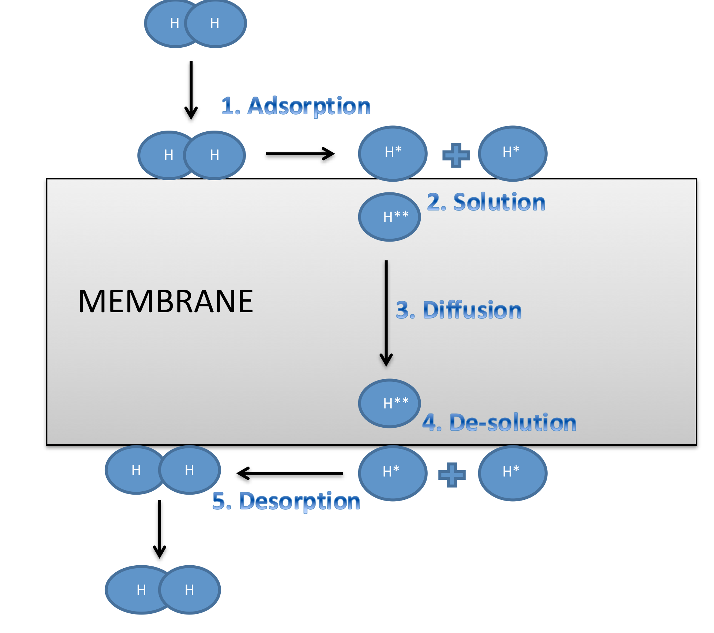
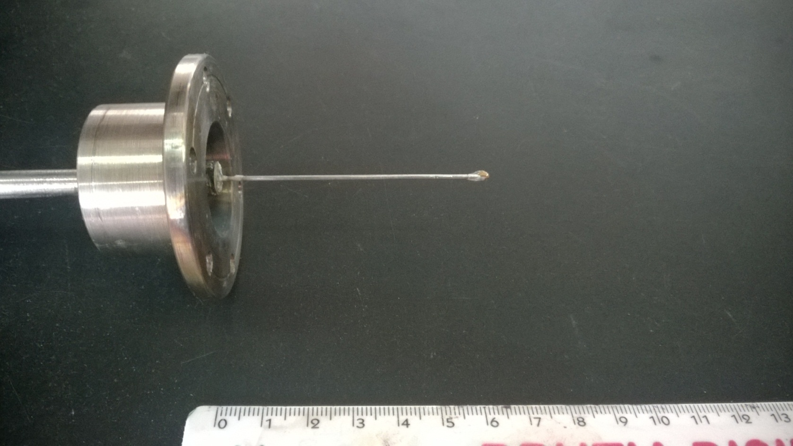
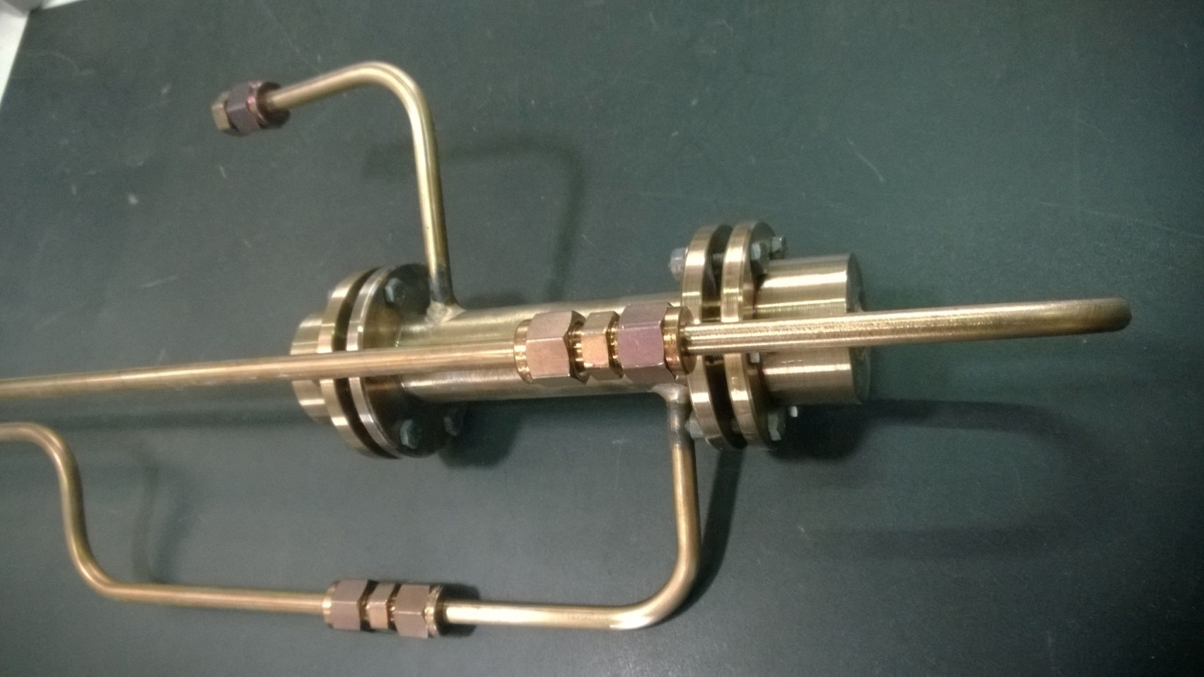
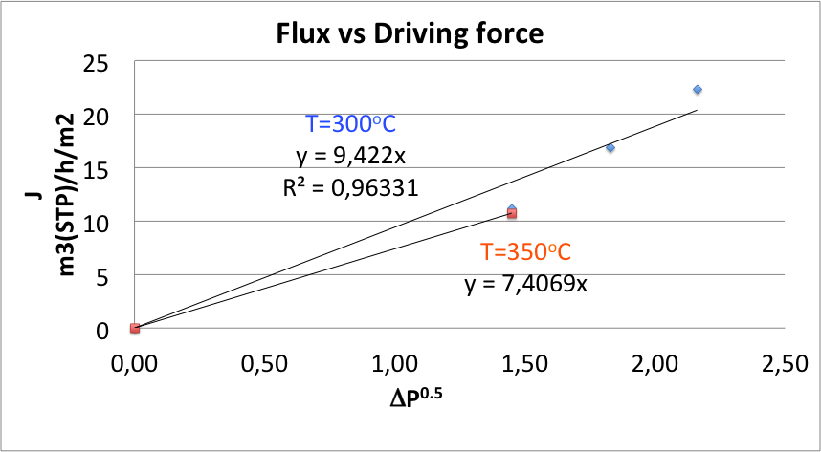
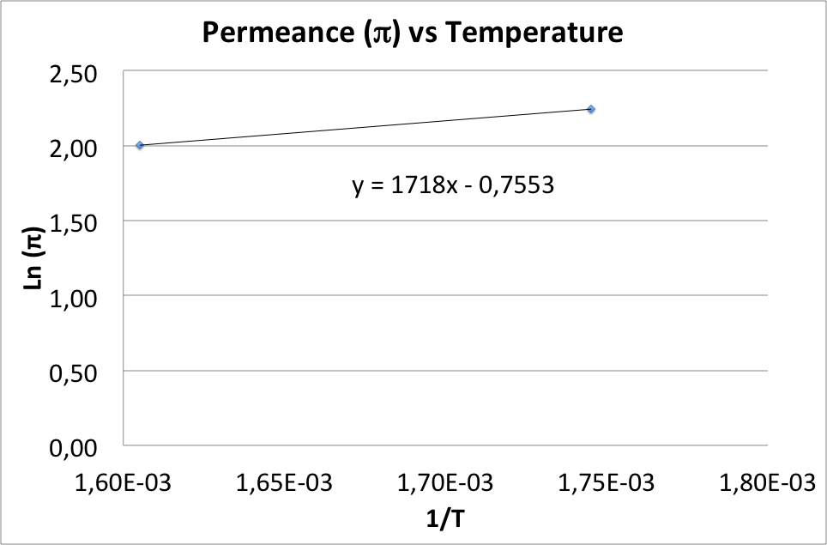
Palladium-based Membranes for Hydrogen Purification
SIACE Ph.D. Students: Fabian ARIAS ARIAS, Patrizia NOTARO, Mara VIGNA
Tutors: Dr. Giuseppe BARBIERI (ITM-CNR), Dr. Adele BRUNETTI (ITM-CNR), Dr. Alessio CARAVELLA (UNICAL)
Objectives
The main aim of the Laboratory activity was the characterization of a Pd-based membrane for hydrogen separation.
Introduction
High-Pressure side
Hydrogen is actually a clean and ecologically sustainable resource. Furthermore it represents a clean energy carrier. For example, in principle the Proton Exchange Membrane Fuel Cells (PEM-FC) water is the only side-product of energy production. Usually, an effective way to produce pure hydrogen is through gas mixture separation.
Why Pd-based membranes?
Palladium-based membranes can be effectively be used in Hydrogen separation because they let just hydrogen pass through by a Solution-Diffusion mechanism.
Low-Pressure side
Experimetal Setup
Palladium-based membrane
Membrane module
Oven Temperature (300 and 350ºC)
Feed Pressure: 5, 7, 9 bar
Permeate Pressure: 1 bar
Flow rate measure by bubble activation
Results
Conclusions
An anomalous behaviour of the membrane was observed: an activated behaviour was expected for hydrogen permeance, whereas a decreasing trend of flux with temperature was found. This is explained by a sealing breaking causing a viscous-like permeation, which is not favoured by temperature (i.e., negative apparent activation energy E).
E, J mol⁻¹= | -14284
π₀, m³(STP) h⁻¹ m² bar^{0,5} | 0,47

