Slide 1
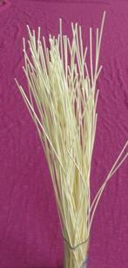
Membrane gas separation:
Fundamentals and applications
Giuseppe BARBIERI
Institute on Membrane Technology (ITM-CNR), National Research Council, c/o The University of Calabria, Cubo 17C, Via Pietro Bucci, 87036 Rende CS, Italy g.barbieri@itm.cnr.it giuseppe.barbieri@cnr.it
School for PhD LTL-2015
Science and Instrumentation Technologies at UNICAL
Rende June 8-12, 2015

Slide 2
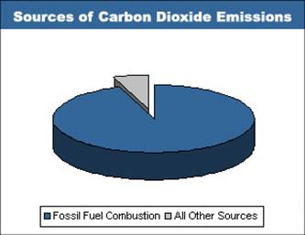
Main sources of CO₂
 | Source | Separation
Flue gas streams | Power plants, coal gasification plants, Steel factory Cement factory, Transportation | CO₂/N₂
Natural Gas | Sweetening of Natural gas, etc. | CO₂/CH₄
Biogas | Various
Inventory of U.S. Greenhouse Gas Emissions and Sinks (2008), EPA

Slide 3
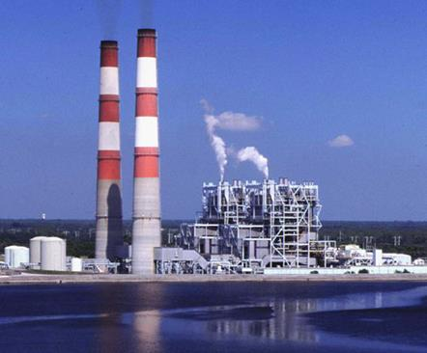
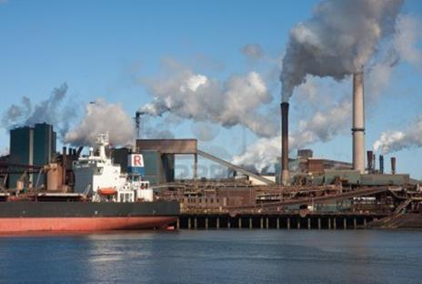
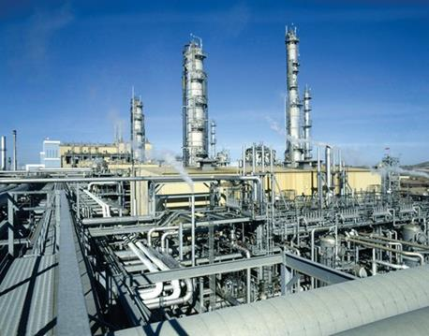
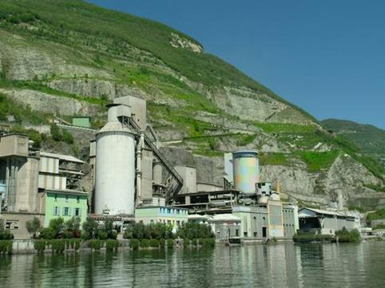
Flue gas emissions by….
Power plant
Steel factory
Coal gasification plant
Cement factory

Slide 4
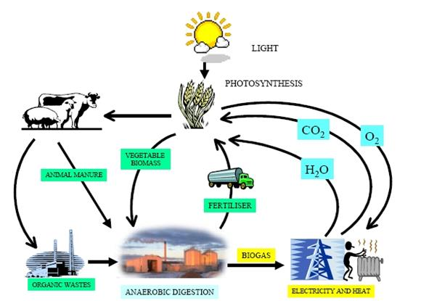

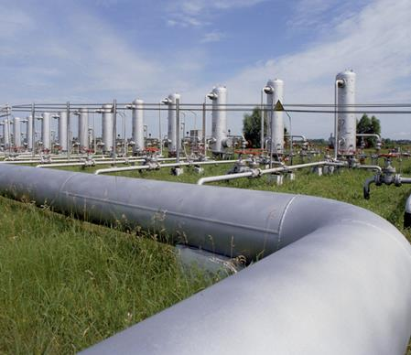
CO₂/CH₄ mixtures by….
BIOGAS
NATURAL GAS SWEETENING

Slide 5
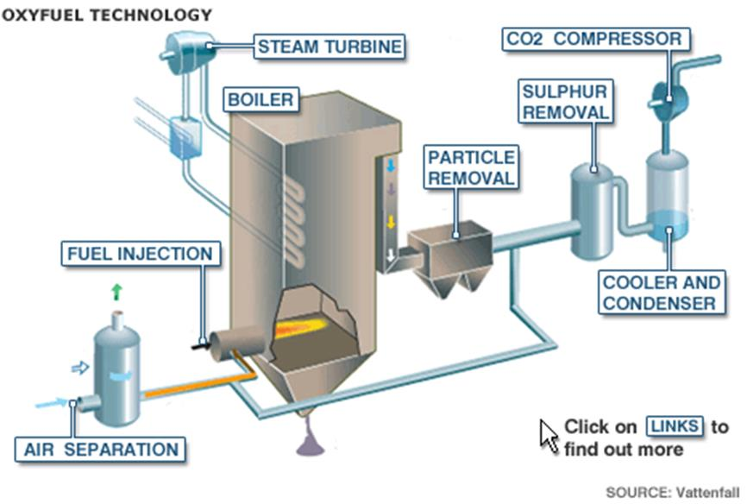
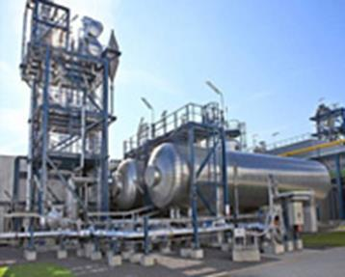
OxyFuel combustion

Slide 6
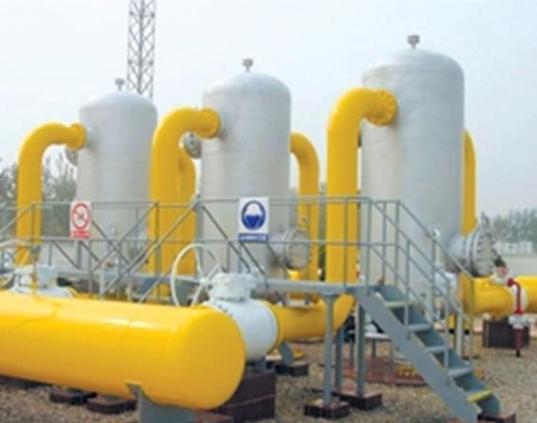
Competing technologies in gas separation
ABSORPTION
Absorption is a process that relies on a solvent’s chemical affinity with a solute to dissolve preferably one species into another. It is widely proposed for CO₂ separation where generally, monoethanolammine or a solid absorbent is used. High amount of energy consumed is for solvent(MEA) recovery (3-4 units)
Aaron D., Tsouris C., Separation Science and Technology, 40, (2005), 321-

Slide 7
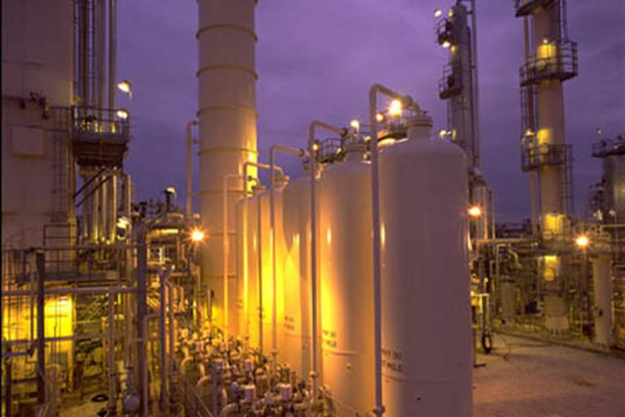
Competing technologies in gas separation
ADSORPTION
The PSA process is based on the capacity of some adsorbents (zeolites, etc.) in adsorbing such gases at high gas-phase partial pressure. Proper selection of the adsorbents is critical for both the performance of the unit and adsorbent life-time.
For instance, the CO2 is adsorbed at higher partial pressure and then desorbed at lower partial pressure. High pressure is required (3-4 units).
Aaron D., Tsouris C., Separation Science and Technology, 40, (2005), 321-

Slide 8
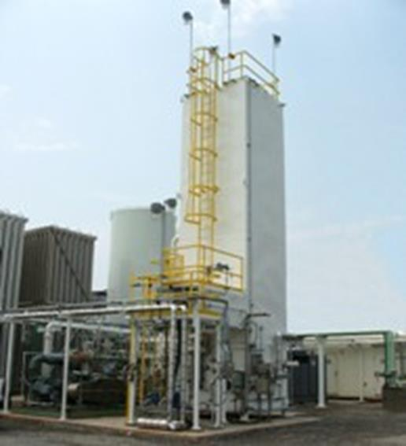
Competing technologies in gas separation
CRYOGENIC
Low temperature separation process. The difference in boiling temperatures of the feed components affects the separation. One of the main advantages is the ability to produce separated hydrocarbon streams rich in C4+, ethane/propane, etc. One of the main drawbacks is the presence of H₂O in the gaseous stream that can strongly affect the separation performance; the gaseous stream to be treated needs to be completely dehydrated prior to be cooled. High energy intensity. Pre-treatment stages of the up-stream. (2 units)
Aaron D., Tsouris C., Separation Science and Technology, 40, (2005), 321-

Slide 9
…
Separations with membranes
  Experiments, simulations, upper limits evaluation, etc.
Conversion using membranes
  Experiments, simulations, thermodynamics, etc.
Membranes and other technologies
  Mass and energy intensity
  Design/process parameters
  Integration of membrane separation/reaction in producing cycles
  Mass and energy intensity
  Design/process parameters

Slide 10
Some separations investigated
CO₂/N₂ separation
  Involved streams have not a value
  Pressure is required only for separation
  The final stream is the permeate (at low pressure)
  Low CO₂ feed concentration (10-30%)
CO₂/CH₄ separation
  A value product (CH₄) containg stream
  Pressurised stream
  The final stream is the retentate (high pressure)
O₂/N₂ separation for oxygen enriched air
  Feed stream need a pretreatment for powder
  Low O₂ concentration (21%)

Slide 11
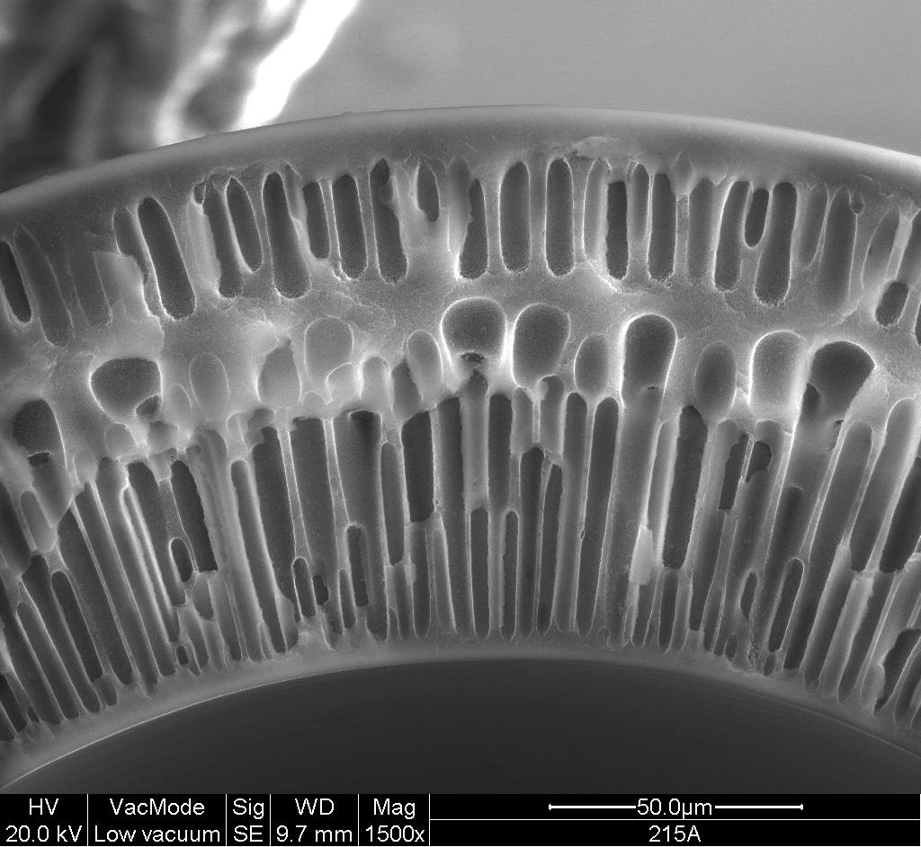
What is a membrane?
A membrane is a physical device able to separate selectively one ore more components in a mixture while rejecting others.

Slide 12
Advantages of membrane technology
efficiency and operational simplicity…
high selectivity and permeability for the transport of specific components…
low energetic requirement…
good stability and compatibility between different membrane operations…
environment-compatibility…
large flexibility and easy scale-up…
advanced levels of automation and remote control …

Slide 13
The most important operations for membrane gas separation
H₂ purification and production
CO₂ capture and sequestration
N₂/O₂ separation
N₂ production
Natural gas sweetening
Biogas separation and conversion

Slide 14
Most important glassy and rubbery polymers used in membrane GS
Rubbery Polymers | Glassy Polymers
Fluoro elastomers Neoprene Nitrile rubber Poly(dimethylsiloxane) Polyethylene chlorine sulfonated Polyvinilchloride plasticized Polyuretane | Aromatic Polyamides Cellulose Acetate Perfluorodioxoles Polyacetilenes Polycarbonates Polyimides Poly(phenileneoxide) Polysulfone Poly(1-trimethysilyl-1-propyne) Polymer of intrinsic microporosity (PIM) Thermally rearranged polymer(TR)

Slide 15
Permeation mechanisms
Sorption-diffusion: e.g. metal membranes, dense polymeric membranes
Molecular sieve: e.g. Ceramic membranes, zeolite, microporous polymeric membranes
Viscous flow: e.g. microporous polymeric membranes in enzyme loaded membrane reactors
Through pore flow: e.g. zeolite membranes, microporous polymeric membranes in enzyme loaded membrane reactors

Slide 16
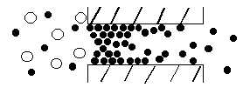
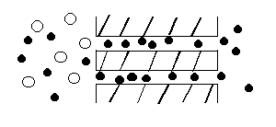
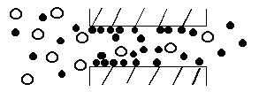
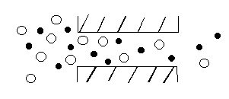
Transport mechanism through POROUS membranes
Viscous flow
Knudsen flow
Surface diffusion
Capillar condensation
H. Strathmann, L. Giorno, E. Drioli, An introduction to membrane science and technology, Publisher CNR Roma, ISBN 88-8080-063-9, 2006

Slide 17
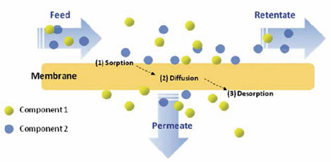
Gas transport by the sorption-diffusion mechanism
In a dense membrane, the mass transport so-called sorption-diffusion consists of three relevant steps:
sorption of the various components from a feed mixture according to their partition coefficient between the gas and polymer phase;
diffusion of the individual components within the membrane phase according to their activity gradients; and
desorption of the components from the membrane in the permeate gas phase.

Slide 18
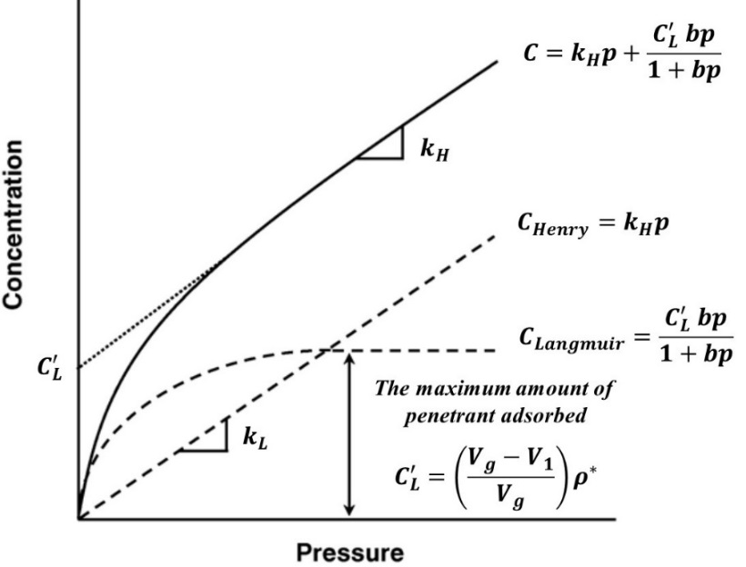




Conventional dual mode sorption
Langmuir:
Henry:
$$C_{Henry}=K_{H }P$$
$$C_{Langmuir}=\frac{C_{L}^{′} bp}{1+bp}$$
Dual Mode Sorption:
$${C=C}_{Langmuir}+C_{Henry}$$
$$C_{Langmuir}=K_{H}P+\frac{C_{L}^{′} bp}{1+bp}$$

Slide 19
  Variables and Units
  Permeability: Mass permeating a unit surface area of the membrane, per unit of time, under a unit of pressure, per unit of THICKNESS
  Permeance: Mass permeating a unit surface area of the membrane, per unit of time, under a unit of pressure, for the whole membrane THICKNESS

Slide 20
Selectivity
The separation capacity of a membrane is a crucial parameter.
The selectivity of a membrane for various components of a mixture is defined by the ratio of the permeability (Permeance, etc.)

Slide 21
  Variables and Units

Slide 22
Experimental analysis

Slide 23
Experimental analysis

Slide 24
Experimental analysis
FotoRiduCO₂

Slide 25
Membrane gas transport properties
FotoRiduCO₂
F. Falbo, F. Tasselli, A. Brunetti, E. Drioli, G. Barbieri, Brazilian Journal of Chemical Engineering, vol 31 n°4, pp 1023-1034 (2014)
F. Falbo, A. Brunetti, G. Barbieri, E. Drioli, F. Tasselli, Applied Petrochemical Research (2015), submitted.

Slide 26
Thermal rearranged polymer membranes
METT

Slide 27
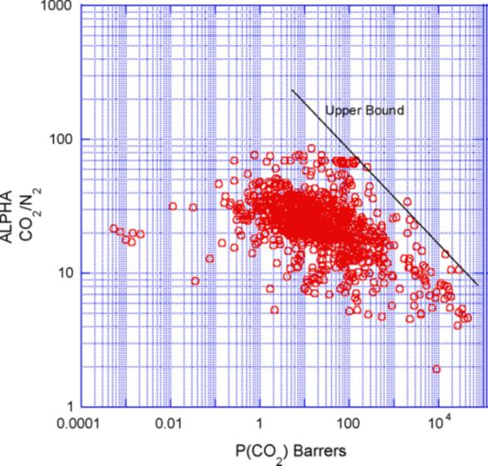
Polymeric membranes generally undergo a trade–off limitation between permeability and selectivity: as permeability increases, selectivity decreases, and vice-versa.
Robeson trade-off
*TR, thermally re-arranged
Robeson L.M., Journal of Membrane Science, 320, (2008), p.390

Slide 28
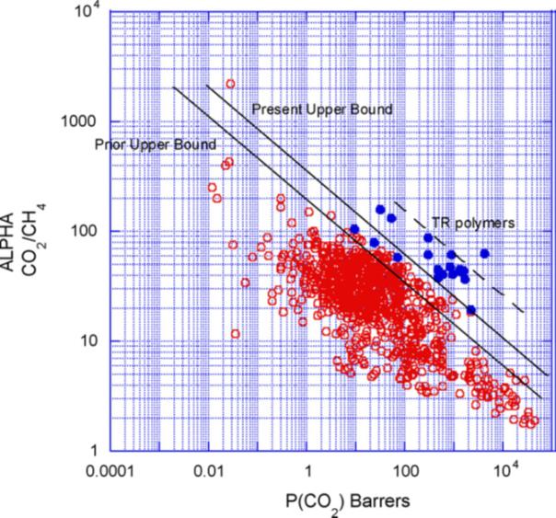
Polymeric membranes generally undergo a trade–off limitation between permeability and selectivity: as permeability increases, selectivity decreases, and vice-versa.
Robeson trade-off
Robeson L.M., Journal of Membrane Science, 320, (2008), p.390
*TR, thermally re-arranged

Slide 29
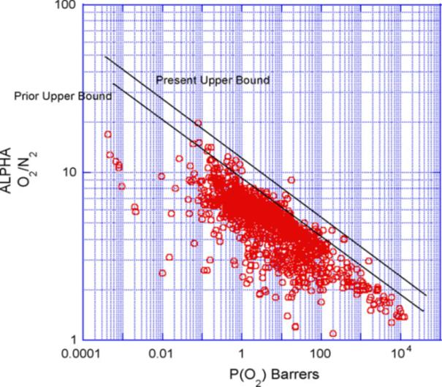
Polymeric membranes generally undergo a trade–off limitation between permeability and selectivity: as permeability increases, selectivity decreases, and vice-versa.
Robeson trade-off
Robeson L.M., Journal of Membrane Science, 320, (2008), p.390

Slide 30
Polymeric membranes generally undergo a trade–off limitation between permeability and selectivity: as permeability increases, selectivity decreases, and vice-versa.
Robeson trade-off
Robeson L.M., Journal of Membrane Science, 320, (2008), p.390

Slide 31
In the equations ϕ_{CO2}, ϕ_{N2} are the dimensionless molar flow rate, for CO₂ and N₂, respectively and ζ is the dimensionless module length.
Θ_{i} and φ are the parameters affecting the performance of a one stage membrane system, the permeation number and the feed to permeate pressures ratio, respectively.
Θ_{i} expresses a comparison between the two main mass transport mechanisms involved: the permeating one through the membrane and the convective flux of the feed stream.

Slide 32
  Separation analysis by Mathematical Modelling

Slide 33
  Separation analysis by Mathematical Modelling

Slide 34
  Separation analysis by Mathematical Modelling

Slide 35
14%

Slide 36
14%

Slide 37
14%

Slide 38
20%

Slide 39
20%

Slide 40
20%

Slide 41
Comparison among some important design parameters
 | Membrane System | Absorption | Adsorption | Cryogenic
Operating flexibility | High (%CO₂>20%) Low (%CO₂<20%) | Moderate | High | Low
Response to variations | Instantaneous | Rapid (5-15 minutes) | Rapid (5-15 minutes) | Slow
Start up after the variations | Extremely short (10 minutes) | 1 h | 1 h | 8-24 h
Turndown | down to 10% | down to 30% | down to 30% | down to 30-50%
Reliability | 100% | Moderate | Moderate | Limited
Control requirement | Low | high | high | high
Ease of expansion | Very high (modularity) | Moderate | Moderate | Very low

Slide 42
The selection of the separation process may be driven by specific considerations, strictly related to the output to be obtained. The feed composition (CO₂%), the feed conditions (pressure and temperature), the product purity and the final destination of the product strongly affect the choice
 | Absorption | Adsorption | Cryogenic | Membrane System
CO₂ in the feed, (% molar) | >5 | >10 | >5 | >10
CO₂ purity, % | >95 | 75-90 | 99.99 | 80-95^{(*)}
CO₂ recovery, % | 80-95 | 80-95 | 99.99 | 60- 80^{(*)}
Energy requirement, MJ/kg_{CO2} | 4-6 (Favre 2007) | 5-8 (Aaron 2005) | 6-10 (Eide et al., 2005) | 0.5-10 (Favre 2007)
CO₂ capture cost, $/ton | 40-100 (Merkel et al, 2010) | - | - | 23** (Merkel et al, 2010
*Considering a CO₂/N₂ selectivity of 50 in one stage process
**Considering a multistage process
[1] Favre E., Journal of Membrane Science, 294, (2007), p.50
[2] Brunetti A., Scura F., Barbieri G., Drioli E., 2010, Membrane technologies for CO2 separation, Journal of Membrane Science, 359, 115–125
[3] Aaron D., Tsouris C., Separation Science and Technology, 40: 321–348, 2005
[4] Eide L.I., Anheden M., Lyngfelt A., Abanades C., Younes M., Clodic D., Bill A.A., Feron P.H.M., Rojey A., Giroudière F., Oil & Gas Science & Technology, 60, (2005), p.497
[5] Bounaceur R., Lape N., Roizard D., Vallieres C., Favre E., Energy, 31, (2006), p.2556.
[6] Merkel T., Lin. H., Wei X., Baker R., Journal of Membrane Science, 359, (2010), 126-139

Slide 43
Selection guidelines for some applications
Process application | Feed conditions | Membrane System | PSA | Cryogenic
Catalytic reformer off-gas | 70-90%_{vol} H₂ 30-10% C₁ to C₆+ ppv of aromatics and HCl Pressure: 15-30 bar Room Temperature | H₂ purity: 98%. Final destination: uses such as catalyst regeneration | H₂ purity: 99+% H₂ recovery: 82-90% Final destination: primary source of make up hydrogen for hydrocracker | Not used due to the necessity of pretreatment for aromatic removals
Hydroprocessor purge gases | High pressure purge gas: 75-90%_{vol} H₂ Hydrocarbon balance Pressure: 50-200 bar Room Temperature | H₂ purity: 92-98% H₂ pressure: 20-40 bar H₂ recovery: 85-95% Final destination: make-up hydrogen compressor | Not used because of the high feed pressure | Not used due to the low flow rates
 | Low pressure purge gas: 50-75%_{vol} H₂ Hydrocarbon balance Pressure: 5-20 bar Room Temperature | Not used because of the low feed pressure | H₂ purity: 99% H₂ pressure: 1 bar H₂ recovery: 80-90% Final destination: primary source of make up hydrogen for hydrocracker
FCC off-gas and other refinery purge streams | 15-50%_{vol} H₂ Hydrocarbon or olefins balance Pressure: 5-20 bar Room Temperature | Feed compression: > 25 bar H₂ purity: 80-90% H₂ pressure: 5-20 bar H₂ recovery: 50-85% Final destination: low pressure hydrotreaters The tail gas is sent to downstream hydrogen recovery units | Not used because of the low H₂ concentration in the feed | H₂ purity: >95% H₂ pressure: 15-30 bar Recovery of a mixed stream containing >99+% of C₂+ components
Ethylene off-gas | 80-90%_{vol} H₂ CO, CO₂, CH₄ balance Pressure: 15-30 bar | H₂ purity: 95-97% H₂ recovery: 80-90% Final destination: make-up hydrogen compressor | H₂ purity: 99.5% H₂ recovery: 80-90% Final destination: primary source of make up hydrogen for hydrocracker | H₂ purity: 95% H₂ pressure: 15-30 bar Final destination: make-up hydrogen compressor

Slide 44
Main industrial applications of GS membrane
Separation | Process | Traditional technology | Membrane Material | Status of membrane technology application
H₂/N₂ | Ammonia purge gas | PSA | Polysulfone | Plant installed (Prism by Permea)
 |  |  | Pd-based | Lab scale
H₂/CO | Adjustment of H₂/CO ratio in syngas plant | PSA | Silicon rubber | Lab scale
 |  |  | Polyimide | Plant installed (Separex)
 |  |  | Pd-based | Lab scale
H₂/hydrocarbons | Hydrogen recovery in refineries | PSA | Silicon rubber Polyimide | Plant installed (Sinopec Zhenhai (china) Prism by Permea Du Pont)
 |  |  | Pd-based | Lab scale
H₂/light hydrocarbons | Ethylene cracker old trains | Cryogenic distillation | PTMSP; PMP | Pilot plant
 |  |  | Pd-based | Lab scale
O₂/N₂ | Air separation | Cryogenic distillation | Silicon rubber | Plant installed (Cynara; Separex; GMS; Air Products)
 |  |  | Polysulfone | Plant installed (Permea)
 |  |  | Polyimide | Plant installed (Medal; Dow-Generan; UBE)
 |  |  | Polyphenilene | Plant installed (Aquilo)
 |  |  | Ethyl Cellulose | Plant installed (Air Liquide)
 |  |  | Ion transport (perovskite) | Lab scale
 |  |  | Pd-based | Lab scale

Slide 45
Main industrial applications of GS membrane
N₂/CH₄ | Nitrogen removal | Cryogenic distillation | Silicon rubber PMP Parel | Pilot plant
 |  |  | PEBAX | Lab scale
H₂O/CH₄ | Dehydration | Glycol absorption | Cellulose acetate Polyimide polyaramide | Plant installed [51]
CO₂/CH₄ | Sweetening of natural gas | Amine absorption | Cellulose acetate | Offshore platforms In Thailand gulf. (Cynara-NATCO); Grace-Separex
 |  |  | Polyaramide | Plant installed (Medal)
 |  |  | Polyimide | Plant installed (Medal)
 |  |  | Perfluoro-polymers | Plant installed (MTR)
CO₂/Hydrocarbons | Natural gas liquid removal | Glycol absorption and cooling inn a propane refrigeration plant (-20°C) | Cellulose acetate Polyimide polyaramide | Early commercial stage. A demonstration system installed
CO₂/N₂ | CO₂ capture from flue gas streams | Amine absorption | Polyimide | Pilot plant
 |  |  | FSC; PEEKWC; Zeolite, silica based; carbon | Lab scale
VOCs/gas | Polyolefin plant resin degassing; Ethylene recovery | Adsorption, Refrigeration and turbo-expander plants | Silicone rubber PTMSP | Plant installed (MTR; OPW VaporsaverTM)

Slide 46
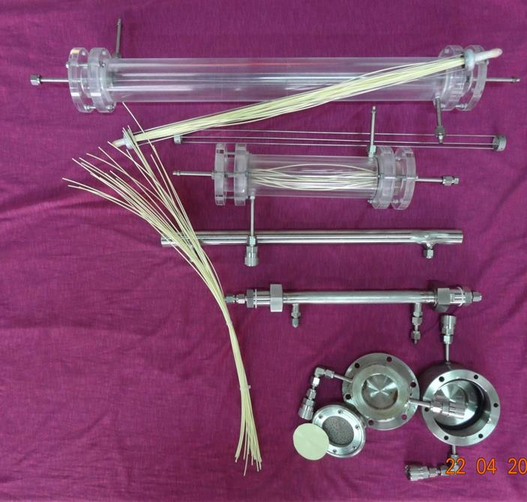
  Membrane modules

Slide 47
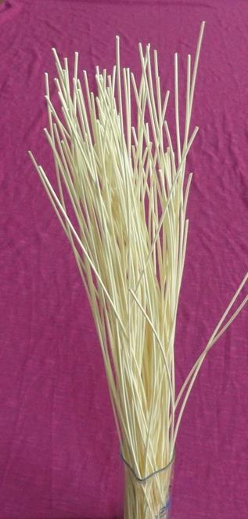
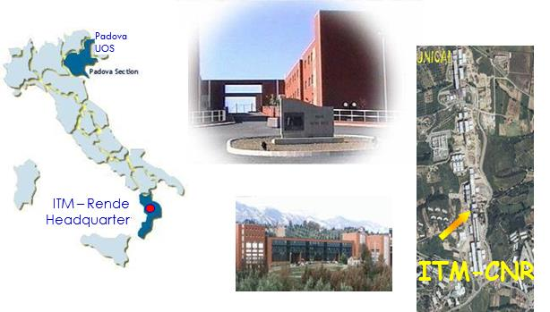

Thank you for your attention
 | National Research Council Institute on Membrane Technology

