Slide 1
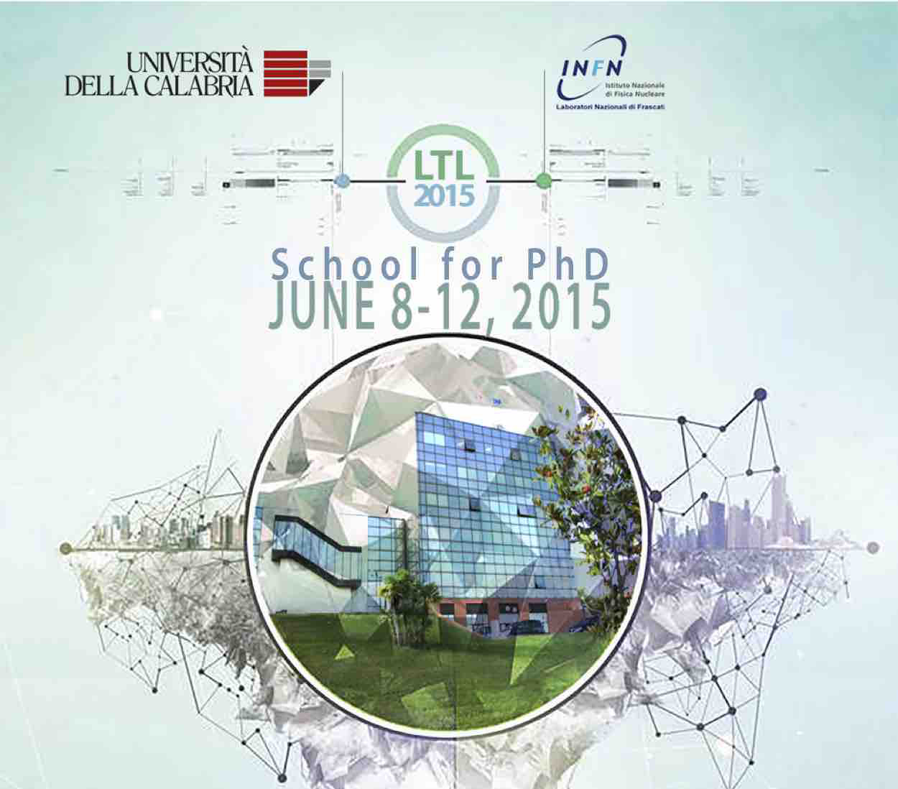

Slide 2
8. Smart cities
(Laboratorio d’Immagini, Cubo 45B II piano)
CONVENER G. Celani (UNICAL/DINCI)
LECTURERS G. Celani (UNICAL/DINCI)
TUTORS P. Celani. E. d’Alessandro, M. Zupi, G. Nicolaci
Lectures content:
Approaches to the contemporary city: Smart city, Creative city, Resilient city, Green city.
Living Labs: open innovation, real-life settings, end user engagement, user-driven innovation.
Tutorials content:
Collection and analysis of case studies on smart city and living labs.
Development of an evaluation matrix of the components of the smart city. Simulation of a program of actions for the construction of smart city.

Slide 3
1st day
Introduction to the concept of smart city
components and indicators of smart city
tutorial on definitions of smart city and best practices

Slide 4
2st day
brain storming on the results of the first exercise
introduction to the concept of living lab
tutorial on definitions of creative city, resilient city, green city and case study on living labs

Slide 5
3st day
brain storming on the results of the second exercise
final project: power point for the poster session.

