Slide 1
3D layout

Slide 2
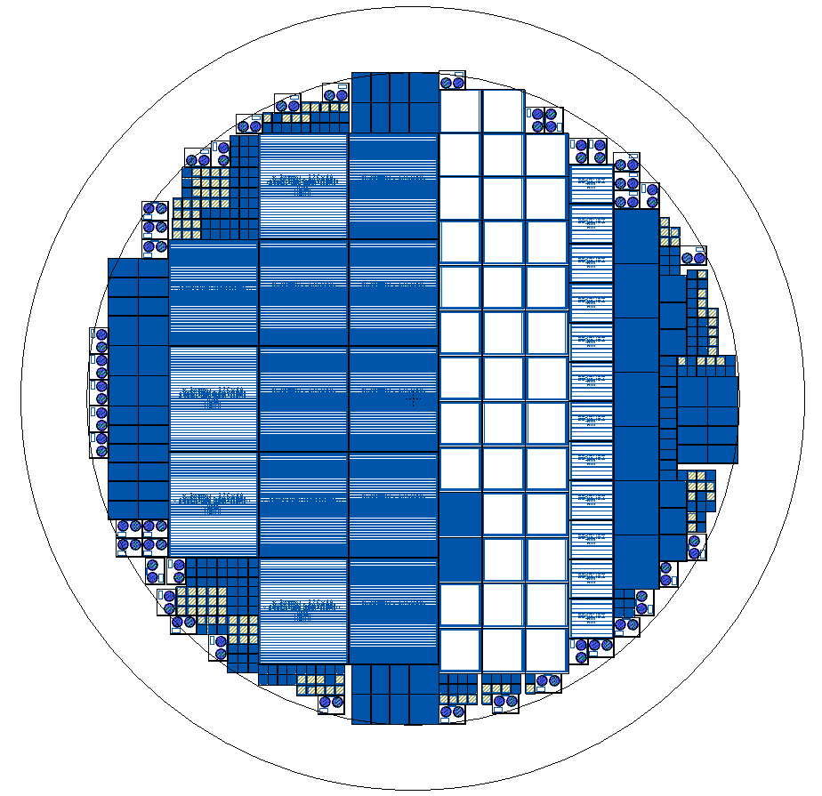
The final Layout (1)

Slide 3
The final Layout (2)
STRIP
FEI4
CMS
FEI3
FEI5 big
STRIP
Fermi
lab
FEI5 small
STRIP
Fermi
lab
STRIP

Slide 4
Different Geometries and multiplicity
Geometries
11 FEI4
19 CMS
3 FEI3
1 Fermilab
1 FEI5 big
2 FEI5 small
4 strip
23 diode
1 test structure
Multiplicities
13 FEI4
38 CMS
9 FEI3
6 Fermilab
6 FEI5 big
6 FEI5 small
48 strips
253 diode
43 test structures

Slide 5
Pixel variants

Slide 7
CMS layouts
2E+6E
2E+4E

Slide 8
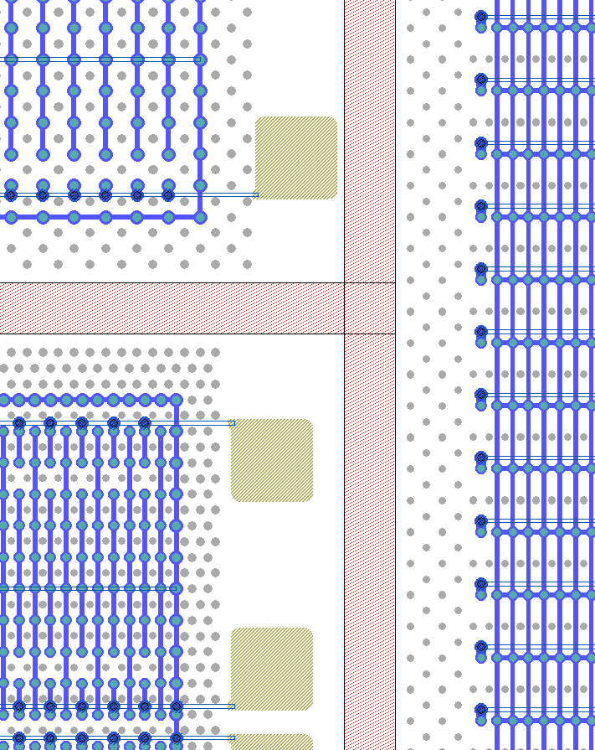
FEI4: edge
In FEI4 the cutting region is 25 um from the outermost Ohmic column.
Only on one side there is extra space for the temporary metal pads.

Slide 9
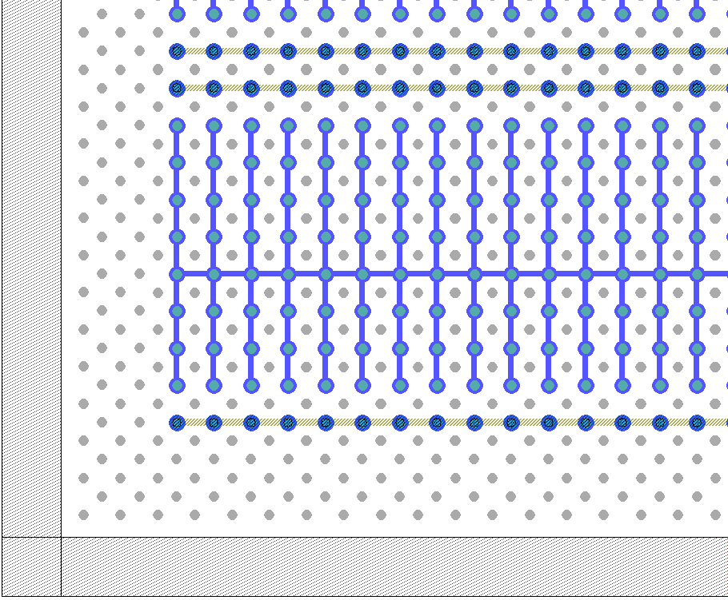
FEI4 and CMS: bump on column

Slide 10
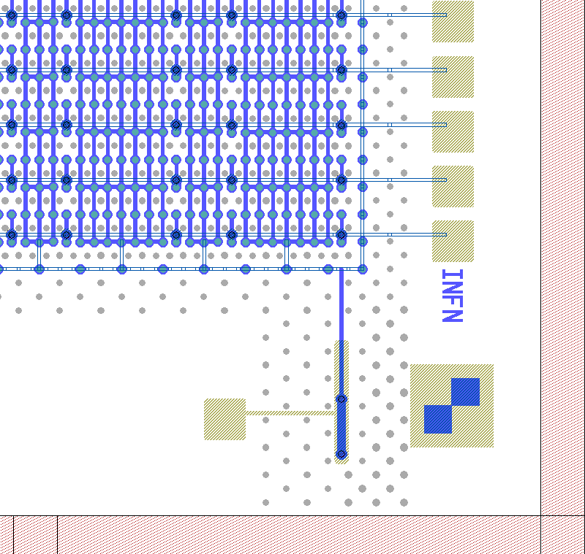
CMS edge
In CMS pixels with guard ring there are two edges that are not “slim”
The Guard ring pad is managed as shown in figure.
Now also in CMS pixelsw the temporary metal is patterned to test single rows

Slide 11
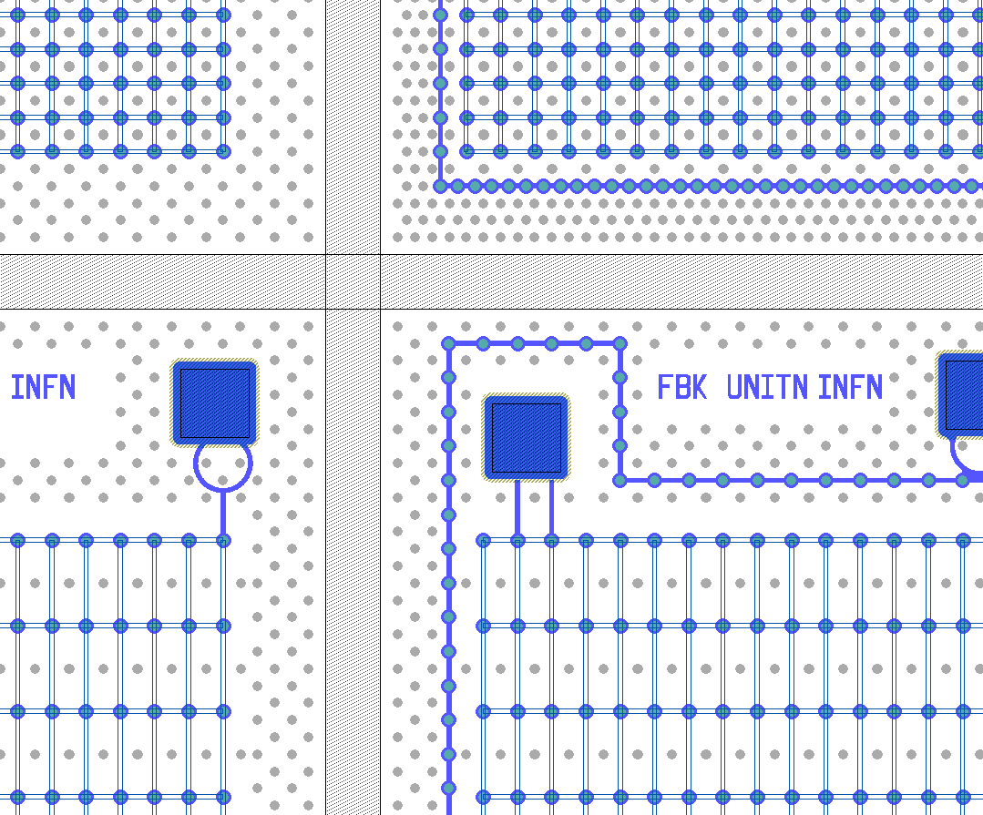
Diode: edge
The cutting region is 25 um from the last Ohmic column.
The contact pads were managed as shown in figure (to avoid the problems observed in 3D-DTC-6).

Slide 12
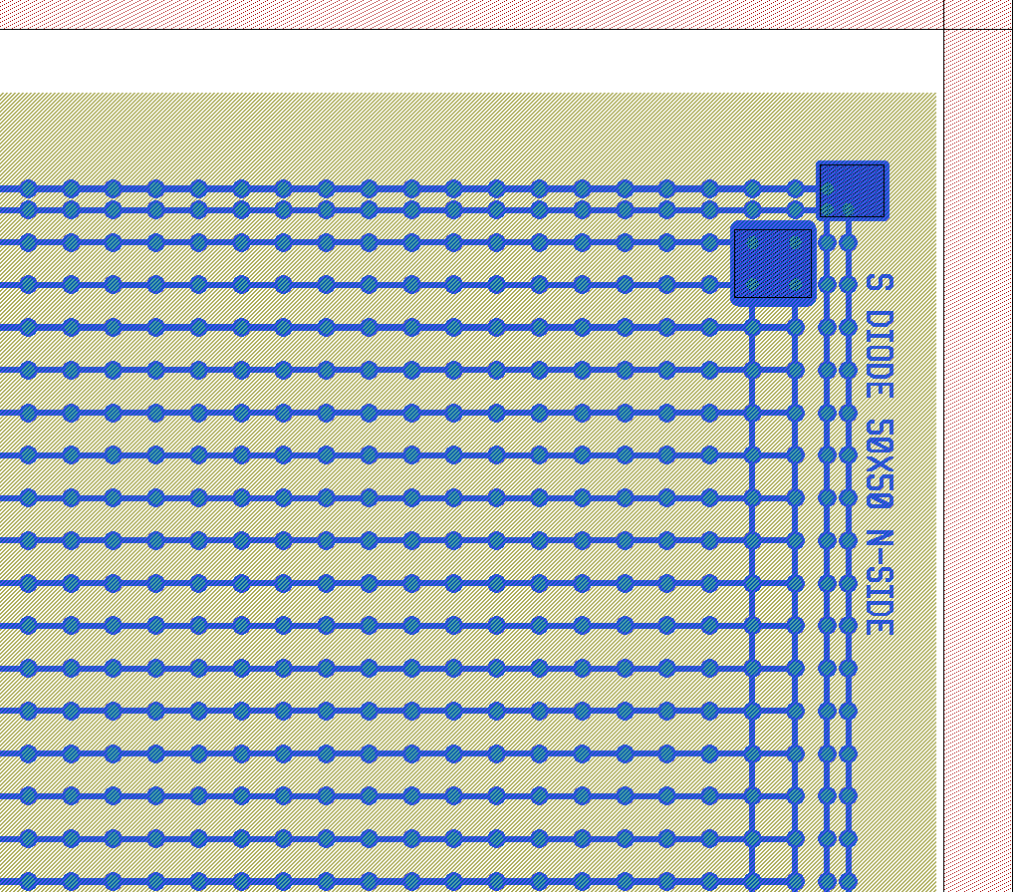
Diode without Ohmic columns

Slide 13
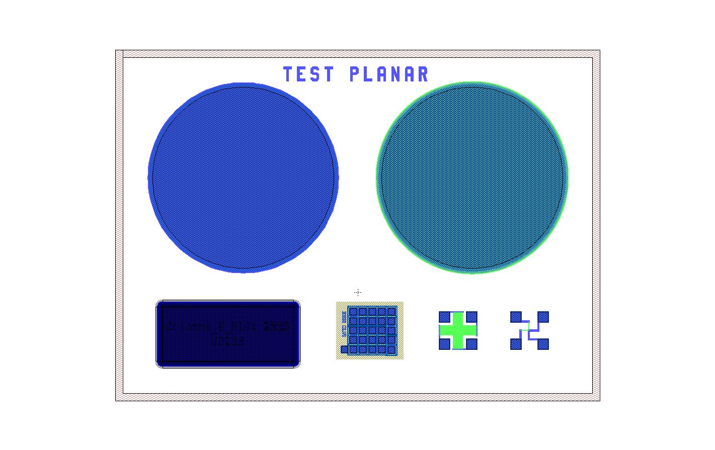
Test structures
MOS metal
MOS n-poly
Contact
on n-poly
resistance
Metal
on p-poly
Capacitor
3D gated diode
N-poly resistance

