Slide 1
The KM3NeT-IT sea bed infrastructure
Collaboration meeting in Ischia, May 19th
sea operations (see talk from Klaus)
The new Cable Termination Frame
Integration of the optical pod in the JB
Upgrades in the shore station

Slide 2
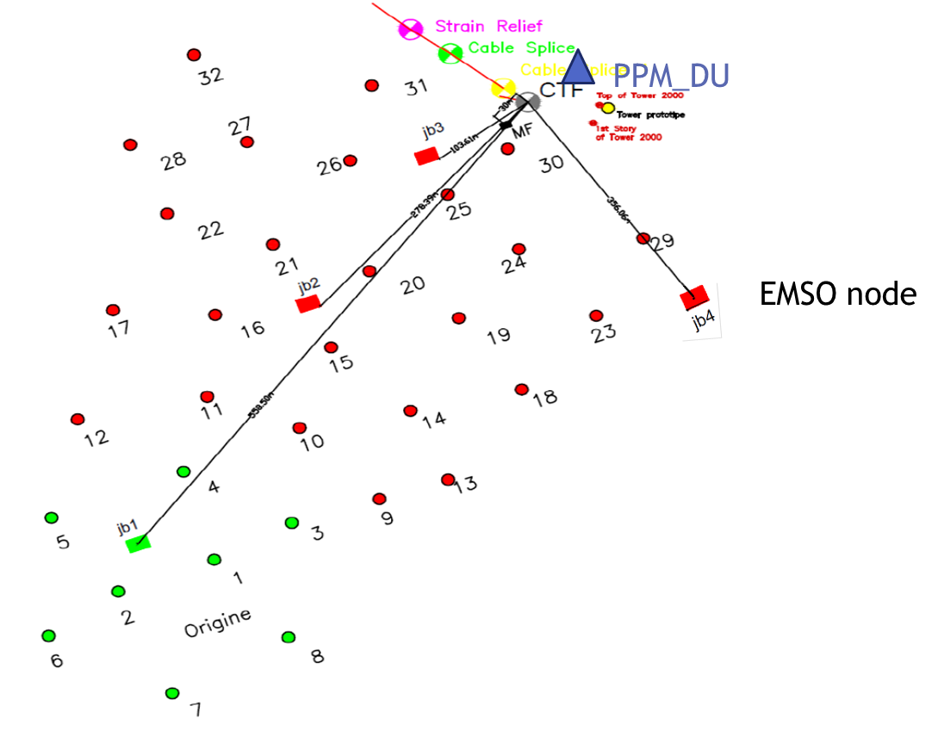
The new Cable termination frame
Exploit the full capability of the main cable (20 optic fibre)
Feeds & connects 4 JBs
Assembled and tested by McArtney in DK

Slide 3
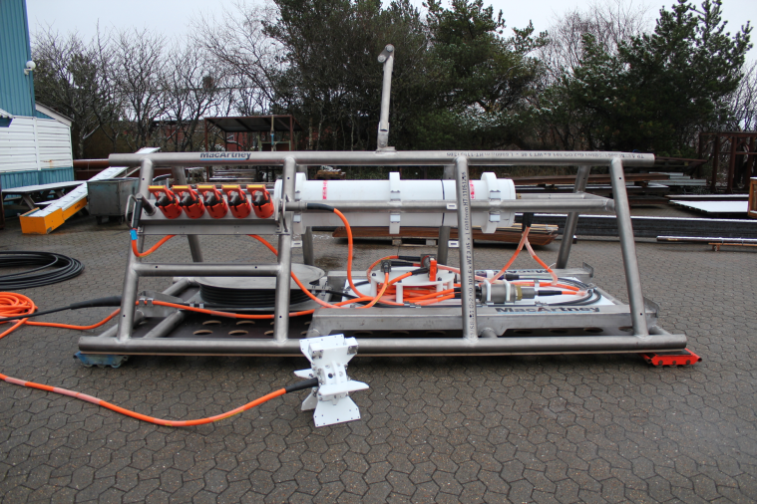
5 ROV-operated ODI connectors
New cable termination frame delivered in mid-April
(acceptance tests successful at MacArtney – first tests at LNS ok)

Slide 4
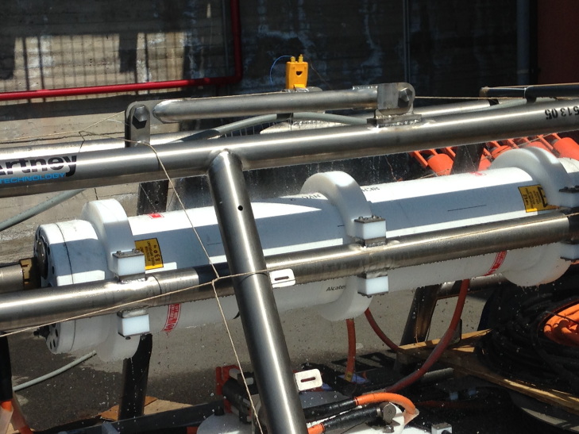
Test at full (10kW) power

Slide 5
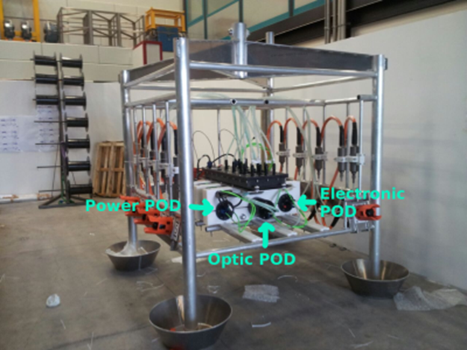
Optical POD integration and more
Integration of the optic pod took place in mid April by Genova,LNS and NIKHEF peoples.
Power and electronic pod already integrated.
Test in the 100km cable of Capo passero to check shore optical amplification layout
Time asymmetry in the optical path in the JB performed

Slide 6
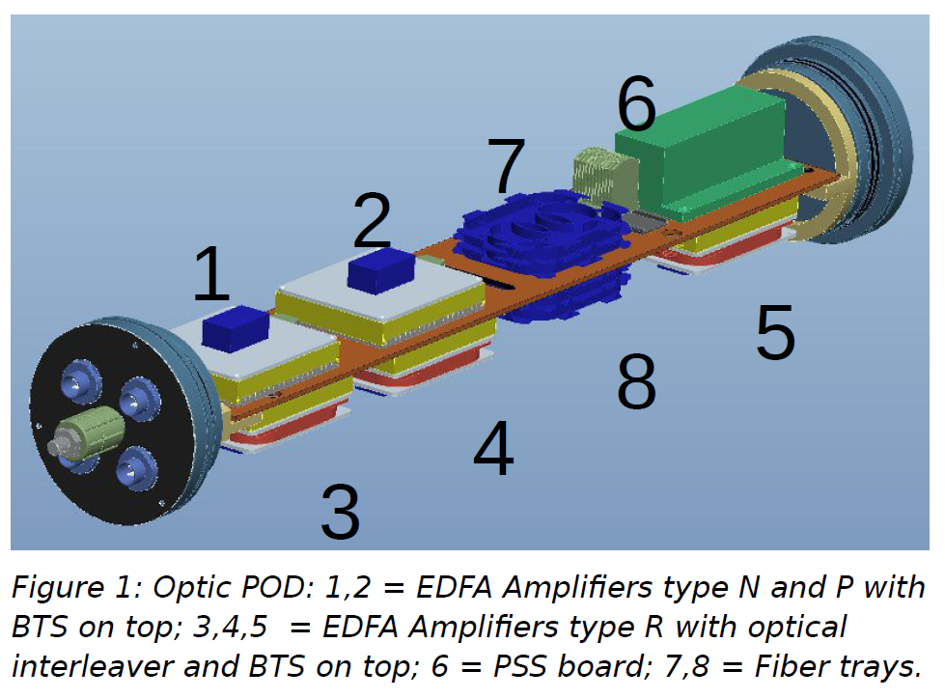

Slide 7
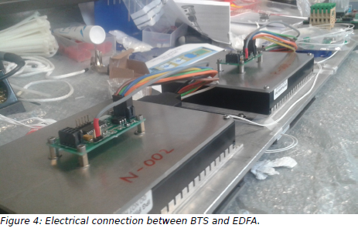
During assembling

Slide 8
In the Capo Passero configuration there is nothing active in the optical path from shore to JB SFP.
Distinction between EDFA communication in :
“normal startup sequence “ and in
“automatic sequence” ie when the communication to JB fails
Both procedure defined and implemented (see details in Gerard’s talk); Firmware completed
Integration of the Optical pod succesfully performed and tested..
Time calibration asymmetry of the Junction Box determined.
Full system test still to be done due to lack of the on-shore electronics.

Slide 9
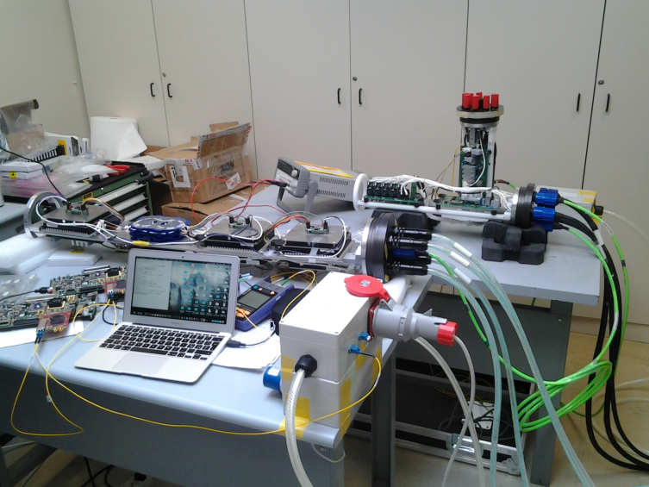
Time asymmetry measure in the Junction Box

Slide 10
Documentation still in progress:
KM3NeT_ISIT_2015_002: This document describes the thermal tests performed on the mockup of the Optical POD for the Junction Box of the string for the Italian site of KM3NeT.
KM3NeT_ISIT_2015_001:This document describes the mechanical structure of the Optical POD for the Junction Box of the string for the Italian site of KM3NeT.
KM3NeT_ISIT_2015_003: KM3NeT_ISIT_2015_001:This document describes the assembling procedure of the Optical POD for the Junction Box of the string for the Italian site of KM3NeT.
KM3NeT_ISIT_2015_004: This document shows the block scheme of the BTS firmware.
KM3NeT-Italy Junction Box Optical POD Assembly:This document details the optical breakdown structure, the assembly and test procedures of the Optical POD of the Junction Box for KM3NeT-Italy.

Slide 11
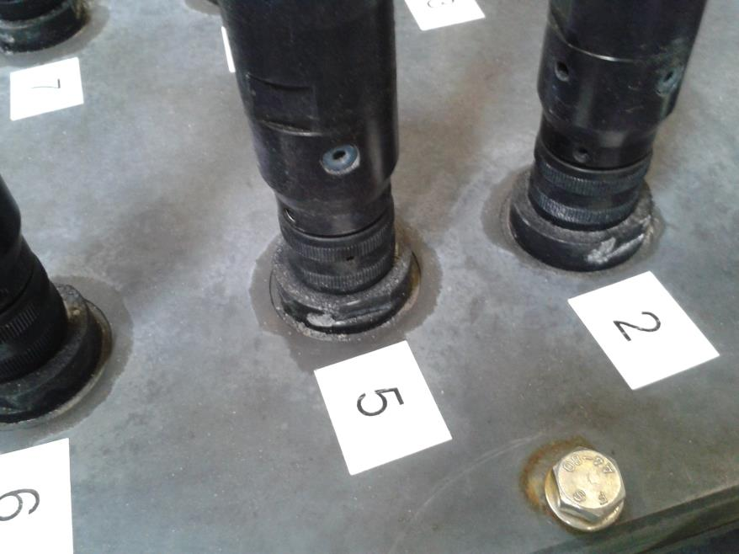
This is an example of corrosion on the SEACON connector of the manifold of the tower
In the JB the evidence is lower but clearly present in the connector #4 plugged to the tower
Likely corrosion is NOT due to the material (aluminum alloy 6000 serie)
In the tower: evidence of water inlet in the transition from the backbone cable (dry) to the SEACON optocon connector
In the JB a similar situation is present but transition is different (from oil hose to the SEACON optocon connector)

Slide 12
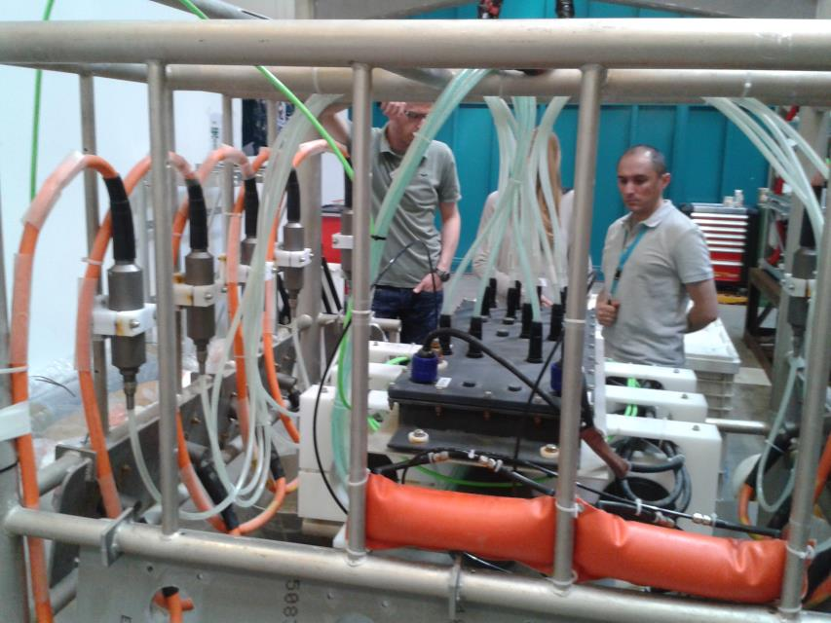

Slide 13
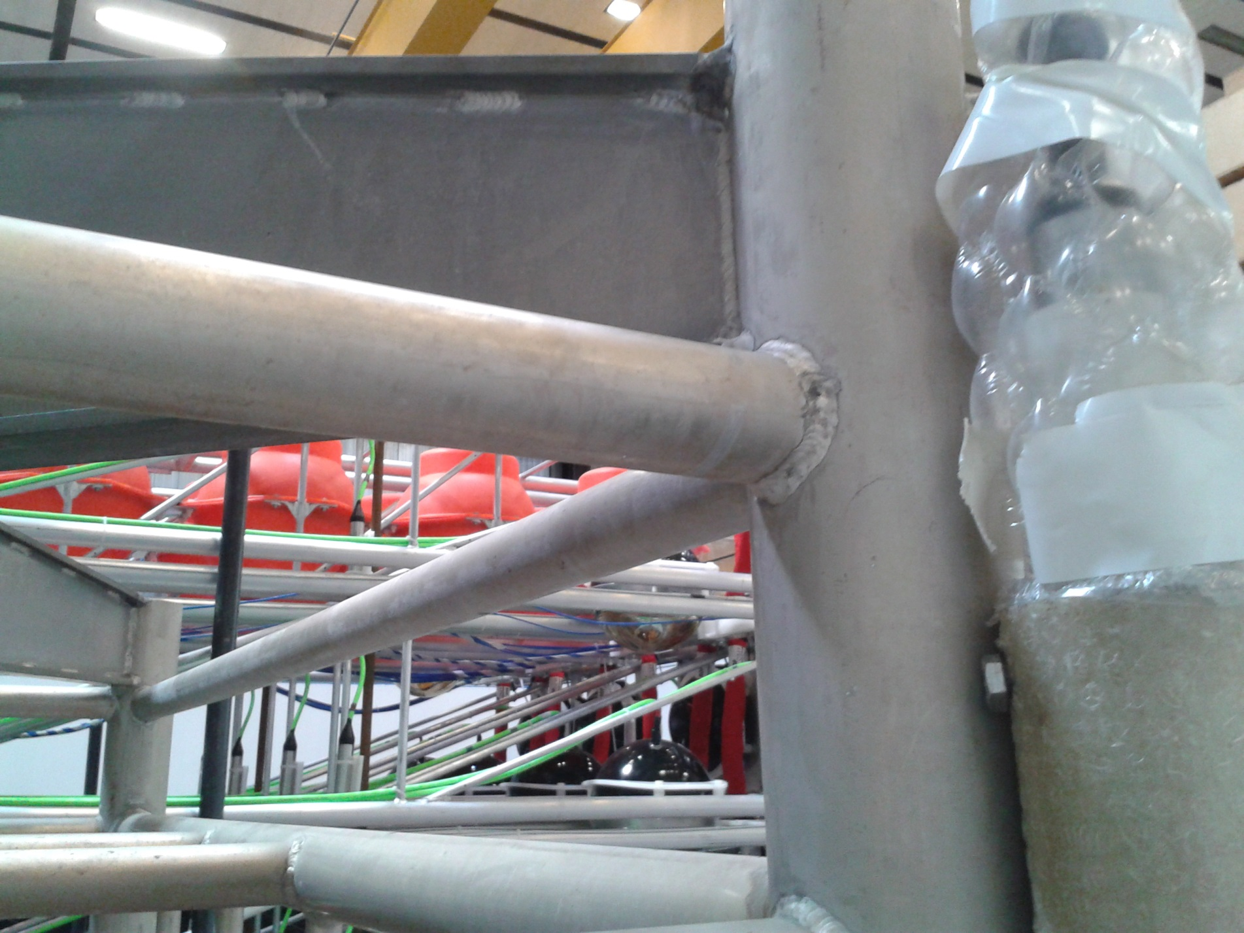
Aluminum frame is well preserved

