Slide 1
The Evolution of the Italian HPC Infrastructure
Carlo Cavazzoni
CINECA – Supercomputing Application & Innovation
31 Marzo 2015

Slide 2
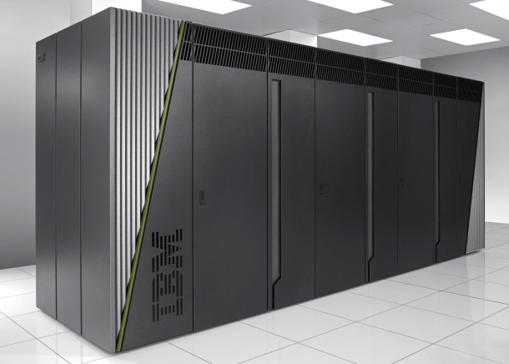
FERMI
High-end system, only for extremely scalable applications
Name: Fermi
Architecture: BlueGene/Q (10 racks)
Processor type: IBM PowerA2 @1.6 GHz
Computing Nodes: 10.240
Each node: 16 cores and 16GB of RAM
Computing Cores: 163.840
RAM: 1GByte / core (163 TByte total)
Internal Network: 5D Torus
Disk Space: 2PByte of scratch space
Peak Performance: 2PFlop/s
Power Consumption: 820 kWatts
N. 7 in Top 500 rank (June 2012)
National and PRACE Tier-0 calls

Slide 3
GALILEO
X86 based system for production of medium scalability applications
Name: Galileo
Model: IBM NeXtScale
Architecture: IBM NeXtScale
Processor type: Intel Xeon Haswell@ 2.4 GHz
Computing Nodes: 516
Each node: 16 cores, 128 GB of RAM
Computing Cores: 8.256
RAM: 66 TByte
Internal Network: Infiniband 4xQDR switches (40 Gb/s)
Accelerators: 768 Intel Phi 7120p (2 per node on 384 nodes
+ 80 Nvidia K80
Peak Performance: 1.2 PFlops
National and PRACE Tier-1 calls

Slide 4
PICO
Storage and processing of large volumes of data
Name: Pico
Model: IBM NeXtScale
Architecture: Linux Infiniband cluster
Processor type: Intel Xeon E5 2670 v2 @2,5Ghz
Computing Nodes: 66+
Each node: 20 cores, 128 GB of RAM
Computing Cores: 1.320+
RAM: 6,4 GB/core
plus
2 Visualization nodes
2 Big Mem nodes
4 BigInsight nodes
Storage
50TByte of SSD
5PByte on-line repository
(same fabric of the cluster)
16PByte of tapes
Services
Hadoop & PBS
OpenStack cloud
NGS pipelines
Workflows (weather/sea forecast)
Analytics
High-throughput workloads

Slide 5
Infrastructure Evolution

Slide 6
HPC “island” Infrastructure
Front End Cluster
HPC Engine
HPC Engine
DB
Web
serv.
FERMI
X86 Cluster
Web
Archive
FTP
Workspace
Workspace
Workspace
External Data Sources
PRACE
EUDAT
Other Data Sources
Repository
Tape
Laboratories
Human Brain Prj

Slide 7
(data centric) Infrastructure
Cloud service
SaaS APP
External Data Sources
PRACE
EUDAT
Other Data Sources
Core Data Store
Laboratories
Repository
5 PByte
Human Brain Prj
Tape
12 PByte
Internal data sources
Core Data Processing (Pico)
Scale-Out Data Processing
viz
Big mem
DB
Web
serv.
Workspace
7 PByte
FERMI
Data mover
processing
Tier-1
Web
Archive
FTP
Analytics APP
Parallel APP

Slide 8
Next Tier0 system
(Late 2015)
Fermi, at present our tier0 system, reaches the normal end
It will be substituted with another system of comparable performance to fullfil the commitments at Italian and European level (order of magnitude 50PFlops -or- 50M€)
BG/Q architecture is no more in the development plans of IBM, the actual tecnology has not yet been identified

Slide 9
Computing Infrastructure
Tier0: Fermi
Tier1: Galileo
BigData: Pico
Tier0: new
(HPC Top10)
BigData: Galileo/Pico
Tier0 BigData:
50PFlops
50PByte
today
1Q 2016
2018

Slide 10
How to get HPC resources
Peer reviewed projects:
you can submit a project that will be reviewed. If you win you will get the needed resources for free
  National → ISCRA
  Europe → PRACE
No selection:
some institutions sign special purpose R&D agreement with CINECA to have access to the HPC resources

Slide 11


Peer reviewed selection
ISCRA
Italian
Super Computing Resource Allocation
Italian
researchers
PRACE
Partnership for advanced Computing in europe
European
researchers
ISCRA: http://www.hpc.cineca.it/services/iscra
PRACE: http://www.prace-ri.eu/Call-Announcements

Slide 12
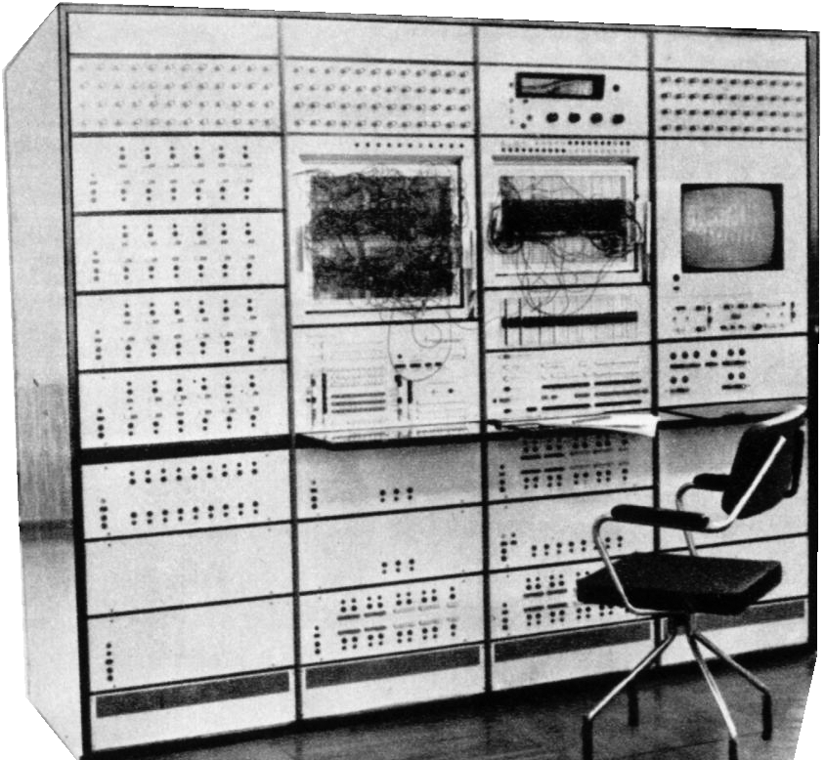
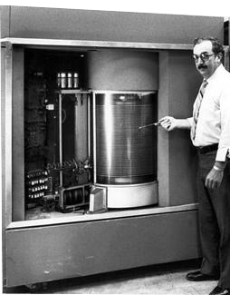
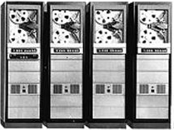
PICO
TAPE
12PB → 16PB
New hw: 10 drives shoud guarantee 2.5GBs troughput
DISKs
5PB distributed storage (GPFS) to be used across diffente platforms.
Servers for Tiering and data migration
COMPUTE
~70 nodes, 20 cores/each NeXtScale
Intel Xeon E5-2600 v2 “Ivy Bridge”
Mem: 128-512 GB/node
4 nodes BigInsight
40TB SSD disk

Slide 13

“BigData”: sw configuration
New services to be defined on this system, taking advance from its peculiarities:
  Low parallelism (less cores with respect to other systems, more cores/node)
  Memory intensive (more memory/core and /node)
  I/O intensive (SSD disk available)
  DB based (a lot of storage space)
New application environments:
  Bioinformatics
  Data anaysis
  Engineerings
  Quantum Chemistry
General services
  Remote visualisation
  Web access to HPC
  HPC Cloud

