Slide 1
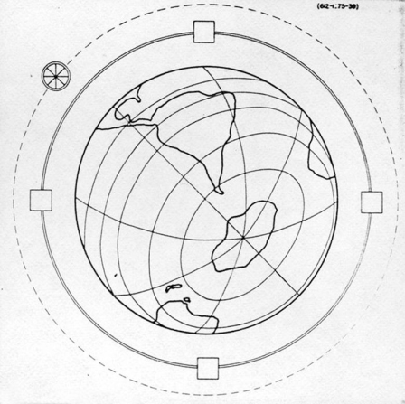
Novel acceleration techniques
Massimo Ferrario
INFN-LNF
LNL Seminar –Legnaro, June 11, 2015

Slide 2
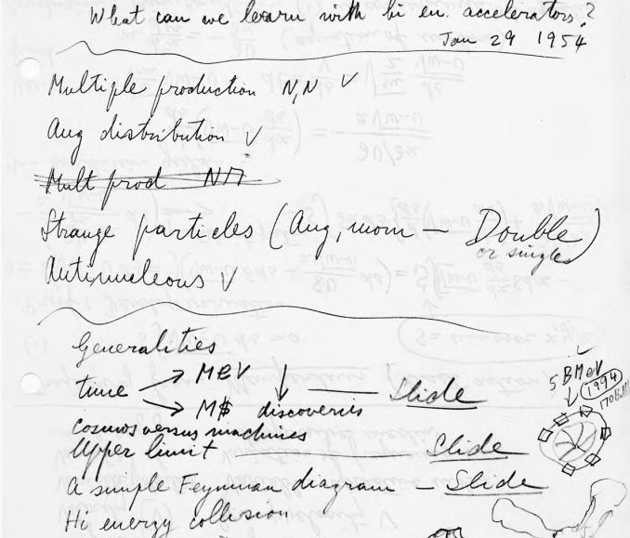
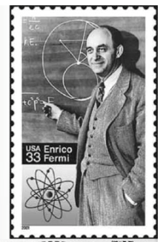

Globatron: 5000 TeV, 170 B$, fixed target 3 TeV cm

Slide 3
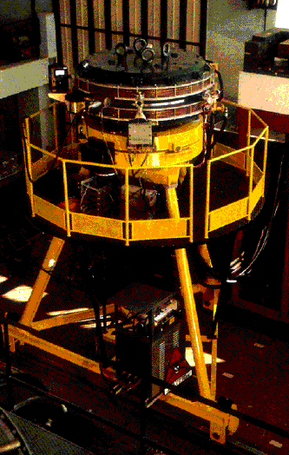
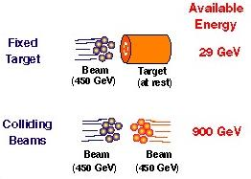
ADA: (Anello Di Accumulazione), 1961-1964
the first e+e- Collider

Slide 4
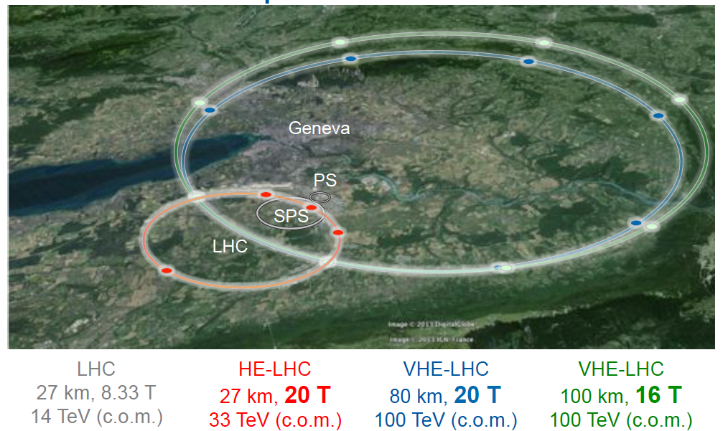

Slide 5
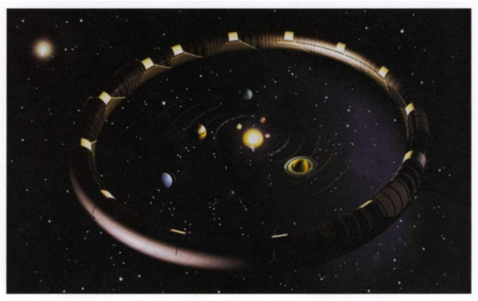
Hawking: the Solartron
Without further novel technology, we will eventually need an accelerator as large as Hawking expected.
“The Universe in a Nutshell”, by Stephen William Hawking, Bantam, 2001

Slide 6
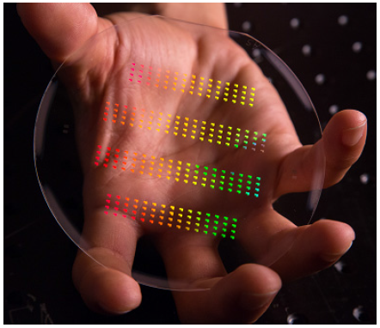
Accelerator on a Chip?

Slide 7
2 WAYS NTA ROAD MAP
Miniaturization of the accelerating structures (resonant)
Wake Field Acceleration (transient)(LWFA,PWFA,DWFA)
Power sources
Accelerating structures
High quality beams

Slide 8
  Modern accelerators require high quality beams: ==> High Luminosity & High Brightness
  ==> High Energy & Low Energy Spread
  N of particles per pulse => 10⁹
  High rep. rate f_{r}=> bunch trains
  Small spot size => low emittance
  Short pulse (ps to fs)
  Little spread in transverse momentum and angle => low emittance

Slide 9
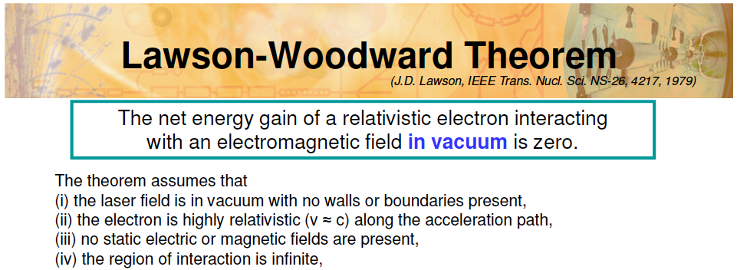
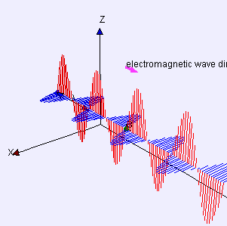


Slide 10
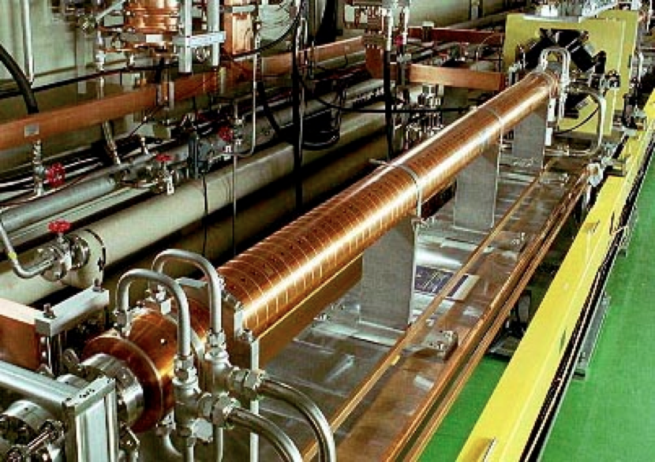
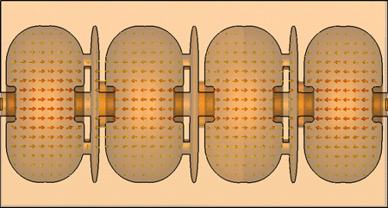
Conventional RF accelerating structures

Slide 11
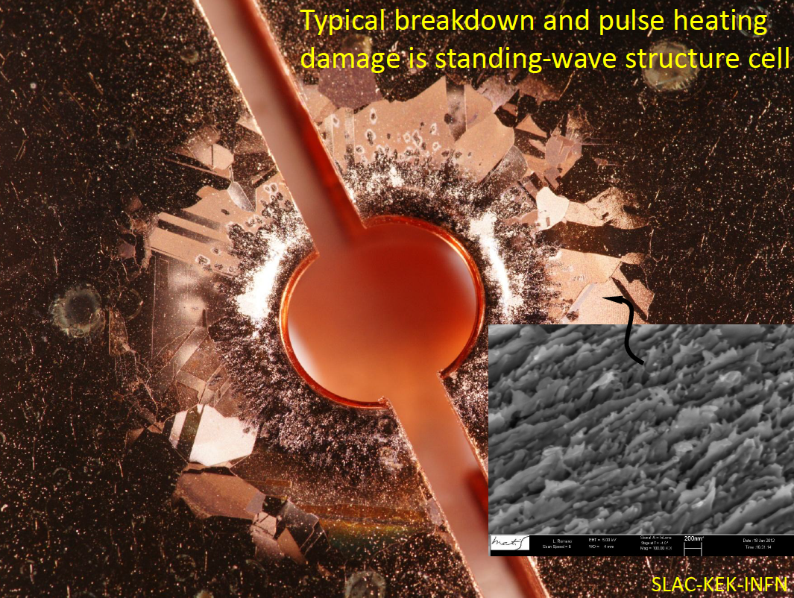

Slide 12
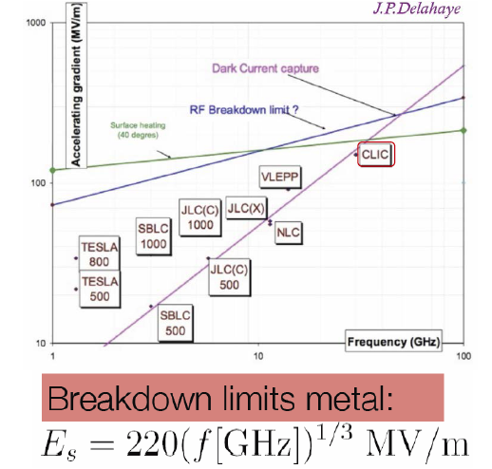
High field ->Short wavelength->ultra-short bunches-> low charge

Slide 13
Miniaturization of the accelerating structures

Slide 14
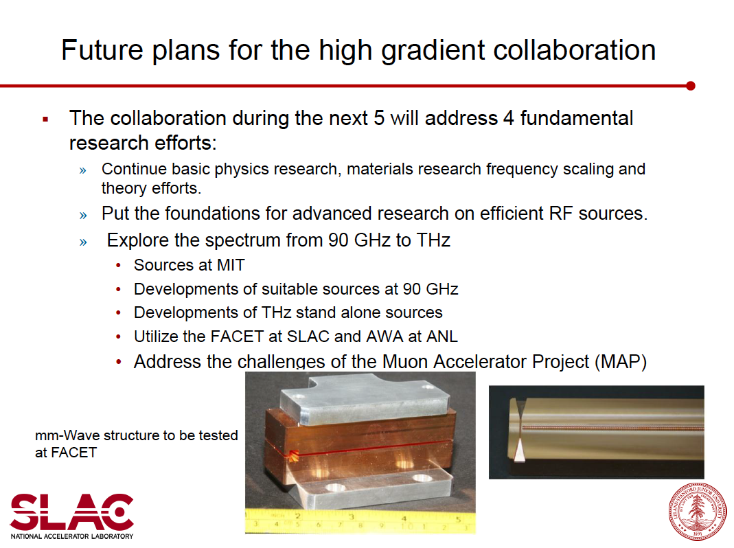

Slide 15
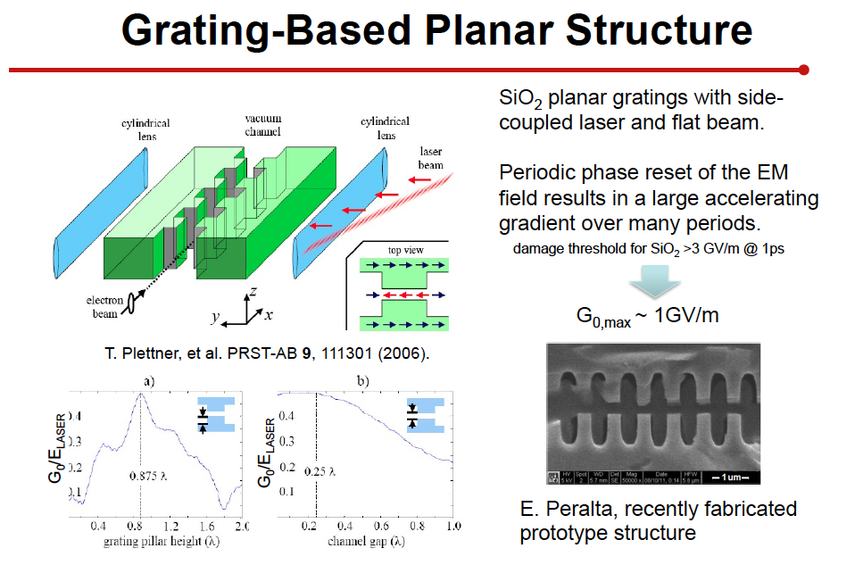
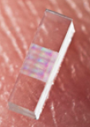
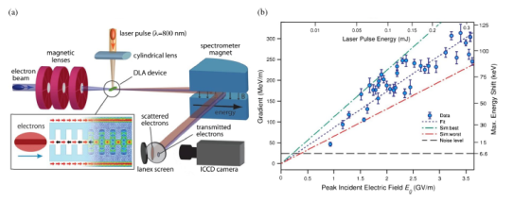

Slide 16
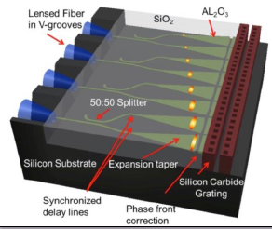

Slide 17
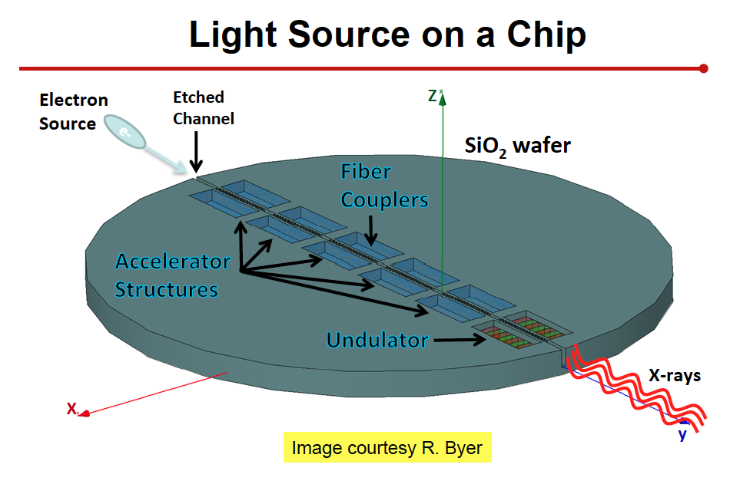

Slide 18
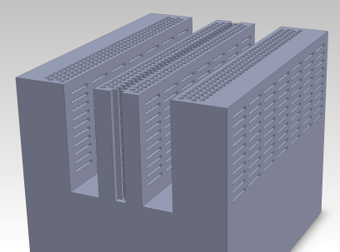
Dielectric Photonic Structure
Why photonic structures?
  Natural in dielectric
  Advantages of burgeoning field
    design possibilities
    Fabrication
Dynamics concerns
External coupling schemes
Laser pulses
180 degrees
out of phase
e-beam
Biharmonic ~2D structure
Schematic of GALAXIE
monolithic photonic DLA

Slide 19
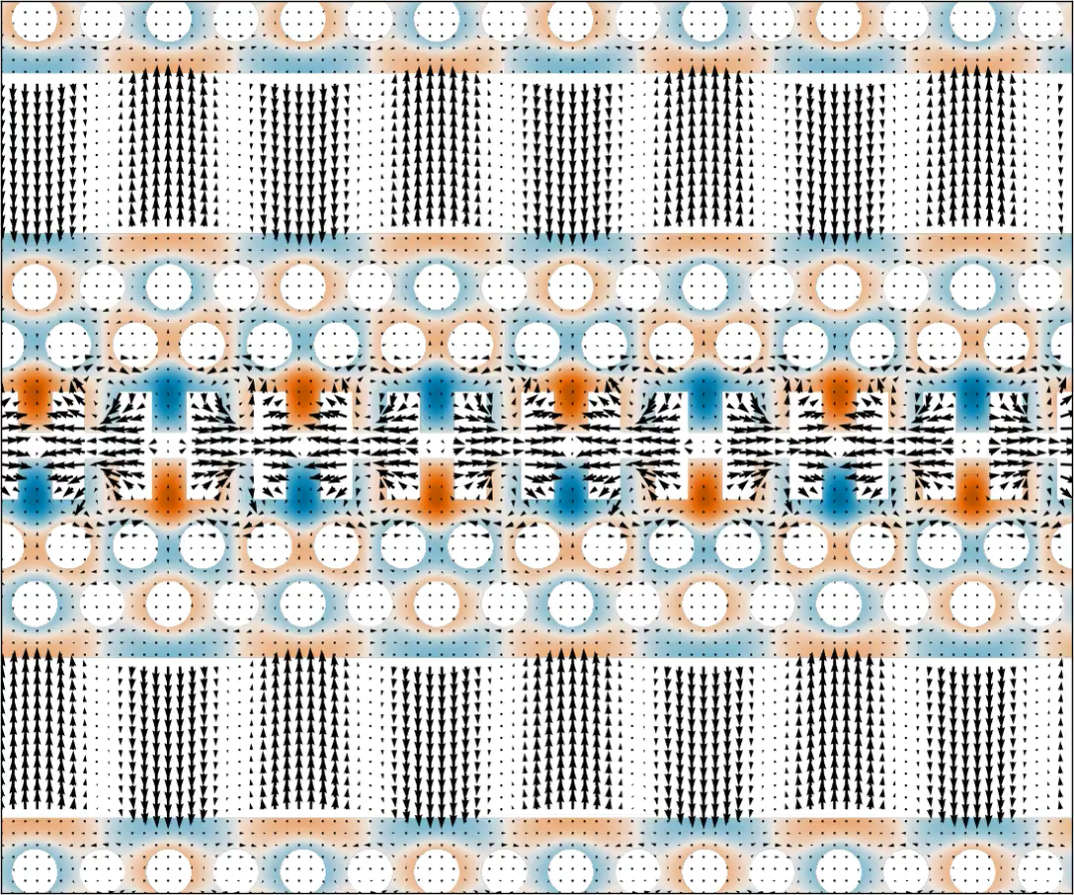
Laser-Structure Coupling: TW
GALAXIE Dual laser drive structure, large reservoir of power recycles
Laser pulses
(180 degrees
out of phase)
e-beam

Slide 20
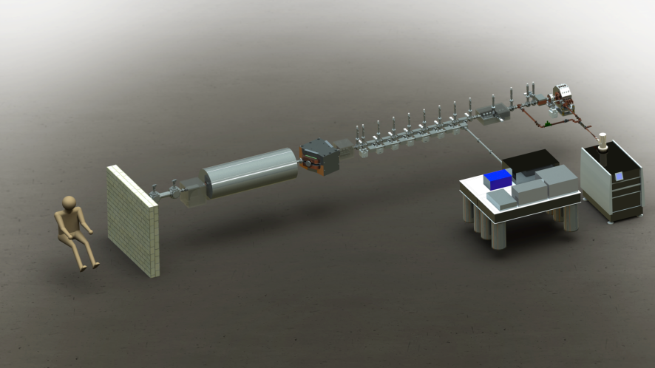
5th Gen Light Source: A Table-top X-ray FEL
GALAXIE: GV-per-meter AcceLerator And X-ray-source Integrated Experiment
Ultra-high brightness
electron source
<2 m 800 MeV Dielectric
Laser Accelerator (DLA)
LCLS photons in <1m
<2 m EM undulator
(λ=100 um)
40 keV quantum
SASE FEL
Long wavelength
(5 um) laser source
All EM system with GV/m fields
Many interconnected physics challenges

Slide 21
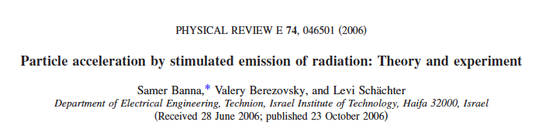
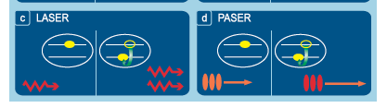
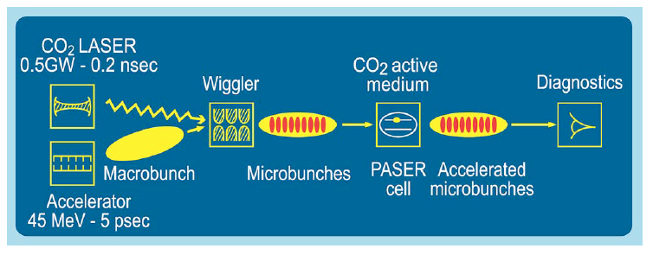

Slide 22
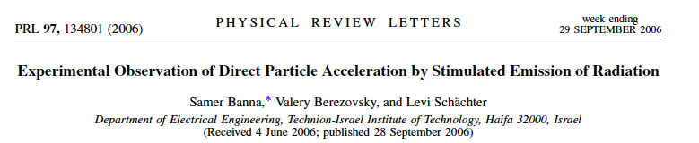
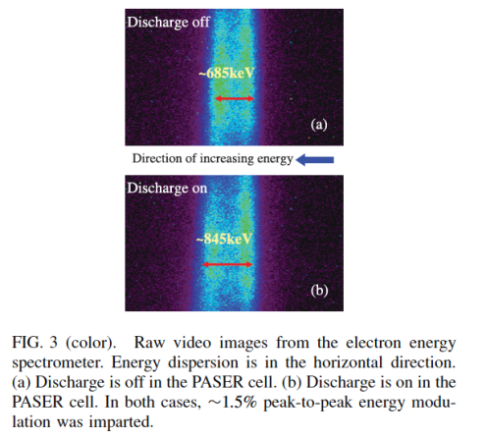

Slide 23
Wake Field Acceleration 1
Laser Driven
LWFA

Slide 24
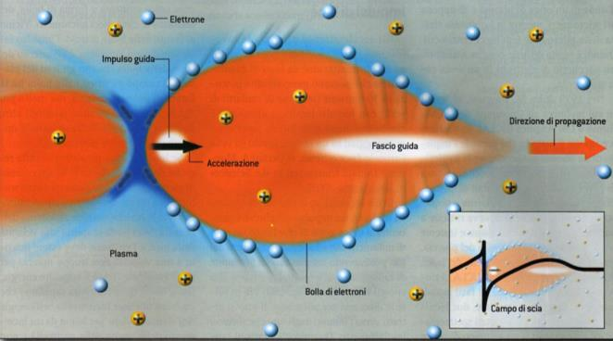

High quality beam Plasma Acceleration
Breakdown limit?

Slide 25
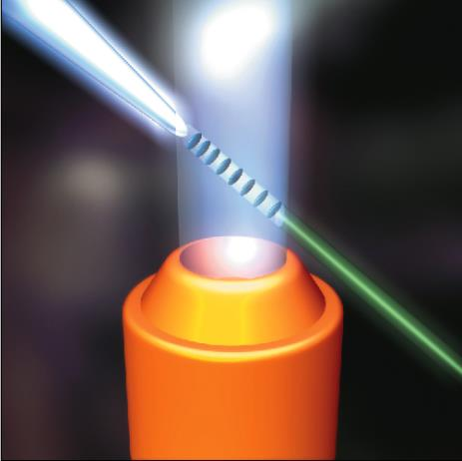
Direct production of e-beam
Laser beam
1 mm
Electron beam

Slide 26
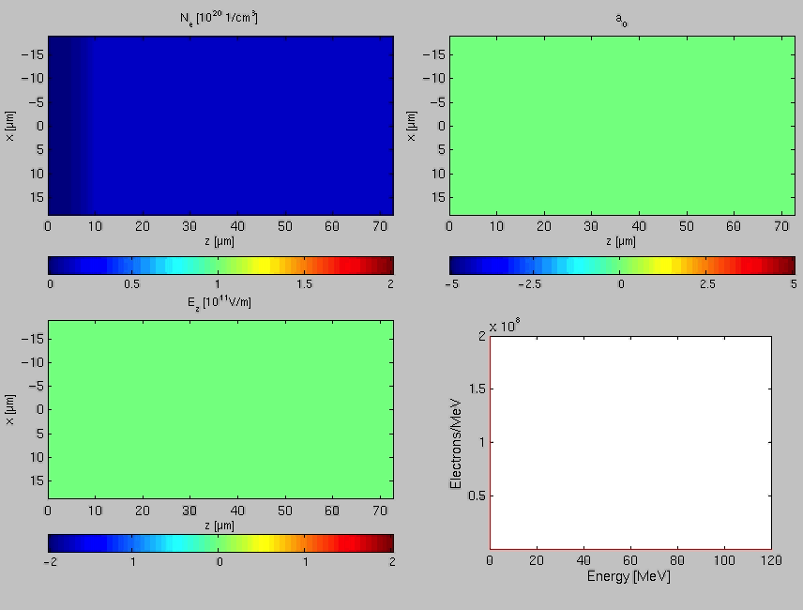

Slide 27
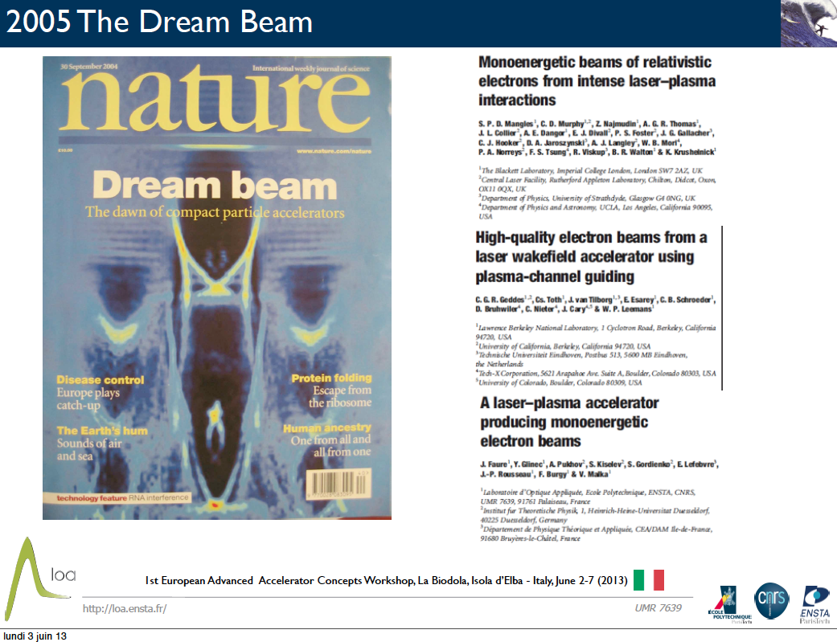

Slide 28
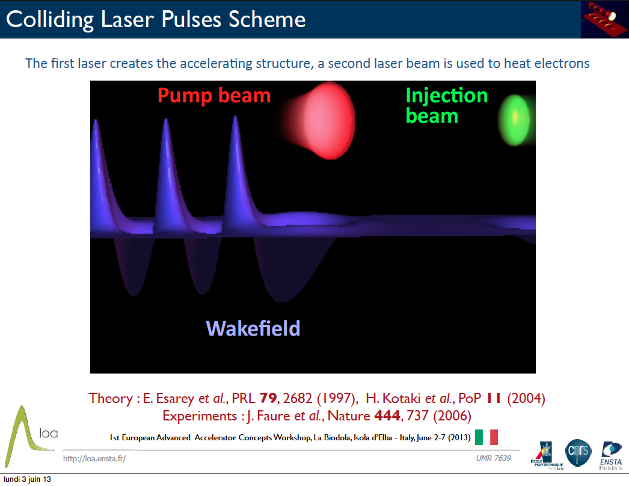

Slide 29
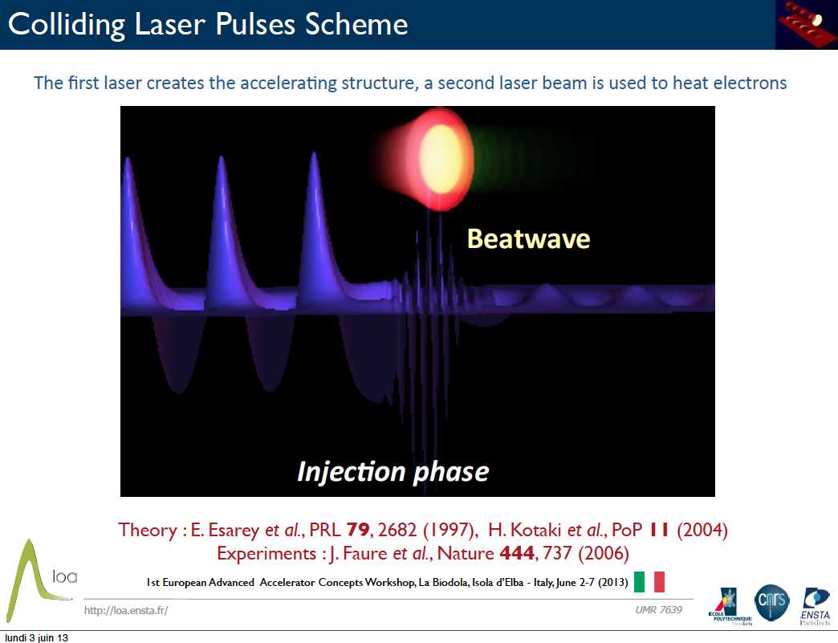

Slide 30
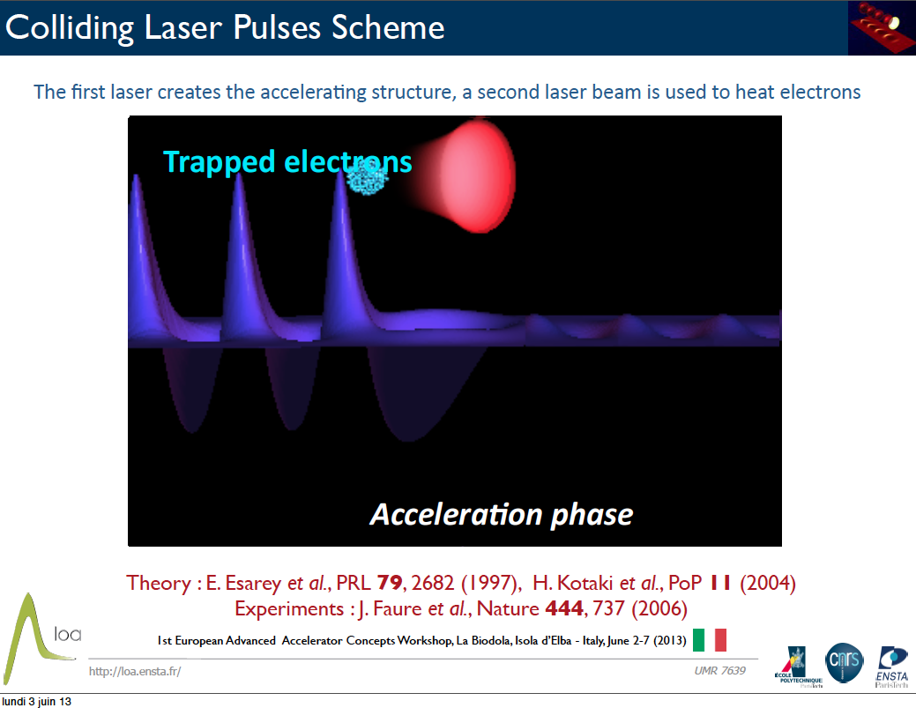

Slide 31
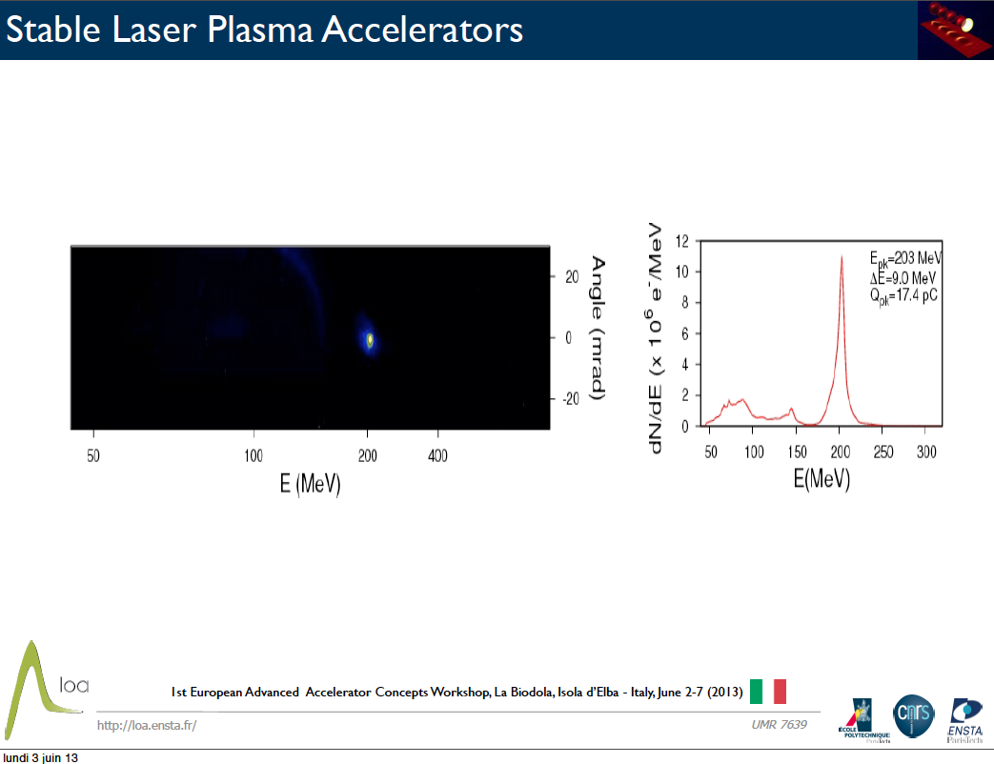

Slide 32
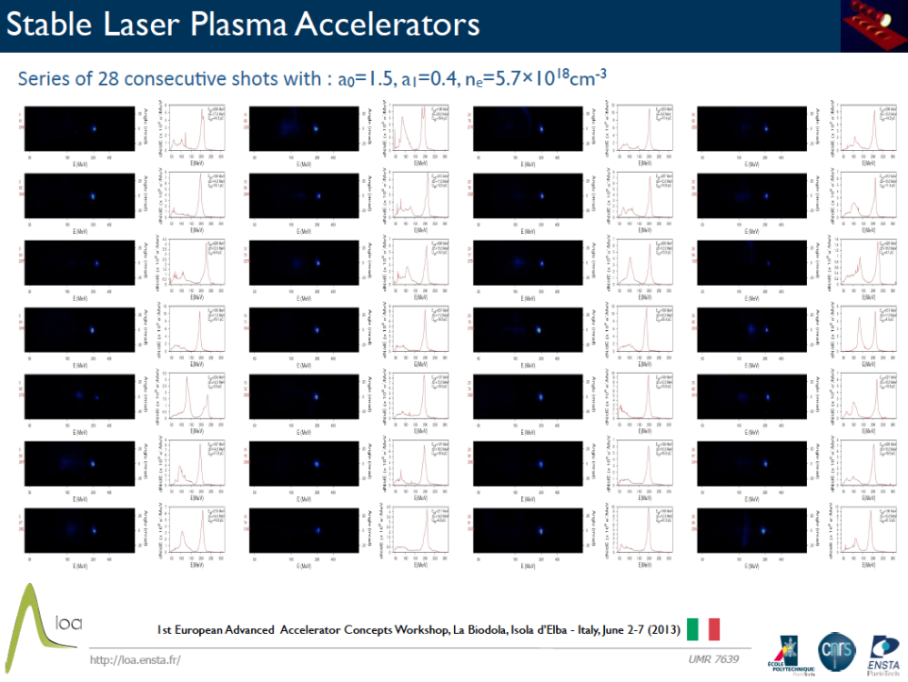

Slide 33
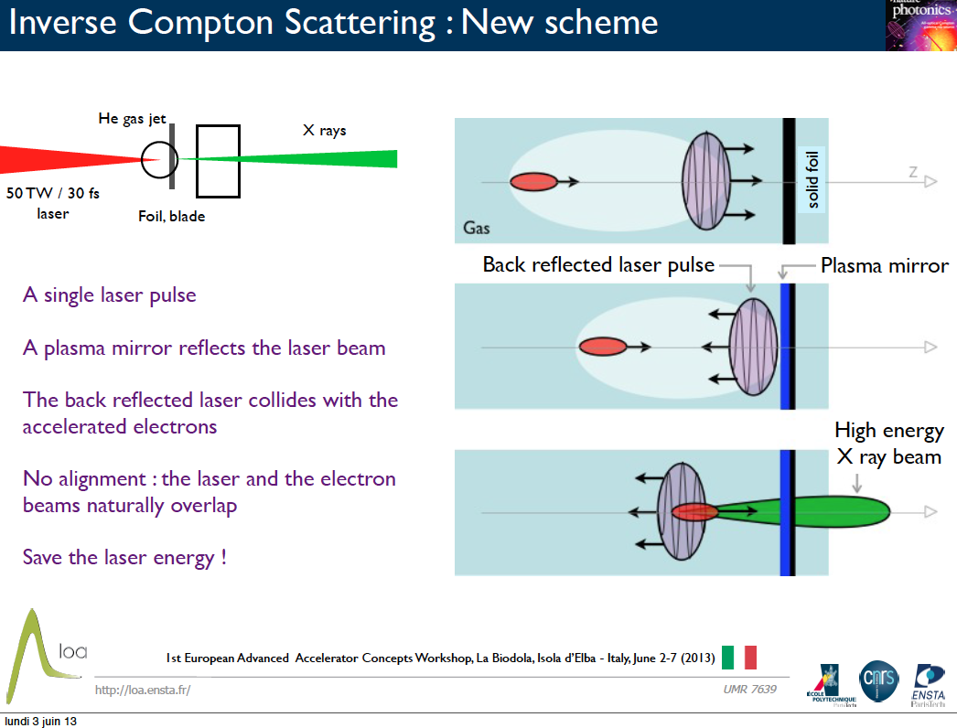

Slide 34
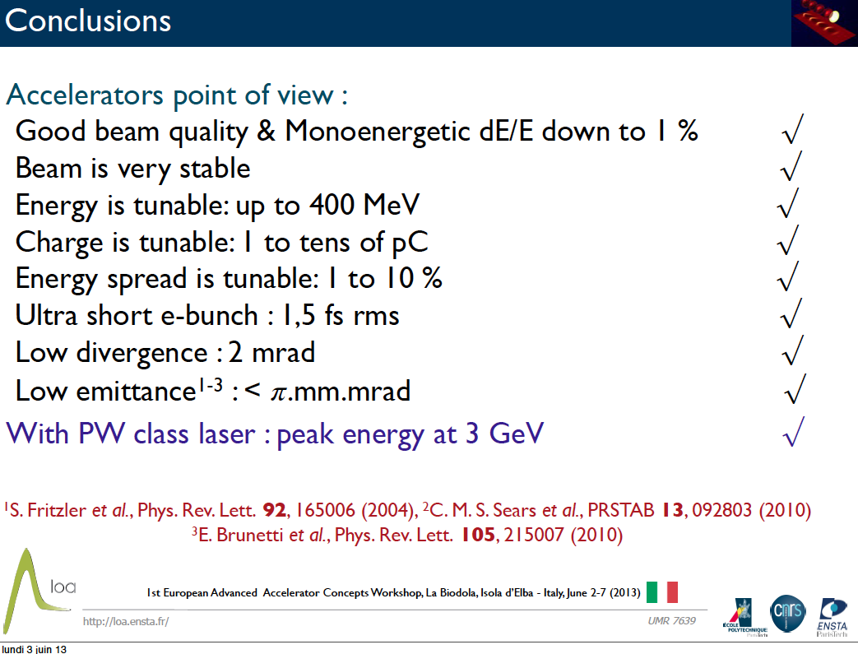

Slide 35
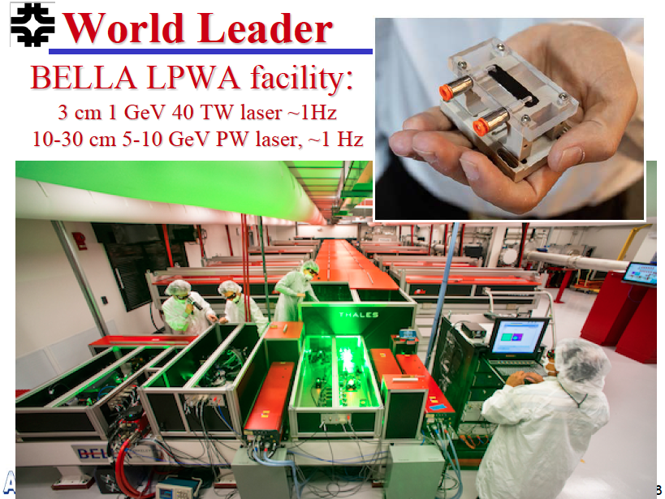

Slide 36
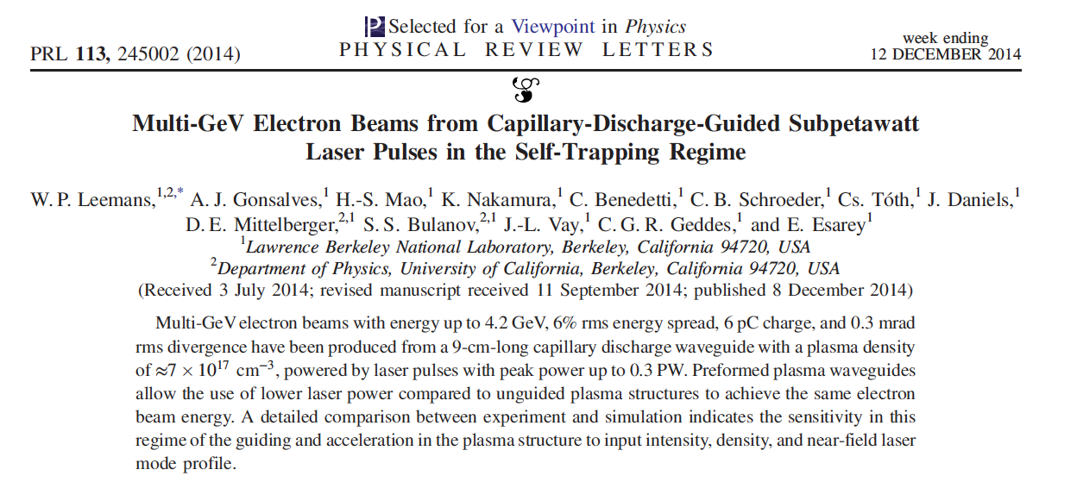
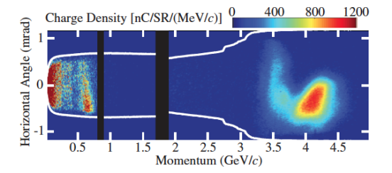

Slide 37
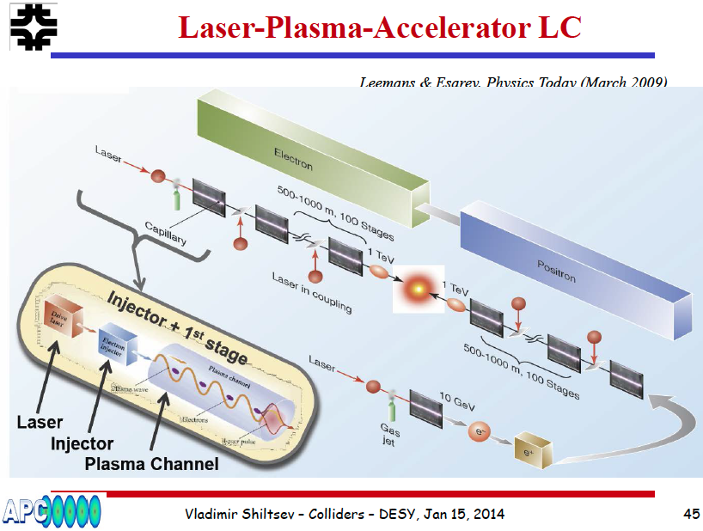

Slide 38
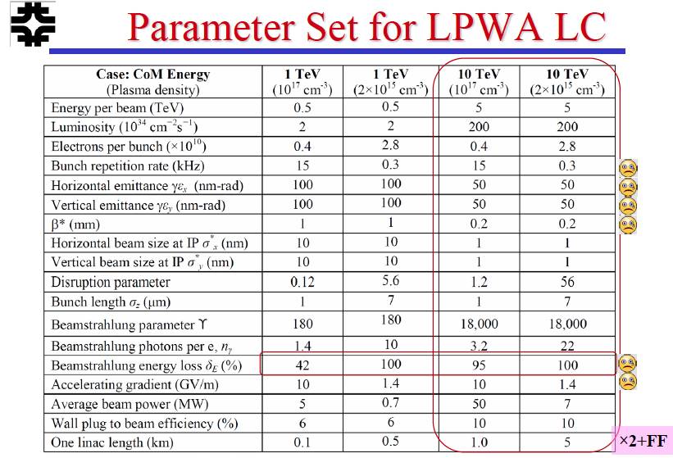

Slide 39
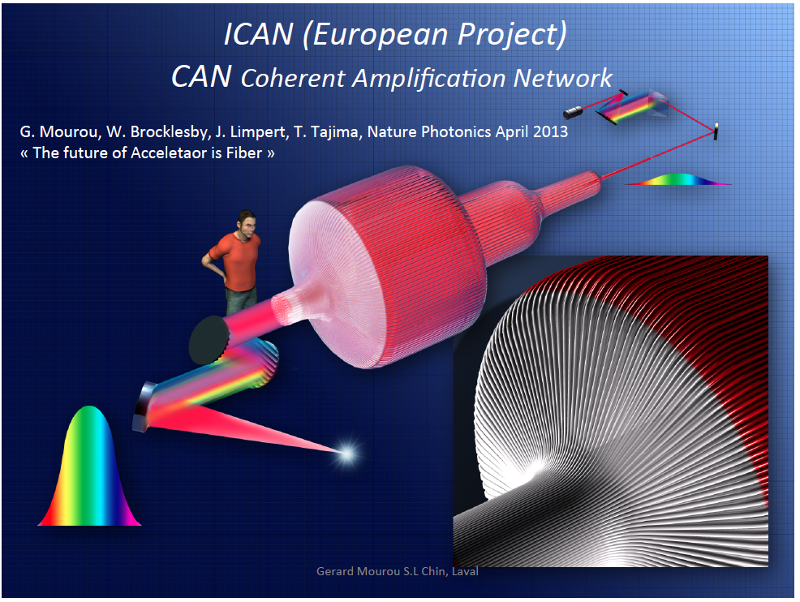

Slide 40
Protons and Ions?

Slide 41
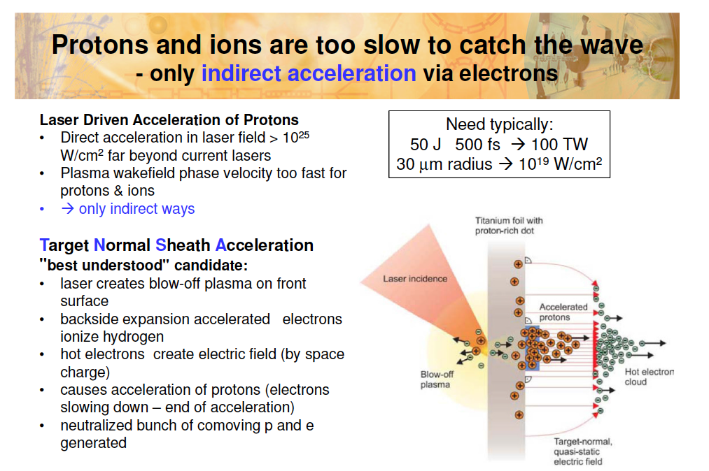

Slide 42
Wake Field Acceleration 2
Beam Driven
PWFA

Slide 43
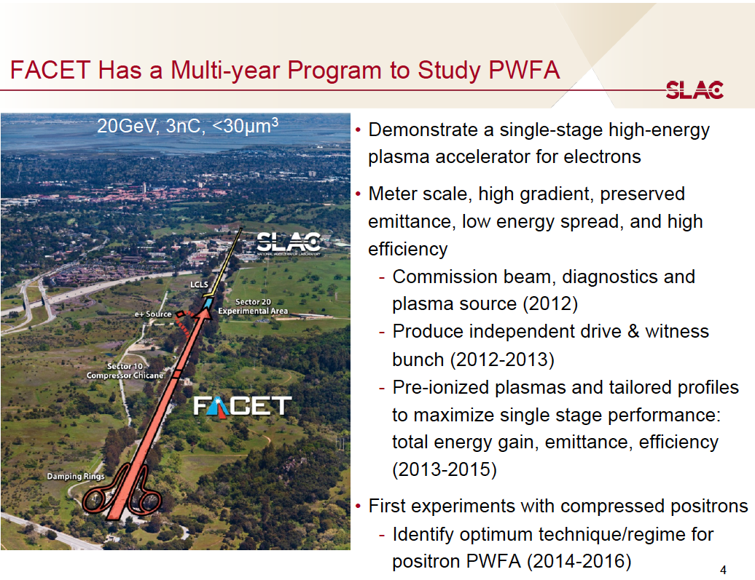

Slide 44
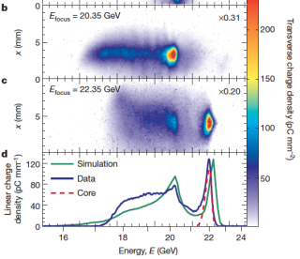
Blumenfeld, I. et al. Energy doubling of 42 GeV electrons in a metre-scale plasma wakefield accelerator. Nature 445, 741–744 (2007).
Litos, M. et al. High-efficiency acceleration of an electron beamin a plasma wakefield accelerator. Nature 515, 92–95 (2014).

Slide 45
Positrons and Hollow Channel Plasma
The physics of accelerating positrons in a plasma is different than that of electrons!
Hollow channel plasmas might be a viable method for accelerating positrons in a plasma.
A special optic called a kinoform is used to create a hollow channel plasma.
Laser Profile for J₅ Bessel Focus
200 μm
Positrons plasma acceleration is a crucial step towards a plasma based linear collider. FACET hosts the only active research on positron PWFA.

Slide 46
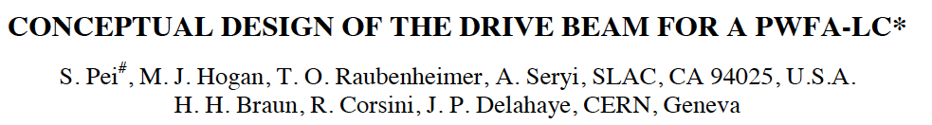
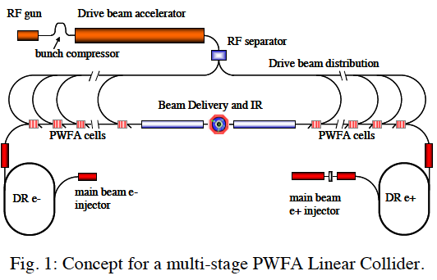

Slide 47



Slide 48

ILC – International Linear Collider

Slide 49


Slide 50


Slide 51


Slide 52


Slide 53
3 Steps towards a reliable PWA
High Gradient – Low e- Beam Quality
High e+e- Beam Quality – Low Gradient
High e+e- Beam Quality - High Gradient

Slide 54

SPARC_LAB
Sources for Plasma Accelerators and Radiation Compton with Lasers And Beams
Thomson X-ray
EOS
FLAME
LWFA
FEL
(2colors)
PWFA
THz Source

Slide 55

Ti:Sa FLAME laser
Stretcher
Amplifiers
Compressor
LWFA
Electron Self Injection
And
Protons

Slide 56





Linac and FEL
150 MeV S-band linac
Velocity Bunching
Diagnostic and Matching
Undulators
λ_{u} = 2.8 cm
K_{max} = 2.2
λ_{r} = 500 nm
12 m
Long Solenoids
S-band Gun
15 m
Seeding
Spectrometer

Slide 57


HB photo- injector with Velocity Bunching

Slide 58


Free Electron Laser

Slide 59


Thomson back-scattering source

Slide 60


Slide 61
Beam Driven Plasma Wake Field Acceleration
(COMB exp.)
Notes:
61

Slide 62
Litos, M. et al. High-efficiency acceleration of an electron beamin a plasma wakefield accelerator. Nature 515, 92–95 (2014).
4-pulses-time-structure
time
In progress at SPARC_LAB
orizontal dim

Slide 63

Laser Comb technique:
generation of a train of short bunches
    - P.O.Shea et al., Proc. of 2001 IEEE PAC, Chicago, USA (2001) p.704. (Low charge regime only)
    - M. Ferrario, et al., Int. J. of Mod. Phys. B, 2006 (High charge, Beam Echo)
Notes:
63

Slide 64

COMB electron beam manipulation

Slide 65

Diagnostics Tools

Slide 66

Four bunches: long. phase space rotation
Measurements with 200pC
Gun energy 5.1MeV
Charge
40pC/80pC/50pC/30pC
Energy 168-109 MeV
Energy Spread <0.8%
Bunch length on crest 2126.3 (8.7) fs
Min. bunch length
168.2 (8.7) fs
Gun ext. phase
35 deg

Slide 67

Three bunches: witness position tuning
+ 1.67 ps
Reference
- 1.67 ps

Slide 68

PWFA interaction chamber
Camera interazione e
Sistemi ancillari di pompaggio e iniezione gas
Gruppo Pompe Vuoto
Sezione Banda C
YAG/OTR actuator
Permanent magnet actuator
YAG/OTR/EOS crystal actuator

Slide 69


Status of the COMB experiment
Vacuum chamber has been designed, ordered and already delivered. First vacuum tests (with capillary, using He and Ar) have been performed.

Slide 70


Status of the COMB experiment
Capillary has been designed and for the moment 3D printer has been used to built it.
However, for the “real” run on the SPARC linac, only the holder will be 3D printed.
Different materials and shapes are overseen to be used, as for example glass, Macor and Sapphire.

Slide 71
Laser Driven Plasma Wake Field Acceleration
(EXIN exp.)
Notes:
71

Slide 72


Slide 73

ExIn interaction chamber
Laser extraction (to diagnostics)
Laser pulse
Target area
Moving mirror with hole
Laser pre-injection diagnostics
e-bunch
Focusing parabola
The interaction chamber is in advanced acquisition and testing stage.
Installation is scheduled within the current year.

Slide 74

Hexapod for the positioning of the capillary
The H-824 is available in vacuum compatible version.
Six Degrees of Freedom (XYZ, Pitch, Roll, Yaw)
Vacuum Compatible Versions
Load Capacity 10 kg
Travel Ranges to 45 mm (linear), 25° (rotation)
7 Nanometer Resolution
300 Nanometer Min. Incremental Motion
Repeatability ±0.5 Micron
Very Compact Design
Self Locking to 10 kg
The hexapod is under test, in the FLAME laboratory, to characterize the features of precision in the positioning of the system

Slide 75


Synchronization System upgrade
Optical reference
  RF reference will be substituted by fiber optical oscillator
  Fiber laser OMO (Optical Master Oscillator) installed and tested
  Systems locked through high resolution optical phase monitors (cross-correlators in house and ready to be tested)
  Fiber link stabilization is ongoing (order placed) to distribute the reference signal
  FLAME laser VS electrons estimated time jitter <50fs_{RMS}
FLAME AREA
FLAME oscillator
79.33MHz
SPARC HALL
PC laser
Oscillator
79.33MHz
OMO
79.33MHz
RF reference
2856MHz

Slide 76

Conclusions

Slide 77


Slide 78

Thank
you

Slide 79




Vorpal simulation: full length of capillary, case 1
Following the previous steps, the “good” simulations over a full length of a capillary. That is, the plasma is simulated to have a density ramp up, 8 mm uniform density length, and then a mirrored density down ramp.
Two cases examined based on the previous results. In the first one the beam is matched for a 1.5 mm gaussian density ramp. Results of this case are shown in this slide. Beam parameters are: 600 pC, 4 mm-mrad normalized emittance, 30 micron rms length, 2 mm waist beta (with no plasma), 110 MeV
Courtesy J. Rosenzweig and S. Barber

Slide 80





Full VORPAL simulations with witness beam, 12 pC, 3 um σ_{ζ}
A 12 pC, 3 micron rms length beam propagates in the plasma, gaining 30 MeV in 8 mm of uniform density plasma (3.75 GeV/m). Emittance grows from ~ 1mm-mrad to 1.5 mm-mrad. RMS energy increases to ~ 4 percent. Note, the beam can be loaded further back in the wake to create larger energy gain.
More charge to flatten wake (watch out for noise).

Slide 81





Vorpal simulations with witness beam, 60 pC, 6 um σ_{ζ}
A 60 pC, 6 um rms length beam propagates in the plasma wake, gaining 45 MeV in 8 mm of uniform density plasma (5.6 GeV/m). Emittance grows from ~ 1mm-mrad to 1.6 mm-mrad. RMS energy increases to ~ 4 percent. This beam is loaded slightly further back in the wake compared to the previous example, hence the larger energy gain
Witness beam is strongly mismatched, but causes not major problem.

Slide 82
Drivers and witness bunches generation
Energy partition
HWP
PBS
CPA Ti:Sapphire + harm. gen.
Periodic multibunch
drivers
αBBOs
Variable delay
witness
HWP
Motorized stage
to the photocathode
PBS
half drivers energy
Courtesy F. Villa

Slide 83

Comb beam manipulation
Gun focusing field (~3kG)
Emittance
Bunches current, length
Accelerating field
(inj. phase)
Energy spread sub-bunch
Accelerating field
(inj. phase)
Energy separation
Inj. phase
Bunch spacing
Train length
TW focusing field (~300G)
Emittance
Bunches current, length and their max compression phase
Gun inj. phase and space charge
Bunches distance at the linac entrance
Energy spread

Slide 84




Matching strategies for external injection
Simulation settings
We assume linear tapering for sake of simplicity. The incoming bunch is an ideal one with bi-Gaussian profiles, 17 fs long (FWHM), 5.5 μm wide (rms), 10 pC charge and 1 μm normalized emittance.
Capillary tips shaping can be a way to modulate both laser convergence (divergence) and plasma ramping.
θ_{in}
L₁ = 2 cm
L_{acc} = 3 cm
L₂ = 4 cm
θ_{out}
L₁
L_{acc}
L₂
Andrea R. Rossi
Laser Plasma Acceleration Workshop, May 11th 2015

Slide 85


Matching strategies for external injection
Simulation results: matching and focusing/defocusing
Energy gain is in excess of 200 MeV in a 3 cm acceleration length, which means an average electric field in excess of
7 GV/m
Energy spread is within 1% (a safe threshold for subsequent transport*) and REDUCED IN THE FINAL RAMP due to beam loading and plasma wavelength increase.
* P. Antici et al., J. App. Phys. 112, 044902 (2012).
σ_{tr} ≈ 5.5 μm (in/out)
ε_{n}≈ 1.1μm
E_{final}=300 MeV
A very nice matching is obtained by laser focusing method.
Beam size is reduced to matched size and then increased back to initial value in a quasi-adiabatic transformation.
Both initial and final sizes seems to be within manageability of permanent magnet quads.
ΔE/E = 0.9%
Andrea R. Rossi
Laser Plasma Acceleration Workshop, May 11th 2015

Slide 86


Dielectric Wakefield Accelerator
*
Electron bunch (β ≈ 1) drives wake in cylindrical dielectric structure
  Dependent on structure properties
  Generally multi-mode excitation
Wakefields accelerate trailing bunch
Mode wavelengths (quasi-optical
Design Parameters
Peak decelerating field
Extremely good
beam needed
Transformer ratio (unshaped beam)
Ez on-axis, OOPIC

