Slide 1
Workpackage 1 presentation
Christoph Schwanda
Institute of High Energy Physics
Austrian Academy of Sciences
JENNIFER Consortium General Meeting
INFN Roma Tre, June 10-12, 2015

Slide 2
Outline
Introduction to the Belle II and WP1
Belle II offline software
Physics analysis tools
The Belle II physics case
Deliverables and milestones

Slide 5

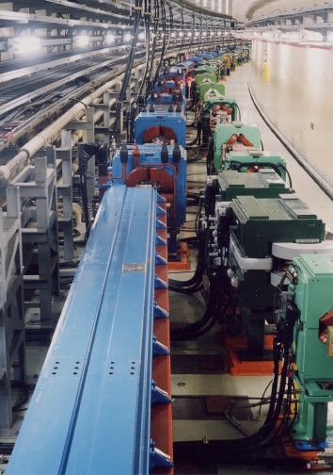
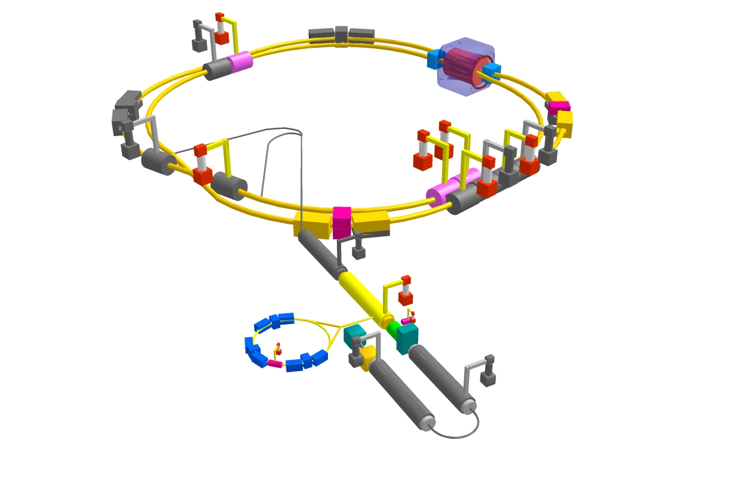

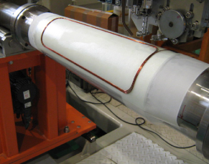

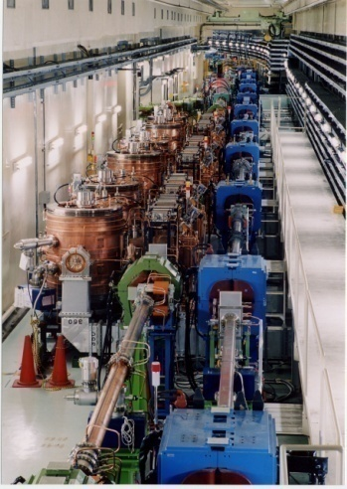

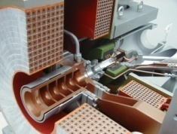
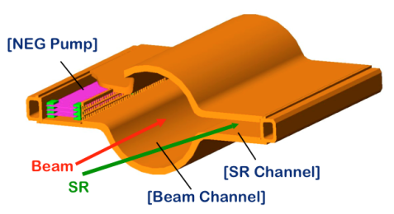
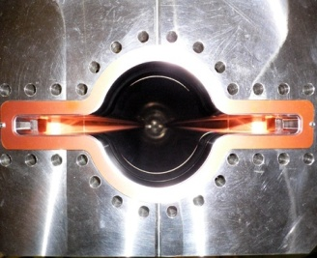
From KEKB to SuperKEKB
Belle II
Colliding bunches
New IR
e⁻ 2.6 A
New beam pipe
& bellows
New superconducting /permanent final focusing
quads near the IP
e⁺ 3.6 A
Replace short dipoles with longer ones (LER)
Add / modify RF systems for higher beam current
Low emittance positrons to inject
Positron source
Redesign the lattices of HER & LER to squeeze the emittance
Damping ring
New positron target / capture section
TiN-coated beam pipe with antechambers
Low emittance gun
Low emittance electrons to inject

Slide 6
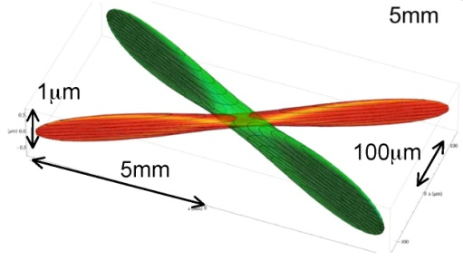
SuperKEKB machine parameters
parameters |  | KEKB |  | SuperKEKB |  | units
 |  | LER | HER | LER | HER
Beam energy | Eb | 3.5 | 8 | 4 | 7 | GeV
Half crossing angle | φ | 11 |  | 41.5 |  | mrad
Horizontal emittance | εx | 18 | 24 | 3.2 | 5.0 | nm
Emittance ratio | κ | 0.88 | 0.66 | 0.27 | 0.25 | %
Beta functions at IP | βx*/βy* | 1200/5.9 |  | 32/0.27 | 25/0.31 | mm
Beam currents | Ib | 1.64 | 1.19 | 3.60 | 2.60 | A
beam-beam parameter | ξy | 0.129 | 0.090 | 0.0886 | 0.0830
Luminosity | L | 2.1 x 10³⁴ |  | 8 x 10³⁵ |  | cm⁻²s⁻¹
-
σ_{x}~10μm,σ_{y}~60nm
Small beam size (“nano-beam”) and
higher currents to increase luminosity
Smaller boost to improve LER lifetime
e⁻
60nm
10μm
e⁺

Slide 7
→ See presentation on WP2 by HGM

Slide 10
Objectives of JENNIFER WP1
Develop, implement and optimize the software tools and algorithms needed for performing physics analysis at the Belle II experiment
Re-examine and strengthen the physics case of the Belle II experiment through collaboration with theorists
Share knowledge about software tools and physics opportunities at Belle II amongst participants, provide training for ESRs on these topics

Slide 11
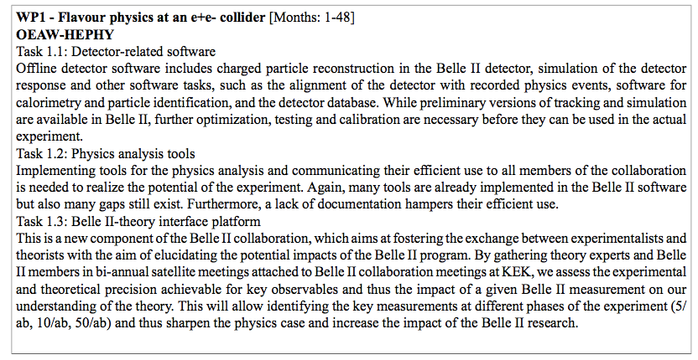
Tasks in WP1

Slide 12
Partners in WP1
 | Person months
OEAW-HEPHY (LB) | 2
INFN | 19
DESY | 25
IFJ PAN | 5
UKP | 3
JSI | 7
METU | 2
CNRS | 1

Slide 13
Offline software

Slide 14
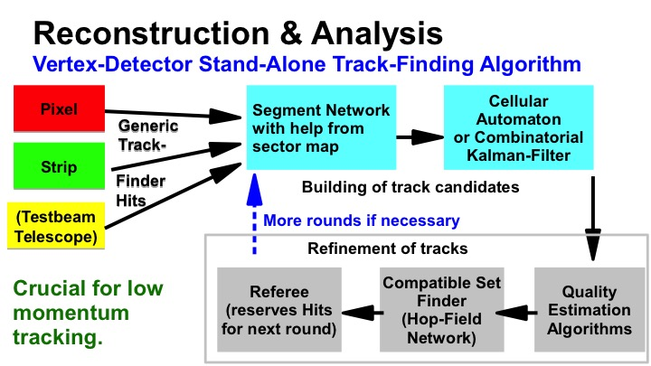

Slide 18
Physics analysis tools

Slide 21
Belle ii physics and The belle ii theory interface platform (b2tip)

Slide 22
Physics during phase 2 commissioning

Slide 27
B2TIP timeline

Slide 30
wp1 secondments

Slide 31
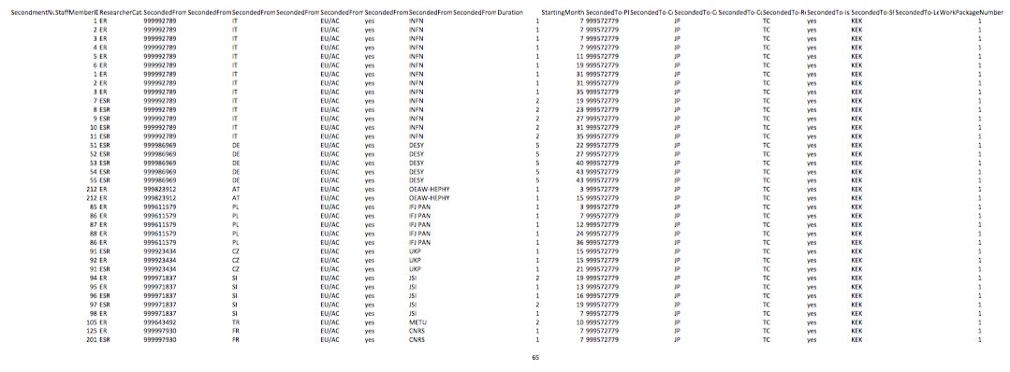
Two secondments (OEAW-HEPHY,
IFJ PAN) now about to start in June 2015

Slide 32
Deliverables and milestones

Slide 33
D1.1: “Offline workshop”
“Annual workshops amongst the participants to discuss the status of offline software, outstanding issues and possible improvements, and to exchange knowledge amongst involved researchers (months 12,24,36,48)”
Due: Apr 2016
Status: Usually we have two workshops per year, one in spring and one attached to the autumn B2GM (but not sure we will have one this year in October). List of previous workshops: http://kds.kek.jp/categoryDisplay.py?categId=502. In May 2016 we will have a workshop at PNNL.

Slide 34
D1.2: “Belle II Tutorials”
“Tutorial courses for Belle II members (especially ESRs) attached to Belle II collaboration meetings, to demonstrate the use of physics analysis tools (months 12, 24, 36, 48).”
Due: Apr 2016
Status: Tutorial are held at least once a year. Most of them are in: http://kds.kek.jp/categoryDisplay.py?categId=503. The next one is in two weeks at the B2GM.

Slide 35
D1.3: “Reference guide”
“Writing and maintaining a reference data reconstruction and analysis tools guide (months 36, 48).”
Due: Apr 2018
Status: Ideas exist, but no fixed plans in the software group. Apr 2018 seems a good target date. The main components of the software should be more or less ready by that date and a guide would be useful for the preparation of data taking.

Slide 36
D1.4: “B2 Yellow Report”
“Belle II Yellow Report summarizing all important observables and including a milestone table, clarifying the targets for the first 5/ab, 10/ab as well as for the final goal at 50/ab.”
Due: Apr 2017
Status: This corresponds exactly to the B2TIP effort which is expected to converge (in a report) by the end of 2016. The due date thus is realistic.

Slide 37
MS2: “Belle-II Yellow Report”
Due: Apr 2017
Corresponds exactly to D1.4

Slide 38
Summary
WP1 deals with Belle II offline software, physics analysis tools and physics preparations for Belle II
Secondments are reconfirmed, at least for the first year of JENNIFER.
There is a plan for the preparation of the deliverables/milestone. Due dates appear to be realistic at this point.

