Slide 1
Jennifer Activities: WP2
B factories
- results and motivation for upgrade
SuperKEB
- how to reach 40x more luminosity
Belle II
- upgrade of the Belle detector to cope with 40x more luminosity
Jennifer WP2: tasks and deliverables
Tracking
Particle ID (Alessandro Gaz)
Forward electromagnetic calorimeter (Claudia Cecchi)
Luminosity monitors (Cecile Rimbaud)
Organisation/Schedule

Slide 2
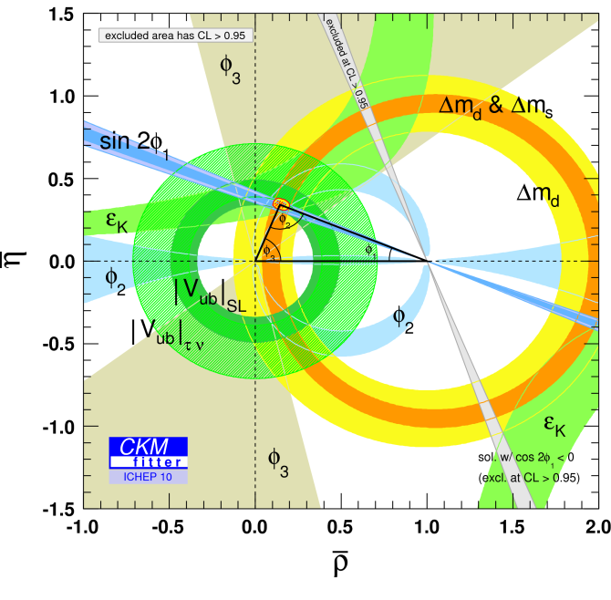
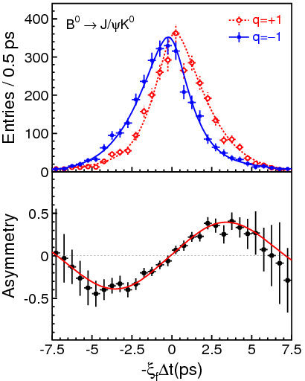
B-factory Detectors – a huge success!
Measurements of CKM matrix elements and angles of the unitarity triangle
Observation of direct CP violation in B decays
Measurements of rare decays (e.g., B→τν, Dτν)
b→s transitions: probe for new sources of CPV and constraints from the b→sγ branching fraction
Forward-backward asymmetry (A_{FB}) in b→sll has become a powerfull tool to search for physics beyond SM.
Observation of D mixing
Searches for rare τ decays
Observation of new hadrons
_
B⁰ tag
B⁰ tag

Slide 3
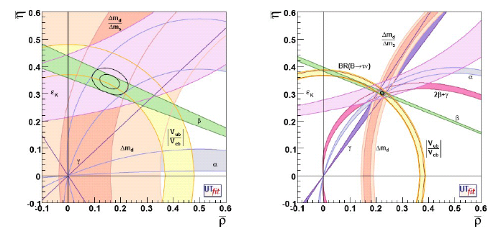
Motivation for Upgrade
Measure CKM elements as precisely as possible
Overconstrain unitarity triangle
Look for deviations from SM
=> Need about 50 ab⁻¹
Φ₁/β = (21.±1 0.9)º
Φ₂/α = (88.4 ±5.6)º
Φ₃/γ = (70 ±29)º
Babar/Belle
With 50 ab⁻¹ (same central values)

Slide 4


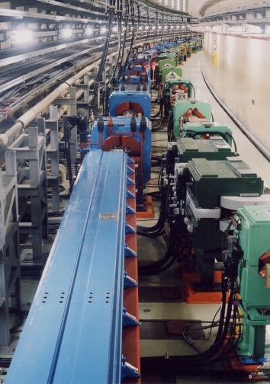
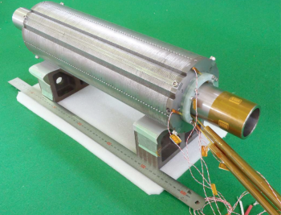
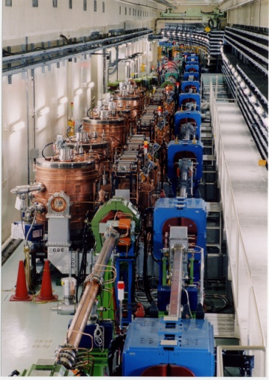
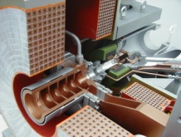
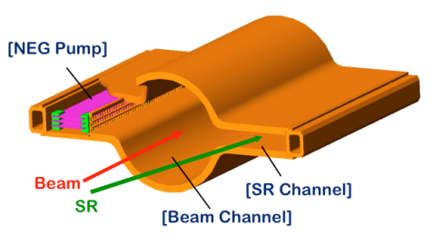
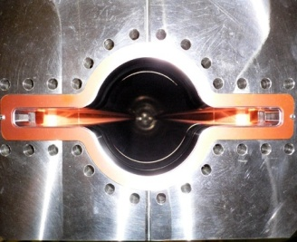
KEKB to SuperKEKB
e- 2.6 A
Colliding bunches
New beam pipes
& bellows
e+ 3.6 A
New superconducting final focusing magnets near the IP
Reinforce RF systems for higher beam currents
Improve beam monitors and control system
Redesign the lattice to squeeze the emittance (replace short dipoles with longer ones, increase wiggler cycles)
e+ Damping ring
New positron capture section
Replace beam pipes to suppress electron cloud (TiN-coated beam pipe with antechambers)
Low emittance electron gun
To get x40 higher luminosity

Slide 5
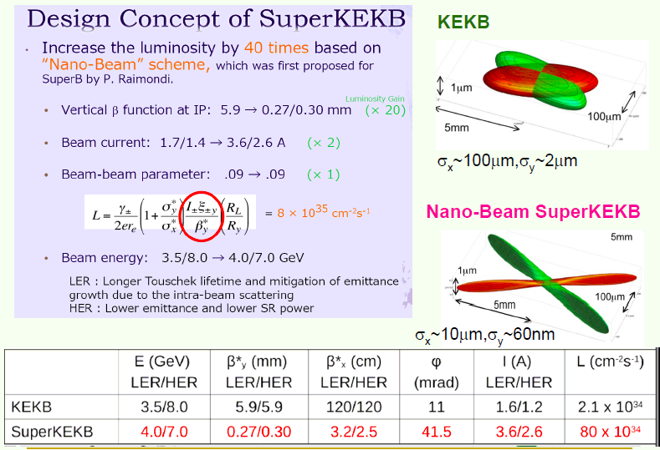
Luminosity Upgrade

Slide 6
Requirements for the Belle II detector
Critical issues at L= 8 x 10³⁵/cm²/sec
4 Higher background ( ×10-20)
4 Higher event rate ( ×10)
4 Special features required
radiation damage and occupancy
fake hits and pile-up noise in the EM Calorimeter
- higher rate trigger, DAQ and computing
- γβ reduced by a factor of 2: compensated by improved vertexing
Result: significant upgrade

Slide 7
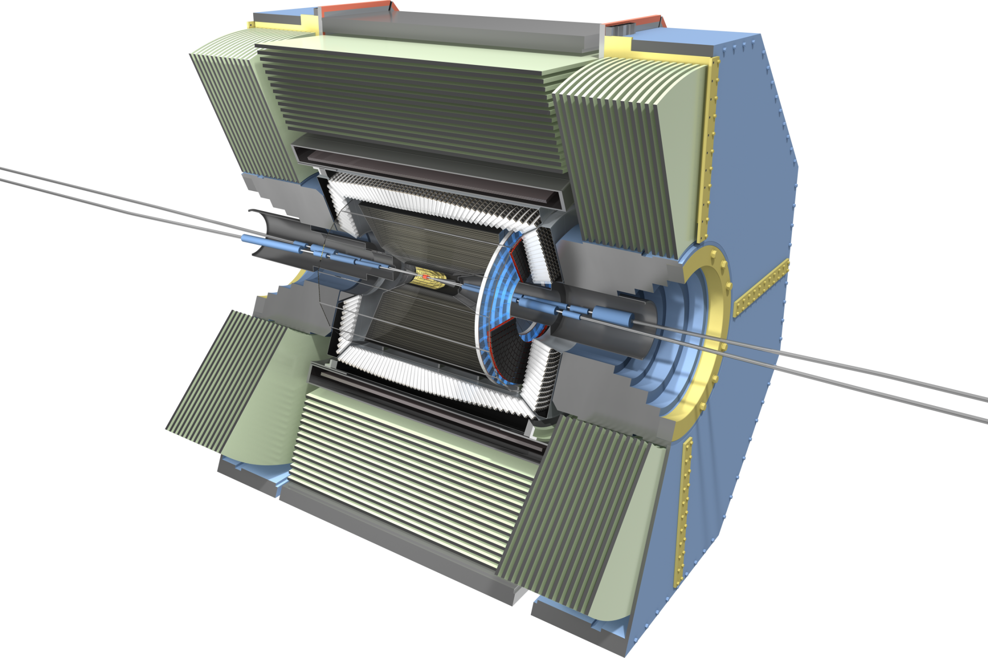
Belle II
CsI(Tl) EM calorimeter:
waveform sampling
electronics, pure CsI
for end-caps
7.4 m
RPC µ & K_{L} counter:
scintillator + Si-PM
for end-caps
4 layers DS Si Vertex
Detector →
2 layers PXD (DEPFET),
4 layers DSSD
8.0 m
Time-of-Flight, Aerogel
Cherenkov Counter →
Time-of-Propagation counter
(barrel),
prox. focusing Aerogel RICH
(forward)
Central Drift Chamber:
smaller cell size,
long lever arm

Slide 8
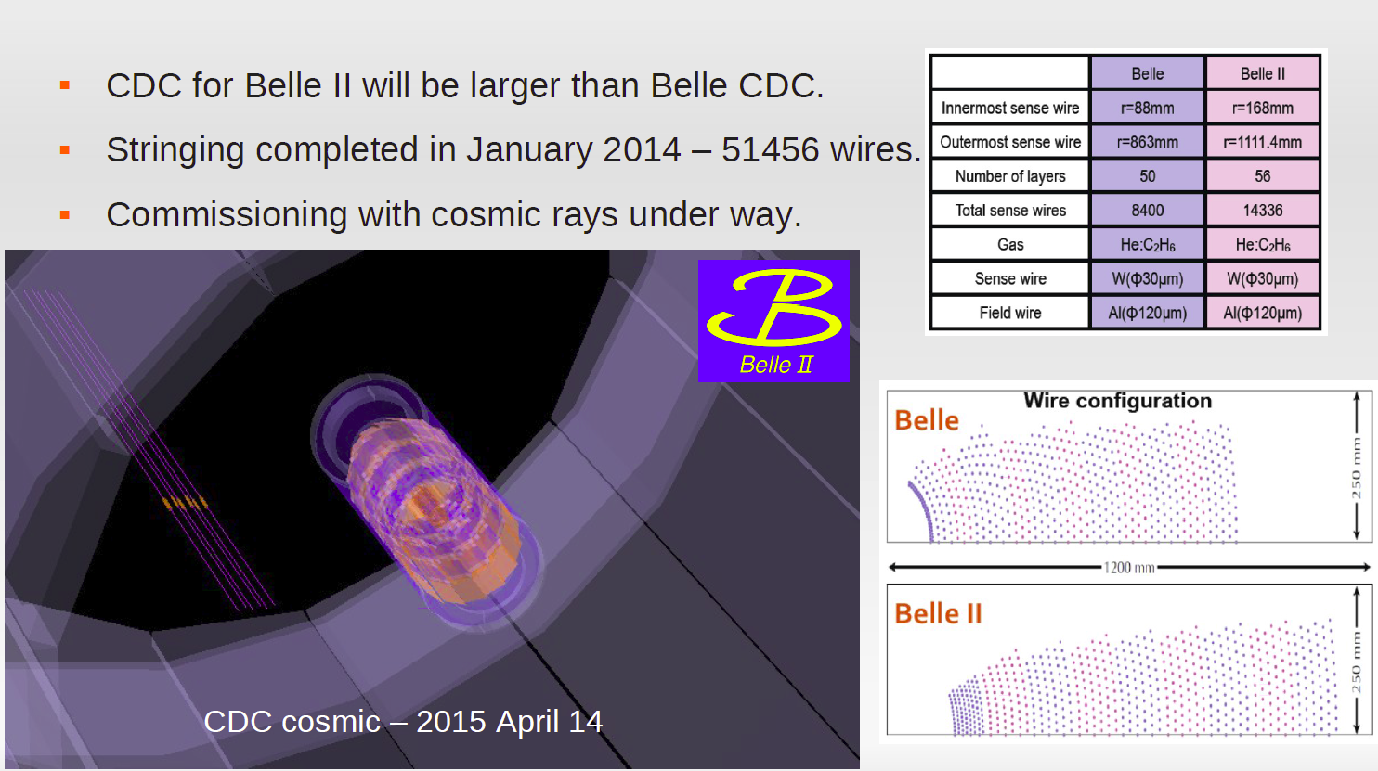
CDC
Smaller Cell size (1-20mm => 6-9 mm) all 51456 wires strung by last summer

Slide 9
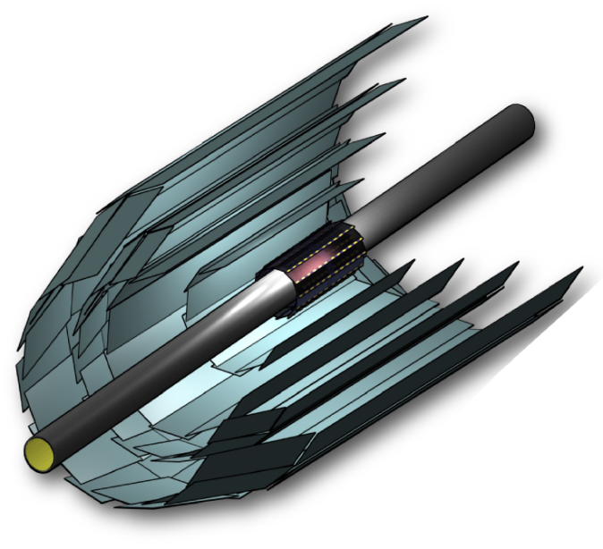
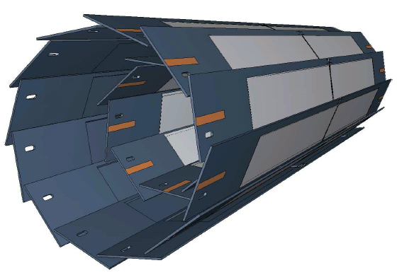
Silicon Tracking System @ Belle II
SVD: 4 layer Si strip detector (DSSD)
(R = 3.8, 8.0, 11.5, 14.0 cm)
PXD: 2 layer Si pixel detector (DEPFET technology)
(R = 1.4, 2.2 cm)
monolithic sensor
thickness 75 µm (!),
pixel size 50 x 55 µm² to 50 x 85µm² (depending on layer and z)
Significant improvement in z-vertex resolution
σ [µm]
PXD
PXD+SVD
100
Belle
50
30μm
20
Belle II
15μm
0
0.4
0.8
1.2
1.6
2.0
pβsin(θ) [GeV/c]

Slide 10
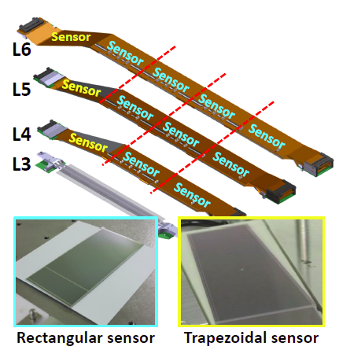
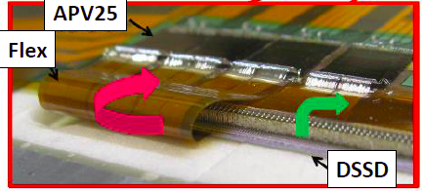
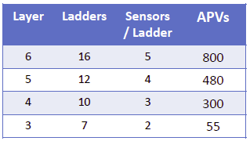
SVD
4 layers of double sided silicon detectors
P-strips 50 – 75 µm pitch
N-strips: 240 µm pitch
Backside side readout signal routed to frontside
by a flex circuit
Low material budget (0.58% X0 /Layer)
Readout chip: APV (originally for CMS)
Very fast readout to cope with occupancy

Slide 11
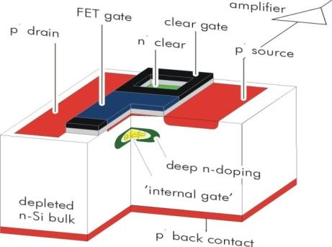

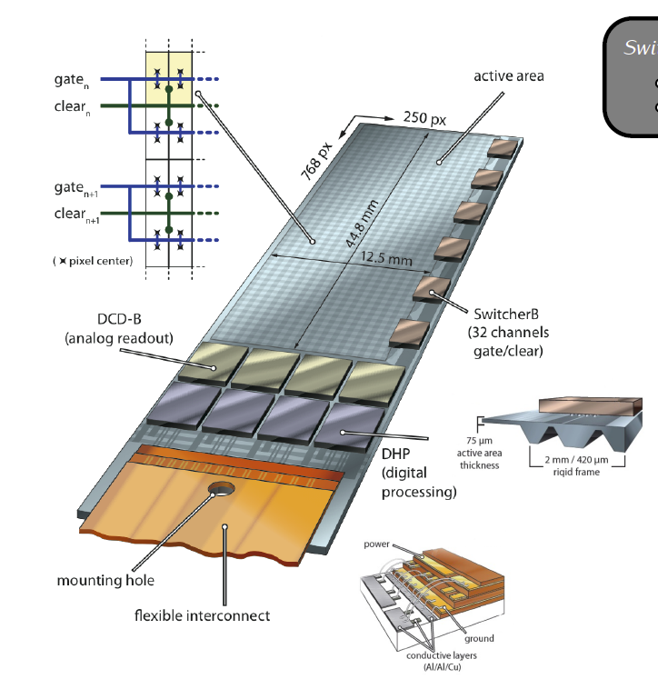
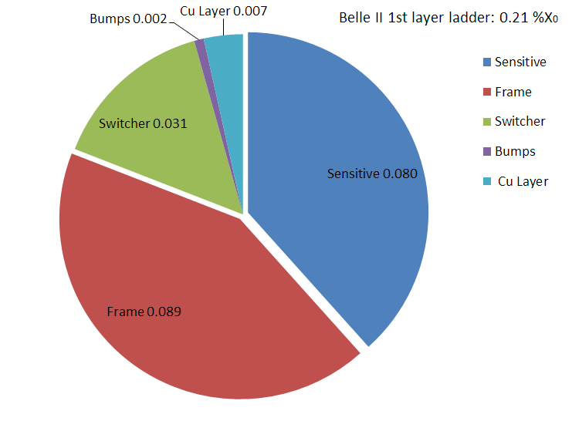
DEPFET
Each pixel is a p-channel FET on a completely depleted bulk
Signal electrons accumulate in the internal gate and modulate the transistor current (g_{q} ~ 400 pA/e⁻)
Fully depleted: large signal, fast signal collection
Low capacitance, internal amplification: => low noise
Rolling shutter mode (column parallel): 20 µs frame readout time
Sensitive area thinned to 75 µm with a rigid support frame (all silicon module)
Low power consumption within sensitive area (air cooling)
Low material to reduce multiple scattering (0.21% X₀)

Slide 12
WP2 Tasks and Deliverables
WP2 - Belle-II detector construction and test [Months: 1-48]
Task 2.1: Forward Electromagnetic Calorimeter [INFN, KEK]
Task 2.2: Tracking detectors [DESY, HEPHY, INFN, METU, IFJ, UKP, KEK]
Task 2.3: Particle Identification [INFN, JSI, KEK]
Task 2.4: Luminosity monitor [CNRS, KEK]
Number Deliverable Lead beneficiary Due Date (in months)
D2.1 FW ECL TDR 1 INFN (10) Jan 2016
D2.2 Commissioning Report FW ECL INFN (48) Mar 2019
D2.3 CDC commissioning METU (14) May 2016
D2.4 PXD White-book 2 DESY (20) Nov 2016
D2.5 SVD+PXD full commissioning DESY (30) Sep 2017
D2.6 TOP commissioning INFN (36) Mar 2018
D2.7 ARICH JSI (26) May 2017
D2.8 Diamond sensor CNRS (36) Mar 2018
WP2: 227 months of secondments (~20 FTE)

Slide 13
Task 2.2 Tracking Detectors
Task 2.2 Tracking Detectors
Full CDC commissioning: (14) May 2016
Cosmic ray test of CDC modules in the Belle II area (6) Sep 2015
Installation of CDC chambers in Belle II (10) Feb 2106
CDC cosmic ray test inside Belle II, with and without magnetic field (12) Mar 2916
PXD Whitebook, “PXD technology, procedure and operation” (20) Nov 2016
Full integration and commissioning of SVD+PXD inside Belle II detector: (30) Sep 2017
First data with 1 VXD (4 SVD+ 2 PXD) Sector (14) May 2016
First cosmic data with SVD+PXD (16) Jul 2016
First beam data with SVD+PXD and all other Belle II sub-detectors (20) Nov 2016
A 4-layer DSSD Vertex Detector integrated in the Belle II tracking system (24) Mar 2017
Environmental monitoring for SVD and Belle II radiation protection system (24) Mar 2017
Jennifer Institutes:
HEPHY (Austria), INFN (Italy), METU (Turkey), IFJ (Poland), UKP (Czech), DESY [DESY, Uni Bonn, Uni Giessen, Uni Heidelberg, MPI] (Germany)
135 months of secondments for 2.2

Slide 14
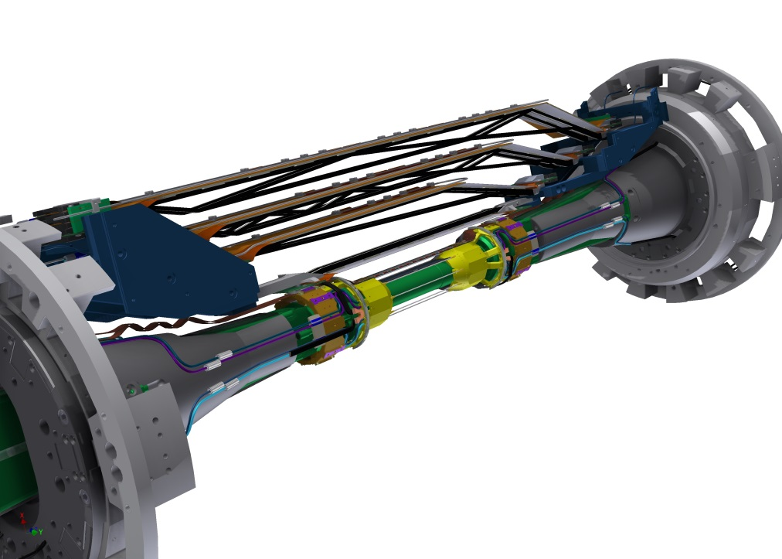

Beast II
Subtask 2.2.1: First data with 1 VXD (4 SVD+ 2 PXD) Sector
Main purpose of Beast II:
Beam conditioning to start collisions
Background measurements and mitigation
Belle II commissioning with partial VXD sensors
Optimization of interlock system
Installation of
2 PXD & 4 SVD layers
(& other specific sensors for background determination)
Beast II: May – December 2017

Slide 15
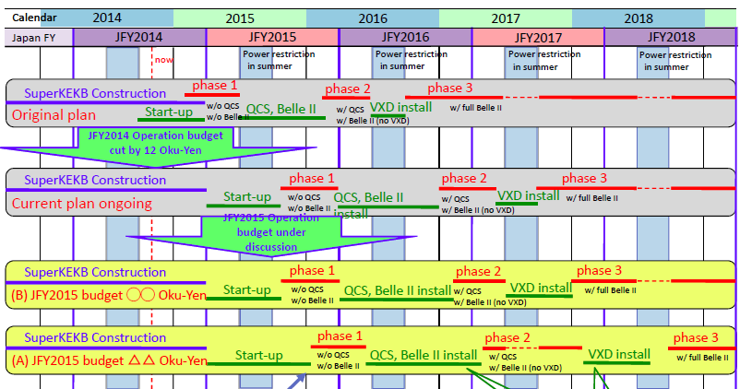
SuperKEKB Cchedule
To budget problems up to 1 year delay (especially VXD installation and physics)

Slide 16
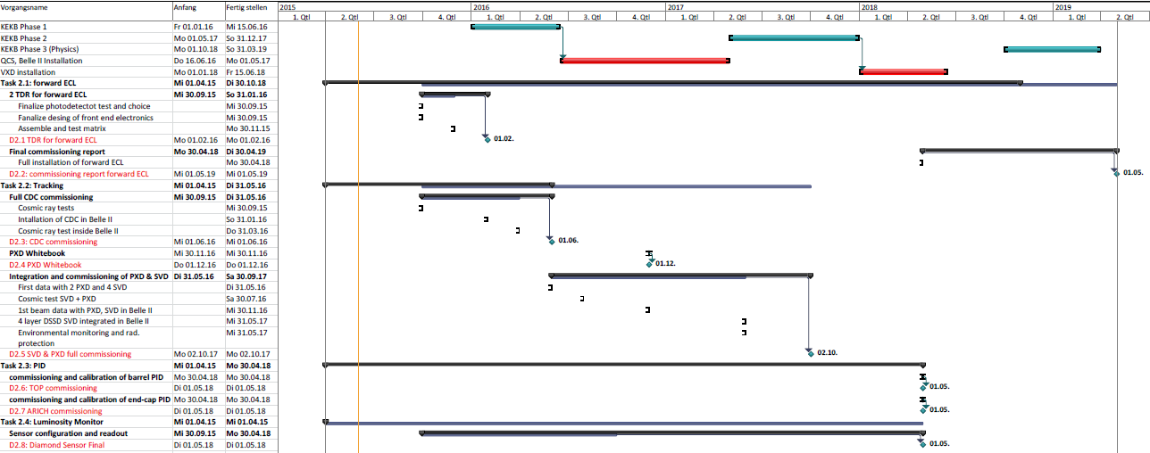
Implications for Jennifer
Schedule changes:
CDC cosmic ray tests (Jennifer Sept. 2015) => May 2016?
CDC installation (Jennifer: January 2016) => August 2016
CDC cosmic ray tests in Belle II (Jennifer: March 2016) => December 2016
CDC fully commissioning (Jennifer May 2016) => March 2017 ?
VXD sector test (Beast II) (Jennifer: May 2016) => May 2017 ?
Full VXD cosmic test (Jennifer: July 2016) => 2nd half of 2017 ?
1st beam with VXD in Belle II (Jennifer: November 2017) => October 2018
For other tasks (PID, ECL, lumi): see next talks

Slide 17
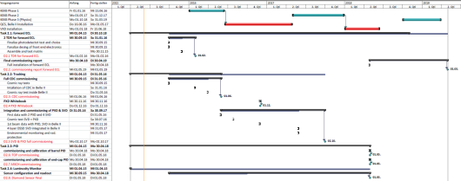
Conclusions
Belle II will be a key player in flavour physics and CP violation
Very challenging upgrade program of the detector
Jennifer supports essential parts of the detector upgrade program
227 months of secondments (20 FTE !)
Due to the latest schedule changes of superKEKB/Belle II some adaptations of the Jennifer deliverables (dates) are needed (mostly tracking detectors)

