Slide 1
Beam-Beam Simulations to Optimize DAΦNE e- Working Point
D.Shatilov (BINP), M.Zobov, C.Milardi (INFN/LNF), A.Valishev (FNAL)
April 23, 2015

Slide 2
Motivation
Collider performance is affected by interplay of beam-beam and machine optics features
Nonlinearities
Coupling (including IR with solenoidal field)
Chromaticity
Imperfections
Our goal was to implement the complete model of DAΦNE in weak-strong beam-beam simulation in order to guide parameter optimization

Slide 3
Model Development
In 2013-2014, Lifetrac functionality was expanded to include the full treatment of machine lattice
Tracking through arcs is performed element-by element
Lattice is imported directly from MAD-X model
All main magnets + multipoles, solenoids, fringe fields, orbit
Main IP inside of a solenoid
We compare the full treatment of machine with previously used approach (arcs=linear maps)
Analysis tools – FMA, DA, Specific Luminosity and Beam Lifetime

Slide 4
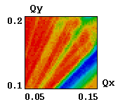
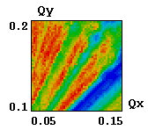
e⁺ Working Point Scan
Luminosity Inverse beam sizes
e+ ΔQx=0.0980; Qx=0.1305

Slide 5
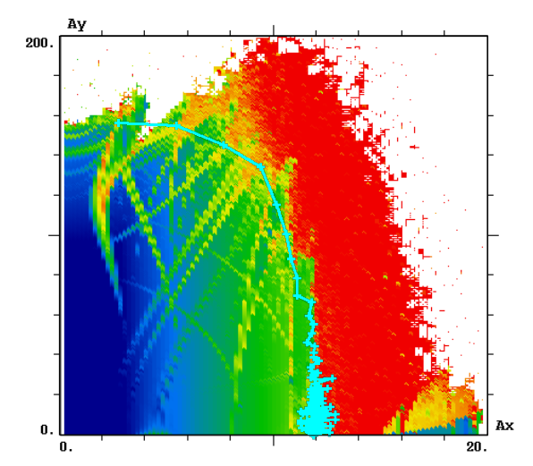
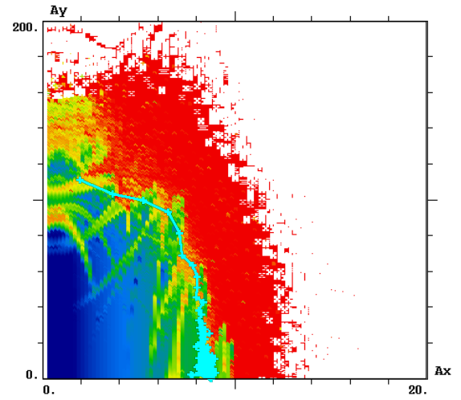
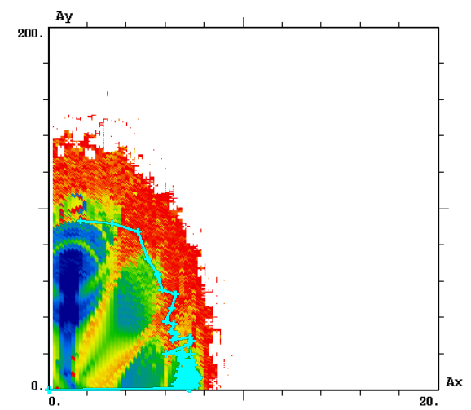
Electron Ring Dynamical Aperture
As=1
As=5
As=9

Slide 6
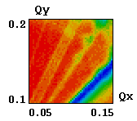
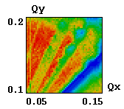
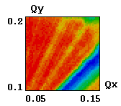
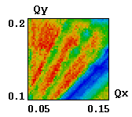
e⁻ Tune Scan
(0.130, 0.170)
Linear model
(0.088, 0.152)
Luminosity Inverse beam sizes
Nonlinear model

Slide 7
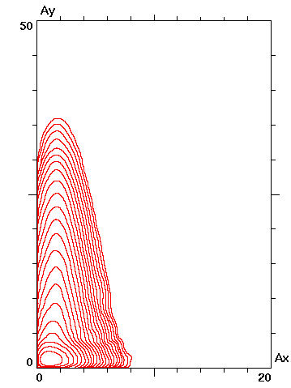
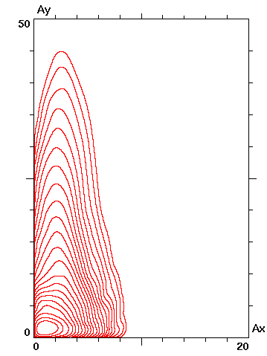
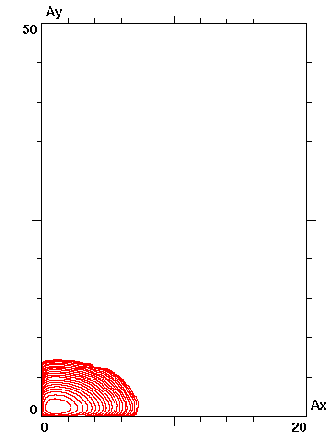
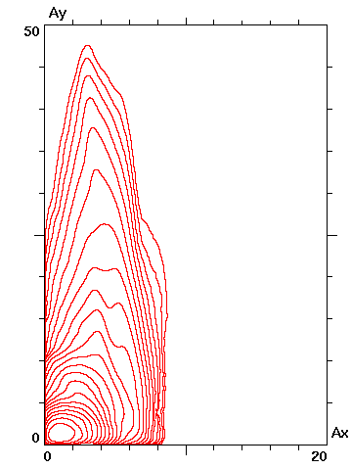
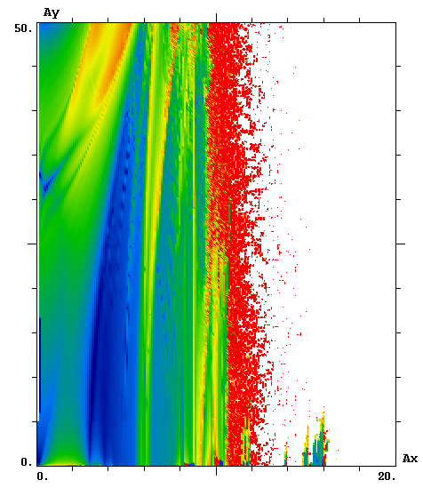
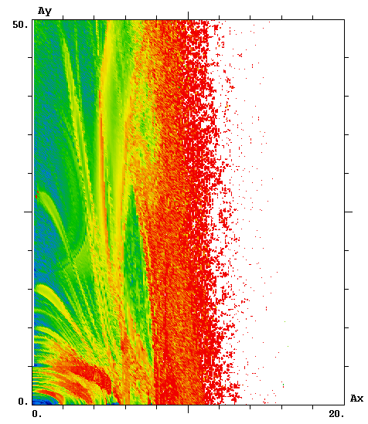
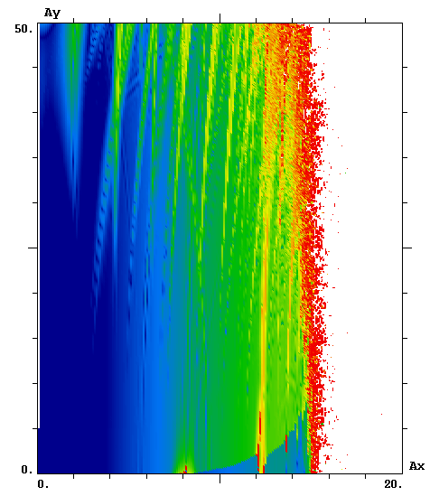
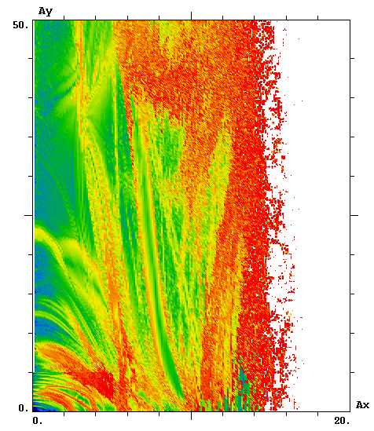
(0.088, 0.152)
(0.130, 0.170)
BB Off BB On BB Off BB On
L_{p} = 7.26⋅10¹³
L_{p} = 7.47⋅10¹³
FMA for A_{s} = 2 sigma

Slide 8
Summary
The simulated e- Dynamical Aperture is similar to that simulated and measured in previous KLOE run.
The simulation using complete machine model indicates that the present e+ working point is optimal.
For the e- ring, we suggest to move the working point to higher tunes:
Moderate increase in luminosity is possible (up to 5%)
More importantly, the DA will increase, which will result in better beam lifetime, injection efficiency, and background.

