Slide 1
STATUS OF MECHANICAL STUDIES FOR THE FORWARD LYSO CALORIMETER
C. Cecchi University of Perugia and INFN

Slide 2
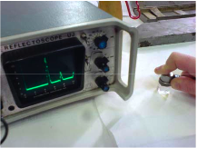
Test to measure elastic properties along cut direction.
Non destructive measurement of the elastic module
Via ultrasounds qualitative investigation of crystals high anisotropy has been observed

Slide 3
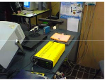
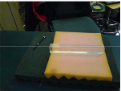
2) Quantitative measurements with Laser vibrometer for Laser Doppler Vibrometry (LDV) Hammer with charge amplifier
  Measurement of the velocity of the propagation of the perturbation induced by the hammer along the longitudinal dimension of the crystal
  4200m/s --> 131 ±12 GPa

Slide 4
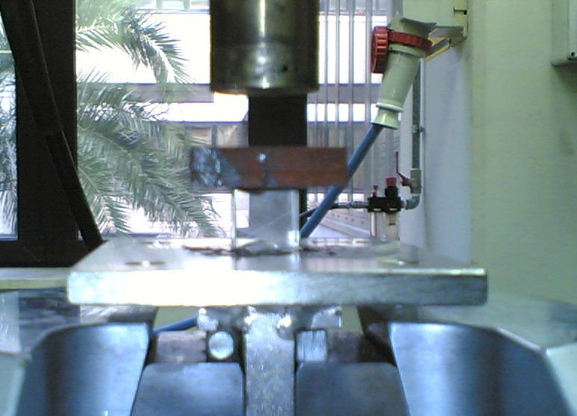
Compression tests
Foam
crystal

Slide 5
LSO orientation unknown

Slide 6
ULTIMATE STRENGTH: 300 MPa
ELASTIC MODULE E = 3.98 - 4.05 GPa

Slide 7
ULTIMATE STRENGTH: 407 MPa
ELASTIC MODULE E = 5.44 – 5.48 GPa

Slide 8
Comparison with PbWO:
Ultimathe strength: is 1 order of magnitude less in PbWO than in
LSO (18 – 30 MPa)
But the used technique is different (bending test).
This test is not possible on long sample such as the two used crystals
(20 cm long).
Elastic module: PbWO litterature 70/80 Gpa
measured 130 GPa

Slide 9
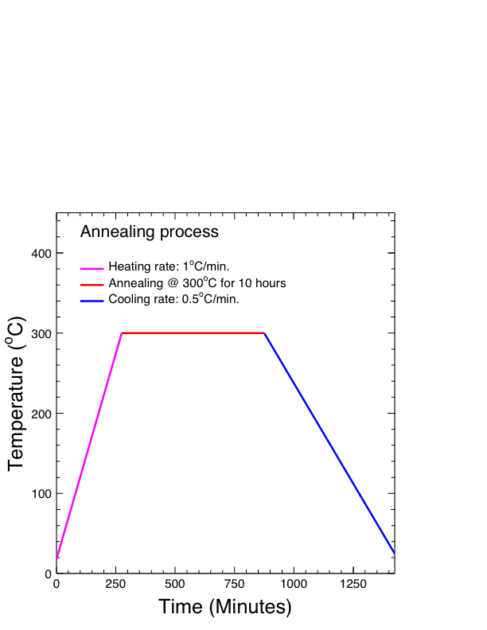
LSO seems to be very hard crystal even with a very low elastic module.
The only conclusion: they have a good resistance to compression
New test on bigger sample: 13 pcs with known orientation to be
delivered on February 20.
Start with annealing on a sample
of them @ ENEA Casaccia
by the end of February

Slide 10
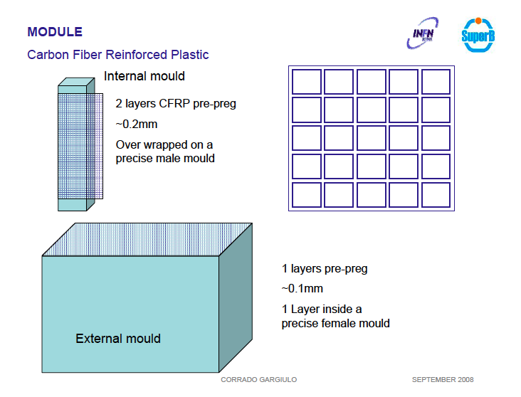

Slide 11
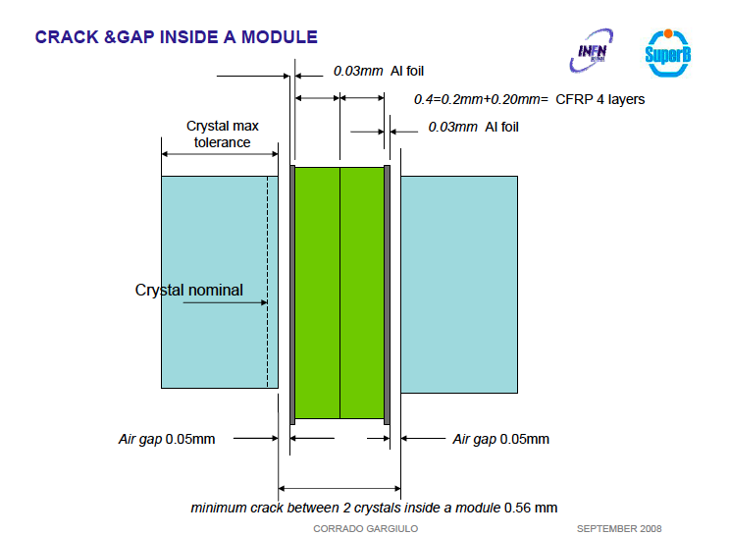

Slide 12
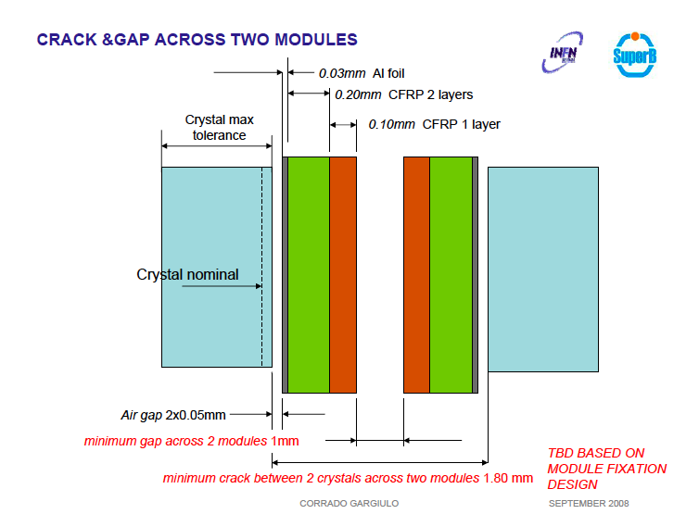

Slide 13
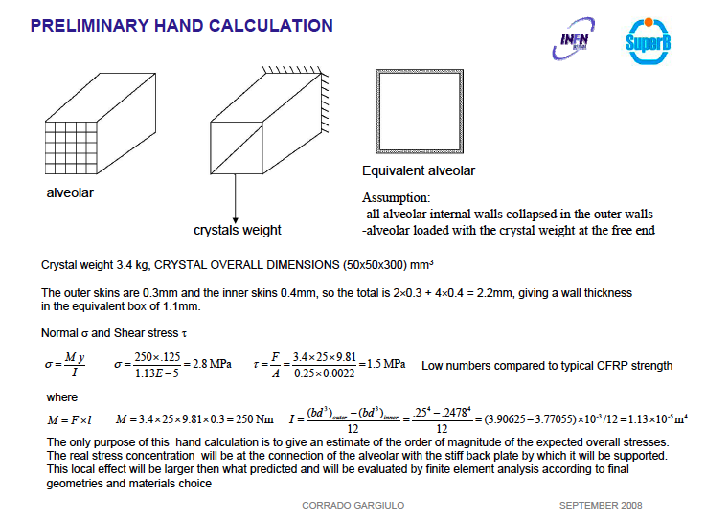

Slide 14
