Slide 1
OVERVIEW for a possible BEAM TEST site for EMC forward
Claudia Cecchi
University of Perugia and INFN

Slide 2
LIST OF POSSIBLE SITES FOR THE BT
CERN
FRASCATI
DESY
BEIJING (proposed by Renyuan)

Slide 3
CERN

Slide 4
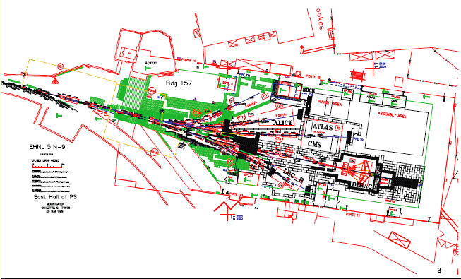

Slide 5
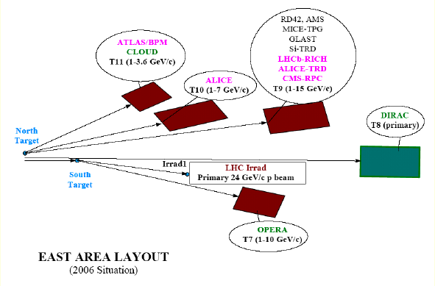

Slide 7
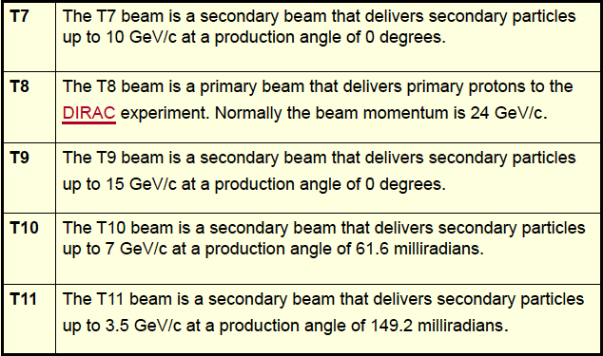
BEAM CHARACTERISTICS

Slide 8
INFRASTRUCTURES
What is (could be ) provided
Counting houses (barracks) with racks and network connections
Beam instrumentation:
Scintillator for beam intensity measurment
XDWC for beam profile measurement
Threshold Cherenkov counter for particle ID
Scanning table (XSCA) shared with SPS North Area users
Magnets

Slide 9
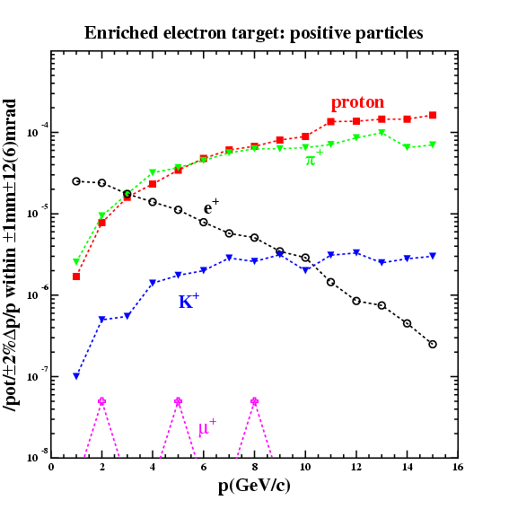
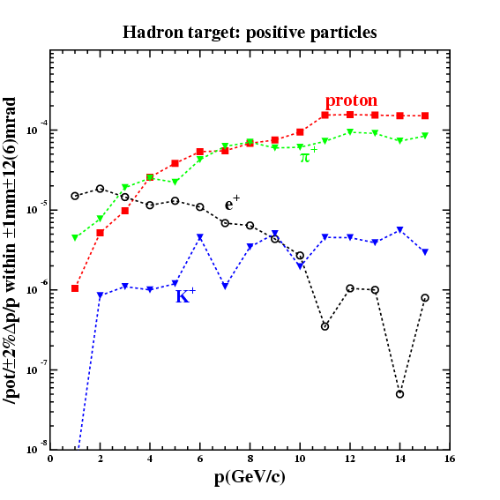
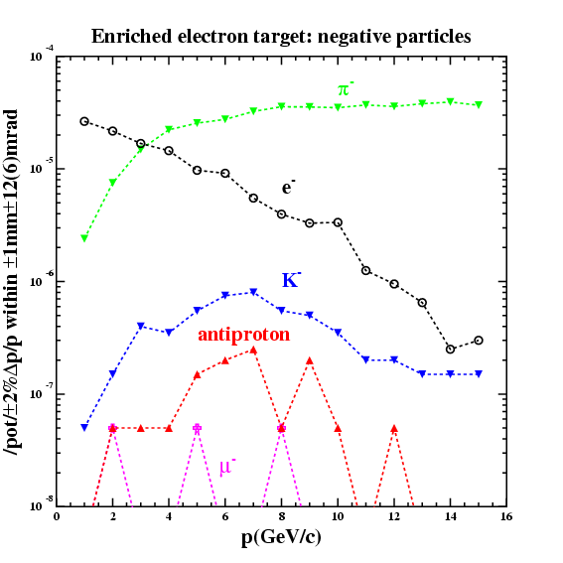
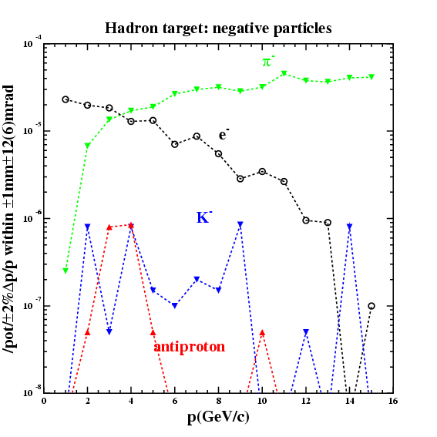
T9 Particle type and intensity

Slide 10
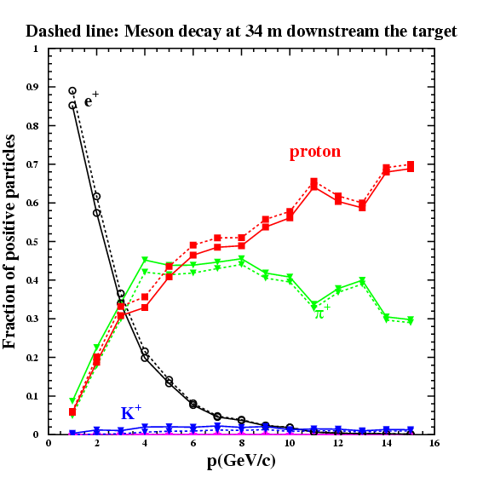
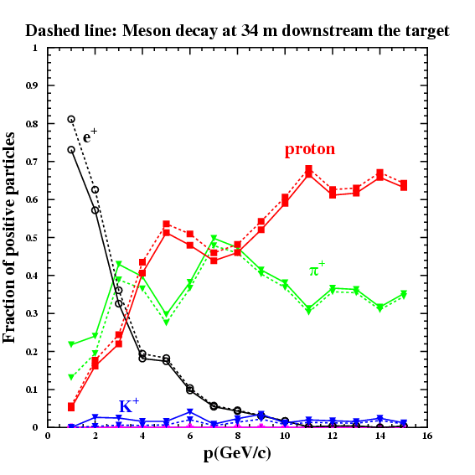
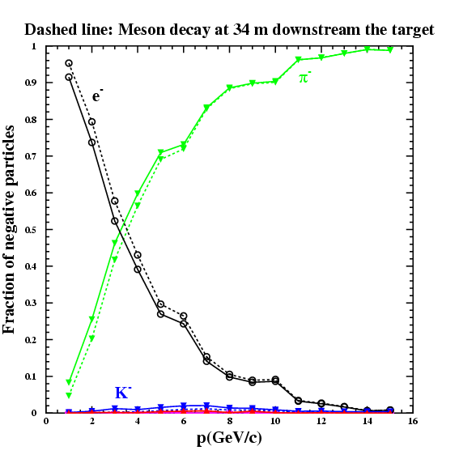
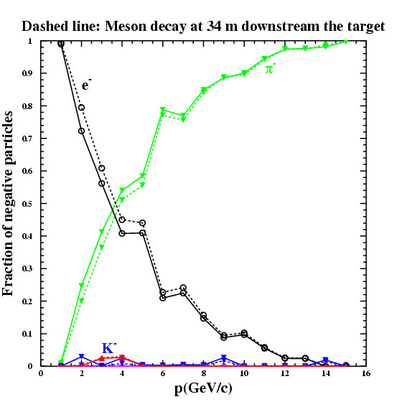
T9 Particle type and fraction
Electron target
Hadron target

Slide 13
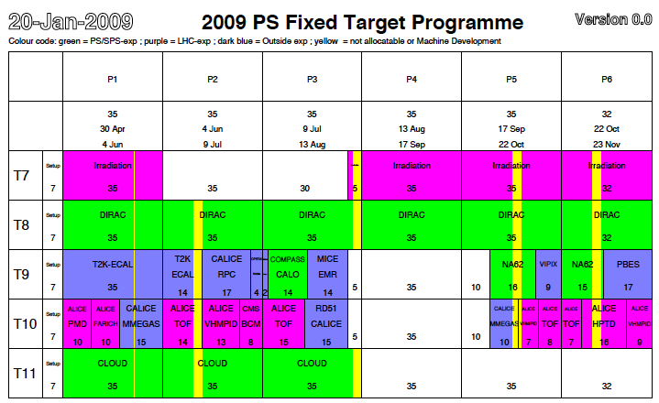

Slide 14
BTF FRASCATI
BTF @ LNF DAFNE Beam Test Facility (BTF). From single up to 10¹⁰ e⁻/e⁺, γ and neutrons
B. Buonomo, G. Mazzitelli, L. Quintieri, P. Valente, with the support of the DAFNE operators and accelerator division staff and all the users who help us developing diagnostic and improving the facility

Slide 15
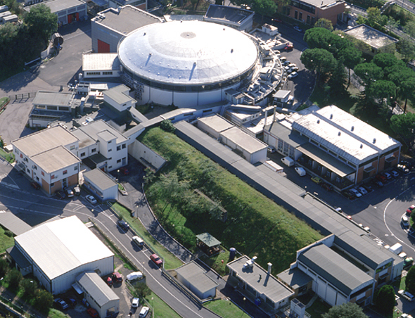
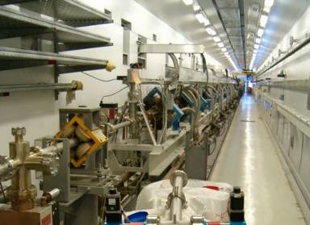
The DAΦNE BTF
BTF
high current Linac:
1 − 500 mA e⁻ 100 mA e⁺,
1 - 10 ns pulses, at least 10⁷ particles
The BTF is a e⁻/e⁺ test-beam facility in the Frascati DAΦNE collider complex
Need to attenuate the primary beam:
Single particle regime is ideal for detector testing purposes
Allows to tune the beam intensity
Allows to tune the beam energy

Slide 17
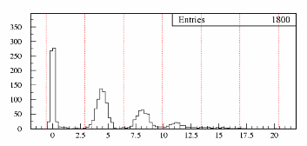
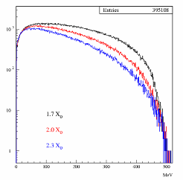
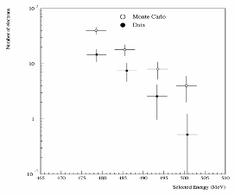
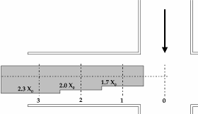
LINAC beam attenuation
0
1e-
2e-
10³
3e-
10²
detector
10
1
LINAC Beam 1-500 mA
0
100
300
500
W slits
N. of particles
tunable Cu target:
1.7, 2.0, 2.3 X₀
45⁰ magnet
Selected energy (MeV)

Slide 18
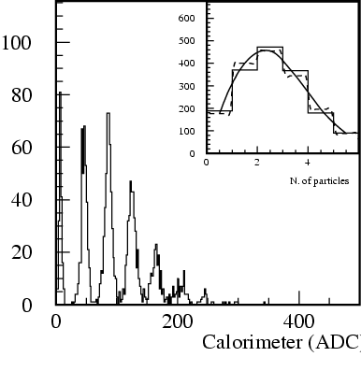
BTF beam characteristic
Beam (e⁻ or e⁺) intensity can be adjusted by means of the energy dispersion and collimators, down to single particle per pulses
Number (particles/pulse) 1÷10⁵ 1÷10¹⁰
Energy (MeV) 25-500 25÷750
Repetition rate (Hz) 20-50 50
Pulse Duration (ns) 10 1 or 10
p resolution 1%
Spot size (mm) σ_{x,y} ≈ 2 (single particle) up to 10*10 (high multiplicity)
Divergence (mmrad) σ’_{x,y} ≈ 2 (single particle) up to 10 (high multiplicity)
Multi-purpose facility:
H.E. detector calibration and setup
Low energy calorimetry & resolution
Low energy electromagnetic interaction studies
High multiplicity efficiency
Detectors aging and efficiency
Beam diagnostics

Slide 19
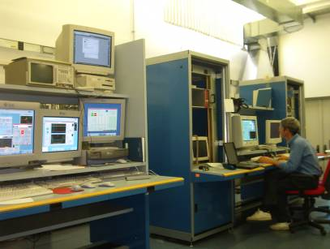
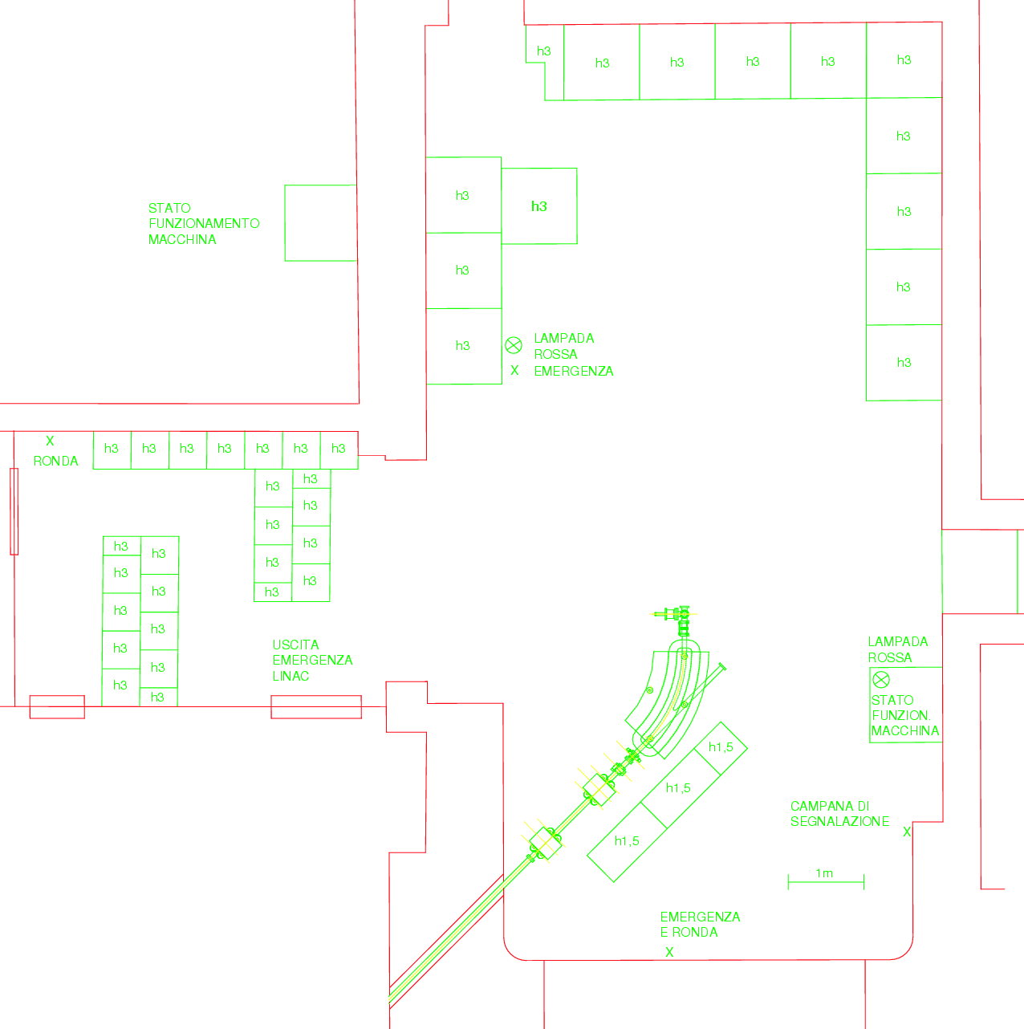
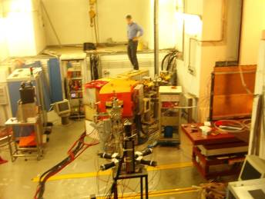
Equipment: infrastructure
one meeting room (WiFi)
one guest office (LAN-WiFi)
Control room:
Pc’s, Controls console, printer cabling, crate and racks, etc
5.5 m
main entrance: radioprotection wall can be removed on demand
4 m
Linac tunnel

Slide 20
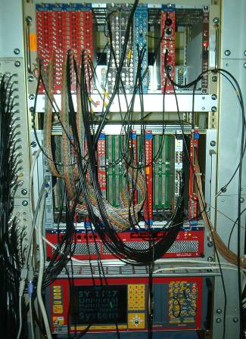
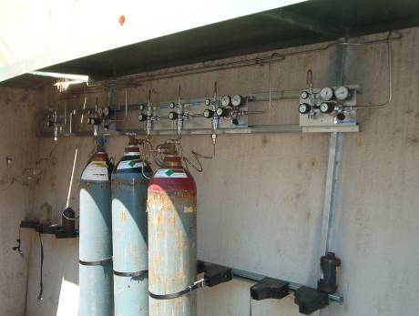
Equipment: infrastructure
permanent DAQ TDC/QDC/ADC/scaler/disc. available
NIM, VME, CAMAC Branch, VME controllers
‘Devil’/VMIC VME and CAMAC controller, NIM modules
Remotely controlled trolley
Gas system
HV system…
crates, rack, etc.
C₄H₁₀
CO₂
Noble Gas
C₂H₆
HV SY2527 (3/4KV neg, 3/4KV pos, 15KV pos)
40 ch. CAEN SY127 pos.
Cabling BTF HALL-BTF CR
Network: Wi-Fi, dedicated-LAN, WAN, printer
http://www.lnf.infn.it/acceleratori/btf/

Slide 21
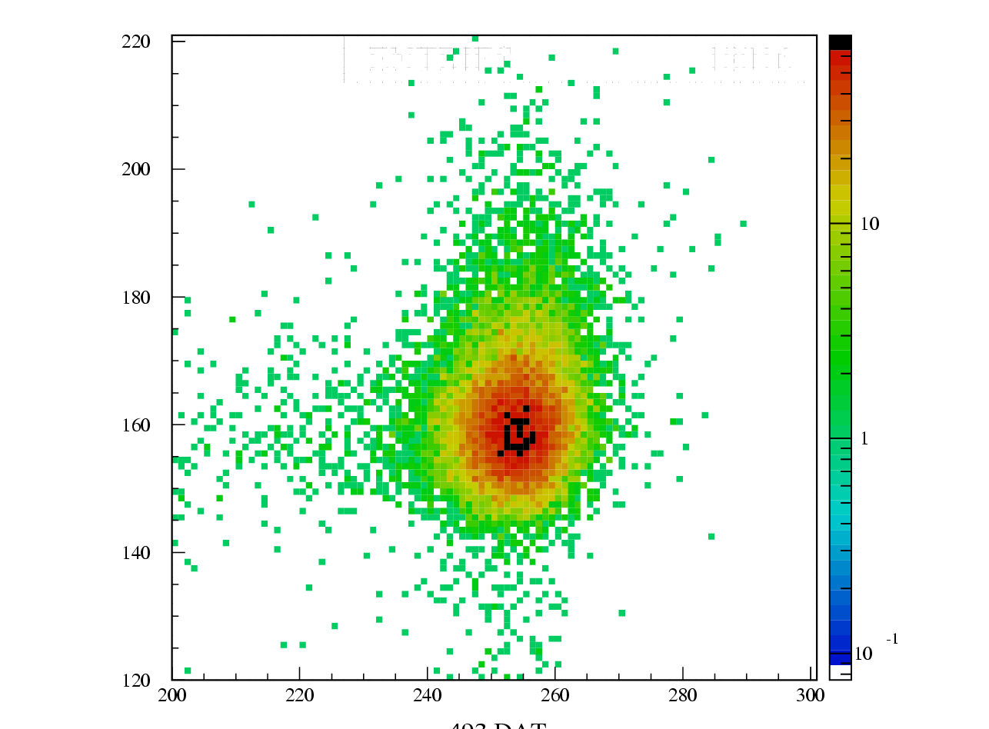
Equipment: Diagnostics
low multiplicity diagnostic (1-100):
(back detector)
lead glass, 5×5×35 - 10×10×35 cm
PbWO₄ crystal 3*3*11 cm
lead/scintillator fibers (KLOE type), 25×50×30 cm
NaI high resolution 30×30 cm
(front/trigger detector/not destructive/tracking)
multipurpose plastic scintillators 10x10x0.5 cm, 10x30x0.5 cm, 1x15x0,5 cm
hodoscope; two bundle of 1 mm fiber for a total active area of 48x48 mm2
Silicon tracker (high gain)
3GEM (Gas Electron Multiplier) detector
2×2 mm spot size in fiber hodoscope
2×2 mm spot size in Silicon XY chamber

Slide 22
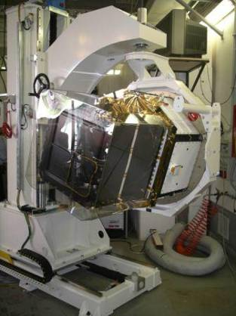
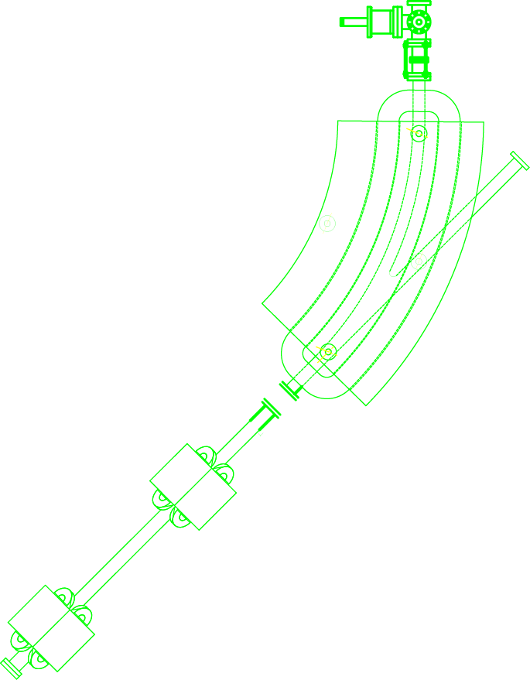
BTF photon tagged source AGILE GRID photon calibration
The AGILE Gamma Ray Imaging Detector calibration at BTF is aimed at obtaining detailed data on all possible geometries and conditions. BTF can provide data in the most significant energy region (20-700 MeV)
spectrometer
silicon detector
silicon tagging target
AGILE
GRID
Be window

Slide 23
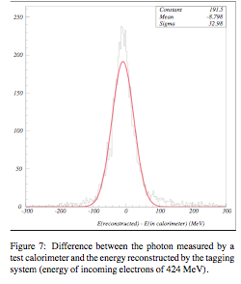
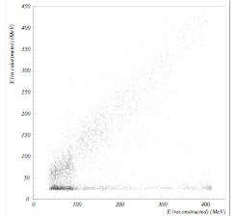
Frascati Tagged Photons
Calculated and measured photon energies are well correlated
Calculated photon energy should be rather precise, much better
than their measured resolution of 33 MeV (7.8%),
Lowest photon energies seem to be ~50 MeV

Slide 24
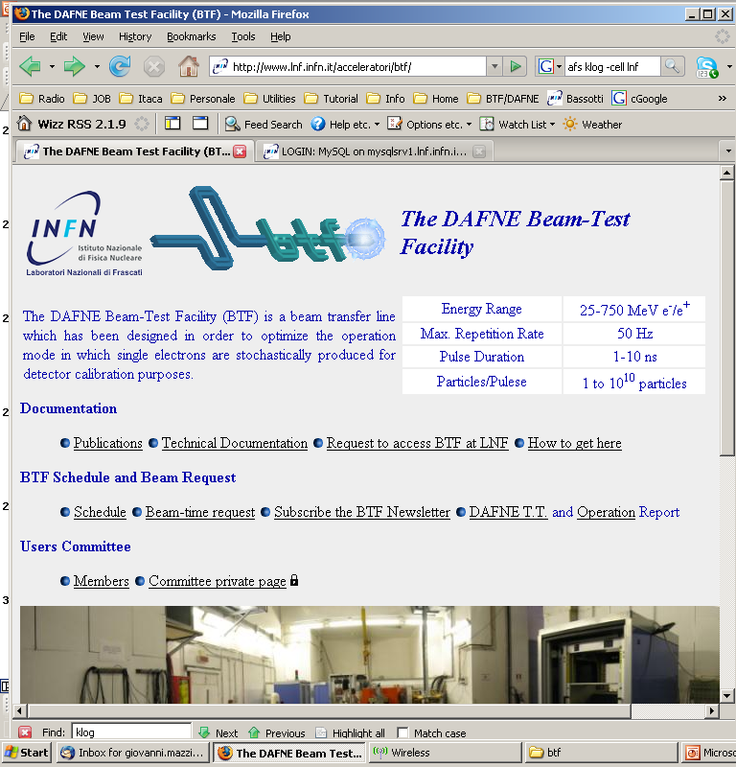
Application form to access BTF
Pasquale Di Nezza - INFN, LNF
Flavio Gatti - INFN, Genova
Clara Matteuzzi (Chairperson) - INFN, Milano
Giovanni Mazzitelli (Responsible) - INFN, LNF
Antonio Passeri - INFN, Roma III
Paolo Valente - INFN, Roma I
Beam Test Facility Secretariat: Annette Donkerlo

Slide 25
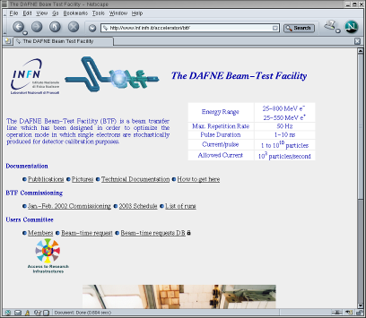
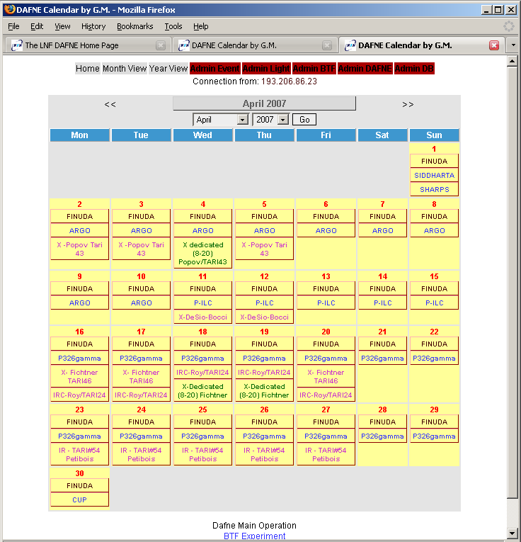
General information
technical documentation for users and operators is available on the web as well as beam request, shift archive, schedule, documentation, virtual logbook, etc
http://www.lnf.infn.it/acceleratori/btf/
The BTF was widely used as a TARI facility in the EU 6th Framework Program
…and will be involved in the EU 7th Framework Program

Slide 26
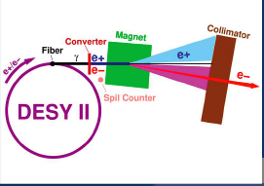
DESY

Slide 27
DESY TEST BEAM
Three test beam lines with 1-6 GeV electrons
Very simple system, non beam optics, only momentum selection via magnet
Bremsstrahlung beam generated by a carbon fiber in the circulting beam of electorn/positron synchrotron DESYII
Photons are converted to electron/positron pairs with a metal plate
Beam is psread out into a horizontal fan with a dipole magnet. Collimator cuts out final beam
DESYII: mainy injector for DORIS and PETRA (synchrotron sources
Test beam runsin PETRA mode: every fourth cycle (320 ms) single bunches with 3*10¹⁰ electrons (1*10¹⁰ positrons) at 7 GeV
Revolution frequency 1 MHz, the RF frequency 500 MHz, and the bunch length around 30 ps. Average radius 46.6m

Slide 28
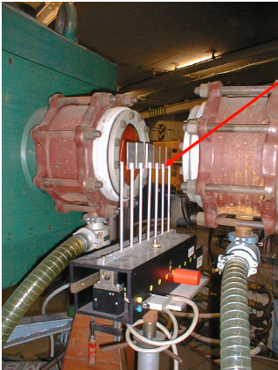
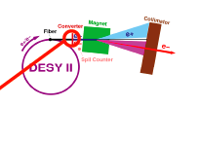
Conversion target (secondary target)
Different conversion targets available
Cu, Al
The selection of the conversion target
is under control of the teat beam user

Slide 29
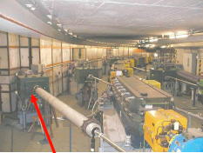
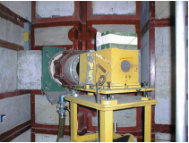
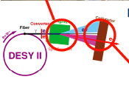
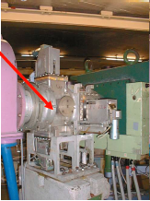
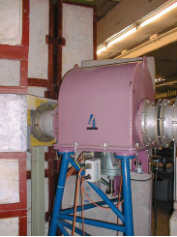
Selection magnet location
FINAL COLLIMATOR
IN AREA
MAGNET
BEAM SHUTTER
COLLIMATOR

Slide 30
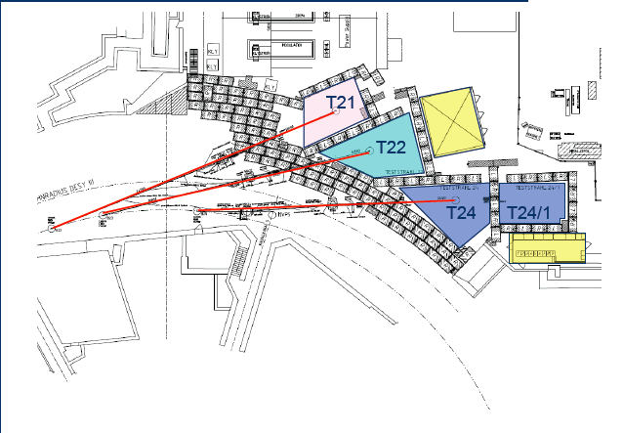
DESY TEST BEAM LAYOUT

Slide 31
Facilities for test beam users
All three test beam lines have:
Interlock system
magnet control
patch panels with preinstalled cables
Gas warning systems
fast internet connection (DHCP)
You have to bring
your Data Acquisition incl. computers
trigger scintillators

Slide 32
AVAILABILITY
Machine study weeks every 6 weeks planned → detailed schedule available
User can apply for beam time through DESY test beam coordinators → up to three weeks possible, longer term negotiable
Expect running of 10-11 months in 2010, similarly as in 2009
Every 80 ms one burst
Typically 1 electron/event, 1% probability to have 2
Nobert Meyners is in charge of test beams at DESY
Web page: http://adweb.desy.de/~testbeam/

Slide 33
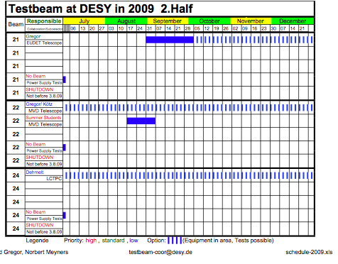
DESY Test 2009 Schedule

Slide 34
IHEP
Beijing
Test Beam Facility

Slide 35
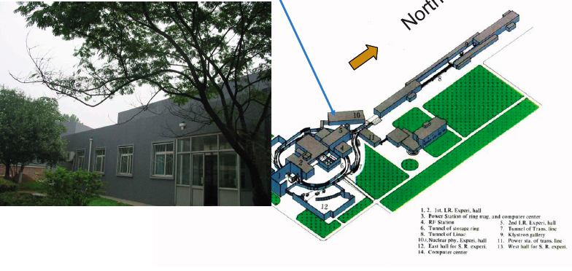
Location is in hall 10

Slide 36
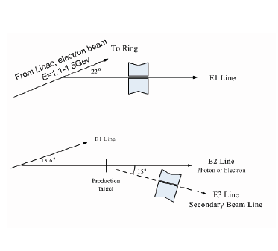
Introduction
LINAC beam which has a bend of 22deg into the hall 10. E1 line
two dipole magnets inserted into the E1 line, beam bend by 18.6deg, E2 line
E3 line is a secondary beam produced by electron impinging target. Particles that are at fixed angular acceptance of 15deg enter a spectrometer and are transported to the beam test area.

Slide 37
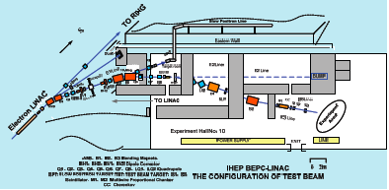
Basic equipments in hall 10
In hall 10 equipped area
of 540 m2
E1 and E2 electron beam line
20m, and 29 m long respectively
E3 line provided with a spectrometer
23m long

Slide 38
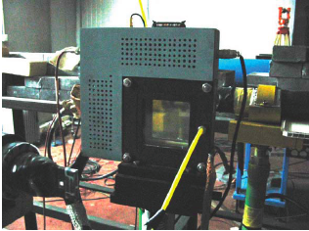
SPECTROMETER
Magnetic spectrometer on E3 line has a momentum resolution of 1%, two running modes to detect both positive and negative particles.
In the spectrometer detector contains Cherenkov counters, TOF counters and MWPC.

Slide 39
Detectors and performances
Cherenkov counter
CO2 gas cherenkov counter provide identification of electrons and pions. Efficiency of selection 99%.
Three scintillator counters
Time of flight of particels measured to identify pions and protons. Time resolution 200ps
Three Multi Wire Proportional Chambers
Each chamber has 1 anode side and 2 cathode sides with 32 induced strips. Strip width 4.2 mm. Position resolution less than 300μm. dE/dx resolution 50%.

Slide 40
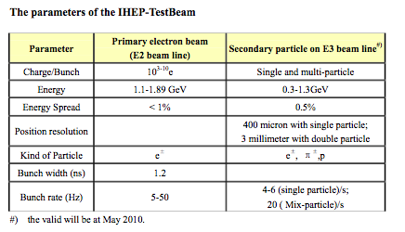
Operation parameters
Primary electron beam from LINAC:
Intensity 10¹⁰ e/bunch
Energy 1.1-1.9 GeV
Secondary beam: e±, π±, p from 300MeV/c up to 1.3 Gev/C
target material: Carbon, Berillium, Cu
derivative angle: fixed forward orientation of 15deg
Momentum resolution 1%
http://www.ihep.ac.cn/english/enews/080409.htm

Slide 41
Comparison of TBFs
Lab | Beam | Momentum [GeV] | σ_{p} [%] | p spread [%] | Repetition rate [Hz] | Particles per pulse | Pulse length [ns] | σ_{x}, σ_{y} [mm] | Divergence [mrad] | Availability 2009/2010
Frascati | e⁺/e⁻ | 0.025-0.5 | 1 |  | 20-50 | 10⁵ | 10 | 2x2 | 0.002 | Yes/yes
 | e⁺/e⁻ | 0.025-0.75 | 1 |  | 50 | 10¹⁰ | 1 or 10 | 10x10 | 0.01 | Yes/yes
 | Tagged γ | 0.02-0.7 | 1? |  |  |  |  |  |  | Yes/yes
DESY 21 | e⁺/e⁻ | 1-6 | 5 |  |  | 10³ /cm²/s |  | 25x15 | 2 | Yes/yes
22 | e⁺/e⁻ | 1-6 | 5 |  |  | 10³ /cm²/s |  | 25x15 | 5 | Yes/yes
24 | e⁺/e⁻ | 1-6 | 5 |  |  | 10³ /cm²/s |  | 25x15 | 2 | Yes/yes
CERN PS T9 | e⁺, μ⁻,h± | 1-12 (15) | 0.5 | 8 | 1/cycle* | <10⁶ | 4x10⁸ | 5x8 | 3x3 | Maybe/yes
T10 | e⁺, μ⁻,h± | 1-6 | 0.7 | 8 | 1/cycle* | <10⁶ | 4x10⁸ | 6x10 | 4x4 | Maybe/yes
IHEP E1,E2 | Primary e | 1.1-1.89 |  | <1 | 5-50 | 10³-10¹⁰ | 1.2 |  |  | ?
E3 | e⁺,π⁺, p | 0.3-1.3 |  | 0.5 | s:4-6,m:20 | Single,multi |  | s:.4, m: 3 |  | ?
SLAC | e⁺,π⁺ | 13.6 |  | 0.05 | 10 | 1-6x10⁹ |  | .1x.1 | 1-2x10⁻⁶ | No/maybe
Novosibirsk |  | ?-5.5 |  |  |  |  |  |  |  | ?, 8 months
 | Tagged γ** | 0.04-1.5 | <1 |  | 10 k |  |  | 20-40 |  | Down
* A cycle is 33.6-48 sec
**At VEPP 4, photon is produced via Compton scattering

Slide 42
Conclusions
Low energy: BTF in Frascati seems to be the best option
Medium and high energy: CERN (DESY) would be the best solution
To be ready for a TB in 2009:
fix as soon as possible final dimensions
of crystals (8 crystals already ordered by Perugia and Rome but not yet in production waiting for the geometry). Procurement of the remaining crystals need a planning.
Mechanical structure for the BT has to be designed after results from mechanical measurements with small pieces
Ask for beam time at CERN as soon as possible, schedule in Frascati is less crowded

