Slide 1
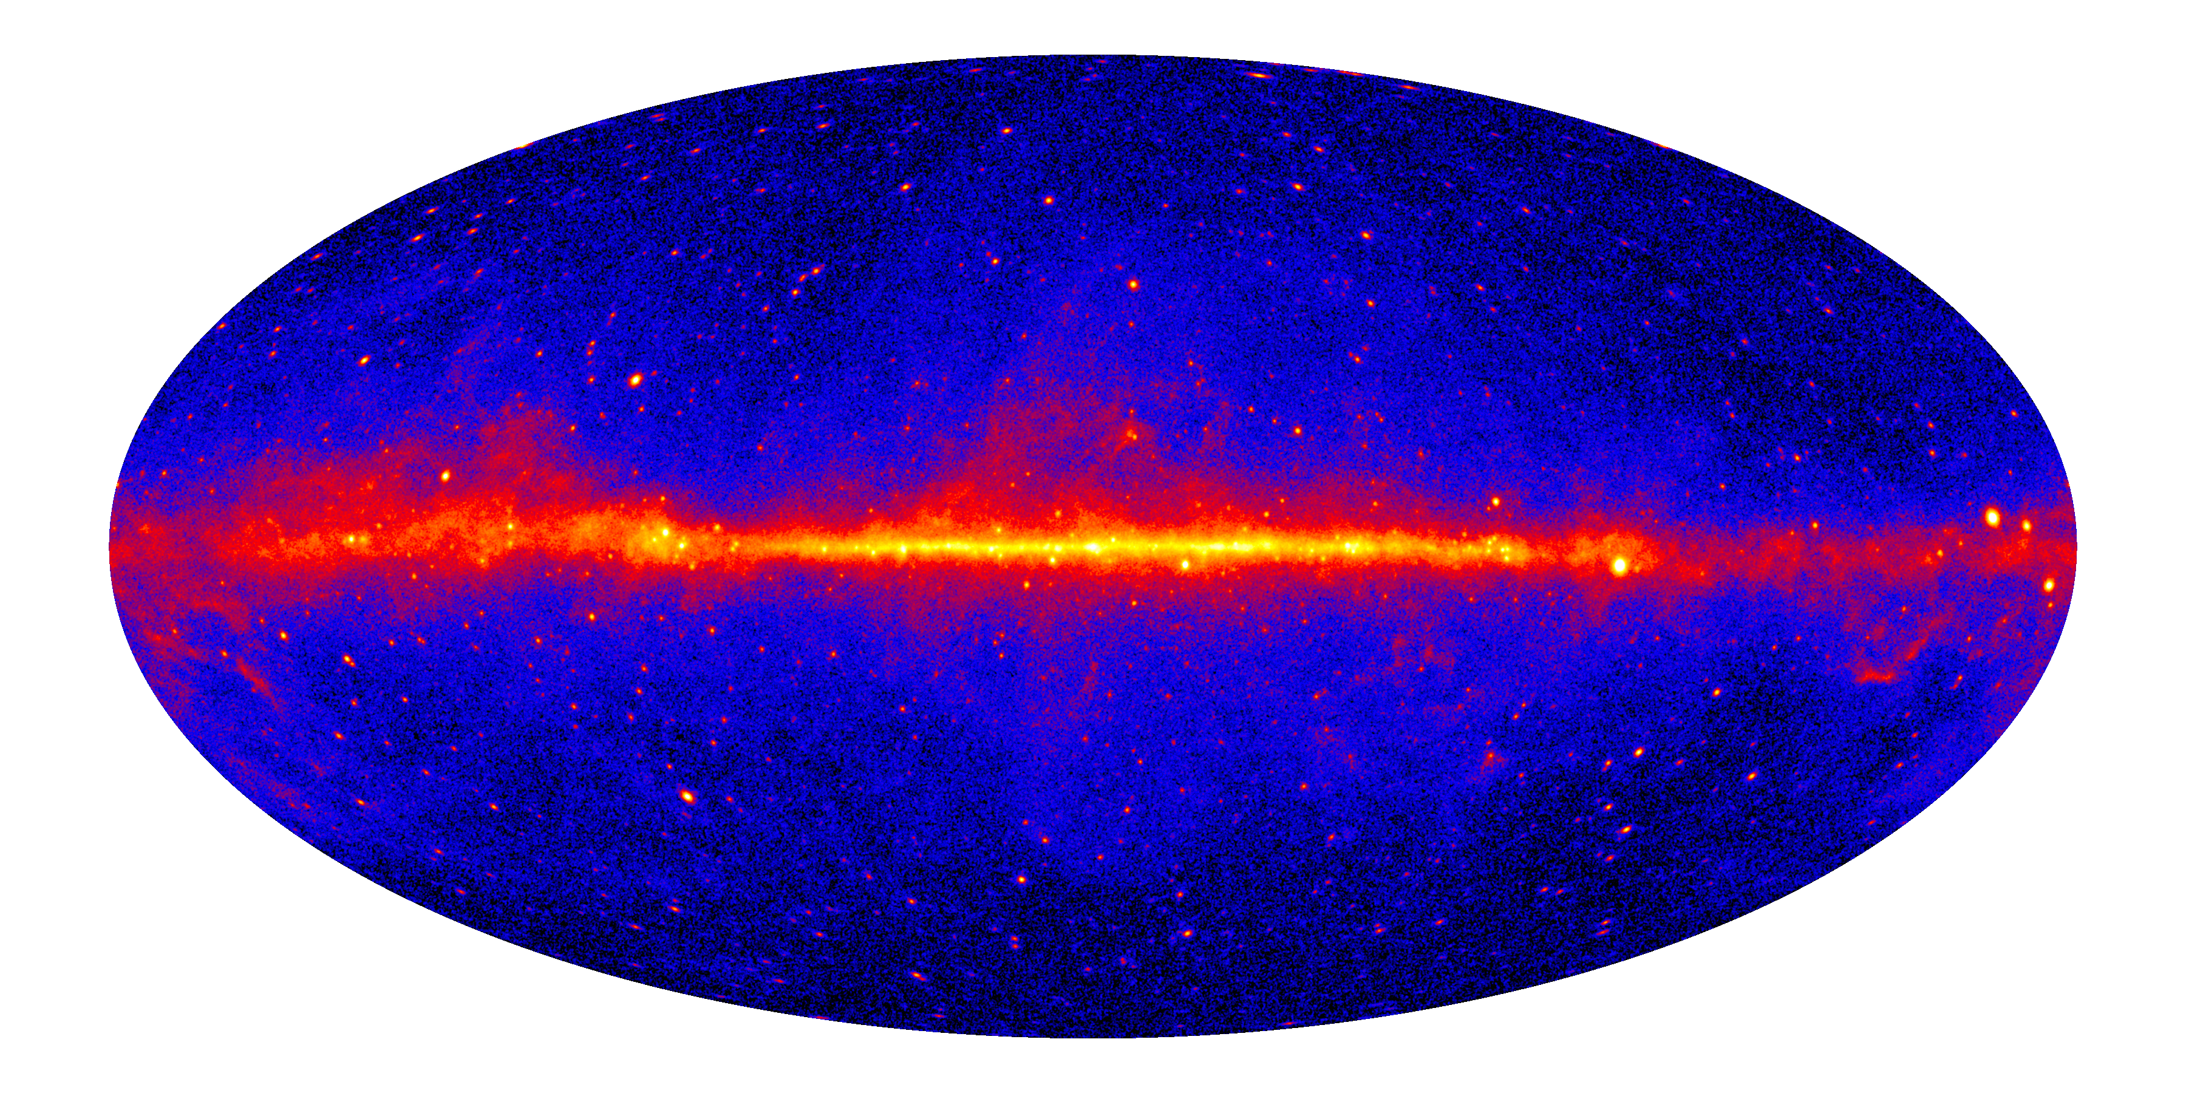
A view of our Galaxy in γ-rays
The Fermi Sky >1 GeV
Patrizia Caraveo

Slide 2
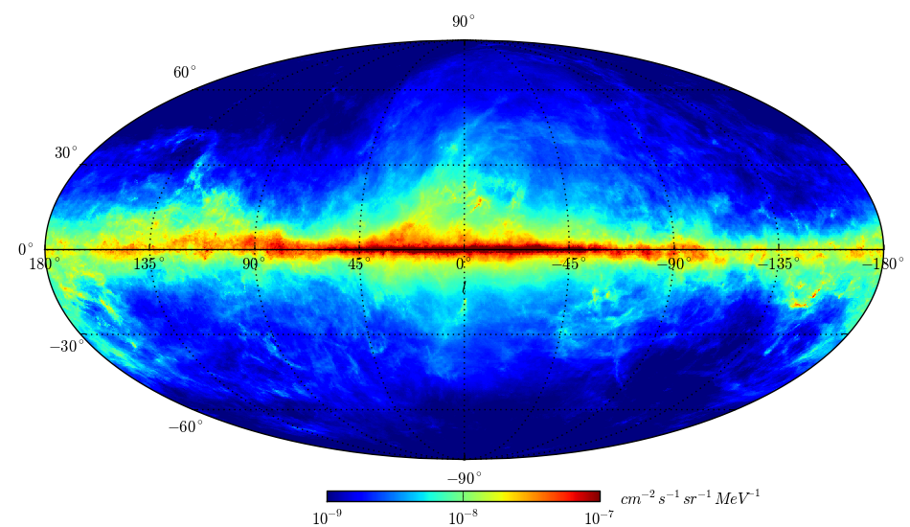

Slide 3
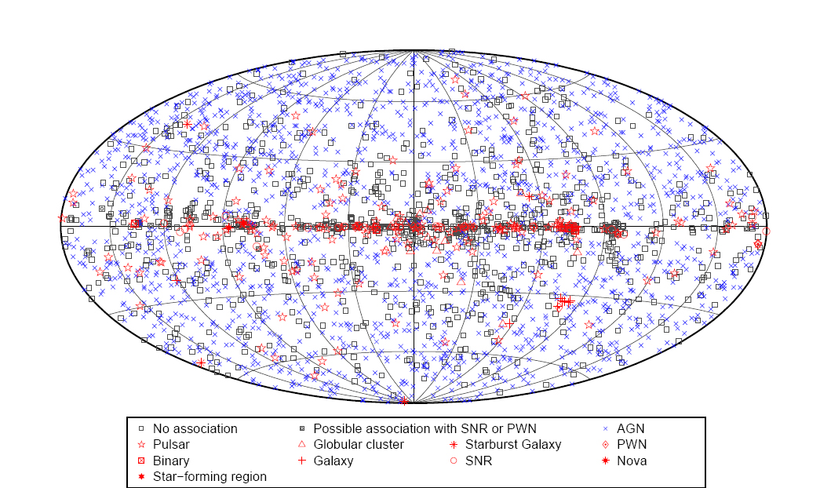

Slide 4
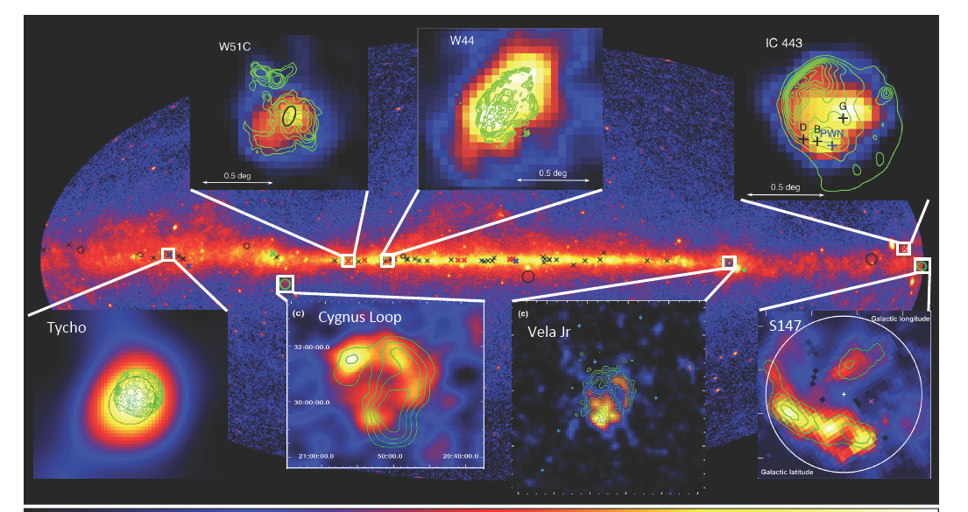
SNRs: extended and (sometime) interacting
with nearby molecular cloud

Slide 5
Exploring SNR as a function of Age
  All gamma-ray studies shed light on the nature and acceleration mechanisms for the highest energy particles in a wide range of astrophysical environments
Example: Supernova Remnants
The measurement of a pion bump in W44 and IC443 is the starting point for a broader population study connecting SNRs to the Galactic cosmic-rays
Middle-aged SNRs have steep spectrum from GeV to TeV; γ-rays likely hadronic in origin
Young SNRs have nonthermal synchrotron X-rays, strong TeV detections, X-ray/TeV correlation; γ-rays likely leptonic in origin
Gamma-ray properties evolve with SNR age

Slide 6
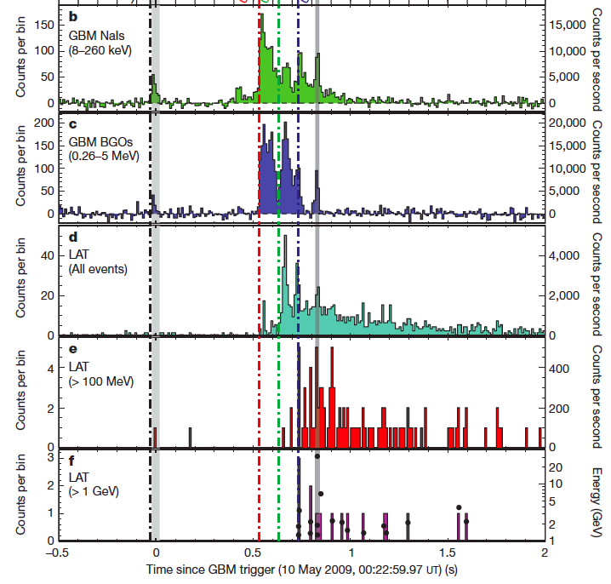
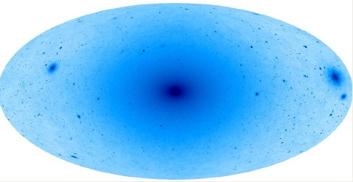
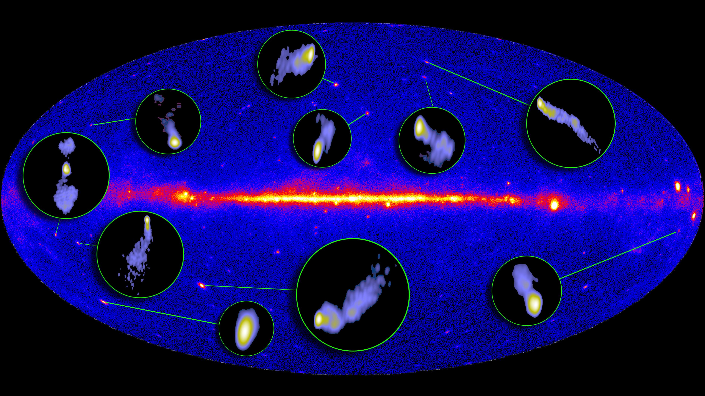
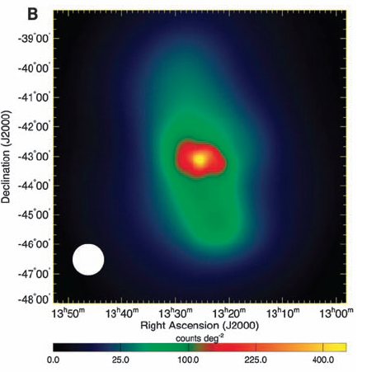
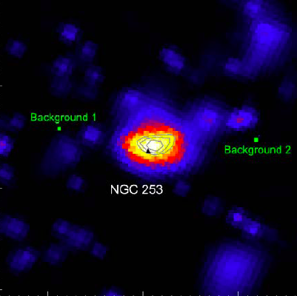
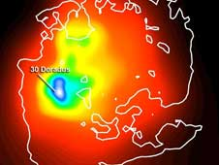
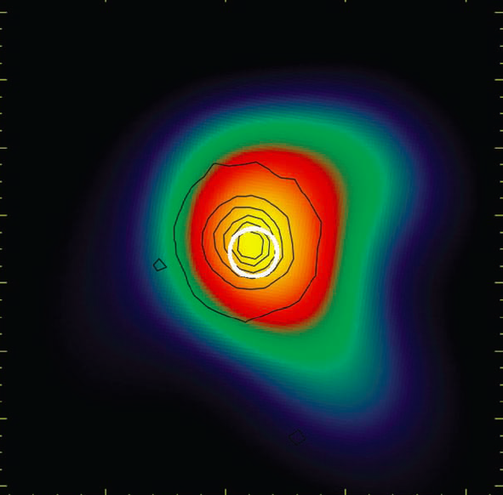
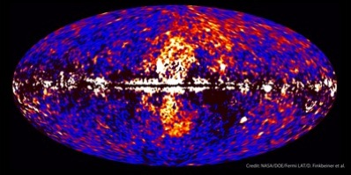
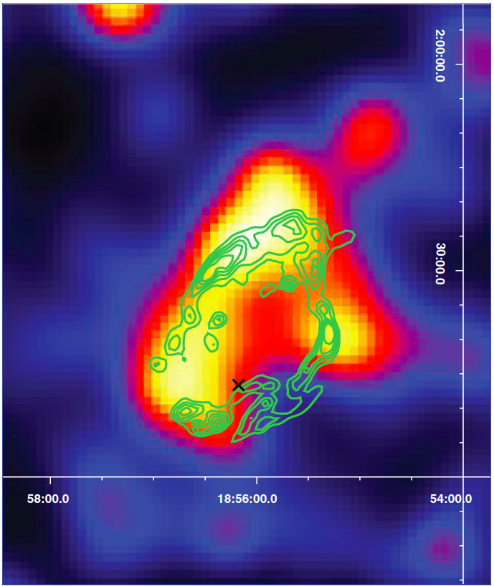
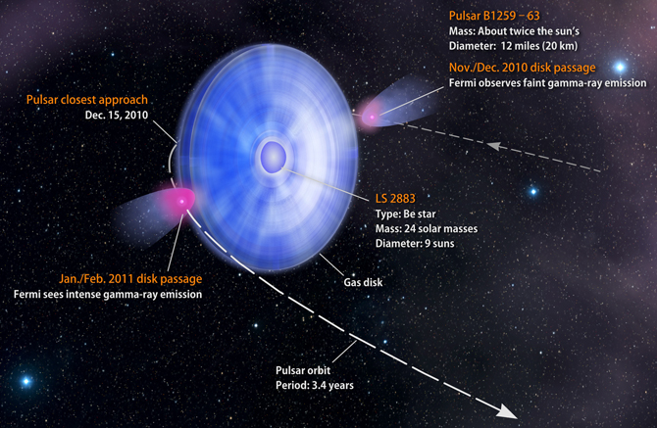
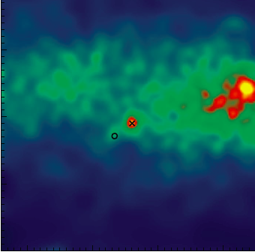
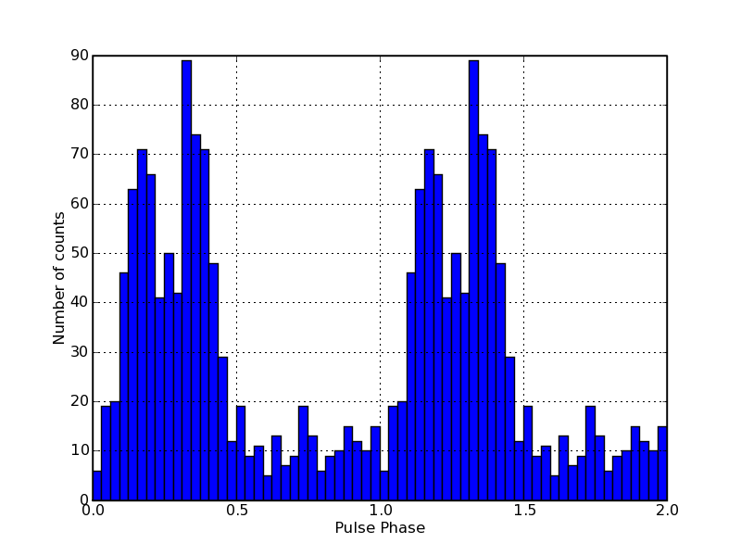
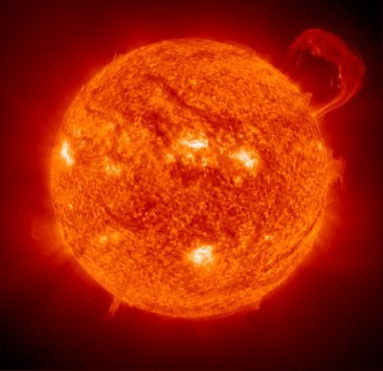
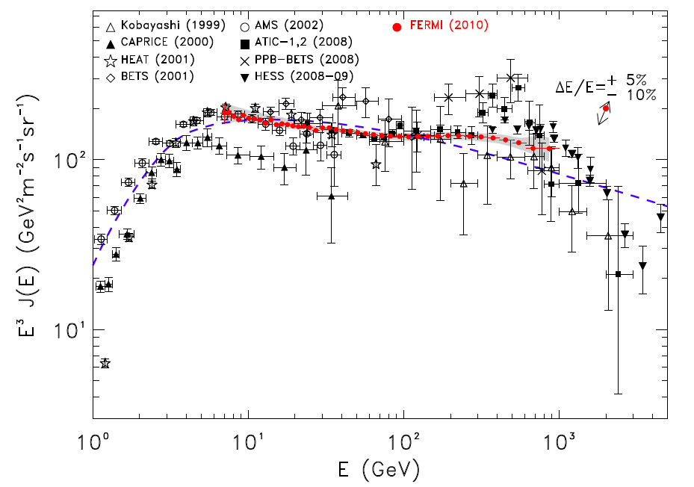
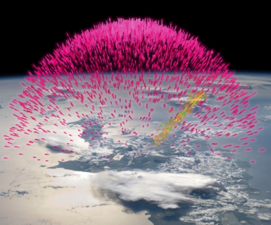
Fermi Highlights and Discoveries
Dark Matter searches
GRBs
Blazars
Radio Galaxies
Extragalactic
Starburst Galaxies
LMC & SMC
Globular Clusters
Fermi Bubbles
SNRs & PWN
Galactic
γ-ray Binaries
Novae
Pulsars: isolated, binaries, & MSPs
Sun: flares & CR interactions
Terrestrial γ-ray Flashes
Unidentified Sources
e⁺e⁻ spectrum
Notes:
Pulsars – more subclasses of a known class

Slide 7
Fermi GALACTIC Highlights and Discoveries
More surprising results
Dark Matter searches
Fermi Bubbles
γ-ray Binaries
Globular Clusters
Galactic
SNRs & PWN
Novae
Pulsars: isolated, binaries, & MSPs
Unidentified Sources
Notes:
Pulsars – more subclasses of a known class

Slide 8
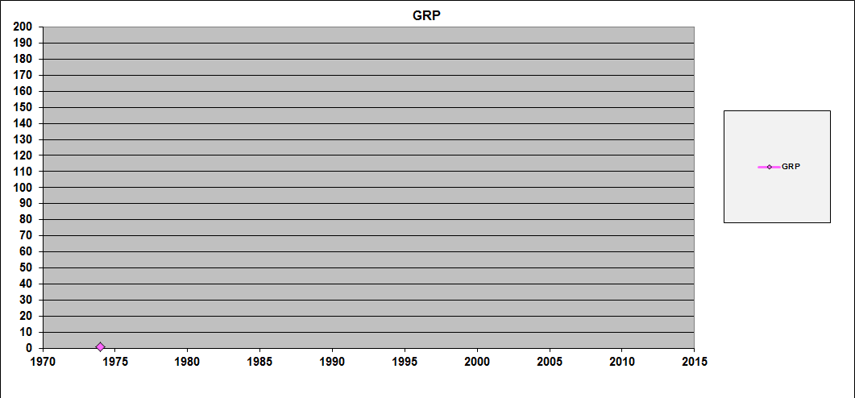
Gamma-ray pulsars: a success story

Slide 9
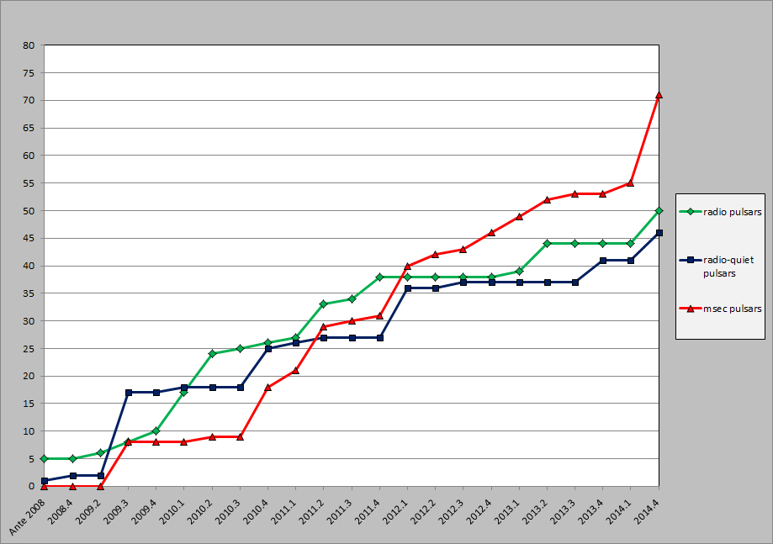
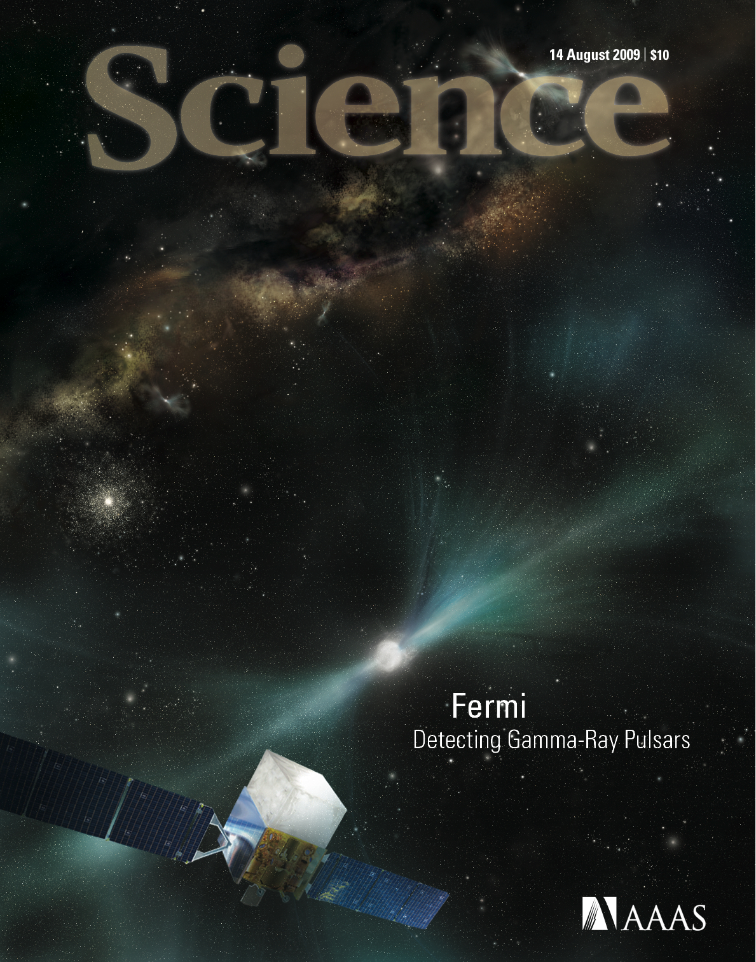
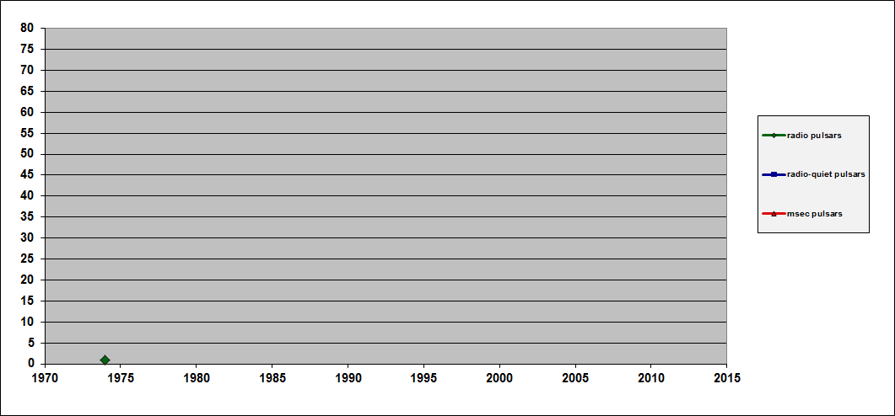
Quantity and quality
2PC catalog
117 pulsars

Slide 10
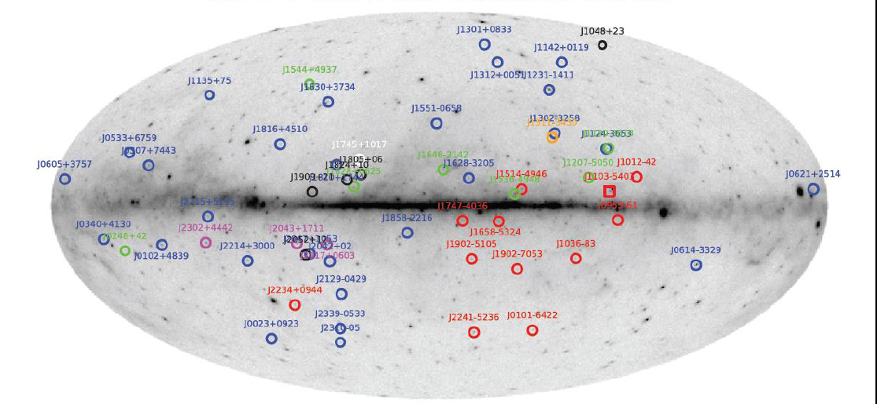
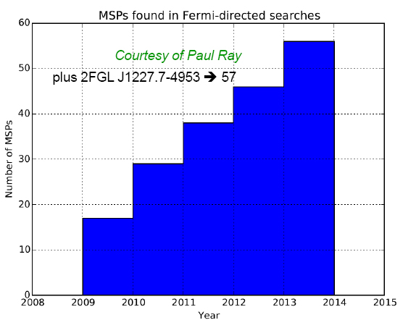
2014: 57 new radio MSPs within Fermi error boxes: a good fraction of all field MSPs
68

Slide 11

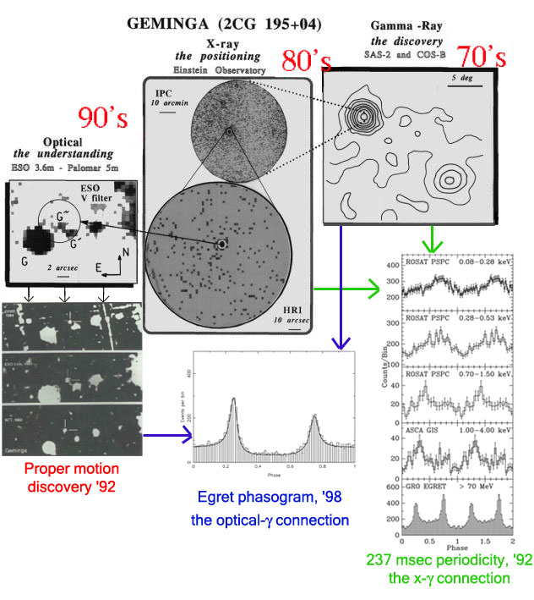
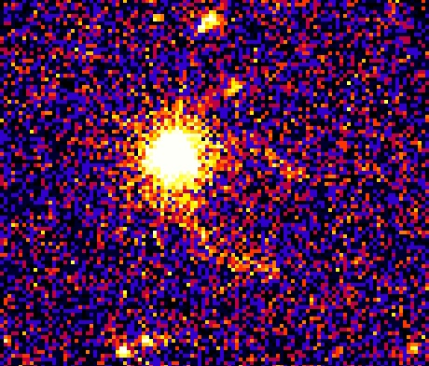
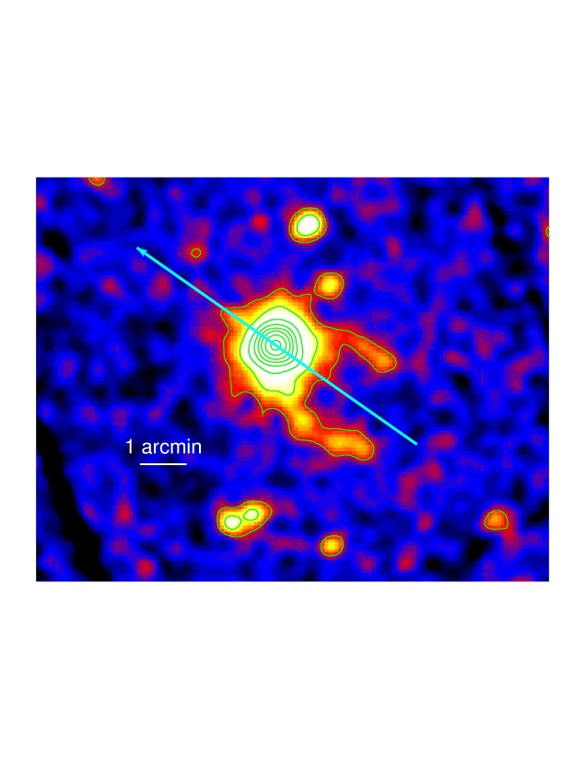
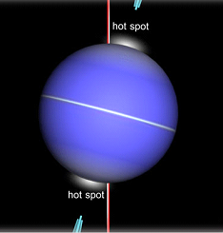
2000….
X-rays
The archetipal radio quiet NS

Slide 12

Two revolutions
1-radio quiet pulsars
2-MSPs

Slide 13
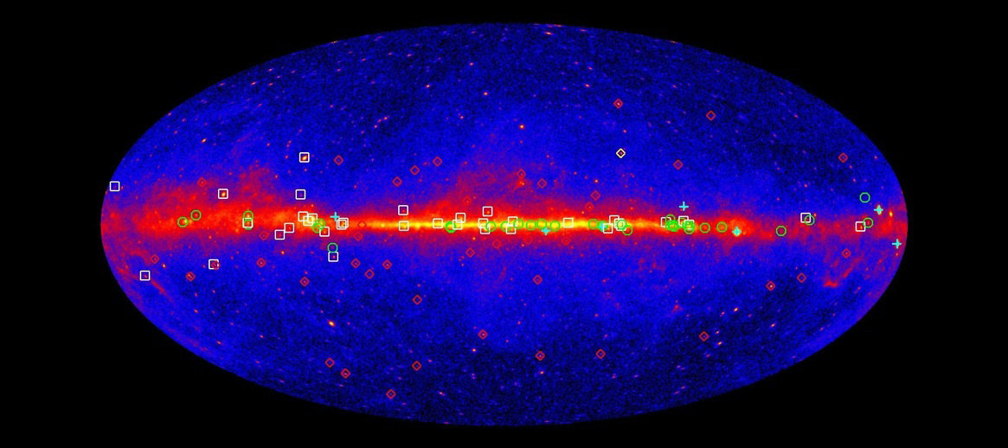
161 Gamma-ray Pulsars
https://confluence.slac.stanford.edu/display/GLAMCOG/Public+List+of+LAT-Detected+Gamma-Ray+Pulsars
Young pulsars: 46 radio selected, 40 gamma-selected, 4 x-ray selected
MSP: 70 radio selected, 1 gamma-selected

Slide 14
Three neutron star families

Slide 15
161 Neutron Stars
Half of the γ-ray PSRs were not known before Fermi

Slide 16
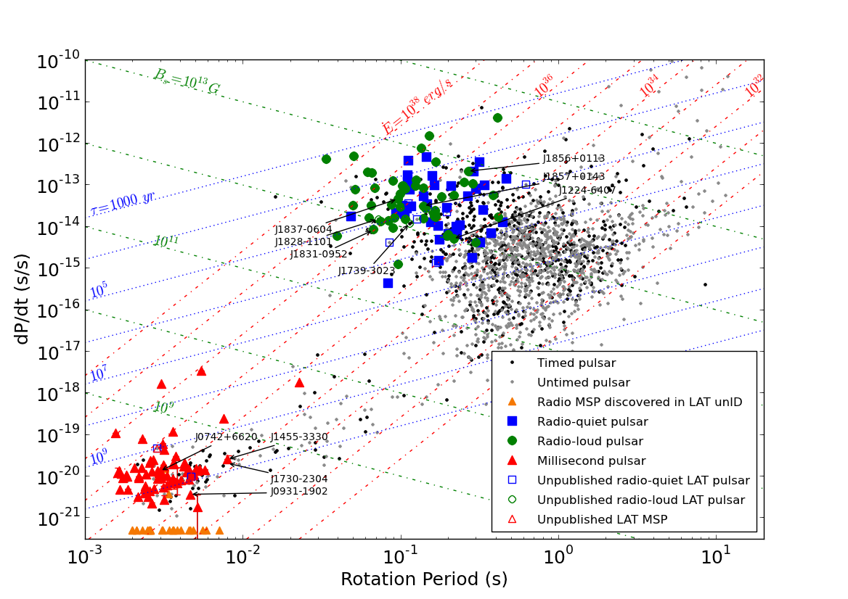

Slide 17
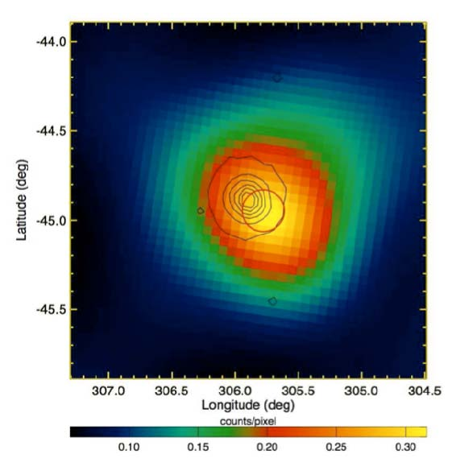
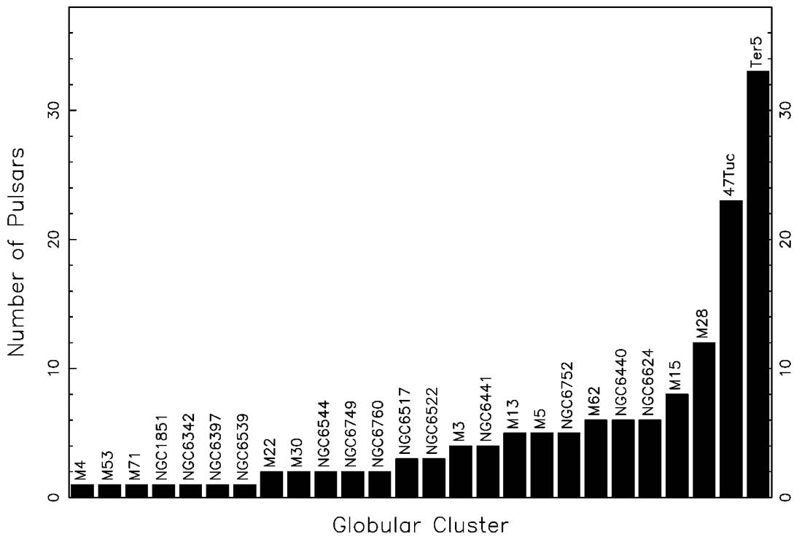

For sure, more MSPs in GCs
47 Tuc
Energetic and far away 8.4 kpc
14 more GCs detected by Fermi

Slide 18
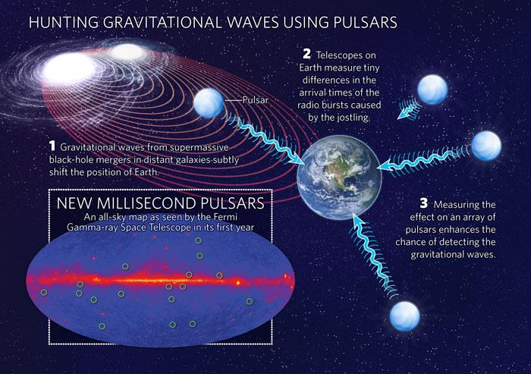
MSP Bonanza BONUS: Gravitational waves ?

Slide 19
Lessons learned from a Revolution
FERMI is a remarkable pulsar hunter
MSPs are winning in the γ-ray pulsar race
INSs (MSPs) are indeed responsible for A LOT of previously unidentified γ-ray sources
X-ray and radio coverage can be complemented by optical variability
…
Notes:
19

Slide 20
X-ray imaging provides position
Optical variability provides orbital parameters
1FGL J1311.7-3429 gamma puls → radio puls
for a while the first radio quiet MSP
1FGL J2339.7-0531 radio puls → gamma puls

Slide 21
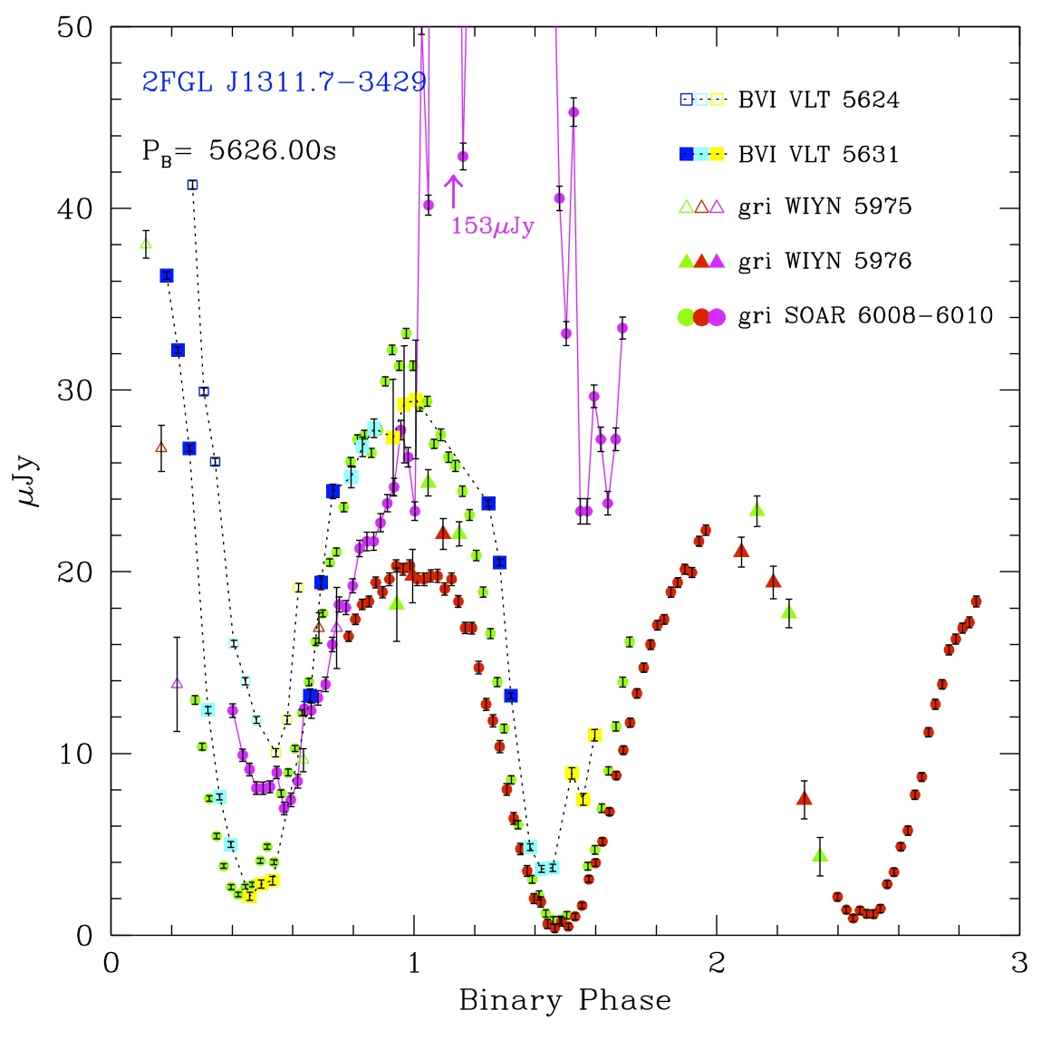
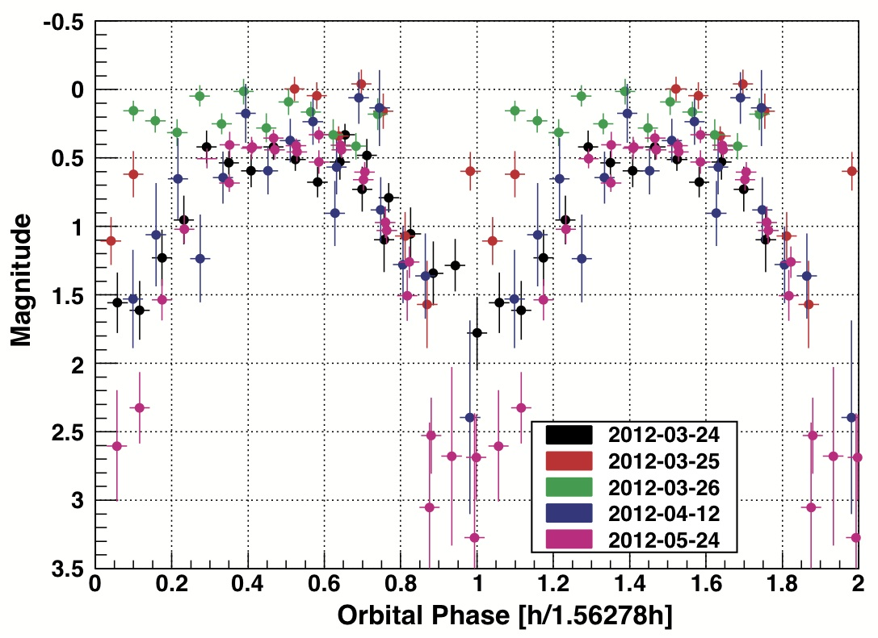
1FGL J1311.7-3429
Possible Chandra counterpart to 1FGL J1311.7-3429
Optical counterpart modulated at an orbital period of 1.56 hrs
Romani et al. (2012)
Kataoka et al. (2013)

Slide 22
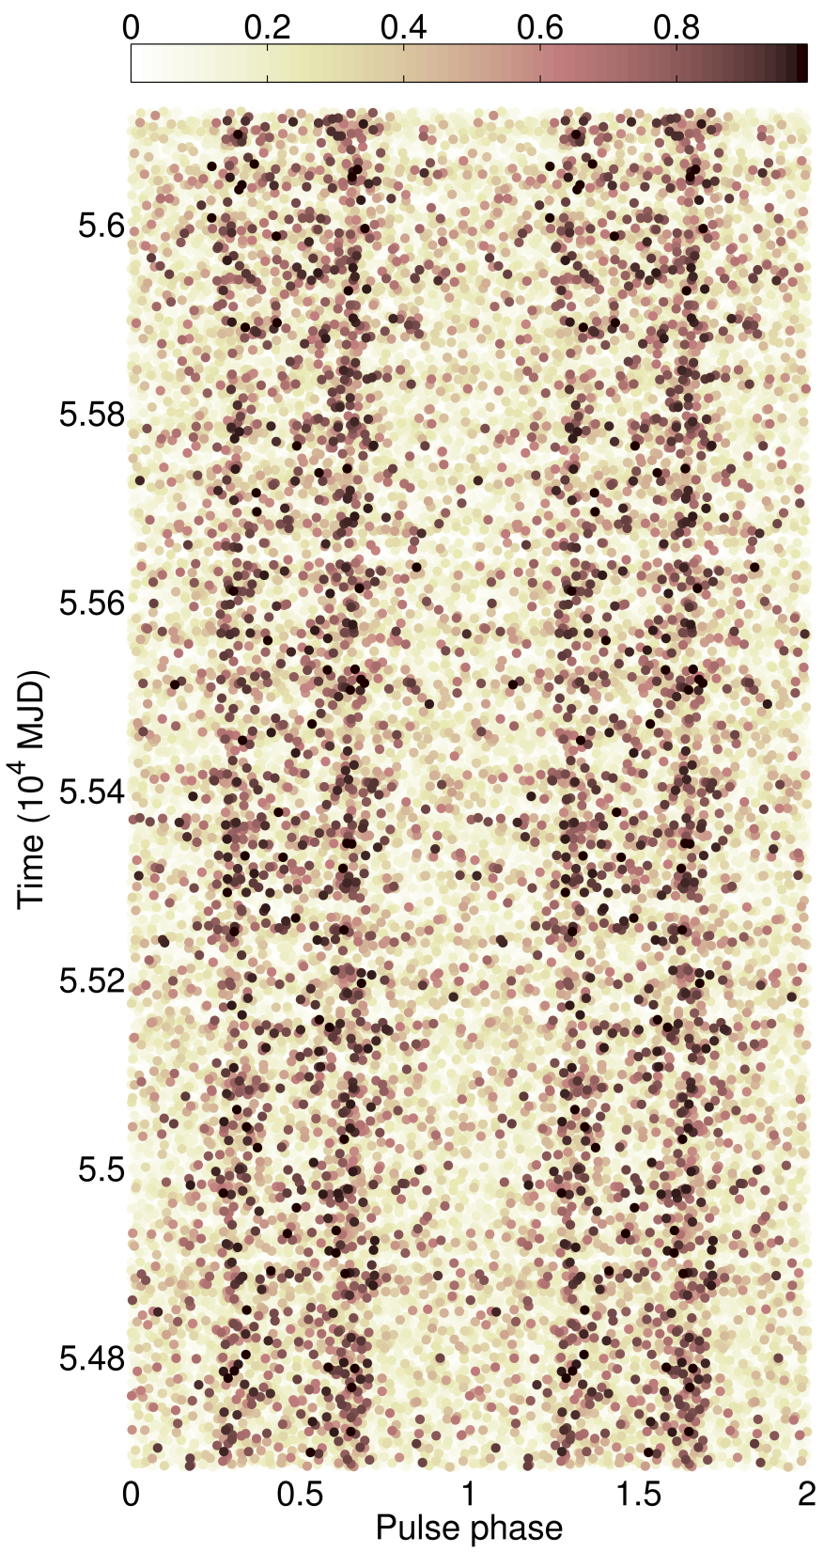
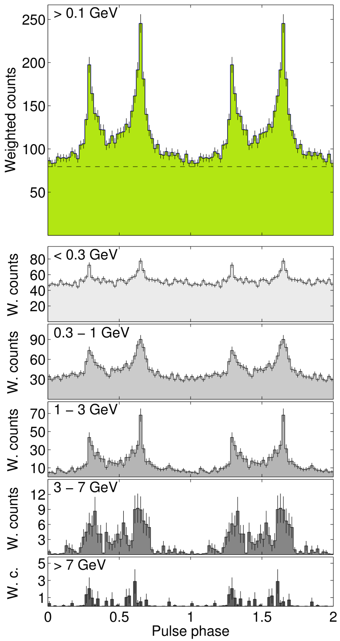
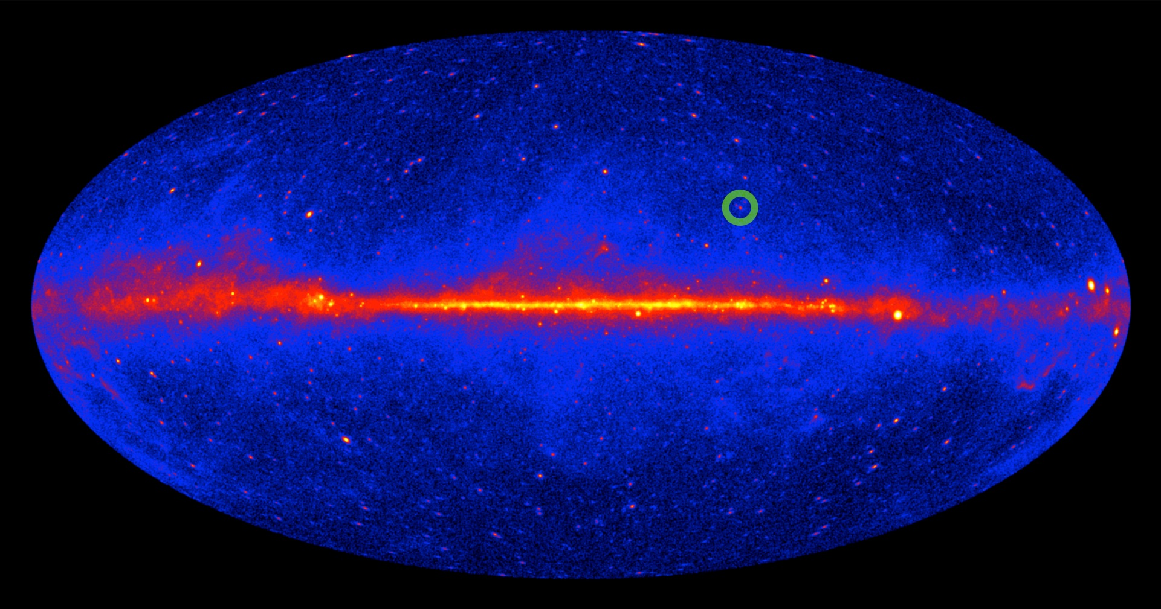
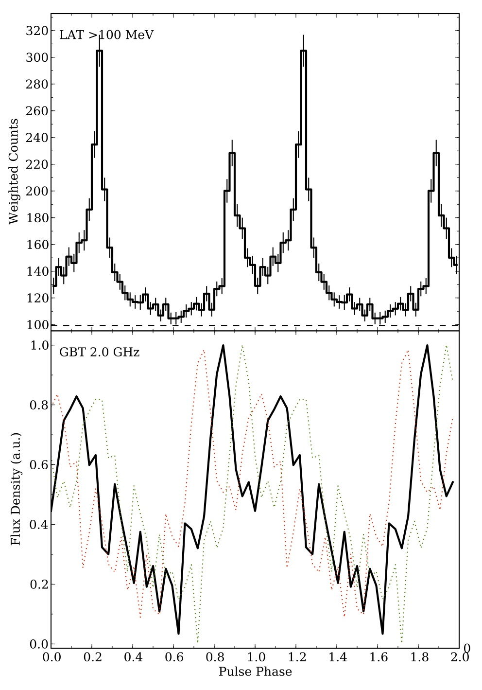
PSR J1311-3433
First gamma-discovered MSP
Detection of Radio
Pulsations followed
(Ray+ 2013)
P=2.5 msec

Slide 23
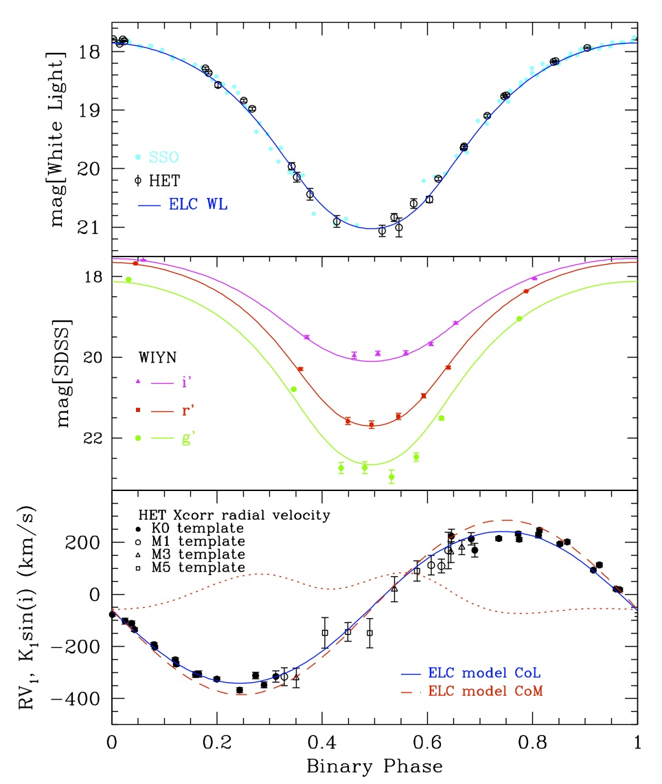
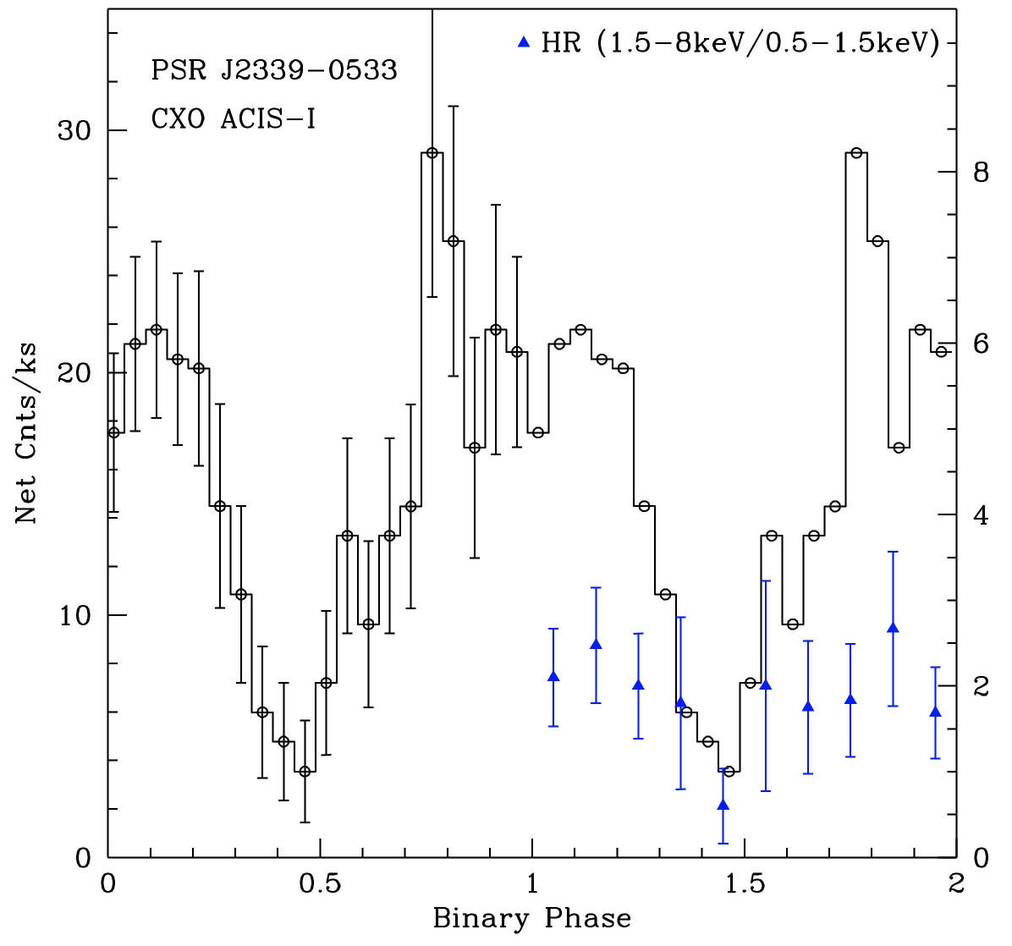
1FGL J2339.7-0531
Discovery of a Chandra source, identified with a variable low-mass star
Optical and X-ray modulation (4.632 h)
Radio detection of PSR J2339-0533 (2.88 ms)
  →gamma-ray detection
Romani & Shaw (2011)
Kong et al. (2012)

Slide 24
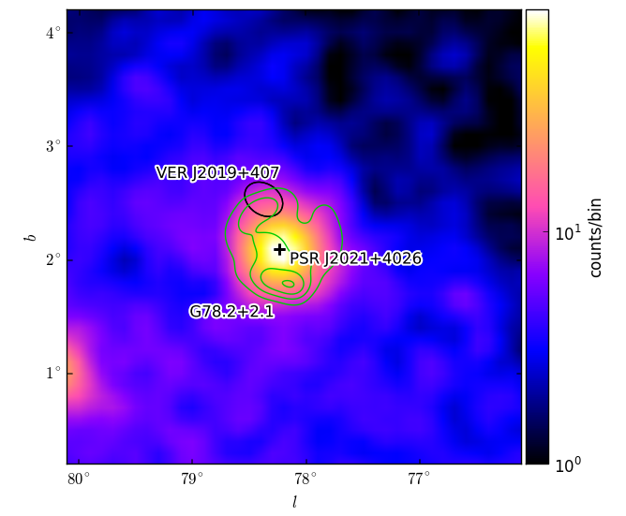
In the heart of the Cygnus
SNR G78.2+2.1 (“Gamma Cygni” SNR)
    Extended source, R~0.6°
    Distance ~ 1.5 kpc
    Age ~ 7 kyr
VERITAS source VER J2019+409
..and then the (radio-quiet) pulsar PSR J2021+4026
52 months, >2 GeV, front events
AGILE team reported variability from 1AGL J2022+4032, positionally coincident with the PSR (Nov ’07-Aug ’09), but concluded it was more likely due to another source along the line of sight
Notes:
24

Slide 25
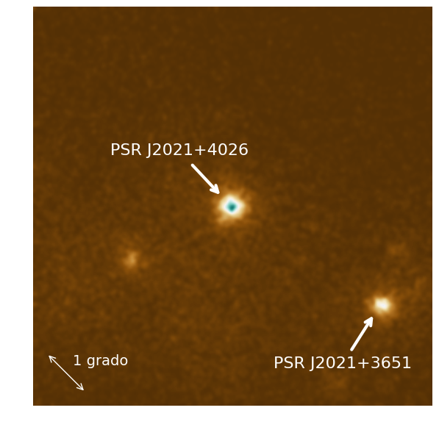
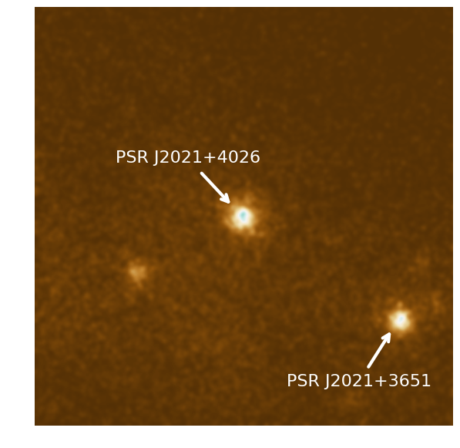
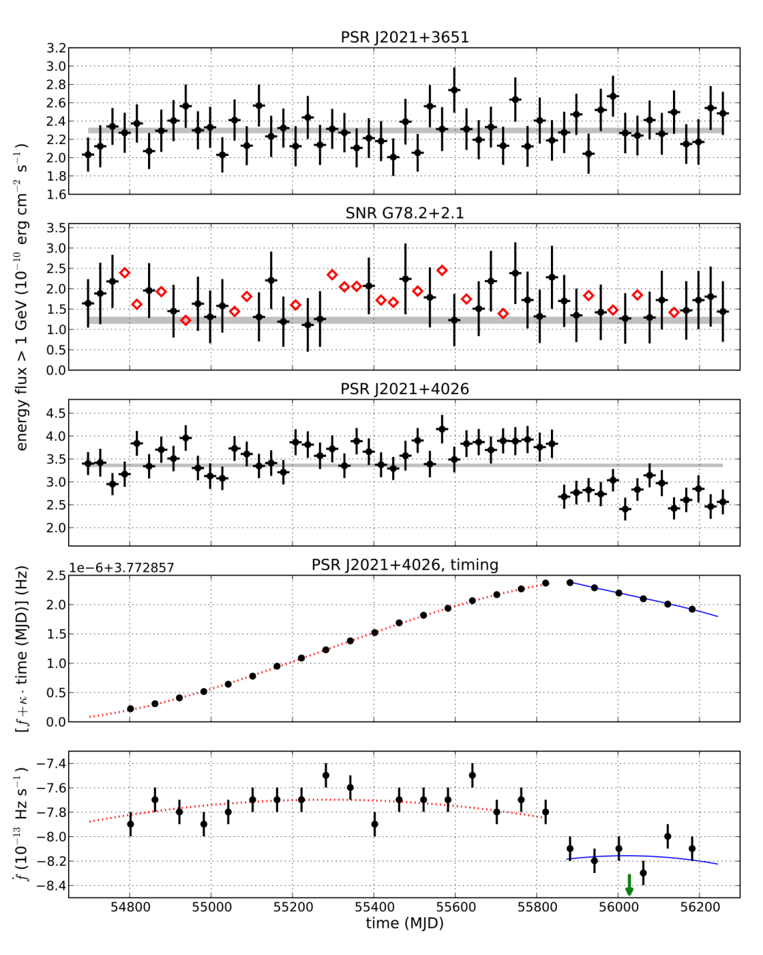
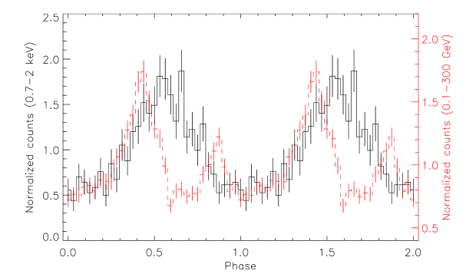

Slide 26
What is varying? ‏
If it’s the pulsar...
…look at the timing !
→Decrease in f₁ !
→Simultaneous with flux drop
Notes:
26

Slide 27
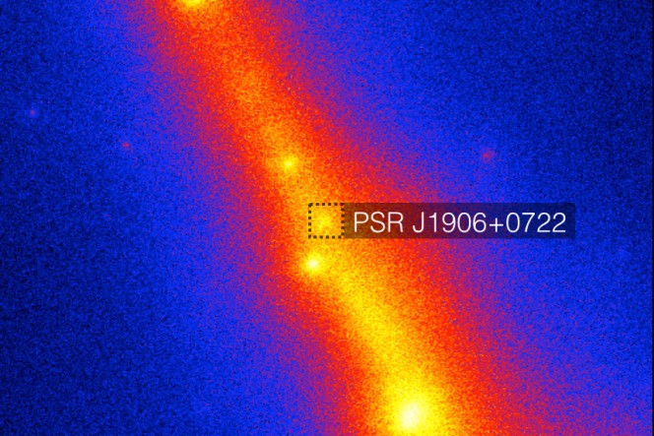
The most recent and the hardest to find with E@H
An energetic pulsar: detection complicated by a huge glitch

Slide 28
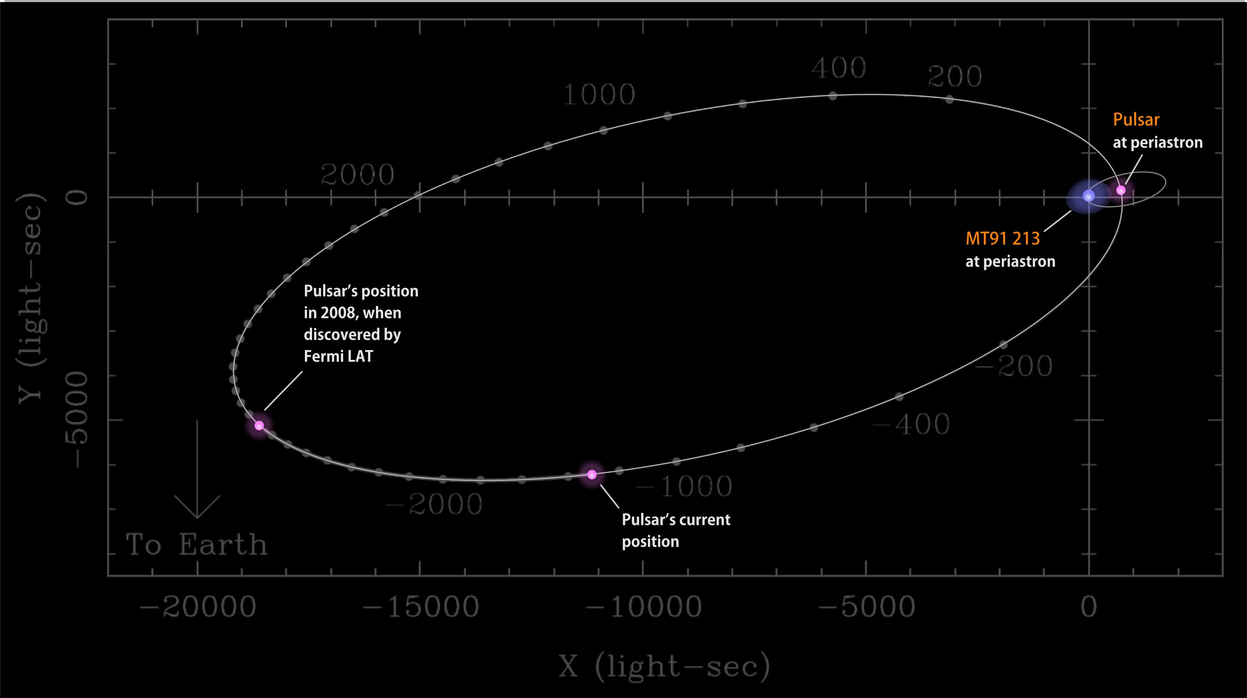
MT91 213 + PSR J2032+4127 - Be star/Pulsar binary system
3 systems-this is the only one showing gamma-ray pulsations

Slide 29
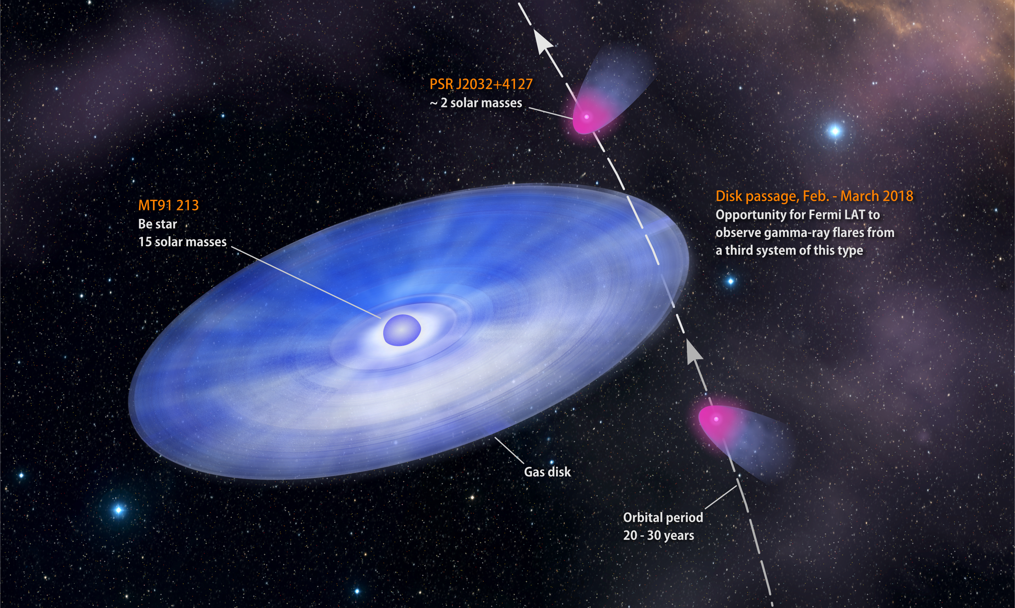
MT91 213 + PSR J2032+4127 - Be star/Pulsar binary system

Slide 30
PSR B1259-63 with its Be companion
the compact object is a pulsar (P~47 ms)
NO gamma-ray pulsations
Highly elliptical orbit (e ~ 0.9) with an orbital period of ~ 3.5 years.
The Be massive star has a disk almost perpendicular a the orbital plane
An enhancement of radio, X-ray and TeV flux is observed in correspondence of the two passages of the pulsar trough the disk

Slide 31

MW campaign on 2010
HE gamma-rays
In 2010 a flaring activity
was detected at HE by
Fermi-LAT only during
the second passage
trough the disk
X-rays
VHE gamma-rays

Slide 32


PSR 1023+0018 – a pulsar in transition
Before (radio-pulsar)
Transition in June 2013
  Radio pulsations disappeared
  Variable flat spectrum radio spectrum suggestive of a jet
  Gamma-ray flux increased by a factor of five
  NOT pulsating in gamma-rays
After (gamma-ray jets)

Slide 33

Surprising variability

Slide 34


A time line of events.
A time line of events. Timetable of the Astronomer's Telegram releases on the recent Crab Nebula flare in universal time, within 1 month after discovery on 22 September 2010. Corresponding telegram IDs are: 2855, 2856, 2858, 2861, 2866, 2867, 2868, 2872, 2879, 2882, 2889, 2893, 2903, 2921, 2967, 2968.
E Bernardini Science 2011;331:686-687
Notes:
A time line of events. Timetable of the Astronomer's Telegram releases on the recent Crab Nebula flare in universal time, within 1 month after discovery on 22 September 2010. Corresponding telegram IDs are: 2855, 2856, 2858, 2861, 2866, 2867, 2868, 2872, 2879, 2882, 2889, 2893, 2903, 2921, 2967, 2968.

Slide 35

April 2011, one more Crab Flare
Lightcurve in bins of equal exposure (mean 9 minutes!)
Apr 9
Apr 19
Flux doubling in 8 hours constrains emission region size <0.0003 pc
Beginning of LAT TOO
Buehler, R. et al. 2011, ApJ
Notes:
Point out Chandra obs here (Apr 12,13, 14 ,16 ,21)? VLA (Apr 15, 18, 20, 30)?

Slide 36

Flaring Crab
Flaring Nebula
Pulsar
Nebula

Slide 37

March 2013, yet another flare
March 2013 flare

Slide 38


More on variable galactic sources
What?
γ-rays
from
a Nova?

Slide 39











Stellar Novae Produce High Energy Gamma-rays
V407 Cyg 2010 | V1324 Sco 2012 | V959 Mon 2012 | V339 Del 2013 | V1369 Cen 2013
Fermi-LAT Collaboration, Science 2014
Serendipitous discovery of gamma-ray transient at the time and location of V407 Cyg – found something that we were not looking for!
Later found 4 more, largely due to target of opportunity observations… but for 1 case

Slide 40




1FGL J1018.6-5856 with Fermi-LAT (and Swift)
Power spectrum from LAT data
Fermi-LAT
Swift
X-ray counterpart
1FGL J1018.6-5856 is the first
(and so far the only) HMXB
discovered by Fermi-LAT .
It has an orbital period of ~16 day.
Fermi LAT Collaboration, 2012, Sci, 335, 189

Slide 41

μQUASARS

Slide 42


Two μquasars

Slide 43

Cyg X3

Slide 44

Cyg X3

Slide 45


Cyg X3- Variability & periodicity

Slide 46
PSRs, PWNe, SNRs, binaries
The Fermi Sky >1 GeV
something else ?

Slide 47

Dark matter in the Inner Galaxy?
Likely the brightest dark matter source in the gamma-ray sky, but...
Embedded in large and complicated backgrounds:
  resolved sources
  unresolved sources
  diffuse emission
Several independent studies find GeV excesses above the expected diffuse background
Daylan+14
The excess at the Galactic center could be due
→to dark matter,
→ to the sum of unresolved sources (e.g. MSPs)

Slide 48

Searching for DM in the GC, we found something funny…

Slide 49

Rolf Buehler
pie chart

