Slide 1
Fermi for blazars
Gabriele Ghisellini
INAF-Osservatorio di Brera

Slide 2
Jet power > disk luminosity
Two formation epochs for giant black holes

Slide 3
Power of jets in blazars
X-ray cavities

Slide 4
Power of jets in blazars
X-ray cavities

Slide 5
jet power and accretion luminosity
Γ
P_{r} = radiation ~ L_{obs}/Γ²
P_{e} = relat. electrons
P_{p} = protons
P_{B} = B-field
R
P_{jet} = P_{e}+P_{p}+P_{B}
~10¹⁷ cm
Shakura-Sunyaev disk: L_{d}

Slide 6
To compare disk luminosity and jet power, the best sample is:
Blazars detected by Fermi → L_{obs, jet}
with broad emission lines → L_{disk}
Shaw+ 2012: FSRQs (~220 sources)
Shaw+ 2013: BL Lacs (26 with BLR)

Slide 7
The jet cannot have less power than what required to produce the observed luminosity:
L_{obs}
P_{jet}
>
Γ²
If P_{jet} is twice as much, Γ halves.
We can take P_{rad} as the minimum P_{jet.}
This limit is almost model-independent.

Slide 8
The jet cannot have less power than what required to produce the observed luminosity:
L_{obs}
P_{jet}
>
Γ²
If P_{jet} is twice as much, Γ halves.
We can take P_{rad} as the minimum P_{jet.}
This limit is almost model-independent.

Slide 9
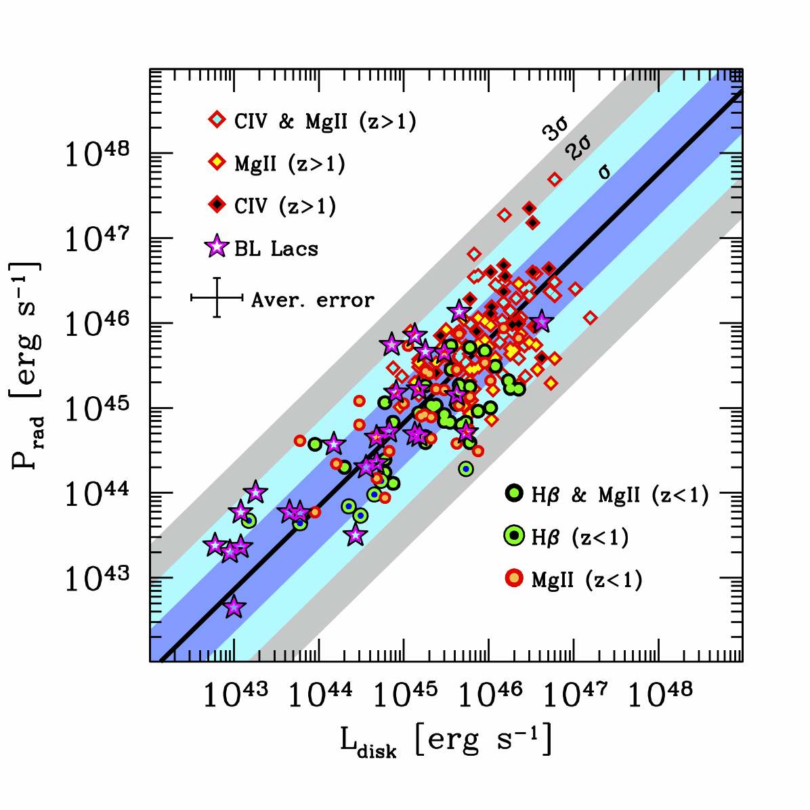
GG+ Nature, 2014

Slide 10
From P_{rad} to P_{jet}
γ_{min} → total number of e- (and of protons, if no pairs…)
Presence of electron positron pairs
Radiative model: SSC vs EC vs baryons

Slide 11
From P_{rad} to P_{jet}
γ_{min} → total number of e- (and of protons, if no pairs…)
Presence of electron positron pairs
Radiative model: SSC vs EC vs baryons
doesn’t fit
even more power

Slide 12
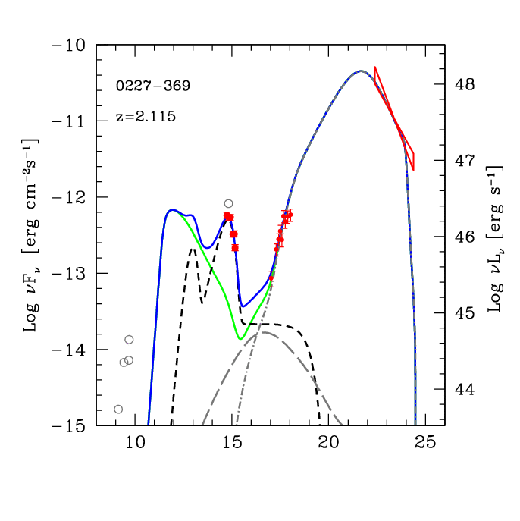
EC
synchro
Low energy e- !
disk
SSC

Slide 13
EC
“X-ray valley”
synchro
disk
SSC

Slide 14
EC
“X-ray valley”
synchro
disk
SSC

Slide 15
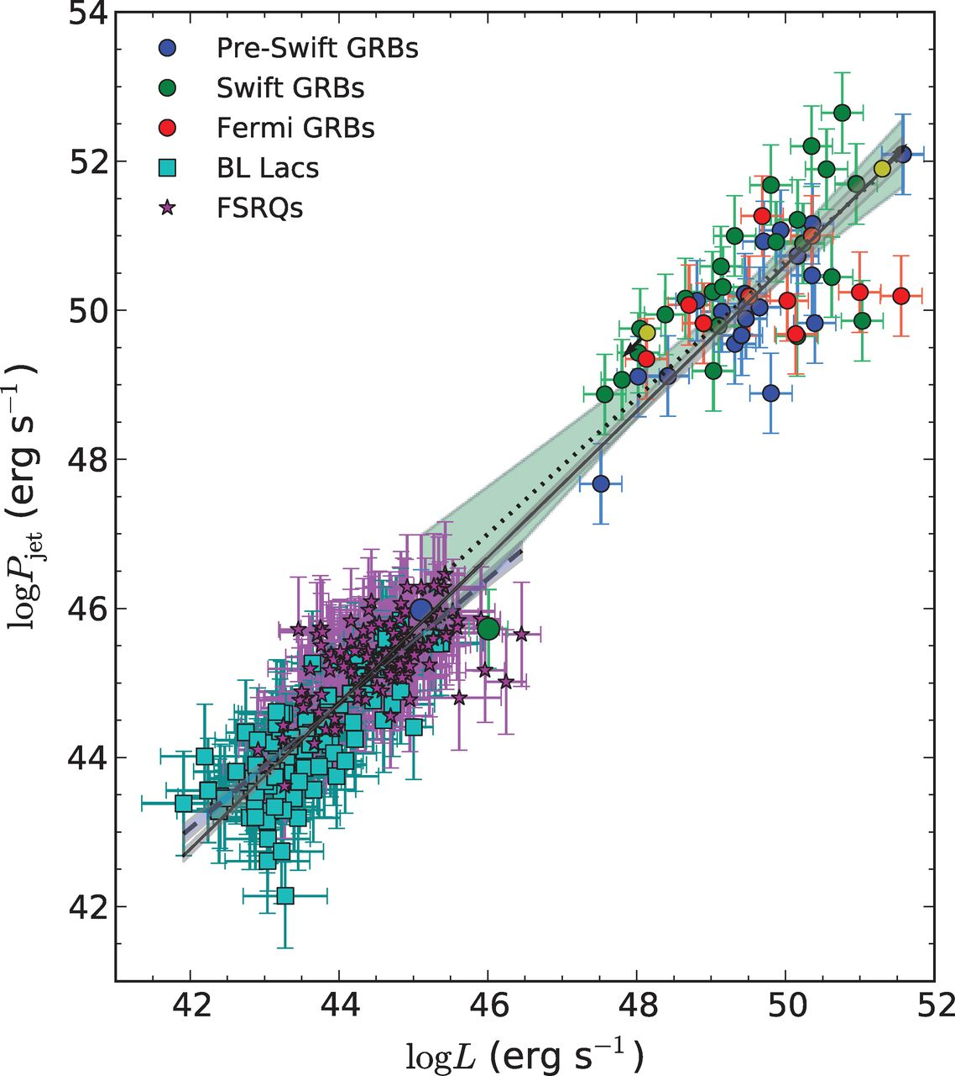
GRBs
P_{jet}=10 P_{rad}
blazars
Nemmen+ Science 2012
P_{jet} = P_{rad}
log P_{rad}

Slide 16
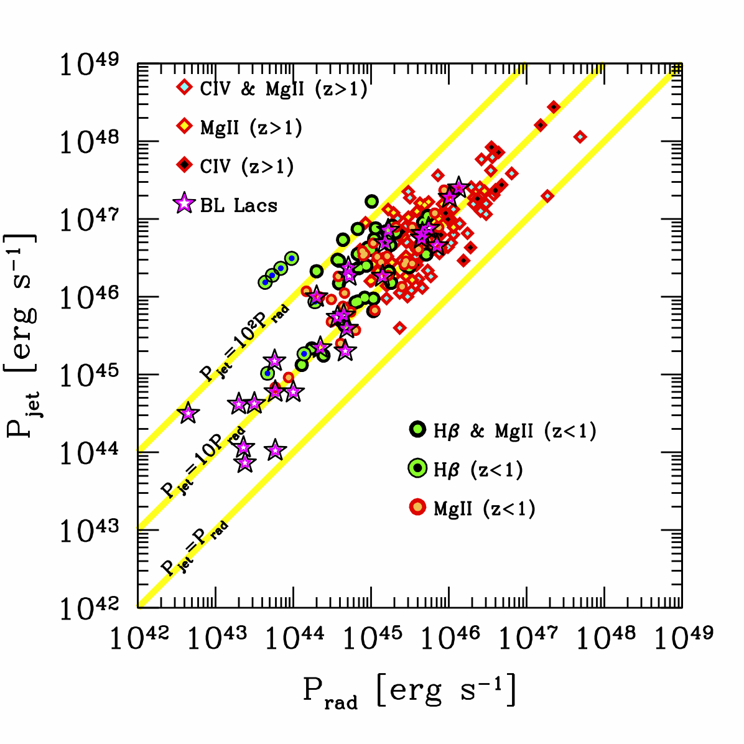
If one p per e-
GG+ Nature 2014

Slide 17
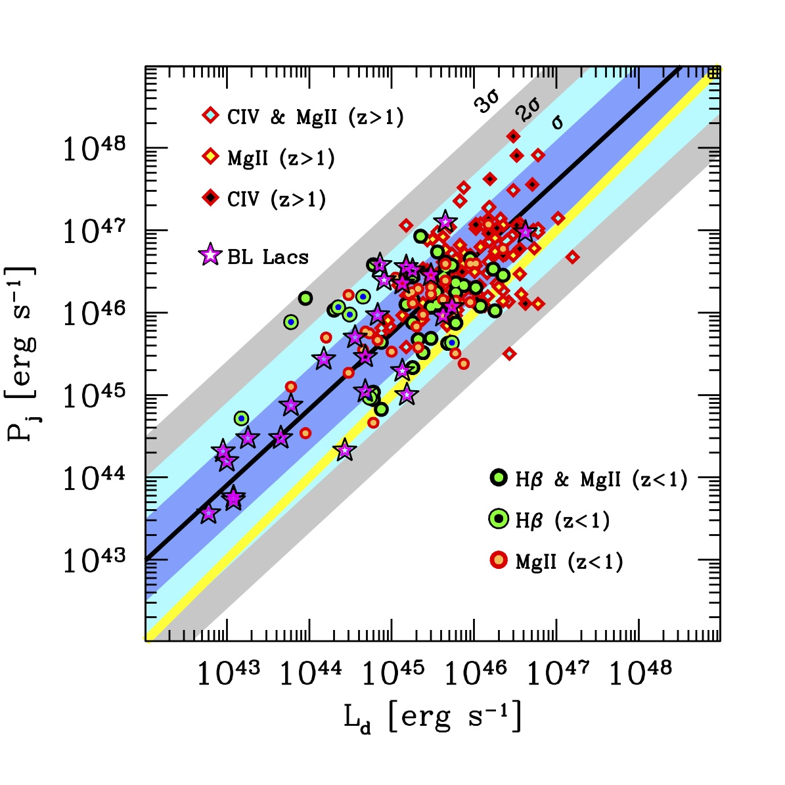

Slide 18
Apparent paradox:
Jet power proportional to accretion
And yet it is greater….

Slide 19
Rotation > Accretion
B-field amplified by accretion can tap the spin energy of the hole
This process is very efficient
The B-field “does not work”, the jet power comes from the BH spin
Yet it is the catalyst for the process. No B no jet.
But B is linked to accretion: that’s why P_{jet} is propto L_{d}

Slide 20
Shows results from the fiducial GRMHD simulation A0.99fc for a BH with spin parameter a = 0.99; see Supporting Information for the movie.
P_{jet}
Mc²
On average: 1 g in → 1.5 c² erg out
Tchekhovskoy A et al. MNRAS 2011;418:L79-L83
© 2011 The Authors Monthly Notices of the Royal Astronomical Society © 2011 RAS
Notes:
Shows results from the fiducial GRMHD simulation A0.99fc for a BH with spin parameter a = 0.99; see Supporting Information for the movie. The accreting gas in this simulation settles down to a magnetically arrested state of accretion. (Panels a–d): the top and bottom rows show, respectively, equatorial (z = 0) and meridional (y = 0) snapshots of the flow, at the indicated times. Colour represents the logarithm of the fluid‐frame rest‐mass density, log₁₀ρc² (red shows high and blue low values; see colour bar), filled black circle shows BH horizon, and black lines show field lines in the image plane. (Panel e): time evolution of the rest‐mass accretion rate, . The fluctuations are due to turbulent accretion and are normal. The long‐term trends, which we show with a Gaussian smoothed (with width τ= 1500r_{g}/c) accretion rate, , are small (black dashed line). (Panel f): time evolution of the large‐scale magnetic flux, ϕ_{BH}, threading the BH horizon, normalized by . The magnetic flux continues to grow until t ≈ 6000r_{g}/c. Beyond this time, the flux saturates and the accretion is magnetically arrested. (Panels (c) and (d) are during this period). The large amplitude fluctuations are caused by quasi‐periodic accumulation and escape of field line bundles in the vicinity of the BH. (Panel g): time evolution of the energy outflow efficiency η (defined in equation (5) and here normalized to ). Note the large fluctuations in η, which are well correlated with corresponding fluctuations in ϕ_{BH}. Dashed lines in panels (f) and (g) indicate time averaged values, 〈ϕ²_{BH}〉^{1/2} and 〈η〉, respectively. The average η is clearly greater than 100 per cent, indicating that there is a net energy flow out of the BH.

Slide 21
Seeking the most distant blazars with the heaviest and active black holes
Risky, but possibly rewarding. ~ 50 radio-quiet quasars known with z>6, and 1 at z~7, with M~10⁹M_{sun}
Even only one blazars at z=6 with M>10⁹M_{sun}….

Slide 22
Fermi

Slide 23
Redshift+
Sequence
BAT
Fermi

Slide 24
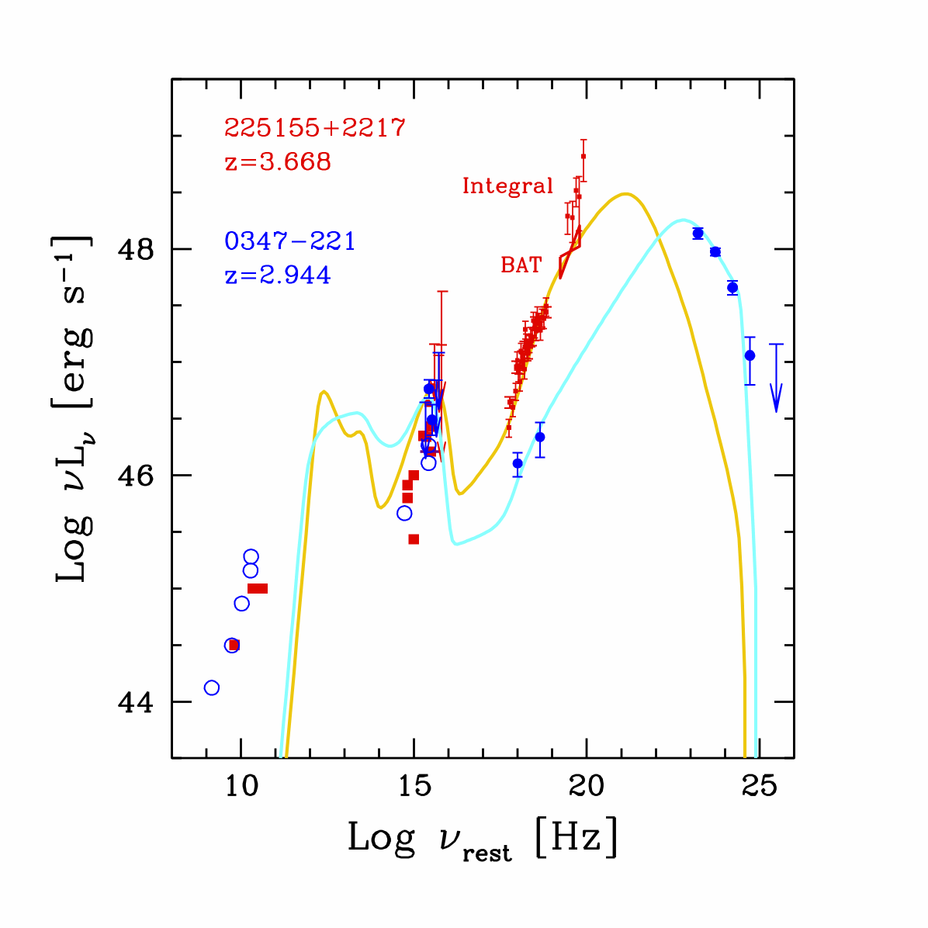

Slide 25
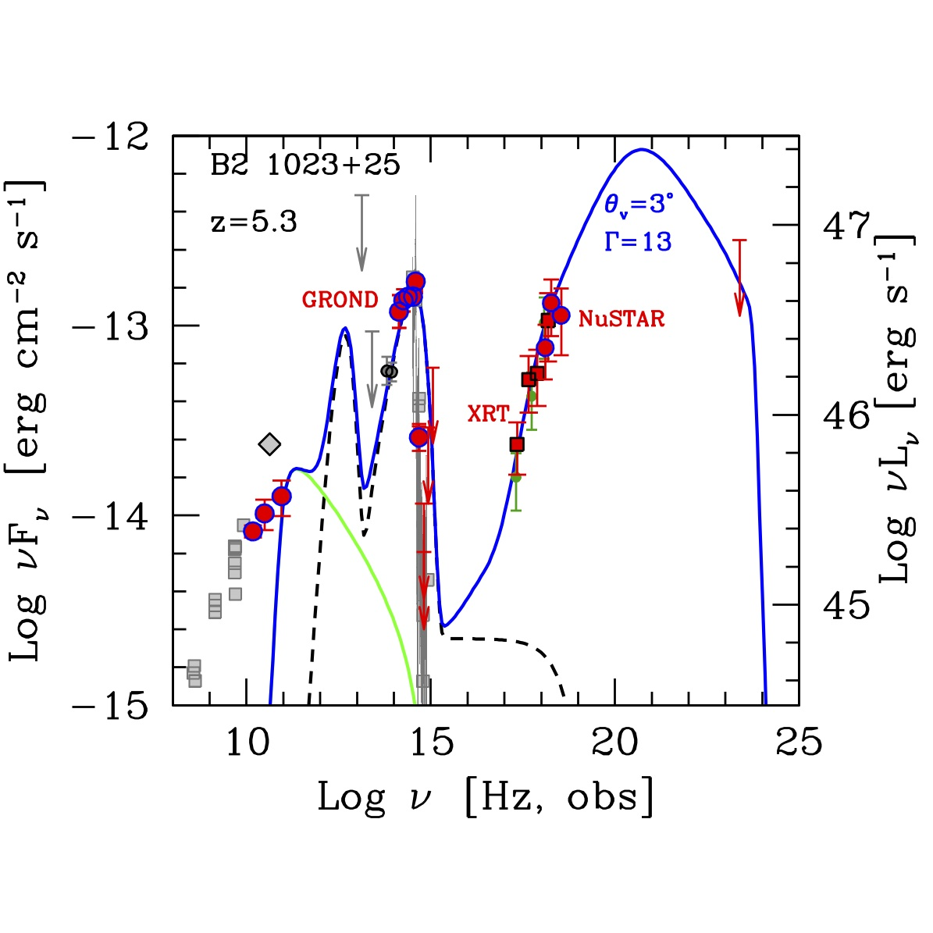
Sbarrato+ 2013

Slide 26
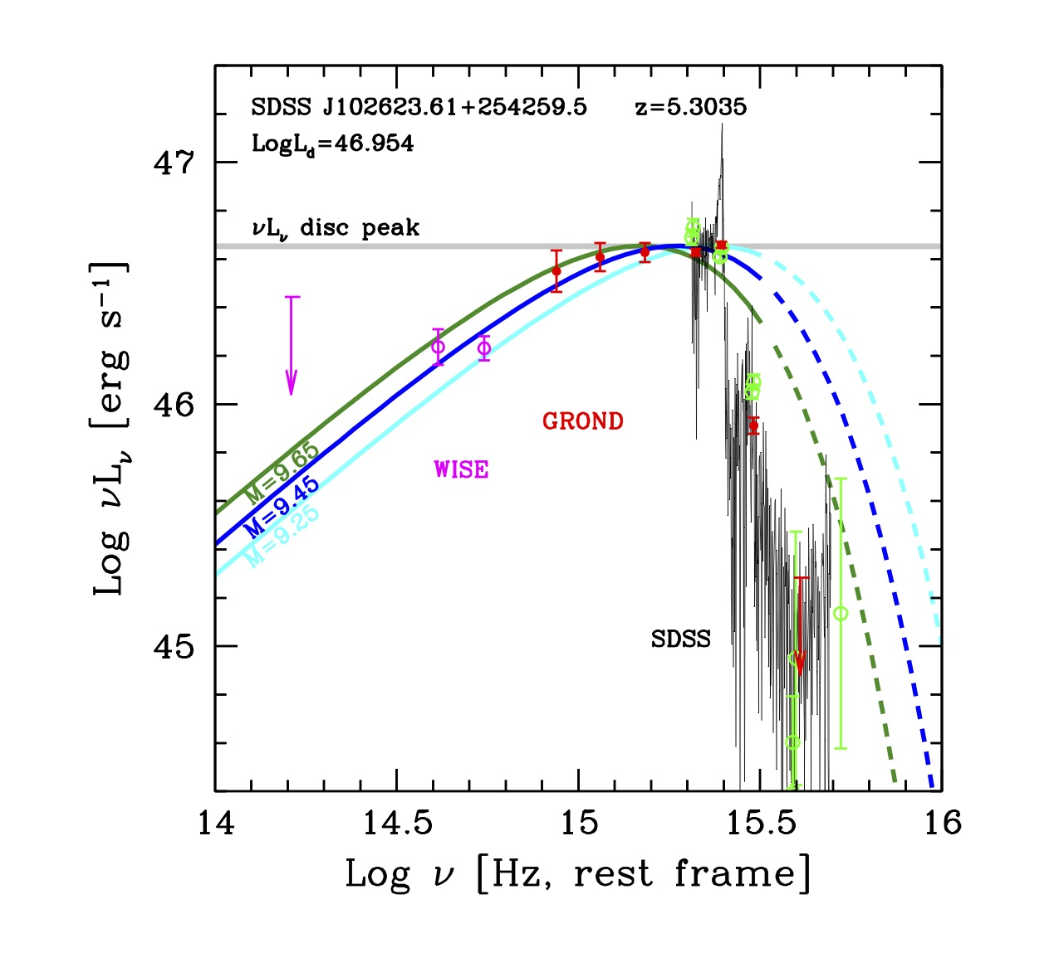
Lyα
Sbarrato+ 2012
M_{BH}=3x10⁹

Slide 27
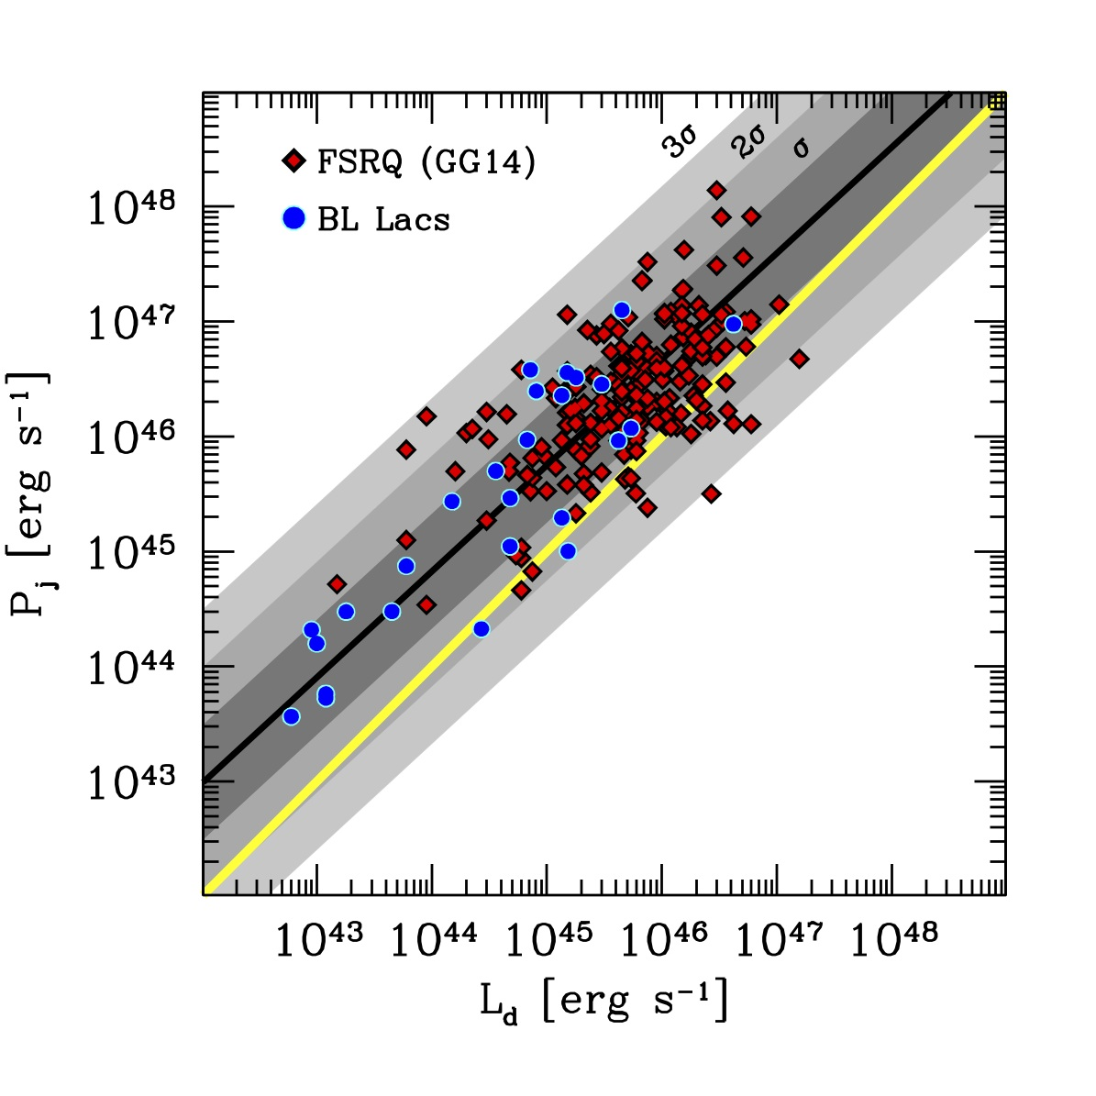
GG+ Nature, 2014

Slide 28
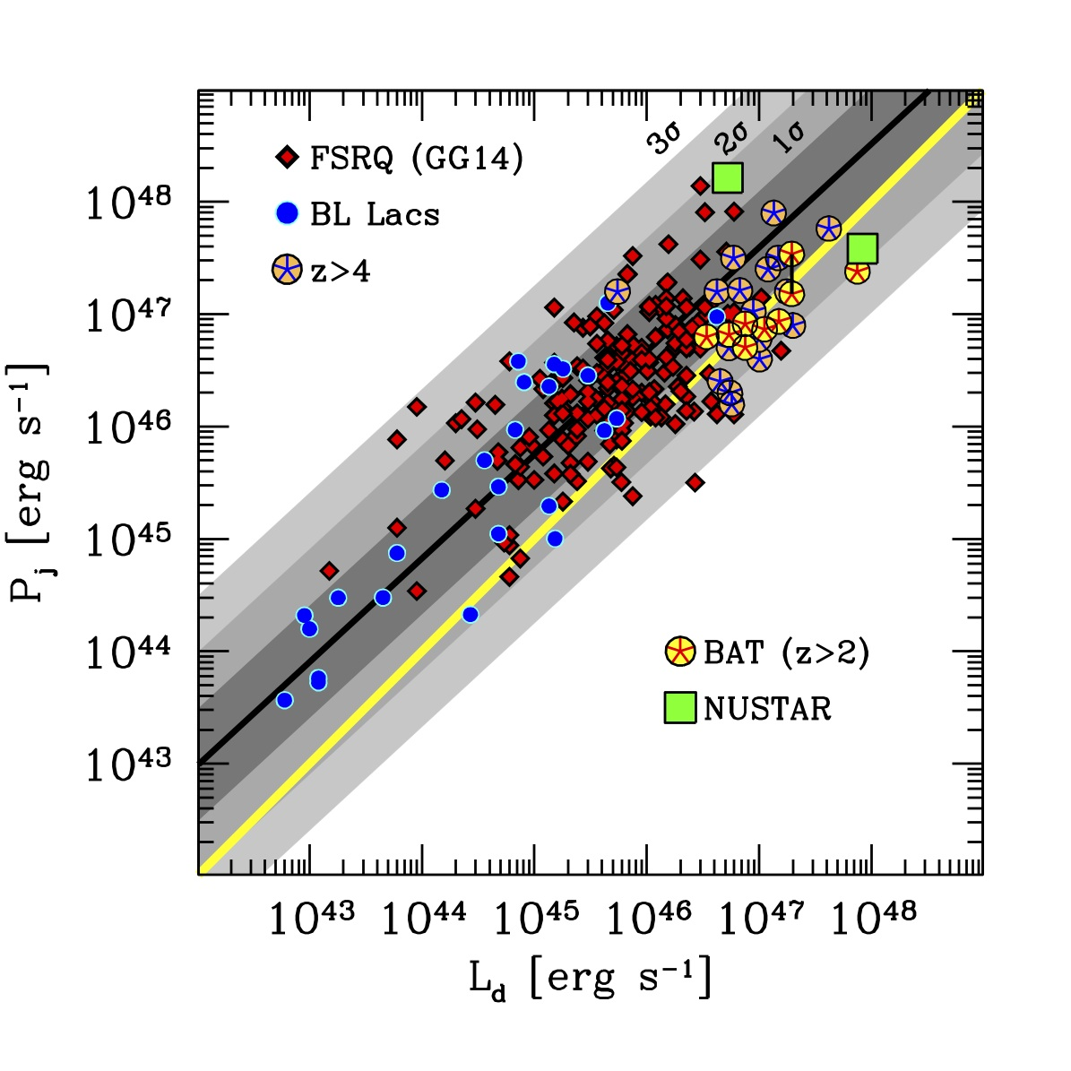
Sbarrato+ in prep

Slide 29
1=2Γ² ~300-500

Slide 30
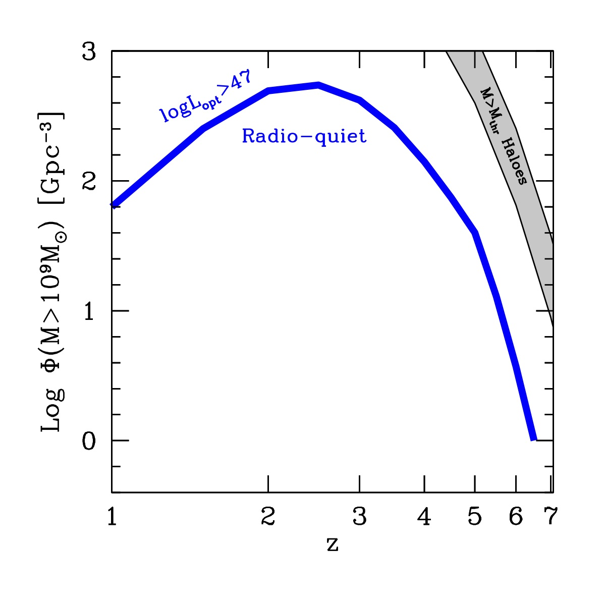
Massive AND active black holes

Slide 31
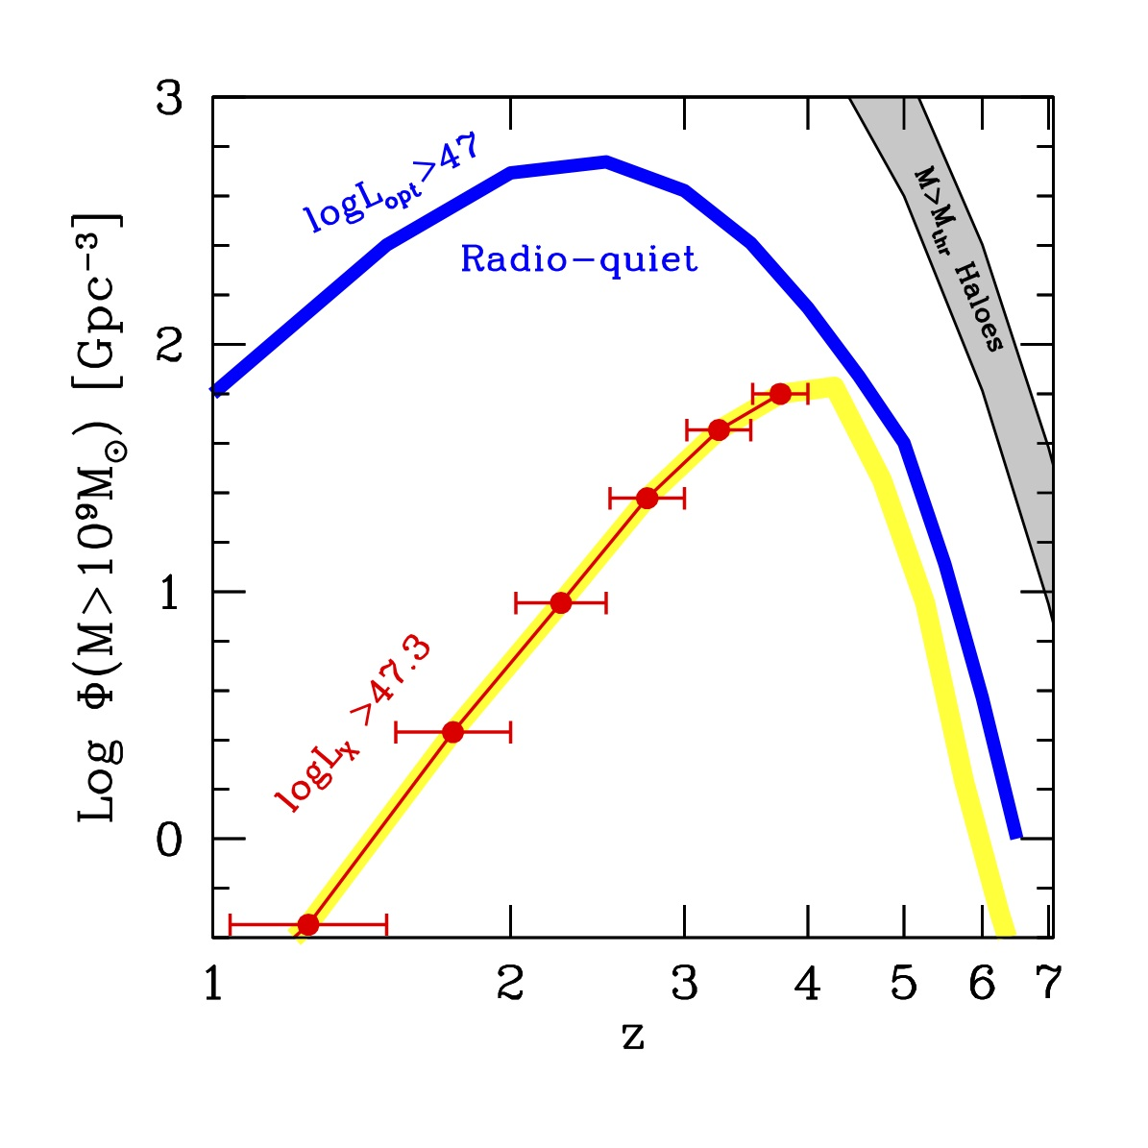
Massive AND active black holes
BAT

Slide 32
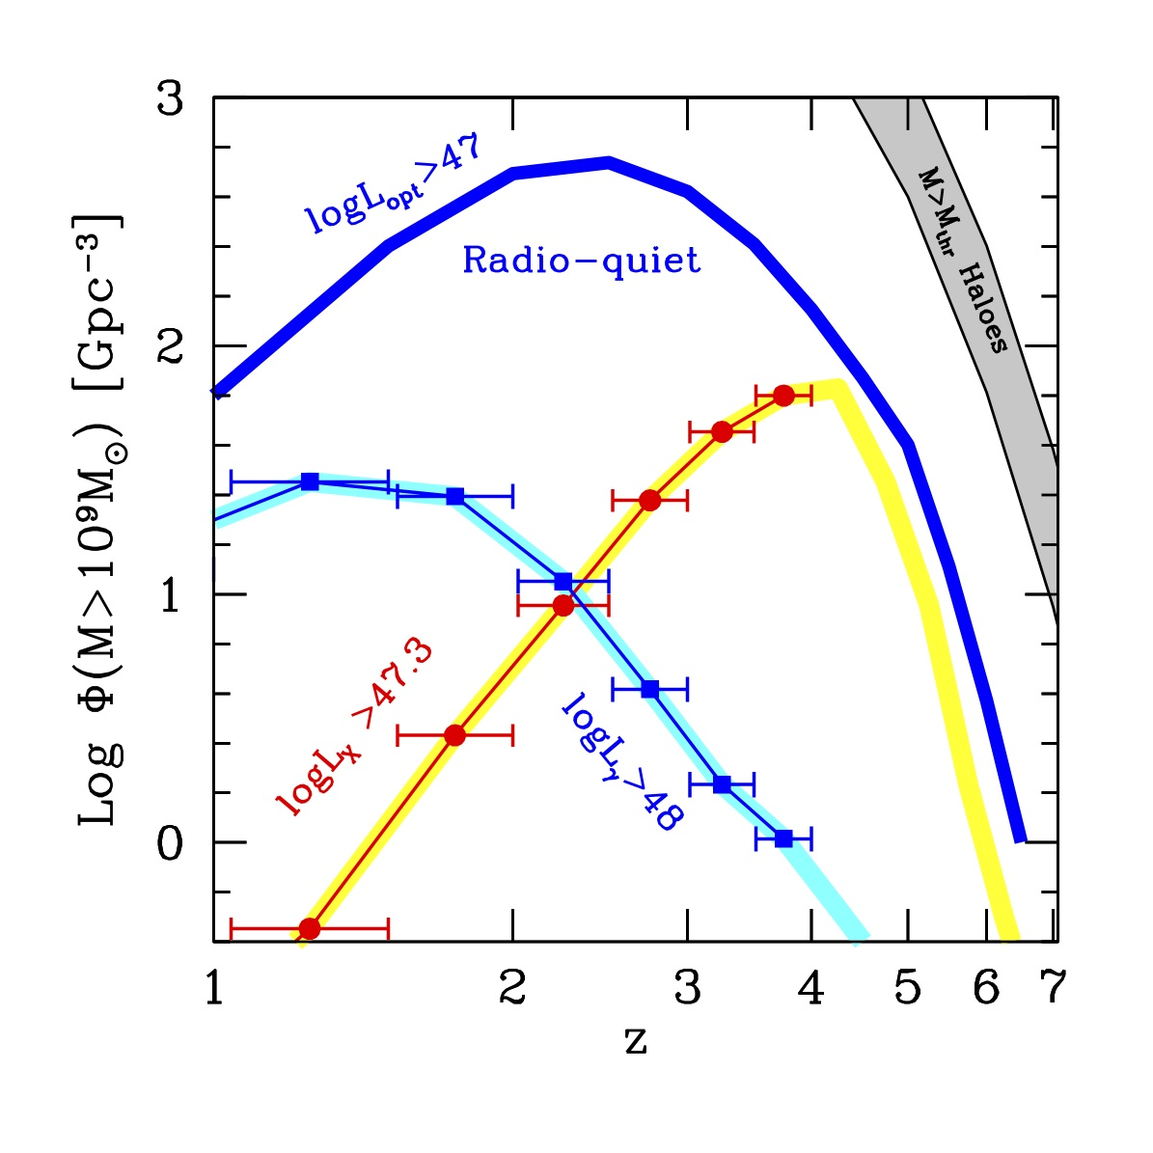
Massive AND active black holes
Fermi
BAT

Slide 33
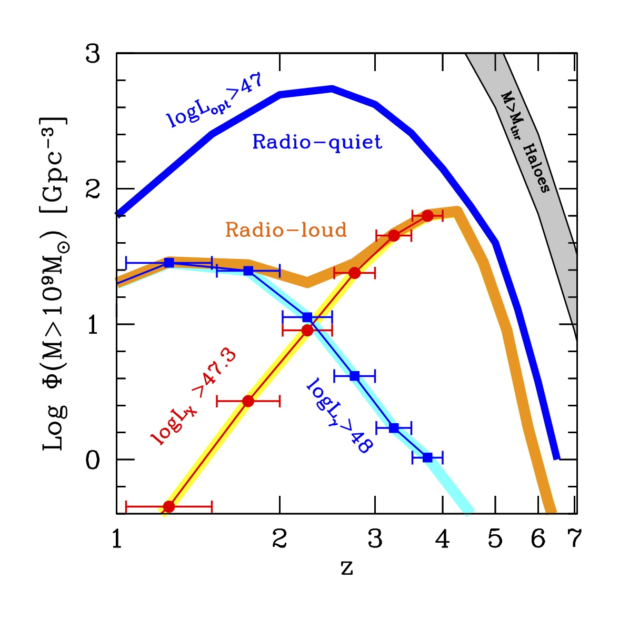
Massive AND active black holes
Fermi
BAT

Slide 34
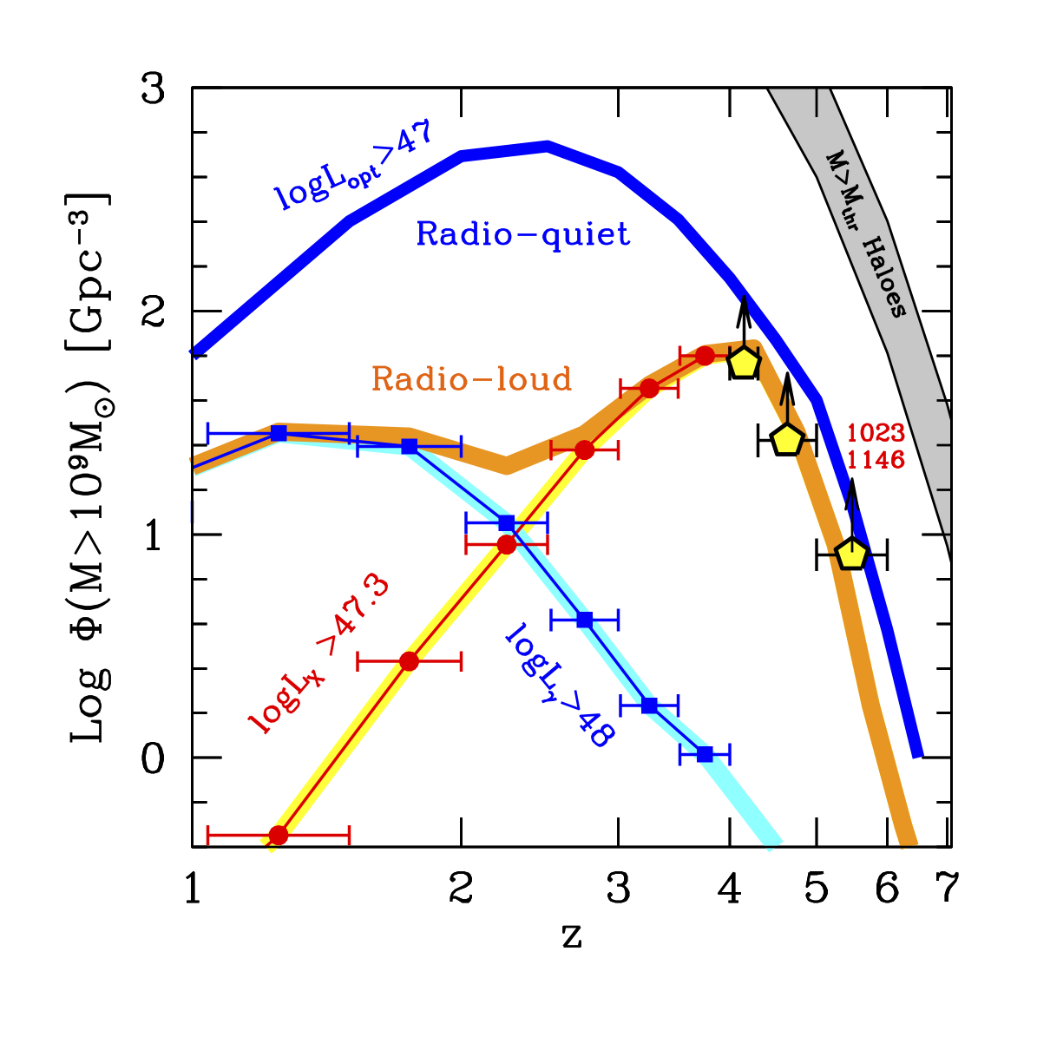
Two formation epochs?
Fermi
Ajello+ 2013
BAT
Ajello+ 2009

Slide 35
Conclusions
P_{jet} ~ Mc², larger than L_{d}
The jet uses to energy stored in the rotation of the hole, that was provided by accretion. But it takes it out faster than when it was put in.
M>10⁹ M_{o} BH with jets are born at z~4.
Radio loud fraction changes with z (for heavy black holes). Does the jet help to accrete faster?

Slide 36
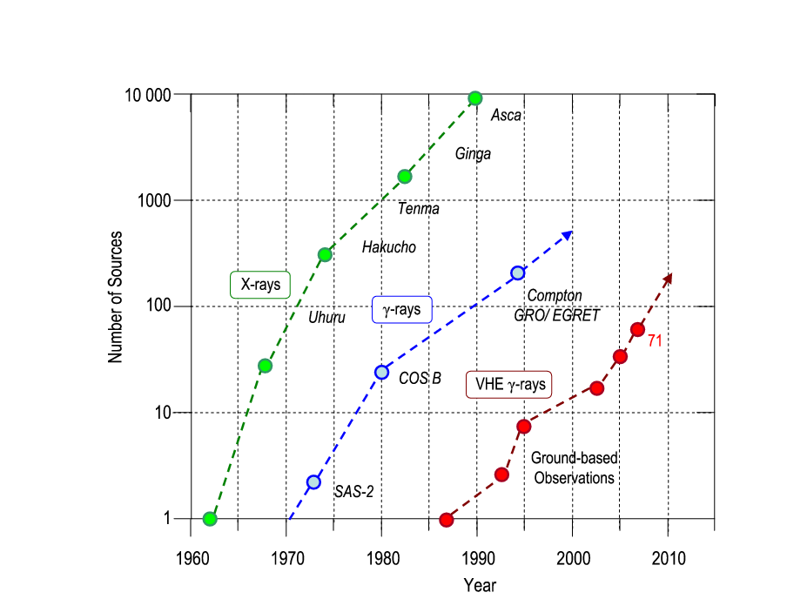
Gamma-ray astronomy
Rosat
Fermi
TeV

Slide 38
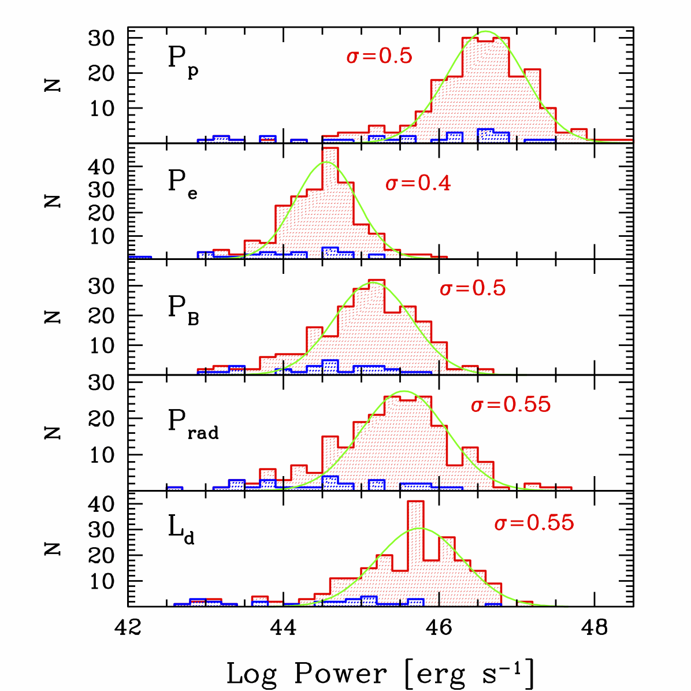
If one p per e-
Relat. electrons
Magnetic Field
Radiation
Disk

Slide 39
Efficiency
E
η
=
mc²

Slide 40
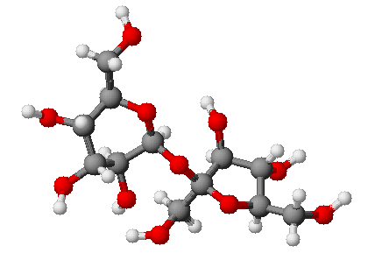
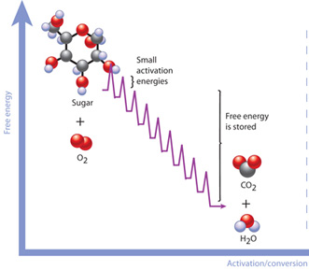
Sugar saccharose C₁₂H₂₂O₁₁
1g → 4 kcal= 16.2 kJ = 1e23 eV = 4.7 eV per molecule
E
1.6x10¹¹erg
η
=
=
=
1.8x10⁻¹⁰
mc²
9x10²⁰ erg

Slide 41
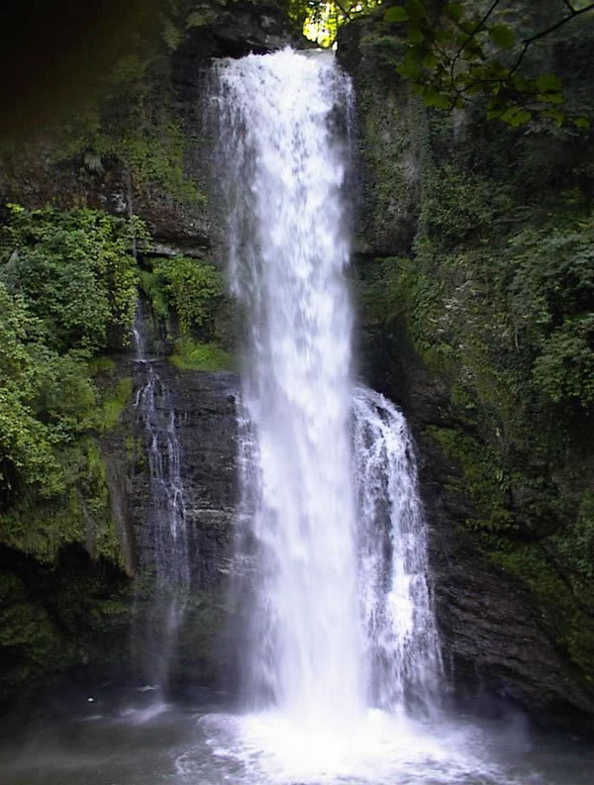
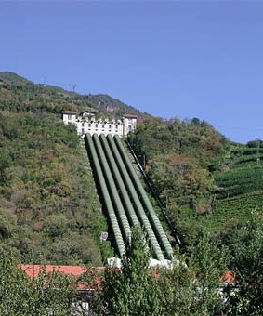
mgh
980x10⁴ (h/100 m)
η
=
=
~
10⁻¹⁴
mc²
9x10²⁰ erg

Slide 42
mv²
(v/c)²
η
=
=
=
4x10⁻¹⁵
(v/100 km/h)²
2 mc²
2

Slide 43
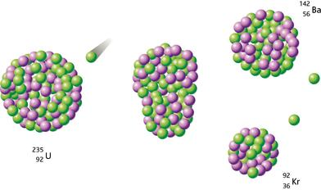
Nuclear fission
E
0.2x10⁹eV
η
=
=
~
9x10⁻⁴
mc²
235x9.4x10⁸ eV

Slide 44
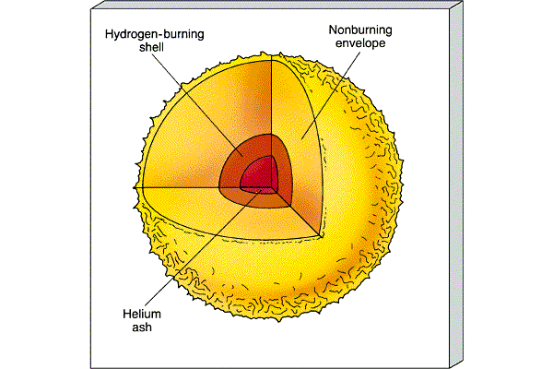
Fusion
η
=
0.008 x 0.1
~ 8x10⁻⁴

Slide 45
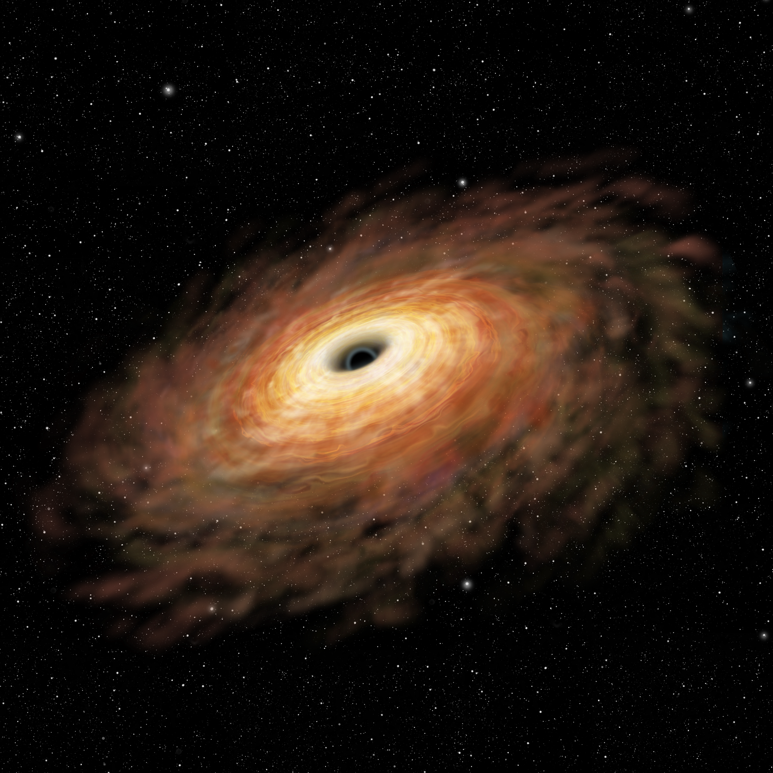
η
GM m
R mc²
R_{g}
=
1
(Newton)
R_{min}=R_{g} for max spin
=
2
2R
η
=
0.1 up to 0.3 for accreting Kerr (Thorne 1974)

Slide 46
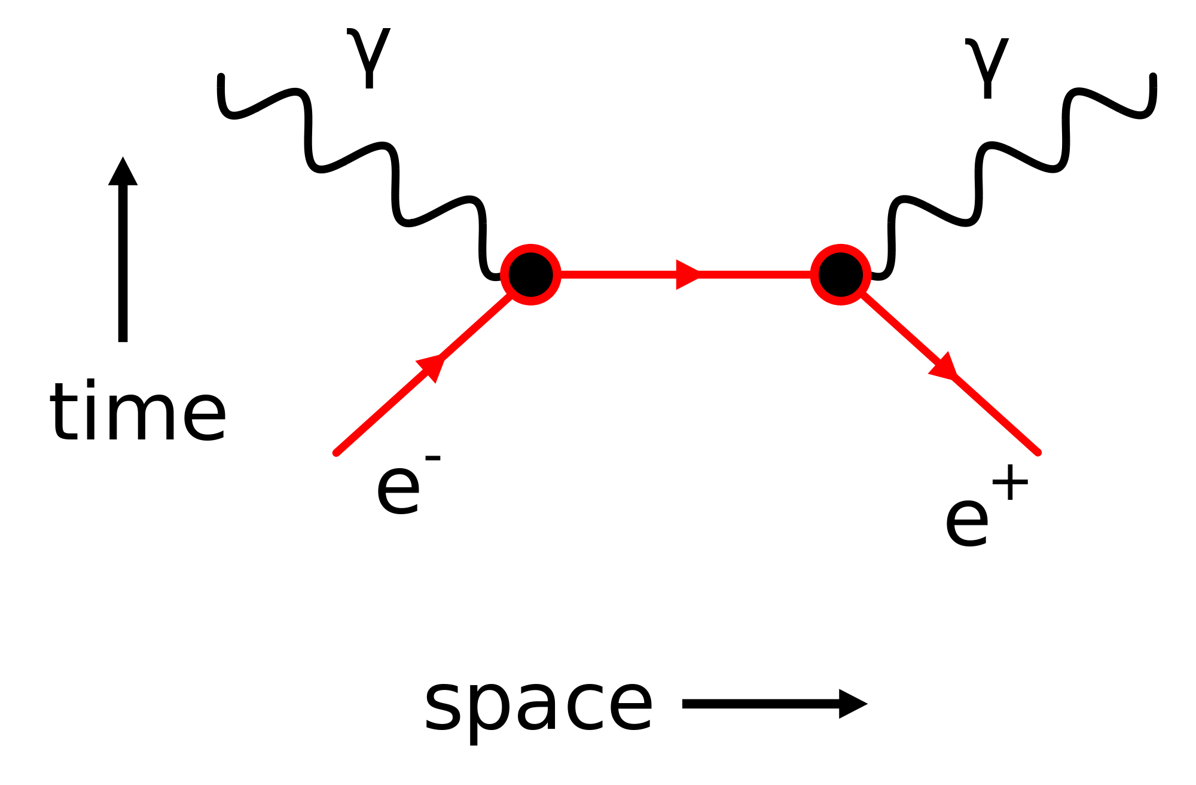
Annihilation
η = 1

Slide 47
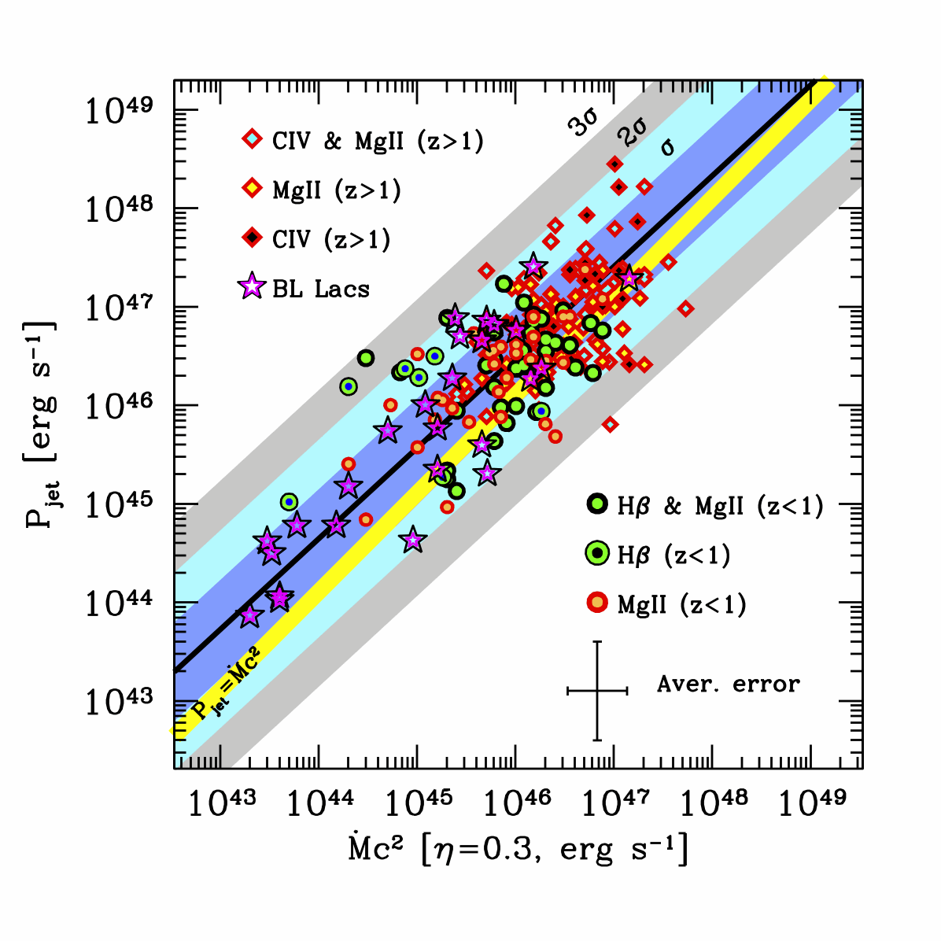
1 proton per electron → no pairs
GG+ Nature, 2014

Slide 48
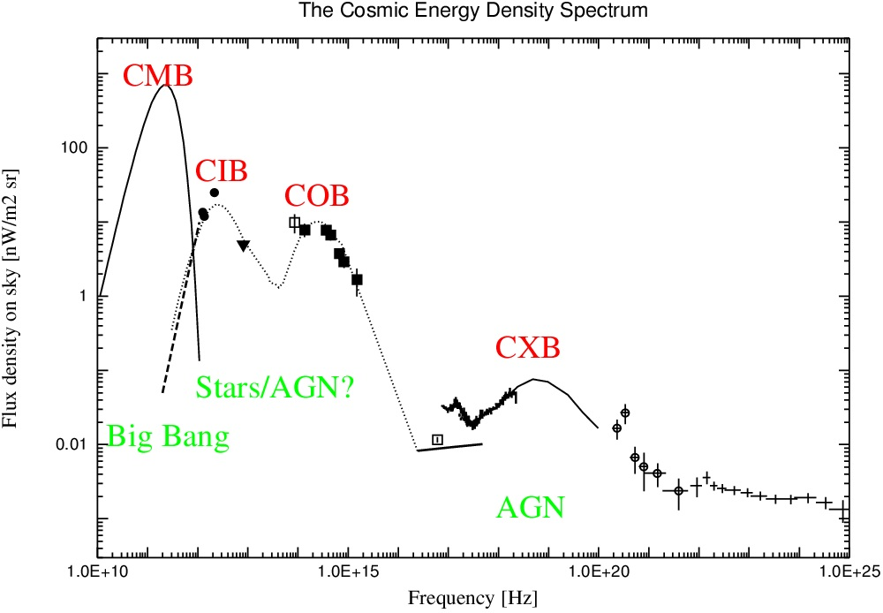

Slide 49
M_{BH} = 5x10⁻³M_{bulge} (Kormendy & Ho 2013 ARAA)
η_{BH} = 0.1; η = 0.008x0.1=8x10⁻⁴
Accretion
??

Slide 50
E_{BH} = 5/8 E = 5/13 E_{tot}
Accretion
??

Slide 51
Power of jets in blazars
X-ray cavities
Minimum energy
t_{lobe}

Slide 52
Power of jets in blazars
X-ray cavities
PV work / t_{sound}

Slide 53
Power of jets in blazars
X-ray cavities
Measure the size, apply SSC model, find δ and # of e-

Slide 54
Annihilation
Nuclear Fusion/Accretion
Accretion
Jets

Slide 55
Blandford Znajek
P_{BZ} ~ a²B²M²

Slide 56
Blandford Znajek
P_{BZ} ~ a²B²M²
P_{BZ} ~ a²B²R_{g}²c Poynting Flux

Slide 57
Blandford Znajek
P_{BZ} ~ a²B²M²
P_{BZ} ~ a²B²R_{g}²c Poynting Flux
P_{BZ} ~ a²ρc² R_{g}²c ρc²~B²/8π
P_{BZ} ~ a²Mc²

Slide 58
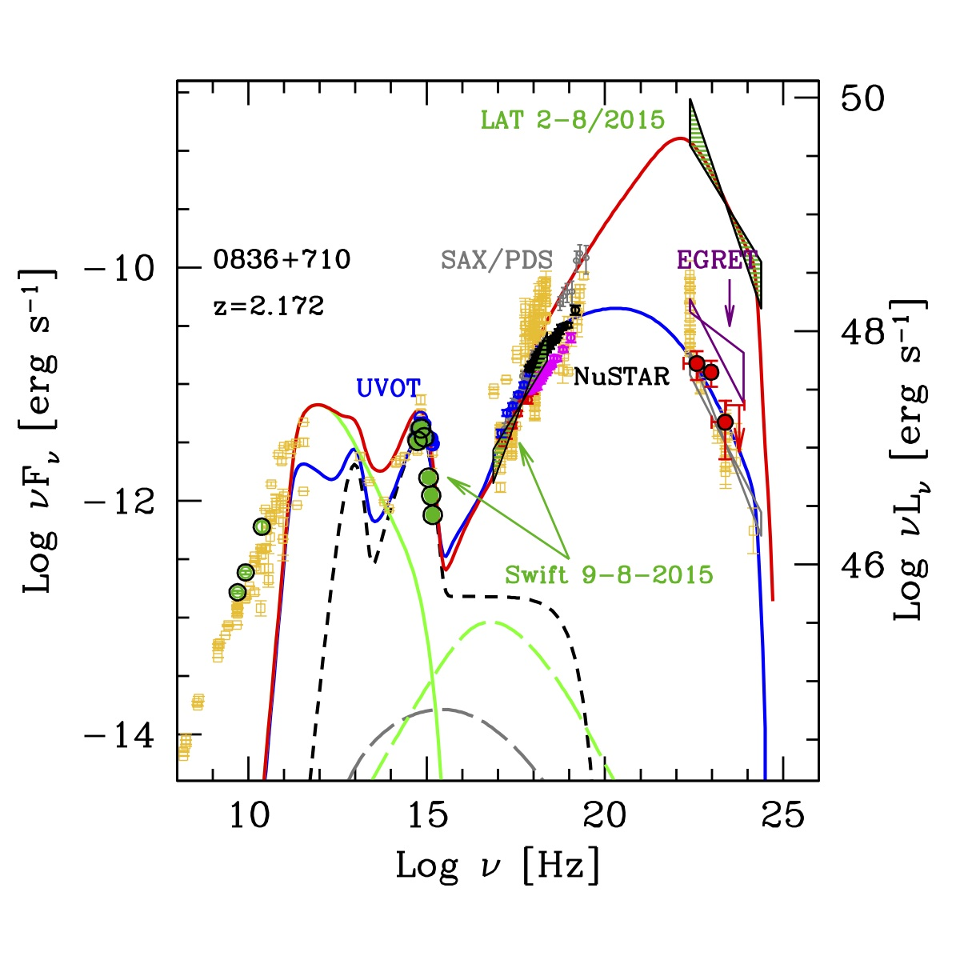

Slide 59
Fermi
EC
M=2x10⁹
synchro
UVOT
XRT
GG, Tavecchio & Ghirlanda 2009
torus
X-ray corona
disk
SSC
Low energy synchro peak: leave the disk naked!

Slide 60
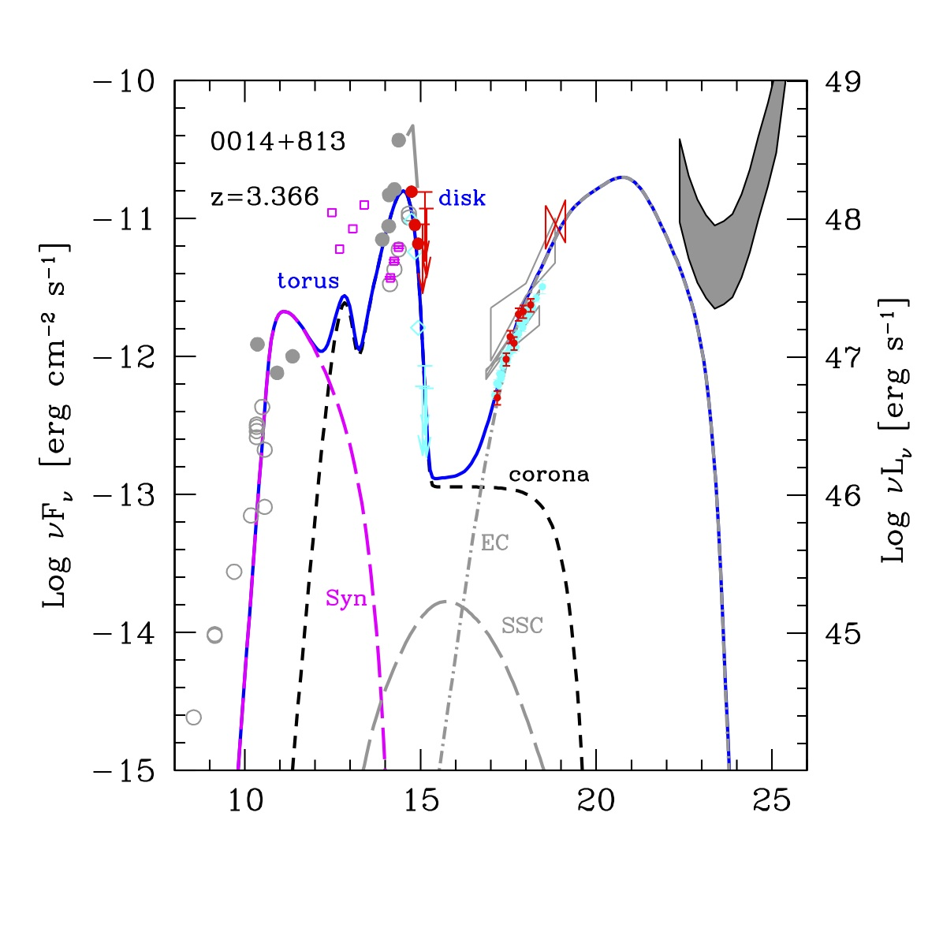
M_{BH}=4x10¹⁰
BAT
Log ν [Hz]
Ly-α: 10⁴⁶ erg/s
L_{ion} ~ 5x10⁴⁷ erg/s
L_{disc} ~ 3x10⁴⁸ erg/s

Slide 61
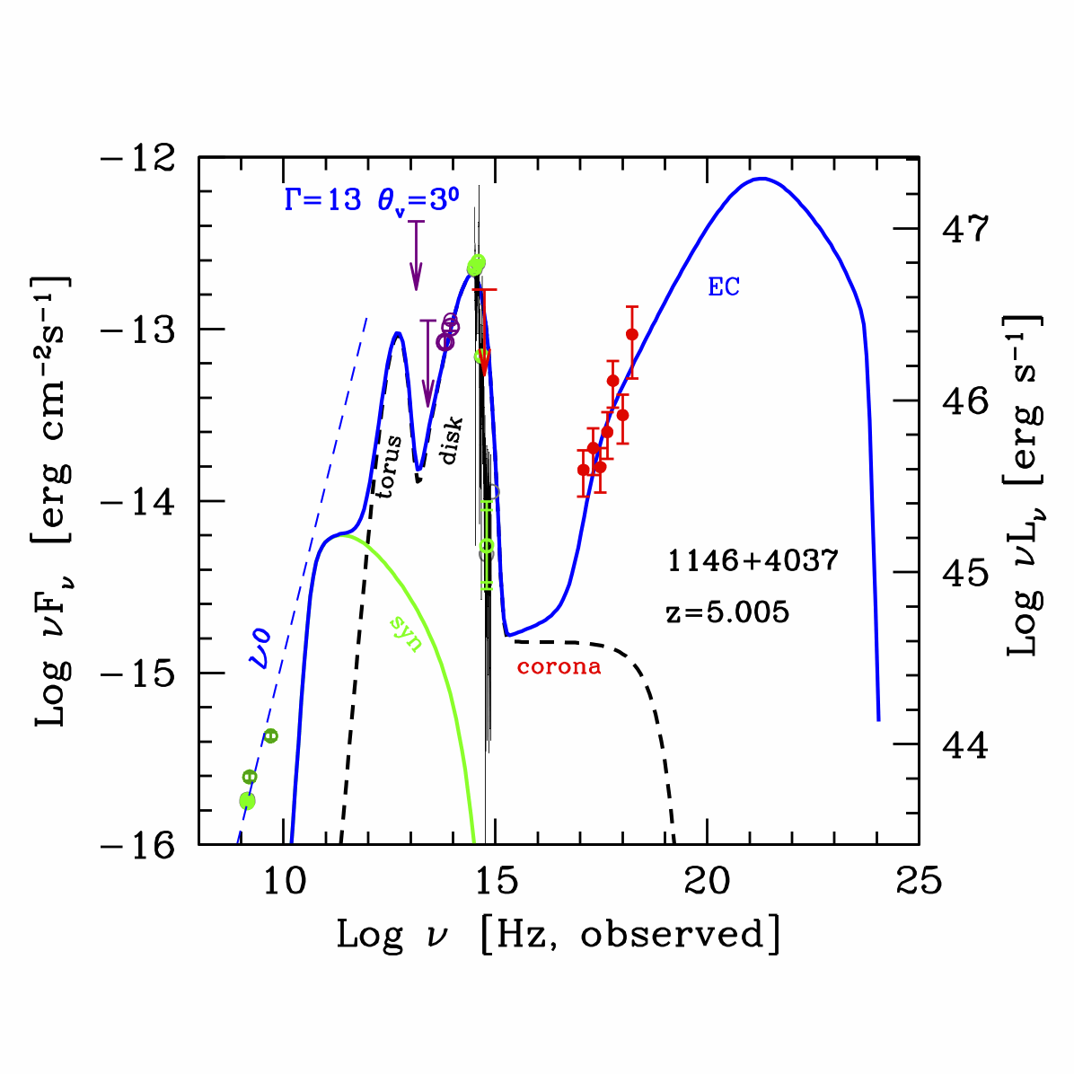
GG+ 2012

Slide 62
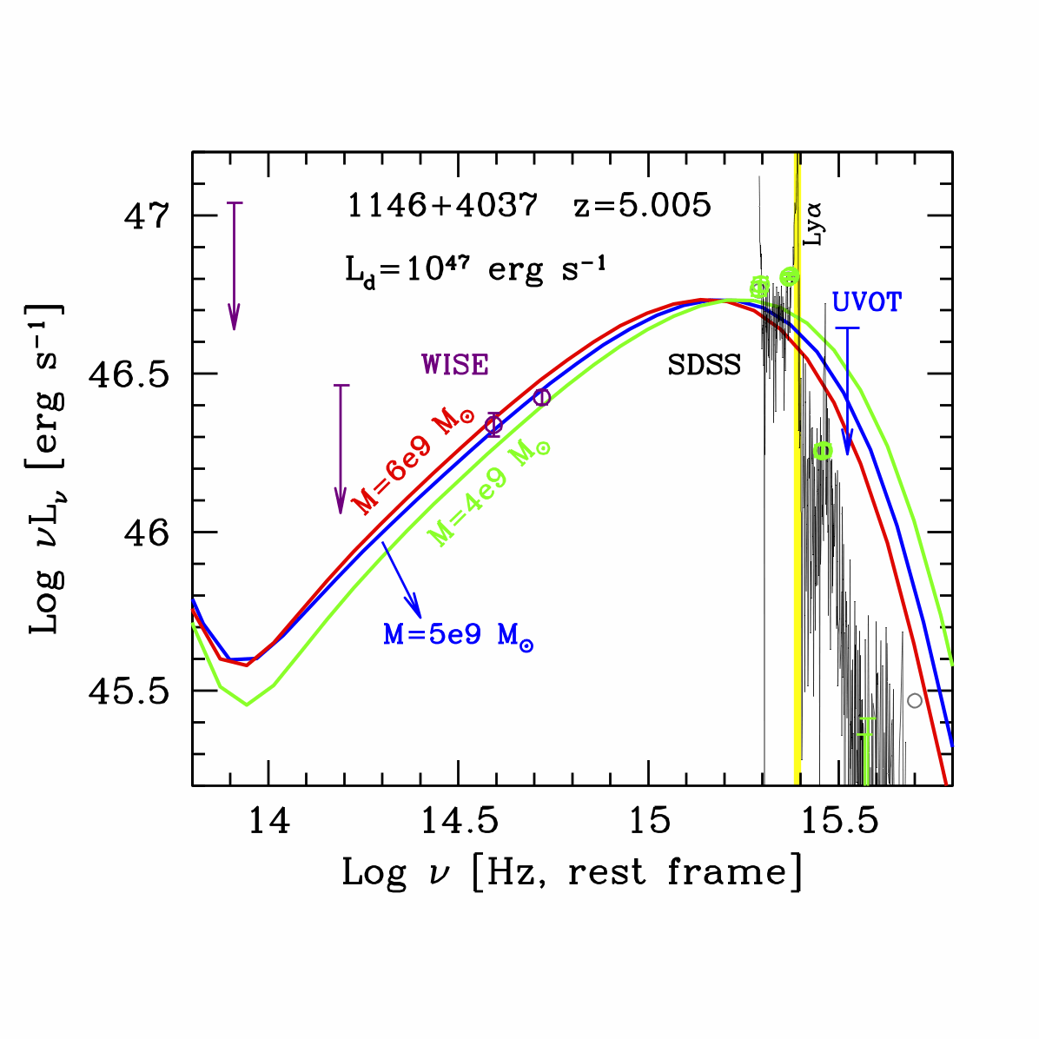
GG+ 2014

Slide 63
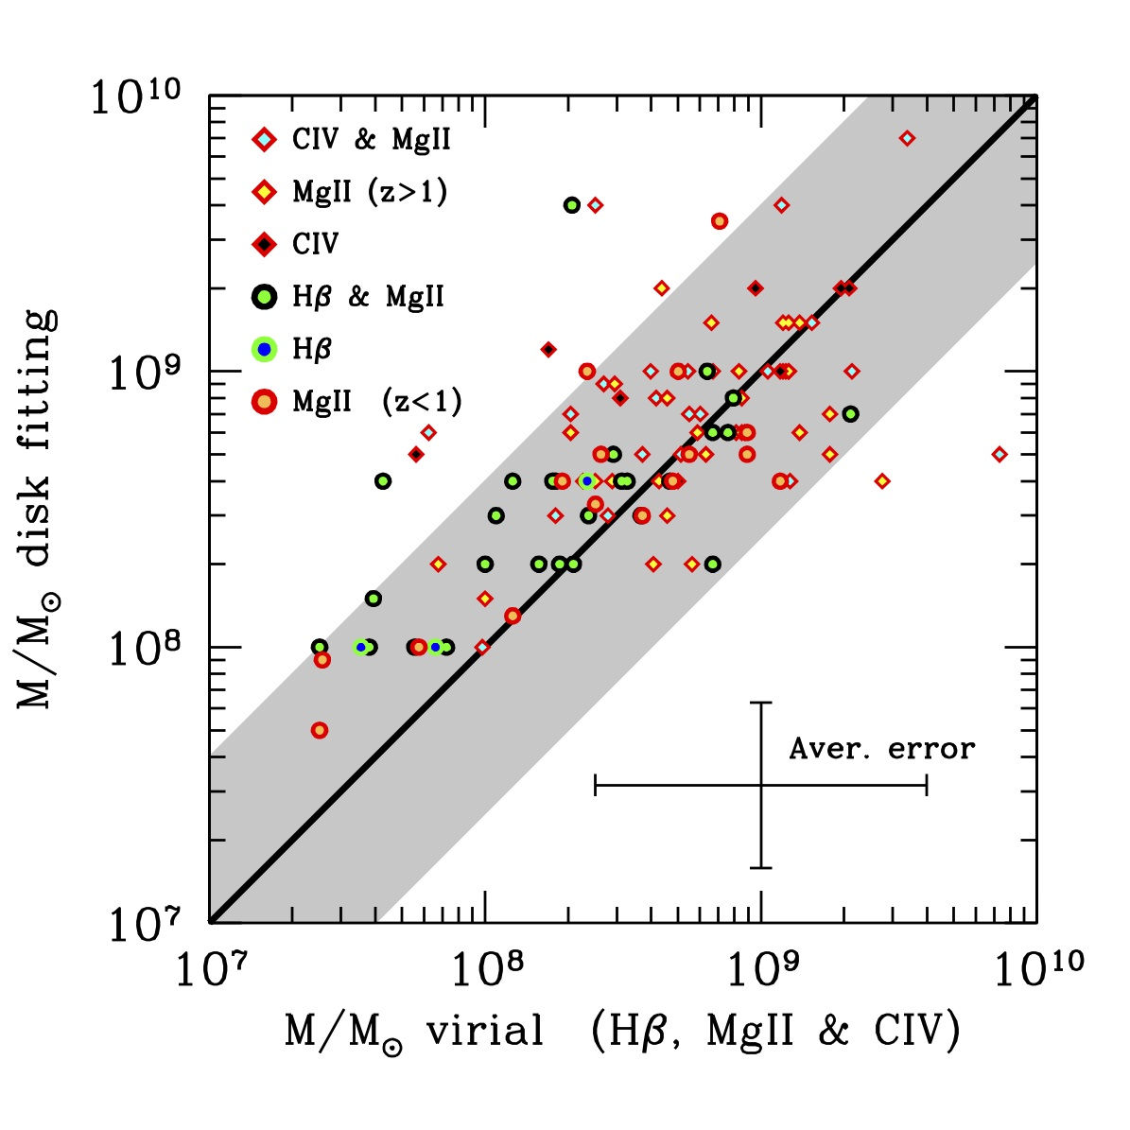
GG+ 2015

Slide 64
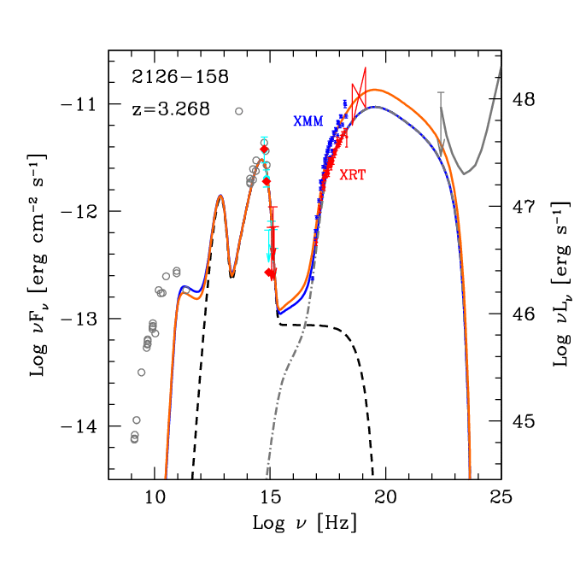
BAT
M_{BH}=10¹⁰

Slide 65
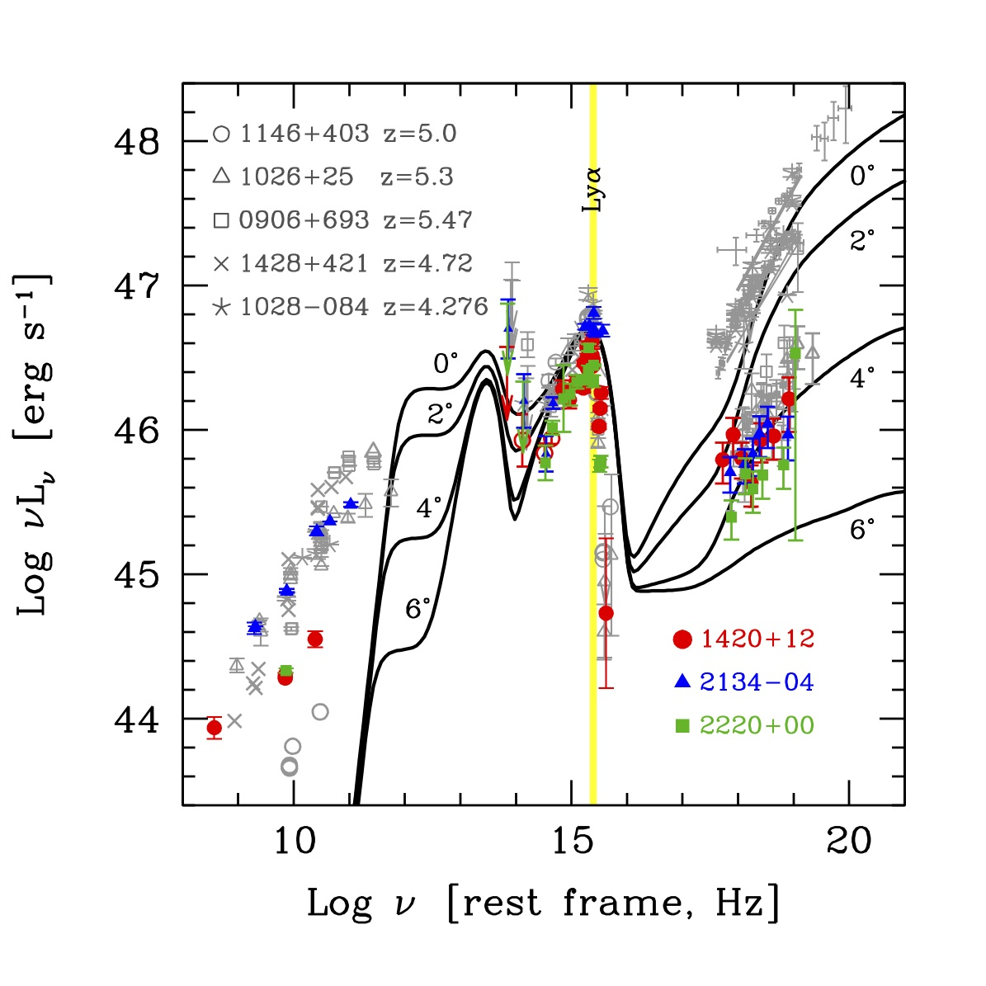
Sbarrato+ 2014
δ^{3+α}
δ^{4+2α}
4<z<5

Slide 66
Shows results from the fiducial GRMHD simulation A0.99fc for a BH with spin parameter a = 0.99; see Supporting Information for the movie.
P_{jet}
Mc²
Tchekhovskoy A et al. MNRAS 2011;418:L79-L83
© 2011 The Authors Monthly Notices of the Royal Astronomical Society © 2011 RAS
Notes:
Shows results from the fiducial GRMHD simulation A0.99fc for a BH with spin parameter a = 0.99; see Supporting Information for the movie. The accreting gas in this simulation settles down to a magnetically arrested state of accretion. (Panels a–d): the top and bottom rows show, respectively, equatorial (z = 0) and meridional (y = 0) snapshots of the flow, at the indicated times. Colour represents the logarithm of the fluid‐frame rest‐mass density, log₁₀ρc² (red shows high and blue low values; see colour bar), filled black circle shows BH horizon, and black lines show field lines in the image plane. (Panel e): time evolution of the rest‐mass accretion rate, . The fluctuations are due to turbulent accretion and are normal. The long‐term trends, which we show with a Gaussian smoothed (with width τ= 1500r_{g}/c) accretion rate, , are small (black dashed line). (Panel f): time evolution of the large‐scale magnetic flux, ϕ_{BH}, threading the BH horizon, normalized by . The magnetic flux continues to grow until t ≈ 6000r_{g}/c. Beyond this time, the flux saturates and the accretion is magnetically arrested. (Panels (c) and (d) are during this period). The large amplitude fluctuations are caused by quasi‐periodic accumulation and escape of field line bundles in the vicinity of the BH. (Panel g): time evolution of the energy outflow efficiency η (defined in equation (5) and here normalized to ). Note the large fluctuations in η, which are well correlated with corresponding fluctuations in ϕ_{BH}. Dashed lines in panels (f) and (g) indicate time averaged values, 〈ϕ²_{BH}〉^{1/2} and 〈η〉, respectively. The average η is clearly greater than 100 per cent, indicating that there is a net energy flow out of the BH.

