Slide 1
The Proton Computed Tomography Apparatus developed by INFN (RDH-WP3)
M. Bruzzi^{1,2}, C. Civinini², G. Maccioni³, S. Pallotta^{2,4,5}, F. Paulis³, N. Randazzo⁶, M. Scaringella⁷, V. Sipala^{3,8}, C. Talamonti^{2,4,5}, E. Vanzi⁹
¹Physics and Astronomy Department, University of Florence, Florence, Italy ²INFN - Florence Division, Florence, Italy
³INFN Cagliari Division, Cagliari, Italy ⁴Department of Biomedical, Experimental and Clinical Sciences, University of Florence, Florence, Italy
⁵ SOD Fisica Medica, Azienda Ospedaliero-Universitaria Careggi, Firenze, Italy ⁶INFN - Catania Division, Catania, Italy
⁷Information Engineering Department, University of Florence, Florence, Italy ⁸Chemistry and Pharmacy Department, University of Sassari, Sassari, Italy ⁹ Fisica Sanitaria, Azienda Ospedaliero-Universitaria Senese, Siena, Italy
RDH Meeting
Roma 24/04/2015

Slide 2
Introduction
Two pCT systems: 5x5cm²; 5x20cm²
Analysis results from the small area system
Algebraic Reconstruction Technique
Large area apparatus configuration
Tracker (some considerations on MLP)
Calorimeter
Present status
Plans for 2015/2016

Slide 3
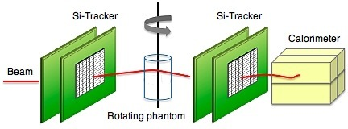
pCT apparatus
Single particle proton tracking: silicon strip detectors → MLP
Residual energy measurement: crystal calorimeter → energy loss
PARAMETER | VALUE
Proton beam kinetic energy | ~200 MeV
Proton beam rate | 1 MHz
Spatial resolution | < 1 mm
Electronic density resolution | <1%
Detector radiation hardness | >1000 Gy
Dose per scan | < 5 cGy
y
x
z
P₁
P₂
P₃
P₄
A set of single event information can be processed by appropriate reconstruction algorithms (ART, FBP) to produce tomographic images.

Slide 4
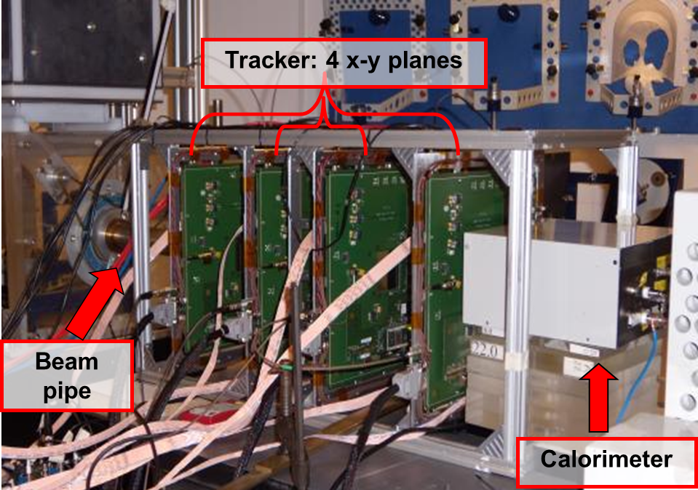
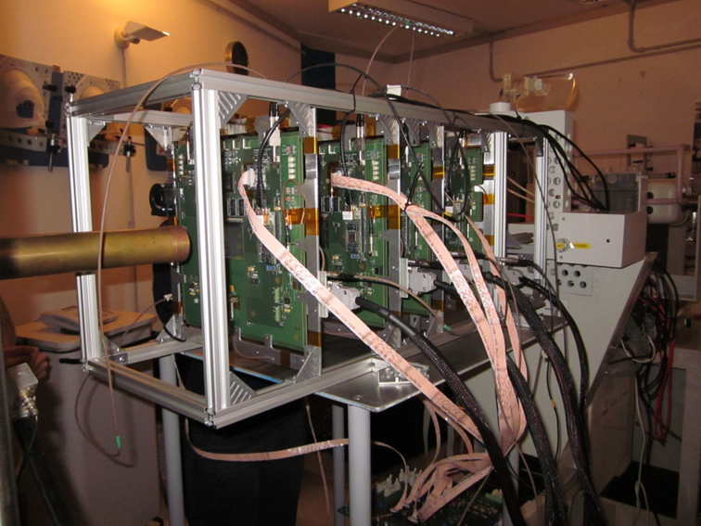
PRIMA collaboration: small area pCT apparatus
First test at INFN-LNS:
May 2011
CATANA beam line:
62 MeV protons
used to treat ocular tumors
Four x-y silicon microstrip based
tracking planes
Yag:Ce calorimeter
Proton entry and exit positions and directions
Proton residual energy

Slide 5
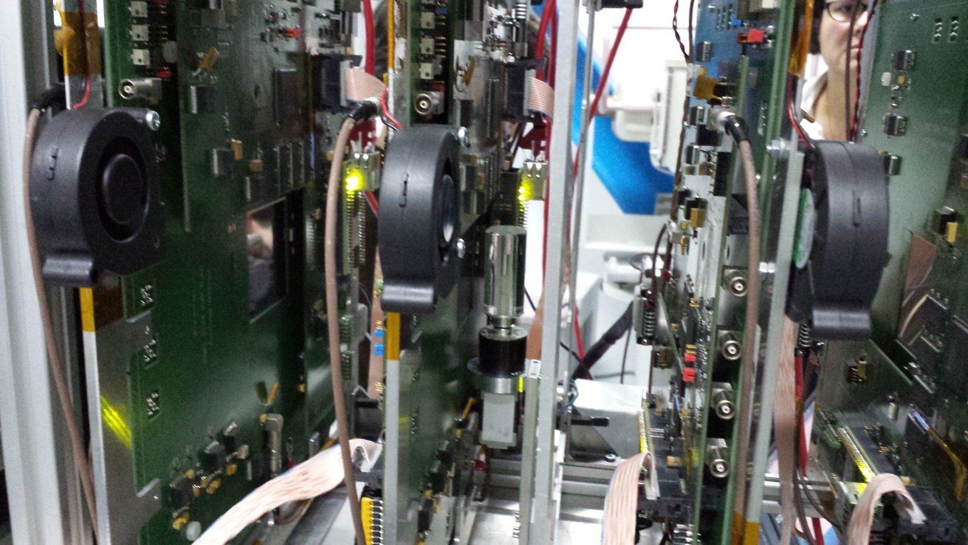
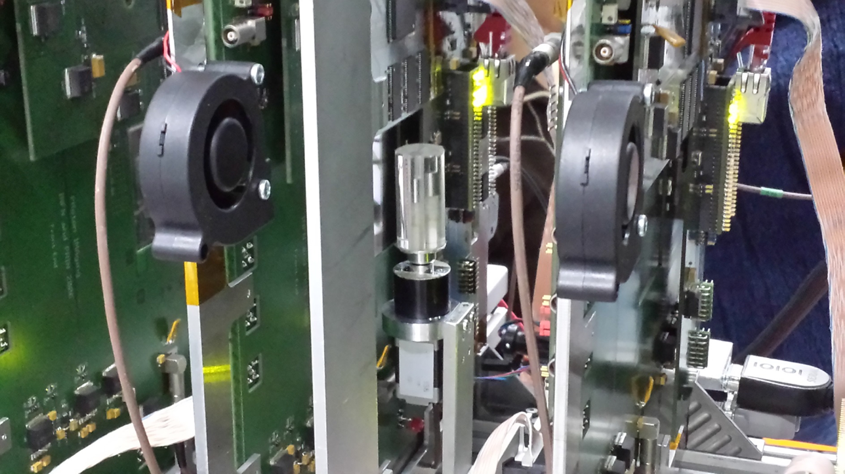
Tomografic set-up

Slide 6
Algebraic Reconstruction Techniques
Iterative algorithm to reconstruct tomographic images from projections (or single events)
Iterative formula:
x^{k+1}= x^{k} + λ_{k} {(b_{i} - <a^{i},x^{k}>)a^{i} / ǁa^{i}ǁ²}
Gordon, R; Bender, R; Herman, GT J. Theor. Biol. (1970) 29 (3): 471–81.
x^{k} image vector at iteration k (relative stopping power)
a^{i} i^{th} event track length in each pixel → Tracker (straigth line, cubic spline or most likely path (MLP) + rasterizing algorithms)
b_{i} i^{th} event stopping power integral → Calorimeter
λ_{k} relaxing factor (constant value or →0 as ~const^{-k})
x⁰ initial image: {0} or approx.

Slide 7
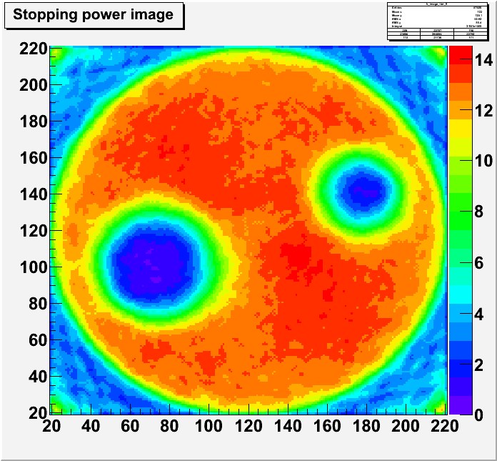
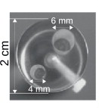
ART images from 62 MeV data
PMMA
phantom
x100μm
cm
ART reconstruction:
14 iteration starting from {0}
~ 10⁶ events per angle
(36 angles)
4mm vertical slice selected
(2D only)
~4’ per iteration CPU time
No MLP is used → to be done
1 cm
x100μm

Slide 8
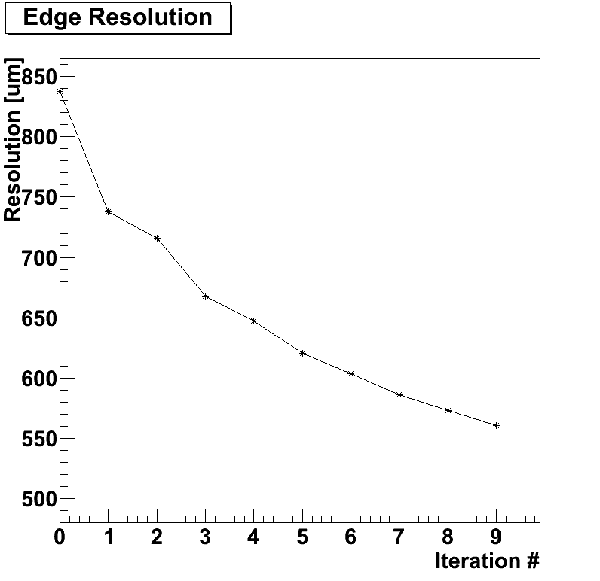
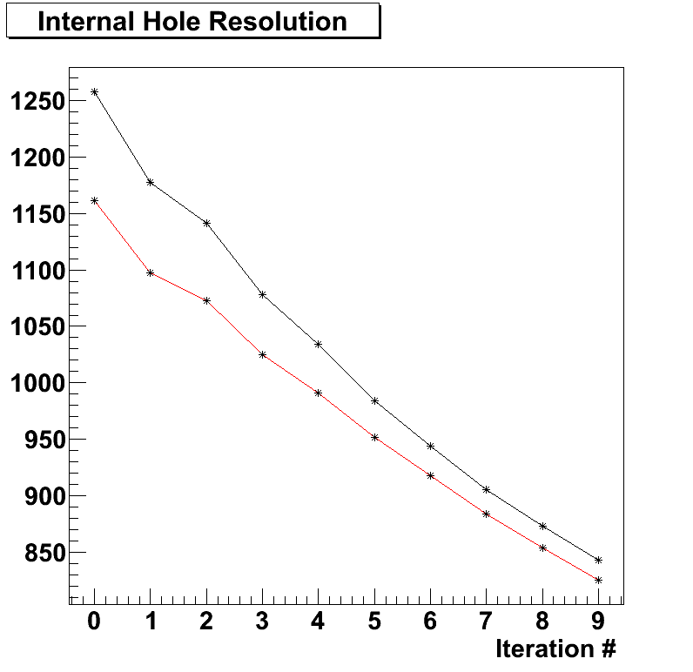
ART images from 62 MeV data
Resolution [μm]
Starting image = {0}, still room to improve

Slide 9
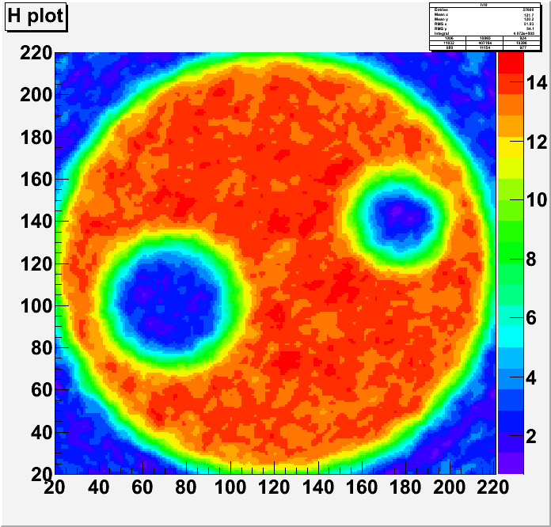
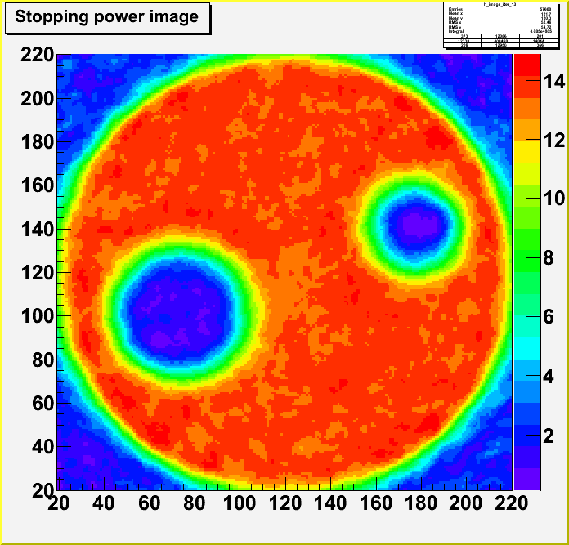
FBP used as seed for ART
x100μm
x100μm
x100μm
x100μm
FBP initial image →
ART after 14 iterations starting
from FBP seed

Slide 10
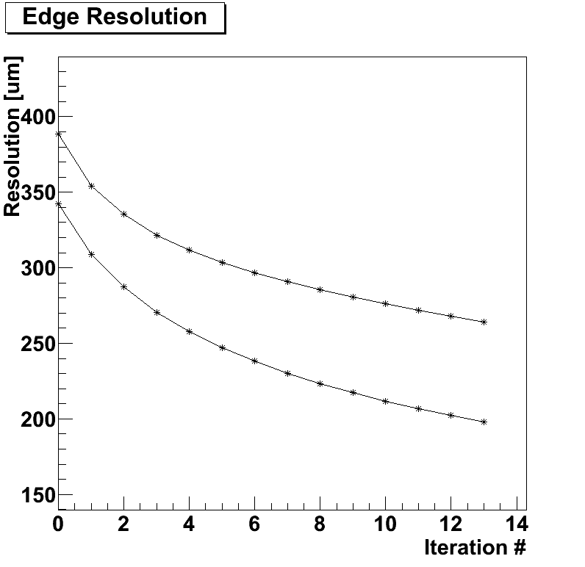
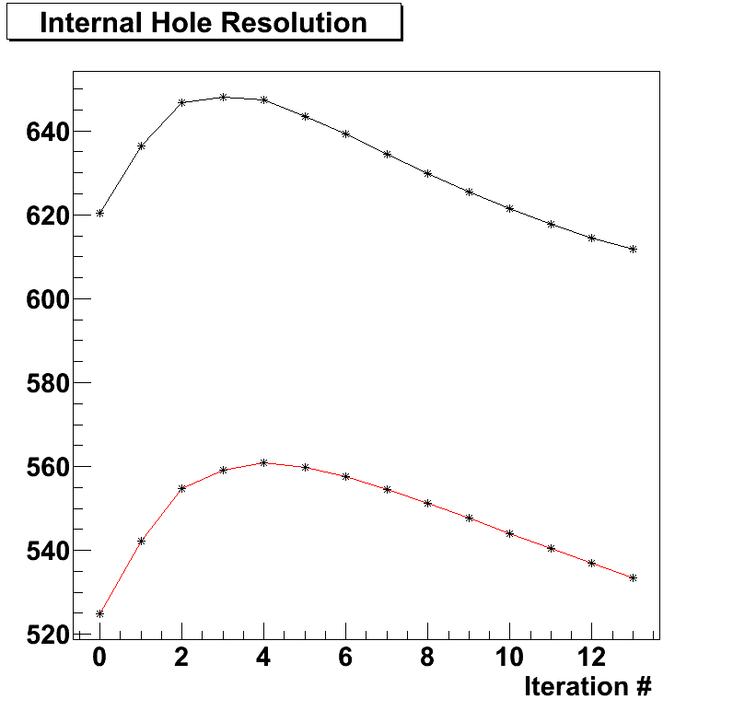
ART Resolutions
Small hole
Resolution [μm]
Two different edge
Positions
Large hole
Inner holes:
resolution affected by
multiple scattering
External edges

Slide 11
Geant4 sim + ART spline reco
As an intermediate step toward the MLP we used a fit to a cubic function to approx. the proton path inside the phantom
The four parameters of the cubic are determined by the two track segments extrapolation point on the phantom envelope and their angles
The MLP takes better into account the multiple scattering but it is much more CPU-time consuming then a simple cubic fit
Cubic: simple constant 4x4 matrix inversion
MLP: point-to-point variable matrix algebra
Spline reco: 15’ pre-processing run + 1’ per iteration on a 62.5K pixel [200x200μm²] image → 1 hour per image

Slide 12
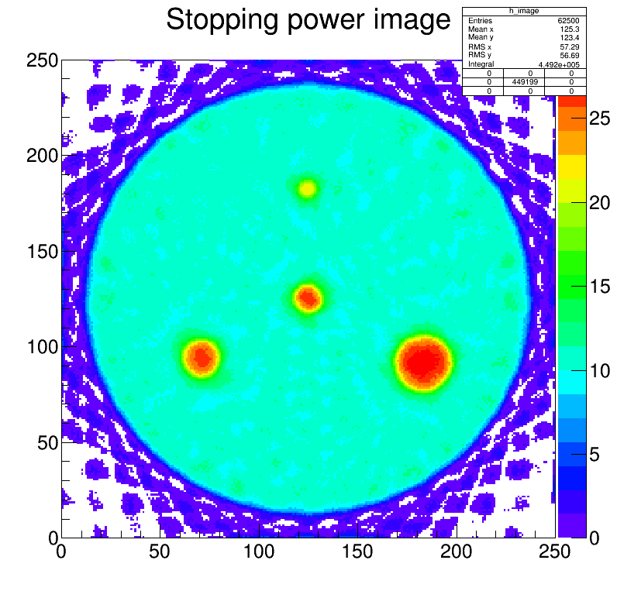
180 MeV proton run simulation
With the 5x5cm² prototype we are forced to use metals to allow for sufficient proton energy loss inside the small phantom:
45mm diameter Aluminum phantom with φ=2-6mm iron or copper inserts
x200μm
x200μm
ART image after 50 iterations (spline proton trajectory approx.)

Slide 13
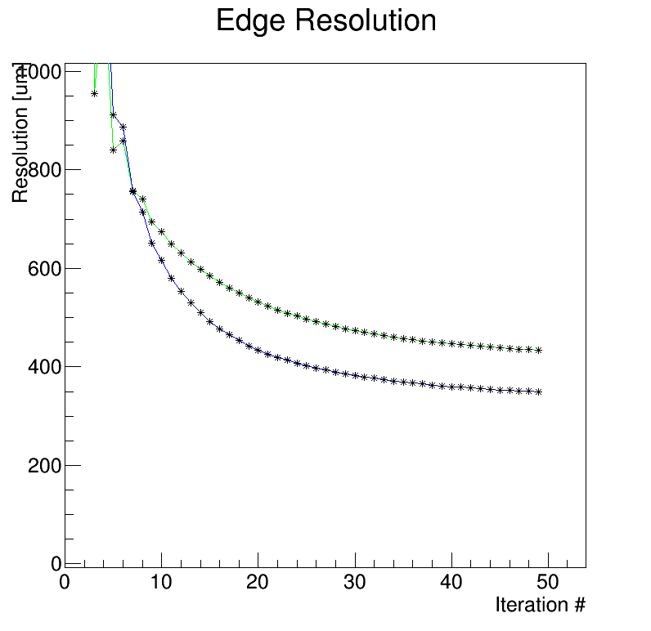
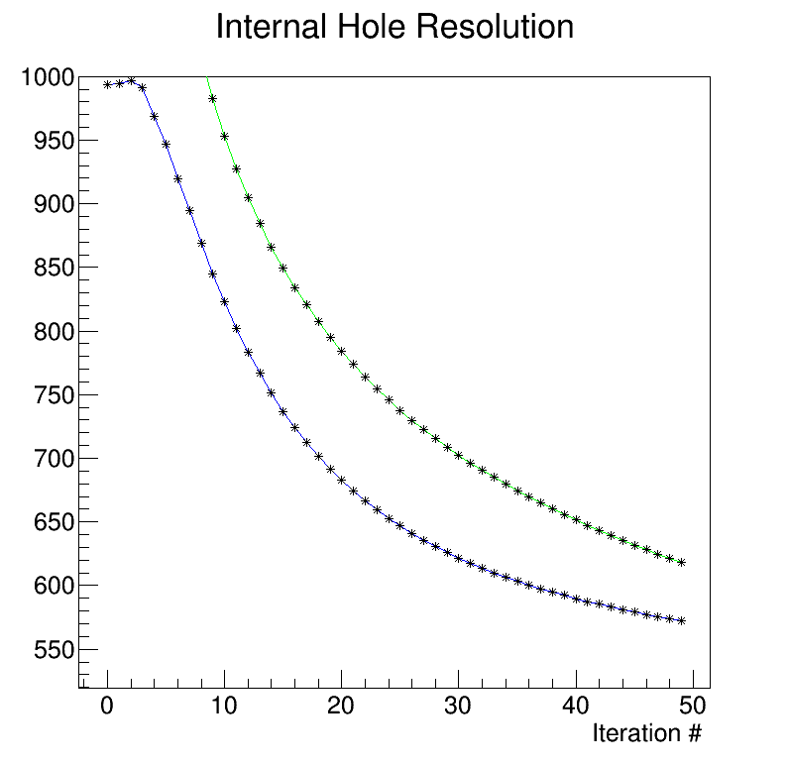
180 MeV proton run simulation
Phantom external edges (two different
positions):
Resolution after 50 iterations: 350-450μm
Phantom internal hole (two different
positions):
Resolution after 50 iterations: 570-630μm

Slide 14
pCT upgrade (5x20cm²)
A system similar to the one already tested
Microstrip tracker
YAG:Ce calorimeter
But with a 50 x 200 mm² field of view
On-line data aquisition
1 MHz capability
Rectangular aspect ratio to perform tomographies in slices
Phantom
Beam pipe
Tracker planes
Silicon sensors
Calorimeter

Slide 15
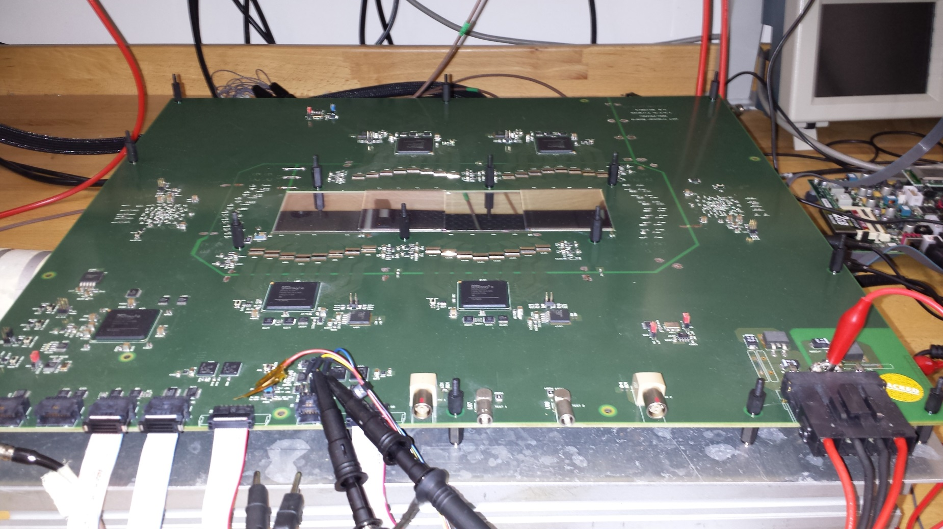
Fully assembled Tracker plane
Chip front-end
Silicon μstrip
Master FPGA
Virtex6
Slave FPGAs

Slide 16
Silicon microstrip detectors
36 p on n single-sided silicon microstrip detectors (HPK):
51.2 x 51.2 mm² active area
<100> crystal type
320 μm thickness
200 μm pitch
256 channels
I(Vfd)~2-3nA/cm²
10 more silicon microstrip sensors have been ordered to FBK (already produced, now under test) to allow for spares leading to, eventually, a 5° tracker plane
Full Depletion Voltage (V)
No bad strips for all 36 detectors (9216 strips)

Slide 17
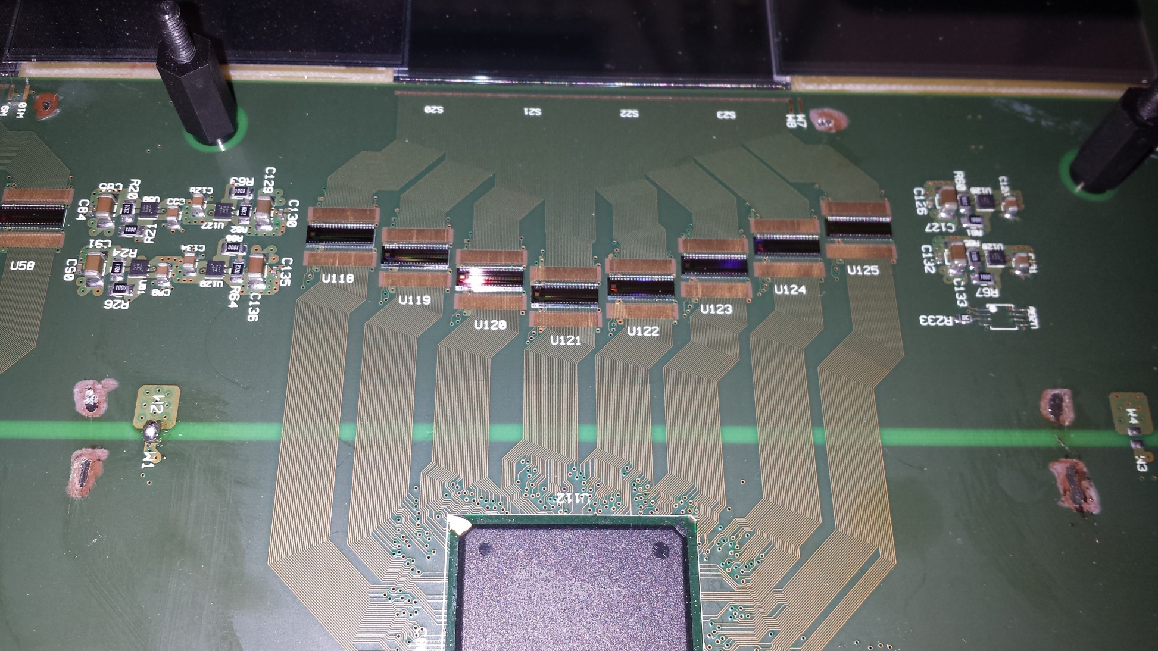
Read-out group
Silicon microstrip detectors
Front-end chips
Power regulators
FPGA slave

Slide 18
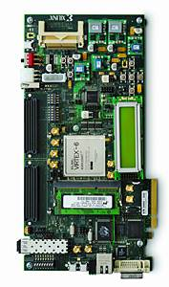
Tracker DAQ architecture
Calorimeter DAQ
SSD 1
SSD 1
Trigger
gen
Trigger
enable
SSD 1
256
Front end 1
256
SS 1
SSD 1
256
Front end 1
256
SS 1
7
256
Front end 1
256
SS 1
256
Front end 1
256
SS 1
.
.
.
SM
.
.
.
SM
4/5 readout links 1.6 Gbs each
.
.
.
SM
SSD 6
.
.
.
SM
SSD 6
SSD 6
256
Front end 6
256
SS 6
SSD 6
256
Front end 6
256
SS 6
256
Front end 6
256
SS 6
256
Front end 6
256
SS 6
Trigger
serial link data/clk
200 Mbs
serial link data/clk
200 Mbs
6 readout links
200(x8) Mbs each
gen
tracker plane
serial link data/clk
200 Mbs
7
2GB DDR3 RAM
tracker plane
tracker plane
Trigger enable
tracker plane
The front end of each detector will read-out by a Xilinx Spartan 6 FPGA (SS)
When a trigger occurs the read-out unit containing at least one hit will send the data to a central FPGA (SM)
The SM will asynchronously send the data to the central acquisition board
Central acquisition
Virtex 6
ML605 board
1Gbs Ethernet

Slide 19
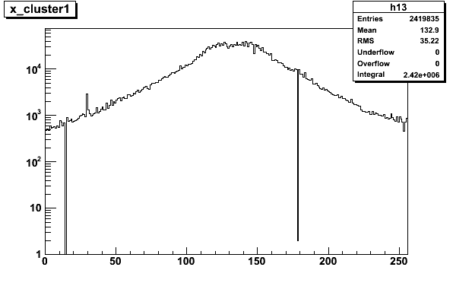
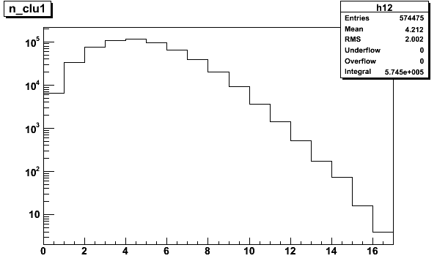
Test results with high intensity ⁹⁰Sr source
Number of clusters (electrons) per
event <N_{clu}>=4.2
2.5μs DAQ window → ~ 2 MHz of e⁻
Presently @350kHz max. trigger rate
# strip
Source profile
Two not working strips:
one because of sensor
one because of front-end chip
(one ~hot)
# cluster

Slide 20
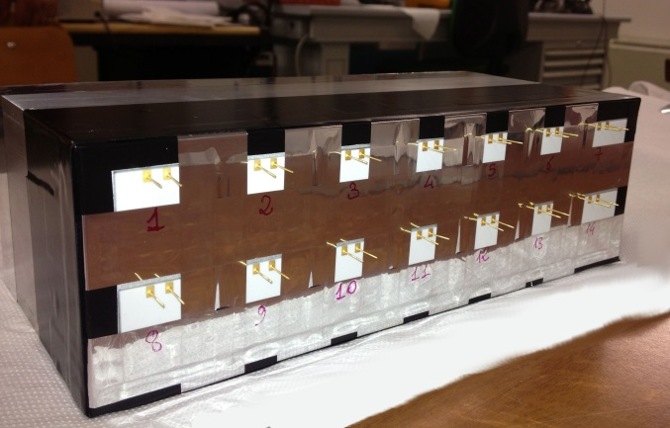
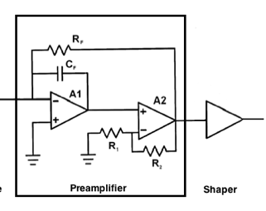
YAG:Ce calorimeter
Data Acquisition System
2x7 YAG:Ce Crystals Array
Size: 3x3x10cm³
FlexRIO
NI PXIe-7962R
CHASSIS NI PXIe-1071
Ad.Mod.
NI-5751
14 Analog Channels
Parallel read-out
Sampling: 5MS/s
24 Samples x event
RT Controller
NI PXI-8102
7Dig I/O GEN
Dig. Trigger
Disable Trigger
Silicon Photodiodes 1.8x1.8cm²
Tracker
x14
Fast Charge Amplifier + Shaper

Slide 21
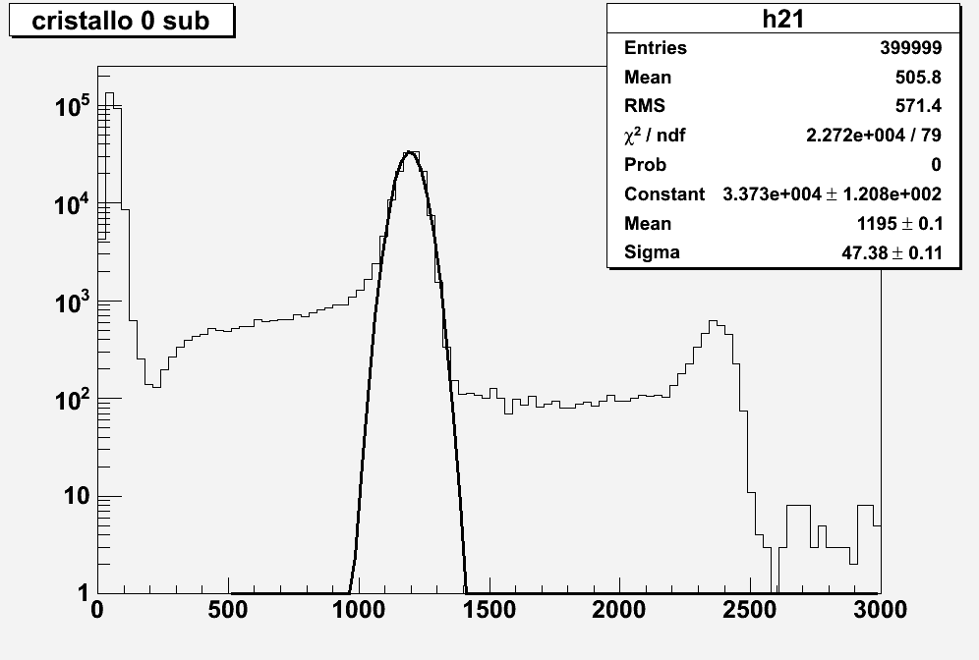
New YAG:Ce calorimeter data
60 MeV
σ=3.9%
Double protons=120 MeV
Noise = 10 MeV
ADC counts

Slide 22
2015/2016 pCT plan
Analysis
Implement MLP into ART (+3D reconstruction) and CPU time optimization: second half 2015
Small area system
A 180 MeV run at Uppsala has been scheduled: 1st-5th June 2015 → end of activities on the small area prototype
Extended view system
Validate the tracker plane hardware at 60 MeV
We have 16 hours of beam at LNS approved, we hope to have them during July 2015 (depends on Catana schedule)
Production and assembly of the 4/5 final tracker planes (PCB and front-end chips) by the end of 2015, beginning of 2016
Integration of the tracker and calorimeter read-out (second half of 2015)
Data taking with the full system during 2016 (at least two runs)

