Slide 1
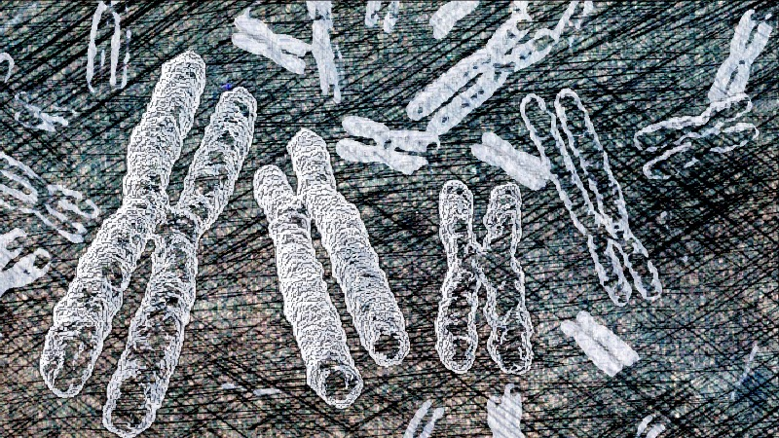
WP2. Combined effect of charged particles irradiation and anticancer drugs in cultured human tumor celLS
Francesco Berardinelli

Slide 2
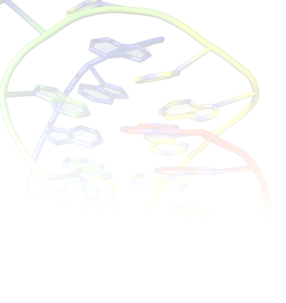
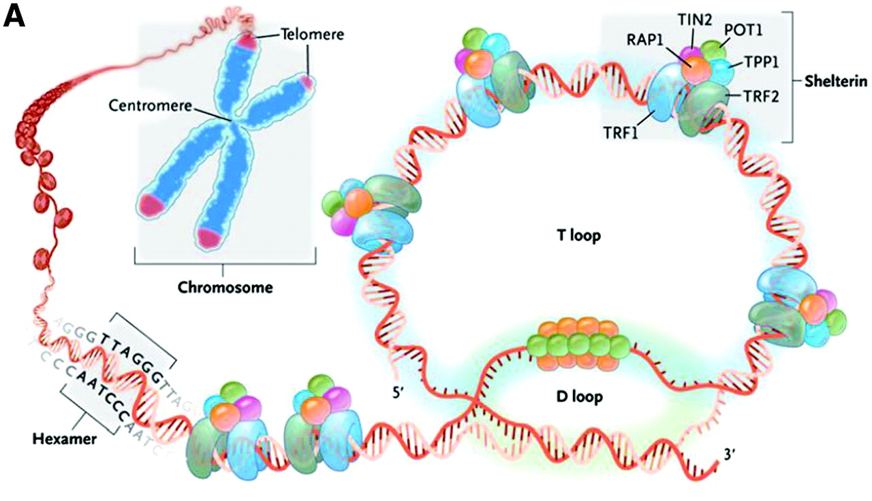
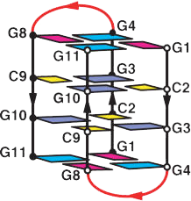
G-QuADRUPlEX (G4)
Non-canonical DNA pairing
Present in G-rich regions, such as Telomeres (confirmed in vivo)
Consensus sequence: G₃₋₅-N₁₋₇-G₃₋₅-N₁₋₇-G₃₋₅-N₁₋₇-G₃₋₅
Characterized by planar cyclical arrangement of four guanine (called G-quartet)
Multiple layers of G-quartets stack to form G-quadruplexes
G-quadruplexes are stabilized by monovalent cations (e.g., Na⁺, K⁺)
Normally resolved by RecQ and Pif1 Helicases
Roles of G4 in human cells are unknown
Human telomeric intramolecular G-quadruplexes. (A) Antiparallel structure in sodium solution (i, ii) or potassium solution (iii, iv) (B) Parallel structure (I, ii, iii) in potassium. (C) Hybrid conformations in potassium solution. Hybrid 1 (i) and hybrid 2 (ii) topologies illustrate differences in loop structures. The NMR structure of hybrid 2 is shown in(iii).
From Cancer Drug Design and Discovery…………………..

Slide 3

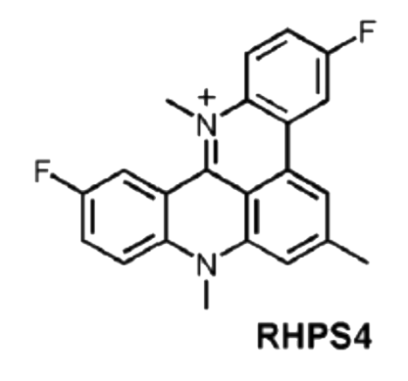
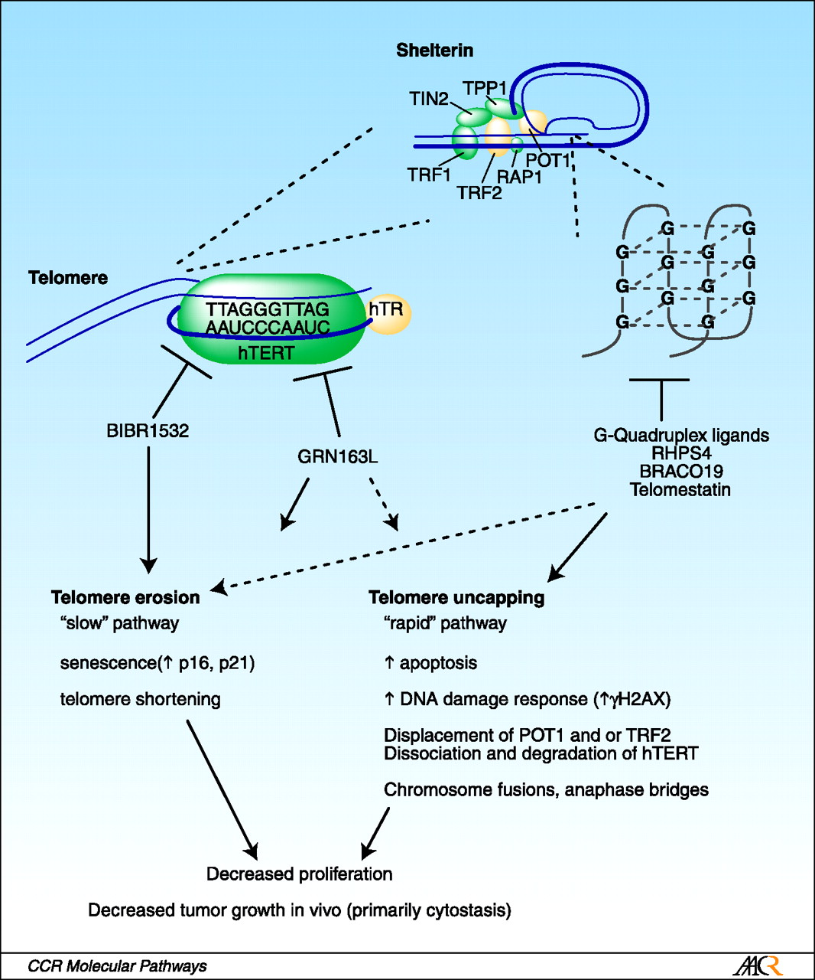
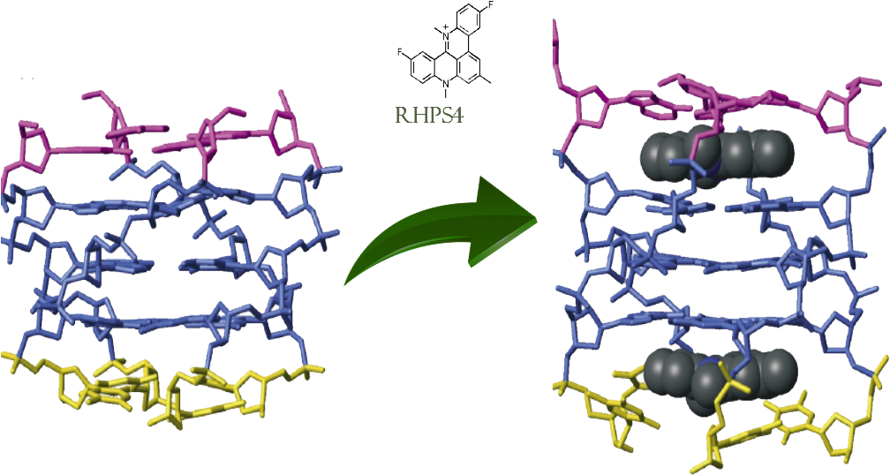
G4-Ligand: RHPS4
Pentaciclic Acridine based compound
3,11-difluoro-6,8,13-trimethyl-8H-
quino[4,3,2-kl] acridinium methosulfate
Telomerase inhibitors
G4 ligands
Notes:
Due modalità di azione diverse, con tempistiche diverse ed effetti diversi che sono state proposte e testate per la terapia farmacologica del cancro ma che non sono mai state prese in considerazione come

Slide 4
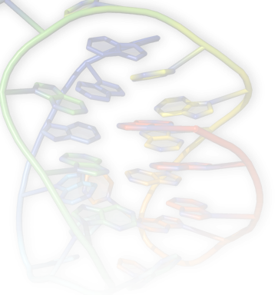
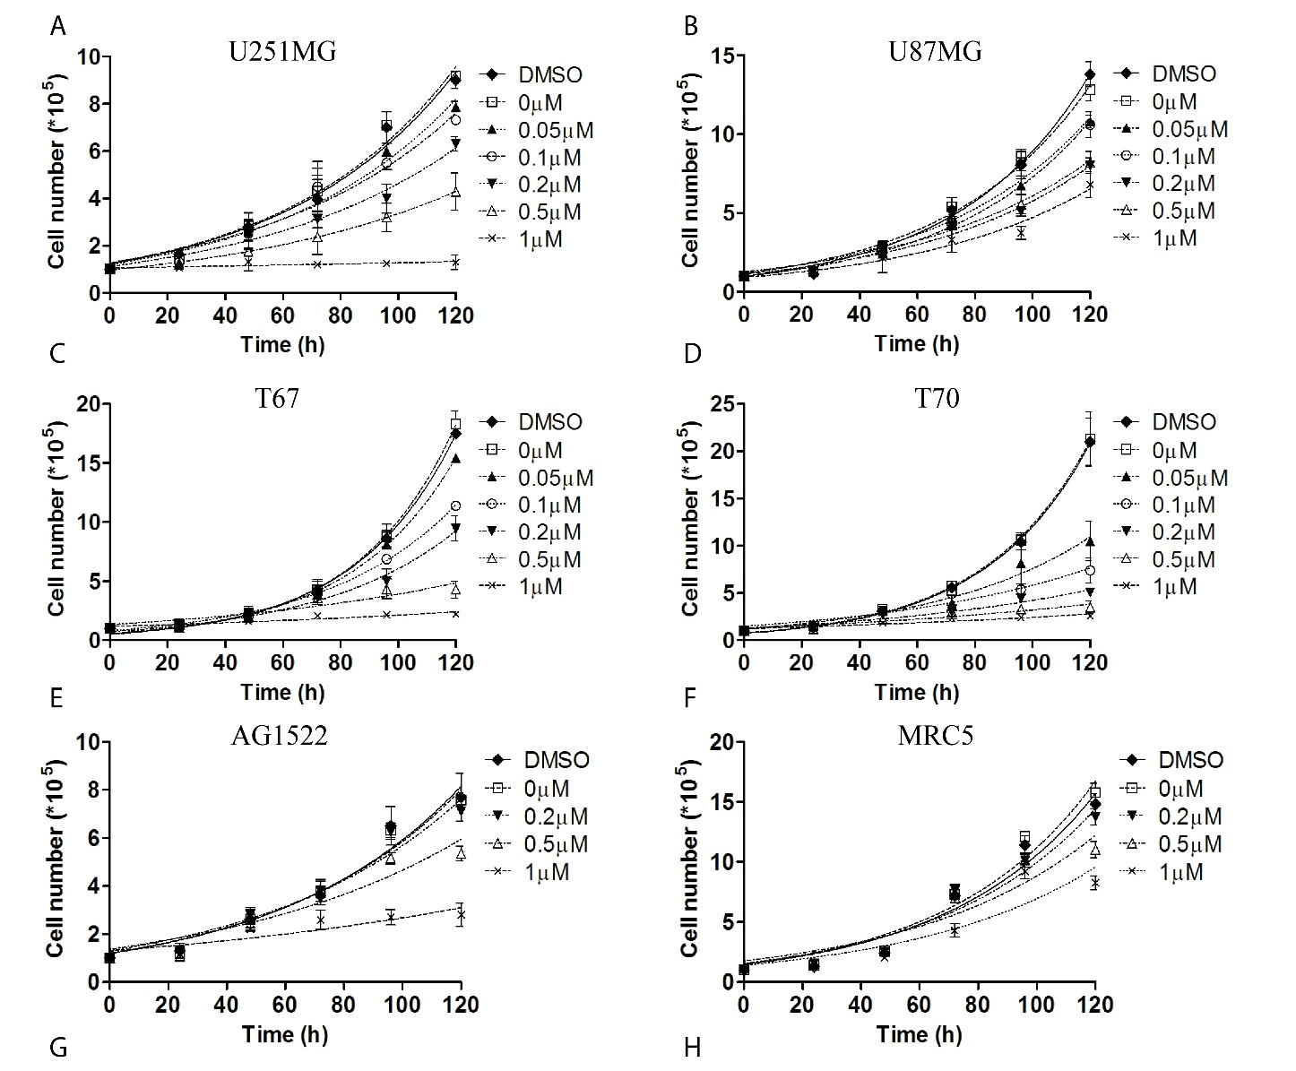
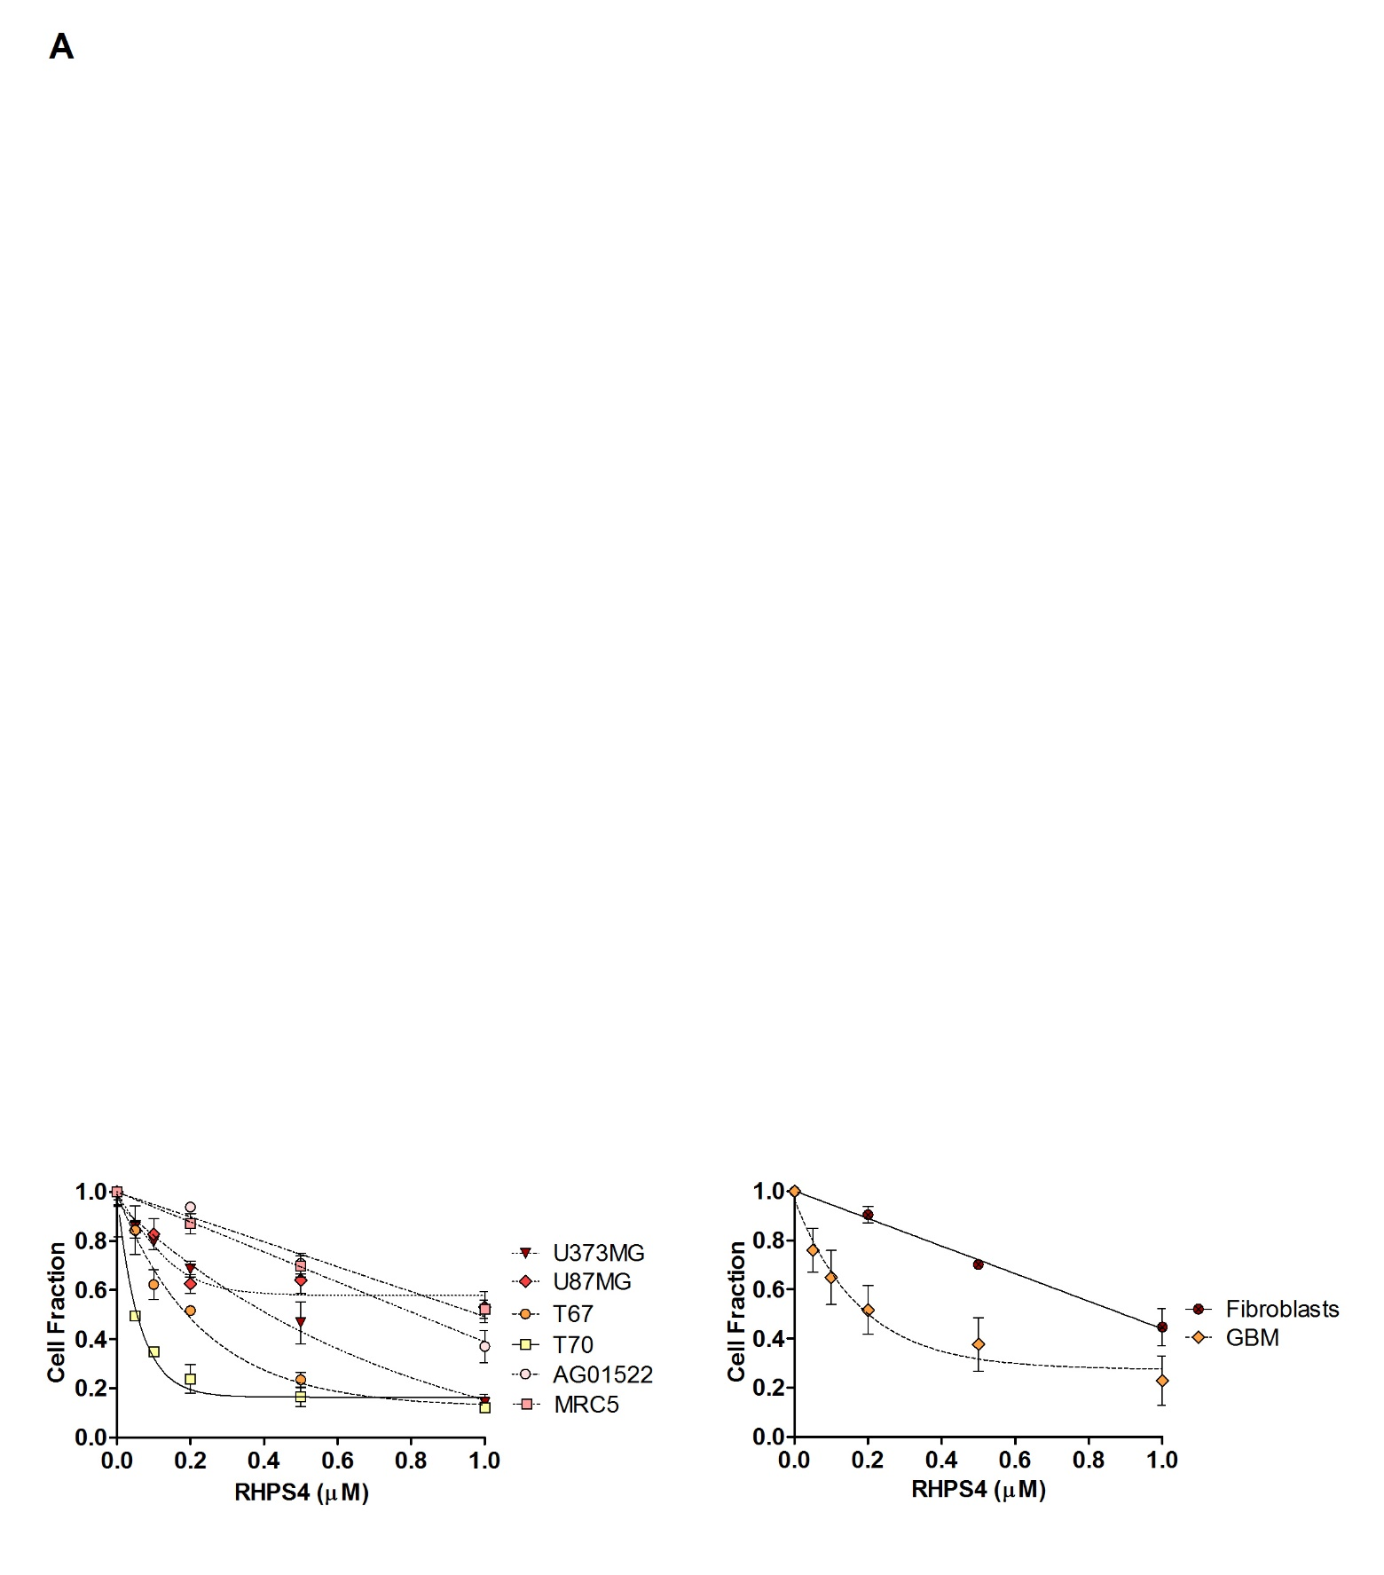
RHPS4 effect on cell growth
RPHS4 is more effective in GBM cells than in normal fibroblasts, especially at low concentrations
IC₅₀ value was about 1µM in normal fibroblasts and 0.2µM in GBM cells
Berardinelli et al., DNA Repair, 25:104-114, 2015

Slide 5
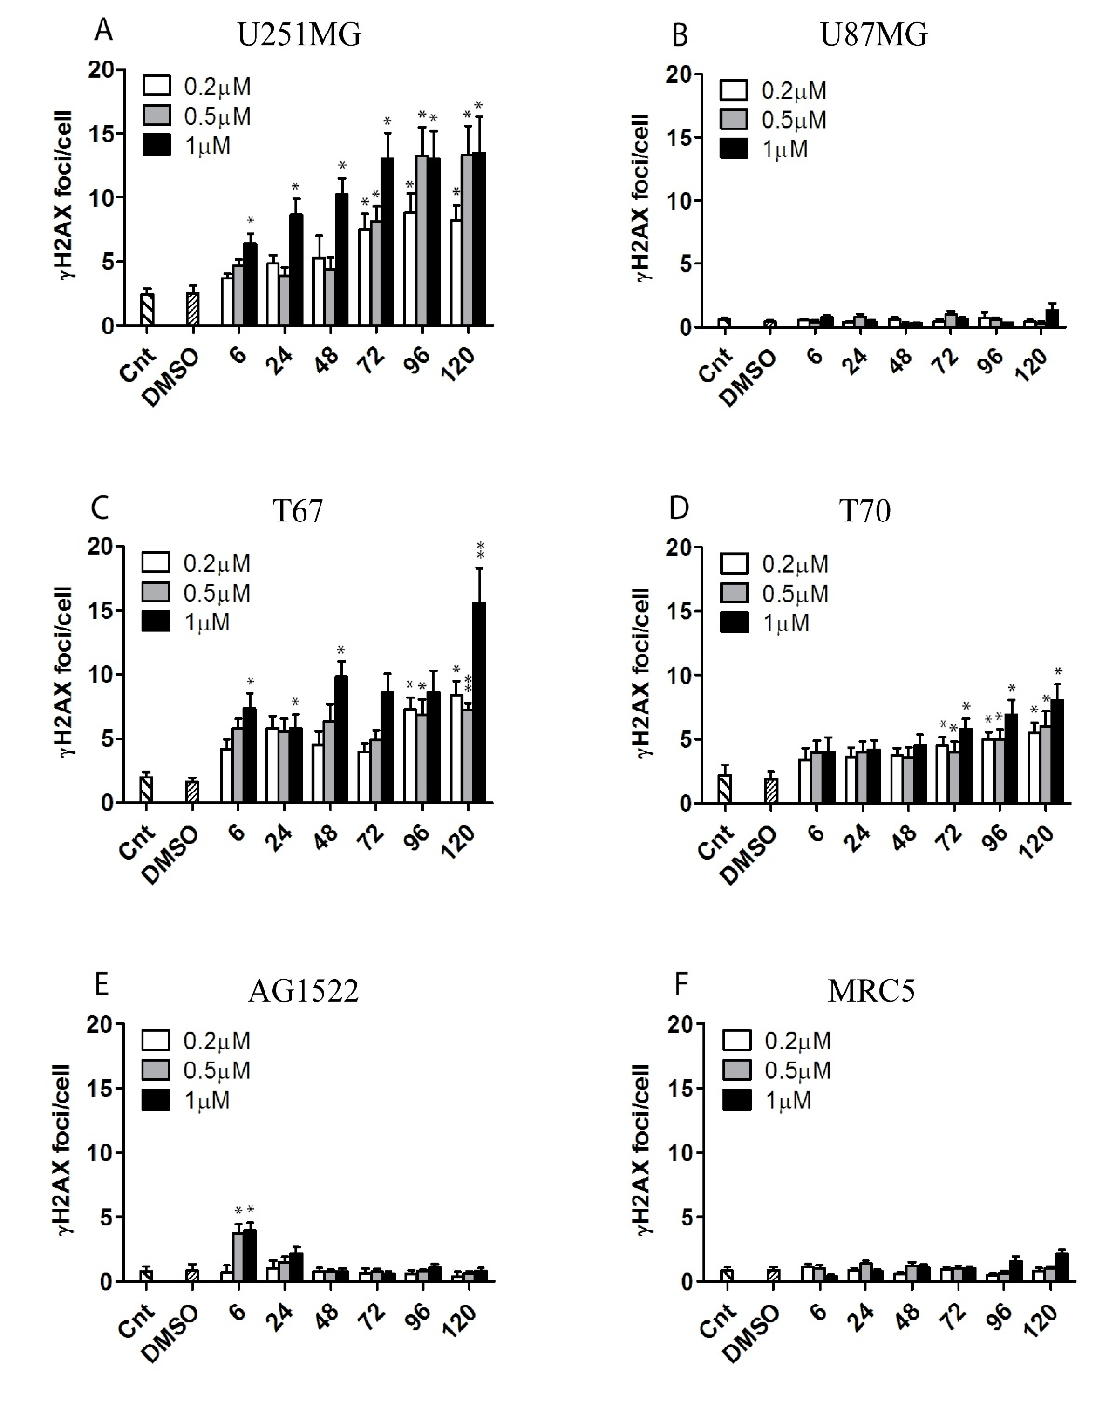
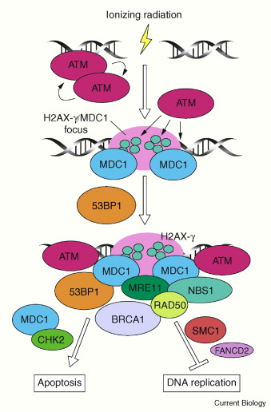
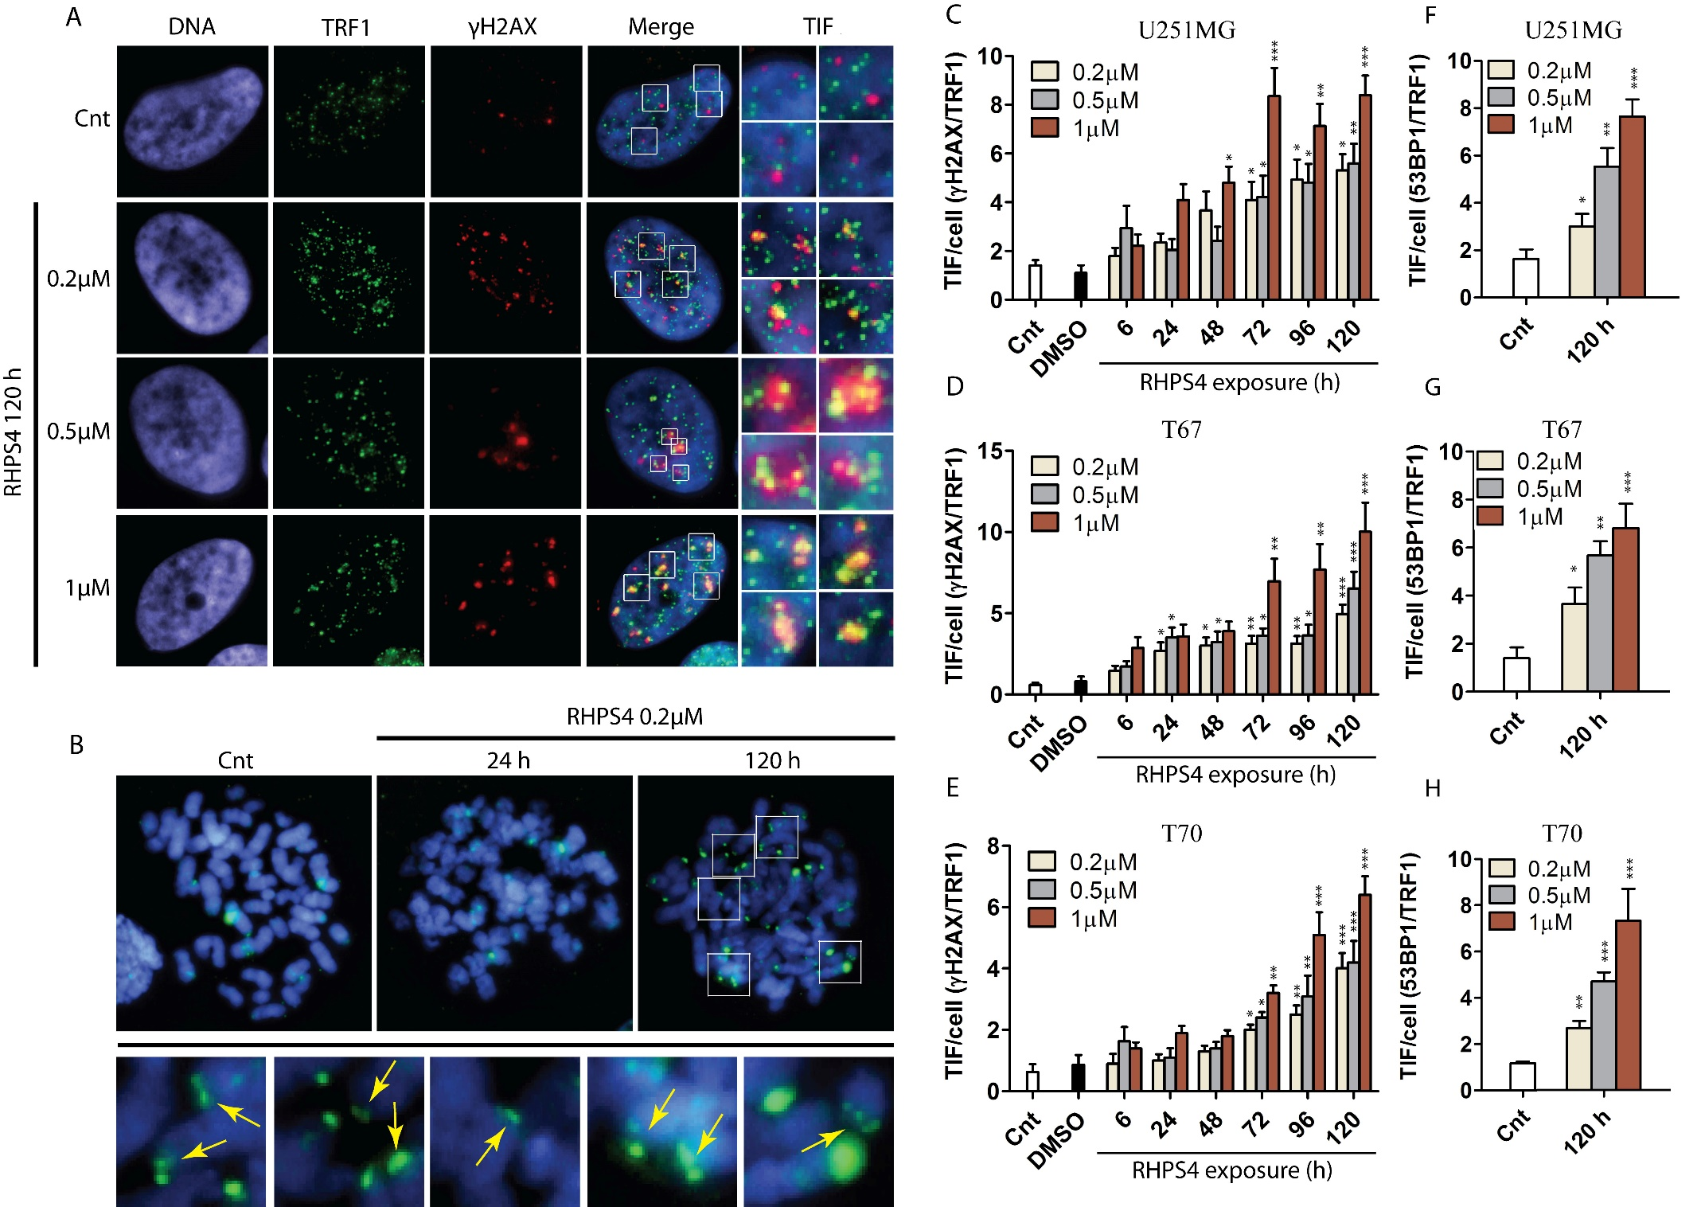


Induction of γH2AX and TIF
Berardinelli et al., DNA Repair, 25:104-114, 2015

Slide 6

Berardinelli et al., DNA Repair, 25:104-114, 2015
DNA
DNA
DNA
γH2AX
γH2AX
γH2AX

Slide 7

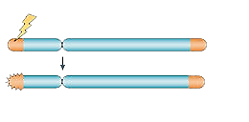
Dysfunctional telomeres confer radiosensitivity
In VITRO and IN VIVO
Functional telomere
Dysfunctional telomere
Ionising
Radiations
INCREASED RADIOSENSITIVITY

Slide 8
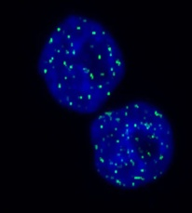
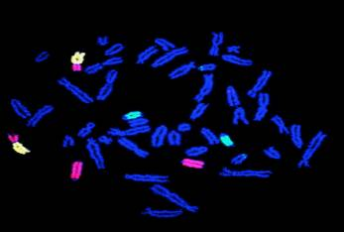
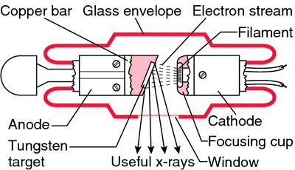
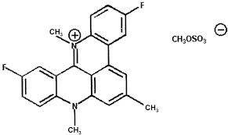
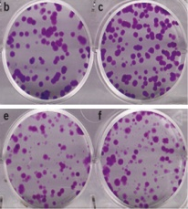
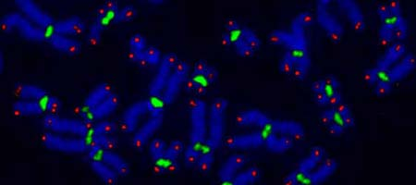

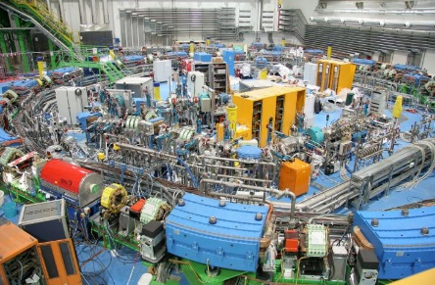
Experimental rationale for RHPS4 and X-rays combined treatment
Cell seeding
(4000 cells/cm²)
RHPS4 addition (0.2 μM)
IR exposure
(1-6Gy)
Cells grown in RHPS4-free medium until the fixing
immediately
120 h
24 h

Slide 9
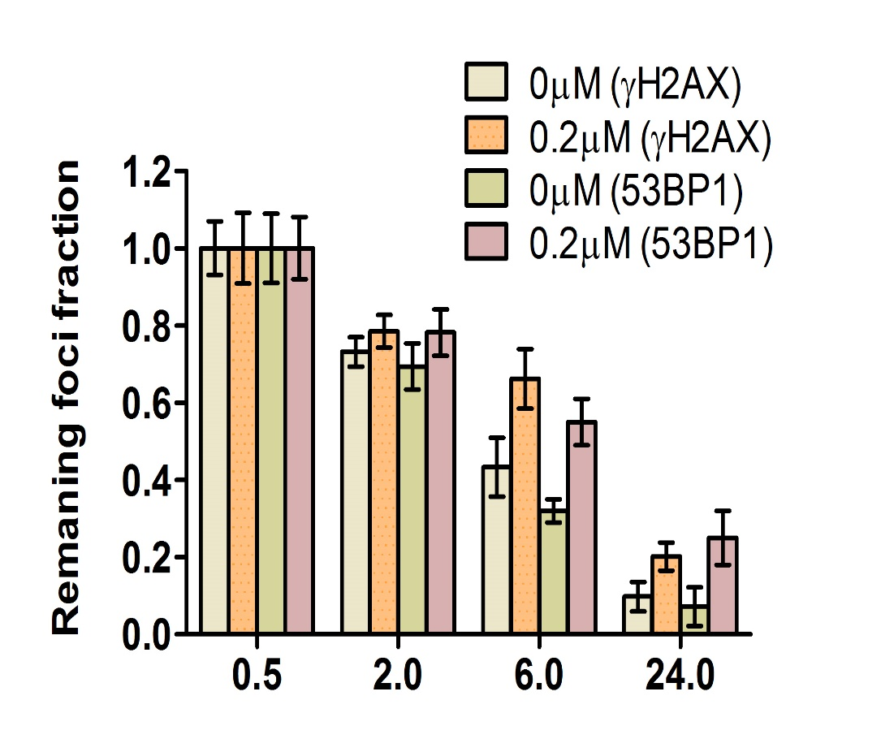
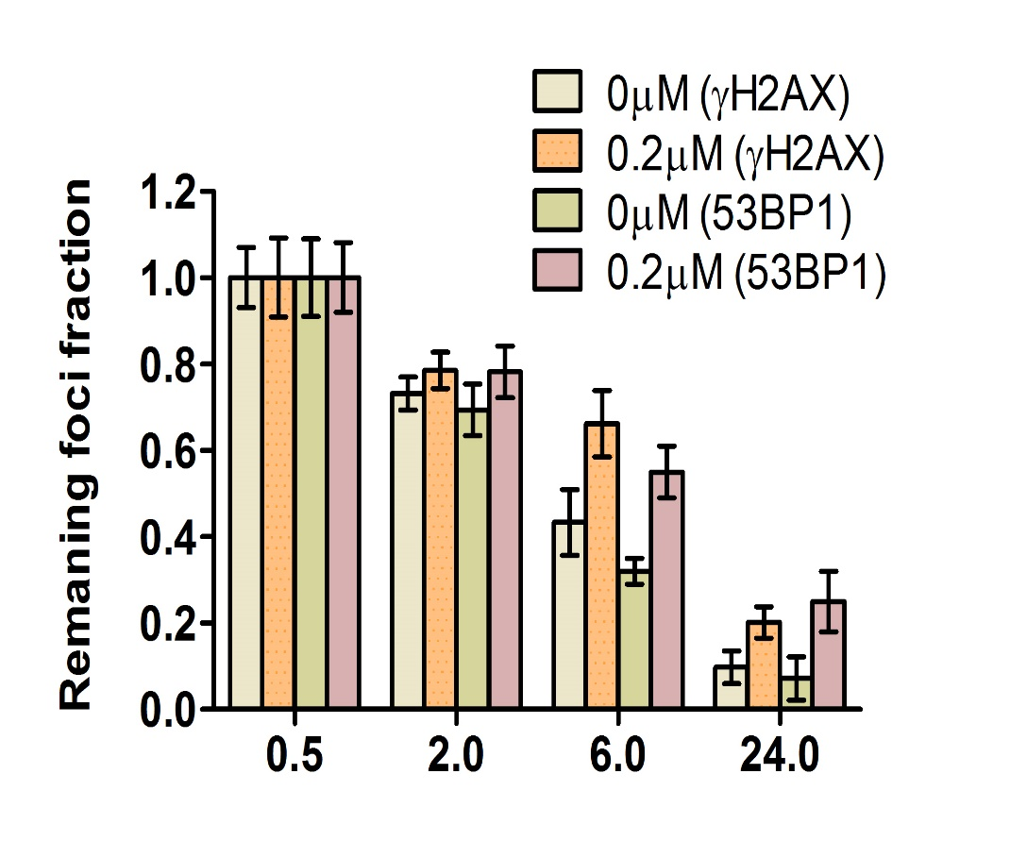
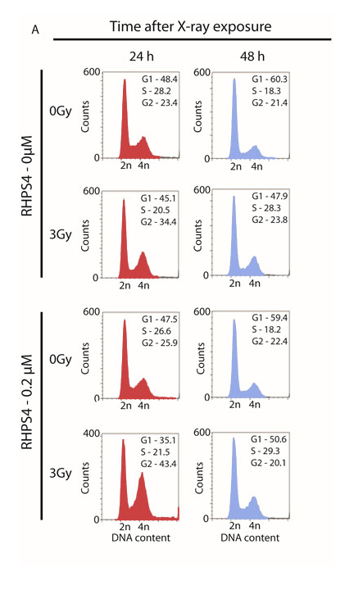
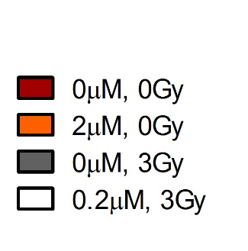

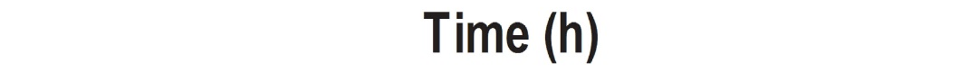

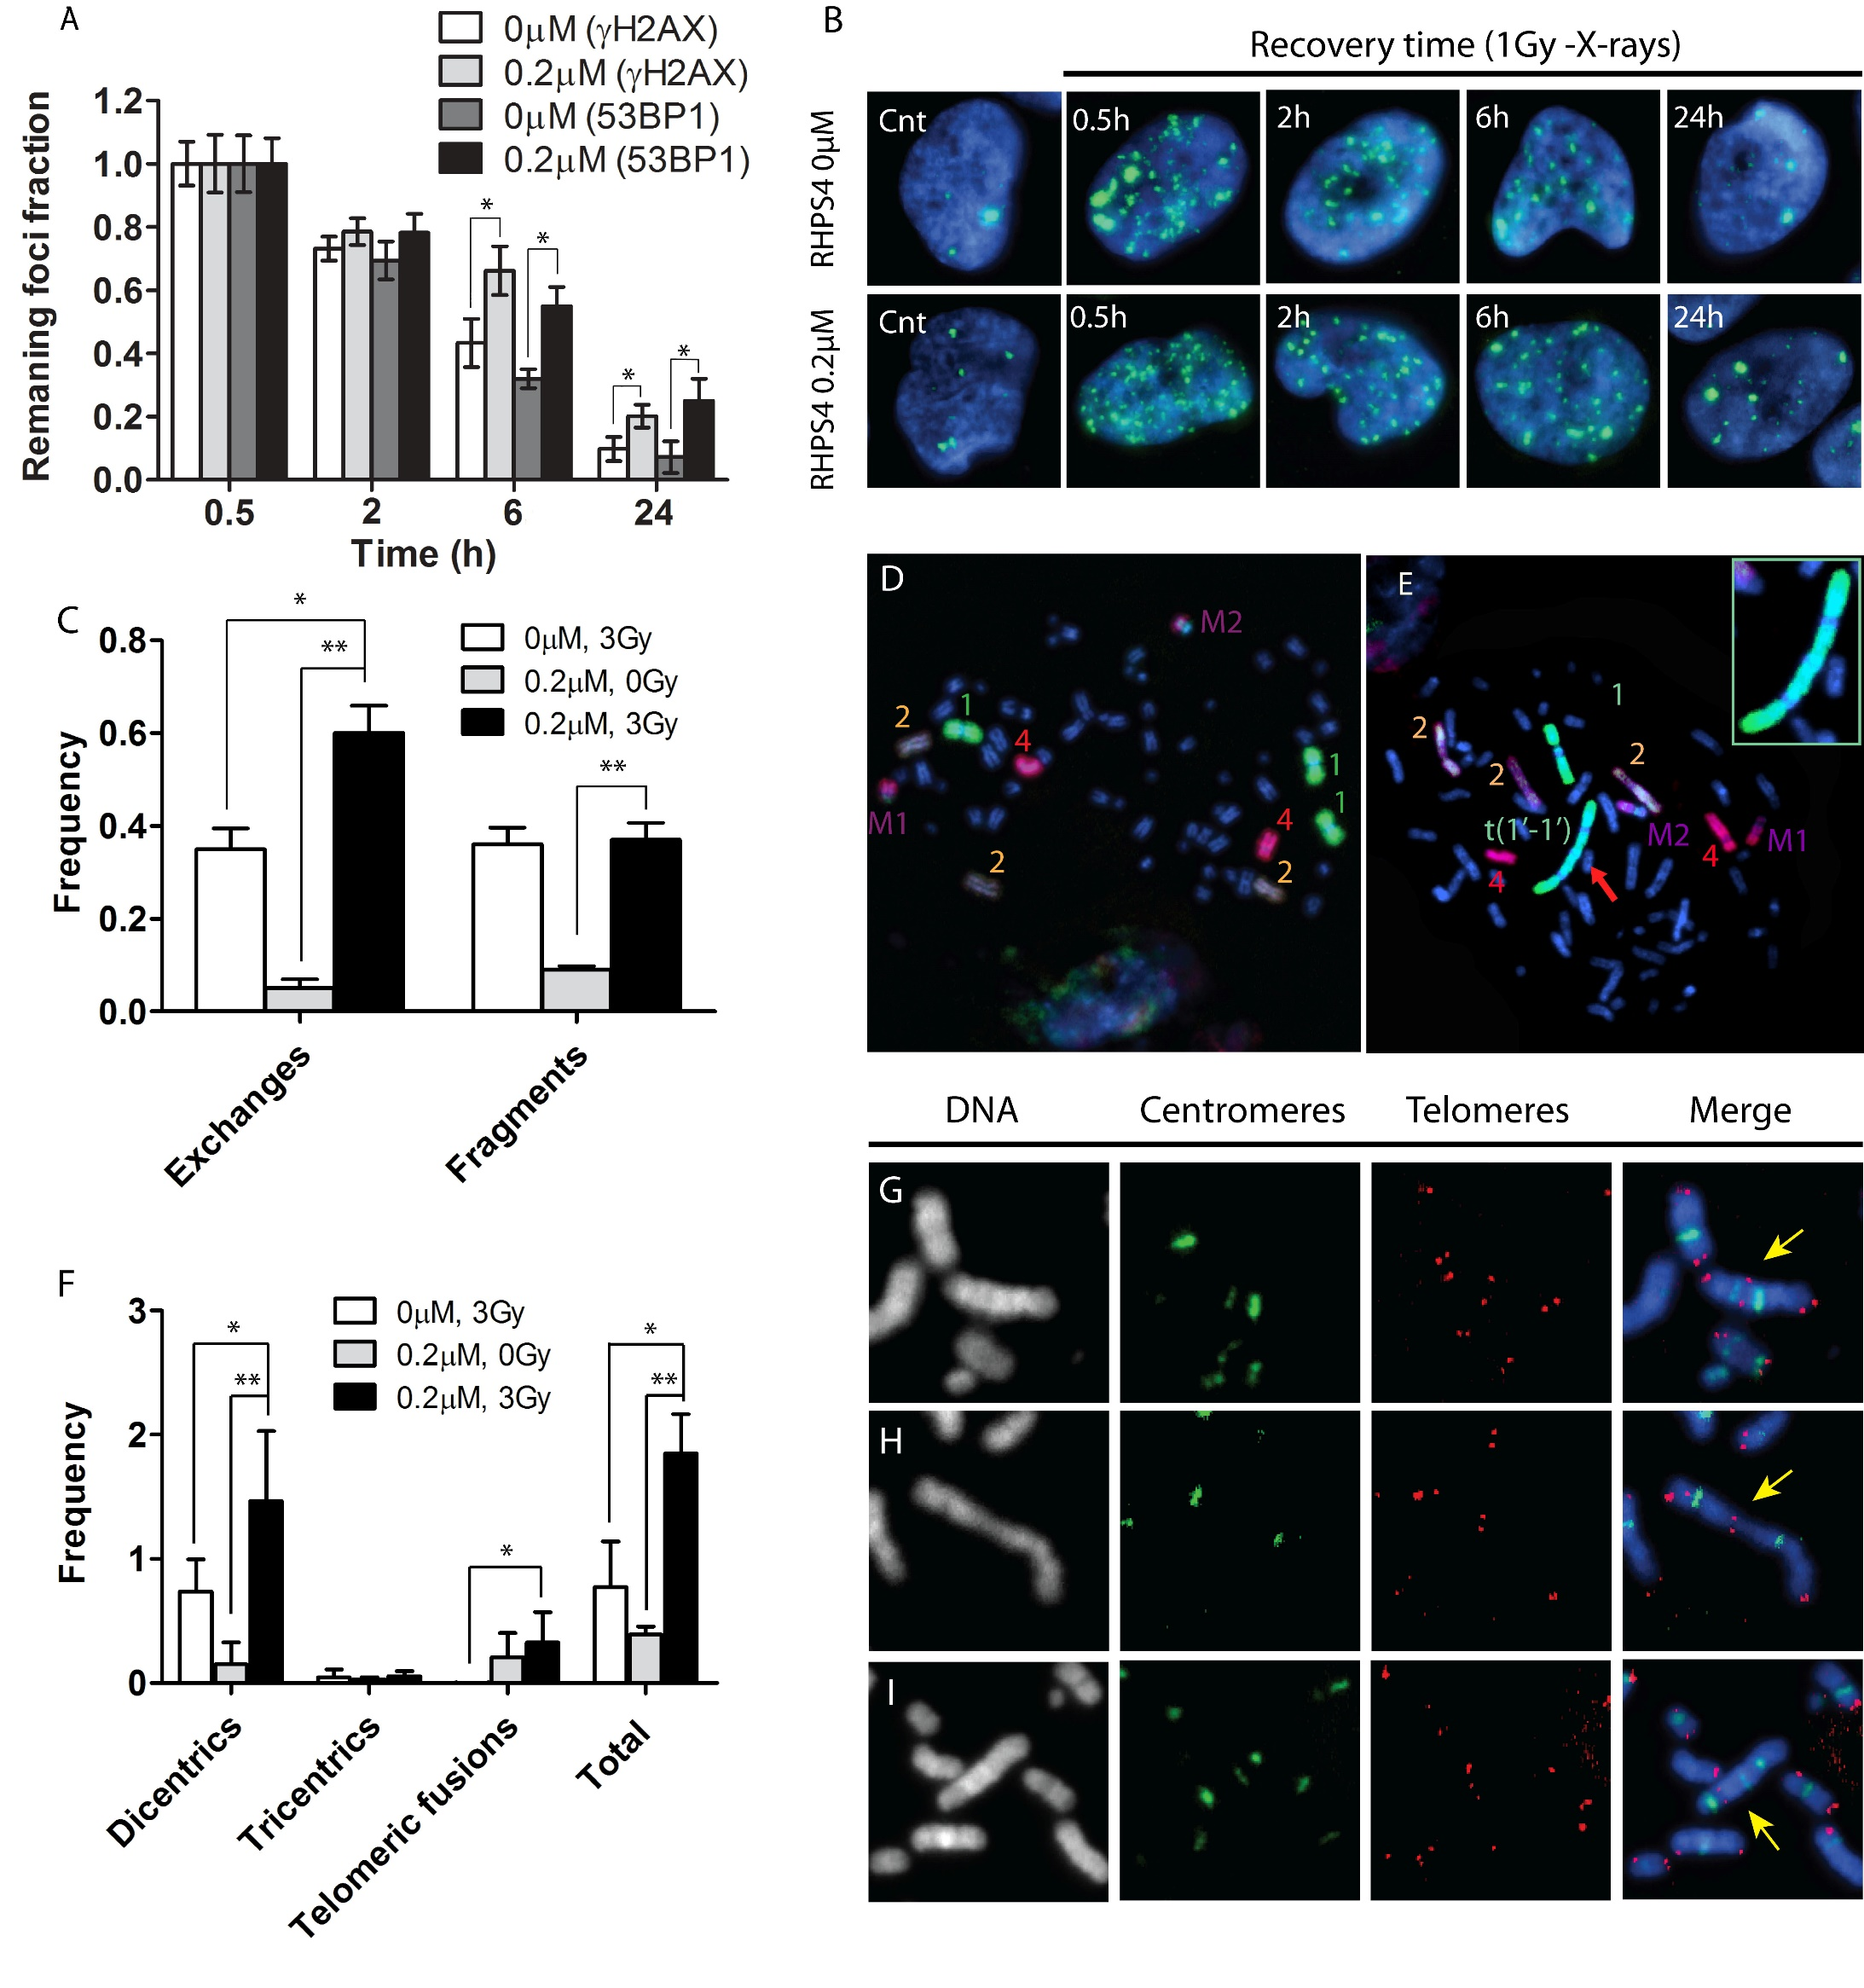
DNA repair kinetic and cell cycle effect
*
*
*
*
*
Delayed DNA repair kinetic
G₂ phase block 24 hours after exposure
Berardinelli et al., DNA Repair, 25:104-114, 2015

Slide 10

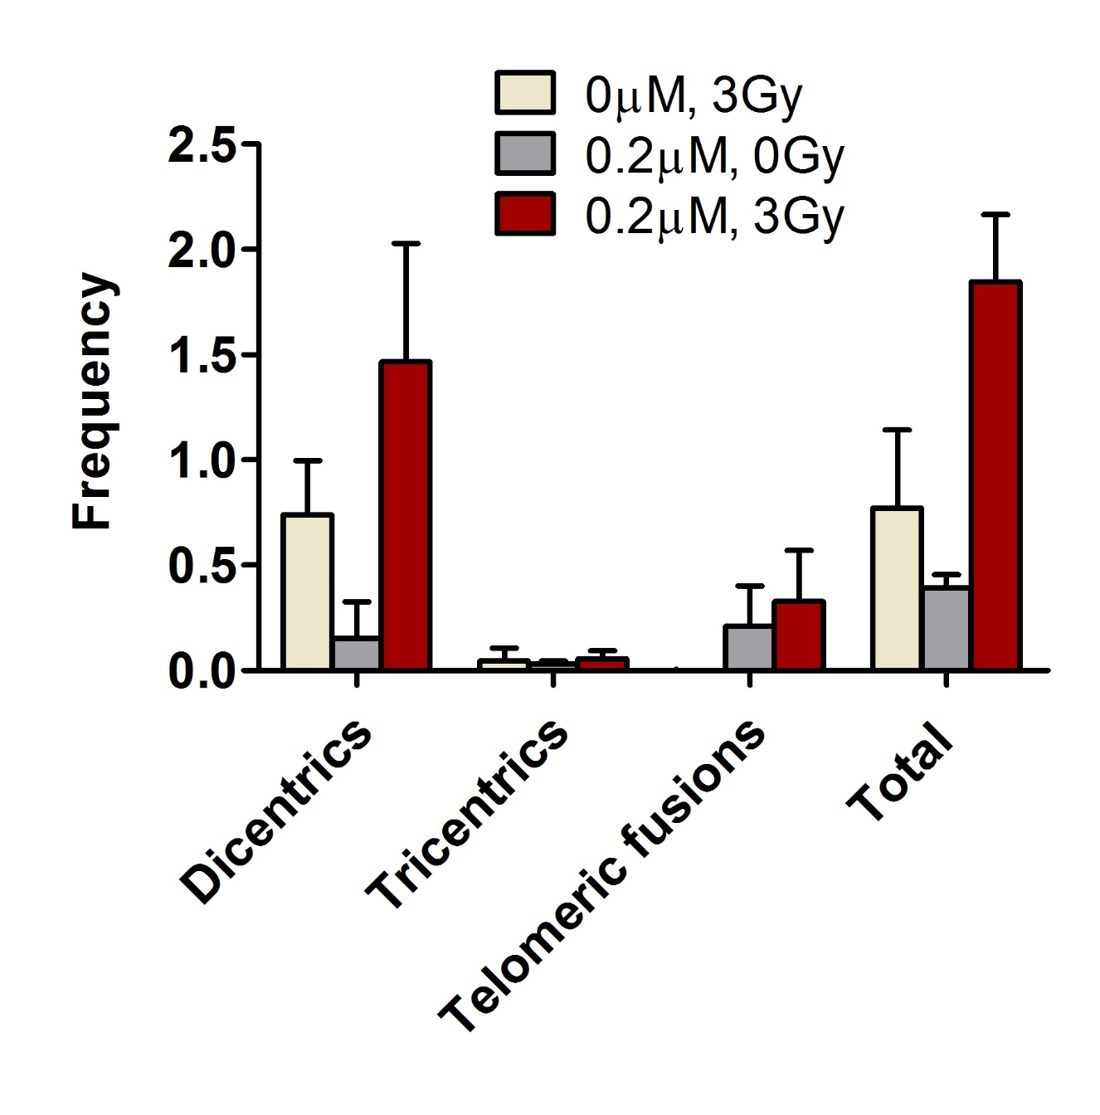
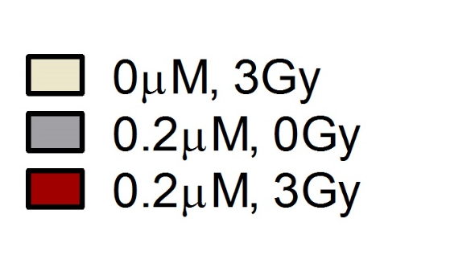
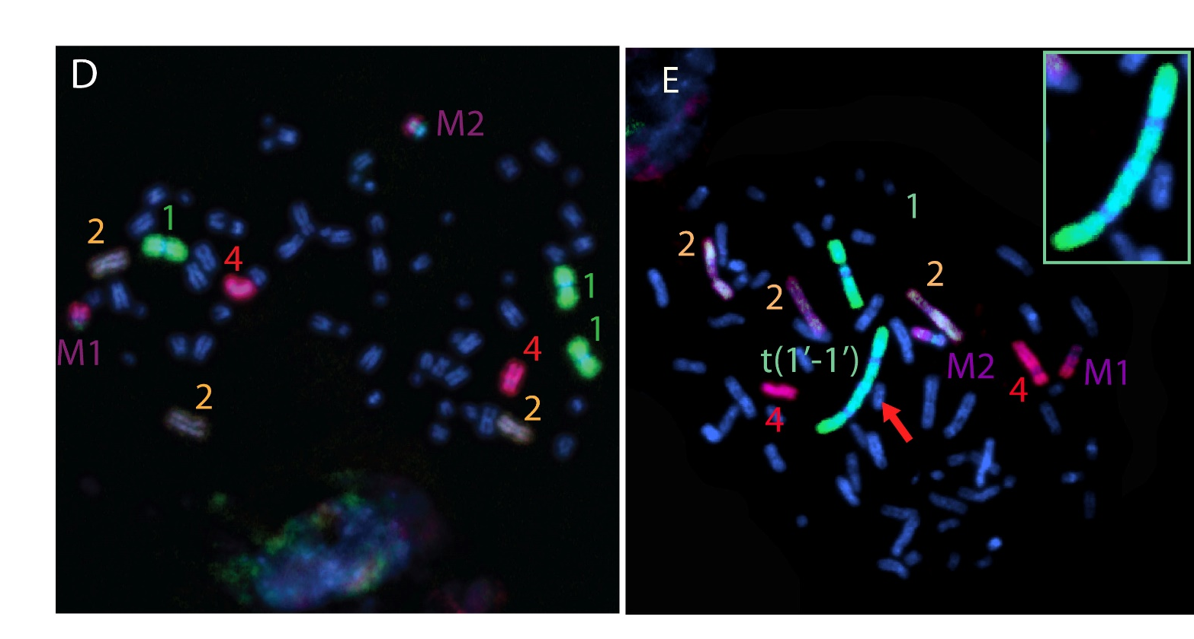

Cytogenetic analysis
*
*
**
*
**
**
**
Berardinelli et al., DNA Repair, 25:104-114, 2015

Slide 11

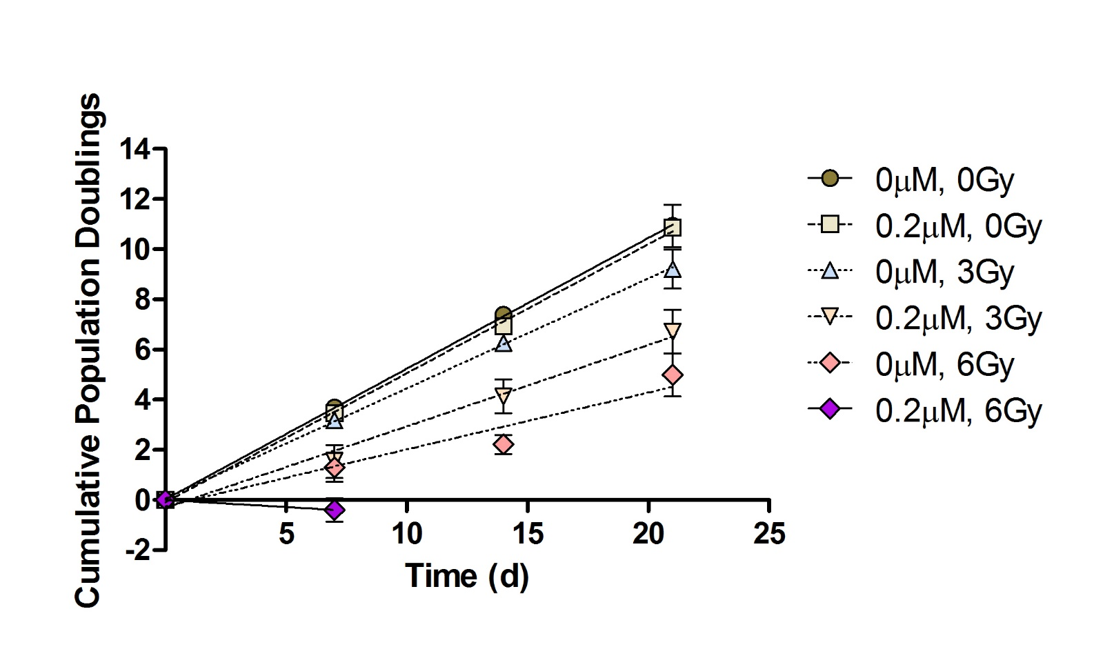


Cell Growth and cell survival
Combined treatment reduce dramatically the growth of glioblastoma cells
The 2Gy-surviving fraction was 2.5 fold lower in RHPS4 pretreated sample than in the samples exposed only to the radiation, whereas the SER (Sensitisation Enhancement Ratio) calculated at 10% survival was approximately 1.9
Berardinelli et al., DNA Repair, 25:104-114, 2015

Slide 12
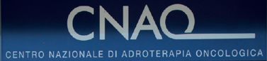
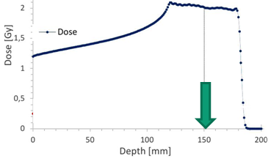
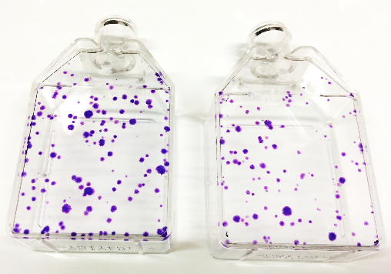

proton irradiation at CNAO in pavia
DNA Repair
Cell Survival
Chromosomal
aberration
Irradiation at ½ S.O.B.P
Dose range (0-5Gy)

Slide 13
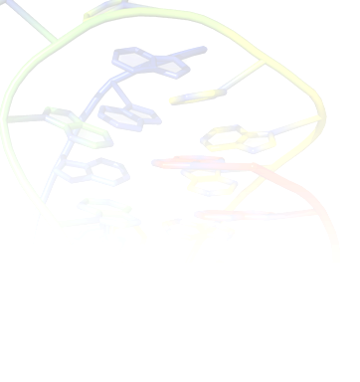
RHPS4 induces a delay in DNA repair after proton irradiation
53BP1
γH2aX

Slide 14
IN THE NEXT FUTURE
Confirm results obtained on RHPS4 induced DNA repair delay after proton irradiation and evaluate combined effect of RHPS4 and carbon ions
Collect data on cell survival in glioblastoma U251MG cells pretreated or not with RHPS4 in combined treatment with charged particles (i.e. protons and carbon ions)
Evaluate chromosomal aberrations induction and in particular those involving telomeres

Slide 15
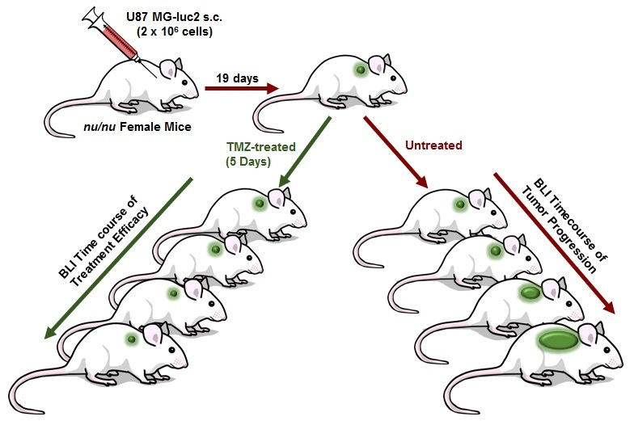
SETTING UP THE ‘IN VIVO’ Model
U251MG (7.5*10⁶ cells)
CD-1® Nude
Mouse:CD1-Foxn1^{nu}
^{CHARLES RIVER}
Nude mice have a spontaneous deletion in the FOXN1 gene, are athymic and immune deficient. Mice with a targeted deletion in the FOXN1 ("knockout" mice) also show the "nude" phenotype.
IR
40 days
RHPS4 treated
In collaborazione con ENEA Casaccia, Dr Mirella Tanori

Slide 16
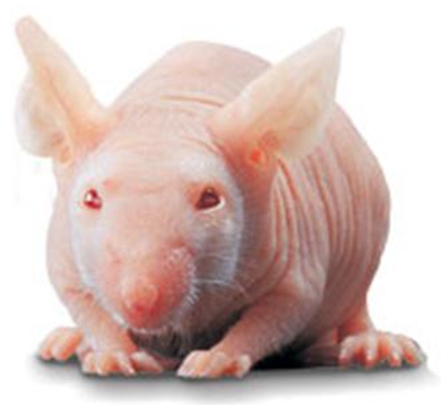
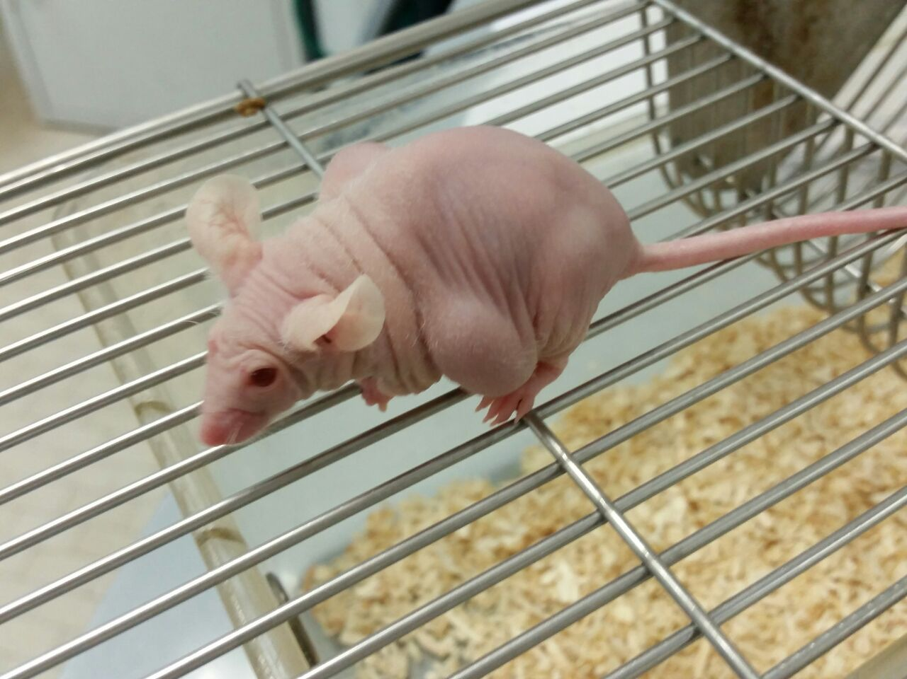
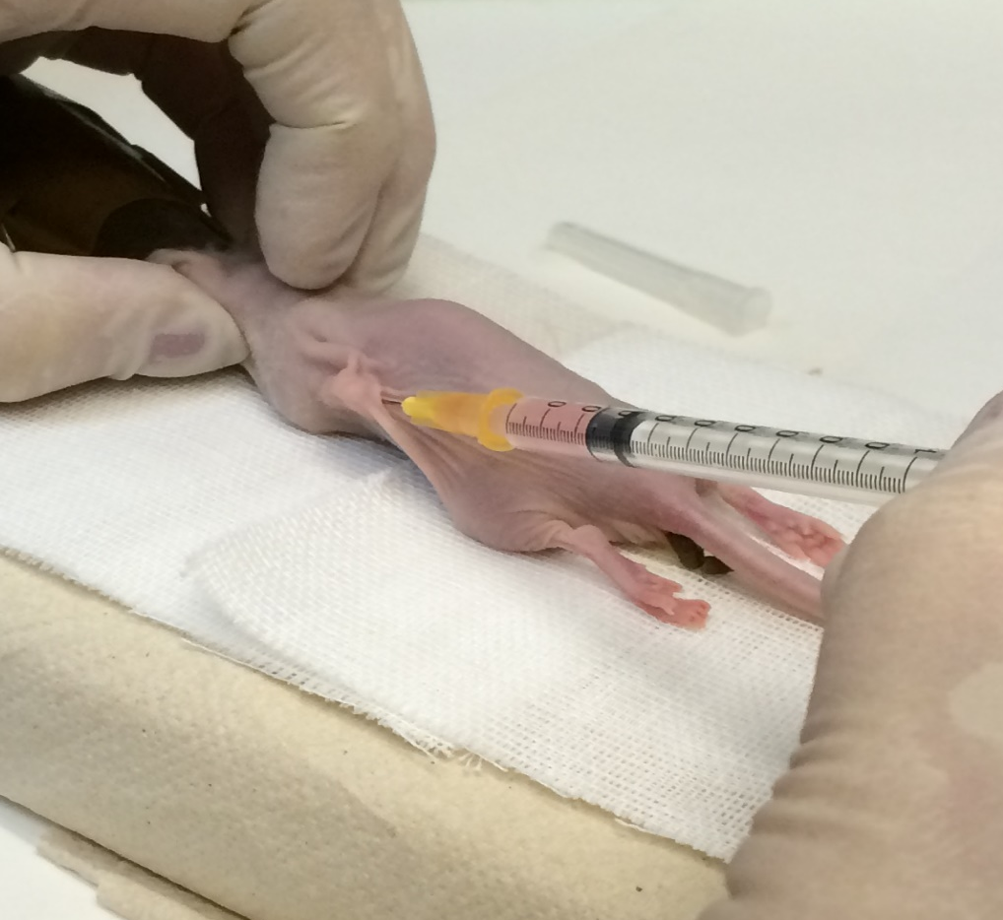
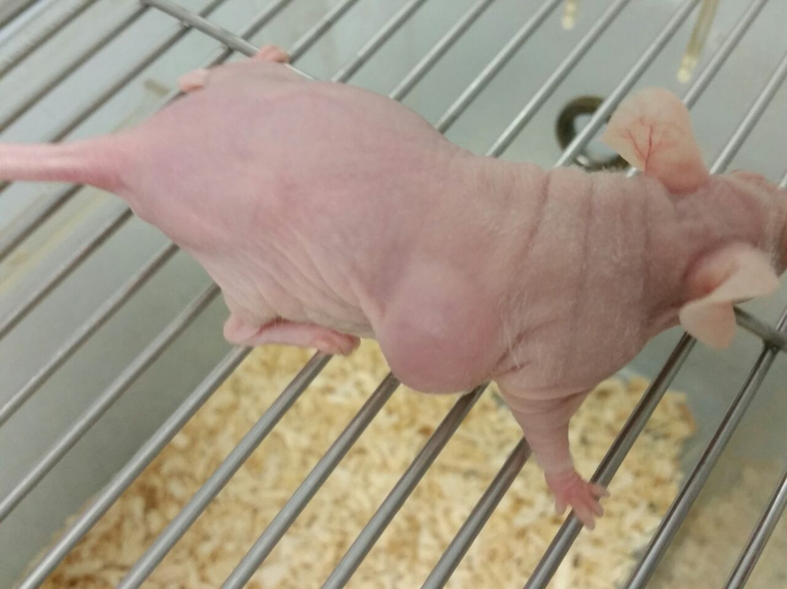
U251MG injection and tumour growth ‘in vivo’
Injection of 7.5*10⁶ U251MG cells
40 days
In collaborazione con ENEA Casaccia, Dr Mirella Tanori

Slide 17
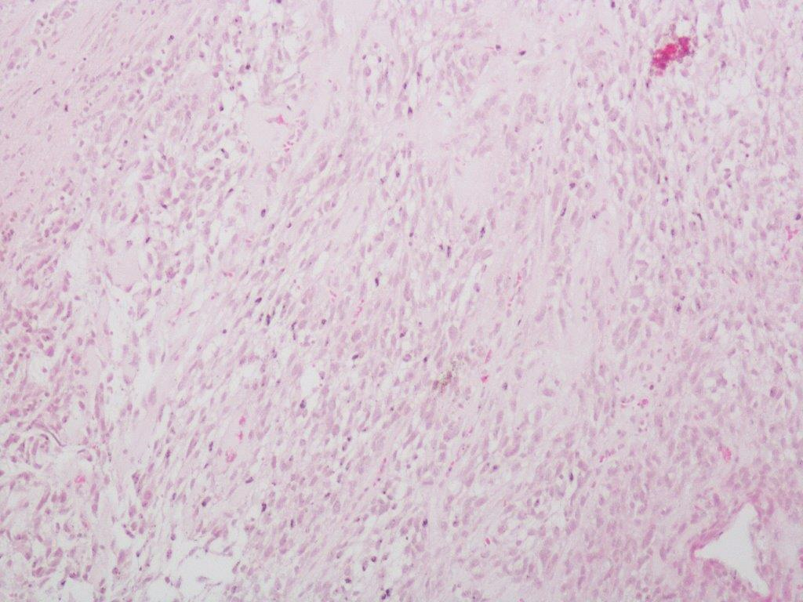
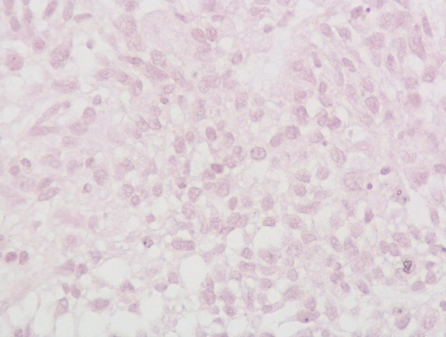
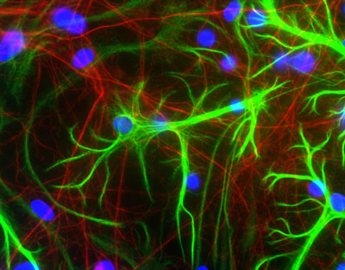
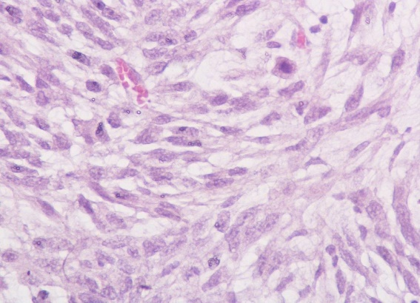
IHC staining for Glial fibrillary acidic protein (GFAP)
Hematoxilin/eosin
GFAP
Glial fibrillary acidic protein (GFAP) is a protein that is encoded by the GFAP gene in humans
Glial fibrillary acidic protein is an intermediate filament (IF) protein that is expressed by numerous cell types of the central nervous system (CNS) including astrocytes
Sample 1
Sample 2
Sample 3
In collaborazione con ENEA Casaccia, Dr Mirella Tanori

Slide 18






ACKNOWLEDGEMENTS
Thank you for your attention!
Supported by INFN - Experiment RDH and IRPT

