Slide 1
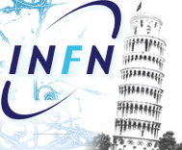

INFN Pisa activity report
RHD WP5
Maria Giuseppina Bisogni
Universita’ e INFN Pisa
On behalf of
RDH PISA

Slide 2
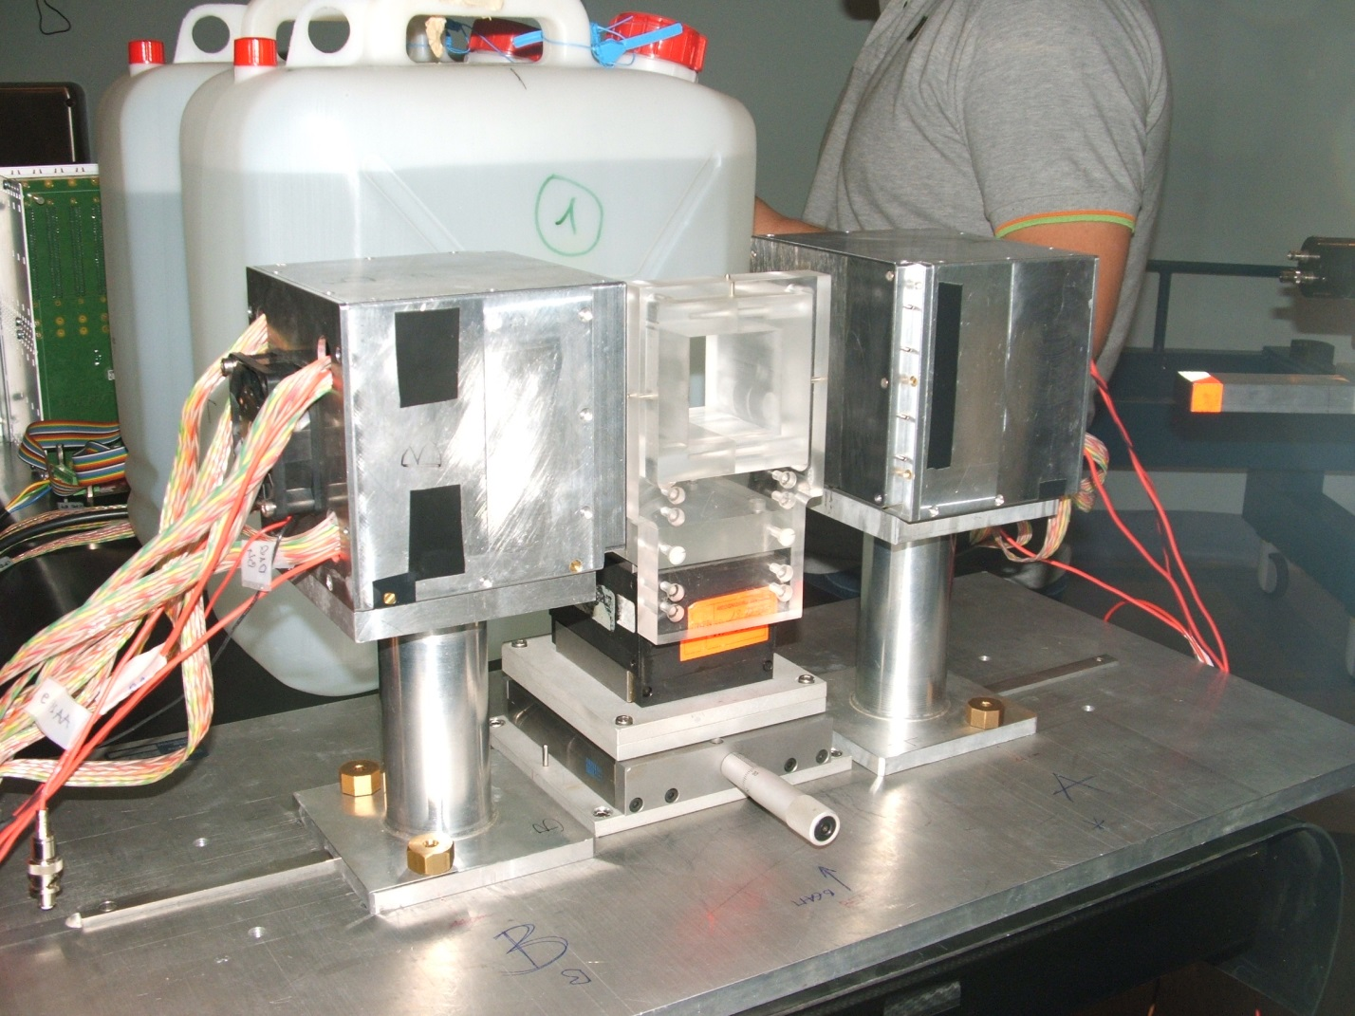
La PET per il monitoraggio della terapia con particelle cariche
Sistema PET
Simulazione Monte Carlo
Misura sperimentale
protons
V. Rosso, A. Kraan, N. Belcari, F. Collini, A. Del Guerra,
S. Ferretti, G. Sportelli, E. Zaccaro
Uni and INFN Pisa
→simulazione e misura della distribuzione dell’attività ß+ prodotta
Notes:
2

Slide 3


FLUKA: esempio di sviluppo spazile e temporale
PMMA
TPS: Syngo PT Planning VC12, Siemens)
2 Gy uniform on 27 cm³ (PTV) 3cm<z<6cm
62.3 MeV - 90.8 MeV (17 EL)
∆Tirr= 146 seconds
proton
simulazione Monte Carlo del profilo (piano y-z) di attività per T= contributo dei diversi isotopi per T<120s

Slide 4

FLUKA: esempio di sviluppo temporale
y
TPS: Syngo PT Planning VC12, Siemens)
2 Gy uniform on 27 cm³ (PTV)
62.3 MeV - 90.8 MeV (17 EL)
∆Tirr= 146 seconds
proton
PMMA
z
x
Simulazione Monte Carlo del contributo dei diversi isotopi a diversi istanti
Time [s] | 15-O (%) | 11-C (%) | 10-C (%) | 8-B (%) | 14-O (%) | Other (%)
30 | 27.0 | 8.6 | 7.6 | 18.3 | 0.7 | 37.7
60 | 34.4 | 11.8 | 9.6 | 14.7 | 1.0 | 28.5
90 | 38.4 | 13.9 | 9.7 | 12.6 | 1.1 | 24.3
120 | 40.4 | 15.0 | 9.7 | 11.7 | 1.2 | 22.0
150 | 44.1 | 17.1 | 9.7 | 9.4 | 1.4 | 18.4
180 | 47.1 | 19.3 | 8.8 | 7.6 | 1.4 | 15.7

Slide 5
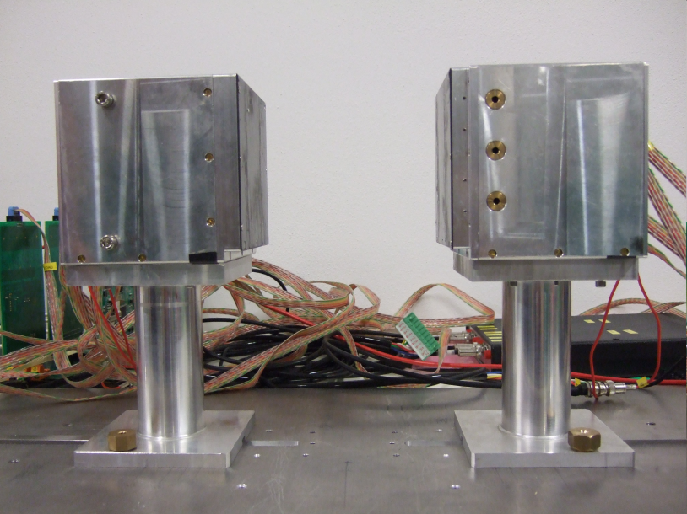
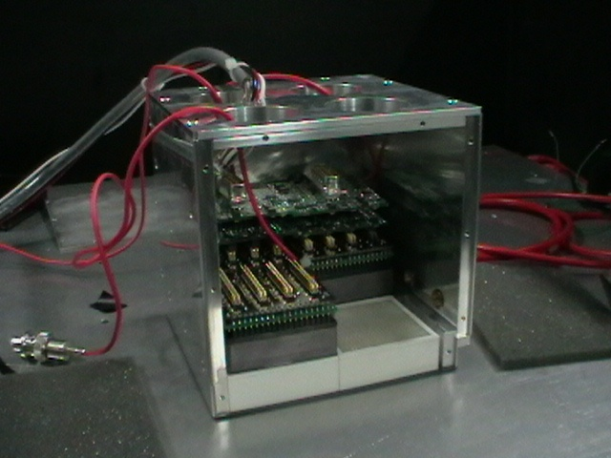
DoPET: un sistema PET in-beam
Come misuriamo sperimentalmente l’attività β⁺?
2 teste planari, ciascuna 10x10 cm²
4 moduli di rivelazione per testa

Slide 6
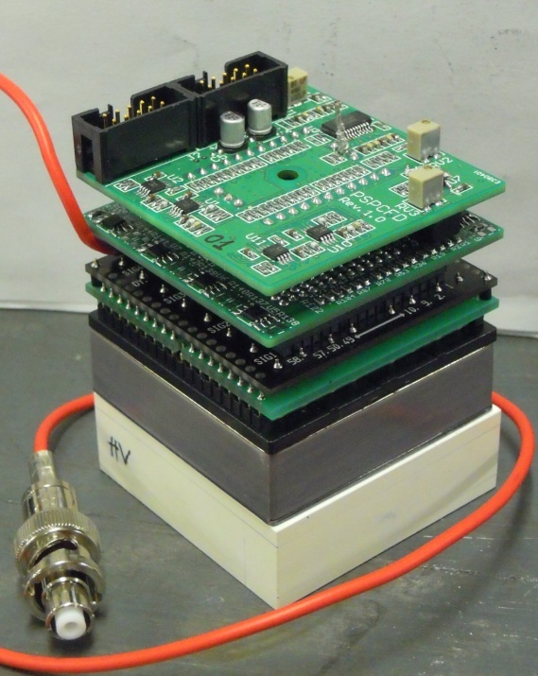
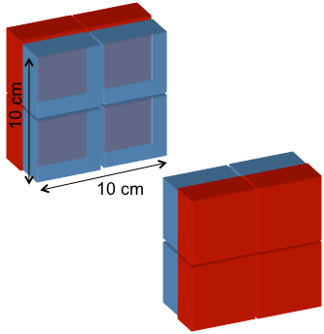
DoPET: modulo rivelazione
  LYSO:Ce Scintillating crystals: 2 x 2 x 16 mm³ pixel
  23 x 23 pixels
PS-PMT H8500
  49 x 49 mm² active area, 8 x 8 anodes
  12 stage dynode
Front-end:
  Resistive chain 64 inputs/8+8 outputs SCD
  2D chain 8+8 inputs/
  2+2 outputs;
  pre-amp
due teste statiche
4 vs 4 moduli
Notes:
SCD (symmetric charge division);

Slide 7
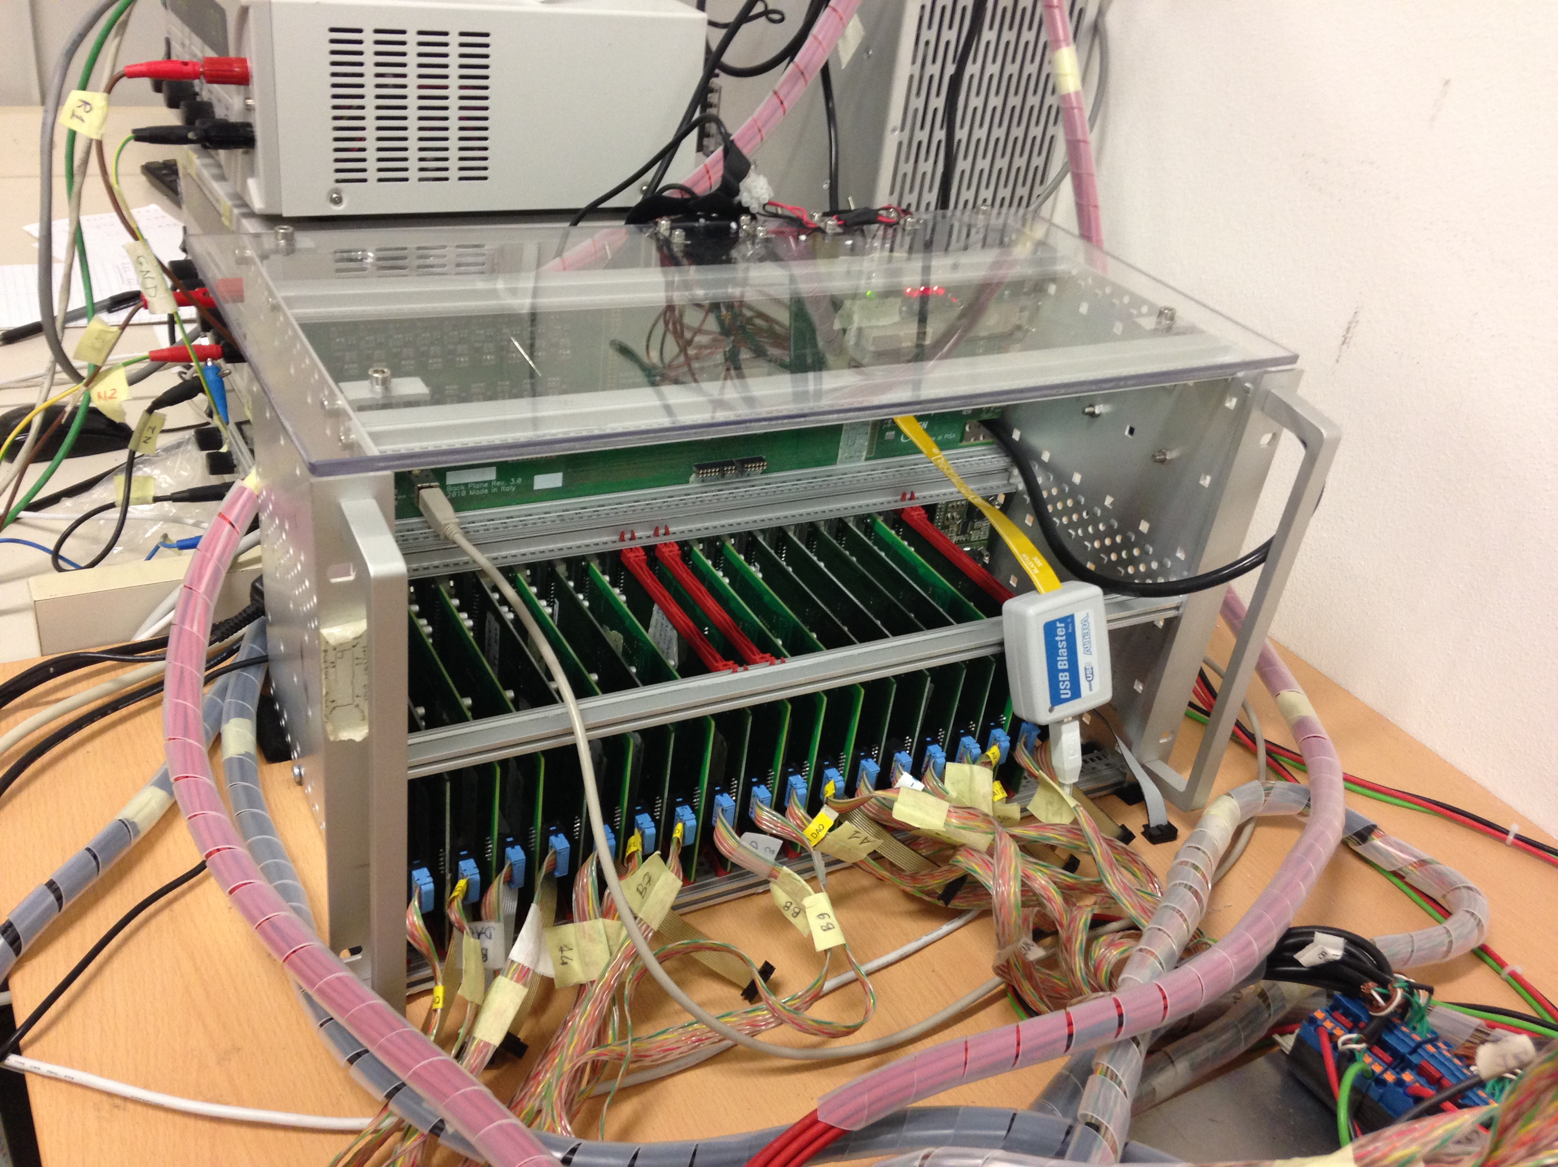
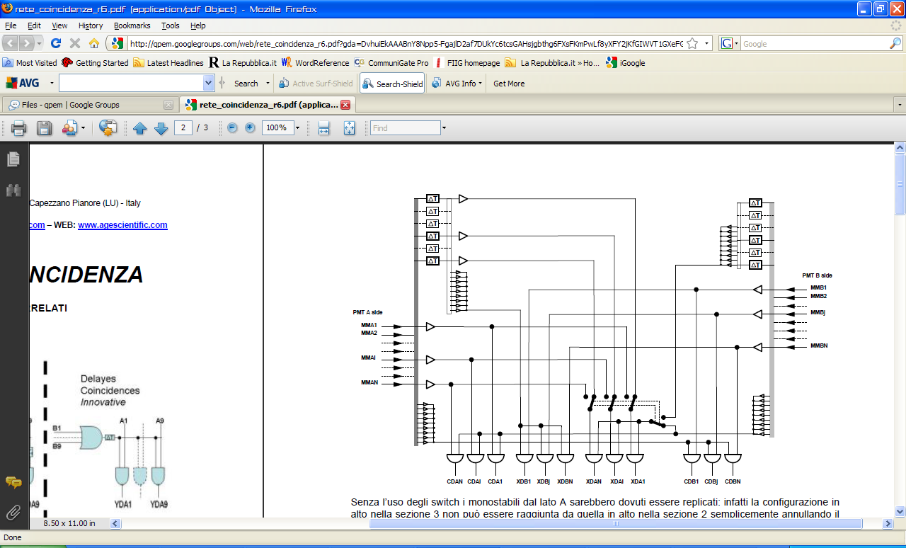
DoPET: Data Acquisition architecture
4 vs 4
FPGA based acquisition and coincidences processing
Time window 5 ns
LYSO1A
Anger-like signals
LYSO2A
PMT 1A
LYSO3A
DAQ 1A
DAQ 2A
PMT 2A
PMT 3A
LYSO4A
DAQ 3A
PMT 4A
DAQ 4A
CFD
CFD
CFD
CFD
Timing signals
MAINBOARD
Master FPGA
USB Controller
coincidence triggers
Host PC
DAQ 1B
DAQ 2B
CFD
Timing signals
DAQ 3B
CFD
CFD
DAQ 4B
PMT 1B
PMT 2B
CFD
PMT 3B
LYSO1B
PMT 4B
LYSO2B
LYSO3B
LYSO4B
Anger-like signals

Slide 8
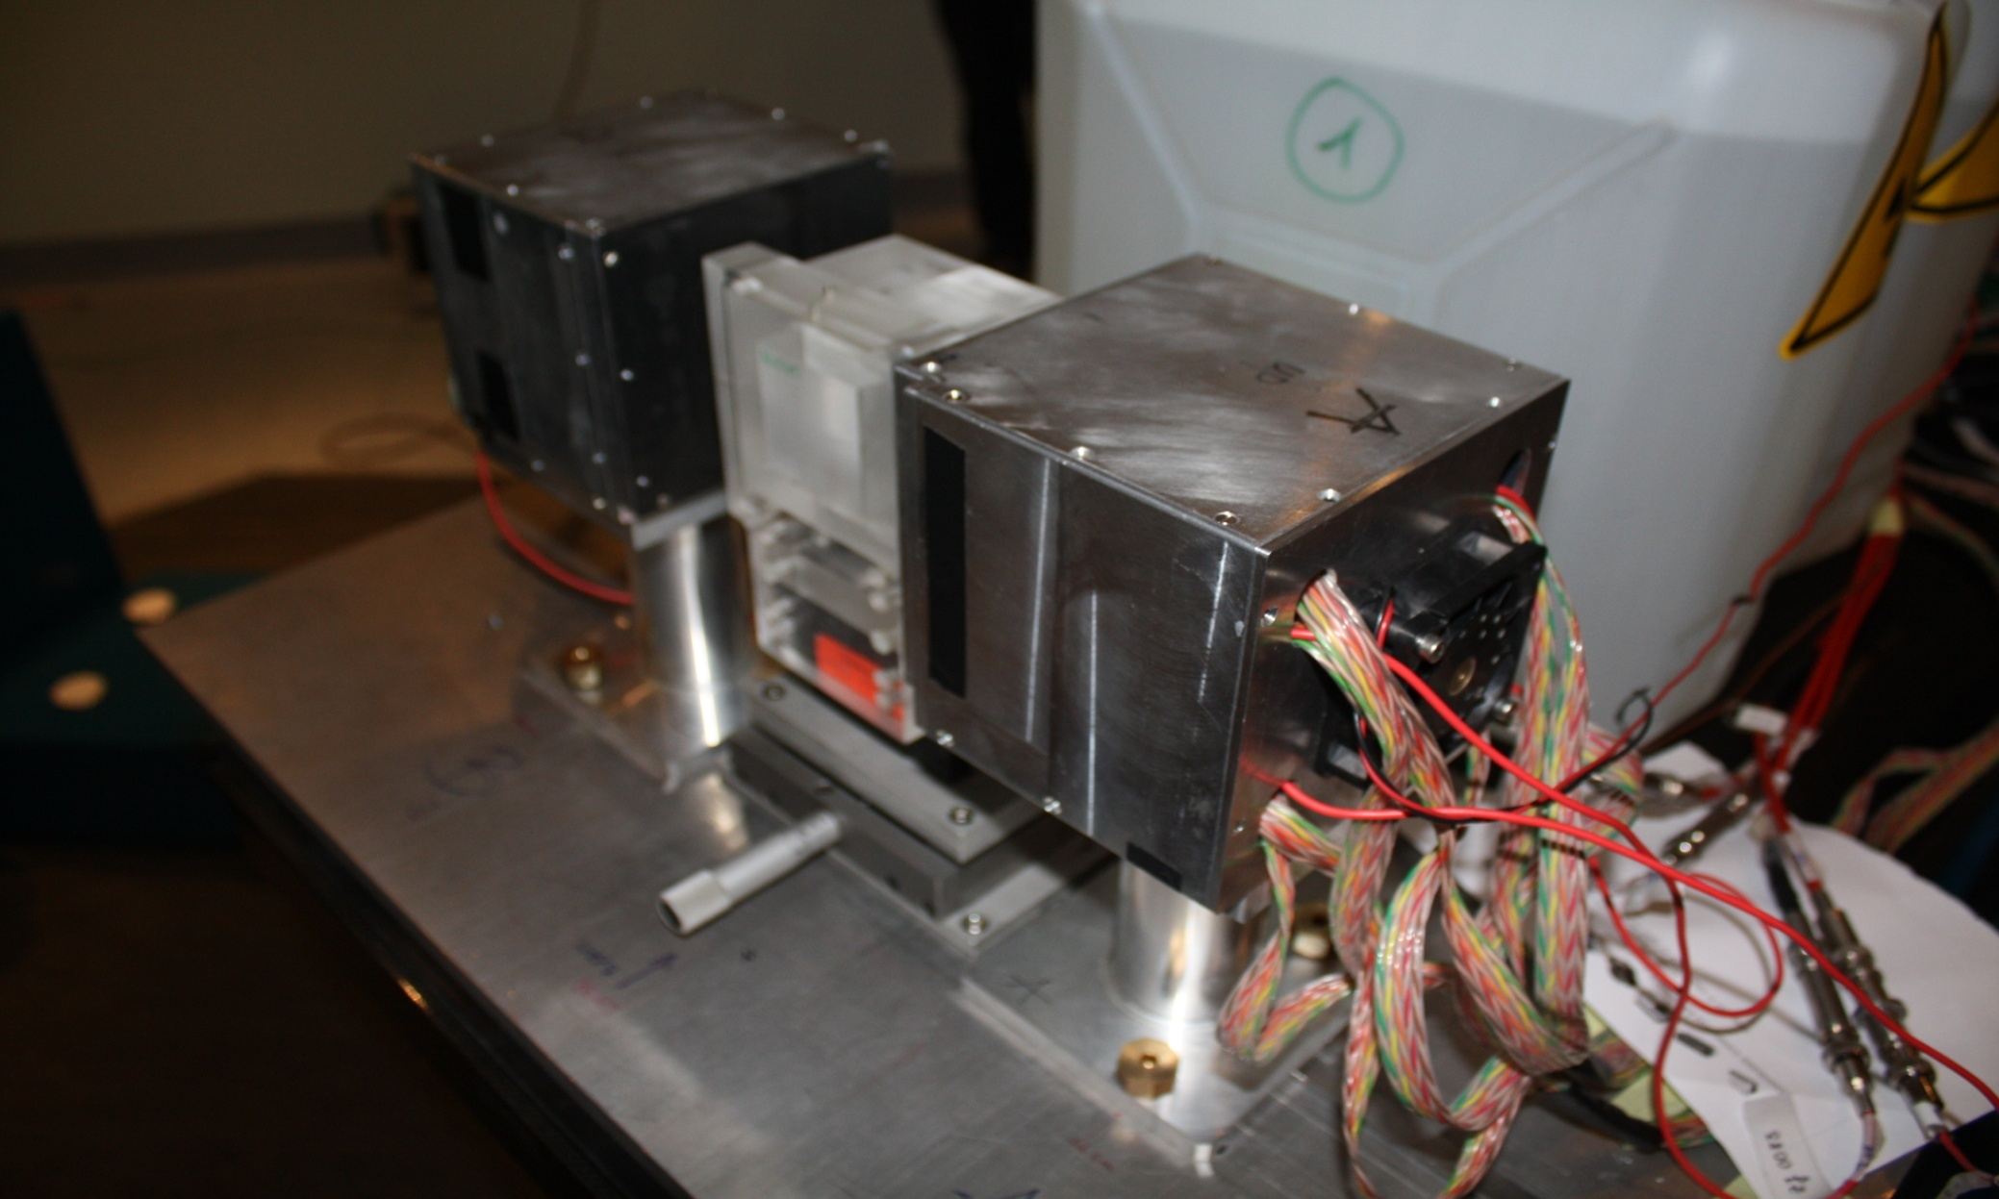
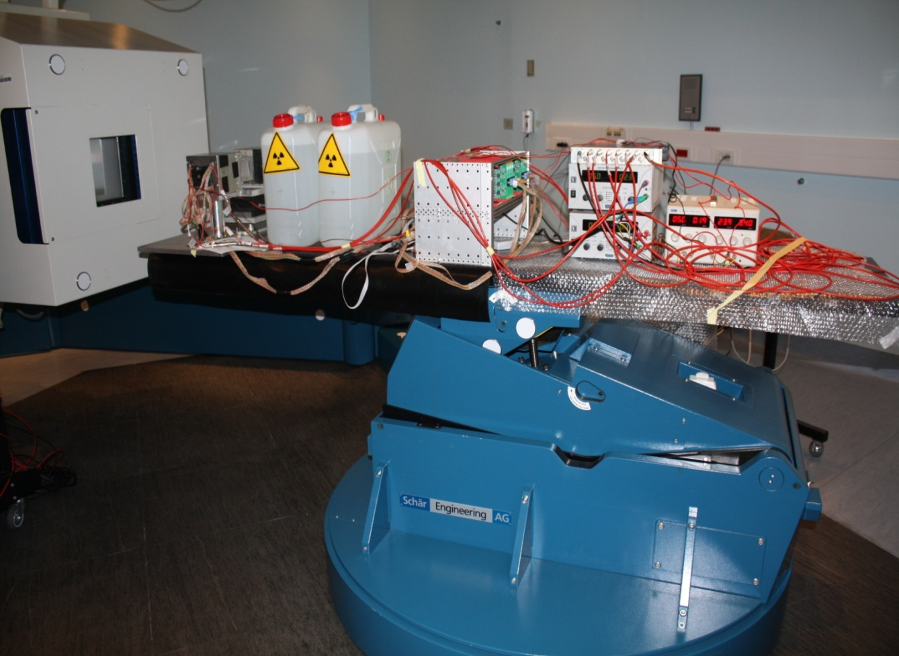
DoPET: Presa dati al CNAO, Pavia
TPS: Syngo PT Planning VC12, Siemens)
2 Gy uniform on 27 cm³ (PTV)
62.3 MeV - 90.8 MeV (17 EL)
∆Tirr= 146 seconds
30
90
Time [s]
180
60
120
240

Slide 9
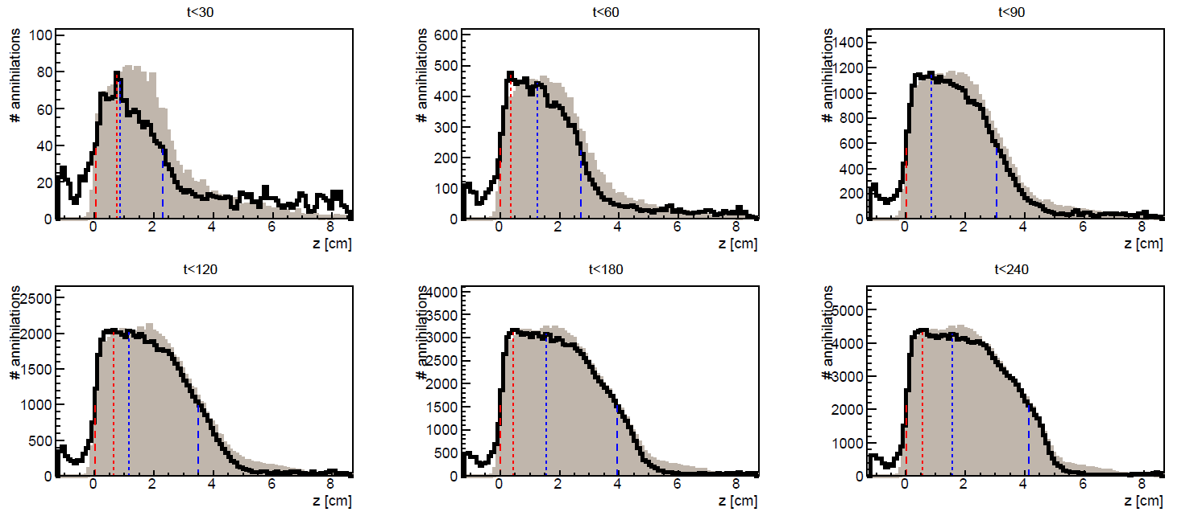
Dati CNAO vs simulazione MC
calcolo ∆w50%
30
90
120
180
Time [s]
60
240

Slide 10
FLUKA: esempio di sviluppo spazile e temporale
Fantoccio con cavita’: air-cavity of 34 mm diameter and 5 mm height starting at a depth of 4 cm from the beam entrance surface (PTV 3cm<z<6cm)

Slide 11
Una procedura per il monitoraggio dei trattamenti
TPS: distribuzione dose
Field 1
CT, parametri trattamento, tempo
simulazione Monte Carlo dell’attività
MC PET pre-calcolata
PET misurata
confronto
AZIONE?

Slide 12
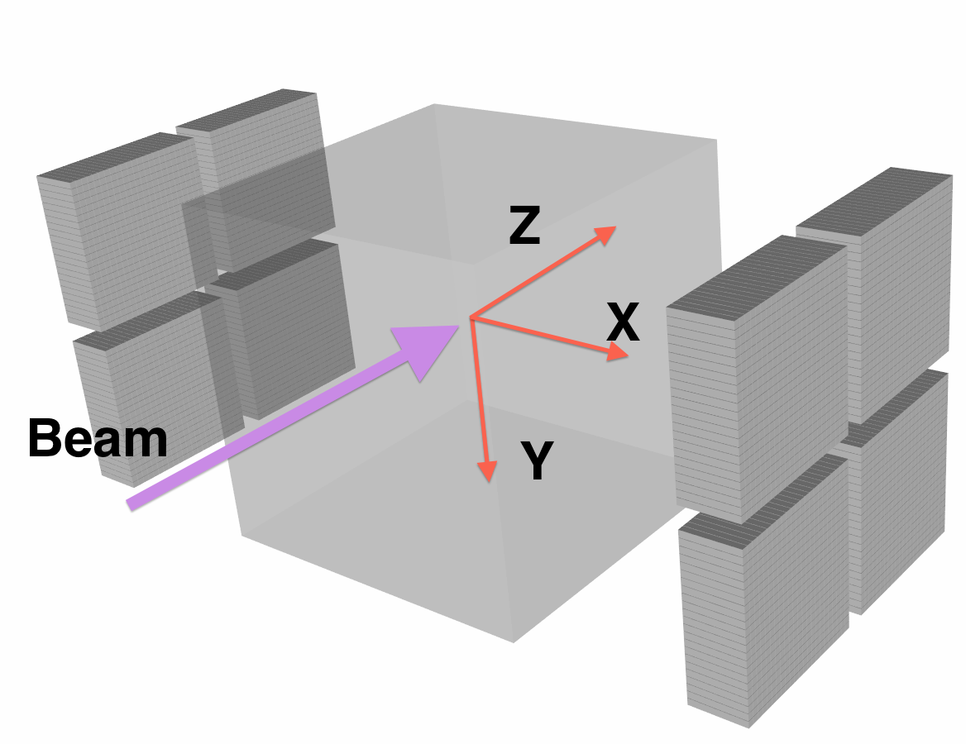
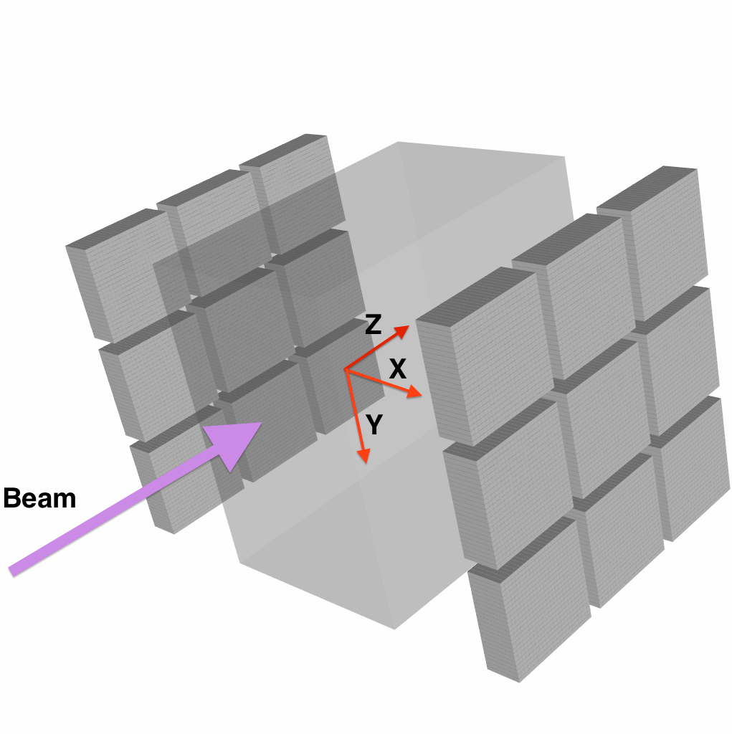
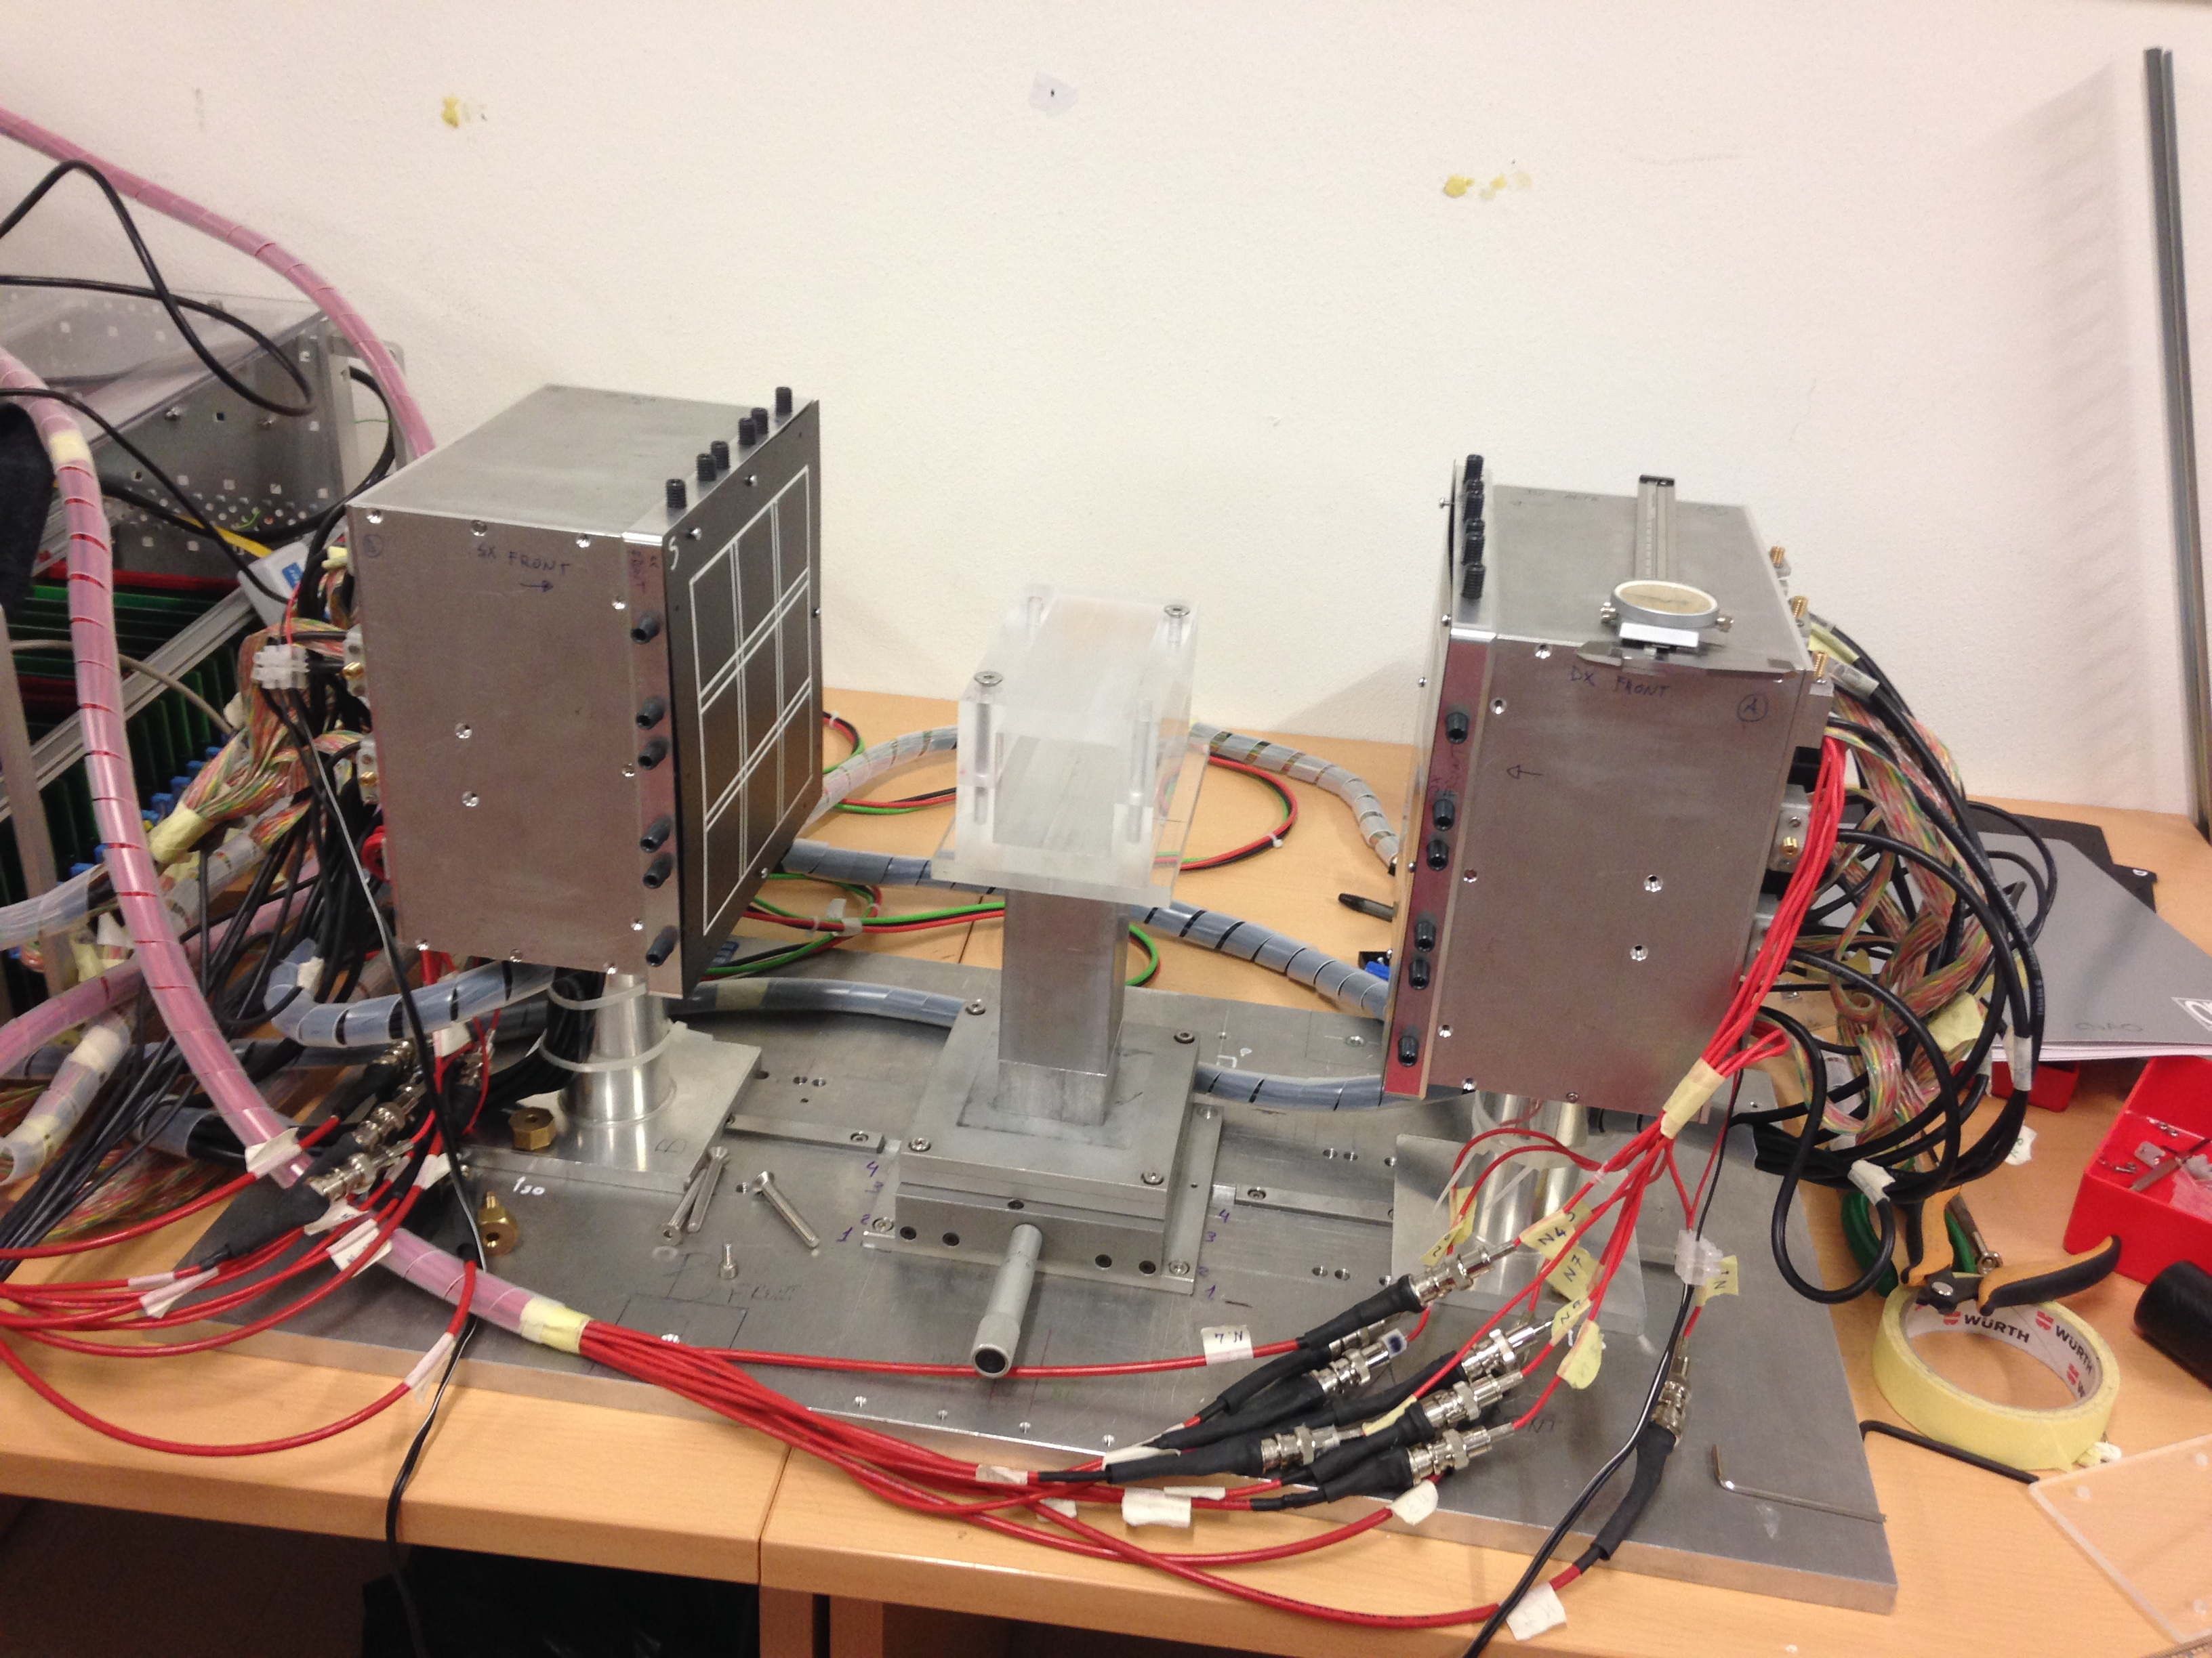
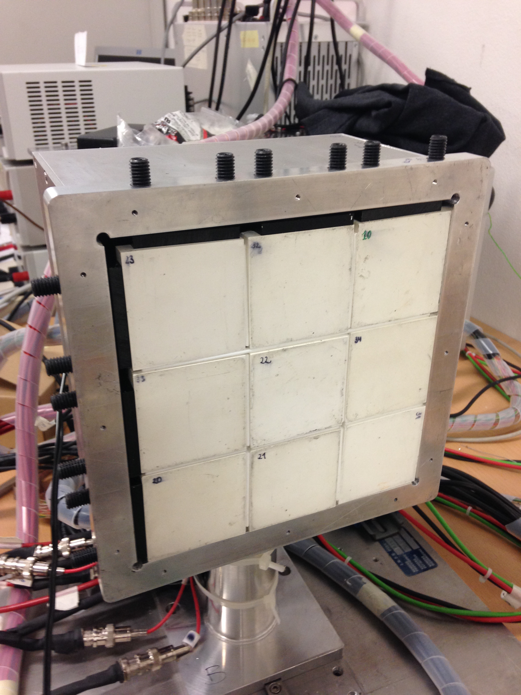
9 vs 9
Area attiva 154x154 mm^3

Slide 13
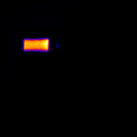
9 vs 9: prime immagini
30mm
Cavita’ riempita con soluzione contenente 18-F
16mm
100mm
Immagine non processata!

Slide 14





INSIDE Project
CNAO
PRIN INSIDE
project:
INnovative Solutions for
In-beam
DosimEtry in Hadrontherapy
Centro Fermi project:
Innovative Non Invasive Imaging of Dose Release in Hadrontherapy
INFN RDH project:
Research & Developments for Hadrontherapy
PRIN MIUR 2010-2011 - 2010P98A75
Notes:
The monitoring is based on the detection of different signal produced by the beam:
Annihilation gammas from β⁺ emitters (PET)
Prompt charged secondaries (mainly protons)

Slide 15

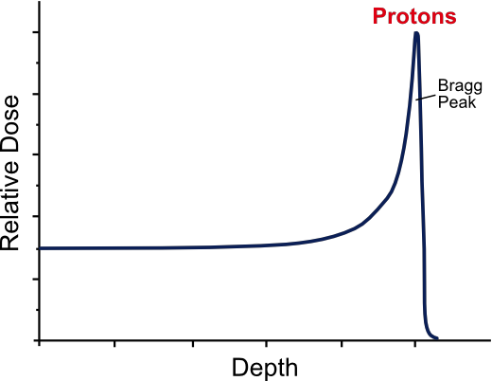





INSIDE
Innovative Solutions for In-beam DosimEtry in hadrontherapy
aims at building an in-beam, multimodal profiler for Hadrontherapy
511 keV
The monitoring is based on the detection of different signal produced by the beam:
Annihilation gammas from β⁺ emitters (PET)
Prompt charged secondaries (mainly protons)
proton
Beam
511 keV
prompt

Slide 16
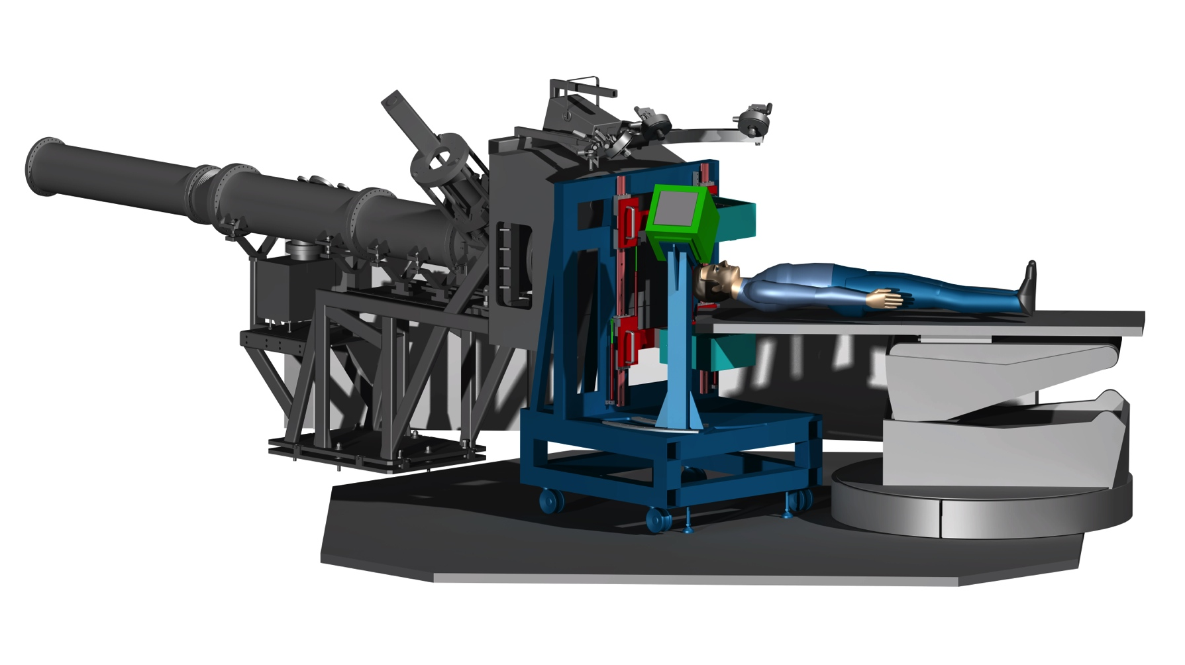
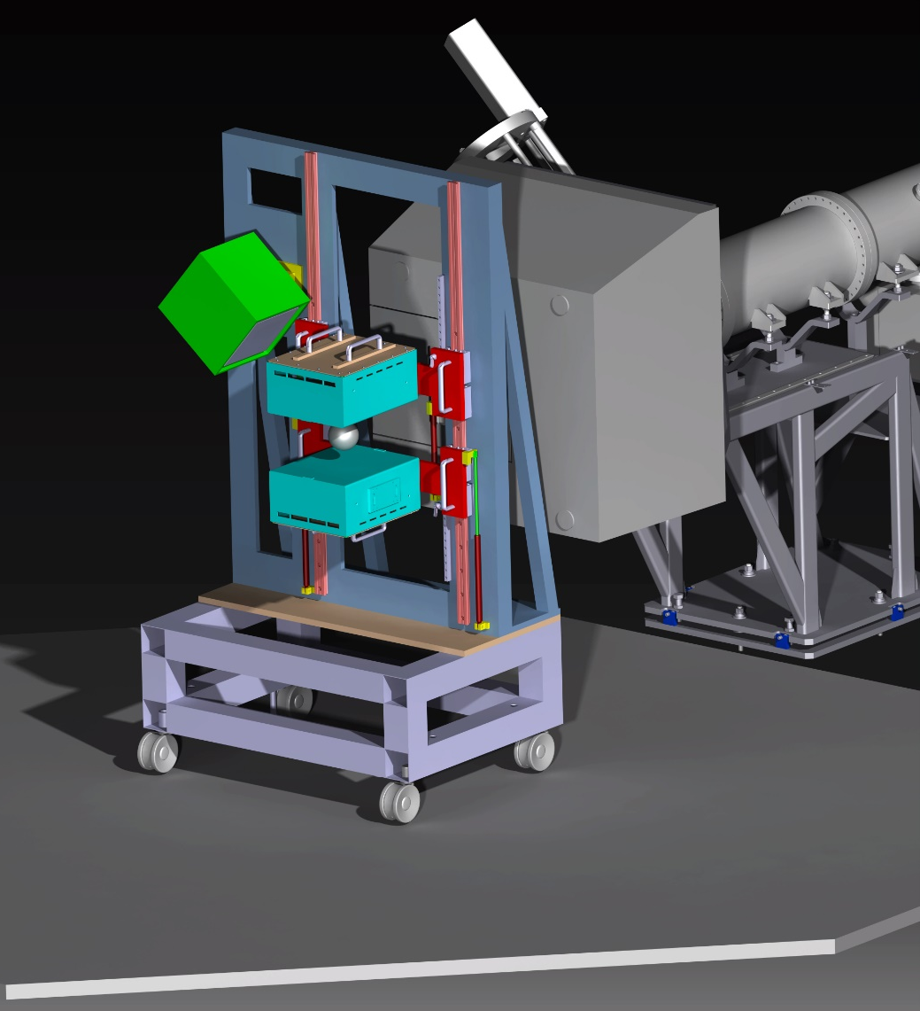
Multimodal approach: The INSIDE project @CNAO
In-beam dose profiling by PET activities and charged secondaries tracking .
PET heads
Charged
tracker
CNAO
nozzle
Mechanics and operation optimized to be tested (and finally operated) at CNAO
G. Giraudo
INFN Torino
INSIDE prototype
Notes:
Sliding pet edges above and below the couch range 200-600 mm +/- 100 – 300 mm wrt isocenter
Charged tracker box: 90⁰-60⁰ wrt the beam
Chariot (mounted on wheels) to be easily placed or removed and parked outside the treatment area

Slide 17
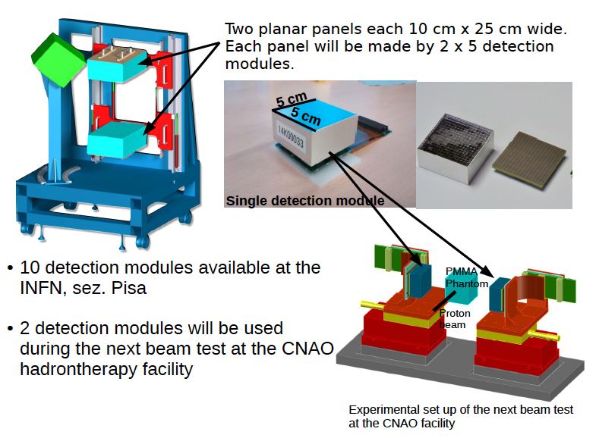
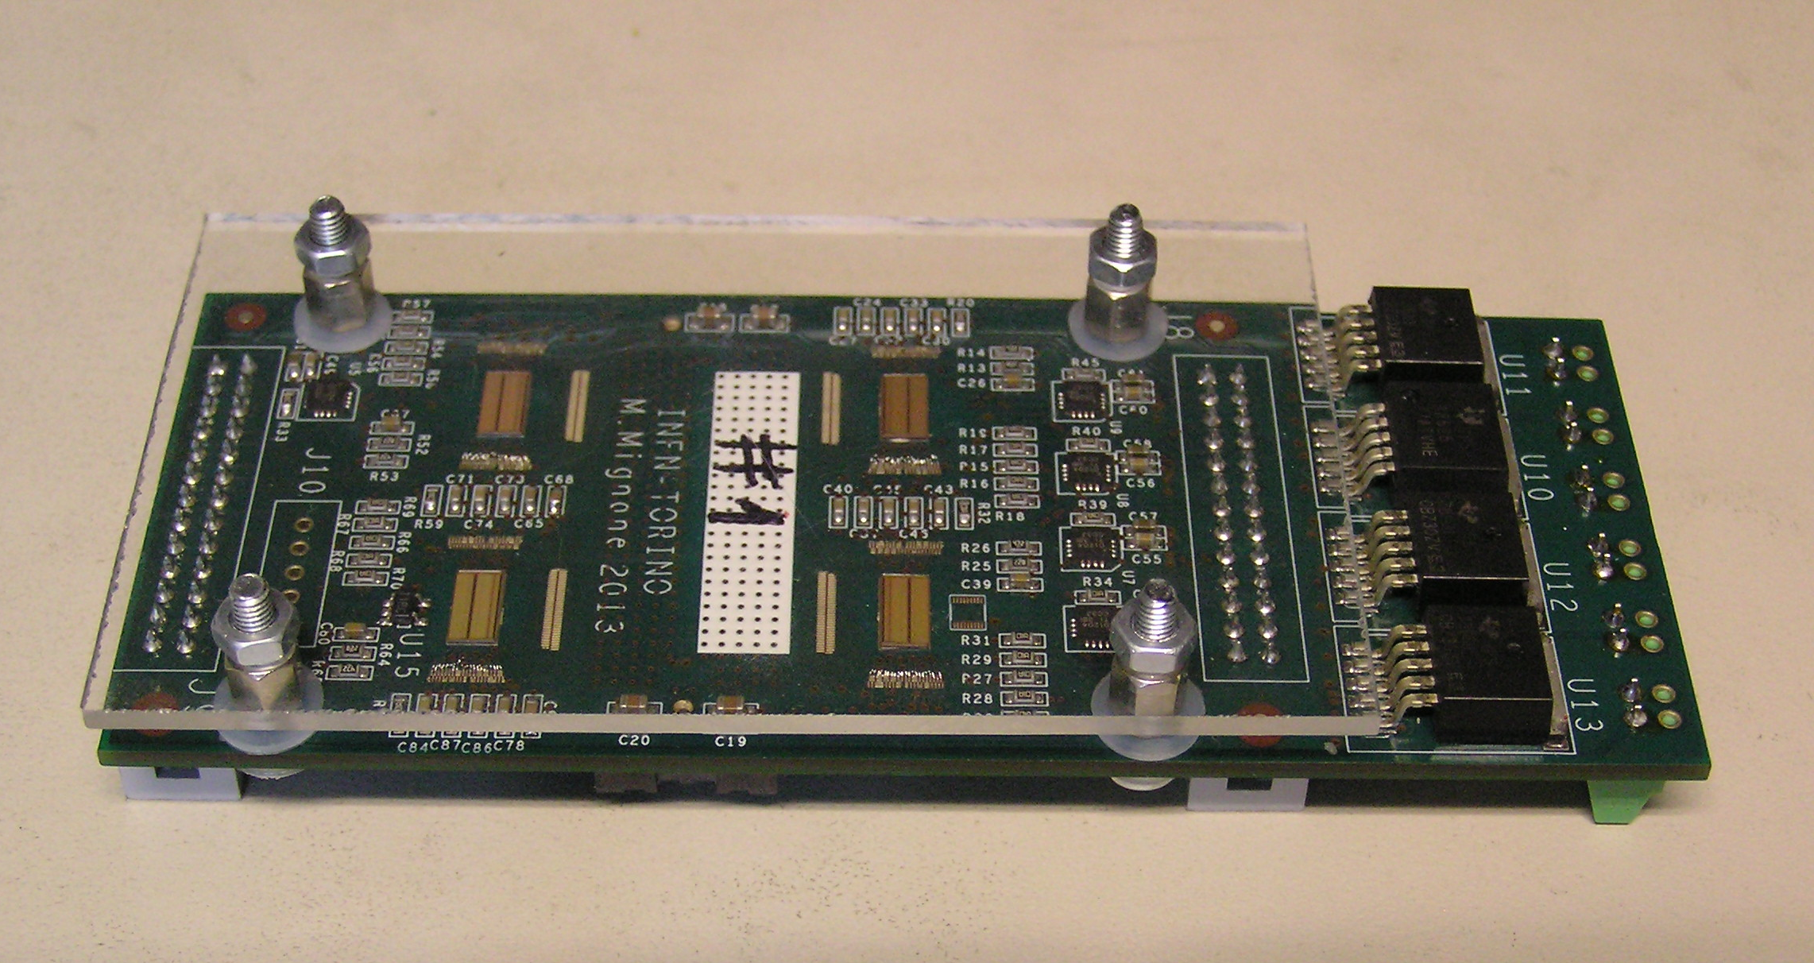
A. Pileiro, G. Pirrone, M.Morrocchi, A. Lodola
INFN Pisa
R. Wheadon INFN Torino

Slide 18
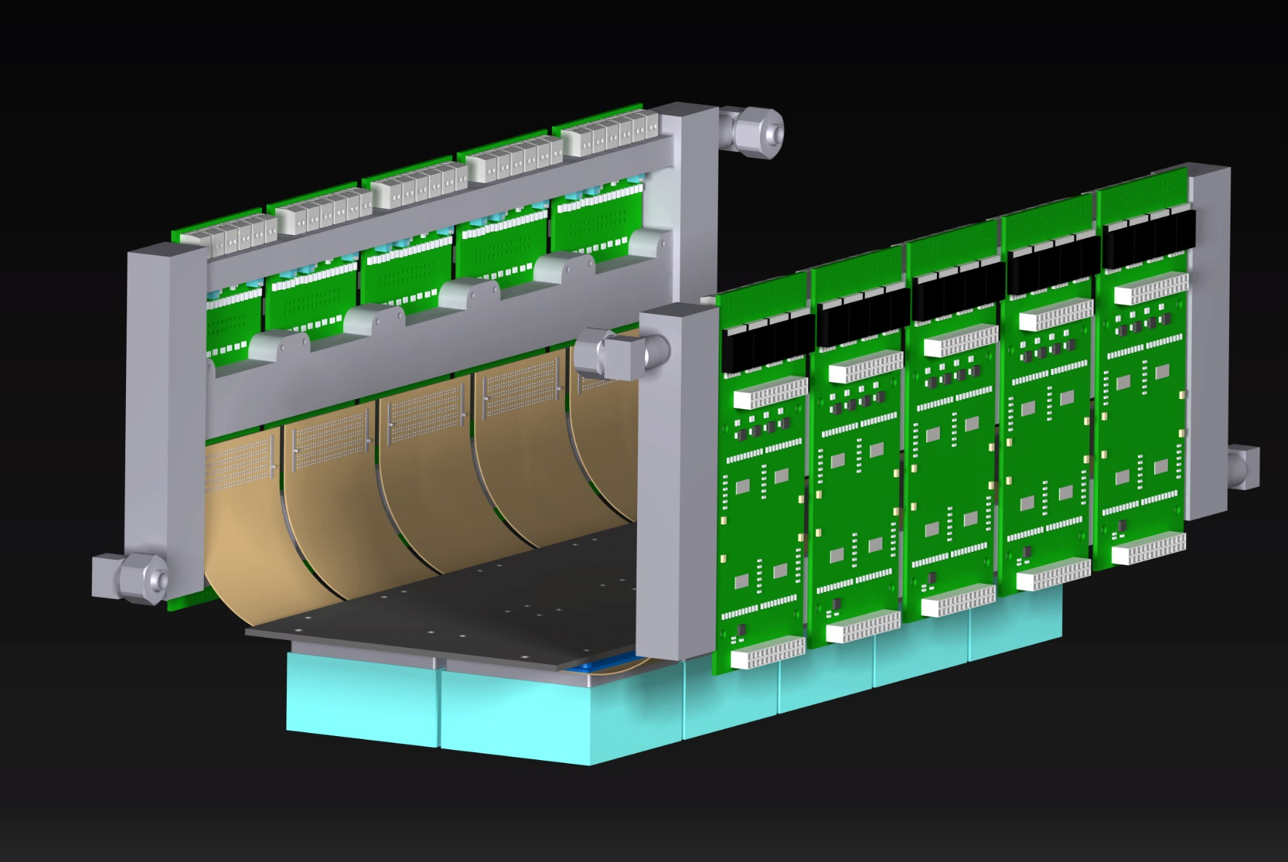
PET detector updates
G. GIRAUDO
INFN Torino

Slide 19
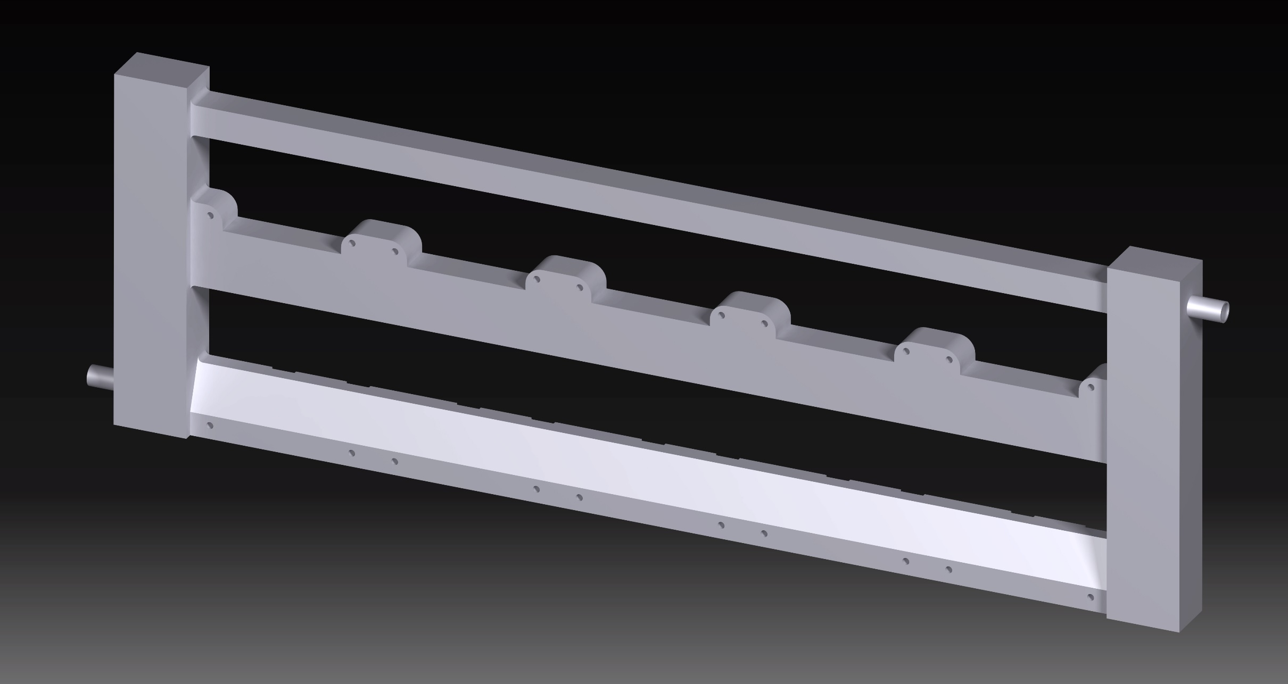
PET detector updates
COOLING PLATE – NEW DESIGN
Tube embedded in the melted plate
ALUMINIUM ALLOY AlSi7Mg T6 → 150 W/m∙K
AISI 316 L → 15 W/m∙K
G. GIRAUDO
INFN Torino
found an art foundry (ITALFOND)
plate in order: minimum 8 pieces

Slide 20
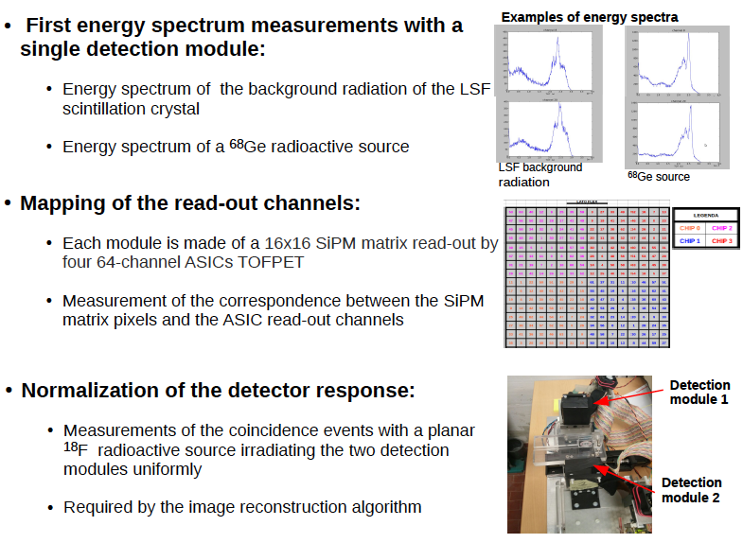

Slide 21
Development of a 64-channel Front End ASIC
Detection module: 16x16 SiPM pixels read-out by four 64-channel ASICs BASIC64
The ASIC provides the energy (in digital) of the detected events and an accurate trigger signal
Technology | Standard 0.35um CMOS
Power supply | 3.3V
No. of channels | 64
Dynamic range | ≅ 2400 p.e.
Minimum threshold level | Single photon
SNR | 20dB
Time resolution | 500ps FWHM
Internal ADC resolution | 10 bits
Current consumption | ≤ 10mW/channel
Read-out frequency | 100 MHz
Digital links | LVDS
C. Marzocca et al.
Politecnico Bari
Italy
Main specifications of the ASIC
Notes:
This is the outline of the presentation.
Fist of all, we needed an accurat model of the detector in order to perform reliable simulations at circuit level. So, the classical model of the SiPM has been modified by adding some relevant features which gives remarkable contributions to the electrical behaviour of the detector itself and, moreover we set up a suitable extraction procedure to evaluate the paramenters involved in the model.
After that, different front-end circuit solutions have been compared to find out the most suitable one, considering the SiPM characteristics. Some prototypes of the very first front-end have been realized and some results fromt their characterization will be shown.
The very first version of the f.e. has been equipped with more building blocks and a first version of the complete analog channel has been designed, realized and characterized. Also in this case some measurements results wil be provided.
Next, the design of an 8 channel test chip has been carried out, togheter with the architecture of the digital read-out section. The chip has been submitted to a MPW for fabrication at the end of July and we expect the delivery of the prototypes by the first part of October.
Eventually some possible future work will be described

Slide 22
Front-end ASIC for the SiPM: main features and specs
Front-end approach for the SiPM: two matched common-gate input buffers in parallel, one for time measurement, one for charge measurement
Fine tuning of the SiPM bias (8 bit DACs, LSB less than 10mV, one every 4 channels)
Both SiPMs “p-on-n” and “n-on-p” can be used
Input impedance of the analog channel: 50Ω
Integration time constant for charge measurement τ_{int}=170ns
Low threshold for fast timing: trigger validation by means of threshold on the charge level
Charge dynamic range: about 2500 p.e. (with SiPM gain 10⁶)
“Slow” path overall gain: about 1.2mV/p.e.
Total current consumption of the analog channel 2.4 mA
64 multiplexed channels, fast-OR of the trigger output of the channels for time measurement
ADC for charge measurements with 10bit resolution
Conversion rate for events involving all the 64 channels (serial read-out): 75kHz
100MHz LVDS communication link for charge and address data

Slide 23
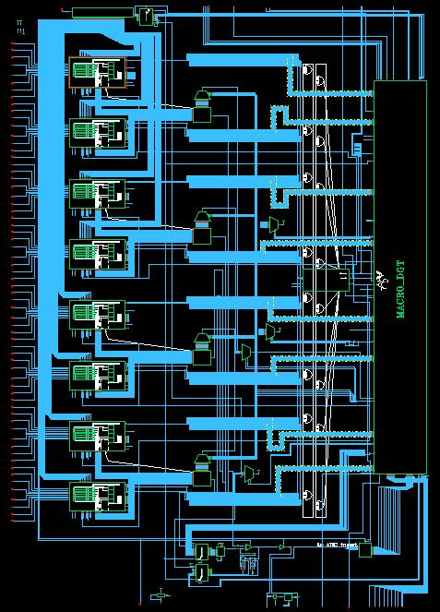
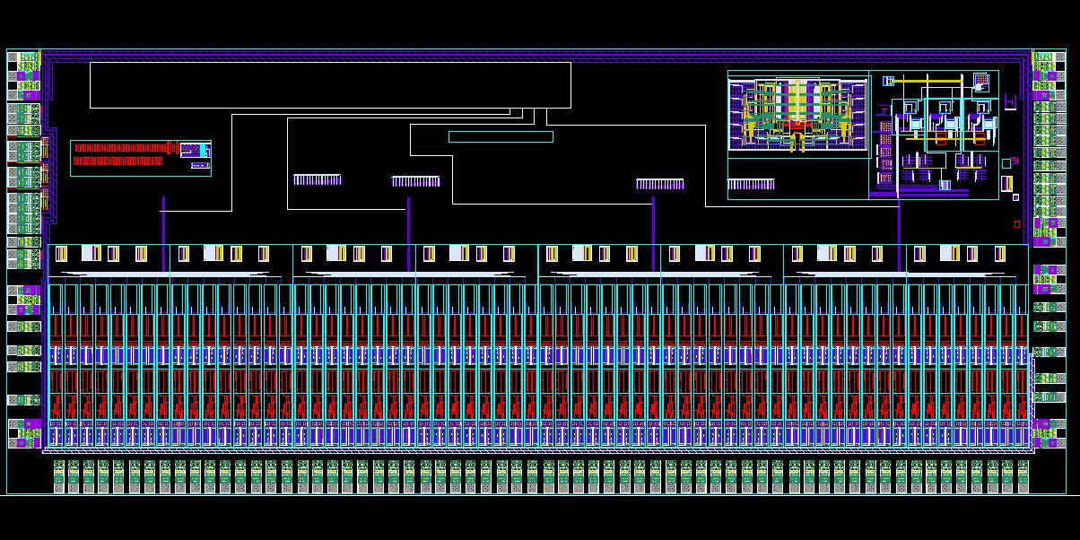
Front-end ASIC for the SiPM: status
Schematic of the ASIC at top level
Design finished at schematic level
Layout of the blocks under verification (Layout Vs Schematic and post-layout simulation)
Provisional floorplan done with the 64 channels, the ADC and the digital part placed
Top level routing and final verifications to be done
Chip size: about 10mmx5mm
Possible placement of two abutted dies in a single package to have an ASIC for 128 channels
Provisional floorplan

Slide 24
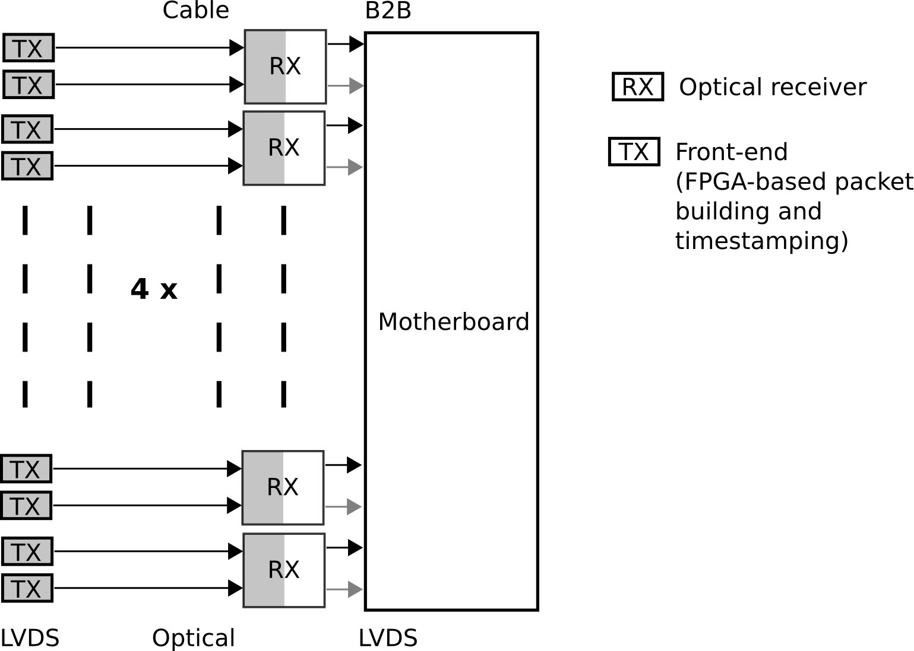
Overall DAQ scheme
FE
FE
FE
FE
R. Wheadon
INFN Torino
Front end board
FE
Objectives
  Provide full in –beam (full-beam ) PET system able to sustain annihilation and prompt photon rates during beam irradiation
  30 kHz/cm^2 maximum sustainable single rate
  Each 5x5 module will provide data at a rate of 720 kHz
Data packet 10 B
Expected module output bandwidth 7.2 MB/s
FE
FE
FE
FE
G. Sportelli, E. Zaccaro, E. Kostara
Uni and INFN Pisa

Slide 25
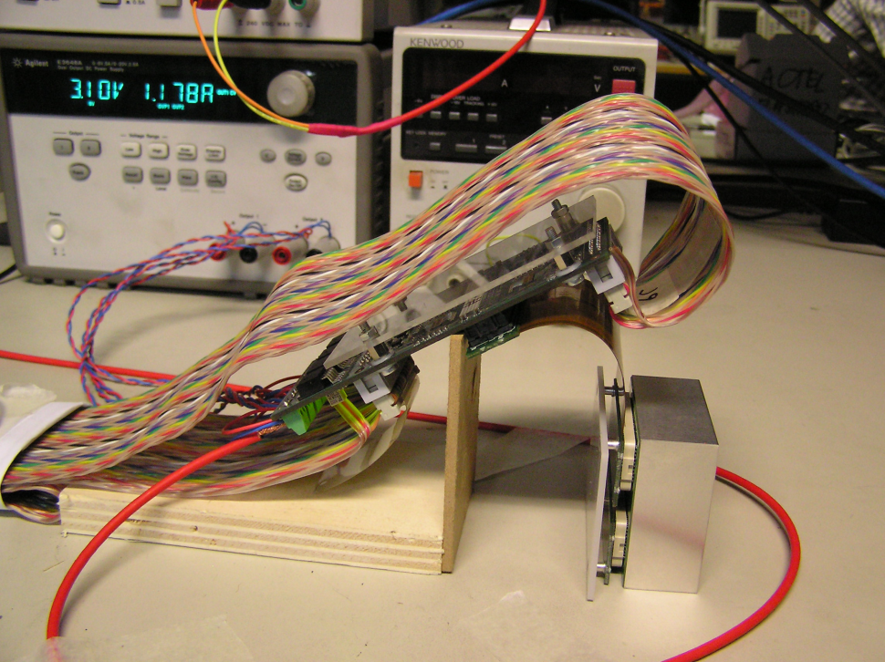
Torino electronics hardware status
(FE and Tx FPGA) 23/4/2015
FE board design (Tofpet ASIC), construction and test of first prototype boards complete
Firmware and software for ML605 (2 FE boards) and SP605 (1 FE board) allow ASIC calibration and data acquisition (up to ~ 83MByte/s) via custom Gbit Ethernet link
Basic Rx firmware for Gbit Ethernet communication delivered to Pisa
Probe station testing of ASIC’s underway
FE boards and dedicated FMC adapters
production underway
SP605 (Tx FPGA boards) procuration underway
Remaining work:
FE board production and calibration
Tx/Rx data transmission firmware
PET detector panel construction
R. Wheadon INFN Torino

Slide 26
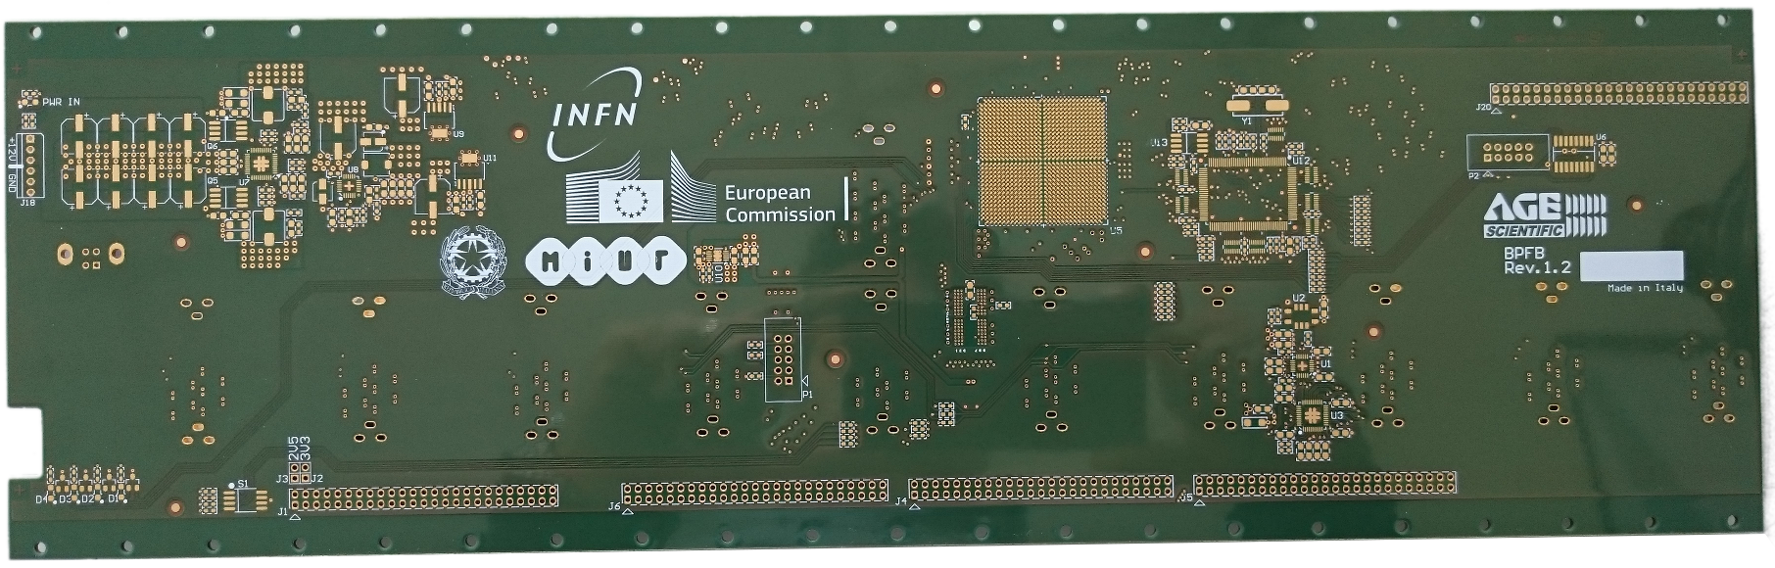
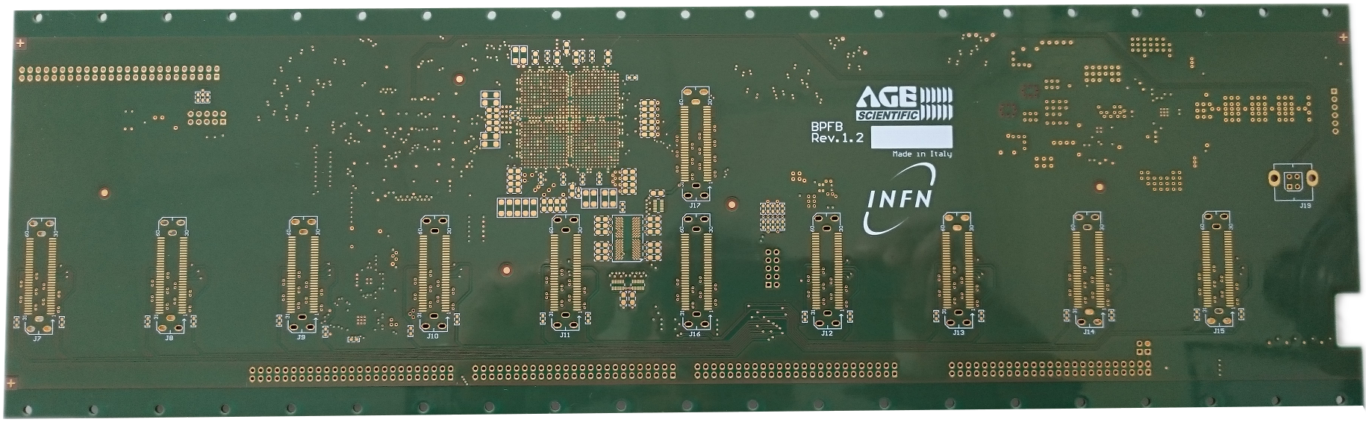
Motherboard
Hosts all the RX boards in a 3U rack
Collects and filters all detected photons
Processes coincidences in real time
Sends coincidence data to the host PC via USB 2.0
HW complete, FW/SW under development

Slide 27
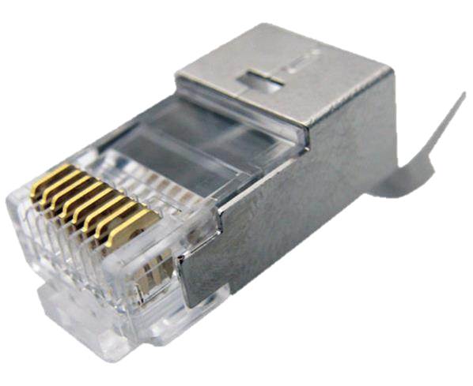
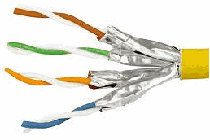
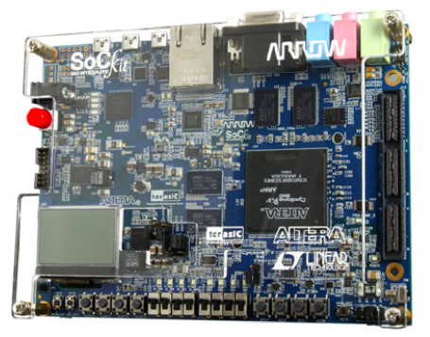
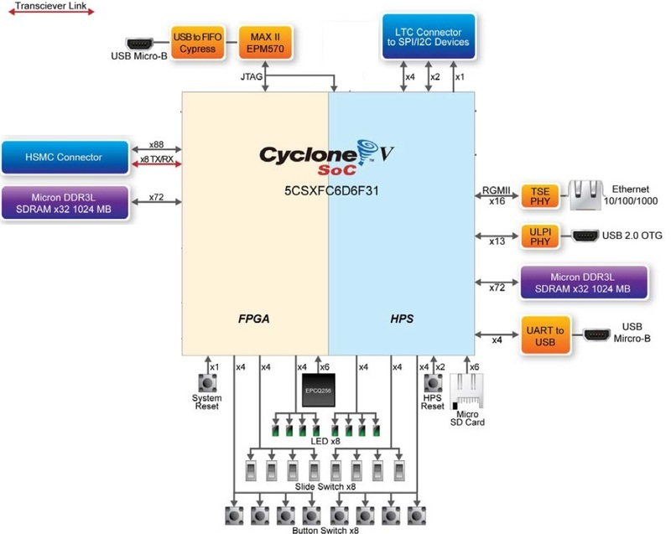
RX Board
cheapest, lowest bandwidth
280 mm
Gb Ethernet
mezzanine
Cat 7
clock
cables
100 mm
Cat7 cable
expensive, high bandwidth
MB
Connection

Slide 28
RX HW development status today
Functional design ✔
Schematic design ✔
Mechanical design ✔
PCB design
  Functional design ✔
  IC and connectors placement ✔
  Negotiation ✔
  External company kick-start ✔
Construction and assembly ✖
Expected delivery 7/2015
Most recent results are marked in blue

Slide 29
Current work
SoCKit board
  Finish time constraining of ethernet connection ✔
  Develop a HW/SW test framework ✖
Motherboard
  Finish hardware tests (mainly LVDS channels) ✖
  Develop clock management boot-strap ✖
  Re-implement control firmware from DoPET ✖
  Test coincidence sorting ✔
  Develop coincidence filtering ✔
RX board
  Construct and test the prototype ✖
  Develop complete firmware ✖
Most recent results are marked in blue

Slide 30
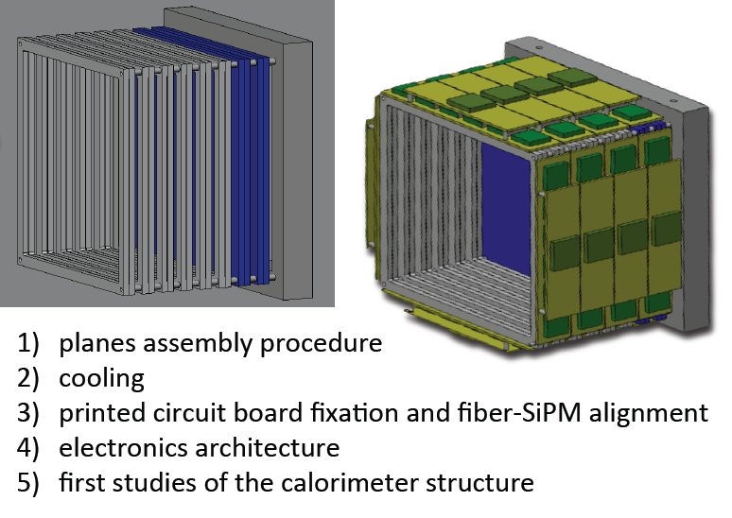
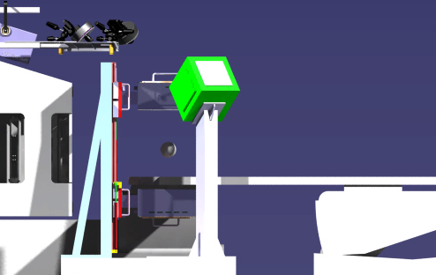

Dose Profiler
V. Patera, Uni La Sapienza, Roma
6 XY planes with 2 cm spacing. Each plane made of 2 stereo layers of 192 0.5x0.5 mm² square scintillating fibers
2x0.5 mm squared fibers read out by Hamamatsu 1mm² SiPM : S12571-050P
32 SiPM feed a 32 ch ASIC BASIC32
E_{kin} ~ 30-130 MeV
p
4x4 LYSO pixellated crystals tracking planes: 50 x 50 x 16 mm³
Plastic absorber 1.5 cm thick in front of LYSO to screen electrons
Crystals read out by 64 ch Hamamatsu MultiAnode
γ ’
19,2 cm
γ
e⁻
19, 2 cm
E_{γ} ~ 1-10 MeV
2 cm
not to scale

Slide 31
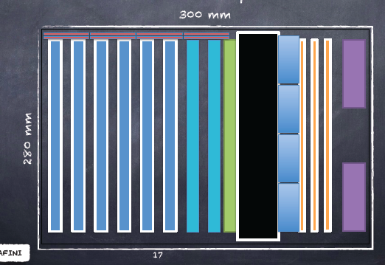
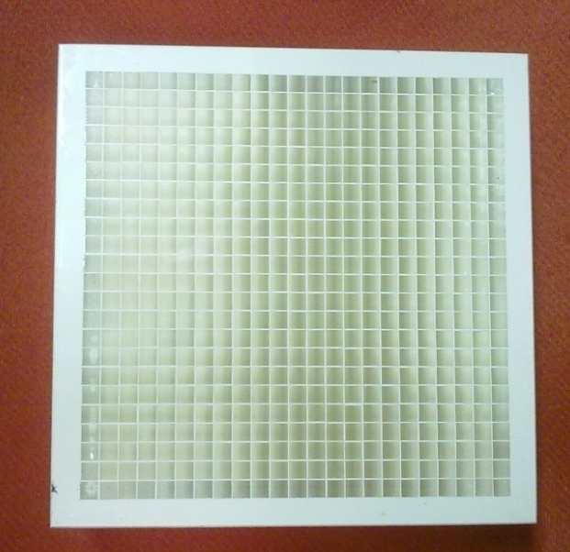
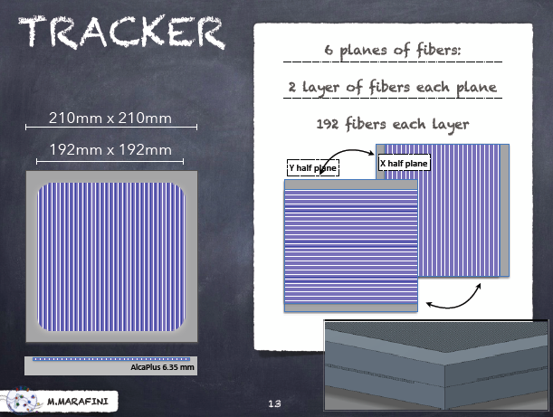
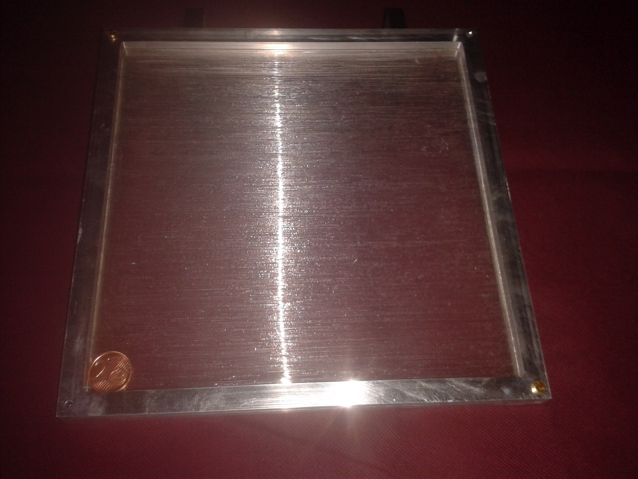
Dose Profiler: components

Slide 32
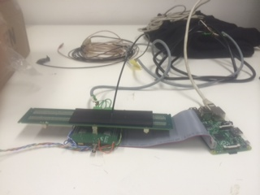
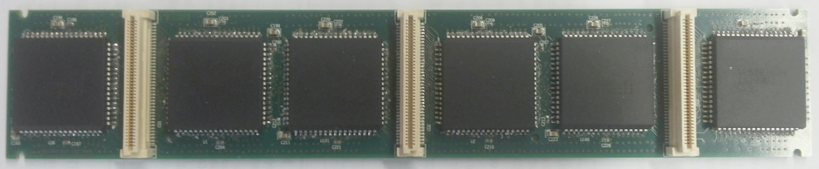
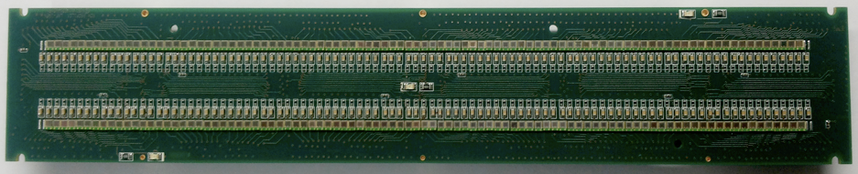
Front-end board
Adalberto Sciubba, Giacomo Traini,
Marco ToppinUni La Sapienza and INFN RM1
The first prototype has been produced
192 SiPM, 6 BASIC32
Check of the board functionality: Raspberry Pi + test board, led driver
TEST SETUP
OPTICAL FIBER
BASIC32
MASK
RASPBERRY
SiPM
TEST BOARD

Slide 33
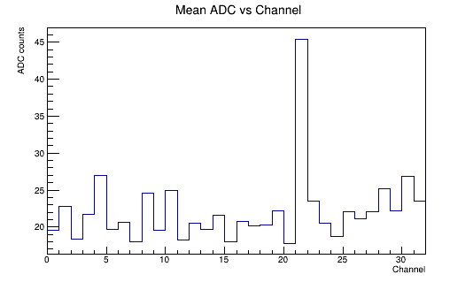
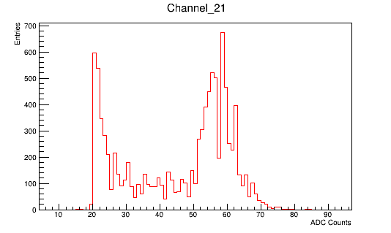
Check of the front-end board functionality
Internal configuration of all BASIC properly performed
External trigger mode acquiring checked
Channel address and charge properly read-out
Internal trigger acquiring mode ok except for 2 SiPM
Pedestal
Led Light
STARTING PRODUCTION OF 18
FRONT-END BOARDS

Slide 34
Next steps
Test of 150 BASIC32 with a dedicated SETUP
(in progress)
Design of FPGA prototype (in progress)
FPGA test
Marco Top

Slide 35
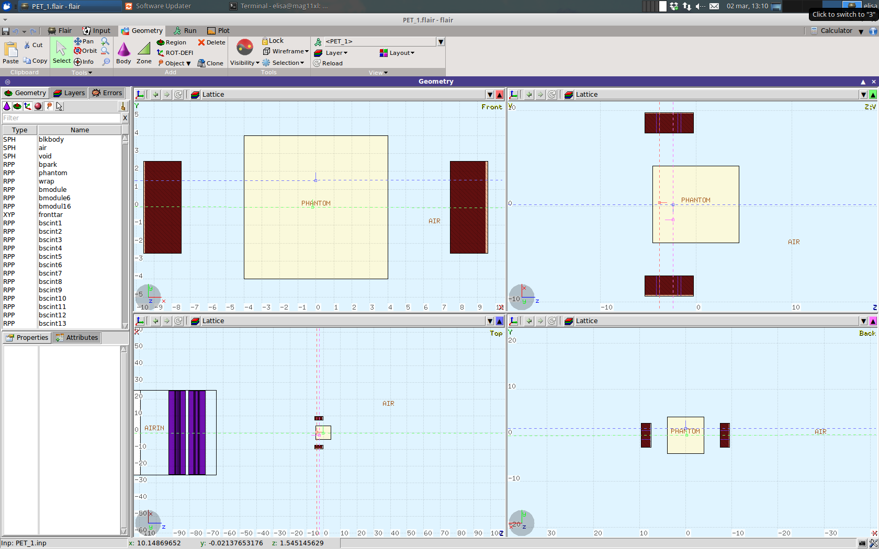
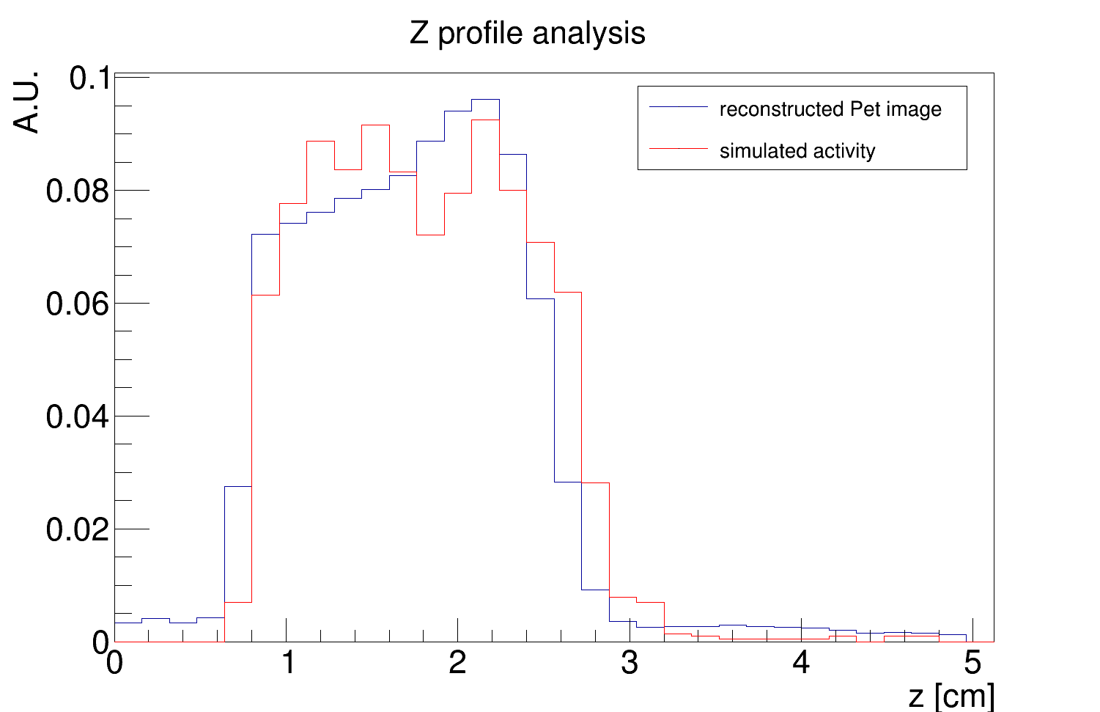
INSIDE PET simulation status
P. Cerello, E. Forina, F. Pennazio
Uni and INFN Torino
FLUKA-based two steps simulation: first the treatment beam is simulated with partial statistics, then, starting from the isotopes production map, the full-statistics PET simulation of the INSIDE detectors is performed. Simulation time decreases of about 70x with respect to a conventional approach.
Dose Delivery System Log Files
Beam simulation
Time-tagged
activity scoring
PET simulation
Analysis of Dose Delivery System (DDS) Log files:
Protons per spot
Spill time structure
About 1/100 of primary hadrons
Beam time structure simulated
Annihilation time and position
Isotopes production map
All the positrons are simulated.
Detector simulation.
Validation will be performed with the beam test of 3 May 2015 at CNAO.
Example of simulated data with the geometry of the beam test at CNAO: comparison between the INSIDE simulated PET image and the simulation input activity profile analysis.
x-z
y-z
beam
beam
beam
x-y

Slide 36
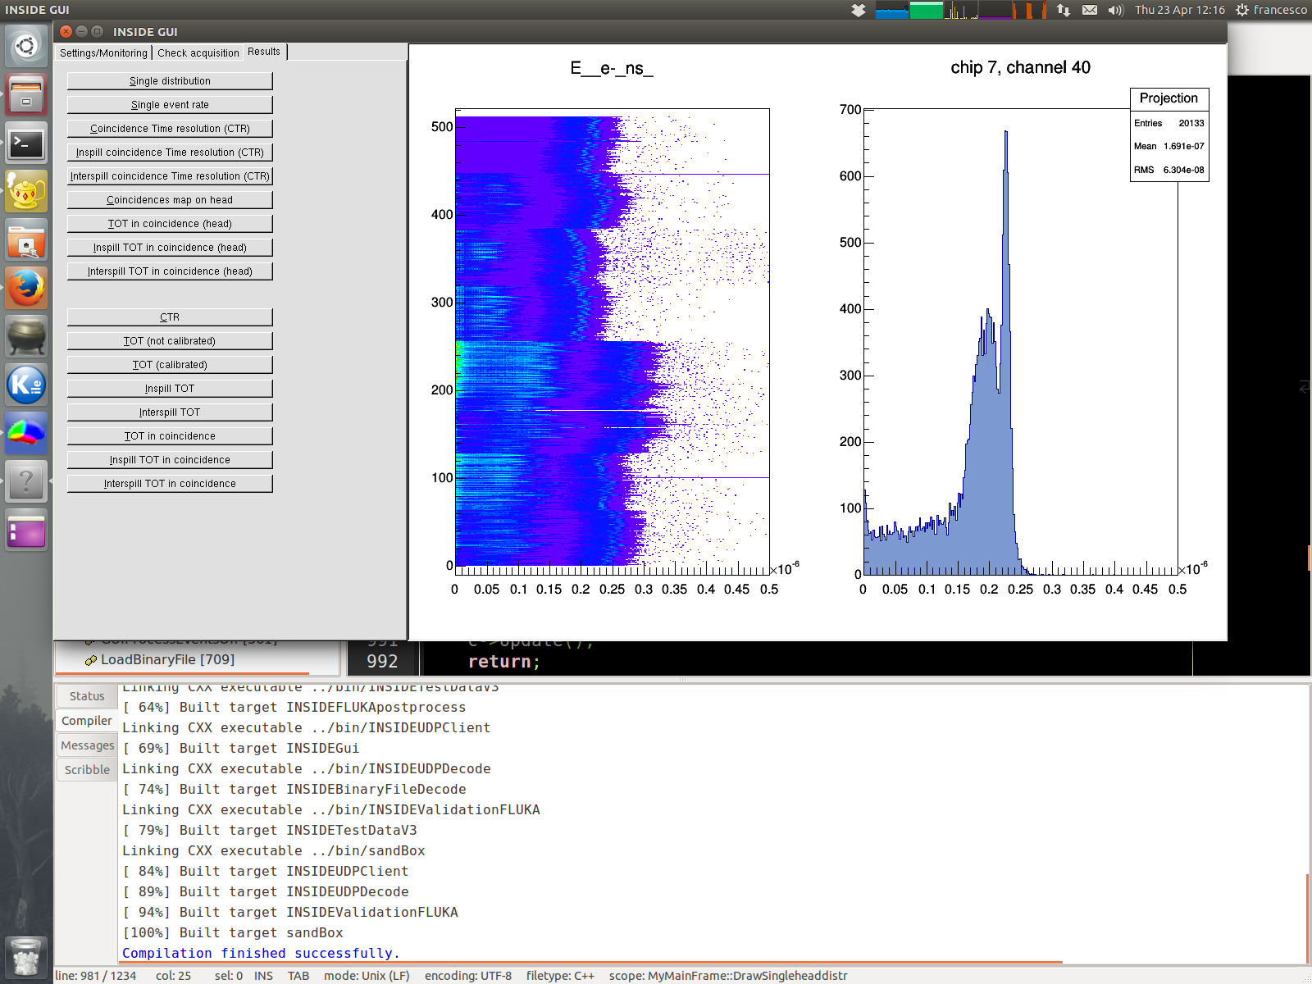
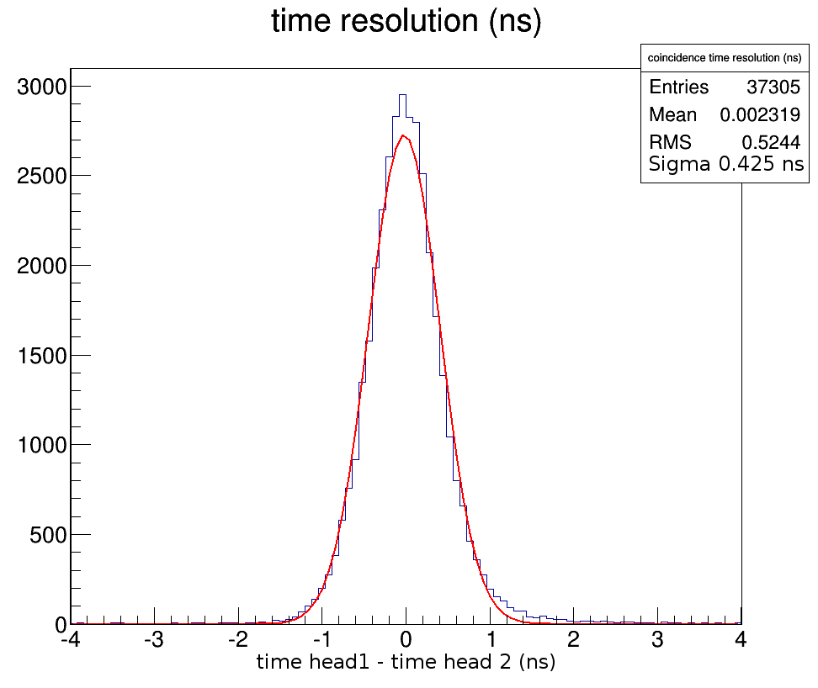
INSIDE PET sofware status
-Online monitoring and analysis or offline analysis
Automated energy window selection channel by channel
Automated time delay calibration
TOT raw [ns]
chip 7, channel 40
INSIDE GUI
Data acquired at CNR Pisa with 18F-FDG planar source and INSIDE geometry of beam test at CNAO
Coincidence Time Resolution (CTR) = 425 ps
preliminary

Slide 37
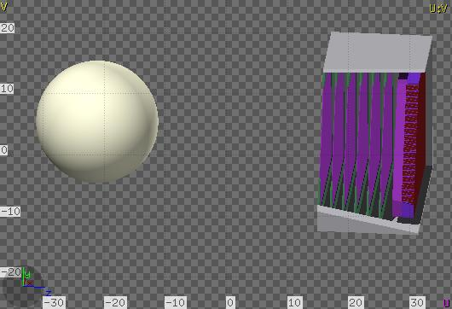
Simulation of the performance of INSIDE Dose Profiler
What is the expected resolution in the estimation of range in the patient using charged particles (mainly protons) emitted from the target?
What is the expected performance with prompt photons?
Simulation studies using a tissue-equivalent phantom (size approximating a human head)
G. Battistoni, S. Muraro
INFN Milano

Slide 38




Lattice Geometry: Optical Fiber & LYSO Crystals
Lattice Copies
Base Cell
LATTICE COPIES
Base Cell
Pixelated LYSO crystal, 23x23
active pixels surrounded by BaSo4
(Barium Sulfate) inactive gap.
In total 4232 pixels implemented.

Slide 39


FLUKA simulation:
Secondary protons fluence
from C 220 MeV
into a “head-like PMMA phantom”
at 90⁰ with respect to the beam axis
¹²C beam

Slide 40



Event display:
Tracks and energy depositions
in fiber and LYSO cristal
Gamma event (Compton)
Protons
Notes:
Plot dei protoni:
la linea tratteggiata e’ il protone primario.
I cerchi rossi(blu) sono i depositi X(Y) nelle fibre. Analogo codice di colore e’ usato per i piani di fibre il cui spessore e’ esagerato volutamente per motivi grafici.
Le linee continue sono il risultato dei fit al chi2 e kalman.
Le linee tratteggiate rosse sono le particelle (elettroni) che vengono dalla ionizzazione del protone.
Plot dei gamma:
Il blu e’ il fotone scattrato.

Slide 41
The INSIDE collaboration: PI Alberto Del Guerra (University of Pisa)
THANKS
University of Torino and INFN Torino
Piergiorgio Cerello
Silvia Coli
Elisa Fiorina
Giuseppe Giraudo
Francesco Pennazio
Cristiana Peroni
Angelo Rivetti
Richard Wheadon
Politecnico Bari and INFN Bari
Fabio Ciciriello
Francesco Corsi
Francesco Licciulli
Cristoforo Marzocca
Gianvito Matarrese
University of Pisa and INFN Pisa
Nicola Belcari
Maria Giuseppina Bisogni
Niccolo’ Camarlinghi
Stefano Ferretti
Eleftheria Kostara
Aafke Kraan
Ben Liu
Nahema Marino
Matteo Morrocchi
Maria Antonietta Piliero
Giovanni Pirrone
Valeria Rosso
Giancarlo Sportelli
INFN (Milano, LNS, LNF)
Giuseppe Battistoni (Milano)
Matteo Cecchetti (Milano)
Giuseppe A. P. Cirrone (LNS)
Giacomo Cuttone (LNS)
Pablo Cirrone (LNS)
Erika De Lucia (LNF)
Fabrizio Cappucci (Milano)
Francesco Romano (LNS)
Paola Sala (Milano)
University of Roma La Sapienza and INFN Roma 1
Riccardo Faccini
Cristina Morone
Vincenzo Patera
Luca Piersanti
Alessio Sarti
Adalberto Sciubba

Slide 42
Back up

