Slide 1

WP 7 (RDH) Detector for high intensity beam
WP 6 (IRPT) New TERA chip development
Leslie Karen Fanola Guarachi
Roma, April 24th, 2015
Notes:
I will describe the progress of the work project 7 and 6 that involves

Slide 2
New Compact Accelerators
Laser-driven accelerators
Cyclinac
Synchrocyclotrons
Fixed Field Alternating Gradient accelerators (FFAG)
Typical Characteristics for high flux pulsed charged particle beams
Pulse frequency (kHz) | 0.2 – 1
Pulse Length (μs) | 5 – 20
Number of particles per pulse (prot/pulse) | 10⁷ -10⁸
Instantaneous Intensity (prot/s) | 10¹² -10¹⁴ (1nA-20µA)
Notes:
Nowadays new compact accelerators for charged particles beam therapy have been proposed where high beam intensities occur in short pulses. The typical characteristics of high flux beam are:

Slide 3
Recombination in a Ionization Chamber
At fixed voltage and distance the ratio of the currents in the 2 chambers only depends on n₀
Current in the chamber
Collection Efficiency depends on:
Chamber voltage V
Electrode distance d
Ionization charge density n₀
saturation
Beam Intensity
Notes:
For High Flux Beams the recombination phenomenon increases and therefore the total charge collection is inefficient unless a very high voltage between the electrodes is applied. The solution is a detector with different gaps….

Slide 4
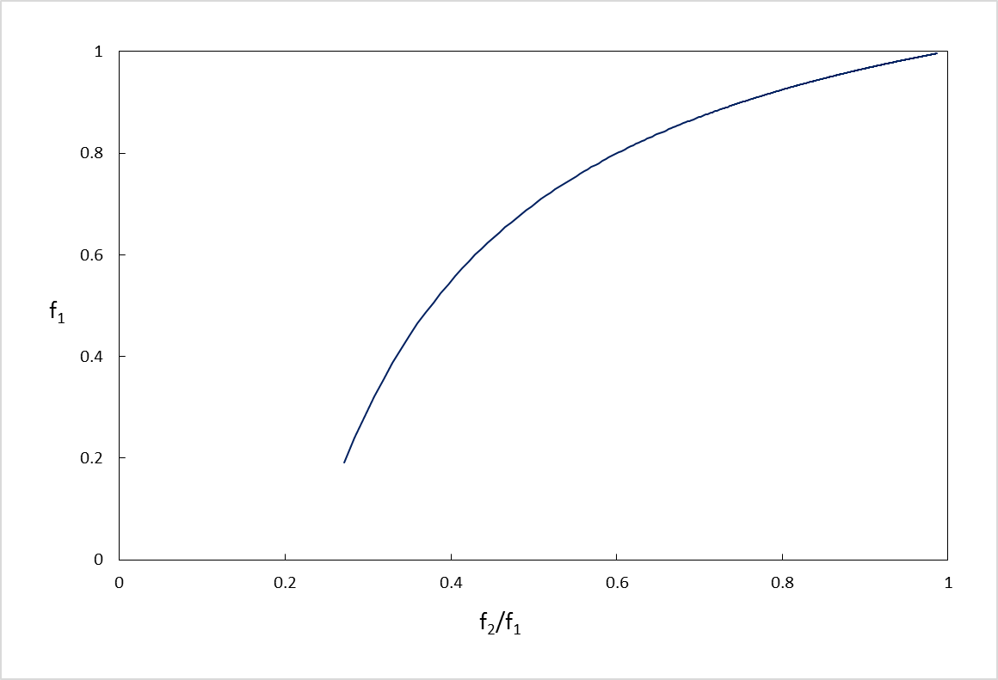
A calibration curve can be determined experimentally
Efficiency of chamber 1 can be determined
f1 = Efficiency of the chamber 1
f2/f1 = efficiency ratio 2/1
Determined by the measured ratio of the currents

Slide 5
Aim of the project
Development of new read-out TERA ASIC for high intensity beams
Construction and Characterization of a multi-gap monitor chamber

Slide 6
READ-OUT TERA ASIC

Slide 7
Readout Front-End Electronics
Method to increase the TERA08 max input current was developed
For high-intensity beams:
Connect all the channels in parallel
Sum of the counts from all the channels
Increase x 64
the maximum input current
From 4 to 256µA
Notes:
For measuring high intensity beams, by the TERA08 we modify the chip connecting all 64 channels in parallel and the total input current can be reconstructed by adding up the counts measured in each channel; Would be allow to reach 64-times higher input current that is 256µA.
Each channel is connected to the common input using a series resistance R of 10MΩ, to equalize the independence of all the channels.

Slide 8
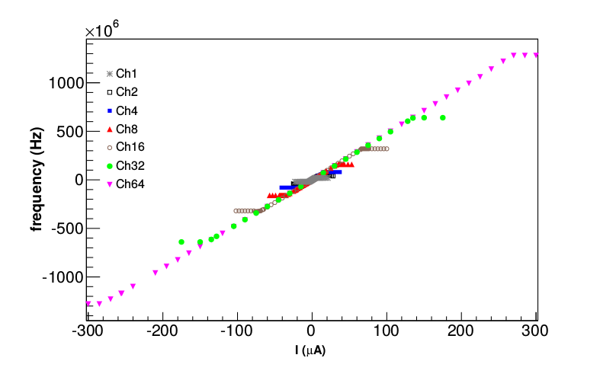
Setup fully characterized in terms of linearity, noise and dynamic range
A simple method to increase the current range of the TERA chip in charged particle therapy applications.
R. Cirio ^{(1,2)}, F. Fausti ⁽²⁾, S. Giordanengo ⁽¹⁾, L. Fanola ^{(1,2)}, F. Marchetto ⁽¹⁾, G. Mazza ⁽¹⁾, V.Monaco^{(1,2)}, R. Sacchi ^{(1,2)}, E. Talpacci ⁽²⁾, A. Vignati ^{(1,2)}
⁽¹⁾ Istituto Nazionale di Fisica Nucleare, sez. di Torino, via P. Giuria,1 I – 10125 Torino (Italy)
⁽²⁾ Dipartimento di Fisica dell'Università di Torino, via P. Giuria,1 I-10125 Torino, Italy
Accepted by NIMA

Slide 9
TERA09 Design
Based on the design of TERA08:
Same process technology AMS CMOS 0.35 μm
Increase clock from 100 to 400 MHz
Max count frequency 80 MHz (20 MHz in TERA08)
Channel additions are integrated in the chip
Cooperation agreement signed with De.Tec.Tor S.r.l for the development of the new chip
A joint patent INFN/UniTo/De.Tec.Tor is being prepared and going to be submitted soon.

Slide 10
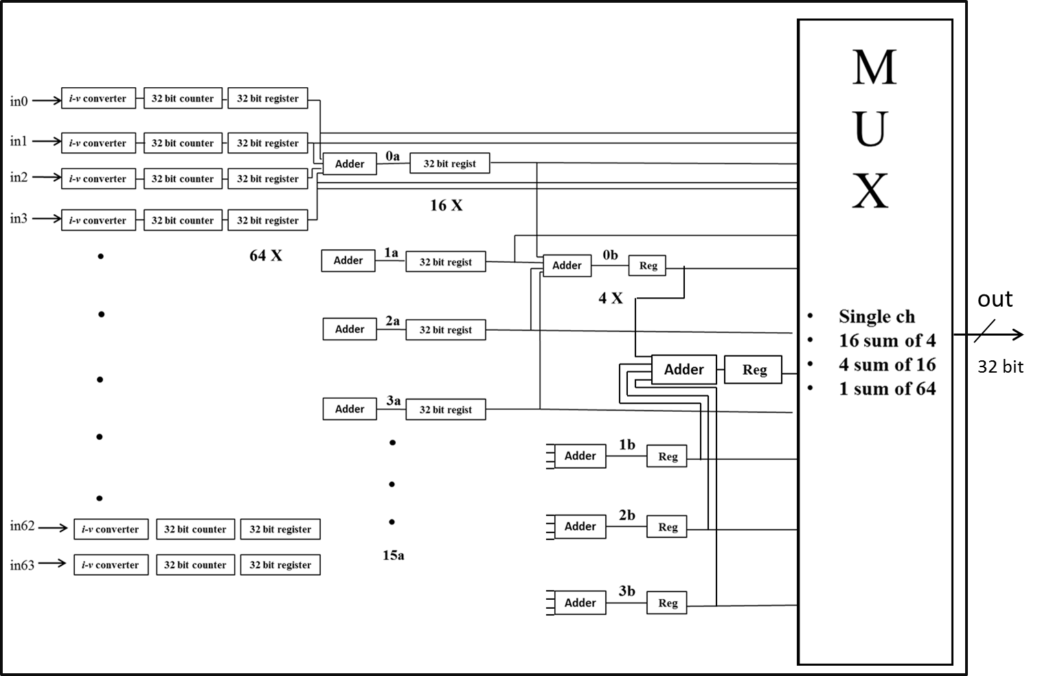
64 channels
registers
Sum of 4 channels
Sum of 16 channels
Sum of 64 channels
Digital part of the chip finalized

Slide 11
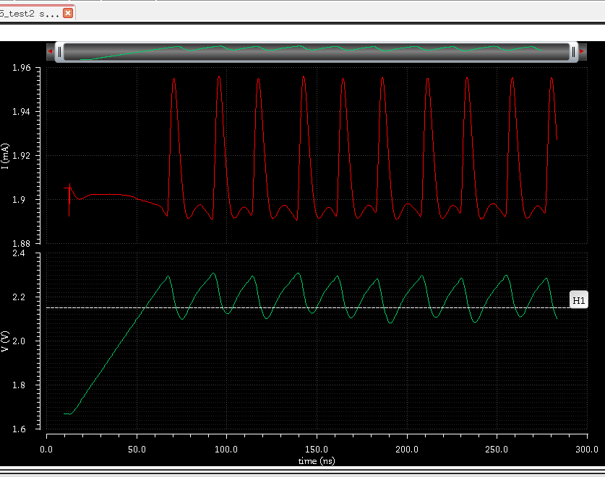
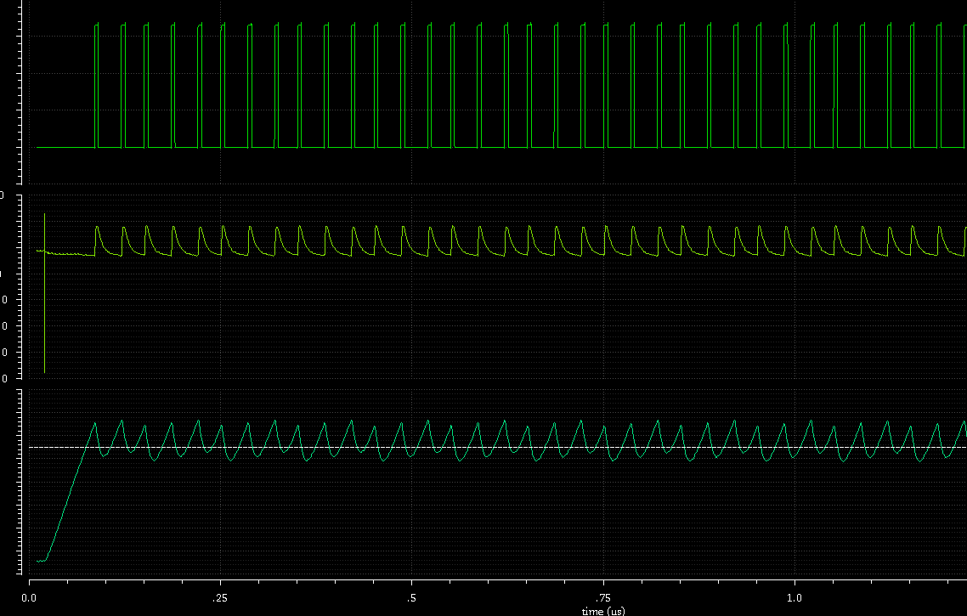
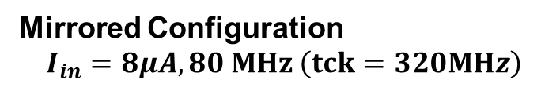
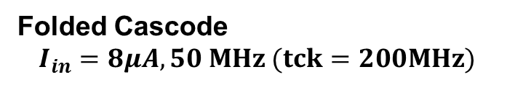
TERA09 Design
Several attempts to modify the analog part to increase the frequency of the recycling integrator.
Two examples of OTA design:
Mirrored Configuration
$$I_{in}=8μA, 80 MHz \left(tck=320MHz\right)$$
Folded Cascode
$$I_{in}=8μA, 50 MHz (tck=200MHz)$$
Submission of the first TERA09 prototype scheduled for July 27th

Slide 12
Construction and Characterization of a multi-gap monitor chamber

Slide 13
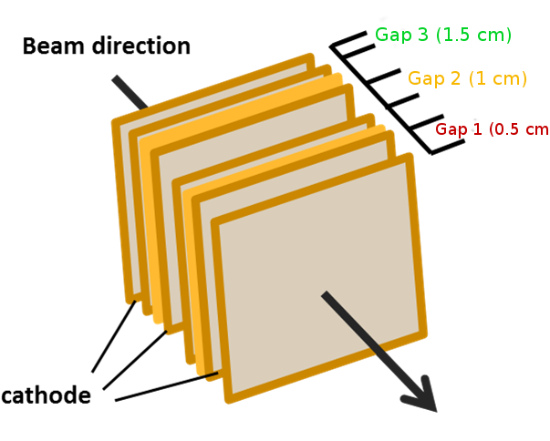
Multi-Gap Ionization Chamber
Material | Thickness (mm)
Mylar | 12,00 E-3 | Cathode
Aluminum
Nitrogen/Air | Gap | Frame
Aluminum | 17,00 E-3 | Anode
Kapton | 25,00 E-3
Notes:
The beam passes through 3 parallel ionization chambers with independent anodes and cathodes separated by a different gaps with the characteristics described in the table…

Slide 14
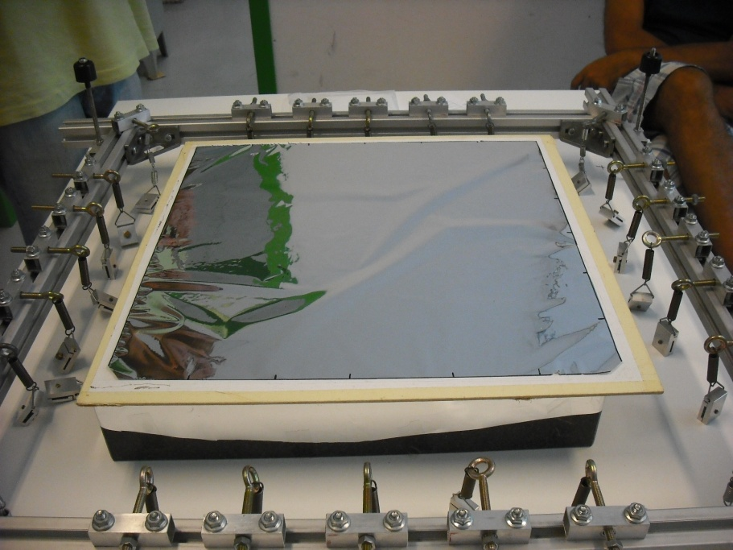
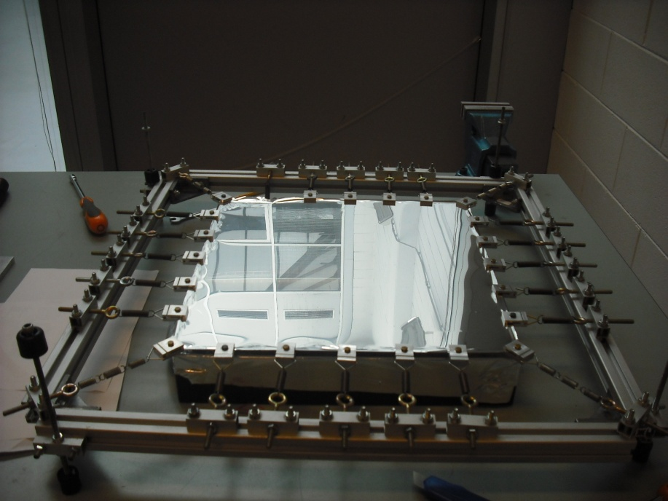
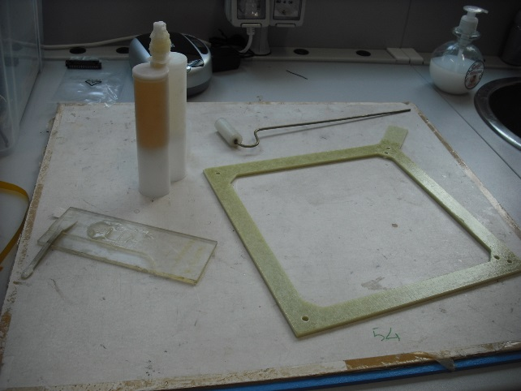
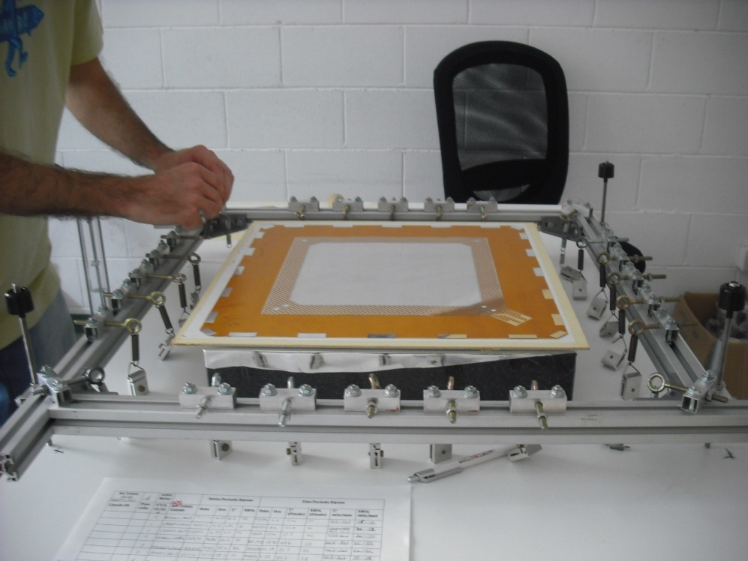
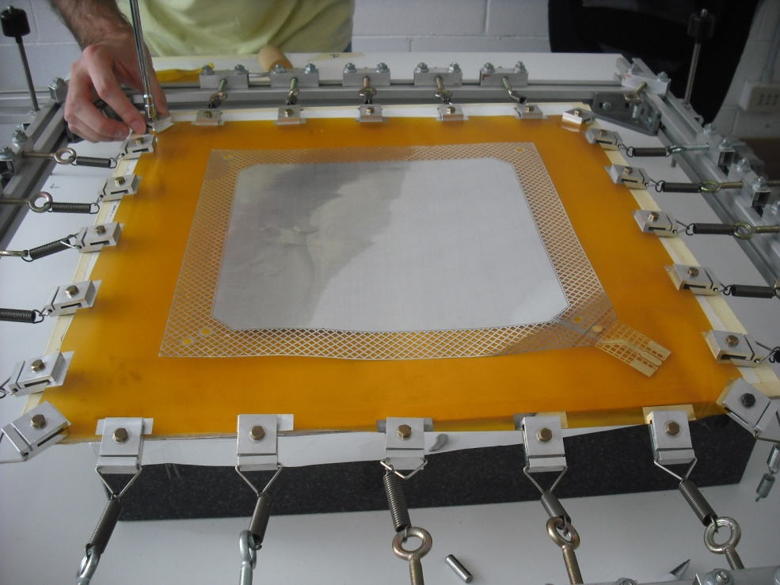
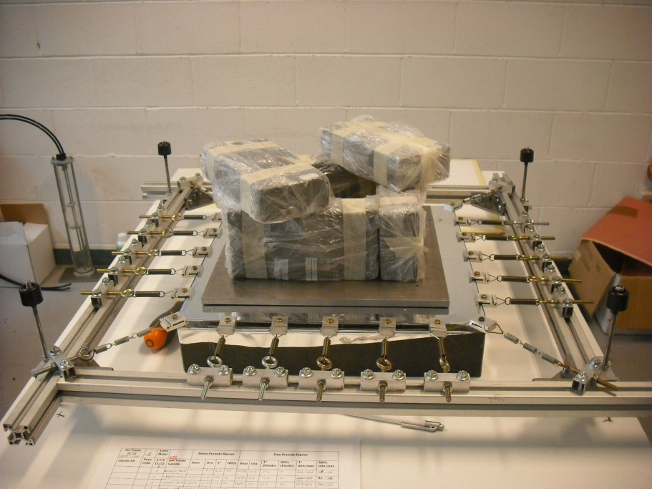
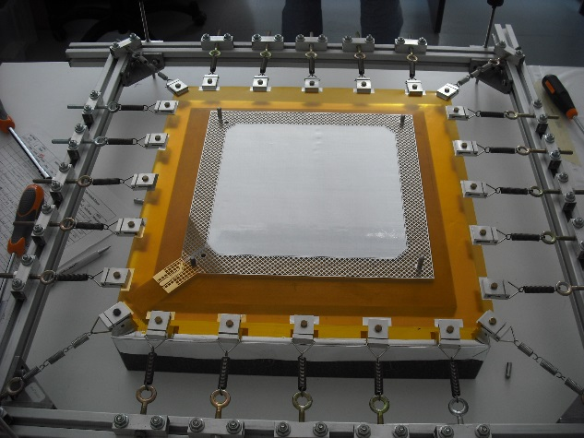
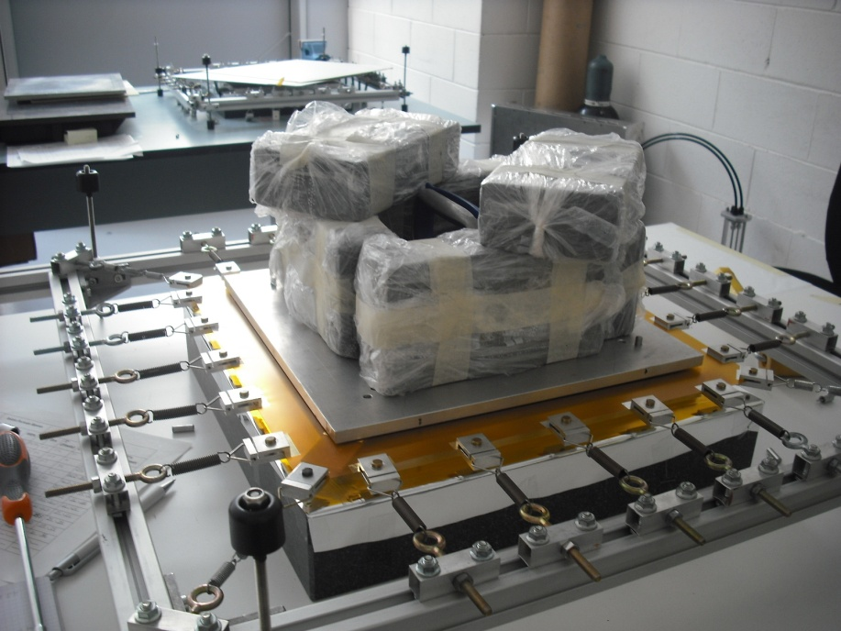
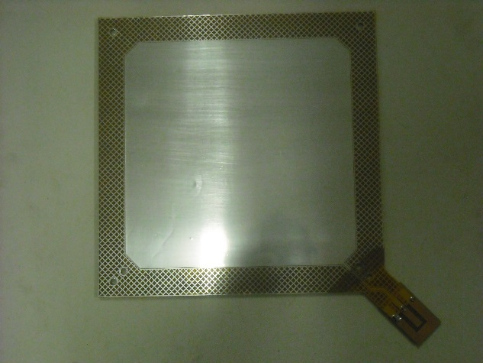
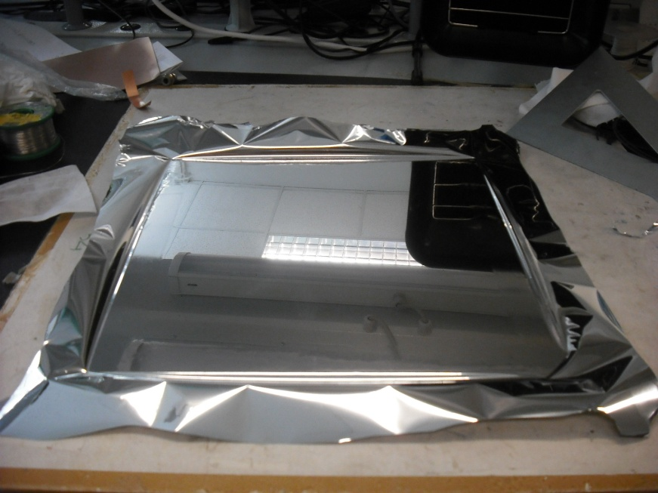
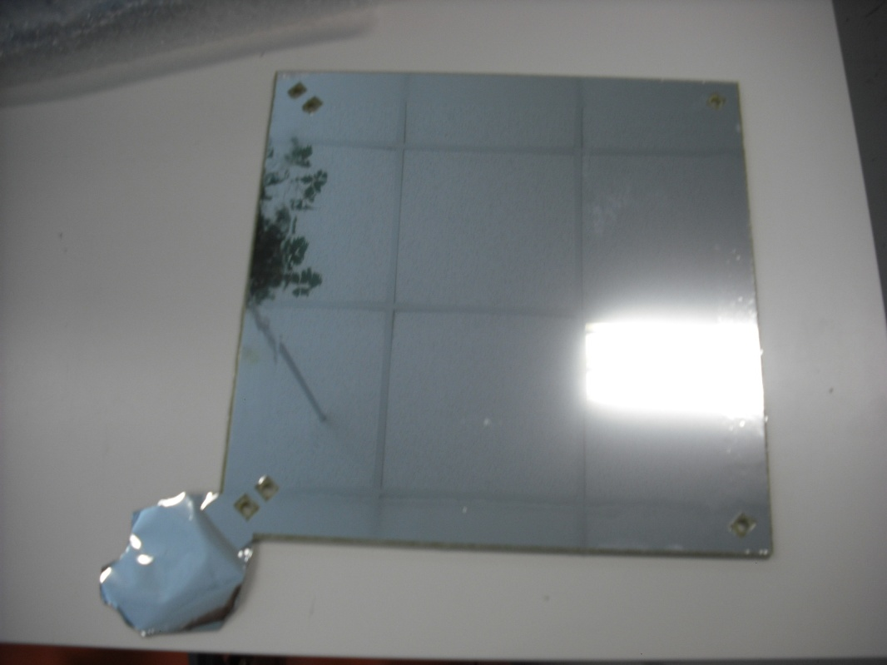
Detector Assembly
Notes:
Every anode or cathode is glued onto a fiberglass frame to assure rigidity and flatness uniformity, this is done in a series of steps. First special stretching procedure using small clamps and springs . Afterwards the anode or cathodes are glued onto the frame and finally after one day the clamps are removed.

Slide 15
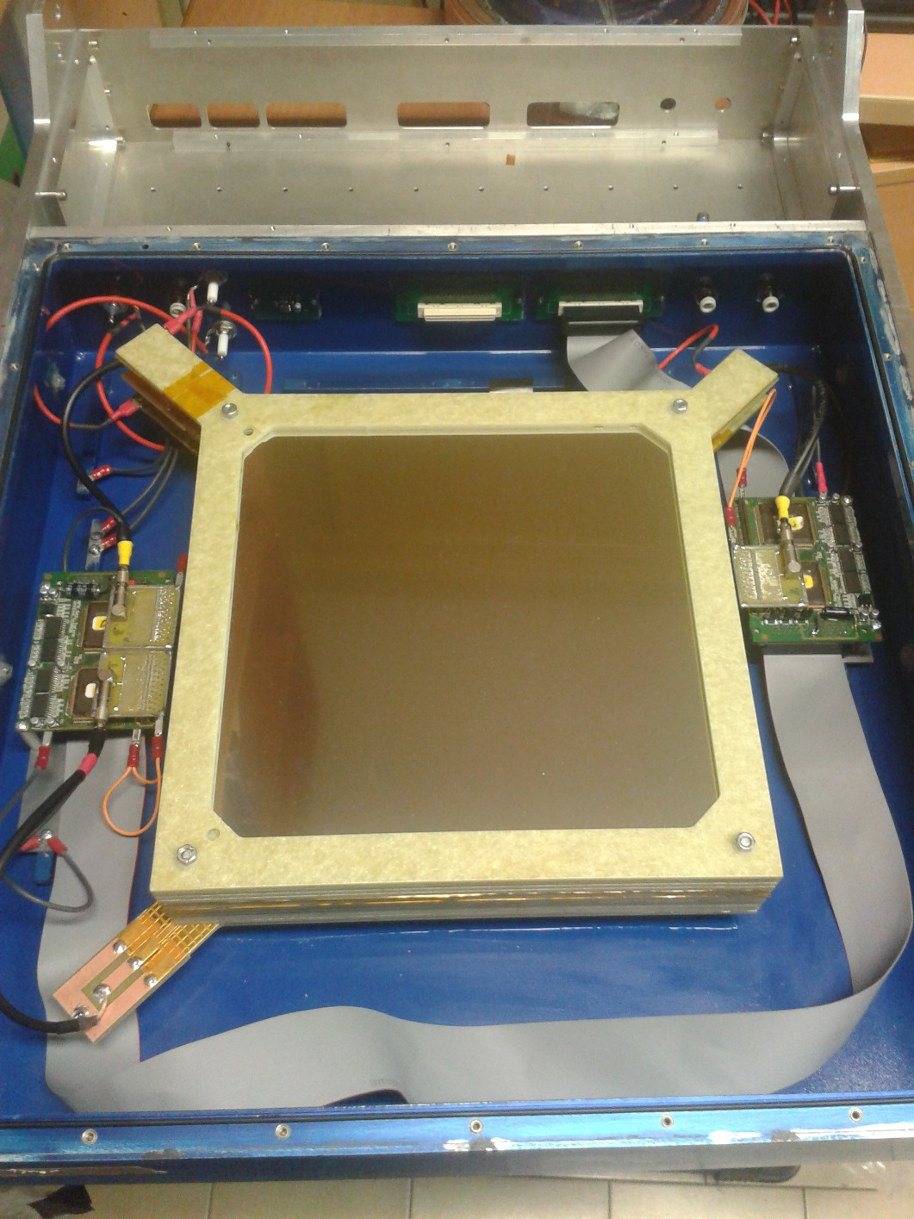
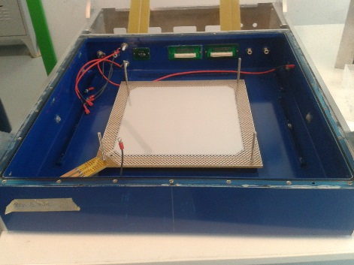
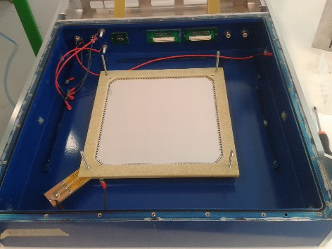
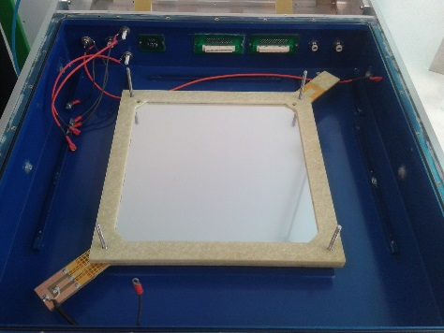
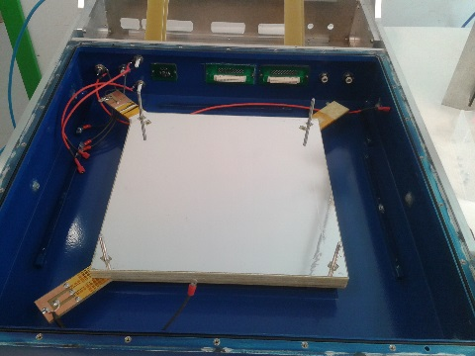
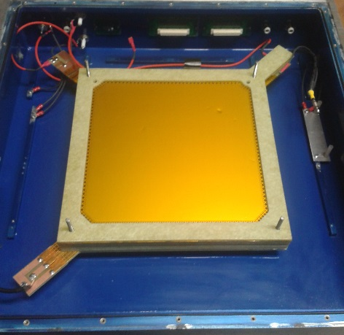
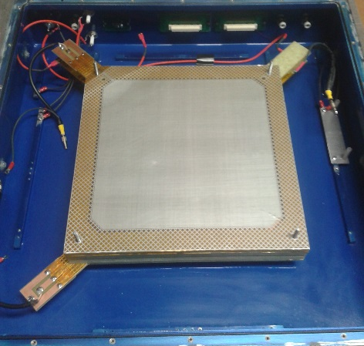
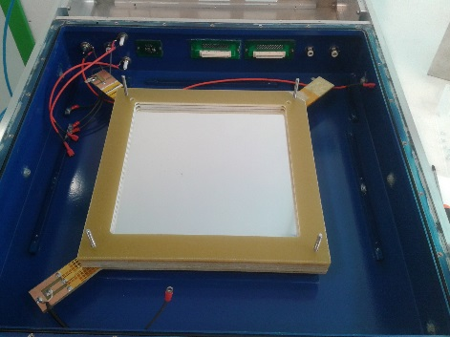
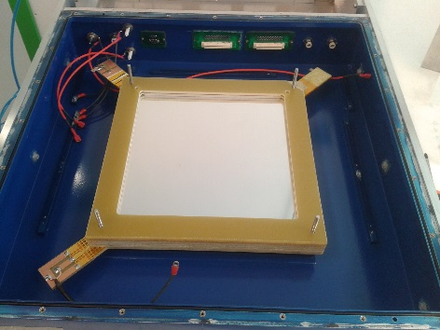
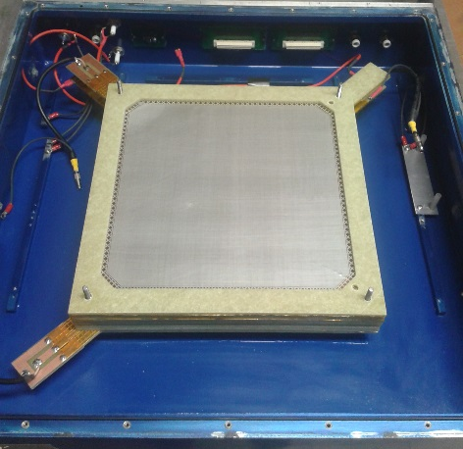
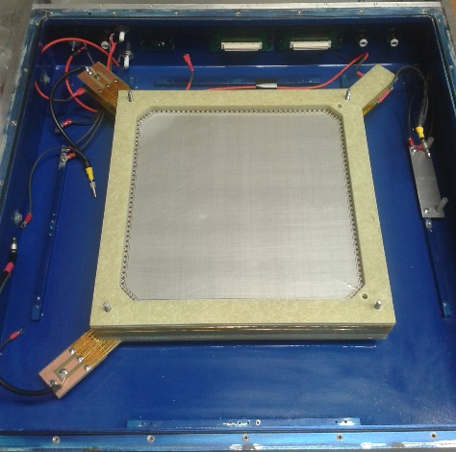
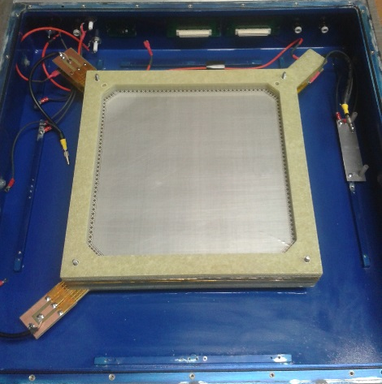
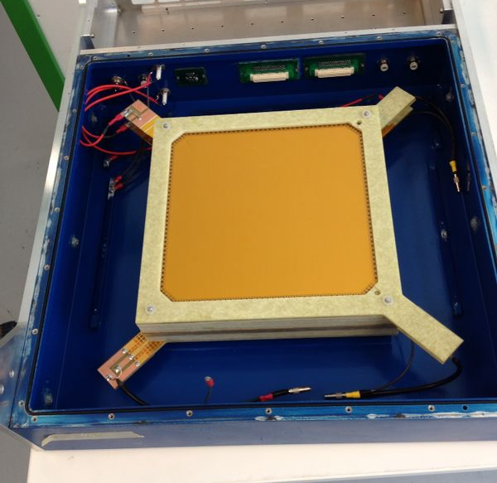
BEAM
Detector Assembly
anode
1
frame
2
cathode
3
cathode
4
frame
5
frame
6
anode
7
anode
8
frame
9
frame
10
frame
11
cathode
12
Notes:
Each frame containing an anode or cathode is placed into the box taking into account its position along the beam line. And when the package is completely assembled the readout electronics is placed.

Slide 16
Detector Characterization
Carbon Ion Beam at CNAO (Synchrotron, 120-400MeV/u)
Proton Beam at Bern University Hospital (PET Cyclotron of 15MeV)
No independent detector measuring the beam flux. Therefore the efficiency was determined by fitting the data with models found in the literature
Both facilities have uniform intensity beams.

Slide 17
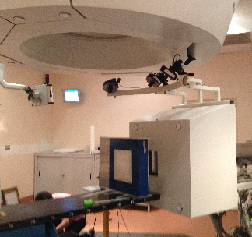
Test with Carbon Ions at CNAO
Synchrotron
Beam Intensity:
≈ 3×10⁷ (part/spill)
≈ 2×10⁷ (part/spill)
≈ 4×10⁶ (part/spill)
Minimum Energy (120MeV/u)
Voltage between plates: 13-400 V

Slide 18
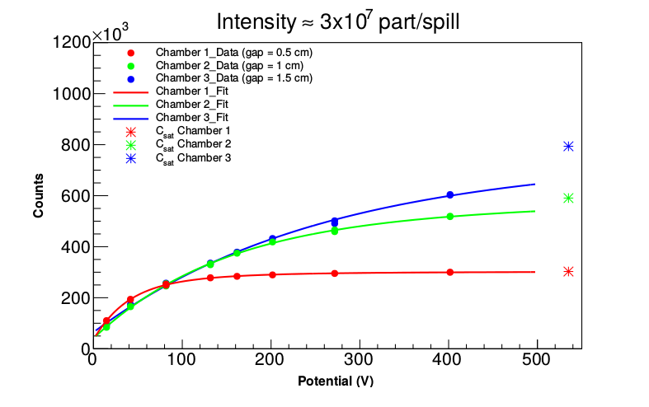
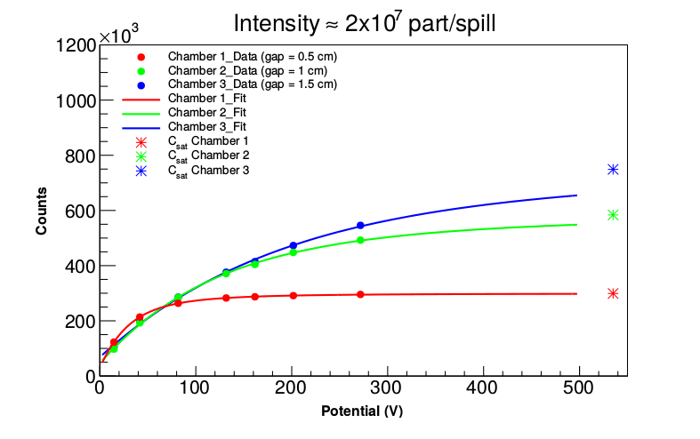
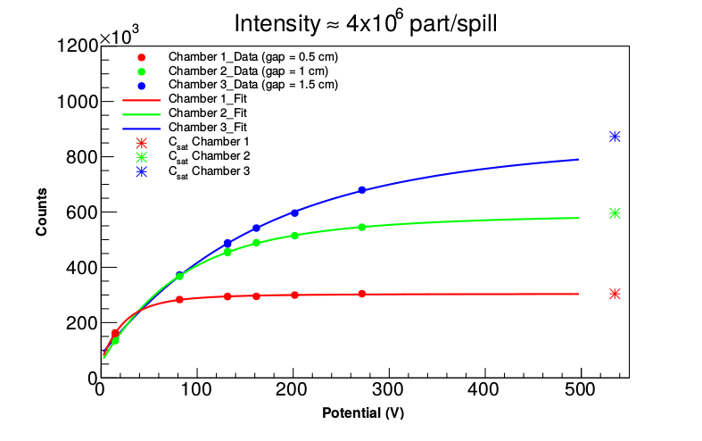
The fits are using the Boag-Wilson Theory for recombination

Slide 19
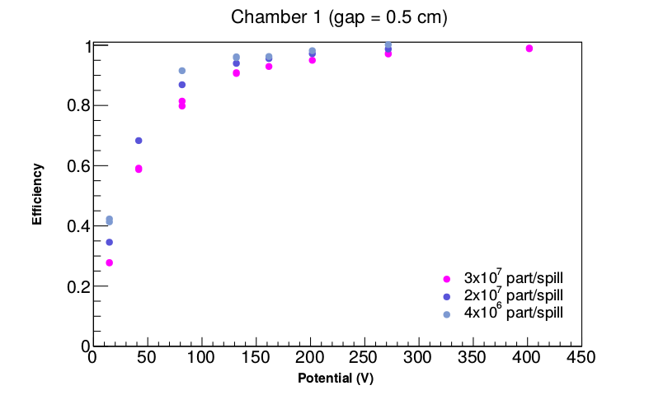
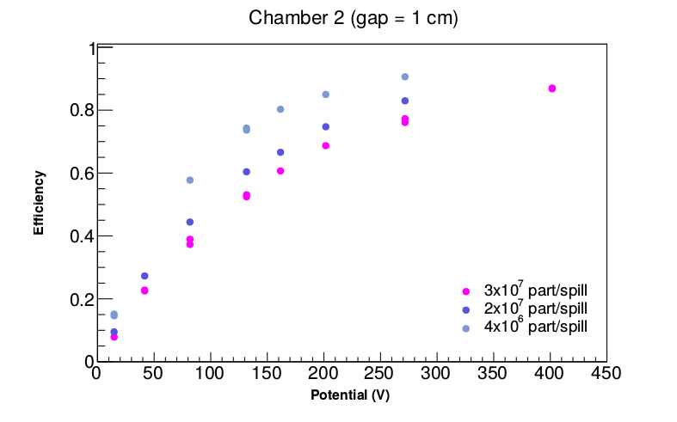
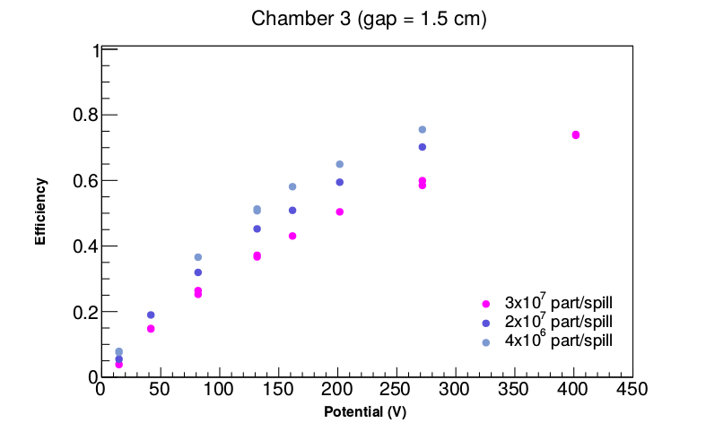
Test with Carbon Ions at CNAO

Slide 20
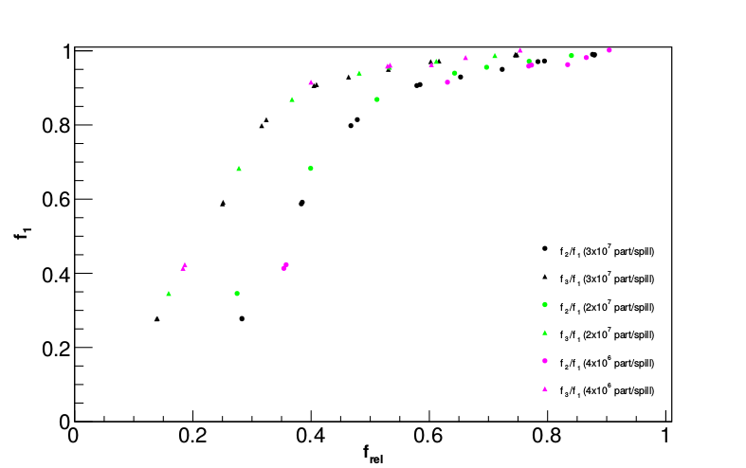
f₃/f₁
f₂/f₁

Slide 21
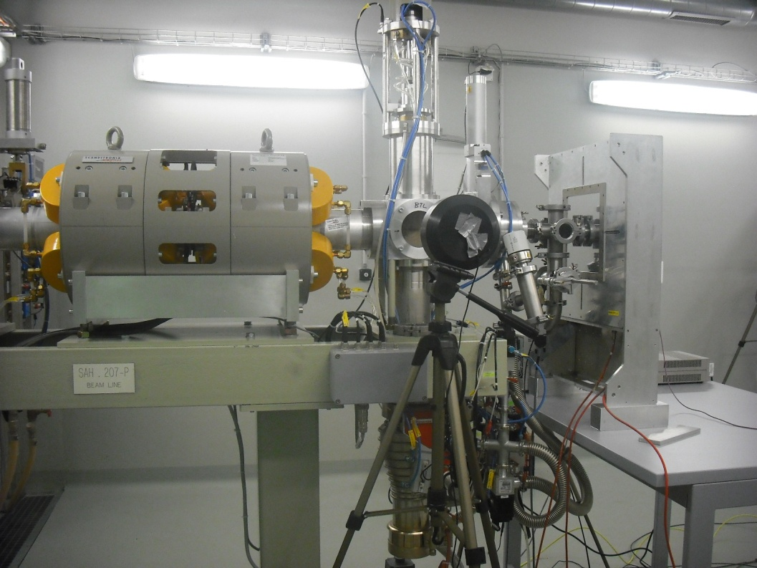
Test with Protons at Bern University Hospital
Cyclotron
Beam Intensity:
1 pA – 400 pA (part/spill)
Energy: 15 MeV
Voltage between plates: 13-400 V

Slide 22
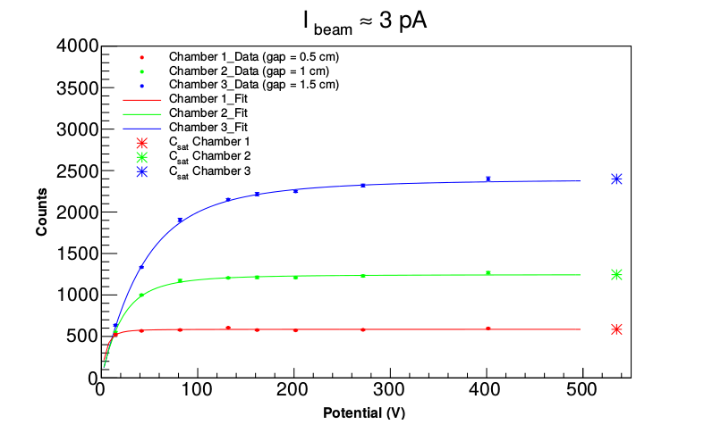
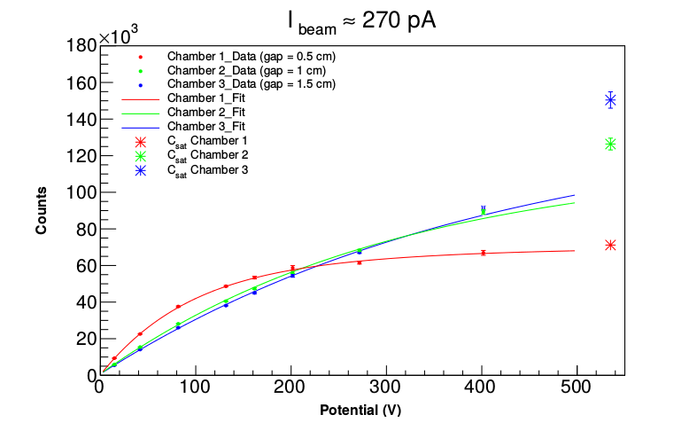
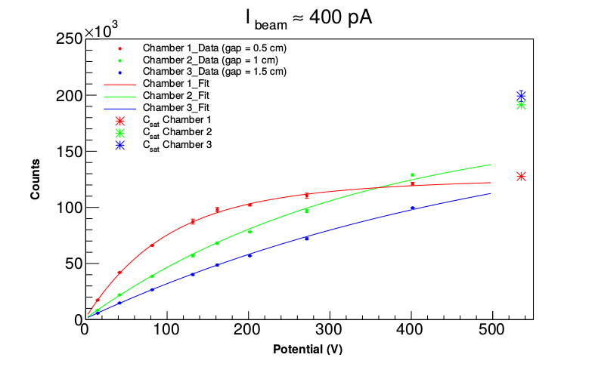
Test with Protons at Bern University Hospital

Slide 23
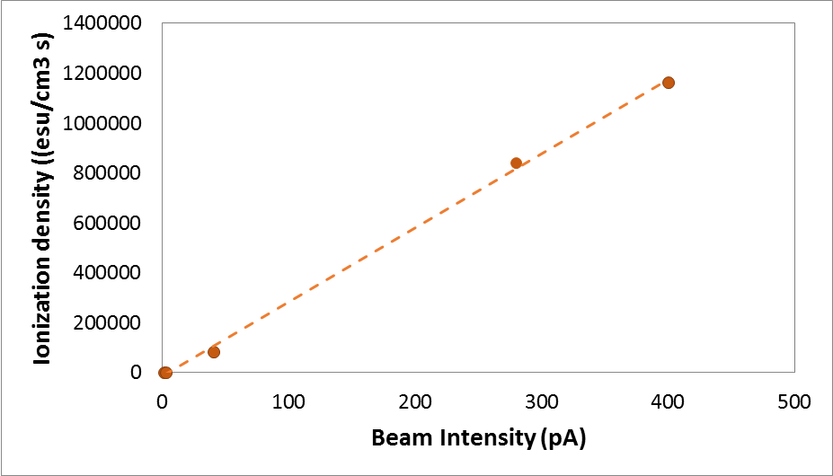

Slide 24
Next ….
Characterize the monitor with pulsed beam.
The test will be at Catana-LNS on May 15 – 21
Contacts with IBA Company for testing the chamber at the Proteus Cyclotron
The test of the chamber will end on 2015, the work on the TERA09 chip will extend up to end 2016

Slide 25

La Paz - Bolivia
THANKS
FOR YOUR ATTENTION

