Slide 1
RIDOS
Simona Giordanengo
INFN Torino

Slide 2
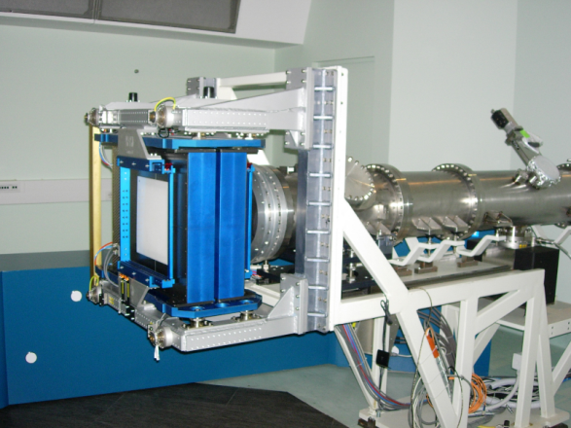
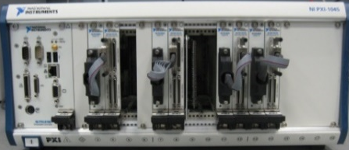

Summary of the operations to perform in the inter-spill time
Start spill
0
DDS
On-line measured spot parameters
(0.01 ÷ 100 ms/spot,
100 byte/spot)
< 10 MB/s
DDS and OTS parameters readout, translation and comunication (spot by spot)
End of spill
1 s
Max freq 1 kHz
< 1 MB/s
FFP1 «measured» dose delivered with the ended spill
FFP2 «expected» dose delivered with the ended spill
OTS
Patient positions deviations (∆X, ∆Y, ∆Z) +
Respiratory phase
(< 0.5 kB/measurement)
GPU1
GPU2
2.5 s
Comparison
Corrections computation for next spots (far from clinical application)
Results publication
FFP = Fast Forward Planning
To remember:
DDS parameters translation for each spill
Monitor counts
(Xstrip, Ystrip)
Currents Ix, Iy
Nparticles
Spot Positions (X,Y)iso
New DDS input creation and data transfer
5 s

Slide 3
First GPU-based FP ready
50000 s
Cut_off (mm) | N_Voxels | time gpu (sec) | time PlanKIT (sec) | Gain | C_grid | N of Rays | N of Slice
10 | 11200 | 1.9 | 40 | 21 | 170x170x125 | 1248 | 39
20 | 44678 | 1.9 | 157 | 83 | 170x170x125 | 1248 | 39
40 | 178702 | 2.17 | 636 | 293 | 170x170x125 | 1248 | 39
50 | 279243 | 2.6 | 997 | 383 | 170x170x125 | 1248 | 39
80 | 714861 | 3.87 | 2534 | 655 | 170x170x125 | 1248 | 39
N_voxels

Slide 4
A1: Different upgrades underdevelopment
Main constraints and upgrades
Constraint of RIDOS_FP_1:
1. Max intercepts/ray = 1024 (sorting algorithm) → now unlimited
Upgrades to improve speed:
1. Ray Dose computation in parallel → done
2. Equal spaced computation grid → done (regular and irregular grids available)
Upgrades to improve accuracy: → work in progress
1. Different ions implementation
2. Sub-beams model
3a. Use of 4DCTs synchronized with the beam delivery and patient tracking
3b. Use of deformation vectors to compare the doses

Slide 5
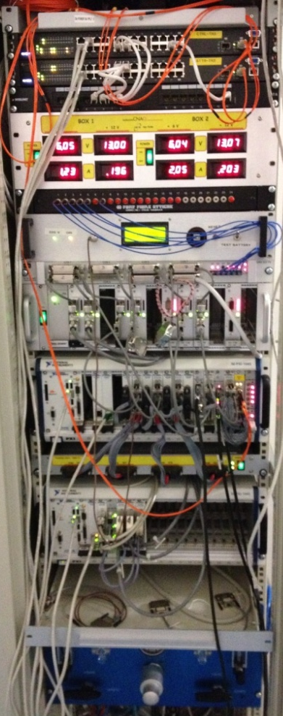

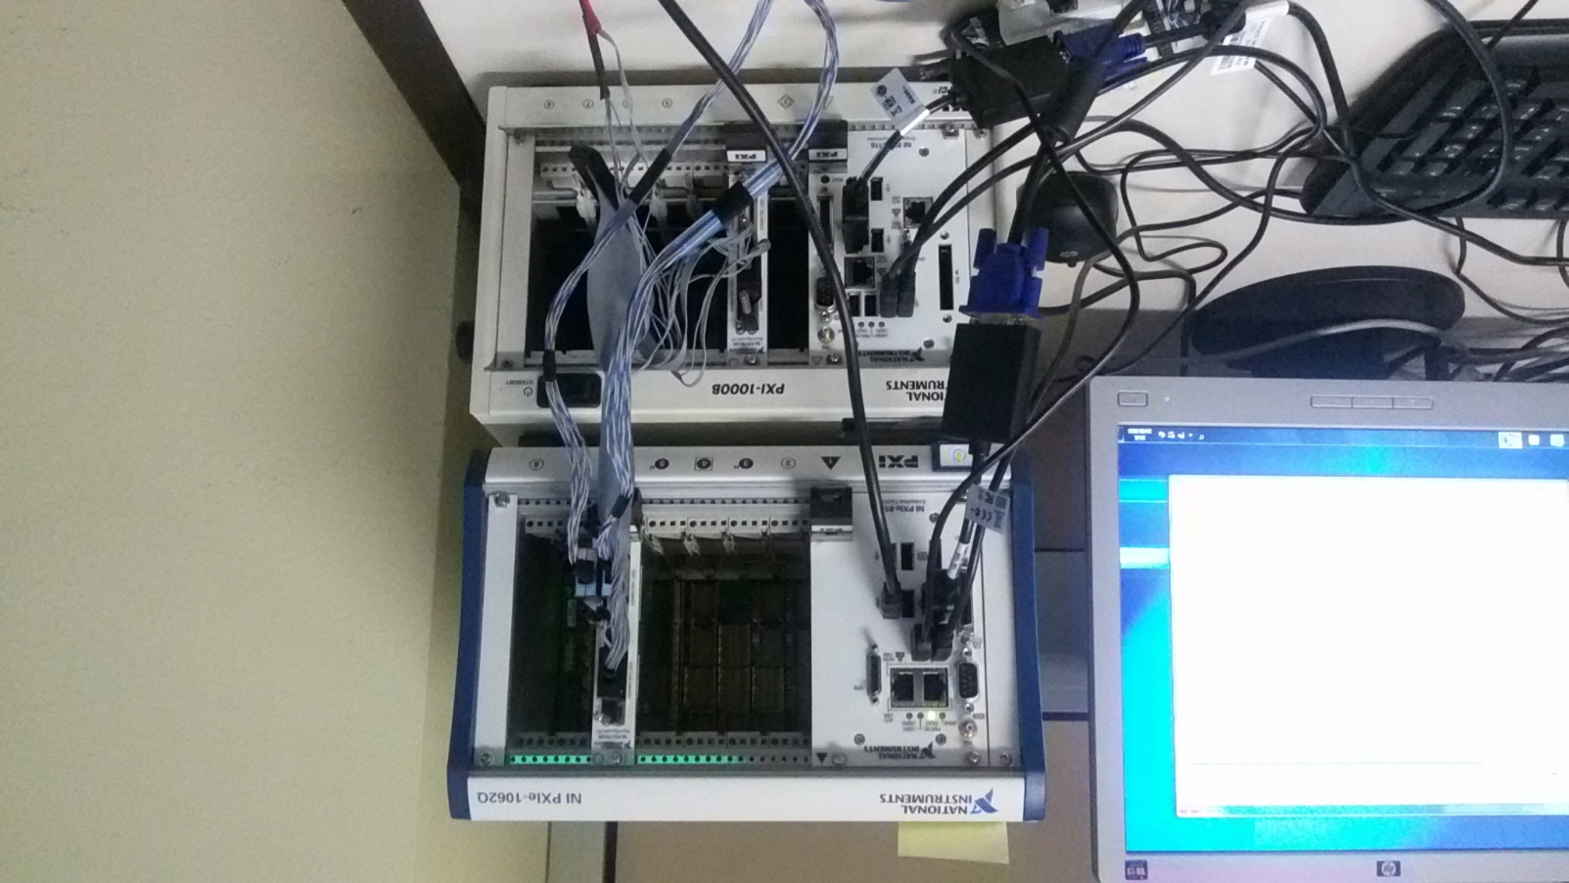
A3: RIDOS HW: defined and under construction
Ethernet connection
Syngo Treatment by Supervision System
Ethernet2
PC in the LCRoom
Ethernet1
Additional RIDOS
FPGA NI 7813R PXI in DD crate
DDS
WS with 1 GPU TESLA K40
Ubuntu 14.04 (or Windows)
I-O vs DD FPGAs
20 MB/sec
VHDCI 68 pin
FPGA1 del DD
RIDOS CRATE (Simulatore + sist finale)
Ethernet connection
FPGAridos1
I-O vs DD FPGAs
??
PCIe – PXIe interface to share memory
OTS data Max freq 1 kHz
FPGAridos2

