Slide 1

Status and future of n_TOF
Gruppi Italiani di Astrofisica Nucleare Teorica e Sperimentale
Padova, April 29, 2015
Paolo Maria MILAZZO

Slide 2

















The n_TOF collaboration
CERN
Technische Universitat Wien Austria
IRMM EC-Joint Research Center, Geel Belgium
Zagreb University Croatia
Charles University, Prague Czech Republic
IN2P3 – IPN – Orsay,
CEA – Saclay France
Wolfgang Goethe Universität, Frankfurt
Karlsruhe Institute of Technology Germany
National Technical University, Athens
University of Thessaloniki Greece
Bhabha Atomic Centre, Mumbai India
INFN Bari, Bologna, LNL, LNS, Trieste
Dipartimento di Fisica Università Bologna
Dipartimento di Fisica Università di Catania
ENEA – Bologna Italy
Uniwersytet Lodz Poland
Universidade de Lisboa Portugal
Horia Hulubei Institute of Physics, Bucarest-Magurele Romania
CIEMAT – Madrid
CSIC – Valencia
University of Santiago de Compostela
Universitat de Catalunya Spain
Paul Scherrer Institute, Villigen
University of Basel Switzerland
University of Manchester
University of York United Kingdom

Slide 3
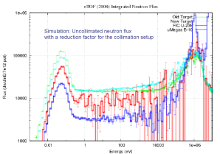
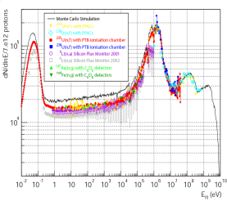
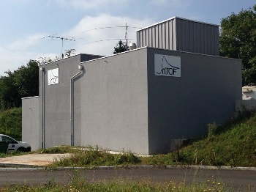
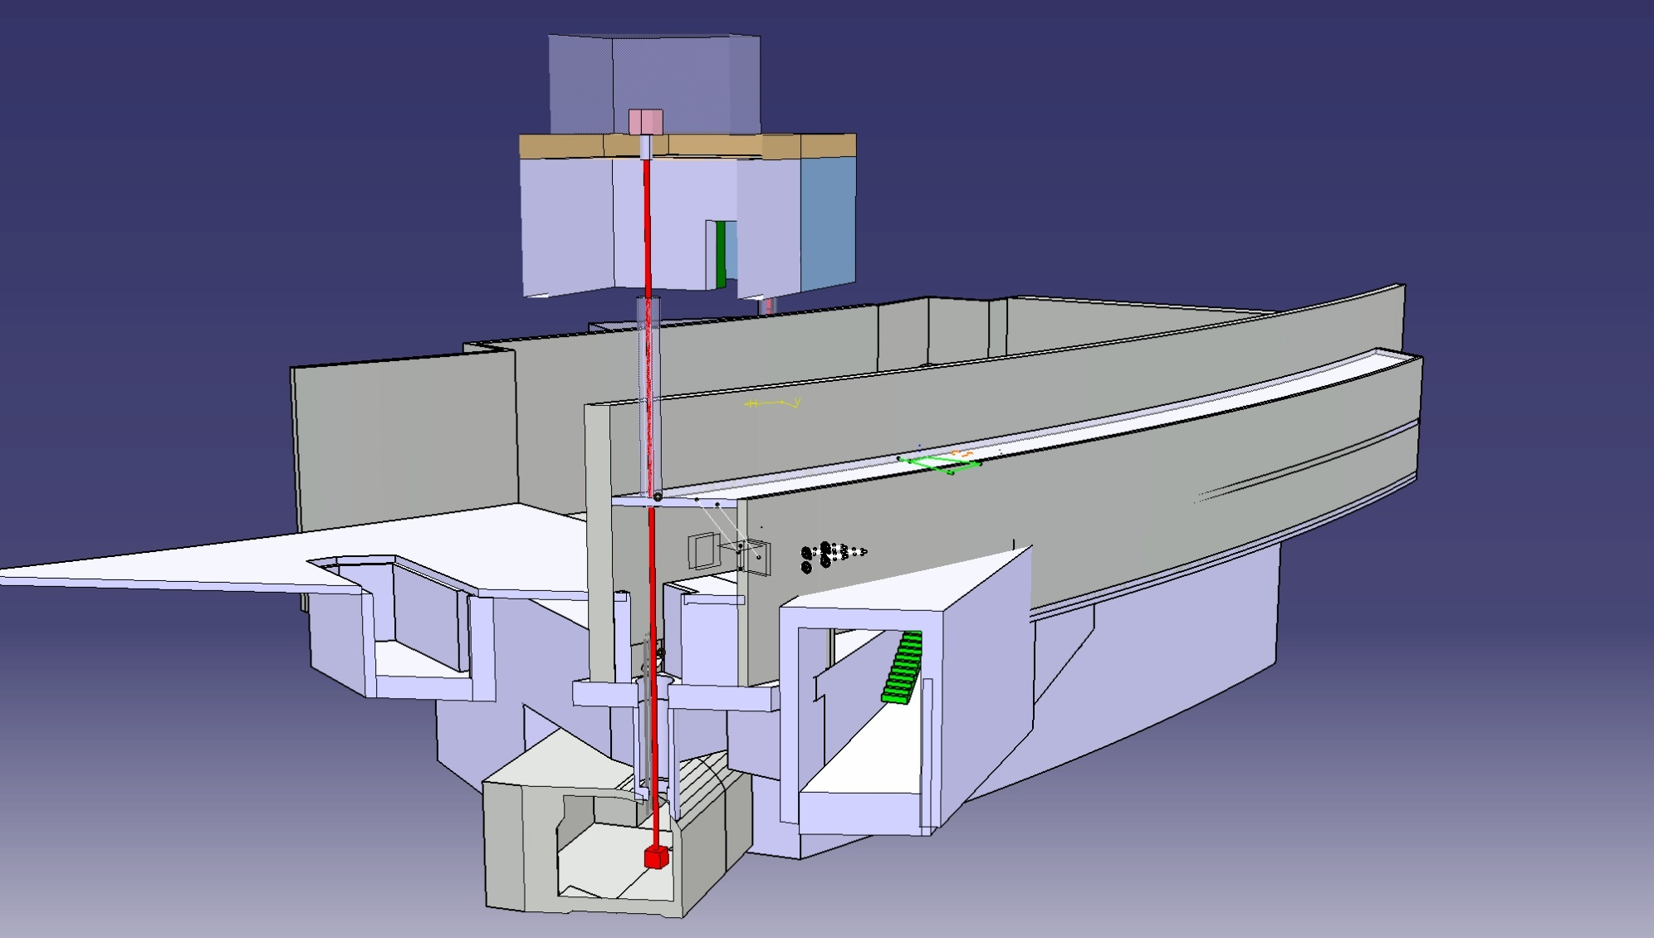
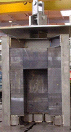
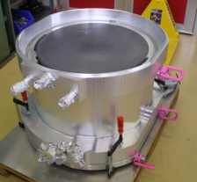
2014-201X
n_TOF Phase 3
2013-2014
EAR-2 construction
Phase 3
2009
Re-Commissioning
Phase 2
2011
EAR-2 project
2001-2004
n_TOF Phase 1
2010
Upgrades:
Borated-H₂O
Second Line
Class-A
1997
2009-2012
n_TOF Phase 2
2015
2000
Commissioning
1998
Preliminary studies
CERN/LHC/98-02+Add
Phase 1
1999
Construction
2004
Spallation target seriously damaged
2008
New target
1997
Idea from C.Rubbia
CERN/ET/Int. Note 97-19
>60 isotopes investigated
>300 publications

Slide 4
neutron Time Of Flight @ CERN
n_TOF is a pulsed neutron source designed to study neutron-nucleus interactions
for neutron kinetic energies ranging from a few meV to several GeV
Neutrons are generated using a pulsed beam of protons with a momentum of 20 GeV/c, hitting a lead spallation target. The proton pulses are delivered by CERN's PS.
Every proton yields about 300 neutrons.
The initially fast neutron spectrum is slowed down, first by the lead target, and then by a water slab in front of the lead target.
Neutrons are collimated and guided through an evacuated beam pipe to two experimental areas at a distance of 19 and 185 m from the spallation target.
The innovative feature of the n_TOF neutron facility, i.e. the high instantaneous flux, the high energy resolution and low background, allow for an accurate determination of neutron induced cross sections.

Slide 5
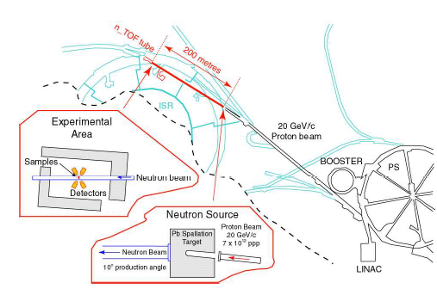
Experimental Area 1 (EAR1)
7x10¹² protons/bunch @ 20 GeV/c dal PS
(6 ns time resolution)
Flight path of 185 m
10⁵ n/cm²/bunch in experimental area

Slide 6
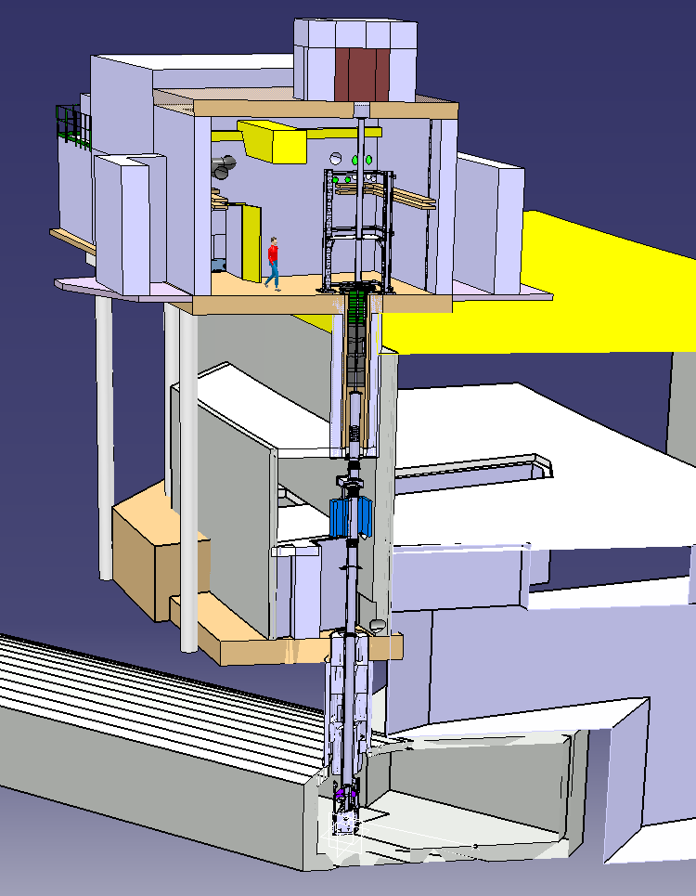
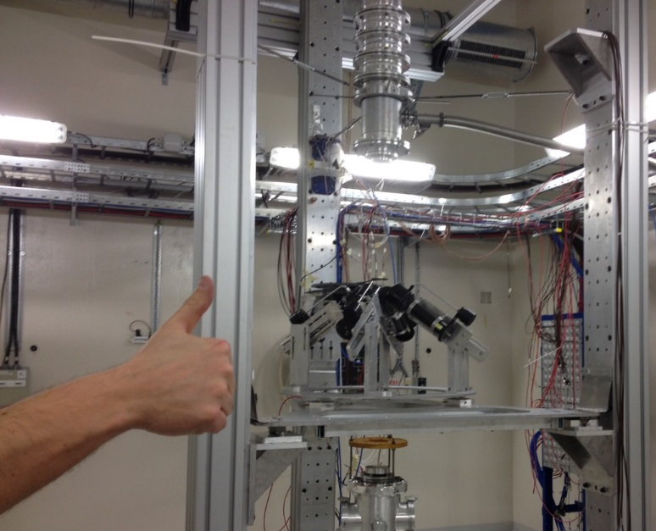
Experimental Area 2 (EAR2)
h [m]
24.4
Beam Dump
Flight path of 19 m
Flux higher than in EAR-1
EAR-2 Exp. Hall
18.1
2nd Collimator
New Area
Shielding
Filter Box
9.8
Magnet
1st Collimator
Existing Area
Pit Shielding
EAR1
0
Target

Slide 7
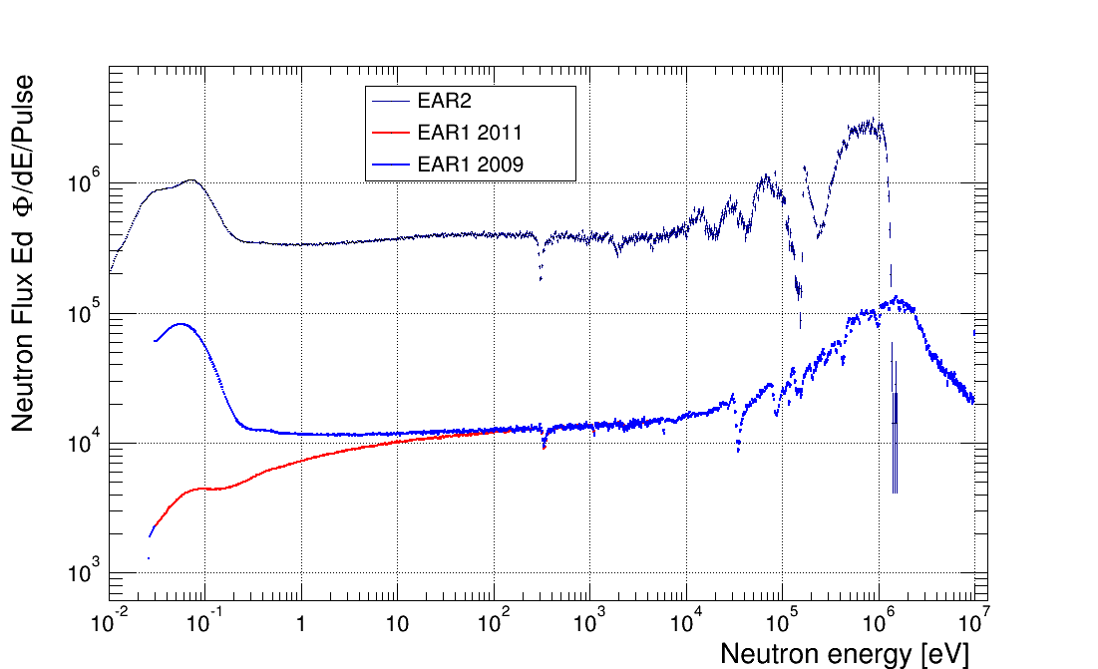
Broad neutron energy range meV → GeV
High instantaneous flux 10⁵ - 10⁶ n/cm²/bunch

Slide 8
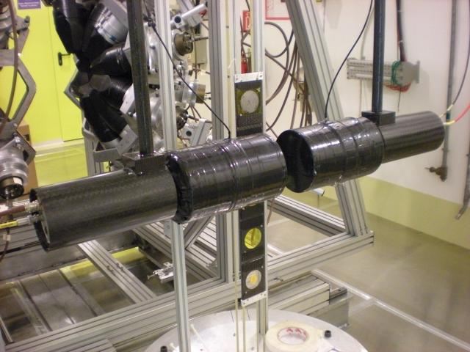
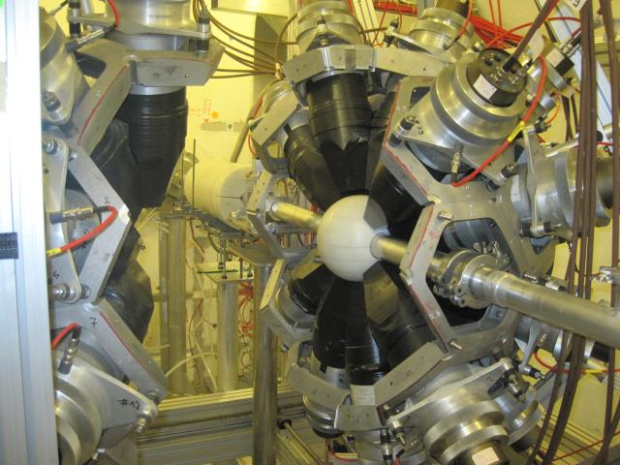
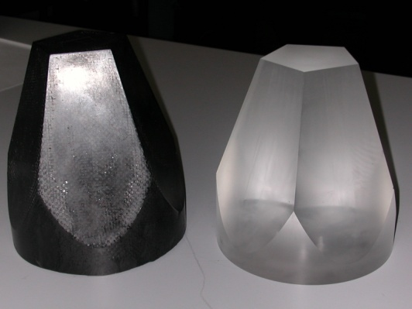
(n, γ) set-up
2. Total Absorption Calorimeter
4π geometry
40 BaF₂ crystals
Good energy resolution
Discrimination of spurious events and background
1. Liquid scintillators
low neutron sensitivity measurements
C₆D₆ detectors
neutrons
Sample changer
NIM A496 (2003) 425
CERN Public Note n_TOF-PUB-2013-002 (2013)
¹⁰B loaded
Carbon Fibre Capsules

Slide 9
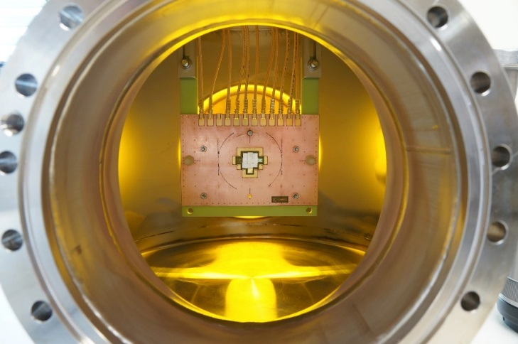
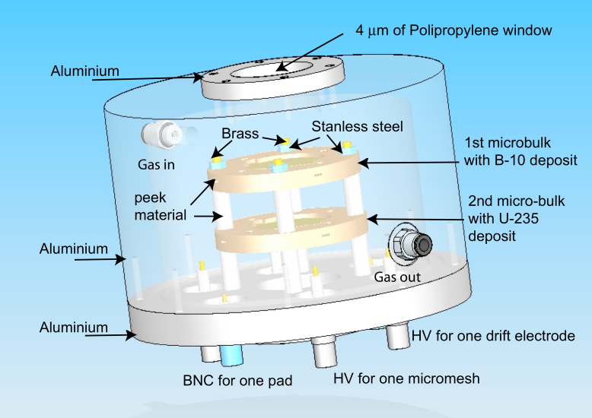
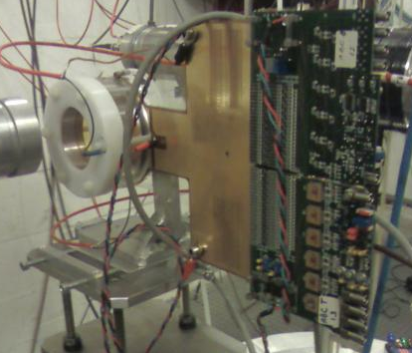
(n, p), (n, α) set-up
MicroMegas
High gain, low noise
Several samples can be measured in parallel
(n,f) measurements
Silicon detectors
Diamond detectors
ΔE-E telescope
Sandwich of detectors in beam
Silicon 1
sample
neutrons
Silicon 2

Slide 10
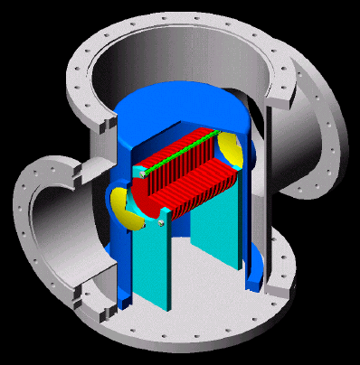
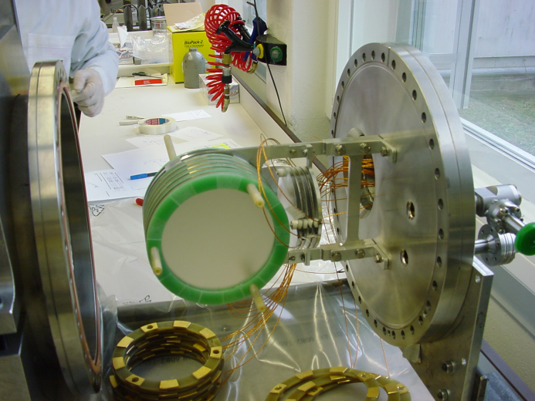
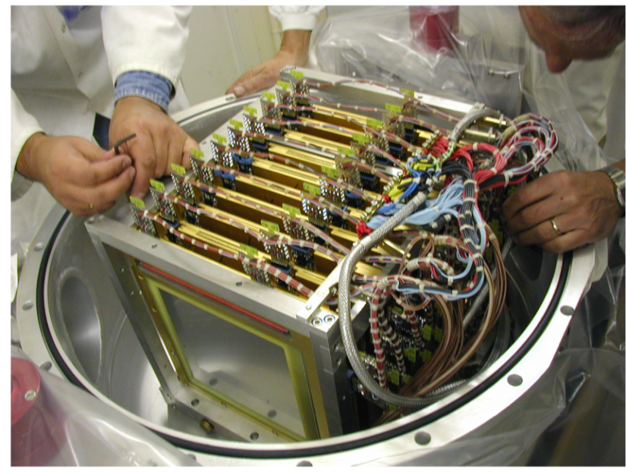
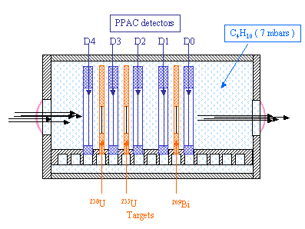
(n, f) set-up
Multi-sample Fission Ionization Chamber
Parallel Plate Avalanche Counters
Fission fragments detected in coincidence
α (from sample decay) discrimination
low sensibility to γ-rays

Slide 11
n_TOF features
Good news
Broad neutron energy range
(meV < E_{n} < GeV)
Measurement of neutron-induced cross sections
in a wide energy range (meV-GeV)
High instantaneous flux
(10⁵-10⁶ n/cm²/bunch)
Measurement of small cross sections
Measurements on samples available in small quantities (isotopically enriched samples)
Measurements on radioactive samples
(low intrinsic background)
Excellent energy resolution
ΔE/E ≈ 10⁻⁴ up to 100 keV
Resonance dominated cross section measurements
Low neutron sensitivity
Low backgrounds
Accurate cross section measurements
even for large σ_{el}/σ_{capture}

Slide 12
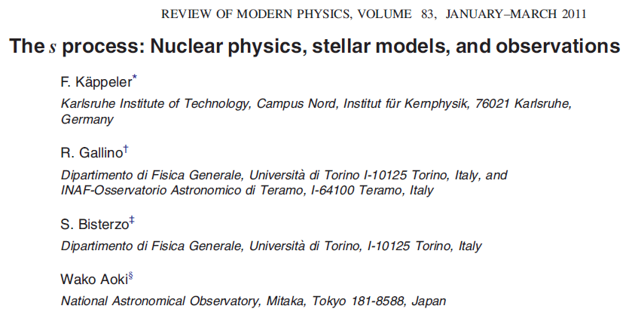
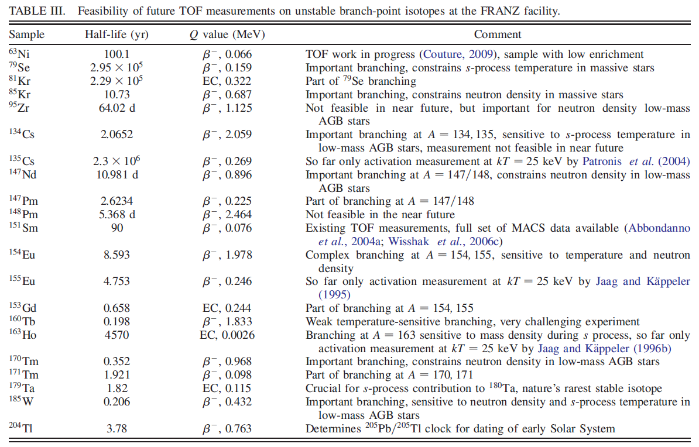
Branching points along the s-path

Slide 13
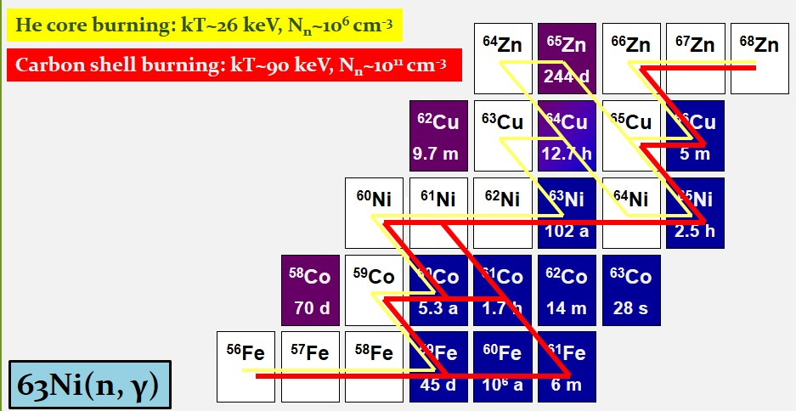
Branching points along the s-path
The ⁶³Ni(n, γ) physics case
Scenarios
in massive stars

Slide 14
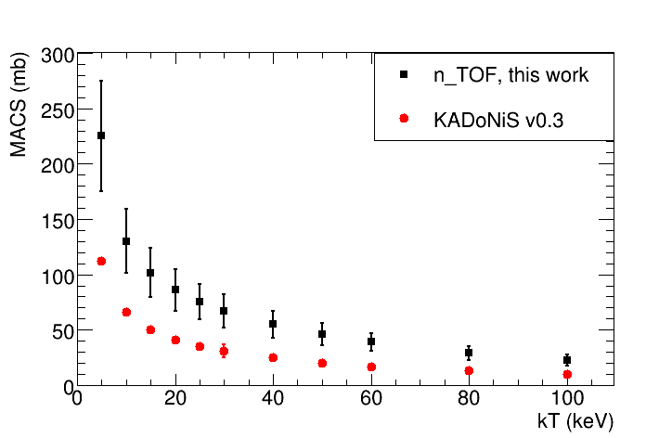
Branching points along the s-path
The ⁶³Ni(n, γ) physics case
C.Lederer, C.Massimi, et al.
PRL 110 022501 (2013)
PRC 89 025810 (2014)

Slide 15

Branching points along the s-path
The ¹⁵¹Sm(n, γ) physics case
¹⁵²Gd
¹⁵⁴Gd
laboratory half-life of 93 yr
reduced to t_{1/2} = 3 yr at s-process site
¹⁵¹Eu
¹⁵²Eu
¹⁵³Eu
¹⁵⁴Eu
The branching ratio at ¹⁵¹Sm depends on:
  Termodinamical stellar conditions
  (temperature, neutron density, …)
  ¹⁵¹Sm(n,γ) cross section
¹⁵⁰Sm
¹⁵¹Sm
¹⁵²Sm
¹⁵³Sm
s-Process
a probe for the temperature at s-process site

Slide 16

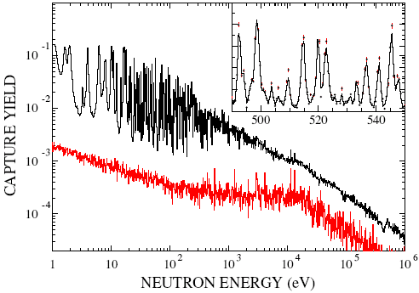
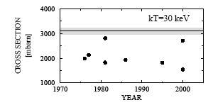
Branching points along the s-path
The ¹⁵¹Sm(n, γ) physics case
Measured for the first time at a time-of-flight facility
Resonance analysis ≈ 500 resonances, mostly new
U. Abbondanno et al.,
Phys. Rev. Lett. 93 161103 (2004)
S. Marrone et al.,
Phys. Rev. C 73 03604 (2006)
Maxwellian averaged cross-section experimentally determined for the first time
s-process in AGB stars produces 77% of ¹⁵²Gd,
23% from p process

Slide 17
Branching points along the s-path
The ¹⁷¹Tm(n, γ) physics case
1400
Isotope production
@ILL
¹⁷¹Tm: ¹⁷⁰Er(n, γ)¹⁷¹Er (β⁻, 7.5h)¹⁷¹Tm (enrichment 1.8%)
→ 3.6 mg of ¹⁷¹Tm (1.9 y) [1.3x10¹⁹ atoms]
Chemical separation and sample preparation
@PSI
→ ¹⁷¹Tm (97.9%) + ¹⁶⁹Tm (2.1%) + ¹⁷⁰Tm(0.07%)
1332
MACS @30 keV (mb)
1200
1000
800
637
600
KADoNiS = 486
400
Karlsruhe Astrophysical Database of Nucleosynthesis in Stars
399
200
309
243
¹⁷¹Tm deposit (20 mm diameter)
YEAR
Aluminum (7 μm) backing
1975
1980
1985
1990
1995
2000
2005
Frame (50 mm diameter)
Mylar (5 μm)

Slide 18
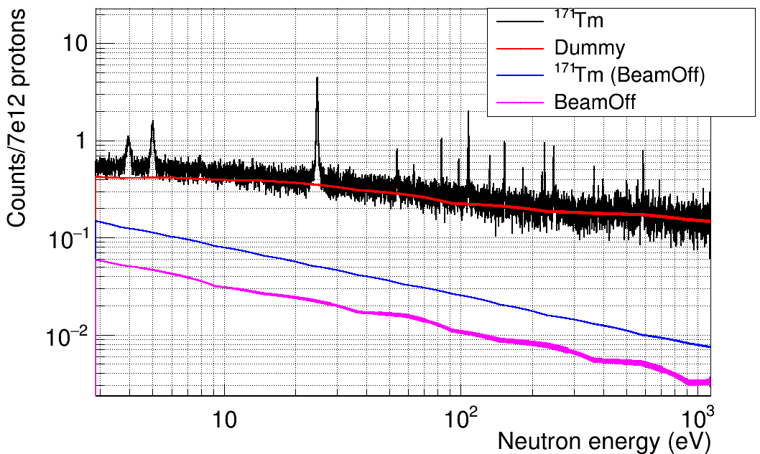
Branching points along the s-path
The ¹⁷¹Tm(n, γ) physics case
First
experimental measurement
VERY PRELIMINARY RESULTS

Slide 19
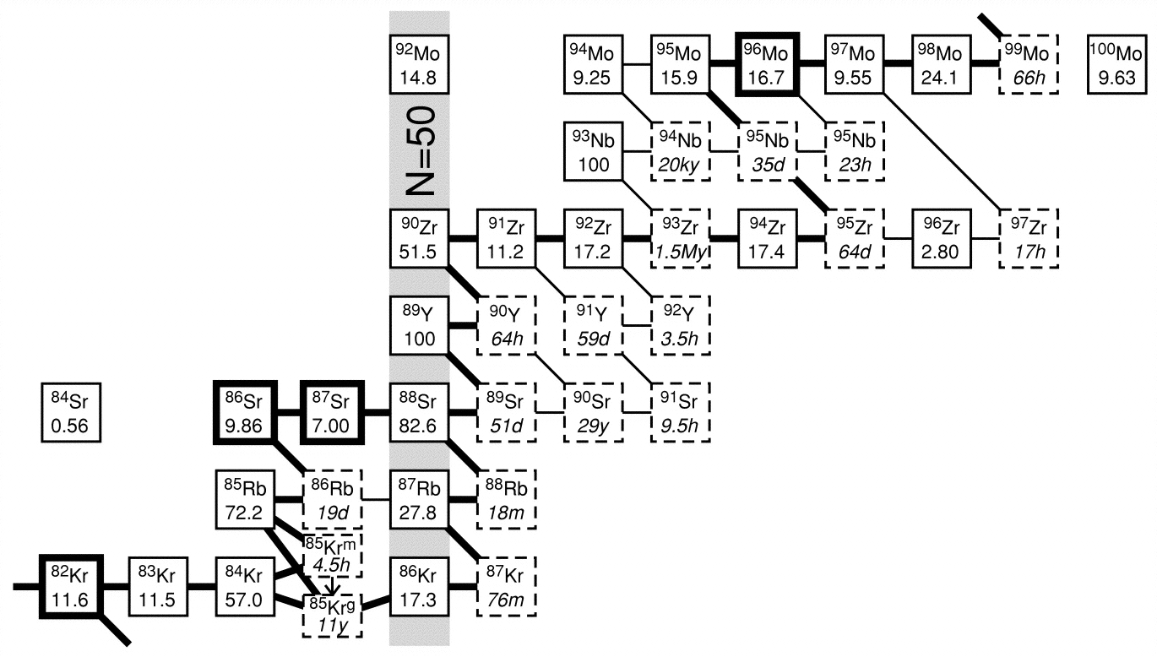
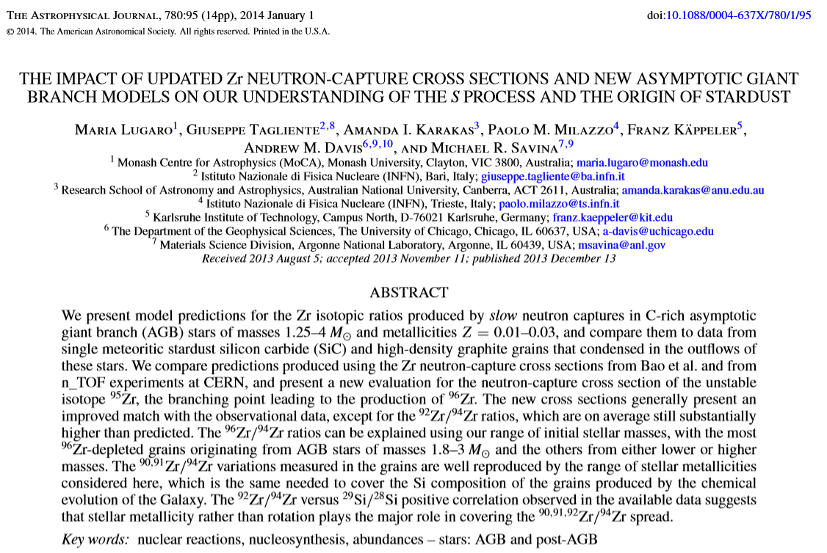
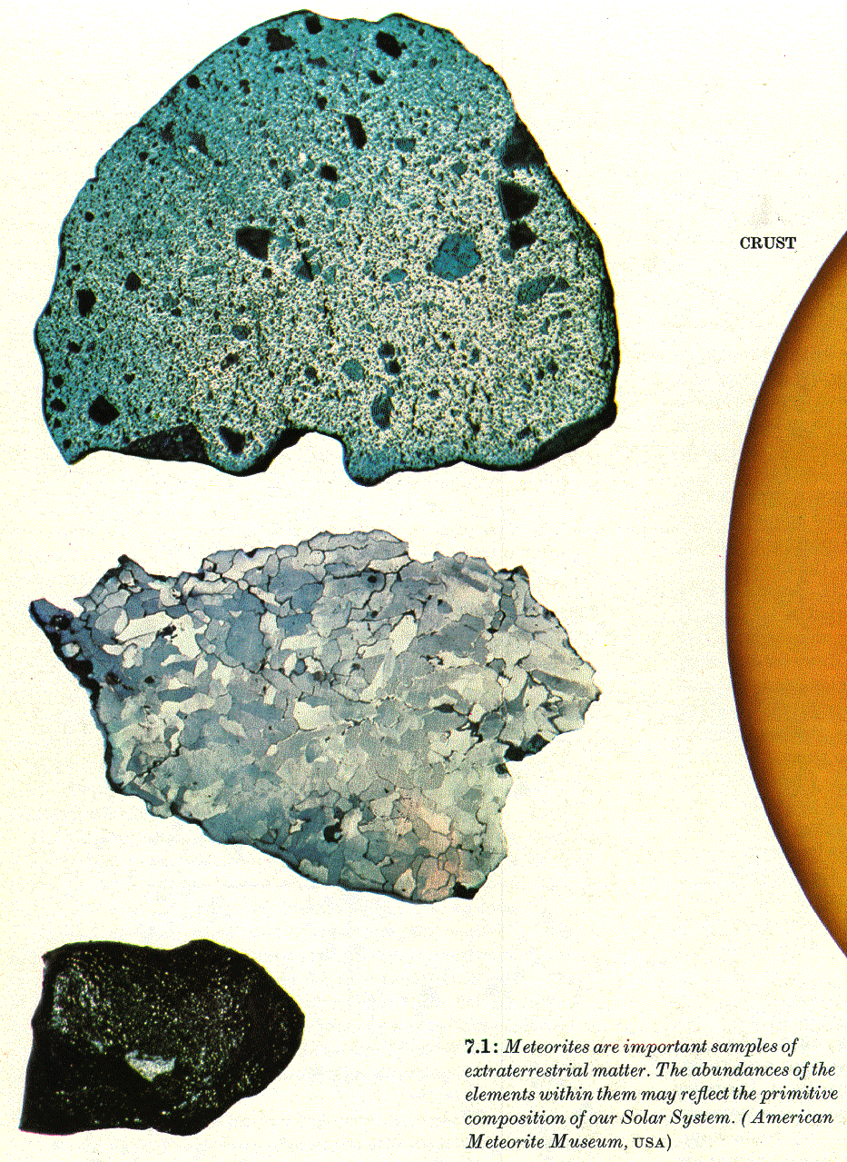
Bottlenecks along the s-path
The ^{9*}Zr(n, γ) physics case
*, 0 →4, 6
M.Lugaro, G.Tagliente et al.
APJ 780:95 (2014)
Stardust grains

Slide 20
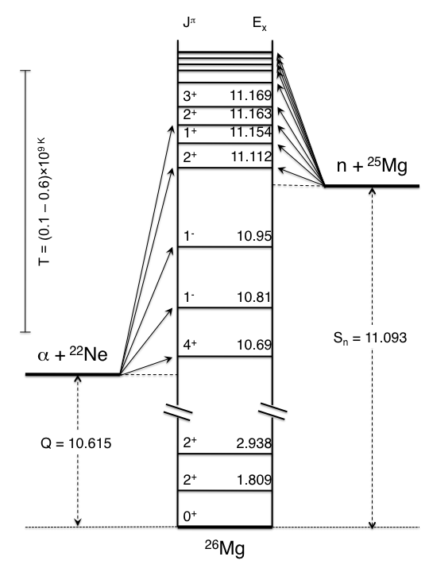
Constraints on the ²²Ne(α, n)²⁵Mg
The ²⁵Mg(n, γ) physics case
Moreover,
neutron capture on Mg stable isotopes is in competition with neutron capture on Fe
Neutron poison
J^{π} information on ²⁶Mg

Slide 21
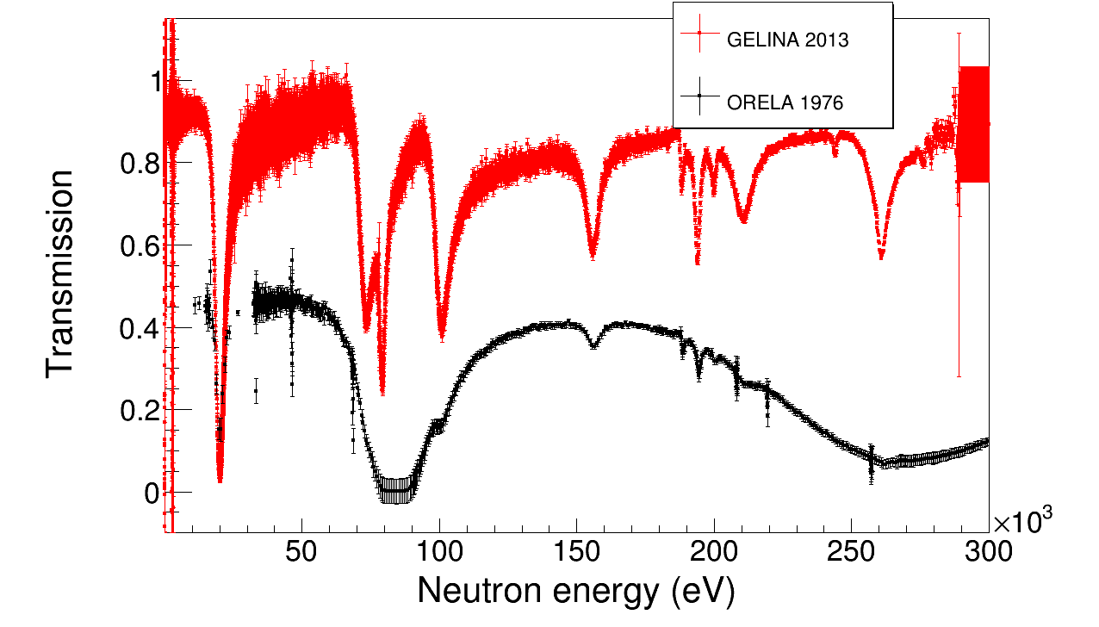
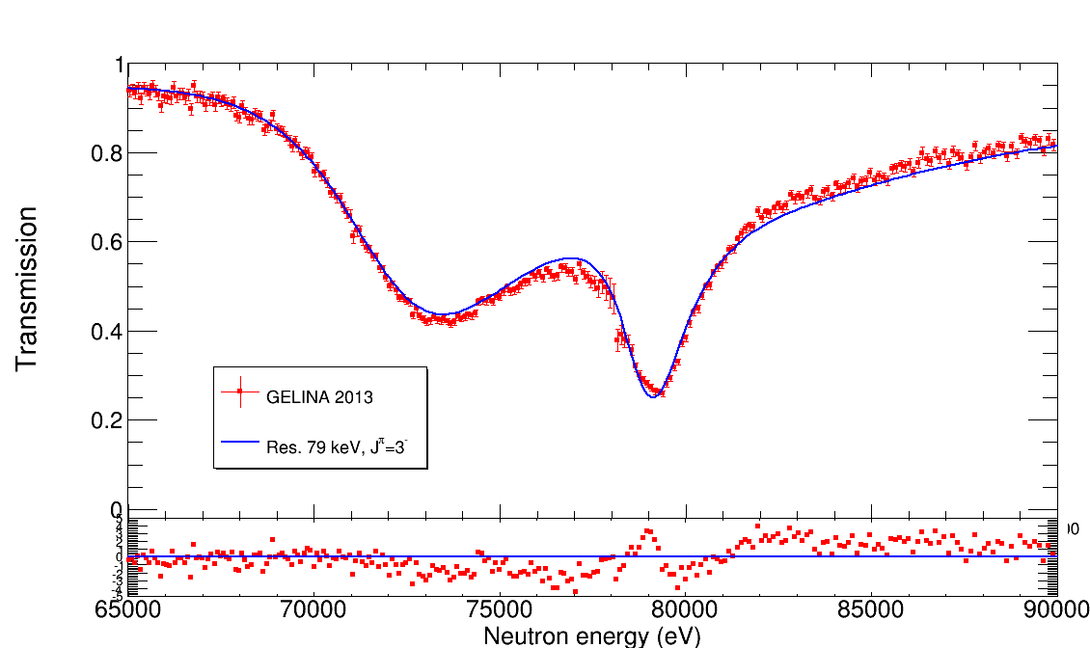
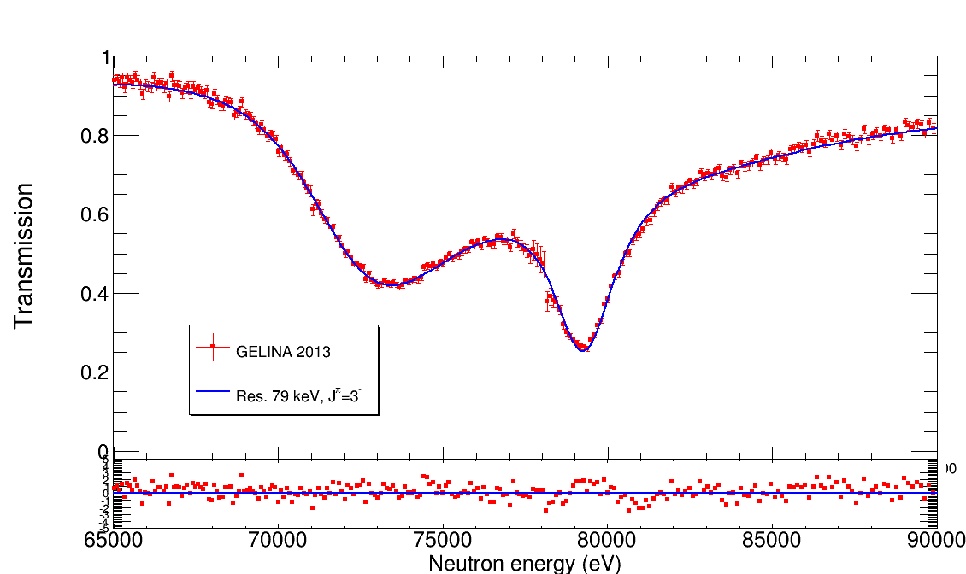
New measurement of ²⁵Mg(n, γ) @ n_TOF + ²⁵Mg(n, tot) @ GELINA
Previous evaluation
E_{R}=72 keV, J^{π}=2⁺
E_{R}=79 keV, J^{π}=3⁺
This work
E_{R}=72 keV, J^{π}=2⁺
E_{R}=79 keV, J^{π}=3⁻
Evidence for more natural states
Than previously thought
→HIGHER ²²Ne(α, n) reaction rate
PRELIMINARY RESULTS
Stellar site | Temperature keV | MACS (this work) | MACS (KADoNiS)
He - AGB | 8 | 4.9±0.6 mb | 4.9 mb
He - AGB | 23 | 3.2±0.2 mb | 6.1 mb
30 | 30 | 4.1±0.6 mb | 6.4±0.4 mb
He – Massive | 25 | 3.4±0.2 mb | 6.2 mb
C - Massive | 90 | 2.6±0.3 mb | 4.0 mb

Slide 22
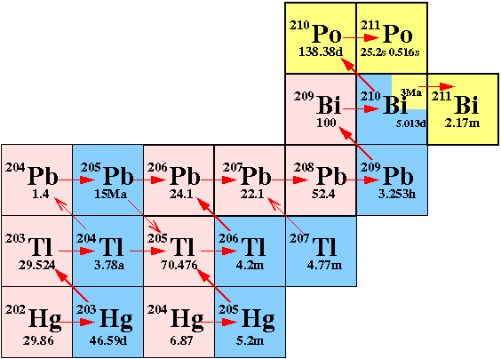
End of the s-path
The ^{204,206,207,208}Pb(n, γ), ²⁰⁹Bi(n, γ) physics case
α-recycling
Normalization of s-process abundances
Discrimination between stellar models (accuracies of 3-5% are needed)

Slide 23
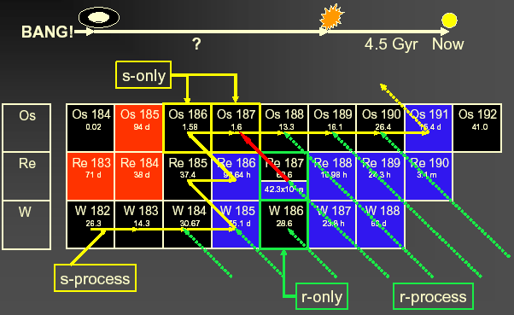
Cosmochronology
σN_{s}(¹⁸⁶Os) = σN_{s}(¹⁸⁷Os)
β-decay half-life of ¹⁸⁷Re (42.3 Gyr)
¹⁸⁷Re contributes to the abundance
of the daughter ¹⁸⁷Os

Slide 24
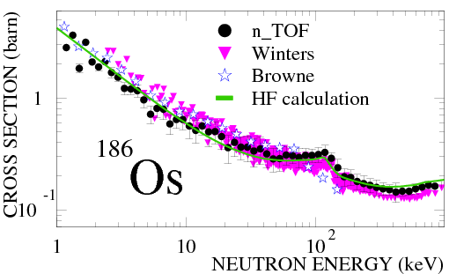
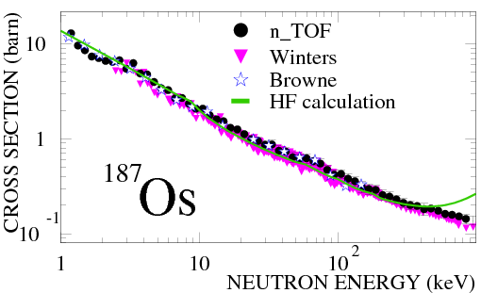
Cosmochronology
The use of Re/Os abundance pair as a clock
address few complications:
The β-decay half-life of ¹⁸⁷Re is strongly dependent on temperature
The stellar (n, γ) cross section of ¹⁸⁷Os is influenced by low-lying excited levels
(strong population of 1st state at 9.8 keV, competition by inelastic channels)
Branching(s) at ¹⁸⁵W and/or at ¹⁸⁶Re
Destruction of ¹⁸⁷Re in later stars (Astration)
The chemical evolution of the galaxy was not uniform
Re and Os abundance uncertainties
Ages
Cosmological way 13.7 ± 0.2 Gyr
based on the Hubble time definition (“expansion age”)
Astronomical way 14. ± 2. Gyr
based on observations of globular clusters
Nuclear way 15. ± 2.^{(*)} Gyr
based on abundances & decay properties of long-lived radioactive species
(*) 0.4 Gyr uncertainty due to x-sections
http://physics.aps.org/synopsis-for/10.1103/PhysRevC.82.015802

Slide 25
Ongoing
The (stable isotopes of) Ge(n, γ)
The neutron capture cross section on Ge
affects the abundances
for a number of heavier isotopes
up to a mass number of A = 90.

Slide 26
Ongoing
²⁶Al(n, p), (n, α)
Observation of the cosmic ray emitter ²⁶Al is proof that nucleosynthesis is ongoing in our galaxy.
The neutron destruction reactions ²⁶Al(n, p) and ²⁶Al(n, α) are the main uncertainties to predict the galactic ²⁶Al abundance.
There are only few experimental data on these reactions and they exhibit severe discrepancies.

Slide 27
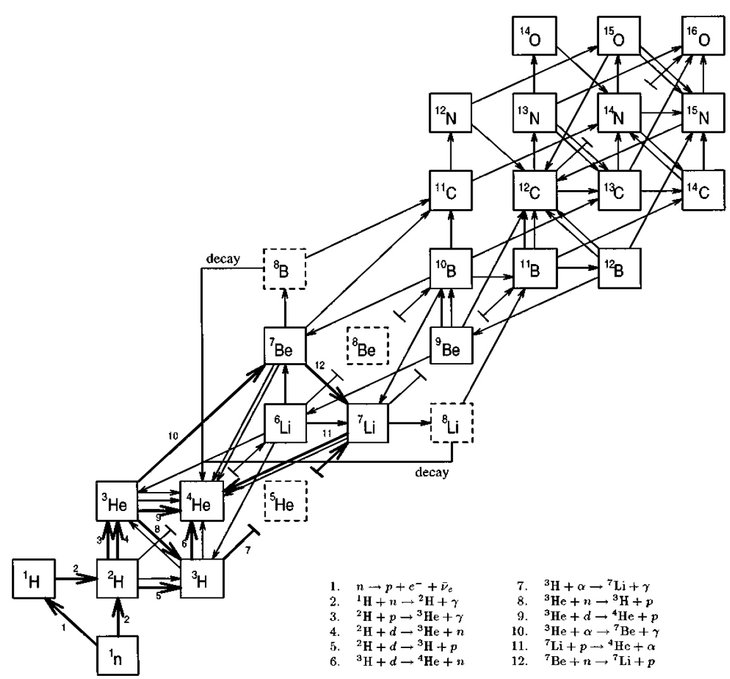
Ongoing
⁷Be(n, p), (n, α)
Big Bang Nucleosynthesis gives the sequence of nuclear reactions leading to the synthesis of light elements up to Na
in the early stage of Universe (0.01-1000 sec).
BBN rests on 3 parameters:
-the baryon-to-photon ratio,
-the number of species of neutrino,
-the lifetime of neutron.

Slide 28
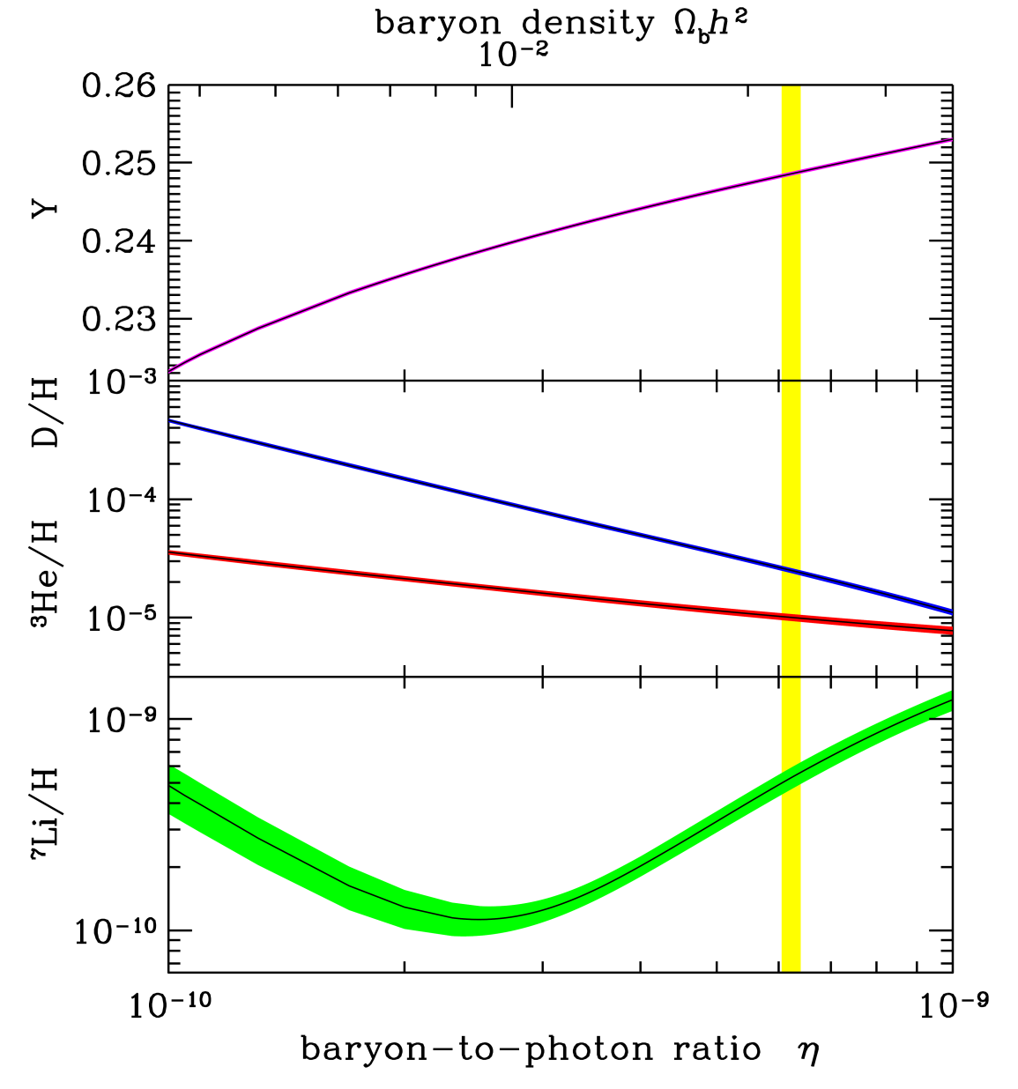
Ongoing
⁷Be(n, p), (n, α)
*
BBN successfully predicts the abundances of primordial elements such as ⁴He, D and ³He
A serious discrepancy (factor 2-4) between the predicted abundance of ⁷Li and the value inferred by measurements
Cosmological Lithium Problem

Slide 29
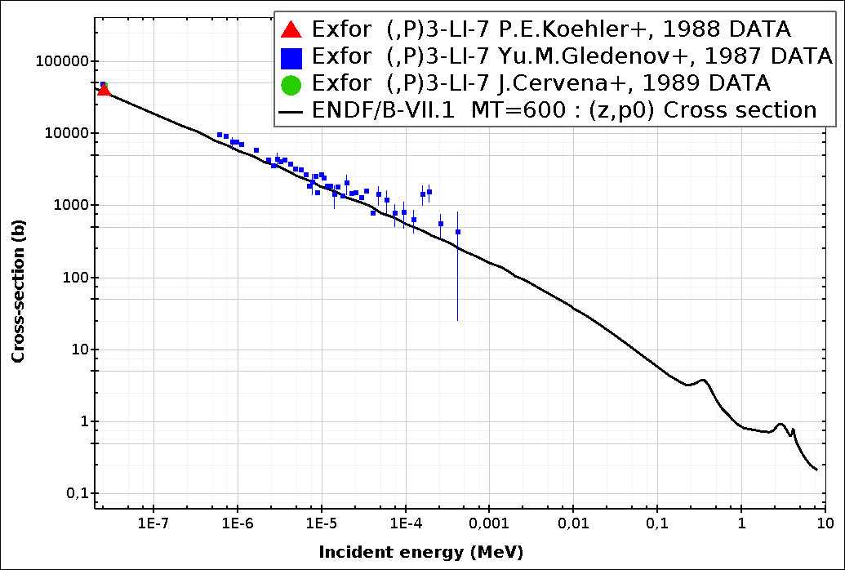
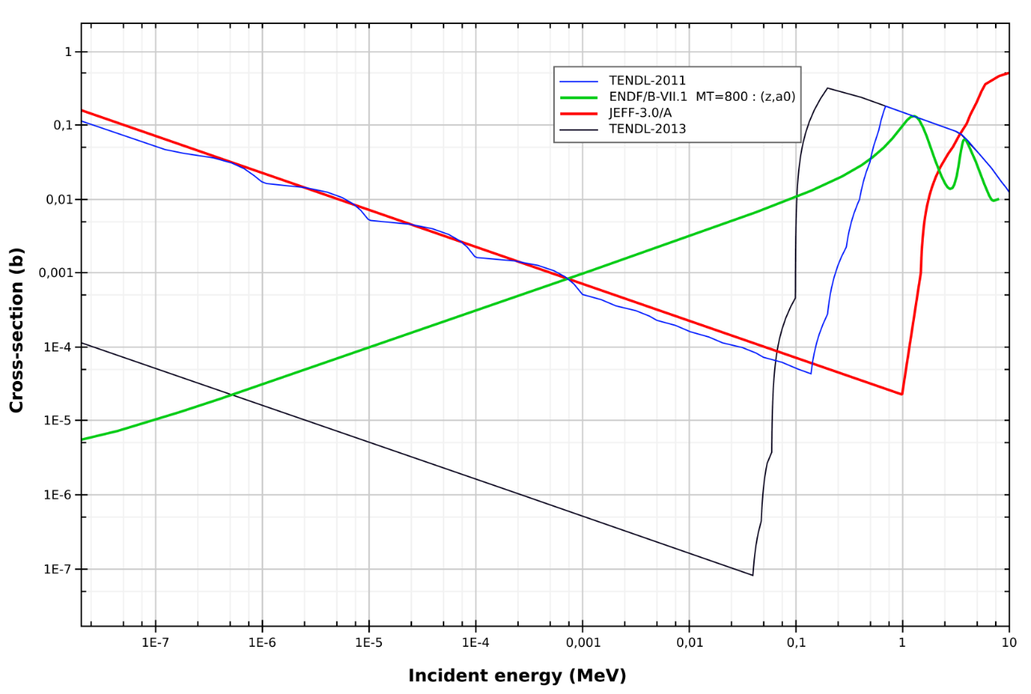
Ongoing
⁷Be(n, p), (n, α)
Approximately 95% of primordial ⁷Li is produced from the electron capture decay of ⁷Be (T_{1/2}=53.2 d)
⁷Be is destroyed via (n, p) (≈97%) and (n, α) (≈2.5%) reactions
A higher destruction rate of ⁷Be can solve or at least partially explain the Cosmological Lithium Problem
Only one direct measurement
(P. Bassi et al., 1963, @ 0.025 eV)
⁷Be(n, p)
⁷Be(n, α)

Slide 30
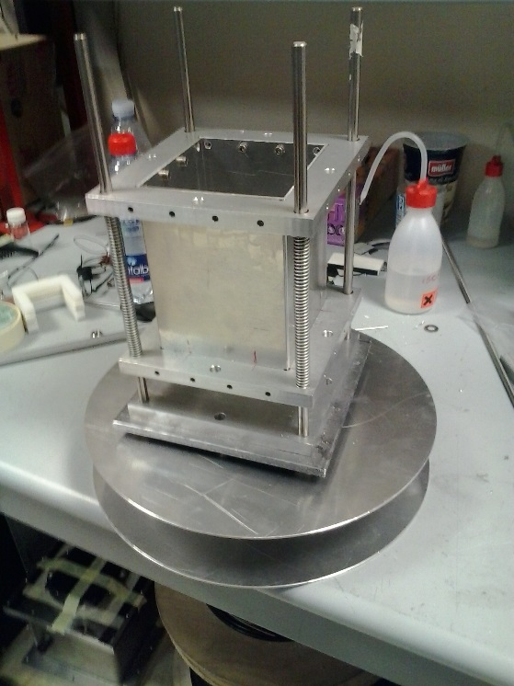
Ongoing
⁷Be(n, α)
Sandwich of silicon detectors directly inserted in the beam
Detection of both alpha particles (E≈9 MeV)
Silicon 1
sample
Coincidence technique:
Strong rejection of background
neutrons
Silicon 2
Sample:
1-10 μg of ⁷Be from water cooling of SINQ spallation target.
(activity of 478 keV γ-rays 1 GBq/μg)
Isotopic composition: 1:1 ⁷Be-¹⁰Be 1:5 ⁷Be-⁹Be

Slide 31
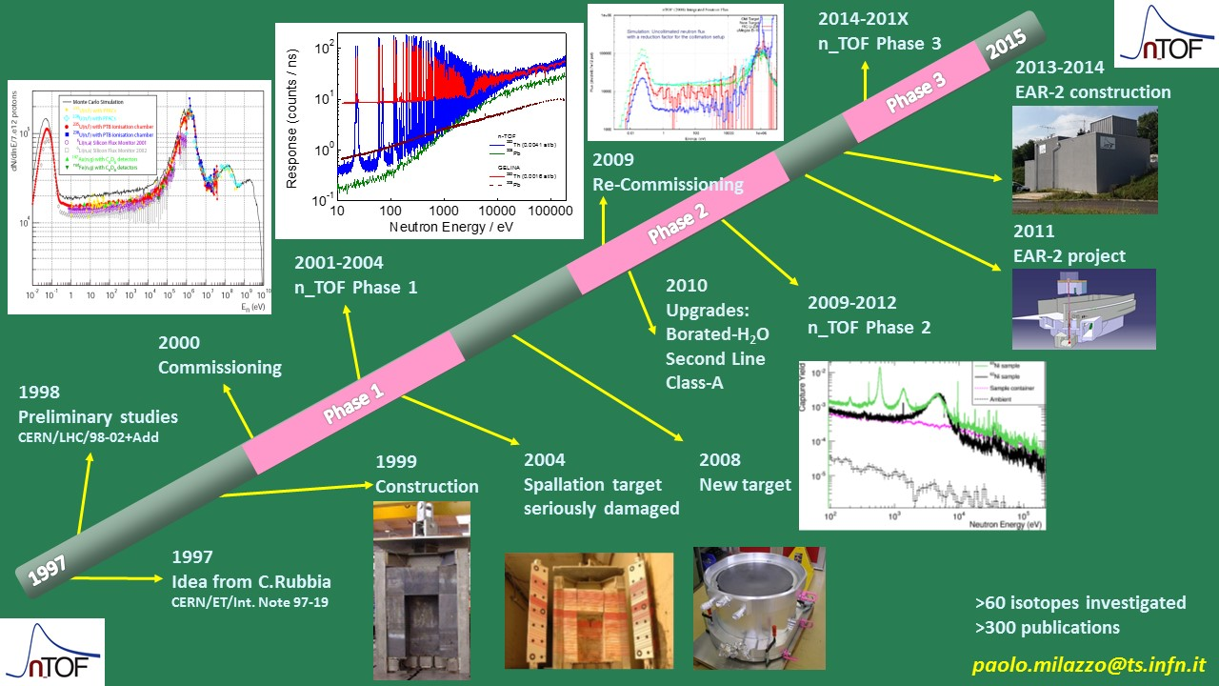




Status and future of n_TOF
Penso ai giovani che coltivano i propri talenti e che vorrebbero vedere riconosciuto il merito
(Sergio Mattarella, Discorso di insediamento a Presidente della Repubblica)

