Slide 1
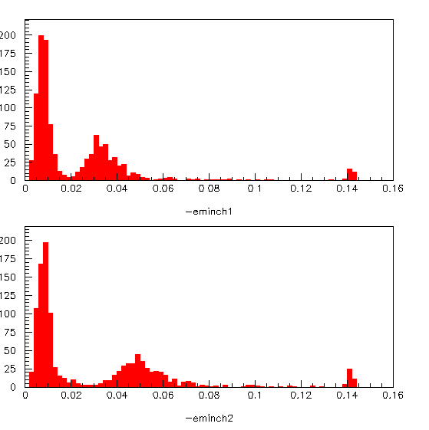
Muon energy distribution in Lyso

Slide 2
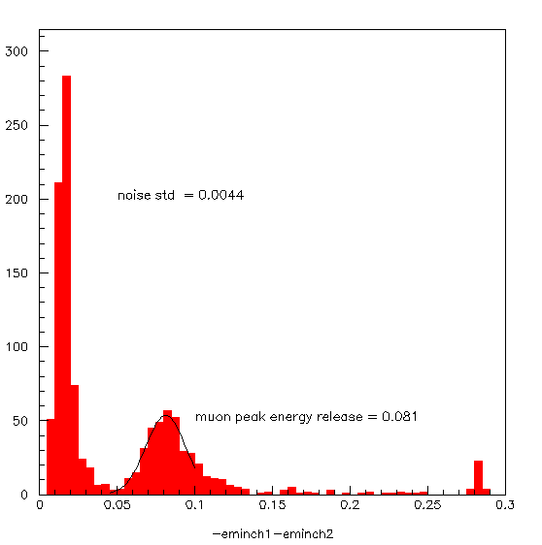
Sum of the 2 APDs
If the energy releasy of a muon in 2.56 cm of lyso
is 20MeV the ENE we get is 1 MeV.

Slide 3
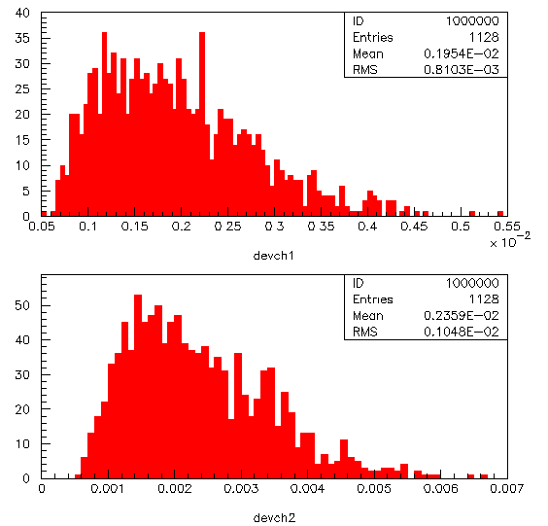
Noise in pre-amp
About 2 mV noise in both of them

Slide 4
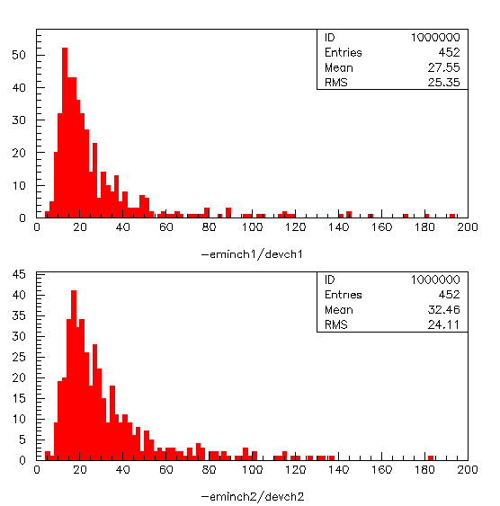
Signal to noise ratio

Slide 5
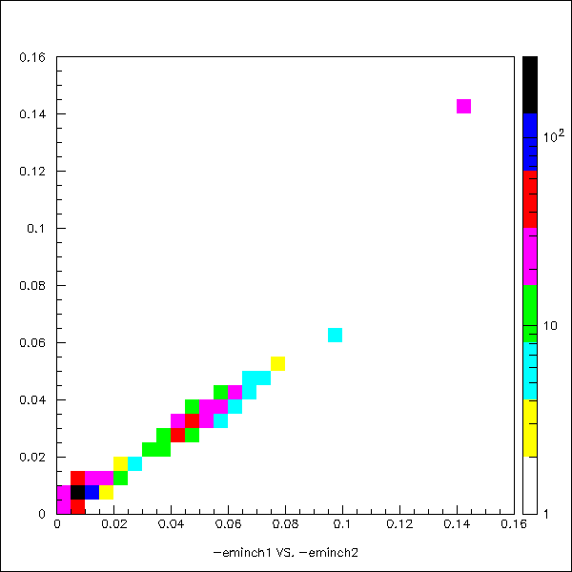
Correlation plot among energy release

Slide 6
HV SCAN
HV break down APD1 = 455 V HV break down APD2 = 453
run number E1 std(E1) E2 std(E2) E1+E2 std(E1+E2) stat VAPD1 VAPD1R VAPD2 VAPD2R
25 0.6 0.15 0.6 0.12 1.2 0.21 5000 450 441 448 462
26 0.3 0.06 0.31 0.06 0.61 0.12 1576 445 436 443 457
27 0.19 0.04 0.20 0.04 0.39 0.08 1718 440 431 438 451
28 0.38 0.06 0.38 0.063 0.76 0.12 1381 448 439 446 459
29 0.25 0.05 0.25 0.05 0.5 0.11 1559 443 434 441 454
Assuming 18 MeV muon energy deposit we have:
Run number ENE(E1) ENE(E2)
90 90 KeV
180 180
270 270
140 140
220 220
Muon energy resolution:
Run number %(E1) %(E2)
25 20
20 20
20 20
16 16
29 20 20

Slide 7
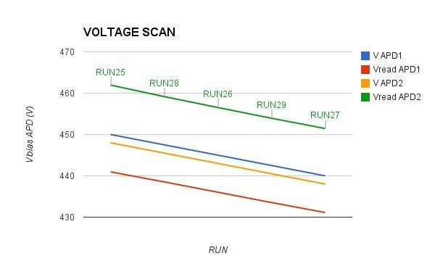
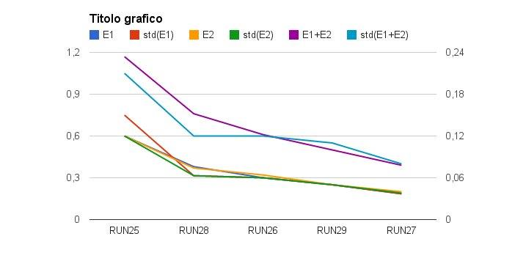
HV scan (2)

Slide 8
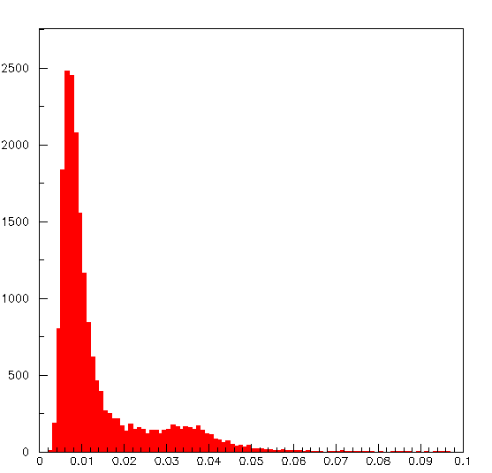
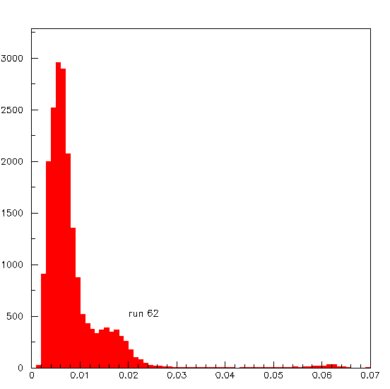
Radioactive source
RUN 61
Vset 445 Vread 428
Vset 440 Vread 423

Slide 9
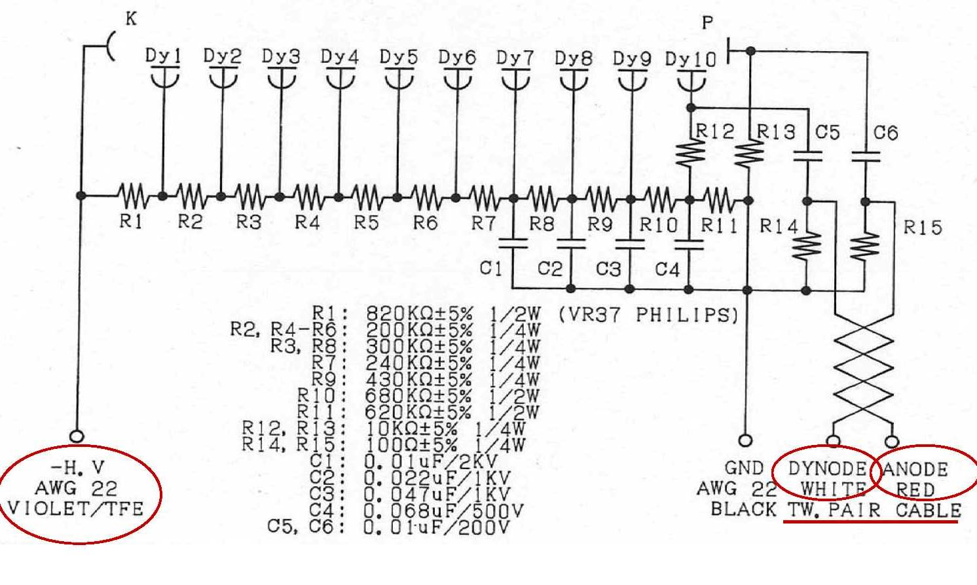
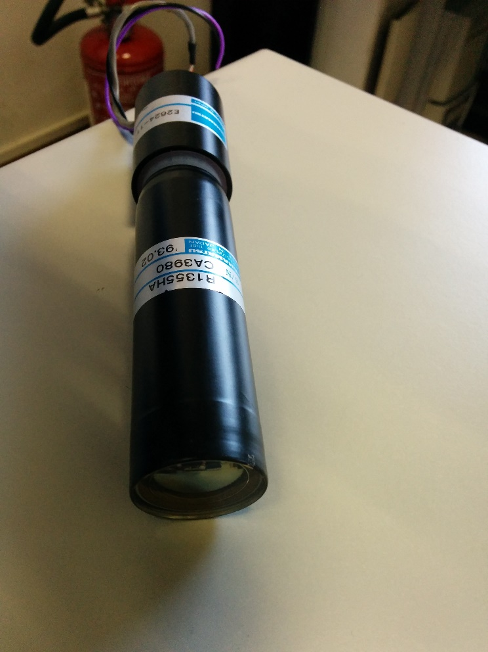
Lyso + pmt
We are using a 1-1/8 inch pm to read it out
Vop= 1550V we are now operating it at 1000V
The Voltage divider was provided by hamamatsu and delivers a differential signal.
We are terminating now a single pole on a 50 Ohm resistor.

Slide 10
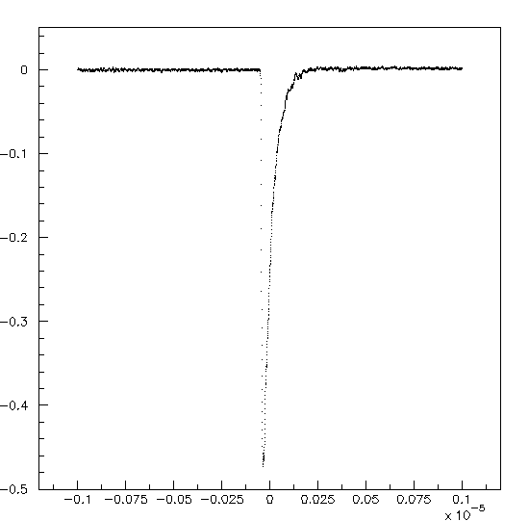
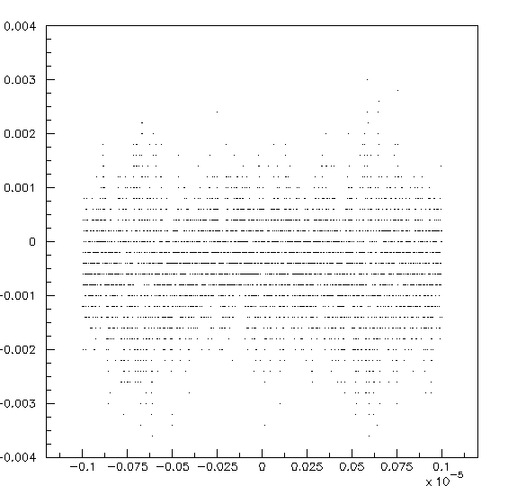
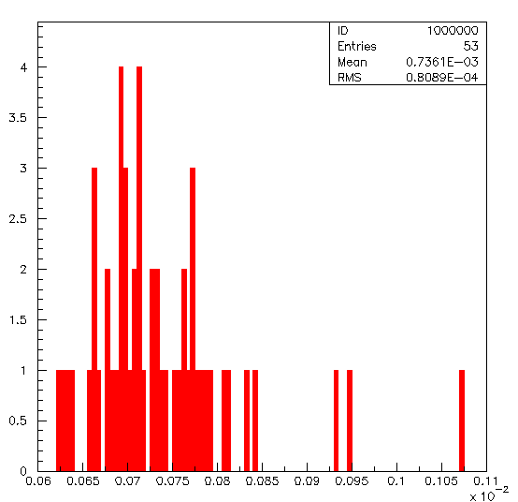
Lyso and pmt now taking data on cosmic
Empty event on lyso
Typical signal

