Slide 1
Ultra peripheral Collisions (UPC) γγ◊ γγ at the LHC Run 2
E. Scapparone
May 27, 2015
• The present: UPC measurements performed so far in p-p, p-Pb, Pb-Pb
• What can we learn on UPC at the LHC Run 2 ? γγ◊ γγ
b > R_{A} + R_{B}

Slide 2
Run 1
arXiv: 1503.09177 (submitted to JHEP)
ρ, J/Ψ, Ψ(2s) in Pb-Pb → nuclear gluon PDF constrain at low-x (ALICE + CMS);
J/Ψ in p-Pb → proton gluon PDF constrain at low-x (ALICE);
J/Ψ, Ψ(2s) in p-p → proton gluon PDF constrain at low-x (LHCb);
PLB 718 (2013) 1273, EPJ C73 (2013) 2017
Phys. Rev. Lett. 113, 232504
J. Phys. G41 (2014) 055002
Exclusive two-photon production of lepton pairs, 40 pb⁻¹ (CMS)
Two-photon production of W pairs and limits on anomalous quartic gauge couplings (CMS)
JHEP 01 (2012) 052
JHEP 1307 (2013) 116

Slide 3
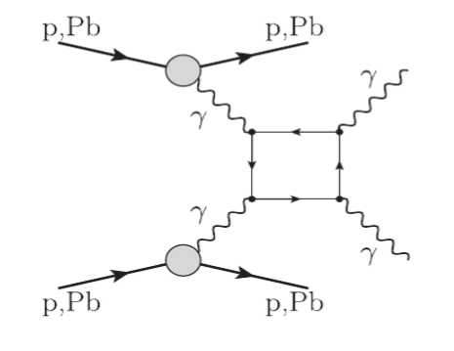
γγ → γγ
γ
~ O(α⁴)
l,,q,W
A very important measurement ...UPC hunting for physics beyond SM
γ
So far, no direct observation of this process.
In the SM the above box diagram involves quarks, leptons, W, etc,
→ Extra contributions from new heavy charged particles and/or super symmetric partners
of SM particles ?
See PRL 111, 080405 (2013)
Experimental approaches proposed:
- Compton-backscattered photons against laser photons.
- Collisions of photons from microwave waveguides, cavities, high-power lasers.
- Collisions at photon colliders (via Compton-backscattering laser-light off e± beams).
- Ultra Peripheral collisions

Slide 4
γγ → γγ
depends on the M_{γγ} threshold. M_{γγ} > 5 GeV → σ ∼ 30−40 nb
PRL 111, 080405 (2013)

Slide 5
Backgrounds
pT ~0.5 GeV
ZDC signal
e⁺
Wrong e ⁺ id
e⁺
e⁻
e⁺
e⁺
e⁻
e⁻
σ(E>5 GeV) ~ few mb

Slide 6
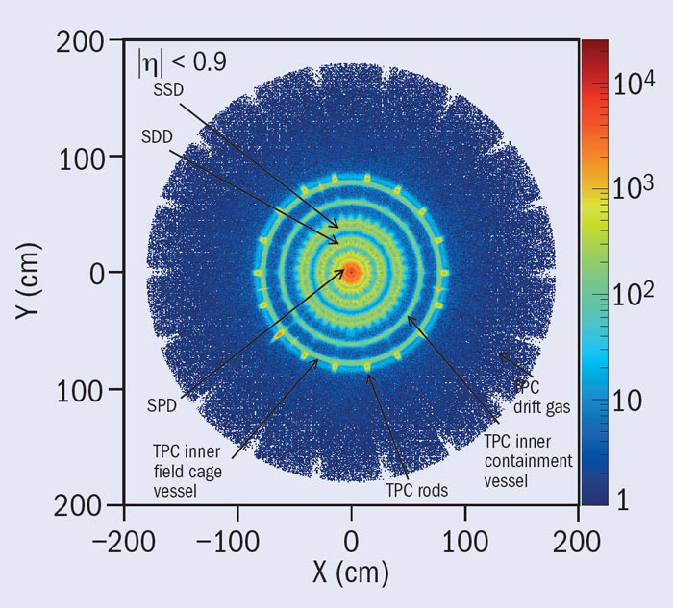
γγ → γγ
In ALICE a lower threshold could be used (but background expected).
a) γ conversion in/before the TPC
b) γ conversion in ECAL/DCAL
CMS/ATLAS: 50% (Acc x eff)
ALICE: Acceptance, efficiency to be evaluated; assuming a conservative 20%
N ~20 events in CMS/ATLAS, 5-10 events in ALICE ( depending on the threshold ).
~ O(α⁴)
l,q,W
With 1 nb⁻¹ , √s_{NN}=5.5 TeV → N~ 30-40 events ( threshold M_{γγ} > 5 GeV)
Run3 is required for a reasonable statistics , but we can start at Run2

