Slide 1
Status of integration in USA15

Slide 2
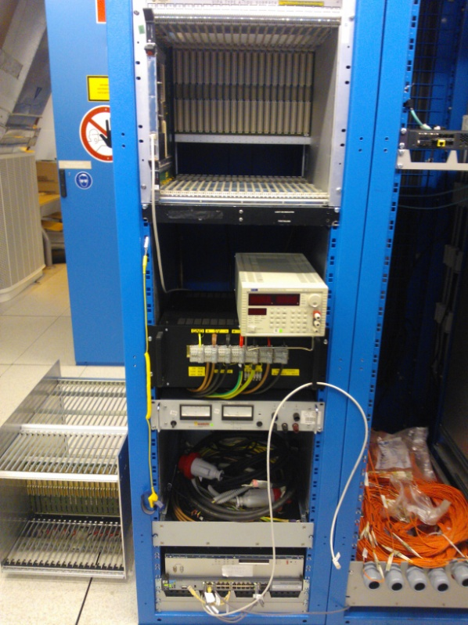
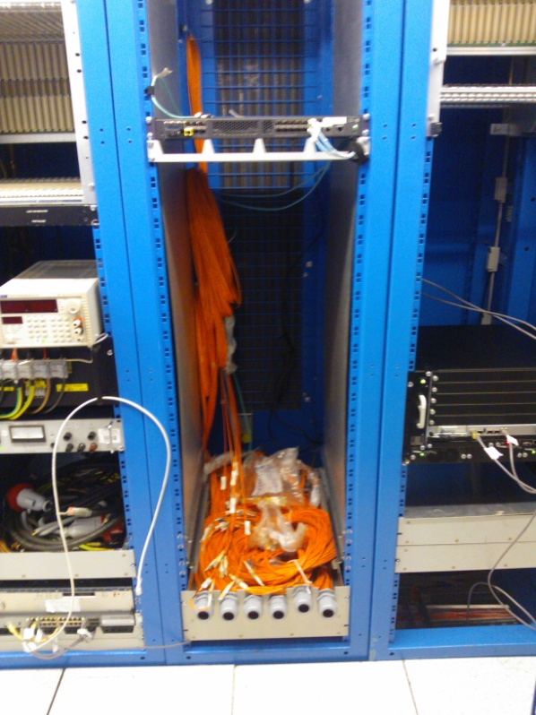
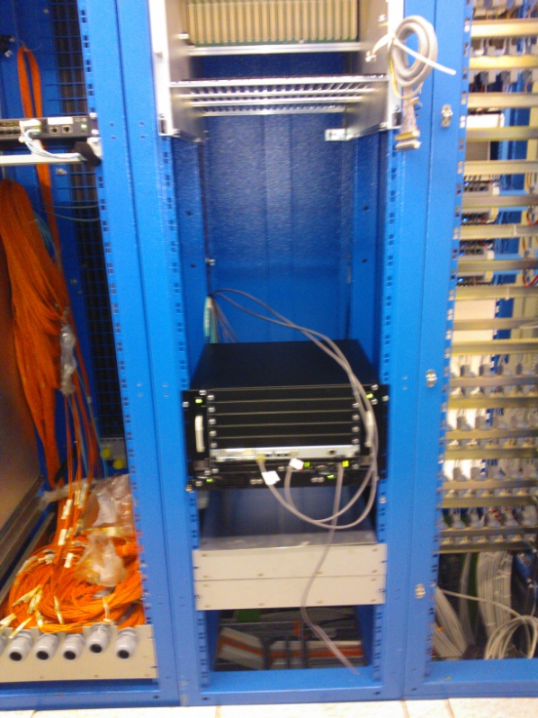
Status of rack layout
Rack Y.05-09.A2 equipped with turbine cooling system and nominal 20kW power. All other racks should be equipped within Easter
Fibers not yet put in final position. Storage boxes placed, lateral fiber trays available but not installed
Rack Y.07-09.A2 temporarily modified (side panels removed) to host a horizontally cooled ATCA crate for fiber validation

Slide 3
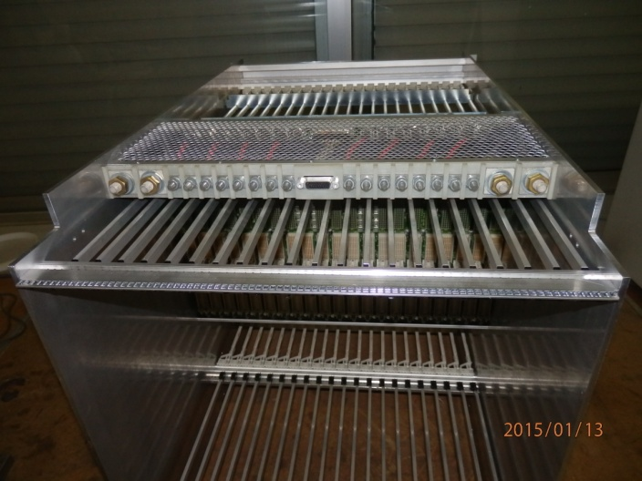
Hardware availability
Two Wiener VME bins and two power supplies sent to the company in February for refurbishing. They should be back around Easter. At the moment only one Wiener bin and one power supply is available in USA15, but not used. They both will be sent to Wiener for refurbishing as soon as the others will be back
A CDF VME bin was mechanically modified in the Pavia workshop to extend the rear cage to 28 cm. Capacitors on the 3.3V distribution lines on backplane were replaced to allow the use of 48V. This crate is now in USA15
The “old” CDF VME crate in rack Y.05-09.A2 was replaced last Friday with the modified CDF crate. Now AMBSLP boards can be powered and tested in this crate

Slide 4
Status of Integration Projects
There are two new projects in progress, in order to supply a full VME rack with one power supply of adequate power
New CAEN Power Supply
Main specifications:
2 independent channels supplying 48V, 24V and 5V
Each channel 48V@150A, 24V@35A, 5V@120A, total power 8.64kW/channel
INPUT voltage separated for each channel, 3-phase 5 poles
OUTPUT connectors made with M13 bolts, minimum distance among bolts 5 cm
External interface implemented by means of Ethernet protocol and manual display, or CANBus and manual display
Local/Remot controls: V/I monitor and ON/OFF for each voltage output
Dimensions are 19” large, 9U tall and 680 mm deep
EU conformity marking
One sample ordered
It will be delivered by next August

Slide 5
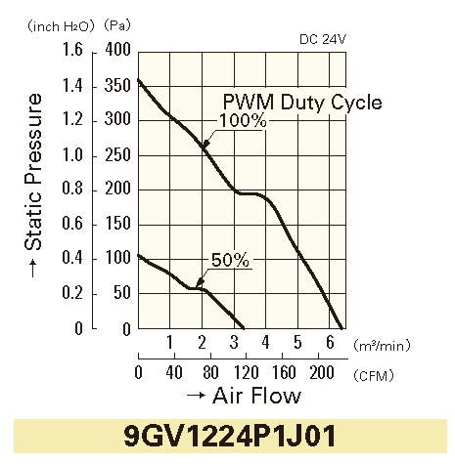
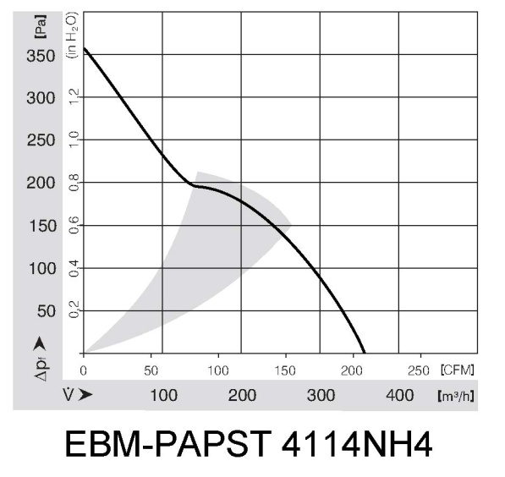
Status of Integration Projects
Custom fan unit
Fan chosen and ordered: Sanyo Denki 9GV1224P1J011, 24VDC (for compatibility with the Wiener HB), 6.35 m³/min max air flow [5.92 the HB], 360 Pa max static pressure [360 the HB], pulse sensor for speed monitoring [no HB], 25kHz PWM for speed control [no HB], expected lifetime 40k hours [35k for HB]. Cost in small quantities: 32.7 euro each (+ VAT) at Mouser
Mechanics is under ordering partly to Cern Stores and partly to a metal selling company (Colombo)
Electronics control and monitor under definition. Control and monitor will be implemented with an Arduino microcontrolled, costing 30 euros

Slide 6
Status of Integration Projects
Custom fan unit – Arduino μcontroller

Slide 7
Thermal simulations of core crates and racks
Ansys Icepack software requested to INFN CNAF. It should be available in April
5-licence pack ordered by CNAF, it costs 2610 euro. INFN Milano required one licence as well, so cost is decreased
When the package will be available, the plan is to verify the results got by IMEC on the single crate, then to simulate a crate with two fans (one on bottom and the second on top), and finally to simulate one full rack

Slide 8
FTK ATCA Components
Three racks
Four 14-slot ATCA shelves for DF in two racks
Full mesh fabric
Switch blade
One 6-slot ATCA shelf for FLIC in one rack
Full mesh fabric
Processor blade

Slide 9
DF Rack Layout
Approved by electronics coordination
Approved by technical coordination
Fiber arrangement needed careful planning
 | TURBINE
 | HEAT EXCHANGER
 | Closing panel
 | ATCA 2 14 slots with 2 fan units (IM + DF)
 | Closing panel
 | HEAT EXCHANGER
 | ATCA 1 14 slots with 2 fan units (IM + DF)
 | Air deflector
 | ATCA power supply (6000W)
 | Closing panel
 | Fiber storage
 | Network switch
ROD Fibers
Inter-board Fibers
 | Closing panel
 | ATCA 2 14 slots with 2 fan units (IM + DF)
 | Closing panel
 | Closing panel
 | ATCA 2 14 slots with 2 fan units (IM + DF)
 | Closing panel
Front with fiber harness
Rear with patch panel

Slide 10
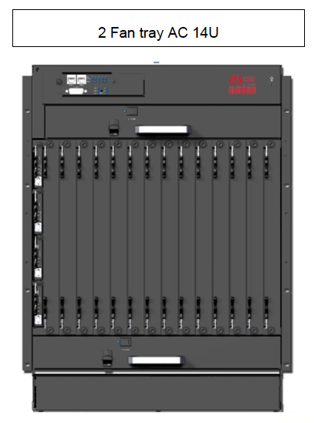
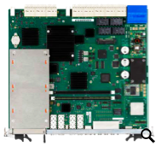
DF Infrastructure
ASIS Vertical cooling 14-slot shelf tested by CERN
4 plus 1 spare
Guardian 3U AC-DC converter (3KW per brick) tested by CERN
2 plus 1 spare (each with 3 bricks)
Emerson switch blade, ATCA-F125
4 plus 1 existing
Procurement started

Slide 11
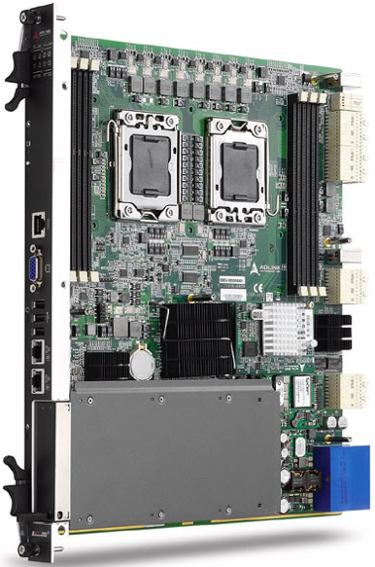
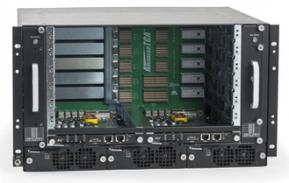
FLIC Infrastructure
ASIS 6-slot shelf, 3X mesh
1 plus 1 in testbed
ADLINK ATCA-6150 processor blade (to be upgraded)
Installed

Slide 12
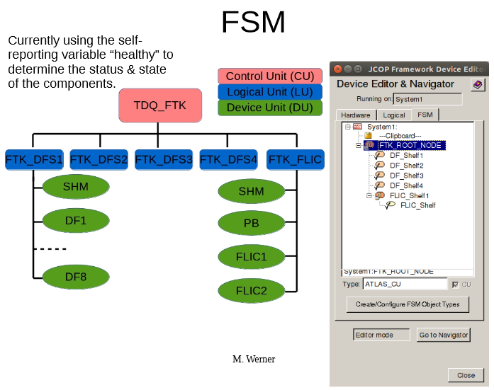
DCS
Implementing the solution recommended by the ATLAS DCS coordination
SNMP daemon on shelf manager in FTK ATCA shelves
SNMP agent on FTK LCS to request data from shelf manager
WinCC OA client on FTK LCS to connect to TDAQ SCS
Working together with other subsystems (CSC ROD team, Tile sROD team, etc)
Shelf manager communication
FSM panel organization
FSM state and status definition
… …
Testing at remote sites and CERN
Integrating the communication
with LAPP IMPC soon
Developing a solution for power
supply (Ethernet)

