Slide 1




The SHiP Facility at CERN
Giovanni De Lellis
University Federico II and INFN Naples
On behalf of the SHiP Collaboration
arXiv:1504.04855v1.
85 theorists
arXiv:1504.04956v1.
240 physicists

Slide 2

Full physics program
SHiP TP demonstrates performance for a few representative channels: HNLs
dark photons, hidden scalars, and neutrino physics

Slide 3
Physics motivation: Standard Model is a great but not complete theory
Experimental facts of BSM physics
  Neutrino masses and oscillations
  The nature of non-baryonic dark matter
  Baryon asymmetry of the Universe
  Inflation of the Universe
Not clear what the scale of New Physics is and what’s the strength of its coupling to SM particles!

Slide 4
High Intensity Frontier
Known physics
Energy frontier
LHC, FCC
Intensity frontier
Flavour physics
Lepton flavour violation
Hidden Sector
….
Interaction strength
unknown physics
Energy scale
This talk

Slide 5
^{Light Hidden particles →} singlets with respect to the SM gauge group
→ couple to different singlet composite operators (Portals) of the SM

Slide 6
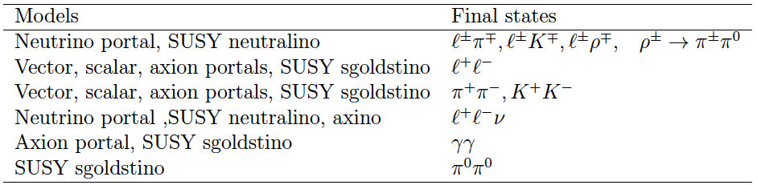
Common experimental features of Hidden Sector (HS)
Production through hadron decays (π, K, D, B, proton bremsstrahlung, …)
Decays:
Full reconstruction and PID are essential to minimize model dependence
Production and decay rates are strongly suppressed when compared to SM
- Production branching ratios O(10⁻¹⁰)
- Long-lived objects
- Travel unperturbed through ordinary matter
Challenge is background suppression → requires O(0.01) carefully estimated
Physics with ν_{τ} produced in D_{s} decays share many of these features

Slide 7
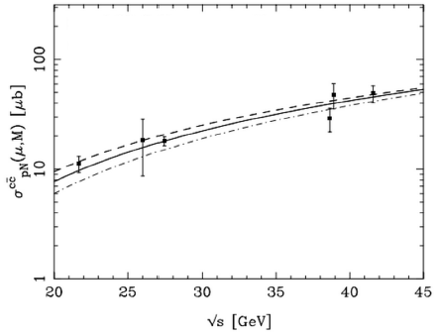
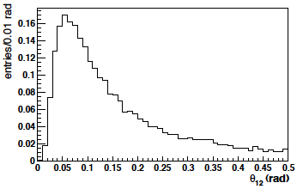
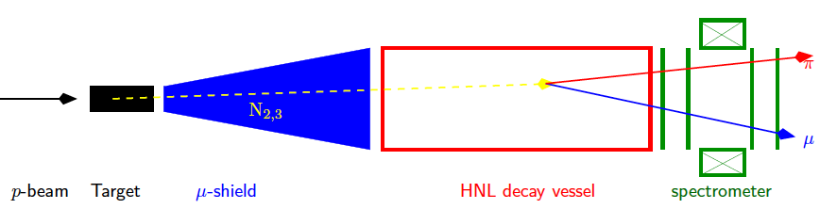
General experimental requirements
Search for HS particles in Heavy Flavour decays
HS produced in charm and beauty decays have
significant P_{T}
Opening angle of the
decay products in N→μπ
Detector must be placed close to the target to maximize geometrical acceptance
Effective (and “short”) muon shield is essential to reduce muon-induced backgrounds
7

Slide 8
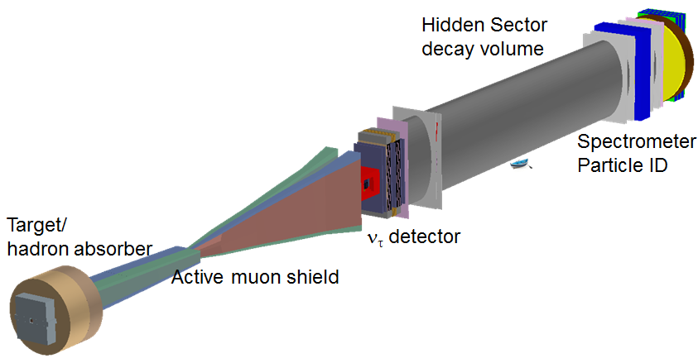
The SHiP experiment
( as implemented in Geant4 )
~150m

Slide 9
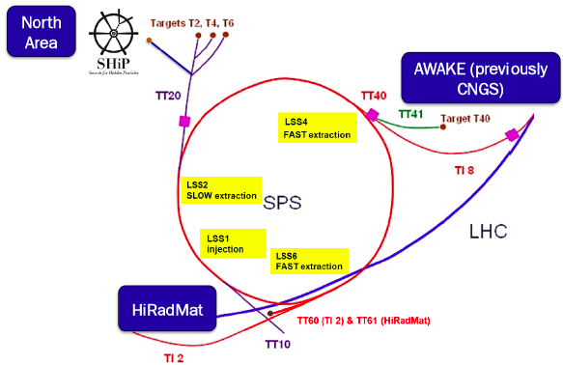
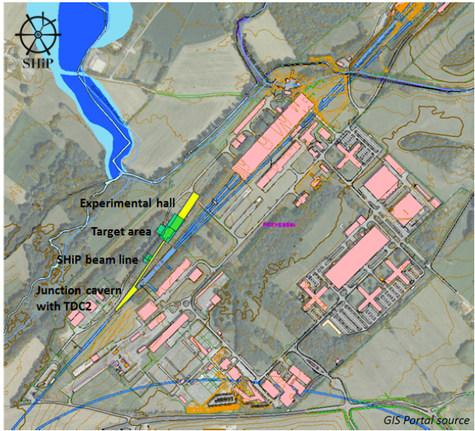
The Fixed-target facility at the SPS: Prevessin North Area site
Proposed implementation is based on minimal modification to the SPS complex
High-intensity proton beam: 4 10¹³ ppp, 4 10¹⁹ pot/yr, 5 years run
The SHiP facility is located
on the North Area, and
shares the TT20 transfer
line and slow extraction
mode with the fixed target
programmes

Slide 10
SHiP beam-line
(incompatible with conventional neutrino facility)
Initial reduction of beam induced backgrounds
Heavy target to maximize Heavy Flavour production (large A)
and minimize neutrinos from π/K → μν decays (short λ_{int})
Hadron absorber
Effective muon shield (without shield: muon rate ~10¹⁰ per spill of 4×10¹³ pot)
Slow (and uniform) beam extraction ~1s to reduce occupancy in the detector
Not to scale!
B
p(400 GeV)
muon
π,K
e.μ, hadrons
HS particle
Mo/W
Target~1m
neutrino
Fe ~5m
Decay volume in vacuum
Active muon shield (magnetic deflection) O(50)m
Tau neutrino
Detector ~10m
Length ~50m
Multidimensional optimization: beam energy,
beam intensity, background conditions and detector acceptance
10

Slide 11
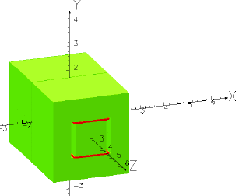
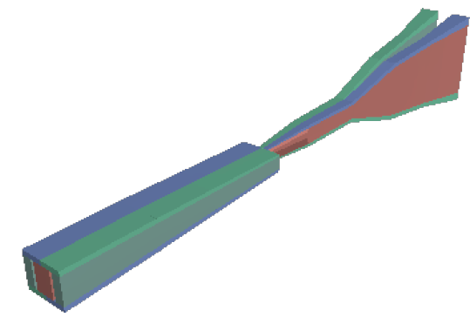
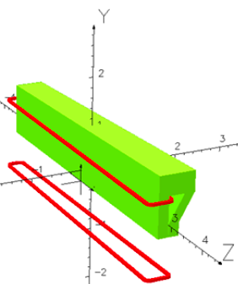
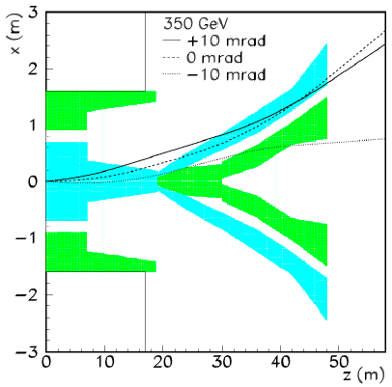
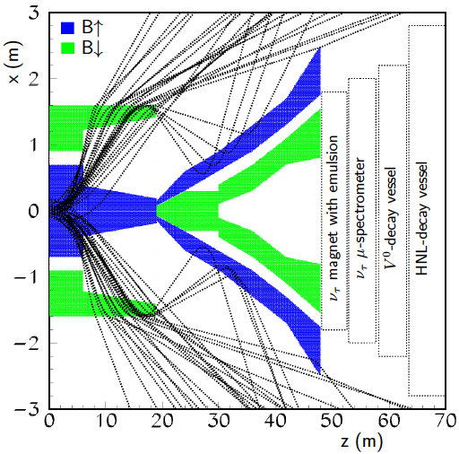
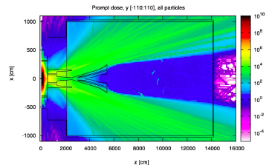
SHiP muon shield
Muon flux limit driven by HS background and emulsion-based neutrino detector
Active muon shield based entirely on magnet sweeper
with a total field integral B_{y} = 86.4 Tm
Realistic design of sweeper magnets in progress
Challenges: flux leakage, constant
field profile, modeling magnet shape
< 7k muons / spill (E_{μ} > 3 GeV)
Negligible flux in terms of detector occupancy
Magnetic sweeper field
Dose rate in the SHiP hall

Slide 12
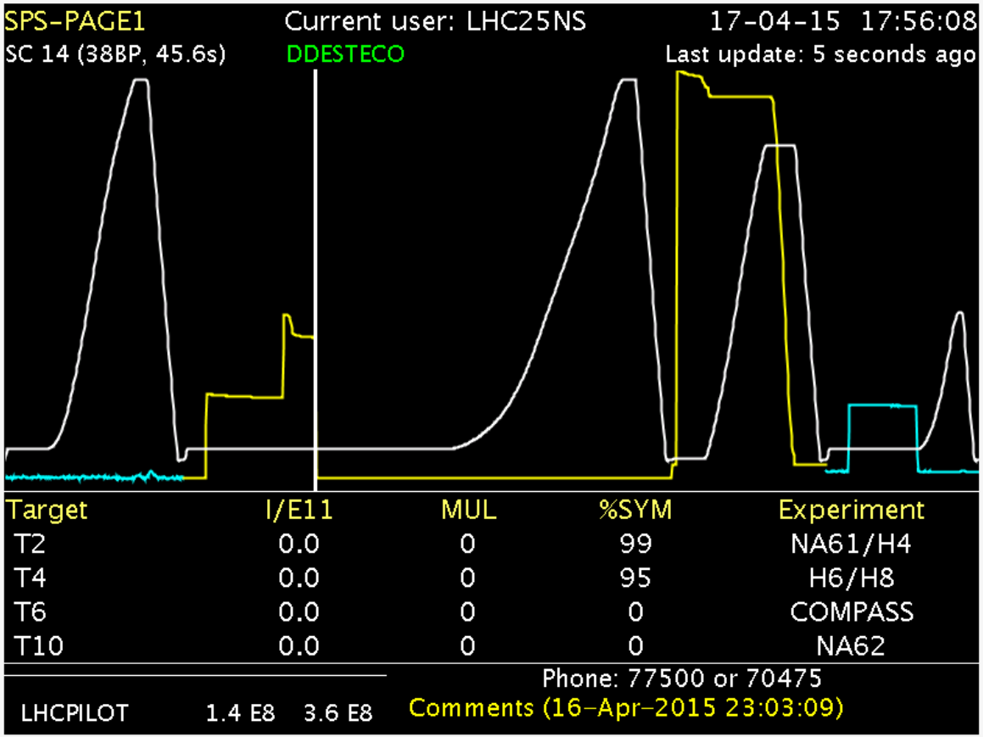
R&D at CERN for extraction and beam lines
Deployment of the new SHiP cycle
Extraction loss characterisation
and optimisation
Reduce p density on septum wires
Probe SPS aperture limits during
slow extraction
Development of new TT20 optics
Change beam at splitter on cycle-to cycle basis
Characterisation of spill structure
R&D and development of laminated splitter
and dilution (sweep) magnets
Successful test in April

Slide 13
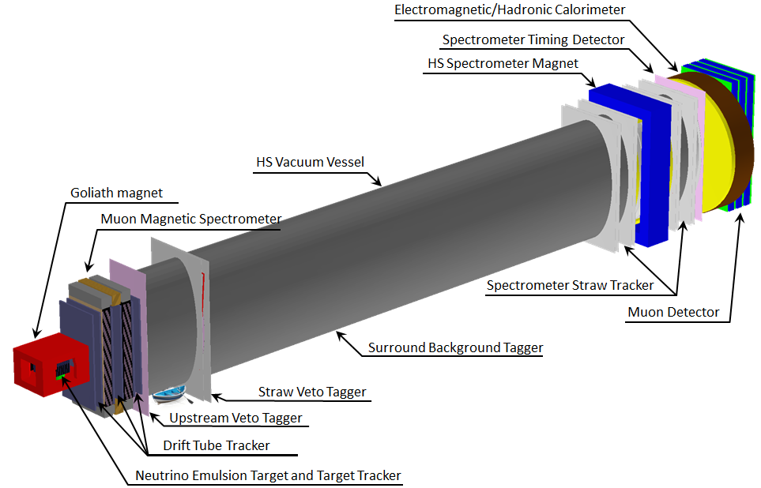
Hidden Sector detector concept
(based on existing technologies)
Reconstruction of HS decays in all possible final states
Long decay volume protected by various Veto Taggers, Magnetic Spectrometer
followed by the Timing Detector, and Calorimeters and Muon systems.
All heavy infrastructure is at distance to reduce neutrino / muon interactions in
proximity of the detector
Challenges:
- Large vacuum vessel
- 5 m long straw tubes
- Timing detector with ~50 ps resolution

Slide 14
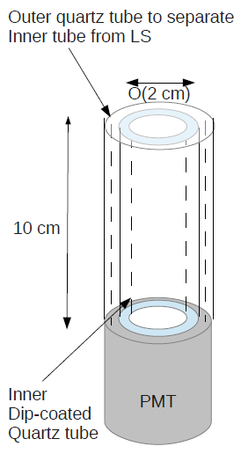
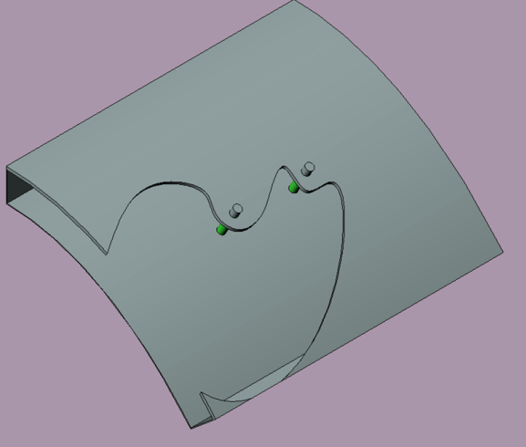
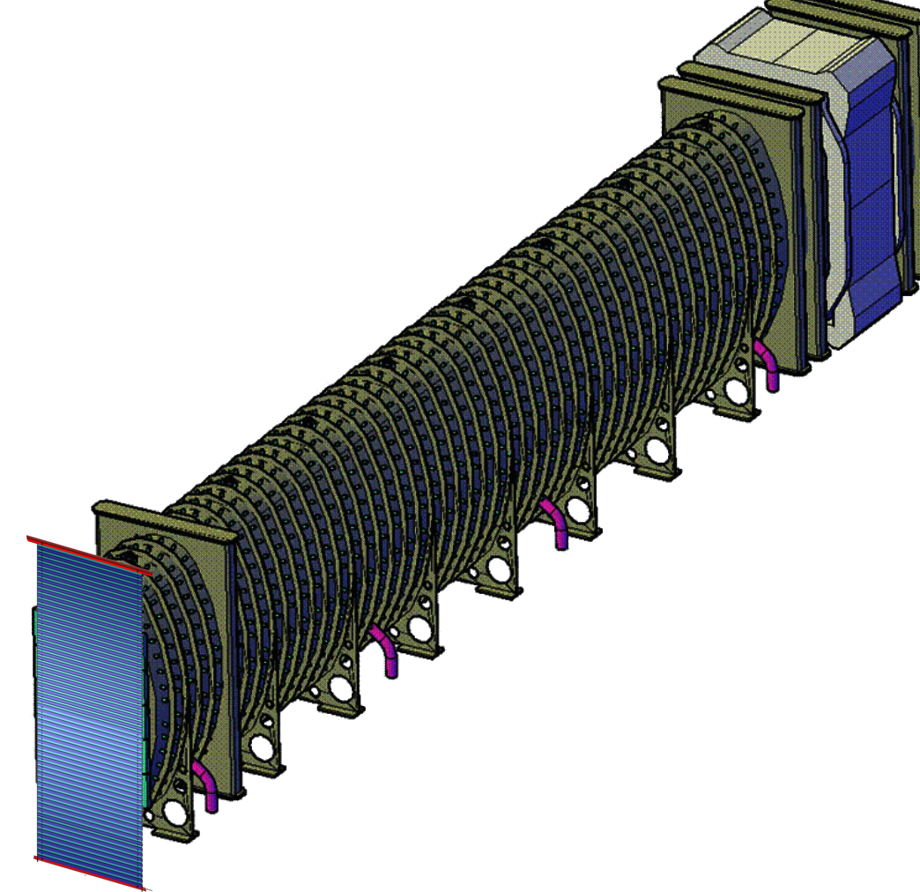
HS decay volume and spectrometer magnet
LS cell with WOMs
Estimated need for vacuum:
~ 10⁻³ mbar
Vacuum vessel
- 10 m x 5 m x 60 m
- Walls thickness: 8 mm (Al) / 30 mm (SS)
- Walls separation: 300 mm;
- Liquid scintillator (LS) volume (~360 m³)
readout by WLS optical modules (WOM)
and PMTs
- Vessel weight ~ 480 t
Magnet designed with an
emphasis on low power
- Power consumption < 1 MW - Field integral: 0.65Tm over 5m - Weight ~800 t - Aperture ~50 m²

Slide 15

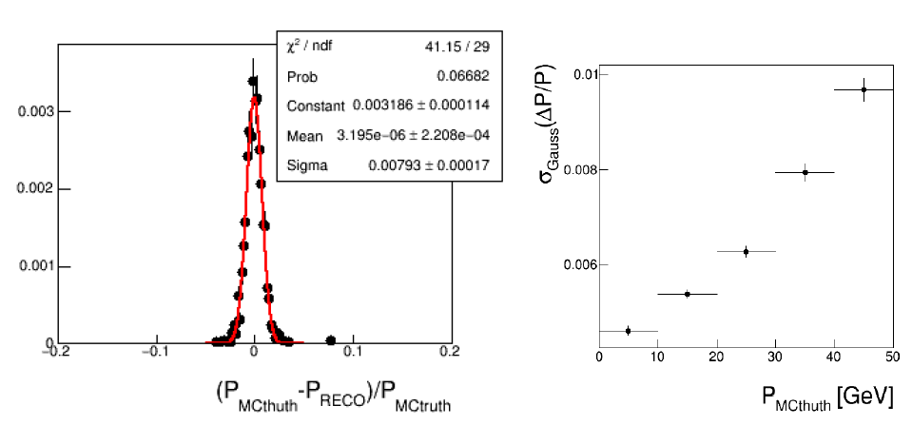
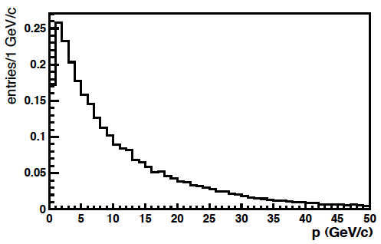
Momentum resolution of the HS (straw tubes) tracker
Assume NA62 parameters:
- material budget per station 0.5% X₀
- position resolution 120 μm per straw, 8 hits per station on average
Momentum resolution is dominated by multiple scattering below 22 GeV/c
(For HNL → πμ, 75% of both decay products have P < 20 GeV/c)
HNL→πμ
Vertex resolution (also driven by multiple scattering and ΔP/P):
σ_{xy} ~ O(mm), σ_{z} ~ O(cm)

Slide 16
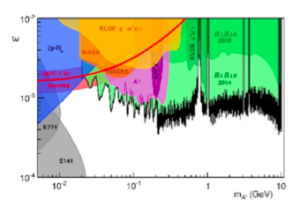
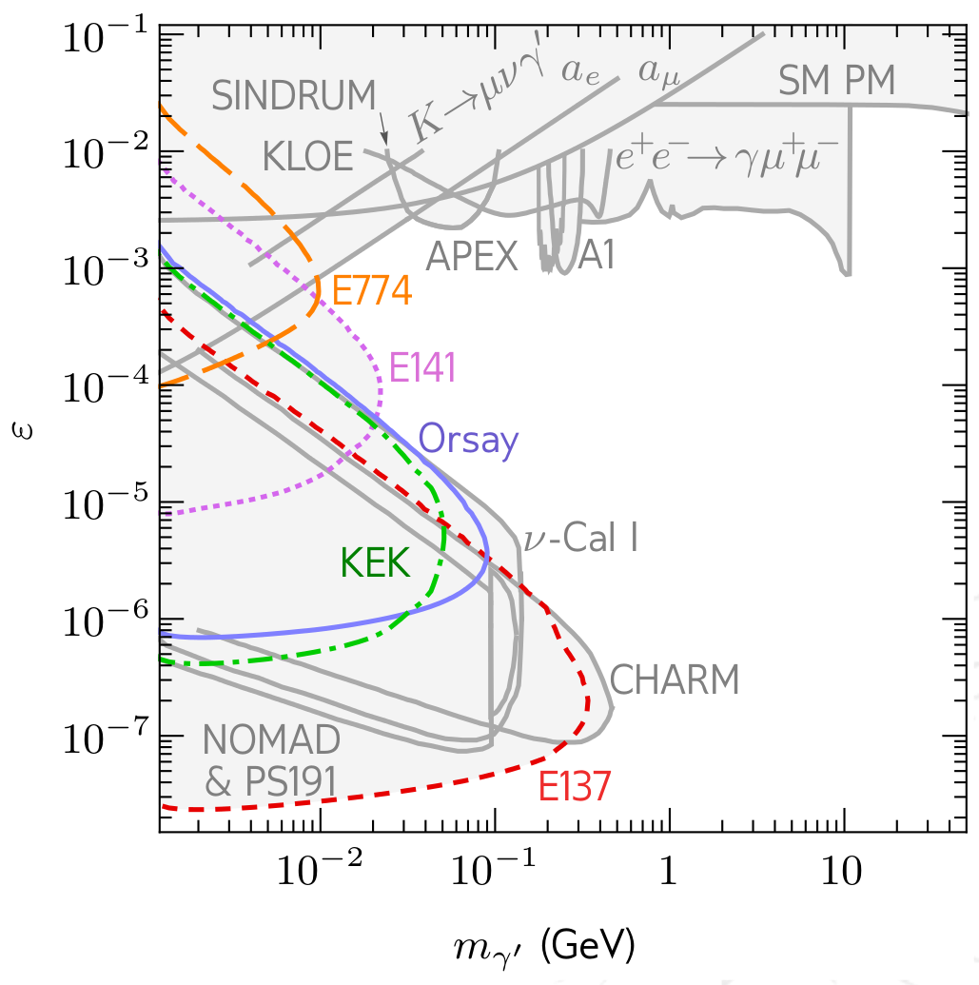
Search for hidden photons (vector portal)

Slide 17
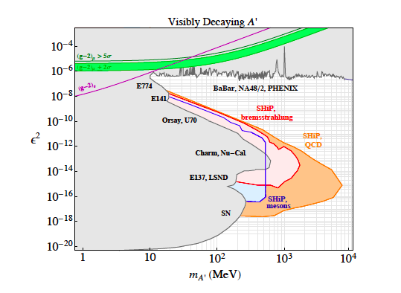
Sensitivity to dark photons
Production:
- mainly decays of π⁰ → γ’γ, η → γ’γ, ω → γ’π⁰ and η’ → γ’γ
- a la proton bremsstrahlung
Decay
into a pair of SM particles by
mixing again with the SM photon

Slide 18
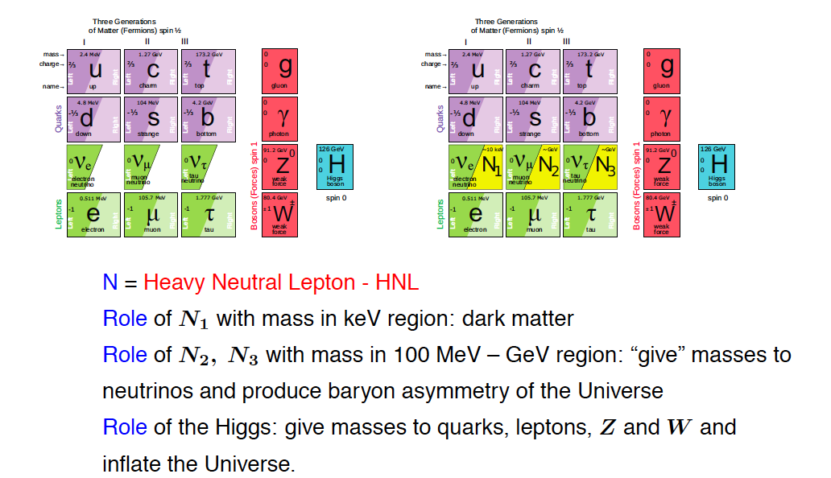
The νMSM model: leptogenesis and dark matter
νMSM: T.Asaka, M.Shaposhnikov PL B620 (2005) 17
M.Shaposhnikov Nucl. Phys. B763 (2007) 49
global lepton-number symmetry broken at the level of O(10⁻⁴) leads to the required pattern of sterile neutrino masses consistent with neutrino oscillations data

Slide 19
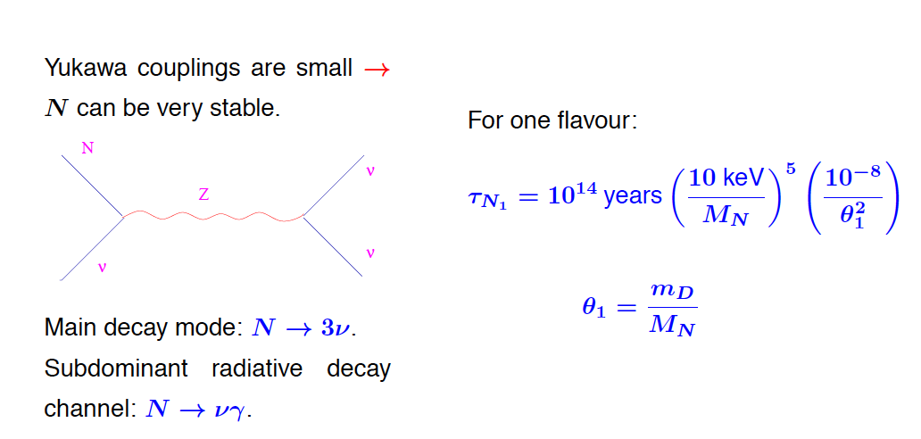
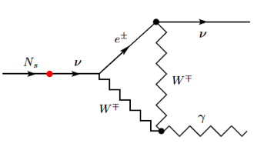
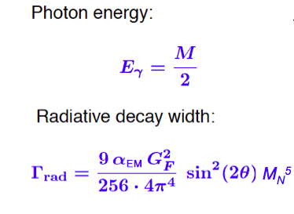
Dark Matter candidate HNL N₁
N₁ can be sufficiently stable to be a DM candidate, M(N₁)~10keV
ν
New line in photon galaxy spectrum at 3.5 keV?
To be checked with higher accuracy
Interaction strength

Slide 20
Masses and couplings of HNLs
M(N₂) ≈ M(N₃) ~ a few GeV→ CPV can be increased dramatically to explain
Baryon Asymmetry of the Universe (BAU)
Very weak N_{2,3}-to-ν mixing (~ U²) → N_{2,3} are much longer-lived than SM particles
Example:
N_{2,3} production in charm
and subsequent
decays
Typical lifetimes > 10 μs for M(N_{2,3}) ~ 1 GeV
Decay distance O(km)
Typical BRs (depending on the flavour mixing):
Br(N → μ/e π ) ~ 0.1 – 50%
Br(N → μ⁻/e⁻ ρ⁺) ~ 0.5 – 20%
Br(N → νμe) ~ 1 – 10%

Slide 21
Experimental and cosmological constraints
Recent progress in cosmology
- The sensitivity of previous experiments did not probe the interesting
region for HNL masses above the kaon mass
Strong motivation to explore cosmologically allowed parameter space
Experimentally this domain has been only marginally explored!

Slide 22
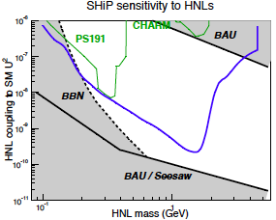
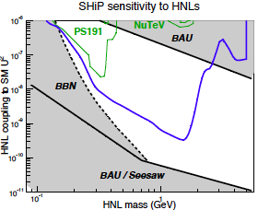
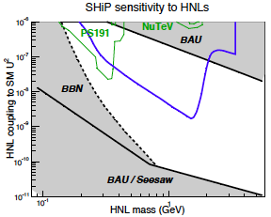
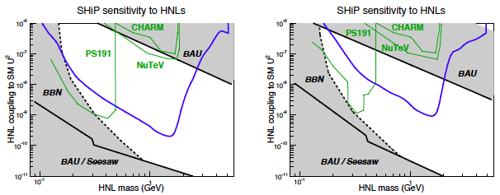
Sensitivity to HNLs for representative scenarios
(moving down to ultimate see-saw limit)
U²_{e}: U²_{μ}: U²_{τ}~52:1:1
Inverted hierarchy
U²_{e}: U²_{μ}: U²_{τ}~1:16:3.8
Normal hierarchy
U²_{e}: U²_{μ}: U²_{τ}~0.061:1:4.3
Normal hierarchy
U²_{e}: U²_{μ}: U²_{τ}~48:1:1
Inverted hierarchy
U²_{e}: U²_{μ}: U²_{τ}~1:11:11
Normal hierarchy
Scenarios for which
baryogenesis was
numerically proven

Slide 23
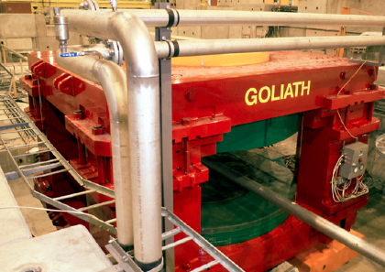
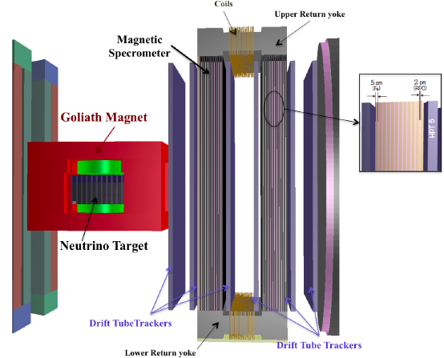
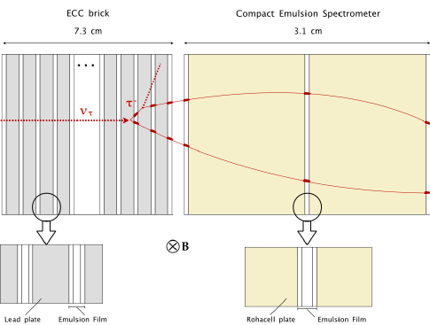
ν_{τ} detector follows the OPERA concept
Emulsion Cloud Chamber
Is a key element of ν_{τ} detection

Slide 24
Motivation For ν_{τ} Studies
A Piece of SM Physics
Less known particle in the Standard Model
  First observation by DONUT at Fermilab in 2001 with 4 detected candidates, Phys. Lett. B504 (2001) 218-224
  9 events (with an estimated background of 1.5) were reported in 2008 with looser cuts
  σ^{const} (ν_{τ}) = (0.39±0.13±0.13)×10⁻³⁸ cm² GeV⁻¹
5 ν_{τ} candidates reported by OPERA for the discovery (5.1σ result) of ν_{τ} appearance in the CNGS neutrino beam
Tau anti-neutrino never observed

Slide 25



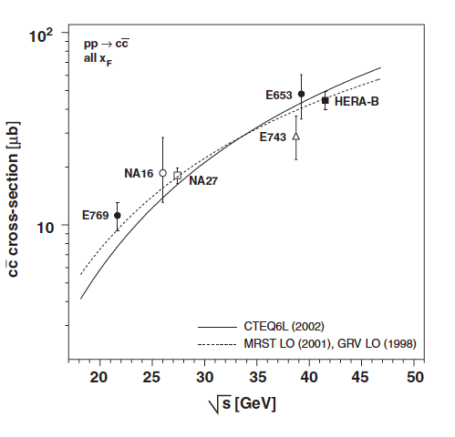
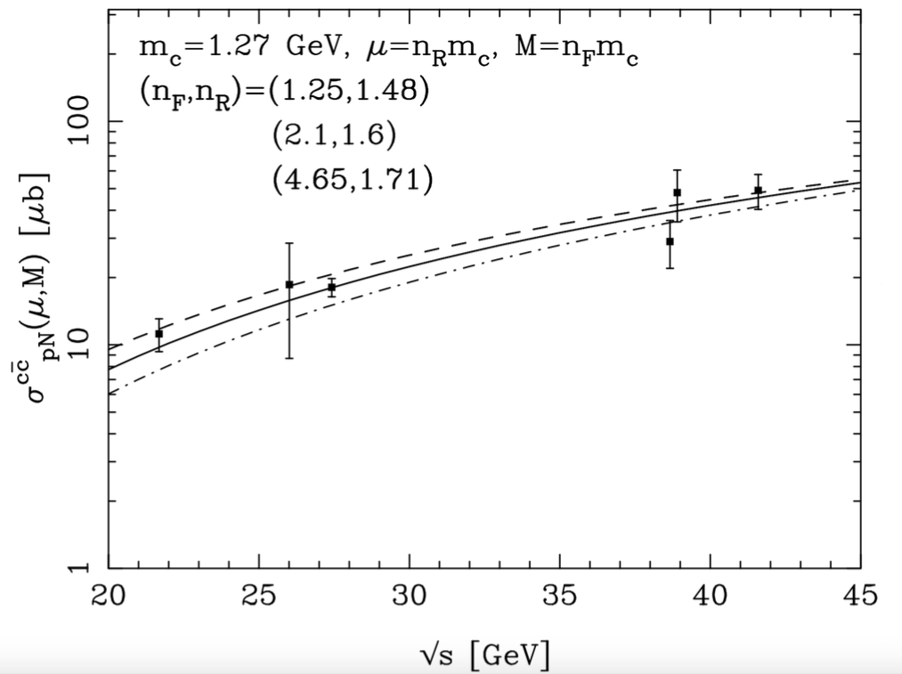
Facility Ideal To Study ν_{τ} Physics
PDG 2014
Physics Reports 433 (2006) 127
JHEP 1309 (2013) 058
NA27 with 400 GeV protons
NA27 with 400 GeV protons
Cacciari, Greco, Nason JHEP 9805 (1998) 007
Cacciari, Frixione, Nason JHEP 0103 (2001) 006
arXiv: 1504.04855 SHiP Physics Proposal

Slide 26
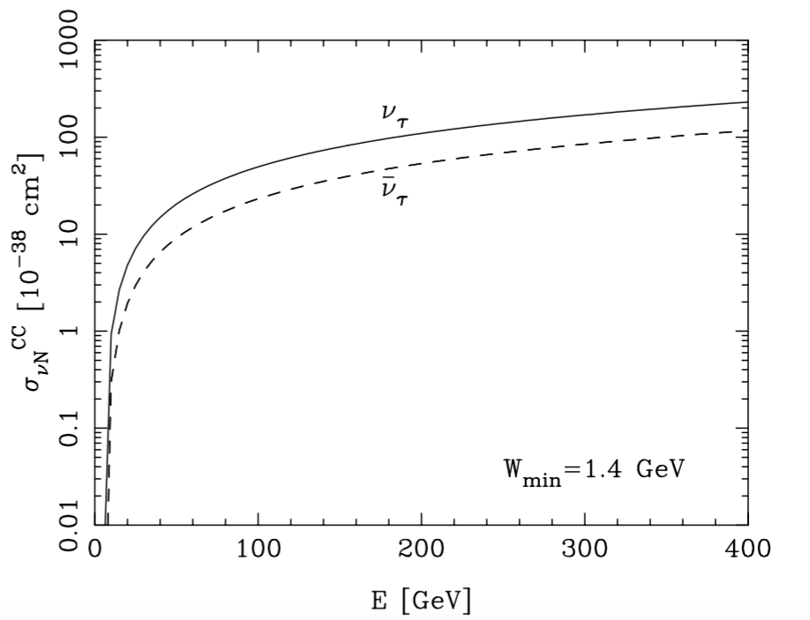
ν_{τ} Interactions In The Target
Expected number of interactions*
*in 5 years run (2x10²⁰ pot)
target mass ~ 9.6 ton (Pb)
20% uncertainty mainly
from scale variations in
ccbar differential cross-section
M. H. Reno, Phys. Rev. D74 (2006) 033001
Scale choices
Pdf
Target mass correction

Slide 27

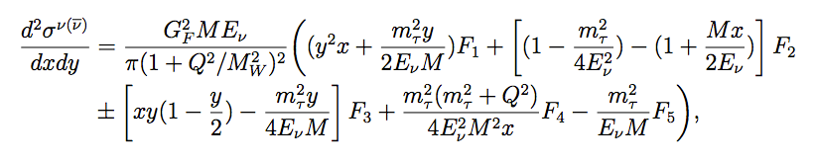



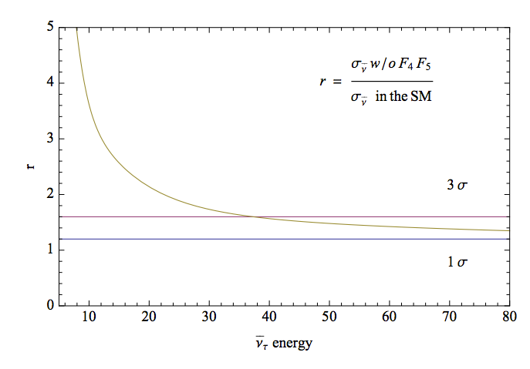
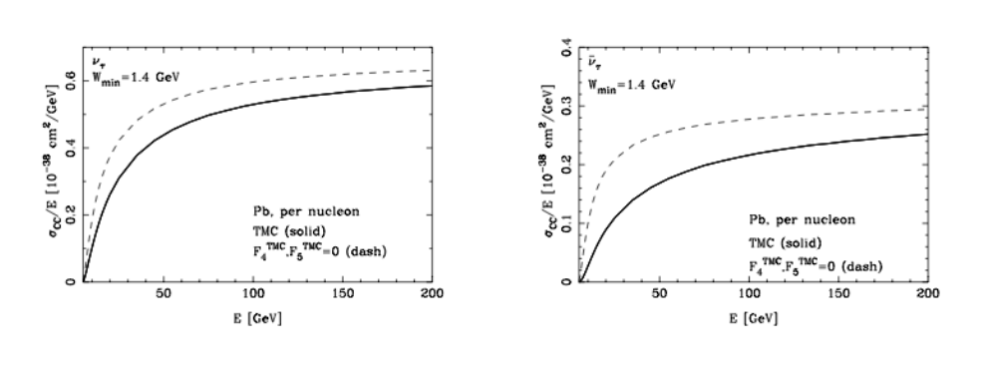
F₄ and F₅ Structure Functions
First evaluation of F4 and F5, not accessible with other neutrinos
F4 = F5 = 0
CC interacting ντ
SM prediction
At LO F₄= 0, 2xF₅=F₂
At NLO F₄ ~ 1% at 10 GeV
E(ντ) < 38 GeV

Slide 28
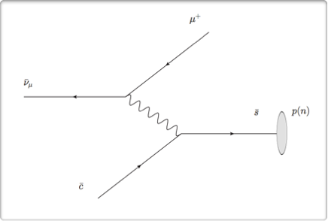
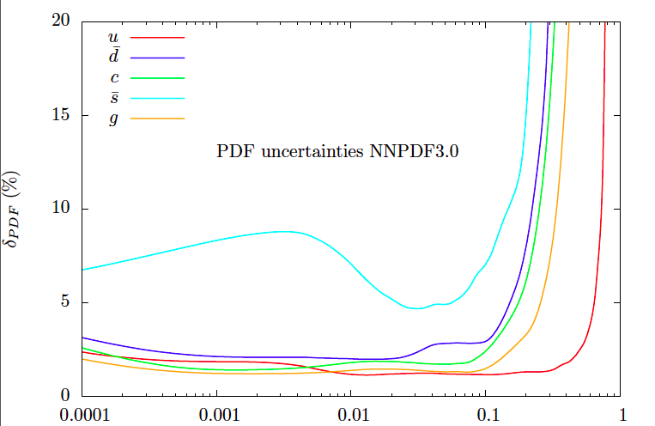
Strange Quark Nucleon Content
Charmed hadron production in anti-neutrino interactions selects anti-strange quark in the nucleon
Strangeness important for precision SM tests and for BSM searches
W boson production at 14 TeV: 80% via ud and 20% via cs
Phys. Rev. D91 (2015) 113005
Fractional uncertainty of the individual parton
densities f(x;m²_{W}) of NNPDF3.0
Notes:
Higher twist made negligible by Q^2 cut

Slide 29
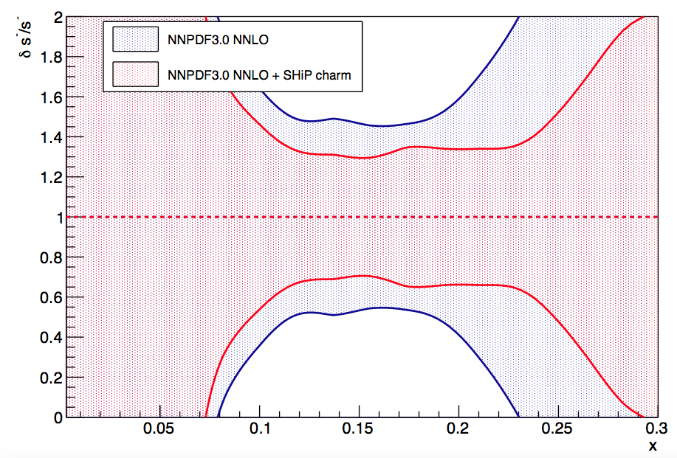
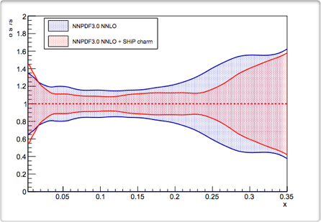
Strange Quark Nucleon Content
Improvement achieved on s⁺/s⁻ versus x
Significant improvement (factor two) with SHIP data
Nucl.Phys. B849 (2011) 112–143, at Q² = 2 GeV²
Notes:
s^- = s(x) - \overline{s}(x)
s^+ = s(x) + \overline{s}(x)

Slide 30
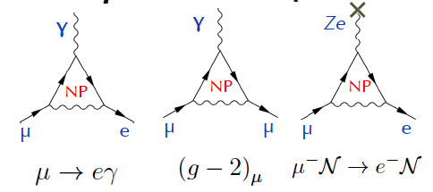
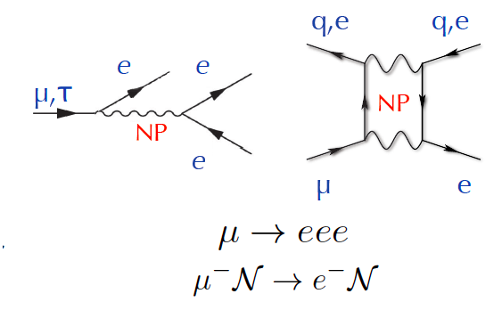
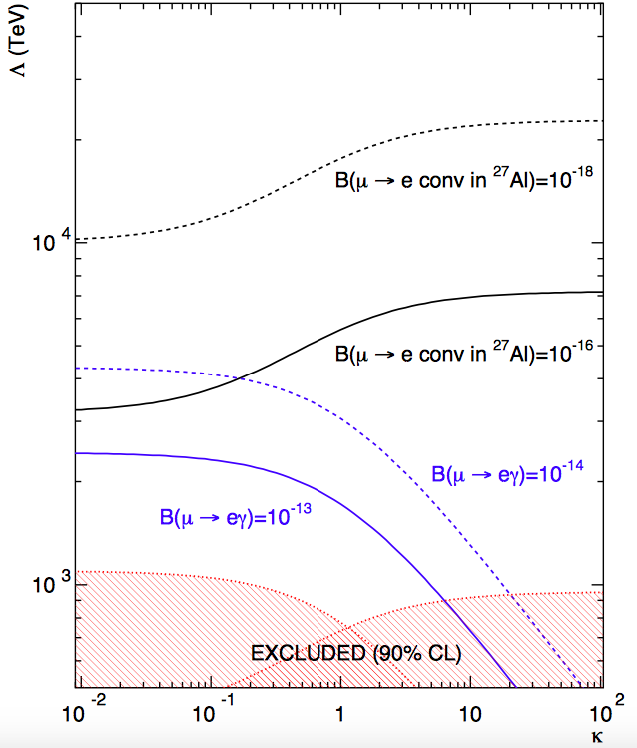
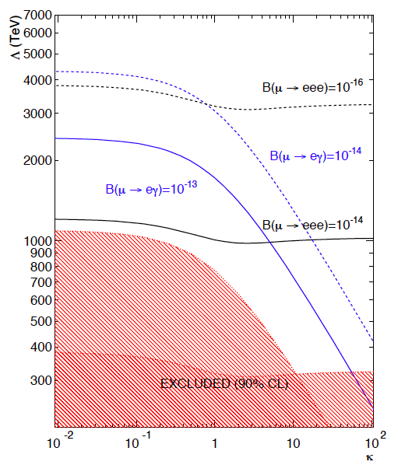
Charged Lepton Flavour Violation (CLFV)
A big step forward expected in the next few years (MEG and MEG-II @ PSI, proposed Mu3e
search @ PSI, new searches for μ – e conversion with Mu2e @ FNAL and COMET@J-PARC
SM contribution negligible, @ 10⁻⁵² level for μ → e γ
Described by dipole amplitudes (dim 5) and four-fermion (dim 6) operators
from de Gouvea and Vogel
1303.4097
Constraints dominated by
-- Dipole type operators
K << 1
-- Four-fermion operators
  K >> 1
Different searches needed
to explore the whole
parameter space

Slide 31
CLFV in τ decays

Slide 32
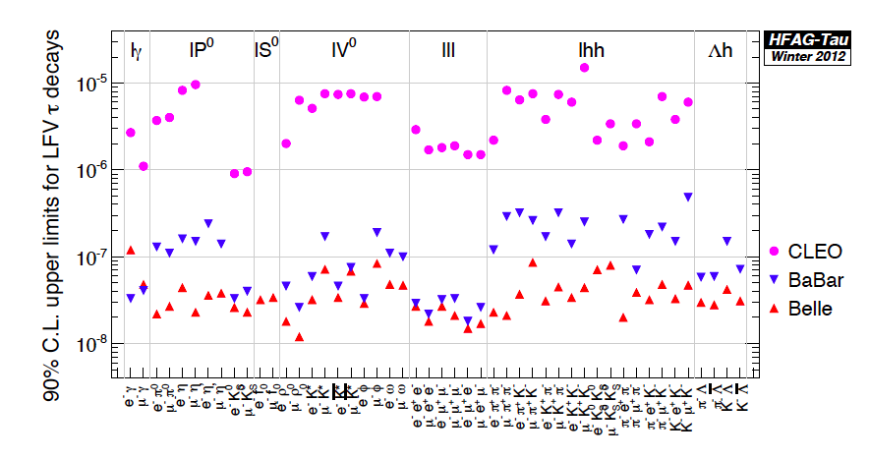
CLFV in τ decays
So far best limits achieved
@B factories (~ 10⁹ τ leptons)
Br(τ →μγ) < 1.4x10⁻⁸ @ 90%C.L.
Br(τ → μμμ) < 2.1x10⁻⁸ @ 90% C.L.
Nearly background free analyses !
Belle II will bring it down
to a few x 10⁻⁹ ÷ 10⁻¹⁰
τ leptons copiously produced in HE pp collisions, mostly in D_{s} → τ ν_{τ} decays, LHCb reached similar sensitivity for Br(τ → μμμ) with 3fb-1 (~10¹¹ τ leptons) in presence of non zero backgrounds, in particular from D_{s} → ημν with η →μμ
LHCb: Br(τ →μμμ) < 4.6x10⁻⁸ @ 90% C.L.
Good possibilities for improvement at LHCb upgrade (50 fb-1) and even better at dedicated flavour experiment running at HL LHC (~10⁶ τ per sec). Expect Br(τ → μμμ) < 10⁻¹⁰, or even 10⁻¹¹ depending on how background scales

Slide 33
τ → μμμ at the SHiP Facility
3 x 10¹⁵ τ produced in the target
Long target (10 λ_{int}) not suitable for this search because muons would originate therein and the measurement of their momentum would be spoiled by MCS
Physics case addressed in the Physics Proposal
Not included in the Technical Proposal
Coexistence with the SHiP experiment and the achievable performances discussed here

Slide 34
τ → μμμ search at the SHiP Facility
>90% τ decays
outside the target
τ
p
Magnetised
Thin target
1 mm W
High precision tracking
Silicon pixel detector
Magnetised hadron
absorber
Timing
detector
~ 1% of proton interactions, 8 x 10¹² τ produced in the thin target
High precision vertex detector to measure the momentum (magnetised volume)
before entering the hadron absorber, similar to LHCb VELO (8mm from beam)
Hadron absorber (magnetised iron) to identify muons
Magnetised iron to use the curvature and improve the matching with the vertex detector
All 3 muons to be measured → optimisation of the material and size to tune efficiency and
resolution versus misidentification

Slide 35
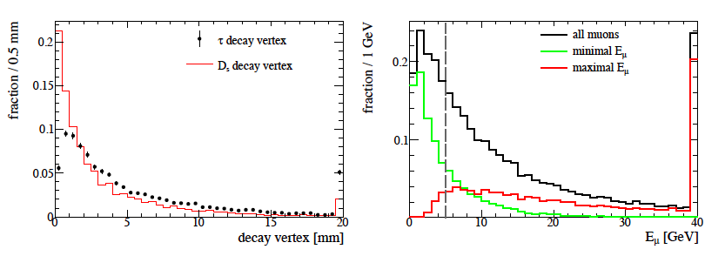
Kinematics and performances
Geometrical acceptance defined by inner (5 mm at 1.5m) and outer (50 cm at 3m) muon chamber size (0.003 < θ < 170 mrad) → ε ~ 33%
Muon momentum > 5 GeV
Di-muon mass > 450 MeV, ε ~ 84%
Main background D_{s} → ημν with η →μμγ (1.5 x 10⁵)
In terms of background, same challenges as collider experiments, given that combinatorial bkg and hadron misid is subdominant to 3μ processes
Br < 10⁻¹⁰

Slide 36
Project schedule
Accelerator schedule |  | 2015 |  |  |  | 2016 |  |  |  | 2017 |  |  |  | 2018 |  |  |  | 2019 |  |  |  | 2020 |  |  |  | 2021 |  |  |  | 2022 |  |  |  | 2023 |  |  |  | 2024 |  |  |  | 2025 |  |  |  | 2026 |  |  |  | 2027
 | LHC |  | Run 2 |  |  |  |  |  |  |  |  |  |  |  |  | LS2 |  |  |  |  |  |  | Run 3 |  |  |  |  |  |  |  |  |  |  | LS3 |  |  |  |  |  |  |  |  |  |  | Run 4
 | SPS
Detector |  |  |  | R&D, design and TDR |  |  |  |  |  |  |  |  |  |  |  |  |  | Production |  |  |  |  |  |  |  |  |  |  |  |  |  |  |  | Inst. |  |  |  | Installation
 | Milestones |  | TP |  |  |  |  |  |  |  |  |  |  |  |  | TDR |  |  |  |  |  |  |  |  |  |  |  |  |  |  |  |  |  |  |  | CwB |  |  |  |  |  |  | CwB |  | Data taking
Facility |  |  |  |  | Integration |  |  |  |  |  |  |  |  |  |  |  |  |  |  |  |  |  |  |  |  |  |  |  |  |  |  |  |  |  |  | CwB
 | Civil engineering |  |  |  |  | Pre-construction |  |  |  |  |  |  |  |  |  | Junction - Beamline - Target - Detector hall
 | Infrastructure |  |  |  |  |  |  |  |  |  |  |  |  |  |  |  |  |  |  |  | Inst. |  |  |  | Installation
 | Beamline |  |  |  | R&D, design and TDR |  |  |  |  |  |  |  | Production |  |  |  |  |  |  |  | Inst. |  |  |  |  | Installation |  |  |  |  | Installation
 | Target complex |  |  |  |  | R&D, design and TDR |  |  |  |  |  |  |  |  |  |  |  | Production |  |  |  |  |  |  |  |  | Installation
 | Target |  |  |  |  | R&D, design and TDR + prototyping |  |  |  |  |  |  |  |  |  |  |  |  |  |  |  |  |  |  |  |  |  | Production |  |  |  | Installation
Commissioning
with beam
10 years from TP to data taking
Schedule optimized for almost no interference with operation of North Area
  ➔ Preparation of facility in four clear and separate work packages (junction cavern, beam line, target complex, and detector hall)
  ➔ Maximum use of LS2 for junction cavern and first short section of SHiP beam line
All TDRs by end of 2018
Commissioning run at the end of 2023 for beam line, target, muon shield and background
Four years for detector construction, plus two years for installation
Updated schedule with new accelerator schedule (Run 2 up to end 2018, 2 years LS2) relaxes current schedule
  Data taking 2026

Slide 37
Summary
SHiP is proposed to search for New Physics in the largely unexplored
domain of new, very weakly interacting particles with masses O(10) GeV
Also unique opportunity for ν_{τ} physics
Sensitivity improves previous experiments by O(10000) for Hidden
Sector and by O(200) for ν_{τ} physics
The technical feasibility of the SHiP facility has been demonstrated
by the CERN Task Force.
The impact of the discovery of a new light hidden particle is hard to
be overestimated!
SHiP will greatly complement searches for New Physics
at energy frontier at CERN
Interesting sensitivity (~10⁻¹⁰) can be reached for τ → μμμ at
the SHiP facility

