Slide 1
Review on the fine-structure constant
and
the g-2 electron
S. Guellati-Khélifa
Laboratoire Kastler Brossel, Paris
FCCP 2015
September 2015, Capri

Slide 2
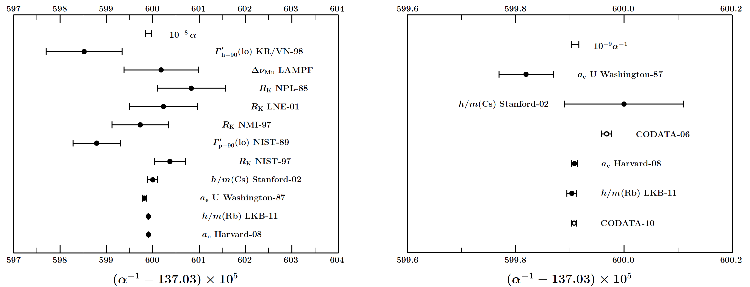
The fine-structure constant α
is the low energy coupling constant of electromagnetic interaction
CODATA 2010: P. J. Mohr et al., Rev. Mod. Phys. 84, 1527-1605 (2012)
Key role:
Redefinition of the new SI
Tests of quantum electrodynamics theory

Slide 3
Re-definition of the New SI
In the proposed new SI, many physical constants, that are set by the CODATA will have a fixed value. The constant α will be a keystone of the proposed SI, as many of the remaining constants will depend strongly on its knowledge (such as the vacuum permeability μ₀ or the von Klitzing constant R_{K} (Hall quantum effect for electric reference, ...)

Slide 4
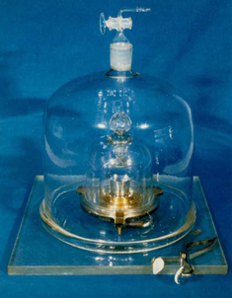

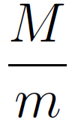
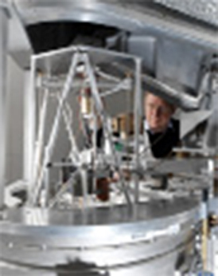
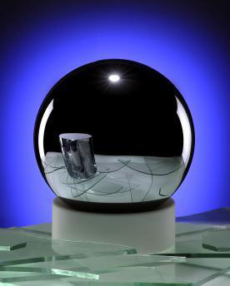
New SI : Redefinition of the kilogram
Prototype of the kilogram:
artefact of platinum-iridium
(kept at the BIPM)
Proposal of New SI: h and N_{A} fixed
Watt balance
Avogadro projet
( unified atomic mass constant)
Direct comparaison of
electrical and mechanical power

Slide 5
Quantum electrodynamic tests
is a basic dimensionless constant of atomic physics, distinguishing
the energy scales of atoms
Since the 50’s,
the best tests of QED are realized with :
Atomic spectroscopy
  Precision spectroscopy of hydrogen (Lamb shift)
  Hyperfine structure of Helium
  Muonic hydrogen and determination of the proton charge radius
  (R. Pohl, A. Antognini, F. Nez et al., Nature 466, 213 (2010))
Electron magnetic moment anomaly
  Measurement by Gabrielse et al.
  Theoretical calculation by T. Kinoshita and M. Nio

Slide 6
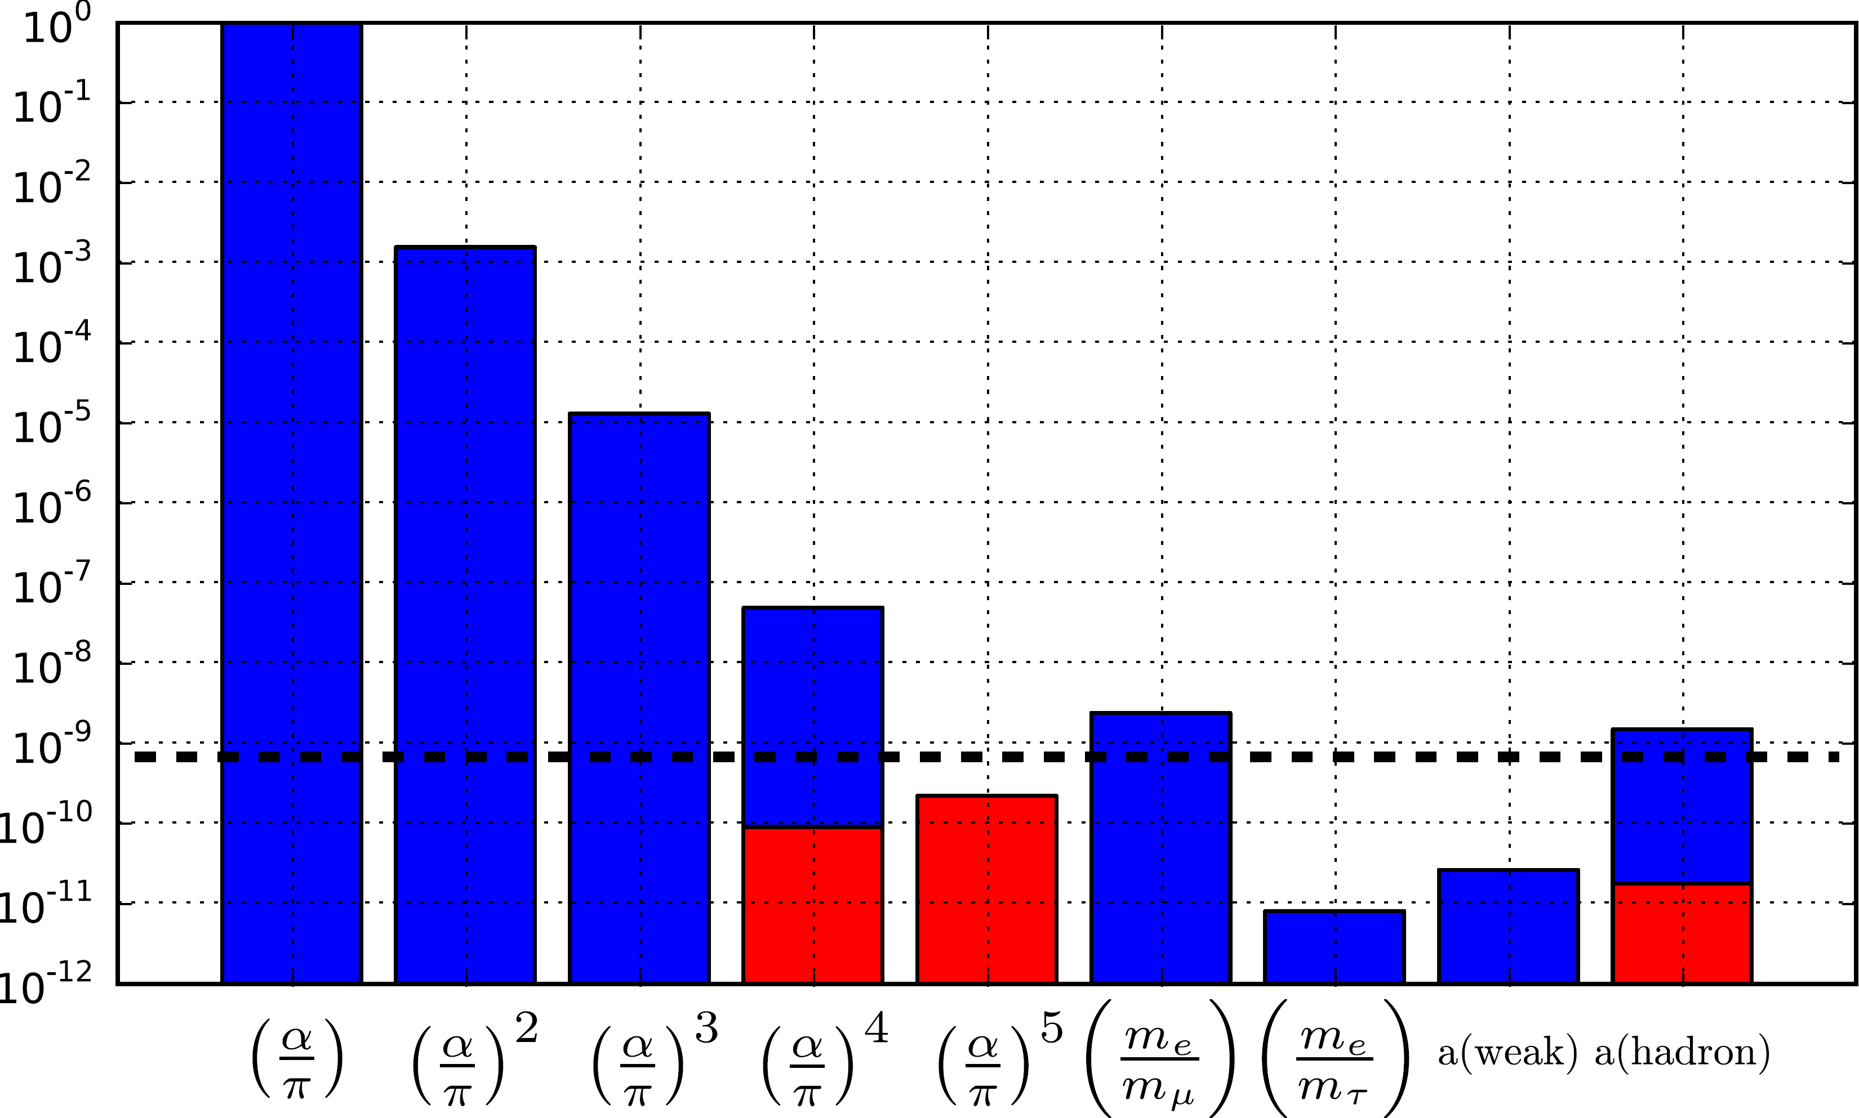
The most precise determinations of α
Electron magnetic moment Measurement of the ratio h/m
T. Aoyama et al. Phys. Rev. Lett. 109, 111807 (2012). R. Bouchendira, et al., Phys. Rev. Lett. 106, 080801 (2011).
D. Hanneke et al., Phys. Rev. Lett. 100, 120801 (2008).

Slide 7
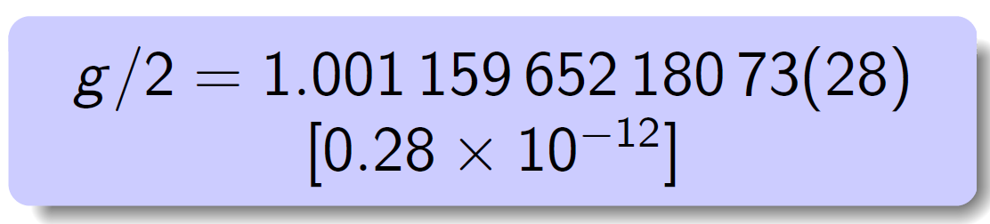
Experiment of Dehmelt and Gabrielse 1984 and 2008
Quantum jumps spectroscopy of one electron in a Penning trap
D. Hanneke et al., Phys. Rev. Lett. 100, 120801 (2008)
New experimental setup is in progress: wainting for a new value !
Cylindrical Penning trap cavity

Slide 8
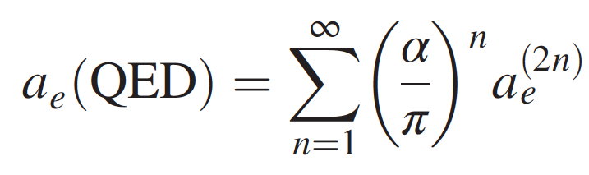
Electron g-2 QED theory: recent progress
HarvU-08+QED07 : α⁻¹ = 137.035 999 084 (51) [3.7 x 10⁻¹⁰]
HarvU-08+QED12 : α⁻¹ = 137.035 999 173 (35) [2.5 x 10⁻¹⁰]
(T. Aoyama et al., PRL 109, 111807 (2012))
HarvU-08+QED15 : α⁻¹ = 137.035 999 1570 (29) (27) (18) (331) [2.5 x 10⁻¹⁰]
Improvement of the calculations of the eighth and tenth-orders
(Contribution of diagrams without closed lepton loops, T. Aoyama et al., PRD 109, 111807 (2015))

Slide 9
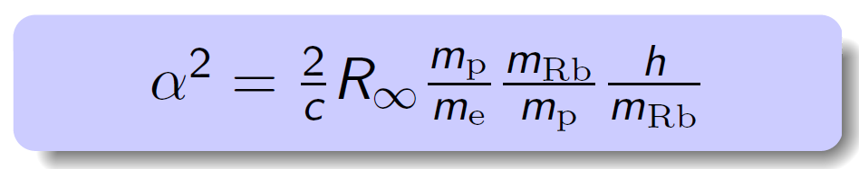
Determination of α from the measurement of h/m
CODATA 2010: P. J. Mohr et al., Rev. Mod. Phys. 84, 1527-1605 (2012)
LKB-11+CODATA2012 : α⁻¹ = 137. 035 999 049 (90) [6,6 x 10⁻¹⁰]
CODATA 2014: to be published
  New measurement of electron mass
S. Sturm et al. Nature 506 (7489), 476-470 (2014)
  Atomic Mass Evaluation of 2012
  New adjustment of Rydberg constant
LKB-11+CODATA2014 : α⁻¹ = 137. 035 998 997 (90) [6,6 x 10⁻¹⁰]

Slide 10
Determination of α from the recoil measurement
Cs in Stanford (1991)
D.S. Weiss et al, PRL 70, 2706 (1992)
Rb in Paris (1998)
He in (New project 2014– Amsterdam)
Status of Paris’s experiment : progress and problems ?

Slide 11
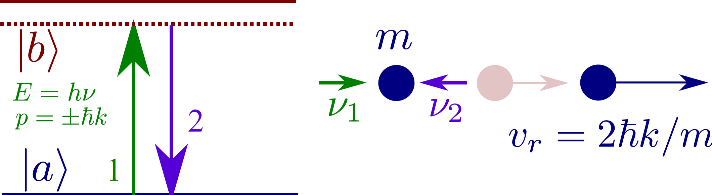
Measurement of the ratio h/m
6 mm/s for Rb: Cold atoms source
Two photon transition to avoid spontaneous emission

Slide 12
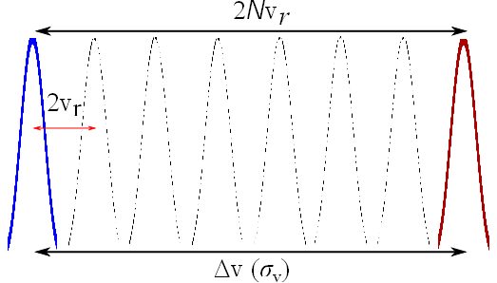
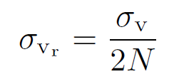
Principle of the experiment
Transfer to the atoms a large numbers of recoils: coherent acceleration (Blcoh oscillation)
Measurement of the change of velocity: Doppler shift and atomic interferometry
Cold atoms source
(3 x v_{r})
Uncertainty:

Slide 13
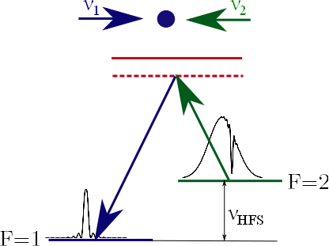
Velocity sensor : Doppler sensitive Raman transition
87-rubidium
Doppler effect
Recoil effect
coherent momentum transfer
control of δ ↠ control of v
measurement of velocity in terms of frequency
selection and measurement of a sub-recoil velocity class

Slide 14
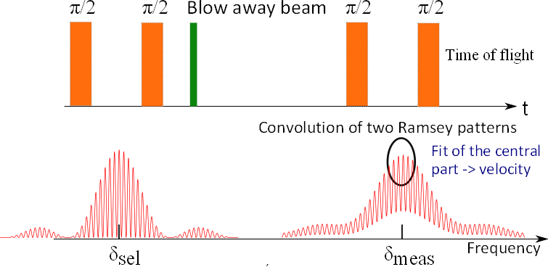
Velocity sensor based on atom interferometery
Ramsey-Bordé atom interferometer
Ramsey velocity selection
T_{R}
laser
pulses
Measurement of
N₁ and N₂
π/2 π/2
Blow away beam
velocity
π/2 π/2
π/2 π/2
selection
measurement

Slide 15
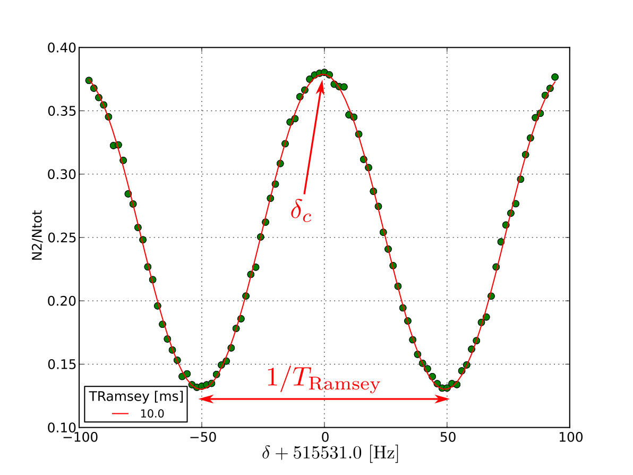
Velocity sensor based on atom interferometry
Typical atomic fringes
Doppler shift due to v_{r} = 15 kHz
≈ 10⁻⁵ in 1.5 min integration time
Typical uncertainty on the center : 0.1 Hz
1 point = 1 full measurement sequence ( 850 ms)

Slide 16
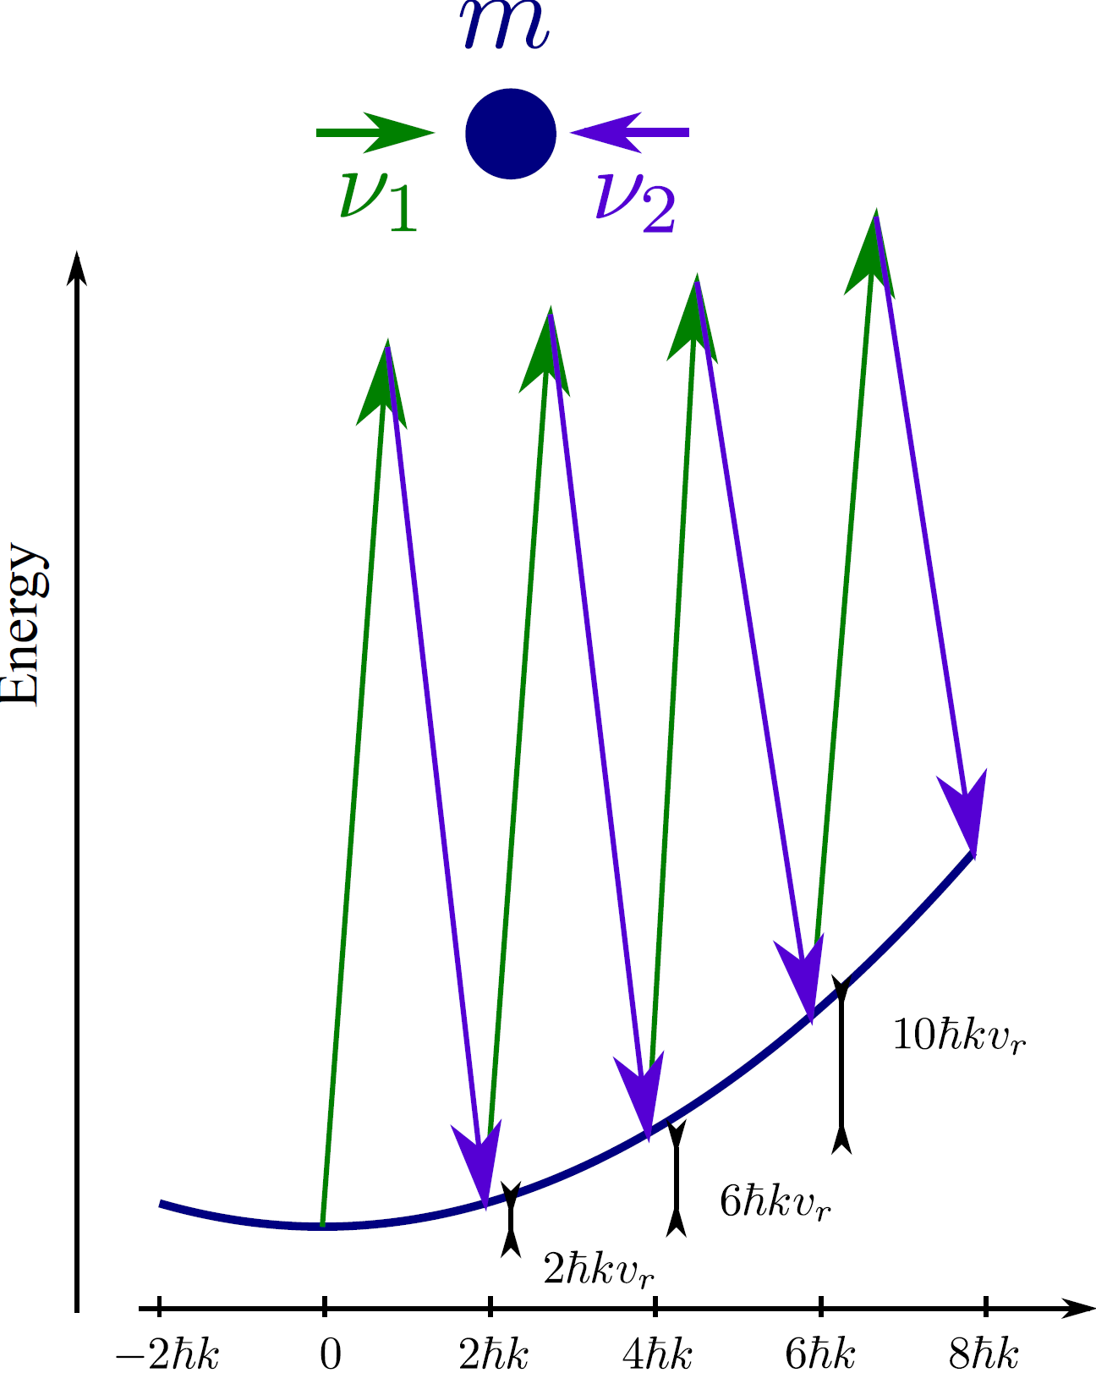
Coherent acceleration of atoms
Succession of stimulated Raman transitions (same hyperfine level F=1)
Δ=30 GHz
F=2
F=1
Adiabatic passage : coherent acceleration of the atoms
Transfer up to 1000 v_{r} with efficiency of 99.97% per recoil

Slide 17
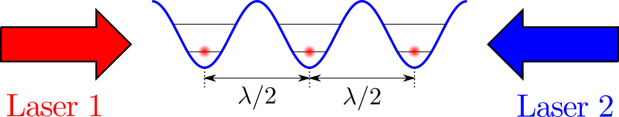
Coherent acceleration of atoms : Bloch oscillations
Atoms placed in an accelerated standing wave experiment periodic potential (light shift) and inertial force.
after one Bloch oscillation atoms get 2 recoils velocity
This point of view is important for understanding systematic effects

Slide 18
Measurement protocol
To get ride of gravity
to cancel level shifts

Slide 19
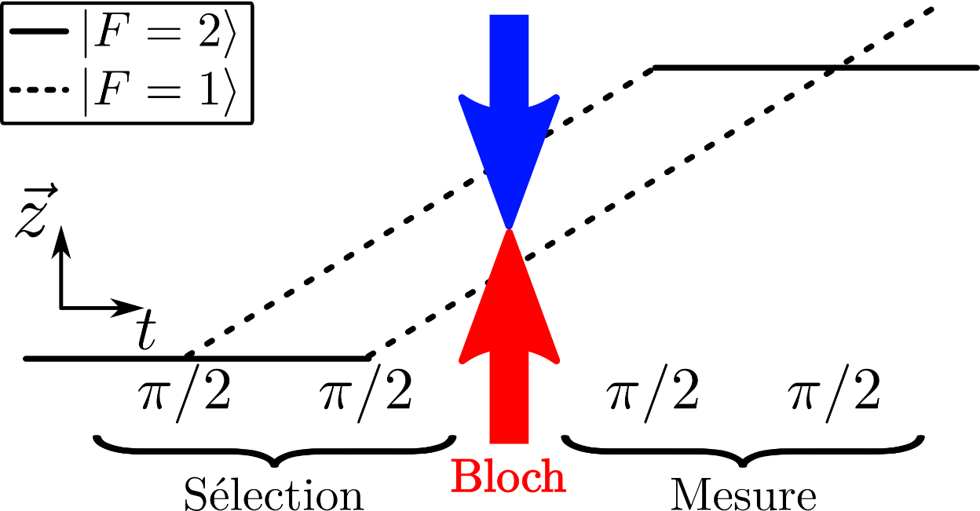
Measurement of the recoil velocity
Transfer up to 1000 v_{r} with efficiency of 99.97% per recoil
statistical uncertainty of 10⁻⁸ in 1.5 min integration time

Slide 20
Errors Budget in 2011

Slide 21
Errors Budget in 2011
Wavefront curvature and Gouy phase
p = ħk holds only for perfect plane wave
For a Gaussian laser beam p = ħk_{eff}

Slide 22
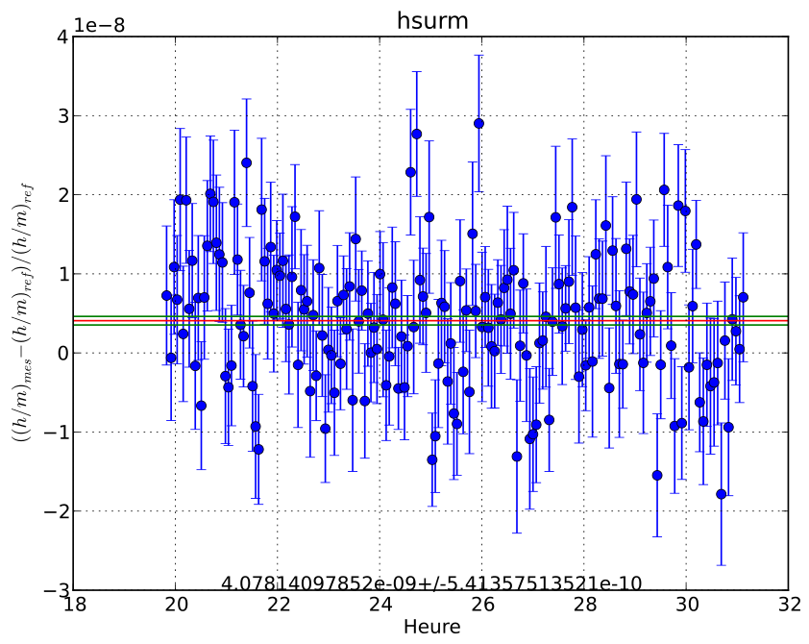
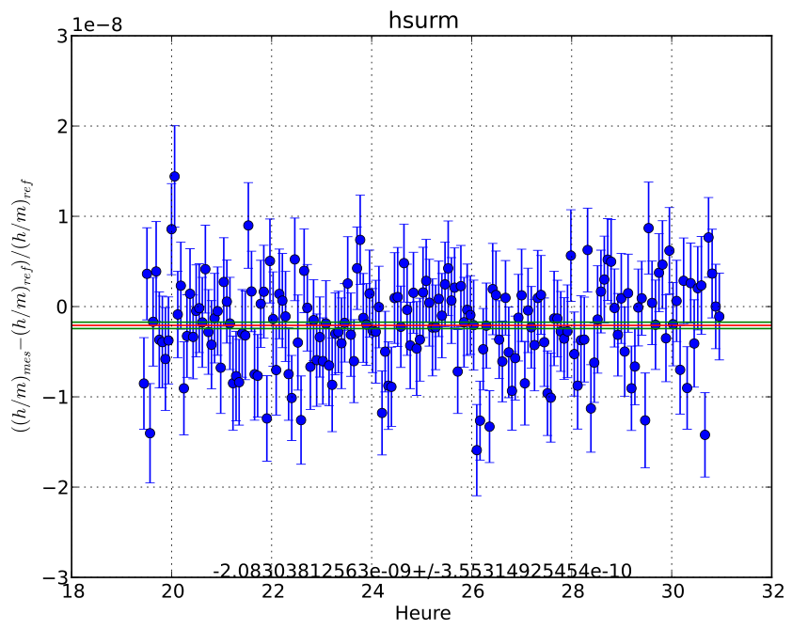
Recent improvments of the experiment
High power laser 11W @780 nm Gouy phase effect / 4
New vibration isolation platform Statistical uncertainty /2
Precise mapping of the magnetic field in science chamber
Precise measurement of systematic effect due to magnetic field
But new systematic effect

Slide 23
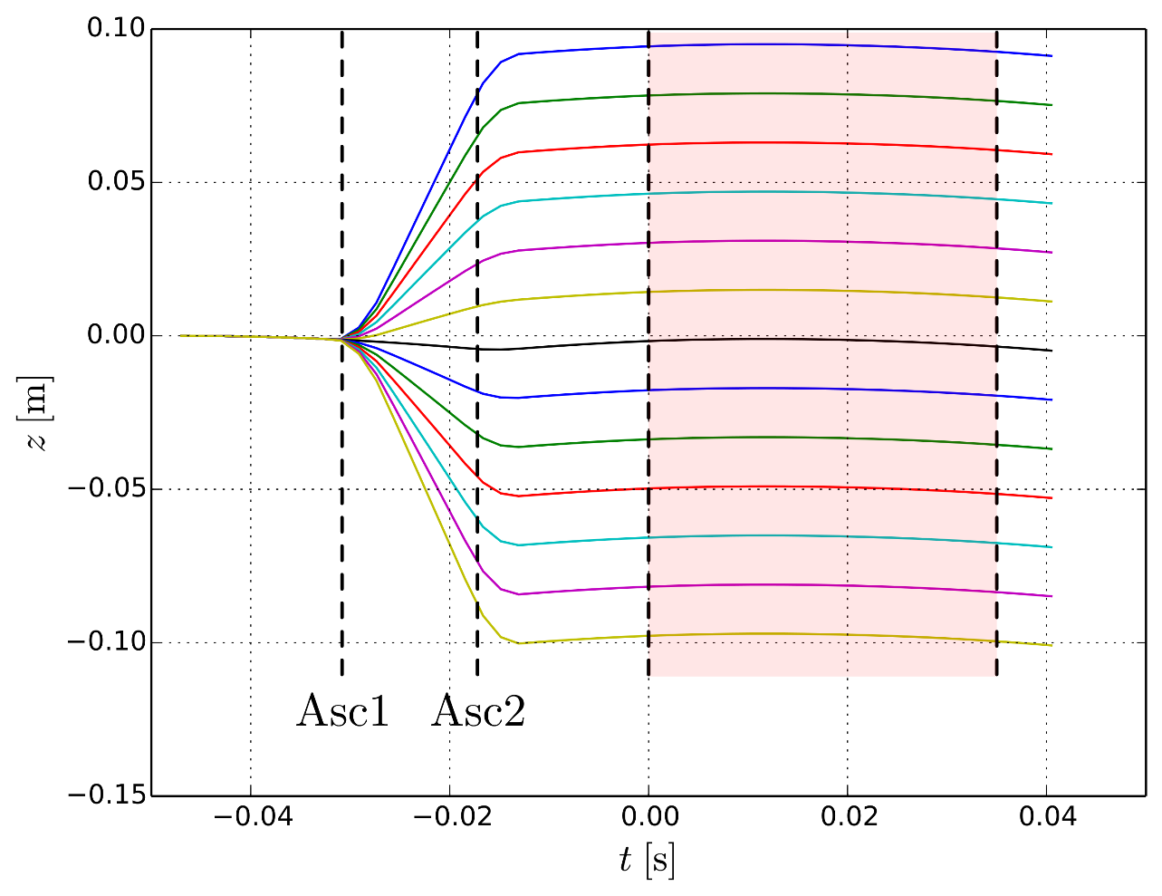
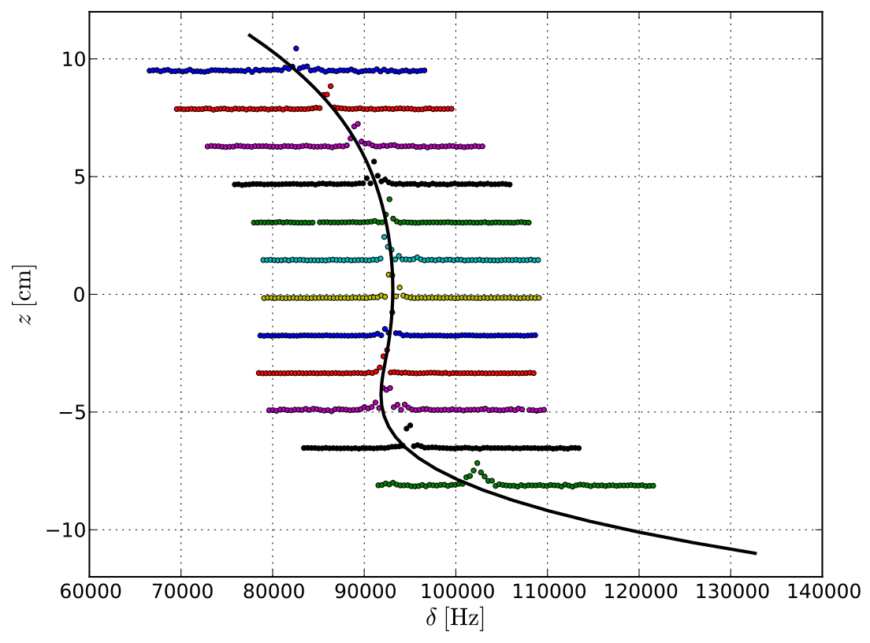
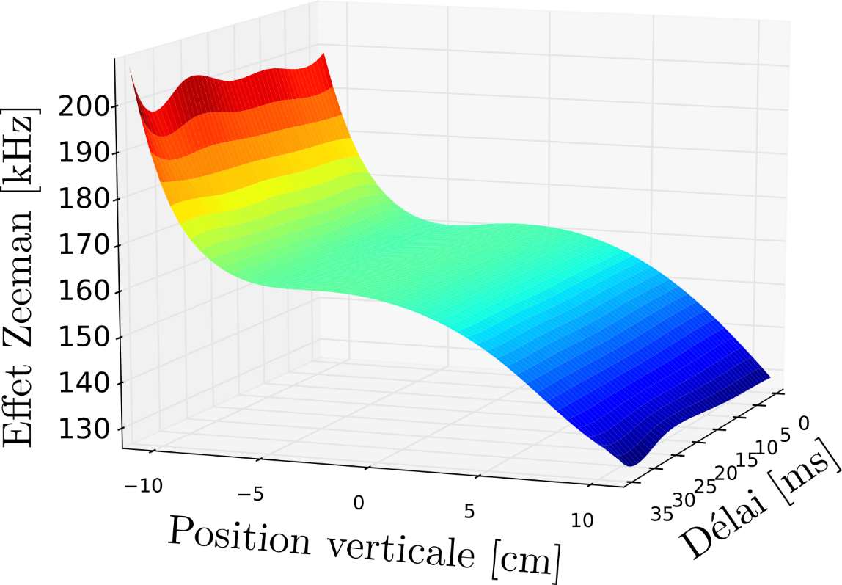
Systematic effect due to magnetic field
Measurement of Zeeman shift at different position in the vacuum chamber using atomic elevator based on Bloch oscillations technique

Slide 24
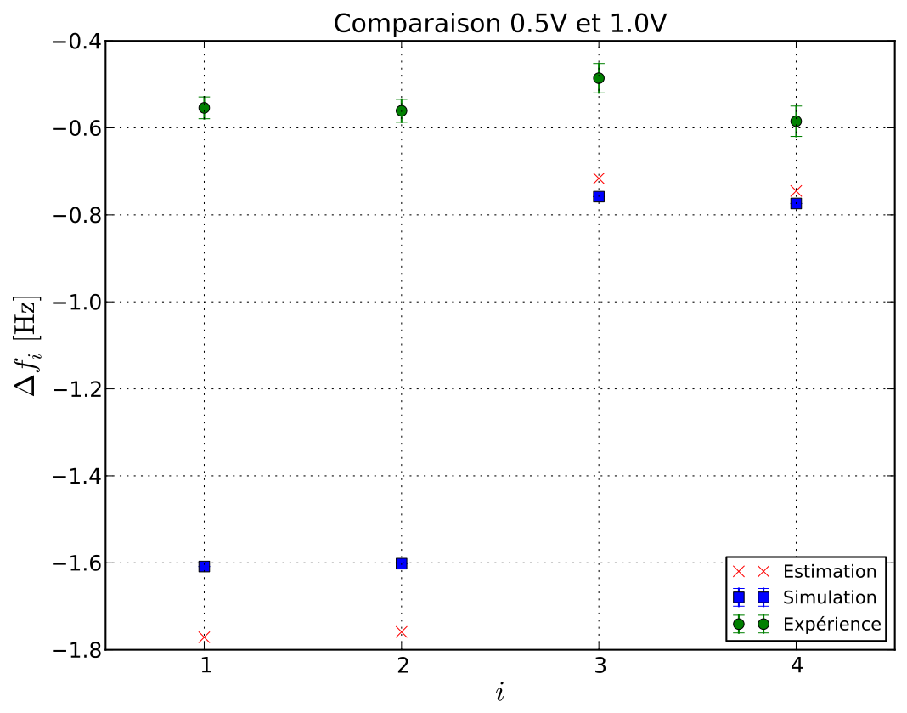
Systematic effect due to magnetic field
Direct measurement of systematic effect due to magnetic field
Simulation using magnetic field data
1 Hz discrepancy (10⁻⁸)
New model including the light polarisation and laser alignment in light shift calculations.

Slide 25
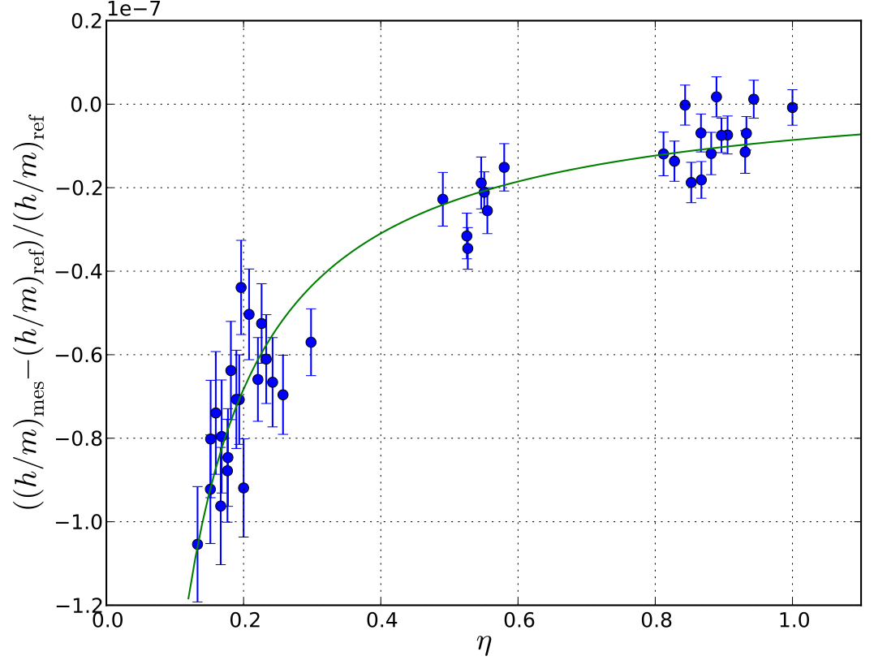
Investigation of the new systematic effect
Using the new laser system,
Systematic effect depending on the efficiency of Bloch oscillations
Not yet understood ?

Slide 26
Conclusion
2011: Determination of the fine structure constant with a relative uncertainty of 6.6 x 10⁻¹⁰
2015 – Improvement of statistical uncertainty better estimation of systematic effects
New laser system for coherent acceleration 11W@780 nm: reduction of Gouy phase effect
New systematic effects not yet understood ?
Prospects
New experimental setup: Bose-Einstein condensate and atom interferometry based on large momentum beam splitters
The goal now is to achieve a relative uncertainty less than 10⁻¹⁰ ?

Slide 28
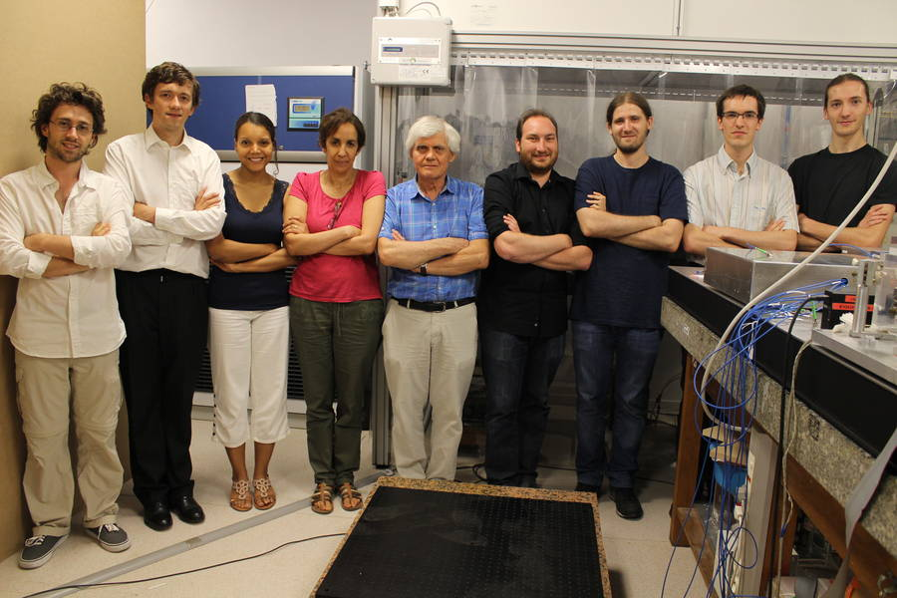
P. Cladé
R.Jannin
R. Metzdorff
M.Andia
S.Galtier
(Hydrogen Exp)
E.Woody
F. Biraben
C.Courvoisier

