Slide 1
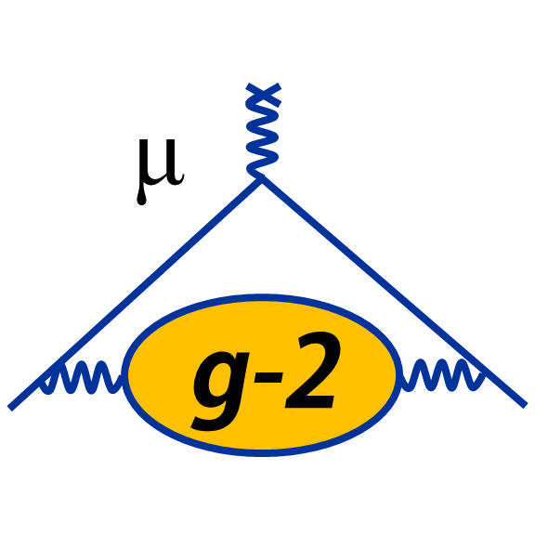

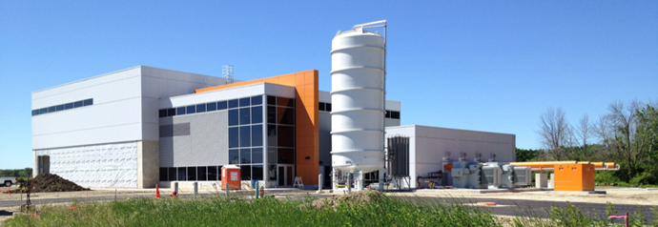
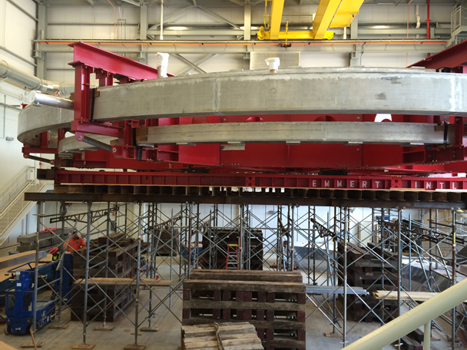
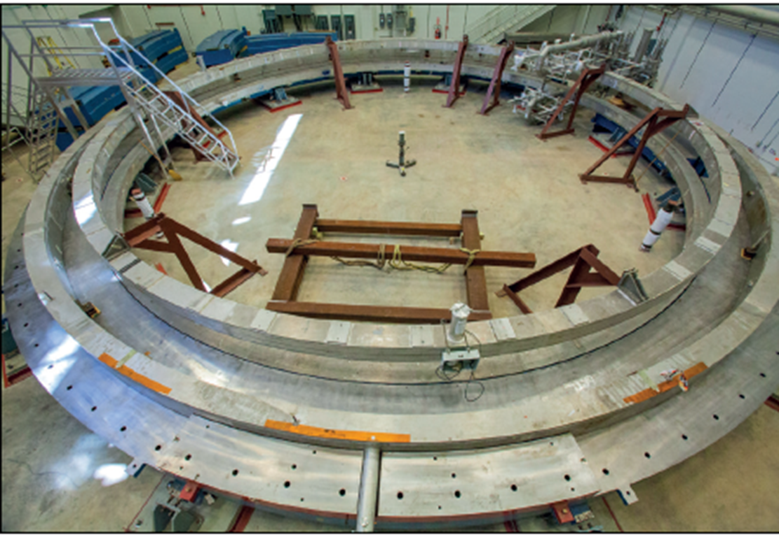
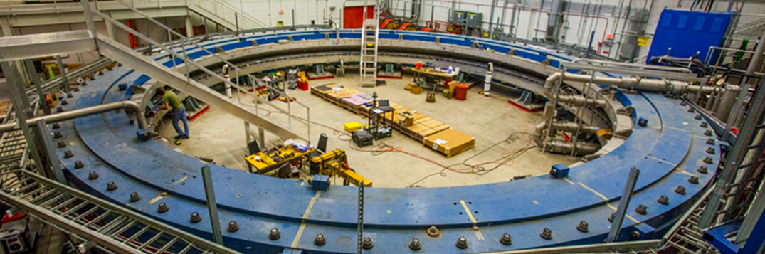
Next Generation Muon (g-2)
Goal δa_{μ} ~ 140 ppb
David Hertzog, University of Washington
for the E989 Muon (g-2) Collaboration
FCCP2015 Flavor Changing and Conserving Processes

Slide 2
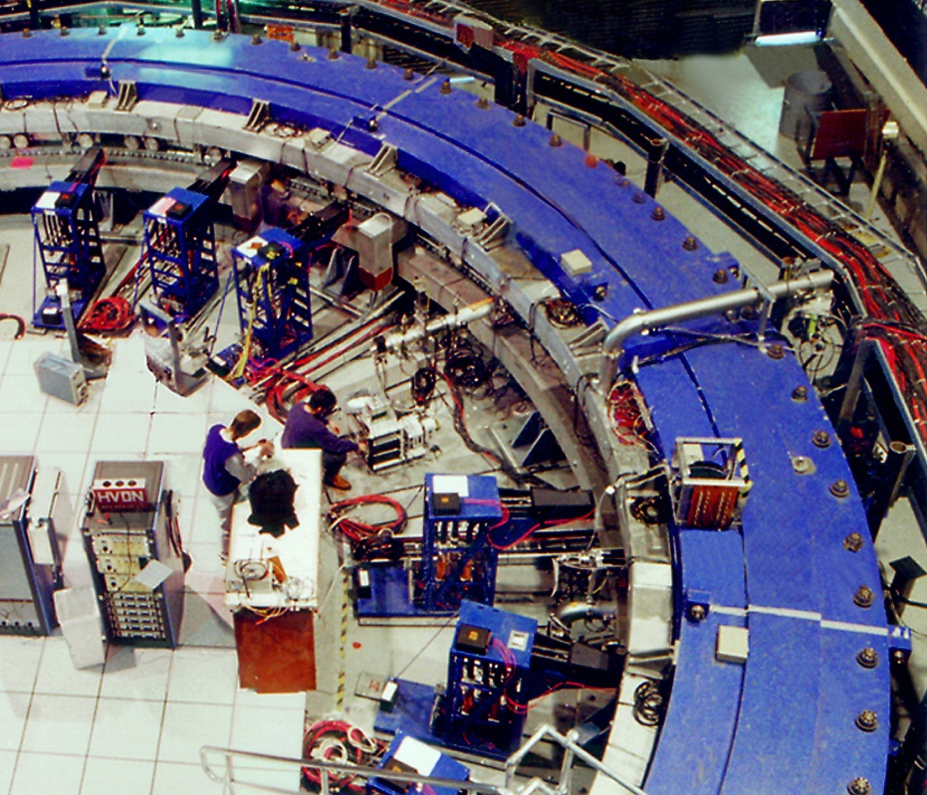
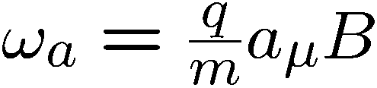
A Case for Challenging the
Standard Model
e
Momentum
Spin
BNL result →
a_{μ}(Expt) = 116 592 089 (63) x 10⁻¹⁰ (540 ppb)
The experiment compares how fast a muon spin rotates in a magnet compared to the predictions from theory

Slide 3

This talk is surrounded by many distinguished g-2 experts. I will assume we know why we are all here
“Five numbers” needed to test for New Physics
  … and many others that are known “too well” to enter the discussion
What do the g-2 experiments provide?
Design and status of efforts
  FNAL
  JPARC
See review: Precision Muon Physics, T.P. Gorringe and D.W. Hertzog , Prog. Part. Nucl.Phys. 84 (2015) 73-123

Slide 4
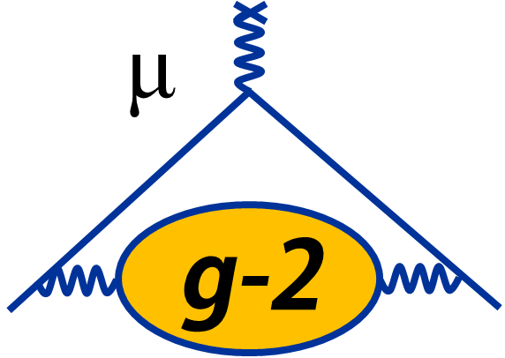








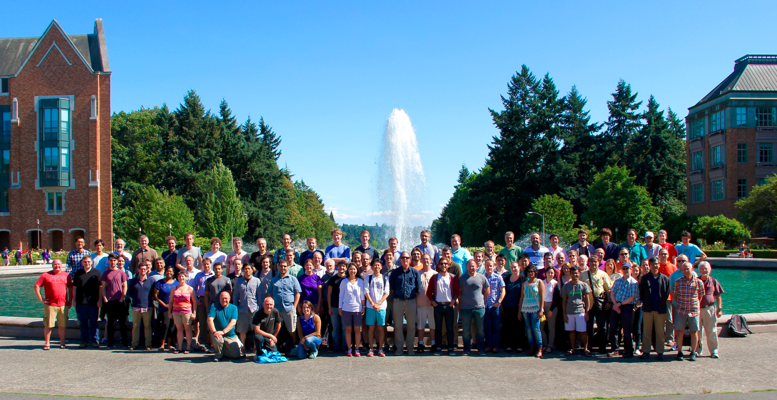
Fermilab E989: 34 Institutes; >150 Members
Italy
  Frascati,
  Roma 2,
  Udine
  Pisa
  Naples
  Trieste
China:
  Shanghai
The Netherlands:
  Groningen
Germany:
  Dresden (thy)
England
  University College London
  Liverpool
  Oxford
Korea
  KAIST
Russia:
  Dubna
  Novosibirsk
Domestic Universities
  Boston
  Cornell
  Illinois
  James Madison
  Kentucky
  Massachusetts
  Michigan
  Michigan State
  Mississippi
  Northern Illinois
  Northwestern (thy)
  Regis
  Texas
  Virginia
  Washington
  York College
National Labs
  Argonne
  Brookhaven
  Fermilab
g-2 Physics Week 2015
Seattle

Slide 5
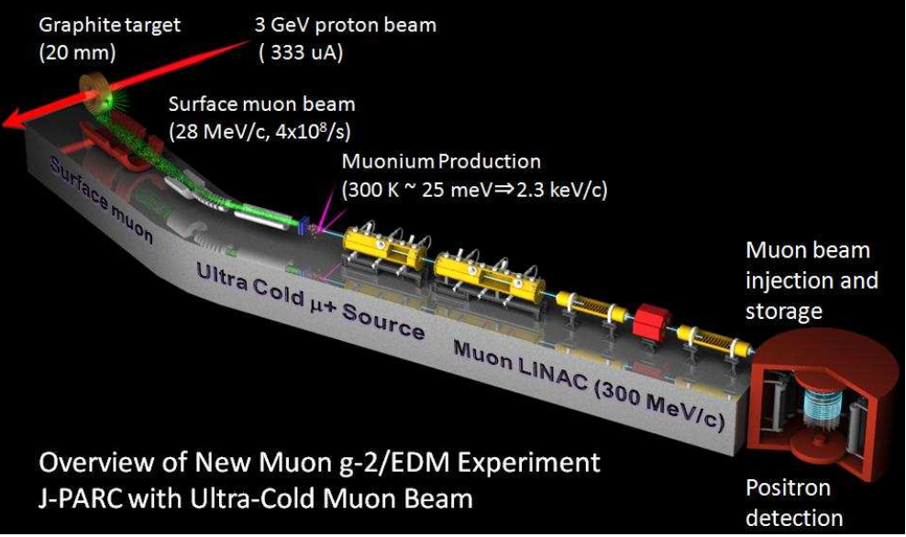
J-PARC E-34 g-2/EDM

Slide 6
5 Numbers to establish the “g-2 Test”
(that is, 5 that have relevant uncertainties to keep watch on)
a_{μ}(New Physics) ≡ a_{μ}(Expt) – a_{μ}(SM)
Discussion today
a_{μ}(Expt)
Expression in BNL PRD
Essentially experimental; limited at 120 ppb by μ_{μ}/μ_{p}
$a_{μ}\left(SM\right)=a_{μ}\left(QED\right)$+$a_{μ}\left(Weak\right)$+$a_{μ}\left(HVP\right){+a}_{μ}\left(Had HO\right){+a}_{μ}\left(HLbL\right)$
✓
✓
✓
Discussion today
Δa_{μ}(Expt) ~ 140 ppb
Δa_{μ}(SM) < 220 ppb
Goals:

Slide 7
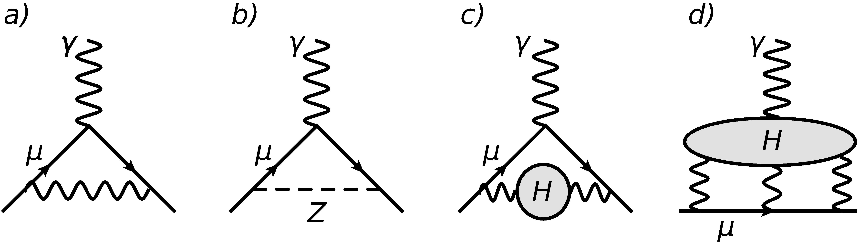
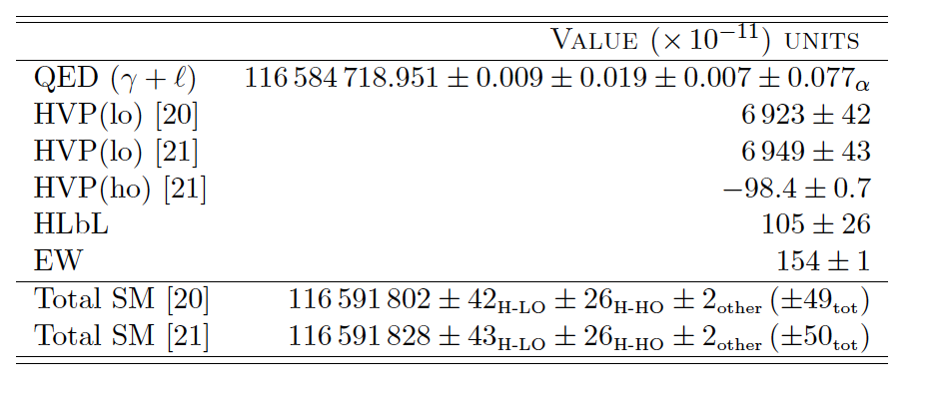
a_{μ}(SM): There are really 2 numbers in play here

Slide 8
a_{μ}(SM): Historical

Slide 9
a_{μ}(Expt) is extracted from several measurements
In E821 ≡ [0.54 ppm]*
CODATA #s
a_{μ}(Expt)
~
-2.002 319 304 361 53(53) [0.26 ppt]
Electron g-2 + QED
-.001519270384(12) [8 ppb]
206.768 2843(52) [25 ppb]
Muonium HFS experiment(s)
Need to measure Δν_{Mu}
*0.46 ppm statistical; 0.28 ppm systematics

Slide 10
Muonium* HFS to determine μ_{μ}/μ_{p} and m_{μ}/m_{e}
In, sum of ν₁₂ and ν₃₄ intervals in strong field
Δν_{Mu}
*We’ll need this again to understand the J-PARC muon source

Slide 11
ω_{a} – What FNAL g-2 plans to deliver
    δω_{a}(statistics) at 100 ppb level
  ~ 1.5 x 10¹¹ events in the final fit
    Multiple independent blind analyses
    Multiple sorting and fitting methods
    Net Systematics error to 70 ppb (x 3 improvement)
    Leading issues
      Pileup
      Gain (energy scale) stability
      Muon losses
Correction for Electric Field and Pitch
    Δω_{a}(E) = +470(50) ppb
    Δω_{a}(Pitch) = +270(40) ppb
Typically ~4-5 analyzers here
BNL numbers;
(errors will be reduced)

Slide 12
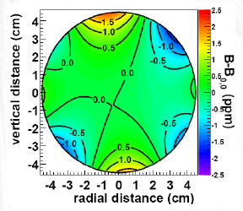
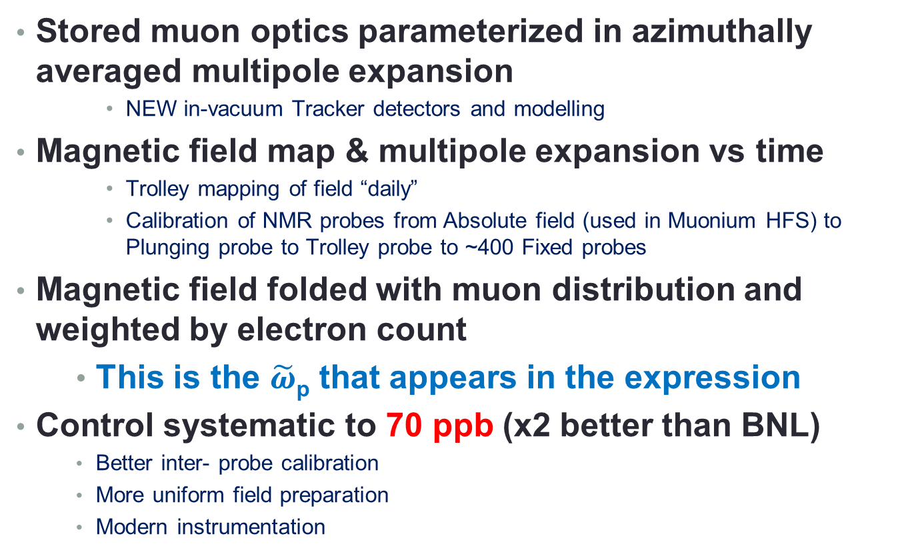
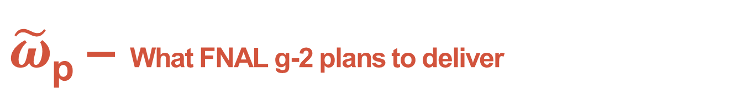
$\tilde{ω}$_{p} – What FNAL g-2 plans to deliver
Stored muon optics parameterized in azimuthally averaged multipole expansion
      NEW in-vacuum Tracker detectors and modelling
Magnetic field map & multipole expansion vs time
      Trolley mapping of field “daily”
      Calibration of NMR probes from Absolute field (used in Muonium HFS) to Plunging probe to Trolley probe to ~400 Fixed probes
Magnetic field folded with muon distribution and weighted by electron count
    This is the $\tilde{ω}$_{p} that appears in the expression
Control systematic to 70 ppb (x2 better than BNL)
    Better inter- probe calibration
    More uniform field preparation
    Modern instrumentation

Slide 13
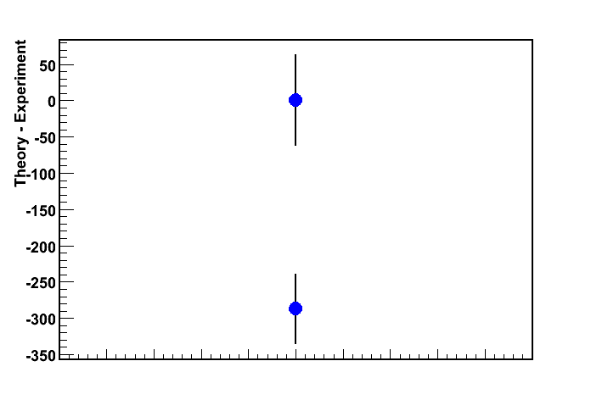
Graphically: Present situation and Goals
x10⁻¹¹
BNL E821
Goal: 140 ppb
Future Goals
>7.5 σ if same central values
3.6 σ
Theory
Expected Improvement
*
a_{μ} ^{exp} – a_{μ} SM | = | (261 - 287 ± 80) × 10 ^{–11}
 3.3 to 3.6 σ
What is nature trying to tell us?
*range of typical SM evaluations

Slide 14
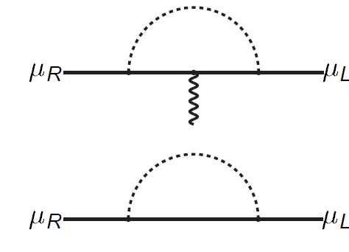
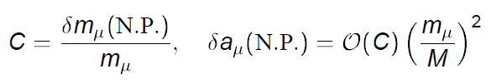
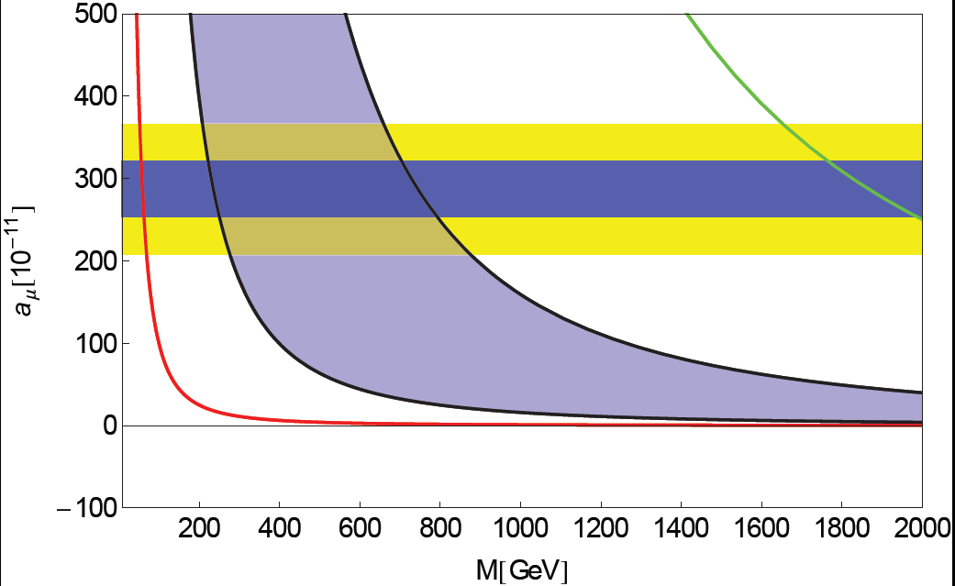
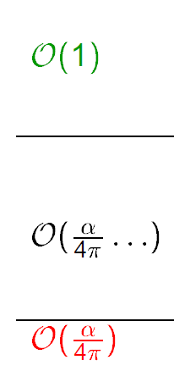
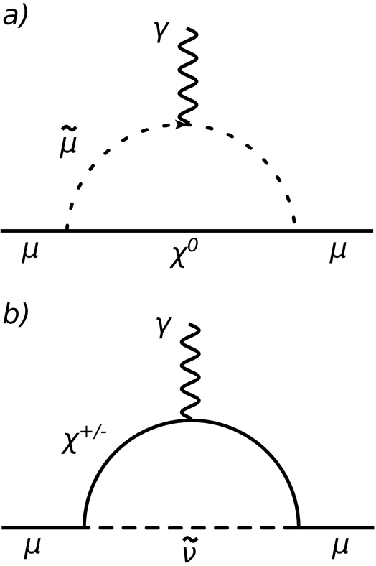
The coupling C is VERY model dependent
g-2 feature: Chirality flipping interactions for mass and charge (moment) terms
g – 2
m_{μ}
Radiative muon mass generation
Goal
Current Δa_{μ}
a_{μ}(New) [10⁻¹¹]
SUSY (tanβ), unparticles
Extra dimensions (ADD/RS)
Z’, W’, UED, Littlest Higgs (LHT) …
From D. Stockinger (See many of this g-2 presentations about new physics impact)

Slide 15




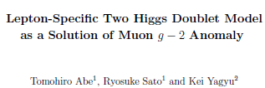
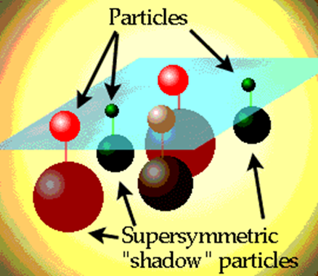
Post LHC Run 1 physics case strong as ever Representative papers –6 weeks in spring – with g-2 in titles are typically refined models of SUSY
Now with more restricted spaces and tanβ ranges

Slide 16
Perhaps something at low scales … not seen at the LHC
Light vector space of dark photon → e⁺e⁻ (visible decays) largely ruled out now
But, the “invisible” decay space is quite alive; Dark Z model also alive and connects to running of sin²θ_{W} vs Q
NA48/2 arXiv: 1504.00607

Slide 17
How is the experiment done ?
… and how to do it better

Slide 18
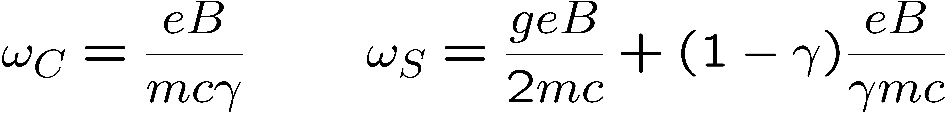
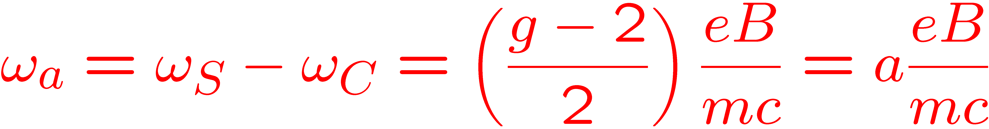
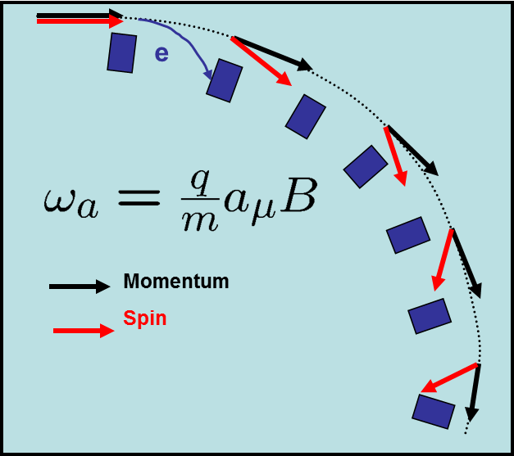
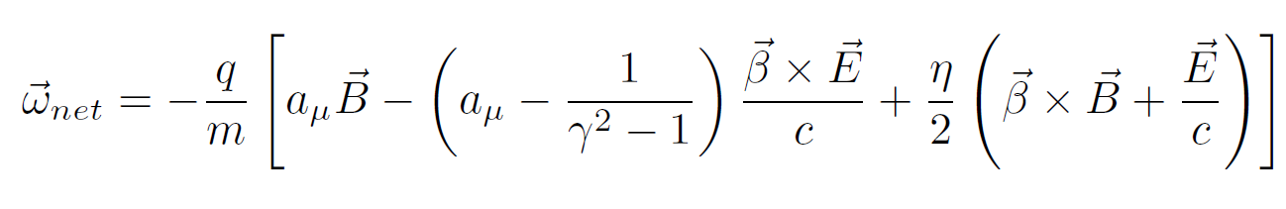

Both experiments will measure the difference between the spin precession and cyclotron motion for a muon moving in a magnetic field, which is
In practice, with E field focusing*
Magic γ
EDM
*Not relevant at J-PARC

Slide 19
4 Key elements of modern storage-ring g-2 measurements
(1) Polarized muons
~97% polarized for forward π decays
~50% (max) from muonium at rest source
(2) Precession proportional to (g-2)
(3) P_{μ} magic momentum = 3.094 GeV/c
not required in J-PARC approach
(4) Parity violation in the decay gives average spin direction
ν π⁺ μ⁺
µ

Slide 20
Two frequency measurements are made and both are “blinded”
Precession frequency
  Detectors involved
Muon distribution
  Measured and Simulated
Magnetic field
  In terms of proton NMR
B

Slide 21
FNAL Requirement and Status
Beam
Intense shots of highly polarized 3.094 GeV/c muons,
  21 times data vs. BNL. (backups to explain)
Instrumentation to inject, kick, and store muons into the Muon Storage Ring
  Lessons learned → new hardware
Methods to shim 1.45 T field to high uniformity and to measure it vs time throughout experiment
  Think: comprehensive refinements
Instrumentation to measure decay positron times and energies, and to determine beam parameters
  Entire overhaul
Ring
Field
Detector
Collaboration is organized around these 4 Teams

Slide 22
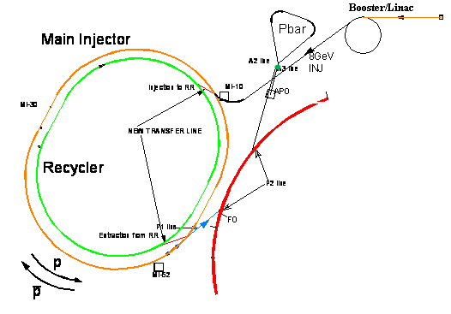
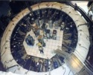
… shots of highly polarized 3.094 GeV/c muons
Beam
Muons
8 GeV Protons
Pions
No hadronic flash
Pions all decay
Protons removed by a DR kicker
Forward muons collected
95% polarized
~800,000 μ⁺/fill (δP/P 2%) at ring
4 bunches
Possible Cycle: 16 Shots / 1.33 s Cycle
All protons are “excess” from those used for NOvA ν Program

Slide 23
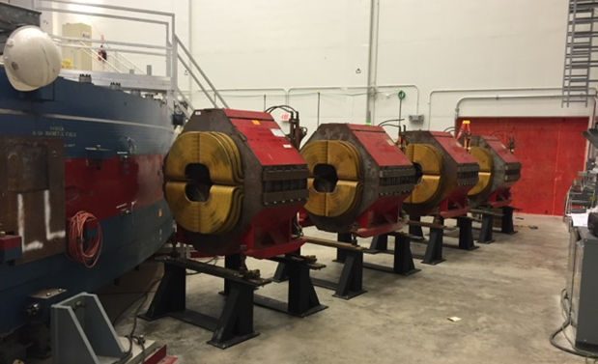
Beamline Progress and End-to-End Modeling Significant and on schedule
Beam
Target working
Beamlines in progress
Ready early 2017
Critical for muon capture
M2-M3 beamline
π → μ ν
Critical for π and p removal
Into and around the DR
M4-M5 into Ring
Handoff to Ring Models
- p. 23

Slide 24
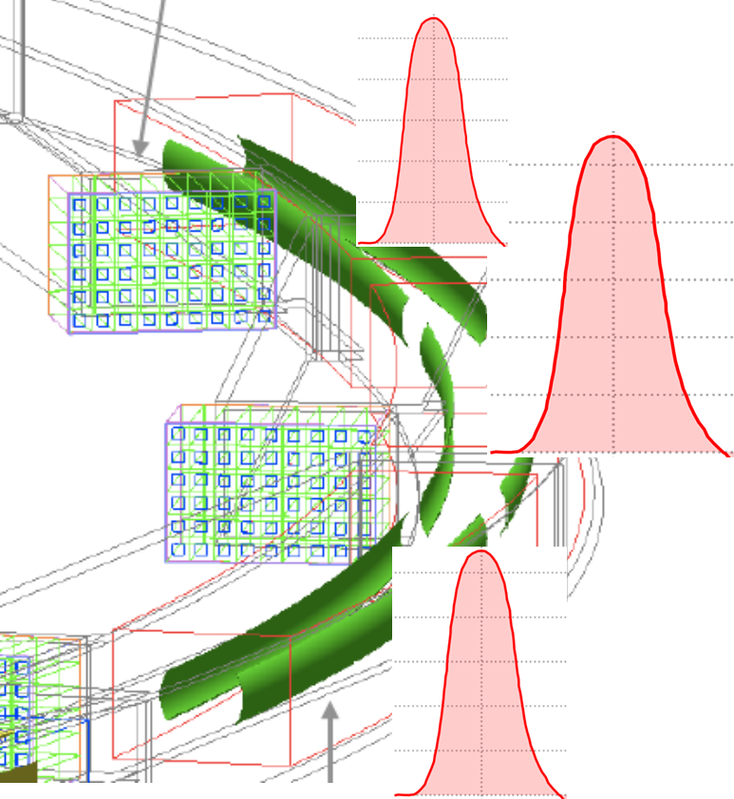
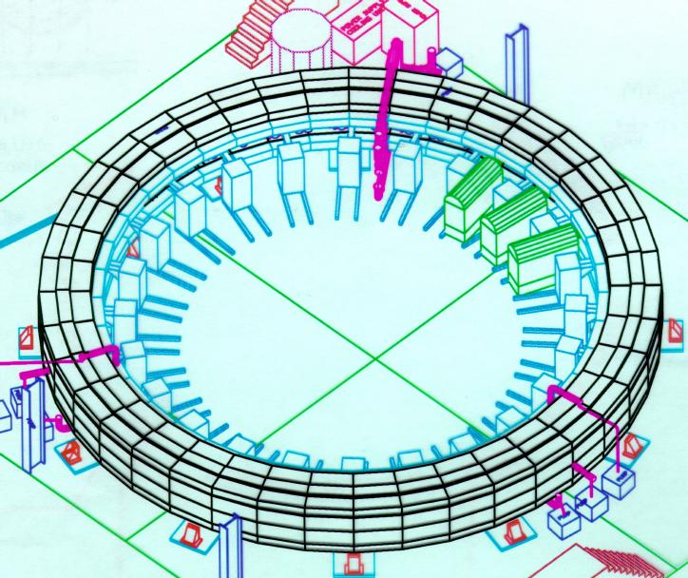
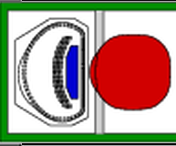
… inject, kick, and store muons in the Muon Storage Ring
incoming muons
Quads
KICKERs
About 2-3% store

Slide 25
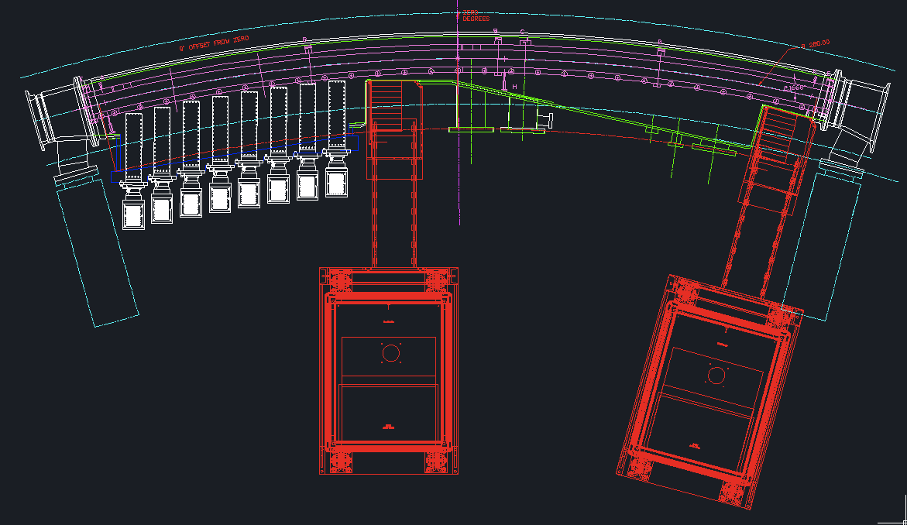
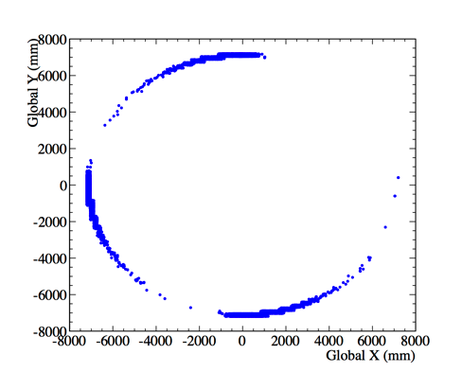
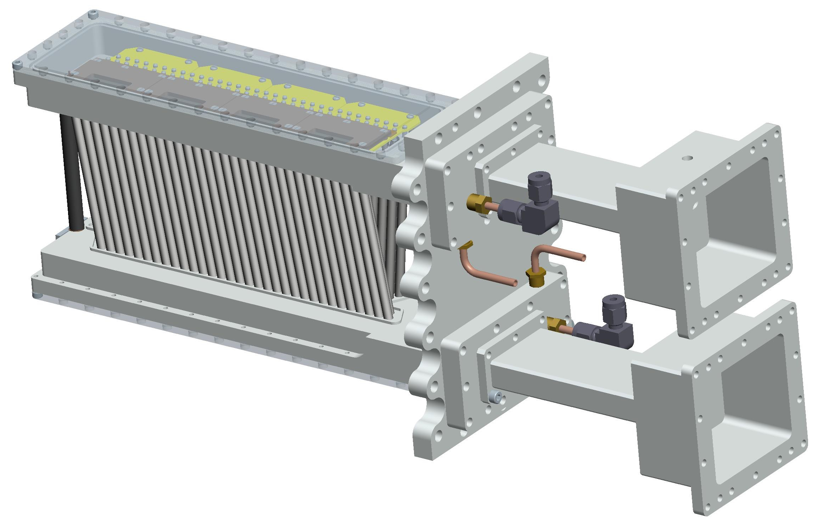
An in-vacuum Tracker can reconstruct the stored muon distribution from the decay trajectories
Determines beam position vs. time
3 locations
8 UV stations
Reconstructed decay position
128 straws per station
Also EDM measurement: See Becky Chislet’s talk
- p. 25

Slide 26
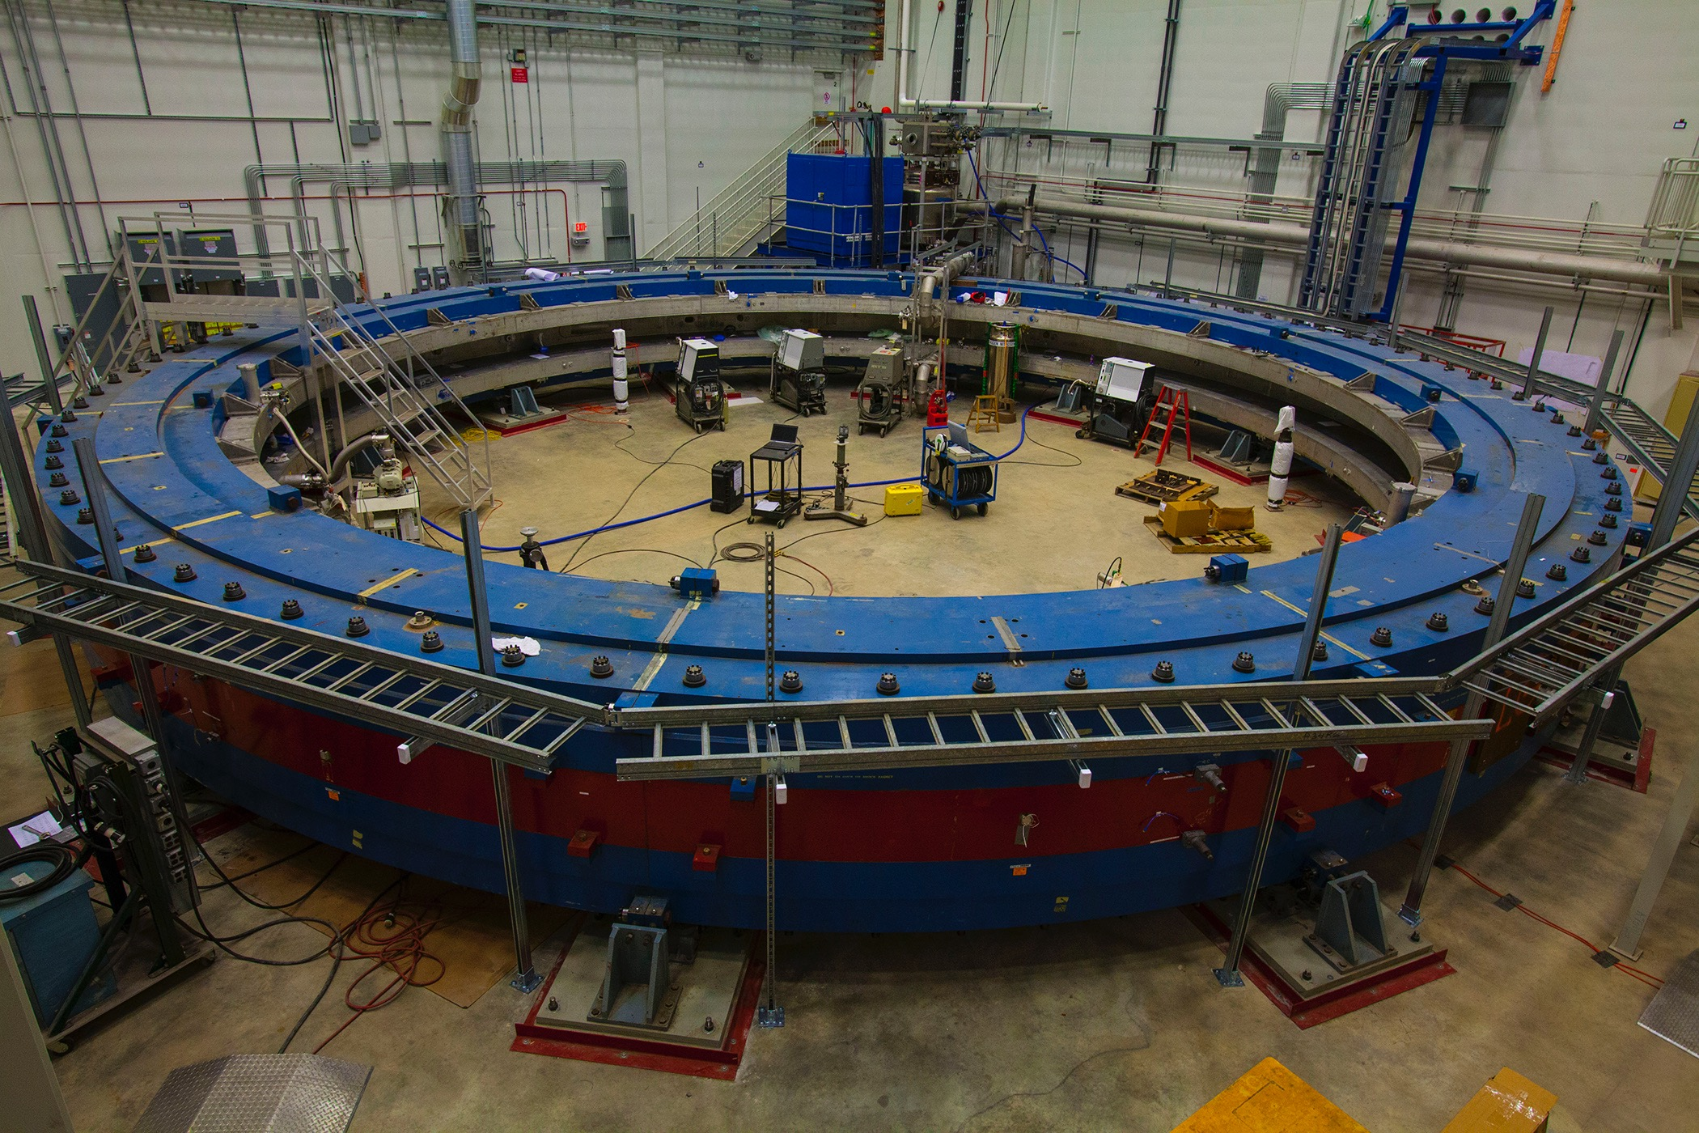
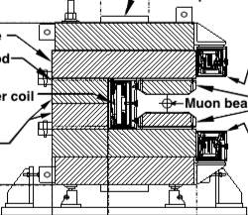
Ring Reassembly Complete
Cool-down and Power on in progress
6 – 9 Months of Field shimming begins next week
Aim: factor of 2 better than BNL

Slide 27
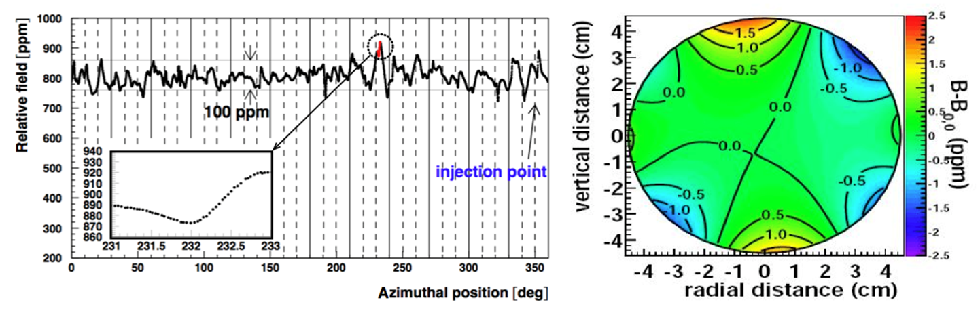
What does the shimming process do?
What matters
  The integrated field experienced by the stored muons
  Therefore, azimuthal average plus transverse multipole decomposition
  For both Field and Stored Muon distribution
Final BNL measurements
As you go around, it is pretty lumpy
But very smooth in transverse average
A more uniform (flat) field reduces uncertainties in the mapping and monitoring. But any individual measurement by NMR is very precise

Slide 28
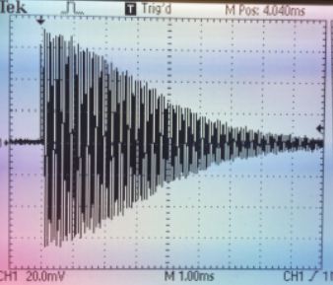
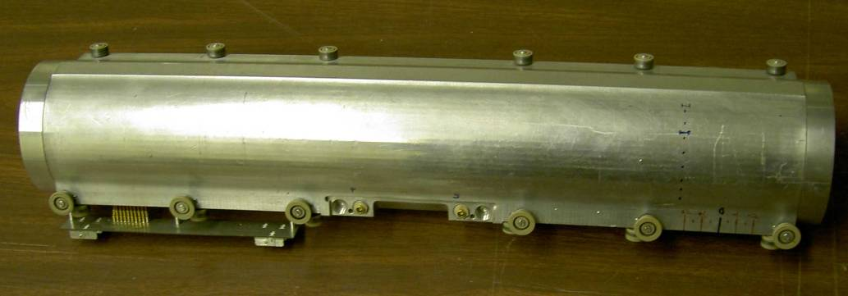
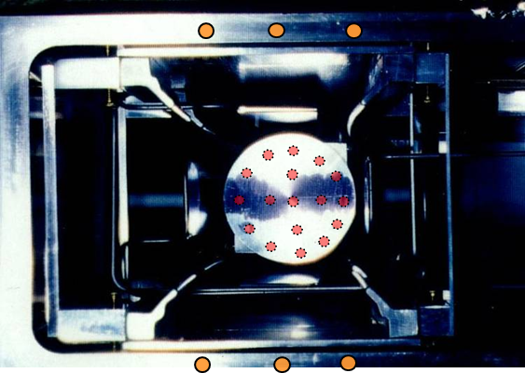
NMR probes determine field in terms proton precession frequency
FID
trolley
trolley
- p. 28

Slide 29
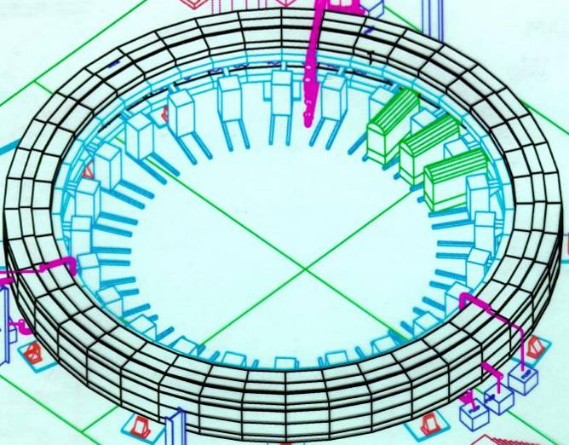
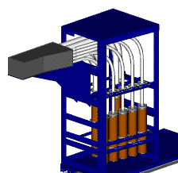
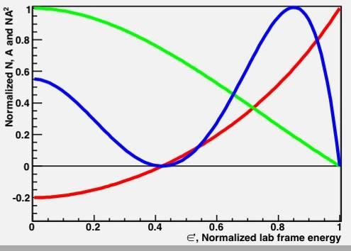
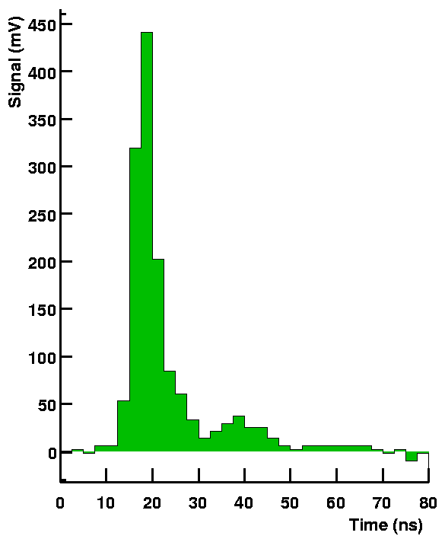
The muon precession frequency is revealed as an oscillating rate of high-energy electrons hitting detectors vs. time
e⁺
NA²
N
54 PbF2 crystals
A
<A>=0.4
1.25 ns samples

Slide 30
Fit to Simple 5-Par Function
N(t) = N₀ e^{-t/τ} [1+Acos(ω_{a}t + φ)]
Few billion events
Getting a good χ²
is a challenge
Of course, much more challenging because of:
Pileup
Gain changes
Coherent Betatron Oscillations
Muon Losses

Slide 31
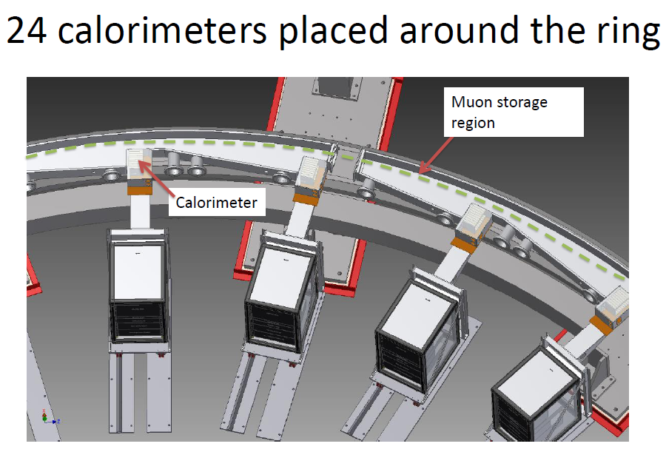
- p. 31

Slide 32
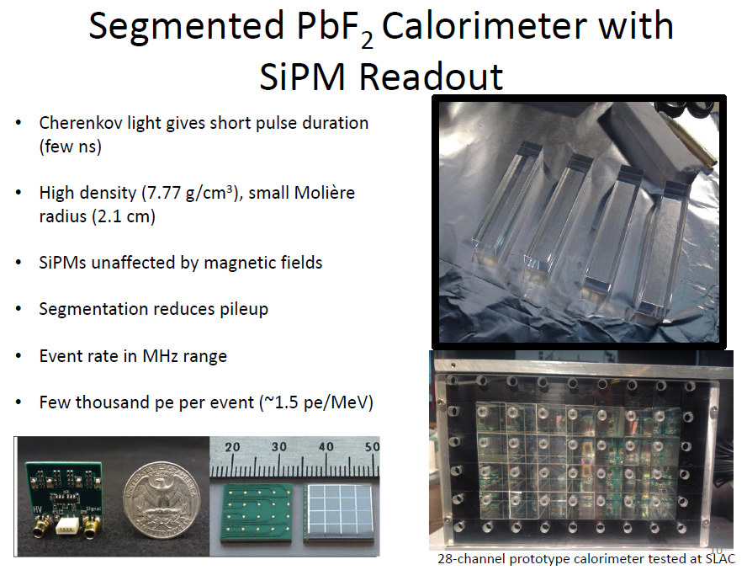
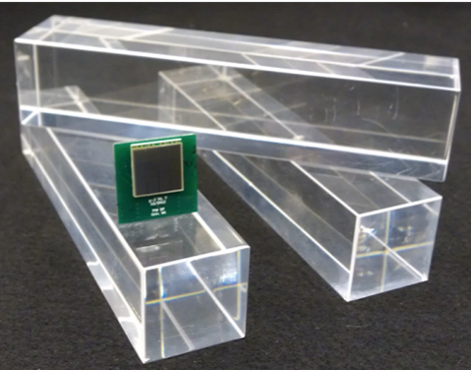
SiPM boards optimized to produce PMT-like pulses to exploit short pulse duration of Cherenkov crystals (relevant: pileup)
- p. 32

Slide 33
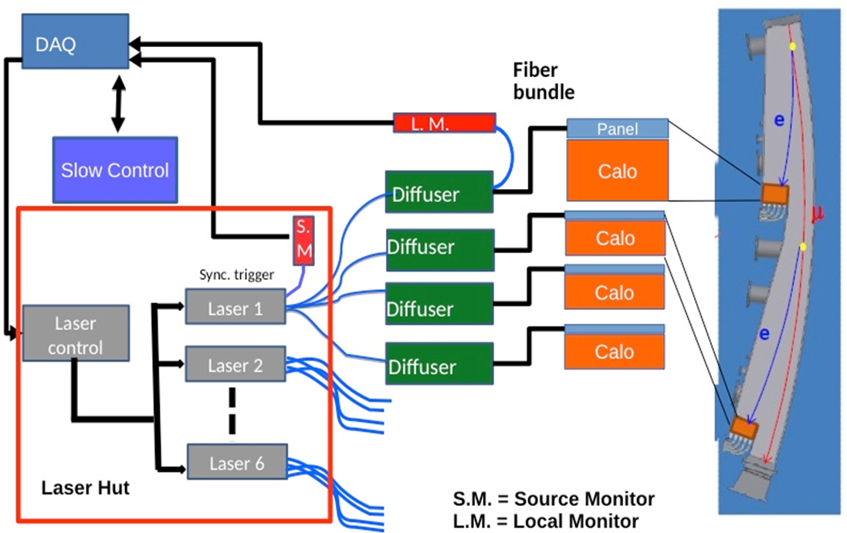



State-of-the-art Laser-based calibration system
Front Panel Prisms
10⁻⁴ / h demonstrated
- p. 33

Slide 34

What impacts statistical precision for N counts in final histogram
Higher momentum → larger γτ_{μ}
Higher magnetic field → greater ω_{a}
Polarization
Asymmetry
  determined by threshold cut, which also impacts the count rate N

Slide 35
The J-PARC approach*
*Slides derived from talk by Glen Marshall, July 2015

Slide 36

What makes them different?
Eliminate electric focusing removes β x E term
→ Do need ~zero P_{T} to store muons
→ Not constrained to run at the “magic momentum”
Create “ultra-cold” muon source; accelerate, and inject into compact storage ring.
Consequences are quite interesting …
  Smaller magnet; intrinsically more uniform
  Issues related to needed counts
Aim for BNL level precision as an important check

Slide 37

Ultra-cold Muons
Surface μ⁺
Stop in Aerogel
Diffuse Mu into vacuum
Ionize
  1S → 2P→unbound
  Max Polarization 50%
Accelerate
  E field, RFQ, linear structures
  P = 300 MeV/c

Slide 39



Continuous detector system of silicon trackers
Expected data. Note shorter lifetime at this momentum, and lower asymmetry owing to polarization of source

Slide 40


Slide 41


Slide 42

Comparison
Gorringe and Hertzog, Progress in Nuclear and Particle Physics, Volume 84 (2015) September 2015

Slide 43
Summary
FNAL: status and the plan going forward …
  Design complete and implementation well along
  Ring cold; Power “on”
  Construction phase for many subsystems
  Beam expected in early 2017
  Goal remains 140 ppb (or 16 x 10⁻¹¹) on a_{μ}
  EDM parasitically
J-PARC: novel method being developed*
  Working out key new issues: source; magnet; detectors, etc.
  Concept has greater reach for EDM owing to detector coverage
  Aiming at 2019 Phase 1 start with
    g-2 to ~400 ppb,
    EDM ~10⁻²¹ e-cm;
*apologies for any errors in describing E34

Slide 44

Systematic Errors on ω_{a} (ppb)
Detector Team
Ring Team
Detector Team
- p. 44

Slide 45

Systematic Errors on ω_{p} (ppb)
Brookhaven E821
FNAL
- p. 45

Slide 46
Conceptual idea of calibration handshake …
Field
Absolute probe was used in the Muonium HFS experiment that established μ_{μ}/μ_{p}, which is needed to determine a_{μ}
A second absolute magnetic field probe is in development at UMass
- p. 46

Slide 47
Acquiring x21 statistics at FNAL vs. BNL
Beam
BNL E821: ~ 4000 μ+ / fill using 4 TP of 24 GeV p / fill
FNAL E989: > 10,000 μ+ / fill using 1 TP of 8 GeV p / fill
  Many design factors recover lower σ and proton intensity / fill
    e.g: target focus, FODO lattice; forward decays; beamline length
  Additionally: 12 Hz fill rate at FNAL vs 4.4 Hz at BNL (factor x 2.7)
    This is a critical advantage
NET: Physics / hour 7 times greater at FNAL compared to BNL.
- p. 47

Slide 48


Existing Cross section measurements for e⁺e⁻ →π⁺ π⁻

Slide 49
Existing Cross section measurements for e⁺e⁻ →π⁺ π⁻

Slide 50


Slide 51
Prospects if these improvements are successful …
Present:
a_{μ}(SM) = 116 591 802(49) x 10⁻¹¹
a_{μ}(E821) = 116 592 089(63) x 10⁻¹¹
E821 New Physics Test
Δa_{μ}(Expt - SM) ~ (287±80) x 10⁻¹¹ (3.6 σ)
E989 + Future SM δHVP → 26 x 10⁻¹¹
δa_{μ}(Expt) 16 x 10⁻¹¹ (140 ppb)
δa_{μ}(SMa) 36 x 10⁻¹¹ (309 ppb) δHLbL = 25 x 10⁻¹¹ (no change)
δa_{μ}(SMb) 27 x 10⁻¹¹ (231 ppb) with δHLbL = 10 x 10⁻¹¹
E989 in possible* scenarios …
Δa_{μ}(Expt - SMa) ~ (287±38) x 10⁻¹¹ (7.5 σ)
Δa_{μ}(Expt - SMb) ~ (287±28) x 10⁻¹¹ (10 σ) !!
possible* if central values stay the same …

Slide 52
a_{μ}(SM): we need 2 more numbers here …
QED: done (amazing, wonderful, wow, etc, but uncertainties tiny)
Weak: done (also amazing, wonderful, etc….and tiny)
Hadronic Vacuum Polarization: 0.42 ppm LARGEST
  See next slide
  Hadronic Light-by-Light: 0.26 ppm (or larger)
  … but what do errors mean here?
  a_{μ}(HLbL) from models and lattice
  The “theory challenge”

Slide 53




New results on a_{μ}^{HLO}→ 6923(42) x 10⁻¹¹ (2011)
  BES
    New; 1/3rd data; ππ results
    consistent with others
    (arxiv:1507.08188)
  VEPP-2000
    New results this year at ~0.6% on ππ
    Aim at ~0.3% by 2017 (the ultimate goal)
  Lattice
    Results on a_{μ}^{HLO} with 4% error; 4x worse
    than the dispersive approach (~1% uncertainty)
✔
F. Burger et al.
arXiv:1311.3885
More from speakers

