Slide 1




Status and perspectives of the MEG Experiment
Fabrizio Cei
INFN & University of Pisa
On behalf of the MEG Collaboration
FCCP 2015 Workshop Capri, 10-12 September 2015

Slide 2
Outline
Generalities on Lepton Flavour Violation (LFV)
The MEG experiment
Results of MEG - phase I
Impact of MEG results
The MEG Upgrade
Perspectives of MEG Upgrade

Slide 3
LFV 1)
In the SM of electroweak interactions leptons are grouped in doublets and there is no space for transitions where the lepton flavour is not conserved.
However, lepton flavour is experimentally violated in neutral sector (neutrino oscillations) ⇒ needed to extend the standard model by including neutrino masses and coupling between flavours.
cLFV indicates non conservation of lepton flavour in processes involving charged leptons.

Slide 4
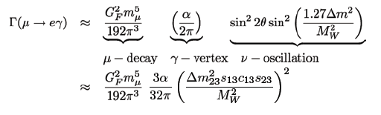
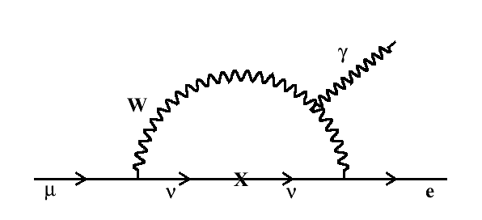
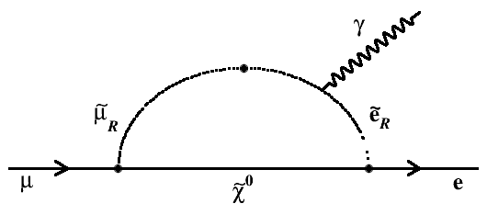
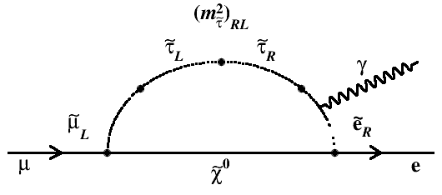
LFV 2)
Including neutrino masses and oscillations in SM:
≈ 10⁻⁵⁴
Experimentally not measurable !
Huge rate enhancement in almost all SM extensions ⇒ predicted rates
experimentally accessible ! (Barbieri, Masiero, Ellis, Hisano ..)
SU(5)
SO(10)
≈ 10⁻¹²
⇒ Observation of cLFV clear evidence for physics beyond SM

Slide 5

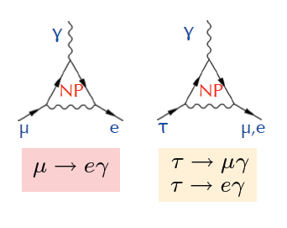
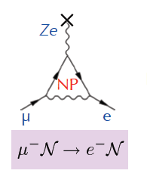
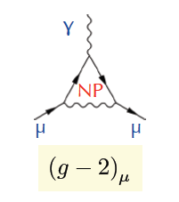
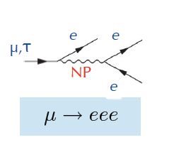
LFV 3)
Several LFV processes, sensitive to New Physics (NP) through
“new” lepton-lepton coupling
μ → e
conversion
Anomalous
magnetic
moment
μ,τ anomalous decays

Slide 6
Why muons ?
Muons are very sensitive probes to study Lepton Flavour Violation:
intense muon beams (≈ 10⁷⁻⁸ muons/sec) can be obtained at
meson factories and proton accelerators (PSI, LAMPF,
J-PARC, Fermilab ...);
muon lifetime is rather long (2.2 μs);
final states are very simple and can be precisely measured.

Slide 7
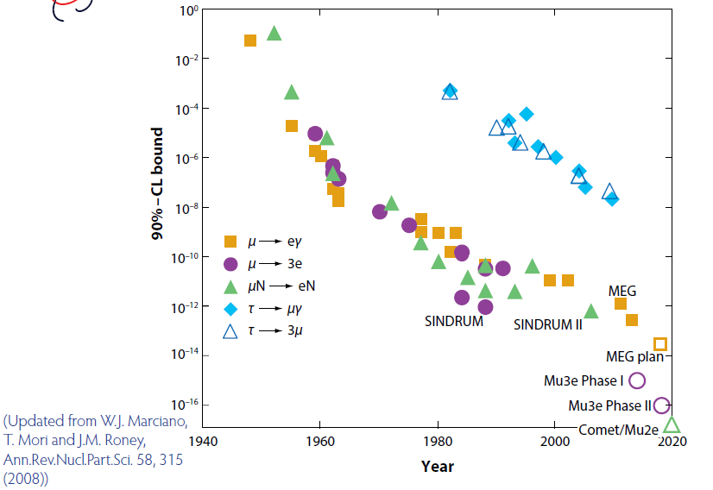
A 70 year history ...
Cosmic μ’s
0.1 (Pontecorvo & Hincks,)
Stopped π’s
5.7 x 10⁻¹³
Gained twelve
orders of
magnitude !
Muon beams
Empty symbols: future experiments

Slide 8
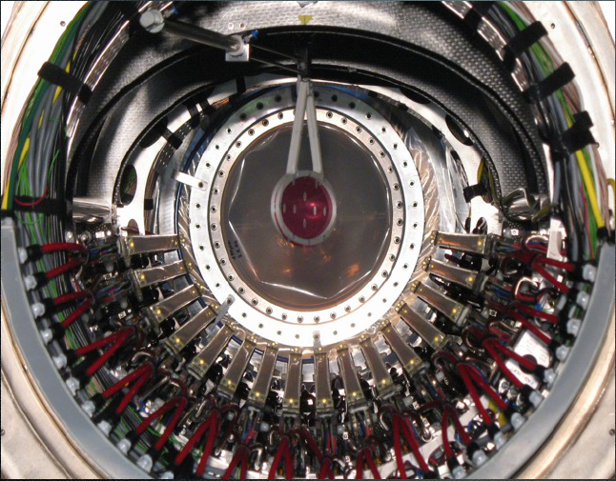
The MEG Experiment
Goal: search for μ⁺ → e⁺ γ decay with a sensitivity on BR ≤ 10⁻¹³

Slide 9





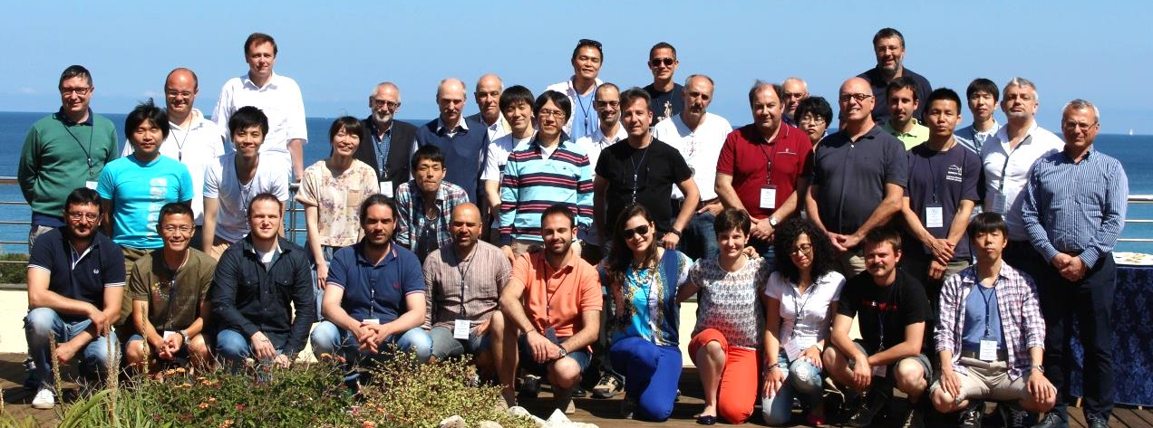
Part of the MEG Collaboration
～60 researchers from 5 countries
Total ≈ 60 physicists

Slide 10
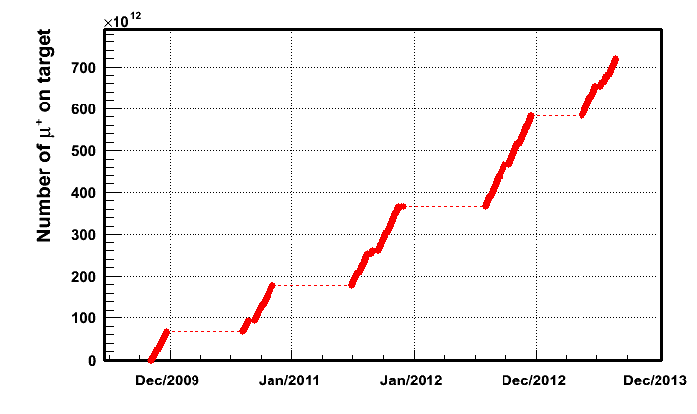
Data taking history
Stable data-
taking runs
from 2009
until 2013
2013
run
2012
run
2011
run
2010
run
2009
run
2009
2010
2011
2012
2013
Analysis of 2009 - 2010 data:
PRL 107 (2011) 171801
Analysis of 2009 - 2011 data:
PRL 110 (2013) 201801
(this presentation)

Slide 11
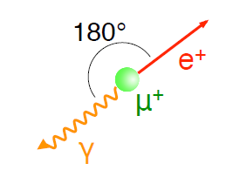
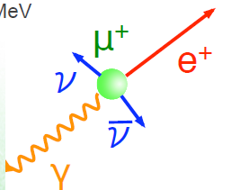
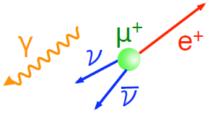
Signal and background
Signal
Radiative muon
decay (RMD)
Accidental
Background
(ACC)
E_{e} = E_{γ} = m_{μ}/2 (52.8 MeV)
T_{e} = T_{γ}
E_{e}, E_{γ} < m_{μ}/2
T_{e} = T_{γ}
e⁺ from Michel decay, γ from RMD,
e⁺e⁻ annihilation ..
Random ΔT, ΔΘ, E_{e}, E_{γ} < m_{μ}/2
Signal, RMD ∝ R_{μ}; ACC ∝ R_{μ}² ⇒
ACC is dominant (> 10 RMD in signal region);
needed continuous beam & accurate choice of R_{μ};
needed high precision experiments.
E_{γ} spectrum

Slide 12
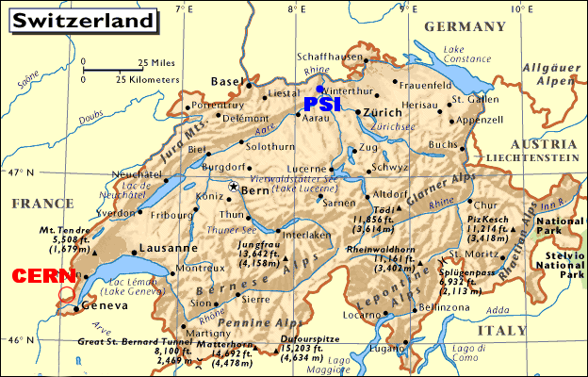
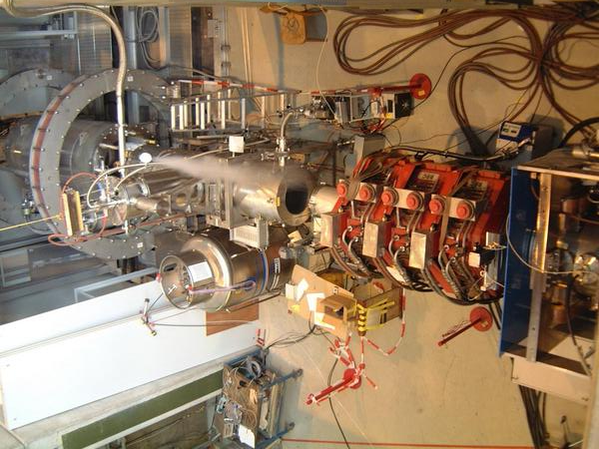
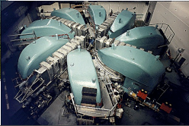
The Paul Scherrer Institute (PSI)
The most powerful continuous
machine (proton cyclotron) in the world;
Proton energy 590 MeV;
Power 1.4 MW;
Nominal operational current 2.2 mA.
MEG beam line
(πE5 secondary
muon line):
Wien filter
Beam transport
solenoid (BTS)
Muon degrader
2-d beam spot on
target: ∼ (1 x 1) cm²

Slide 13
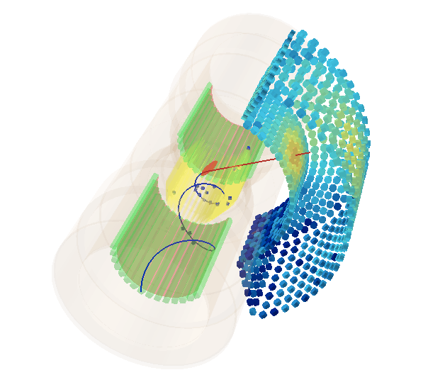
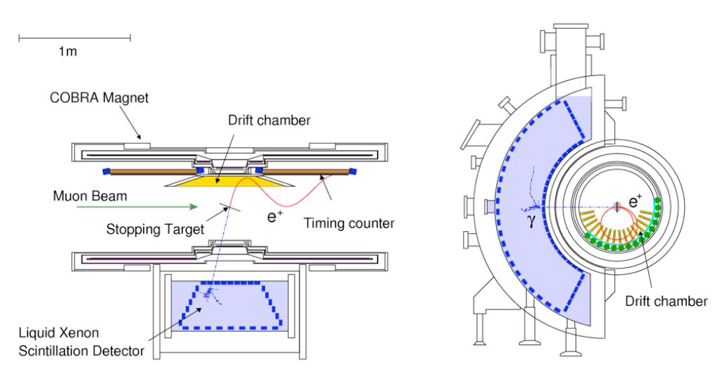
Detector layout
Eur. Phys. J. C 73 (2013) 2365
Muon beam intensity 3 x 10⁷ stopped μ⁺/s
Positron spectrometer: measurement
of positron momentum vector and timing
μ⁺
γ
e⁺
Photon detector: measurement
of photon energy, impact point and timing

Slide 14
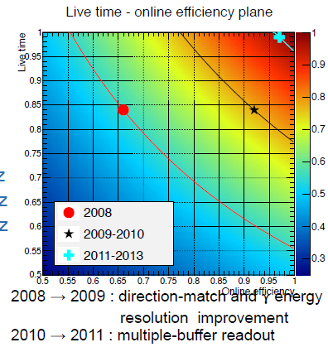
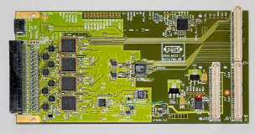
Trigger and electronics
Trigger
  FPGA based system
  designed to reduce the trigger
  rate by using fast estimates:
  γ-energy: → 2 x 10³ Hz
  e⁺γ timing → 100 Hz
  e⁺γ direction → 10 Hz
  Signal efficiency > 95%
  Live Time fraction 99%
Readout
  DRS custom-made digitizer chip.
  Maximum sampling speed 5 GHz,
  used in MEG 0.8 and 1.6 GHz.
  12 bit voltage digitization.

Slide 15
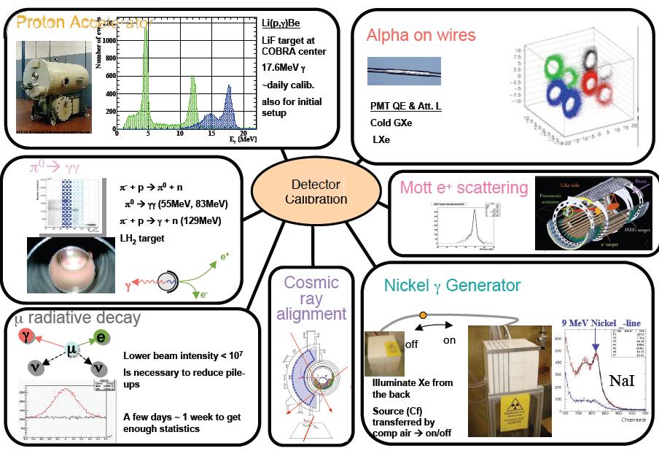
Overview of calibration system
Needed to ensure:
Required precision;
Long term detector stability;
Continuous checks.

Slide 16

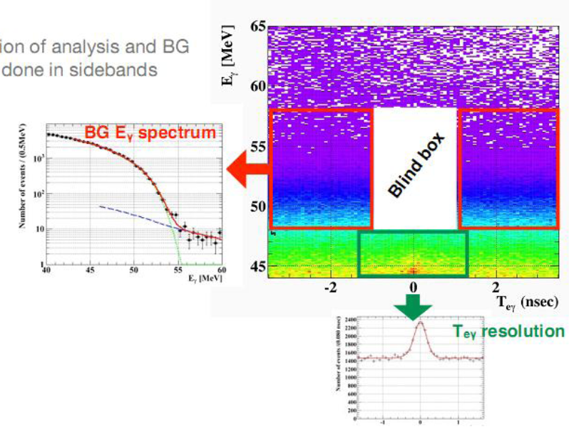
MEG analysis
Likelihood + Blind analysis
Signal and background
optimization done in sidebands
Timing sidebands
E_{γ} sideband
Events in the blind box (≈ 0.2%) are hidden up
to the end of optimization procedure
RMD events

Slide 17
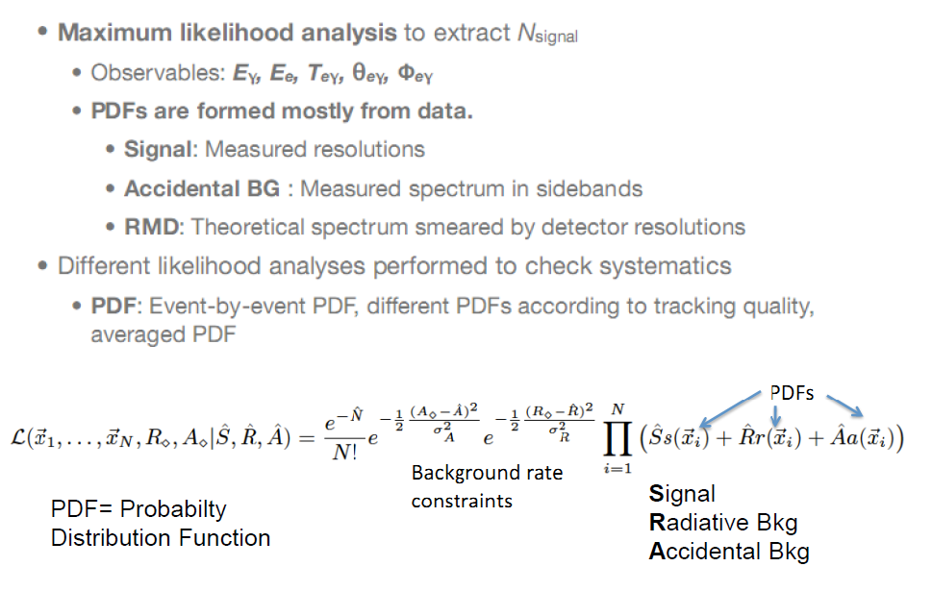
MEG likelihood analysis
Most dangerous
background is measured !
Likelihood function

Slide 18
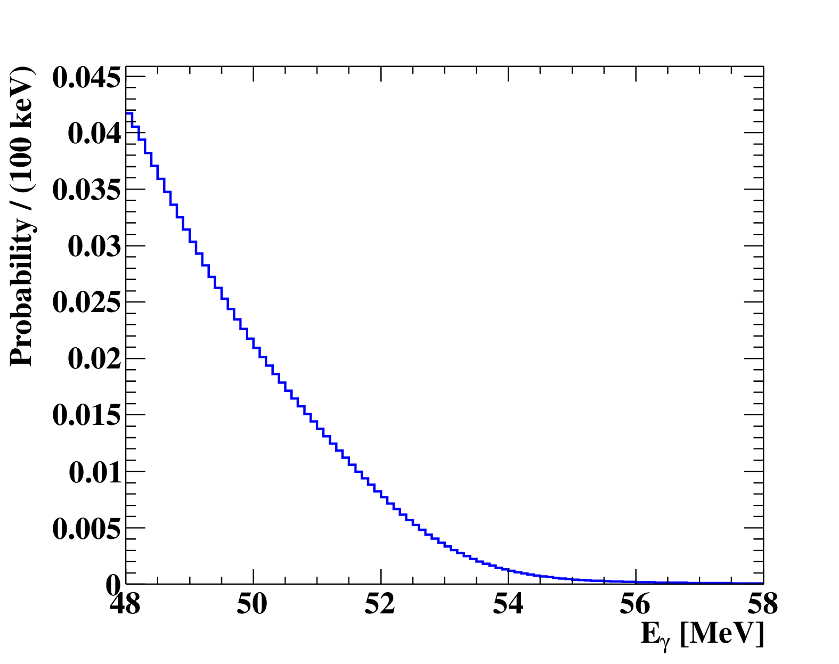
PDF’s
Signal
BCK
Signal
BCK
fit from sidebands
Two types of PDF’s:
Per-event (variable
uncertainties, 10%
improvement in
sensitivity);
Constant w/o positron
categories
Results in agreement.
RMD peak

Slide 19
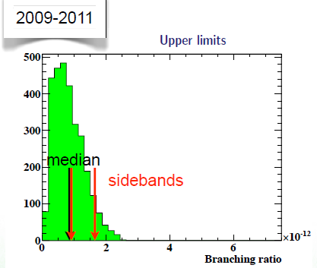
Sensitivity
Median upper bound of a sample of toy MC experiments generated with
zero signal hypothesis using the measured background pdf’s.
Median = 7.7 x 10⁻¹³
10⁻¹³ level reached !

Slide 20
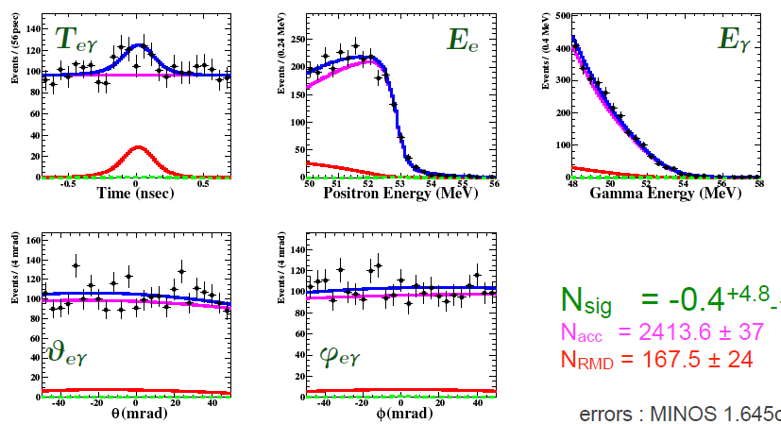
2009-2011 likelihood fit
Unbinned maximum likelihood fit on (E_{e}, E_{γ}, ΔT_{eγ}, θ_{eγ}, φ_{eγ})
NSIG = -0.4 (+4.8, -1.9)
NRMD = 167.5 ± 24
NBCK = 2414 ± 37

Slide 21
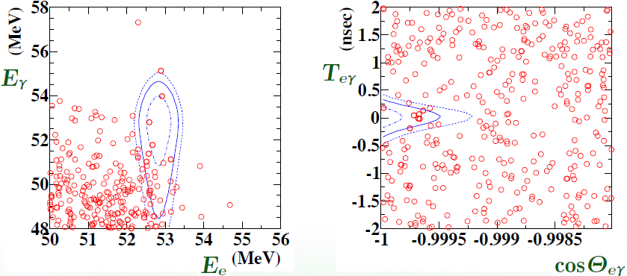
Event distributions
Signal PDF contours at
39.3, 74.2, 86.5 %
No excess observed

Slide 22
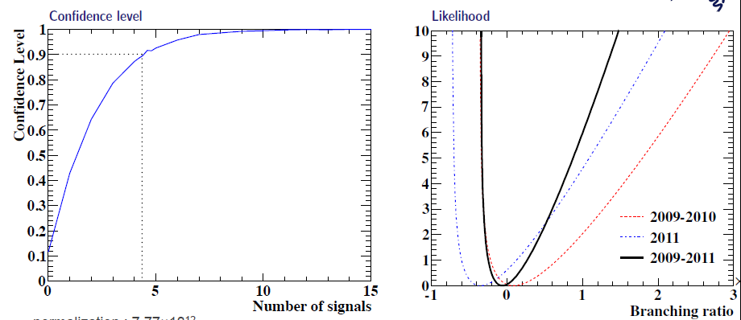

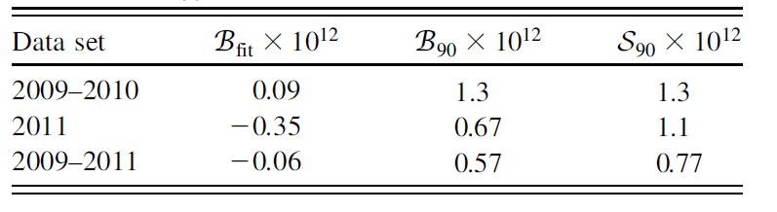
Confidence level
Frequentistic analysis, Feldman-Cousins method
NSIG → BR
(normalization factor)
x 10⁻¹²
BR (μ⁺ → e⁺γ) < 5.7 x 10⁻¹³ (90% C.L.)
Summary of all samples
Result published in PRL 110 (2013) 201801

Slide 23
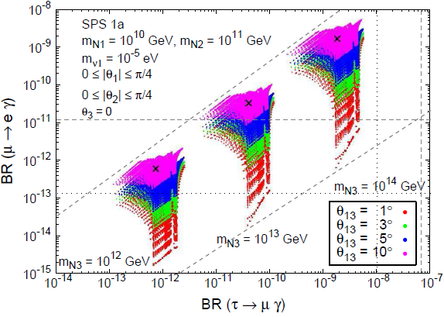
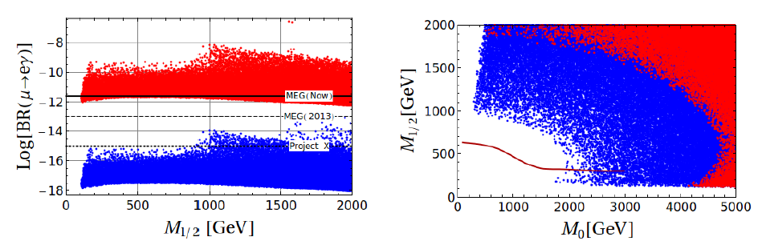
Impact of MEG results
MEG 2013 excluded
Antusch et al. JHEP 0611 (2006) 090
L. Calibbi et al.,
Eur. Phys. J.
C74, (2014), 1-20
MEG 2013
excluded
θ₁₃ measured by Daya Bay, Reno, Double Chooz
(8.9 ± 0.3)º
Adapted from L. Calibbi et al., JHEP 1211 (2012) 040
MEG 2013 excluded
mSUGRA,
tan β = 10, U_{e3} = 0.11
Red points:
PMNS based mixing
Blue points:
CKM based mixing
Excluded by direct LHC searches

Slide 24
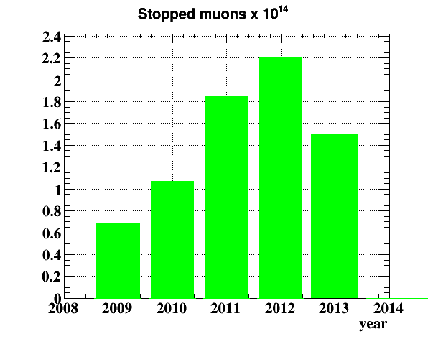
Final data and sensitivity
Number of μ⁺ → e⁺ γ candidate events = (k factor) x BR (μ⁺ → e⁺ γ)
BR < 5.7 x 10⁻¹³
S = 7.7 x 10⁻¹³
(2012 + 2013) ≈
(2009 + 2010 + 2011)
Double statistics !
Estimated final
sensitivity (toy MC)
∼ 5 x 10⁻¹³
BR < 2.4 x 10⁻¹²
S = 1.6 x 10⁻¹²

Slide 25
Status of final analysis
Further improvements in analysis quality:
Recovery of tracks which cross the target twice (∼ 5 %), producing
wrong vertex identification;
Accurate 3-D scanning of target shape to improve positron vertex
reconstruction quality;
Development of algorithms for identification of photons from
positron annihilation in flight.
Data reprocessing ended; checks under way and results soon.

Slide 26
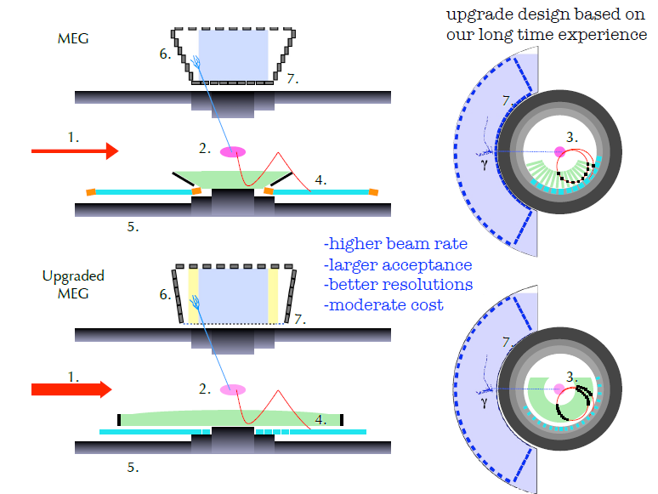
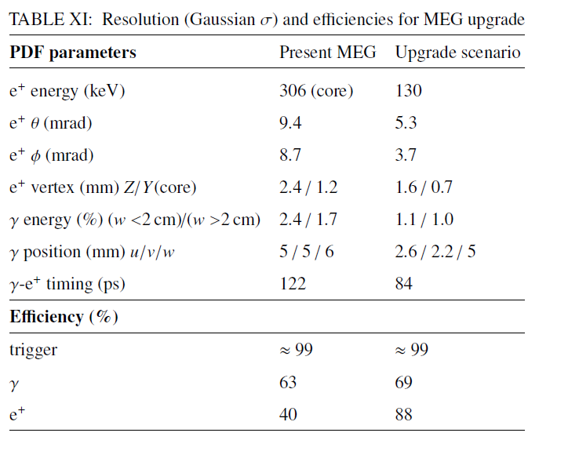
MEG Upgrade: introduction
Upgrade proposal:
arXiv:1301.7225
[physics.ins-det]

Slide 27
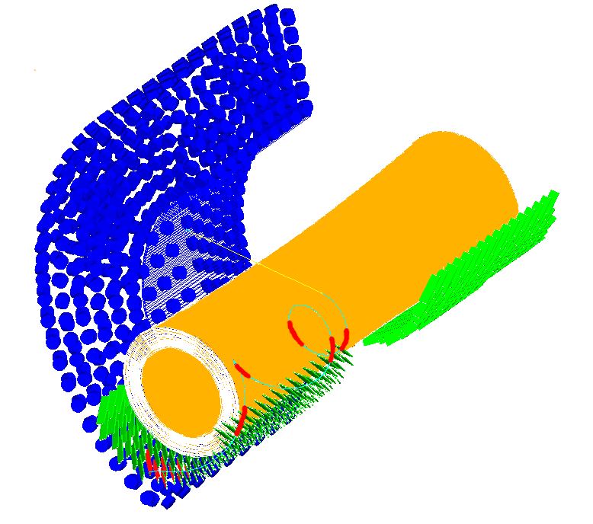
MEG Upgrade: overview 1)
Increased beam intensity 3 x 10⁷ μ/s → 7 x 10⁷ μ/s.
Optimized target thickness and slant angle: 140 μm thickness, 15º slant angle
Unique volume cylindrical drift chamber;
He/Isobutane 85:15;
∼ 1300 sense wires, ∼ 7000 field + guard wires;
High transparency (< 2 x 10⁻³ X₀);
Positron efficiency > 85% (better coupling
with TC, no extrapolation needed);
Stereo view, (7÷8)º angle;
Hit resolution 120 μm;
2π coverage over about 2 meters;
Based on KLOE experience;
Single hit resolution and gas aging effects
verified on prototypes and test stations.

Slide 28
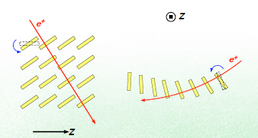
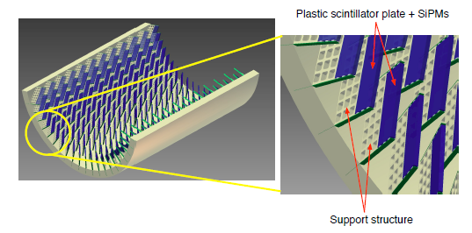
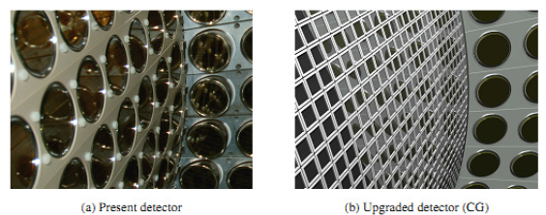
MEG Upgrade: overview 2)
Pixelated Timing Counter equipped with SiPM
Improved resolution by multiple hits
Expected σ = 35 ps
(factor 2 better than present)
LXe detector: modifications in lateral faces & finer photon sensors at entrance face
12 x 12 mm² SiPM sensitive
to LXe scintillation light.
Expected a factor 2 better resolution
in position and almost a factor 2
in energy.

Slide 29
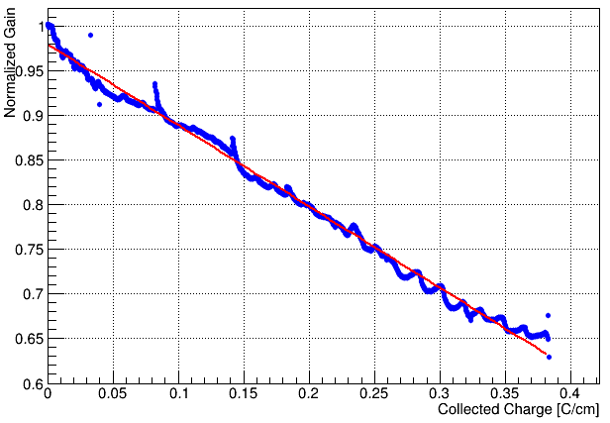
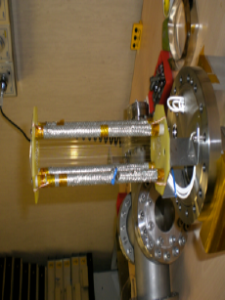
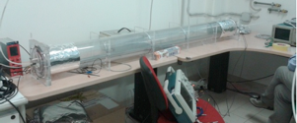
Drift chamber R&D 1)
Ageing prototype
Ageing effects obtained by high irradiation rate, corresponding to 0.32 C/cm for 3 years of DAQ;
Tested up to 0.5 C/cm using powerful x-ray source;
No severe problem (increase HV to compensate 40% gain drop).
Ageing test
Ageing Rate (slope):
(90.9 ± 0.3)% /(C/cm)
Full length prototype
Charge division, time difference and gain variation confirmed using ⁹⁰Sr source:

Slide 30
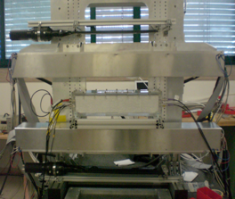
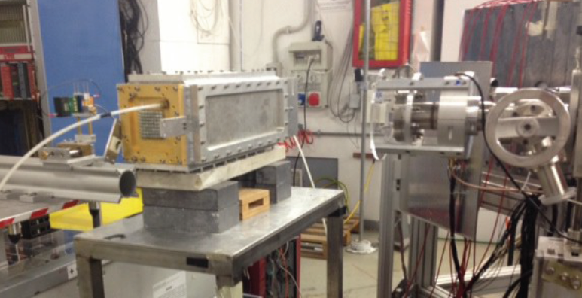
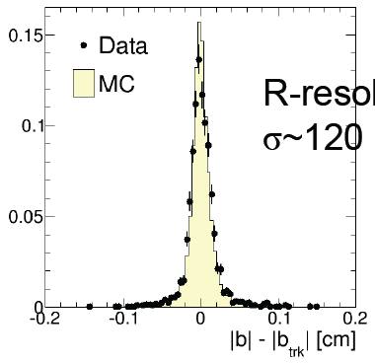
Drift chamber R&D 2)
Cosmic ray telescope in Pisa
Beam tests @ LNF and PSI
Measured single hit resolution: 125 μm
Status:
Prototypes successful, resolution and ageing better than design specifications;
Chamber design finalized;
Wiring machine operating in Lecce;
Partially wired mock-up chamber delivered at PSI in July; to be used in engineering run this Autumn.
Measured
single hit
resolution:
105 μm
better than
requirements

Slide 31
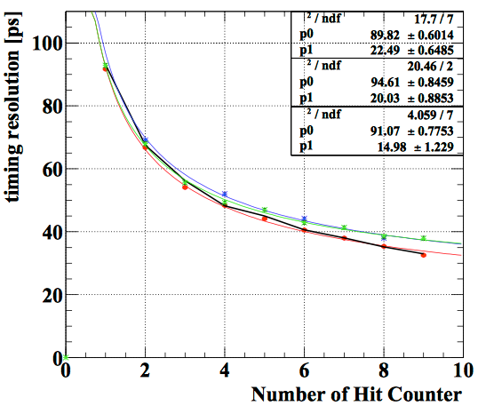
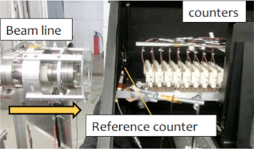
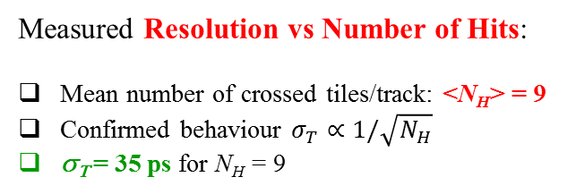
Timing Counter R&D
Beam test @ LNF
Status:
Excellent resolution achieved with single tile prototypes;
Resolution improvement using multiple tiles confirmed;
Tile configuration and detector layout finalized;
Half a detector ready this Autumn.
Measured Resolution vs Number of Hits:
Mean number of crossed tiles/track: <N_{H}> = 9
Confirmed behaviour $σ_{T}∝1/\sqrt{N_{H}}$
σ_{Τ} = 35 ps for N_{H} = 9

Slide 32
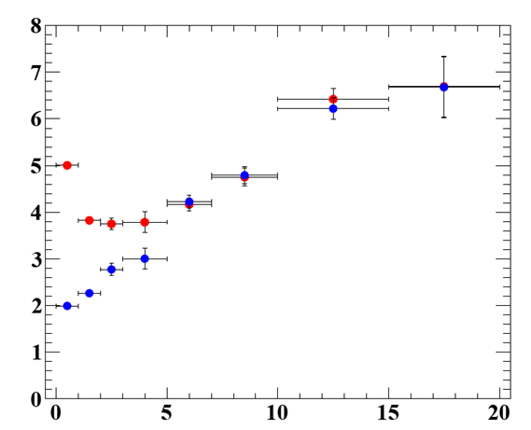
New LXe photon detector 1)
Goals:
Improve light collection efficiency and uniformity;
(higher granularity and active coverage);
Increase pile-up rejection efficiency;
Increase γ detection efficiency (lower mass)
⇒ improve energy and position resolution.
Depth < 2cm
2.4% → 1.1%
upgraded
present
Present detector:
2-inch PMTS
Upgraded detector:
12 x 12 mm² SIPM
position resolution [mm]
present
upgraded
depth from window [cm]

Slide 33

New LXe photon detector 2)
New MPPC (Multi-Pixel Photon
Counter = SIPM) under development
in collaboration with Hamamatsu.
Photon detection efficiency at 175 nm
wavelength (LXe emission peak)
increased by 15%
Succesful operation test on 600 MPPC;
∼ 4000 to be produced and tested.
Normal MPPC
(3x3 mm²)
VUV MPPC
(12x12 mm²)
2-inch PMT
Expected improvement
of figures of merit
Position
Energy
Timing

Slide 34


Trigger & Electronics
Motivation:
Increased # of readout channels
Higher bandwidth to preserve full waveform digitization
Higher event rate → faster readout
# of readout channels:
WaveDREAM board:
Multi-functional purpose board that integrates analog frontend, trigger, digitization (DRS4 chips, 2 GHz sampling) and HV supply on a single board.
Trigger:
Trigger principle unchanged; new system with higher performances (online reconstruction speed) in more severe working conditions.
LXe
WaveDREAM Status:
1 full crate (256 channels) ready this Autumn

Slide 35


Radiative Decay Counter (RDC)
  Motivation:
  Identify photons from muon radiative decay by tagging low energy positrons
  emitted in the same decay: $μ^{+}→e^{+}ν_{e}\overline{ν_{μ}}γ$ in coincidence with a γ in LXe detector.
Radiative
Decay
Counter
Up-stream RDC
scintillation fiber
Down-stream RDC
plastic scintillator + LYSO
needs study
about beam
disturbance
Under
Construction

Slide 36


MEG Upgrade: statistics & sensitivity
Expected final sensitivity ∼ 5 x 10⁻¹⁴
∼ 10 times larger statistics wrt MEGI

Slide 37
Summary and Perspectives
The MEG experiment collected data in the years 2009-2013,
corresponding to a total sample of > 7 x 10¹⁴ μ⁺ stopped on target.
Using 2009-2011 data, MEG established a new upper limit on
BR(μ⁺→e⁺γ) < 5.7 x 10⁻¹³ (90% C.L.), with sensitivity = 7.7 x 10⁻¹³.
Expected final sensitivity 5 x 10⁻¹³ using the full 2009-2013 sample
(results soon).
Detector upgrade under way to improve the sensitivity by an order
of magnitude.
Tests on upgrade detector prototypes indicate resolutions in
agreement with design requests.
Engineering run shortly; data taking expected to start next year.

