Slide 1
Study and characterization of FBK SiPM
Daniela Simone
INFN Bari
CTA Meeting - 12th March 2015

Slide 2
OUTLOOK
Study of performances of FBK matrix SiPM 3x3 mm² – 40 μm cell
Data acquisition FBK SiPM 1x1 mm² – 40 μm and 50 μm cell
Conclusions

Slide 3
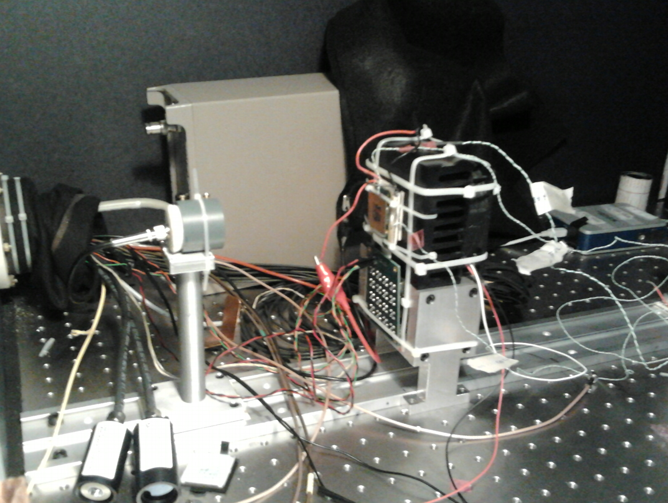
SETUP
SiPM Matrix 3x3 mm², cell 40 μm, 16 channels;
AD8000 OPA based electronics;
Laser (380 nm) controlled by a picosecond pulsed driver (PDL 800-B);
Peltier cell for temperature control;
Waveform generator LeCroy ArbStudio;
Keithley 2400 source meter;
Tektronix TDS5104b Oscilloscope

Slide 4
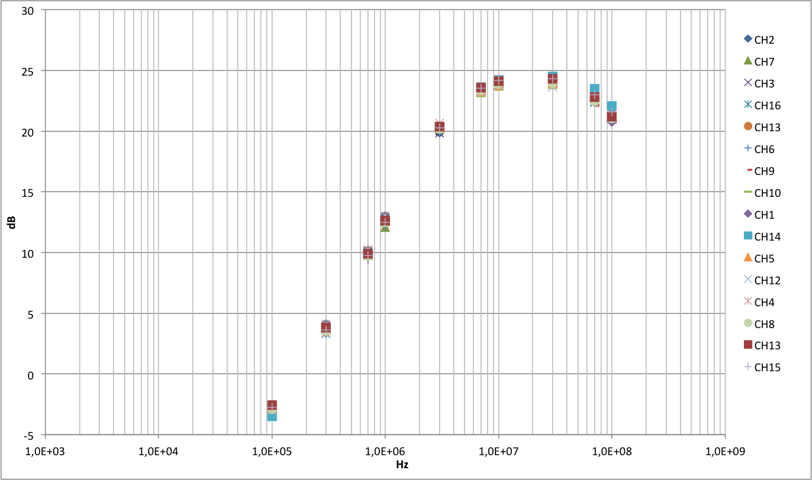
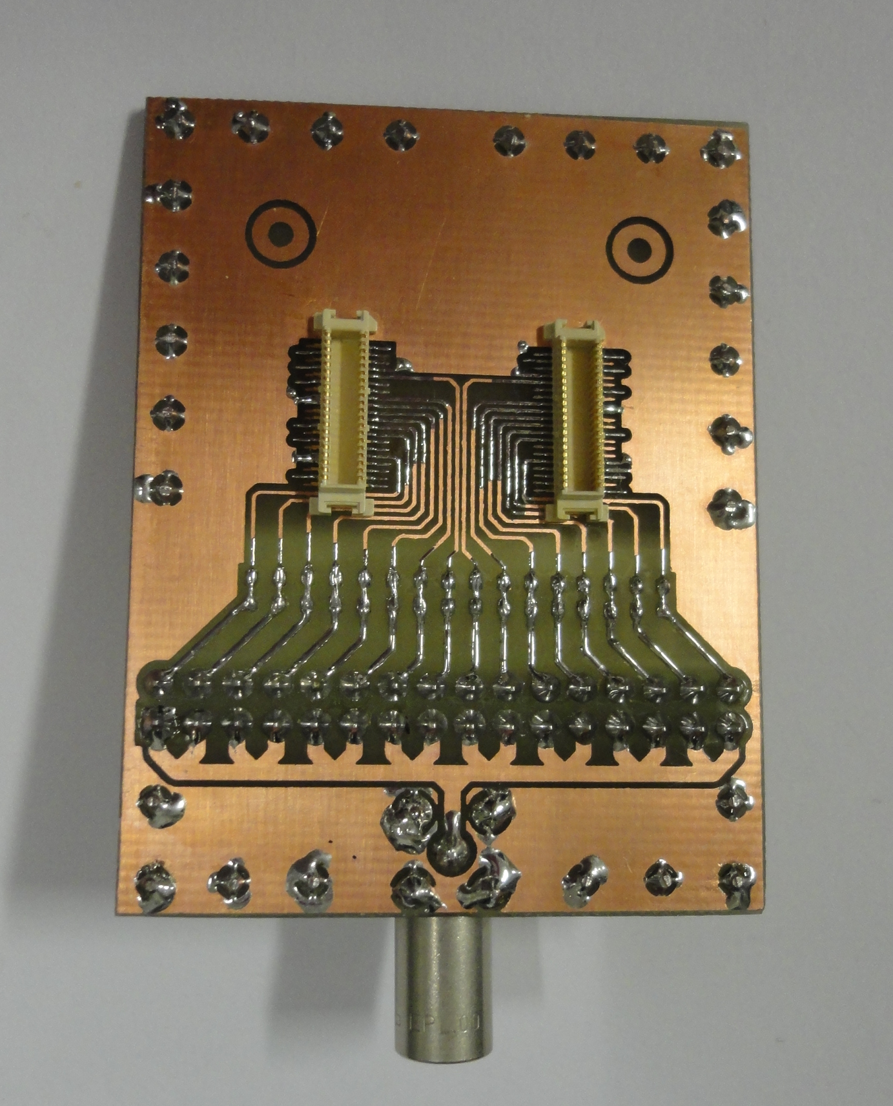
GAIN OF 16 CHANNELS

Slide 5
SOME WAVEFORMS…
Waveforms corrected (first 50 points)
Look for the minimum of each acquired
waveform at a fixed time (mean of the
distribution of times at which minima
are detected)

Slide 6
AMPLITUDE DISTRIBUTION (HV = 29V)

Slide 7
GAIN (HV = 29V)
16 | 3 | 13 | 2
12 | 7 | 9 | 6
4 | 11 | 1 | 10
8 | 15 | 5 | 14

Slide 8
GAIN (HV = 29V)
Values between ≈ 3.65 mV/PE and ≈ 4.4 mV/PE (Variation of 10 %)

Slide 9
Signal to Noise Ratio (HV = 29V)

Slide 10
SNR and GAIN (HV = 29V)

Slide 11
AMPLITUDE DISTRIBUTION (HV = 30V)
16 | 3 | 13 | 2
12 | 7 | 9 | 6
4 | 11 | 1 | 10
8 | 15 | 5 | 14

Slide 12
GAIN (HV = 30V)
16 | 3 | 13 | 2
12 | 7 | 9 | 6
4 | 11 | 1 | 10
8 | 15 | 5 | 14

Slide 13
GAIN (HV = 30V)
Values between ≈ 4.7 mV/PE and ≈ 5.7 mV/PE (Variation of 10 %)

Slide 14
Signal to Noise Ratio (HV = 30V)

Slide 15
SNR and GAIN (HV = 30V)

Slide 16
AMPLITUDE DISTRIBUTION (HV = 31V)
16 | 3 | 13 | 2
12 | 7 | 9 | 6
4 | 11 | 1 | 10
8 | 15 | 5 | 14

Slide 17
AMPLITUDE DISTRIBUTION (HV = 31V)
16 | 3 | 13 | 2
12 | 7 | 9 | 6
4 | 11 | 1 | 10
8 | 15 | 5 | 14

Slide 18
GAIN (HV = 31V)
Values between ≈ 5.6 mV/PE and ≈ 6.9 mV/PE (Variation of 10 %)

Slide 19
Signal to Noise Ratio (HV = 31V)

Slide 20
SNR and GAIN (HV = 31V)

Slide 21
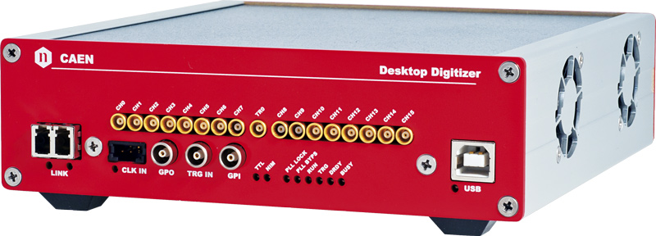
FBK 1x1 mm² – 40μm and 50μm SiPM
SiPM 1x1 mm², cell 40 and 50 μm;
AdvanSiD evaluation board signal amplifier;
Laser (380 nm) controlled by a picosecond pulsed driver (PDL 800-B);
Peltier cell for temperature control;
Waveform generator LeCroy ArbStudio;
Keithley 2400 source meter;
DT5742 Switched Capacitor Digitizer (12 bit, 5 GS/s – 1024 storage cells/CH)

Slide 22
FBK 1x1 mm² : I – V plots
Breakdown voltage: 26V @ 21°C
Breakdown voltage: 25.2V @ 21°C

Slide 23
FBK 1x1 mm² : Data acquisition (DOMINO)
Spikes at constant time intervals
(maybe due to a clock ofthe board)
Jitter is equal to the distance between
two consecutive spikes
Jitter squeezing algorithm

Slide 24
FBK 1x1 mm² : Data acquisition (DOMINO)
Spikes at constant time intervals
(maybe due to a clock ofthe board)
Jitter is equal to the distance between
two consecutive spikes
Jitter squeezing algorithm

Slide 25
FBK 1x1 mm² and 3x3 mm²: 40μm and 50μm cell
FBK 1x1 mm², 40 μm, T = 23°C, HV = 31V
FBK 1x1 mm², 50 μm, T = 23°C, HV = 28V
SINGLE PE
SINGLE PE
FBK 3x3 mm², 40 μm, T = 23°C, HV = 31V
FBK 3x3 mm², 50 μm, T = 23°C, HV = 28V
SINGLE PE
SINGLE PE

Slide 26
CONCLUSIONS
Study of performances of matrix SiPM 3x3 mm² with 40 μm cell
  Gain shows variation of 10 % (HV = 29V, 30V, 31V)
  SNR related to the amount of light incident on the SiPM
  Determination of link between number of photons and SNR (work in progress)
  Acquisition (using DOMINO) of waveforms generated from SiPM 1x1 mm² with
  40 μm and 50 μm cell
  Need to study a model for the SiPM 1x1 mm² with 40 μm cell (work in progress)

Slide 27
FBK 1x1 mm² : Data acquisition
Baseline correction between two
consecutive spikes
Minima distribution is gaussian
after correction --> value is chosen
to draw the histogram of amplitude
distribution at minimum

