Slide 1
Andrea Vinante Testing the limits of quantum mechanics (& other) using micro-magnetomechanical systems INFN – Tifpa Trento

Slide 2
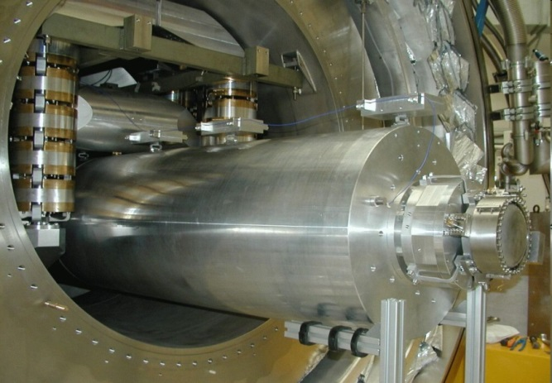
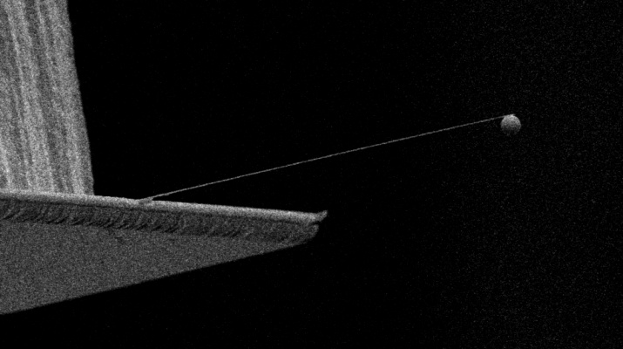
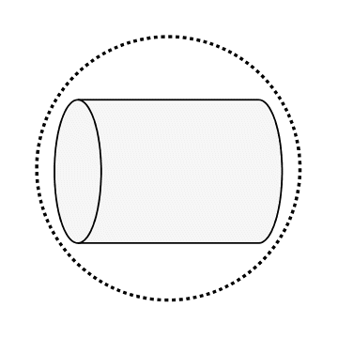
Brief Self-Presentation
1) The AURIGA gravitational wave detector, INFN Legnaro (<2009)
2) Ultracold Micro-Nanomechanical Systems (Leiden University , Trento)
SQUID-based displacement sensor with extreme displacement sensitivity (∼10⁻²⁰ m/√Hz)
(P. Falferi et al, PRL 2005)
Feedback-cooling below 1 mK (A. Vinante et al, PRL 2008 + Physics 2008)
Limit on Planck-scale physics with macroscopic objects
( F. Marin et al, Nature Phys. 2013)
SQUID-based detection & Cooling thermal
motion below 20 mK (O.Usenko et al, APL 2011)
Coupling mechanical motion to electron spins
(Magnetic Resonance Force Microscopy) (A. Vinante et al, Nature Comm. 2011)
Parametric thermal squeezing well beyond 3 dB (A. Vinante et al, PRL 2012)

Slide 3
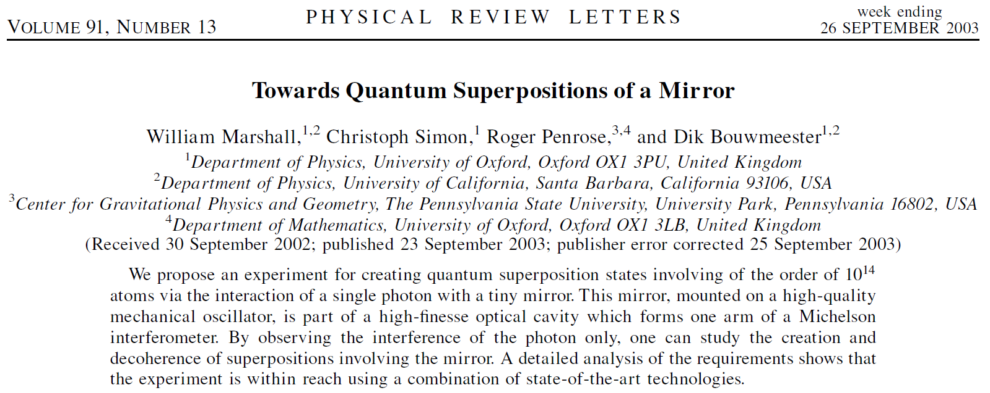
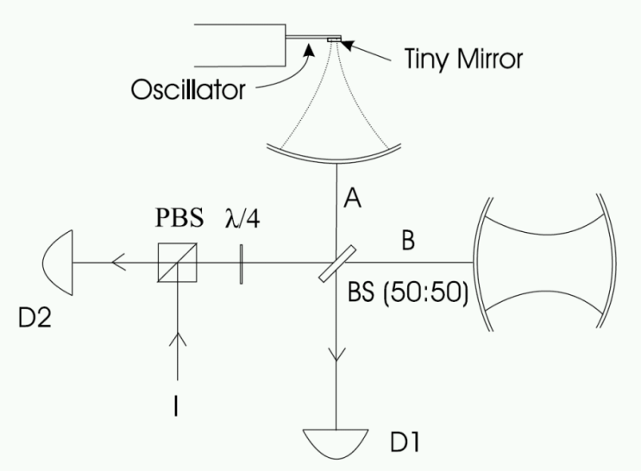
Test quantum mechanics with mechanical resonators?
(D. Bouwmeester – Leiden University)
Idea: couple to a single photon interferometer
Similar schemes: couple to a qubit (example a spin)

Slide 4
Is quantum mechanics true at all scales?
Are quantum superpositions of an arbitrarily massive object (Schroedinger cats) possible?
The DECOHERENCE PICTURE (Zurek et al)
Yes in principle, but coupling to environment destroys quantum superpositions very quickly, NATURALLY LEADING TO LOCALIZATION and classical behaviour
Alternative picture: COLLAPSE MODELS
CSL: Continuous Spontaneous Localization (Ghirardi et al)
Massive quantum superpositions may be eventually “collapsed” by gravity (Diosi, Penrose et al)

Slide 5
Collapse model: basics
Quantum and Classical are microscopic-macroscopic limits of a more general theory.
Schrodinger Equation + (Universal stochastic collapse term)
Stochastic Collapse ∼ Mass² May be related with gravity (Karolhyazy, Diosi, Penrose models)
Micro-Macro size-scale transition ∼ 10⁻⁷-10⁻⁶ m
Everything else is naturally derived by Fundamental Equation - Quantum Mechanics at microscale - Measurement Postulate and Born rule - Classical Mechanics at macroscale

Slide 6
Decoherence vs Collapse models can we test experimentally?
$\left\langle x | ρ\left(t\right) | x′\right\rangle$=$e^{−Γt}\left\langle x | ρ\left(0\right) | x′\right\rangle$
$$Γ=γ\left(1−\text{exp}\left[−{\left(\frac{x−x′}{r_{C}}\right)}^{2}\right]\right)$$
FORMALLY,
THE EFFECT IS SIMILAR !
ENVIRONMENT DECOHERENCE
γ: Depends on environment parameters (Pressure, Temperature, Loss Factor …)
r_{C}: Wavelength of the environment “particle” (gas particle, blackbody photon … )
SPONTANEOUS COLLAPSE (CSL)
γ: model parameter x M²
r_{C}: model parameter
GRAVITY-BASED (DIOSI-PENROSE)
$$γ≈ \frac{GM^{2}}{ℏR}$$
$$r_{C}≈R$$

Slide 7
Experimental (Indirect) methods
Look for side effects of collapse models
Anomalous Heating/Diffusion of a free particle/resonator
Collett, Pearle, Found. Phys. 33, 1495 (2003)
Broadening of spectral lines
Bahrami, Bassi, Ulbricht, Phys. Rev. A 89 032127 (2014)
Spontaneous emission NEXT PRESENTATION BY C. CURCEANU

Slide 8
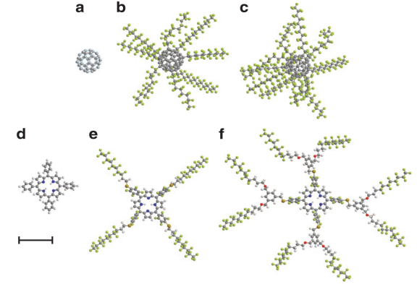
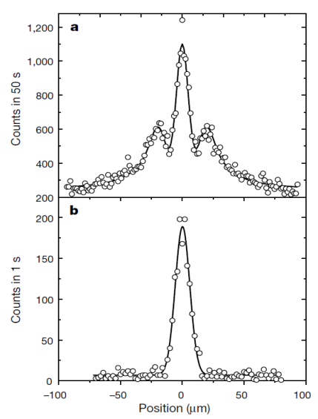
Experimental (Direct) Methods
“Double-slit” MATTER WAVE INTERFEROMETRY with complex molecules.
(M. Arndt et al, Vienna)
Create quantum superposition of MICROMECHANICAL RESONATOR by coupling to a single photon or qubit
(D. Bouwmeester et al, Leiden)
Quantum behaviour demonstrated for molecules made of up to 800 atoms (>10000 AU) !
Trillions of atoms…
BUT, LITTLE PROBLEM: ENVIRONMENT DECOHERENCE IS WAY TOO LARGE!

Slide 9
Decoherence in a mechanical resonator
Γ ∝ T/Q T Temperature
Q Quality Factor (=isolation from thermal bath)
From intrinsic mechanical (for ex. Clamping) losses
From residual gas scattering
Γ ∝ P T^{1/2} ∝ T/Q_{GAS} P Gas Pressure
Q_{GAS} Quality Factor due only to gas
From blackbody photons
Γ ∝ T⁹ (scattering)
Γ ∝ T⁶ (absorption-emission)

Slide 10
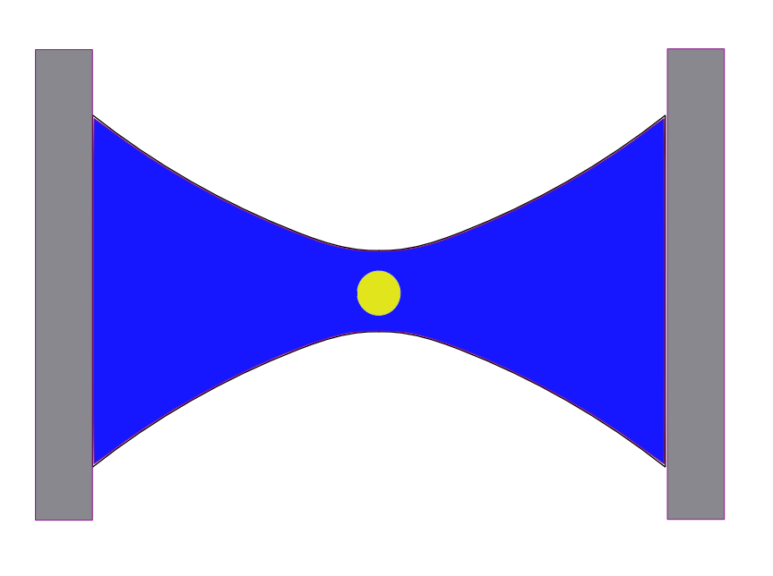
Suppress dissipation / decoherence Optically levitated nanoparticles
( Aspelmeyer, Quidant, … )
Dielectric nanosphere trapped in maximum optical field (harmonic trap)
Center of mass motion = Mechanical resonator (3 axis) with PURE OPTICAL SPRING
(NO MECHANICAL - CLAMPING LOSS) Strong Decoupling between CM and bulk modes !
ULTRA-HIGH Q up to 10⁷-10⁸ DEMONSTRATED at room T
Limited by residual GAS ( typically Q<10⁶ for nanoresonators )

Slide 11
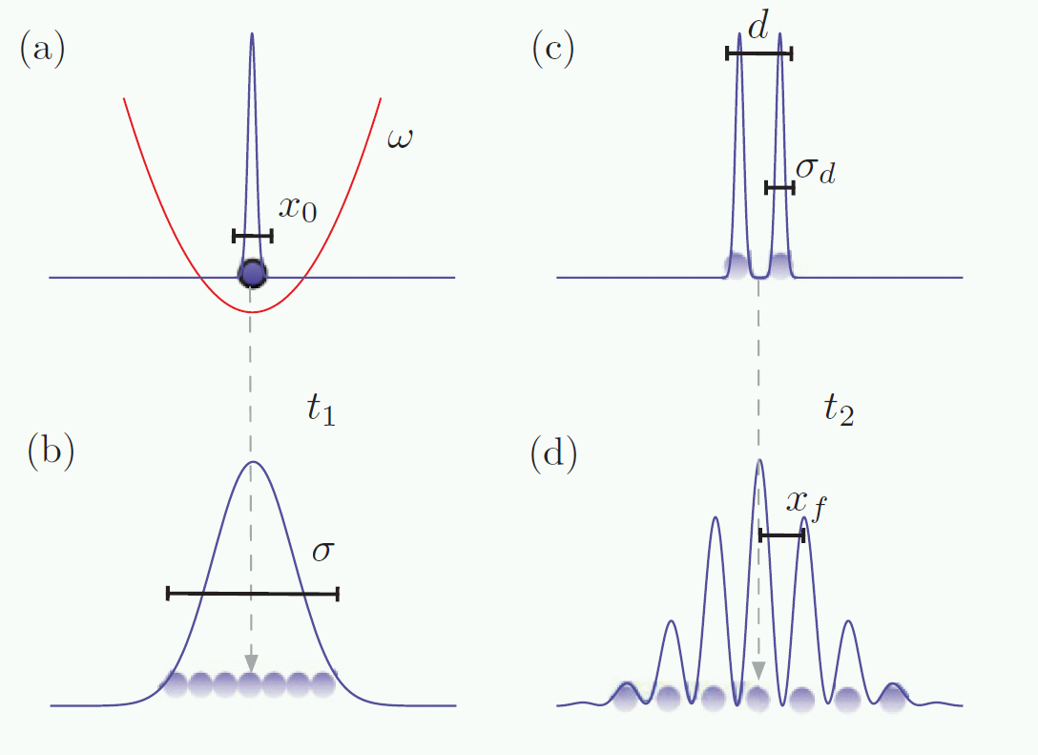
Wavefunction expansion protocols to test decoherence and collapse models
COOLING TO GROUND STATE of nanoparticle in the harmonic trap
Removing optical trap: COHERENT EXPANSION OF WAVEFUNCTION IN FREE SPACE
Virtual double slit (x² measurement)
Measurement
O.Romero-Isart et al, Phys. Rev. A 052121 (2011)
Kaltenbaek et al. Experimental Astronomy 34, 123 (2012)
(MAQRO proposal)

Slide 12
The Problem: NANOPARTICLE OVERHEATING !
Particle absorbs energy from trapping laser and re-emits Blackbody
Need to cool bulk at least below 100 K (MAQRO proposal: T=90 K) Otherways decoherence from BB radiation will eventually dominate
Example: R=50 nm, Δx=100 nm

Slide 13
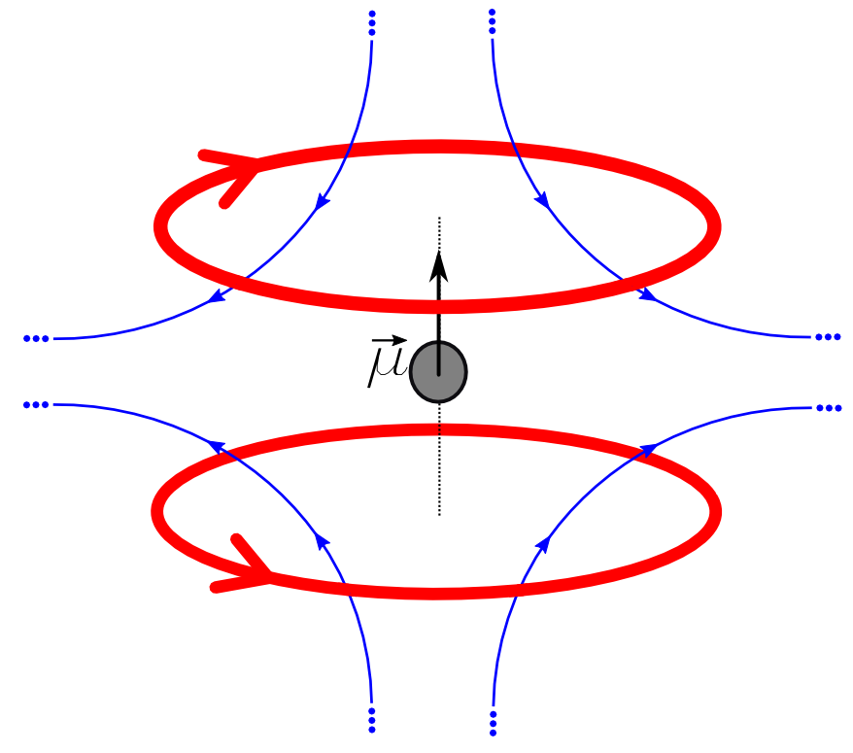
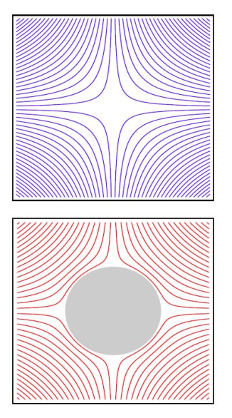
A better way? Magnetic levitation!
(O. Romero-Isart et al, PRL 2012)
SUPERCONDUCTING MICROPARTICLE
trapped in a magnetic field
(zero-field point)
PURE MAGNETIC SPRING
NO CLAMPING LOSS (as in optical case) !
ULTRAHIGH Q foreseen (Q>10⁹)
Field lines
KEY ADVANTAGE over OPTICAL:
NO power absorption (Trapping field is static !)
LOW TEMPERATURE operation is possible

Slide 14
Magnetic Levitation: Summary of attracting features
NO CLAMPING LOSSES as in optical levitation
NO BLACKBODY PHOTONS
(T<10 K is sufficient)
NO RESIDUAL GAS ?
T<0.1 K: Vapour pressure of everything (He included) → $\text{exp}\left[−∞\right]$
Looks like a PROMISING SYSTEM
But no experimental attempt yet !

Slide 15
Realistic proposal: do a first experimental exploration
Levitate type I (Pb) superconducting microparticles (D∼1-10 μm)
Trap resonant frequencies up to 20 kHz
Q>10⁹ at T≈100 mK
10⁴ improvement in T/Q compared to current optical levitation
Notes:
.

Slide 16
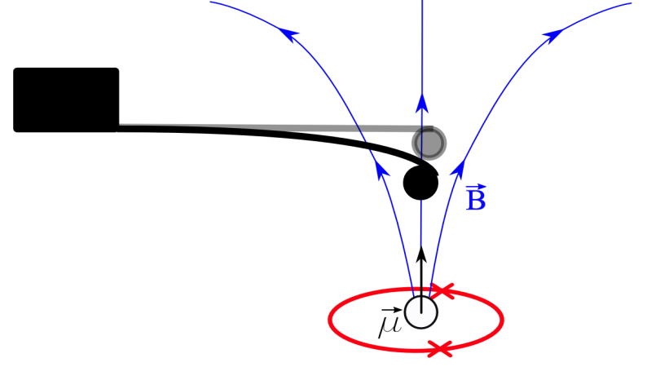
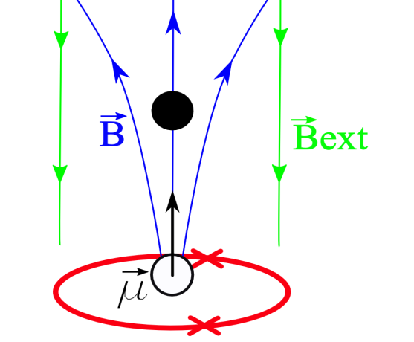
Levitation schemes
1) Cantilever with SC microparticle
above a micro-ferromagnet
“Semilevitation”
SQUID readout
Magnetic spring dilution
2) Levitation above micro-ferromagnet
Easy “setup” (2D circuit)
SQUID readout
Need weak external field to stabilize
3) Anti-Helmholtz Coils Trap
3D microfabrication
Tunable symmetric trap
SQUID or Microwave LC

Slide 17
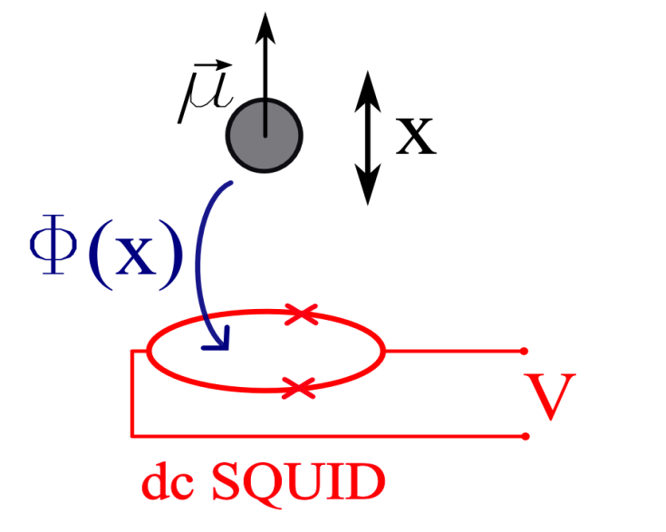
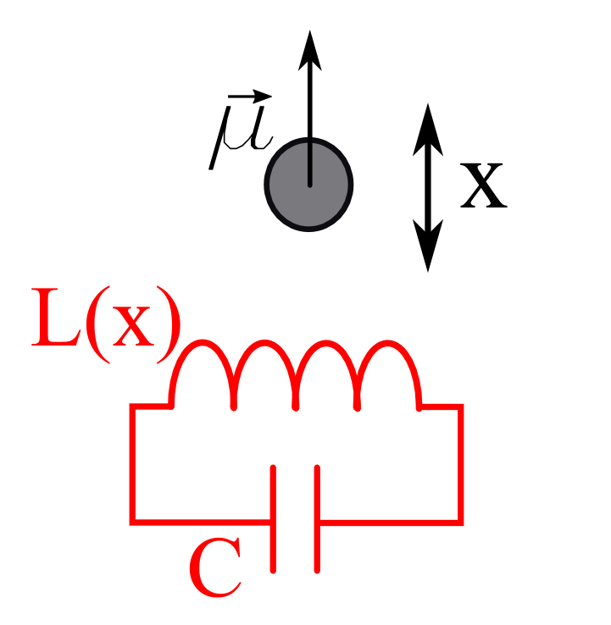
Ultralow power detection techniques
Conventional dc SQUID
Sensitive near quantum limited magnetometer based on Josephson effect.
FEEDBACK-COOLING techniques to freeze the CM motion close to ground state
A. Vinante, Appl. Phys. Lett. 105, 032602 (2014)
Microwave LC-detection
Motion of SC particle changes inductance L of a pick-loop embedded in a LC resonator
Measure LC frequency shift (standard optomechanics scheme)
Allows for ground state cooling

Slide 18
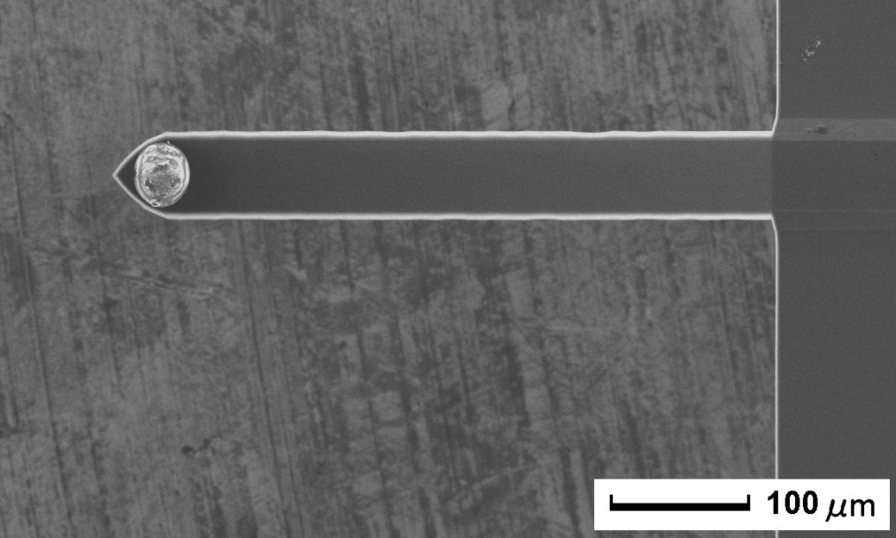
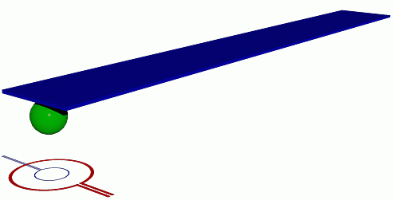
Preliminary results: Superconducting microparticle on a cantilever
Superconducting (Pb) Microsphere on a silicon microcantilever
Weak B field (100 μT) through a on-chip microcoil (RED loop)
SQUID readout (BLUE loop)
Coupling and magnetic spring (frequency shift) in agreement with Meissner effect
Displacement sensitivity 20 pm/√Hz
A. Vinante, Appl. Phys. Lett. 105, 032602 (2014)

Slide 19
Very high mechanical Q - low T/Q
Surprisingly high Q>10⁷ given the thickness (2 μm) and the manual glueing
Observed behaviour in agreement with tunneling two-level systems model

Slide 20
Other applications of levitated microsystems: force sensing applications
Ultralow force noise ∝ T/Q ∼ 1 zN/√Hz (=10⁻²¹ N/√Hz )
Indirect effects of collapse models (anomalous diffusion)
Exotic forces at μm scale:
nonnewtonian gravity
spin-gravity

Slide 21
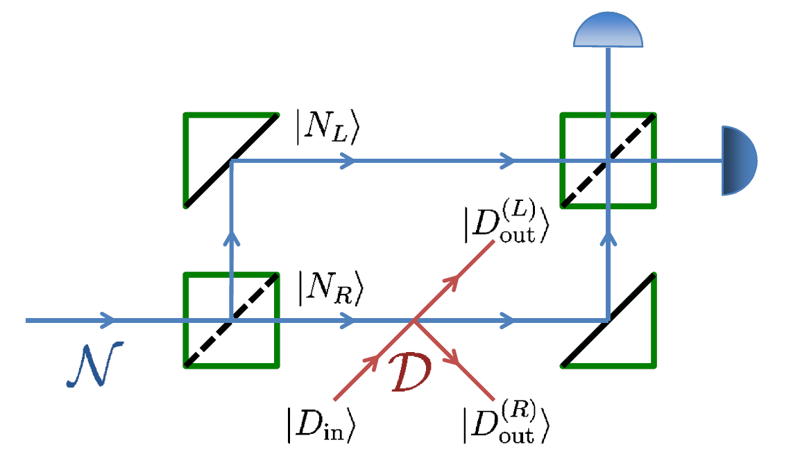
Decoherence as sensor of classically undetectable dark matter?
C. Jess Riedel, Phys. Rev. D 88, 116005 (2013)
Hypothetical Dark Matter with:
Mass < 1 MeV
spinless
only elastic scattering with ordinary matter
CLASSICALLY UNDETECTABLE
However, DM would still cause decoherence of a massive superposition !
Distinguishable by other effects through DM modulation
Is such candidate compatible with cosmology/particle physics ? May be ( J. Bateman et al, Scientific Reports 2015 )

Slide 22
Conclusions
MAGNETICALLY LEVITATED MICROPARTICLES are in principle a nearly ideal system to probe macro-limits of Quantum Mechanics, ie Decoherence vs Collapse Models
The FIELD IS ESSENTIALLY UNEXPLORED (at micro-scale). Unique experimental opportunity TIMELINESS
Simple “explorative” levitation schemes are not very demanding Symmetric Tunable trap requires more work
EXTRA-APPLICATIONS of INFN interest can devised (force sensing, UNCONVENTIONAL DARK MATTER DETECTION)

Slide 23
Extra-Slides

Slide 24
DUE TO LOW DECOHERENCE, LARGE AND MASSIVE DELOCALIZATIONS BECOME POSSIBLE !
Example: diameter=1 μm, Δx=1 μm

Slide 25
Possible sources of dissipation / decoherence
Intrinsic losses in superconductor (quasiparticles and residual surface loss)
Negligible if T<<T_{c} and f<<f_{gap}
Vortices in superconductor Absent in Type I superconductor (unlikely even in Type II microspheres)
Ferromagnetic losses (ferromagnet scheme only)
Negligible provided that the ferromagnet particle behaves as single domain.
Eddy currents in ferromagnet (ferromagnet scheme only) Negligible down to Q=10¹² level.
Absent if a insulating ferromagnet is used
Magnetic coupling to the nearby substrate (paramagnetic spins or others)
Can be suppressed by playing with distance from substrate
Coupling to readout losses? Use non-dissipative SQUIDs

Slide 26
Other technical sources of decoherence
Trap frequency fluctuations, due to coil current fluctuations or vibrations
∝ ω₀² S_{ω} (2ω₀)
Trap center fluctuations, due to vibrational noise
∝ ω₀² S_{x} (ω₀) / x²_{zp}
Solutions:
Persistent current in superconducting coils
Strong passive vibrational attenuation (< 10⁻²⁰ m achieved at f>1kHz in gravitational wave detectors)

Slide 27
Thermalization under continuous measurement
Power dissipation ∼ aW in the superconducting particle (residual surface resistivity) due to continuous measurement using microwaves (or SQUIDs).
To maintain particle overheating T< 100 mK, a residual gas pressure of the order of 10⁻¹⁰ mbar is needed to remove power.
It may be possible to probe the particle temperature by measuring the frequency shift due to T-dependent penetration depth, for Tc/2 < T < Tc

Slide 28
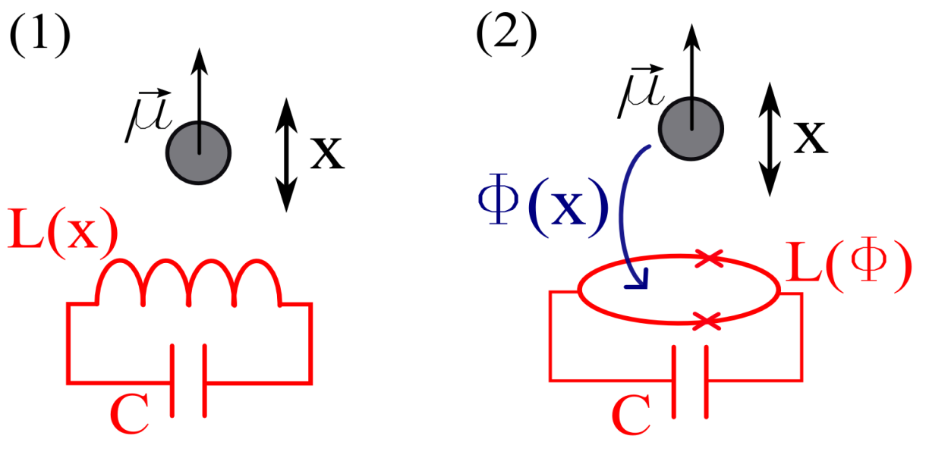
Microwave optomechanics
H_{int}=-hg₀aa⁺(b+b⁺)
a: cavity LC mode
b: mechanical mode
Assume: L pick-up loop radius r=10 μm,
microsphere radius a=2 μm
Trap frequency 12 kHz
Pure diamagnetic inductance shift : g₀ ~ 1 Hz
Flux-induced “SQUID” inductance shift: g₀ ~ 10³ Hz
Ground state cooling achievable for cavity decay rate κ ~ 10⁴ Hz
Very high coupling factor g₀ compared to relevant damping rates!

Slide 29
Decoherence: an example
1 μm
Any environment particle (residual gas, blackbody photon) scattering off the body gets entangled with the mass position, recording “which-path” information. This leads to localization.
Localization time = decoherence time ∼ 10⁻¹⁶ sec !!
(Room pressure and temperature)

