Slide 1
Neutron imager and flux monitor based on Micro Channel Plates (MCP) in electrostatic mirror configuration
Vincenzo Variale INFN-Bari, Italy
MCP detector features
Neutron detection with MCP
Proposal of a new Neutron Beam Monitor based on MCP
Monitor design
Conclusion

Slide 2
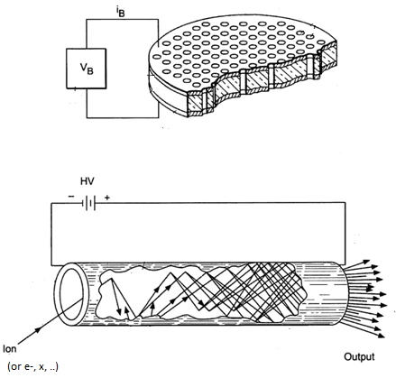
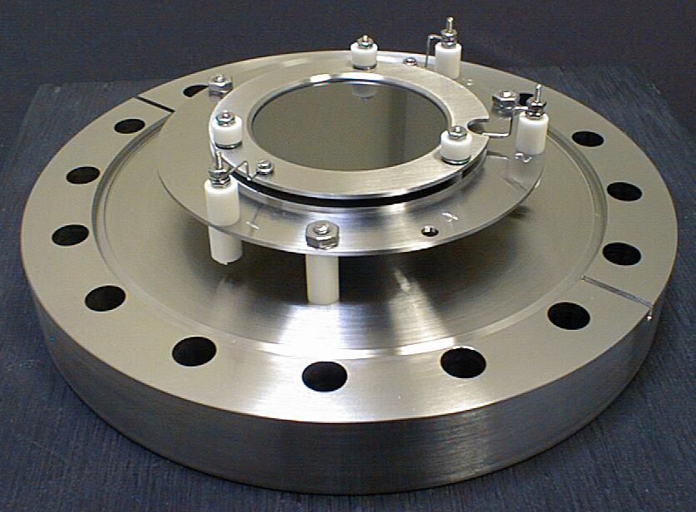
The Micro Channel Plate (MCP) features
The MCP consists of a two-dimensional array with a great number of very small glass channels bundled in parallel and formed into the shape of a thin disk. Each channel has an internal diameter ranging from 6 to 20 microns with the inner wall processed to have the proper electrical resistance and secondary emissive properties.
MCP behavior scheme
Each channel acts as an independent electron multiplier →
d
L
Gain = exp(k .L/d) (k=channel e⁻ emission factor)

Slide 3
Advantageous MCP features for detection
fast time response (rise time ˞ 300 ps, fall time 600 ps)
high spatial resolution (up to 6 μm for single MCP, 25 μm for a 2-stage MCP)
Very low dead time (depending on d, for a d ≈ 6 μm, about 100 ns)
High Counting rate (more than 10⁸ s⁻¹)
Low dark current (for a vacuum < 10-6 mbar, < 1Hz/cm2)
Detection efficiency (up to 85% depending on the radiation type → see following )

Slide 4
MCP detection efficiency
Types of Radiation | Energy or wavelength | Detection Efficiency (%)
Electrons | 0.2 keV to 2 keV 2 keV to 50 keV | 50 to 85 10 to 60
Ions (H+, He+, Ar+) | 0.5 keV to 2 keV 2 keV to 50 keV 50 keV to 200 keV | to 58 60 to 85 4 to 60
UV | 300 Å to 1100 Å 1100 Å 1500 Å | to 15 1 to 5
Soft x-rays | 2 Å to 50 Å | 5 50 15
Hard x-rays | 0.12 Å to 0.2 Å | to 1
High energy particles (ρ,π) | 1 GeV t 10 GeV | to 95
Neutrons | 2.5 MeV to 14 MeV | 0.14 to 0.64
From Ref.[1]
For e⁻ around 1 keV is ≈ 80%
Very low efficiency

Slide 5
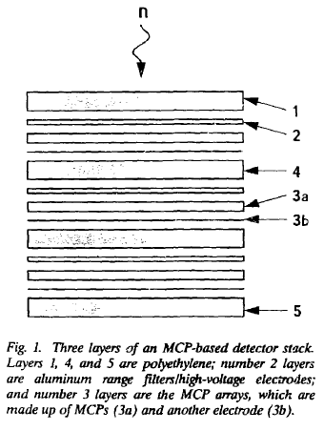
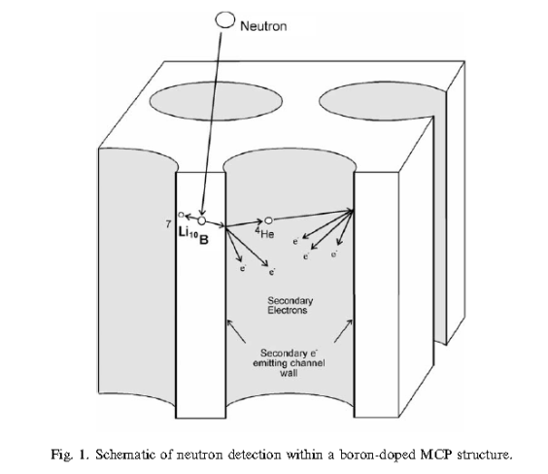
Neutron detection with MCP: past proposal
In 1987 →
Fast neutron detection proposed by D. W. MacArthur, Los Alamos [2]
In analogy with Multi Wire Proportional Chamber (MWPC) detector
MCP for proton detection
Polyethylen layers for fast neutron → proton recoils
In 1990 →
Frazer and Pearson proposed to dope directly the MCP with ⁶Li atoms [3] to detect thermal neutron.
Some years later, Tremsin et al used ¹⁰B [4]
Behavior scheme
Note: ¹⁵⁷Gd or ¹⁵⁵Gd have been also used as doping element
Position sensitivity 10 μm
Time accuracy about 100 ps
Detection efficiency ~21% (low)
→ The detection efficiency depends on ¹⁰B doping percentage ( < 20%)

Slide 6
In 2012 →
The ¹⁰B doping concentration is limited by production process of the MCP glass
→ low neutron detection efficiency .
In order to increase the neutron detection efficiency, a ^{nat}Gd coating has been
proposed by Nianhua Lu et al. in ref [5] on the MCP channel
They used Atomic layer deposition (ALD) technique to implement the ^{nat}Gd₂O₃ film
coating process. In [5] about 100nm of ^{nat}Gd₂O₃ film on the inner surface of MCP pores
has been realized. Simulations show a detection efficiency of 60 ÷ 70 % can be reached
in this way.
Note: The ALD technique can give uniform layer also for large values of L/D (~37) but that technique is not easy to realize.

Slide 7
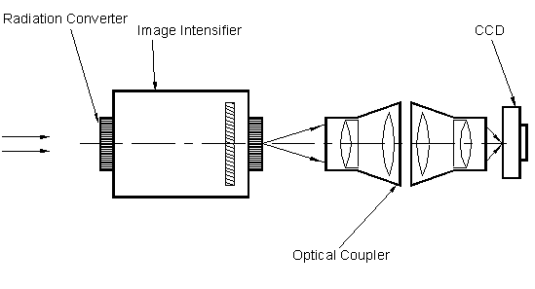
Commercially available Neutron detector with image intensifier (MCP inside)
The radiation converter is doped with ¹⁵⁷Gd
luminescent screen + multialkali photocathode
Neutron beam
MCP
Note: the detection device and the read-out system is on the same axis of the neutron beam

Slide 8
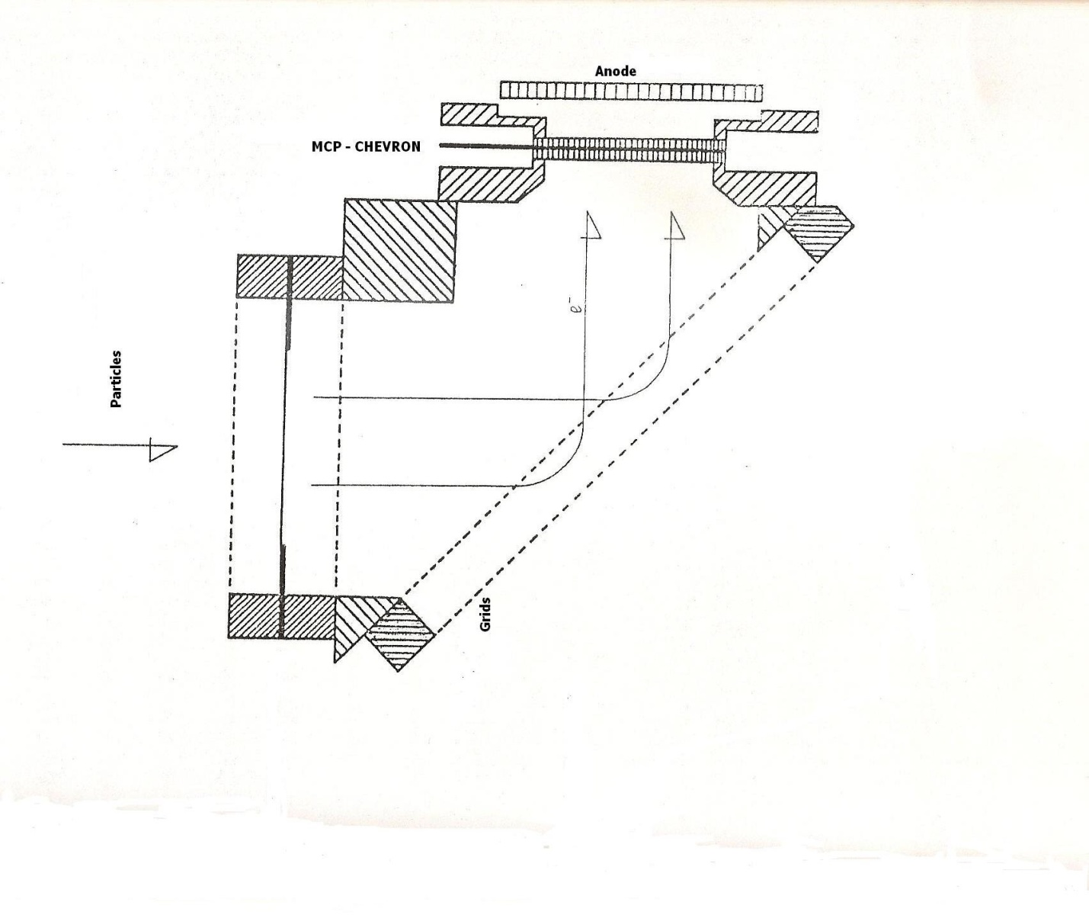
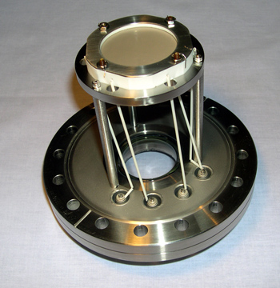
Neutron beam monitor with a MCP in an Electrostatic Mirror
In this configuration the neutron beam profile image is obtained in the transverse
plane (the plane parallel to the beam) →
To detect the neutrons a Carbon foil with
a ⁶Li deposit could be used
Stainless steel
Plastic
Neutron
e-
⁶Li
t
α
e-
Grids at ~1,2kV
Note: The Secondary electrons (SE) are emitted with few eV (black arrow) and then they are
accelerated by the 1kV grid towards the grids placed at 45° in such a way
that they are deflected towards the MCP in CHEVRON configuration.
Note :as detection readout it can be used a phosphor screen instead of a anode and in this way
we could obtain a neutron beam profile

Slide 9
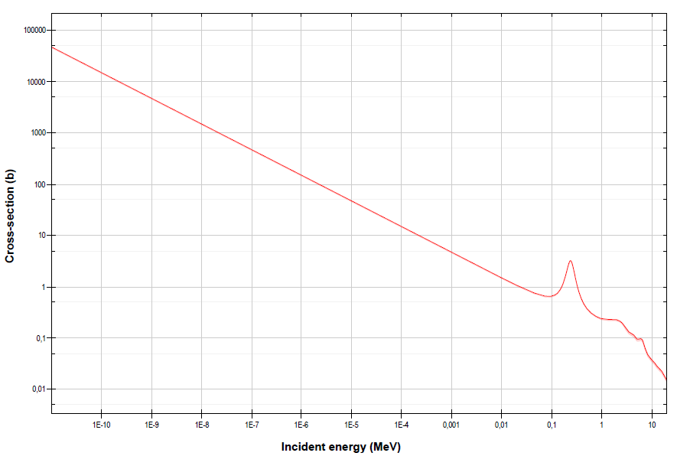
The neutron detection efficiency: neutron counting
The detected neutron number will depend essentially on the cross- section reaction used:
n + ⁶Li → t + α (con Q = 4.7 MeV)
T_{t} = 2.7 MeV
T_{α}= 2.0 MeV
For the conservation law: m_{t}/m_{α}=T_{t}/T_{α}
Note: for the above energies , the range of α is about 5 μm In the C foil and 22 μm in the Li
the range of t is about 30 μm in C and i 120 μm n the Li )
Note: assuming a carbon foil of about 20 μg/cm² we get a corresponding tickness of l_{c} = 9 μm
which allows the 100% transmission of t ions but stops all the α .

Slide 10
Note: However a neutron flux , usually, do not have a unique energy but a very large energy distribution then a more
realistic capture reaction rate evaluation can be done only through MC simulations. The MCNPX code has been used for that.

Slide 11
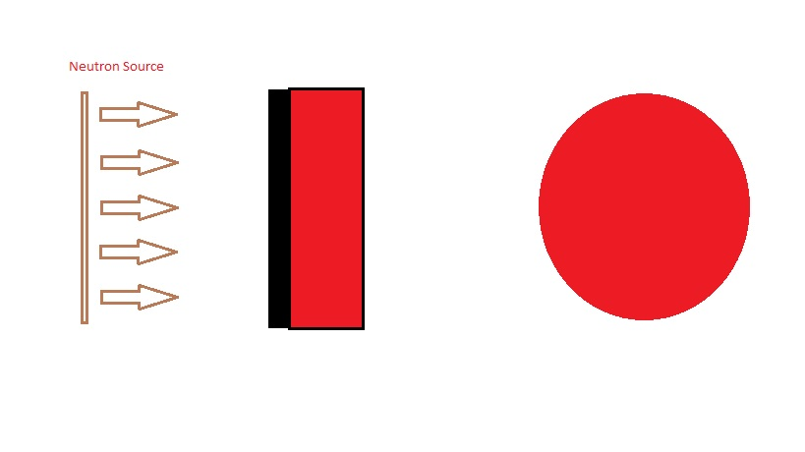
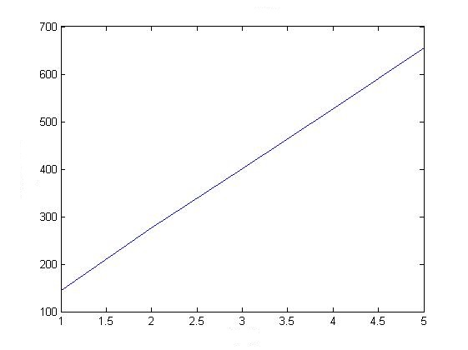
MCNPX simulations for N_{t} evaluation
MCNPX Geometry:
Parameters used in the simulations:
r = 2. cm
l₁ = 1, 2, 3, 4, 5 μm ; l₂ = 9 μm
d_{n} = 4. cm
As source → CERN n_TOF neutron flux
N_{t} are the Triton exiting by the C foil (x p pulse)
⁶L_{i} deposit depth
Transverse
section
r
d_{n}
N_{t} /cm²
l₁
l₂
Carbon foil
Note : to get the effective neutron counting, N_{t} should be
multiplied for the intrinsic 1 keV electrons MCP detection
efficiency shown before.
l₁

Slide 12
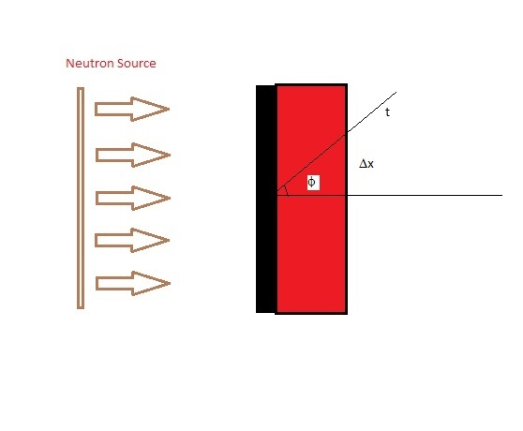
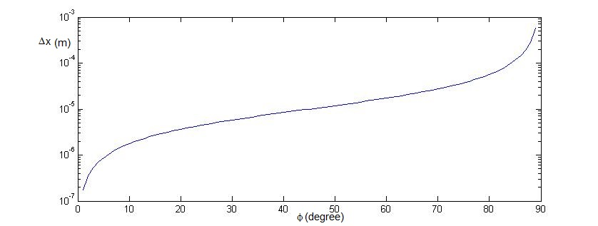
Neutron position uncertainty evaluation
The reaction ⁶Li(n,t)α is isotropic → triton coming out from C foil are uniformly
spread out through a cone angle φ up to 90° (see fig.)
neutron position uncertainty = Δx = l tgφ → few tens of μm
l
Note: the most part of t should be emitted with angle φ < ~85° (corresponding to a Δx < ~100μ).
Furthermore the beam profile image precision will depend also on the SEE trajectories → Simulations with SIMION

Slide 13
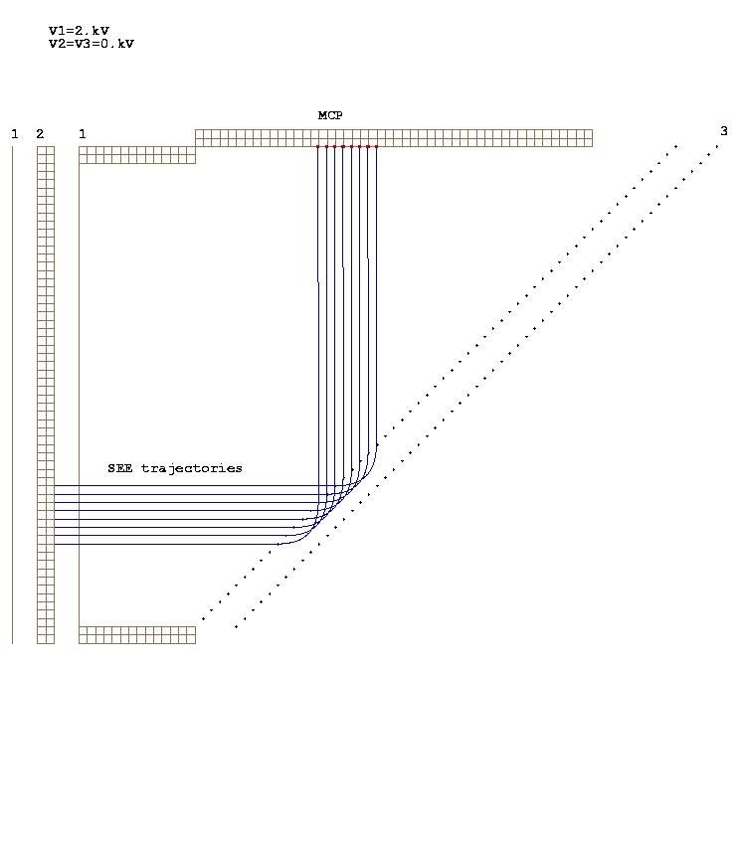
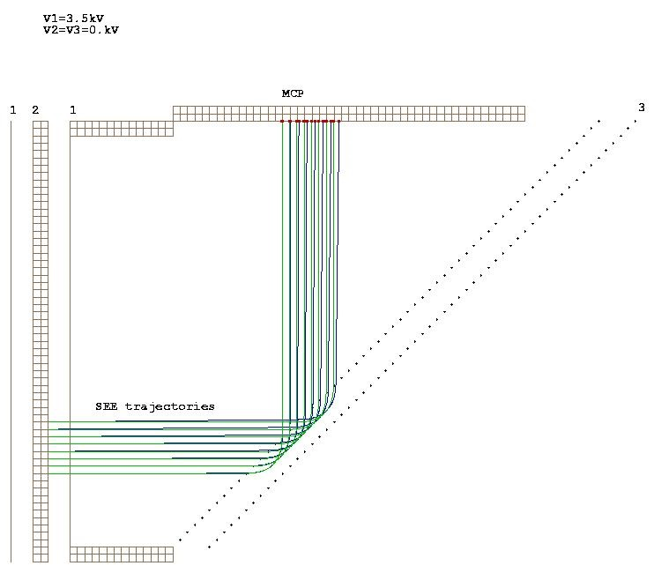
SE trajectory simulations in the Electrostatic mirror
Trajectory simulations of 8 equidistant SE :
y_{n} → initial positions of the n_th SE
E_{kn} → initial kinetic energy (increasing from 1 to 8 eV)
→ emission Cone angle =0 for all SE)
x_{n} → final positions of th n_th SE (x_{n} remain equidistant)
Trajectory simulations for φ ≠ 0 (blue-lines); E_{kn} = 4 eV for all SE
x_{i}’→ final positions of n_th SE for
δx_{i} → x_{i}’ – x_{i ←} (deformation)
→ SE trajectories with φ =0 (green lines) are shown for comparison
Δx
y
φ_{n} increasing up to 20°
Δy
x
z
Note: the initial SEposition differences are maintained
on the MCP plane → Δy = Δx
→ That means the beam image in (y,z) is
preserved in (x,z) plane (MCP plane).
Note: for φ_{n} = 20° → δy_{i}= 80%
this maximum deformation results
is due to the high initial kinetic
energy used.

Slide 14
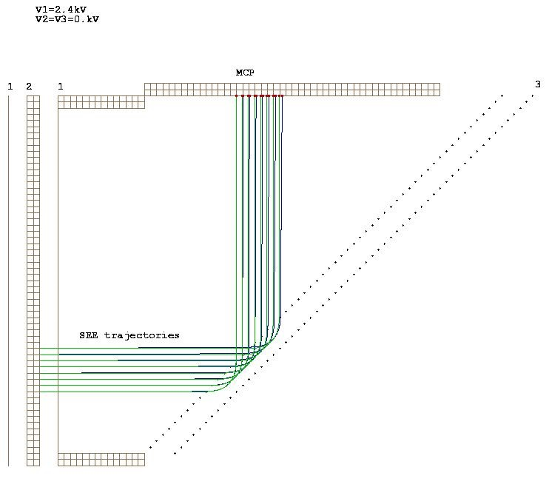
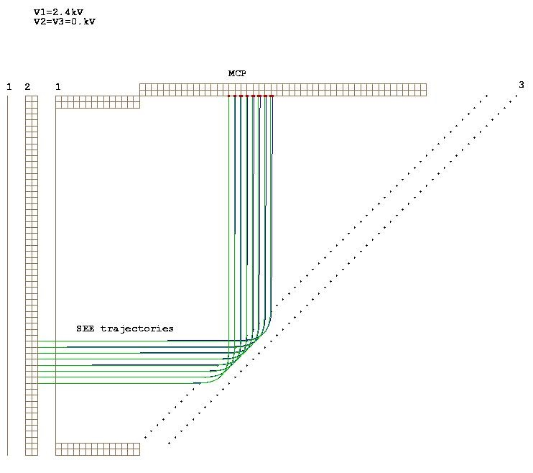
By reducing the initial kinetic energy to 1 eV
a deformation, δy, of ≈ 20% is obtained →
(φ_{n} increasing up to 20°
SE tajectories with Ek =2 eV Seand increasing cone angle with
a maximum φ =10° → maximum deformation, δy, of ≈ 10% .
Note: SE with emission cone angle, φ < 10°, and
initial kinetic energy of ≈2 eV can be considered
good SE initial conditions →
Tajectories simulation with a large number of SE
have been also considered →

Slide 15
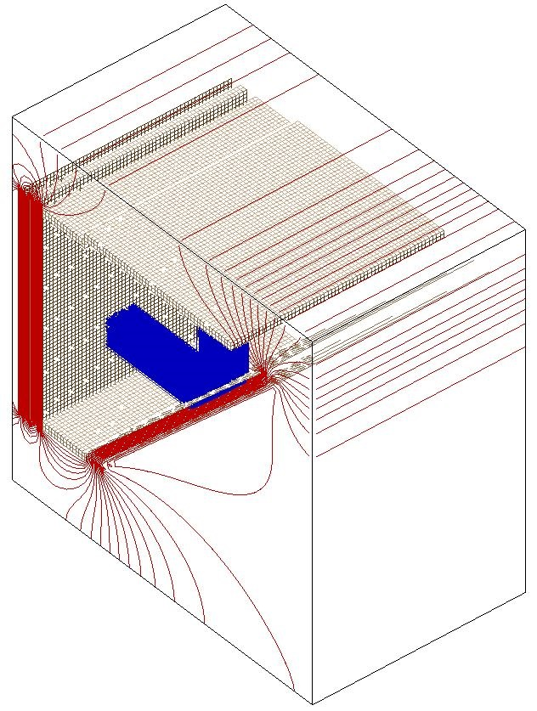
Simulations of ≈ 1000 SE trajectories which have a square shaped initial position (Δy=Δz=8mm) and a flat distribution in the emission cone angle and initial kinetic energy.
Further initial conditions used:
E_{ki}= 2 eV with PERCENT_ENERGY_VARIATION = 50%
SE Emission Cone_Angle = 10° (max. value)
Δy_{i} = 8 mm
→ deformation: <δx’> = 6%
3D view
SE with Flat distribution in φ and E_{k}

Slide 16
Summary of simulation results
The beam profile in the (y,z) plane (perpendicular to the beam axis) is reproduced on the MCP, the (x,z) plane (the one parallel to the beam axis).
The image quality depends strongly by the SEE initial conditions
Good quality beam image can be obtained for SE with initial conditions having E_{ki}= 2 eV and Φ_{i}< 10°.
It is important evaluate the SEE initial conditions to evaluate the beam image
quality and then the spatial resolution

Slide 17
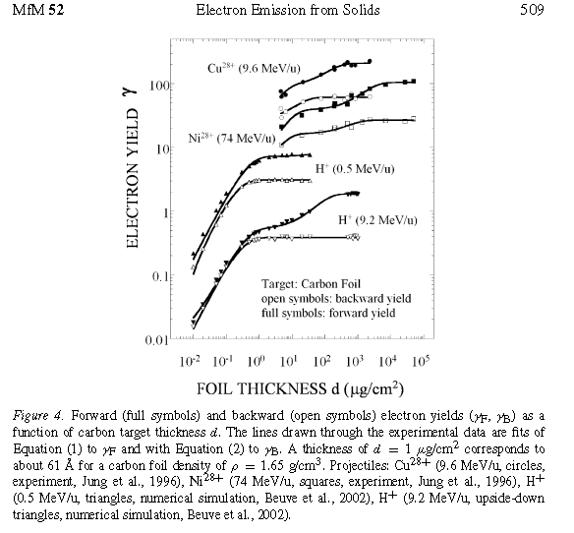
Initial condition features for SE Emission
The SEE depend on the stopping power of the particles impinging or exiting from the foil surface.
The forward SEE can be greater than the backward SEE up to a factor 1.55.
The SEE energy distribution, due to ions with energy of about few MeV, has a peak around a value of few eV.
Forward and backward SEE Yield measurements carried out on
ions hitting a Carbon foil target, with different energies.
Ref.: - N Nickles, R. E. Davies and J. R. Dennison, ”Applications of
Secondary Electron Energy and angular distribution to space
Charging”, 6th SPACE CHARGING CONFERENCE, AFRL-VS-TR 20001578 (1998).
- h. Rothard and B. Gervais, “Electron Emission from Solids Irradiated with Swift Ion Beams”, in ION BEAM SCIENCE; Solved and unsolved problems, Ed. By P. Sigmund, Royal Danish Academy of Scienc and Letters, Copenhagen 2(006).
- A. Billeband et al. “Ion by ion measurements secondary electron emission of carbon foils under theimpact of MeV H+, H0, H- projectiles” on Phys. ReV. A , vol. 55, N. 2 Feb. 1997.

Slide 18
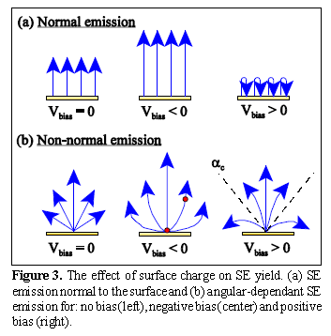
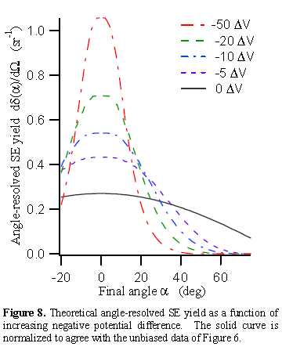
Angular distribution of the SEE
SEE angles can be reduced by applying a negative bias to the emitting surface
In first approximation theory
emission angle could not
be considered.
The SEE angular distribution probability
Can be given by:

Slide 19
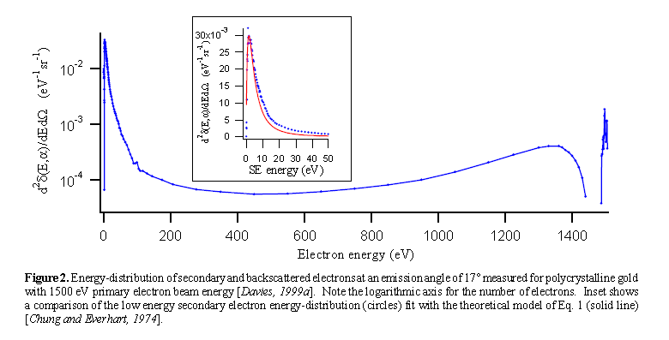
Energy distribution of SEE
CONCLUSION: the SE initial conditions used in the trajectory simulations shown in the slide 15
That is: E_{k} ≈ few eV and the emitted cone angle φ <10° have been reasonable assumptions.

Slide 20
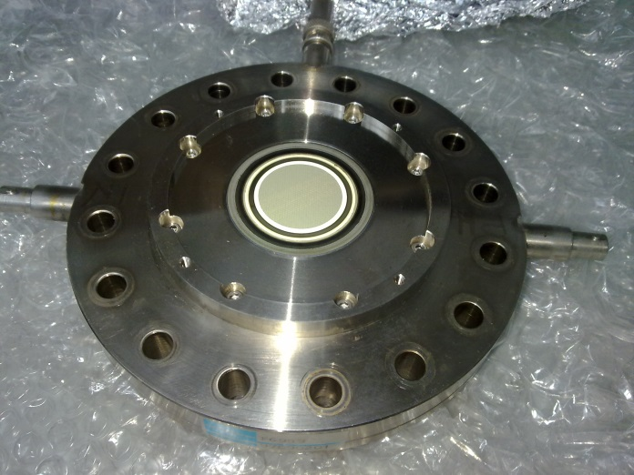
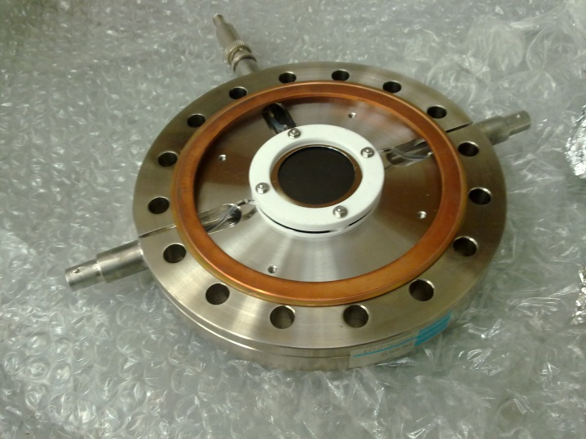
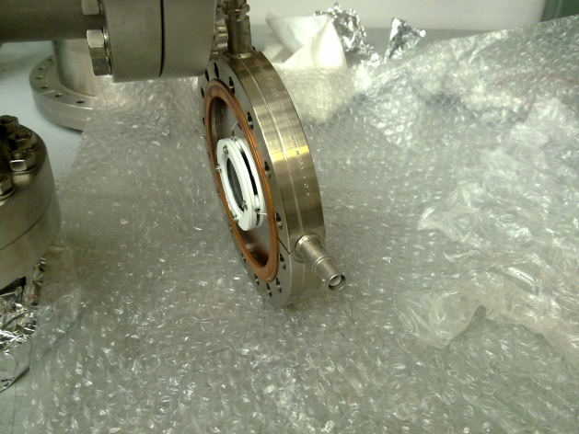
Monitor construction
→Not enough funds obtained, but we had in our lab. a MCP + phosphor screen assembled
on the vacuum flange (Hamamtsu) used in the past.
The phosphor screen is of P47 type (It has an afterglow time very short (0.11 μs) and a light emission in the range 430 nm →
A CCD camera with a high sensitivity in that light wavelength is needed.
MCP phosphor window (Air side)
MCP assembly (vacuum side)
Note: it need to be regenerated and will be ready in 3 month

Slide 21
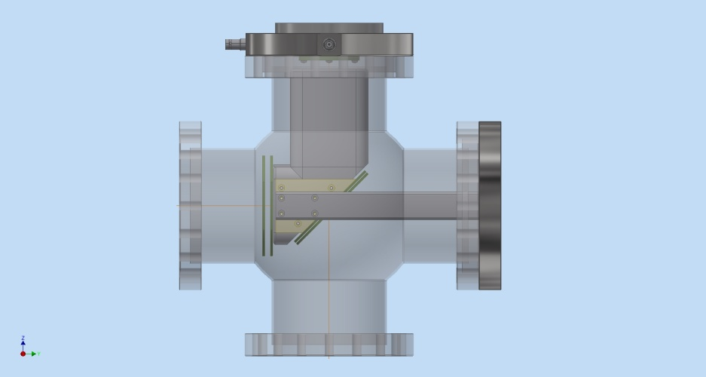
That vacuum flange which will be mounted on a Cross shaped vacuum chamber → The MCP will be about 8 cm away from the neutron beam axis where the electrostatic mirror must be placed →
Flange with MCP
Vacuum chamber
d
n
Electrostatic mirror
Device mechanical drawing
→The beam profile image quality shown in
previous simulations will be still
maintained?
MCP Assembly (vacuum side)
→ New simulations of the modified electrostatic mirror design are needed

Slide 22
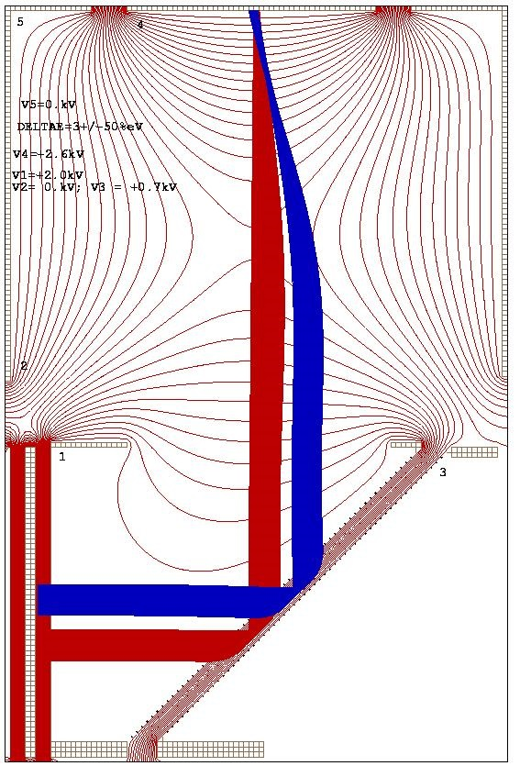
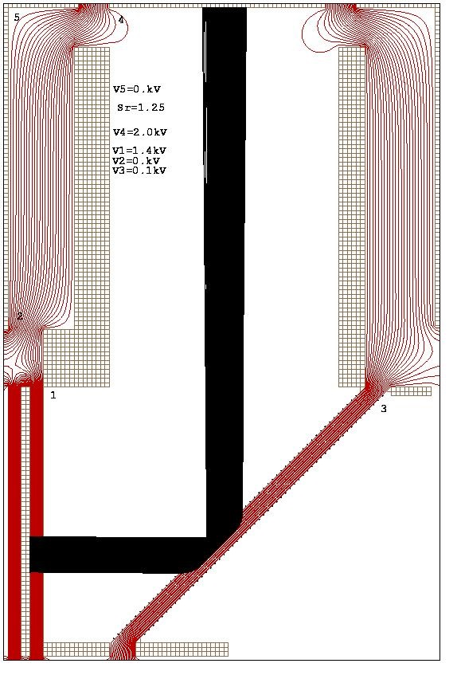
Further SE trajectory simulations for the modified electrostatic mirror configuration →
→ The vacuum chamber walls are on the ground then the beam profileimage on MCP results deformed →
Δx
MCP (V4)
MCP
Electrons
Equipotential lines
Vacuum chamber walls(V5)
d_{F}
By shielding the vacuum chamber
wall with the electrode 1
Neutrons
Δy
Note: in this case, however, we have
a Δy/Δx ~ 1.35 instead of 1.04
Note: the 2 arrow indicate neutron beams entering the ⁶LiC foil from 2 different positions.

Slide 23
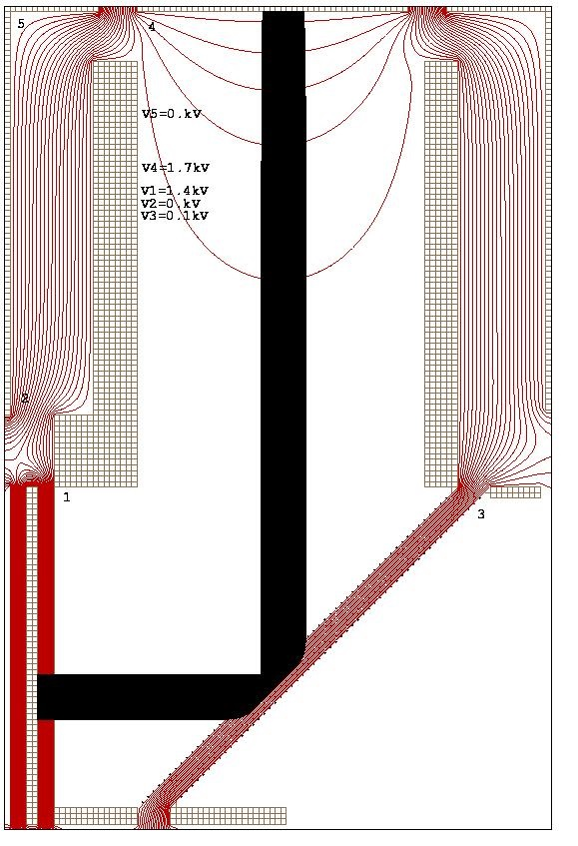
Electrostatic lens
In order to reduce the SE divergence the input
MCP surface can be put to a higher voltage than
the electrode 1 to obtain a focusing lens as
shown in the simulations →
Inside the vacuum is shown the Electrostatic mirror
mechanical design:
MCP
Shielding electrode
Grids with C foil
insulators
Support bar
Cross vacuum chamber
Reflecting grids

Slide 24
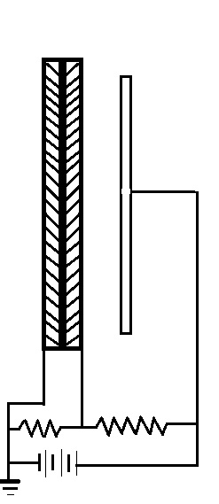
The Phosphor screen coating the Fiber Optic Plate (FOP) window present on the vacuum flange is of P47 type. It emits in a wavelength range peaked at 430 nm (UV) but has also a long tail in the visible light region.
Read out system
Phosphor screen
MCP- Chevron configuration
PC
Lens
CCD camera
2 MΩ
4 MΩ
V=+6kV max.
The phosphor light will be detected by a CCD camera (of type Kodak KAF 1400, sensivity in wavelength range 400 ÷ 1000 nm, it has 1317x1070 pixels of 6.9 μm and a resolution of 40 line-pair/mm (→ 25 μm)).

Slide 25
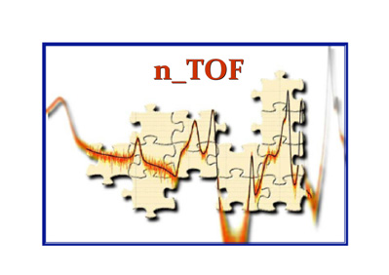
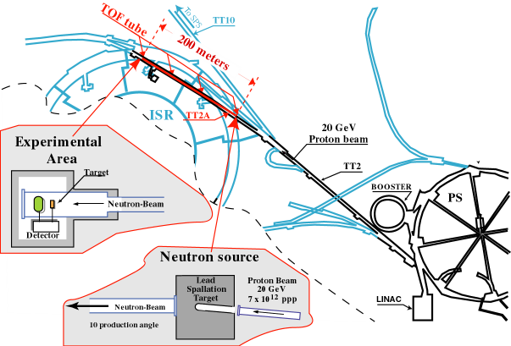
CERN n_TOF facilty
n_TOF is a spallation neutron source based on 20 GeV/c protons from the CERN PS hitting a Pb block (~360 neutrons per proton).
Experimental area at 200 m.
Main feature: very high instantaneous neutron flux (10⁵ n/cm²/pulse):
high resolution in energy (ΔE/E = 10⁻⁴)
wide energy range (25 meV<E_{n}<1GeV)
low repetition rate (< 0.8 HZ)

Slide 26
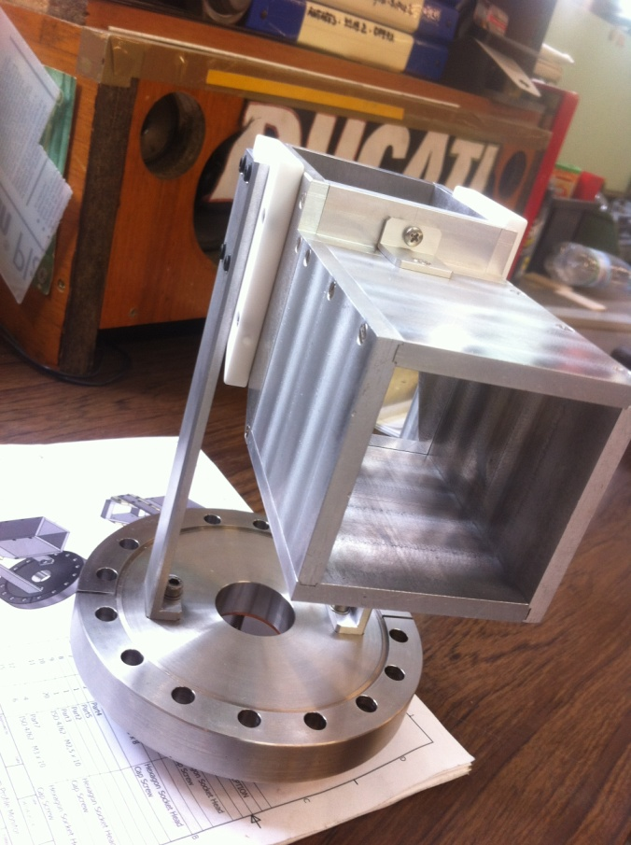
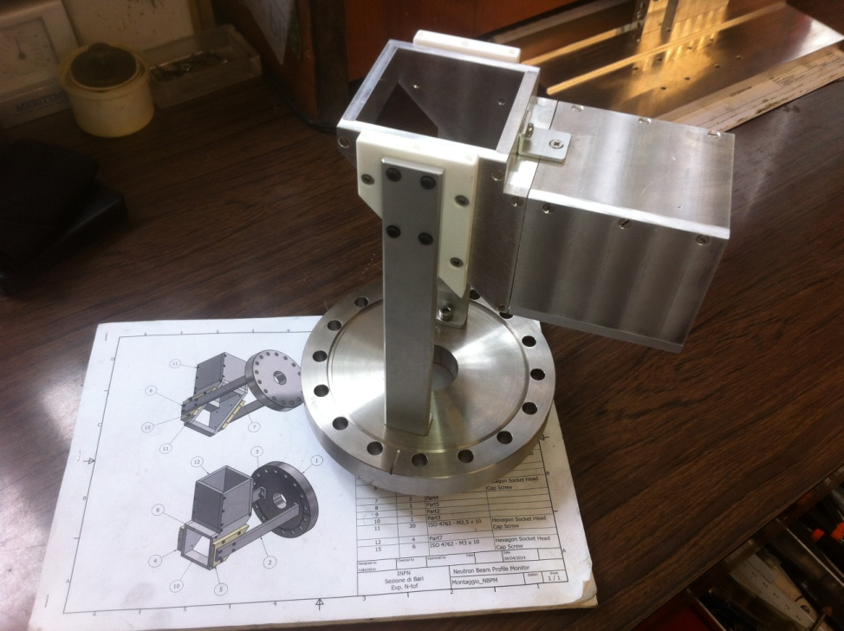
Electrostatic Mirror in construction:

Slide 27
Conclusion
A new kind of neutron beam imager with minimal perturbation of the
beam based on the 6Li(n,t) reaction is being considered for various applications.
It uses a MCP assembled with a phosphor screen and an electrostatic mirror
that reflects the neutron beam profile image on a plane off the beam axis.
The Computer simulations show that the device could have a very good spatial
resolution (up to few hundreds of μm) and good efficiency.
The device is under construction and will be tested at the CERN n_TOF facility
the beginning of the next year.
References: [1] Hamamatsu MCP assembly data sheets; [2] Report LA- 11039-MS ; [3] NIM A293 (1990) 569; [4] NIM A539 (2005) 278;
[5] Physics Procedia 26 (2012) 61.

