Slide 1
Long term Upgrade of the ATLAS barrel muon trigger system
G. Aielli – LVL1 RPC workshop
ROMA– March, 26 2015

Slide 2
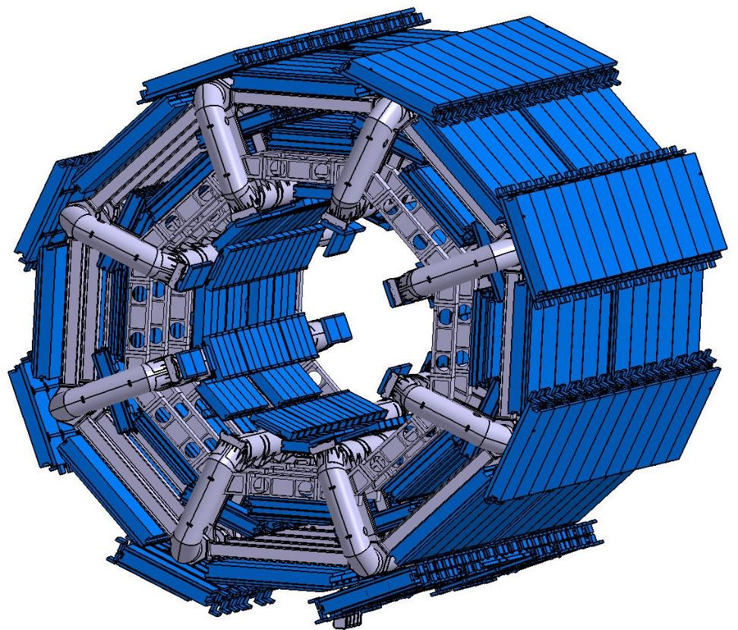

The ATLAS RPC Muon System today
No RPCs in the inner layer just MDTs
OUTER LAYER for High pT trigger
  One doublet chamber
MIDDLE LAYER for Low pT trigger
  Two doublet chambers
IN TOTAL 6 independent layers measuring Eta and Phi
Hard wired trigger system (on chamber)

Slide 3
Trigger and detector performance issues
The present barrel coverage is 73%
To keep the L1MU20 rate in a reasonable range we need to sharpen the momentum resolution and suppress fakes
It will be unlikely to keep the present level of selectivity of the RPC system since they have insufficient redundancy to face phase II condition
In both cases additional redundancy will solve the problem, as we will see…

Slide 4
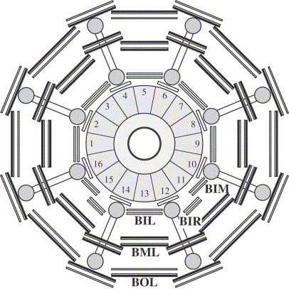
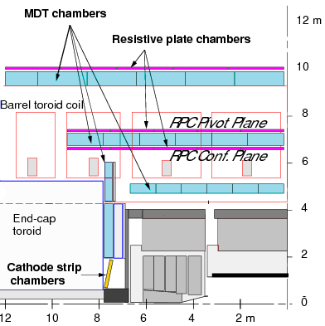
Trigger detector upgrade proposal: new rpcs
increase the redundancy by adding the RPC inner layer
  This idea was already considered in the original project of the barrel trigger detector, but at that time the need for the 3rd station was not stringent and it was canceled when a substantial downgrade was required to Atlas
BO
BM.PI
BM.CO
BI
10 layers instead of 6
4 chambers instead of 3

Slide 5
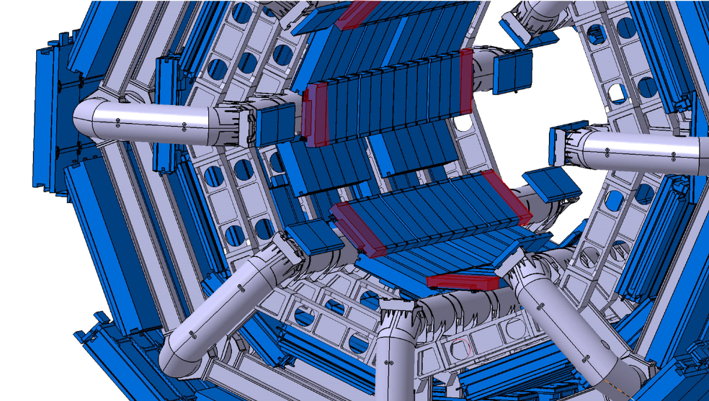
Complete the job: From the bis78 to the bi…

Slide 6
How it will look like…
BIL
BIS
BIS
New RPC doublet
New RPC doublet
New RPC doublet
New RPC doublet
sMDT
sMDT
New RPC doublet
New RPC doublet

Slide 7
Main advantages (anticipation)
The combination of a new electronics and an additional layer in the inner region will permit to gain several key advantages:
Coverage increase (from 73 → >96%) closing the holes in the barrel
Trigger robustness
  Increased redundancy to backup the old chambers
    → BI quadruplet can replace a BM fully
  Very efficient the new generation of RPCs can work at > 20 kHz/cm²
  stand alone dedicated system → reliable
Trigger selectivity
  Pileup insensitive due to High space –time RPC granularity ~ 0.5 cm² x 0.5 ns
  sharper momentum threshold→ increase of the lever arm

Slide 8
Improving The present RPC system - -performance and longevity

Slide 9
Background maps with 2012 data
Sector |  |  |  |  | RPC unit Id. along Z direction |  |  |  |  |  |  |  |  |  |  |  |  |  |  |  |  |  | Average (μA/m²)
Φ Id. | -7 | -6.2 | -6.1 | -5 | -4 | -3.2 | -3.1 | -2.2 | -2.1 | -1.2 | -1.1 | 01.01 | 01.02 | 02.01 | 02.02 | 03.01 | 03.02 | 4 | 5 | 06.01 | 06.02 | 7
01.01 | 40 | 42 | 37 | 36 | 29 | 19 | 14 | 17 | 13 |  | 9 | 8 | 9 | 14 | 15 | 16 | 18 | 26 | 36 | 34 | 36 | 30 |  | 23
01.02 |  | 38 | 35 | 38 | 28 | 21 | 16 | 18 | 16 |  | 10 | 9 | 10 | 15 | 17 | 17 | 19 | 28 | 40 | 35 | 39 | 38 |  | 24
2 |  | 16 | 26 | 24 | 18 | 14 | 12 | 10 | 9 | 7 | 7 | 6 | 7 | 9 | 10 | 13 | 12 | 18 | 26 | 25 | 21 |  |  | 15
03.01 |  | 37 | 37 | 38 | 26 | 18 | 16 | 15 | 14 | 9 | 9 | 9 | 10 | 16 | 16 | 16 | 17 | 26 | 38 | 34 | 36 |  |  | 23
03.02 |  | 38 | 36 | 39 | 27 | 19 | 16 | 18 | 15 | 11 | 10 | 10 | 9 | 16 | 17 | 19 | 19 | 26 | 38 | 33 | 37 |  |  | 23
4 |  | 14 | 23 | 23 | 20 | 14 | 12 | 9 | 10 | 7 | 7 | 6 | 7 | 10 | 10 | 12 | 14 | 20 | 24 | 23 | 20 |  |  | 15
05.01 | 35 | 27 | 27 | 32 | 21 | 13 | 13 | 16 | 15 | 9 | 9 | 9 | 10 | 15 | 20 | 13 | 15 | 22 | 31 | 24 | 24 | 27 |  | 19
05.02 |  | 29 | 29 | 28 | 18 | 14 | 15 | 16 | 16 | 10 | 8 | 9 | 10 | 14 | 16 | 13 | 16 | 21 | 29 | 32 | 32 |  |  | 19
6 |  | 16 | 24 | 25 | 19 | 13 | 12 | 11 | 11 | 8 | 7 | 6 | 8 | 10 | 10 | 12 | 14 | 21 | 24 | 26 | 22 |  |  | 15
07.01 | 34 | 37 | 34 | 35 | 25 | 21 | 17 | 16 | 15 |  | 10 | 10 |  | 15 | 18 | 16 | 20 | 24 | 35 | 34 | 37 | 32 |  | 24
07.02 |  | 40 | 33 | 30 | 16 | 18 | 14 | 16 | 13 |  | 10 | 10 |  | 13 | 16 | 15 | 20 | 15 | 39 | 35 | 32 | 36 |  | 21
8 |  | 15 | 25 | 24 | 20 | 13 | 11 | 10 | 9 | 7 | 7 | 6 | 7 | 8 | 9 | 11 | 14 | 20 | 24 | 24 | 22 |  |  | 15
09.01 | 28 | 39 | 32 | 37 | 26 | 20 | 15 | 17 | 14 |  | 7 | 9 |  | 13 | 16 | 16 | 18 | 25 | 35 | 34 | 36 | 28 |  | 23
09.02 |  | 40 | 33 | 35 | 25 | 19 | 14 | 14 | 13 |  | 8 | 10 |  | 13 | 14 | 13 | 18 | 24 | 35 | 32 | 35 |  |  | 22
10 |  | 16 | 26 | 26 | 18 | 11 | 11 | 9 | 9 | 6 | 6 | 5 | 7 | 9 | 9 | 10 | 11 | 18 | 24 | 25 | 23 |  |  | 14
11.01 | 29 | 37 | 31 | 30 | 20 | 14 | 11 | 12 | 10 |  | 6 | 5 |  | 10 | 11 | 12 | 13 | 19 | 29 | 28 | 33 | 22 |  | 18
11.02 |  | 25 | 23 | 20 | 14 | 11 | 9 | 7 | 7 |  | 5 | 5 |  | 7 | 8 | 8 | 10 | 13 | 19 | 21 | 23 | 32 |  | 13
12 |  |  |  |  |  | 14 | 13 | 10 | 9 | 6 | 5 | 5 | 6 | 9 | 11 | 13 | 14 |  |  |  |  |  |  | 9
13.01 | 40 | 37 | 34 | 30 |  | 17 | 13 | 12 | 11 | 6 | 6 | 6 | 7 | 11 | 12 | 11 | 16 |  | 30 | 33 | 37 | 30 |  | 19
13.02 |  | 37 | 33 | 28 |  | 14 | 12 | 13 | 11 | 6 | 7 | 7 | 7 | 12 | 13 | 12 | 15 |  | 27 | 29 | 35 | 31 |  | 18
14 |  |  |  |  |  | 15 | 18 | 10 | 8 | 6 | 5 | 5 | 6 | 8 | 10 | 17 | 15 |  |  |  |  |  |  | 10
15.01 | 25 | 23 | 25 | 19 | 14 | 11 | 9 | 9 | 7 |  | 5 | 5 |  | 7 | 8 | 10 | 12 | 14 | 19 | 22 | 23 | 24 |  | 13
15.02 | 34 | 24 | 21 | 31 | 20 | 16 | 12 | 13 | 10 |  | 6 | 6 |  | 10 | 13 | 14 | 15 | 20 | 31 | 24 | 27 |  |  | 18
16 |  | 16 | 27 | 27 | 21 | 13 | 11 | 8 | 9 | 8 | 7 | 7 | 7 | 9 | 8 | 11 | 13 | 21 | 26 | 26 | 21 |  |  | 15
Average (μA/m²) | 34 | 25 | 29 | 29 | 21 | 15 | 13 | 12 | 11 | 7 | 7 | 7 | 8 | 11 | 12 | 13 | 15 | 21 | 29 | 28 | 28 | 29 |  | 17
Hz/cm^2 measured at L=6*10³³ cm⁻² s⁻¹ and normalized at 10³⁴ cm⁻² s⁻¹ at 13 TeV
The average value is 17 Hz/cm² close to the average prediction (20 Hz/cm^2)
the spread is a factor of 7. The maximum rate with respect to the average is a factor > 2
The rate is systematically higher on the large sectors

Slide 10
Extrapolation to the future runs
AGEING TESTS (3 years at GIF)
Extrapolating 2012 data to PH II
~150 Hz/cm^2 in average
~300 Hz/cm^2 in the hot sectors
Lumi From 10 ³⁴ to 7*10 ³⁴
Extrapolating Integrated Luminosity from Phase0 to Phase I to Phase II 30 fb⁻¹ → 300 fb⁻¹ → 3000 fb⁻¹ !!
In 2012 a 0.6% of gaps statistically correlated with highest rates needed to be reconditioned
Consequences:
  Run far beyond the safety margin
  exceed the validation limits
Requested longevity certification 100 Hz/cm^2 X 10 years → 300 mC/cm^2
Peak rate capability 1 kHz/cm^2 for a limited time
gas flow (2 change/h)
Ageing acceleration factor ~3.5 → 300-400 Hz/cm^2 ageing rate
Results: no change in performance at 100 Hz/cm^2. Resistivity increased * 10 but stabilized

Slide 11
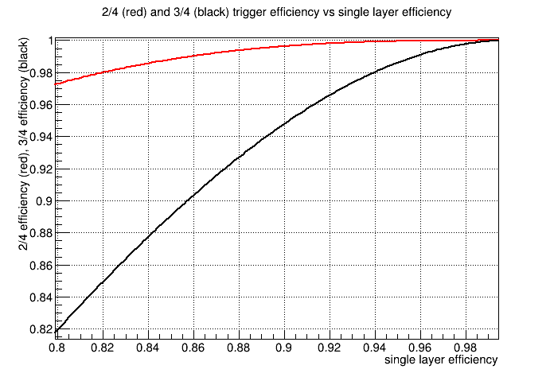
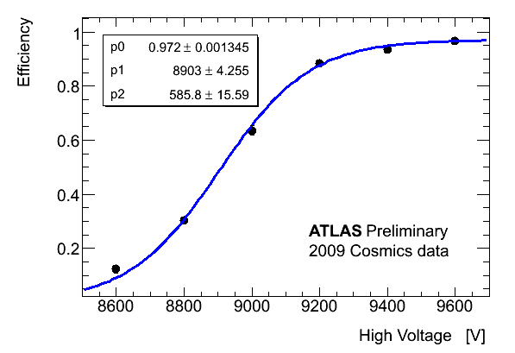
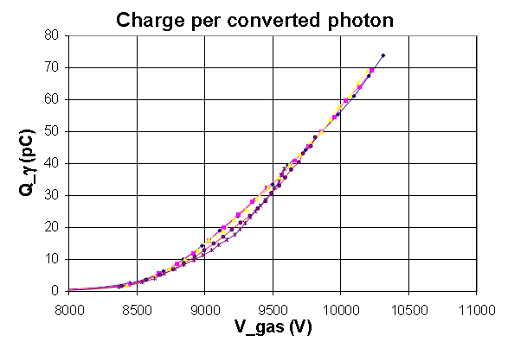
Mitigation of the problem:
The BM station can be used with a 2/4 majority instead of the 3/4, allowing a consistent reduction of gap efficiency without affecting the trigger efficiency
it is possible to recuperate a factor of 3 → working at constant current above the known limits
To operate this majority an increase of redundancy is needed
For most the chambers this operating point restores a reasonable safety factor
For the highest z large ones we may still be marginal (risk evaluation criteria)
2/4 vs. 3/4 majority

Slide 12
Trigger Performance studies and alternative solutions
(from a study by M. Corradi and Silvia Biondi)

Slide 13
Further safety factor refurbishing of the BOLs 5 and 6
Under the shadow of the BI RPC project the refurbishing the External BOLs is relatively easy and with negligible core impact (32 BOL chambers)
The BMLs 5-6-7 are in a very hot region → still marginal at 80% of efficiency but can not be moved out for reinforcement.
The BML7 are small and can be refurbished as well if needed

Slide 14
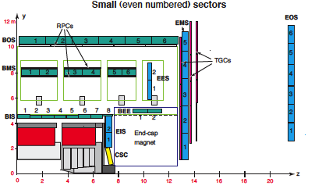
The present barrel acceptance limits
Acceptance holes of L1 barrel trigger
- feet + elevators (partially cured…)
toroid (and ribs) holes in small sectors
BM chambers
2012 data
eta=0.0
0.4
0.75
1.0
2012 data

Slide 15
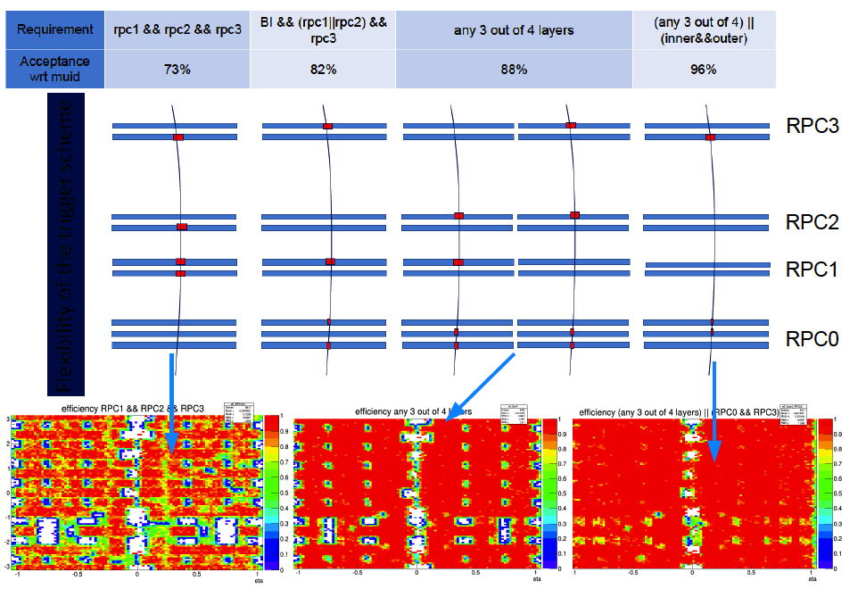
BI+ old RPC trigger acceptance
Flexibility of the trigger system
S. Biondi

Slide 16
BI + present RPC Trigger rates
Overall results based on 2012 data extrapolated to
13 TeV (x2) and L=7E34:
BI RPC simulated through BI MDTs
3-station requirements (BI-BM-BO , BI+2*BM , 2*BM+BO )
- present 2*BM+BO trigger (e.g. MU20) has 15% of fakes
- BI+2*BM will have similar fake rejection and sharpness of pt threshold
- BI+BM+BO will have better fake rejection and better sharpness
=> overall rate close to present high-pt triggers (~12 kHz @ L= 7E34)
Additional 2-station requirement (BI+BO) :
2-stations coincidences rate is 5X > than 3-stations (high-pt)
→ to be used just on BMS holes (~15% of the acceptance)
=> adds 4.5*0.15 = 0.67% of rates : (total of ~20 kHz @ L= 7E34)
BO
BM.PI
BM.CO
BI
BO
BM.PI
BM.CO
BI

Slide 17
RPC + MDT trigger @Level0
MDT can be used in barrel to confirm RPC proposal within Level0 latency.
Two algorithms tested:
“tube counting” in a road defined by the RPCs
”tube segments” made in a road defined by the RPCs.
- Test: open a road around RPC hits and count # of tube layers with hits
BO
Δη(BM-BO)=0.02
Good muons triggered by high-pt and matched to reco:
- Rec. muons with p_{T}>20 GeV
*
Fraction of hits in “tube segments”
BM
*
*
Δη(BM-BM)=0.01
IP
#tube layers with hits

Slide 18
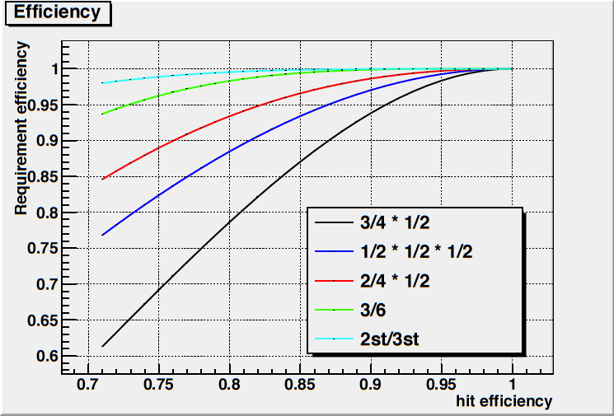
Predicted rates with background
Estimated requiring >=5 hits, tighter cuts may be applied to the BI)
- Situation much worse than without bkg.
- BM*BO gives too large rate (~50 kHz)
BI*BM*BO gives ~16 kHz, lower efficiency

Slide 19
Performance summary
BI + old RPC trigger
  Raw rate estimate.
  Work ongoing to improve
RPC+MDT @L0
  - Acceptance limited to present BM-BO RPC trigger (~73%)
  - Efficiency reduction: MDTs ~90 – 94% depending on 3 or 2 MDT stations used.
  A few % of efficiency can be partly recovered by running in OR with old trigger
Rate increases significantly when backgrounds are included.
  Requiring BM*BO, the estimated rate is ~50 kHz → unacceptable efficiency 78%
  Clustering + tighter cuts on BI may improve the rate. → ~16 kHz efficiency 72%
  Requiring BI*BM*BO, the estimated rate is ~30 kHz → imply replacing the MDT FE in the BI
NO WAY of recovering the acceptance holes
ZERO REDUNDANCY: each minor problem immediately reflects on efficiency and rate
NO WAY for the tile cal. Coincidence → rate ~500 kHz
Station req. | 3 station | 3 + 2(local)
Acceptance | 88% | 96%
Rate @ 7E34 | 12 kHz | 20 kHz

Slide 20
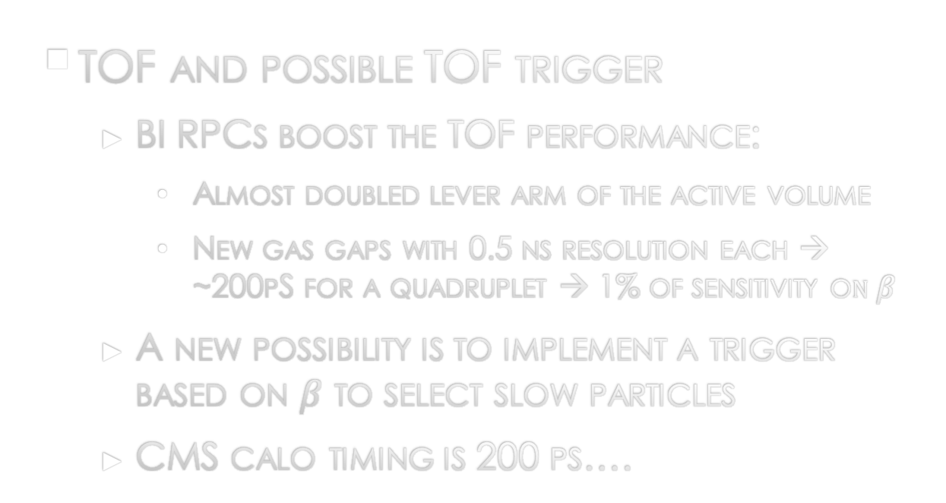
Impact on physics (just mention, real studies needed)
  Benefits of the extended coverage in the barrel.
  E.g. Channels with a single muon (for example W’)
  Eta distribution is more peaked in the barrel.
  Spatial correlation effect for two muon decays (also holes are very correlated in space).
TOF and possible TOF trigger
  BI RPCs boost the TOF performance:
    Almost doubled lever arm of the active volume
    New gas gaps with 0.5 ns resolution each → ~200pS for a quadruplet → 1% of sensitivity o$n β$
  A new possibility is to implement a trigger based on $β$ to select slow particles
  CMS calo timing is 200 ps….
BO
9,5m
T2
BM
7,2m
T1
BI
5m
T0
Bunch crossing

Slide 21
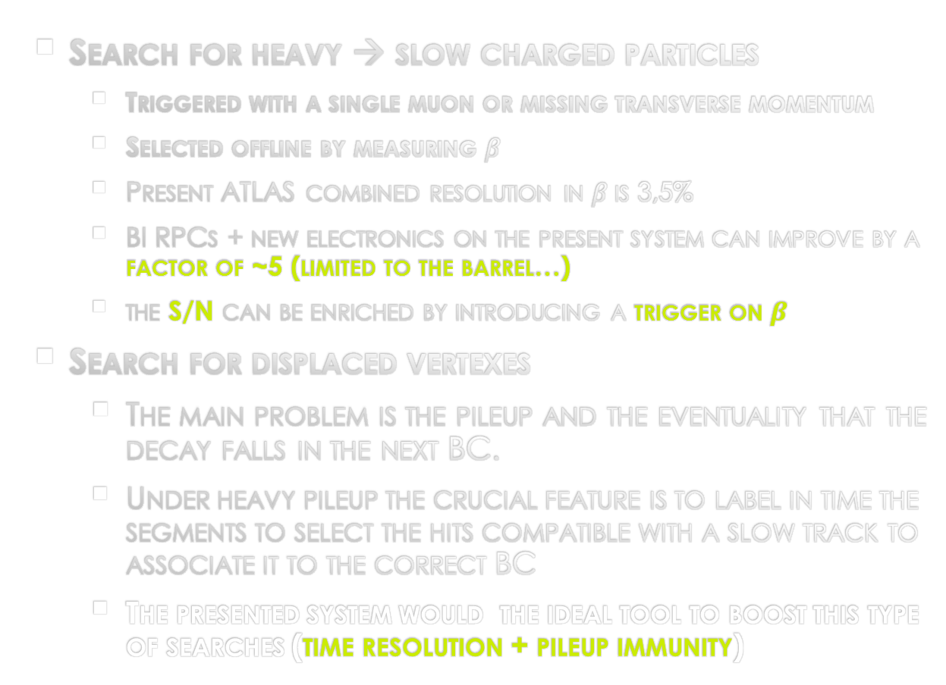
search for long lived sleptons and R-hadrons
CERN-PH-EP-2012-236
arXiv:1211.1597v2 [hep-ex] 25 Mar 2013
  Search for heavy → slow charged particles
    Triggered with a single muon or missing transverse momentum
    Selected offline by measuring $β$
    Present ATLAS combined resolution in $β$is 3,5%
    BI RPCs + new electronics on the present system can improve by a factor of ~5 (limited to the barrel…)
    the S/N can be enriched by introducing a trigger on $β$
  Search for displaced vertexes
    The main problem is the pileup and the eventuality that the decay falls in the next BC.
    Under heavy pileup the crucial feature is to label in time the segments to select the hits compatible with a slow track to associate it to the correct BC
    The presented system would the ideal tool to boost this type of searches (time resolution + pileup immunity)
Thanks to Roberto Iuppa!

Slide 22
Performance summary and strategic points
BI + present RPCs LVL0/LVL1 trigger
  Raw rate estimate.
  Work ongoing to improve
The proposal adequate the RPC trigger system to the Phase II requirements
This is a proven solid design, based on a trigger dedicated detector
A good antidote against increasing pileup is the time resolution→ the hits will stay in a much larger parametric space
Extension of the BIS78 project for Phase1 representing about 10% of the BI
Exploit the investment of the new trigger electronics for phase II (4,5 MCHF)
  Alternative combination anyhow relying on the existing rpc system, being left for the next decades without a substantial upgrade would be extremely week and risky (imho)
  All the alternatives shown up to now have definitely lower performance
Station req. | 3 station | 3 + 2(local)
Acceptance | 88% | 96%
Rate @ 7E34 | 12 kHz | < 20 kHz

Slide 23
Implementation studies

Slide 24
Early implementation studies
With the help of Tatiana (TC) we started the implementation study, basing on the experience of the BIS78 project as a pilot project for the BI proposal.
The main problem is given by the limited space available and the difficulty of finding appropriate mounting points for the additional chambers
For the BIS78 we analyzed different strategies
  Adding the new RPCs to the already existing MDTs, by exploiting the residual envelope
  Remove the old MDTs and replace them with new generation-low profile integrated muon station (sMDT+RPC), within the existing envelope
The first strategy looks mechanically very difficult while the second is being implemented for the BIS78 project

Slide 25
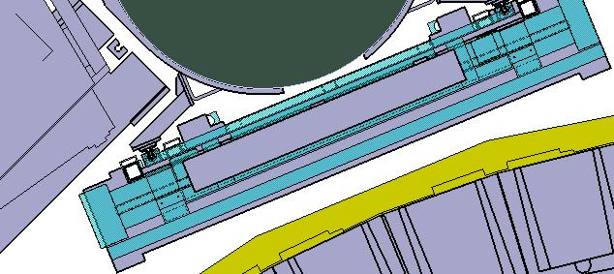
replacing the BIS MDT with new muon stations
As we did for the BIS78 it is possible to remove the old MDTs and add new BIS muon station in a smaller envelope
It also helps for the BIL installation
Sector 2
For the BIS this would allow to have better performance being able to add 2 RPC doublets instead of a triplet, technically replacing the BMS chambers in the 30% of uncovered areas
BIS7 sMDT
BIS7 RPC
BIS7 MDT
envelope

Slide 26
How to install the BILs in case of BIS replacement
A clear advantage: the BIS MDT replacement provides a clean solution for the BIL RPCs
The new BIS can work as a support structure for the new BIL
BIL
BIS
BIS
New RPC doublet
New RPC doublet
New RPC doublet
New RPC doublet
sMDT
sMDT
New RPC doublet
New RPC doublet

Slide 27
Recent studies from tATIANA

Slide 28
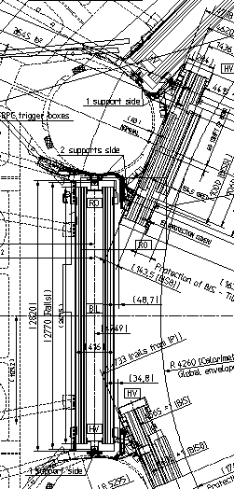
Additional RPC in the BI region
( first step of investigation)
Following variants can be proposed for the investigation:
For BIS:
To insert RPC on the inner side between BIS and calorimeter surface
To replace BIS chambers by sMDT with RPC attached to it taking together the same envelope as the existing MDT
For BIL:
- To install RPC on the MDT inner side
- To install RPC on the MDT outer side
Tatiana Klioutchnikova USC meeting 26/03/2015

Slide 29
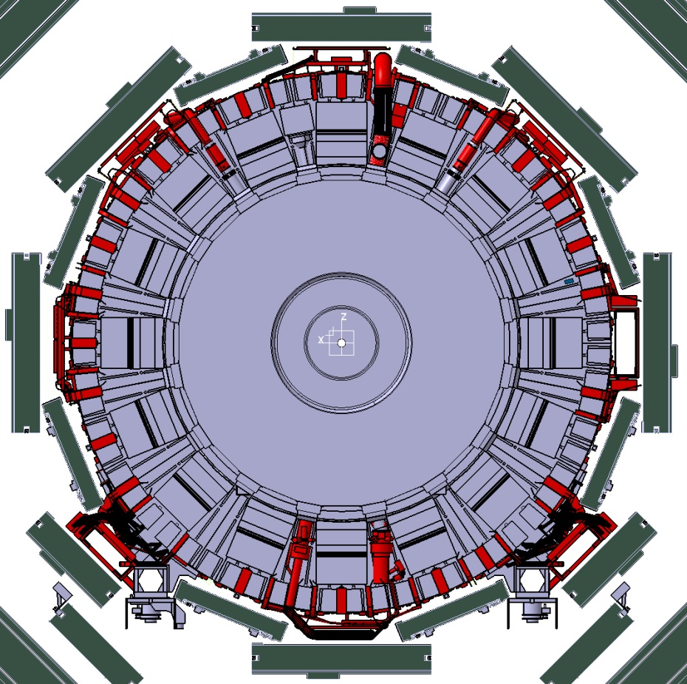
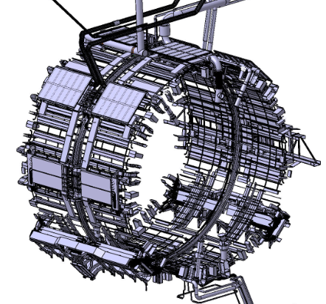
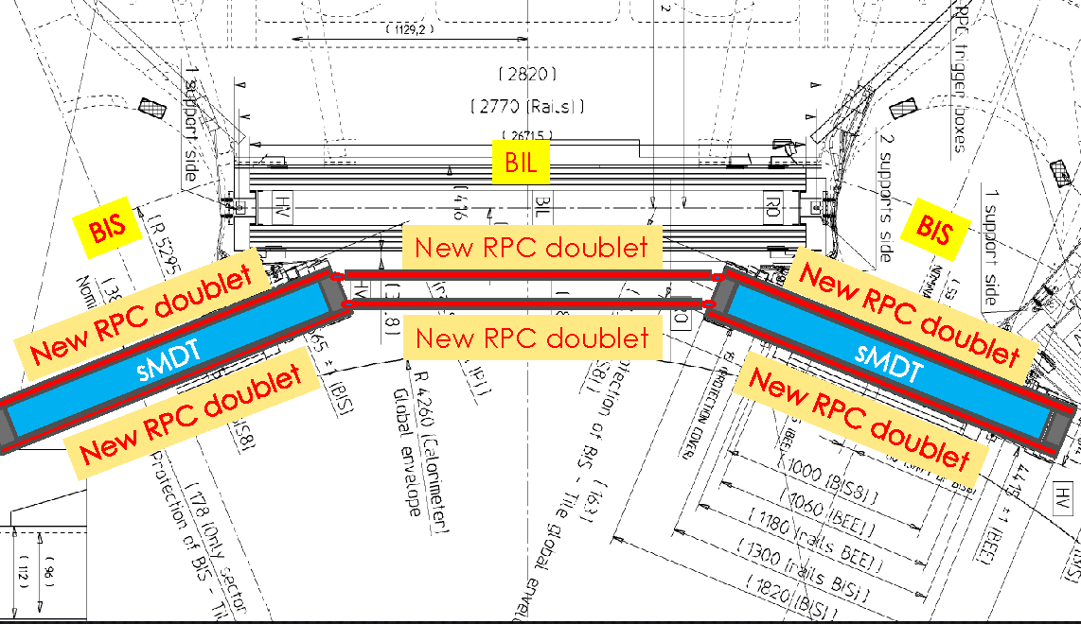
Space between Barrel Calorimeter and BI layer
The space between Barrel Calorimeter and BI layer is quite occupied by services (see 3D model and photos in the next slide).
A detailed study and measurements in place are crucial to make a conclusion if needed space is available at least for one RPC layer.
3D model of services on the surface of the Barrel Calorimeter
Upgrade proposal from muon community

Slide 30
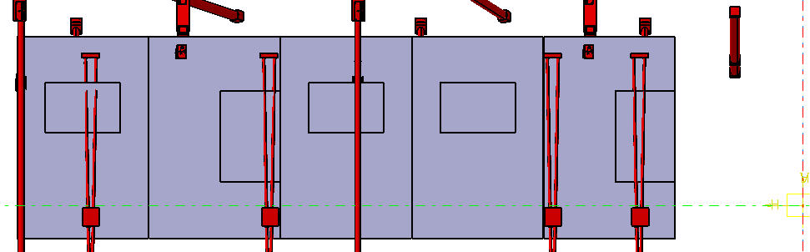
BIM Alignment
From BIM to IP

Slide 31
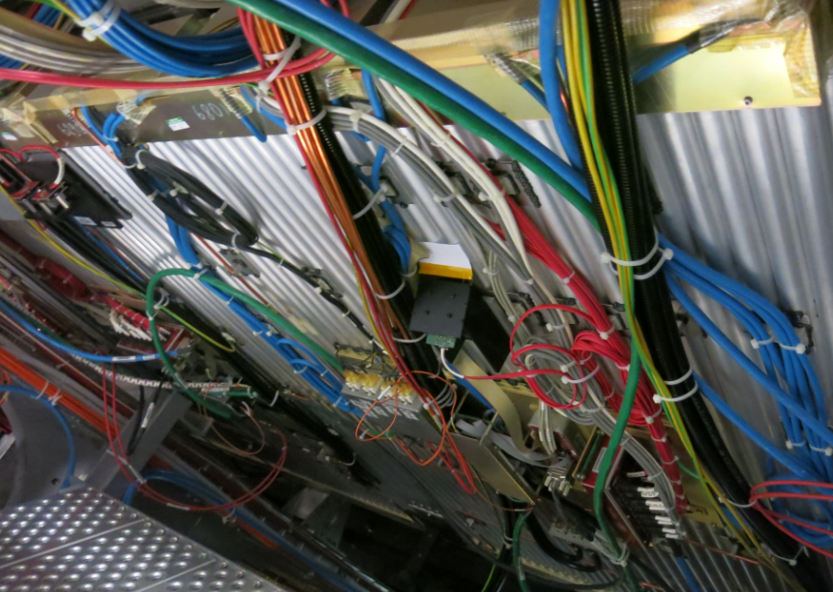
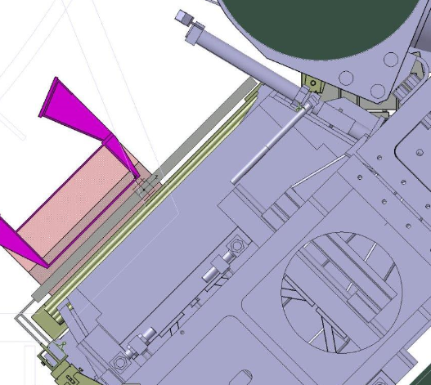
Questions we need to answer:
- which positions are more optimal from point of view of coverage, installation, services, etc ?
- how to bring the RPCs?
- how to fix to the existing structures?
- what to do with services on chambers: boxes, cables, gas and other services, like cable trays
EIL4 open
Space between calorimeter chain and BIM – to be studied

Slide 32
Where do we stand? Some recent history
December 2011→ Phase II LOI. In this document the upgrade of the barrel detector is just mentioned in a couple of lines. The emphasis is just on the necessary replacement of the LVL0/1 electronics. This is due to the non prompt reaction of the RPC community mostly busy in the present detector works and NSW trial
The improvement of the trigger performance was focused only on the inclusion of MDT hits for the LVL1 decision
January 2013 → Rinaldo proposed the BIS78 project for Phase I in the trigger upgrade meeting
November 2013 → RPC community decided to step in Phase II presenting the BI RPC proposal in the Atlas Upgrade Week
A long internal muon discussion process started culminating in the endorsement of the BI project by the muon IB in December 2014
Now…the problem is that we are not in the LoI

Slide 33
Muon management discussion
Christoph Amelung, Massimo Corradi, Oliver Kortner
Report from the last Muon Steering March 23, 2015

Slide 34


Three scenarios for the scoping document
The LHC experiments have been asked by the funding agencies to work out three scenarios (“high”, “middle”, “low”) for the phase-II upgrade with different cost profiles:
“High”: The optimum upgrade option for 275 MCHF.
“Middle”: The medium quality upgrate option for 235 MCHF.
“Low”: The miminal upgrade option for 200 MCHF.
Next three slides summarize the muon spectrometer upgrade programme in the three options.
Colour code on the next slide
Green : Upgrade item common to all three options. Red : Upgrade item only in first or second option.

Slide 35














Optimum muon spectrometer upgrade
Electronics replacements
New RPC and TGC read-out electronics capable of 1 MHz level 0 rate. New MDT read-out electronics:
New mezzanine cards for all MDT chambers:
To cope with 400 kHz level 1 trigger rate,
For a fast read-out chain for a L0 MDT trigger.
New CSMs.
Chamber replacements
New inner sTGC chamber ring in the big wheel to cope with high rates. New thin RPC chambers in the inner barrel
To maximize the muon trigger coverage.
To compensate for inefficiencies of RPCs (caused by reduced HV for safe operation) in regions with high background.
sMDT chambers in small sectors to free space for new RPC chambers. Muon tagger at large pseudorapidities.
Muon trigger upgrade
BI RPCs in the L0 trigger. L0 MDT trigger.
RPC/TGC/MDT power system replacement.
Costs: 32.4 MCHF.

Slide 36











Medium quality muon spectrometer upgrade
No muon tagger at large η.
The rates in EO are moderate enough to operate the MDT chambers with the old electronics.
The installation of the MDT electronics and the installation of new RPCs in BI-1 to BI-3 requires the deinstallation of the existing BI chambers (∼2 years according to TC).
BI-4 to BI-6 are easier to access.
RPCs in BM/BO-4 to BM/BO-6 which are projective with BI-4 to BI-6 will encounter the highest rates and therefore have the lowest efficiencies.
⇒ Changes to the optimal solution:
MDT mezzanine cards will only be replaced in BM, BO, and EM. BI RPC/sMDT chamber upgrade only in BI-4 to BI-6.
Drawbacks:
ATLAS L1 trigger rate limited to 200 kHz by the legacy MDT electronics.
RPC chamber inefficiency not fully recovered.
Only 2/3 of the acceptance gaps of the barrel muon trigger will be closed.
Cost reduction compared to the optimal solution: ∼ 5.5 MCHF.

Slide 37




Minimal muon spectrometer upgrade
The miminal option is the same as the programme described in the letter of intent.
⇒ This has major drawbacks:
ATLAS L1 trigger rate limited to 200 kHz by the legacy MDT electronics.
No recovery of RPC chamber inefficiencies which will lead to a reduced muon trigger efficiency in the barrel.
No closing of acceptance gaps in the barrel muon trigger.
Cost reduction compared to the optimal solution: ∼ 8.8 MCHF.

Slide 38
Agenda

Slide 39
The scoping document
Time scale
June 2015: Requested to submit a document to LHCC in draft form in June.
September 2015: Final form which upon successful review by LHCC and UCG, will be presented at Oct RRB ⇒ leading to overall envelope for phase-2 funding (?) and to the start of the “TDR period” (second phase of CERN phase-2 review process).
What we need to provide
The 3 muon upgrade options.
A description in detail of each detector element, supported by R&D results.
Detailed plan and schedule for remaining R&D, prototyping, etc. needed to develop detailed designs, and to determine final estimates for cost and schedule.
Current estimates of approximate total CORE project costs, manpower, schedule and funding profile, in sufficient detail to allow a meaningful review.
Milestones and schedule for producing the muon phase-II upgrade TDR.

Slide 40
Detector studies
We can exploit the BIS78 project technical document as a starting point
The BI rpc will share with the BIS78 most of the technical content
We could think to include by September some early result of the test beam in preparation for june – july where we are going to test a bis8 shaped chamber with non–final-but-close-to Front End, gas gap and faraday cage structure.
  Participation and help form all the detector enthusiast is welcome
  The test beam is open to new non Italian groups involver in the BIS78 project
A strong effort is necessary in collaboration with ATLAS TC and MPI to give a more realistic layout of the proposed system (by September at latest)

Slide 41
Upgrade physics studies
The physics case for the HL-LHC is studied by the ATLAS upgrade physics groups.
It is the upgrade physics group’s task to compare the physics potential of the different upgrade options.
Our task: Performance estimates like rate/efficiency/turn-on curves for the different options that can be used in the physics simulations.
Proposal to set up a muon performance upgrade group lead by Massimo.
Help is needed to setup this group so all the interested people is warmly encouraged to participate

Slide 42
Proposal how to organize the work for the scoping document
Uniform cost estimation
Set up a muon costing group with the following members: G. Aielli, Ch. Amelung, T .Kawamoto, O. Kortner, A. Lanza, O. Sasaki, R. Vari. Muon representative in the ATLAS costing group: R. Vari.
Writing the document
Editors/writers: M. Corradi, O. Kortner.
Experts providing detailed information, checking the document draft:
RPC chambers + front-end electronics: G. Aielli.
sMDT chambers + MDT on-chamber electronics (mezzanine cards+CSM): J. Chapman, H. Kroha.
RPC, TGC trigger electroncis: O. Sasaki, R. Vari. MDT trigger: Y. Horii, F. M¨uller.
Power supplies and services: A. Lanza.
“Referees” for the entire draft: R. Richter, T. Schwarz.

Slide 43

Conclusions (to ask the MUON IB endorsement)
The proposed upgrade of the inner barrel muon layer will ensure:
- Close to 100% muon trigger acceptance.
- A stand-alone muon trigger with high robustness and selectivity.
We have a new generation of detectors HL-LHC ready
Extension of the BIS78 being installed in Phase1
Refurbishing of some hot existing RPCs can be arranged
The present RPC chambers will also benefit from a new RO electronics
A real study done by TC will be needed if the project goes beyond this stage
It is relevant that BI RPCs will add outstanding TOF capability to ATLAS muon LVL0/LVL1 trigger in the barrel

Slide 44
Backup Slides

Slide 45
BO map (preliminary)
L=5,95E33 → multiply rates by about 20 for phase2
Colder than the BM but the rate on the extreme BOL is slightly above the limit
Still a risk factor connected to the integrated charge (x10 the expected)
Another risk factor is given by the large size → gas pollution pileup

Slide 46
BM background maps with 2012 data
Sector |  |  |  |  | RPC unit Id. along Z direction |  |  |  |  |  |  |  |  |  |  |  |  |  |  |  |  |  | Average (μA/m²)
Φ Id. | -7 | -6.2 | -6.1 | -5 | -4 | -3.2 | -3.1 | -2.2 | -2.1 | -1.2 | -1.1 | 01.01 | 01.02 | 02.01 | 02.02 | 03.01 | 03.02 | 4 | 5 | 06.01 | 06.02 | 7
01.01 | 40 | 42 | 37 | 36 | 29 | 19 | 14 | 17 | 13 |  | 9 | 8 | 9 | 14 | 15 | 16 | 18 | 26 | 36 | 34 | 36 | 30 |  | 23
01.02 |  | 38 | 35 | 38 | 28 | 21 | 16 | 18 | 16 |  | 10 | 9 | 10 | 15 | 17 | 17 | 19 | 28 | 40 | 35 | 39 | 38 |  | 24
2 |  | 16 | 26 | 24 | 18 | 14 | 12 | 10 | 9 | 7 | 7 | 6 | 7 | 9 | 10 | 13 | 12 | 18 | 26 | 25 | 21 |  |  | 15
03.01 |  | 37 | 37 | 38 | 26 | 18 | 16 | 15 | 14 | 9 | 9 | 9 | 10 | 16 | 16 | 16 | 17 | 26 | 38 | 34 | 36 |  |  | 23
03.02 |  | 38 | 36 | 39 | 27 | 19 | 16 | 18 | 15 | 11 | 10 | 10 | 9 | 16 | 17 | 19 | 19 | 26 | 38 | 33 | 37 |  |  | 23
4 |  | 14 | 23 | 23 | 20 | 14 | 12 | 9 | 10 | 7 | 7 | 6 | 7 | 10 | 10 | 12 | 14 | 20 | 24 | 23 | 20 |  |  | 15
05.01 | 35 | 27 | 27 | 32 | 21 | 13 | 13 | 16 | 15 | 9 | 9 | 9 | 10 | 15 | 20 | 13 | 15 | 22 | 31 | 24 | 24 | 27 |  | 19
05.02 |  | 29 | 29 | 28 | 18 | 14 | 15 | 16 | 16 | 10 | 8 | 9 | 10 | 14 | 16 | 13 | 16 | 21 | 29 | 32 | 32 |  |  | 19
6 |  | 16 | 24 | 25 | 19 | 13 | 12 | 11 | 11 | 8 | 7 | 6 | 8 | 10 | 10 | 12 | 14 | 21 | 24 | 26 | 22 |  |  | 15
07.01 | 34 | 37 | 34 | 35 | 25 | 21 | 17 | 16 | 15 |  | 10 | 10 |  | 15 | 18 | 16 | 20 | 24 | 35 | 34 | 37 | 32 |  | 24
07.02 |  | 40 | 33 | 30 | 16 | 18 | 14 | 16 | 13 |  | 10 | 10 |  | 13 | 16 | 15 | 20 | 15 | 39 | 35 | 32 | 36 |  | 21
8 |  | 15 | 25 | 24 | 20 | 13 | 11 | 10 | 9 | 7 | 7 | 6 | 7 | 8 | 9 | 11 | 14 | 20 | 24 | 24 | 22 |  |  | 15
09.01 | 28 | 39 | 32 | 37 | 26 | 20 | 15 | 17 | 14 |  | 7 | 9 |  | 13 | 16 | 16 | 18 | 25 | 35 | 34 | 36 | 28 |  | 23
09.02 |  | 40 | 33 | 35 | 25 | 19 | 14 | 14 | 13 |  | 8 | 10 |  | 13 | 14 | 13 | 18 | 24 | 35 | 32 | 35 |  |  | 22
10 |  | 16 | 26 | 26 | 18 | 11 | 11 | 9 | 9 | 6 | 6 | 5 | 7 | 9 | 9 | 10 | 11 | 18 | 24 | 25 | 23 |  |  | 14
11.01 | 29 | 37 | 31 | 30 | 20 | 14 | 11 | 12 | 10 |  | 6 | 5 |  | 10 | 11 | 12 | 13 | 19 | 29 | 28 | 33 | 22 |  | 18
11.02 |  | 25 | 23 | 20 | 14 | 11 | 9 | 7 | 7 |  | 5 | 5 |  | 7 | 8 | 8 | 10 | 13 | 19 | 21 | 23 | 32 |  | 13
12 |  |  |  |  |  | 14 | 13 | 10 | 9 | 6 | 5 | 5 | 6 | 9 | 11 | 13 | 14 |  |  |  |  |  |  | 9
13.01 | 40 | 37 | 34 | 30 |  | 17 | 13 | 12 | 11 | 6 | 6 | 6 | 7 | 11 | 12 | 11 | 16 |  | 30 | 33 | 37 | 30 |  | 19
13.02 |  | 37 | 33 | 28 |  | 14 | 12 | 13 | 11 | 6 | 7 | 7 | 7 | 12 | 13 | 12 | 15 |  | 27 | 29 | 35 | 31 |  | 18
14 |  |  |  |  |  | 15 | 18 | 10 | 8 | 6 | 5 | 5 | 6 | 8 | 10 | 17 | 15 |  |  |  |  |  |  | 10
15.01 | 25 | 23 | 25 | 19 | 14 | 11 | 9 | 9 | 7 |  | 5 | 5 |  | 7 | 8 | 10 | 12 | 14 | 19 | 22 | 23 | 24 |  | 13
15.02 | 34 | 24 | 21 | 31 | 20 | 16 | 12 | 13 | 10 |  | 6 | 6 |  | 10 | 13 | 14 | 15 | 20 | 31 | 24 | 27 |  |  | 18
16 |  | 16 | 27 | 27 | 21 | 13 | 11 | 8 | 9 | 8 | 7 | 7 | 7 | 9 | 8 | 11 | 13 | 21 | 26 | 26 | 21 |  |  | 15
Average (μA/m²) | 34 | 25 | 29 | 29 | 21 | 15 | 13 | 12 | 11 | 7 | 7 | 7 | 8 | 11 | 12 | 13 | 15 | 21 | 29 | 28 | 28 | 29 |  | 17
22 cases in total on ~3600 gaps (0,6 %)
Some correlation with higher rate is clear
Seem related to a gas supply problem

Slide 47
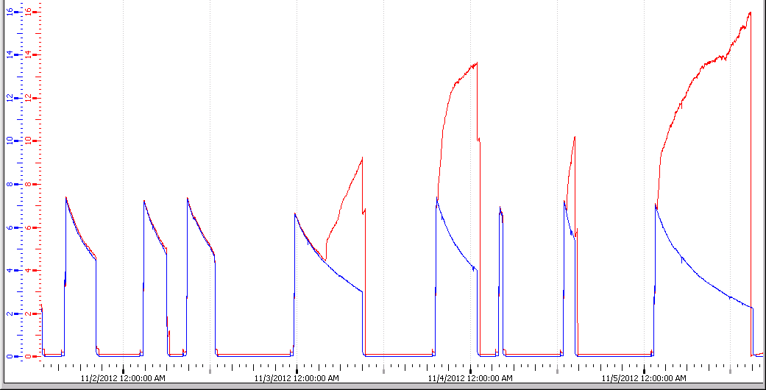
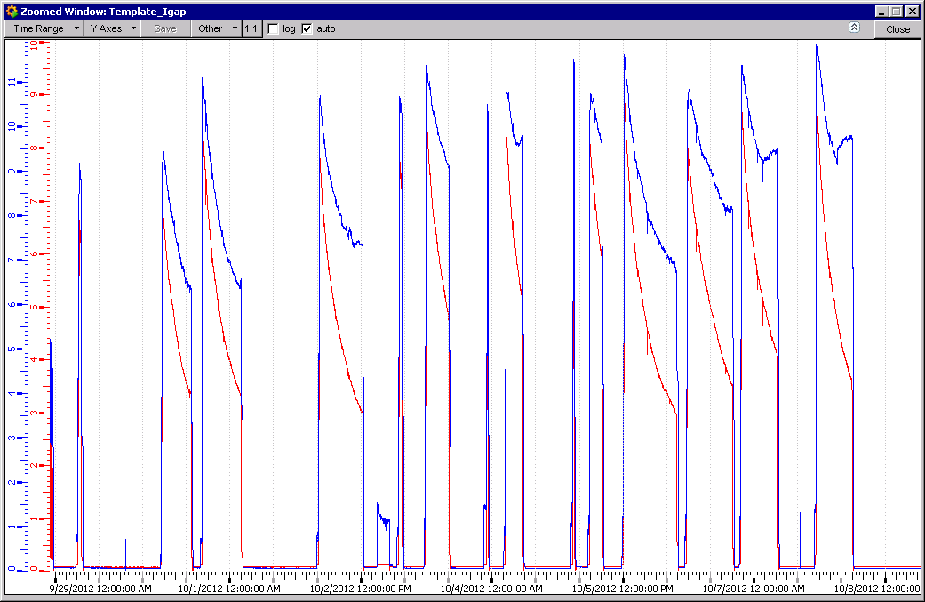
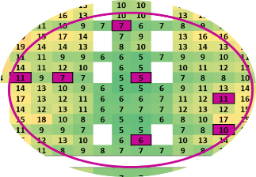
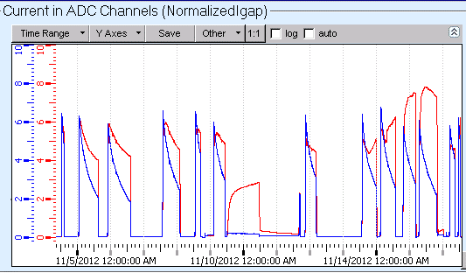
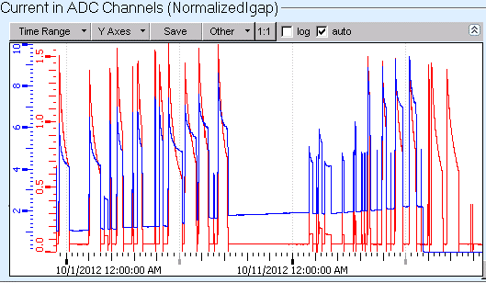
A few examples of misbehaving gaps
BML6C03.CO.DP1-DZ1
Layer 0
Layer 1
BML6C03.CO.DP2-DZ1
Identical overlapped gaps in the same doublet
BML6A03.CO.DP1-DZ2
BML1A11.PI.DP2-DZ1

Slide 48
Ageing results
Fast ageing (1kHz)
  Gap spread
  Noise increase
  Temperature sensitive
  Resistivity increase
RH effect
  Stabilize resistivity if rate is ~100 Hz/cm²
  50 mC/Yr.
  ρ ~ 2*10¹¹ voltage drop non negligible ~ 300 V (50 μA)
  Can be corrected by overvoltage
Noise stay low at 50 mC/Yr
  Healthy situation
  Can be kept “indefinitely”
Above this limits the main detector parameters worsen

Slide 49
Damage recovery – results
Current evolution
gap 1
gap 2
gap 3
gap 4
gap 5
gap 6
T
gap 1
gap 2
gap 3
gap 4
gap 5
gap 6
T
I(μA)
T (°C)
I(μA)
T (°C)
Working currents
Ohmic currents
Recovery from damage is possible but long and “expert” operation

Slide 50
Extrapolation for the ageing test
The following features prevent from performing effectively an ageing test at x7 speed:
  Peak rate capability (x7 the Max expected rate including safety factor)
  Ageing working Rate (at least x3 with respect to the Max expected rate)
  Gas change rate to be set to keep the current/change rate constant

Slide 51
Risk analysis (1) – present RPC risk
The risk of operating beyond the specs. is a progressive detector deterioration
What are the consequence of a detector fraction failure
yes
Detector Fraction failure
Recovery?
yes
Limited recovery possible in the long/ winter shutdown
Highly intensive in expert man power
Can guarantee a fully operative system
Impact on LVL0 in barrel
NO
NO
Progressive LVL0 loss of coverage/ rejection
yes
Can be repaired?
NO
NO
Apply safeguard criteria → constant current
yes
FE upgrade?
NO
Can be Replaced?
NO
Have a backup?
NO
yes
Mitigation strategies sufficient?
Lower HV + 2/4 majority →
Increase of LVL0 fakes
yes
yes
yes

Slide 52
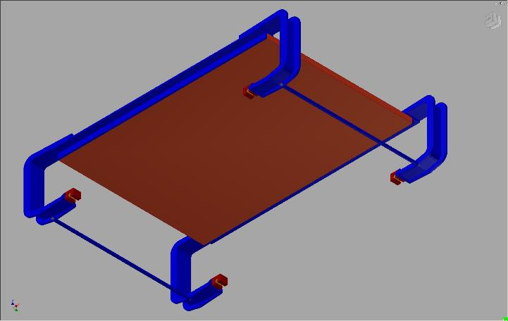
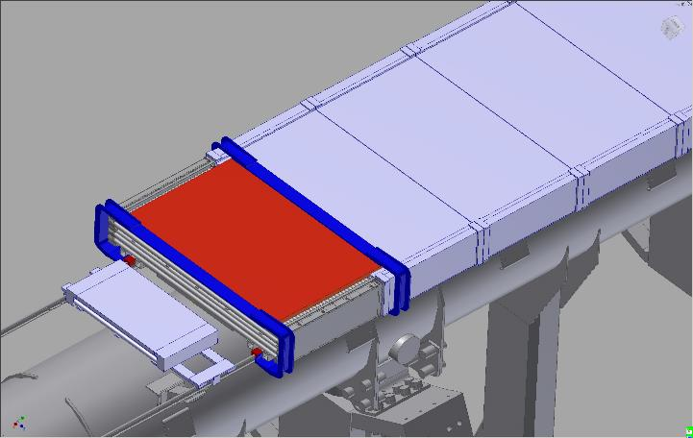
Scenario A: adding new RPCs in the residual envelope
BIS
Available space limited in the small sectors in between the MDT and the TileCal surface. Can be achieved by cleaning up the TileCal cables.
The BIS MDT can be displaced/removed to reinforce the rail and install the RPCs
BIS 7

Slide 53
Scenario A: alternatives for the BIL
The free space in front of the BIL is much larger but the BIL rail is not very accessible since the BIL MDTs are not removable
Two alternative solutions:
  Exploit the space on the outermost face of the BIL. Here the problem is not yet studied but there are services and alignment sensors to cope with.
  Install the RPC directly on the Tile external surface by installing pins to hold the RPC just above the existing Tile cables
    This solution is also a possible alternative for the BIS case. Certainly this will exploit the envelope at best
    The Tile community has to evaluate the feasibility of such installation
BIL
TILE CAL envelope

