Slide 1
The Barrel Level-1 Muon Trigger: Status and perspective for run-2
C.Luci 26/03/2015 Rome University La Sapienza and INFN Rome-1

Slide 2
Outline
Current status of the trigger
Repair work done during LS1 shudown
New feet trigger
New trigger on sector 13
Work to be done in the next months
Other activities

Slide 3
Current status (offline monitoring)
Sector 13
Sector 12
Mapping is not yet
up to date

Slide 4
Current status (offline monitoring)
Sector 13
Sector 12
Mapping is not yet
up to date

Slide 5
Online rates
sector 22 is masked in the DAQ;
BME/BOE and new RPC in the feet have HV off;
grey towers (12) are masked; (13 pads; s58_t2 low and high)
6 blue towers have 0 rates:
BML7C13; BML7A13; BMS2C06-RO; BMF2A14-HV
2
Total rates: 760 Hz

Slide 6
Wheel of fortune

Slide 7
Problems found and fixed
about 120 pads affected
Fast-on and power cables unplugged: 37
Can bus and I2C cables unplugged/broken: 14
Fibers bent/unplugged/broken: 10
low-2-high cables unplugged: 3
Miracles (lousy contact, dust, ?): 15
TTC card replaced: 4
Pad replaced: 18
Pads still not working: 13
Trigger sector 22 is out of DAQ
79

Slide 8
Details about pads replaced
6 BML
1 BMS
1 BMF
4 BOL
1 BOS
5 new feet trigger
TTC replaced: 2 new-feet; 1 BOS; 1 BMS
8 low-pt pads
5 high-pt pads
(low-pt pads with G-link)
We are running out of spares

Slide 9
Details about pads to be replaced
Killed by SL ( 2 BOF; 1 BOL)
link not ready (1 BOS; 1 BOF)
G-link card broken (1 BOL)
TTC error (2 new feet)
CM error (1 BOS; 1 new feet)
FPGA error (1 new feet)
temperature sensor (1 BMS)
splitter not connected (1 BMF)
7 high-pt
2 low-pt
4 new-feet

Slide 10
Work to do
set up the pad test facility at BB5
test and repair the broken pads
replace the pads in the cavern

Slide 11
New feet trigger

Slide 12
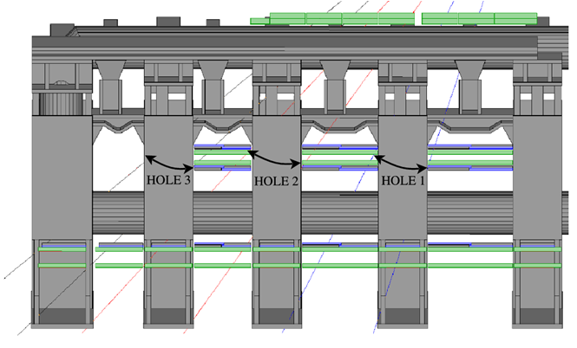
New RPC feet chambers
Low-pt confirm plane
Low-pt pivot plane
High-pt confirm plane (RPC-3)
BOF7
BOF5
BOF3
BOG8
BOG6
New RPC chamber (RPC-4)
In every sector we have a second RPC plane in the BOF3-BOF5-BOG6-BOF7-BOG8 chambers

Slide 13
RPC units for BOF-BOG chambers - Sector 12
Splitter
hole
PAD
Pad dummy only for read out and not for trigger. It is no longer there.
Wired_or
Side A
Z= 0
Side C
Upgrade PAD
HV
9 - 32
9 - 32
6
0
0
1
3
3
h₀ h₁
h₁
h₀ h₁
h₁
h₀ h₁
h₀
h₀ h₁
h₀
h₁
h₀ h₁
h₁
h₀ h₁
h₀
h₀ h₁
h₀ h₁
A
A
E
E
C
C
B
B
B
B
C
C
E
E
A
A
h₀ h₁
h₀
h₁
1-32
1-32
1-24
1-24
9-32 ; 1-24
1-32
1-32
8-32
8-32
1-24
9-32 ; 1-16
Ist.
Ist.
Ist.
Ist.
Ist.
9-32 ; 1-24
9-32 ; 1-16
D*
D*
D*
D*
D*
D*
D*
16 – 1 ; 32 - 9
24-1 ; 32-9
16 – 1 ; 32 - 9
h₀
24-1 ; 32-9
24-1
h₁ h₀
24-1
24-1
32-1
32-1
24-1
24-1
h₁ h₀
h₁ h₀
h₀
32-1
32-1
h₁
h₁
h₁
h₀
h₀
h₀
h₁ h₀
h₁
h₁ h₀
h₁ h₀
h₁ h₀
h₁ h₀
h₁ h₀
32 - 9
32 - 9
8A12 7A12 6A12 5A12 4A12 3A12 2A12 1A12
0B12
1C12 2C12 3C12 4C12 5C12 6C12 7C12 8C12
RO
strip eta number
RO
2
4
5
7
A
A
E
E
C
C
C
C
RO
E
E
h₁ h₀
h₁ h₀
h₀
h₁ h₀
h₁ h₀
h₁ h₀
h₁
h₁ h₀
A
h₁ h₀
h₁ h₀
A
Upgrade PAD
24-1 ; 32-9
24-1 ; 32-9
40
D*
New splitter
D*
In a trigger sector, 4 splitters were replaced with an upgraded version.
h₀ h₁
h₀ h₁
9-32 ; 1-24
9-32 ; 1-24
h₀
h₀ h₁
h₁
h₀ h₁
h₀ h₁
h₀ h₁
h₀ h₁
h₀ h₁
HV
HV
We got rid of one pad
64 strips
What is the phi cabling?

Slide 14
feet: hardware status
32 pads (4 per trigger sector);
32 new splitters (32);
“old” high-pt trigger recabled (we need to check the cabling)
new pad-splitter cabling was completed by June 2014 (thanks to Stelian Buda).
“minor” cabling, such us canbus, power cables, optical fiber patch cords done in September 2014
a lot of new pads with hardware problems.
We are waiting HV to start the commissioning

Slide 15
Pad numbering: continuos
R (mm)
PAD 2
PAD 4
PAD 5
PAD 7
RPC4
PAD 1
RPC3
PAD 0
PAD 3
PAD 6
Red one: high-pt trigger
BMF (Pivot)
BMF (confirm)
Blue one: new trigger
The overlap is between contiguous pads, like:
pad2-pad3 ; pad3-pad4; pad5-pad6; pad6-pad7
BOF1-hpt-pad 0; BOF3-hpt-pad 1; BOF3-nt-pad 2 BOF5-hpt-pad 3; BOF5-nt-pad 4; BOG6-nt-pad 5;
BOF7-hpt-pad 6; BOG8-nt-pad 7
IP
Z (mm)
Pad numbering will change with respect to run 1. Online monitoring, HLT and offline decoding have to be changed accordingly. Work is going on.

Slide 16
Potential problem with the feet trigger
RPC units for BOF-BOG chambers - Sector 12
New pivot recabling (by a printed board) to go from 5 pads to 4 pads
go
Pad 3: η0 32; η1 32
OK
OK
OK
BOG6 has 24 strips and BOF7 has 40 strips (mapped to two cables).
So the total make 64 strips that could be handled by one pad (32 strips go to CM eta-0 and 32 to CM eta-1).
So we need to unscramble three flat cables to rearrange them into two 32 pins cables, feeding the pad on BOF7.
h₁ h₀
RO
C
C
E
E
h₁ h₀
h₁
h₁ h₀
A
h₁ h₀
A
24+24 strips
24-1 ; 32-9
16+24
32+32 strips
D*
9-32 ; 1-24
24
16+24
h₀ h₁
h₀ h₁
h₀
h₀ h₁
h₀ h₁
HV
BOG6
64 strips
BOF7
We need a printed board that receives three eta 32-pin flat cables, one from BOG6 and two from BOF7 and produce two 32-pin flat cables as input for the pad.
Another printed board will do the wired OR between bog6 and bof7 phi strips
i) Different grounding; ii) signal adaptation; iii) wrong eta channel mapping. We need cosmic muons to sort out everything.

Slide 17
Sector 13

Slide 18
RPC units for BML chambers - Sector 13
Side A
Z= 0
Side C
RO
η₁
η₀
E
E
A
D
D
D
D
E
E
D
D
D
D
D
D
A
E
E
G*
0
1
2
3
4
G*
η₀ η₁
η₀ η₁
η₀ η₁
η₀ η₁
5
pivot
Lift
Lift
η₁ η₀
η₁ η₀
η₁ η₀
η₁ η₀
η₀
η₁
Outer layer
HV
6 pads instead of 7 as the other Large standard sectors
E
E
A
D
D
D
D
E
E
D
D
D
D
D
D
A
E
E
confirm
Lift
Lift
Inner layer
One RPC chamber (BML4) is missing due to the lift

Slide 19
RPC units for BOL chambers - Sector 13
Side A
Z= 0
Side C
Cables of 4.88 m
RO-MDT
D
D
B
B
B
B
E
E
E
E
D
D
B
B
E
E
E
E
B
B
B
B
D
D
0
1
2
3
4
5
Lift
Lift
HV-MDT
We have a hole but we are not missing a chamber, BOL4 is there, but without the pad.
Once we add another pad on the BME, we have to put the corresponding high-pt pad on BOL4.
N.B. BOE splitter is connected to the pad on BOL3 (13 m long cables).

Slide 20
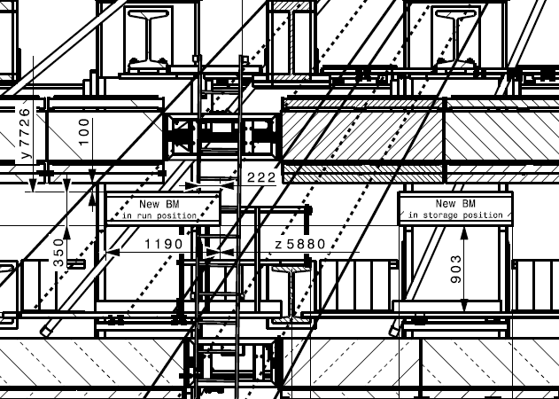
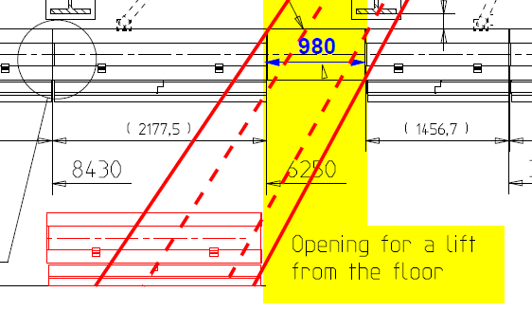
RPC completion in sector 13
BME (two doublets for Low PT trigger)
Confirm (upper) plane: single RPC unit. Dead reagions for the allignment optics.
Pivot (lower) plane: same structure of the Confirm but no dead regions (same coverage of the MDT).
Chamber thickness < 5cm
1 mm gas gap + new FE
BOE (one doublet for High PT trigger)
One unit almost sufficient to cover the acceptance hole (3920mm X 1300mm)
Chamber thickness < 5cm
2 mm gas gap + standard FE
Differences are transparent to the trigger system
BML
BML
BME
BOL
BOL
BOE

Slide 21
BOE
BOL1
BOL2
BOL3
BOL4
BOL5
BOL6
BME
BML1
BML2
BML3
BML6
BML7
BML5
1: BML3-η0
2: BML3-η1
3: BME-η0
4: BME-η1
5: BML5-η0
6: BML5-η1
Full Geant Simulation

Slide 22
Sector 13
BML6
geantinos
6 GeV muons
BML5
BME
Trigger cabling is done by using the same plot CM by CM
BML3
BML2
Warning: feeding a signal from a RPC strip to the right CM channel is not straightforward
BML1
BML1
BML2
BML3
BML7
BME
BML5
BML6

Slide 23
Sector 13
BOL6
geantinos
10 GeV muons
BOL5
BOL4
BOE
BOL3
BOL2
BOL1
BML1
BML2
BML3
BML7
BME
BML5
BML6

Slide 24
NEW CABLING IN SECTOR 13
BOE
PAD
SPLITTER
Low to High
13 m cables
Splitter to Pad
New pad
BOL3
BOL4
BME
BML3
BML5

Slide 25
Taken from an old presentation of Giulio A.
The full project of trigger coverage in elevator shafts is a complex project, have a large manpower overhead on the RPC community
This project has two main goals:
Extend the muon coverage in the barrel
Allow to study «in vivo» innovative detector and trigger solutions in view of future ATLAS upgrades
Groups external to the RPC community are welcome to join the collaboration

Slide 26
Double readout scheme (e.g. Confirm)
PAD
RPC trigger and readout (depends on RPC DCS+LVL1 DCS)
RPC FE (depends on RPC DCS)
SPLITTER
13 Mezzanine boards
Tiesheng adaptor boards
MDT FE and RO (depends on MDT DCS)
CSM
Technical contact Tiesheng
SPLITTER
Tiesheng adaptor boards
RPC trigger and readout (depends on RPC DCS+LVL1 DCS)
MROD
PAD
Sec. Logic
Sec. Logic
It has to be the new splitter

Slide 27
Double readout for the pivot
MDT READOUT
BME PIVOT
PAD
splitter
Pivot plane normally goes directly to the pad, that receives single ended signal.
Because of the splitter in between, we had to modify the low-pt pad to accept LVDS signals as the high-pt pad does
We used Tiesheng adaptor board to connect the splitter (eta output RJ45) to the pad (input Robinson-Nugent 68 pin) (plus a special cable 80-68 pins, used also for the phi inputs)
pay attention: the splitter invert eta numbering for layer 1 (0:31 → 31:0)

Slide 28
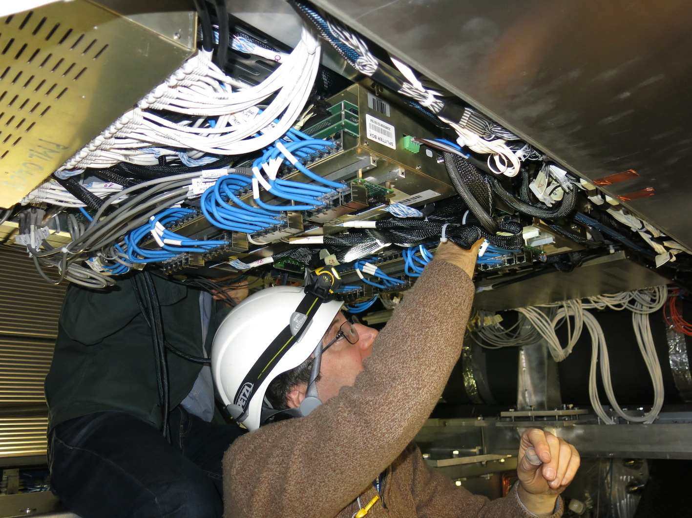
BME Cabling
pad
splitter
Tiesheng adaptor board

Slide 29
Hardware for sector 13 trigger
4 high-pt pads mounted on BOL4 (thanks to Lecce technicians)
4 low-pt pads (modified at Rome 1)
8 new splitters (assembled at Rome 1)
4 standard splitters
trigger cables: - long cables (13 m) made at Rome1 (128 eta; 48 phi, 24 L2H) - pivot-splitter-pad cable done at Rome1 (40+40 eta; 16 phi)
Front end cables: 96 (thanks to Bologna technicians)
Tiesheng adaptor boards for double readout
WARNING: the new hardware have not been tested in the lab

Slide 30
Other activities

Slide 31
Online software - status
Control layer
New control architecture (2PC+4SystecCAN modules)
New CANbus controllers => new pad access layer
New RCD for trigger towers + combined RCD for SL+ROD
Resynchronizations (towers, SL+ROD)
Lots of stuff still missing (both in tools and DAQ, see next slide The most urgent expert tools have been ported [kind of]
Port of s/w to latest DAQ releases
tdaq-05-05-00 as of today
New config w/new roads for added pads
(only new pads!) timing still to be done
Personnel (s/w “proper” ONLY)
0.7FTE (RM1) trigger towers/tools + 1 FTE (Na) ROD+SL

Slide 32
Online software - future
Tools
Streamlining/rationalization
New as needed
Configuration database
Which will require all the DAQ to be adapted as well
And new tools, naturally
Shifter assistant
Expert system rules as a way to encode our knowledge of the system and automate tasks
Resource manager
Req'd by core DAQ community
Documentation (sorely missing)

Slide 33
LVL1 RCD Application: ROD + RXs
With respect to RUN I a new C++ driver for the RX/SL board has been developed in order to integrate it with the ROD RodCrateDaq (RCD) application.
A now RCD Module has been developed to manage the ROD board and the respective RX/SL boards at once:
This new approach has been fundamental to develop automatic recovery procedure that involve action on both ROD & RX. In the previous scheme this was not possible.
An unique RCD application now is running on each SBC in a VME, loading two instances of the new RCD Module library.
No problem in configuring and running the system.

Slide 34
LVL1 RCD Application: ROD + RXs
Automatic procedure has been developed to recover the LVL1 and/or BCID misalignment between the ROD and the RX fragment (with its sub-fragments: PADs and CMs).
Automatic Resynch procedure has been developed to recover the system during TTC restart procedure.
Both recovery actions has been successfully tested.
The experience gained in last weeks suggests minor modification both in explanations of the actions performed (MRS and log files) and in the optimization of the sequence of the low-level operation on the hardware.

Slide 35
RPC & LVL1 Online Monitoring
The system has been updated only to be compliant with new TDAQ Architecture and software release.
A problem has been spotted in last few weeks: too few events sampled at ROD level, no problems in the analysis after HLT algorithms.
Initially we thought to a gnam application and/or histogramming service configuration, but we found they are ok.
The issue has been finally addressed last week. Events are not correctly sampled at ROD level on VME bus by the new RCD application.
In few days a solution will be produced. We are in touch with TDAQ expert on this item.

Slide 36
Wrong Cablings on BOG0
Stefania and Gabriele have found some cabling errors by projecting MDT tracks on RPC positions.
fixed
Strips to be connected on the pad on side A have been connected to the pad on side C and viceversa

Slide 37
Sectors 12-13-14 software status
Simulation and digitization: done!
Definition of trigger connections by using 6 GeV single muons for sectors 12, 13, 14: done!,
New chambers in cabling scheme in athena: done !
Check functionality of converters and trigger simulation: ongoing;
Definition of trigger roads: ongoing
Study thresholds and overlaps with the old trigger: ongoing

Slide 38
Conclusions
A lot of work in the cavern to get the trigger back in full swing;
Feet trigger: hardware installation completed; a lot of new pads had problems. We need to take data to start the commissioning.
Sector 13: hardware installation and cabling completed just in time. We need to take data to start the commissioning.
Urgent: setting-up of the test facility at BB5.

