Slide 1
Gruppo di Coordinamento e news Eu-t0
Disposizione del Presidente
Sviluppi Eu-t0 a livello Eu
30 Marzo 2015
L.Perini
1

Slide 2
Disposizione del 24 Marzo 2015

Slide 3
Formalizza e specifica meglio la via intrapresa ad inizio 2015 con la ripresa delle riunioni cosiddette ‘Eu-T0’ al CNAF. Di seguito alcune slides presentate alla prima riunione, che restano valide. Il Comitato coordina il lavoro strategico che si farà nei WG, lungi dal sostituirsi ad essi. Non mi pare il caso di elaborare di più prima che tutti i 5 ne abbiamo discusso insieme.

Slide 4
Eu-t0 meetings e WGs
Riprendiamo la serie di riunioni
Parziale sovrapposizione con CdGA
Temi e scopi, WG’s

Slide 5
Temi per le riunioni Eu-T0
Discussione progetti eu, incubazione e follow up
  Per permettere armonizzazione anche informazione/discussione su :
    altre attività su fondi non nativi INFN: da PRIN calcolo a Prisma, OCP etc
    su attività INFN per HPC
    Ad es. NUOVI PROGETTI BIG DATA
Discussione evoluzione e utilizzi di «infrastruttura di calcolo» ( oggetto specifico di Eu-t0 internazionale)
  Anche in continuità con CdGA e sua attendace tipica…

Slide 6
Sinergie e WG
Per molti dei temi elencati le riunioni Eu-t0 non sono l’unico forum di discussione dentro INFN
  Per efficacia del lavoro a livello di infrastruttura Eu sembra importante avere queste riunioni come forum generale, con larga presenza delle persone interessate/coinvolte nei diversi progetti/attività
Per organizzare in modo pratico le attività, proponiamo di riprendere e rivedere una struttura di WG’s con persone e argomenti e piani di lavoro
  Segue slide di introduzione alla discussione da riprendere oggi più tardi

Slide 7
Meetings Eu-T0 EU
Da riunione scorsa settimana
  Raccolta di alcune slides per indicare prospettive e possibilità
  Non organica né completa
  La strada di eu-t0 EU non ancora completamente definita a livello consorzio Agenzie eu
31-3 Meeting Eu-t0 con le Agenzie
  Fare il punto dopo un anno
  Definire meglio la roadmap per il futuro. Agenda next slide

Slide 8
2nd EU-T0 interim Consortium Board meeting
Tuesday 31 March 2015
Welcome and introduction - Room: 1213-RC-11 (14:00-14:05) Conveners: medland, tony
Actions Arising from the Last iCB Meeting (14:05-14:30)Conveners: medland, tony
Summary of actions during the first year life of EU-T0 (report from the iEB)(SID, Exascale Data and Zephyr, INDIGO-dataCloud, EU-T0 & PRACE, accessibility integrating AAA) (14:30-15:15)
Conveners: Lamanna, Giovanni
Funding Agency activities and progress : Round table -- Conveners: ALL
EU-T0 MoU - (16:30-17:00)
- Conveners: medland, tony
EU-T0 Governance Structure - Conveners: Lamanna, Giovanni
Mid-term plans and long-term vision - (Services portfolio and communities, towards a workshop and working groups; Interfaces EUDAT & EU-T0;EGI & EU-T0; ESC; ESFRI; PRACE)
- Conveners: Lamanna, Giovanni

Slide 9
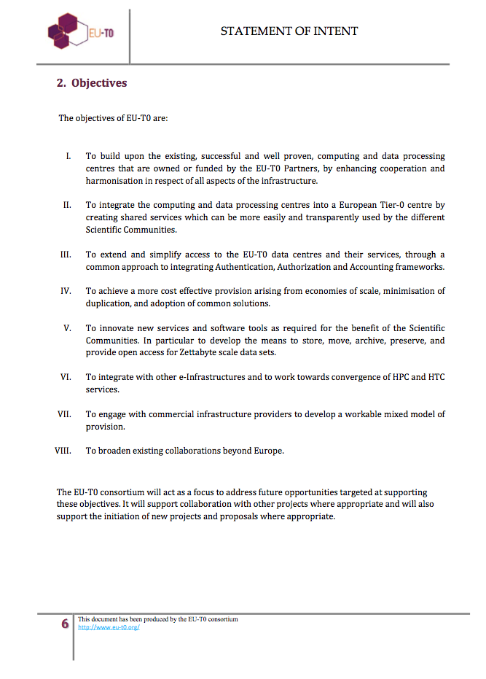
SID and main actions
FROM IDEAS AND PATHS:
EU-T0 consortium itself helps the cooperation.
Competence groups and technical board are recommended
To be discussed during the second part of the meeting:
mid/long-term visions and organization.
Ideas and perspectives defined & major European project just starting.
EU-T0 computing centres cooperation.
From ideas to projects: H2020 funding proposal.
Meeting and discussions and pilot cooperative actions in progress .
Based on CERN recent experience and initiatives.
In existing international frameworks (WLCG, HSF) and international research projects.

Slide 10
One year summary
Meeting with
DG-Connect
DG-Connect
Workshop
2016-2017
actions
11/2/2014
CERN Workshop
ERF Big-Data Workshop
WLCG
Workshop
Meeting PRACE
31/3/2015
PS doc.
WEB page
SI doc.
H2020 proposals
iCB and iEB established
H2020 proposals
results
PRACE & EU-T0 pilot call
9/2014
1- Draw up draft MoU,
2- Mandates for (interim) CB and EB
3- Nominate Chair for iCB (Tony Medland)
4- Invite nominations for iEB – Giovanni (IN2P3), Donatella (INFN), Achim (KIT), David (STFC), Frederic (CERN), Manuel (IFAE+CIEMAT) and Volker (DESY) proposed.
5- Contact other new partners: IRFU-CEA and NIKHEF (Nordics is pending).
6- iEB at work…
7- iCB considers how best to engage with ESFRI

Slide 11


Cooperation with PRACE
What is PRACE?
  PRACE = Partnership for Advanced Computing in Europe
  A Research infrastructure for High Performance Computing
  (HPC) in Europe focussing on the Tier-0 level
  A series of EC-funded projects
  A legal entity with PRACE aisbl with headquarters in Brussels
PRACE calls: computing time on Tier-0 systems; via scientific peer review process
  11th call includes a pilot for data
  MOTIVATION to cooperate on building a new approach in Europe to support the HTC & HPC (Tier 0-level) infrastructures for research.
  The pilot call has technical interest and political value
  Allocations on “Fermi” (IBM Blue Gene/Q @ CINECA, Italy; 390 Mio core hrs) and “Mare Nostrum” (IBM System X iDataplex @BSC, Spain; 120 Mio core hrs)
  “data partners”: EUDAT, EU-T0, BSC, SURFsara + Nikhef, EPCC/EPSRC, CaSToRC
  Supporting European researchers
Tier 1
Tier 2
Tier 3
A. Streit

Slide 12
Cooperation with PRACE (2)
  150 TB per project (1 PB in total for all projects) provided
  individually by CC-IN2P3, DESY-IT, INFN, KIT-SCC, PIC, STFC/GridPP via
  GridFTP, scp, (UNICORE)
Future:
  in summer: decision about computing grants, A. Streit will be involved
  for EU-T0
  (-> PRACE and EU-T0 centers as reference HPC and HTC Tiers 0 in Europe?)
  To be discussed later when we’ll talk about future …

Slide 13
INDIGO-Datacloud and EU-T0
➢ Project has its own life, the consortium will define strategies, but... we, as participants, should offer the project the opportunity of inserting in a larger picture.
➢ EU_T0 should have an active role in helping to connect Tier-1 and Tier-2 with the consortium
➢ For a good and large cooperation the issue of the relationship
with EGI has to be addressed; EGI is strongly involved in the project
➢ Among the stakeholders of the project other communities, not physics, are legally represented and have official roles
➢ EU_T0 participation to the projects through its partners and not as single entity weakness its position, for example respect to EGI that speak with one voice
D. Lucchesi

Slide 14
Astronomy, Astrophysics and Astroparticle Physics
Among the good news (for our community) of the first round H2020-2014 calls:
-> ASTERICS project (ASTronomy Esfri and RI CluSter) was funded under the INFRADEV-4
15 MEUR for four years.
CNRS, IFAE, INFN, STFC, DESY, UvA, VU,ASTRON, VLBI, SURnet, FOM are also members.
Main projects are CTA and SKA (but also E-ELT, KM3NEt, EGO, EUCLID, LSST, JIVE/LOFAR)
G.L. leads the WP about the data management challenges.
EU-T0 is mentioned in the proposal as one of the reference infrastructure in Europe
in support of a very large community merging Astronomers and Radio Astronomers,
Astrophysicists.
-> This is the first Scientific Community
as target for EU-T0 purpose.
  (To be discussed later or tomorrow …)

Slide 15
Mid-term plans and long-term vision
ESFRI
How best to engage with ESFRI?
ESFRI takes part in the e-IRG meetings for the ICT and e-infra. issues in Europe.
We should maybe address formally the EU-T0 Consortium aims and vision to ESFRI chair
and discuss.
B) PRACE is the unique IT RI in the ESFRI roadmap.
We could maybe target this place (in cooperation with PRACE) at the next round of the
roadmap updating.
How to cooperate with PRACE in the future?
Maybe through A) and then discussing about B) together with ESFRI.
D) On 8 April 2015 EU-T0 will meet EUDAT management aiming at exploring
and likely establishing a platform for a fruitful cooperation.
EU-T0 Parties should have a shared strategy and then bring it to the attention of
the respective Ministers’ representatives in ESFRI and e-IRG for consensus/approval.

