Slide 1
Do we need dosimetry?
The Italian group is studying this problem.
There are several options:
passive and rather cheap dosimeter
active ones and rather expensive.
A possibility would be to have a test station with active ones to calibrate all the other dosimeters.
The Italian group is collecting all the necessary info in order to come to a proposal in a very short time.

Slide 2
What we could get (within some months)
USOP
Maybe a different mechanical support is needed.
We’ll have more on this subject soon.

Slide 3
Calliope fits very nicely for our tests

Slide 4
Conservative radiation dose assumed 10 Gy/yr

Slide 5
Conservative flux assumed: 5x10¹⁰ n/(yr cm²⁾

Slide 6
Alexandre comments/suggestions:
Dear Paolo,
We will effectively have 2 He-3 tubes on either side of the CDC (so 4 in
total). However those (as far as I can tell) are only used to measure
neutron fluxes at these positions, which are different than the CsI
positions. Sam de Jong (at uvic, in cc) is the expert on this system.
In the original plan, we don't have a secondary measurement of the dose near
the crystals, but having 2 CsI crystals per box provide some cross-check
capabilities. I know Claudia Cecci talked about plans to put a LYSO counter
in the CsI enclosure to measure the dose as well.
One thing that we have to keep in mind though is the cabling requirement and
rack usage of the BEAST devices. It seems to me that measuring absolute dose
in the CsI boxes is a great idea, but I would be more inclined towards the
simplest (and smallest-footprint) options. Perhaps a passive device not
relying on DAQ at all --- and _possibly_ a G-M active counter --- will
already give us all the information we need?
Cheers,
Alexandre

Slide 7
6 different LiF-based TL detectors was investigated: standard LiF:Mg,Ti (MTS-N) equivalent to TLD-100 ⁷LiF:Mg,Ti (MTS-7) equivalent to TLD-700 ⁶ LiF:Mg,Ti (MTS-6) equivalent to TLD-600 high sensitive LiF:Mg,Cu,P (MCP-N) equivalent to TLD-100H ⁷LiF:Mg,Cu,P (MCP-7) equivalent to TLD-700H ⁶LiF:Mg,Cu,P (MCP-6) equivalent to TLD-600H LiF:Mg,Ti TLDs (100, 600 and 700) are used in thermal neutron fields, thank to the ⁶Li high cross section for the reaction ⁶Li(n, α)³H LiF detectors are sensitive to slow neutrons, their response to neutrons being enhanced by ⁶Li-enriched lithium or suppressed by using lithium consisting entirely of ⁷Li.
Obryk B. Radiation Measurements 43 (2008)

Slide 9
Comparison pf results of irradiations in the box using TLDs and Alanine
Good agreement especially at higher doses

Slide 10
The results of the experiment performed at the lateral shielding positions show that 25 cm diameter PMMA moderators enhance the response of all types of TL detectors.
These moderators provide a 25% enhancement of the signal of MCP-6 detectors, but for MTS-6 detectors the enhancement is about 41%.
For MCP-N and MTS-N detectors the difference in the enhancement of the dose deposited due to neutron contributions is 22% and 40%, respectively, nearly the same as in the previous case.
This results in an enhancement of the signal due to thermal neutrons (6 Li–7 Li) by 55% and 58% for the MCP- and MTS-type detectors, respectively.
AT LHC MCP-N detectors (TDL-100H)

Slide 11
Conclusions
In this investigation over 600 TLDs had been irradiated at the low (mGy) and at high doses (up to 150 Gy).
The results of the high-dose experiment are compared with Monte Carlo simulations giving good agreement for high energy mixed fields.
In a comparison between TLDs and alanine good agreement was found at doses above a few Gy; at lower doses TLDs appear to be more accurate.
Our studies confirm that the efficiency for thermal and epithermal neutrons is higher for MTS than for MCP detectors. This enhancement is almost constant for the different radiation fields available in this experiment.
All types of detectors used in this study show a consistent response and stable characteristics in different fields over the high-dose range.
Results indicate that TLDs can be successfully applied at the LHC to measure low and high doses. While our results are very encouraging, further calibration of TLDs in high-energy mixed fields will be of great importance.

Slide 12
CaF₂:Tm dosemeters (TLD-300, 200) are characterized by a sensitivity to ⁶⁰Co rays 6-10 times higher with respect to that of Li:Mg,Ti dosemeters and they do not contain isotopes with high cross section for thermal neutrons.
α−Alanine by Electron spin resonance technique

Slide 13
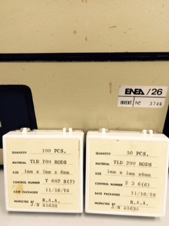
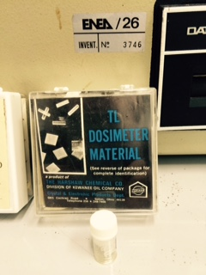
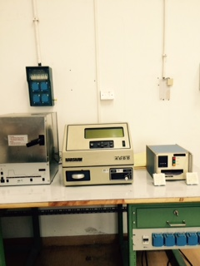
What we have now
TLD700 (neutron flux LiF)
TLD(200) (photons) (CaF2) and alanina
We need a Temperature measurement, a humidity mesuarement could also help. (uSOP)
For fast neutrons a polyethylene moderator is necessary.
They are very small and can be accomodated in the foreseen mechanical support.
they can be read at ENEA Casaccia with exsisting equipment.

Slide 14
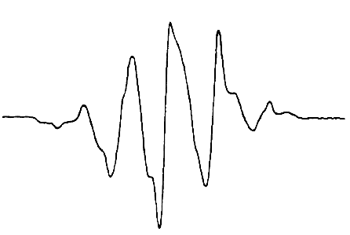
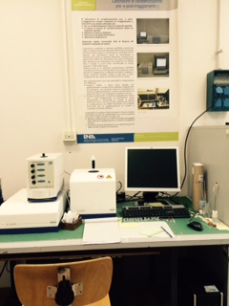
Electron spin resonance
Alanine
ESR dosimeter with alanine
(1Gy-500 kGy)
γ
50 G

