Slide 1
New Detectors Ideas for a Possible Class of Experiments
G. Carugno – INFN & Padova University
A short list of theoretical motivations
New Possible Low Energy Active Detectors:
Ideas and Facts
Electron / Nuclear Spin Detection
Preliminary Results

Slide 2
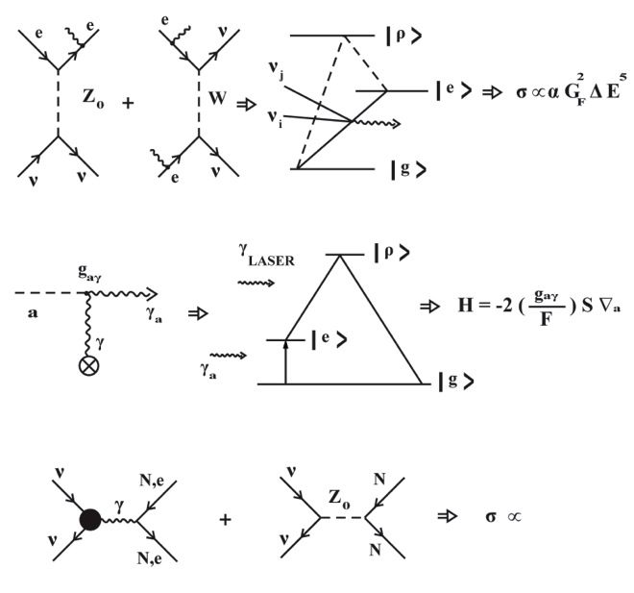
Processi Fisici e Basse Soglie di Energia
Emissione a 2 neutrini
Yoshimura
Assione-Effetto Primakov
Sikivie
Scattering coerente di neutrino
Via EM e Debole su Nuclei
Lattice displacements

Slide 3




Axion Electron interaction
The interaction of the axion with the a spin ½ particle
In the non relativistic approximation
The interaction term has the form of a spin - magnetic field interaction with playing the role of an effective magnetic field

Slide 4
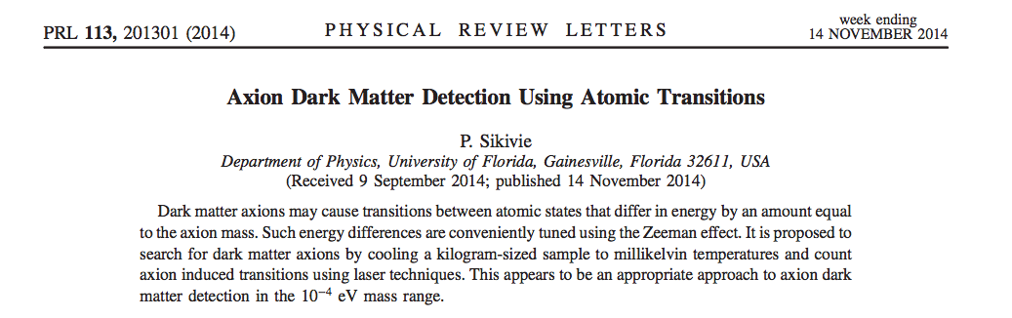


ZEEMAN TRANSITION RATE With 1 Mole of Polarized Electrons
Hz Rate

Slide 5

Neutrino Nuclear Spin Interaction
Forward Neutrino Scattering
Michael,Stodolsky,Langacker,Gelmini,Dyson
I neutrini esercitano un torque sulla particella di spin s data da :
Un Flusso di una specie di neutrino Su Materia Polarizzata e’ come se producesse
un Campo Magnetico Efficace B costante
Per flusso da reattore e spin 1/2h allora =10^-33 eV

Slide 6
A New Class of Detectors
Rivelatori bassa energia dal KeV all’eV
basati su Mezzi Attivi:
a)Quantum Counter
b)Maser detector
Magnetometria EPR = LODER
Quantum Limited Parametric Amplifier

Slide 7
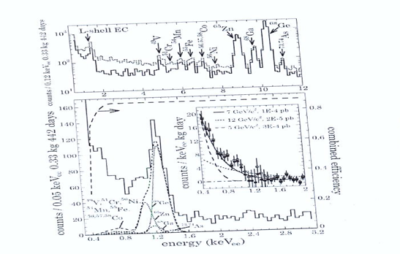
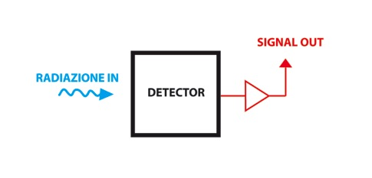
Stato Attuale Rivelatori Basse Soglie
( Fano Factor , Quenching Factor,…)
Shockley
Scintillatori : Kev (40 ph/KeV) Q.F. elevato alle basse energie , F.F. alto
Semiconduttori : 400 eV ( 1 e/h /3,6 eV Si , 100 elettroni rumore a bassa Capacita’)
MicroBolometri : 1 eV (Capacita termica totale, basse soglie MA piccole masse e mK)

Slide 8
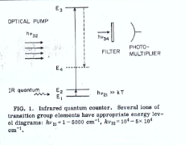
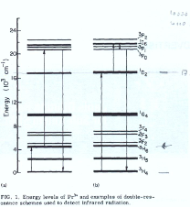
Infrared Quantum Counter Idea
Bloembergen ( Nobel Prize ) suggested to detect IR photons with large Q.E. where No Phototube are available at IR wavelenght (PRL ‘59 )
Quantum Efficiency for 20 micron IR photons almost at 100% level
GAS and CRYSTALS

Slide 9
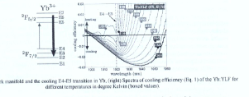
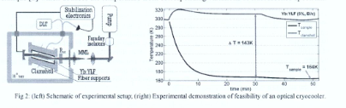
Laser Cooling of Solid
Densita’ Fononica Cristallo KT= 25 meV
Promuove stati eccitati a bassa energia
I quali sono portati su stati eccitati elevati
Da laser tunato su opportune transizioni.
Fotone Fluorescenza emesso = Fotone laser + Fonone Reticolo

Slide 10
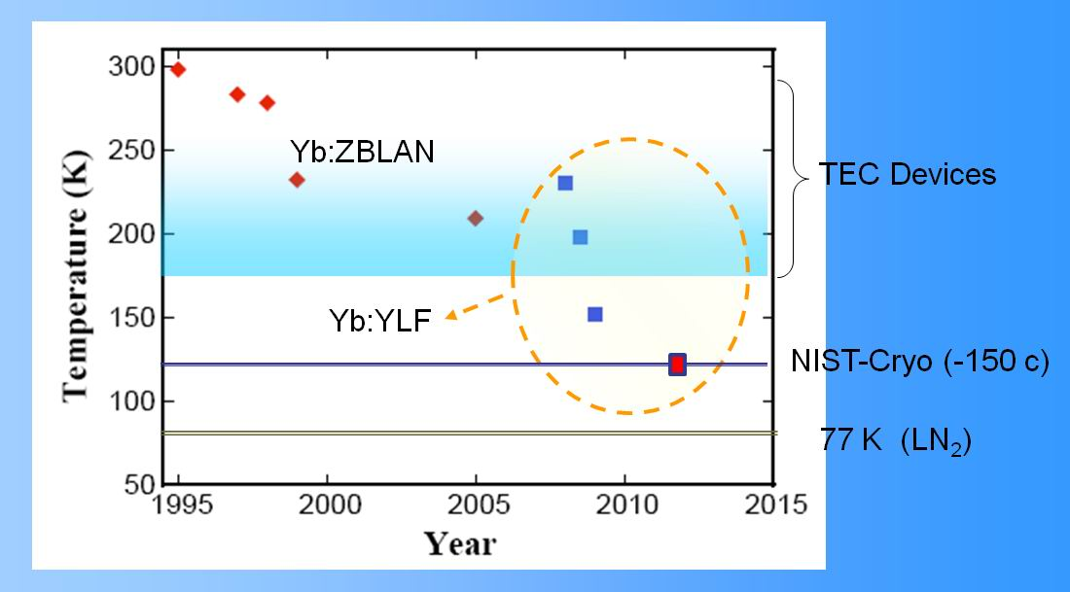
Optical Cooling
Now the lowest temperature: 119+_ 1 K ( ~ -154 C)!
Opt. Letters 38 (2013) 1588-1590
Nature Photonics 4 (2010) 161-164
Opt. Express 18 (2010) 18061-18066
α_{β} = ~ 10⁻⁴ cm⁻¹

Slide 11
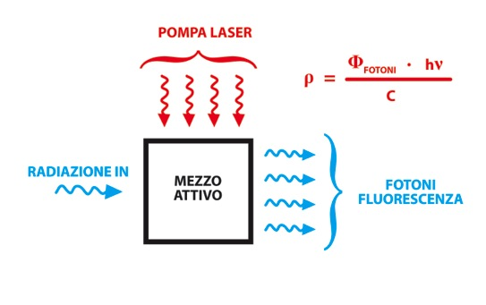
A New Detector Approach for Low Energy Release
SATURATION VALUE
-Radiazione in Attraverso dE/dx o Nuclear Recoil Promuove atomi su stati eccitati
-Maggior probabilita’ P(E) = 1/E^2 su stati di bassa energia
-Campo Cristallino Mezzo Attivo rimuove la degenerazione sullo stato
Fondamentale , generando primi stati eccitati a livelli dei meV

Slide 12
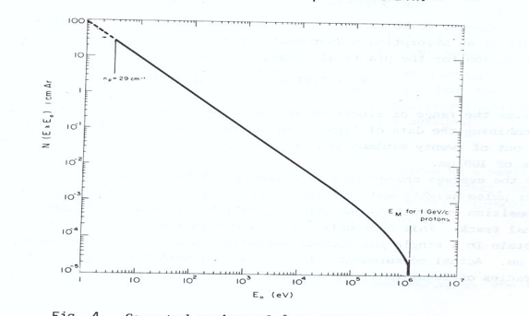

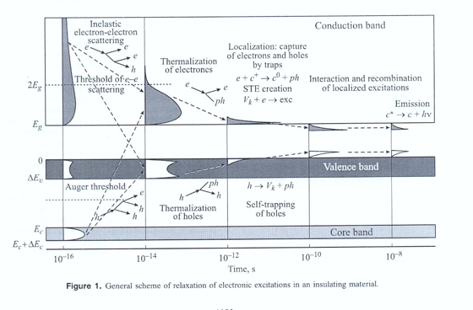
BETHE -BLOCH
Scattering elettroni su Fononi Ottici

Slide 13
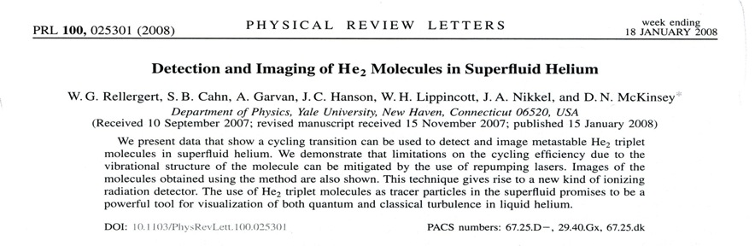
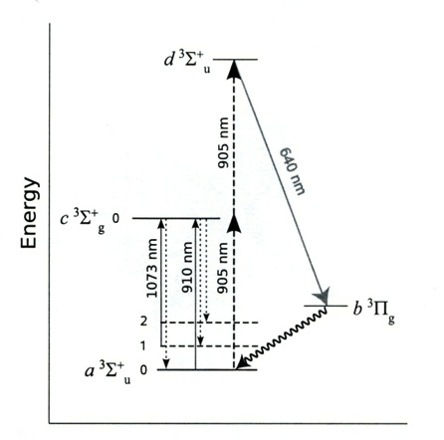
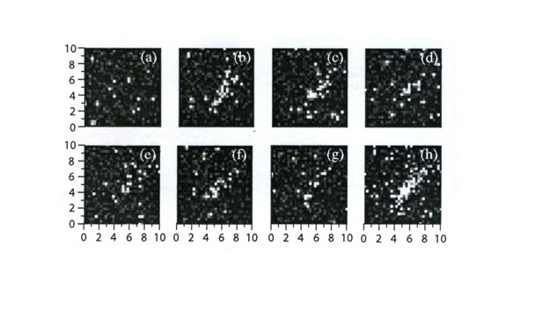
Tracce Elettrone Compton in Elio Liquido CCD

Slide 14
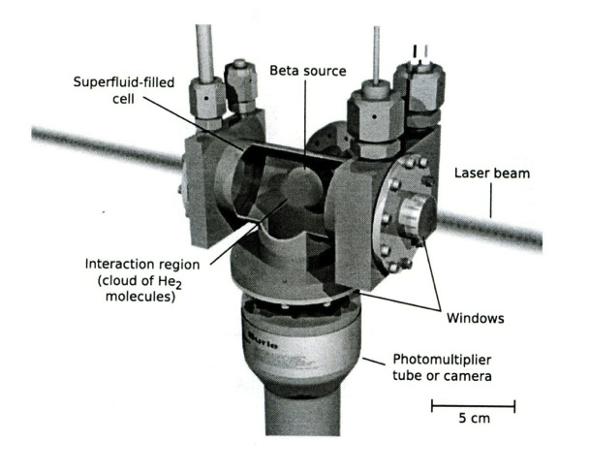

Slide 15
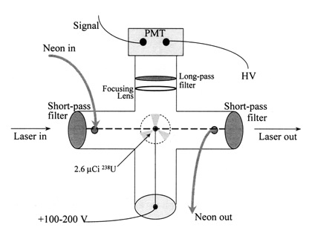
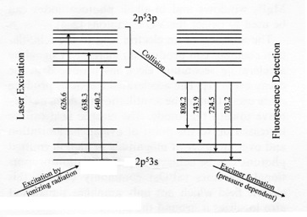
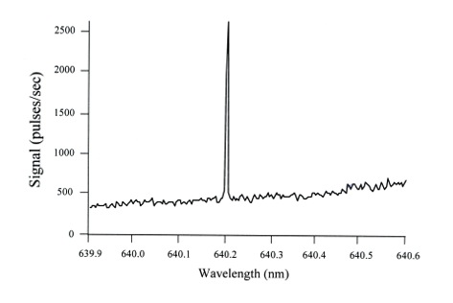
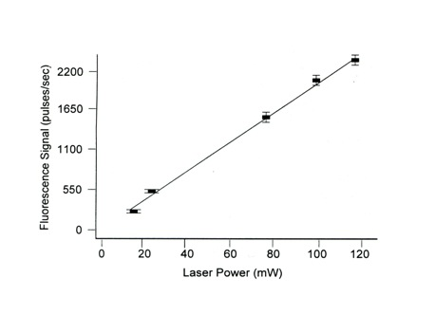
Laser Based Scintillation: Alfa Detection NIM 2002
Neon 100Torr
Diam. Laser beam 2 mm
Tau = microsecond
DE/Dx =10 KeV/mm
Transizione saturata a 10 W/cm2

Slide 16
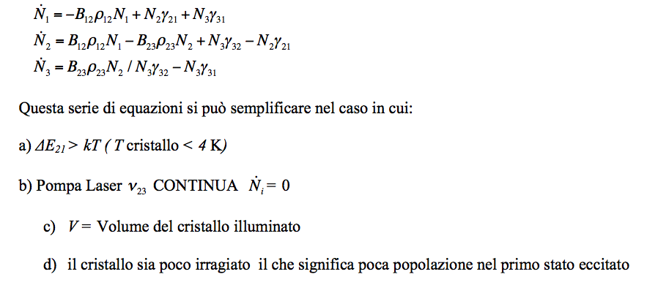
Rivelatore Particelle = Sistema a 3 livelli

Slide 17
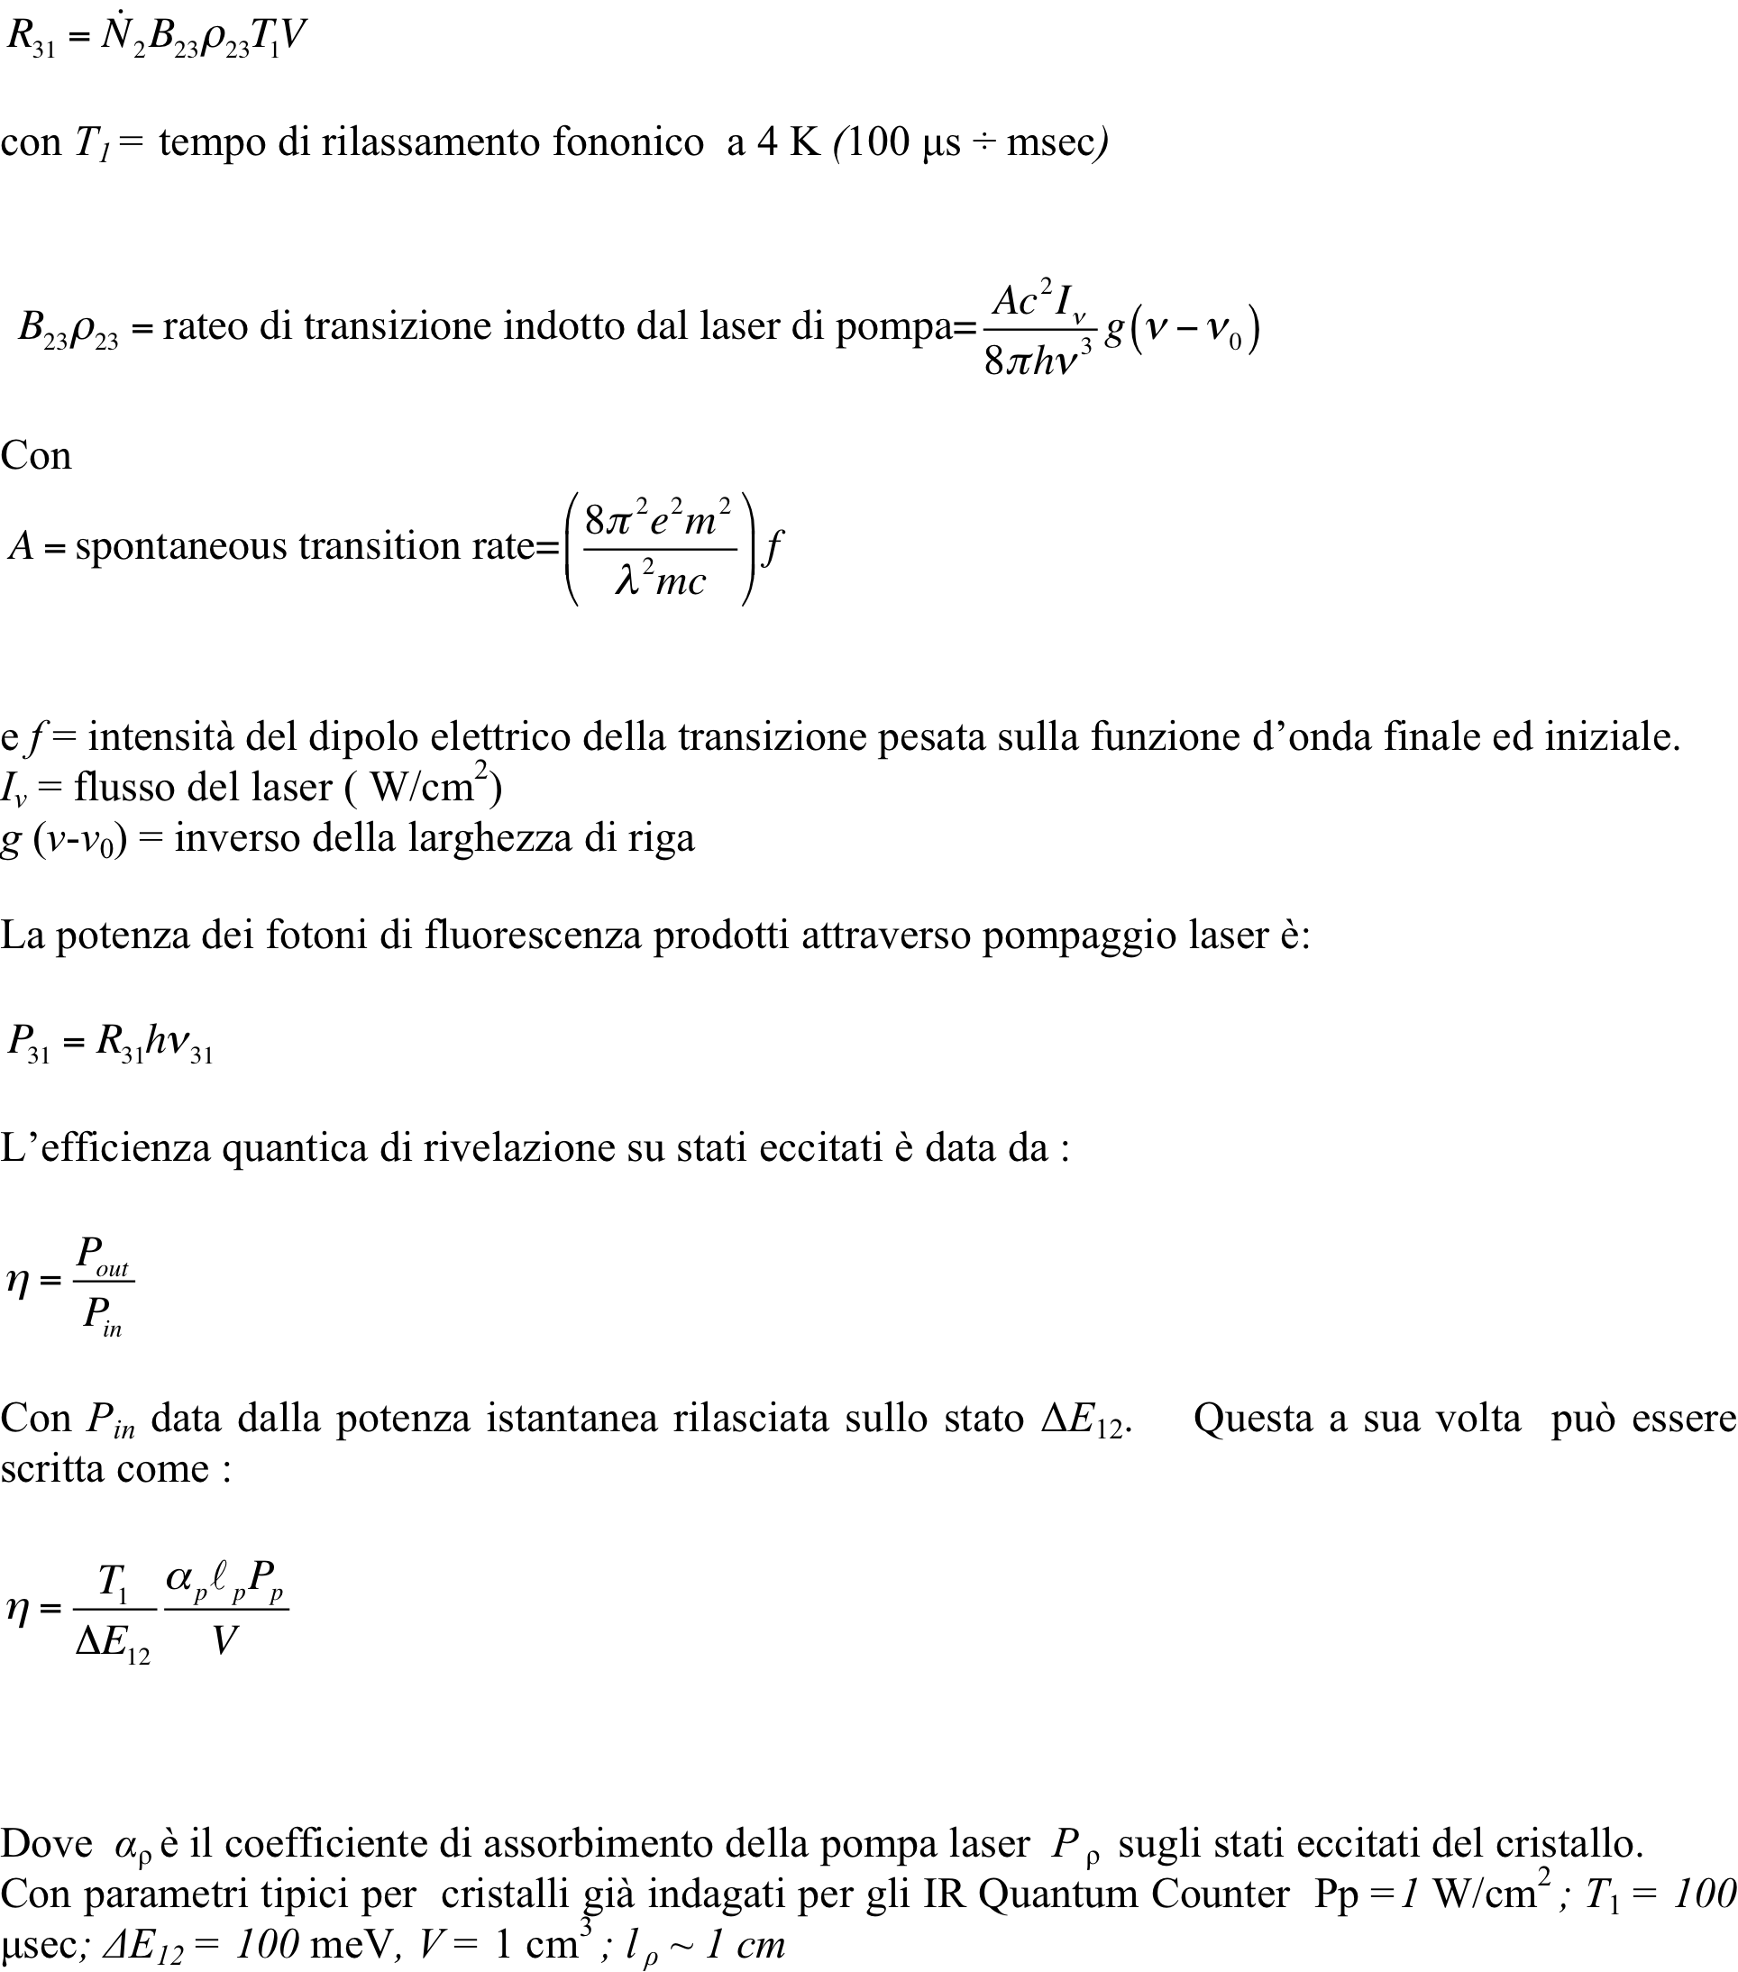

Slide 18
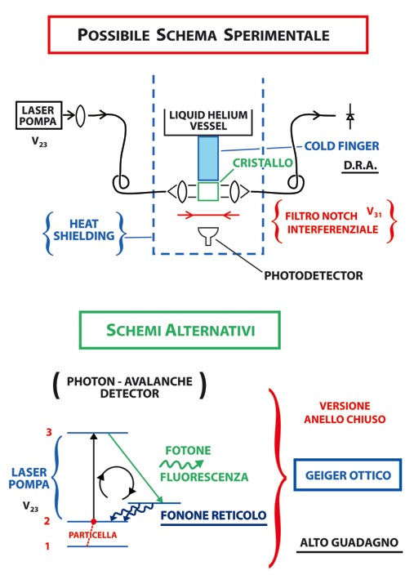

Slide 19
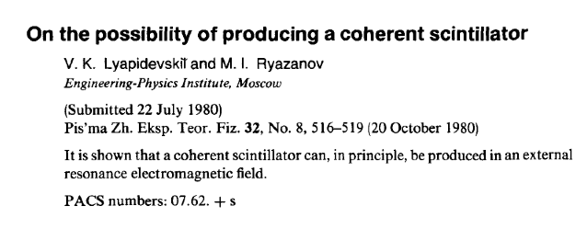
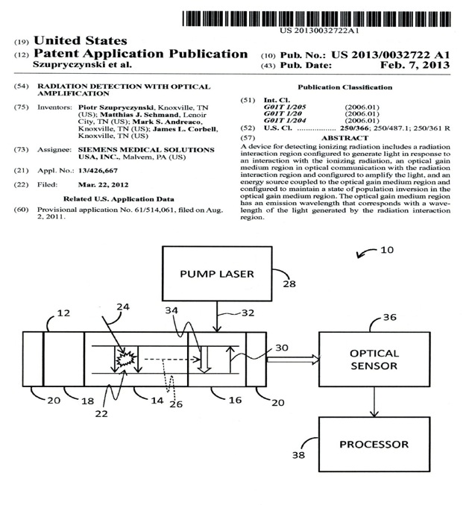

Slide 20
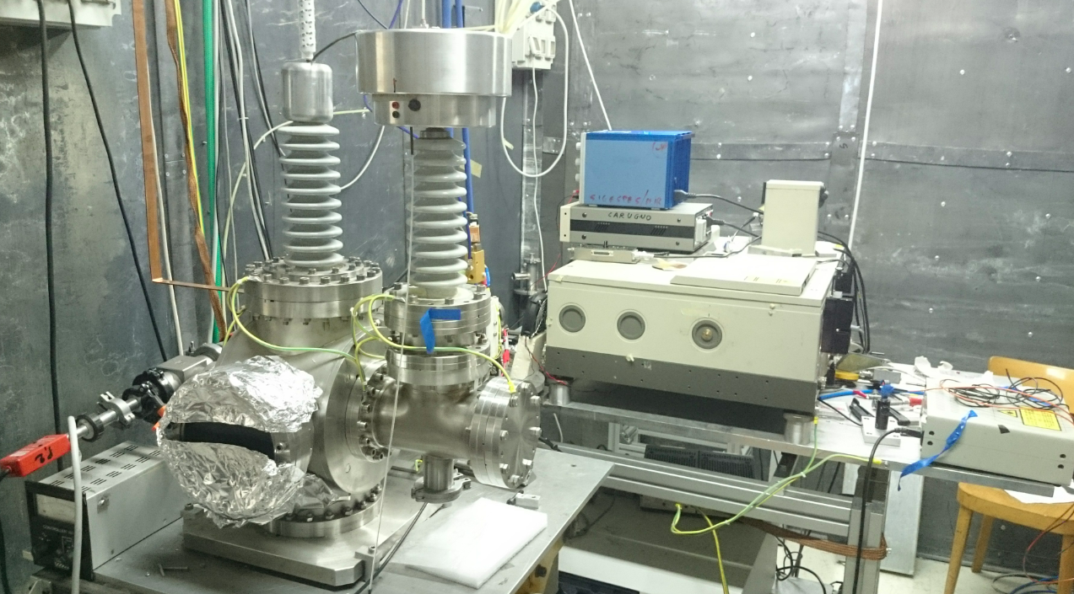
PRELIMINARY RESULTS: ( PD – PI – CA )
X Rays Facility @ Legnaro

Slide 21
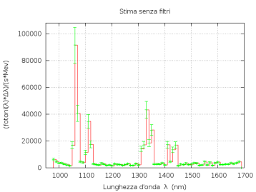
Nd:YAG IR Transitions and Spectra
At Room Temperature
0.75 eV
0.5 eV
IR Emission Efficiency larger than 15%

Slide 22
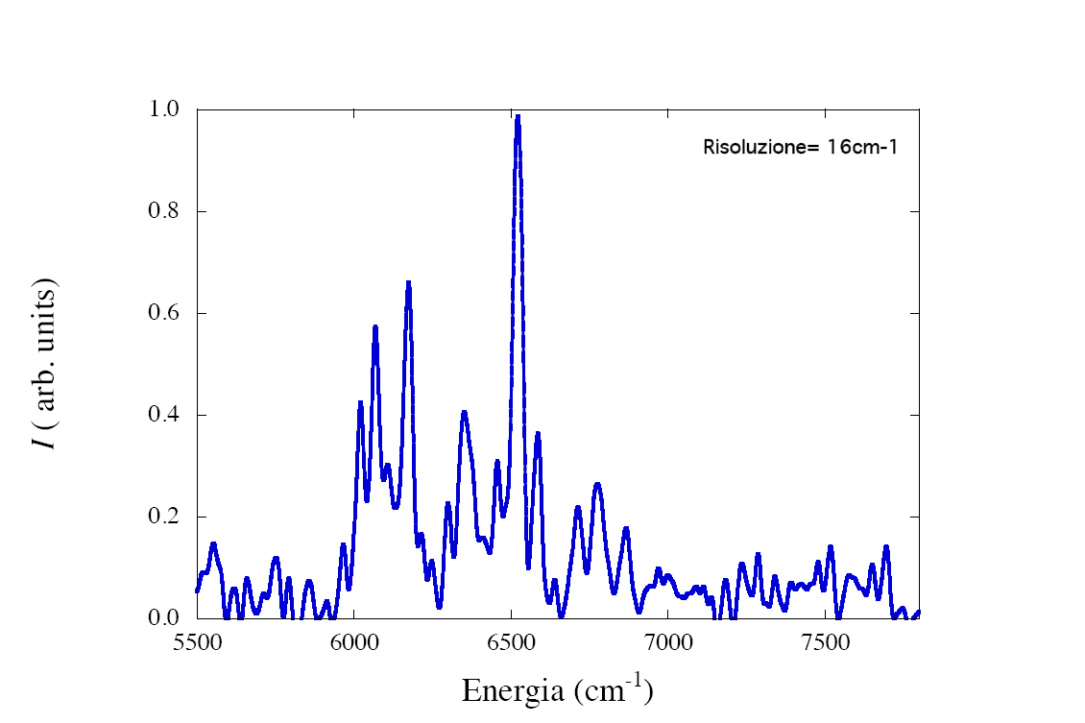
Erbium:Yag Emission Spectrum
0,4% Er
⁴I_{13/2} --⁴I_{15/2}

Slide 23
Double Laser Resonance Experimental Apparatus PISA
lens
Crystal
lens
\
Laser
Diode
chopper
Laser
Diode
fluorescence
collecting lens
UP CONVERSION
LASER PROBE
LASER PUMP
X Rays Source
Monochromator
Detector
Lock-in amplifier

Slide 24
BaY₂F₈: 8% Tm³⁺,
Tm population density: 10²³ ions/cm³
A:Pump @ 780 nm
B: Pump @ 635 nm
C: Emission @ 480 nm
B
C
A
Excitated populations
³F₄: 8x10²⁰ ions/cm³

Slide 25
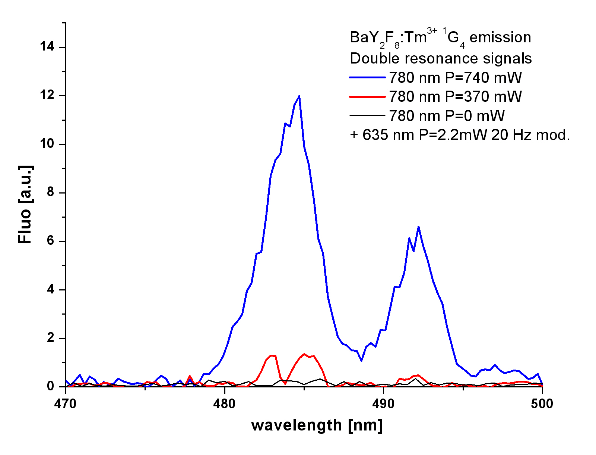
Double Resonace Spectrum
Pump : ³F₄ ----- ¹G₄ ( 633 nm)
Emission: ¹G₄ ---- ³H₆ (480 nm)

Slide 26
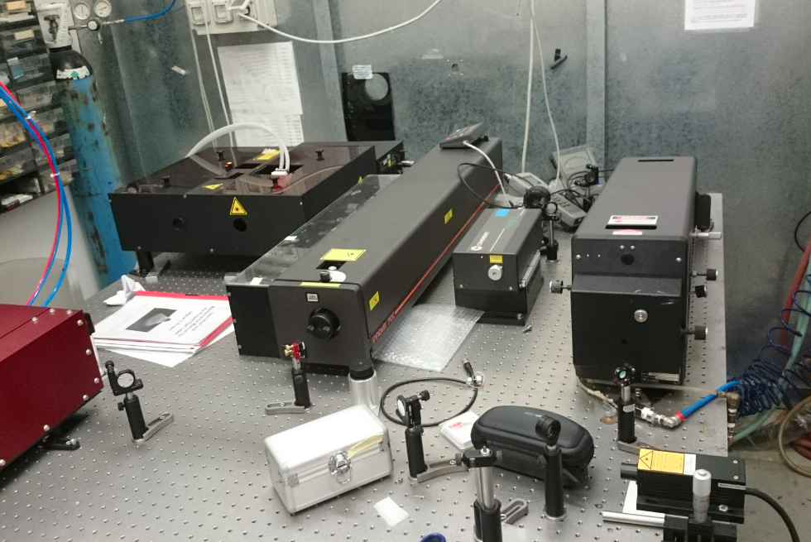
Tunable CW Titanium:Zapphire Laser @ LNL
from 740 nm to 920 nm , Power higher than 100 mW

Slide 27
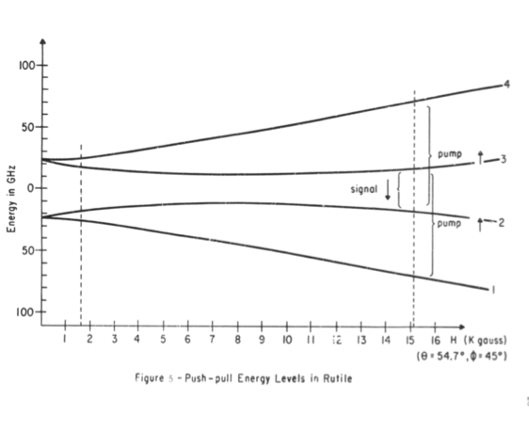
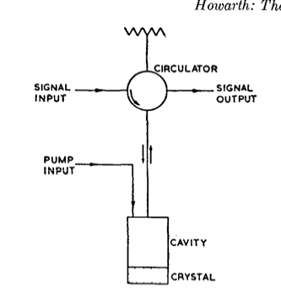
MASER AS LOW RF MICROWAVE FIELD AMPLIFIER
AND NEUTRAL PARTICLE DETECTOR
Bloembergen Paramagnetic Maser 4 Level System

Slide 28
Power Stimulated Emission :
Where
Quantum Maser Noise :
or
Minimum Detectable B field:
Minimum Cross Section Attainable:
WEAK CROSS SECTION SEEMS ATTAINABLE 10-43 cm2

Slide 29
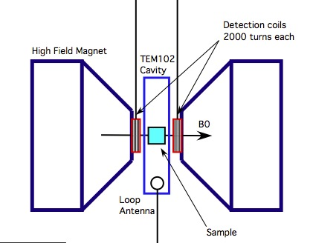
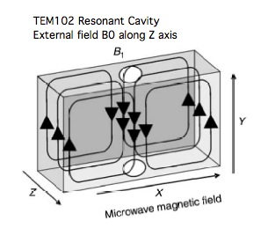
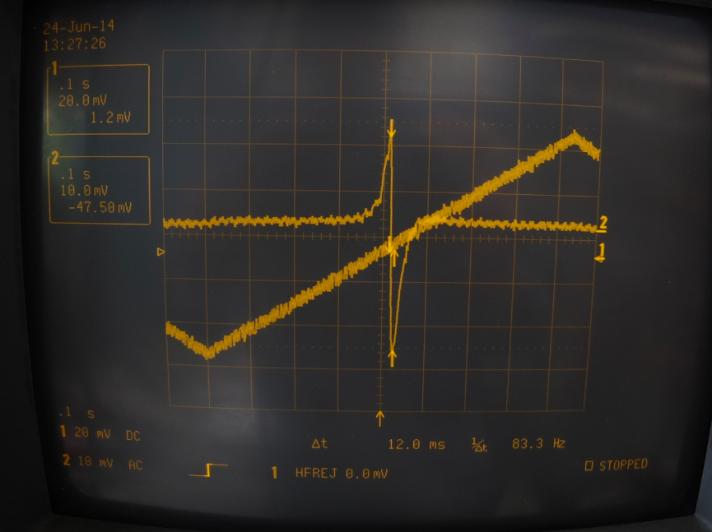
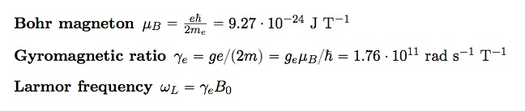
ESR / MR magnetometry
We exploit the Magnetic Resonance (MR) inside a magnetized material (Electron Spin Resonance - ESR)
ESR/MR resonances inside a magnetic media can be tuned by an external magnetizing field and lies in the multi GHz range (radio frequency)
1 T -> 28 GHz

Slide 30
Experimental parameters
Axion /Photon/Neutrino En.
Equivalent RF magnetic field
Working frequency
Measurement at the quantum limit
Electron Larmor Frequency
;
Magnetizing field
Working temperature

Slide 31
Detection issues
The working frequency lies in a region at the interface of two different regimes for best detection sensitivity
Frequency
Below 40 GHz
Above 40 GHz
FIELD DETECTION
(Linear detection)
ENERGY DETECTION
(Square detection)
- EPR Magnetometry
- MASER Amplifier
- QUANTUM COUNTER
(ZEEMAN Transitions)
In either case to reach quantum limit sensitivity 1/100 -1 mole of a magnetized sample at cryogenic temperature is necessary

Slide 32
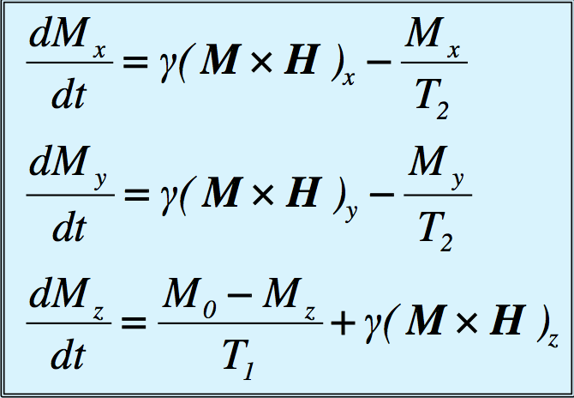
The Bloch equations
The evolution of the electron spin (spin precession) under the influence of external fields is described by a set of coupled non-linear equations due to Bloch (Magnetizing field H₀ along z-axis)
T₁ – longitudinal relaxation time
T₂ – transverse relaxation time
Radiation Damping to be investigated
At low temperature T < 1 K
T₁ ~ 10⁻⁶ to 10 s
T₂ ~ 10⁻⁶ to 0.1 s
depends on spin density
Magnetization
N₀ – spin density
μ_{B} – Bohr magneton
T_{s} – sample temperature

Slide 33
Longitudinal detection of axion field
We magnetize the sample along the z-axis and orient the sample in order to have the equivalent axion field h_{a} in the transverse direction
H₀ amplitude matches the searched value of the axion mass
We drive the sample with a pump field H_{p} at the Larmor frequency
H₀
h_{a}
H_{p}
The total driving radio-frequency field is then
Also Present

Slide 34
Longitudinal detection of axion field II
The relevant Bloch equations
A stationary solution can be obtained.
The magnetization along the z-axis (longitudinal component) shows a term modulated at the difference frequency ω_{D}.
Saturation parameter s
for
H_{p}, h_{a} in Tesla M₀ , m_{z} in A/m

Slide 35
Longitudinal detection of axion field III
We can define some sort of gain G_{m} for the low frequency field component μ₀ m_{z} with respect to the high frequency one h_{a}
If we put some relevant numbers (already published)
T₁ = 10⁻³ s
T₂ = 3 x 10⁻⁷ s
M₀ = 200 A/m
We obtain G_{m} > 1
for a pump field of H_{p} ~ 1 nT
Can we get enough gain G_{m} to be able to reach a measurable low frequency value from the axion field h_{a} ~ 10⁻²² T?
find the right material
power dissipated in the cryogenic system
noises in the system

Slide 36
Detection of Low Frequency Field
The most sensitive device for measuring magnetic field is the DC squid.
Squid measures magnetic flux Φ, the best sensitivity Φ_{s} obtainable is:
Φ_{s} = 10⁻²² Wb/√Hz
The flux that can be obtained at low frequency is:
Φ_{lf}= G_{m} h_{a} A
where A is the area covered by the sample.
For A ~ 10⁻⁴ m², the gain necessary to obtain a signal 1/100 x Φ_{s} is:
G_{m} ~ 100
To reach this gain, given the material (T₁, T₂), the free parameter is the pumping field.

Slide 37
Pumping field
The pumping field H_{p} is limited by two factors:
- saturation of the spins in the material
- power dissipated into the lattice (having volume V_{s})
The most stringent limitation comes from the power dissipation, which must be lower than the cryogenic power available.
@ 100 mk P_{cryo} ~ 1 mW
@ 1 K P_{cryo} ~ 300 mW

Slide 38
Noise
Supposing to reach the limiting sensitivity for the detector, residual intrinsic noise will be present as magnetization noise δm_{z} in the sample.
A first guess of its level can be calculated using Fluctuation-Dissipation theorem. This is in general correct for system at the equilibrium, which in principle is not our situation (stationary system).
Gd2Si5O2 @ 100mK + 1 Tesla SQUID , Noise @ 10^-15 T/Hz^0,5
The noise level must be measured experimentally!
(A/m)

Slide 39
Calibration
We have illustrated a technique which is not new (Pescia 1965, Ablart and Pescia 1980), however it has been normally used with very small values of relaxation times: t₁, t₂ < 1 μs.
Moreover, the theoretical framework is correct for paramagnets with small spin density N₀ ~ 10²² m⁻³. For higher densities radiation damping mechanisms and coupling to the pumping cavity must be taken into account.
In order to reach the necessary gain G_{m}, we will need t₁ ~ 10-100 ms, N₀ ~ 10²⁴-10²⁵ m⁻³.
The system must be verified, both from an experimental and a theo-retical point of view, in this extreme regions. Calibration is possible:
Provide h_{a} with a second RF generator

Slide 40
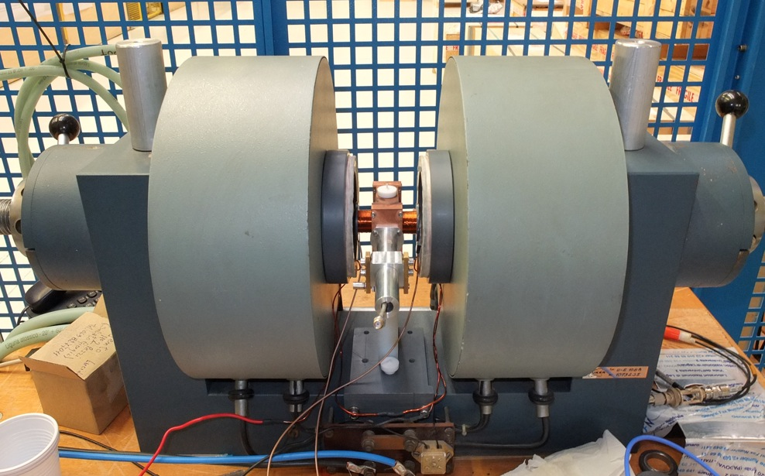
First prototype at Legnaro
Using an old EPR magnet we have set-up an apparatus to test the measurement scheme at room temperature.
The equivalent axion field ha was generated using a second RF generator frequency locked to the pump H_{p}.
As a magnetized sample we used DPPH (2,2-diphenylpicrylhydrazyl) at 300 K.
T₂ = 24 ns (measured by us)
T₁= 60 ns (from literature)
M₀ = 3.7 A/m (N₀ ~ 10²² m⁻³)

Slide 41
Detection scheme

Slide 42
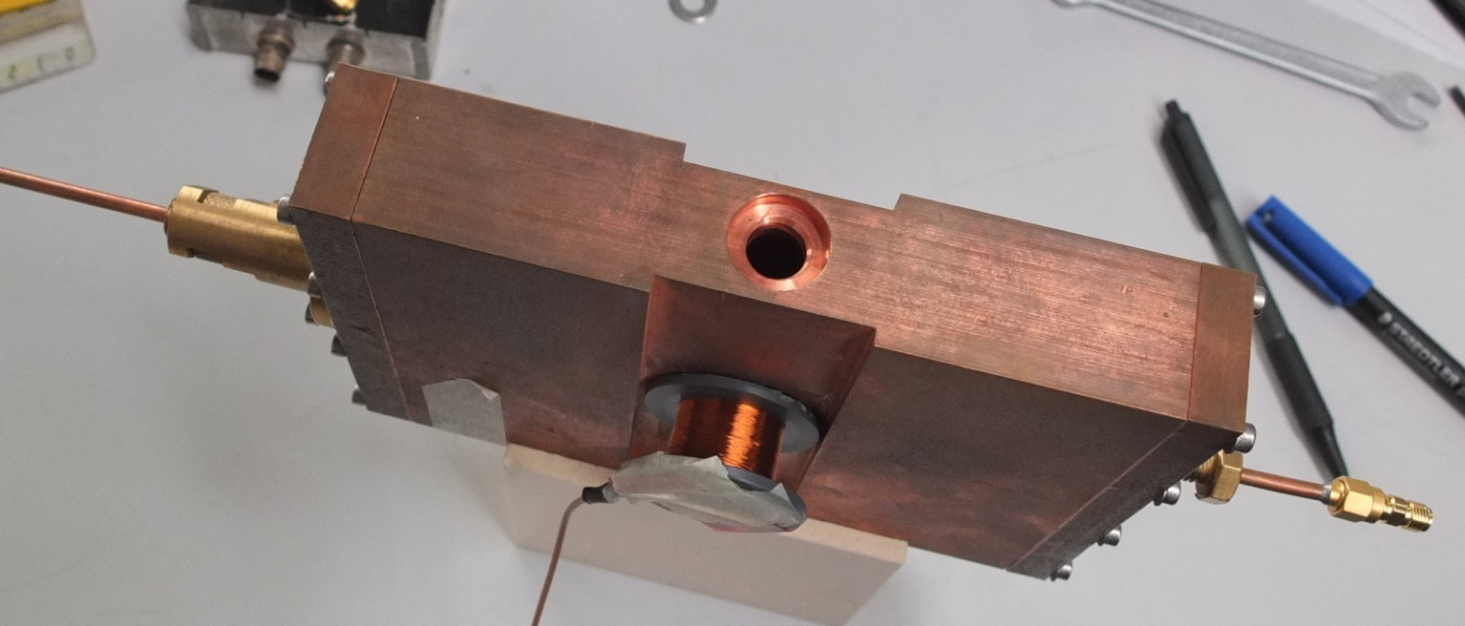
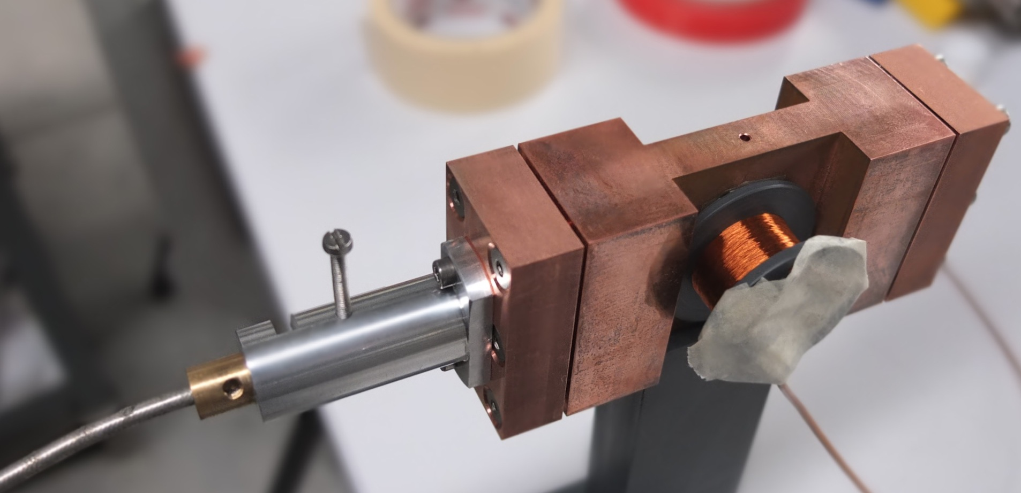
Cavities
2.5 GHz
TE102 mode
5.0 GHz
At critical coupling
B in Tesla
From Poole 1967

Slide 43
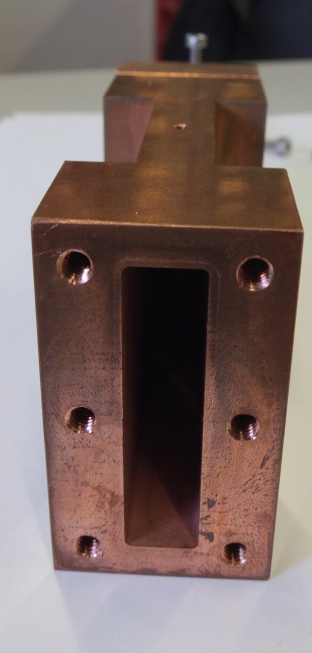
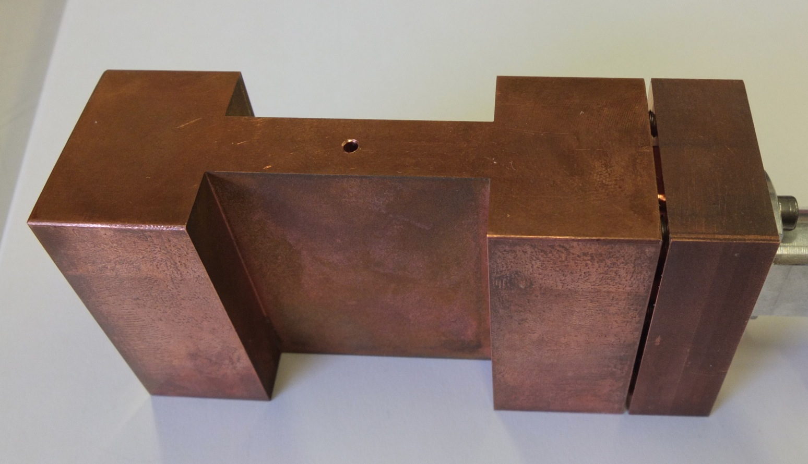
Cavities
300 μm thick wall to allow low frequency magnetic field to pass

Slide 44
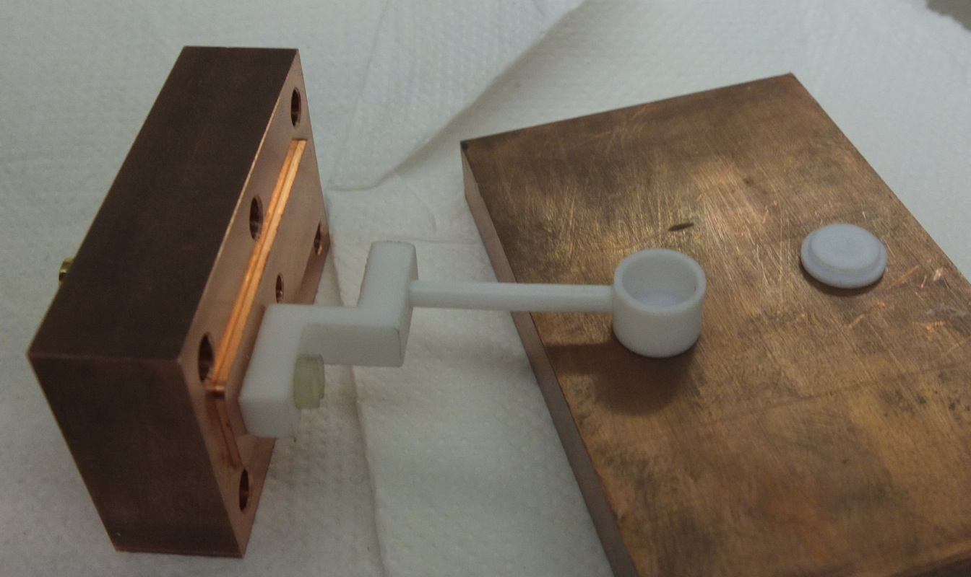
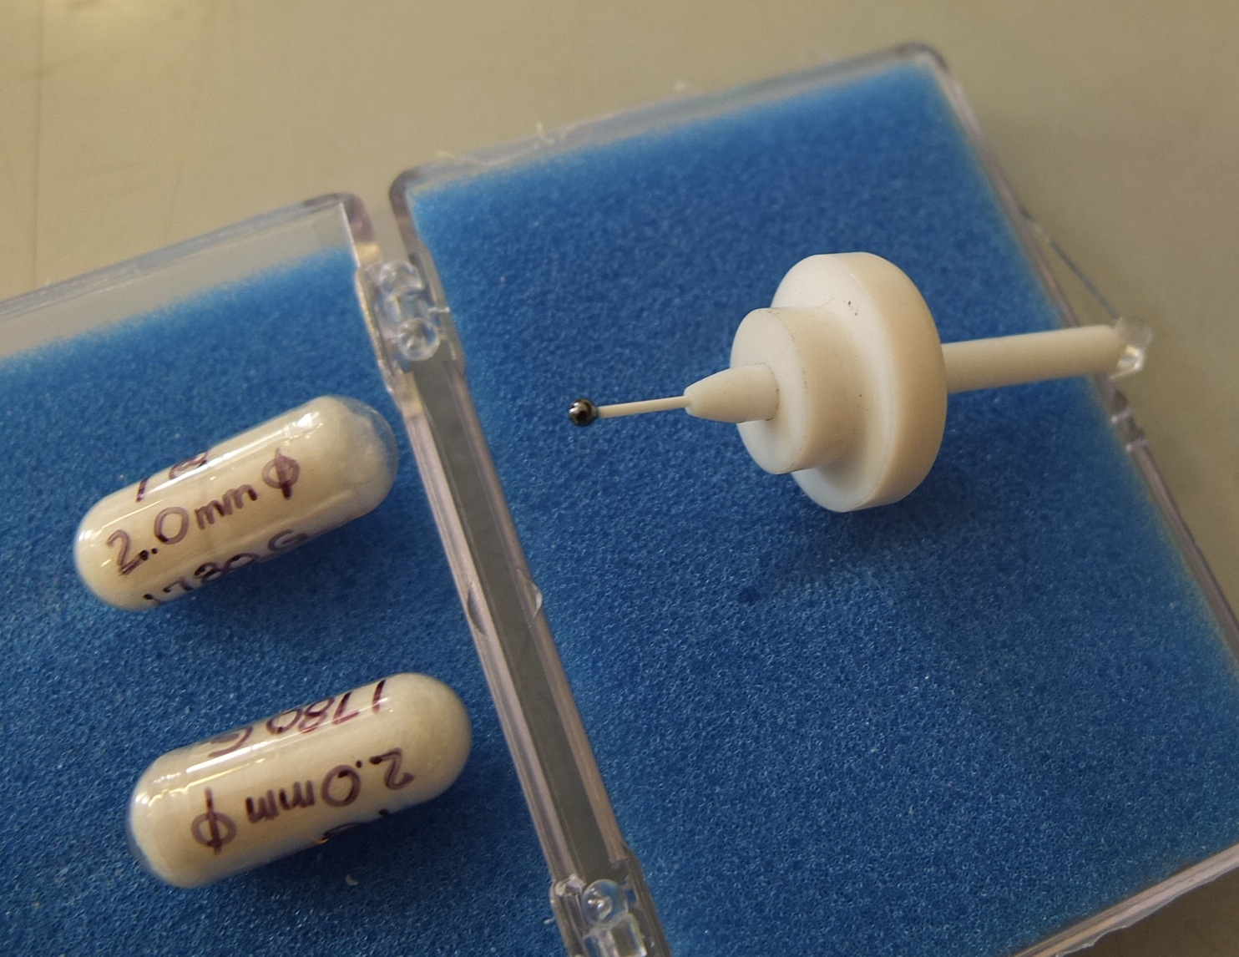
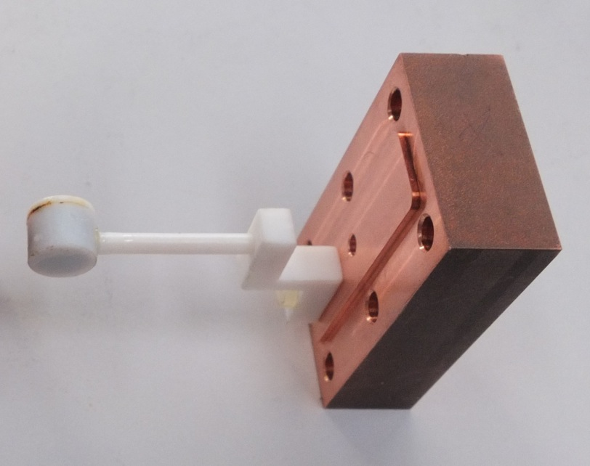
Magnetic samples
Material | Spin density | M0 | T1 | T2 | Size
DPPH | 2.1 x 10²⁷ [1/m³] | 8 A/m | 60 ns | 60 ns | Cylinder 8 mm diameter 8 mm length
YIG | 2.1 x 10²⁸ [1/m³] | 1.4 10⁵ A/m | 0.16 μs |  | Sphere 2 mm radius
All values at room temperature
YIG
DPPH box
DPPH box
DPPH box

Slide 45
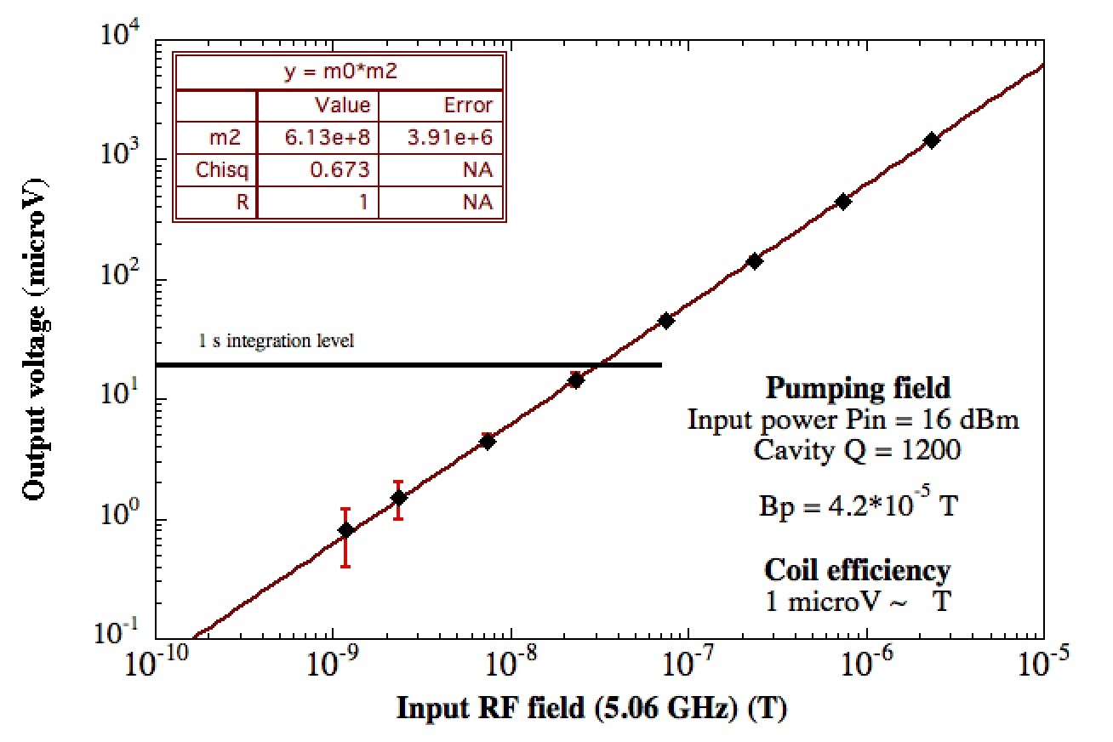
DPPH @ 5.0 GHz

Slide 46
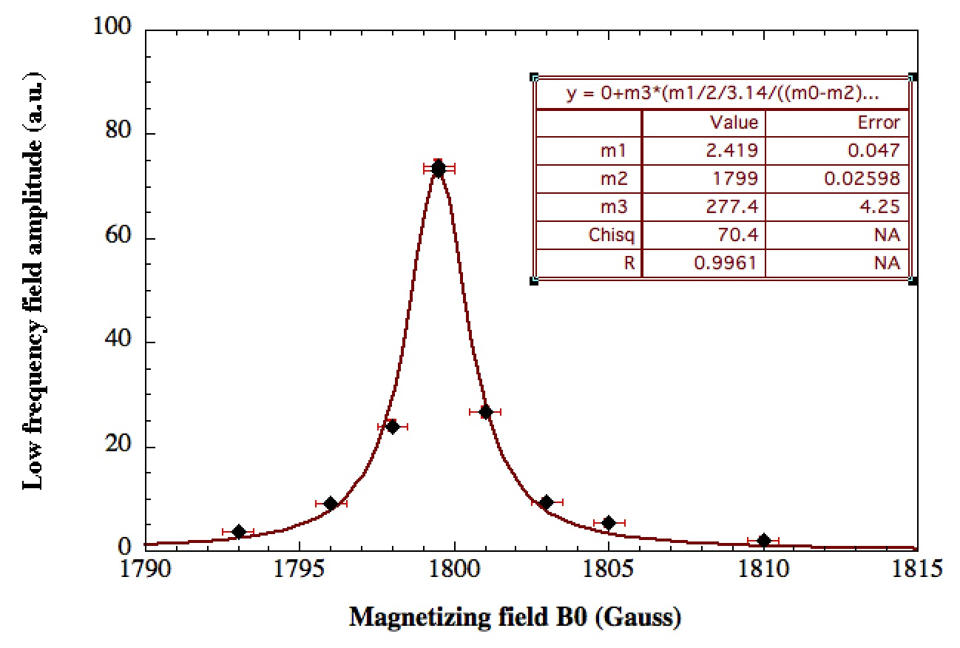
DPPH linewidth @ 5 GHz

Slide 47
Prospettive a Breve Termine (2015)
Dimostrare Quantum Counter per Particle Detection
Magnetometro EPR a 4 Kelvin Bmin = 10-14 T @ 10 GHz - NO SQUID
Studiare soluzioni numeriche Equazioni Bloch con radiation Damping e accoppiamento con Cavita’ ( Esercizio da svolgere per R.Barbieri )
- Esplorare Approccio QC per rivelare B a 10^-21 Tesla
Assieme a : PISA , LENS , NAPOLI ( cristalli/Gas Freddi )
- Dettagliare Calcoli Per Maser come Detector attraverso SiC.N

Slide 48
FINE

Slide 49
ZEEMAN TRANSITION RATE With 1 Mole of Polarized Electrons
Hz Rate

Slide 50
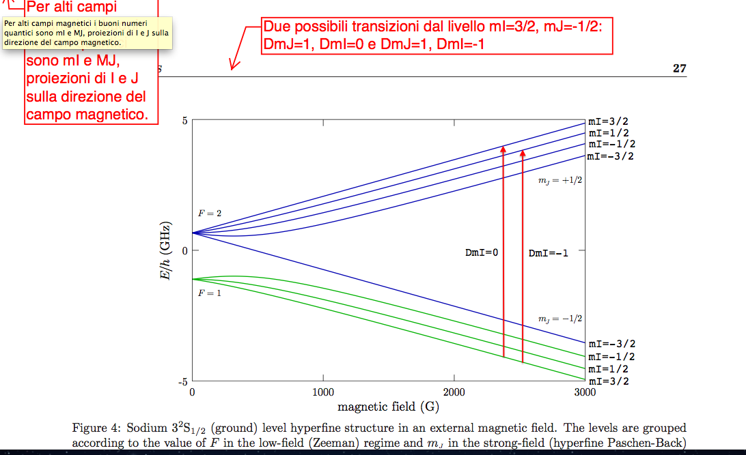
Infrared Quantum Counter Idea
Bloembergen ( Nobel Prize ) suggested to detect IR photons with large Q.E.
where No Phototube are available at IR wavelenght (PRL ‘59 )
Actual Quantum Efficiency for few 100 GHz Photons at 10-5 level

Slide 51
Short term perspectives
Build up a prototype apparatus capable of working at low temperature (at 4 K)
Find a material with long T1 and large magnetization at low temperature
In a first step: use as low frequency detector a resonant pick up coil.
We will integrate a SQUID into the system in a second step/phase.
One year goal: reach a sensitivity at 10^-14 Tesla
Study numerically the solution of the Bloch equations with radiation damping and coupling to external cavity.
- Esplorare diversi approcci per rivelare B tra 10^-21 e 10^-22 Tesla
Assieme a : PISA , LENS , NAPOLI

Slide 54
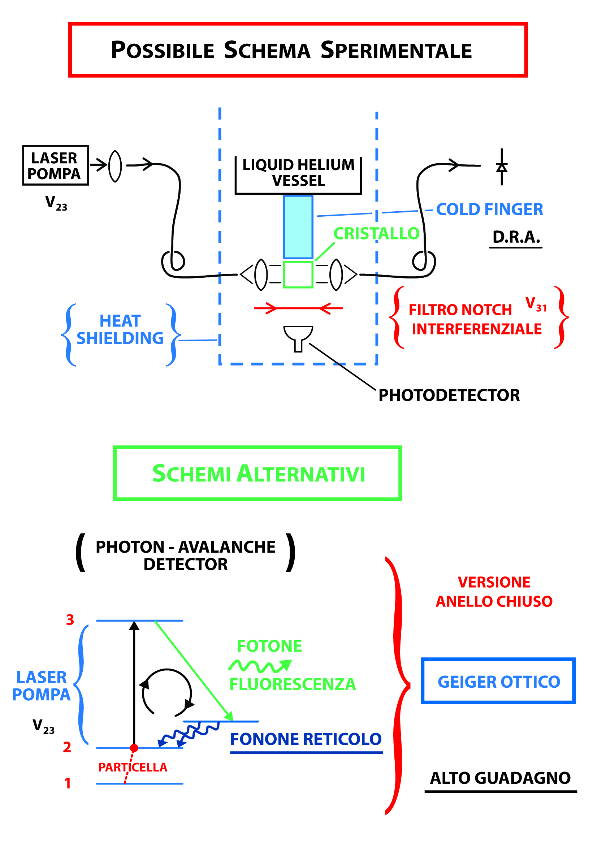

Slide 55
Infrared Quantum Counter Idea
Bloembergen ( Nobel Prize ) suggested to detect IR photons with large Q.E.
where No Phototube are available at IR wavelenght (PRL ‘59 )
Actual Quantum Efficiency for 10 micron IR photons almost at 100% level

Slide 56

BLOCH EQUATION FOR ELECTRON SPIN PRECESSION
MAGNETIZATION
T1=Longitudinal Relaxation
T2=Transverse Relaxation
At low temperature < 1K
T1 larger than a seconds
T2 depends on spin density
from micros to sec

Slide 57
Particle Detector = 3 Levels System

Slide 59
FASE A : Activity 2015 @ 4 Kelvin
1)Caratterizzazione materiali a 4 Kelvin in Cavita' e misura di rumore di magnetizzazione nelle micronde
2) Misura di parametri di alcuni materiali magnetici fatta dai
colleghi 4 K dell' INRIM di Torino + Simulazione Sistema
3) Misura Temperatura Rumore Amplificatore LNA a 4 Kelvin CON e SENZA Cavita’ ( Q cavita’ e Tnoise @ 4 Kelvin ) ( 58 Keuro )
5) Progettazione magnete da usare nell'esperimento.
Le richieste finanziarie per il 2015 sono in realta' ridotte
perche' utilizzeremo :
a) Un Magnete di polarizzazione in prestito dal CNR o dall'INFN di
Frascati o dal CERN.

Slide 60
Particle Detector = 3 Levels System

Slide 61
FASE A : 4 Kelvin R&D Activity
1)Validazione schema proposto per la misura della componente longitudinale della magnetizzazione utilizzando cavita’ risonanti e misure di rumore di magnetizzazione.
2) Misure di parametri di materiali magnetici a 4K in collaborazione con i colleghi dell' INRIM di Torino
3) Esplorare diversi approcci per rivelare B tra 10^-21 e 10^-22 Tesla
Assieme a : PISA , LENS , NAPOLI
IN ATTESA DI : FINANZIAMENTI / MAGNETE / SPAZIO LABORATORIO

Slide 62
Short term perspectives
Build up a prototype apparatus capable of working at low temperature (at 4 K)
Find a material with long T1 and large magnetization at low temperature
In a first step: use as low frequency detector a resonant pick up coil.
We will integrate a SQUID into the system in a second step/phase.
One year goal: reach a sensitivity at 10^-14 Tesla
Study numerically the solution of the Bloch equations with radiation damping and coupling to external cavity.

Slide 63
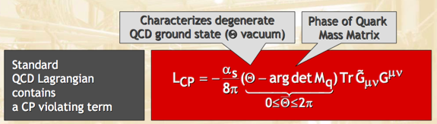


The strong CP problem
The QCD lagrangian contains a term that foresees CP violation
The parameter θ is unprescribed by the theory, it is expected to be θ ~ 1. QCD interaction actually depends on θ through its difference with the phase of the quark mass matrix:
VERY FINE TUNING! -> STRONG CP PROBLEM

Slide 64


ADMX Haloscopes – Galactic axions
Search for cold dark matter constituent
Original proposal by P. Sikivie (1983)
DM particles converted into photons inside a magnetic field (Primakoff)
The mass of the DM particle determines the frequency of the photons to be detected. For axions we are in the microwave range.
β_{a}~10⁻³ axion velocity
Use a microwave cavity to enhance signal. Cavity must be tuned to axion mass. Being this unknown, tuning is necessary: very time consuming experiment!
μeV <-> GHz

Slide 65



Haloscope detectors
Pilot experiments in Brookhaven (1988) and University of Florida (1990)
Second generation experiments:
  ADMX @ Lawrence Livermore employing low noise amplifier detectors
  CARRACK @ Kyoto employing Rydberg atom detectors
ADMX – Axion Dark Matter eXperiment
High Q microwave cavity inside an 8.5 T magnet
Almost Quantum Limited SQUID detector
Reached sensitivity for probing DM axion:
If all galactic DM is all made of axion
If we assume KSVZ model right
If the axion has the right mass, i.e. resonant with the cavity

Slide 66


ADMX recent progress and prospects
The experiment goes to a second stage with a collaboration between University of Washington Berkeley JPL and Yale
New scheme to employ SQUID at higher frequency
New type of amplifier at frequencies above a few Ghz
Use higher order modes in the resonant cavity
Optimize cavity material to obtain higher Qs – hybrid superconducting cavities
http://www.phys.washington.edu/groups/admx/future.html
Photonic band gap cavity in the multi-GHz range

Slide 67
Tale effetto e’ presente per le interazioni deboli ed e’ stato osservato
Sia sul neutrone ( Ramsey) che sugli Atomi (Bouchiat)
= 10^-7 rad/cm
L’effetto per il neutrino :
Michael,Stodolsky,Langacker,Gelmini
( 1 )
I neutrini esercitano un torque sulla particella di spin s data da :
I neutrini esercitano un torque sulla particella di spin s data da :
Su Materia Polarizzata e’ come se fosse presente un Campo Magnetico Efficace
Attualmente si misurano Campi di 10-^20 T

Slide 68
Processi Fisici e Basse Soglie di Energia
- Neutrino Scattering Coerente via Zo su Nuclei
(Neutrini Solari o da Reattore rilasciano 10 – 100 eV)
Neutrino Momento Magnetico su Nucleo
Materia Oscura : Assioni e WIMPS Ridurre Energia Soglia
Electron Capture Enhancement under Atom-Laser Illumination
Sezione d’urto differenziale neutrini Vs elettroni (nuclei)
Forward Scattering dei Neutrini e Campo Magnetico Efficace
Violazione di CP attraverso esperimenti di EDM e Assioni
Accoppiamenti Gravito-Magnetici su Particelle Elementari

Slide 69



Axion interactions
Axion interactions are model dependent
Axion photon photon
g_{γ} = 0.36 (DFSZ)
g_{γ} = - 0.97 (KSVZ)
Axion electron electron
(DFSZ)
g_{e} = 10⁻³ (KSVZ)
All couplings are extremely weak!

Slide 70
Low Energy Particle Detector:
Laser Induced
DORELAS
Fisica vs Rivelatori a Bassa Soglia di Energia
Da KeV a eV Breve sguardo d’insieme e prospettive
Pompaggio Laser su “ Mezzo Attivo “ : RIVELATORE
Progetto di Ricerca
Richieste :Finanziarie ,Sezione, F.T.E.

Slide 71
Infrared Quantum Counter Idea
Bloembergen ( Nobel Prize ) suggested to detect IR photons with large Q.E.
where No Phototube are available at IR wavelenght (PRL ‘59 )
Actual Quantum Efficiency for 10 micron IR photons almost at 100% level

Slide 72
Infrared Quantum Counter Idea
Bloembergen ( Nobel Prize ) suggested to detect IR photons with large Q.E.
where No Phototube are available at IR wavelenght (PRL ‘59 )
Actual Quantum Efficiency for 10 micron IR photons almost at 100% level

Slide 73


Slide 74


Slide 75
Axion interactions
Axion interactions are model dependent
Axion photon photon
g_{γ} = 0.36 (DFSZ)
g_{γ} = - 0.97 (KSVZ)
Axion electron electron
(DFSZ)
g_{e} = 10⁻³ (KSVZ)
All couplings are extremely weak!

Slide 76

Does the axion exist?
While the standard Peccei Quinn Weinberg Wilczeck (PQWW) axion was soon ruled out ( Electro Weak Scale F = 250 GeV ), the other axion (DFSZ, KSVZ) continues to evade all current experimental limits
A reduced window of possibilities is actually left for discovery
Excluded
Searches
Hint
From G. Raffelt talk in Vistas in Axion Physics, INT, Seattle, 23–26 April 2012

Slide 77
Axion Electron interaction
The interaction of the axion with the a spin ½ particle
In the non relativistic approximation
The interaction term has the form of a spin - magnetic field interaction with playing the role of an effective magnetic field

Slide 78


QUAX Beam Pattern
EFFETTO DIREZIONALE
SPIN ELETTRONE -ASSIONE

Slide 79

QUAX goal
Reach the axion model coupling constant within a 5 year development in a narrow axion mass range
Major issue is to demonstrate that noise sources are under control in reasonable amount of time, thus allowing to extend the mass range in a larger apparatus

Slide 80
Infrared Quantum Counter Idea
Bloembergen ( Nobel Prize ) suggested to detect IR photons with large Q.E.
where No Phototube are available at IR wavelenght (PRL ‘59 )
Actual Quantum Efficiency for few 100 GHz Photons at 10-5 level

Slide 81

Magnetic detection
A possibility is to exploit the axion electron coupling
Due to the motion of the solar system in the galaxy, the axion DM cloud acts as an effective RF magnetic field on electron spin
This field excites magnetic transition in a magnetized sample
( Larmor frequency ) and produce a detectable signal
MS – Magnetized sample
Axion
MS
Measurable signal
Wind
Idea comes from several old works:
L.M. Krauss, J. Moody, F. Wilczeck, D.E. Morris, ”Spin coupled axion detections”, HUTP-85/A006 (1985)
L.M. Krauss, ”Axions .. the search continues”, Yale Preprint YTP 85-31 (1985)
R. Barbieri, M. Cerdonio, G. Fiorentini, S. Vitale, Phys. Lett. B 226, 357 (1989)
A.I. Kakhizde, I. V. Kolokolov, Sov. Phys. JETP 72 598 (1991)

Slide 82
Frequency prescriptions
The general solution for the variable component of the magnetization is:
For large values of T₁ and T₂ ( T₁ > T₂ ) the gain drops off as 1/ω above ω₁ ~ 1/T₁.
T₁
T₂
ω_{D}(rad/s)
This has to be taken into account in order to keep the largest gain-bandwidth.

Slide 83

Pick – up coils
Before using squids the system can be studied with a pick-up coil.
A pick-up coil surrounding the magnetized sample will produce an induced voltage which is:
Which has now the form:
there is a different frequency behavior, but sensitivity is in general much worse than squids
ω_{D}(rad/s)

Slide 84
e

Slide 85
Longitudinal detection of axion field
We magnetize the sample along the z-axis and orient the sample in order to have the equivalent axion field h_{a} in the transverse direction
H₀ amplitude matches the searched value of the axion mass
We drive the sample with a pump field H_{p} at the Larmor frequency
H₀
h_{a}
H_{p}
The total driving radio-frequency field is then

Slide 86
Longitudinal detection of axion field
The relevant Bloch equations
A stationary solution can be obtained.
The magnetization along the z-axis (longitudinal component) shows a term modulated at the difference frequency ω_{D}.
Saturation parameter s
for
H_{p}, h_{a} in Tesla M₀ , m_{z} in A/m

Slide 87
Longitudinal detection of axion field
We can define some sort of gain G_{m} for the low frequency field component μ₀ m_{z} with respect to the high frequency one h_{a}
If we put some relevant numbers (already published)
T₁ = 10⁻³ s
T₂ = 3 x 10⁻⁷ s
M₀ = 200 A/m
We obtain G_{m} > 1
for a pump field of H_{p} ~ 1 nT
Can we get enough gain G_{m} to be able to reach a measurable low frequency value from the axion field h_{a} ~ 10⁻²² T?
find the right material
power dissipated in the cryogenic system
noises in the system

Slide 88

Results

