Slide 1
Controls and Computing First Ideas
PADME Kick-Off Meeting – LNF, April 20-21, 2015
Emanuele Leonardi
INFN Roma

Slide 2
DAQ Data Rate - Preliminary estimate
Tentative setup: all channels read with Fast ADC
1024 samples, 12 bits per sample → 1536 Bytes per channel per event
Beam rate: 50 Hz
Data source | # channels | Data rate (MiB/s)
Active target | 32 | 2.3
Hodoscope | 200 | 14.6
Calorimeter | 656 | 48.0
SAC | 4 | 0.3
Positron veto | 50 | 3.7
Total |  | 69.0
Preliminary DAQ L0 Rate

Slide 3
After L1 (zero suppression)
Data source | # channels |  | Data rate
 | Total | 0-supp | MiB/s | TB/y
Active target | 32 | 6 | 0.44 | 14.5
Hodoscope | 200 | 5 | 0.37 | 12.1
Calorimeter | 656 | 25 | 1.83 | 60.6
SAC | 4 | 4 | 0.29 | 9.7
Positron veto | 50 | 5 | 0.37 | 12.1
Total |  |  | 3.30 | 109.0
Notes:
Occupancies from MC studies
1 year = 365 days of data taking
No event selection: all events are written to disk
ROOT can give a 30-50% data compression factor when writing data to disk
RAW data keeping full
ADC samples

Slide 4
RAW data
L2
Reconstruction format (RECO)
Energy/Time per Channel
Physics objects (Clusters/Tracks)
O(10 TB/y)
Analysis format (ANAL)
Physics objects only
O(1 TB/y)

Slide 5
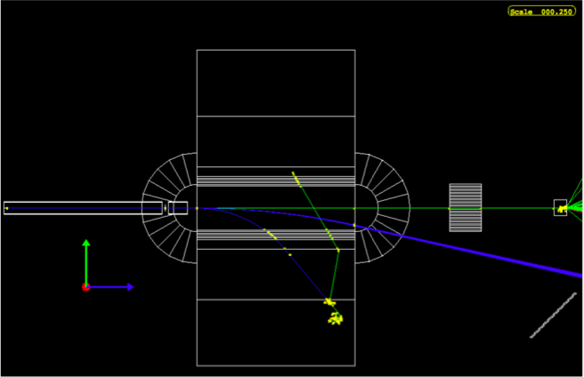
Monte Carlo production - Storage
Production Unit
10¹³ e⁺ i.e. 2x10⁹ bunches of O(5000) e⁺
N.B. 1 bunch = 1 MC event
Event size: O(1KB/event)
Includes only E,t for
each active channel
Storage requirements
~2 TB/Production Unit
If we want 10x statistics each year: ~20 TB/y

Slide 6
Monte Carlo production - CPU
Full GEANT4 simulation of the experimental setup
Running on a HP Proliant DL560 server
4 Intel Xeon E5-4610v2 @ 2.3GHz (32 cores)
128 GB ECC RAM
Current MC production rate:
3 Hz/core (3 bunches per second per core)
10 production units per year → 37 days per production
CPU power needed: 210 cores, i.e. 7 servers.
Use of GRID for MC production under investigation

Slide 7
Costs
Disk costs: 0.2 K€/TB
Tape costs: 0.1 K€/TB
CPU: 6K€ per server (32 cores)
All data (RAW+RECO+ANAL) written to tape
10% RAW + 100% RECO + 100% ANAL kept on disk
 | Disk |  | Tape
 | TB/y | K€/y | TB/y | K€/y
Data | 20 | 4 | 120 | 12
MC | 20 | 4 | 40 | 4
CPU: 7 server → 42 K€
Accessories: racks, networking, cables, … → O(10 K€)

Slide 8
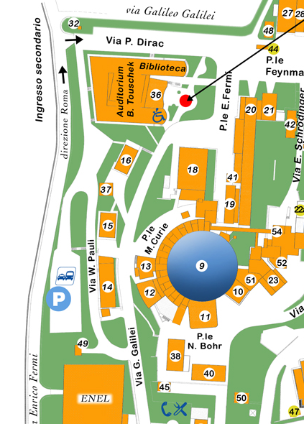
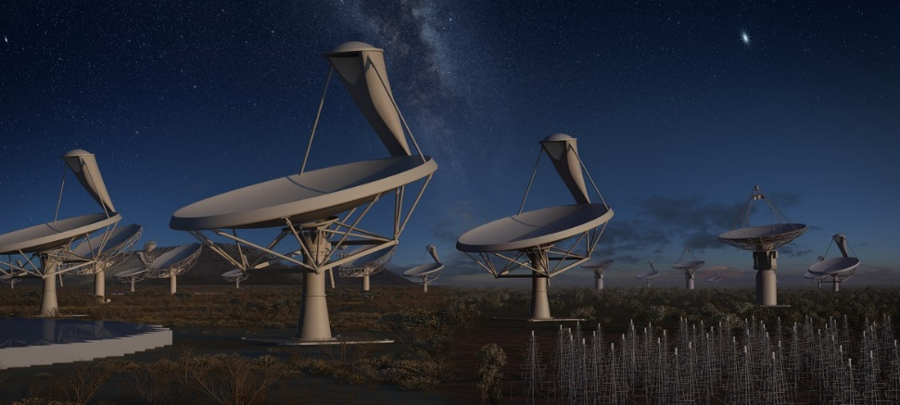
IT @ LNF – Central services
Informal preliminary meeting with Massimo Pistoni, head of the LNF IT services, on April 1st.
Space, power, cooling, UPS, network are available.
No technical problems to host computing resources for PADME.
Computing Center
BTF
Caveat
New collaboration INFN-INAF
LNF will be asked to host computing resources for the CTA/SKA project.
Allocate computer room resources for PADME ASAP

Slide 9
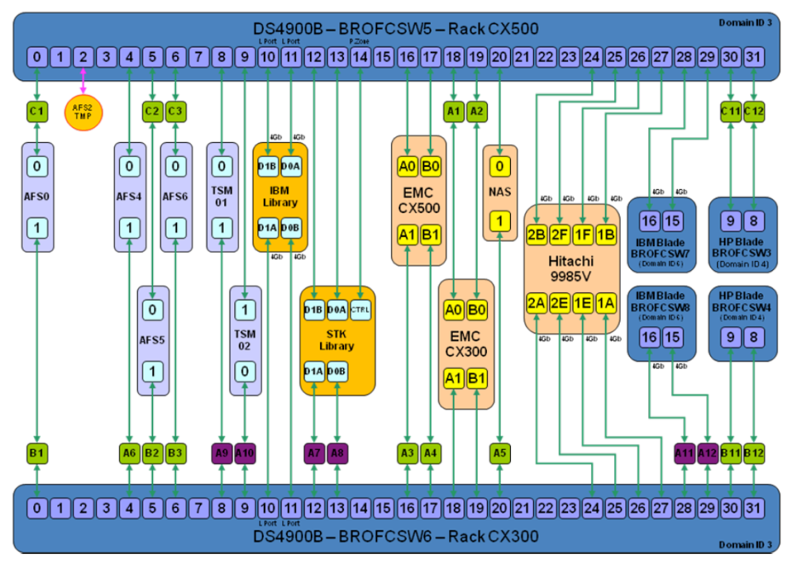
IT @ LNF - Disk
A Storage Area Network (SAN) exists
EMC² CX500 (120 disks) + CX300 (60 disks)
Hitachi-Storagetek 9985V (up to 240 disks)
2 Switch FC Brocade DS4900B
2x32 ports @ 4 Gbps
It can host storage for PADME but the current SAN infrastructure (servers and switches) is close to saturation
Bottlenecks are possible
Might need an upgrade
Cloud-based storage is being investigated by INFN (CNAF, LNGS, To)
Good scaling properties (PB and beyond)
Automatic and configurable redundancy (not RAID-based)
Lower cost per TB → SAN ~200€/TB vs. Cloud ~100€/TB

Slide 10
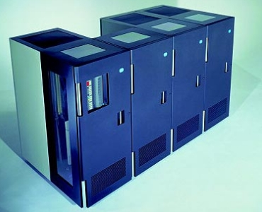
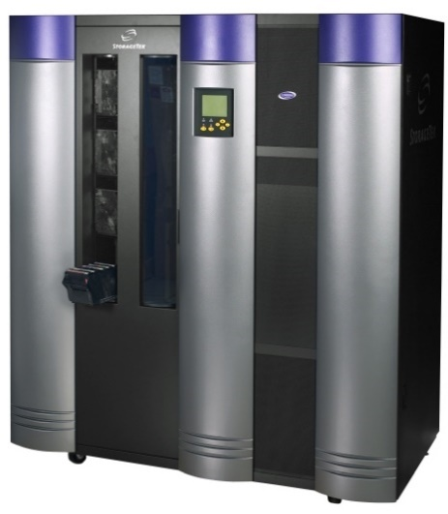
IT @ LNF - Tapes
Two tape libraries are available.
IBM 3494
1000 slot
4 Magstar 3592, 300 GB/tape, 40 MB/s
StorageTek L1400
700 slot (max 1400)
2 STK 9940, 200 GB/tape, 30 MB/s
Both have spare cartridge slots and can be upgraded with TB-class tape drives.
Alternative: buy a new LTO tape library
IBM 3494
STK L1400
Format | Capacity (unc.) | Transfer rate (unc.) | Cost per tape | Cost per TB | Availability
LTO-6 | 2.5 TB/tape | 160 MB/s | 50 € | 20 € | Now
LTO-7 | 6.4 TB/tape | 300 MB/s | (?) | (?) | End 2015
Cost of tape storage: ≤100 €/TB (less for LTO)
Need to evaluate cost of new tape drives/library for different solutions

Slide 11
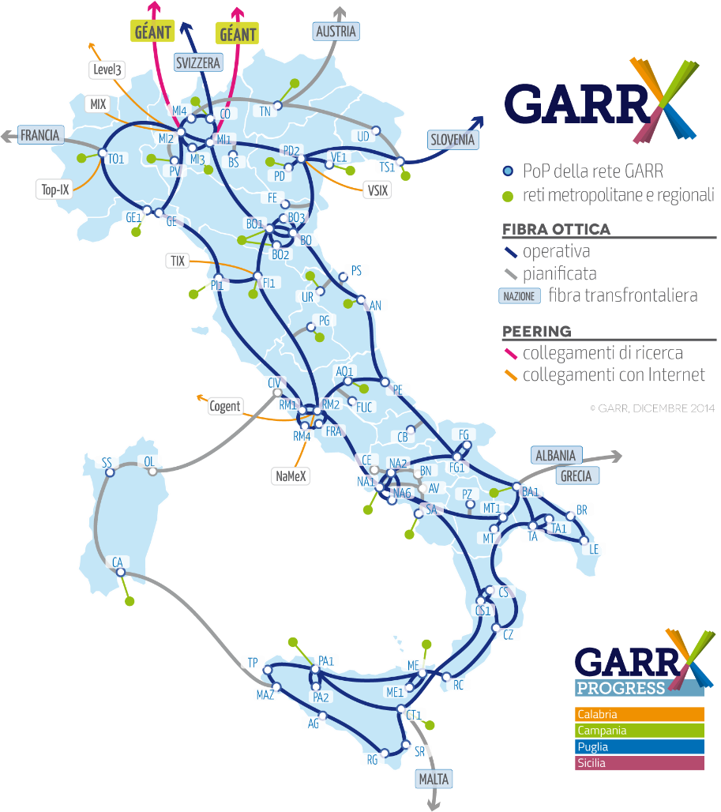
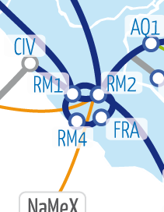
IT @ LNF - Networking
Geographical
ATLAS T2 has a dedicated 10 Gbps link
Other traffic on a 1 Gbps link → will be upgraded to 10 Gbps soon
Internal
BTF control room close to LAT room
Existing single-mode fiber link @ 10 Gbps
BTF experimental area: currently connected @ 1 Gbps
No upgrade planned. Should we require one?
Computer room
Central switch with 40 ports @ 10 Gbps

Slide 12
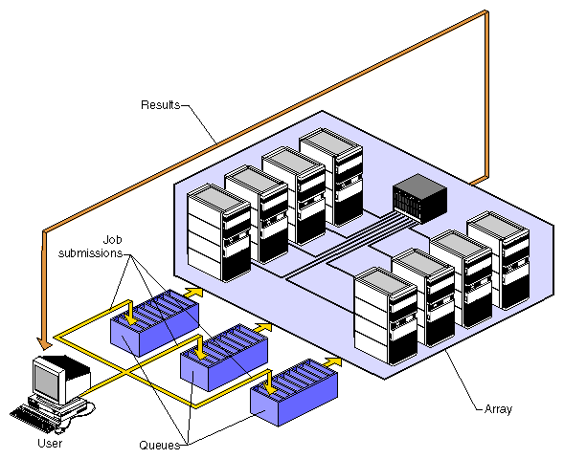
IT @ LNF - Services
Batch system
LSF is commonly used
Central license administered by CNAF
@LNF: batch farms are managed by each collaboration with “some support” from IT
Uses AFS to manage clients’ common area
DataBase
MySQL available. Currently used for LNF web services.
Oracle used by INFN central services
Cloud-based DB-as-a-service being investigated
GRID Computing
Used (and managed) by ATLAS T2
M.Antonelli, E.Vilucchi

Slide 13
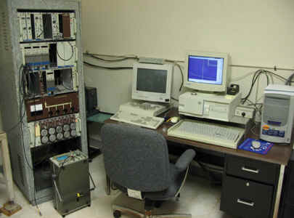
Controls
Slow control
DAQ monitoring
Long data taking
Small collaboration
Unattended DAQ
Remote alarm system
Automatic recovery
Investigate solutions used by other experiments

Slide 14
Conclusions
Data production
Preliminary estimate of DAQ rate: ~70 MiB/s
Data production close to 100 TB/y
MC production
G4 simulation already quite advanced
Storage requirements close to 40 TB/y
Investigate use of GRID for MC production
LNF IT resources
Well suited to host PADME computing
Allocate computer room resources ASAP
Investigate use of existing SAN and alternatives
Investigate use of existing tape libraries and alternatives
Controls
Controls must allow automatic and unattended run of the experiment

