Slide 1
First TDAQ ideas
Mauro Raggi
PADME Kick-off meeting Frascati, 20th-21st April 2015

Slide 2
Outline
General structure of the padme TDAQ
The actors
Calorimeter DAQ
L0 triggerless
L1 zero suppressing
L2 reconstruction
Conclusion

Slide 3
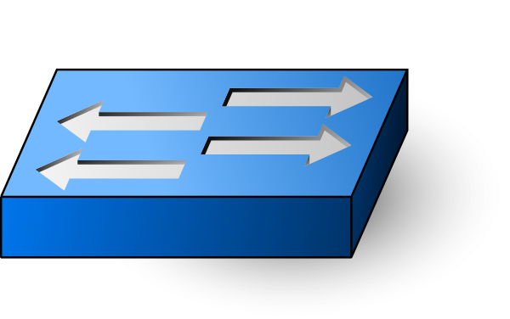
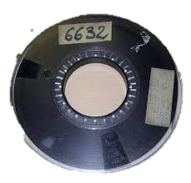
General DAQ structure on line
Target
64ch
FADC
Spect.
200 ch
TDC
Beam
veto 64ch
TDC
Ecal
656 ch
FADC
SAC
32 ch
FADC
L0 trigger less distribute beam trigger
BTF
Beam
Trigger
50 Hz
Raw data
L1 software zero suppression
L2 Neutral (Inv) 1 or more Ecal clusters
L2 Charged (Vis) 2 or more tracks
< 1Hz
< 1Hz

Slide 4
General DAQ structure off line
Target
64ch
FADC
Spect.
200 ch
TDC
Beam
veto 64ch
TDC
Ecal
656 ch
FADC
SAC
32 ch
FADC
L0 trigger less distribute beam trigger
BTF
Beam
Trigger
50 Hz
L1 software zero suppression
L2 Neutral (Inv) 1 or more Ecal clusters
L2 Charged (Vis) 2 or more tracks

Slide 5
Definitions of data streams
Raw data is defined as every points on the digitizers

Slide 6
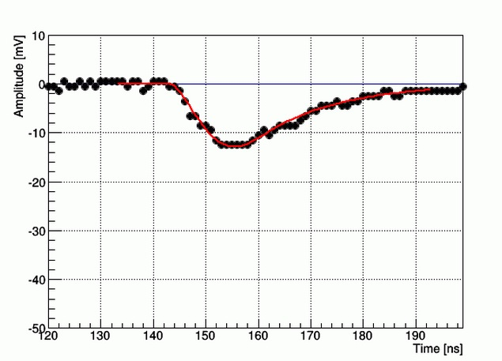
Expected L1data reduction
Depending on the detector different amount of point will be different from 0
In Ecal on 25 cell on average different from 0 over 656
In Target only ~100 non zero samples in 1μs (100 samples over 1024)
In Positron spectrometer veto only (100 samples over 1024)

