Slide 1
PADME dump proposal
Mauro Raggi
PADME Kick-off meeting
Frascati, 20th-21st April 2015

Slide 2
Searching for new physics in dump
Dump experiments are able to provide extreme sensitivity to low couplings because the whole beam charge is spent (~10²⁰ particles)
  Sensitivity to extremely rare production processes
  Sensitive to every long living particles which can even escape LHC experiment acceptance
They provide general searches for new states
  Interpretation of data by many different models is possible even 20 year after the end of the experiments (E137 E714 )!
Due to that recently new generation of dump experiments has been proposed
  SHIP at CERN for heavy lepton searches and dark photons
  BDX at JLAB for dark photon searches
  PADME dump at LNF to search for dark photon

Slide 3
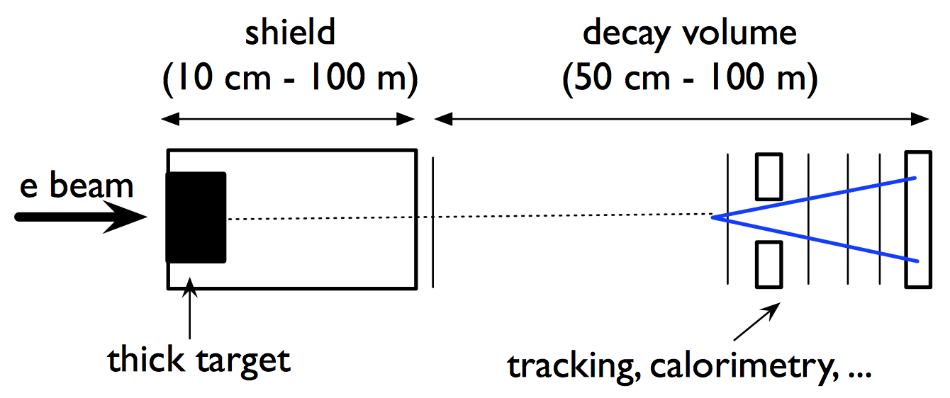
Dump experiments concept
Very intense beam over a massive high Z target (W,Pb,U)
  Produce a dark photon through bremsstrahlung into the target
  Absorb all standard model particle in huge shielding
  Dark photon traverse the dump due to his small interaction with ordinary matter
  Dark photon decays into SM particles after the dump in the decay region
  Electron or muon pairs are detected in the far detector

Slide 4
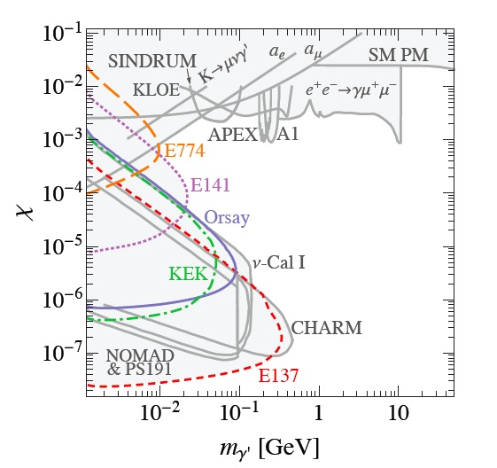
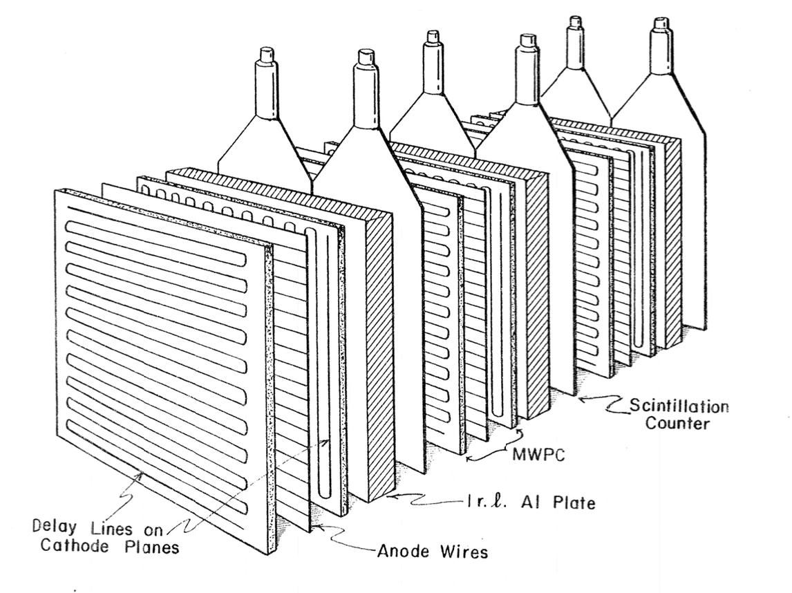
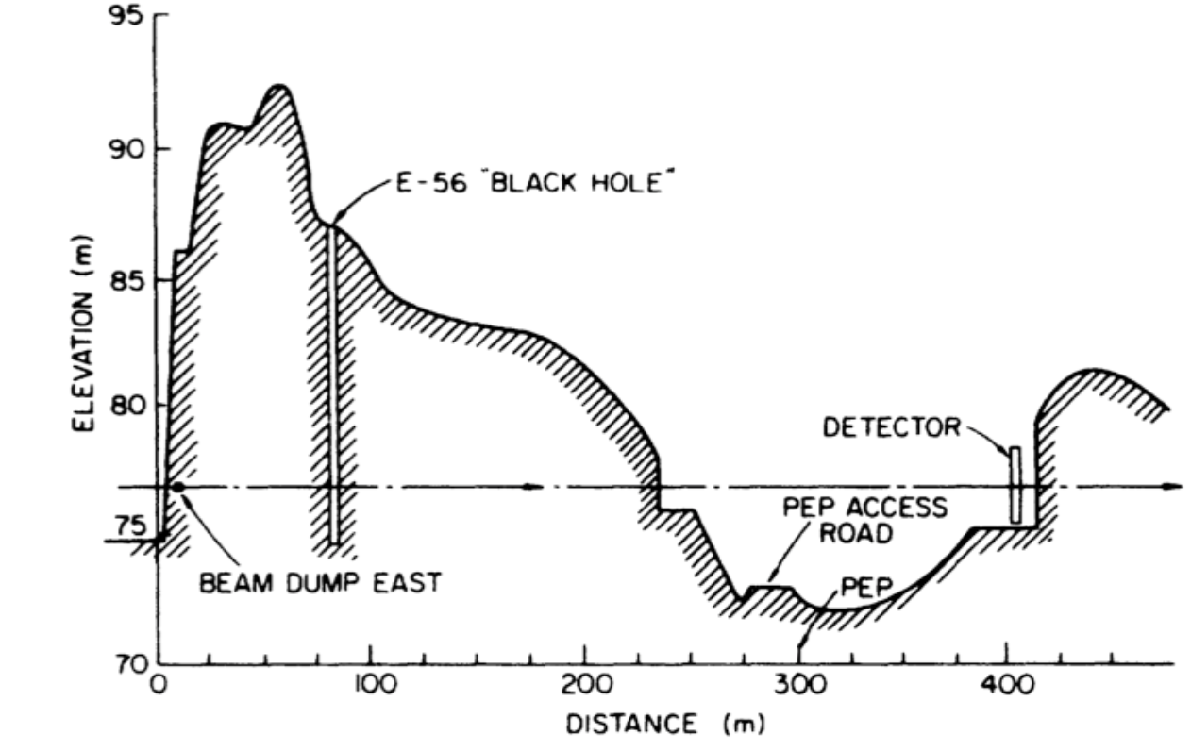
Dump experiment example: E137
~10²⁰ EOT 20 GeV e⁻
Al target
L_{shield} = 179 m
L_{decay} = 204 m
N_{Observed} = 0

Slide 5
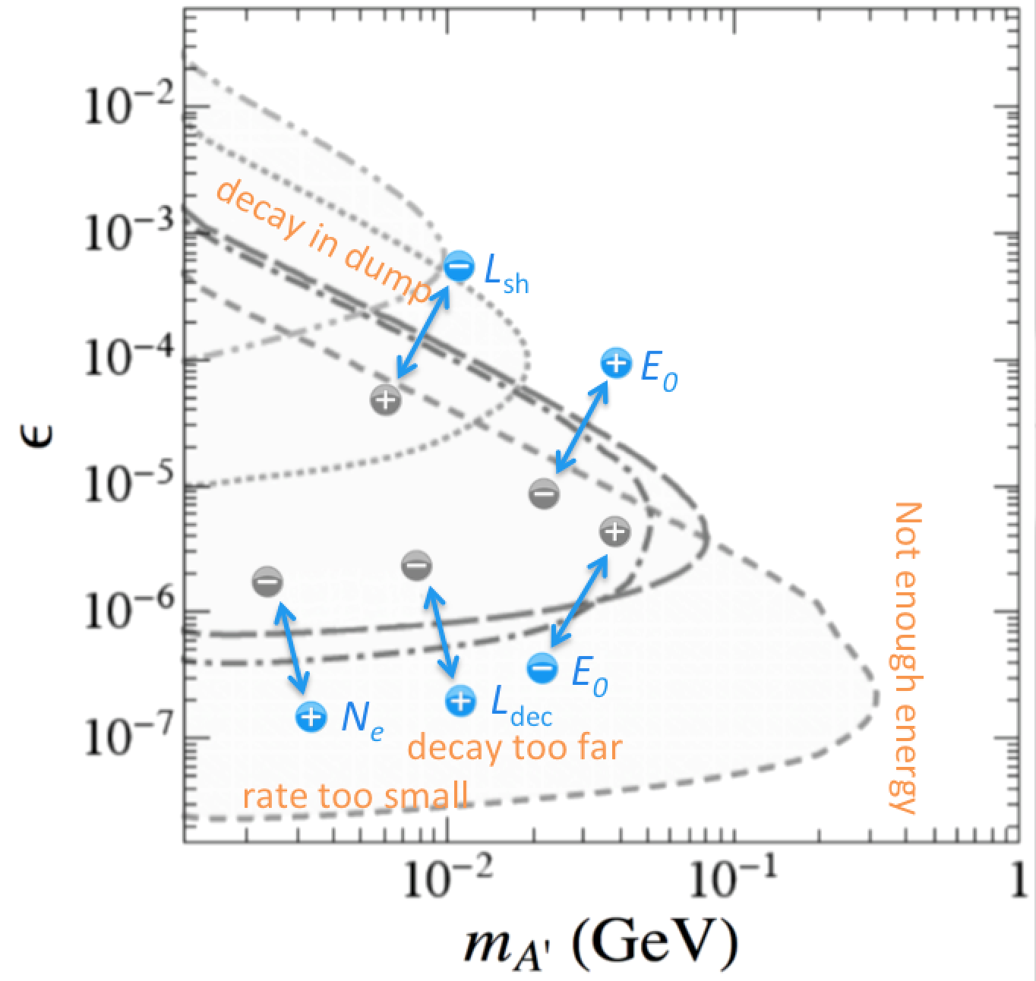
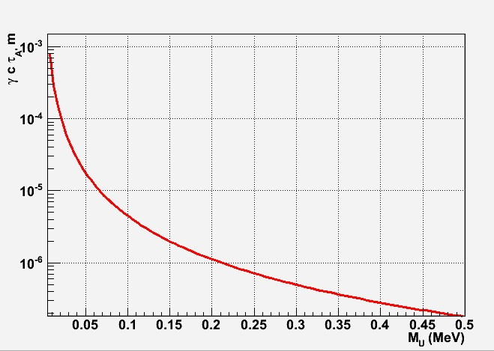
Beam dump limitations
Main limitations comes from decay length of the dark photon
1 mm
γcτ_{A’} for ε=1e⁻³ at 0.55 GeV
0.1 μm

Slide 6
A dump at Frascati Linac: why?
No dedicated electron dump experiment so far to search for dark photon
All results by dump are coming from data mining by theoreticians
DAFNE linac is able to provide more than 10C electrons per year
  Almost the same order of JLAB accelerator and E137 experiment
Possibility of tuning the parameters to access unexplored regions
  Beam energy
  Beam geometry
  Dump length shape and material
  Detector acceptance (decay region and detector geometry)

Slide 7
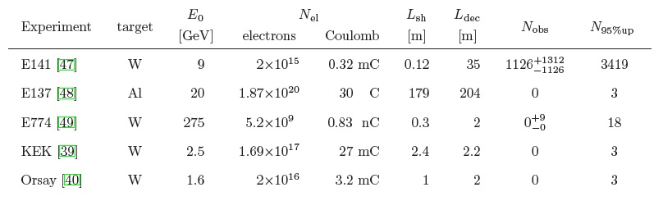
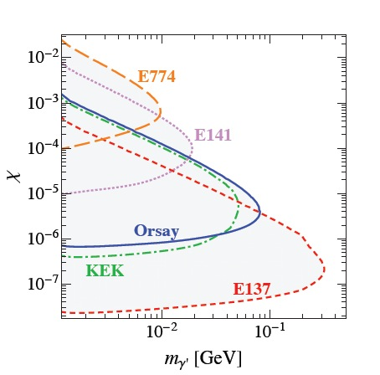
Status of e⁻ dump experiments
PADME DUMP W 1.2 2・10²⁰ ~30 C 0.1-0.2 0.5-2
S. Andreas: arXiv:1209.6083v2
Due to authorization of LNF site we cannot exceed
  Total limit on Year at BTF = 9.8x10¹⁷ e⁻/Year
PADME DUMP (E_{e-} 1.2 GeV)
  e⁻/Year=1.2x10¹¹x50x3.15x10⁷=2x10²⁰ e⁻/Year
  We can get 4.5x10¹⁷ in 3 days at 3x10¹⁰ e⁻/bunch

Slide 8
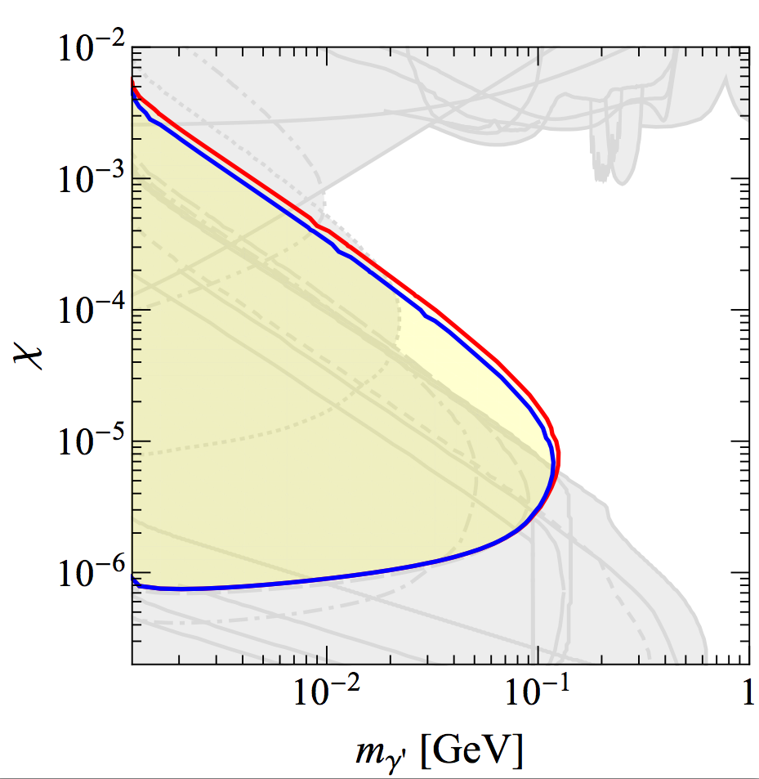
PADME early sensitivity estimate
Uses the same detector
  Change the target with 5-7.5 cm W one
  Build a W collimator
By Sarah Andreas
10¹⁶ 750 MeV e⁻
PADME early schematic
50 cm
W target
5-7cm
Magnet
W collimator
Vacuum vessel
Spectrometer
e⁻ beam
Hole
1 m
Spectrometer
Magnet
1 m
Early study for a beam dump experiment @ LNF (Sarah Andreas)
  1E7 electrons of energy 750 MeV per bunch in 50 bunch/s over 1 year
  Total e⁻ on target being: 50*1x10⁷*3.15x10⁷ = 1.6x10¹⁶ (we use 1x10¹⁶)
  Study based on 0 BG events observed after the dump. (not easy to achieve with so short dump)

Slide 9
The PADME DUMP concept
Thin dump experiment (order 10 cm W or U dump)
  Allow to explore region of high couplings (short lifetimes)
  Maximize DUMP containment with very high Z materials
In vacuum decay region (thinner dump required)
  Allow to contain only charged component of the shower in the dump
SM particle veto after the dump
  Allow to veto charged remnants of the beam to reduce BG
Kinematic to suppress background (bump hunting)
  Use the spectrometer M²_{miss} resolution to reduce BG in each of the mass regions explored.
Near detector to maximize acceptance
  Use the magnet to collect almost all tracks in to the chambers

Slide 10
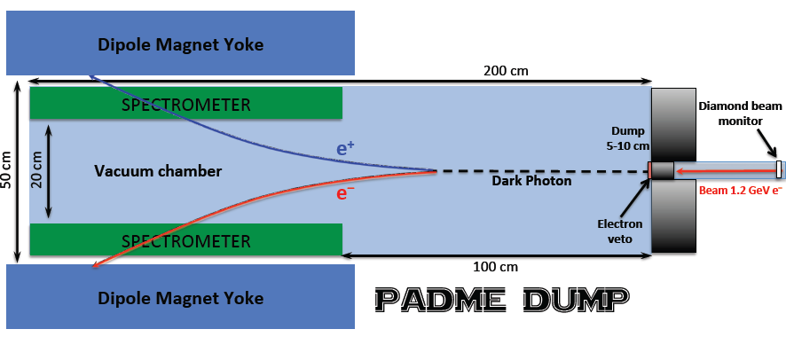
PADME dump layout
Designed inherited from the visible invisible expeirment

Slide 11
Possible spectrometer layout?
Dipole Magnet Yoke
200 cm
SPECTROMETER
Diamond beam monitor
e⁺
Dump
5-10 cm
50 cm
Dark Photon
Beam 1.2 GeV e⁻
e⁻
Electron veto
100 cm
Dipole Magnet Yoke
PADME DUMP
Can we have a full coverage spectrometer? Flux of gamma and neutrons has to be understood.

Slide 12


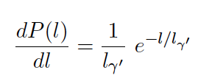
PADME dump toymc
Try to evaluate driving design parameters for the PADME dump
Toymc includes:
  Production cross section by MADgraph (thanks to A. Celentano)
  Evaluate the produced number of dark photons
  Scale by decay length acceptance
  Scale by electron acceptance in the detector using kinematical distribution from a toy
    Distribution have been compared with MADGraph for several M_{A’}
  Electrons scaled by 1/e each X₀ to take into account in depth productio
  Exclude the parameter space point if N_{obs}(m_{A’},ε) > 3

Slide 13
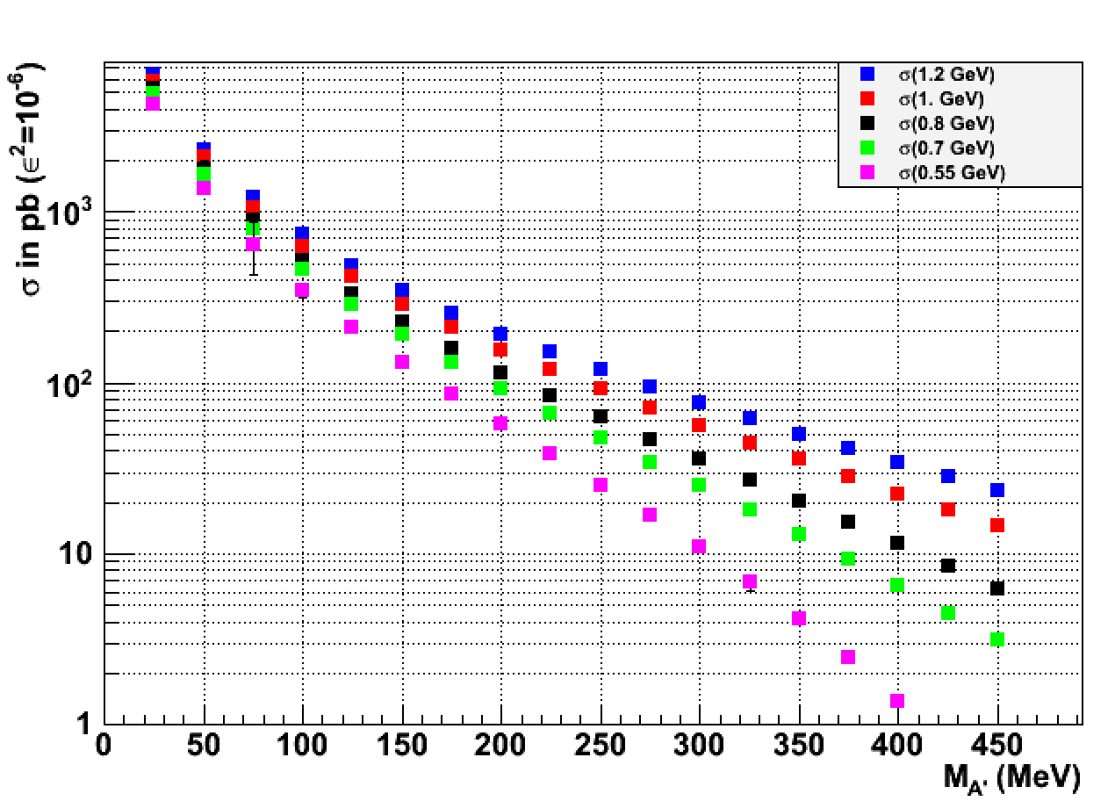
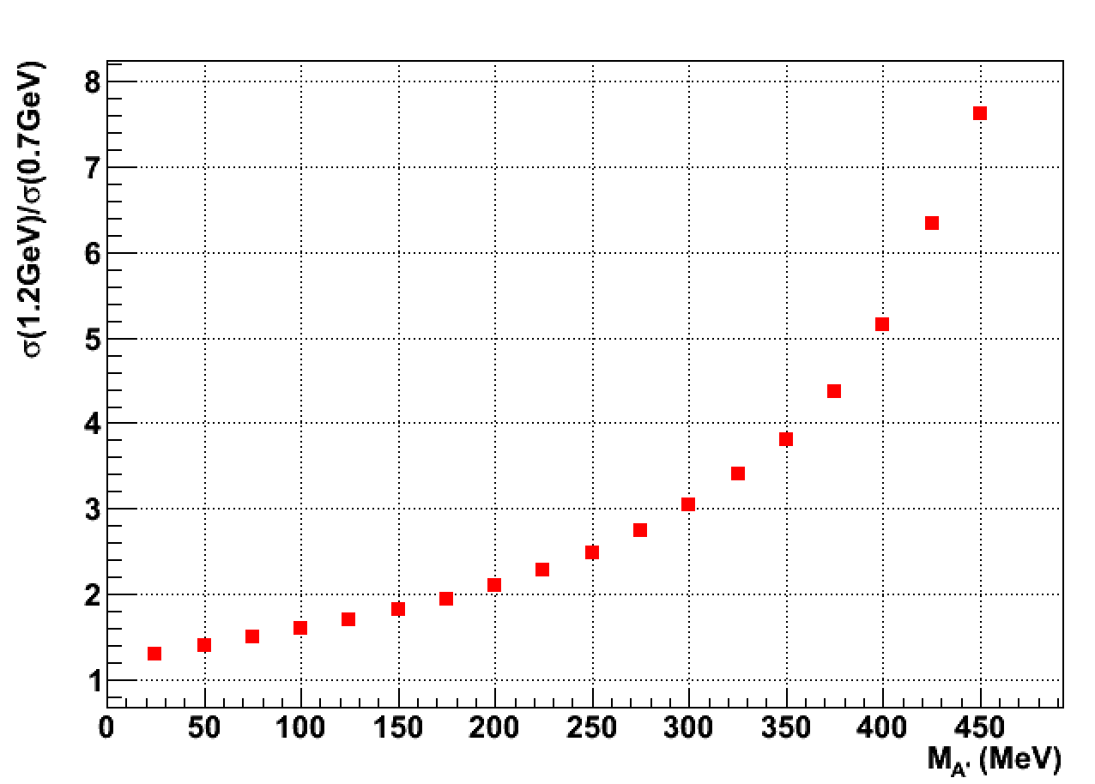
A’-strahlung cross section MADgraph
Cross section on tungsten for ε²=10⁻⁶
Increasing beam energy improves cross section
  Higher cross section up to 8 larger for higher masses
  Better boost for short living particles (most massive one!)
  Better decay products acceptance

Slide 14
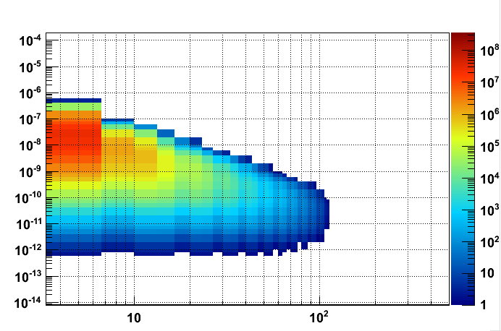
Comparison with S. Andreas
e⁻
e⁻
DUMP
DUMP
My montecarlo doesn't implement the in depth production
Bigger suppression of short lining particles

Slide 15
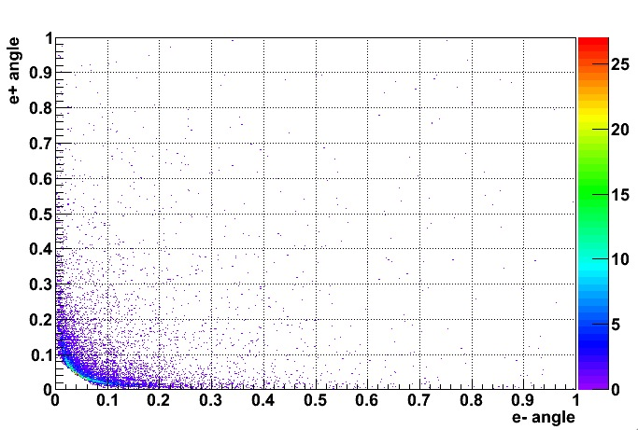
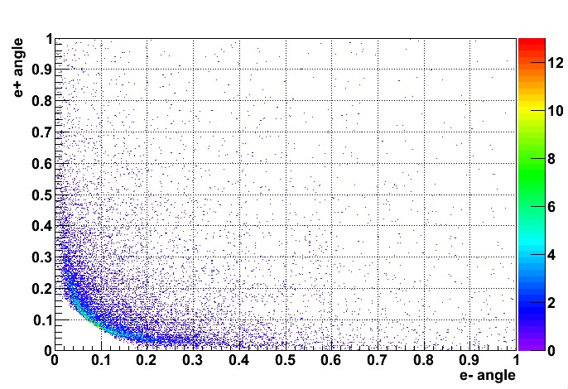
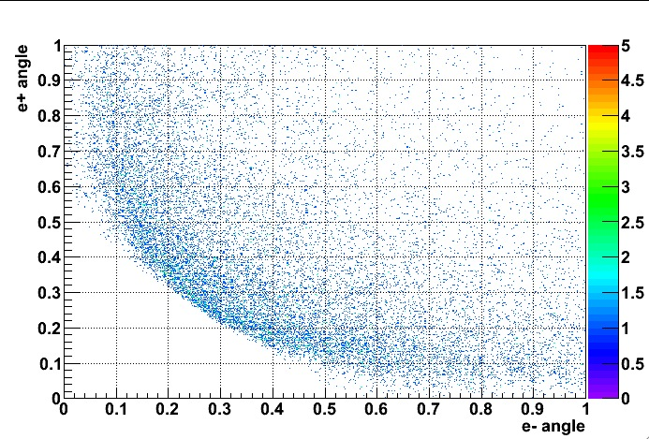
Detector acceptance E_{b}=1.2 GeV
M_{U} = 50 MeV
e⁺e⁻ acceptance
±10 cm at 1m
±10 cm at 0.5 m
M_{U} = 100 MeV
M_{U} = 300 MeV

Slide 16
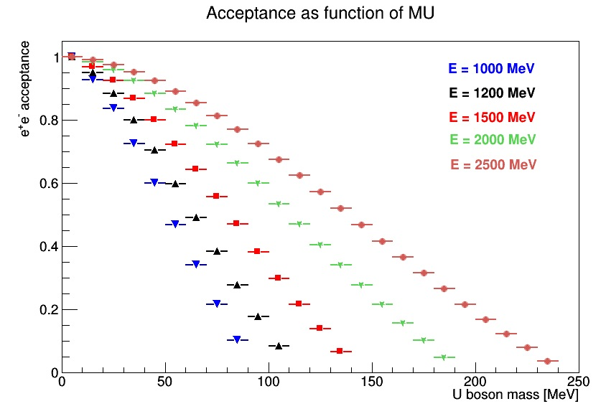
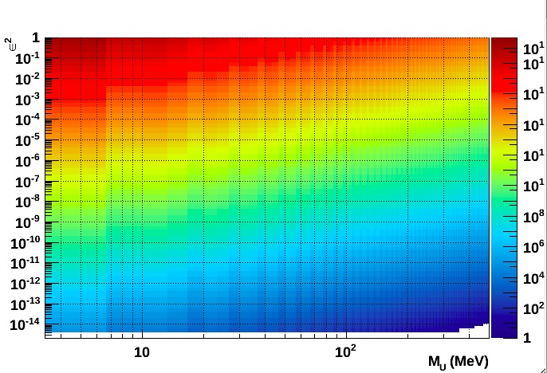
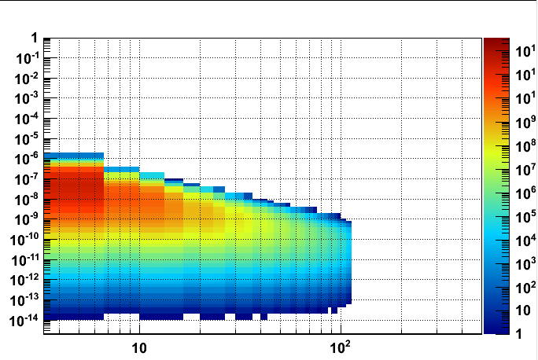
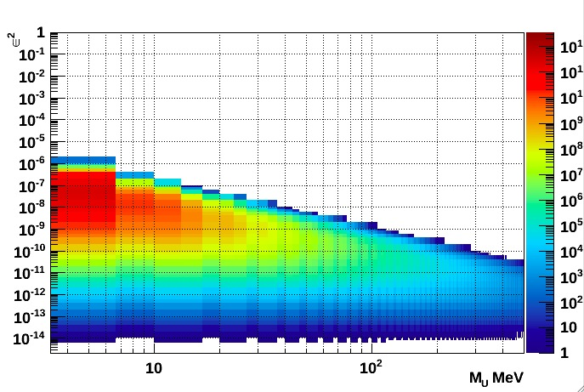
PADME dump main parameters
Dark photon production
±10 cm at 1m
5
4
3
2
1
0
Decay length acceptance applied
Electron angular acceptance
Decay into the dump
e⁺e⁻ out of Acc

Slide 17

Dump comparison
Zero BG hypothesis, in depth production to be refined, not yet a sensitivity plot
NA48/2
BaBar
e⁻
DUMP
PADME ee
PADME μμ
E137
1・10²⁰, 1.2 GeV electrons; 20 cm aperture at 50 cm from 10 cm W dump

Slide 18
Systematic check on the model

Slide 19
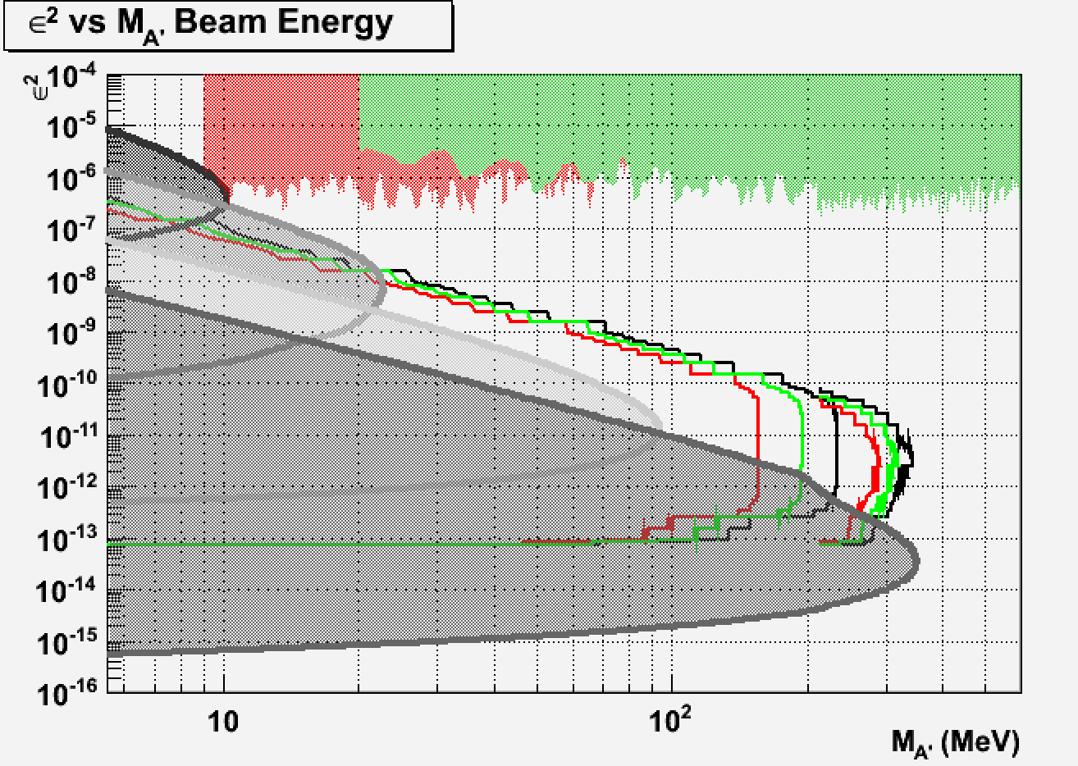
Energy of the primary beam
NA48/2
BaBar
E = 0.8 GeV
E = 1. GeV
E = 1.2 GeV
E137

Slide 20
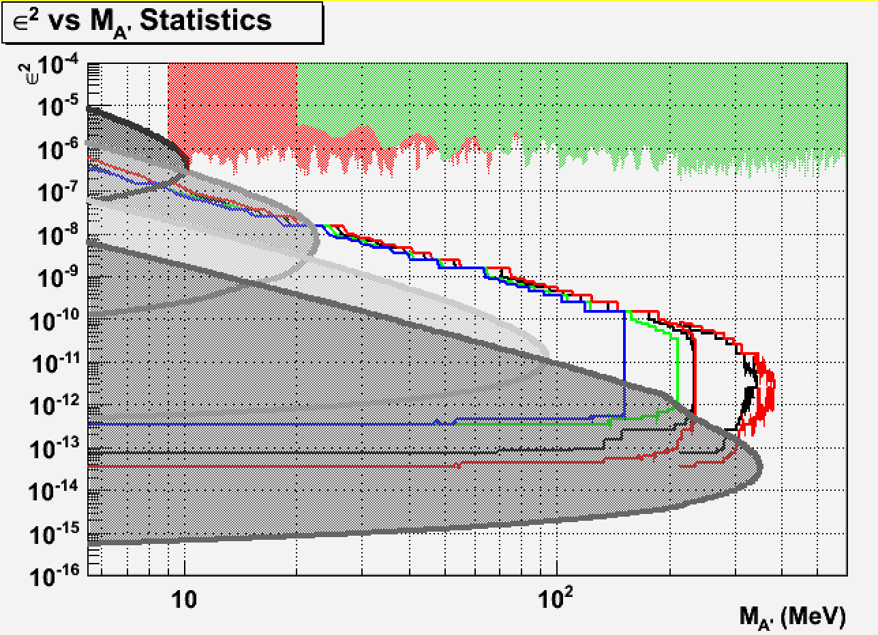
Number of primary electrons
NA48/2
BaBar
#e⁻ = 5e²⁰
#e⁻ = 1e²⁰
#e⁻ = 5e¹⁹
#e⁻ = 5e¹⁸
E137

Slide 21
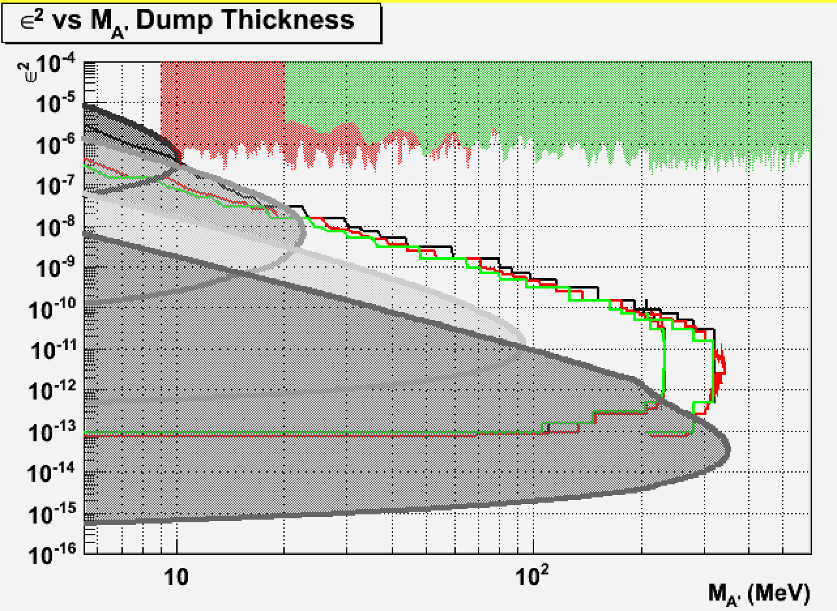
Dump thickness
NA48/2
BaBar
8 cm
10 cm
12 cm
E137

Slide 22
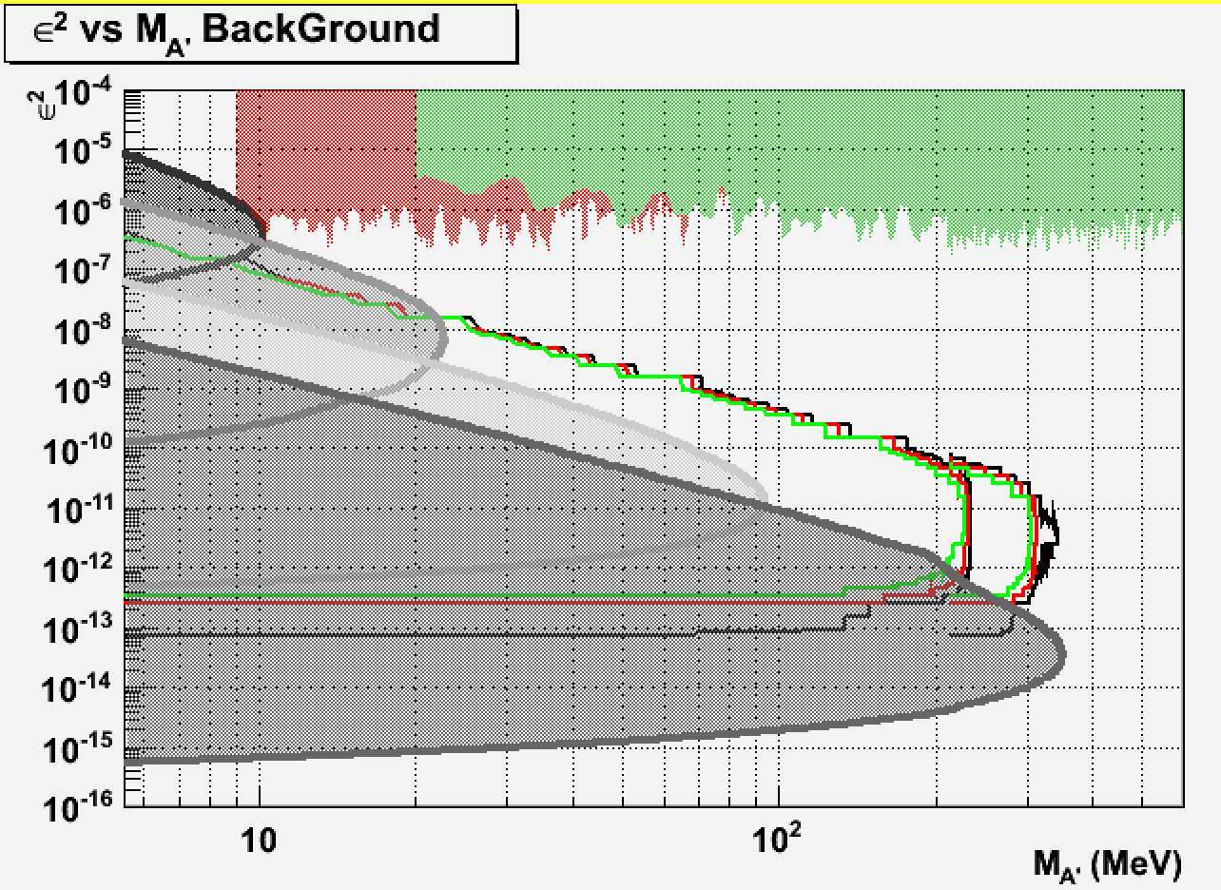
# of background events
NA48/2
BaBar
N_{BG}=0
N_{BG} =100
N_{BG}= 1000
E137

Slide 23
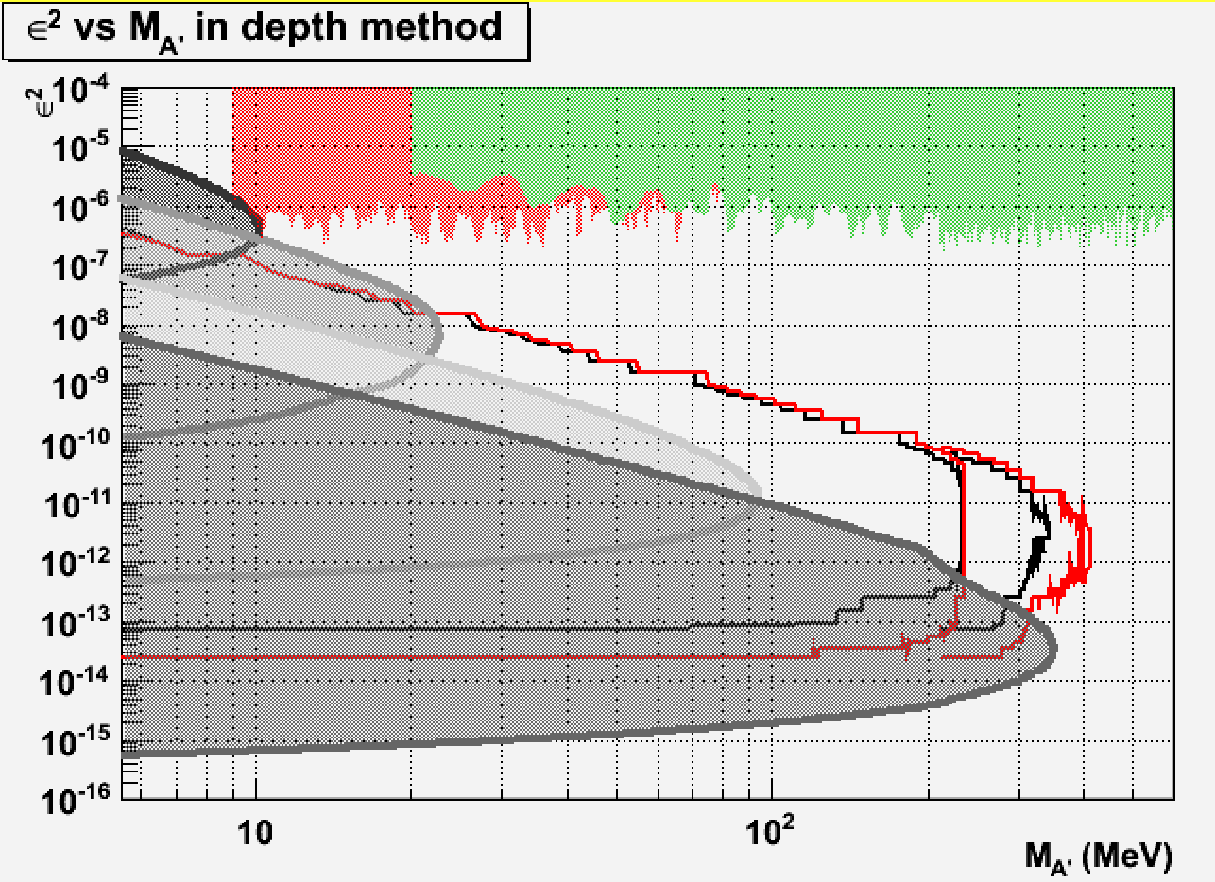
In depth production method
NA48/2
BaBar
E137

Slide 24
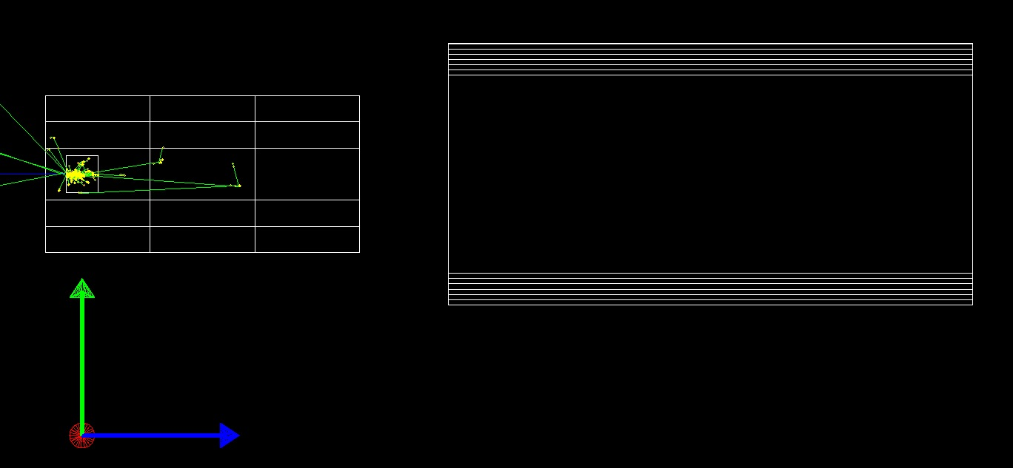
PADME dump MC model
Chamber 1
Lead Bricks
Chamber 1
Lead Bricks
Lead Bricks
Chamber 2
Lead Bricks
Chamber 2
A MC simulation in G4 to understand the BG has been started but 10²⁰ e⁻ will be never explored.
Only reliable estimate of the BG can be obtained with test runs
1s at BTF (7・10¹² electrons) is equal to 2 month of MC generation

Slide 25
Conclusion
The LINAC of DAFNE is a high current source for e⁻ up to 10C/year
A toy simulation allowed to identify driving parameters for the dump experiment design.
  A first sensitivity region is identified
  Background need to be study for different dump thickness
Limiting factor on mass achievements with current geometry is the electron acceptance
  Can improve much by upgrading the LINAC energy
  Is a dedicated magnet design needed for the dump experiment?
Limiting factor on coupling constant sensitivity is the decay region length:
  What about a 100MeV run for long living particles?

Slide 26
Spare slides

Slide 27
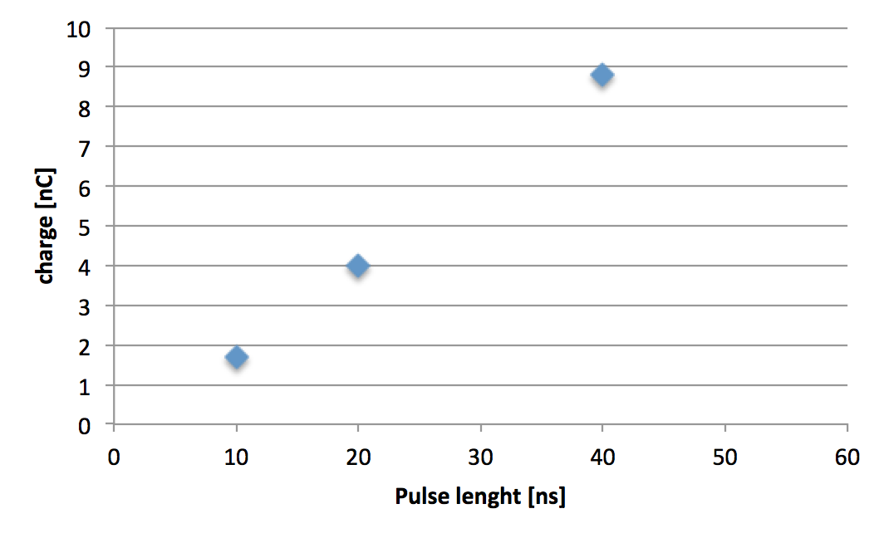
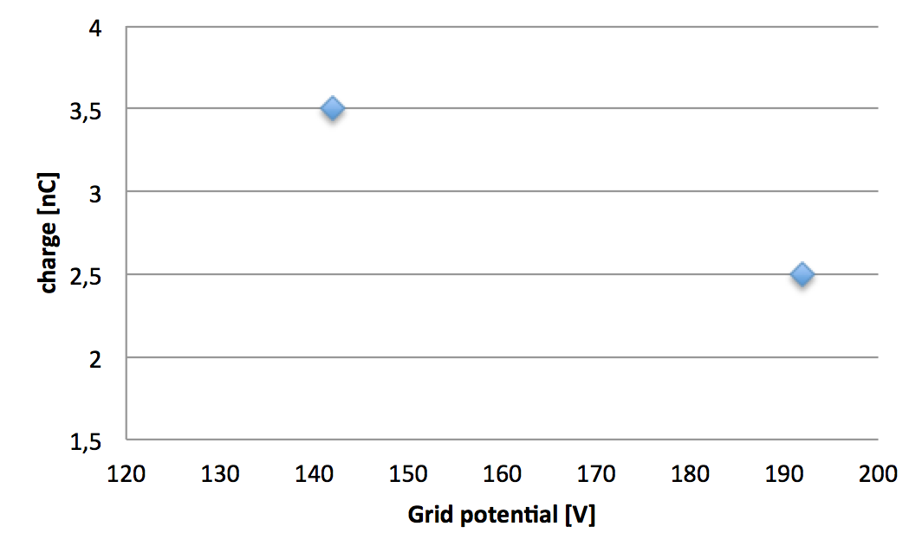
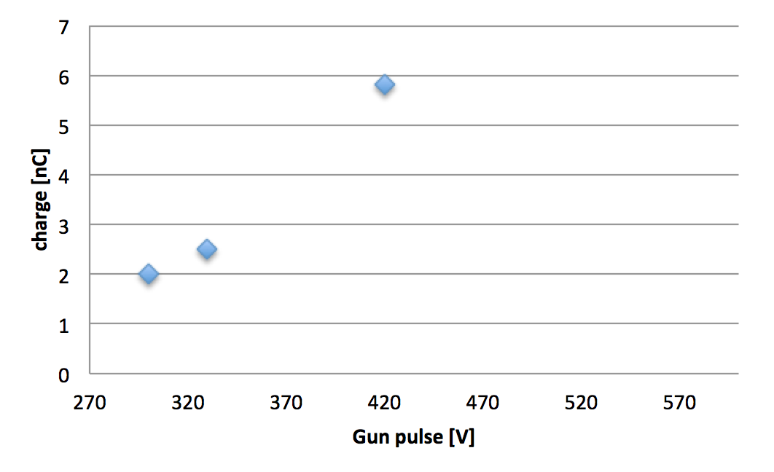
Improving BTF performance
E_{beam} = 725 MeV
×4 increasing pulse length
P. Valente: LINAC and BTF: looking at the future
+30% Decreasing grid stopping potential
×3 - ×5 Increasing gun pulse height

Slide 28
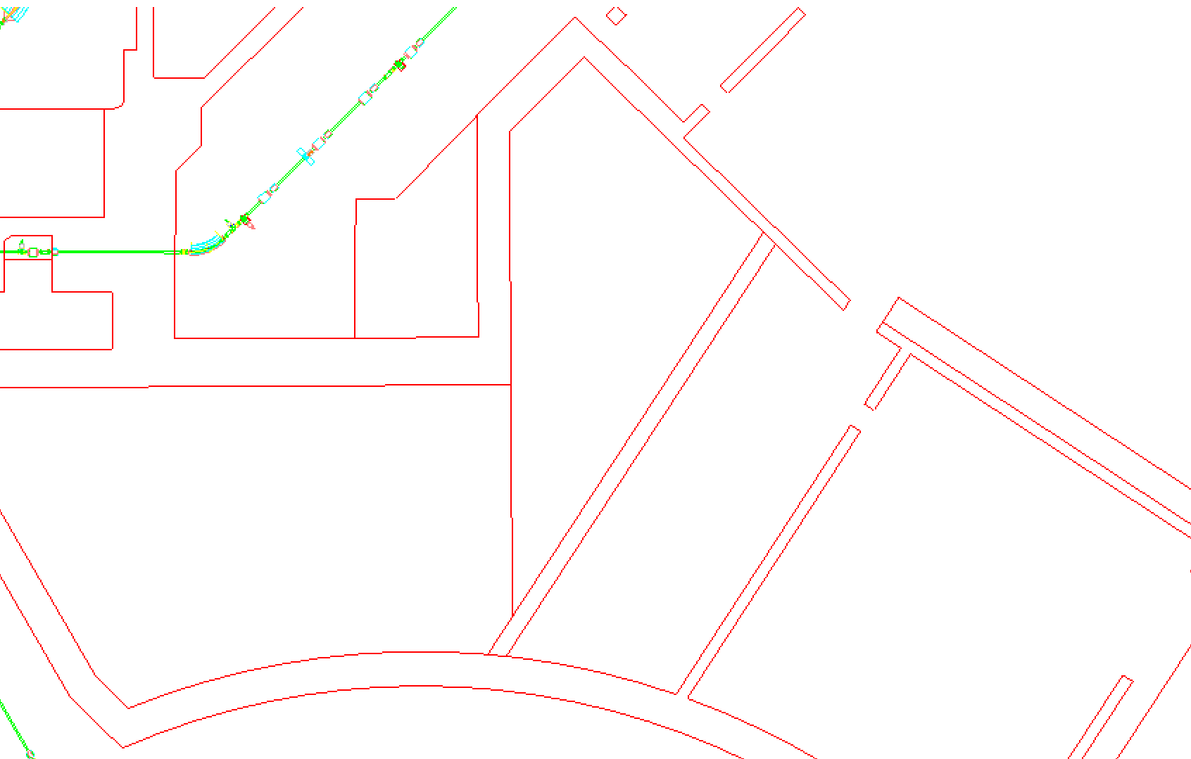
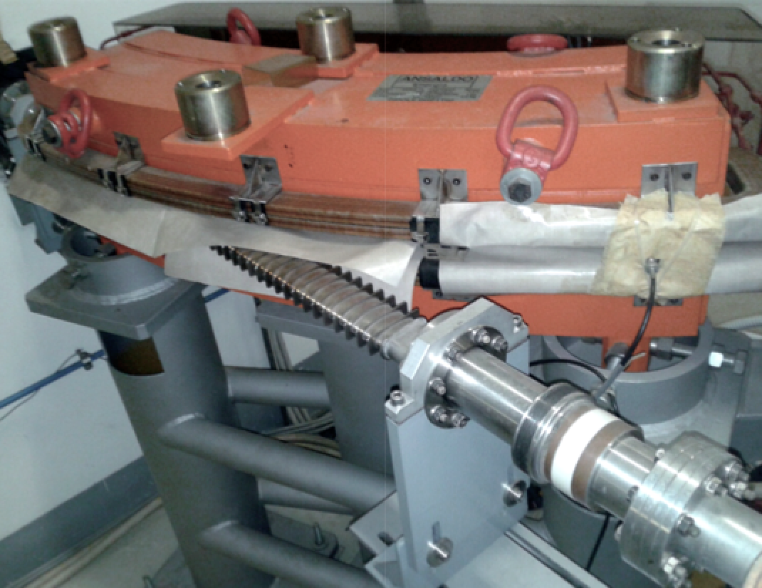
PADME DUMP location
Option A:
A new thin vacuum chamber for DHPTT01 with a double exit
Exactly the same design of the one of DHPTT02
PADME spectrometer
10¹⁰ e-/bunch beam
Chamber 1
Chamber 2
Diamond
flux monitor
Tungsten dump
What Next LNF, 10-11 November 2014

