Slide 1
High intensity electron beam and infrastructure
Paolo Valente*
INFN Roma
*On behalf of the BTF and LINAC staff

Slide 2
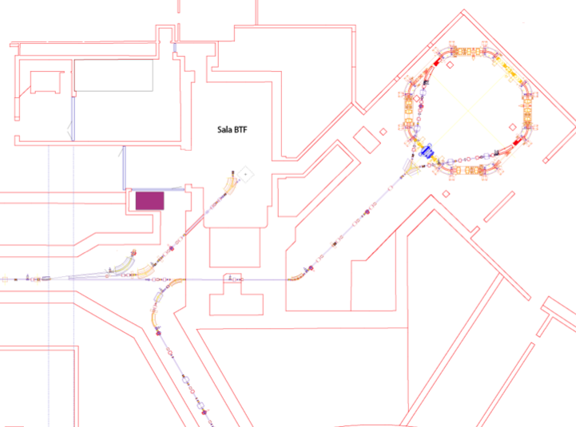
The DAΦNE complex
Power supplies
BTF
control room
BTF
Damping
Ring
transfer line
LINAC
transfer line
Main rings

Slide 3
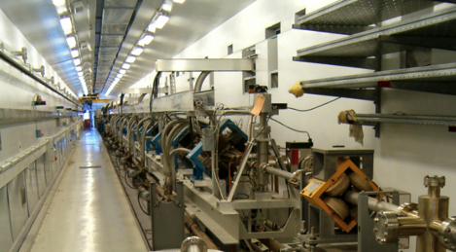
The DAΦNE LINAC
 | Design | Operational
Electron beam final energy | 800 MeV | 510 MeV
Positron beam final energy | 550 MeV | 510 MeV
RF frequency | 2856 MHz
Positron conversion energy | 250 MeV | 220 MeV
Beam pulse rep. rate | 1 to 50 Hz | 1 to 50 Hz
Beam macropulse length | 10 nsec | 1.4 to 40 nsec
Gun current | 8 A | 8 A
Beam spot on positron converter | 1 mm | 1 mm
Normalized Emittance (mm mrad) | 1 (electron) 10 (positron) | < 1.5
rms Energy spread | 0.5% (electron) 1.0% (positron) | 0.5% (electron) 1.0% (positron)
electron current on positron converter | 5 A | 5.2 A
Max output electron current | >150 mA | 500 mA
Max output positron current | 36 mA | 85 mA
Trasport efficiency from capture section to linac end | 90% | 90%
Accelerating structure | SLAC-type, CG, 2π/3
RF source | 4 x 45 MWp sledded klystrons TH2128C

Slide 4
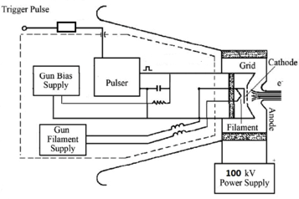
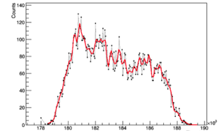
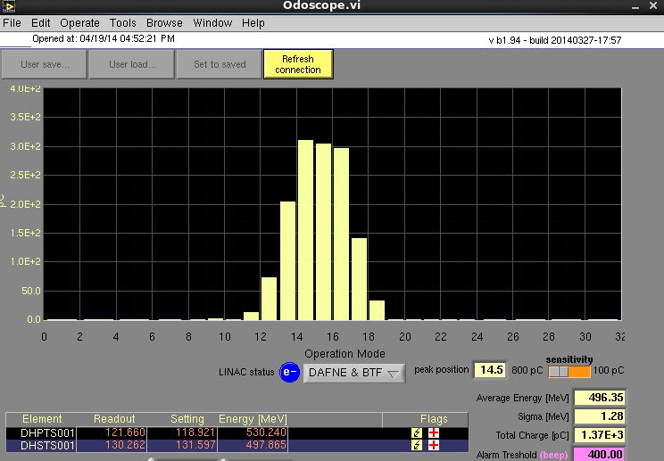
Pulse charge: gun
10 ns, 100 mA
10 ns
DAΦNE LINAC gun
During parasitic operation, pulse duration is fixed at 10 ns for the injection into the damping ring
Bunched structure at 2856 MHz is visible with a good enough timing resolution
Typical charge: 1–2 nC for e⁻, 0.5–0.8 for e⁺
i=100 mA current corresponding to 1 nC/10 ns
10 ns, 100 mA
40 ns, 150 mA
4

Slide 5
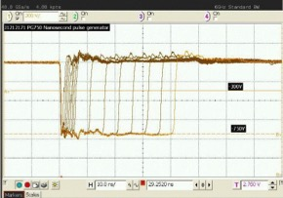
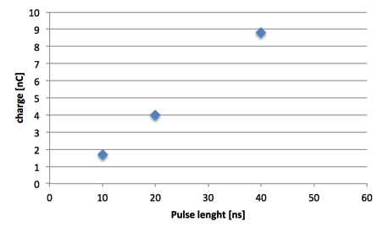
Increasing the charge: pulse width
Present gun pulser: from 1.5 to 40 ns in 0.5 ns steps
Working to further extend the pulse width (see presentation on positron beam for PADME)
In principle, the gun cathode produces a current, thus no limitation expected in emitted total charge increasing the pulse width!
Of course, cathode consumption will be also much faster
Scales linearly up to 40 ns: 4×
Standard setting
E = 725 MeV

Slide 6
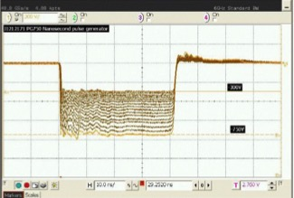
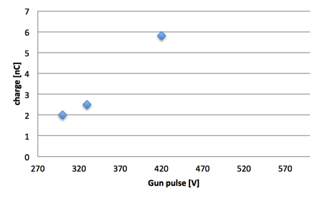
Increasing the charge: gun voltage
Present gun pulser: from 300 to 750 V in steps of 30 V
Standard setting
Scales more than linearly up to 420 V: 3×
More measurements needed in dedicated mode
E = 725 MeV
10 ns

Slide 7
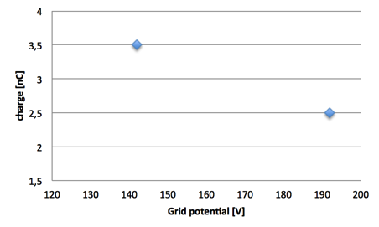
Increasing the charge
Decreasing the “stopping” voltage applied to the grid should increase the extracted charge
Standard setting
More measurements needed in dedicated mode
E = 725 MeV
10 ns
Increasing the pulse width and the gun voltage at the same time: saturation of current monitors at 16 nC

Slide 8
Possible beam parameters for electron dump experiments
Measured maximum energy: E=725 MeV
Conservative value: Q=25 nC
40 ns pulses
8.5 nC ×3 gain using grid and gun pulse height
N_{e} = 1.6·10¹¹ e/pulse× 49 pulse/s= 0.784·10¹³ e/s
P = 0.9 kW
0.784·10¹³ e/s × 3·10⁷ s = 2.4·10²⁰ eot
Further increase by enlarging the pulse time width to >100 ns
Gun extraction saturation and beam loading effects to be checked
Full gain extrapolation: Q=50 nC
Single factors well measured
But the combination of pulse height, length and grid voltage has to be tested
As a comparison, the design intensity on positron converter is 1.44·10¹³ e/s at 10 ns
Efficiency of the acceleration & transport has to be considered

Slide 9
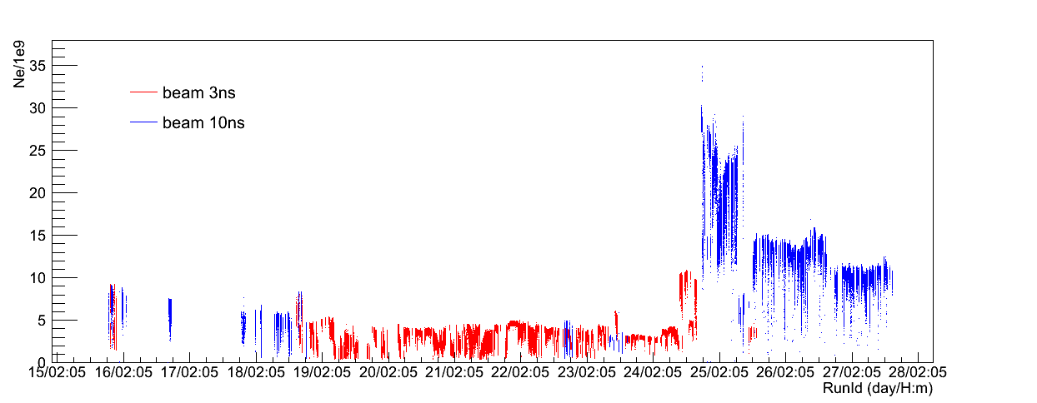
Maximum intensity in BTF hall
Authorization limit is 3.125 10¹⁰ particles/s
1 Hz operation
No more than 10¹⁸ eot/year
Where to dump the maximum available electron charge?

Slide 10
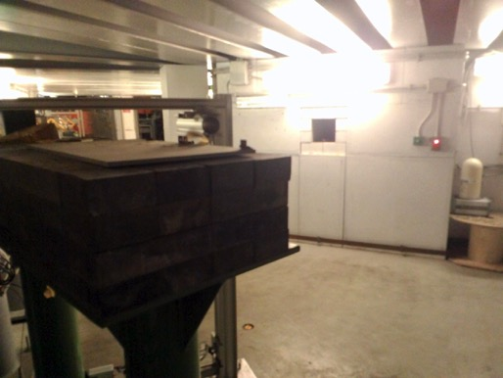
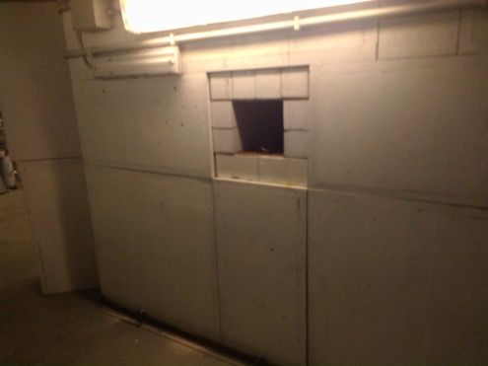
LINAC beam dump
Beam dump at the end of LINAC to damping ring transfer line

Slide 11
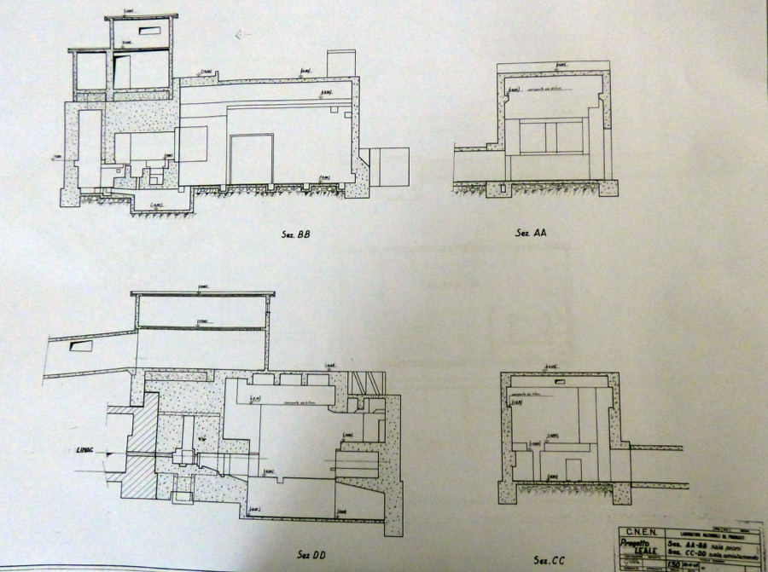
LEALE, “Sala pioni”, “Cella calda”, drawings of 1964-1969

Slide 12
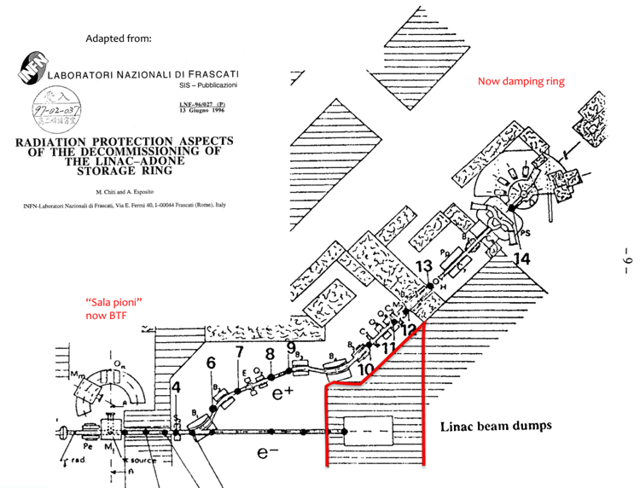
The ADONE LINAC beam dump
LEALE line, drawing sent to authorities in 1991

Slide 13
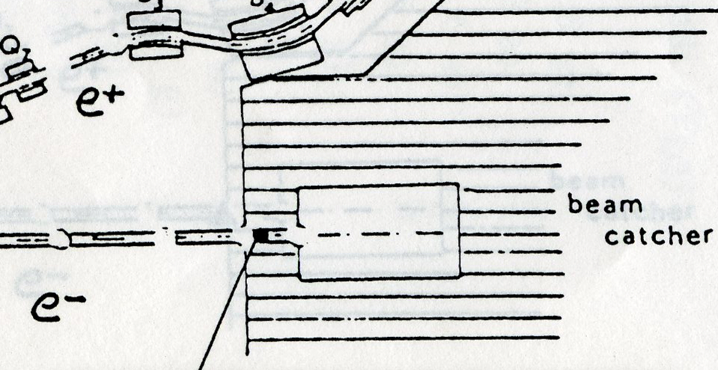
The ADONE LINAC beam dump
100 cm
130 cm
75 cm
40 cm
200 cm
[dimensions estimated from drawing scale]

Slide 14
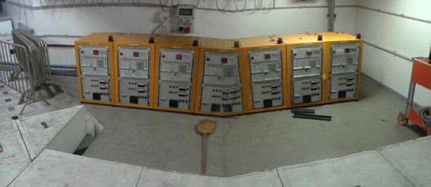
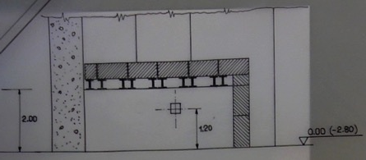
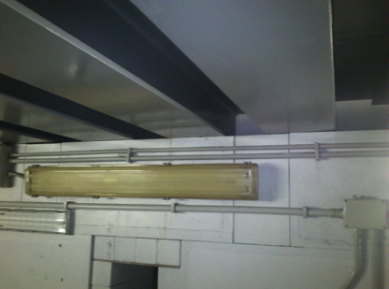
“Livello 1”

Slide 15
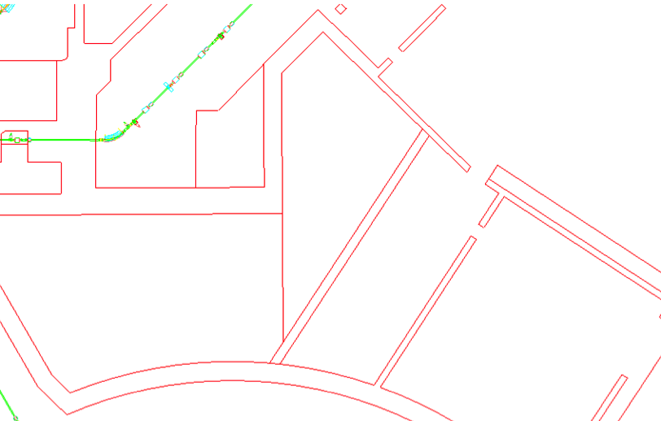
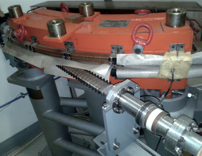
A possible location for dump experiments
Check depth/exact composition of the dump and the wall behind
Move or dismantle pumps in order to use the pump hall behind the wall
Build (two-exits) new vacuum pipe for DHPTT01
DHPTT01
DR Pumps hall
Check doses vs. beam intensity

Slide 16
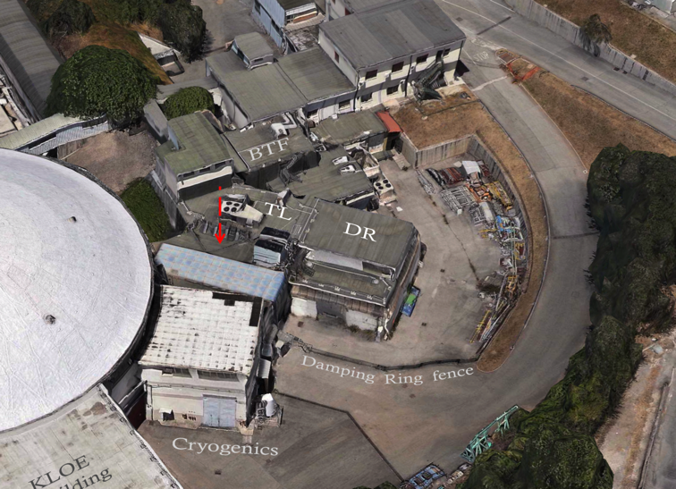

Slide 17
Conclusions
The DAΦNE LINAC can provide >10¹¹ e⁻/bunch in 40 ns long pulses at 49 Hz
There is room for a further increase of the delivered charge, both increasing the pulse width and pushing the gun emission
Limits of this charge increase to be checked experimentally
New hardware for longer pulses is needed
It is possible to dump the electron beam at the end of the transfer line towards the damping ring
Room for an experimental installation downstream of the dump is available (but work is needed to make it available)
Radio-protection is the primary issue

