Slide 1
PADME ecal studies
Mauro Raggi
PADME Kick-off meeting Frascati, 20th-21st April 2015

Slide 2
Outline
Ecal and the gamma measurement
Possible Ecal materials
Ecal geometry constraints
Ecal in the PADME MC
Ecal Read out schematics
Conclusion and prospects

Slide 3
Aims of the PADME Ecal
PADME Ecal is the heart of the PADME invisible experiment
Calorimeter performance reflects on the M²_{Miss} resolution which is a crucial ingredient of the invisible decay sensitivity
Ecal is supposed to measure E, position and time of the cluster
Δx,Δy ~ 2-3 mm
σ(E)/E ~ 1-2%/sqrt(E) for energy as low as 50-100MeV
ΔT < 500 ps on single cell
Need a very dense, high light yield, good timing crystal and a segmentation at the cm² level in the readout

Slide 4
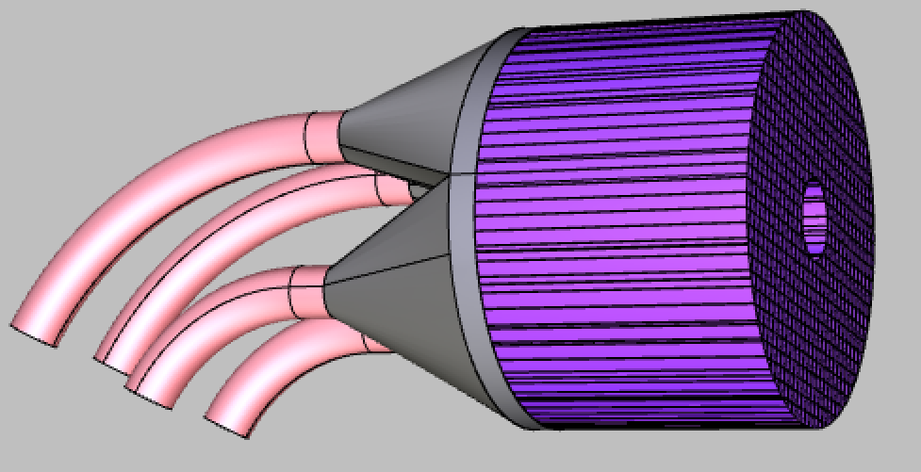
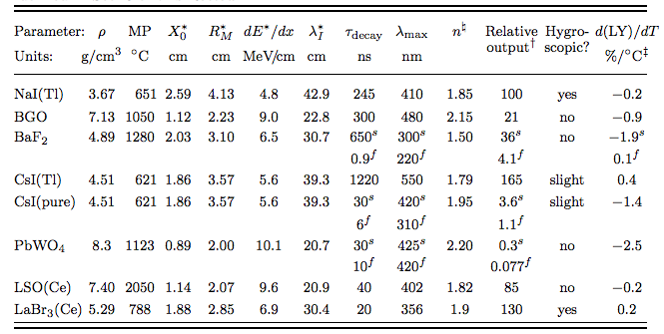
The calorimeter geometry
30 cm
Cylindrical shape: radius 150 mm, depth > 200 mm
Inner hole 4 cm radius
Active volume 13120 cm³ total of 656 crystals 10x10x200 cm³
Material LSO(Ce): high LY, high ρ, small X₀ and R_{M}, short τ_{decay}
Material BGO: high LY, high ρ, small X₀ and R_{M}, long τ_{decay}, (free form L3?)
Expected performance for LYSO ECAL:
σ(E)/E =1.1%/√E ⨁ 0.4%/E ⨁1.2% superB calorimeter test at BTF [NIM A 718 (2013) 107–109]
σ(θ) = 3 mm/1.75 m < 2 mrad
Angular acceptance 1.5-5 degrees

Slide 5
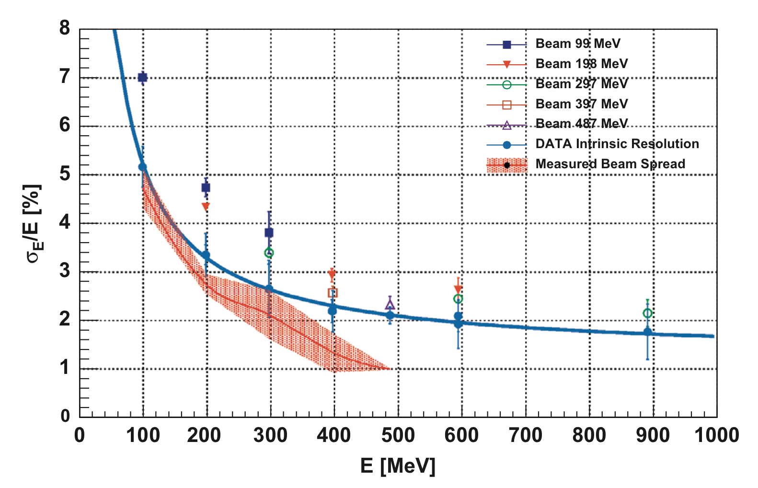
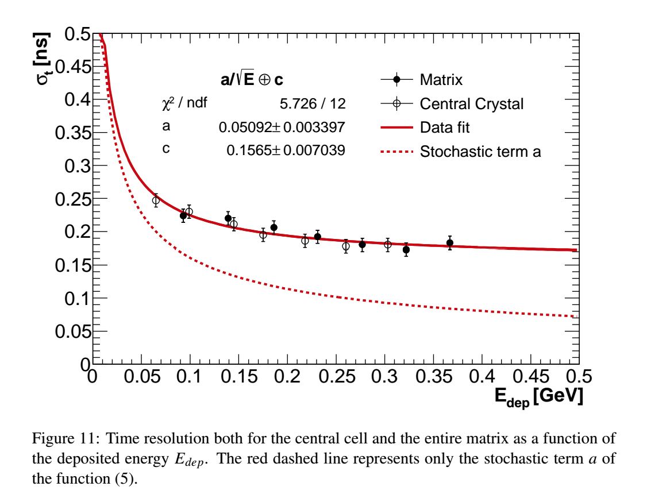
LYSO performance
SuperB prototype
Mu2e LYSO matrix time resolution
Preliminary
^{NIM} ^{A 718 (2013) 107–109}
constant term due to trigger
Obtained in a test beam at BTF
Mu2e DocDb # 5377
Courtesy of Mu2e INFN group.
M. Cordelli, G. Corradi, F. Colao, S. Giovannella, F. Happacher, M. Martinia, S. Miscetti, L. Morescalchib, ^{G. Pezzullo,} ^{I. Sarra, and S.R. Soleti}

Slide 6
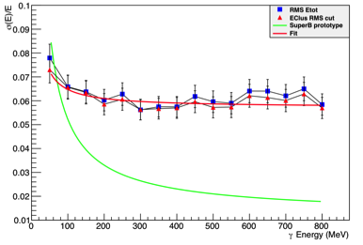
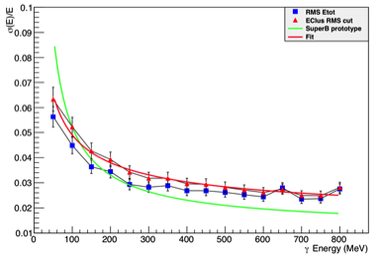
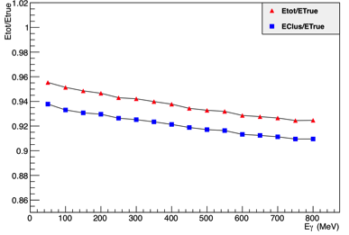
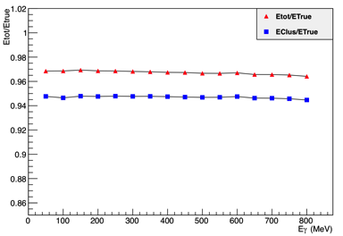
PADME calorimeter simulation
15 cm long LYSO crystals
20 cm long LYSO crystals

Slide 7
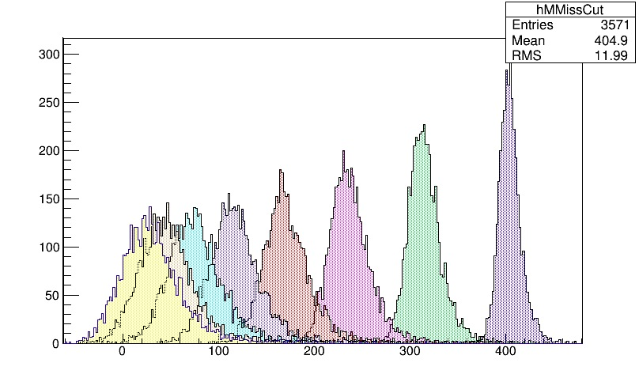
MC calorimeter performance
Mmiss²(MeV)
Missing mass resolution in agreement with toy MC using
σ(E)/E =1.1%/√E ⨁ 0.4%/E ⨁1.2% [NIM A 718 (2013) 107–109]
Differences are ~ 10%
Resolution is the result of combination of angular resolution energy resolution and angle energy correlation due to production

Slide 8
Cost of a LYSO calorimeter
Official quote from Saint Gobain for more than 250 LYSO crystals of 10x10x200 mm³ 650 euro/pcs
Tolerance 0.1 mm in side and 0.2mm in length.
10-12 weeks after acceptance of order by Saint Gobain
Scaling the price to the full calorimeter ~700 pcs ~455Keuro
Opportunity to have even smaller crystals explored can reach 4x4x210 mm increasing spatial resolution of the ecal.

Slide 9
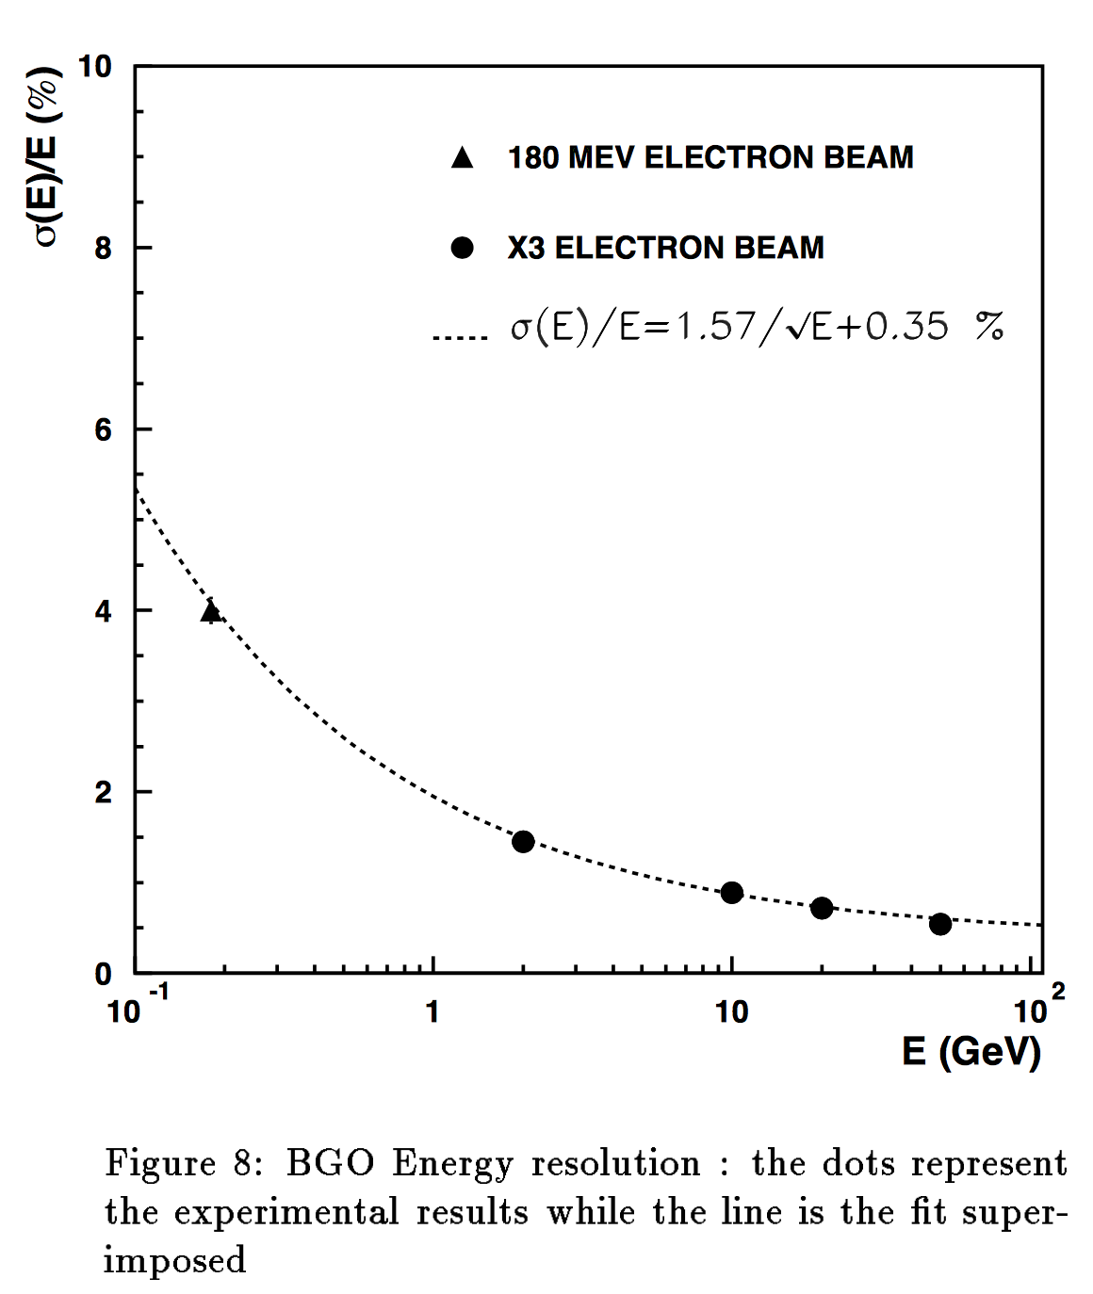
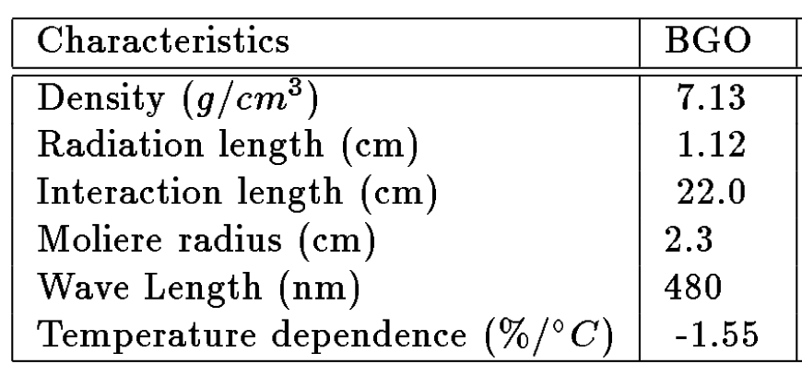
L3 BGO calorimeter performance

Slide 10
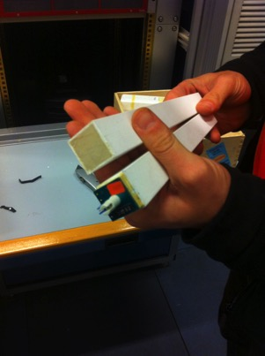
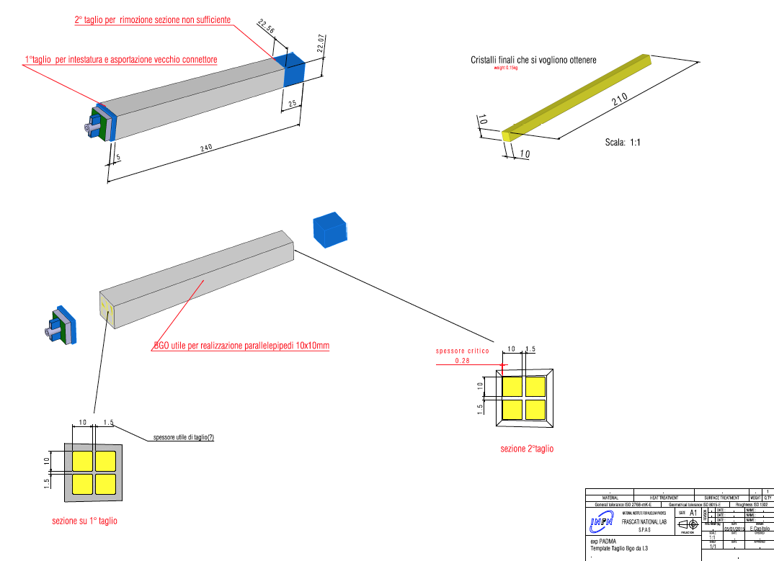
PADME ecal using L3 BGO crystals
What about collecting the L3 calorimeter BGO?
We collected ~80 BGO crystal from L3 calorimeter.
Negotiation started by INFN and DOE to get more crystals ~200 pcs.

Slide 11
Cutting the L3 BGO crystals
On 13 of April we went to Silo (FI) to start crystal cutting procedures
We already have 3 crystals in @ Silo firm to get back:
4 crystals 10x10x200 mm optically polished
4 crystals 10x10x220 mm optically polished
4 crystals 10x10x220 mm raw surfaces
We expect to get the crystals back for the end of April
Present cost of the cutting is 200+VAT per original L3 crystals
4 PADME crystal per 250 euro
Cutting order 200 L3 crystals will cost 50Keuro to be compared with 450K

Slide 12
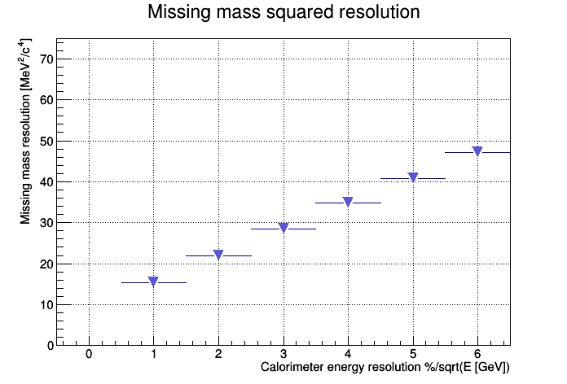
Missing mass and Ecal resolution
LYSO
L3 BGO
Are we able to get the same figure of merit with PADME Ecal?

Slide 13
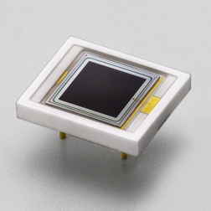
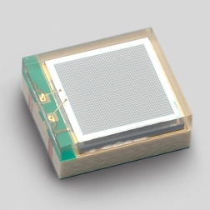
Calorimeter photosensors
The basic solution for the photo sensors is APD S8664-55
High gain
Linear on full range
Price 120 euro/pcs (~1000 pcs)
SiPM Hamamatsu: MPPC S12572-010P, -015P, -025P
3x3mm2 MPPC 1.3x10⁵ gain
Number of cells: 90000, 40000, 14400
Is it linear for 10x10x200 mm³ BGO crystals up to 300-400 MeV?
We have few of them to try linearity at the BTF in may
Price 17 euro/pcs.
Cost of photo sensor solution is ~10 times smaller with SiPM

Slide 14
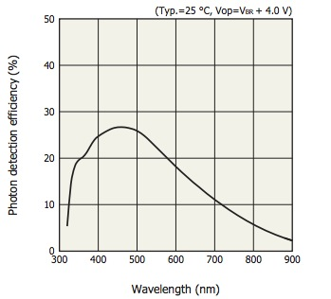
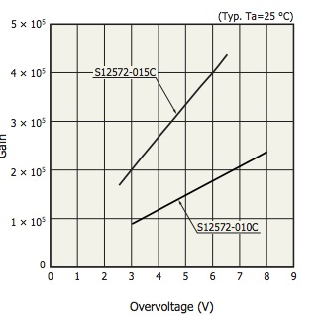
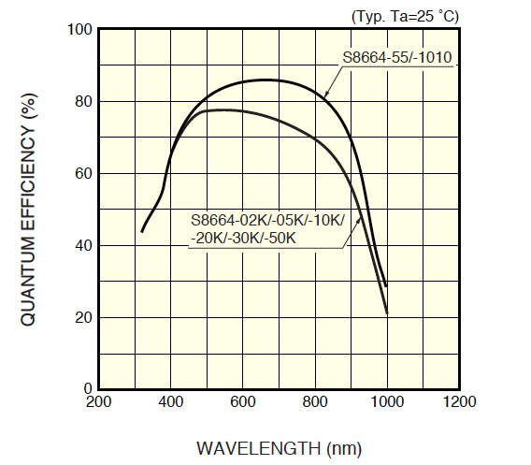
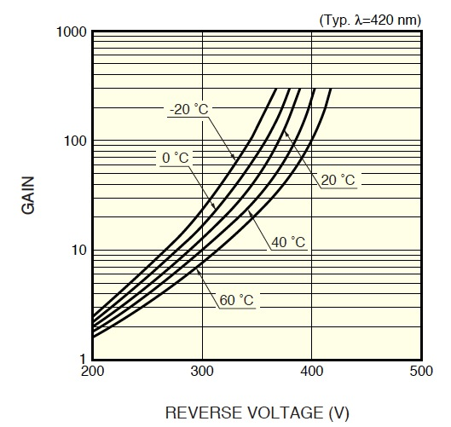
QE and GAIN APD vs SiPM
MPPC
APD

Slide 15
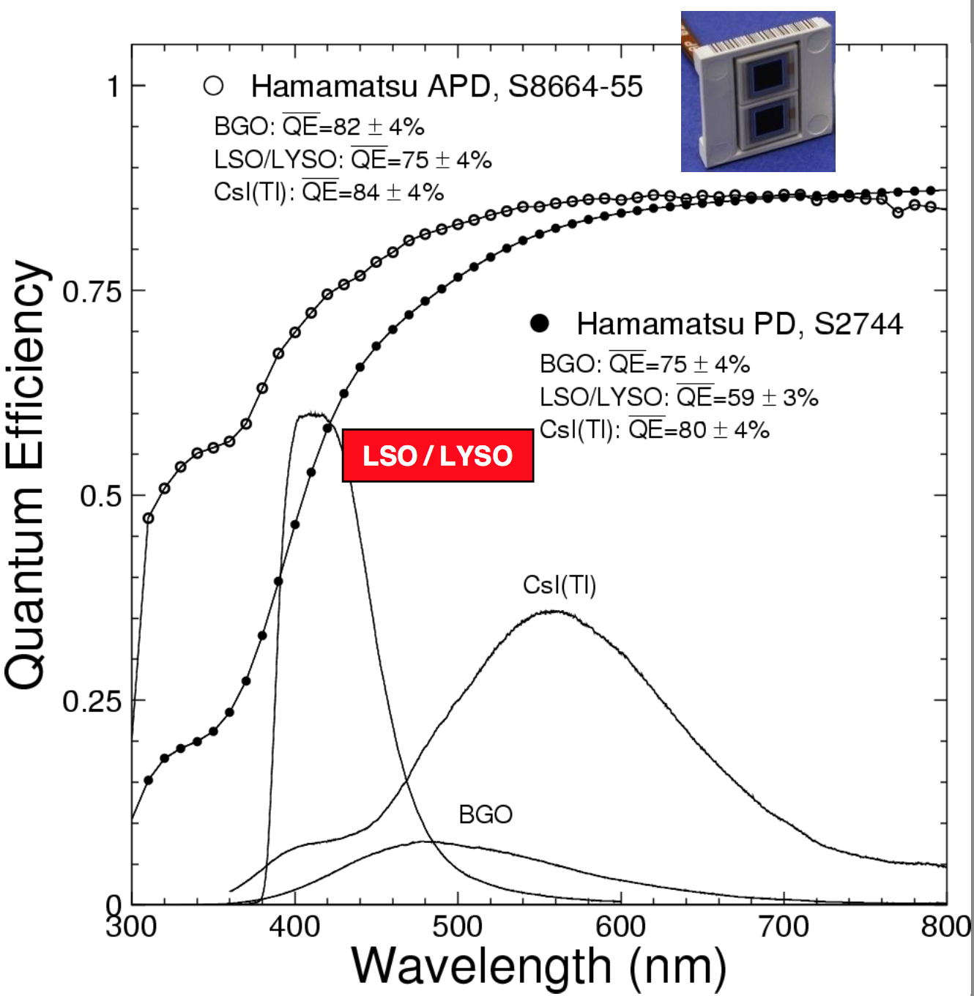
BGO and LYSO with APD

Slide 16
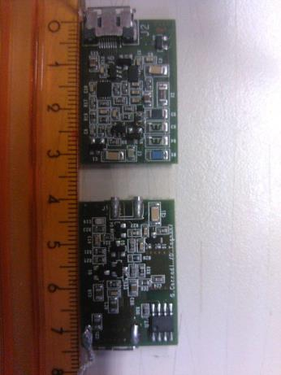
Ecal front-end electronics?
TOP side View
Detector linear voltage regulator
- Charge or Transimpedence preamp and detector
- Voltage regulator programmable.
BOTTOM side View. Charge preamp View.

Slide 17
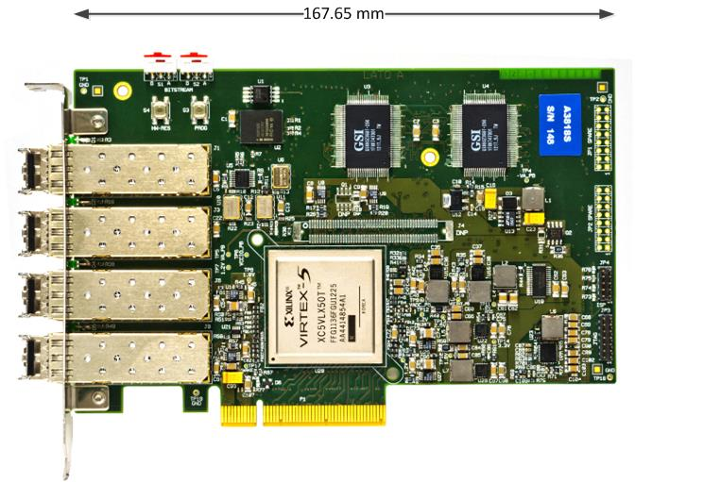
Calorimeter readout
V1742
PCI Express CONET2 Controller
12-bit @ 5 GS/s, 1024 samples per event
5, 2.4,1 GS/s selectable sampling frequencies
VME64/VME64X (32 ch.)
Special analog inputs 2 ch.
1 Vpp input dynamic range with programmable DC offset adj.
16 programmable LVDS I/Os
Daisy chain capability
A3818
PCI Express CONET2 Controller
PCIExpress x8 card 4 independent optical links
CONET2 CAEN Proprietary Optical link Compatible
Up to 32 CAEN CONET2-compliant Optical slave cards (CAEN VME Bridges or Waveform Digitizer) controlled by a single A3818
Data Transfer rate up to 85MB/s per link
Threshold (mV)
Minimum effective threshold < 12 mV
Small dispersion (RMS = 1.3 mV)
High and Low threshold channels can be swapped reducing the minimum threshold

Slide 18
Calorimeter readout model
A3818
Server
All the chain already available test will start in May for the PADME test beam.
CAEN V1742
Needs 21 V1742 to collect a total of 656 channels
All the board receive the trigger from BTF in daisy chain (50 Hz)
On each trigger all the boards digitize all channels and send data to optical links
4 V1742 digitizers connected on each of the 4 optical receiver on A3818 installed in the server
16 V1742 boards per A3818 on a single server

Slide 19
Calorimeter readout data load
Data transfer rate per each A3818 optical link with 4 V1742
Max samples per channel: 1024
Nbits per sample: 12
Number of channel per link = 32x4 =128ch
Without zero suppression = 128x12x1024x50 = 78Mbit/s ~1/8 of the A3818 nominal bandwidth
Total Ecal data transfer to server
Without zero suppression = 656x12x1024x50 = 403 Mbit/s

Slide 20
Calorimeter readout cost
Electromagnetic calorimeter readout
656 channels required for digitization
2 VME 6U crates
21 boards V1742 = 672 channels
2 A3818 = 4 boards on each optical link (4Boards/link x 4links/board x 2boards = 32 boars max)
2 server PC with 2 PCIExpress x8
Item | Npieces | Unit cost | Total cost
VME 6U crate | 2 | 5000 | 10K€
VME 1742 | 22 | 8000 (CAEN quote 2pcs) | 176K€
A3828 | 2 | 2500 (CAEN quote 1pcs) | 5K€
Servers | 2 | 4000 (already have 1) | 8K€
Total |  |  | 200K€+44K€ I.V.A

Slide 21
Global Ecal cost estimate
Item | Solution BGO | Solution LYSO
Crystals | 50Keuro | 450Keuro
ReadOut | 250Keuro | 250Kero
Front End | 100Keuro?? | 100Keuro??
Photo sensors | 80K APD/12K MPPc | 80K APD/12K MPPc

Slide 22
SPARE SLIDES

