Slide 1



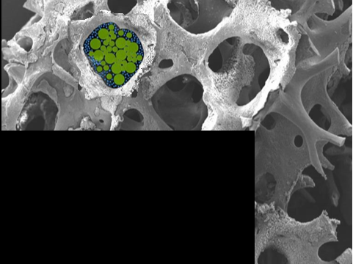

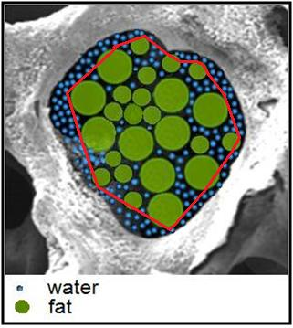
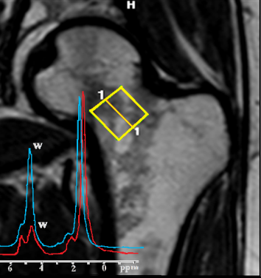
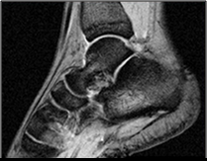
La diffusione NMR per la diagnosi dell'osteoporosi.
Silvia Capuani*,
Giulia Di Pietro*,
Guglielmo Manenti°,
Umberto Tarantino^
*CNR ISC, Physics Department Sapienza University, Rome, Italy
°Department of Diagnostic Imaging and Interventional Radiology, Molecular Imaging
and Radiotherapy, PTV Foundation “Tor Vergata” University of Rome, Italy
^Department of Orthopaedics and Traumatology, PTV Foundation, “Tor Vergata”
University of Rome, Italy
silvia.capuani@roma1.infn.it

Slide 2
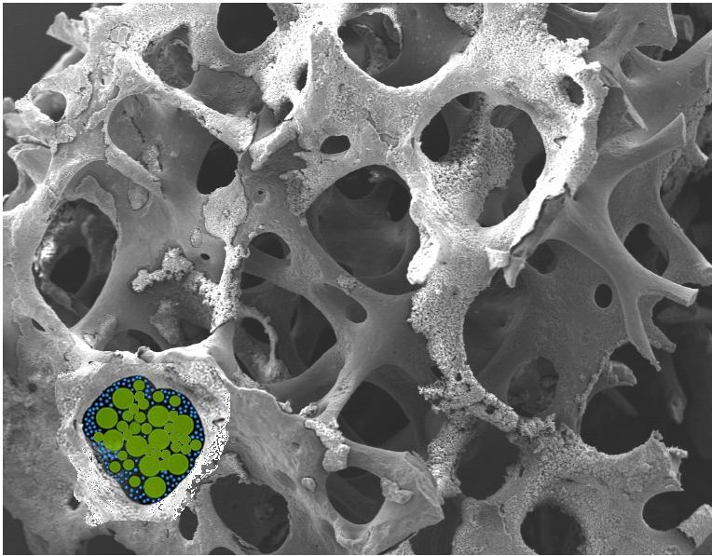
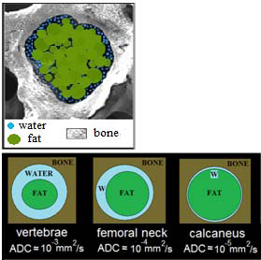
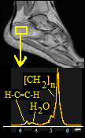
Highlights
101° Congresso della SIF, Roma 21-25 settembre 2015
Biophysical applications
Fundamental physics
Translational longitudinal studies in Humans
NMR Diffusion in porous systems
Transfer of technology
Clinical application
Models
-S. Capuani, et al. Solid State NMR 2005;28:266-272
-C. Rossi, et al. Magn Reson Imag 2008;26:1250-1258
-S. De Santis, et al. Phys Med Biol 2010
-S. Capuani, Microp Mesop Mater 2013;178:34
-M. Rebuzzi et al. BONE 2013;57:155-163
-G. Manenti et al. BONE 2013;55:7-15
-M. Palombo et al. Appl Magn. Reson 2014
-S. Capuani et al. BioMed Res Intl 2015; 948610
-G. Di Pietro et al. Acad. Radiology submitted
-G. Di Pietro et al. NMR Biomed submitted

Slide 3
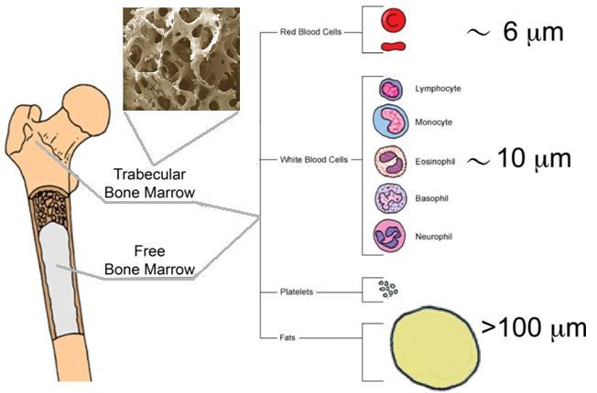
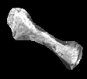
101° Congresso della SIF, Roma 21-25 settembre 2015
Introduction
Human cancellous bone: components and porous structure
water
Osteoporosis = “porous bone”
BMD is reduced
Trabecular bone network is rearranged or disrupted
Bone marrow quality is altered
FAT
bone

Slide 4
101° Congresso della SIF, Roma 21-25 settembre 2015
Why would we want to evaluate the Diffusion Coefficient of water in cancellous bone tissue?
Clinical diagnosis of osteoporosis: is based on BMD quantification in skeletal sites with high trabecular content, such as spine, proximal femur calcaneus...
the poor correlation between fracture prevalence and BMD diagnosis
suggests that
other factors besides low BMD contribute to bone fragility
New potential surrogate markers for osteoporosis
T2*
Mfc
water
don't allow the definition of cut-off values of normality to be applied on a single subject level
FAT
bone

Slide 5
101° Congresso della SIF, Roma 21-25 settembre 2015
Purpose
Diffusion NMR methods allow to measure water displacements at the cellular level by probing motion on the micrometer length scale
S_{NMR} (D)∝FT (MP)
MSD∝2nDt
(MSD) ^{1/2} <<voxel resolution
Aims of the study were:
To describe and corroborate by means of in vivo experiments, the porous system model suitable to investigate the structural properties of the cancellous bone by using diffusion NMR techniques
The final goal of the study was :
To evaluate the potential ability of diffusion techniques,
in association with bone marrow NMR spectroscopy
to discriminate among healthy, osteopenic and osteoporotic
postmenopausal women
water
FAT
bone

Slide 6
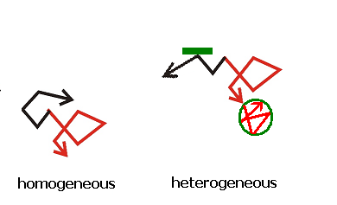
101° Congresso della SIF, Roma 21-25 settembre 2015
Restricted diffusion, Apparent diffusion coefficient :ADC
30
25
20
15
10
5.0
0
MSD^{1/2}
MSD^{1/2} = (2DΔ)^{1/2}
(μm)
D(parallel) about
free diffusion
coefficient,where
D(perp.) is more
defined by the
geometric barrier,
as t=Δ becomes
longer:
√Δ
0 0.05 0.10 0.15 0.2 0.25 0.30
Hindered diffusion
D0=2.3·10⁻⁹ m²/s
D1=2.0·10⁻⁹ m²/s
D2=9·10⁻¹¹ m²/s
D0
Restricted diffusion

Slide 7
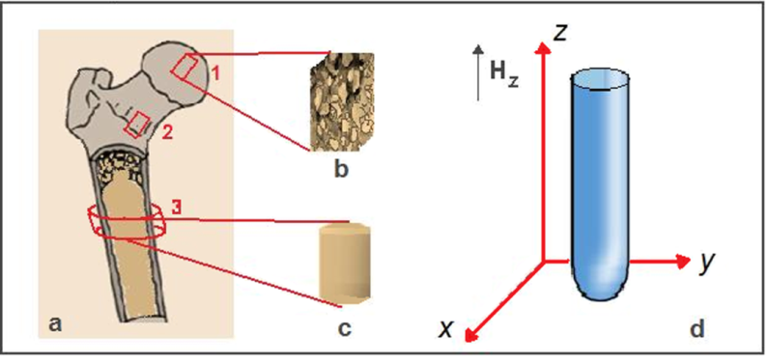
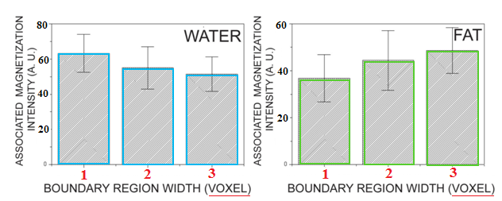
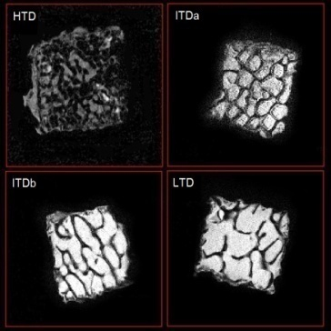
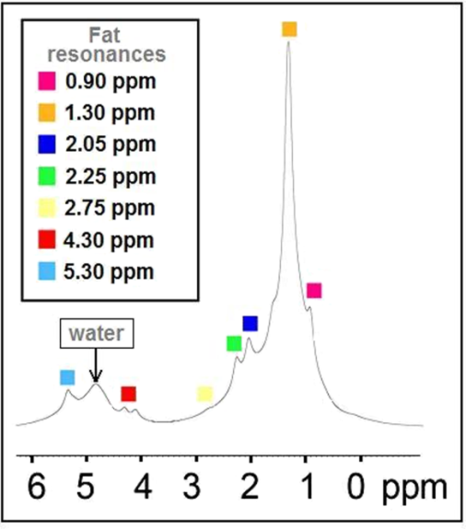
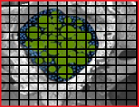
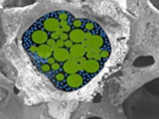
101° Congresso della SIF, Roma 21-25 settembre 2015
Water diffusion behavior in calf bone samples at 9.4T
In vitro experiments
20x20 μm² resolution
water
FAT
bone

Slide 8
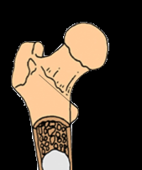
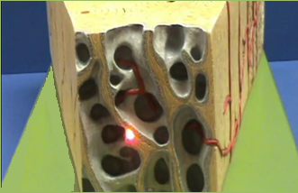
101° Congresso della SIF, Roma 21-25 settembre 2015
The porous system model
“Water is more prevalent in the boundary zone while fat occupies primarily the central zone of the pore”
De Santis S. et al. Phys Med Biol 2010;55:5767-5785.
Justification: histology of bony surface
water
Endosteum, is a thin membrane (≈5-10μm) of soft tissue that lines the medullary cavity. Moreover, due to a biological division of the bone-marrow compartment, granulocytes and other non-fat entities accumulate at the boundary of the bone-marrow compartment adjacent to the endosteum
FAT
bone

Slide 9
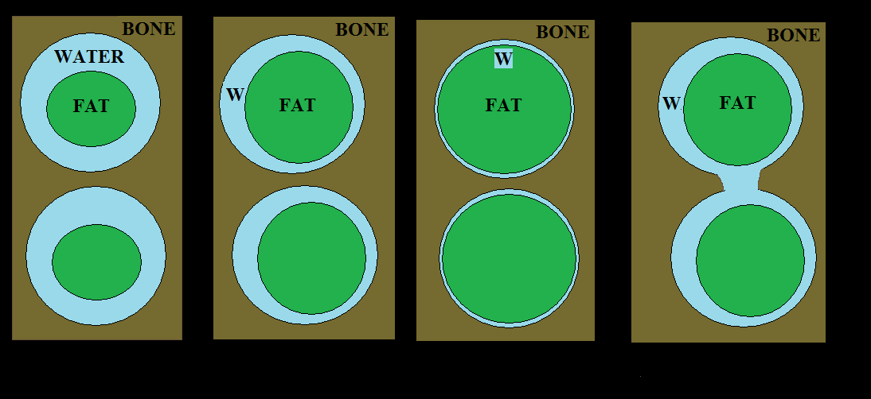
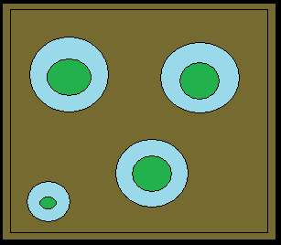

101° Congresso della SIF, Roma 21-25 settembre 2015
The porous system model: restricted diffusion
S. Capuani, Microp Mesop Mater 2013;178:34
Healthy
Vertebrae
ADC ≈ 10⁻³ mm²/s
Femoral neck
10⁻⁴ mm²/s
Calcaneus
10⁻⁵ mm²/s
Increased ADC
ADC
ADC
water
FAT
Osteoporosis
bone

Slide 10
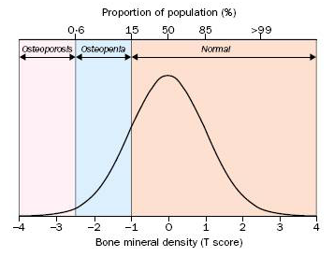
101° Congresso della SIF, Roma 21-25 settembre 2015
Methods: patients selection
Group I: calcaneus
30 postmenopausal women
mean age (64.5±6 years)
10 healthy,
10 osteopenic
10 osteoporotic women,
Group II: femoral neck
30 postmenopausal women
mean age (64.5±6 years)
10 healthy,
10 osteopenic
10 osteoporotic women,
The status of each subject was assessed with QCT
BMD measurements
in lumbar vertebral
according to the following criteria*:
The status of each subject was assessed with DXA
BMD measurements
in femoral neck
according to the following criteria:
T-score ≥ -1.8 :healthy
-3.3 < T-score < -1.8 : osteopenia
T-score ≤ -3.3 osteoporosis
T-score ≥ -1.0 :healthy
-2.5 < T-score < -1.0 : osteopenia
T-score ≤ -2.5 osteoporosis
water
FAT
*ISCD Official Position, reported by K. Engelke, J.E. Adams et al., Journal of Clinical Densitometry: Assessment of Skeletal Health, 2008;11:123-162
bone

Slide 11
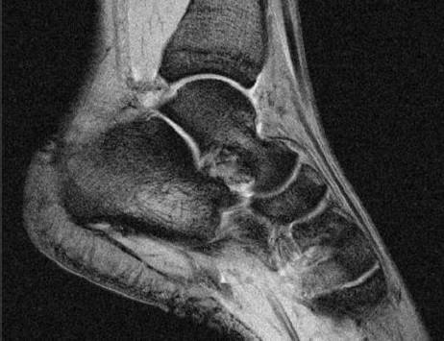

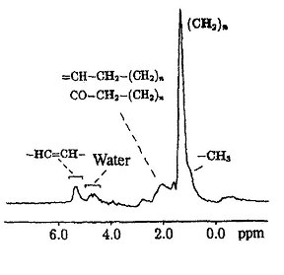
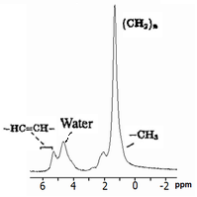
101° Congresso della SIF, Roma 21-25 settembre 2015
Methods: MR at 3T
ADC +MRS in calcaneus ADC+MRS in femoral neck
Parameter | Protocol: diffusion weighted segmented EPI to evaluate ADC in calcaneus
Slice thickness Square FOV Matrix Epi factor b values G direction TE/TR NS | 5 mm 192 mm² 128X128 7 0, 8000 s/mm² anterior.-posterior 89/2500ms 2
Parameter | Protocol: diffusion weighted segmented EPI to evaluate ADC in femoral neck
Slice thickness FOV Matrix Epi factor b values G direction TE/TR NS | 5 mm 160 mm x142mm 72X49 7 0, 2500 s/mm² left - right 104/2500ms 2
Parameter | Protocol: SVS (PRESS) to obtain bone marrow spectra
Voxel size TE/TR NS | 15x15x15 mm 22/5000 ms 32
Fat fraction %
FF=A^{fat}/(A^{fat}+A^{w})
water
Mono-exponential decay
S(b)=S(0)exp(-ADC*b)
FAT
bone

Slide 12
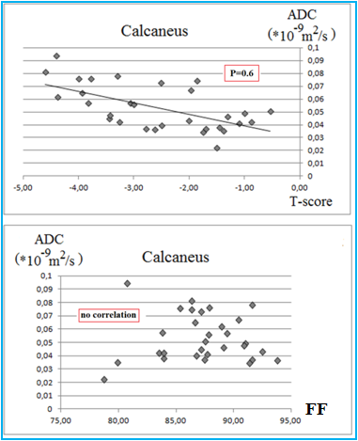
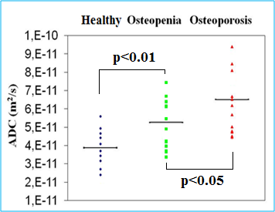
101° Congresso della SIF, Roma 21-25 settembre 2015
Results
ADC +MRS in human calcaneus
FF was not significantly different
between BMD groups
MSD = 6 DΔ
MSD^{1/2} ≈ 4 μm
D=5*10⁻⁵ mm²/s Δ=70ms
water
FAT
M. Rebuzzi ,et al. BONE 2013;57:155-163
bone

Slide 13
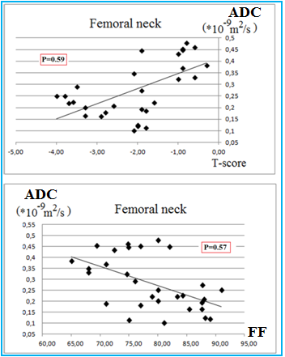
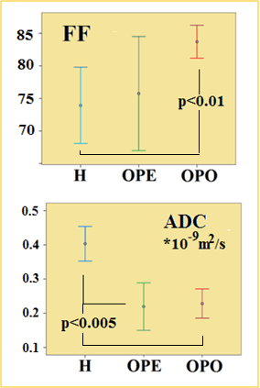
101° Congresso della SIF, Roma 21-25 settembre 2015
ADC+MRS results obtained in human femoral neck
FF was significantly different between healthy (H)
subjects and patients with osteopenia (OPE) and osteoporosis (OPO)
MSD = 6 DΔ
MSD^{1/2} ≈ 9 μm
D=2*10⁻⁴ mm²/s Δ=80ms
H
OPO
water
FAT
Manenti G, Capuani S et al. BONE 2013;55:7-15.
bone

Slide 14
101° Congresso della SIF, Roma 21-25 settembre 2015
Conclusions
Water is more prevalent in the endosteal boundary zone while fat primarily occupies the central zone of the intra-trabecular space. The work shows that water diffusion in this boundary zone provides new insight into cancellous bone microstructure.
In calcaneus
FF was not significantly different between BMD groups
Patients with osteoporosis compared to age-matched controls
showed significantly higher ADC values.
Findings may be a consequence of pore enlargement and increase in
interconnections between adjacent pores in the trabecular bone
network due to formation of perforations of trabecular plates.
In femoral neck
FF was significantly different between healthy
subjects and patients with osteopenia and osteoporosis
Patients with osteopenia and osteoporosis compared to age-matched controls
showed significantly lower ADC values.
Findings may be a consequence of fat increase in each cancellous bone pore that causes a narrowing of the space between fat and bone where the water diffuses (more restricted water!)
water
FAT
bone

Slide 15
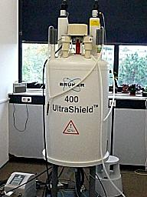
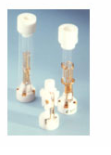
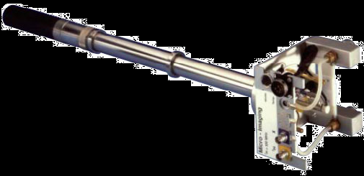
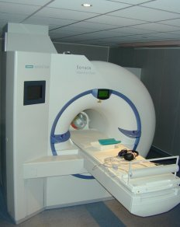
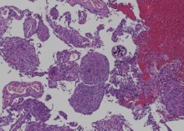
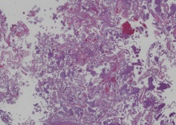

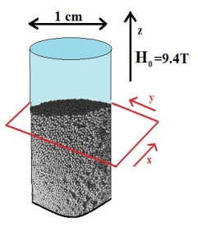
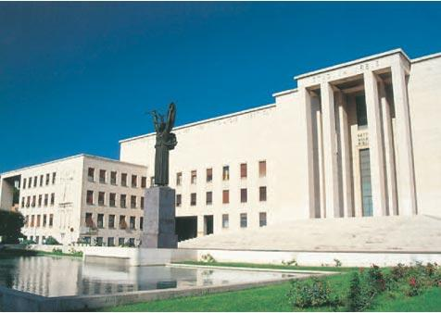

NMR Laboratory
Physics Dpt.
Fermi Building
Sapienza Univ.
silvia.capuani@roma1.infn.it
Thank you for your attention.

