Slide 1


!01° Congresso della Società Italiana di Fisica
Microrisonatori ottici per diagnostica biomedica
Optical Microresonators for Biomedical Diagnostics
Giancarlo C. Righini
Enrico Fermi Centre, Roma
Nello Carrara Institute of Applied Physics, Firenze

Slide 2
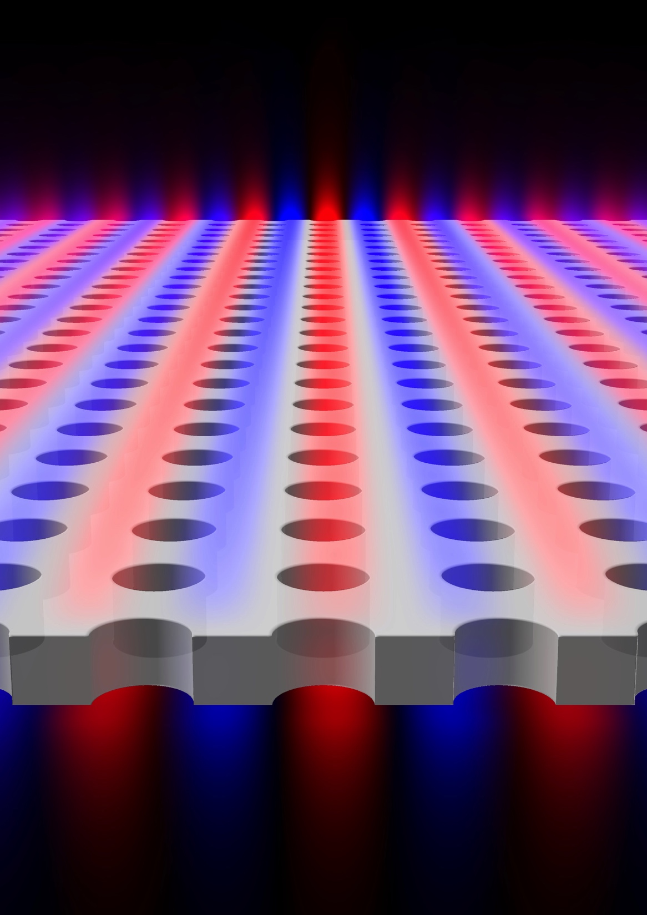
Photonic Biosensors
Photonic sensors, which rely on the manipulation and detection of light that is either transmitted through, absorbed by, or emitted from a sample, have revolutionized medical diagnostics.
Since the use of color strips to measure the pH of a solution (probably due to the French chemist J.L. Gay-Lussac in early 1800s) many other simple or complex methods have been developed to measure biochemical and biologic properties or to detect the presence of a specific analyte.
Notes:
. Label-based sensors require the analyte to be modified with the addition of a label that is detectable by the sensor

Slide 3
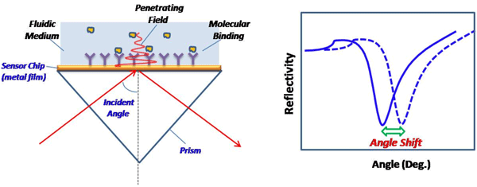
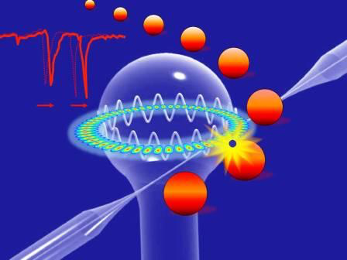
Photonic Biosensors (ctd)
Optical sensors are classified into either label-based or label-free (LF) devices. The latter ones usually have the advantage of being faster and less intrusive to the analyte.
Most common LF devices are based on interaction of evanescent tail of e.m. waves with the analyte, exploiting
Surface Plasmon Resonance or Whispering Gallery Modes.

Slide 4
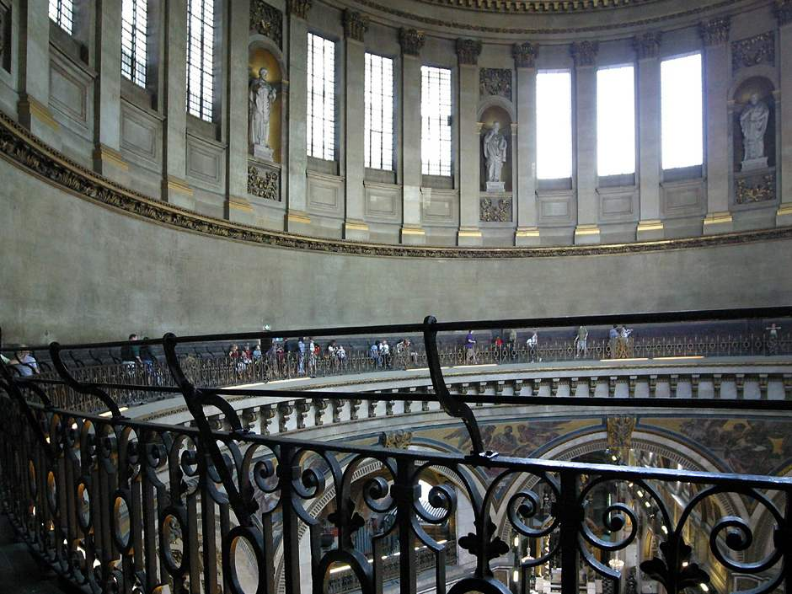
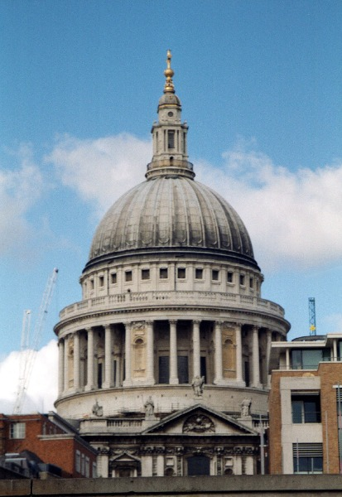
Whispering Gallery Modes (WGM)
The Whispering Gallery phenomenon was first described in 1910 by Lord Rayleigh, based on observations in St. Paul’s Cathedral in London.
A person just whispering close to the wall can be heard all the way along the gallery, more than 40 m to the other side, due to the sound reflections along the circular wall.
L. Rayleigh, “The Problem of the Whispering Gallery”, Philosophical Magazine 20, 1001–1004 (1910).
Whispering Gallery under the cupola of the
St. Paul’s Cathedral in London

Slide 5
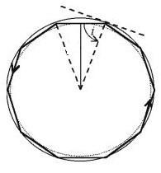
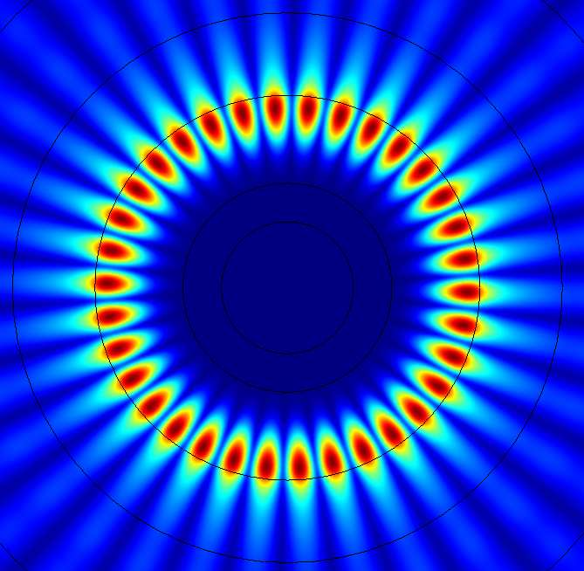
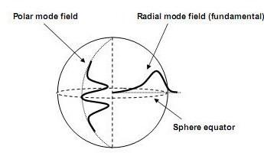
WGM Microresonator
Geometrical optics
Light is confined near the border of microresonator
by consecutive total internal reflections
i > i_{c} = arcsin(1/N);
Electromagnetic Theory (3D)
Maxwell's equations + boundary condition :
Radial field component: r<R → spherical Bessel function
r>R → evanescent tail
Polar field component: Legendre spher. armonics
Azimutal field component: sinusoidal function
Notes:
We can view whispering-gallery modes as… possiamo trattarli attraverso…
_____________________________________
High angular momentum electromagnetic modes in which light propagates by repeated total internal reflections with the proper phase condition after circling along the sphere surface, for example.
Evanescent tail, the faint outer edge of the light wave that penetrates through the surface of the sphere from the inside and travels around the equator. So it interact with the material near the surface.

Slide 6
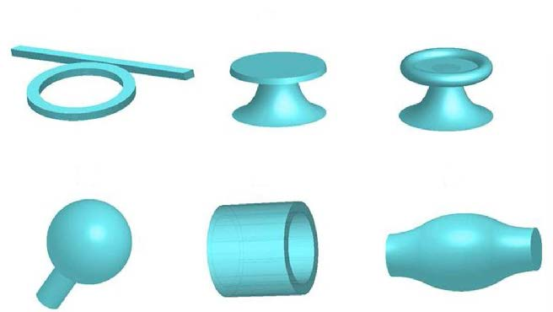
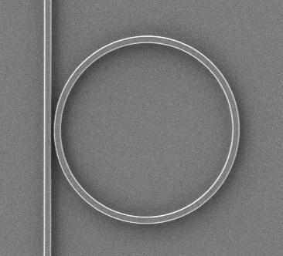
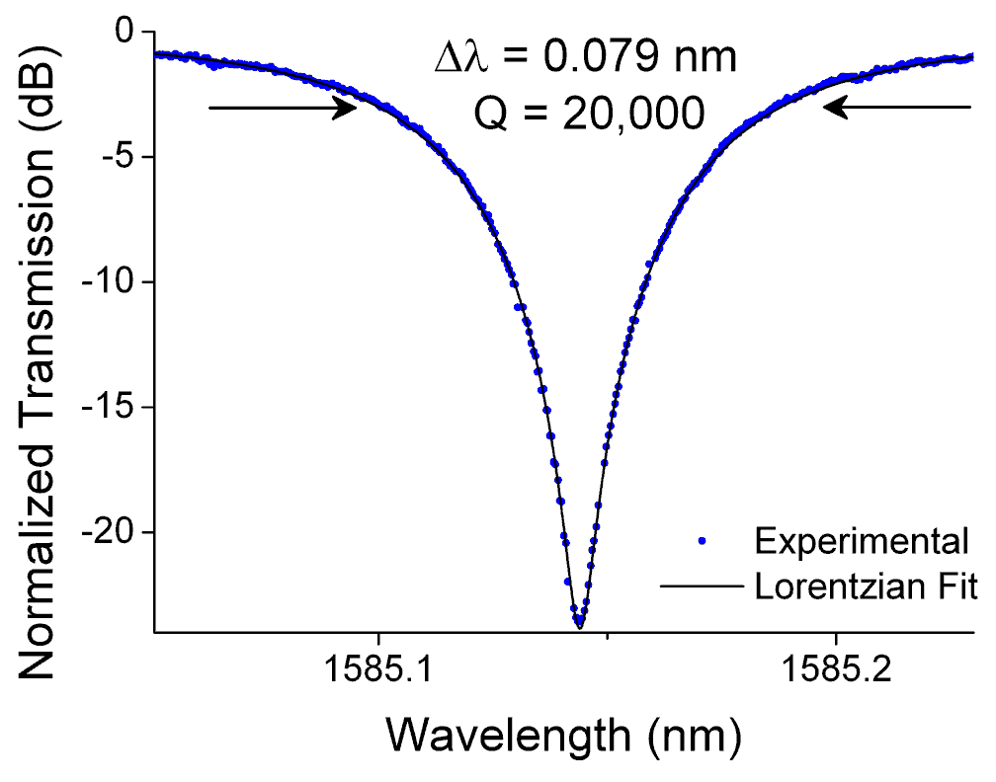

WGM Geometries
K. Preston, Michal Lipson, et al., Opt. Exp. 2007
WGM resonators may have different geometries:
planar ring; disk; toroid; sphere; cylinder; bottle.
For all of them a key parameter is the quality factor:
Q = ν/Δν ( 10⁴ - 10¹⁰ )
Notes:
Polysilicon ring

Slide 7
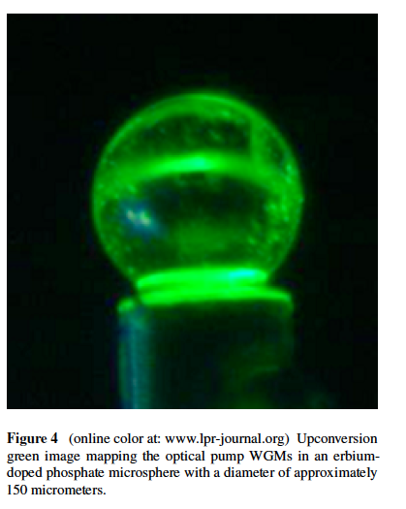
Spherical microresonators
Among the various types of 3D WGM microresonators (WGMR), the spherical one is the simplest to fabricate and the one with the highest Q = 10⁶ ÷ 10⁹.
Its very critical morphology dependence makes this WGMR particularly suitable to the implementation of sensors with very high accuracy.
A. Chiasera, Y. Dumeige, P. Féron, M. Ferrari, Y. Jestin, G. Nunzi Conti, S. Pelli, S. Soria, and G.C. Righini.“Spherical whispering-gallery-mode microresonators”, Laser & Photonics Reviews 4 (2010) pp. 457-482
G.C. Righini, Y. Dumeige, P. Féron, M. Ferrari, G. Nunzi Conti, D. Ristic, S. Soria., “Whispering gallery mode microresonators: fundamentals and applications”, Rivista del Nuovo Cimento 34 (2011) pp. 435-488.

Slide 8
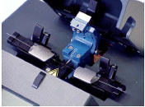
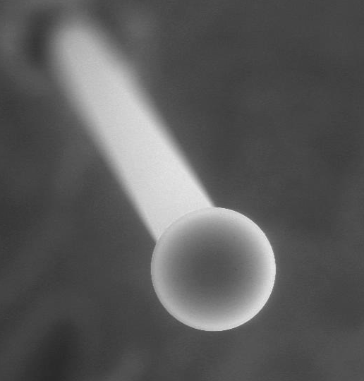
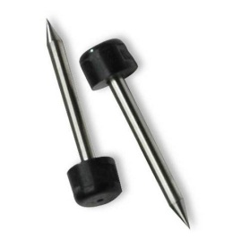
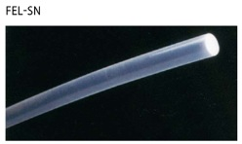
Fabrication of a microsphere
A simple and effective method is based on the melting (usually by a fiber fusion splicer or by a CO₂ laser) of the end of a standard telecom fiber.
In our lab the end of an SMF-28 optical fiber is partially fused by the arc discharge generated between two metal electrodes. Due to the surface tension, the optical microsphere is formed.
150 – 250 microns silica optical microspheres (Q ~ 10⁸)
Optical fiber
electrodes

Slide 9
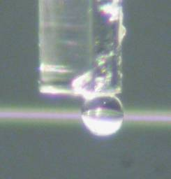
Fabrication from glass
BUT …non-silica microspheres have to be fabricated by other methods !! e.g.:
Selecting and handling
1) Glass grinding
2) Melting by a plasma torch
O₂
MW power
2.4 GHz 2kW
Ar
Each sphere is measured by using a microscope and glued to the end of an optical fiber.
Glass powder
Microspheres
(10:200 μm)
Torch

Slide 10
Tapered fiber coupling
D. Ristić, A. Rasoloniaina, A, Chiappini, P. Féron, S. Pelli, G. Nunzi Conti, M. Ivanda, G.C. Righini, G. Cibiel, and M. Ferrari “About the role of phase matching between a coated micro-sphere and a tapered fiber: experimental study” Optics Express, 21 (2013), 20954.

Slide 11
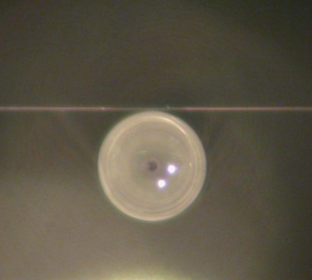
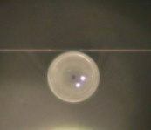
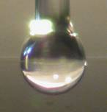
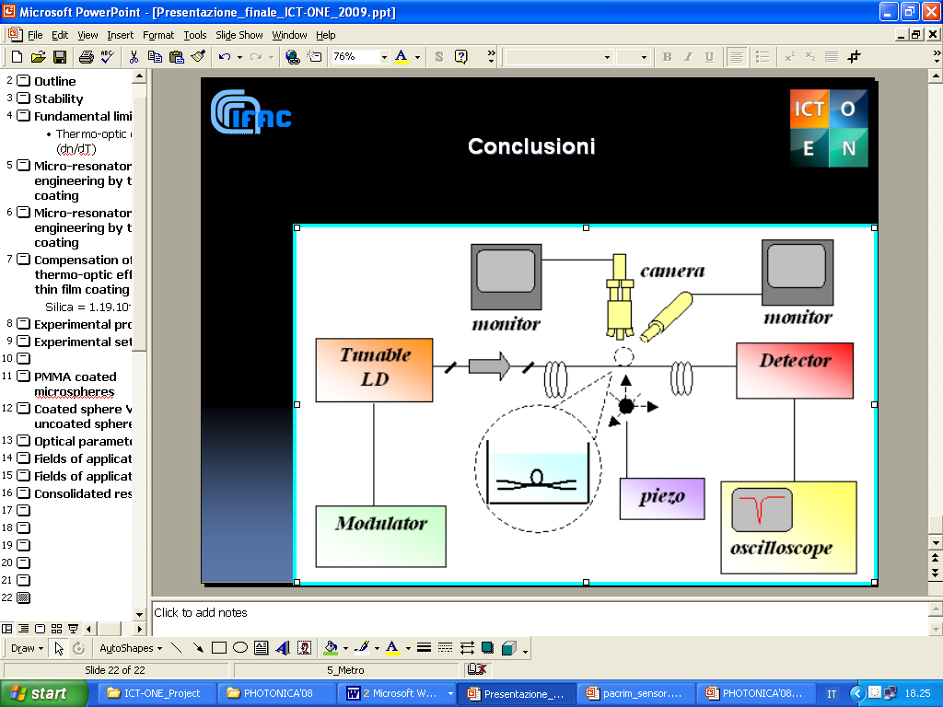
Measurement set-up
Laser Source: Tunics Plus tunable laser
operating around 1550 nm
δν=300 KHz (linewidth)
Δν=±1.5 GHz (laser line sweep)
< 1 KHz freq. mod
Detector: InGaAs
Thorlabs PDA 400 (10 MHz bandwidth) for slow scanning;
From WGM spectral linewidth dν
Q=ν/dν

Slide 12
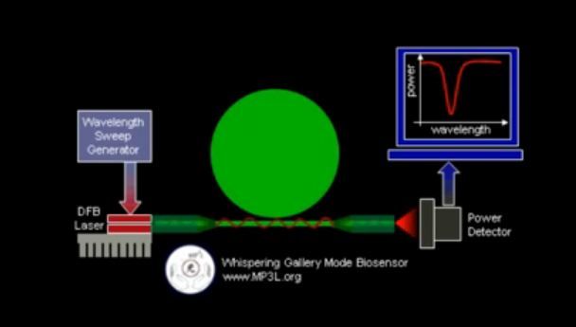
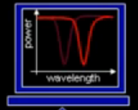
WGM sensing
WGMs are morphologically dependent in
a very sensitive way
Arnold, Fan, Ilchenko,Vollmer, …
In general, the narrower is the cavity linewidth and:
1) the higher is the Q factor;
2) the higher is the sensor resolution (i. e.: its ability to discriminate the smallest frequency shift that can be accurately measured).
Wavelength
Sweep
Generator
R ’
DFB
Laser
R
Power
Detector
A. Chiasera, Y. Dumeige, P. Féron, M. Ferrari, Y. Jestin, G. Nunzi Conti, S. Pelli, S. Soria, and G. C. Righini, Laser Photon. Rev. 4, 457 (2010).
from the resonance condition:

Slide 13
Basics of a biosensor

Slide 14
Biosensing: various binding cases
A crucial issue for biosensing is the selectivity of detection: it can be achieved by the functionalization of the surface of the microsphere, in order to specifically bind only the biochemical element to be recognized and, at the same time, to maintain a good value for the Q factor.
antibody
streptavidin
aptamer
enzyme
antigen
biotin
protein
aminoacid

Slide 15
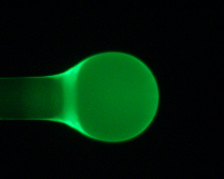
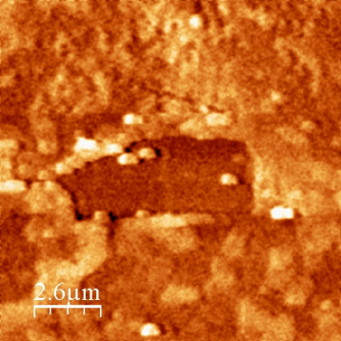
Functionalization of microspheres
General Requirements:
Possibility to excite WGMs in efficient way by means of evanescent field tail
  a thickness < 100 nm
  good homogeneity
High Q factor for the (microspheres +
coating) structure
We developed a very easy and repeatable protocol in order to obtain a homogeneous polymeric coating on the surface of the microspheres.
Thickness: 30 ± 6 nm
Roughness: ~ 6 nm)
Notes:
For this purpose we adopted Eudragit® L100 (anionic copolymer made of metacrylic acid and methyl methacrylate) as functionalising material. The addition of fluorescein (a fluorescent marker which remains trapped inside the polymeric mesh of Eudragit) guarantees an easy imaging of the microspheres by fluorescence microscopy, in order to check the quality of the surface after the functionalization procedure.

Slide 16
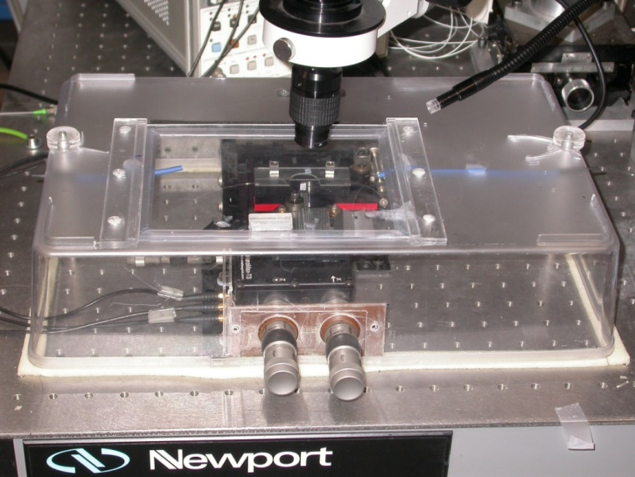
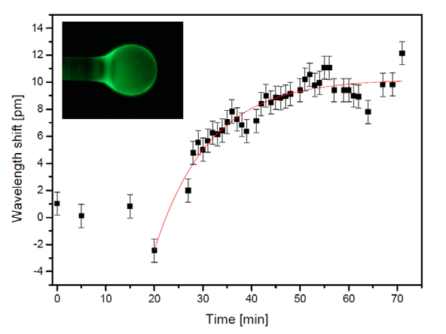
Immunosensor
A resonance wavelength shift ≈ 10.2 ± 0.3 pm after injection of 10 μL of 50 mg·L⁻¹ anti-IgG in the PBS solution was measured. Theoretical analysis gave a value for the association constant about 1.9 × 10⁵ M⁻¹s⁻¹ for IgG, which is in good accordance with known results for IgG/anti-IgG binding.
A. Giannetti, S. Berneschi, F. Baldini, F. Cosi, G. Nunzi Conti and S. Soria, “Performance of Eudragit Coated Whispering Gallery Mode Resonator –Based Immunosensors”, Sensors, Vol. 12 (2012), 14604-14611.
Notes:
An immunoassay is a biochemical test that measures the presence or concentration of a macromolecule in a solution through the use of an antibody or immunoglobulin. The bioreceptor molecules of an immunosensor are the antibodies. The antibodies are also called immunoglobulins, because they are proteins related to the immunological system.
An immunosensor is generally reusable.

Slide 17
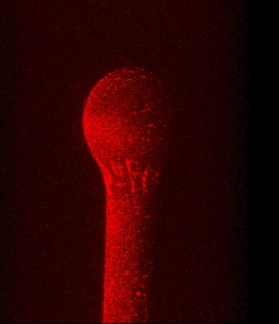
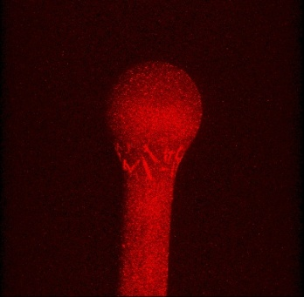
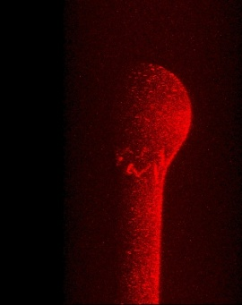
Aptasensing: AFFINITY BINDING APTAMER - THROMBIN
Analysis of the coated microsphere surface, functionalized with MPTMS, aptamer and thrombin, by confocal fluorescent microscopy
500 µl cell, laminar flow, aptamer chain lenght 15
Thrombin: 40 nM
MPTMS + aptamer + thrombin
S. Soria et al., WGM microresonators for biosensing, Adv. in Science and Technology, 82 (2013), 55-63.
Q ≅ 10⁷ @ 770 nm
The Aptamer – Thrombin binding in PBS solution. The reaction is very fast: after 800 s the saturation condition is reached.
After functionalisation and binding with thrombin: Q ≅ 10⁷ @ 770 nm
Notes:
Thrombin: An enzyme that presides over the conversion of a substance called fibrinogen to fibrin, which promotes blood clotting (coagulation).

Slide 18
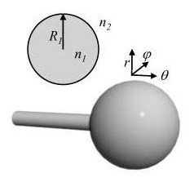
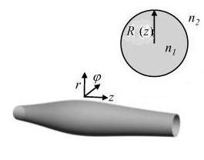
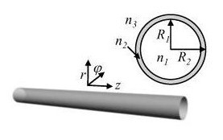
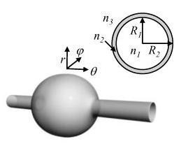
Why not using hollow structures ?
Microsphere
Microbottle
BULK structures
Capillary
Microbubble
HOLLOW structures

Slide 19
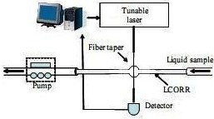
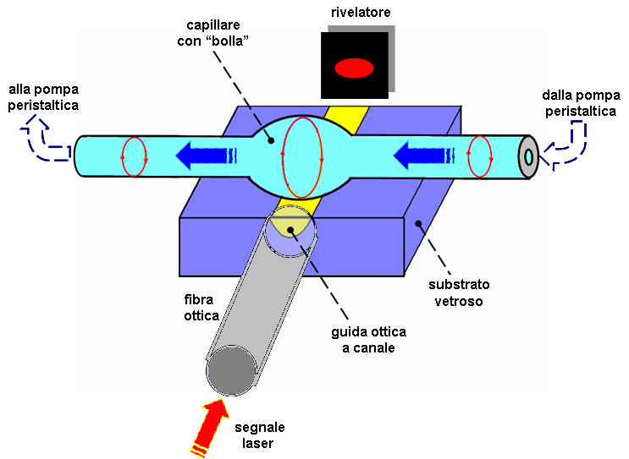
Solution: MICROBUBBLE
M. Sumetsky et al., Opt. Lett. 35, 898 (2010)
WGM
profile
WGM
No perturbation in coupling and less breakable structure
Field profile in waveguide
To obtain easily integrable and robust set-up we can combine the microbubble geometry with waveguide coupler.

Slide 20
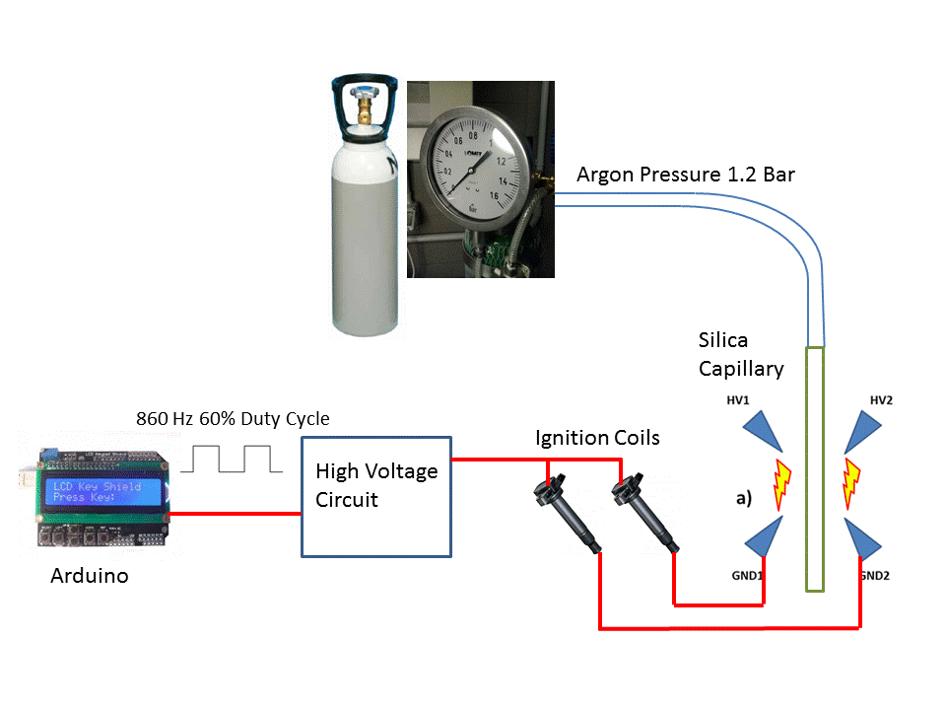
Microbubble Fabrication

Slide 21
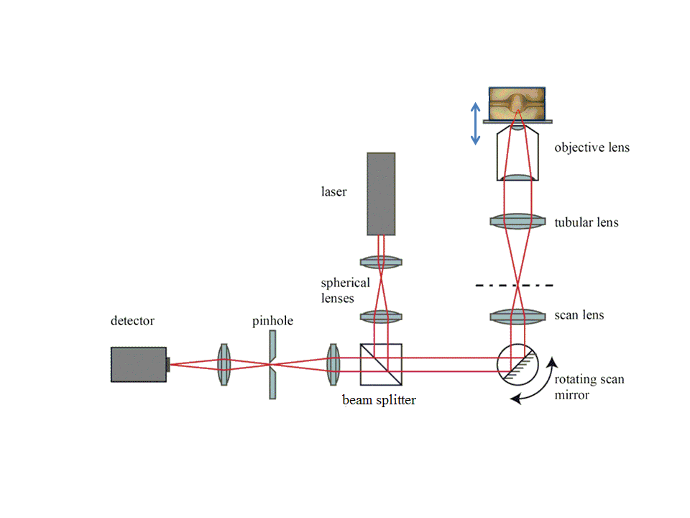
Wall thickness measurement
The thickness of the wall is critical to get highly efficient interaction with the liquid flowing inside. We developed a non-destructive measurement technique by using confocal microscopy.
A. Cosci, F. Quercioli, D. Farnesi, S. Berneschi, A. Giannetti, F.. Cosi, A. Barucci, G. Nunzi Conti, G. Righini, and S. Pelli, "Confocal reflectance microscopy for determination of microbubble resonator thickness," Opt. Express 23, 16693 (2015)

Slide 22
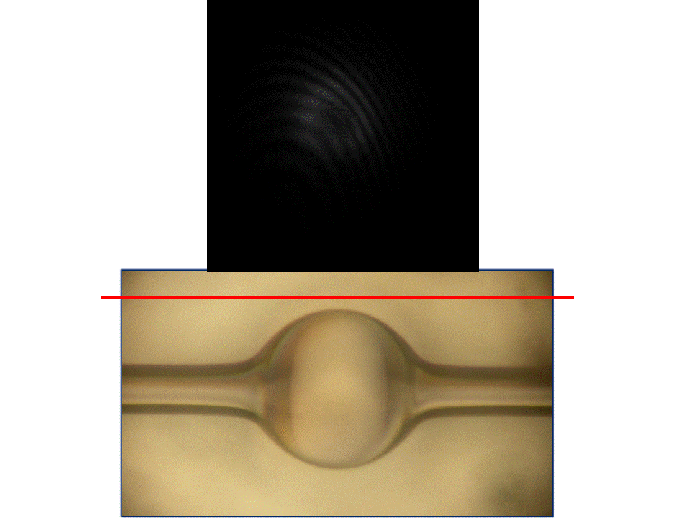
Confocal measurement

Slide 23
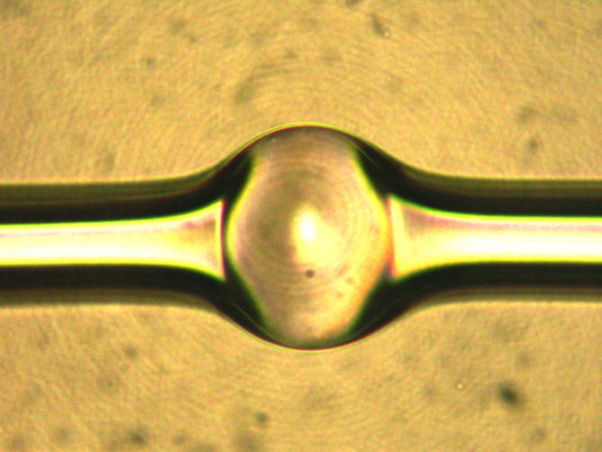
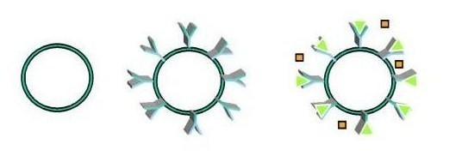
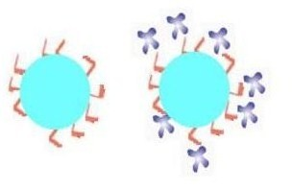
Last step: Microbubble Functionalization
Metal mask
A proper chemical solution is flown through
the capillary to activate its inner surface by a
spatially-selective (i.e. through a mask) UV
photo-activation.
Silanization
Biotin-Streptavidin layer
→ selectivity with one step process
WGM
profile
WGM
Field profile in waveguide

Slide 24
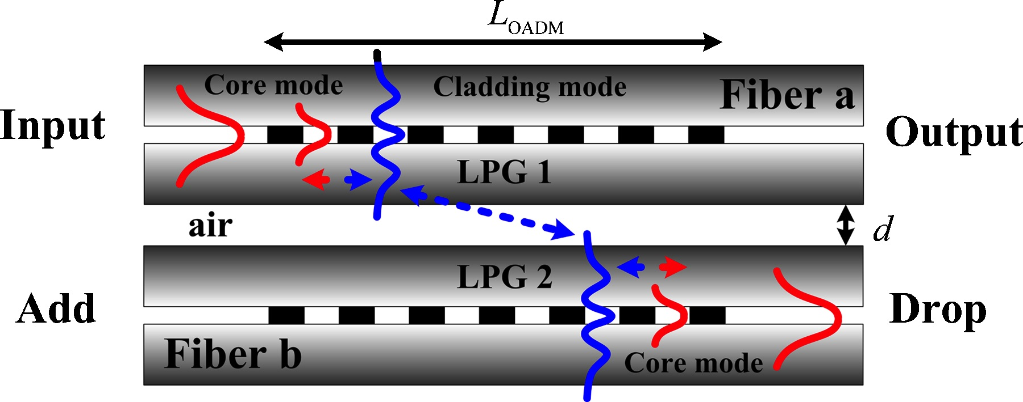
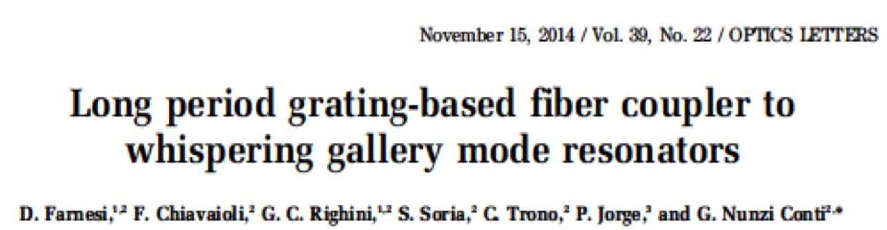
Towards a device: a more robust coupling
Boron-germanium codoped optical fibers (Fibercore PS1250/1500); point-to-point writing technique; KrF excimer laser (Lambda Physic COMPex 110, λ = 248 nm).

Slide 25
CONCLUSIONS
Bulk (spherical) and hollow (bubble) microresonators have proved to be very efficient and sensitive biosensors.
Microbubbles make much easier the integration with microfluidics.
A robust coupling technique, based on LPGs, which allows to use thicker tapers, was demonstrated.
The use of two LPGs, one before and the other after the taper section, also makes possible quasi-distributed sensing.
D. Farnesi et al. , Opt. Exp. 23, 21175 (10 August 2015)

Slide 26

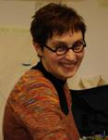


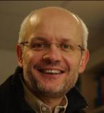


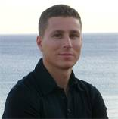
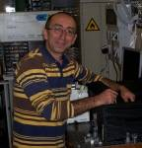

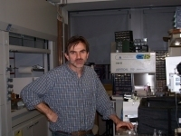
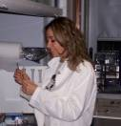

Acknowledgments
Stefano Pelli
Daniele Farnesi
Franco Cosi
Gualtiero Nunzi Conti
Silvia Soria
I would also like to acknowledge the collaboration of
Alessandro Chiasera, Andrea Chiappini
(IFN-CNR, Trento),
Cecilia Pederzolli
(FBK, Trento),
Franco Prudenzano
(Bari Polytechnic).
Simone Berneschi
Andrea Barucci
Cosimo Trono
Maurizio Ferrari
Alessandro Cosci
Francesco Baldini
Ambra Giannetti

