Slide 1
Nonlinear Gamow Vectors in nonlocal optical propagation
VANGUARD
Grant 664782
M.C. Braidotti ^{1,2}, S. Gentilini ^{1,2}, G. Marcucci ³, E. Del Re ^{1,3} and C. Conti ^{1,3}
¹ Institute for Complex Systems (ISC-CNR), Rome (IT)
² Department of Physical and Chemical Sciences, University of L’Aquila, L’Aquila (IT)
³ Department of Physics, University Sapienza, Rome (IT)
www.complexlight.org
101° Congresso della Società Italiana di Fisica, Rome December 21-25 2015, the 21th June 2015
Notes:
Good evening, I’m MCB, a PhD student of prof Conti.
My talk is about nonlinear Gamow vectors in nonlocal optical propagation

Slide 2
Outline
Subject
Dispersive Shock Waves
Challenge
Description of Shock Waves beyond Shock Point
Shock phenomena
Reverted Harmonic Oscillator
Numerical Simulations
Experimental Results
Notes:
The subject of my talk ase DSW in optical systems. Our challenge is to find a way to describe shock waves bejond the shock point since current theoretical models are not valid in that regime.
So at first I will describe breifly shock phenomena and then introduce the model of the RHO in order to answer the challenge posed. Than I will show the validity of it through numerical simulations and experiments.

Slide 3
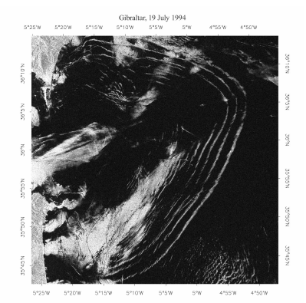
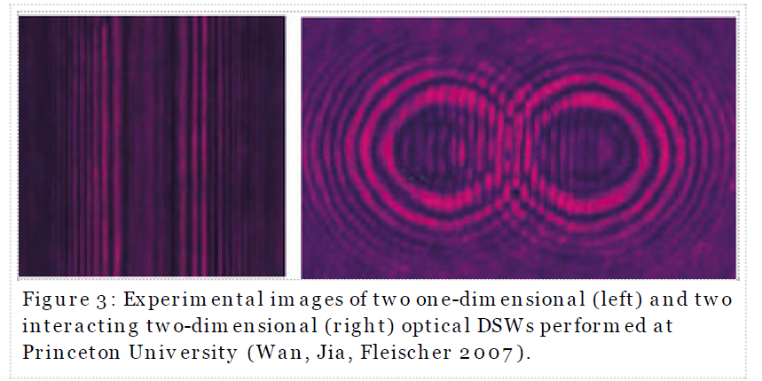
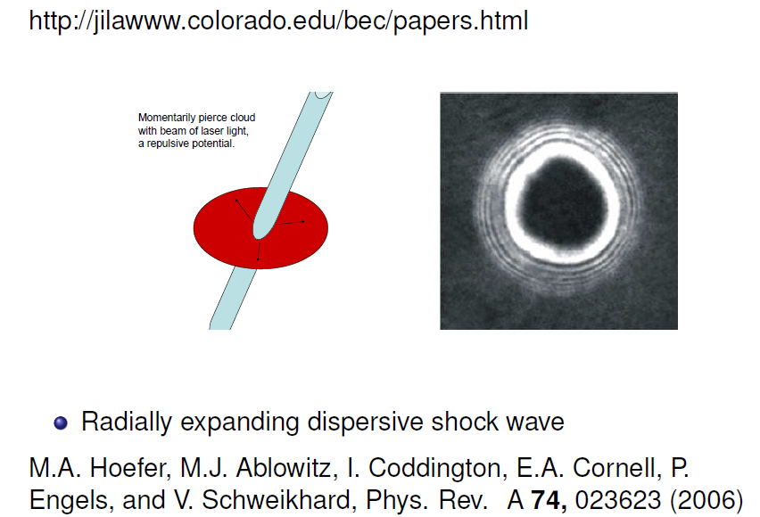
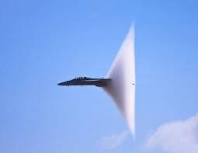
Dispersive Shock Waves in Physics
Shock in fluidodynamics
Shock in nonlinear optics
Shock in supernova explosion
Shock in Bose-Einstein condensation
Shock in supersonic flows
Illustration of propagation W44 shock waves in the molecular cloud. Keio University/NAOJ
Notes:
DSW are ubiquitous in nature infact as we can see they are present in a wide variety of fields as Fluidodynamics, astrophysics and BE condesation. The reason why they are ubiquitous in nature is because they are a singular solution of the hyperbolic partial differential equations, that are a class of equations describing a wide variety of wave-like physical phenomena ranging from the water waves to plasmas and optics.
A singular solution is a function which develops a discontinuity in its derivative as a consequence of an abrupt jump in some of the quantities involved in the wave propagation. The point at which such a singularity arises, is called shock point, and can be mathematically predicted together with its speed.
We now focus our attention on nonlinear optics

Slide 4
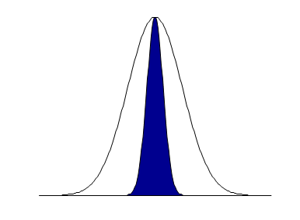
Nonlinear Schrödinger Equation
Local NLS equation
$$i\frac{∂ψ}{∂z}+\frac{1}{2}\frac{∂^{2}ψ}{∂x^{2}}−P{\left|ψ\left(x\right)\right|}^{2}ψ=0$$
Optical Intensity
Nonlocal NLS equation
$$i\frac{∂ψ}{∂z}+\frac{1}{2}\frac{∂^{2}ψ}{∂x^{2}}−P\int{K(x−x′){\left|ψ\left(x′\right)\right|}^{2}dx′}ψ=0$$
Refractive index
perturbation
$$i\frac{∂ψ}{∂z}+\frac{1}{2}\frac{∂^{2}ψ}{∂x^{2}}−PK(x){∗\left|ψ\left(x\right)\right|}^{2}ψ=0$$
Notes:
In optics the equation used to describe the nonlinear regime is NLS. We can see the 1D NLS in the most used form and we can see that it has a derivative in the propagation direction and a second derivative in the transverse one (this is the diffracting term). The nonlinear term in the NLS, takes into account a nonlinear variation of the refractive index proportional to the optical field intensity.
We can write this equation in a general form (the nonlocal expression) where the nonlinear index perturbation is expressed as the integral of a nonlocality function with the square modulus of the field. This mean that the refractive index in a certain point is affected by the value of itself and of the beam intensity in another point.
Generally we can write the equation in this form.

Slide 5
From NLS to Hydrodynamic Model
$$ψ→ε^{−2}ψ$$
$$∂_{x}→ε^{−1}∂_{x}$$
$$∂_{z}→ε^{−3}∂_{z}$$
$$i\frac{∂ψ}{∂z}+\frac{1}{2}\frac{∂^{2}ψ}{∂x^{2}}−{\left|ψ\left(x\right)\right|}^{2}ψ=0$$
$$iε\frac{∂ψ}{∂z}+\frac{ε^{2}}{2}\frac{∂^{2}ψ}{∂x^{2}}−{\left|ψ\left(x\right)\right|}^{2}ψ=0$$
$$ε=\sqrt{\frac{L_{nl}}{L_{d}}}$$
WKB Approach
If
$$ψ(z,x)=\sqrt{ρ(z,x) }e^{iφ/ε}$$
and
$$u=∂_{x}φ$$
$$iε\frac{∂ψ}{∂z}+\frac{ε^{2}}{2}\frac{∂^{2}ψ}{∂x^{2}}−{\left|ψ\left(x\right)\right|}^{2}ψ=0$$
$$u_{z}+uu_{x}+ρ_{x}=0$$
Continuity eq.
0° order
$$ρ_{z}+{(ρu)}_{x}=0$$
Eulero eq.
1° order
Dynamics driven by the phase tilt, the intensity follows
Notes:
By rescaling the NLS with suitable variables we can obtain another form of the dimensionless NLS, where explicitly appears a parameter, epsilon, which takes into account the competition between diffraction and nonlinearity in the propagation of the optical field.
Expressing the optical field in a factorized way, the adimensional NLS can be splitted into two equations describing separately the propagation of the amplitude and of the phase velocity of the field. Now when the hydrodynamical holds true we can perturbatively neglect the amplitude equation and focus our attention on the evolution of the velocity field. This continuity equation has the form of an Hopf equation, which is the considered the proptotype for the shock phenomenon.

Slide 6
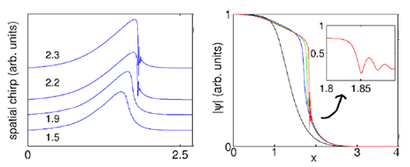
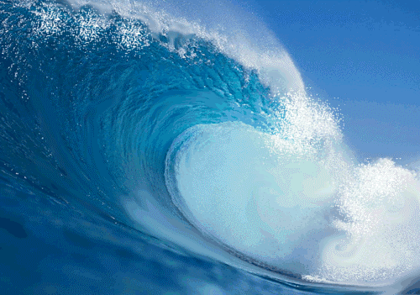
Hopf Equation
$$u_{z}+uu_{x}=0$$
$$\overset{→}{v}$$
z
Regularization by dissipation
Regularization by dispersion
N. Ghofraniha, S. Gentilini, V. Folli, E. DelRe, and C. Conti PRL 109, 243902, 2012
N. Ghofraniha, C. Conti, G. Ruocco, S. Trillo, PRL 99, 043903, 2007
W. Wan, S. Jia, J. W. Fleischer, Nature Phys., 2006
Notes:
The Hopf describes the evolution of a wave front that starts with a certain profile and develop a discontinuity in the velocity field because the formation of a steep gradient in some of the physical quantities involved in the wave propagation. It rules the dynamics of shallow water and many other phenomena in fluidynamics. However since discontinuity are not allowed in physical processes, some wave breaking phenomenon is expected to overcames the singularity. It actually occur via dissipation or dispersion mechanisms.
For shallow water the regularizing mechanism is the dissipation of energy, fundamentally due to the collision of particles at the discontinuity surface.
(The simplest 1D mathematical modelization is furnished by the Burger equation, where the dissipation is introduced with a second derivative term weighted by the viscousity coefficient. The solution of such an equation still displays a steep front, but it is a smoother and smoother profile with the increase of the viscousity coefficient.)
Conversely in optics the solution dispaly in correspondence of the discontinuity a regularizing mechanism via an oscillatory structure.
(in the case of dispersive shock waves, the mathematical protype is represented by Korteweg de Vries equation.)
We see how the coherent oscillations caracteristic of the dispersive shock appears in the spatial derivative of the phase, that is the chirp.
Afterwards the oscillations are visible also in the following variable, that is the amplitude. The fact that the undular bores are predicted also in the amplitude of the field is particularly important from an experimental point view, because the intensity is the quantity we are able to access experimentally.

Slide 7
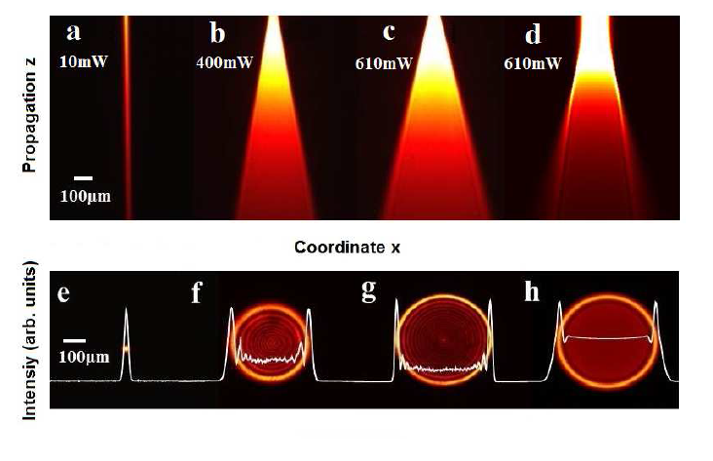
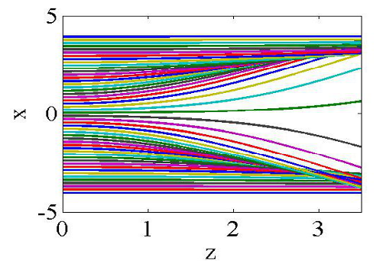
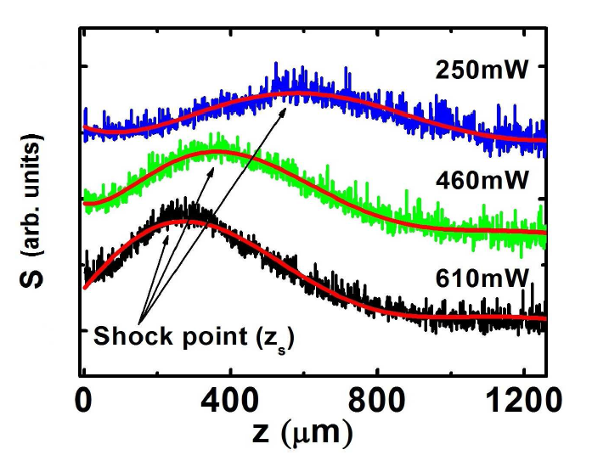
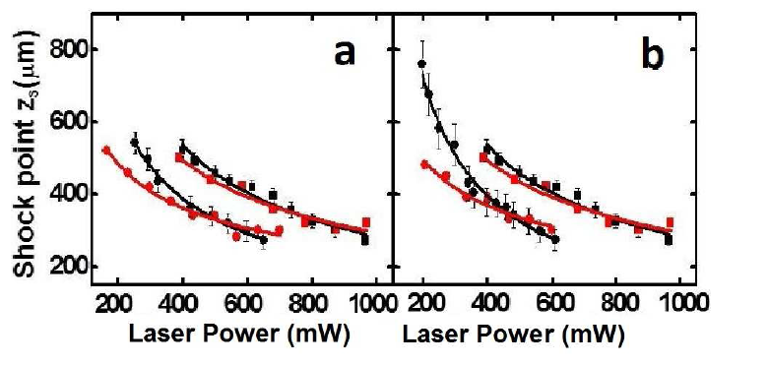
Characteristic lines Method & Shock Point
N. Ghofraniha, S. Gentilini, V. Folli, E. DelRe, and C. Conti PRL 109, 243902, 2012
The characteristic lines method allows to predict the scaling law of the shock point
$$\frac{du}{dz}=0$$
$$u_{z}+uu_{x}=0$$
$$\frac{dx}{dz}=u$$
The Hydrodynamical regime is only valid before the shock point
Notes:
The Hopf equation can be solved through the characteristic line method which tranform the equation in a couple of coupled equaitons in which we can see the derivative of the velocity depends by the velocity itself. The Hopf equation supports a singular solution, the the point at which the derivative of the velocity goes to infinite is defined as the shock point. The position and velocity of the occurrance of this point che be predicted from this method. In this study for example has been reported the variation of posision of the shock point as a function of hte beam input power.
However, sfortunately the hydrodynamic regime is only valid before the shock point.
(fact by exploiting the characteristic method, the Hopf equation can be transformed into the motion equation of a particle in potential barrier, where the particles are the photons and the potential is the refractive index change induced by the impinging light beam.
On the right side we see the results of a simulation set performed starting with hundreds of particles with an initial position uniformely distributed over a certain interval, after a certain propagation distance we see the trajectories of the particles collide in a point that correspond to the shock point. )

Slide 8
Challenge! the description of shock waves beyond the shock point

Slide 9
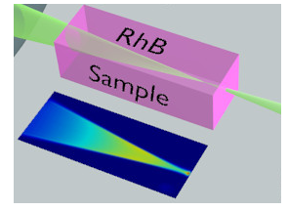
Nonlocal NLS Equation
$$i\frac{∂ψ}{∂z}+\frac{1}{2}\frac{∂^{2}ψ}{∂x^{2}}−PK(x){∗\left|ψ\left(x\right)\right|}^{2}ψ=0$$
Highly Nonlocal Approximation
$$i\frac{∂ψ}{∂z}+\frac{1}{2}\frac{∂^{2}ψ}{∂x^{2}}−Pκ(x)ψ=0$$
$$κ(x)≈K(x){∗\left|ψ\left(x\right)\right|}^{2}$$
$$κ\left(x\right)≈κ_{0}^{2}−\frac{1}{2}κ_{2}^{2}x^{2}$$
Snyder, A. W. & Mitchell, D. J. Accessible Solitons,
Science 276, 1538–1541, 1997
Sample
Linear Schrödinger Equation for Nonlinear Propagation
$$i\frac{∂ψ}{∂z}=\hat{H}ψ$$
$$\hat{H}=\frac{1}{2}{\hat{p}}^{2}+V(x)$$
$$\hat{p}=−i∂_{x}$$
Beam
Δn(x,y)
$$V\left(x\right)=Pκ\left(x\right)$$
Notes:
Let’s consider the NLS in a nonlocal medium. This situation can be seen as an optical beam propagating in a medium. If the perturbative refractive index is much larger than the beam dimention we can make the Highly nonlocal appoximation. In this way the convolution product can be written as a function k(x), with this taylor expantion. So the NLS becomes a linear equation which has the same form of the linear schroedinger equation of QM with this hamiltonian (cinetic + potential).

Slide 10
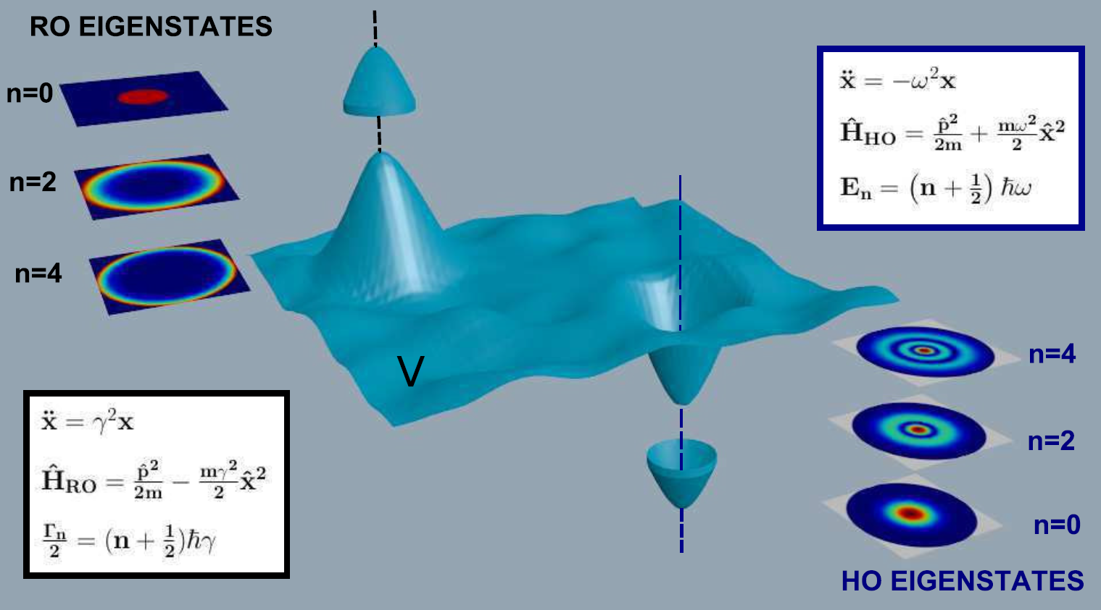
Reversed Harmonic Oscillator
Physical realization of the Glauber quantum oscillator,
S. Gentilini, M.C. Braidotti, G. Marcucci, E. DelRe, Claudio Conti, submitted
Reversed Harmonic Oscillator
$$\hat{H}=\frac{1}{2}{\hat{p}}^{2}−\frac{1}{2}γ^{2}x^{2}$$
$$γ^{2}=Pκ_{2}^{2}$$
Ampliﬁers, Attenuators, and Schrödinger’s Cat, Annals of the New York Academy of Sciences 480, 336–372, 1986
Glauber
Bohm, A. R. Time Asymmetric Quantum
Physics Phys.Rev. A 60, 861–876, 1999
A. Bohm
Irriversible Quantum Mechanics
Notes:
This hamiltonian is the one of a reversed harmonic oscillator.

Slide 11
From HO to RO
Complex extension
At any eigenstate of the HO we can associate two solutions of the RO
$$x→\sqrt{∓i}x$$
$${\hat{H}}_{ho}=\frac{1}{2}{\hat{p}}^{2}+\frac{1}{2}ω^{2}x^{2}$$
$${\hat{H}}_{ro}=\frac{1}{2}{\hat{p}}^{2}−\frac{1}{2}γ^{2}x^{2}$$
$$φ_{0}\left(x\right)=e^{−x^{2}}$$
Ground state of the Harmonic oscillator
$$𝔣_{0}^{±}\left(x\right)=e^{∓ix^{2}}$$
Analytical prolongation
$${E_{0}→E}_{0}^{±}=±iE_{0}$$
Eigenvalues of the RO with complex energy !
Gamow vector Ground state (shock front) NOT NORMALIZABLE!!!!
Notes:
This system can be deduced from an HO making an analitical prolongation. Substituting x in this way wa can tranform the hamiltornian and the eigenstates and eigenvalues of a HO into that of a RHO. It’s important to notice that in this way the eigenfunction of this system ar not normalizable so does not belong to the Hilbert space of standard QM. These unnormalizable states are called gamow vecotrs.

Slide 12
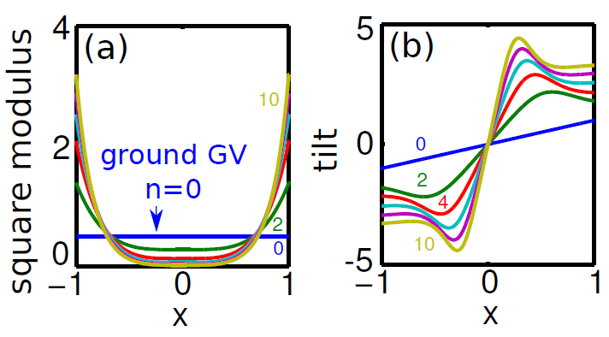
Gamow Vectors
RO eigenfunctions
$$f_{n}^{±}\left(x\right)=\frac{\sqrt[4]{±iγ}}{\sqrt{2^{n}n!\sqrt{π}}}H_{n}(\sqrt{±iγ}x)e^{∓i\frac{γ}{2}x^{2}}$$
Fig.: (Color online) (a) GV ${|f_{n}^{−}(x)|}^{2}$ for increasing even order n; (b) $∂_{x}arg⁡[f_{n}^{−}(x)]$ for increasing even order;
GVs are numerable generalized eigenvectors of $\hat{H}$ with complex eigenvalues. They exist in the Rigged Hilbert space (RHS), where they furnish a generalized basis for normalizable wavepackets:
Quantized decay rate!
$$ψ^{G}(x,z)=\sum_{n=0}^{∞}{φ_{n}^{G}\left(x\right){ e}^{−iE_{n}^{R}z−\frac{Γ_{n}}{2}Z}}$$
with
$$E_{n}=E_{n}^{R}−iΓ_{n}/2$$
$$Γ_{n}=γ(1+2n)$$
GV have exponential evolution.
Notes:
Here we can see the expression of the eigenstates of a RHO and in figure are reported theis square modulus and their tilt.
These GV are generalized eigenvectors of an hamiltonian H with complex eigenvalues. They belong to a rigged hilbert space where they are a generalized basis. We can see thet these states have an exponential evolution

Slide 13
Numerical Validation We compare simulation with the solution of the nonlocal Schrödinger equation (in the finite nonlocality case)

Slide 14
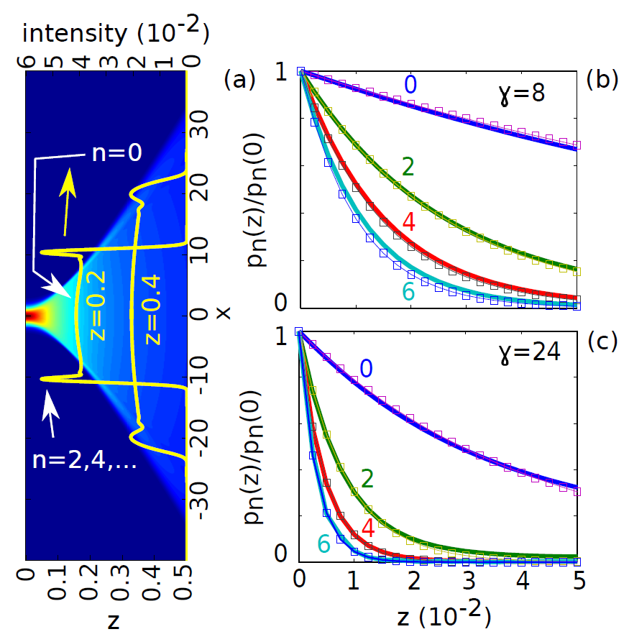
Numerical Simulation vs Theory
Propagated equation
$$i\frac{∂ψ}{∂z}+\frac{1}{2}\frac{∂^{2}ψ}{∂x^{2}}−PK(x){∗\left|ψ\left(x\right)\right|}^{2}ψ=0$$
Gaussian wave packet
$$ψ(x,0)=\frac{e^{−x^{2}/2}}{\sqrt[4]{π}}$$
$$p_{n}\left(z\right)=Γ_{n}{|\left\langle f_{n}^{+} | ψ(x,0)\right\rangle |}^{2}e^{−Γ_{n}z}$$
The evolution AFTER the shock point is described by the superposition of Gamow vectors!!!

Slide 15
Experimental Results

Slide 16
Experimental Set-Up
A. Schematics of experimental setup to obtain transmitted and top flourescence images of DSWs excited by focusing a cw laser in aqueous solution of Rhodamine B; B. Top fluorescence image of the propagating laser at P=380mW; C. Numerical solution; D. Section of experimental intensity profile at different z; E. The same of panel (D) obtained from numerical profile in (C).
Notes:
We realized an experimental setup into two different configurations in order to access either the intensity profiles along the propagation direction and to the angular spreading of the transmitted intensity from the exit face of the holder cell.
In order to obtain the propagation measurements we focused a CW laser beam within the sample cell and we directly visualized the propagating profiles by collecting the top fluorescence emission by a microscope placed above the sample top surface. The images were collected by a CCD camera.

Slide 17
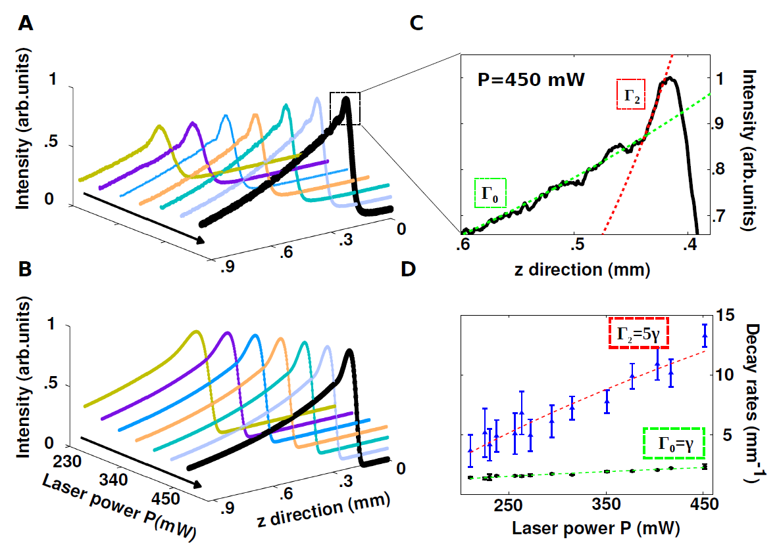
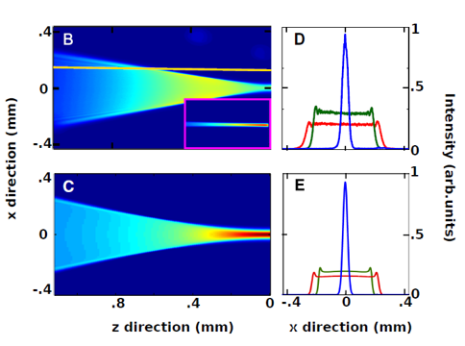
Decay Rates
Experimental evidence of the quantization of decay times !!!!

Slide 18
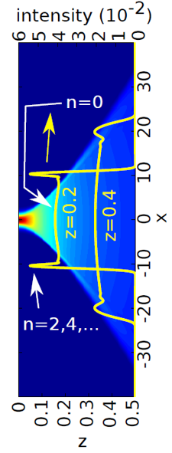
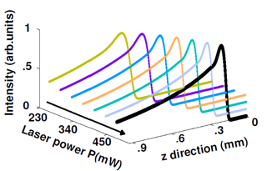
Conclusions
www.complexlight.org
VANGUARD
Grant 664782
Nonlinear Gamow vector describe shock waves at any z
The quantized decay rates are observed in the experiments and depends on power
Applications
Control of extreme nonlinear regimes (supercontinuum generation)
Analogies of fundamental physical theories
[1] S. Gentilini, M.C. Braidotti, G. Marcucci, E. Del Re and C. Conti, “Nonlinear Gamow vactors, shock waves and irreversibility in optically nonlocal media”, Phys. Rev. A 92, 023801 – Published 3 August 2015
[2] S. Gentilini, M.C. Braidotti, G. Marcucci, E. Del Re and C. Conti, “Physical realization of the Glauber quantum oscillator", submitted;

