Slide 1




Il progetto HOPE e l’indagine SSQ sugli aspetti che ispirano i giovani a studiare fisica
Marisa Michelini, Lorenzo Santi, Alberto Stefanel, Stefano Vercellati
Research Unit in Physics Education, University of Udine, Italy
Geshe Pospiech, Technical University of Dresden Germay
marisa.michelini@uniud.it, alberto.stefanel@uniud.it, lorenzo.santi@uniud.it,
gesche.pospiech@tu-dresden.de
University of Udine

Slide 2
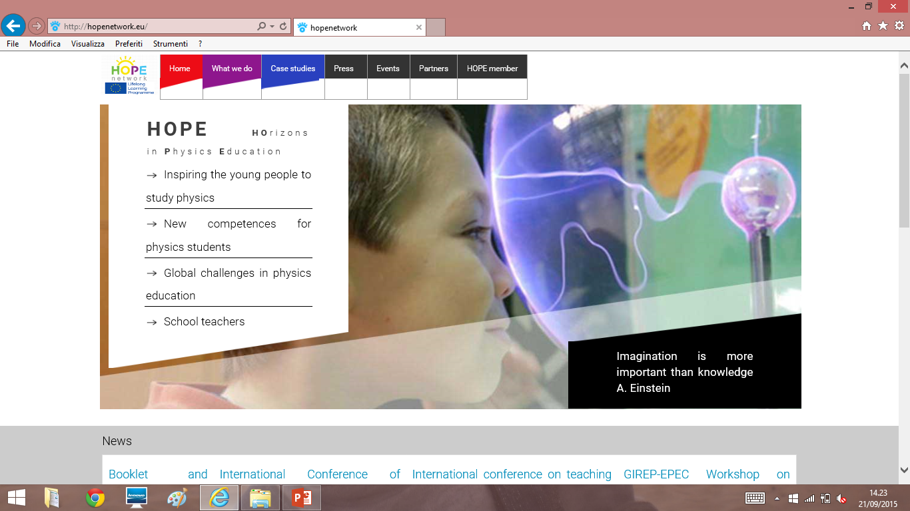
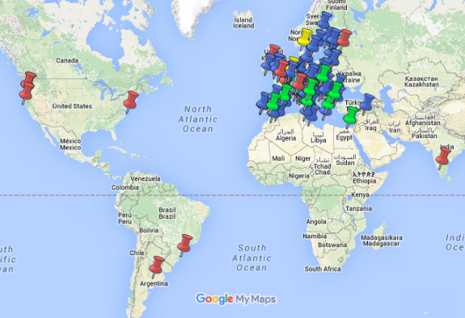
Il progetto HOPE coinvolge
nel triennio 2013-2016
fisici di 71 Università in Europa per:
Studio dei fattori che ispirano i giovani a studiare fisica (WG1)
Nuove competenze per i laureati in fisica e l'imprenditorialità (WG2)
Miglioramento della didattica della fisica universitaria in prospettiva globale (WG3)
Come i dipartimenti di fisica possono sostenere la formazione degli insegnanti (WG4)
http://hopenetwork.eu/

Slide 3
Si discutono qui:
dati preliminari relativi alle risposte date da studenti italiani e tedeschi al questionario per studenti di scuola secondaria (SSQ)
sviluppato nell'ambito di WG1
per indagare i fattori interni ed esterni che ispirano giovani studenti di talento di scuola secondaria superiore a studiare fisica.

Slide 4
MILESTONES OF THE WORK DONE BY HOPE-SSQ Group
Jan, 2014 – Hope Warsaw meeting: SSQ proposal by WG1-Subgroup D
Preparation of SS-Q1 and 1st pilot study in UniUD (57 good students)
Preparation of SS-Q2 and 2nd pilot study in UniUD (29 talent students)
Sept, 2014 – Hope Helsinki Forum: Presentation of pilot studies
Preparation of SS-Q3 - Final version of SSQ
January 2015: Distribution of SSQ to WG1 partners to create a SSQ Community among voluntary partners participants to SSQ inquiry
April, 2015: SSQ – Community individuated - Meeting (Erasmus meeting) in UniUD of TUD and UniUD to discuss data analysis
April-June, 2015 – preliminary analysis of a limited sample (Masterclass in UniUD+TUD – 118-108 students) of only Sections A and C to learn how organize data analysis
July, 2015 - Presentation of SSQ pre-analysis in GIREP-EPEC Conference and Sept, 2015 – Hope Coimbra meeting

Slide 5
SSQ questionnaire characteristics
( 3rd version after two preliminar versions and administrations)
SSQ - organized in 4 parts:
Evaluation of the interest in physics in several dimensions (following Krapp) (5 level Likert scale)
Open questions concerning factors influencing the choice of a career as well content-related aspects as social aspects such as the image of a physicist
factors inspiring young people to study physics (Hope-QA – 5 level Likert scale)
Information about the student (gender, age, type of school, intension of study)
Data collection is supposed to take place in special events for talented students in physics.

Slide 6
SSQ Community
( July 2015 – will be defined at the end of October 2015)
Partners participating: 13 partners + 3 associated partners
Countries involved: 14
Events of data collection: 68 (expected 72)
N of questionnaires filled in: 809 (expected 1000)
People interested in participating to data analysis: 16
Local pre-analysis of events done: 19/68
The samples in the different countries appear to be not too different as concern event of collection (Full immersion; educ lab; Olimpia), but very different in size.

Slide 7
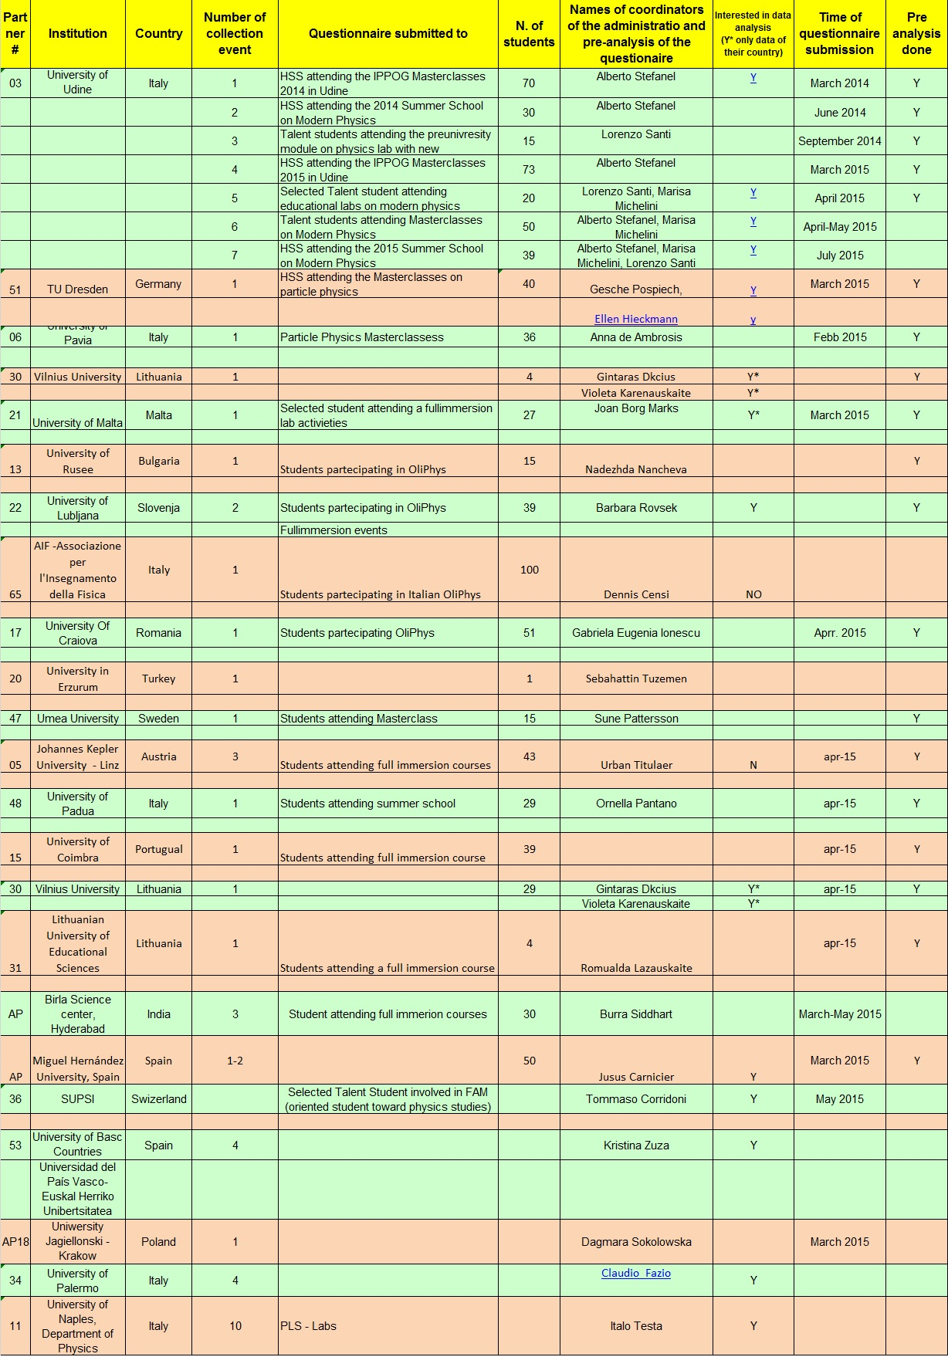
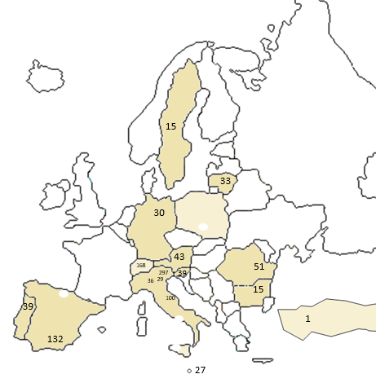
THE SAMPLE
India 30

Slide 8
Analisi dati e risultati preliminari
Pilot studies by means of SSQ1 and SSQ2
Preliminar analysis of Masterclass TUD-UniUD – section A&C

Slide 9
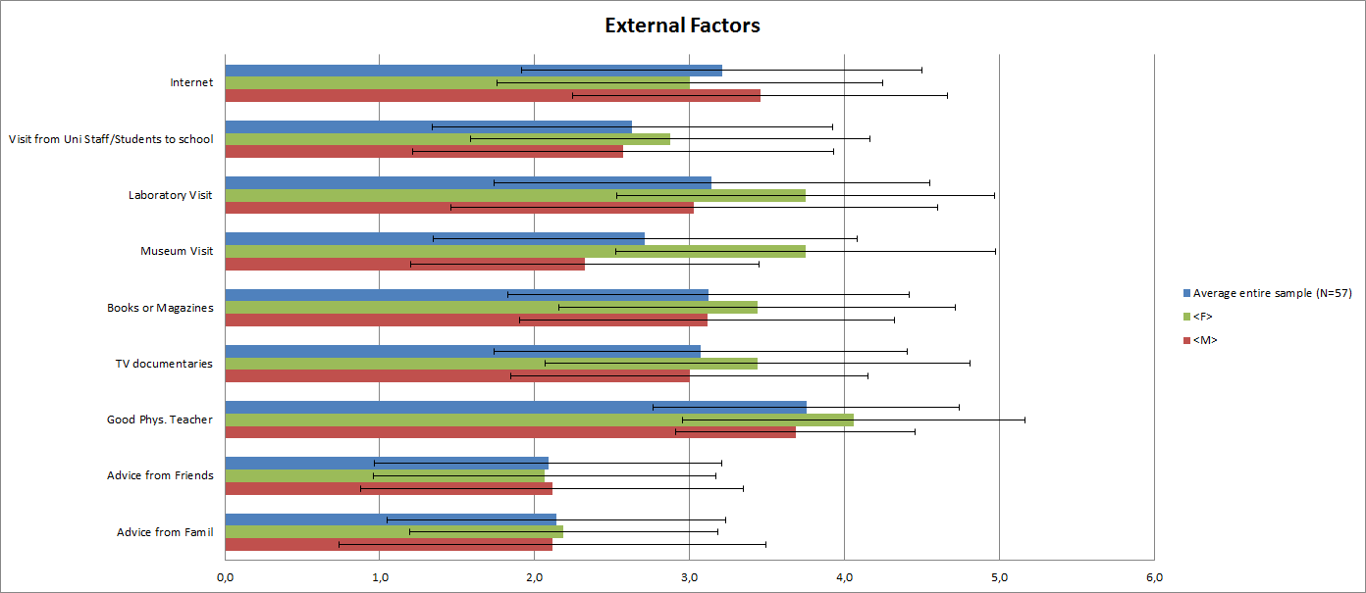
1st preliminar study (march ’14)
N= 57 (34 m, 15 f) students attending the IPPOG Masterclasses Udine
schools of Udine, Pordenone, Venezia, Bolzano, Trento. 17-19 y
External factors motivating to study physics
The different factors have equivalent importance with the exception of Advices from friends and family, which appear very little influence.
The importance of the teacher of physics is the factor most quoted in this section (mean 3.8)
No statistical differences in male and female
Schraw, et al 2001; Su Swarat 2008; LAVONEN J., BYMAN R., JUUTI K. 2005, Trumper 2006; SADLER et al 2012)

Slide 10
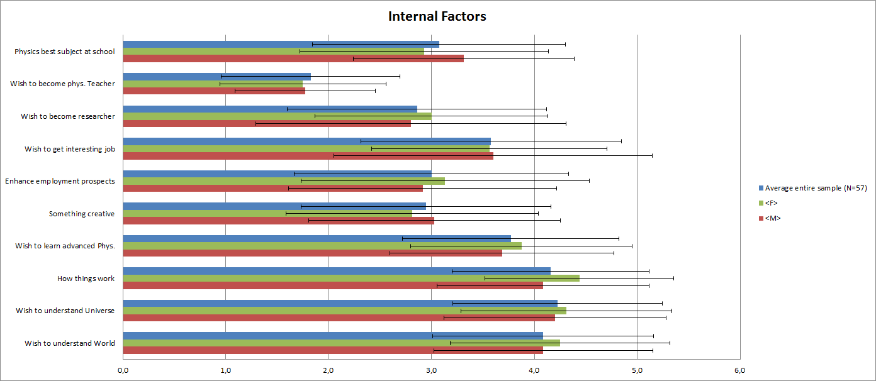
1st preliminar study (march ’14)
Internal factors motivating to study physics
The main factors (4) are:
to understand the world, the universe,
how things work, the advanced physics.
Minimum score: the perspective to become a physics teacher
No difference in male and female

Slide 11
1st preliminar study (march ’14)
OPEN QUESTION
The most important factor that triggered interest in physics
Almost half took personal reasons (17/37) related to:
  Personal interest (8/17) for physics in general and understanding how universe works
  Curiosity (5/17): personal, on how things work, understanding the universe (all male)
  Willingness to learn (2/17); Passion (1/17); Predisposition (1/17);
Other 4/37 students (all male) quoted: knowledge of specific content (relativity) (1/4), importance or application of physics (2/4), the beauty of natural order (1/4)
About one-fifth of the sample indicated school factors (7/37), focusing on:
  Role of the teacher in physics (4/7)
  The study of physics at school (2/7)
  Guidance activities made ​​at school (1/7).
The remaining students (9/37) quoted:
  visits to laboratories (4/7) (all female)
  stimuli of family and friends (3/7) (all female)
  sources of information (2/7) [two students, included in interest category, quoted sources also].

Slide 12
1st preliminar study (march ’14)
Some indications:
Open questions: a rich overview on important factors; make explicit differences in the sample (otherwise quite similar)
Male-female differences (i.e. age of the choice; importance of sources of information)
Need for more insight on role of school activities

Slide 13
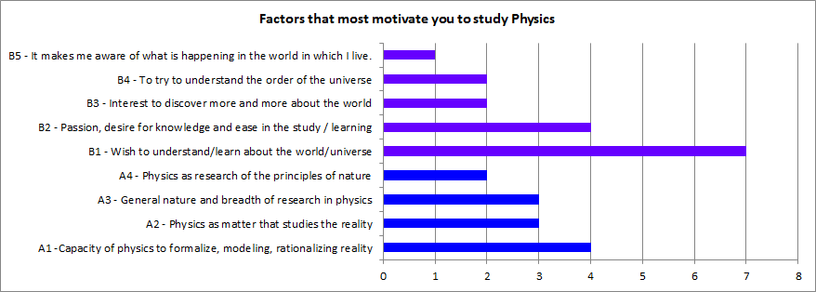
2nd preliminar study (July ’14 – Summer school- 29 students- all Italy)
Part A: You've chosen a school of excellence in Physics
A1. What are the factors that most motivate you to study Physics
personal aspects that physics is able to satisfy
aspects that characterize the physics as a discipline.
Aspect characterizing physics emerge
B4 - “The curiosity to know the laws of nature and the order of the universe”
B3 - “The curiosity to discover more about the world and the search for answers to morrow still unanswered about the world”
B1 - “Trying to understand the phenomena as they occur in nature and therefore the laws that regulate them”
A3 - “The very general nature of his research”
A1 - "The ability to rationalize and model the reality that surrounds me”

Slide 14
2nd preliminar study (July ’14 – Summer school- 29 students- all Italy)
A3. I like physics because (explain)
The 28 who responded, with no significant differences between males and females, have indicated reasons in three main areas:
the features of the physics as a discipline (22/28 )
A1) "Can you explain the basic principles of the universe” (10/22)
A2) "Study the phenomena of the real world" (5/22)
A3) "It allows me to acquire proper tools to analyze the reality“ (4/22)
A4) “It is a discipline both practical and theoretical “ (2/22)
A5) “It consists in the application of mathematical logic by formulas (1/22)
B) personal aspects which gives the physical response (5/28);
B1) It Fulfill my desire to know and it is a noble source of progress (3/5)
B2) I am fascinated by the mechanism of nature (2/5)
C) the social role of physics (1/28 – “It suits my natural aptitudes: it is an example of knowledge in the service of the common good”)

Slide 15
2nd preliminar study (July ’14 – Summer school- 29 students- all Italy)
A4. I like to study Physics at school for the following reason
28 students who responded to the question
4 - inadequacy of school-physics ("The physics studied in school is not enough depth“)
21 indicate one aspect that like to study physics at school, 3 indicate both.
A) Physics as subject-matter (10/21)
A1) I can closer to the world of physics, and learn about the world (6/10)
A2) It gives the instruments used to face modern physics (2/10)
A3) is based on the scientific method and not on a type mnemonic (2/10)
B) the characteristic aspects of physics teaching in their experience (11/21)
B1) interaction with teacher (4/11 – Explanations, Answers to questions)
B2) interaction by peers (3/11)
B3) possibility to make experiments (2/11)
B4) Positive school perfomances (3/11)
[1 student quoted 2 aspects]

Slide 16
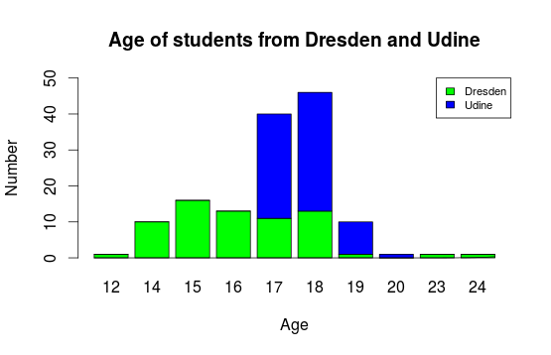
Participants
PRELIMINAR DATA ANALYSIS
(presented at GIREP-EPEC Conf. Wrozlaw July 2015 – Coimbra HOPE annual forum sept 2015)
Indicated: all participants
Included in results:
Only students 16 y or older
68 from Udine (37f, 31m)
40 from Dresden (10f, 30 m)

Slide 17
Research questions for preliminar data analysis
RQ1) Does the group of students with positive attitude towards physics show a special pattern of interest?
RQ2) Do they accept for themselves the role model of physicists?
RQ3) Which aspects of physics or doing physics have contributed to their choice?
Methods for data analysis
Item analysis
Cluster analysis
Factors analysis
Qualitative analysis of answers of students decide to study physisc

Slide 18
Factors of interest
Factor 1: (K) Knowledge about physics research and the work of physicists (self estimation)
  A5. I have some insight into the goals of physics research
Factor 2: Deep (I) interest in physics
  A8. I like to be engaged in physics in my free time
Factor 3: Attitude towards physics (L) lessons at school
  A1. I think that the physics lessons are important for the culture of the citizen

Slide 19
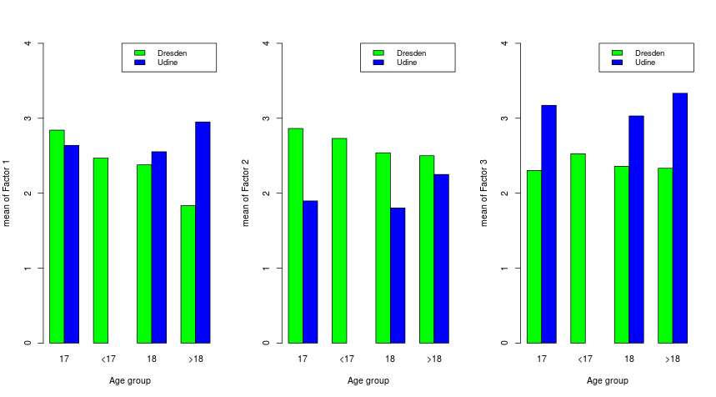
Mean of the factors, separated
Knowledge Interest Lessons

Slide 20
Influence on intention to study physics
Deep Interest
    - Highly significant correlation to positive decision (p<.001, Cramers V =.475)
Knowledge on research and physicists
  - Weakly significant correlation to positive decision (p=.03, Cramers V = .219)

Slide 21
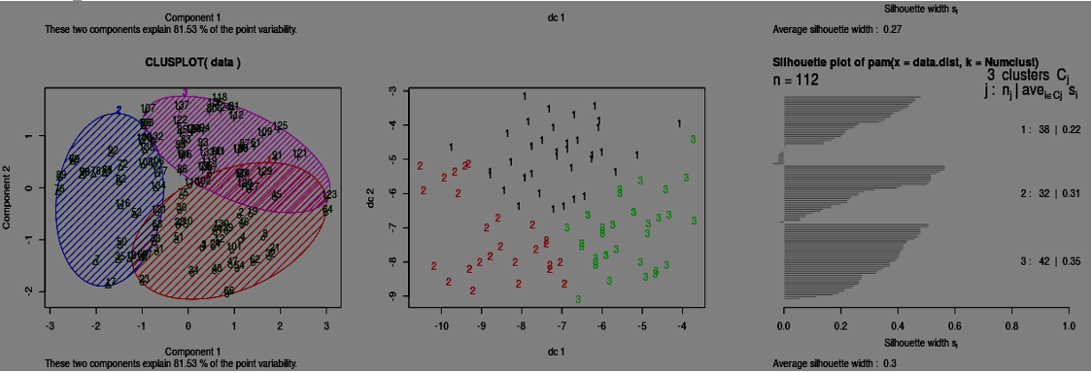
The difference between the 3 Clusters with respect to Study.Physics is significant.
The Chi-Value is 12.96592 and the p-value is: 0.001529276
Cluster analysis (3 clusters)
The differences in the means between the clusters are highly significant.
Cluster 1: ¾ D-students in cluster 1; ¾ of students in cluster 1 come from D.
In cluster 1: M > F; ∼1/2 of M and 1/5 of F are in cluster 1.
The students show positive values in all three factors (K-I-L).
Cluster 2: Most students come from U
In cluster 2: M≅F; 2/3 F are in cluster 2.
The students have very good values in all three factors (K-I-L). Half of those who do want to study physics are in Cluster 2,
Cluster 3: Nearly all students in cluster 3 come from U
In cluster 3: M≅F ; ∼1/2 F in cluster 3. The students enjoy physics lessons (L) much more than students from Cluster 1 but have least deep interest in physics (I).
Most of students in cluster 3 have decided to not study physics.

Slide 22
Qualitative questions
Traits of Physicist:
  Traits were categorized into 5 categories:
    Ability: "intelligent", "Capacity of abstraction"
    Curiosity: "curiosity", "passion for science"
    Inquiry: "search for explanation of different processes", "not to be discouraged if an experiment fails the first time."
    Mathematical mind: "logical thinking", "precision", "mathematical understanding"
    Other: "big imagination", "evaluation of statistics"

Slide 23
Qualitative questions
Reasons to learn physics more deeply at school
  emotional aspects
  personal interest
  knowledge
  scientific approach
  insights
  research
  societal role
  achievement

Slide 24
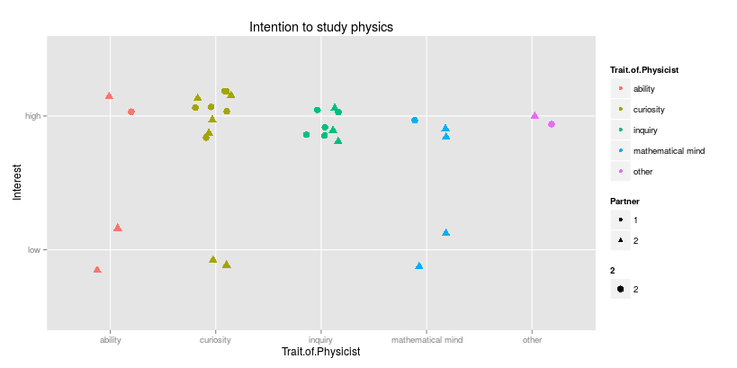
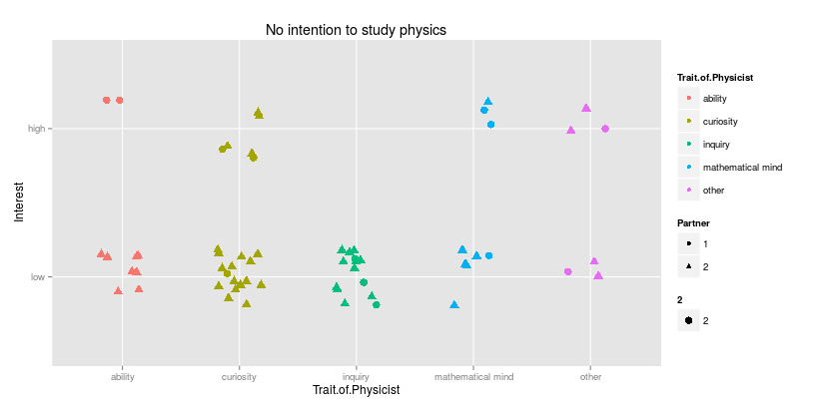
Traits and Intention of Study
Intention to study physics
  Significant correlation between Trait and Study (p=0.01, Cramers V= 0.235)
    Those students who do not want to study physics more often connect “ability” with a physicist
    Those students expressing interest to study physics more often connect “inquiry” with a physicist
interest
traits
NO intention to study physics
interest
traits

Slide 25
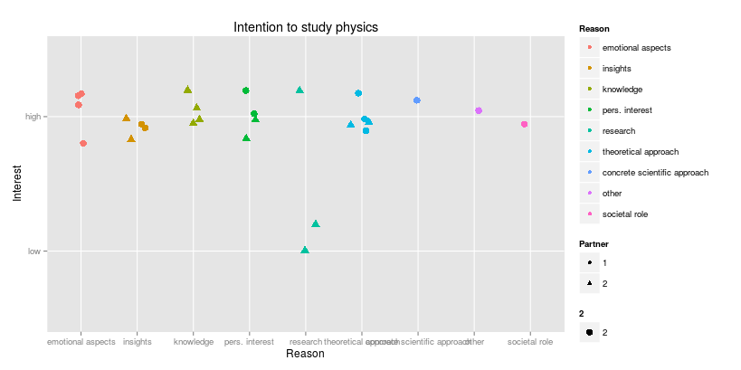
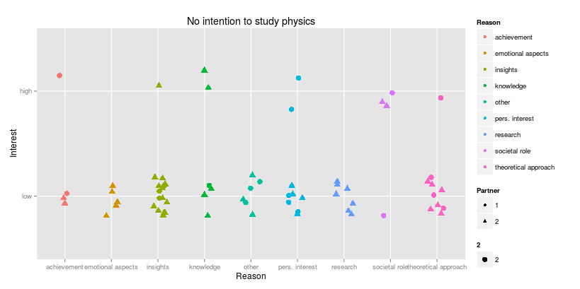
Reasons for learning physics
Intention to study physics
  Only weak correlation to intention to study physics
    Those students who want to study physics more often name “emotional aspects” and “wish for knowledge”
    Those students who are not decided to study physics more often name “concrete scientific approach” or the “societal role”
    Those students who do not want to study physics indicate especially often “achievement”, but less the “concrete scientific approach”
interest
reason
NO intention to study physics
interest
Reason

Slide 26
Research questions results
The most obvious factor for studying physics is a deep interest in physics
  Doing it in free time
  Being interested in fascinating topics like Astrophysics, dark matter, ..
The most prominent traits of a physicist are curiosity and the urge for inquiry.
A positive choice seems to be correlated with positive emotional attitude and the desire to know more deeply and understand better the world.

Slide 27
Conclusion of pre-analysis
The older the students the less decided are they to study physics
  It seems important to stabilize interest in last years of school
Physics seems to require special innate gifts
  This seems to deter students from study
Physics seems attractive mainly for mathematically thinking students
  It seems important to show the societal role and possibility of learning physics
Studying physics needs genuine deep interest, resulting in doing it in free time
  It seems important to provide adequate opportunities for students

