Slide 1




“The Experimental Activity of GAMMA”
Silvia Leoni
Università degli Studi di Milano and INFN sez. Milano
ROMA, 21-25 September 2015
GAMMA: an INFN CNS3 EXPERIMENT
Nuclear Structure with γ Spectroscopy
68 scientists (50 FTE)
6 INFN Sections (FI,LNL,MI,NA,PD,PG)

Slide 2
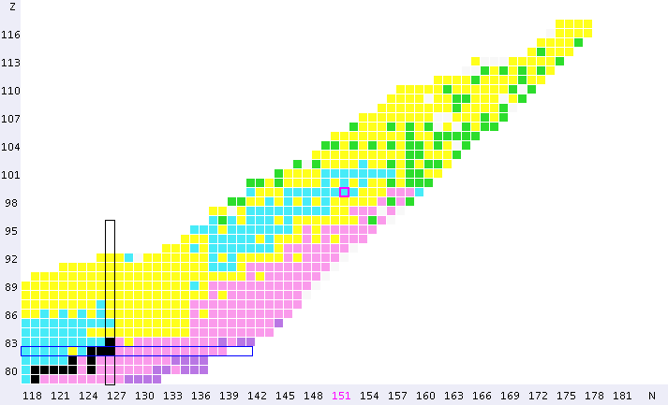
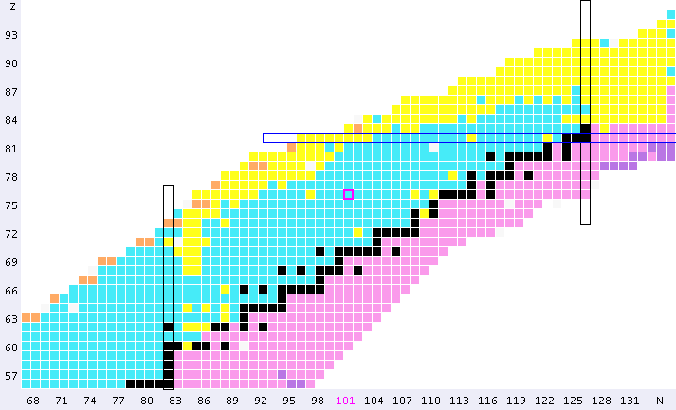
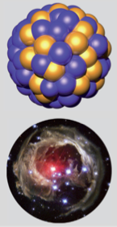
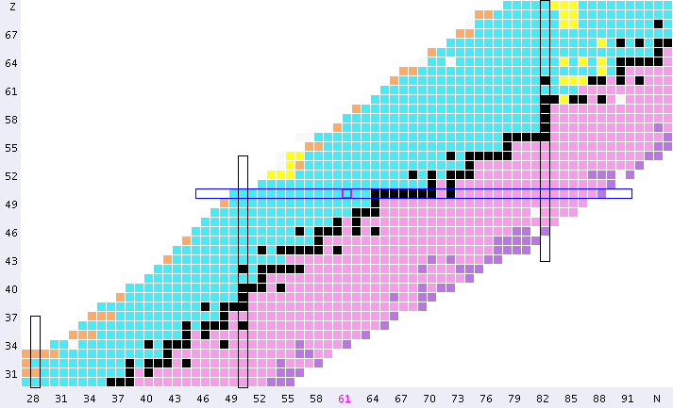
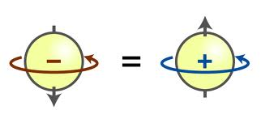
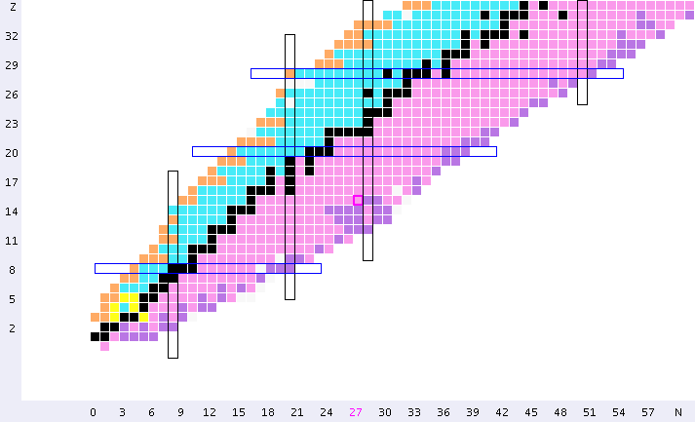
Challenges in MODERN NUCLEAR PHYSICS
Quest for a UNIFIED DESCRIPTION of ALL Nuclei
248 Stable
~3000 discovered
82
BASIC SCIENCE
126
126
Many Body Finite Quantum System
Proton number Z
n
p
Symmetry
Principle
50
82
82
28
50
50
> 6000 expected
20
8
28
2
20
Neutron number N
2
8

Slide 3
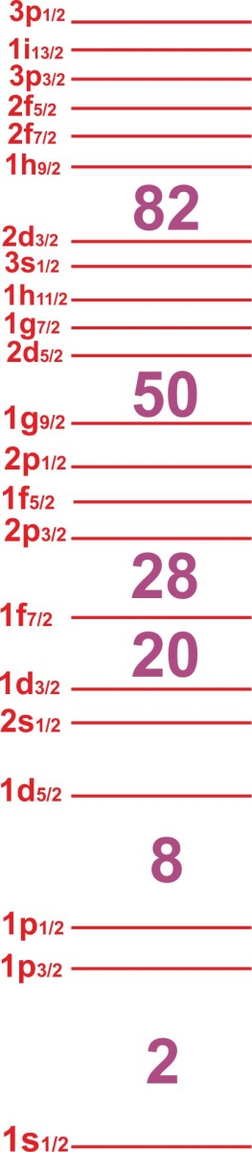
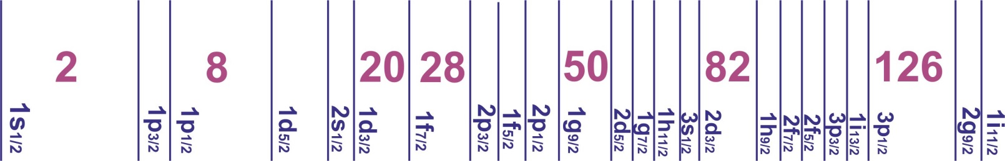
Challenges in MODERN NUCLEAR PHYSICS
Quest for a UNIFIED DESCRIPTION of ALL Nuclei
82
²⁰⁸Pb
BASIC SCIENCE
126
126
Many Body Finite Quantum System
Proton number Z
n
p
Symmetry
Principle
¹⁰⁰Sn
¹³²Sn
50
82
82
SHELL STRUCTURE
(Magic Numbers)
28
⁷⁸Ni
50
50
20
⁴⁸Ca
8
¹⁶O
28
2
20
Neutron number N
2
8

Slide 4
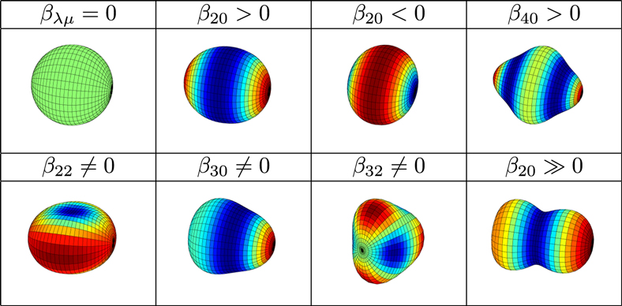
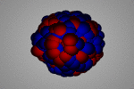
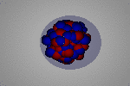
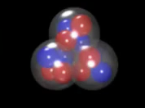
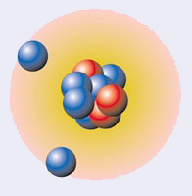
Challenges in MODERN NUCLEAR PHYSICS
Quest for a UNIFIED DESCRIPTION of ALL Nuclei
²²⁴Ra
Stable
octupole
GIANT DIPOLE
pygmy DIPOLE
N SKIN OSCILLATION
82
BASIC SCIENCE
Collective Excitations:
RESONANCES
126
126
Many Body Finite Quantum System
Proton number Z
n
p
Symmetry
Principle
50
82
82
SHELL STRUCTURE
(Magic Numbers)
28
Shape Evolution
50
50
SHAPES
20
EXCITATIONS
8
28
¹²c
2
20
Neutron number N
2
8
Clusters
¹¹Li
Halos

Slide 5
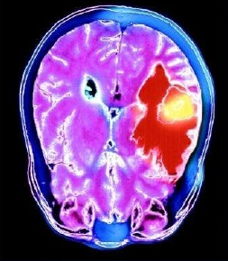
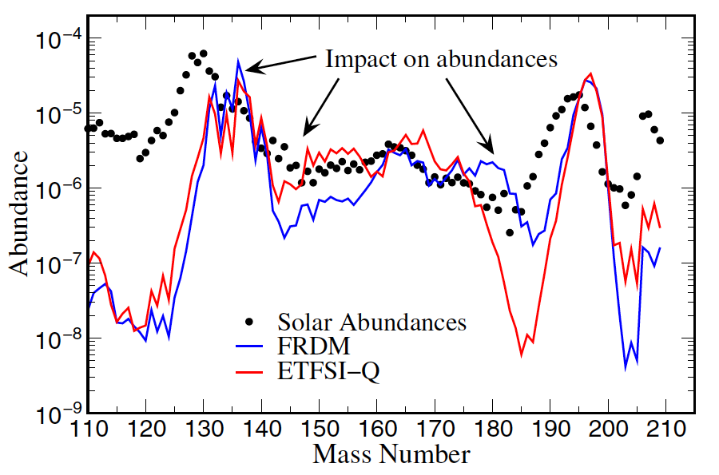
Challenges in MODERN NUCLEAR PHYSICS
Quest for a UNIFIED DESCRIPTION of ALL Nuclei
INTERDISCIPLINARITY
Astrophysics
Nucleosynthesis
C
BASIC SCIENCE
82
126
Applications
Radioisotopes,
Reactors, …
126
Many Body Finite Quantum System
Proton number Z
n
p
Symmetry
Principle
50
r-process path
82
82
SHELL STRUCTURE
(Magic Numbers)
28
50
50
SHAPES
20
Impact on abundances
EXCITATIONS
8
28
2
20
Neutron number N
2
8
Element
ABUNDANCES

Slide 6

A World Wide Effort to Expand the Nuclear Chart …
PRODUCTION: stable and radioactive ion beams, neutron beams, …
INVESTIGATION of Nuclear Structure: gamma and particle spectroscopy
TRIUMF
LNL
LNS
GANIL
GSI
ISOLDE
MSU
Argonne
RIKEN

Slide 7
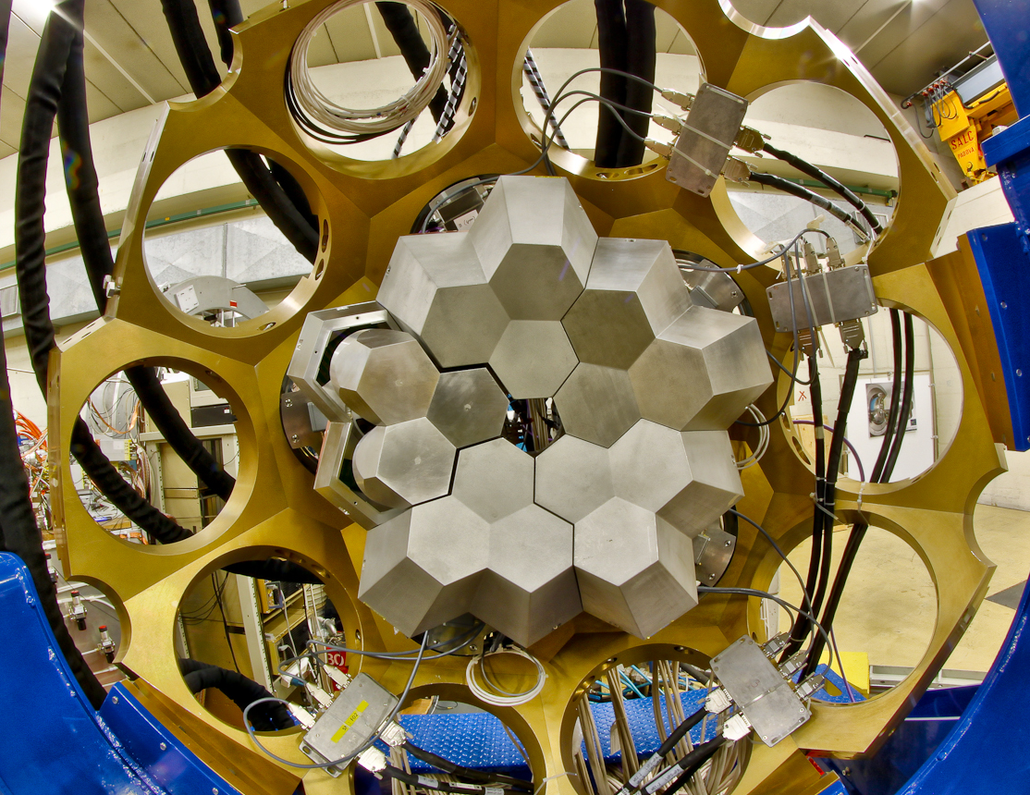
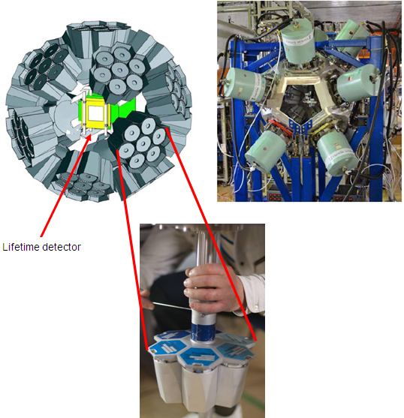
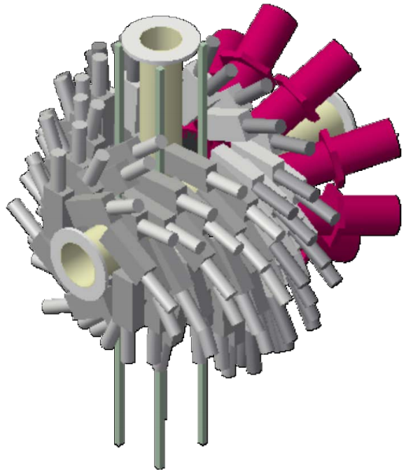



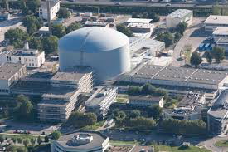

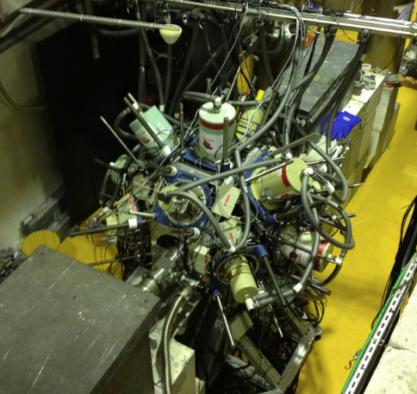
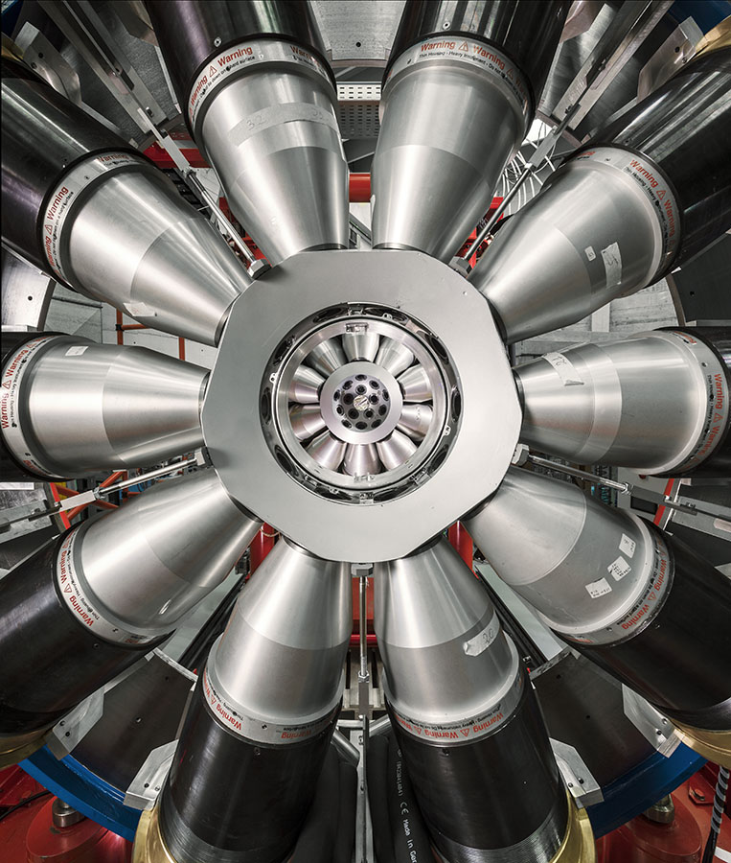

Selected Examples of Recent γ-Spectroscopy Activities
DUBNA
Oslo
JYFL
Warsaw
GANIL
GSI
Orsay
Legnaro
ILL
ISOLDE
CERN
RIKEN
Bucharest
EXILL
LNS
GALILEO Array at LNL
Working horse for

Slide 8


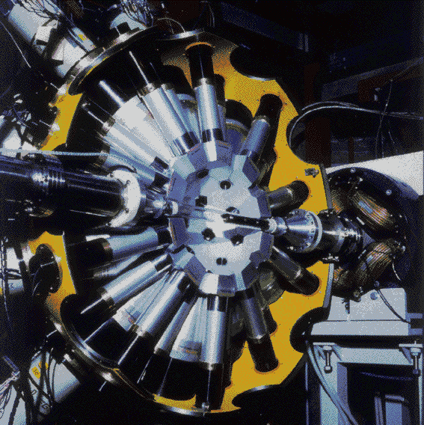
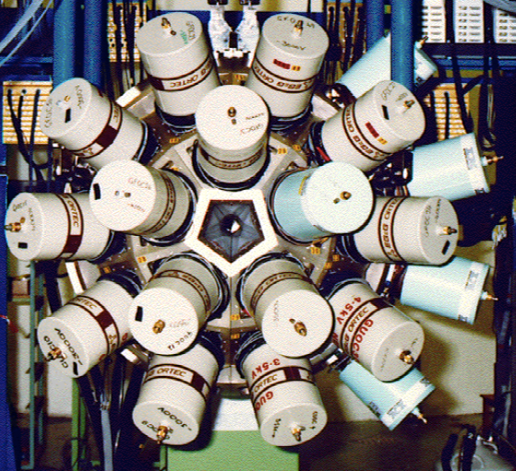
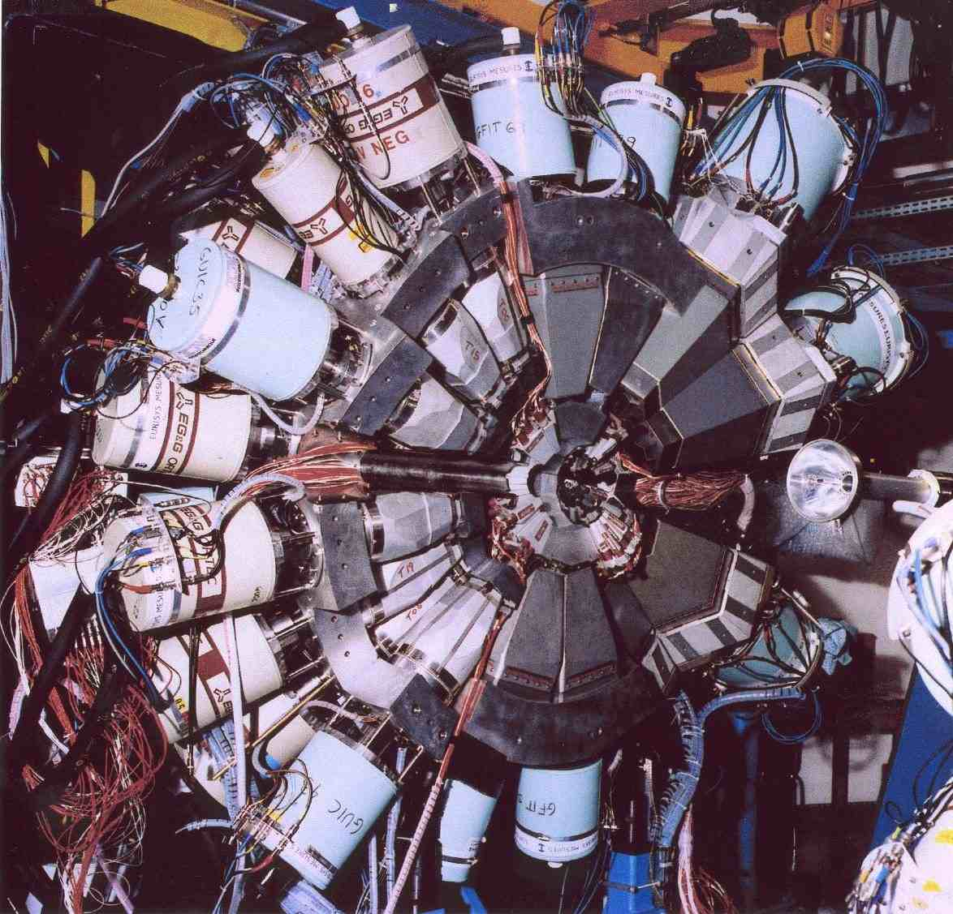
LONG TRADITION OF γ-SPECTROSCOPY
Arrays based on Compton suppressed Ge detectors
Starting from the 80’s:
TESSA (Daresbury)
OSIRIS (Berlin)
ARGONNE-ND ARRAY (Argonne)
NORDBALL (Copenhagen)
JUROSPHERE (Jyvaskyla)
EUROGAM (Strasbourg)
CLARION (Oak Ridge)
GASP (Legnaro-Padova)
EUROBALL
GAMMASPHERE
GASP
Legnaro
EUROGAM
Daresbury
EUROBALL
Legnaro, Strasbourg

Slide 9
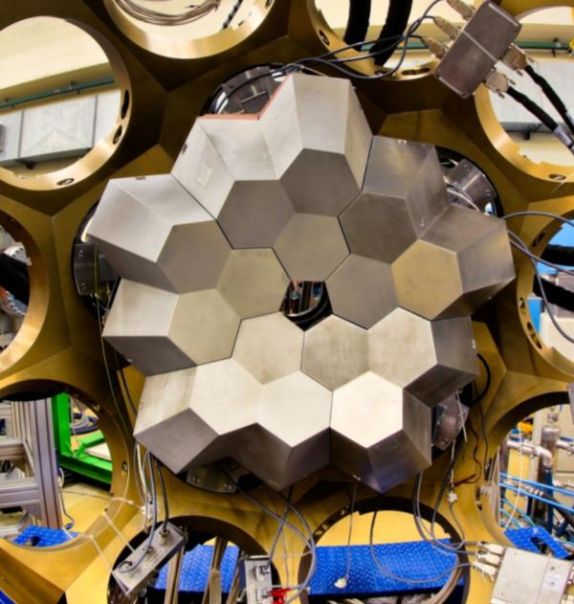
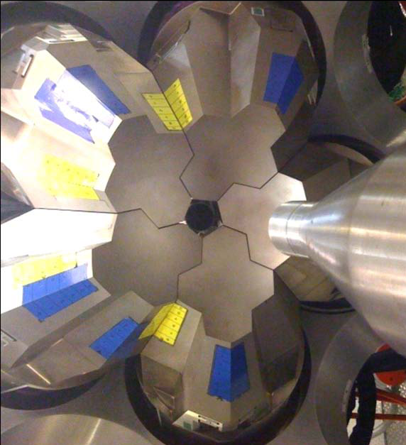
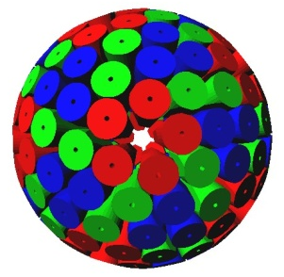
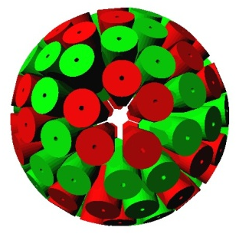
STATE of the ART Ge ARRAYS
AGATA
(Advanced-GAmma-Tracking-Array)
GRETA
(Gamma-Ray Energy Tracking Array)
LNL, 2011
LBNL, 2011
S. Akkoyun et al, NIMA 668 (2012) 26-58
S. Paschalis et al, NIMA 709 (2013) 44-55
The “Ultimate” Ge Arrays
EFFICIENCY: 43% M_{γ} = 1 and 28% Mγ = 30 (@ 1 MeV, FULL BALL)
COUNT RATE capabilities (100s KHz)
ANGULAR RESOLUTION of the γ interaction point (θ~1º)
“PERFECT” DOPPLER CORRECTION (6 keV @ 1 MeV, β=50%)

Slide 10
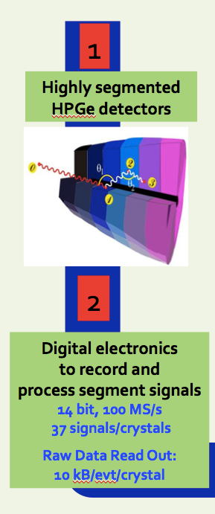
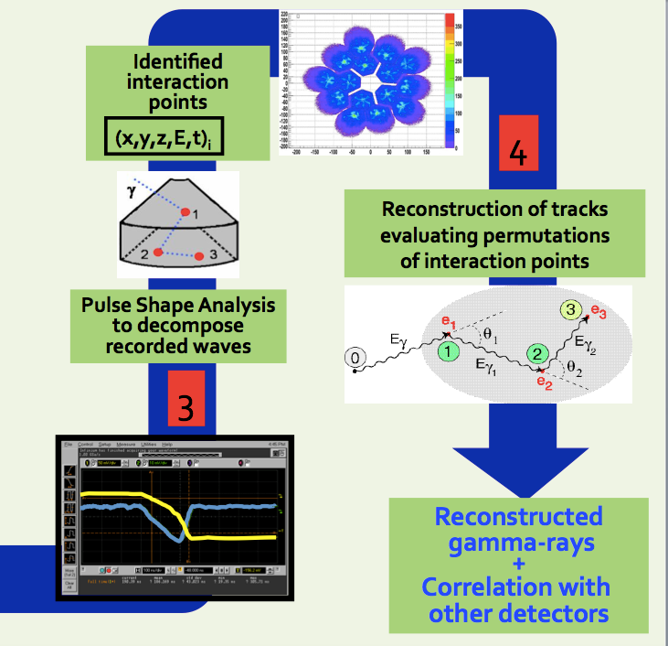
The Gamma Tracking Array Concept
HARDWARE
SOFTWARE

Slide 11
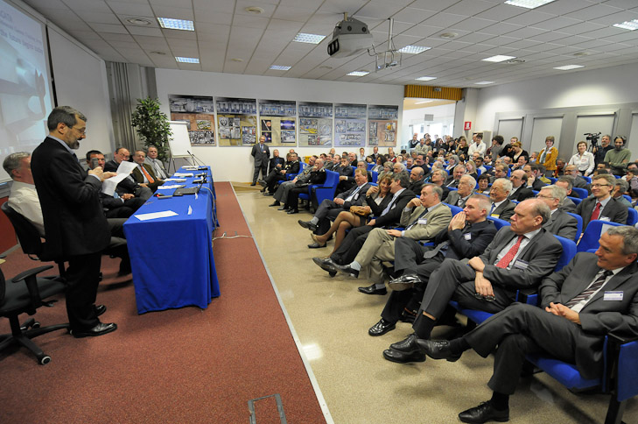
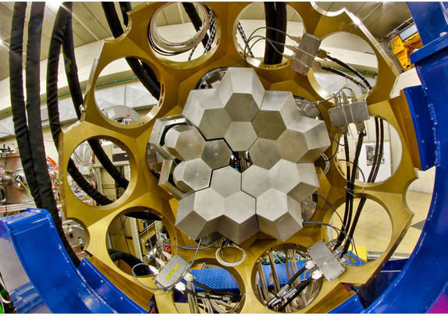
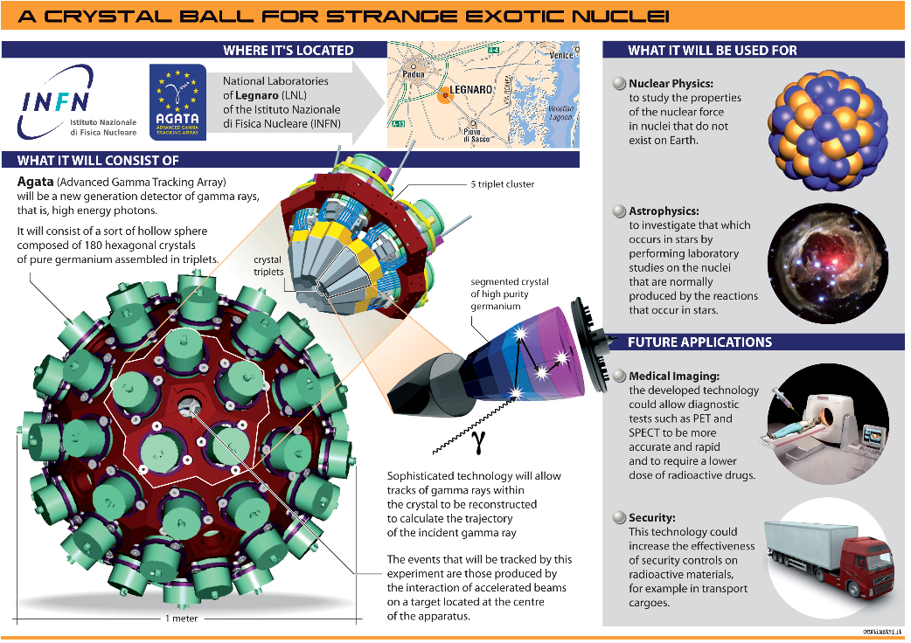
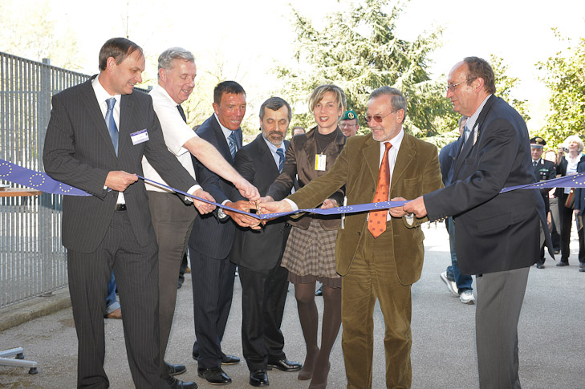
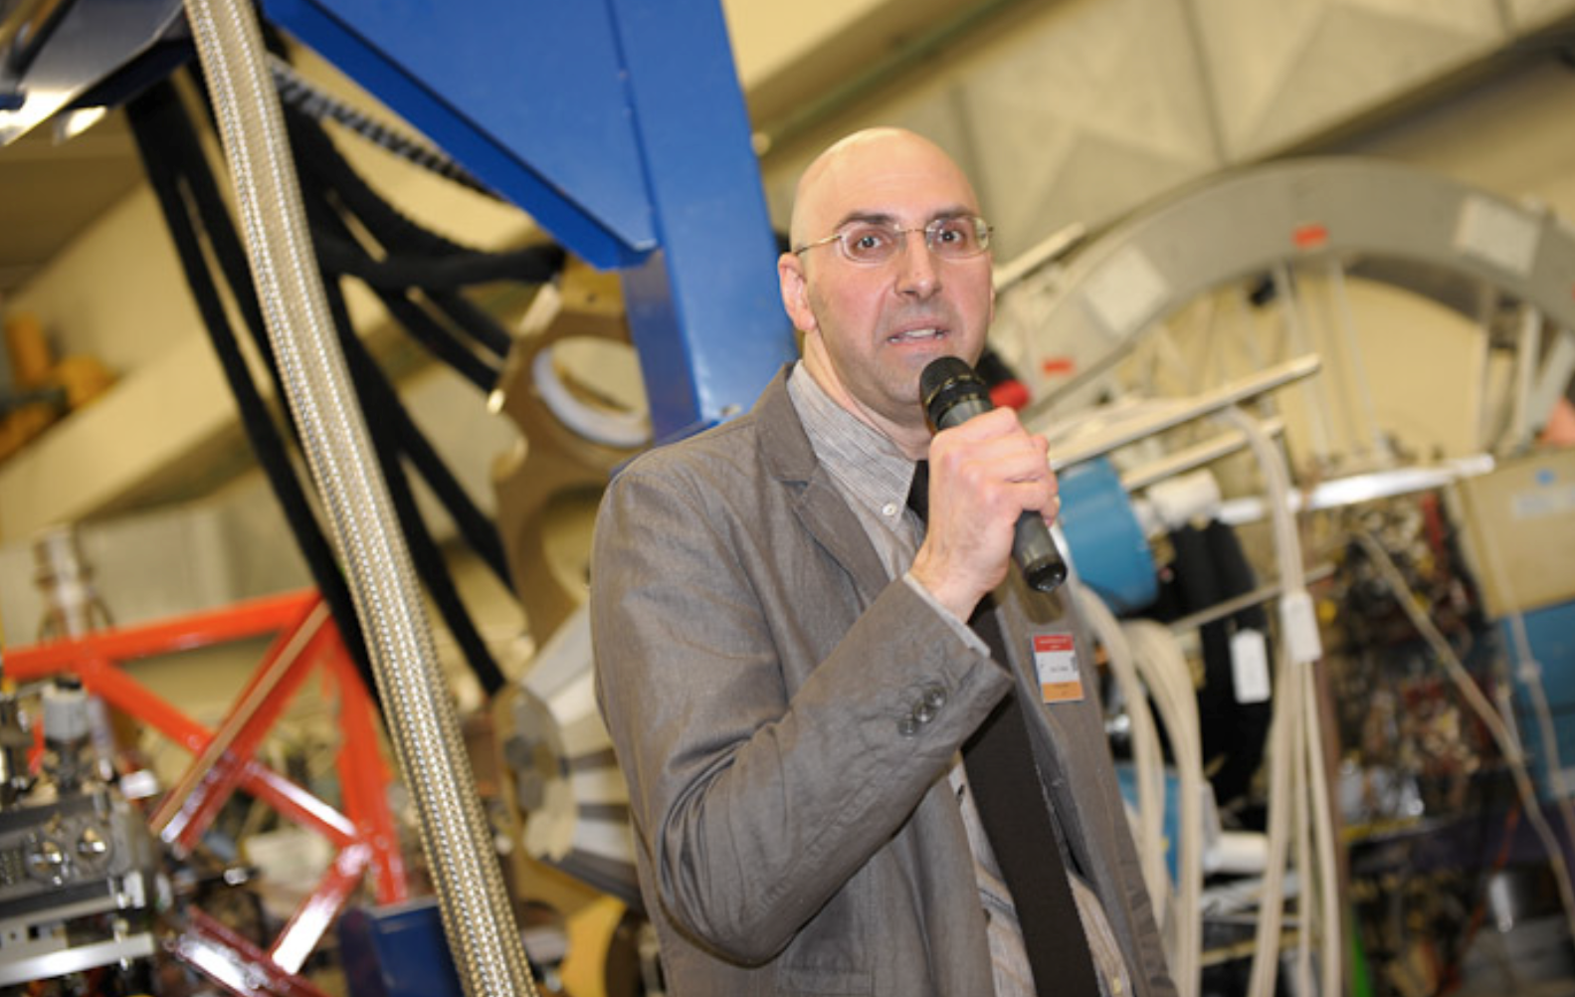
LNL: 2010-2011
15 crystals (5TC)
Total Eff. ~6%
1/12 FULL BALL
180 crystals
60 triple-cluster
Solid ang. 82%
Eff. 43% (M_{γ}=1)
P/T 58% (M_{γ}=1)
AGATA Inauguration: 9th April 2010 – Legnaro National Laboratory INFN
Enrico Farnea (1970-2013)
AGATA Project Manager@LNL

Slide 12
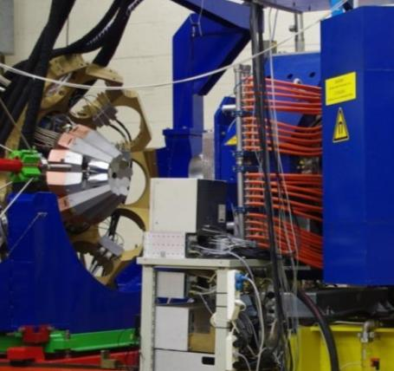
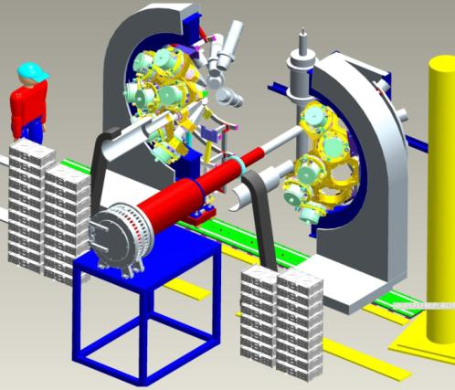
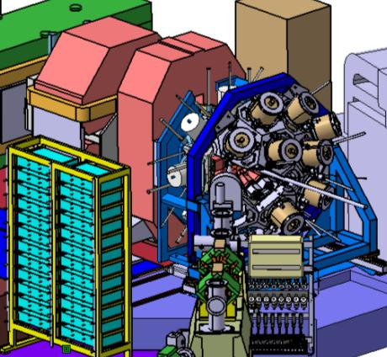
The AGATA Evolution Towards 1π
LNL: 2010-2011
15 crystals
Total Eff. ~6%
GSI: 2012-2014
22 crystals
Total Eff.~10%
GANIL: 2015-2018
up to 39 crystals Total Eff. ~15%
Demonstrator + PRISMA
“backward”
STABLE BEAMS
20 experiments
AGATA + FRS
“forward”
RELATIVISTIC
EXOTIC BEAMS
7 experiments
AGATA+VAMOS
“backward”
EXOTIC (ISOL)
& STABLE BEAMS
6 experiments in 2015
→ From 2018 at LNL at SPES (ISOL Beams)

Slide 13


HIGHLIGHTS from AGATA
LEGNARO and GSI
NUCLEAR STRUCTURE &
ASTROPHYSICS APPLICATIONS
82
126
¹⁵O
LIFETIMES
C. Michelagnoli,
C. Ur
Padua
¹⁹⁶Os
SHAPE
TRANSITIONS
P.R. John
Valiente-Dobon, …
Padua
Proton number Z
50
82
28
50
^{52,54}Fe, ¹²⁴Sn
PYGMY RESONANCES
O, Wieland, F. Crespi,
A. Bracco
Milano
20
8
28
2
20
Neutron number N
2
8

Slide 14
HIGHLIGHTS from AGATA
LEGNARO and GSI
SHAPES and DEFORMATIONS
in Heavy Systems
AGATA@LNL
Heavy-Ion
BINARY Reactions
82
126
¹⁹⁶Os
SHAPE
TRANSITIONS
P.R. John
Valiente-Dobon, …
Padua
Proton number Z
50
82
28
50
20
8
28
2
20
Neutron number N
2
8

Slide 15
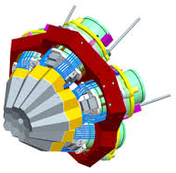
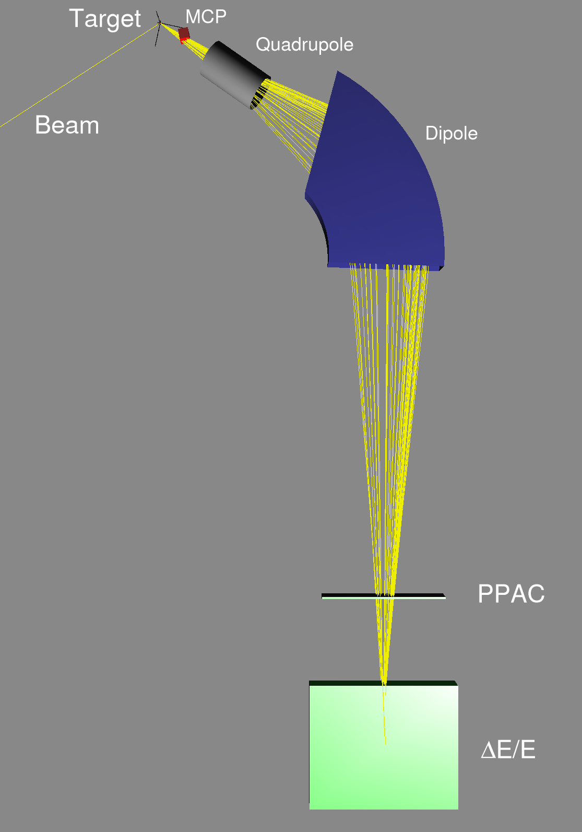
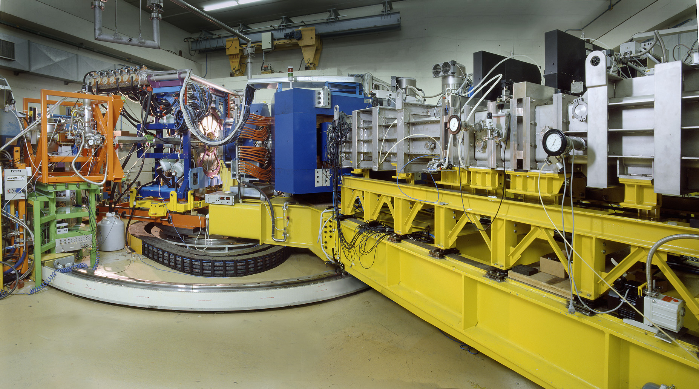
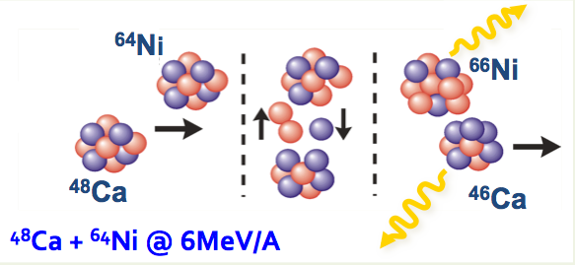
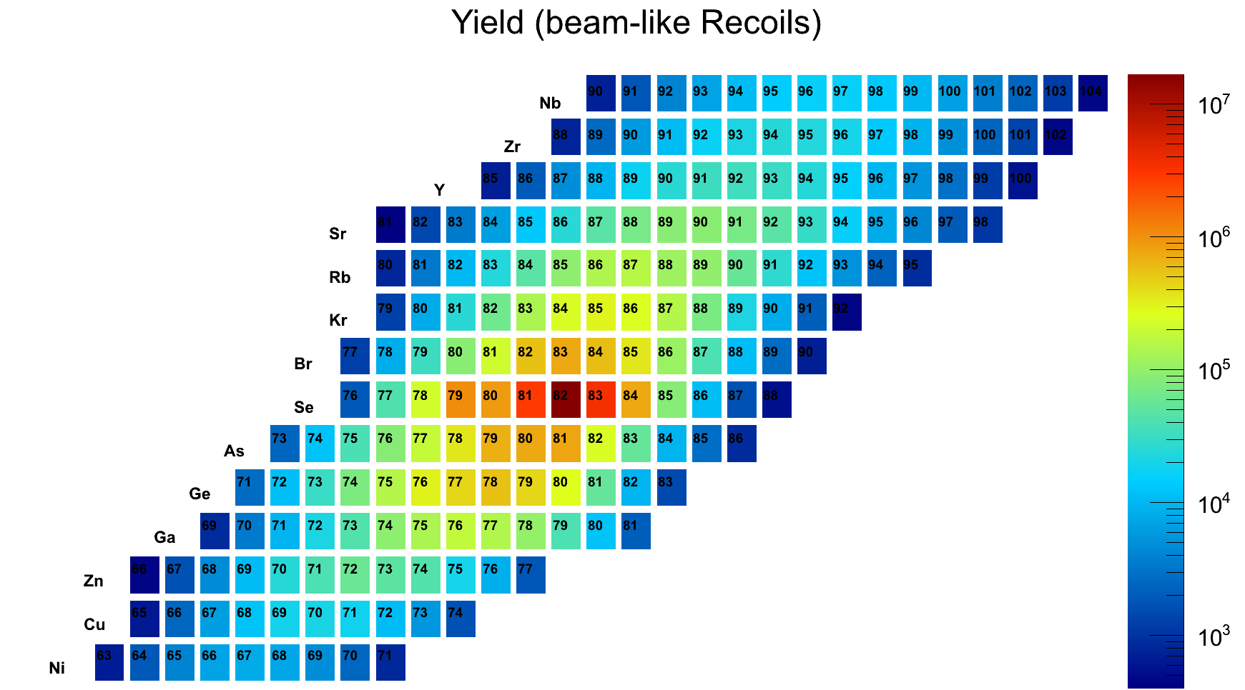
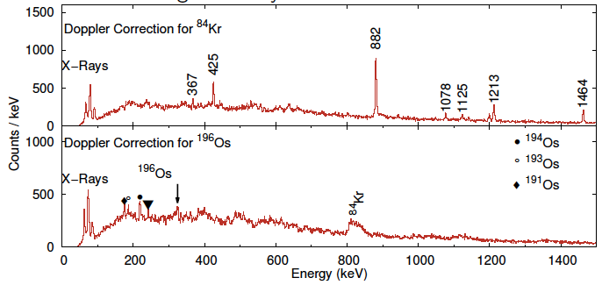
Ge Array coupled to a Magnetic Spectrometer
AGATA
Ge Array
⁸²Se (6.2 MeV/A) + ¹⁹⁸Pt
¹⁹⁸Pt
¹⁹⁶Os
Legnaro Laboratory - INFN
90
104
⁸²Se
⁸⁴Kr
Lighter Ions
(Beam-like)
FULLY
IDENTIFIED
Nb
Beam-like
Ions
PRISMA
Large acceptance Magnetic Spectrometer
84
Se
ΔΩ = 80 msr
ΔZ/Z ≈ 1/60
ΔA/A ≈ 1/190
Energy acceptance ±20%
Bρ = 1.2 Tm
⁸⁴Kr
Ni
¹⁹⁶Os
partner
63
71
Trajectory Reconstruction Ion identification
Particle – γ coincidences
Kinematic Reconstruction

Slide 16
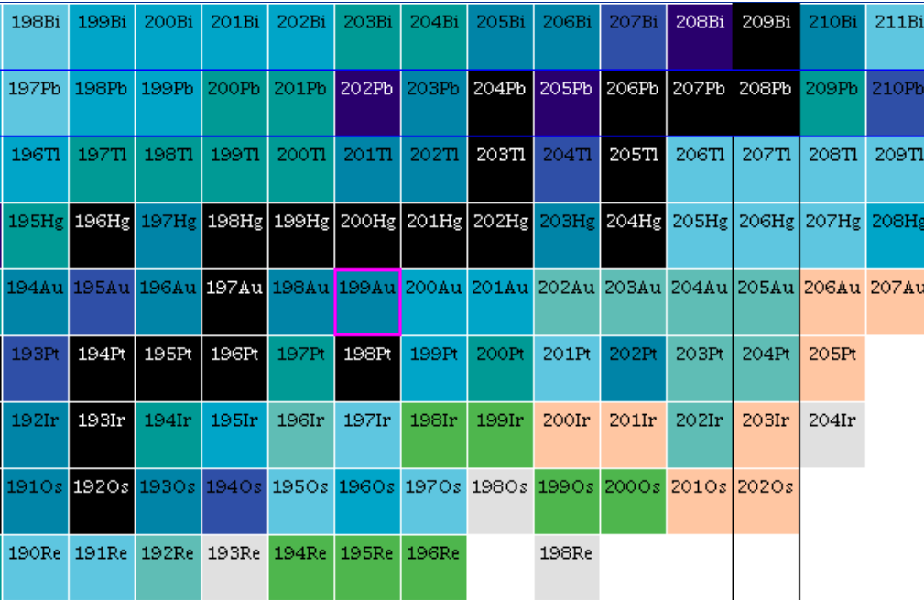


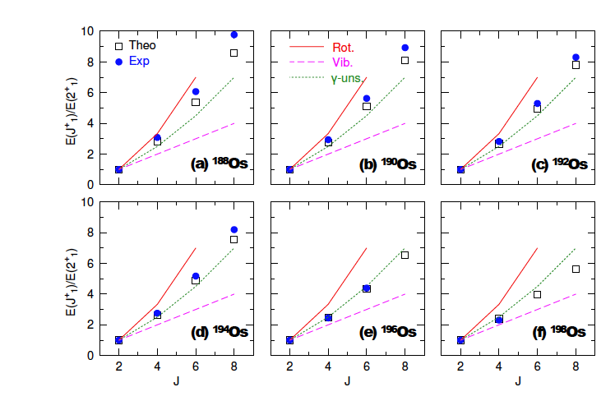
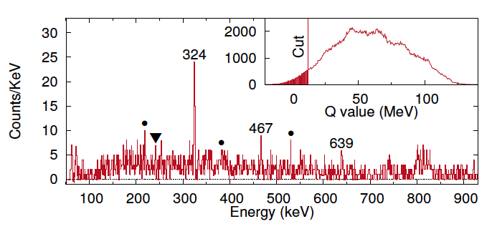
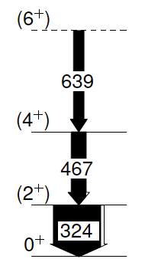
SHAPE evolution in Os
Tuning of Theory
(For Extrapolations)
South-West of ²⁰⁸Pb (r-process far out)
Z=82
²⁰⁸Pb
ISOMERS (longed-lived)
Different SHAPES
(Prolate, oblate, triaxial)
Os
192
194
?
198
State-of-the-art
beyond mean-field calculations
describe entire Os chain (A=188-198)
N=126
⁸²Se (6.2 MeV/A) + ¹⁹⁸Pt
First Observation of Excited States
¹⁹⁶Os
¹⁹⁶Os is
γ-soft
E(J⁺)
E(2⁺)
AGATA
Editor
Suggestion
P.R. John et al, PRC 90 (2014) 021301 R

Slide 17
HIGHLIGHTS from AGATA
LEGNARO and GSI
82
126
¹⁵O
C. Michelagnoli,
C. Ur
Padua
Proton number Z
50
82
LIFETIME MEASUREMENT
ASTROPHYSICS APPLICATION
28
50
20
8
28
2
20
Neutron number N
2
8

Slide 18
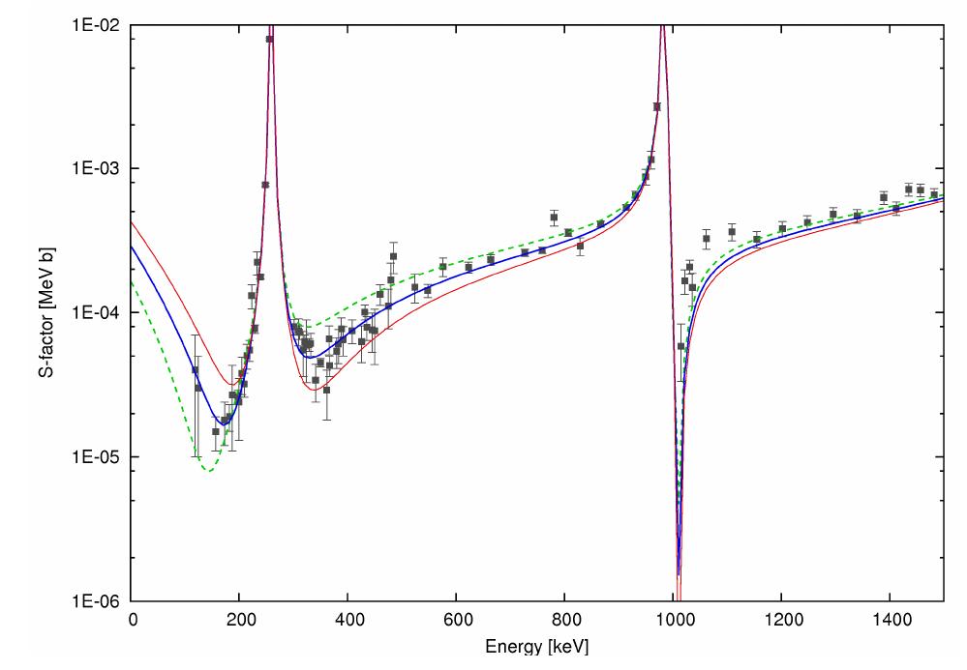
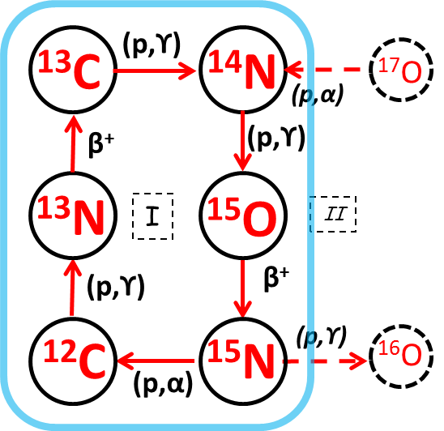

Sub-femtosecond LIFETIME measurement
Astrophysical interest
The ¹⁴N(p,γ)¹⁵O reaction:
BOTTLENECK of the Carbon-Nitrogen-Oxygen (CNO) cycle
Crucial for stellar burning rate
S-Factor (CROSS SECTION)
h/τ
J^{π}=3/2⁺
Γ₆₇₉₂=
6792 keV
E_{γ}=6792 keV
τ=0.7 fs
¹⁴N
¹⁵O
τ=0.8 fs
τ=1.1 fs
p
Γ₆₇₉₂ = /τ₆₇₉₂
dominates extrapolation of cross-section at STELLAR ENERGIES
→ need for precise τ at < 1 fs level ….

Slide 19





Doppler Shift Attenuation Method (DSAM)
γ LINE SHAPE - simulation
γ EMISSION while
slowing down in
ABSORBER
Conventional
DSAM
t [fs]
10⁻¹
1
10
10²
10³
10⁴
10⁵
AGATA
position sensitivity (θ~1º)
“CONTINUOUS”
angular measurement
DSAM at the limit
τ < 0.5 fs (99% C.L.)
Γ₆₇₉₂ > 1.32 eV
(99% C.L.)

Slide 20


¹⁴N(p,γ)¹⁵O
S factor S_{GS}(E)
for ground state capture
S_{GS}(0) > 0.05 keV b
(99% C.L.)
For the First Time a DIRECT LOWER LIMIT on the ¹⁴N(p,γ) reaction
C. Michelagnoli, PhD Thesi - Padua (Premio VILLI – CNS3 INFN) and submitted to PRL
Notes:
DA TOGLIERE ????

Slide 21
HIGHLIGHTS from AGATA
LEGNARO and GSI
PYGMY RESONACES
in STABLE and EXOTIC Nuclei
AGATA@LNL
AGATA@GSI
82
126
Proton number Z
50
82
28
50
^{52,54}Fe, ¹²⁴Sn
O. Wieland, F. Crespi,
A. Bracco
Milano
20
8
28
2
20
Neutron number N
2
8

Slide 22



The DIPOLE Response In Nuclei
Element Abundance
Relevant ENERGY window for
(γ,n) reactions in STARS
n
RESONANCES
Exp
PYGMY
with pygmy
Theory
S_{n}
Few %
GIANT
UNDERLYING Structure
(KVI and Darmstadt)
Different probes
(α,α’)
(γ,γ’)
→ Important for ASTROPHYSICS
(Nucleosynthesis, Neutron Stars )
(α,α’)
(γ,γ’)
Relevant in NUCLEAR STRUCTURE
(Microscopic Nature…)
D. Savran et al. PRL97,172502(2006)
J. Endres et al., PRL105, 212503 (2010)

Slide 23


Pygmy Resonances in STABLE NUCLEI
Heavy-Ion Inelastic Scattering: a probe sensitive to the surface
LNL Campaign
AGATA +
Si Telescopes +
Scintillators (LaBr3)
¹⁷O @ 20 MeV/A
on ²⁰⁸Pb, ¹²⁴Sn, ⁹⁰Zr, ¹⁴⁰Ce
AGATA
LaBr₃
ΔE-E
pixel
detectors

Slide 24




CONTINUOUS
Angular Ditributions
²⁰⁸Pb(¹⁷O,¹⁷O’γ)
E_{γ} = 5512 keV
E1
AGATA
E_{γ} = 4085 keV
E2
Pygmy Strength (E1) :
1-3% EWSR isoscalar E1

Slide 25

¹²⁴Sn – 3 different probes
(α,α’)
KVI
PYGMY
5< E <7 MeV
E1 Isoscalar
n skin
oscillation
(¹⁷O,¹⁷O’)
AGATA-LNL
GIANT
(γ,γ’)
Darmstadt
7< E <9 MeV
E1 Isovector
GDR Tail
F.C.L. Crespi, A. Bracco et al., PRL113 (2014) 012501
L. Pellegri, A. Bracco et al., PLB738 (2014)519
F.C.L. Crespi et al, PRC 91 (2015) 024323

Slide 26





A NEW OBSERVATION: ¹²⁴Sn – QUADRUPOLE PYGMY
Multitude of 2⁺ discrete states
¹²⁴Sn(¹⁷O,¹⁷O’γ)
AGATA
Review Paper
E1
A. Bracco, F. Crespi, E.Lanza,
Eur. Phys. J. A51 (2015) 99
E2
GQR
Concentration of E2 Strength
much below the GIANT QUADRUPOLE resonance
- In agreement with Quasi-phonon Model predictions -

Slide 27




Pygmy Resonances in EXOTIC NUCLEI
Relativistic Coulomb Excitation: high selectivity for E1 excitation
2+
GDR
Experimental
Area
Ion Source
GQR
3-20 MeV/nucleon
(8-20% c)
T.Aumann et al EPJ 26(2005)441
Up to
1 GeV/nucleon
(90% c)
GSI
2012-2014
INCOMING
identification
Ion SELECTION
OUTGOING
Identification
LYCCA
Koeln-Lund
LaBr₃
FRagment Separator
AGATA @ GSI

Slide 28


FIRST Case with RISING Setup
(2005: EUROBALL Clusters + BaF2)
PYGMY Strength:
5-9 % EWSR
⁶⁸Ni
⁶⁸Ni
⁶⁴Fe
O.Wieland, A. Bracco et al., PRL 102, 092502 (2009)
AGATA + LaBr3 Setup
Preliminary …
⁶⁴Fe
2+
Doppler
correction
v/c = 73%
8 % EWSR
R. Avigo, O.Wieland, … MILANO

Slide 29
FIRST Case with RISING Setup
(2005: EUROBALL Clusters + BaF2)
PYGMY Strength:
5-9 % EWSR
⁶⁸Ni
⁶⁸Ni
⁶⁴Fe
O.Wieland, A. Bracco et al., PRL 102, 092502 (2009)
AGATA + LaBr3 Setup
Preliminary …
⁶⁴Fe
Structures
at 6-7 MeV
Above
background
8 % EWSR
R. Avigo, O.Wieland, … MILANO
New Measurements @ RIKEN: ^{70,72}Ni, ^{52,54}Ca

Slide 30








GAMMA@RIKEN: The most Intense RIB Facility …
Pygmy Evolution
In n-Rich Nuclei
Ca
⁷⁰Zn
⁷⁶Ge
⁸⁶Kr
²³⁸U
250-350 MeV/A
up to 100 pnA
MILANO LaBr₃
ε=1-2%@ 10 MeV
Analysis
DALI₂ -NaI
ε=4%@ 10 MeV
Beam
Gamma Arrays
Particle id. plot
EURICA ARRAY
Big Rips
Ni
12 EUROBALL Clusters
(Eff 15% at 662keV)
18 LaBr3 array
(for FAST TIMING)
WAS3ABi
(Wide-range Active
Silicon Strip Stopper Array)
Co
Fe
Mn
New
Isotopes
… The most
Exotic Nuclei
⁷⁰Fe
At Final FOCAL PLANE of Big Rips
β decay and γ spectroscopy

Slide 31
Selected Examples of Recent γ-Spectroscopy Activities
DUBNA
Oslo
JYFL
Warsaw
GANIL
GSI
Orsay
Legnaro
ILL
ISOLDE
CERN
RIKEN
Bucharest
EXILL
LNS

Slide 32

The γ-spectroscopy campaign @ ILL-Reactor (Grenoble)
2012-2013: 100 days, 95% DATA taking
EXILL
Array
58 MW
World brightest
continuum
neutron source
In pile
Φ_{n} = 5×10¹⁴ n cm⁻² s⁻¹
Dedicated ballistic neutron guide
highly collimated beam (1 cm²)
cold neutrons (meV)
Φ_{n} = 2×10⁸ n cm⁻² s⁻¹

Slide 33


First time a large HPGe array (up to 52 Ge crystals)
installed around a highly collimated cold-neutron beam
SETUP 1
SETUP 2
γ – spectroscopy
lifetime measurement
10 EXOGAM – Clovers + 6 Ge GASP
6% efficiency
8 EXOGAM – Clovers + 16 LaBr3
FATIMA ARRAY
LaBr3
LaBr3
LaBr3
LaBr3
Autumn
2012
Spring
2013
15 (n,γ) and cold-neutron induced fission on ²³⁵U and ²⁴¹Pu
ACQUISITION SYSTEM
fully digital approach, TRIGGERLESS
>10 kHz/crystal, >600 kHz total, 10 ns clock
Unique opportunity for γ-coincidences over several ms time window

Slide 34


EXILL: γ-Spectroscopy Around DOUBLY MAGIC Nuclei
82
r-process path
126
50
terra incognita
82
28
50
20
8
28
2
20
2
8
VALENCE particles Interactions:
SHELL Model
COUPLINGS particles + CORE excitations:
Fragmentation of single particle strength,
damping mechanisms, hanarmonicity of vibrational spectra …

Slide 35


EXILL: γ-Spectroscopy Around DOUBLY MAGIC Nuclei
133
Neutron-induced
FISSION
n + ²³⁵U
n + ²⁴¹Pu
¹³²Sn – DOUBLE SHELL Closure away from stability
¹³³Sb: ¹³²Sn + 1 π
G. Bocchi, S. Leoni , B. Fornal, … (Milano, Krakow)

Slide 36



long-lived
microsecond isomers
132
133
130
(25/2+)
243
(21/2+)
(23/2+)
Prompt-Delayed
Coincidences
over μs time range
208
318
561
16.6 μs
16.6 μs
FEEDING of the ISOMER
up to 25/2+
Lifetimes Analysis
with Scintillators
PROBLEM:
SHELL Model Calculations
are NOT possible:
Too Large Space !!
delayed gates: 2792 and 1510
n+ ²⁴¹Pu
 | Τ_{1/2} | B(M1)
15/2+ | <20 ps | >0.3 W.u.
13/2+ | ≈30 ps | 0.004 W.u.
Not Simple
Configurations !
W. Urban et al., PRC79(2009)037304

Slide 37

The New “HYBRID” Model (G. Colò, P.F. Bortignon - Milano)
Extended Microscopic Particle-Vibration Coupling Model
FRAGMENTATION of
single-particle proton strength
COMING SOON:
¹³³Sb Off Yrast States
¹³³Sb = ¹³²Sn + 1π
NO FREE PARAMETERS
same SkX interaction in coupling matrix elements
8
7
6
5
4
3
2
1
0
S_{n}
¹³²Sn + ⁷Li →
^{135-x}Sb + α+xn
¹³²Sn CORE
Excitations
< 5.5 MeV
(phonons and
non-collective):
RPA - Skyrme X
4 MeV/A – HIE-ISOLDE
MIXED STATES
E [MeV]
17μs
Phonon Mixing
ν(f_{7/2}h⁻¹_{11/2}) ⊗ π(g_{7/2}) > 90%
⊗
Spec. Factor
0.92
0.8
π = +
Proton Single particle states
Hartree-Fock
Skyrme X
Single
Particle
states
THEORY
Tested reaction
(Cluster-Transfer)
@ REX-ISOLDE
S.Bottoni et al., PRC92(2015)024322
0.94
EXP
0.96
1/2 3/2 5/2 7/2 9/2 11/2 13/2 15/2 17/2 19/2 21/2 23/2 25/2
SPIN

Slide 38

EXILL: γ-Spectroscopy Around DOUBLY MAGIC Nuclei
lo
Neutron
CAPTURE
²⁰⁹Bi (n,γ)²¹⁰Bi
82
r-process path
Low
spins
126
50
terra incognita
82
28
50
20
8
28
210
2
20
2
8
²¹⁰Bi: ²⁰⁸Pb + 1 π + 1 ν
N. Cielicka, B. Fornal, S. Leoni, … (Milano, Krakow)

Slide 39




²⁰⁹Bi(n,γ)²¹⁰Bi ILL Grenoble
S_{n}
3081
64 primary transitions (40 new)
4605.2(1) keV
4-,5-
70 excited states (33 new)
530
674
320
320
Gate 3081 keV
Angular Correlations
Multipolarities of γ-decay
Spin (Parity) of States
530
674
3081
[chns]

Slide 40


Complete Low Spin
Spectroscopy of ²¹⁰Bi
PARTIAL
Comparison with SHELL Model
considering
²⁰⁸Pb + 1𝜋 + 1𝜈
(4+)
frozen
CORE
VALENCE
Particles
(3)
1898
3+
12 Low-Spin States
2 < E < 3 MeV
NOT described by SHELL Model
3 10⁶ y
9-
Couplings with CORE Excitations ?
E_{x}(3⁻) = 2.6 MeV, B(E3) = 34 W.u.
0-
1-
3⁻
Experiment
SHELL Model

Slide 41





GAMMA in ITALIA LNL (e LNS)
Spettroscopia γ di alta risoluzione e alta efficienza - ARRAY γ a LNL
GASP
1992 - 2012
EUROBALL
1997 - 1998
CLARA
2004 - 2008
AGATA
2009 - 2011
GALILEO
2014 - ...
AGATA
2019 - …
MIPAD 1988 - 1992
Laboratori Nazionali di Legnaro
INFN
Tandem
ALPI – PIAVE
SPES – ISOL Beams:
n-rich Nuclei by U Fission
(up to 10¹³ f/s)
reacceleration up to > 10 MeV/u
2018: first beam

Slide 42



GALILEO
The LNL Array
ε_{ph} ~ 8%
P/T ~ 50%
30 GASP HPGe (80%) @ 22.5 cm
5 5 5 5 5 5
29º 51º 59º 121º 129º 151º
30 EB cluster capsules (60%)
(10 EB clusters) @ 24 cm, 90º
4.5 %
4 %
using AGATA R&D
preamplifiers, digital sampling, preprocessing, DAQ
→ high count rates
(30–50 kHz/det)
using EXISTING DETECTORS
GASP detectors
EB cluster detectors capsules
→ high photopeak efficiency
using EXISTING DETECTORS
GASP detectors
EB cluster detectors capsules
→ high photopeak efficiency
using AGATA R&D
preamplifiers, digital sampling, preprocessing, DAQ
→ high count rates
(30–50 kHz/det)

Slide 43


ANCILLARY Detectors
  INTERNI (reaction chamber)
    EUCLIDES (GAMMAPOOL)
    PLUNGER (Kholn/LNL)
    TRACE (Padova)
    SPIDER (Firenze)
    DANTE (LNL)
  ESTERNI
    n–Wall (GAMMAPOOL)
    LaBr₃ (Milano)
    RFD (IFJ PAN Krakow)
    NEDA (LNL)
GALILEO – Activity
  COMMISSIONING: 2014/2015
  1° Experiment: July 2015
  25 HPGe + EUCLIDES + n-Wall
  5 Exp. Approved
  (PAC July 2015, 50% LNL Beam Time)
GALILEO upgrade to 60 HPGe
  10 TRIPLE Cluster @ 90°: 2016/2017
n–Wall
→ a KEY permanent SETUP for SPES

Slide 44
Conclusions
The GAMMA community studies the most fundamental aspects of
Nuclear Structure by gamma spectroscopy
(exotic nuclei, limit of nuclear existence, excitation modes…)
Strong International Collaborations
State of the art SETUP: AGATA, EXILL, MINIBALL, …
Solid National Project: GALILEO Spectrometer
** Thank You for the Attention **
GAMMA
is getting ready for SPES ….

Slide 45
GAMMA
Milano University and INFN
A. Bracco, G. Benzoni, N. Blasi, F. Camera, F. Crespi, S. Leoni, B. Million, O. Wieland,
R. Avigo, S. Bottoni, G. Bocchi, S. Ceruti, A. Giaz, R. Nicolini, L. Pellegri,
P.F. Bortignon, G.Colò, et al.
Legnaro INFN Laboratory
G. DeAngelis, D. Napoli, J.J. Valiente-Dobon, L. Corradi, E. Fioretto, A. Stefanini et al.
Padova University and INFN
D. Bazzacco, E. Farnea, S. Lenzi, S.Lunardi, D. Mengoni, G. Montagnoli, F. Recchia, F. Scarlassara, C.Ur, et al.
Firenze INFN
A. Nannini, B.Melon et al.
Camerino/Perugia University and INFN
A. Saltarelli, S. Simonucci et al.
Napoli University and INFN
E. Vardaci et al.
MAIN International Collaborations
IFJ-PAN, Krakow, Poland (A. Maj, B. Fornal et al., )
KU Leuven (R. Raabe et al., )
IFIN-HH Bucharest (N. Marginean, D. Bucurescu, C. Mihai, C. Nita et al.)
CSIC-University of Valencia (A. Gadea et al.,)
EXILL (G. DeFrance, A. Blanc, U. Koster, M. Jentschel, C. Michelagnoli, P. Mutti, G. Simpson, J.M. Regis et al. )
AGATA

Slide 46
Backup Slides

Slide 47






GAMMA in ITALIA (LNL)
Spettroscopia γ di alta risoluzione e alta efficienza
Rivelatori HPGe per raggi gamma ai LNL
GASP
1992 - 2012
EUROBALL
1997 - 1998
CLARA
2004 - 2008
AGATA
2009 - 2011
GALILEO
2014 - ...
AGATA
2019 - …
MIPAD 1988 - 1992
Spettroscopia γ di alta energia
Rivelatori scintillatori per raggi gamma (BaF₂, LaBr₃, ...)
HECTOR
1980' @ NBI
HECTOR
1990' @ LNL
HECTOR
2000' @ IRES
HECTOR
2000' @ GSI
HECTOR+
2010' @ GSI
HECTOR+
2014' @ RIKEN
Ricerca e Sviluppo
Rivelatori HPGe, scintillatori e nuovi materiali, elettronica dedicata …

Slide 48

HIGHLIGHTS from EXILL
EXILL
NUCLEAR STRUCTURE &
APPLICATIONS
82
²⁰⁹Bi(n,γ)
N.Cieplicka
B. Fornal
Krakow
126
Proton number Z
¹⁹⁴Pt(n,γ)
D. Wilmsen
U. Koester
Koeln
ILL
50
82
28
¹³³Sb: fission
G. Bocchi
S. Leoni
B. Fornal
Milano
Krakow
50
20
8
28
2
20
Neutron number N
2
8

Slide 49


¹⁹⁴Pt(n,γ)¹⁹⁵Pt
EXILL
High Spin Isomer (13/2+)
Strong population from low spin capture state
Auger
e⁻
nm
range
IDEAL Properties for Medical Application:
4 days half-life (nuclear medicine in-vivo)
IMAGING with 99 keV γ-ray and X-rays (similar to ^{99m}Tc and ²⁰¹Tl)
Conversion and Auger electron used in RADIO-CHEMOTHERAPY
Chemical similarities with cytotoxic chemotherapeutic compounds
→ Search for low-spin “doorway states” feeding the isomer

Slide 50

¹⁹⁴Pt(n,γ)¹⁹⁵Pt
EXILL
½+
Capture level
doorway
state
½+
13/2+
isomer
½-
¹⁹⁵Pt
D. Wilmsen, Master and PhD (Koeln, CEA/GANIL/ILL)
→ photoproduction (ELI like GAMMA Beam Facility ?)

Slide 51







AGATA + VAMOS @ GANIL (2014-2018)
Magnetic Spectrometer
VAMOS
dispersive mode
Commissioning
in December 2014
6 Experiments
in 2015
beam
AGATA
²³⁸U+⁹Be @ 6.6 MeV/u
⁹⁸Zr
→ 4.8 keV ←
→ 7.2 keV ←
PSA hits for 24 crystals
See A. Gottardo: Preliminary from AGATA@GANIL

Slide 52

The Experimental Campaign @ LNL
Stable Beams: A < 136, E up to 22 MeV/A

Slide 53


GSI-PRESPEC Campaign: 7 exps
GSI – FRS secondary Beams
AGATA and HECTOR
PRESPEC
LYCCA
2012-2014
Coulomb excitation of the 12+band-terminating yrast trap in ⁵²Fe
Evolution of collectivity in the ²⁰⁸Pb region
Transition rates and mirror energy differences in isobaric multiplets
Proton hole states in ¹³²Sn and N=82 shell structure
N=Z
Shape evolution in the region of the neutron-rich Zr
protons
Relativistic
M1-Coulomb excitation of ⁸⁵Br
Pygmy dipole resonance in ^{62,64}Fe and the properties of neutron skin
neutrons

Slide 54


Importance of Nuclear Deformation
for r-process
β-decay half-lives and neutron emission probabilities
are different in DEFORMED and SPHERICAL nuclei
τ_{β SPH} ~ 7 x τ_{β DEF}
P_{nSPH} ~ 0.5 x P_{nDEF}
Large uncertainty in
r-process location
difficult to extrapolate
to more exotic regions
Nuclear Structure studies are needed
P. Moller et al., Phys. Rev. C67, 055802 (2003) and ref. therein.

Slide 55


AGATA Doppler correction capabilities (β~20%)
inelastic scattering of ¹⁷O @ 20 MeV/u on ²⁰⁸Pb
Charged particles detected
in pixel ΔE-E Telescopes
No Doppler Corr.
Crystal Centers
Segment Centers
PSA+Tracking
F
¹⁶O
O
N
v/c 20%
C
dE (MeV)
B
Be
Li
a
TKE (MeV)
AGATA @ LNL
F. Crespi et al., NIMA75(2013)47

Slide 56


Extraction of Pygmy E1 Strength
Via comparisons of measured cross sections and DWBA calculations
(microscopic form factors including E1 PDR states - E.G. Lanza, E. Litvinova, …)
Transition probabilities
Cross Section
EXP. Vs. DWBA
Pygmy Strength
E1ISOSCALAR
Form Factors for DWBA

Slide 59


The DIPOLE Response In Nuclei
SURFACE MODE
Element Abundance
Relevant ENERGY window for
(γ,n) reactions in STARS
Exp
Average Transition
charge densities
with pygmy
Theory
UNDERLYING Structure
(KVI and Darmstadt)
Neutron Pressure from SKIN
Extrapolations for ²⁰⁸Pb
Different probes
(α,α’)
(γ,γ’)
(α,α’)
PDR
(γ,γ’)
D. Savran et al. PRL97,172502(2006)
J. Endres et al., PRL105, 212503 (2010)

Slide 60








Neutron Beam: dedicated collimation system (5 m)
Sequence of apertures made from High Absorbing Materials (+5 cm Pb): ¹⁰B, ⁶LiF
Φ = 2×10¹⁰ n/(cm s)
ΔΘ = 7 mrad
20 x 6 cm²
Borated plastics + ⁶LiF
5 cm Pb
1cm B₄C ceramics
5 cm Pb
On TARGET:
Collimated
Beam
Φ = 10⁸ n/(cm² s)
1 x 1 cm²

Slide 61

TARGETS: Two Dedicated Chambers
REQUIREMENTS: Optimal Conditions for γ-Spectroscopy
Minimum absorbing material for γ’s : Al pipe, Ø = 50 mm, 2mm thick
Low n-capture rate
Close positioning of detectors
²⁴¹Pu (n,f)
Electrovalve
100 μm Zr-foil, diam. 32 mm
Internal chamber
- Independent -
Vacuum gauge
External chamber
²³⁵U (n,f)
(n,γ)
Target
Target holder

Slide 62







TARGETS for (n,γ): 15 different samples
MORE than 6 orders of magnitude in variation of Capture Cross Section
²⁰⁹Bi
_{th}= 0.023 b
Metal cylinder
⁹⁵Mo
_{th} = 13.4 b
Metal foil
⁴⁶Ca(NO₃)₂
_{th}= 0.7 b
Powder/lump
¹⁹⁴Pt
_{th}= 1.1 b
Metal balls
TARGETS for FISSION: 3 different samples
Targets sandwiched between dense backings
for rapid stopping of fission fragments.
²³⁵UO₂
_{f} = 586 b
Layer sandwiched between Zr or Be backing
²⁴¹PuO₂
_{f} = 1010 b
Layer sandwiched between Be backing
Chamber in glove box
²³⁵UO₂ : 99.7% enriched (525 μg), 15 μm thick Zr backing
²³⁵UO₂ : 99.7% enriched (675 μg), 25 μm thick Be backing
²⁴¹PuO₂ : 78.6% enriched (300 μg), 25 μm thick Be backing

Slide 63



SHELL MODEL Approach
Relevance of
CORE Excitations
SHELL GAPS as
Truncation Scheme
  Complex, collective excitations dominate
  Low Lying states in DOUBLY MAGIC Nuclei
  2⁺, 3⁻,4⁺, … PHONONS
VALENCE
Nucleons
3⁻
Frozen CORE
Doubly magic nucleus
⁴He, ¹⁶O, ⁴⁰Ca,
¹³²Sn, ²⁰⁸Pb
The Structure of Nuclei with
one or two valence particles is influenced by
Particle-PHONON couplings
    LIMITATION
    Interactions among VALENCE nucleons:
    excitations restricted
    to ONE-TWO oscillator SHELL
    CORE excitations NOT fully included:
    NOT always doable, few nucleons only
Key Ingredient for:
  Quenching of Spectroscopic Factors
  Anharmonicity of vibrational spectra
  Damping of Giant Resonances, …
PHENOMENOLOGICAL models (Bohr-Mottelson)
MICROSCOPIC models (Dobaczewski, Sagawa, Colò, …)

Slide 64


¹³³Sb
    Single particle levels
    Couplings between
    particle and phonons
132
133
130
88
86
Double
SHELL CLOSURE
away from Valley
of Stability
B(Eλ)
≈7 W.u.
long-lived microsecond
isomers
limited yrast spectroscopic studies
W. Urban et al., PRC79(2009)037304

Slide 65
HYBRID Model – (G. Colò, P.F. Bortignon - Milano)
Extended Microscopic Particle-Vibration Coupling Model
6
5
4
3
2
1
0
¹³³Sb: ¹³²Sn + 1π
¹³²Sn CORE Excitations
RPA (Skyrme X)
Proton Single particle states
Hartree-Fock (Skyrme X)
E* < 5.5 MeV
2-
9+
7+
5+
8+
6+
E [MeV]
4+
3-
2+
Coupling
1/2⁺
B(Eλ)
≈7 W.u.
11/2⁻
3/2⁺
17 states
J^{π} < 11^{(+,-)}
5/2⁺
7/2⁺
0+
→ Coupling matrix elements between single particle and CORE excitations
are consistently calculated with the same SkX interaction: NO FREE PARAMETERS
Notes:
Scrivi „positive parity..” , ma dopo fai vedere anche lo stato con parita’ negativa 13/2-

Slide 66


Lifetimes Analysis from EXILL-FATIMA:
Nature of particle-CORE coupled states
(25/2+)
21/2+
(23/2+)
13/2⁺ @ 4302 keV
208
318
(19/2+)
17/2+
16.6 μs
223
75
15/2+
62
75
²³⁵U: T_{1/2} = 32(10) ps
²⁴¹Pu: T_{1/2} = 30(12) ps
162
15/2-
13/2+
4302
4297
13/2-
11/2+
1510
1505
11/2-
2792
16 ps
4192
4297
1830
2792
5/2+
962
15/2⁺ @ 4464 keV
962
²³⁵U: T_{1/2} < 17 ps
²⁴¹Pu: T_{1/2} < 21 ps
7/2+
¹³³Sb

Slide 67


Lifetime Measurements by Fast-Timing
¹⁵²Eu
⁴⁸Ti(n,γ)⁴⁹Ti
Prompt Response
Difference
Energy Dependence

Slide 68

REX-ISOLDE experiment – test of the method
Spectroscopy of n-rich ⁹⁸⁻¹⁰⁰Sr nuclei
with triton transfer reaction induced by ⁹⁸Rb on ⁷Li
Spokespersons: Bogdan Fornal and Silvia Leoni (November 2012)
⁹⁸Rb + ⁷Li ^{101-x}Sr+α+xn
98
99
100
Sr
Sr
Sr
98
Rb
Advantages:
α
n
- The very inverse kinemarics,
Doppler correction does not
require recoil detection.
⁷Li
~2º
^{A}X
^{A+1}Y
^{Z}
^{Z+1}
n
γ
- Reaction channel
uniquely associated α particle
particle emission

Slide 69
REX-ISOLDE + MINIBALL + T-REX
⁹⁸Rb(60%)+⁹⁸Sr(40%) (2.84 MeV/u) + ⁷LiF (1.5 mg/cm²)
99
Y
98
99
98
Sr
Sr
Sr
98
Rb
I_{BEAM} (⁹⁸Ru/⁹⁸Sr) ≈ 2.5 x 10⁴ pps
Counting rate:
~0.03 ev/s for α-γ
(10 k in 4 days)
Simone Bottoni, Ph.D. Thesis
Univ. of Milano and KU Leuven and
PRC92(2015)024322

Slide 70

Signature of Particle-CORE Couplings
Multiplet of States:
(CORE-Excitation) _{Iπ} ⊗ (particles)_{jπ}
⁴⁸Ca
(Z=20,N=28)
3⁻ 4.507
COLLECTIVE
CORE-Excitation
⁴⁹Ca
7/2⁺
5/2⁺
3/2⁺
4
9/2⁺
3⁻ ⊗ p_{3/2}
E [MeV]
B(E3)
6.8 ^{± 1.0} _{Wu}
3
7 _{Wu}
⁴⁸Ca
⁴⁹Ca
⁴⁹Ca
2
0
0⁺ 0.0
3/2-

Slide 71


Theoretical Description
PHENOMENOLOGICAL
Particle-phonon
WEAK coupling calculations
(Bohr & Mottelson)
MICROSCOPIC
Calculations based on
SELF-CONSISTENT Scheme
(Colò, Bortignon, Sagawa, …)
3⁻ ⊗ p_{3/2}
[λ ⊗ j₁]_{I}
RPA
⁴⁹Ca
microscopic V_{ph}
Multiplet of States 9/2⁺, 7/2⁺, 5/2⁺, 3/2⁺
Energy Shift
Hartee-Fock with V_{eff}
→ short-range correlations included
Particle-Vibration coupling on top
→ same Hamiltonian or EDF
NO approximation in the vertex
EXACT treatment of COUPLING
use of WHOLE phonon wave function
ω_{λ} , B(Eλ)
→ Exp. Values/Theory
s.p. Energies
ε(j₁), ε(j₂)
→ HF – SkX
matrix element
h(j₂,j₁,λ)
→ Bohr & Mott.
Need for More Experimental Input
G. Colò, H. Sagawa, P.F. Bortignon, PRC 82, 064307 (2010).

