Slide 1
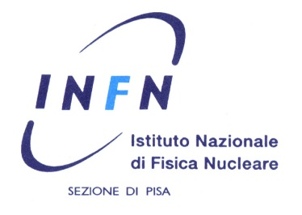
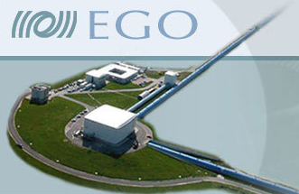
Compensazione termica dei difetti superficiali delle ottiche per interferometri di Onde Gravitazionali
A. Allocca, R. A. Day, G. Cella

Slide 2
Outline
Detecting Gravitational Waves with interferometers
The problem of mirror aberrations and the corrective thermal compensation devices for GW detectors
New idea for thermal compensation: CHRAC
Conclusions

Slide 3
Outline
Detecting Gravitational Waves with interferometers
The problem of mirror aberrations and the corrective thermal compensation devices for GW detectors
New idea for thermal compensation: CHRAC
Conclusions

Slide 4
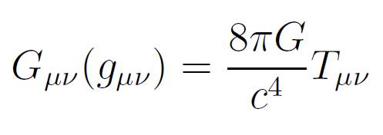
Gravitational Waves and their detection
Einstein’s Theory of General Relativity foresees the existence of Gravitational Waves
Effect of a GW on free-falling masses
y
L’
$$δL∝h L$$
x
L
z
Very weak amplitude: $h≈{10}^{−21}$
The distance between two masses separated by ~Km will change by $δL≈{10}^{−18}$m
“That is comparable to a hair’s-width change in the distance from the Sun to Alpha Centauri, its nearest star”.

Slide 5
Michelson Interferometry to detect GWs
$$δL∝h L$$
Use an interferometer as a transducer: convert displacements into optical signals
Suspended mirrors to reproduce the free-fall condition
Free-falling
masses
Enhance the signal
A differential variation of the arm lengths is revealed at the antisymmetric port of the interferometer

Slide 6
Michelson Interferometry to detect GWs
$$δL∝h L$$
Use an interferometer as a transducer: convert displacements into optical signals
Suspended mirrors to reproduce the free-fall condition
Enhance the signal
Fabry-Perot cavity for “longer arms”
Recycling mirror to recover the power reflected from the arms
Recycling mirror to enhance GW audio sidebands
Heterodyne detection to get a signal linearly proportional to the GW amplitude
$$P_{ASY}∝ P_{0}{(2 k δL)}^{2}$$

Slide 7
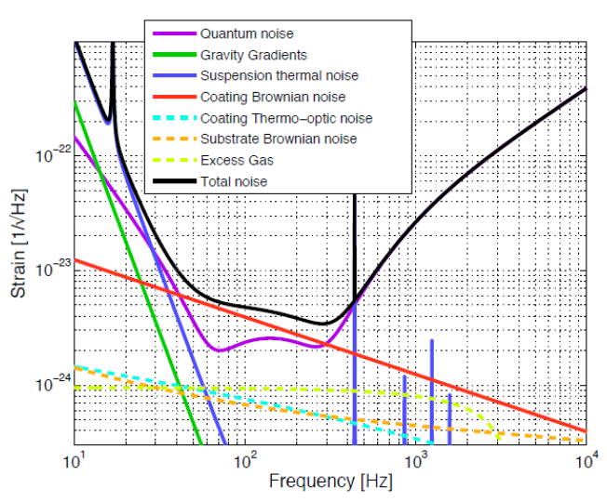
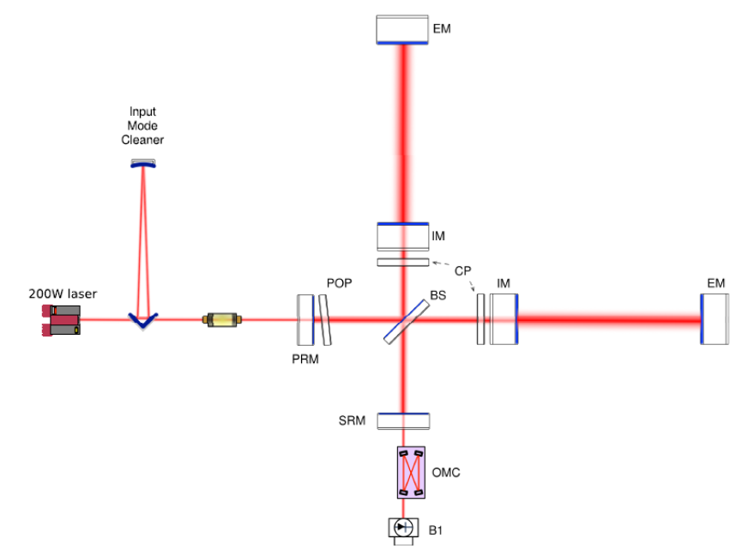
Advanced Virgo
125 W
F = 450
To reach the design sensitivity it’s necessary to limit effects preventing the perfect destructive interference between recombining beams
Interferometer working point: dark fringe condition
(destructive interference between beam recombining at the Beam Splitter)

Slide 8
Outline
Detecting Gravitational Waves with interferometers
The problem of mirror aberrations and the corrective thermal compensation devices for GW detectors
New idea for thermal compensation: CHRAC
Conclusions

Slide 9
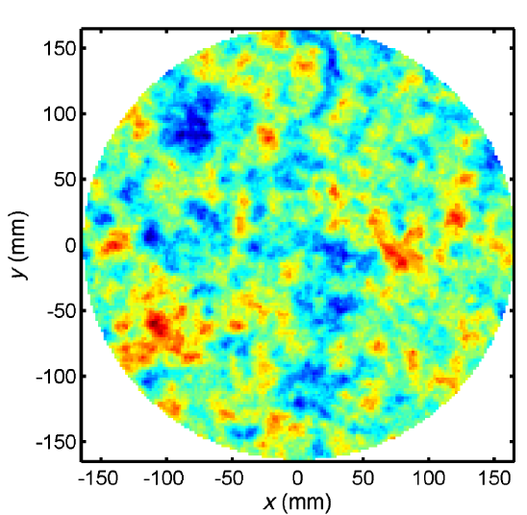
Mirror aberrations
Mirror aberrations (cold and thermal defects) can spoil the sensitivity of the interferometer
Mode mismatch – beam intensity profile and phase don’t match that of the resonator
Scattering – the cavity beam is scattered by a rough surface can bring higher order modes into resonance and produce diffuse light
Frequency splitting – modes of the same order see a different overall radius of curvature, and their resonance frequencies result to be different.
Mechanisms reducing sensitivity
Residual mirror RMS $<$0,5 nm RMS to fulfill the requirements of Advanced Virgo

Slide 10
Mirror aberrations
Mirror aberrations (cold and thermal defects) can spoil the sensitivity of the interferometer
Mode mismatch – beam intensity profile and phase don’t match that of the resonator
Scattering – the cavity beam is scattered by a rough surface can bring higher order modes into resonance and produce diffuse light
Frequency splitting – modes of the same order see a different overall radius of curvature, and their resonance frequencies result to be different.
Mechanisms reducing sensitivity
Residual mirror RMS $<$0,5 nm RMS to fulfill the requirements of Advanced Virgo

Slide 11
Scattering
At low angle ➔ can bring into resonance High Order Modes (HOMs) which could be close to the resonance
At large angle ➔ can introduce losses in the intra-cavity power and diffuse light
At intermediate angle ➔ can excite HOMs whose spatial extension is as large as the mirror size and also induce clipping losses

Slide 12
One possible solution: in-situ thermal compensation
A different mode content in the two arms prevents a perfect distructive interference between the beams recombining at the beam splitter

Slide 13
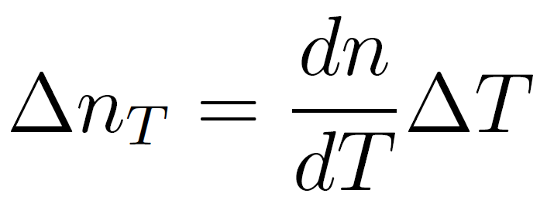
The principle of thermal compensation
Use an auxiliary heat source to induce controlled thermal effects in the optics and therefore correct the beam phase aberrations
Thermo-elastic deformation
Thermo-refractive effect
Elasto-optic effect

Slide 14
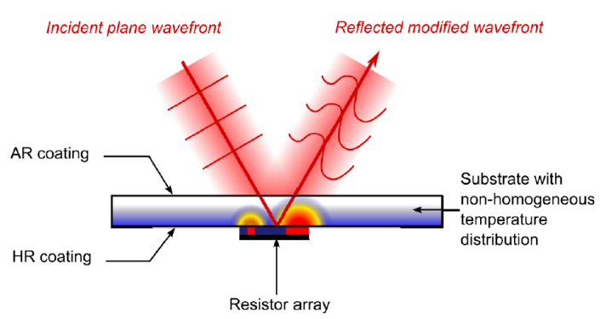
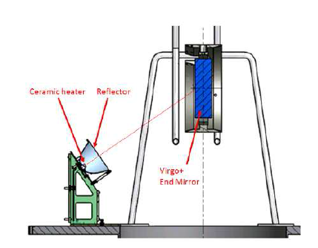
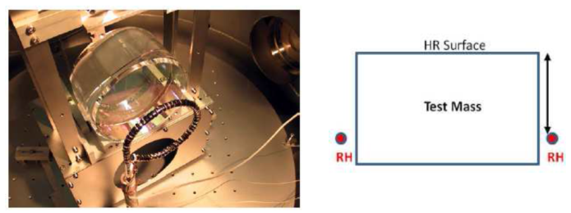
Existing thermal compensation devices
Thermally Deformable Mirrors to improve mode matching
Ring heater and CHRoCC to change the mirror Radius of Curvature

Slide 15
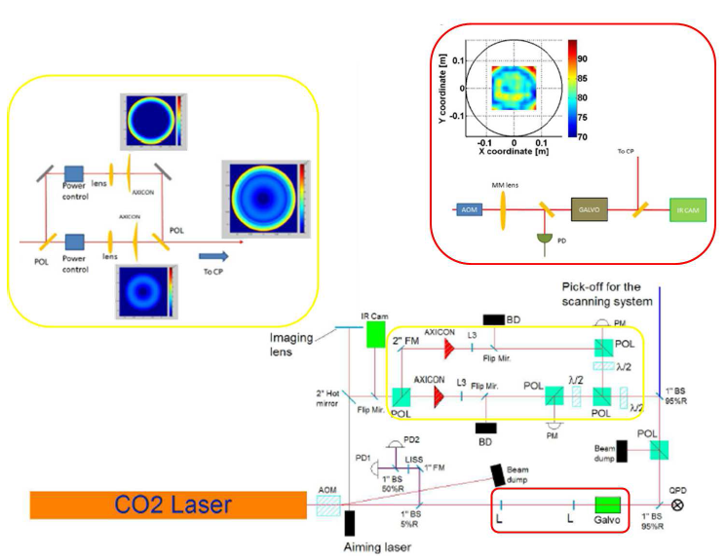
Thermal compensation devices
CO2 laser to correct High spatial Frequency defects
Scanning system for
non-symmetrical defects
Double axicon for symmetrical aberrations

Slide 16
Outline
Detecting Gravitational Waves with interferometers
The problem of mirror aberrations and the corrective thermal compensation devices for GW detectors
New idea for thermal compensation: CHRAC
Conclusions

Slide 17
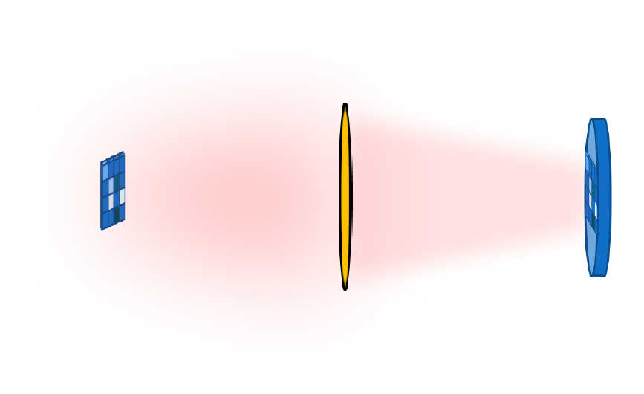
A new thermal compensation system: the CHRAC
Central Heating Residual Aberration Correction
Correction of high spatial frequency defects with CHRAC
Very simple system!
Thermo-elastic deformation
Matrix of actuators emitting thermal radiation
Optical telescope to image the matrix on the mirror surface
All aspects must be accurately analyzed in order to be able to design the whole system from scratch

Slide 18
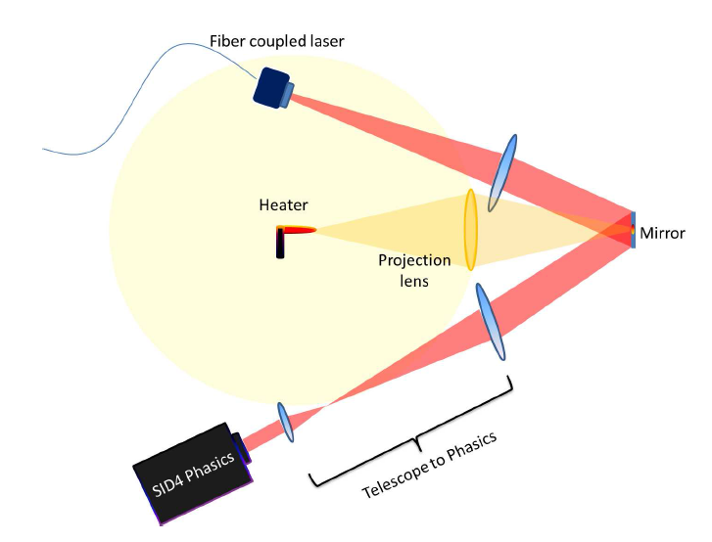
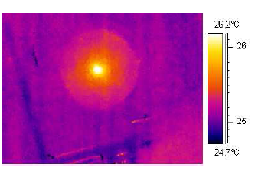
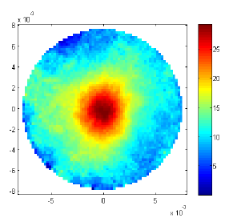
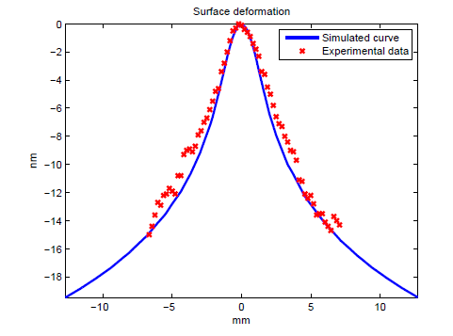
One pixel full characterization
Temperature increase of about 1°C for 6 mW absorbed
Wavefront deformation sensed with a wavefront sensor
Deformation of about 15 nm for 6 mW absorbed

Slide 19
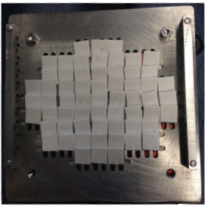
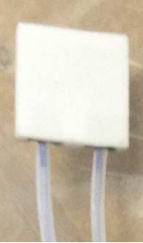
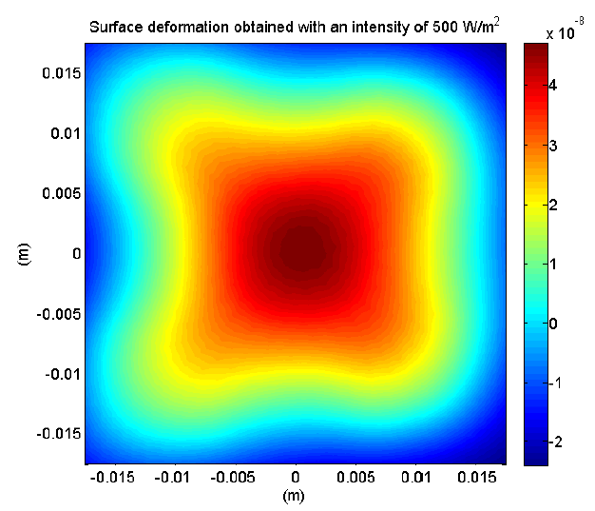
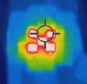
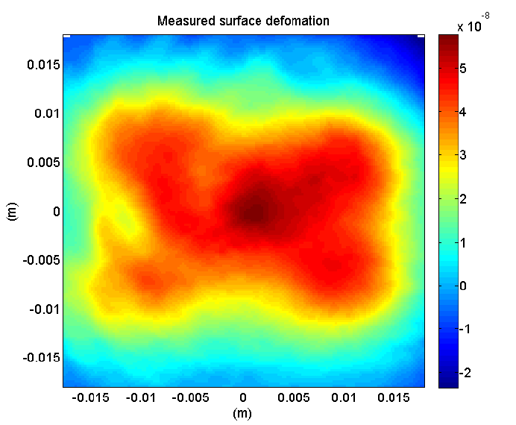
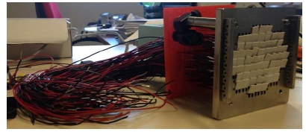
CHRAC matrix first prototype
Simulated
About 30mW absorbed per pixel
1 cm
61 actuators
Measured
Deformation of about 70 nm PtV (same order of magnitude as in simulation)

Slide 20
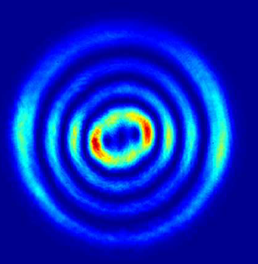
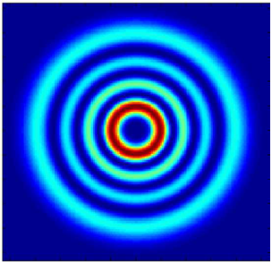
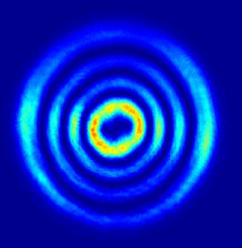
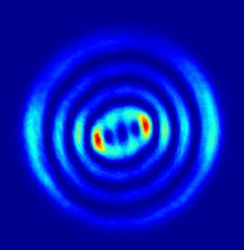
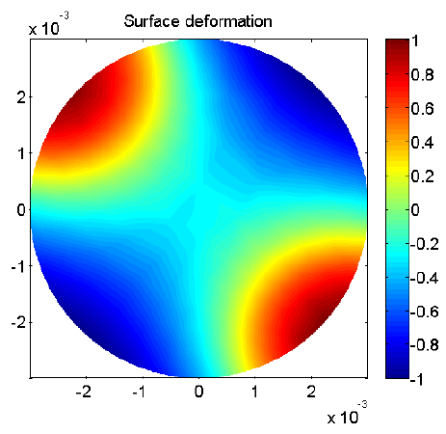
Effect of the correction on a single table-top Fabry-Perot cavity operated with Laguerre-Gauss modes LG33 (ANR-Laguerre project at APC in Paris)
Astigmatism
Cavity transmitted beam used as error signal
By projecting a thermal pattern e were able to:
Ideal beam shape
reduce astigmatism of about 42%
enhance astigmatism of about 58%

Slide 21
Outline
Detecting Gravitational Waves with interferometers
The problem of mirror aberrations and the corrective thermal compensation devices for GW detectors
New idea for thermal compensation: CHRAC
Conclusions

Slide 22
Conclusions
The CHRAC is a simple system of contact-less thermal compensation
It seems to work very well! The experimental results obtained so far were only limited by the power provided by the specific source. There’s room for more investigation.

Slide 23
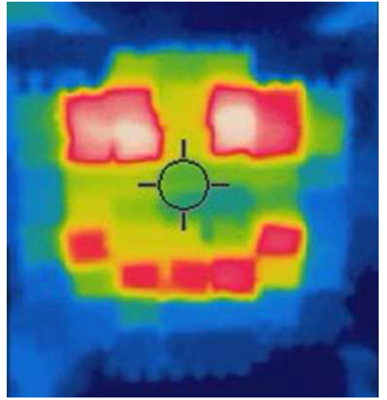
Thanks for your attention

